Slide 1
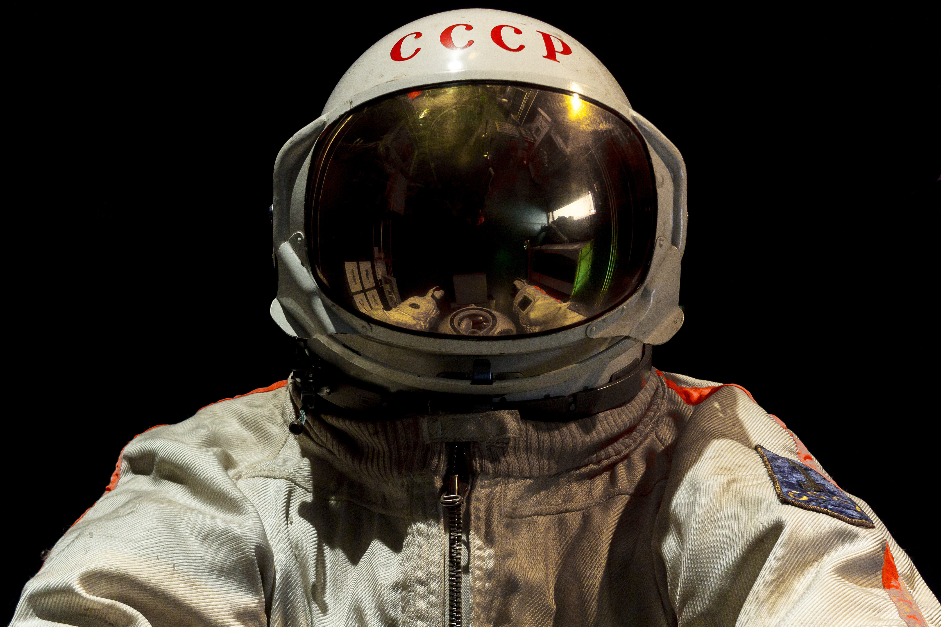
STARS & GALAXIES
Learning about our “Cosmic home”

Slide 2
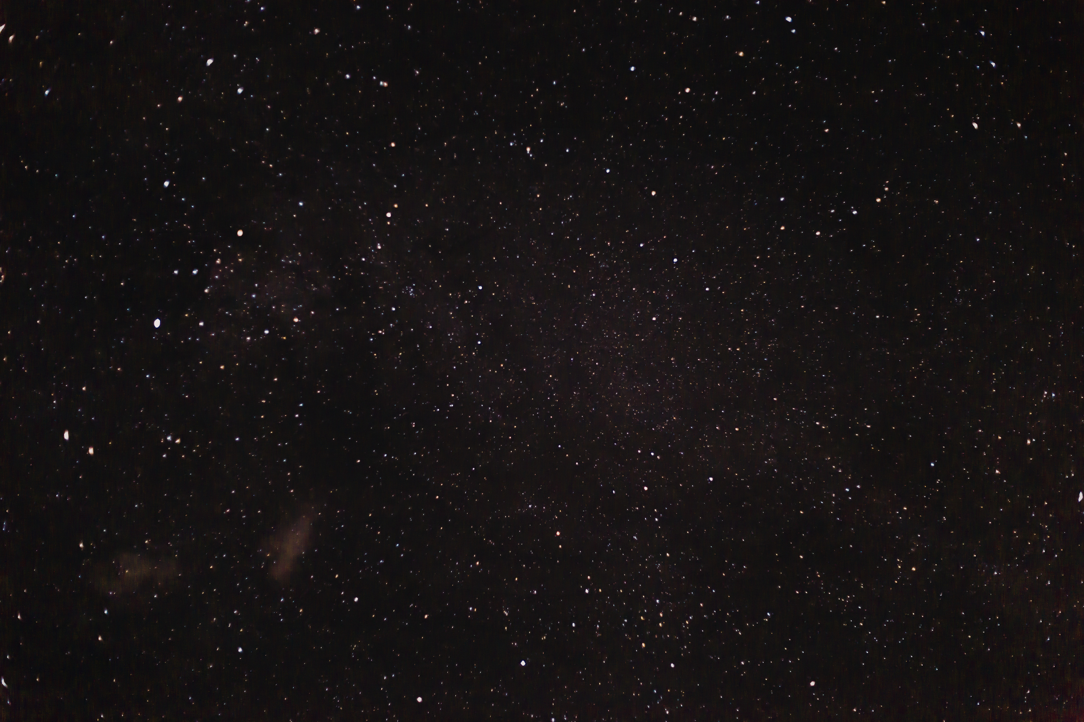
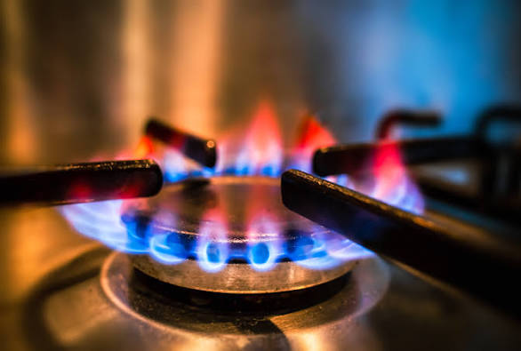
If you look at a candle flame or a gas stove, which part is the hottest:
The red part or the blue part?

Slide 3
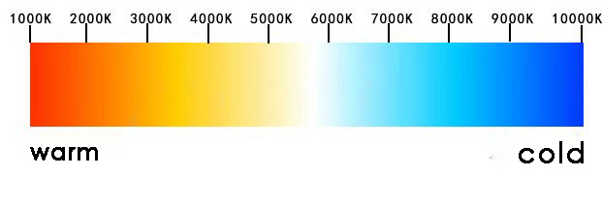
Color-to-Temperature Scale
WARM
HOT
*K stands for Kelvin, it is scientist’s standard unit of temperature. To convert Celcius into Kelvin you add ~273 degrees

Slide 4
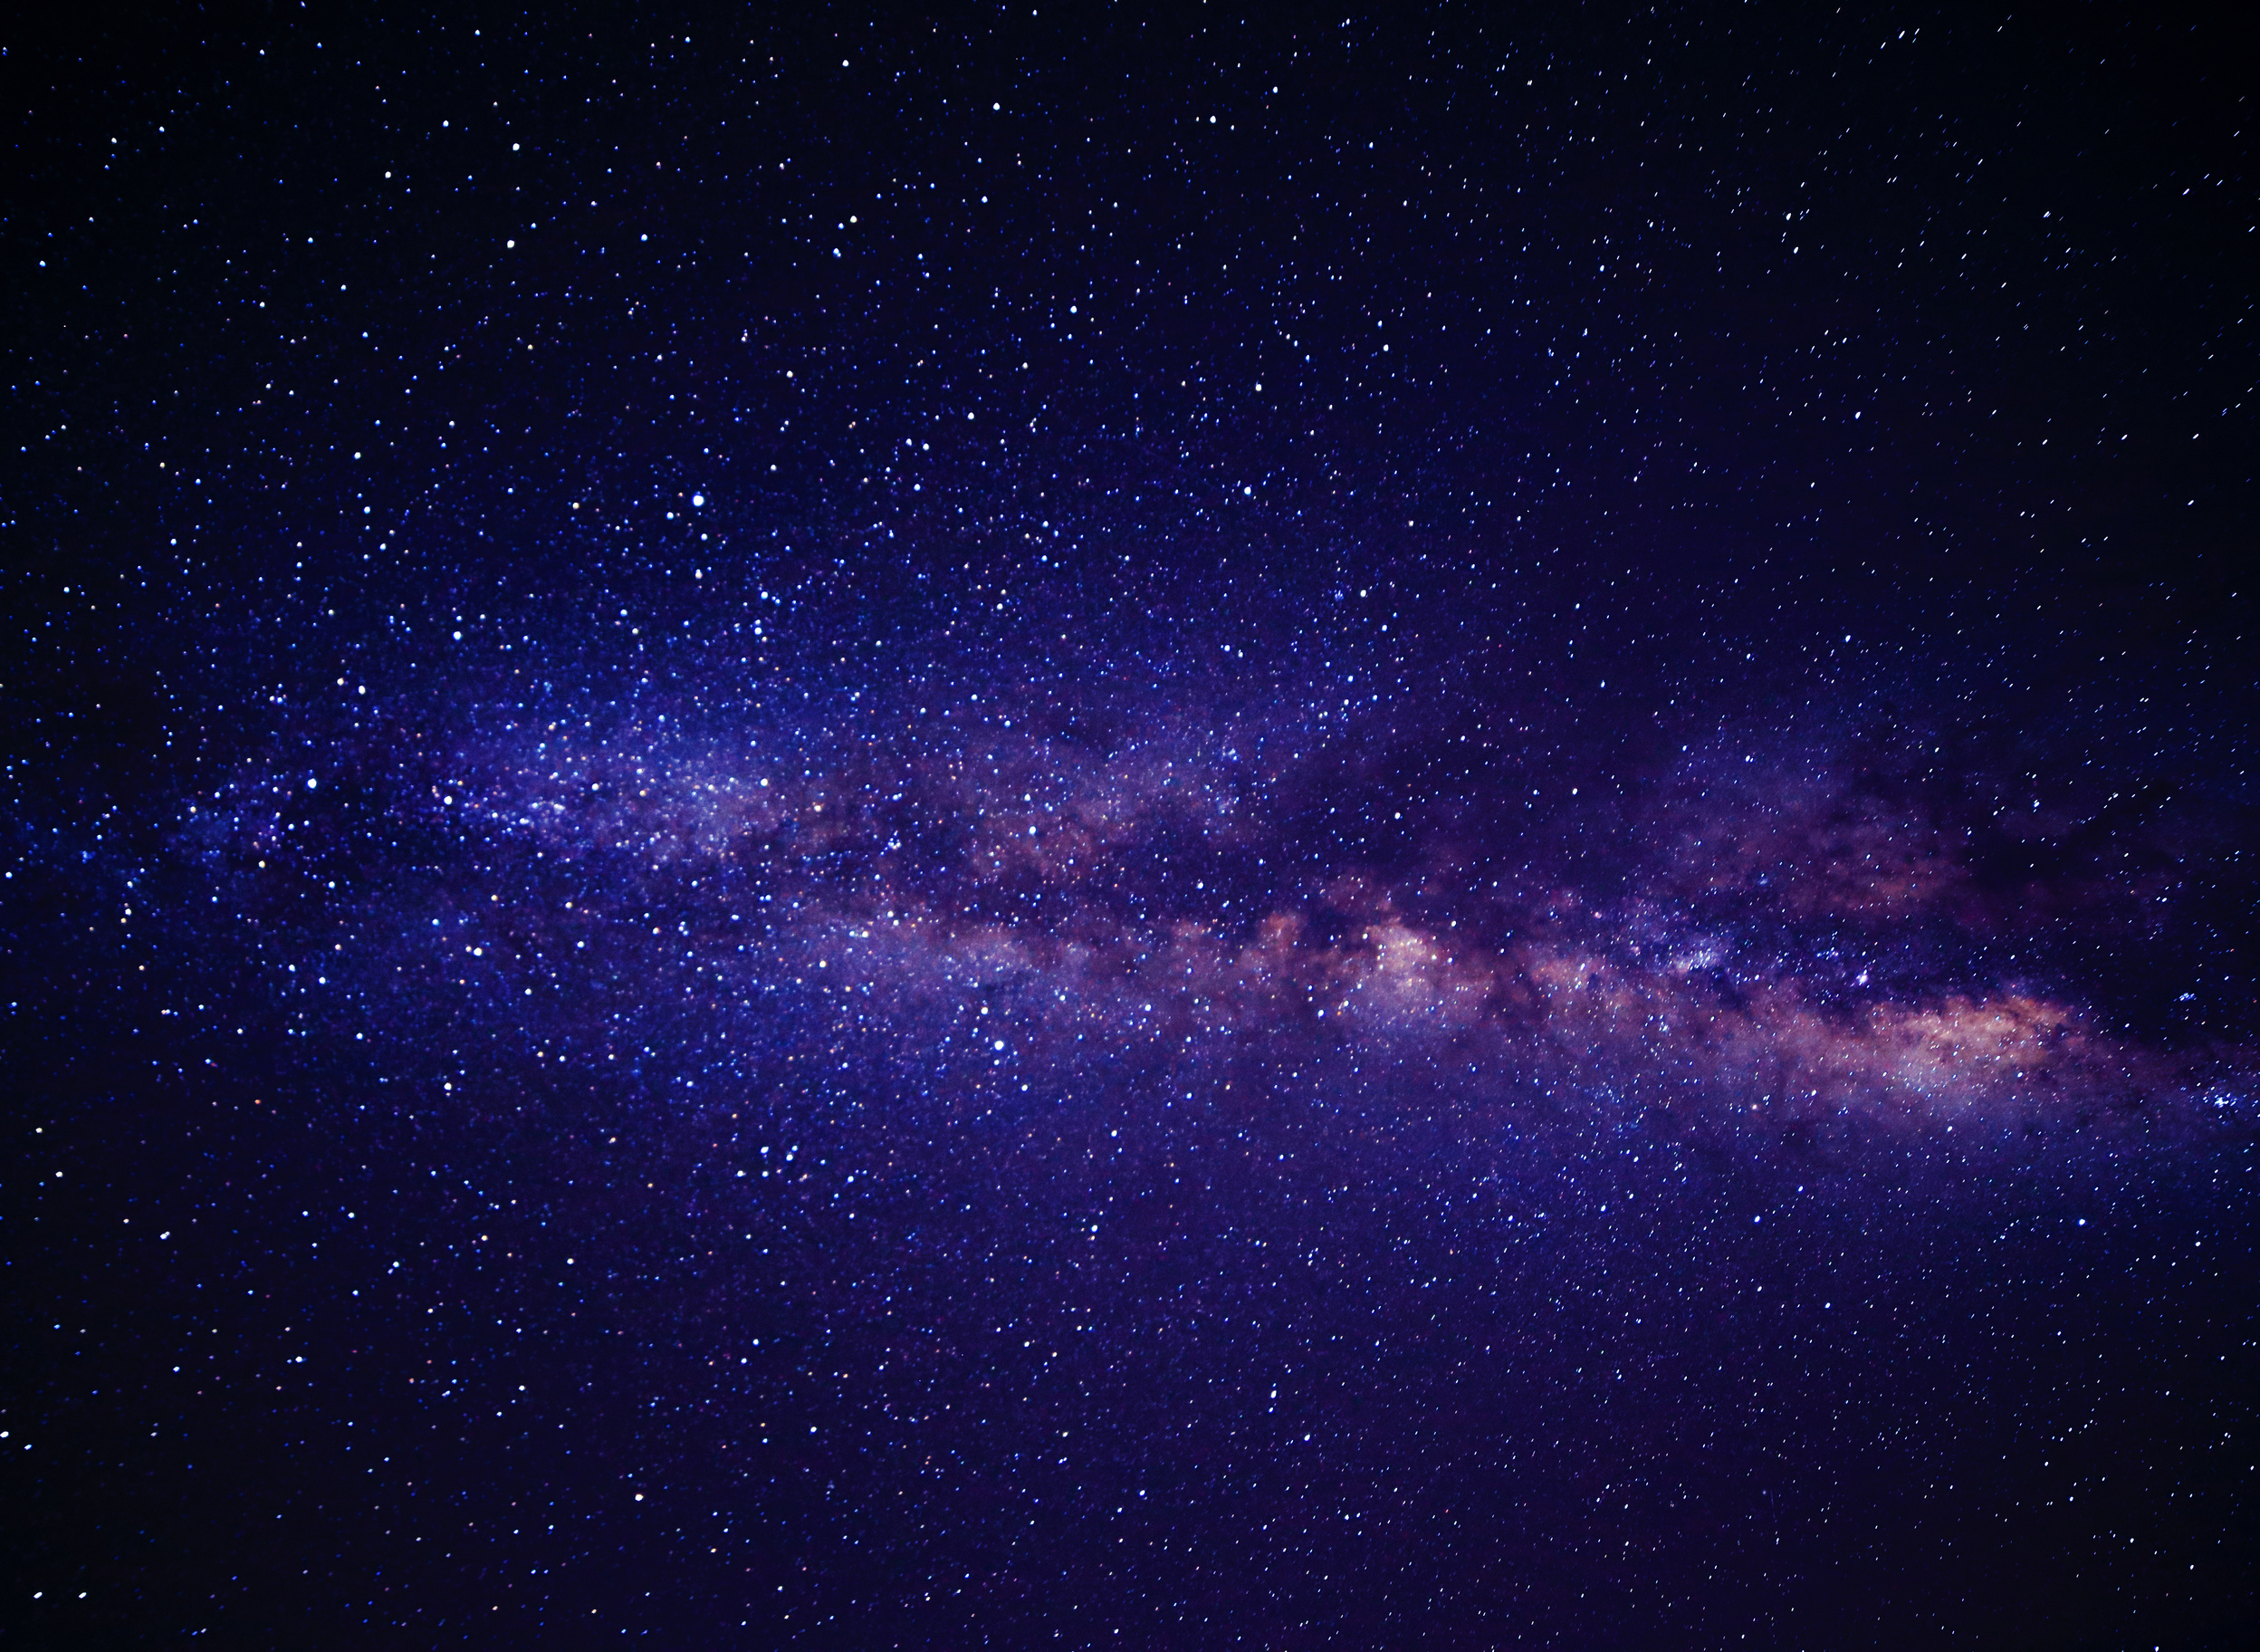
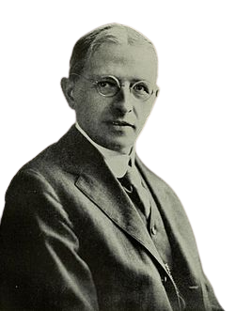
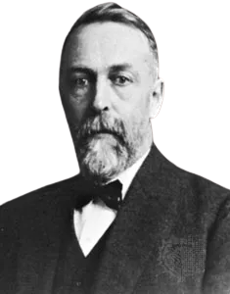
WHAT IS AN HR-DIAGRAM?
A Hertzsprung-Russell (HR) diagram is a current portrait of known stars in the universe. It shows how luminosity, absolute magnitude, special class, color, and temperate are related.
Russell
Hurtzsprung

Slide 5
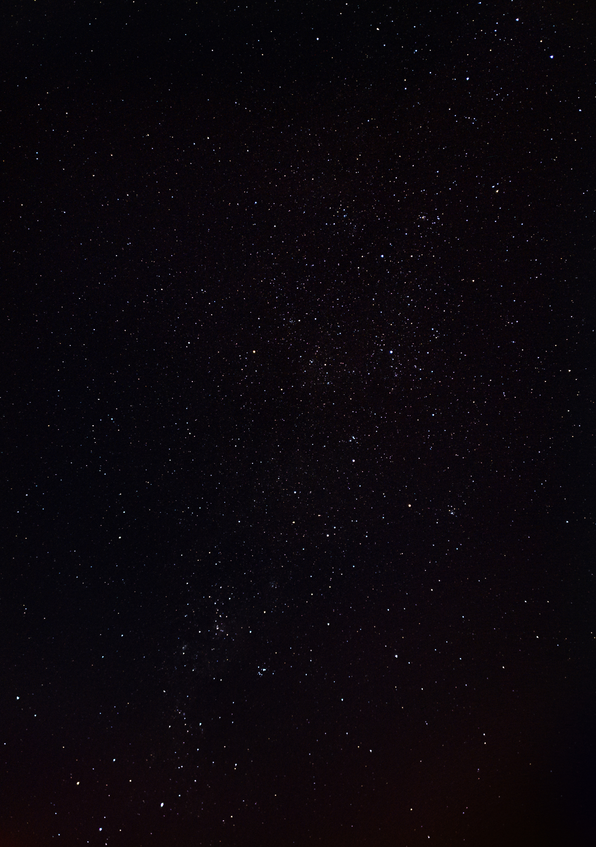
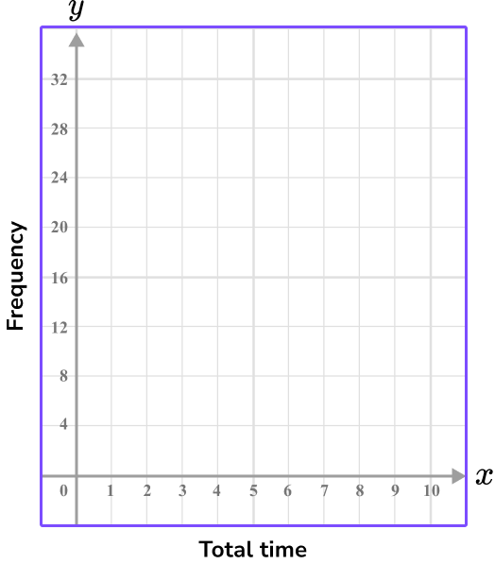
Graphing Review
Y-Axis
Which is the X axis and which is the Y axis?
X-Axis

Slide 6
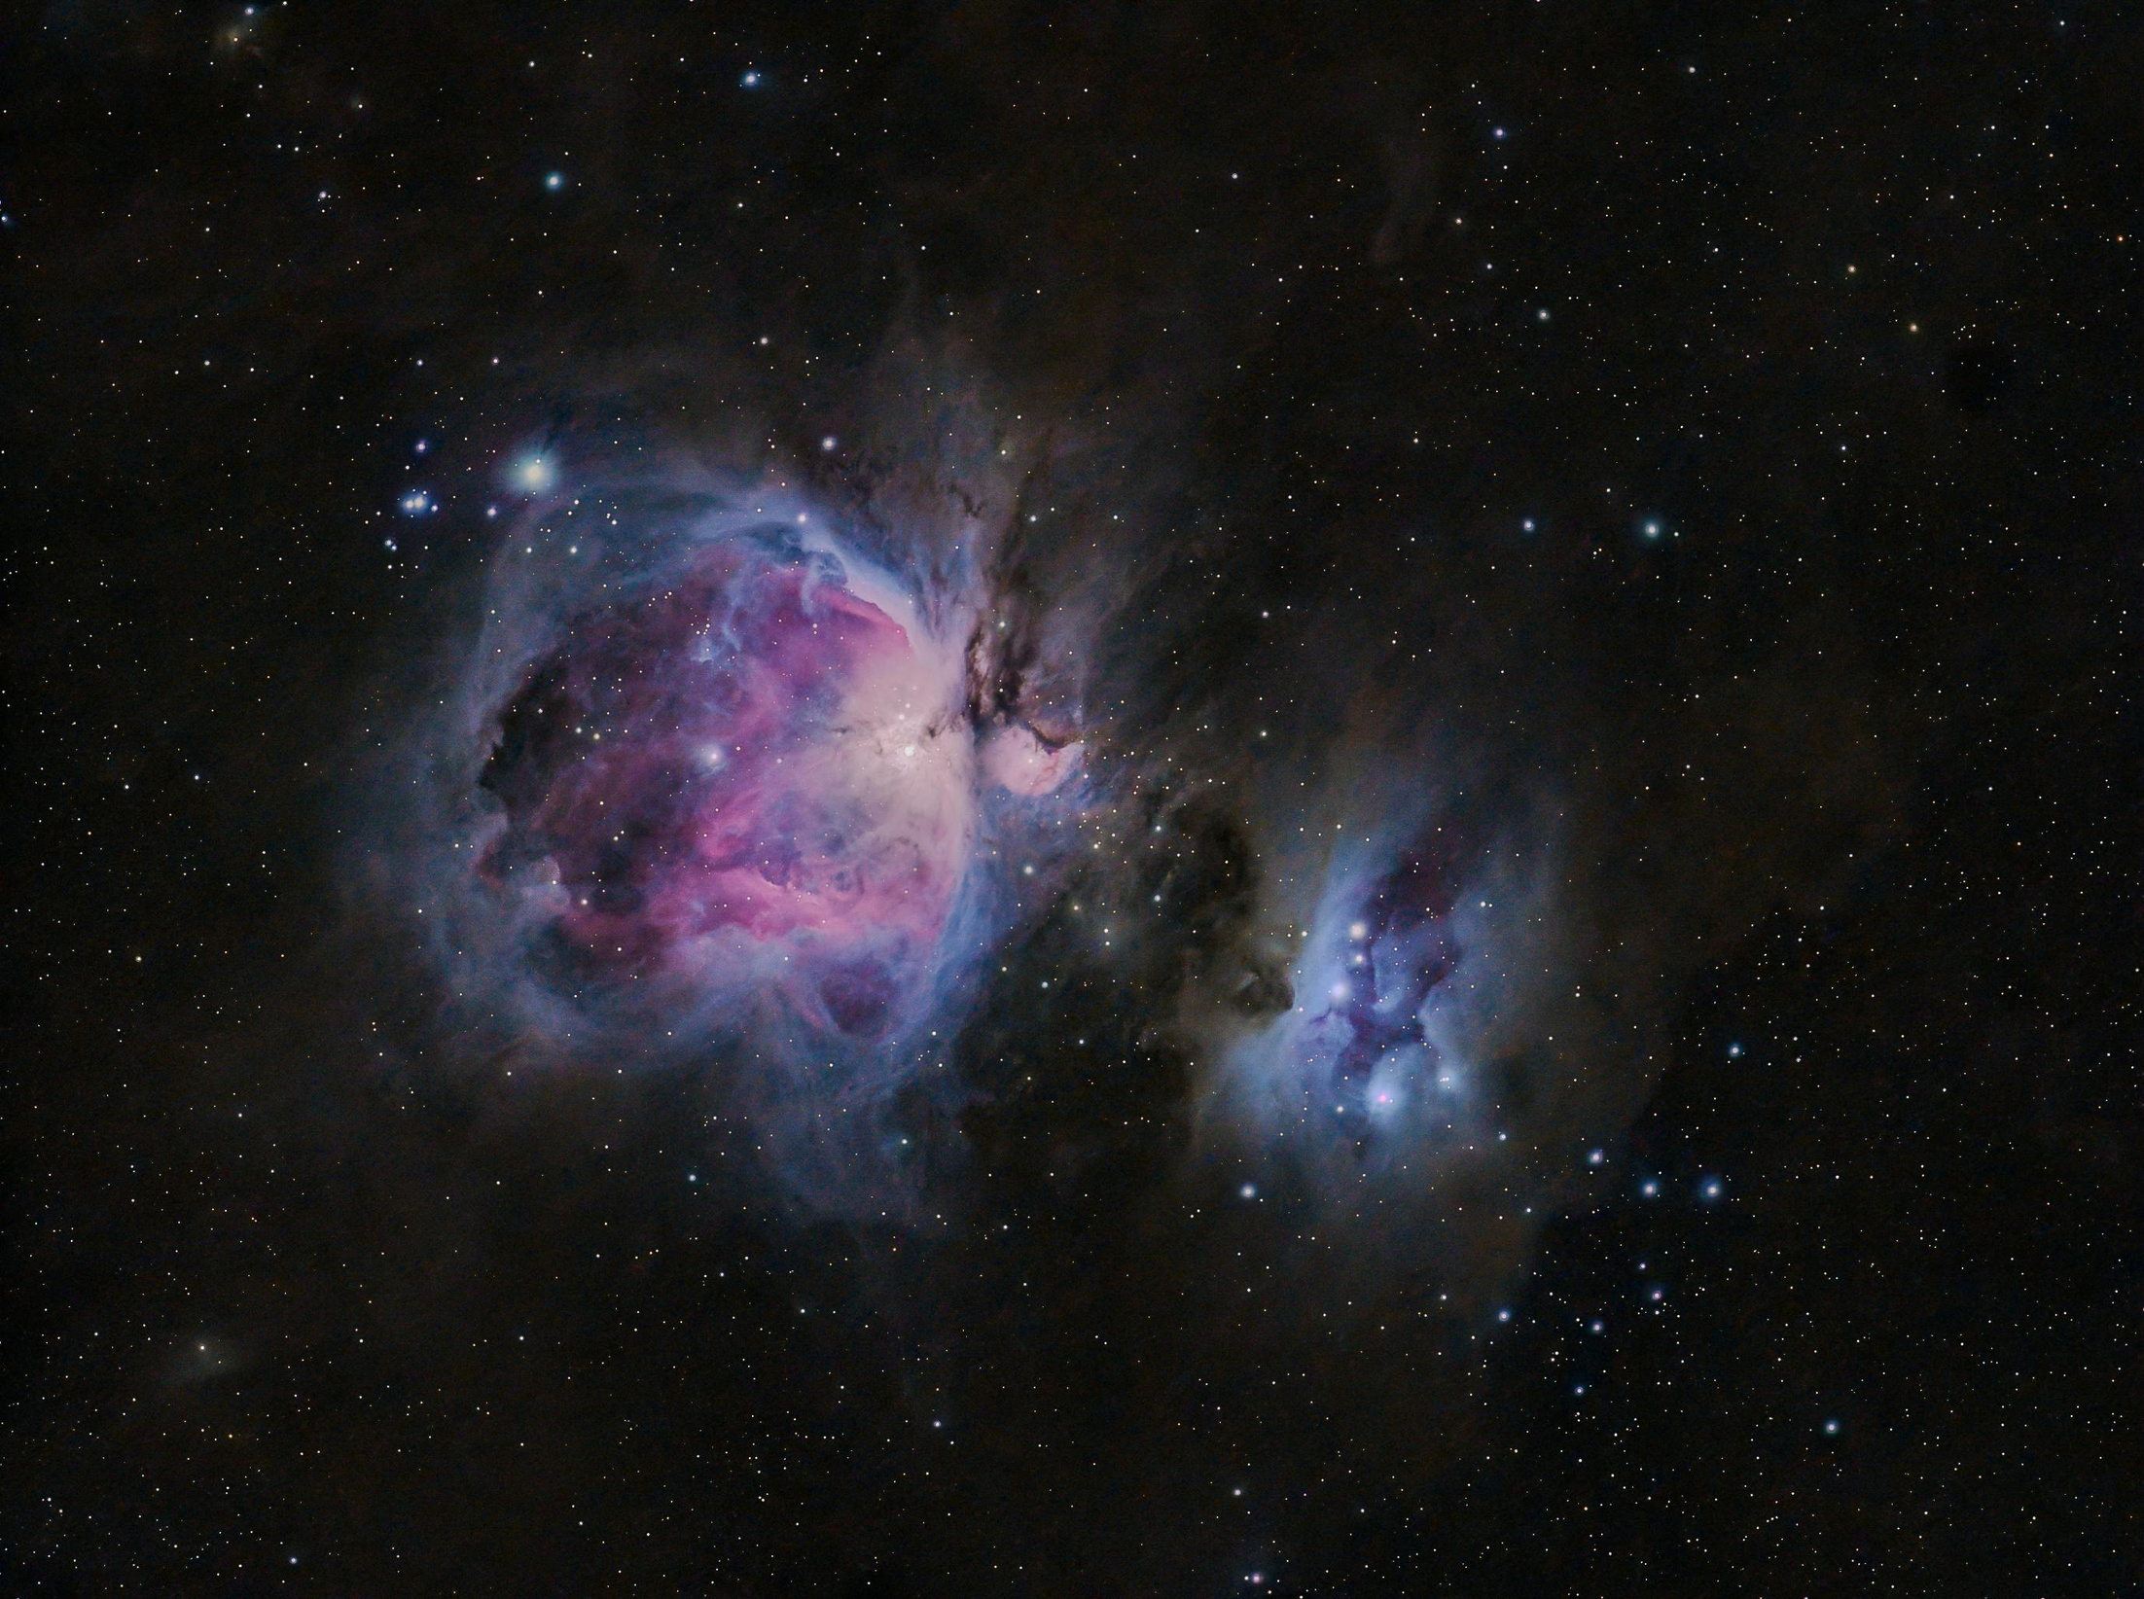
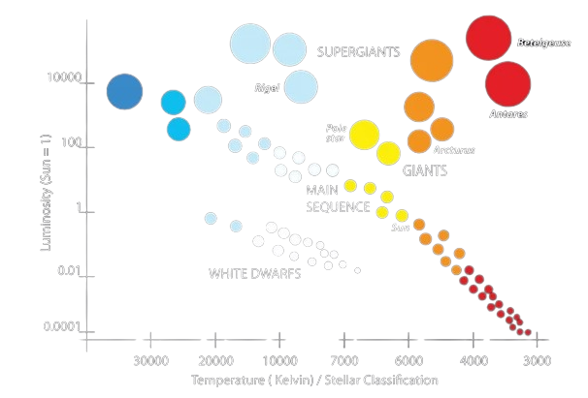
How do we label the X and Y axis on an HR diagram?
How brightly the star shines
The Y-Axis = Luminosity
How hot the surface is.
The X-Axis =Temperature

Slide 7
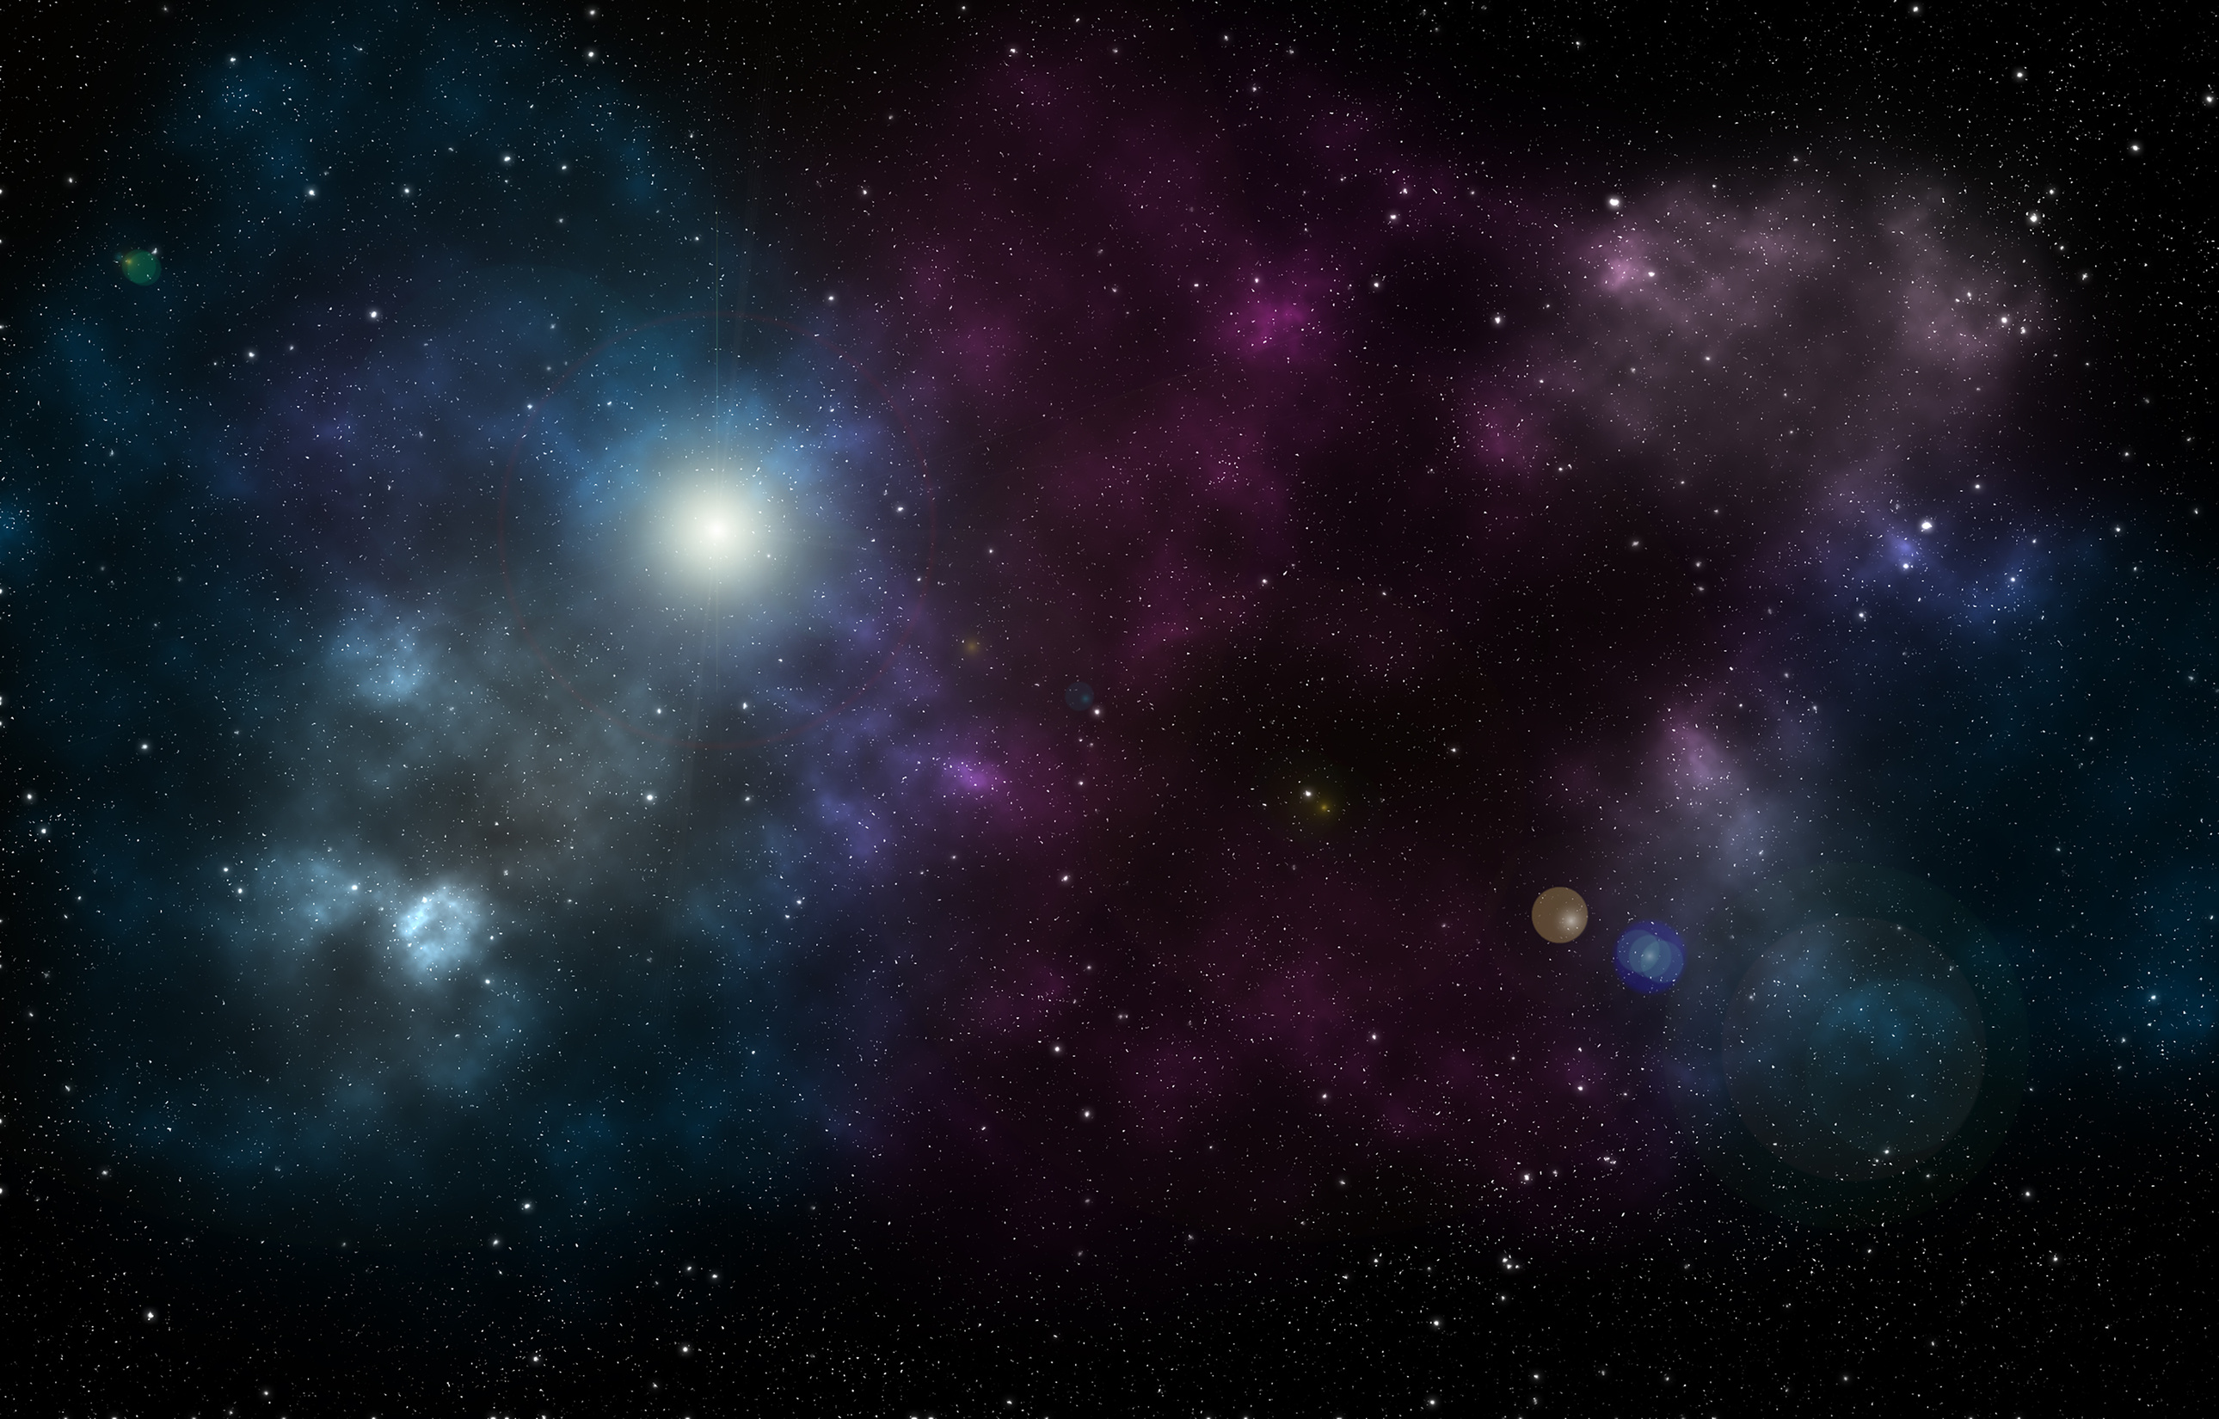
Are the brightest stars always the hottest? Why or why not?
TURN AND TALK

Slide 8
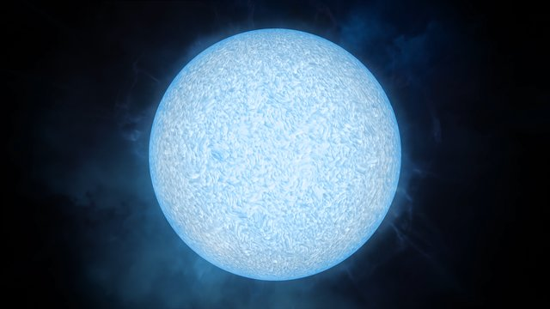
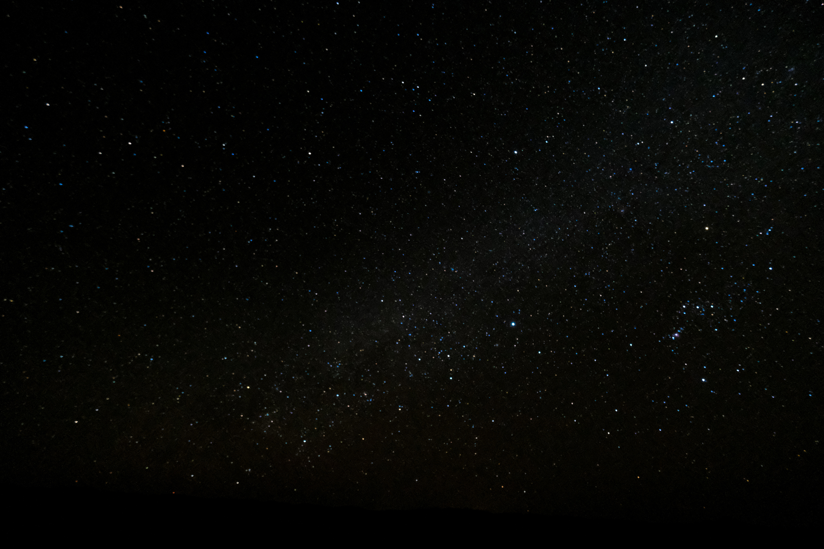
Short answer...
No.
While temperature and brightness are often linked, a star's size plays a massive role in how much light it emits.

Slide 9
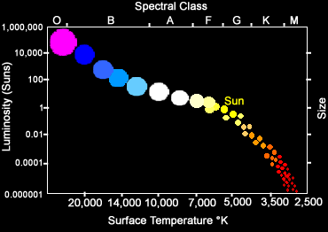
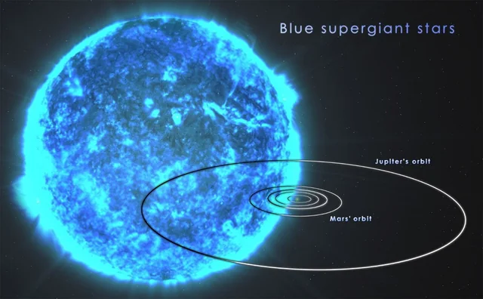
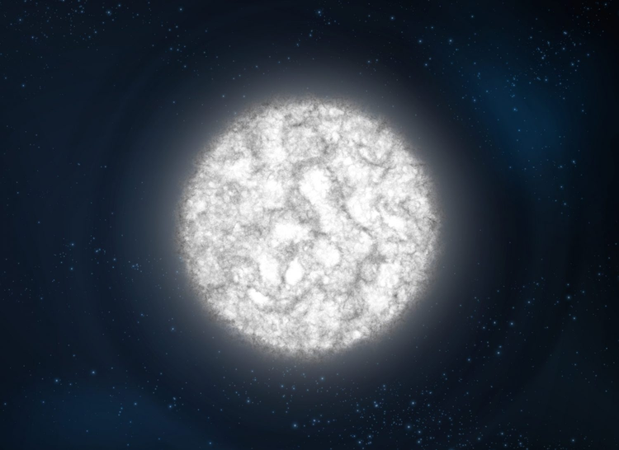
Types of Stars:
The Main Sequence:
The Giants and Supergiants:
The White Dwarfs:
This diagonal strip contains 90% of stars (including our Sun) that are currently fusing hydrogen.
The "retired" stars. These are massive, bright, but relatively cool. They’ve puffed up as they run out of fuel.
These are tiny, incredibly hot, but very dim "dead" stars.

Slide 10
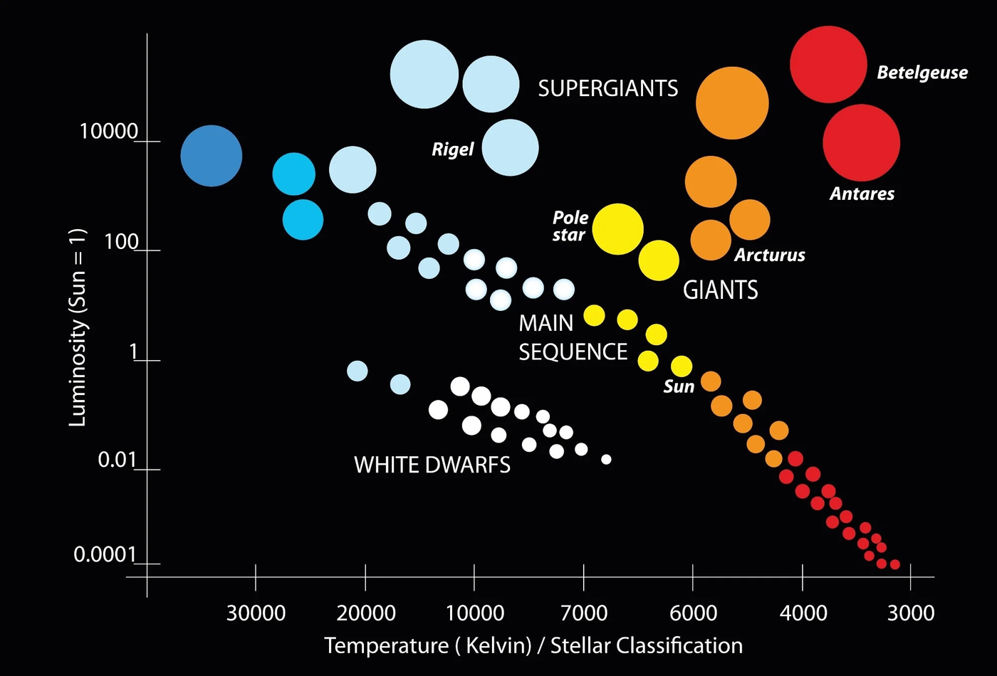
This is an Hr-Diagram!
What type of star is the sun?

Slide 11
TIME TO MAKE YOUR OWN DIAGRAM!

Slide 12
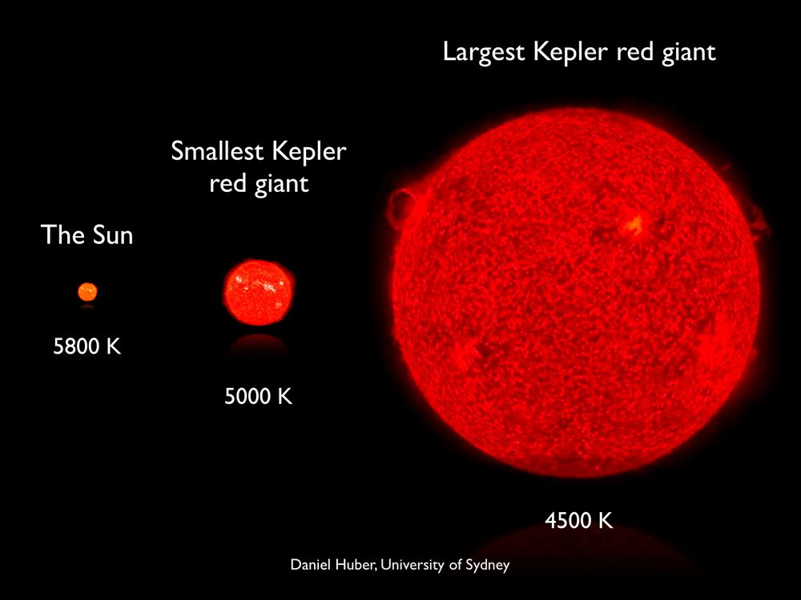
Some stars (like Red Giants) are very bright despite being "cool."
Why do you think this might be?

Slide 13
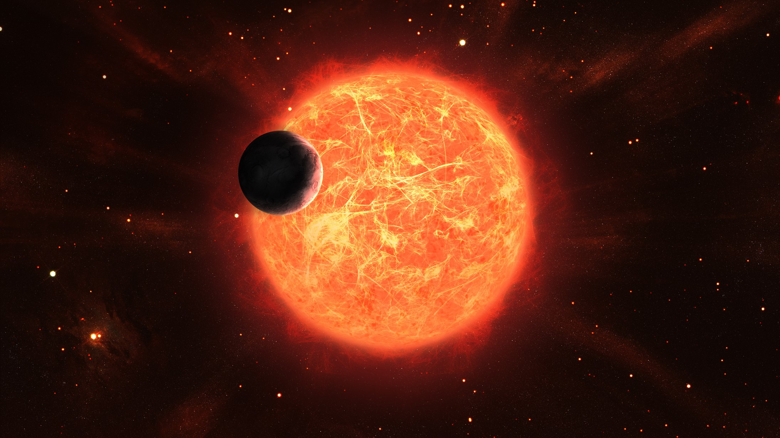
Even though Red Giants have cooler surface temperatures, they are massive. Because they have so much more surface area than smaller stars, they emit a huge amount of total energy, making them incredibly bright.

Slide 14
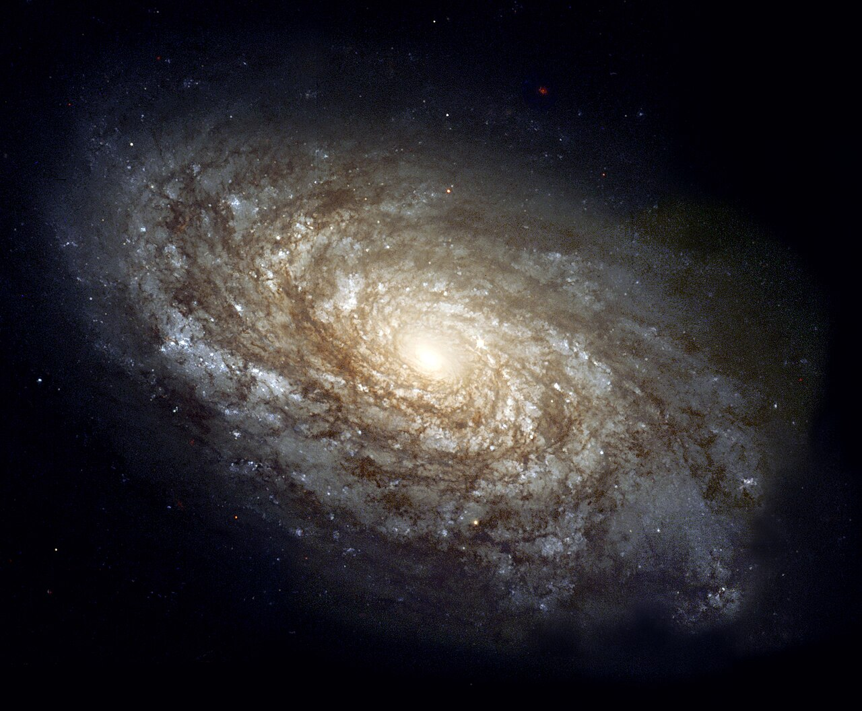
Now that we know about stars...
Let’s talk about galaxies!

Slide 15
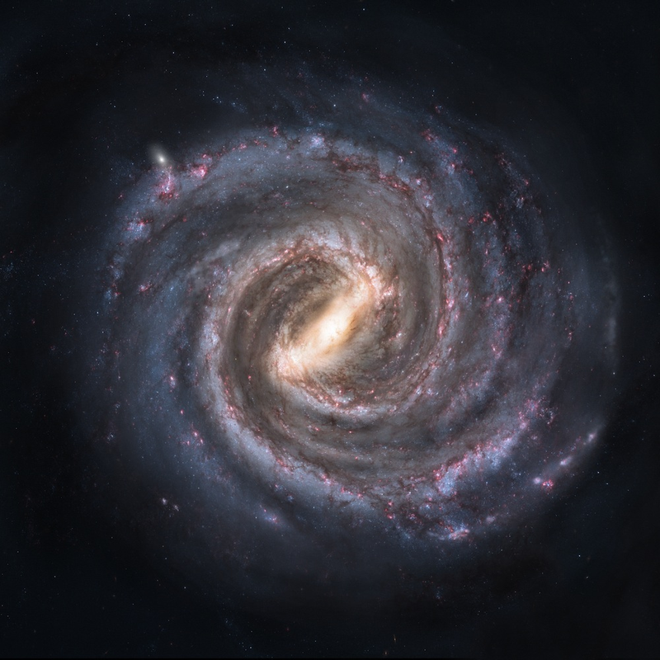
SPIRAL GALAXY
A galaxy exhibiting a central nucleus or barred structure from which extend curved arms of higher luminosity.
The Milky Way

Slide 16
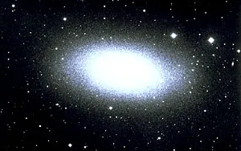

ELIPITCAL GALAXY
A galaxy that has a generally elliptical shape and that has no apparent internal structure or spiral arms.
standard elliptical shape
Messier 110

Slide 17
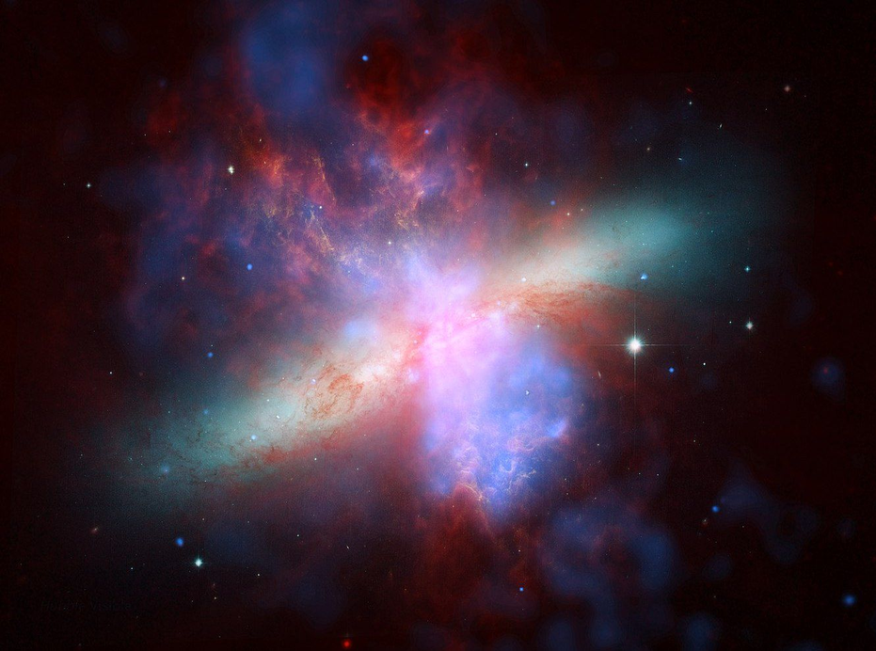
IRREGULAR GALAXY
A galaxy that does not have a distinct regular shape.
Messier 82- “The Cigar Galaxy”

Slide 18
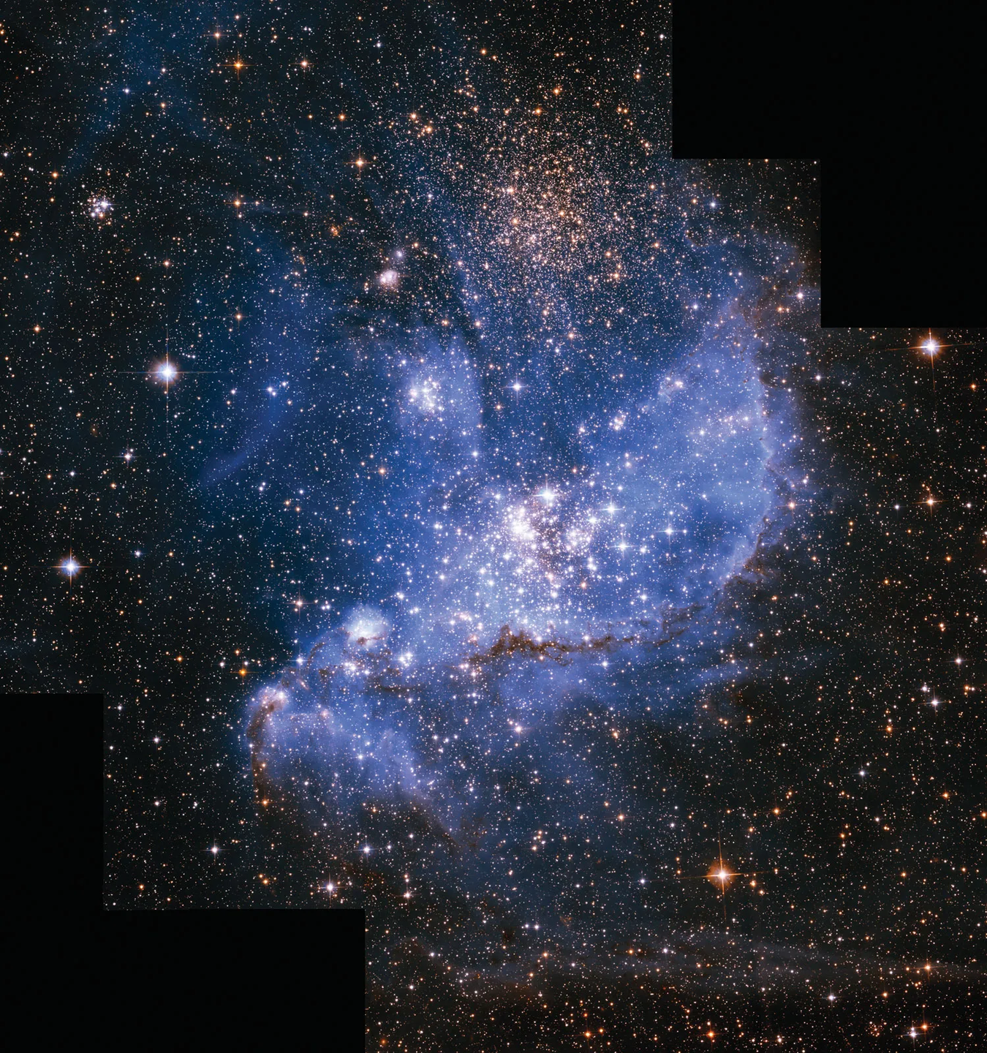
What type of galaxy is this?

Slide 19
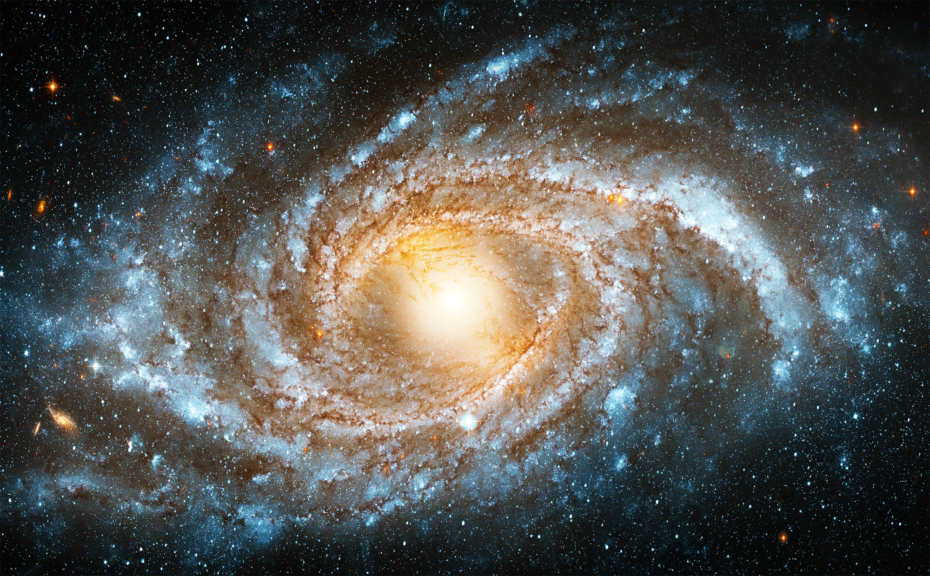
What type of galaxy is this?

Slide 20
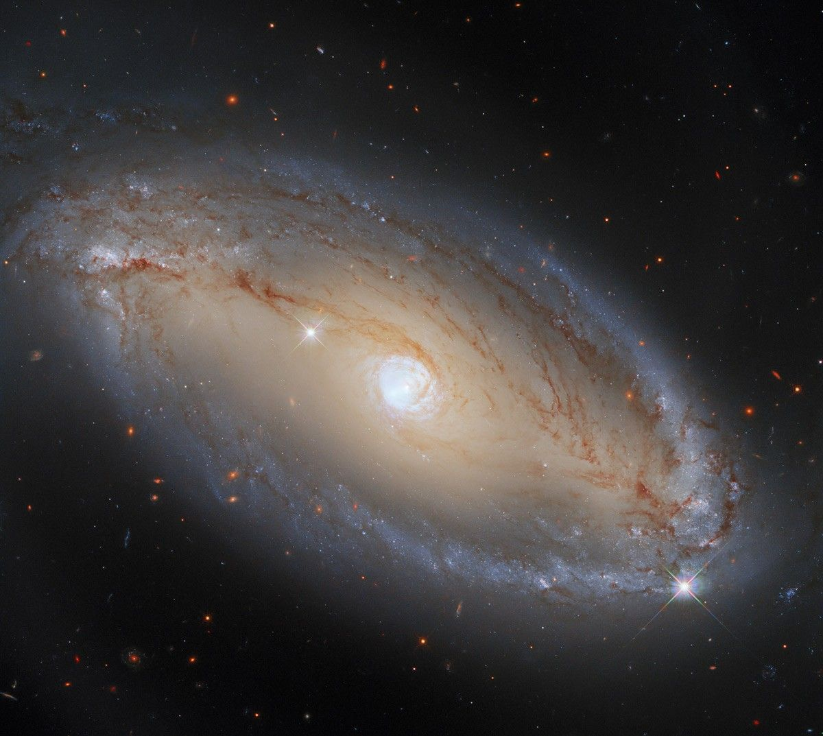
What type of galaxy is this?

Slide 21
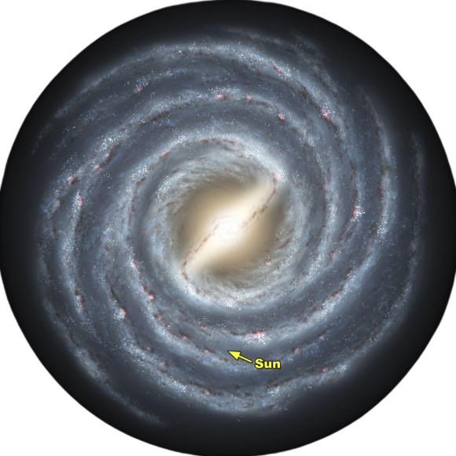
More about the Milky Way
aka 'our' galaxy
Our galaxy holds between 100 and 400 billion stars.
The Sun is located about halfway out from the center, nestled in the Orion Cygnus spiral arm.
It looks "milky" from Earth because we are viewing the dense disk of the galaxy from the inside out.

Slide 22
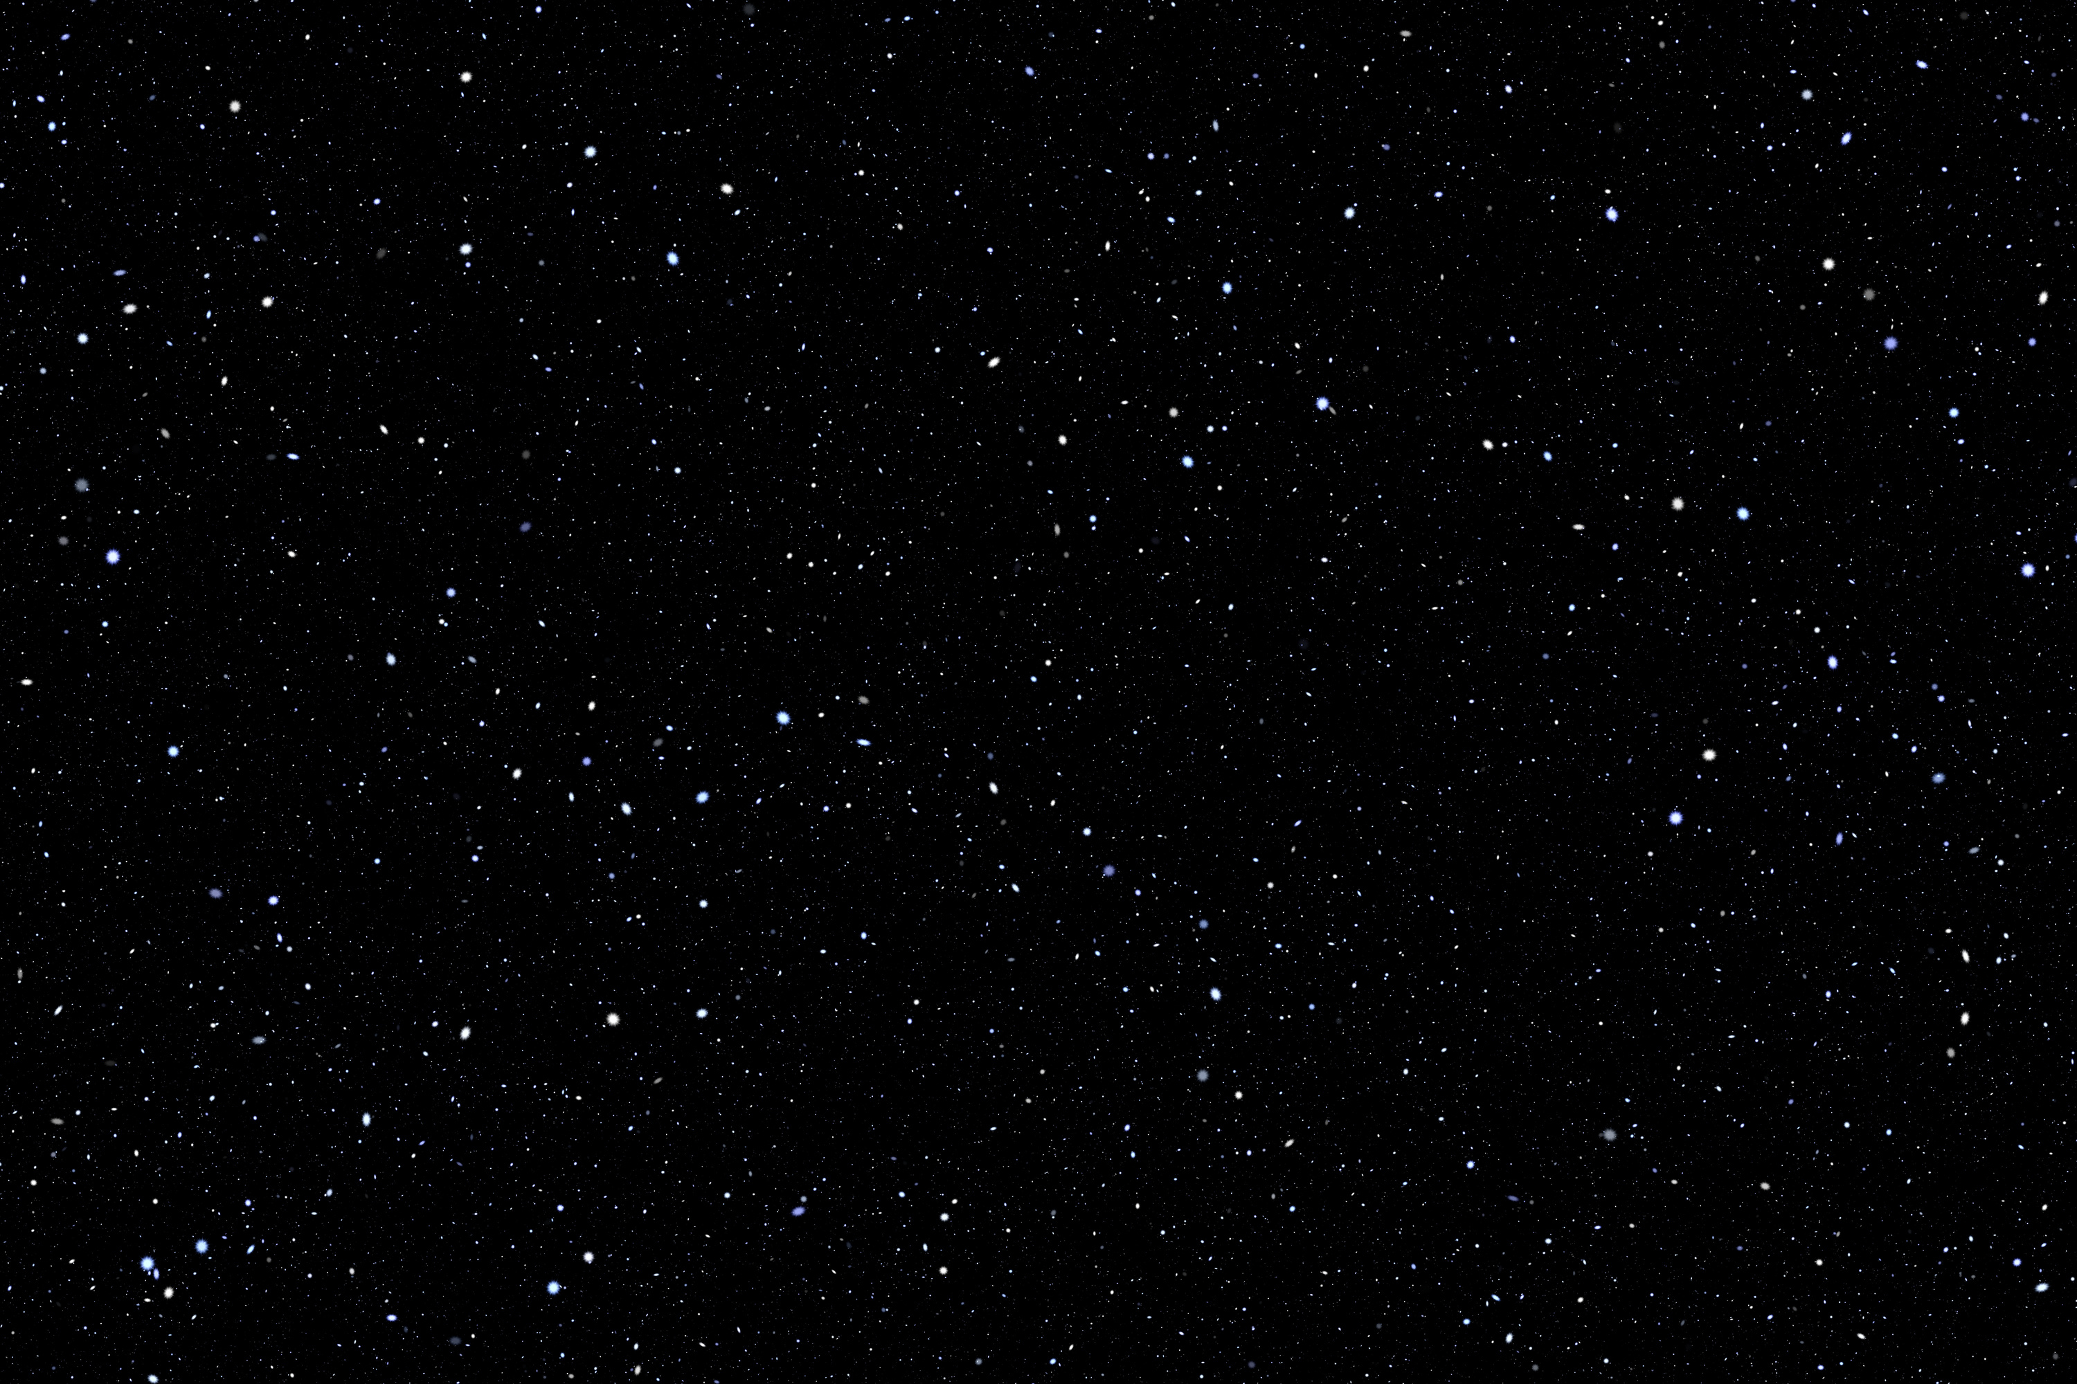
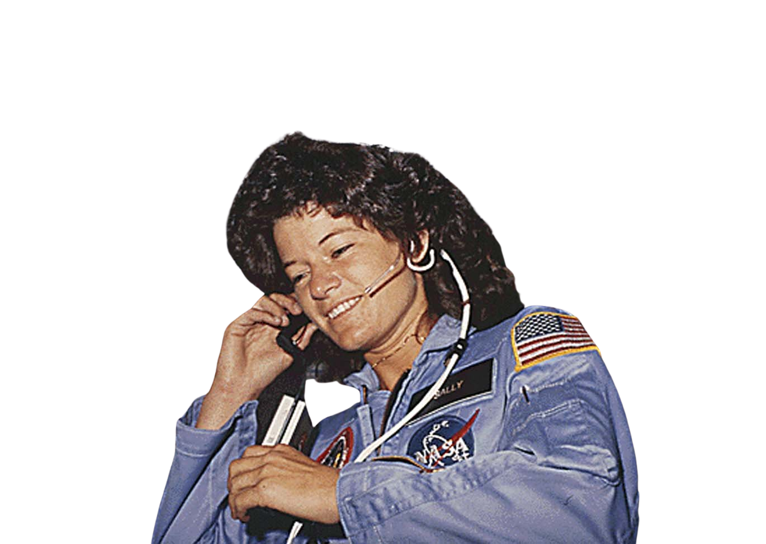
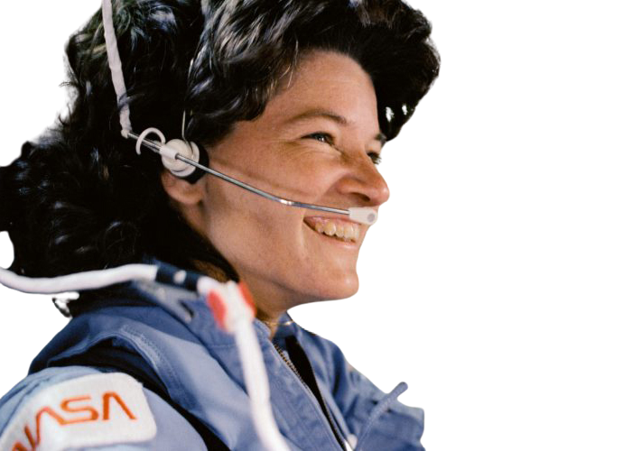
Mini-Research Project Example
Scientist Chosen | Dr. Sally Ride
Mystery Match | Mystery A & C. Her research helps us see things that are usually invisible to the naked eye.
College Degrees | She earned four degrees from Stanford: A Bachelor's in English, a Bachelor's in Physics, a Master's in Physics, and a Ph.D. in Physics.

Slide 23
A class is making a poster about the sun. The poster includes drawings and information about the sun. Which statement should the students include on the poster?
A. The sun has a solid, rock core.
B. The sun is one of the largest stars in the universe
C. The sun is farther from the earth than some other stars are
D.The sun is located on a spiral arm of the Milky Way galaxy
Think by yourself for 30 seconds then disucss with your table group for one minute.

Slide 24
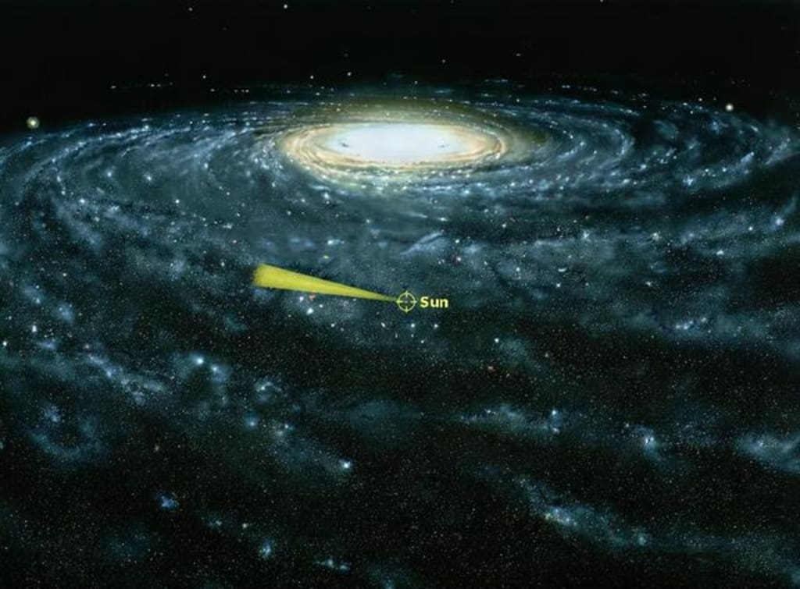

A class is making a poster about the sun. The poster includes drawings and information about the sun. Which statement should the students include on the poster?
A. The sun has a solid, rock core.
B. The sun is one of the largest stars in the universe
C. The sun is farther from the earth than some other stars are
D.The sun is located on a spiral arm of the Milky Way galaxy
sun

Slide 25
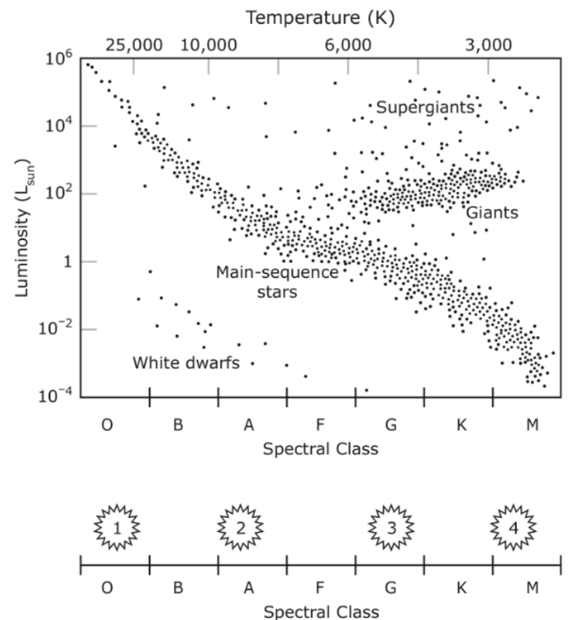
The spectral classes of four stars are shown in comparison with a HR- diagram
Based on the information, which star is most like the sun?
A. Star 1
B. Star 2
C. Star 3
D. Star 4
Think by yourself for 30 seconds then disucss with your table group for one minute.

Slide 26
The spectral classes of four stars are shown in comparison with a HR- diagram
Based on the information, which star is most like the sun?
A. Star 1
B. Star 2
C. Star 3
D. Star 4

Slide 27
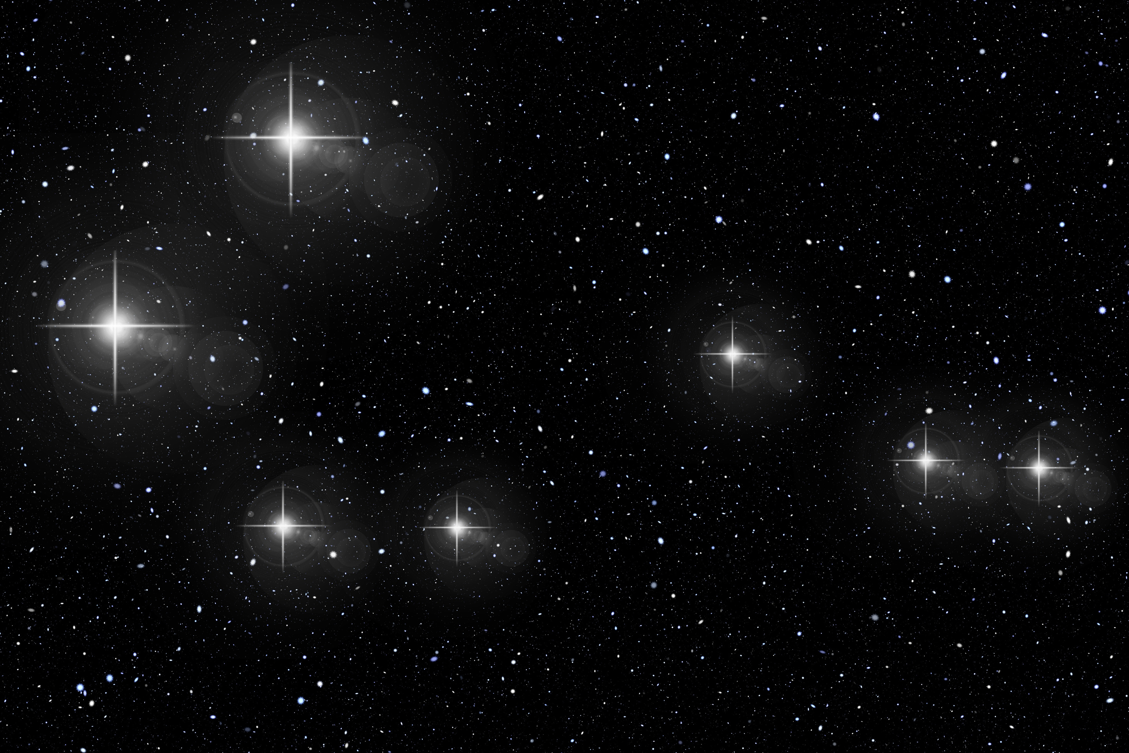
TICKET!
You have the rest of the class time to finish your exit ticket.

