Slide 1
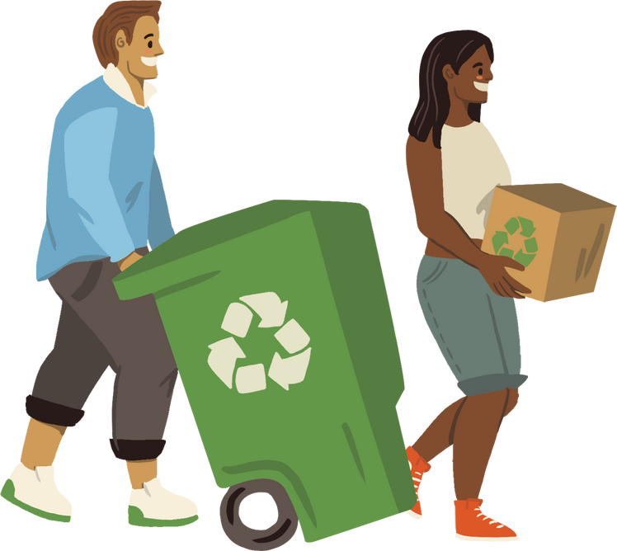
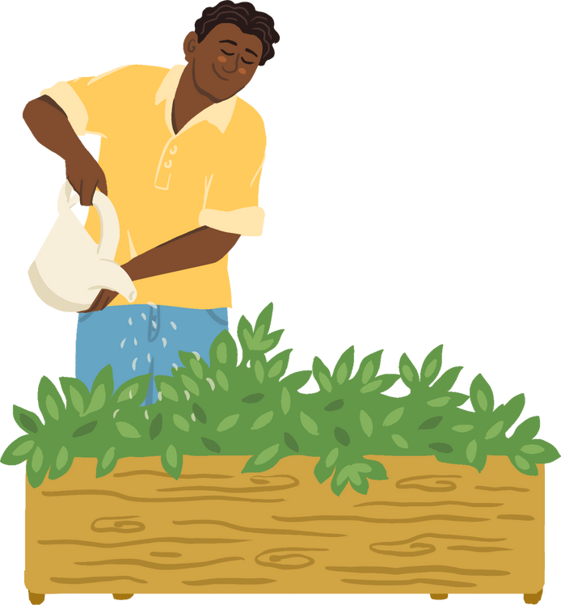
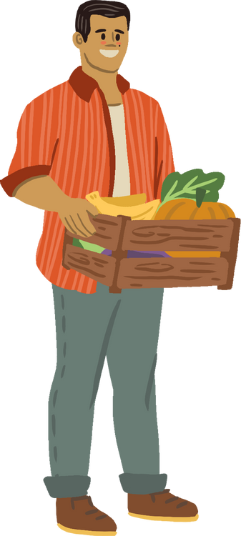
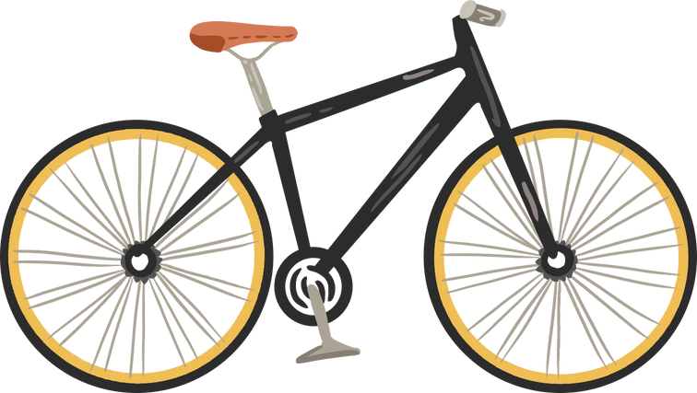

APES- Land and Water Use Unit
How Can You
Take Sustainable Initiative?
Teacher name here

Slide 2
How Do We Use Water?

Slide 3
What Is Your Water Footprint?
  Complete the water footprint calculator and compare results
  How can you reduce your water usage at home?

Slide 4
Nexus Guide
  How can you reduce your footprint by changing your food and energy choices?
  Redo the Water Footprint Calculator with these changes

Slide 5
Where Do We Go Now?
  How can your changes be implemented at your house? At school? In your city?
  Are there habits that can be changed at school or at home to help conserve water?
  How does the growth of Texas affect the water supply?
  How can you help?

Slide 6
Sustainability Project
Goal:
  To plan, design, and engineer your own sustainable initiative.
  Projects will be counted as your [final/ midterm] exam
4 Main Criteria:
  Projects must fulfill rubric criteria for: Topic Selection, Design Process, Solution- Based Artifact, and Impact

Slide 7
Rubric Objectives
Topic Selection
  Creative, focused, manageable topic from the “Land and Water Use” unit (including ‘Urbanization and Ecological Footprints’ and ‘Sustainable Practices’) that addresses the issue of water scarcity, urbanization, or pollution
    Ex: Student chooses topic of water county backed up with current research, history, laws, environmental impacts, current solutions (or where they fall short)

Slide 8
Rubric Objectives
Design/ Solution
  Design a solution that is relevant to your topic (increases water conservation OR reduces water pollution) and impact level.
    View specific examples from Potential Project List
  The options are vast!
      Design/ engineer
      Educate
      Advocate
      Write

Slide 9
Rubric Objectives
Impact
  Solution is relevant and presented to community, classmates, administration and potentially implemented. Presentation is engaging and able to be interpreted by broad audiences.
    View examples for your solution type from Impact Resources file
  Ex. Write a letter/ email to officials to have your design implemented

Slide 10
Initiative Timeline
Today
Day 2
Day 3
Day 4
Day 5
  Research
  Review Potential Project List
  Brainstorm
  Commit to a solution
  Peer Review
  Submit projects and make an impact!

Slide 11
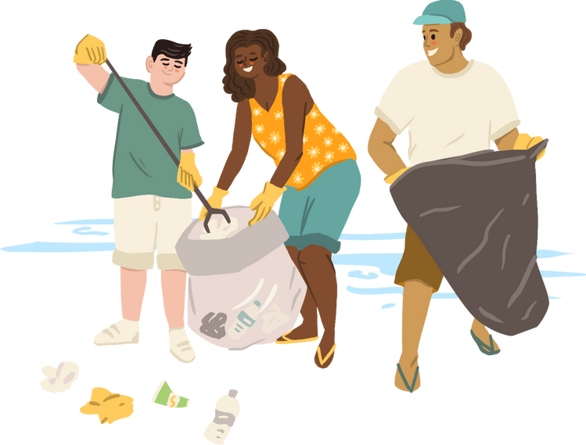
Research Time
  Complete the Day 1 Research sheet
    You may fill out multiple handouts to see how different ideas will play out
  For the “Solution”, review the Potential Project List
    What stands out to you? Which one correlates to the level of impact you chose?

Slide 12
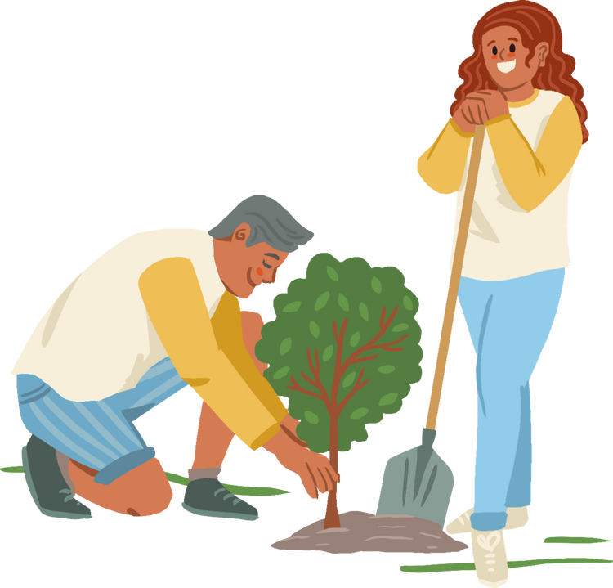
Day 2
  Water Quality Activity
  Brainstorm sheet
    What ideas from last class do you want to take to the next level?

Slide 13
Reminder: Rubric Objectives
Topic Selection
  Creative, focused, manageable topic from the “Land and Water Use” unit (including ‘Urbanization and Ecological Footprints’ and ‘Sustainable Practices’) that addresses the issue of water scarcity, urbanization, or pollution
    Ex: Student chooses topic of water county backed up with current research, history, laws, environmental impacts, current solutions (or where they fall short)

Slide 14
Day 3
  Complete “Benchmark 1”
    Submit the brainstorm sheet from last class
    Receive teacher’s approval for the design process and begin working on your solution

Slide 15
Project Work Time
  Make sure your Design Process has been teacher approved
  *If you are certain about your outreach plan for your ‘Impact’, work on this before your ‘Solution’*
  Be courteous of others still brainstorming or working on their projects

Slide 16
Day 4
  Complete “Benchmark 2"
    Complete and submit the Peer Review Checklist
    Be respectful, concise, and relevant with all feedback

Slide 17
Project Work Time
  Make sure your Design Process has been teacher approved
  *If you are certain about your outreach plan for your ‘Impact’, work on this before your ‘Solution’*
  Be courteous of others still brainstorming or working on their projects

Slide 18
Day 5
  Submit all projects
  Share projects with the world
    Refer to the “Impact Resources” file for help
    Remember to have some proof of outreach (video, photo, screenshot, etc.)

Slide 19
You Did It!
No matter which level your impact was, or whether your outreach plan was successful or not, you have officially gone out and made an impact on the world for the better.

