Slide 1
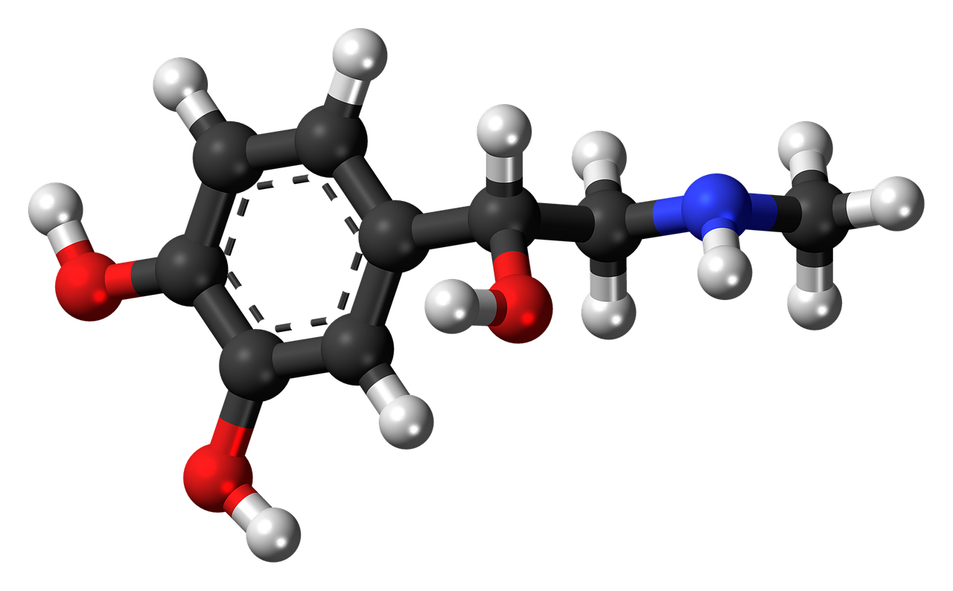
The Power of Hormones!
Your Brain on Birth Control

Slide 2
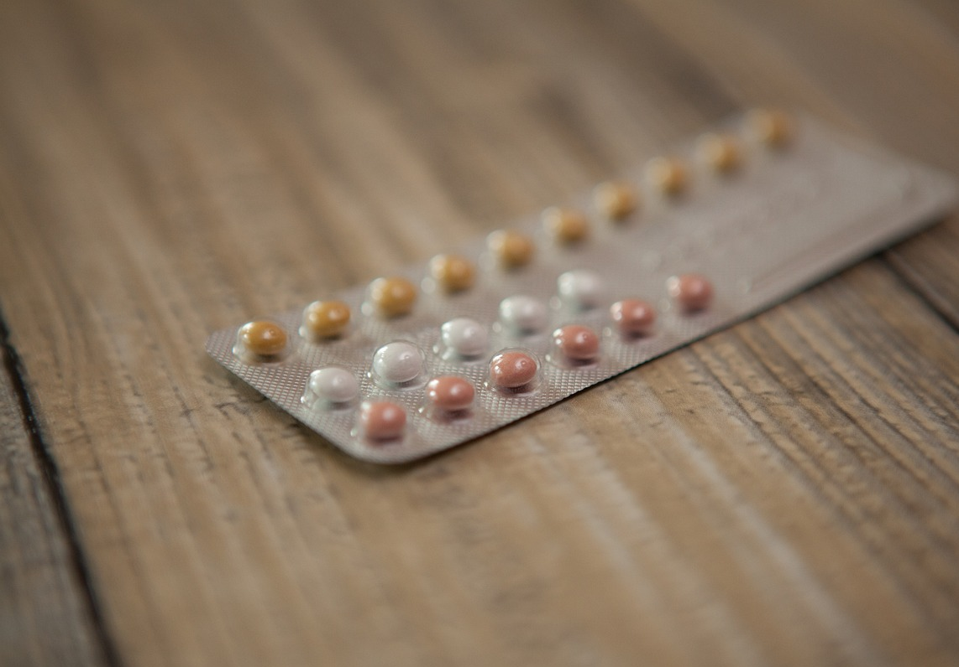
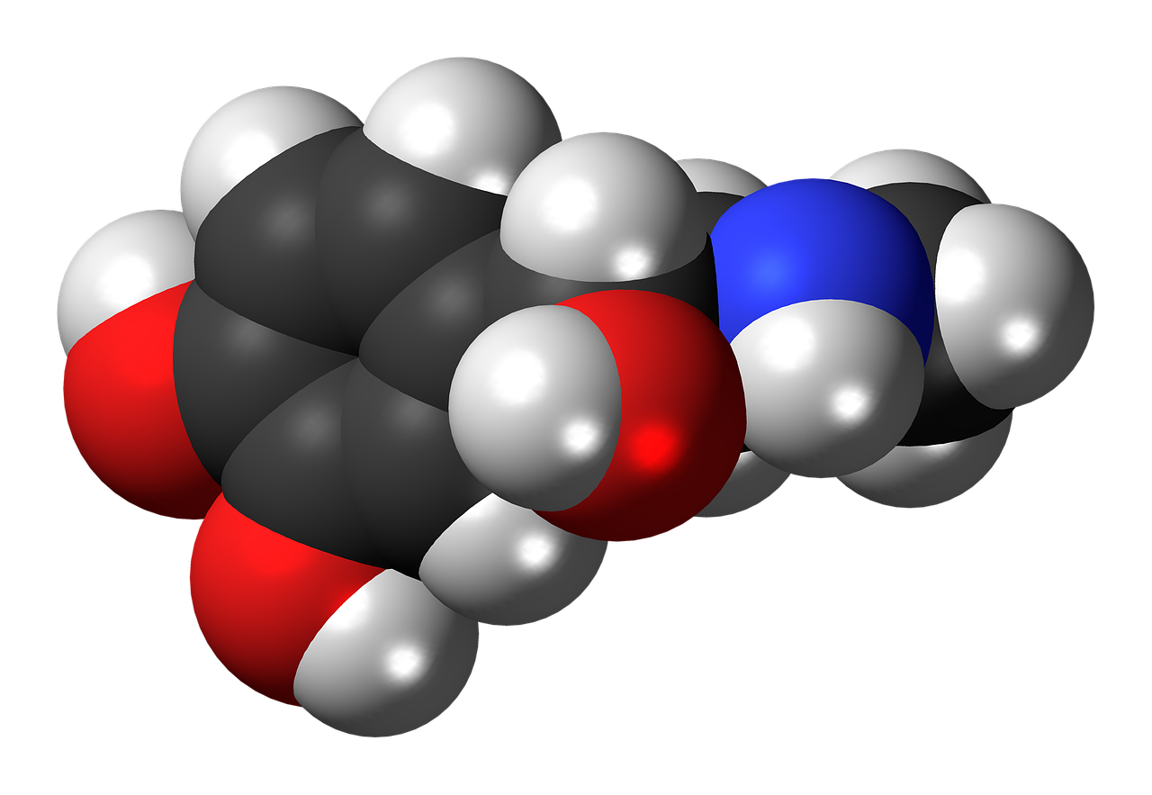
What do you know?
In your table groups, spend 5 minutes answering the following questions
What do you know about hormones?
Can you name any?
If so, what do these hormones do?
Notes:
If students in a group are stuck, you can ask the the following guiding question:
Where have you heard to term hormones before?

Slide 3
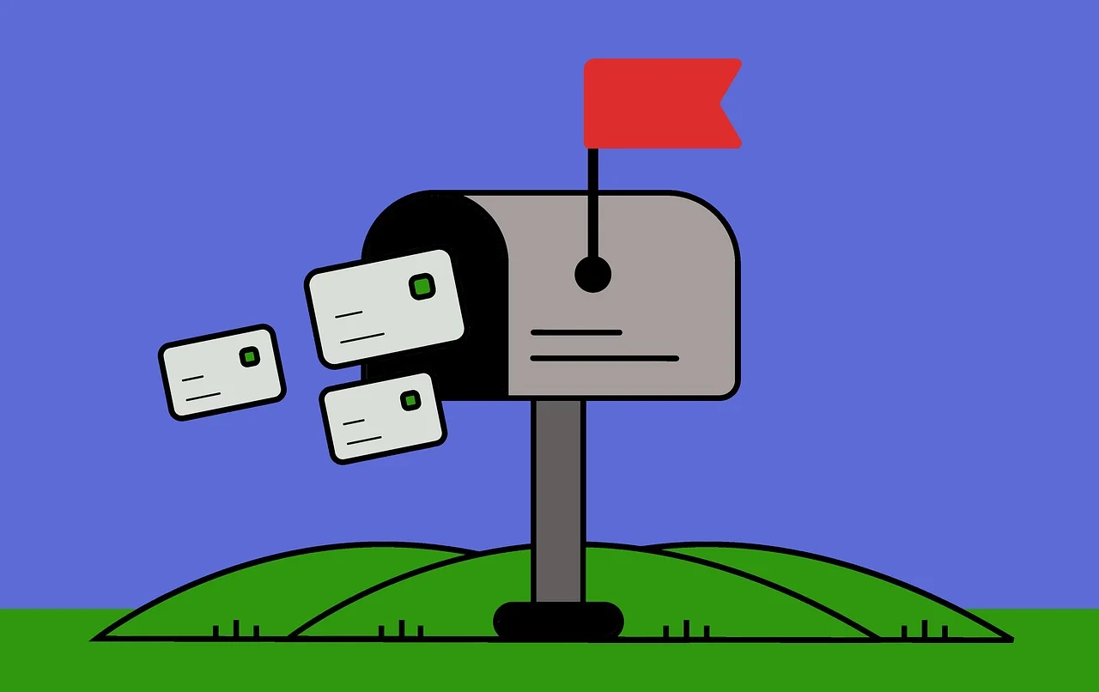
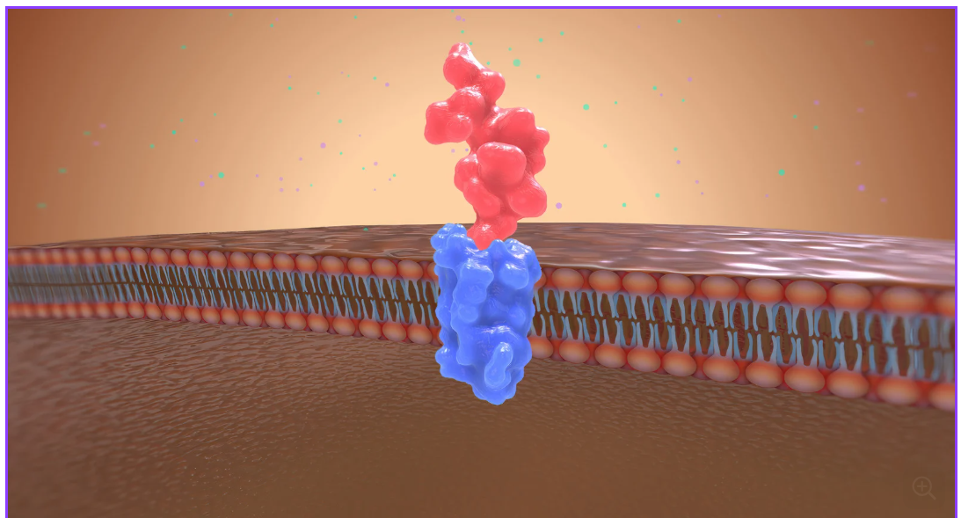
What are hormones?
Hormones are chemical messengers that allow multiple body systems to work together in unison.
Hormones control important body processes like sleep, stress, immune response, nutrient absorption, ect.
You can think of hormones as mail containing instructions for our cells and organs!
Example of a hormone binding to a cells hormone receptor

Slide 4
The endocrine system
Hormones are primarily produced by the organs and glands of the endocrine system.
As seen in the diagrams, the endocrine system is spread throughout the entire body with many of its organs and glands positioned next to other major body systems.
This positioning allows the endocrine system to work alongside the nervous system to control the body.

Slide 5
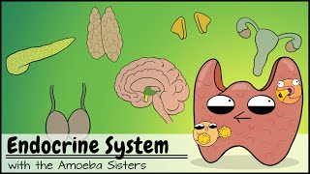
Amoeba sisters!

Slide 6
List of body systems:
Muscular
Skeletal
Nervous
Endocrine
Cardiovascular
Respiratory
Digestive
Reproductive
Excretory
Integumentary
Endocrine
Lymphatic (Immune)
Guess the body system
Which body system(or systems) is affected by the following hormone
Gastrin, produced mainly by your stomach, is a hormone that prepares your body to digest food by releasing gastric acid(stomach acid) and causing the muscles around your stomach to contract and push food forward.
Notes:
Systems affected: Muscular, Digestive, Endocrine

Slide 7
List of body systems:
Muscular
Skeletal
Nervous
Endocrine
Cardiovascular
Respiratory
Digestive
Reproductive
Excretory
Integumentary
Endocrine
Lymphatic (Immune)
Guess the body system
Which body system(or systems) is affected by the following hormone
Insulin, produced by the pancreas, is responsible for allowing glucose(sugar) to be moved from your bloodstream to your cells. This glucose is than metabolised(broken down into energy) by your cells. Muscular cells and Nerves are especially reliant on insulin.
Notes:
Systems affected: Cardiovascular, Neurovous, Muscular, Digestive, Endocrine

Slide 8
List of body systems:
Muscular
Skeletal
Nervous
Endocrine
Cardiovascular
Respiratory
Digestive
Reproductive
Excretory
Integumentary
Endocrine
Lymphatic (Immune)
Guess the body system
Which body system(or systems) is affected by the following hormone
Adrenaline, produced by the adrenal gland, is released in stressful situations in order to keep you alive and active. It does this by reducing pain, increasing blood flow to the brain and muscles, increasing sweat production and forcing you to take quicker, deeper breaths.
Notes:
Systems affected: Cardiovascular, Muscular, Nervous, Respiratory, Integumentary, Endocrine

Slide 9
List of body systems:
Muscular
Skeletal
Nervous
Endocrine
Cardiovascular
Respiratory
Digestive
Reproductive
Excretory
Integumentary
Endocrine
Lymphatic (Immune)
Guess the body system
Which body system(or systems) is affected by the following hormone
Testosterone, primarily produced by the testes, is responsible for sexual function and development in hormones. It is also crucial in brain development during puberty.
Notes:
Systems affected:Reproductive, Endocrine and Nervous. (Integumentary and muscular is also acceptable)

Slide 10
List of body systems:
Muscular
Skeletal
Nervous
Endocrine
Cardiovascular
Respiratory
Digestive
Reproductive
Excretory
Integumentary
Endocrine
Lymphatic (Immune)
Guess the body system
Which body system(or systems) is affected by the following hormone
HGH(Human Growth Hormone) produced by the pituitary gland is responsible for causing skeletal and muscular growth in children. In adults it helps maintain homeostasis by regulating the production of insulin.
Notes:
Systems affected:Skeletal, Muscular, Nervous, Endocrine

Slide 11
Hormones disrupted
Based on the activity from the previous slide, what might occur if your hormones were not doing their job properly?
Due to their nature as chemical messengers, a disruption in any of your hormones can have wide ranging effects on MANY of your body systems. For example…

Slide 12
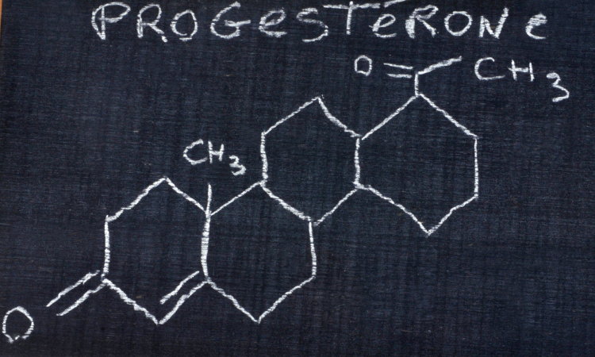
Estrogen and the menstrual cycle!
Most people of the female sex will experience the menstrual cycle, a 28 day cycle that prepares the body for pregnancy. Each phase is triggered by a specific concentration of the 2 primary female sex hormones, estrogen and progesterone.
The menstrual cycle is made up of 4 phases
Menstruation:
Follicular:
Ovulation:
Luteal:

Slide 13
The effects of Estrogen and Progesterone
Estrogen(Controls attraction and desire)
Sexual desire
Increased attention to potential partners
Increased energy
Reduced appetite
Increased competitiveness
Contributes to bone density
Thins mucosal lining of uterus
Increases focus
Increases serotonin(feel good chemical)
Decreases body temperature
Progesterone(Prepares body for pregnancy)
Sleepier(Makes it easier to sleep)
Increased appetite
More emotional sensitivity
Decreased anxiety
Prepares body for lactation
Increases the mucosal lining of the uterus
Increases body temperature
What body systems do you think are most affected by estrogen and progesterone?
Answer on your whiteboard and justify your answer.
Notes:
Students should be working within their groups to answer each question. If possible they should record their answers on a whiteboard.
The intended answer
Reproductive, nervous, skeletal and digestive system

Slide 14
The effects of Estrogen and Progesterone
Estrogen(Controls attraction and desire)
Sexual desire
Increased attention to potential partners
Increased energy
Reduced appetite
Increased competitiveness
Contributes to bone density
Thins mucosal lining of uterus
Increases focus
Increases serotonin(feel good chemical)
Decreases body temperature
Progesterone(Prepares body for pregnancy)
Sleepier(Makes it easier to sleep)
Increased appetite
More emotional sensitivity
Decreased anxiety
Prepares body for lactation
Increases the mucosal lining of the uterus
Increases body temperature
What might low estrogen cause? How about high estrogen?
Answer on your whiteboard and justify your answer/
Notes:
Students should be working within their groups to answer each question. If possible they should record their answers on a whiteboard.
The intended answer
Low estrogen causes brittle bones, increased appetite, low energy. High estrogen causes thin mucosal lining, high energy, low body temp and high focus.

Slide 15
The effects of Estrogen and Progesterone
Estrogen(Controls attraction and desire)
Sexual desire
Increased attention to potential partners
Increased energy
Reduced appetite
Increased competitiveness
Contributes to bone density
Thins mucosal lining of uterus
Increases focus
Increases serotonin(feel good chemical)
Decreases body temperature
Progesterone(Prepares body for pregnancy)
Sleepier(Makes it easier to sleep)
Increased appetite
More emotional sensitivity
Decreased anxiety
Prepares body for lactation
Increases the mucosal lining of the uterus
Increases body temperature
What might low progesterone cause? How about high progesterone?
Answer on your whiteboard and justify your answer?
Notes:
Students should be working within their groups to answer each question. If possible they should record their answers on a whiteboard.
The intended answer
Low progesterone causes thin uterine lining, anxiety, lower body temperature, and low appetite. High progesterone causes craving, sleepiness, low anxiety and increased body temperature.

Slide 16
The effects of Estrogen and Progesterone
Estrogen(Controls attraction and desire)
Sexual desire
Increased attention to potential partners
Increased energy
Reduced appetite
Increased competitiveness
Contributes to bone density
Thins mucosal lining of uterus
Increases focus
Increases serotonin(feel good chemical)
Decreases body temperature
Progesterone(Prepares body for pregnancy)
Sleepier(Makes it easier to sleep)
Increased appetite
More emotional sensitivity
Decreased anxiety
Prepares body for lactation
Increases the mucosal lining of the uterus
Increases body temperature
How are the effects of Estrogen and Progesterone different? How are they similar.
Answer on your whiteboard and justify your answer?
Notes:
Students should be working within their groups to answer each question. If possible they should record their answers on a whiteboard.
The intended answers
Many of the effects of Estrogen and Progesterone are opposites of each other

Slide 17
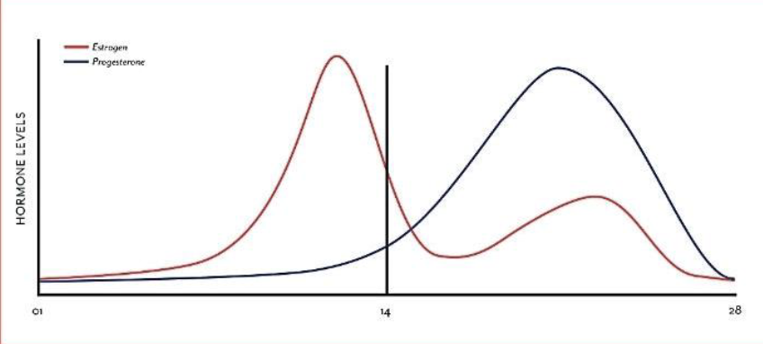
Menstrual cycle hormone chart
What do you notice about the hormone chart?
Based on your answers from the previous slide, how would you expect the body to change at each phase of the cycle?
Follicular period
Luteal phase
Estrogen
Progesterone
Menstruation
Ovulation
Notes:
Answers are covered in the next two slides.

Slide 18
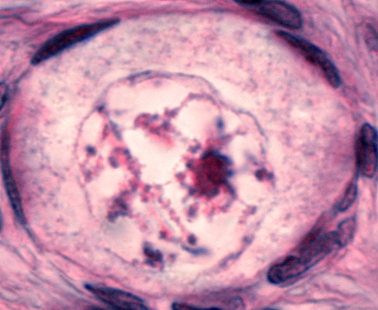
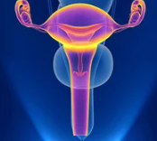
Stages of the menstrual cycle
Low estrogen low progesterone
High estrogen low progesterone
Stage 1: Menstruation
Menstruation, also known as the period, occurs for the first 3-7 days of the menstrual cycle. During this period, the uterus sheds its lining unless pregnancy has begun.
Other effects include
Low energy
Trouble sleeping
Aching joints
Headaches
Bloating
Difficulty focusing
Stage 2: The follicular phase
For the first 14 days of the menstrual cycle, the uterine lining thickens as follicles in the ovaries begin to grow. Eventually one of these follicles will burst open and release an egg
Other effects include
Increased energy
Increased focus
Decreased body temperature
Decreased appetite
Increased sexual desire

Slide 19
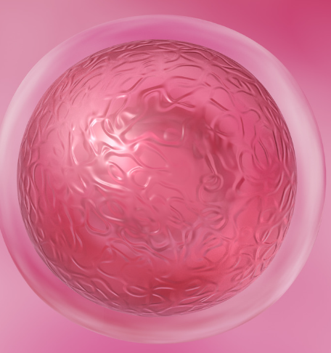
Stages of the menstrual cycle continued
Mid estrogen Mid progesterone
Low estrogen High progesterone
Stage 3: Ovulation
Ovulation occurs around the 14th day of the menstrual cycle. During this 24 hour period, the egg from the follicular phase travelers down the fallopian tube, where it can then be fertilised by sperm. If fertilisation does not occur within 12-24 hours, the egg dies and is reabsorbed into the body.
Increasing appetite
Increased body temperature
Increased energy
Increased anxiety
Stage 4: The luteal phase
The luteal phase takes place right after ovulation in order to prepare the body for a potential pregnancy. To do this it releases progesterone to heavily thicken uterine lining so that the potential embryo is safe from infection.
Sleepiness
Bloating
Increased appetite
Cramps
Decreased focus
Do these effects match your predictions? Why or why not?

Slide 20
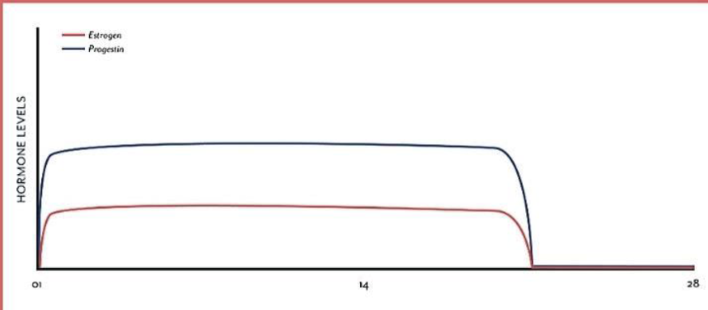
Menstrual cycle hormone chart under hormonal birth control
What do you notice about the hormone cycle under birth control?
What effects might this flattened curve have on the body?
What phase of the menstrual cycle is hormonal birth control closest to?
Answer on your whiteboard and justify your answer
Naturally cycling hormones
Cycle on hormonal birth control
Follicular period
Luteal phase
Progesterone
Estrogen
Menstruation
Ovulation
Notes:
Points that should be discussed
Decreased estrogen causes: Lower bone density, Reduced energy, Reduced focus and reduced sexual attraction.
Some good things from this include: Lack of pregnancy(purpose of drug), creating a relatively stable state of body and mind (no wild mood swings from rapidly changing hormones).
Since birth control replaces the natural production of estrogen and progesterone, it can be used to treat illnesses related to the hormones.
Sleep disruption due to the constant level of progesterone and estrogen.
The levels of progesterone and estrogen on hormonal birth control partially mimic the menstrual and luteal phases.
It’s important to note that estrogen and progesterone tend to have opposite effects on many parts of the body(temperature, mood, appetite, desire. sleep and energy). This means that many of the effects of progesterone while on hormonal birth control will be less pronounced.
The hormone levels for the first 20 days of birth control are irregular (not at levels the body is accustomed to)
The body is VERY sensitive to hormone changes. Even a minor change in hormones can have a potent domino effect.

Slide 21
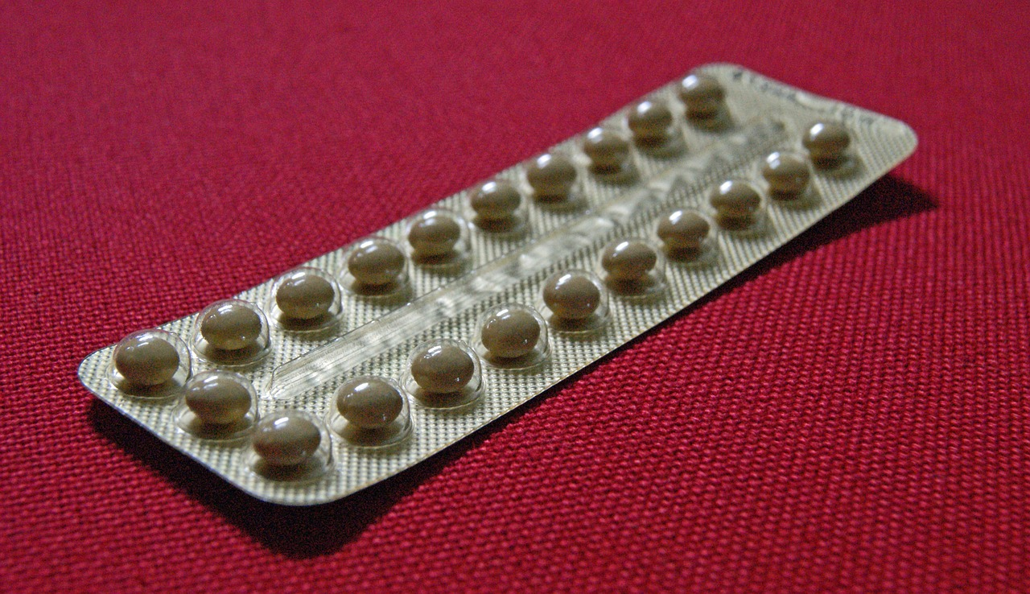
Hormonal Birth Control
Hormonal birth control pills work by reducing the bodies natural estrogen and progesterone production, and replacing it with a steady dose of artificial hormones.
By preventing the primary female sex hormones from cycling, the pills effectively halt the follicular and the ovulation phase entirely. High levels of progesterone also increase the thickness of uterine lining, making it impossible for sperm to reach the egg, even if ovulation does somehow occur. Since women are only fertile around the ovulation phase, preventing it from happening will prevent pregnancy!
Notes:
It should be emphasised to students that Hormonal Birth Control is not a bad thing. Like any other medication, Hormonal Birth Control does more than just one thing.

Slide 22
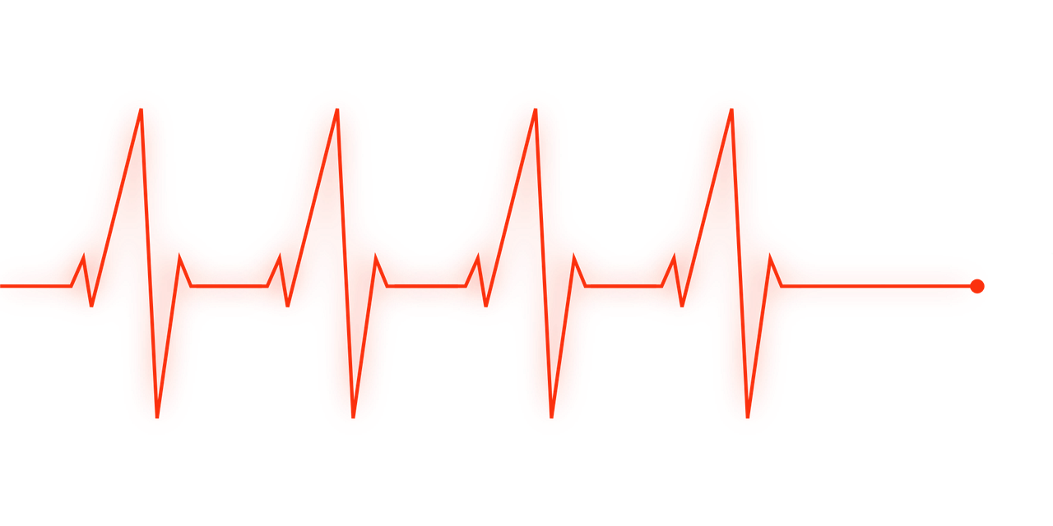
Research Project!
In your groups, research one of the following endocrine illnesses
Diabetes type 1&2
Hypothyroidism
Cushing's syndrome
Allergies (Both severe and minor)
Hypogonadism(both male and female)
You will be responsible for knowing which hormone(s) cause the illness, the symptoms it causes, and the groups of people most affected by it.

Slide 23
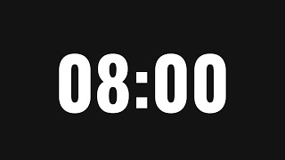
Exit Ticket
Before you leave, pair up with a student from another group and explain to them some facts about the illness you researched.
You should include the following in your explanation:
The name of your illness
The hormones that cause the illness
2 of the main symptoms of the illness
The people most affected by the illness
Use this information to fill out the exit ticket on the back of your endocrine disorder worksheet

