Slide 1




The True “Cost” of Food
Food and Our Environment

Slide 2

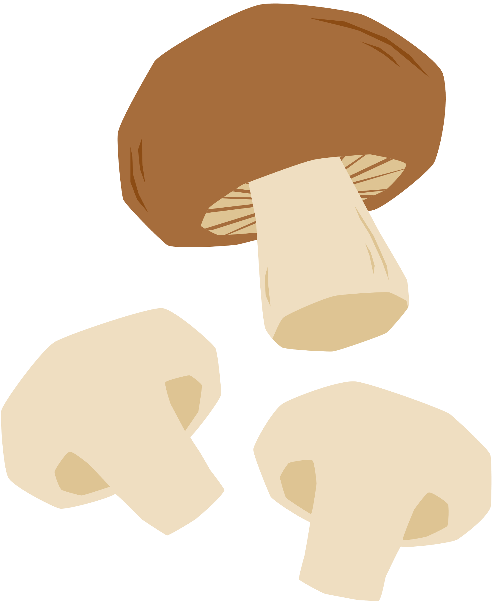

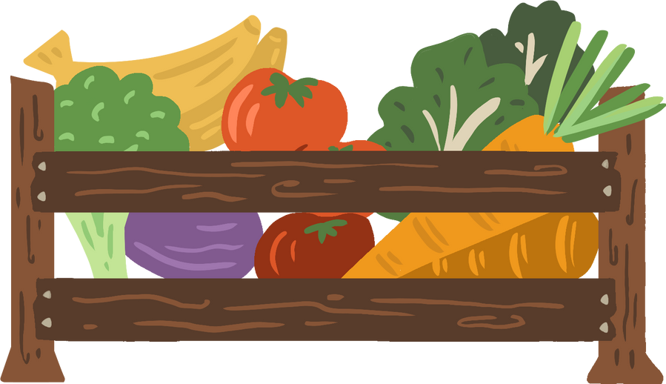


Why?
What is your favorite food?
Why is that your favorite food?
Where?
Where does that food come from?
How?
How is that food made?
What?
What does it “cost” to make that food?

Slide 3


Food Footprint
Think of a dish--any dish! Have you ever wondered how much goes into making it? In this activity, we will be exploring how much goes into producing the different foods we eat every day, and the hidden price we are paying.

Slide 4
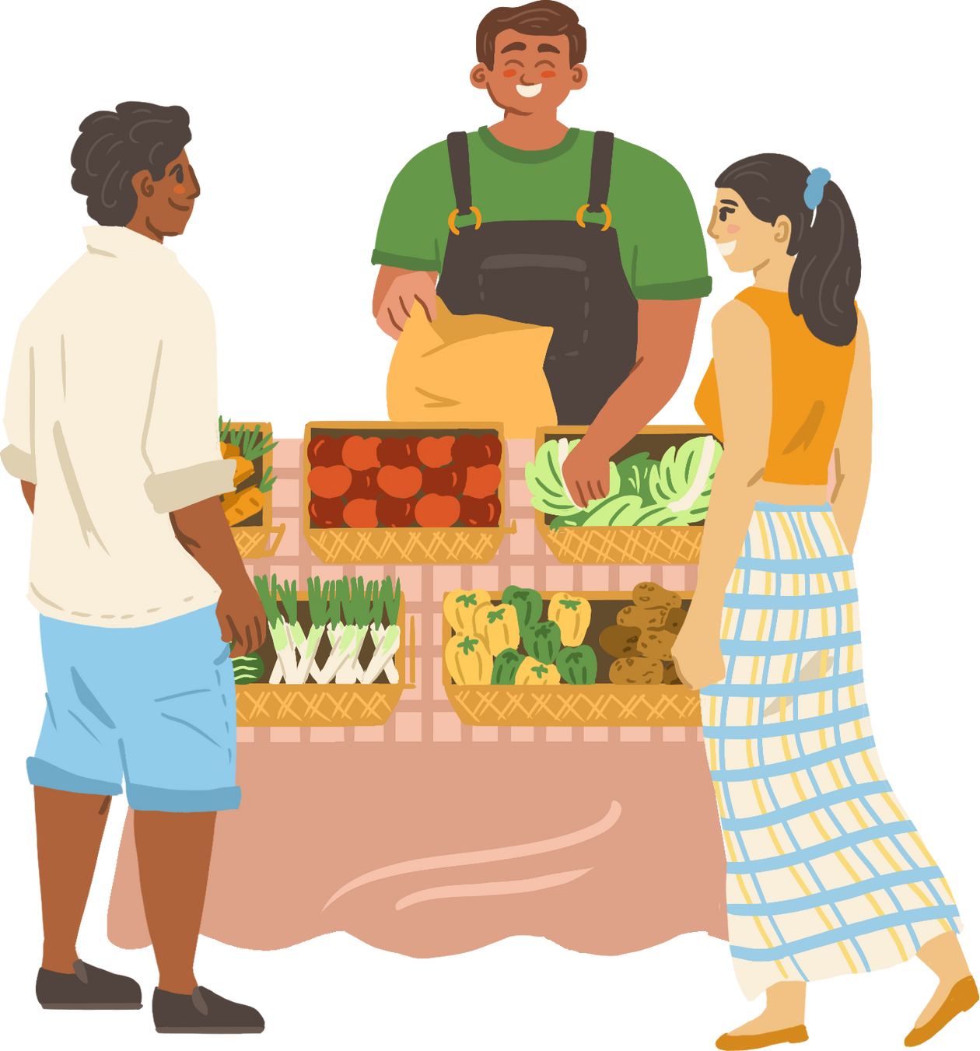
Jigsaw!
In your jigsaw groups, discuss your findings, and answer some of the following questions:
  What was your food item? What were its contributors? Were you surprised?
  How do your foods compare to the group? Why do you think that is?
  What are some potential strategies for reducing the impact of certain foods?

Slide 5

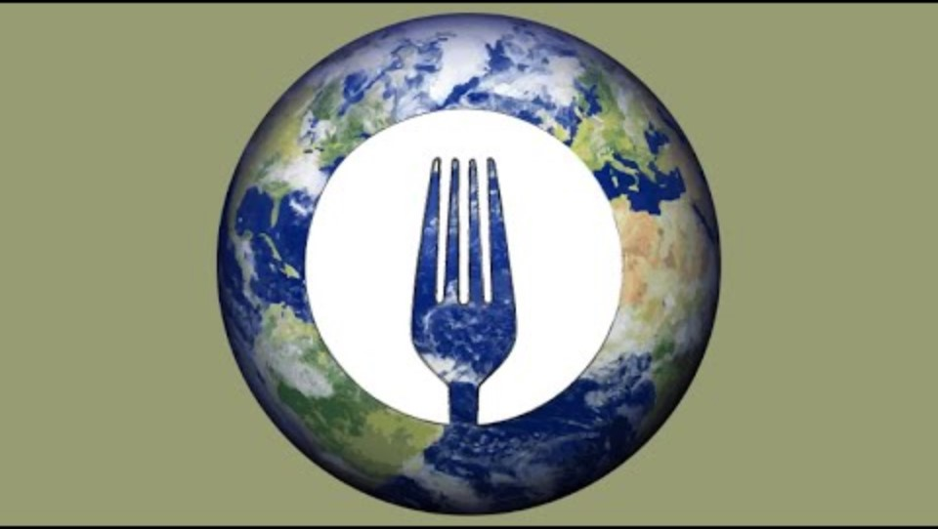
The True Expense of Food

Slide 6


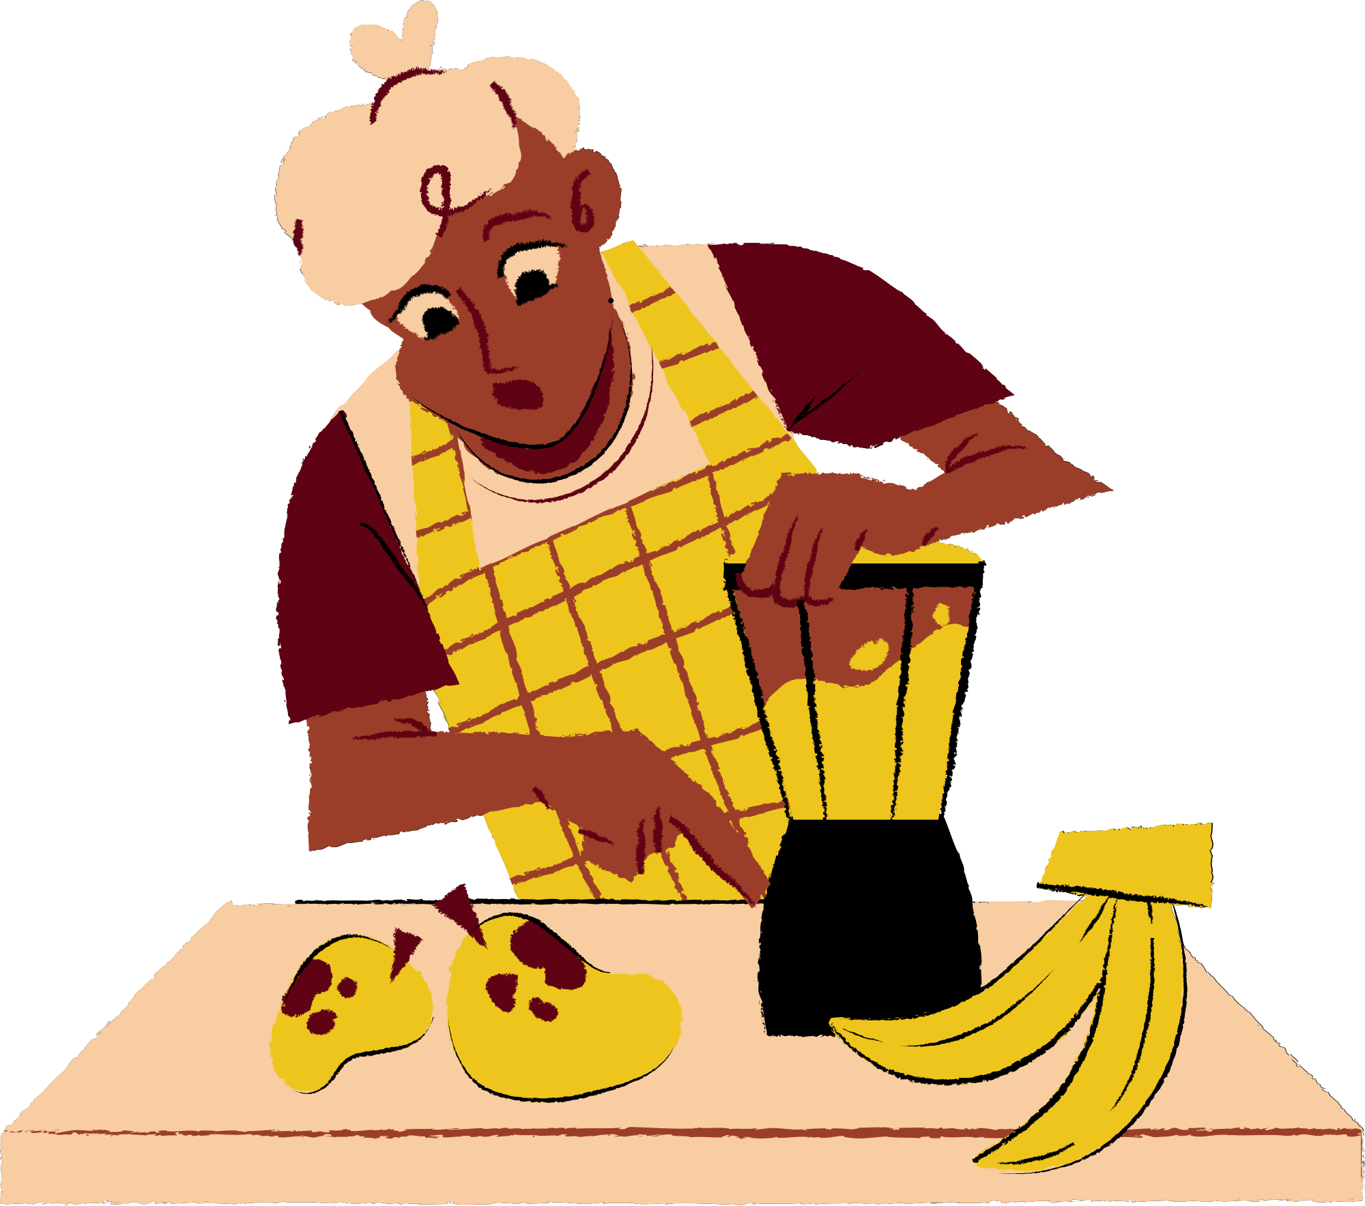

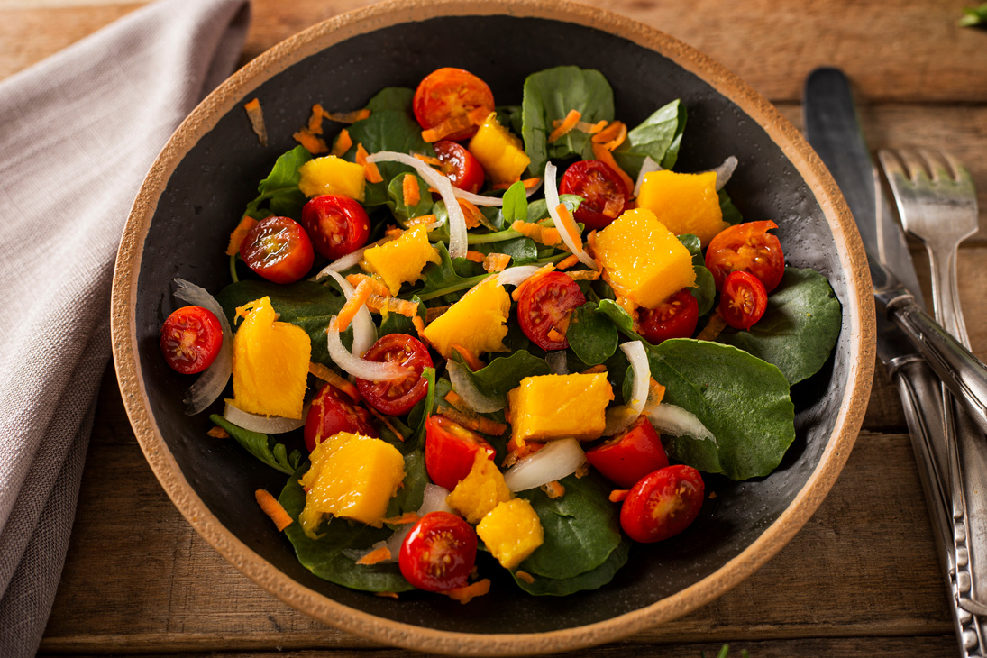


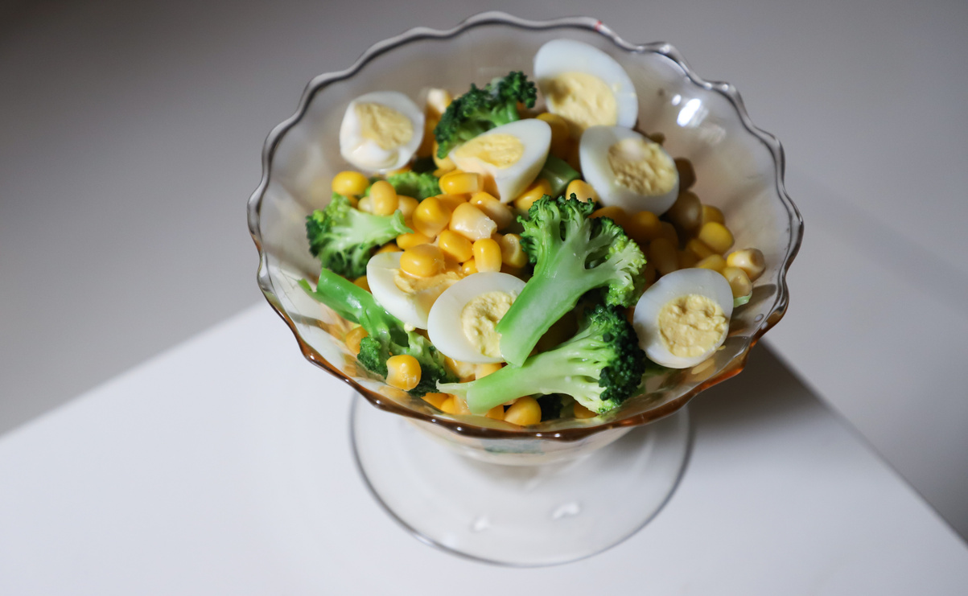

Let’s Discuss
What were some key points Dr. Patel made about the impact of the food industry on the environment?
Were there any points that surprised you or challenged what you know about the food industry?
How can we begin to address the “true cost” of food?

Slide 7
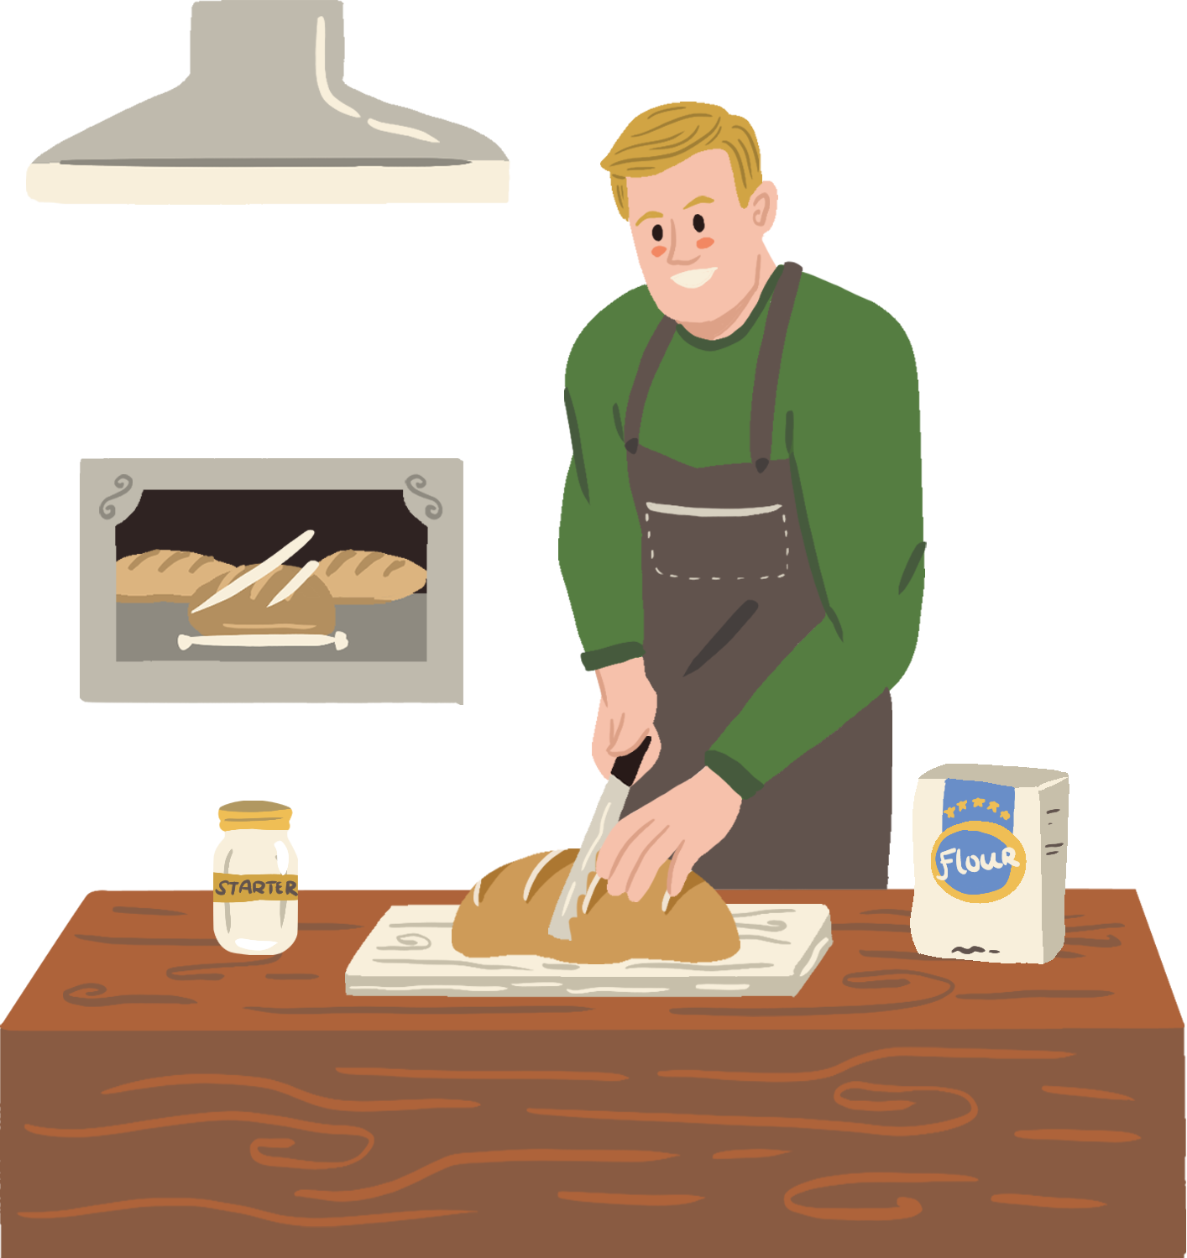
Now, think about...
Think about your favorite dish or food from the beginning of class, and in your journal, ask yourself:
  What are the main ingredients?
  Where do they come from/how are they produced?
  What resources are used in the production, transportation, preparation?
  What are the effects of using these resources?
  What is the “true” cost of your favorite food, and how might you change it?

