Slide 1
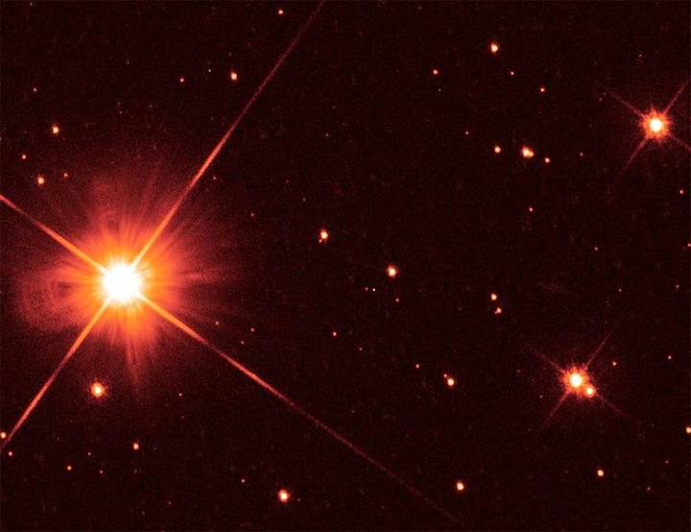
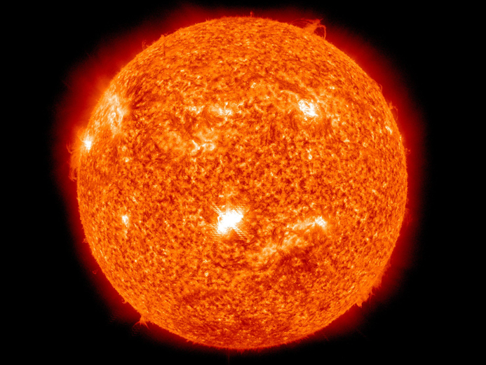
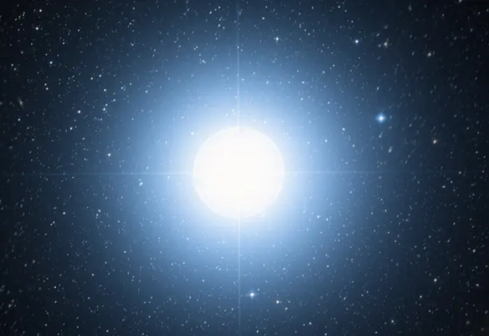
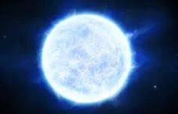
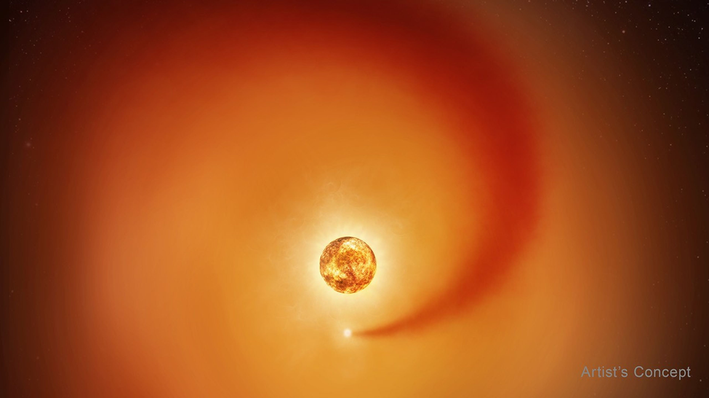
Student Star Mapping Project
Data Set 1
Proxima Centauri
Sun
Vega
Sirius A
Betelgeuse
STAR NAME | LUMINOSITY | TEMPERATURE | CATAGORY
SUN | 1 | 5,772 K | MAIN SEQUENCE
PROXIMA CENTAURI | 0.0017 | 3,000K | RED DWARF
SIRIUS A | 25 | 9,900K | MAIN SEQUENCE
BETELGEUSE | 126,000 | 3,500 K | RED SUPERGIANT
VEGA | 40 | 9,600 K | MAIN SEQUENCE

Slide 2
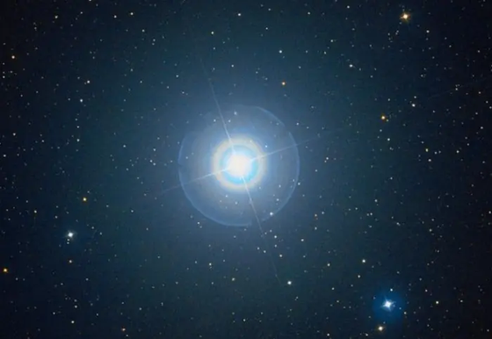
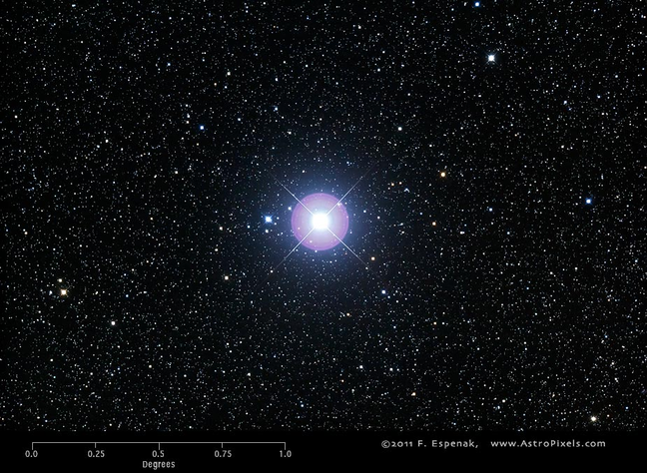
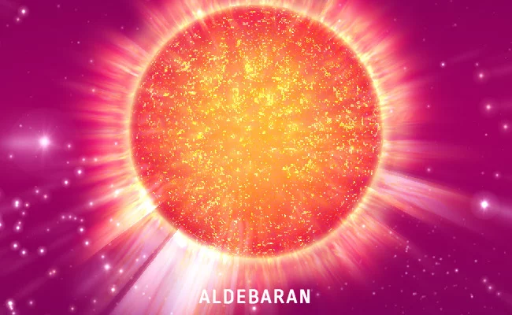
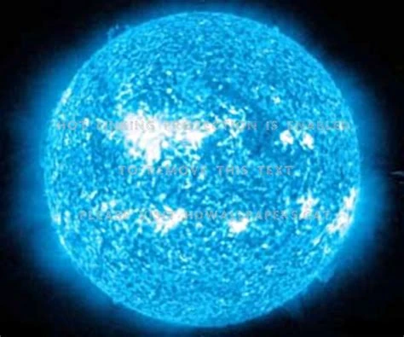
Student Star Mapping Project
Data Set 2
Polaris
Sun
Procyon A
Alderbaran
Rigel
STAR NAME | LUMINOSITY | TEMPERATURE | CATAGORY
SUN | 1 | 5,772 K | MAIN SEQUENCE
POLARIS | 2,500 | 6,000K | YELLOW SUPERGIANT
PROCYON A | 7 | 6,500 K | MAIN SEQUENCE
ALDERBARAN | 440 | 3,900 K | ORANGE/RED GIANT
RIGEL | 120,000 | 12,100 K | BLUE SUPERGIANT

Slide 3
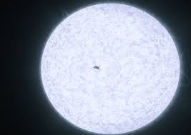

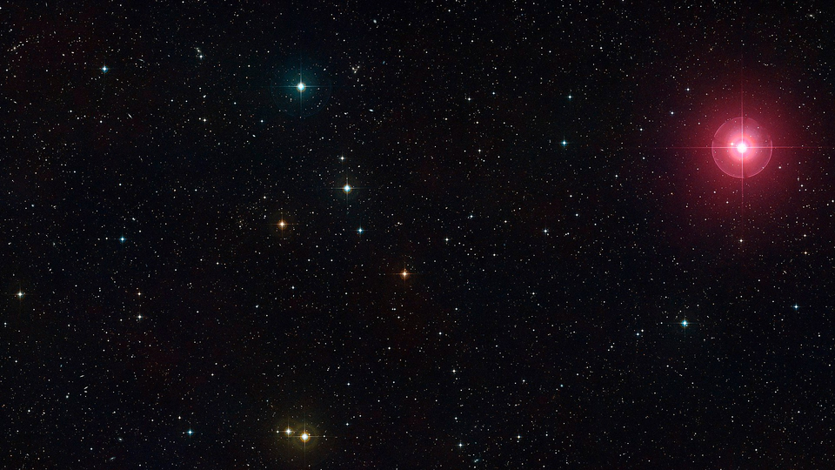
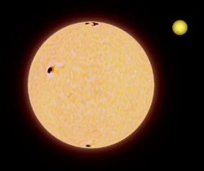
Student Star Mapping Project
Data Set 3
Altair
Sun
Regulus
Mira A
Polllux
STAR NAME | LUMINOSITY | TEMPERATURE | CATAGORY
SUN | 1 | 5,772 K | MAIN SEQUENCE
REGULUS | 150 | 10,300 K | MAIN SEQUENCE
ALTAIR | 10.6 | 7,550 K | MAIN SEQUENCE
POLLUX | 32 | 4,865 K | ORANGE/ RED GIANT
MIRA A | 9,000 | 3,000 K | RED GIANT

Slide 4
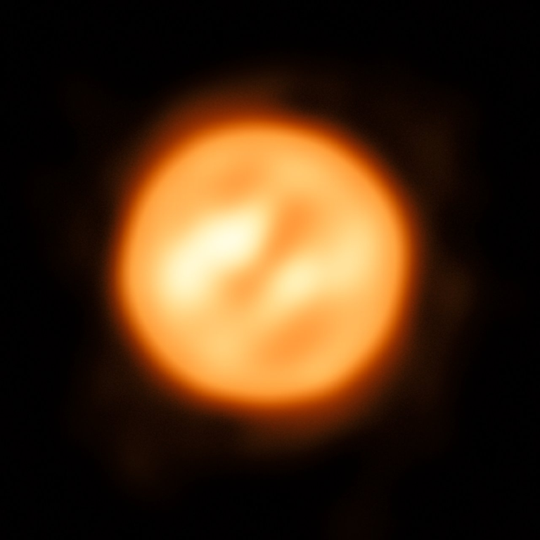
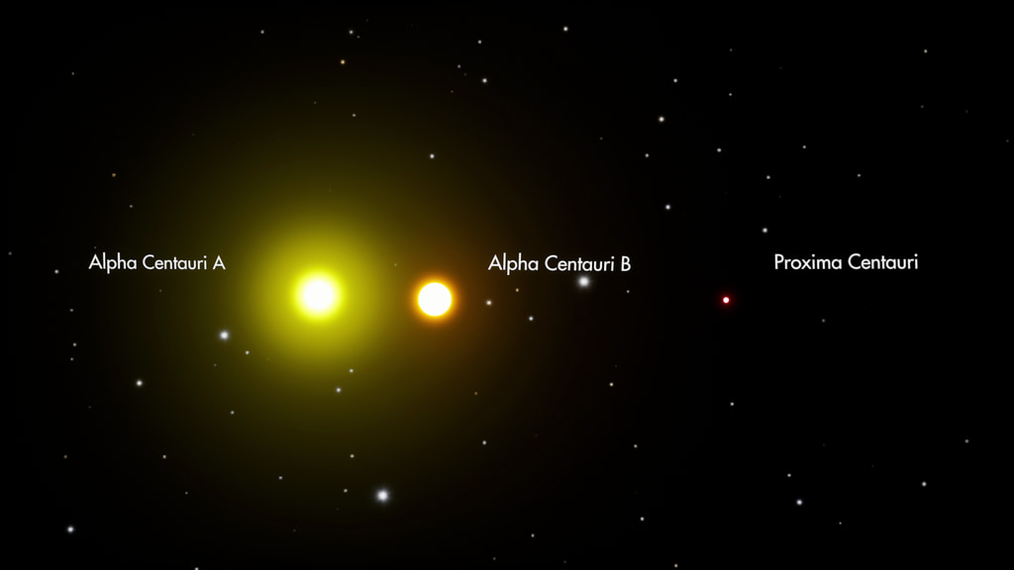
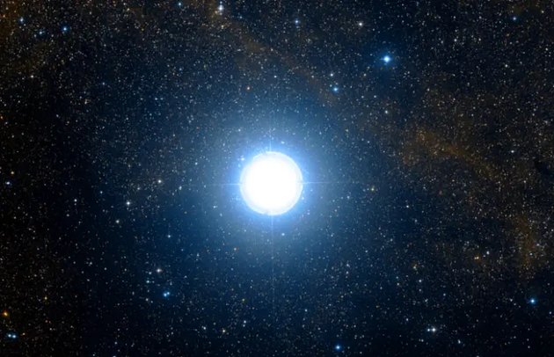
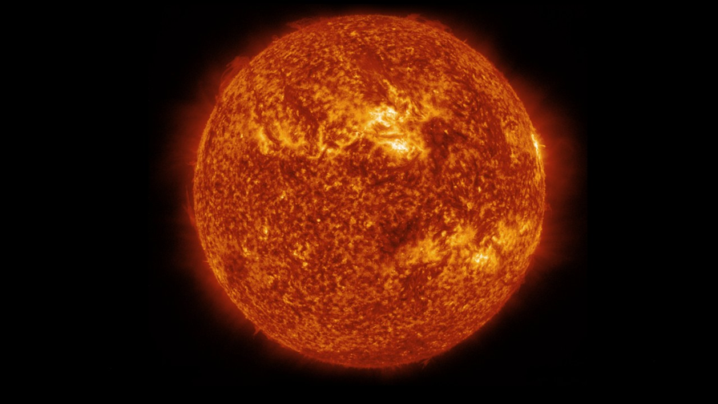
Student Star Mapping Project
Data Set 4
Antares
Sun
Alpha Centauri A
Deneb
Arcturus
STAR NAME | LUMINOSITY | TEMPERATURE | CATAGORY
SUN | 1 | 5,772 K | MAIN SEQUENCE
DENEB | 196,000 | 8,500 K | BLUE SUPERGIANT
ARCTURUS | 170 | 4,300 K | RED GIANT
ALPHA CENTAURI A | 1.5 | 5,800 K | MAIN SEQUENCE
ANTARES | 75,000 | 3,500 K | RED SUPERGIANT

Slide 5
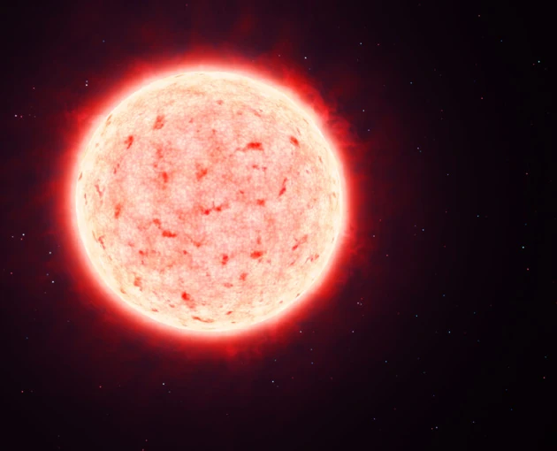
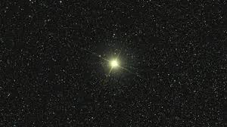
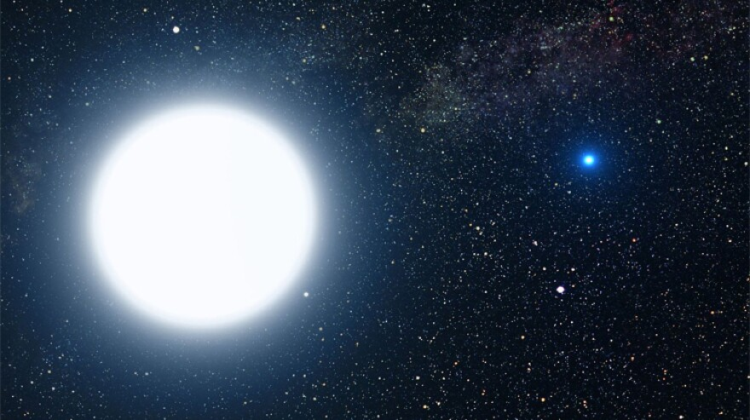
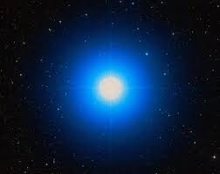
Student Star Mapping Project
Data Set 5
Barnard’s Star
Sun
Capella A
Spica
Sirius B
STAR NAME | LUMINOSITY | TEMPERATURE | CATAGORY
SUN | 1 | 5,772 K | MAIN SEQUENCE
SPICA | 20,000 | 22,400 K | MAIN SEQUENCE
SIRUS B | 0.026 | 25,000 K | WHITE DWARF
CAPELLA A | 78 | 4,970 K | GIANT
BARNARD’S STAR | 0.0035 | 3,100 K | MAIN SEQUENCE

