Slide 1
spiral galaxy
irregular galaxy
elliptical galaxy
Giants and Supergiants
Main Sequence Stars
White Dwarfs

Slide 2
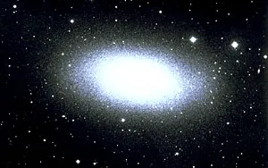
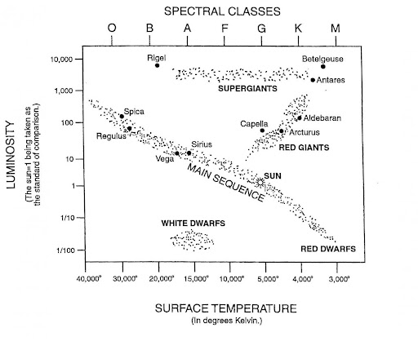
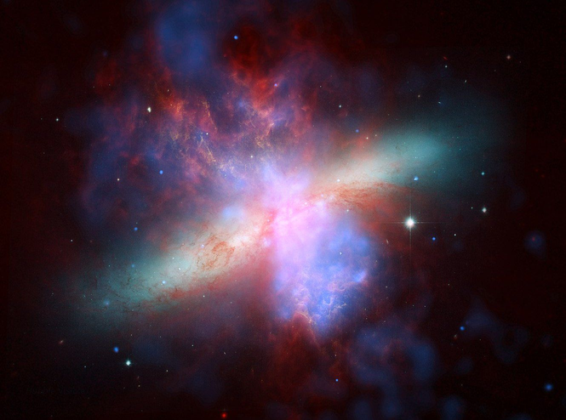
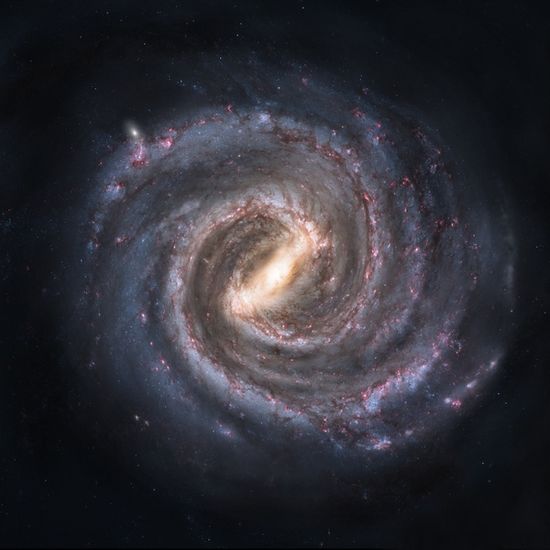
_______________________________
_______________________________
_______________________________
_______________________________
_______________________________
_______________________________
DEFINITION
Draw an image representing the shape of this galaxy:
Draw an image representing the shape of this galaxy:
Draw an image representing the shape of this galaxy:
DEFINITION
DEFINITION
___________________
Locate and label the three main categories on your diagram. For each group, circle/highlight the cluster and clearly label it:
Label each galaxy:
___________________
The temperature of the sun is approximatly _______ degrees Kelvin
___________________
_______________________________
_______________________________
_______________________________
_______________________________
_______________________________
_______________________________
DEFINITION
DEFINITION
DEFINITION

