Slide 1
Life and Death by Impact
How we know about prehistoric events

Slide 2
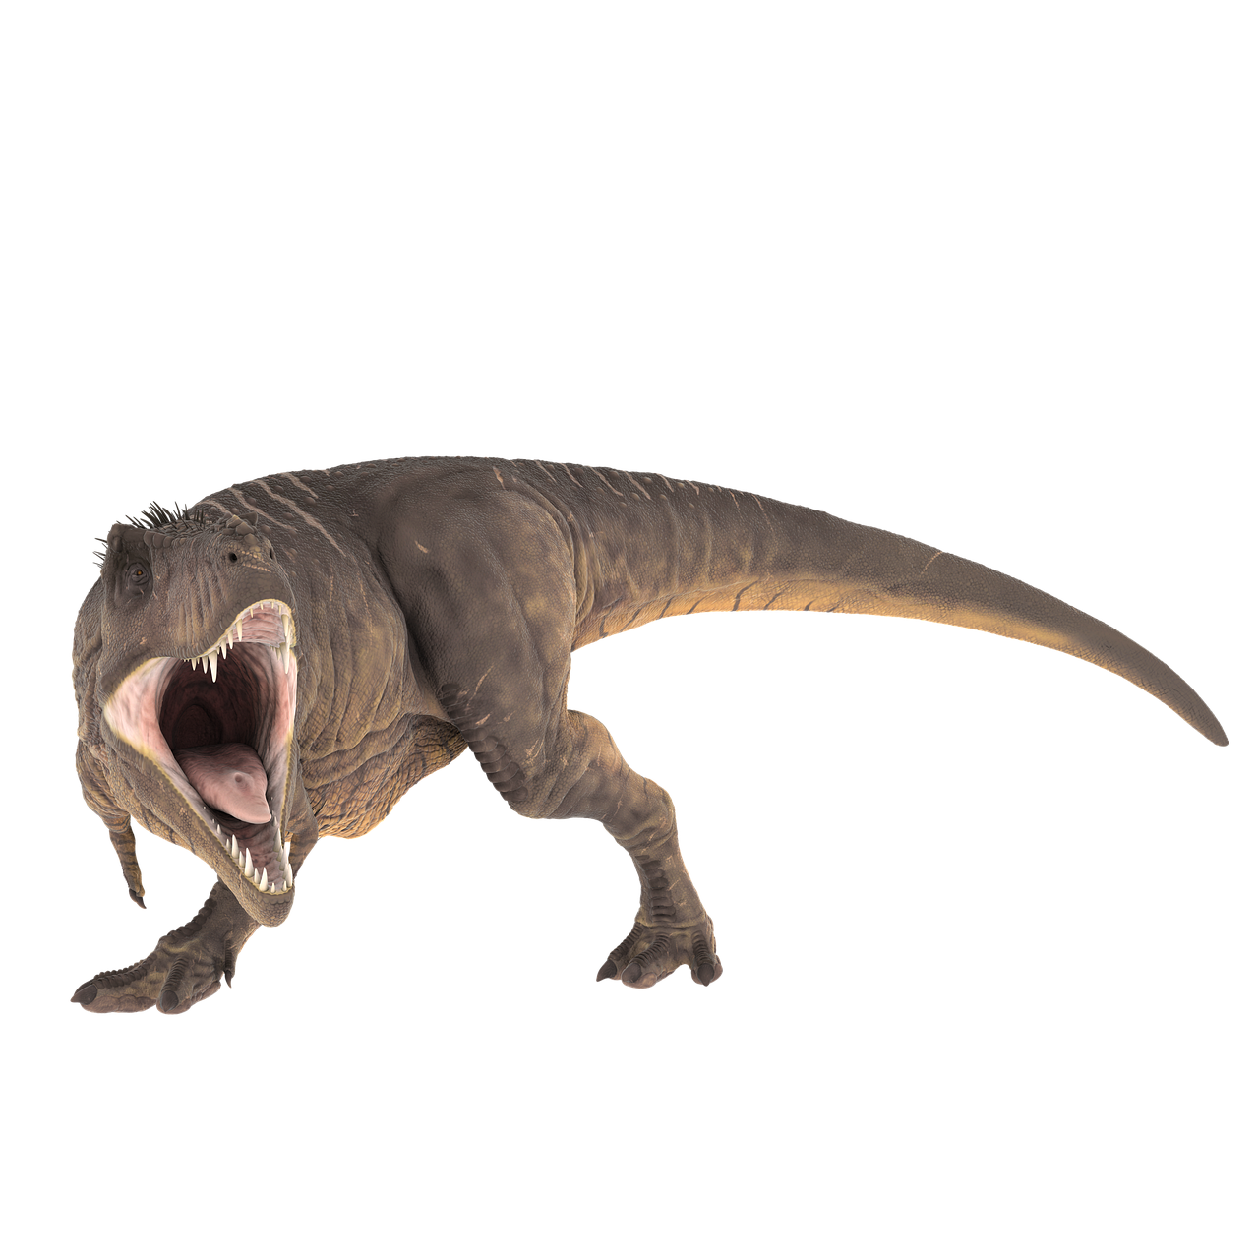

Warmup!
With your groups, discuss the following questions. Be prepared to share your answers!
How did the dinosaurs go extinct?
How do we know?
How do we know that dinosaurs existed at all?

Slide 3

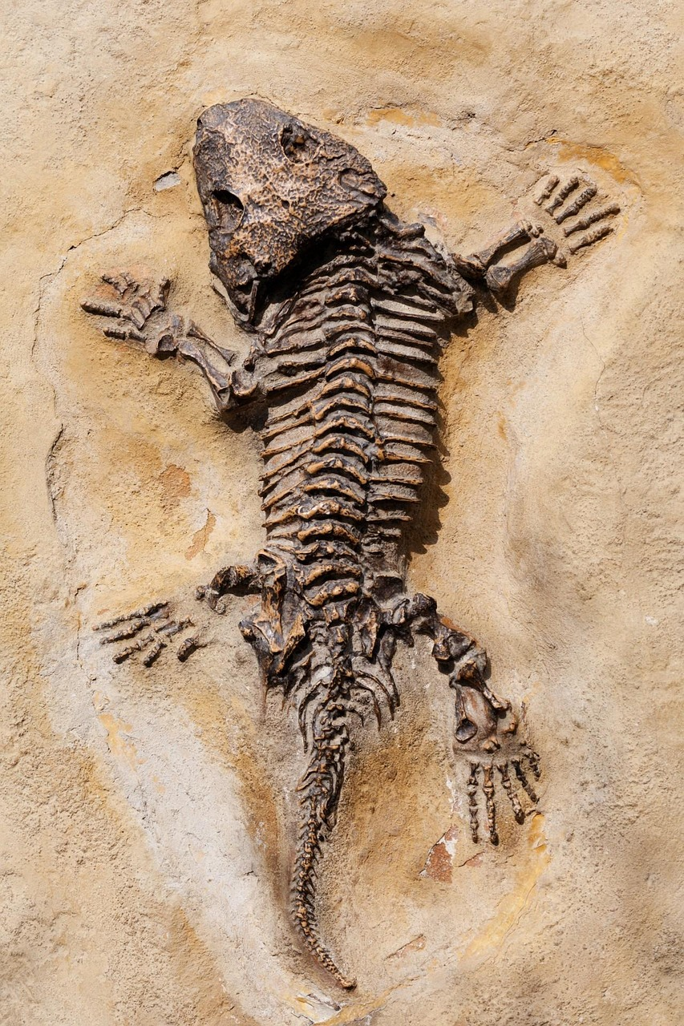
How do we know?
How do we know about what happened millions of year before humans existed?
We know because evidence is left including
Geologic features(Such as craters and canyons)
Fossils
But how do we know old these features are?

Slide 4

Geologic Dating
Geologists have 2 main methods of determining how old something is
Relative dating: Comparing the age of 2 objects. Does not give a specific age.
Absolute dating: Finding the exact age of an object.
This provides exact ages, but not everything can be dated this way.

Slide 5
Relative dating
Relative dating tells if an object is older than another using the following simple principles:
Superposition
Cross cutting
Uniformitarianism
There are many more principles, but these are the simplest!

Slide 6
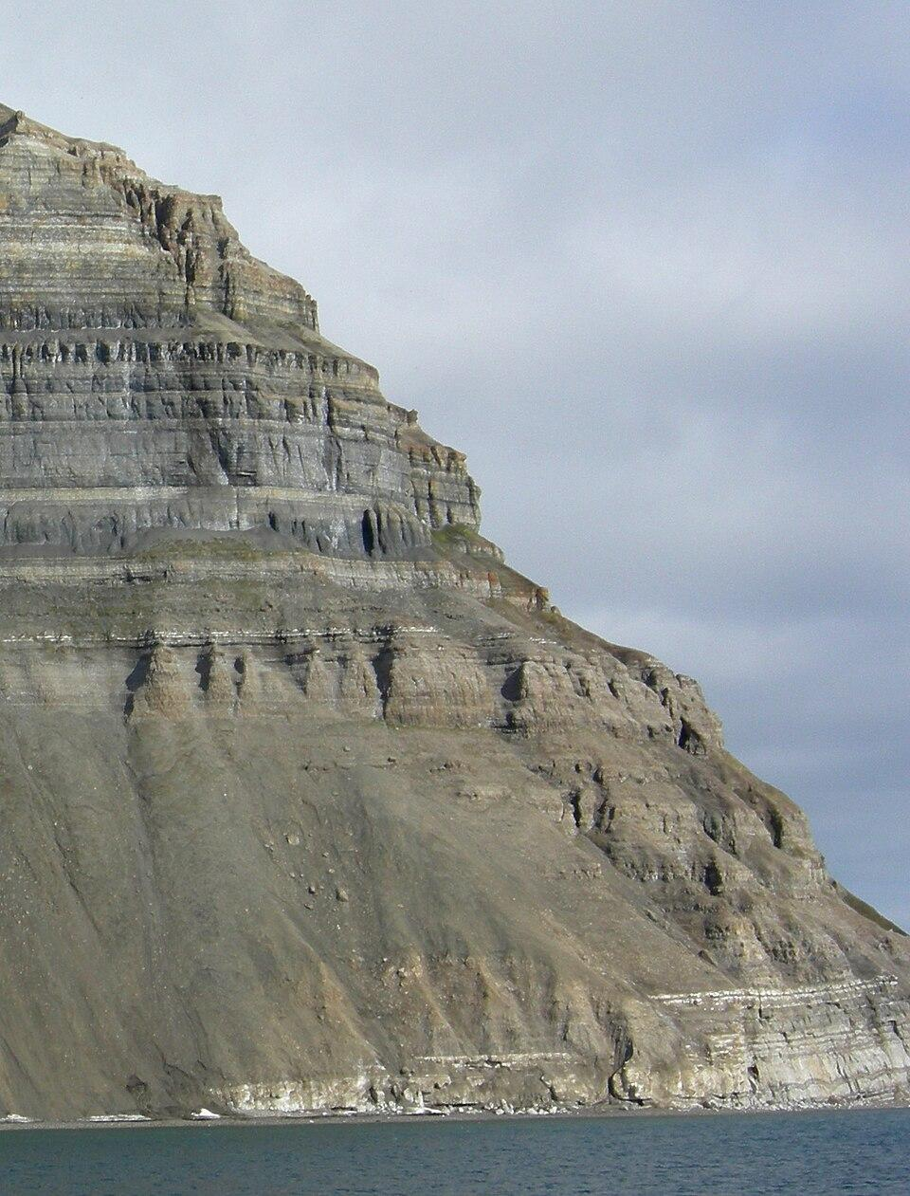
Superposition
Younger rock
Rock layers stack on top of each other, with newer rock on top
Layers of rock found deeper in the earth are older than those closer to the surface!
Older rock

Slide 7
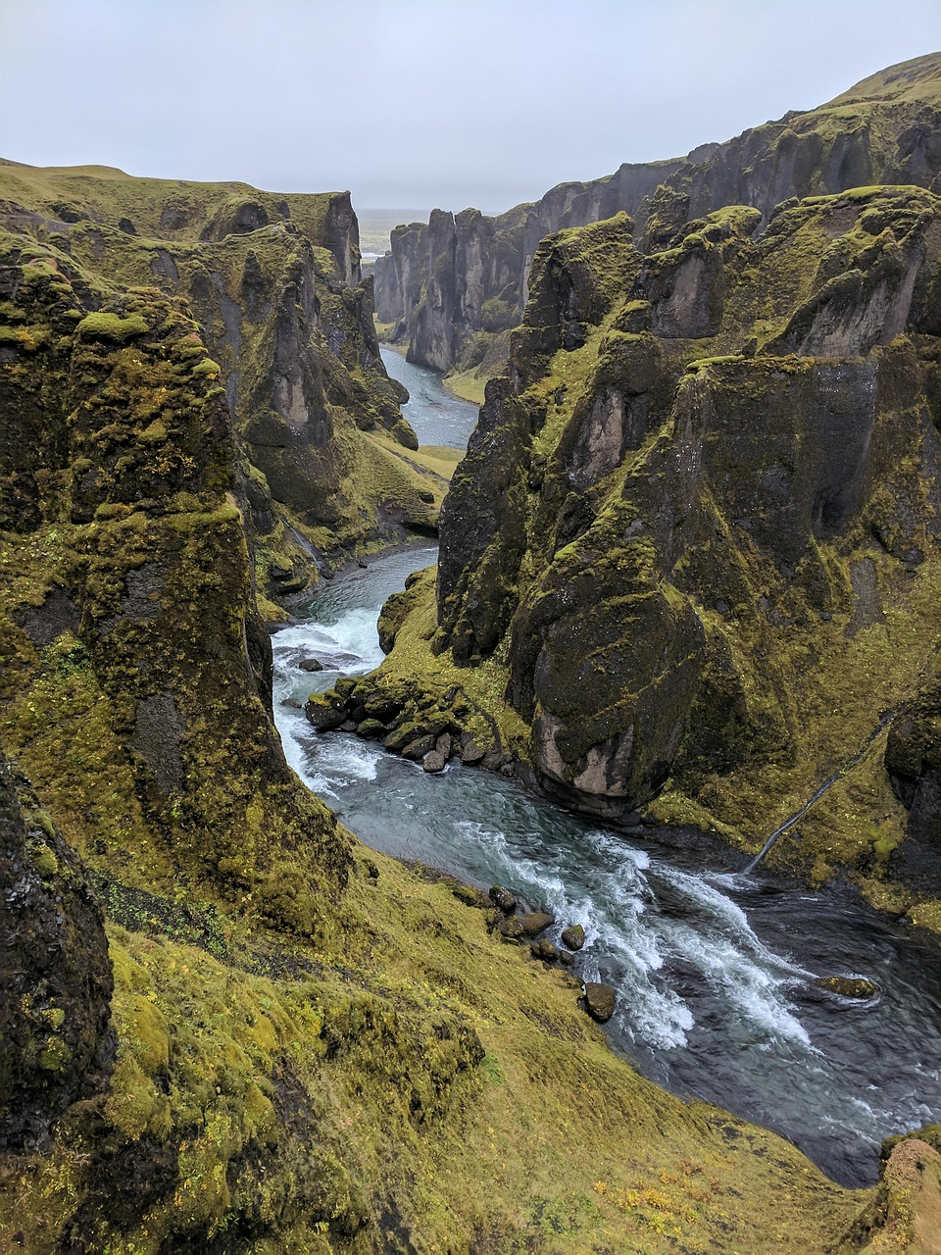
Cross cutting
Older rock wall
Younger river
Objects that cut into or split rock layers are younger than the surrounding rock
In this example, the rock must have been made before the river split them apart

Slide 8

Uniformitarianism
Rock layers and craters are made the same way today as they were millions of years ago.
For example, after a flood, we can see sand and mud left behind
By Uniformitarianism, we know that floods millions of years ago did as well.

Slide 9
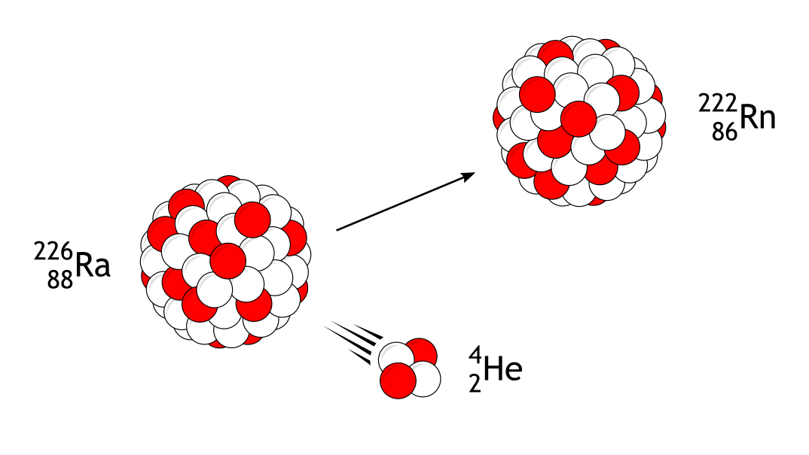
Absolute dating
Absolute dating gives a specific age to objects, but it is not always possible
One of the most important methods is known as Radiometric Dating.
Certain Atoms are unstable, and they slowly decay into other atoms called products over time.
Notes:
Image by MikeRun used under the Creative Commons attribution sharealike license

Slide 10
Half-life
The Half-Life of an atom is the amount of time it takes for half of the atom to decay
For example, if we have 8 of atom A (in yellow) and we know that it has a half life of 6 years…
We will have 4 of atom A after 6 years
We will have 2 of atom A after 12 years
6 more years
6 more years
6 years
Time passed
Notes:
Teachers note if students have any questions: Note that particle decay is probabilistic, which means that it works well for large numbers of particles but less so for small numbers. Because of this, it is impossible to determine how long it will take for a single particle to decay. This also means that if you have a large number of atoms, you cannot know which ones will decay first, just that half of them will decay after a half life.

Slide 11
Radiometric dating
Rock when it was formed
Using various methods, scientist can determine what atoms make up an object.
But how does that tell us how old it is?
Well, if we find the decay product of an atom, we can use the half life to work backwards!
If for example, we find 4 of atom A and 4 of its product, we know that there must have been 8 of atom A one half life ago
One half life
One half life
Rock found today
Notes:
Note that this only holds true if there is no way for an object to gain or lose radioactive atoms outside of decay.

Slide 12
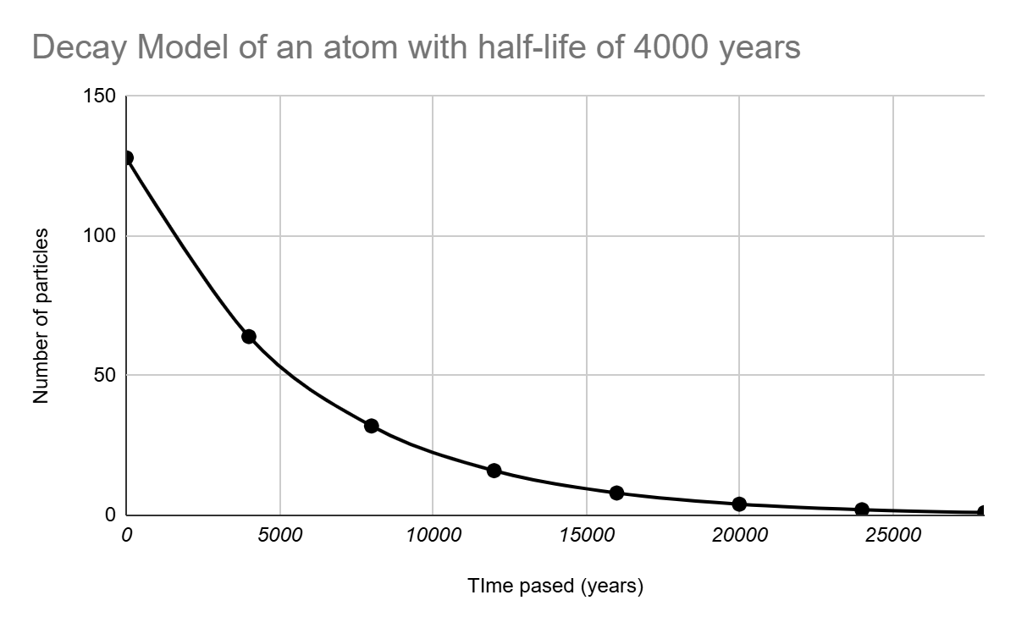
Example
Atom A decays into Atom B with a half-life of 4,000 years.
Long ago, the object started with 128 atoms of A and 0 atoms of B.
After 4,000 years, half of Atom A has decayed → 64 A and 64 B.
After 8,000 years, half of the remaining A has decayed again → 32 A and 96 B.
If we find 96 B and 32A today, we can tell the object is about 8,000 years old.
4000 years apart
Example of a decay graph
Notes:
(animate slides later)

Slide 13


Impact Stations
In your groups you will rotate between stations
At each station you will read through the evidence sheets present at each subject and use that information to complete your individual station worksheets
After reading through worksheets you and your group will fill out the group evidence sheet
For stations 2-4, you will also read the responses written by previous groups and each piece of evidence to your previous stations
Station 1 timer
Stations 2-4 timers

Slide 14
Claim, Evidence and Reasoning
When making a claim in science, it's very important to back it up with evidence. One common way to do this is known as the Claim, Evidence, Reasoning method.
Claim: A scientific claim or hypothesis made to describe a phenomenon
Example: Dinosaurs went extinct 66 million years ago
Evidence: Evidence in support of the claim
Example 1: There were many dinosaurs fossils found originating more than 66 million years ago
Example 2: No dinosaur fossils originating from less than 66 million years ago have been found
Reasoning: A string of reasoning linking the the evidence to the claim
Example: Dinosaur fossils suddenly stopped being formed about 66 million years ago, indicating a sudden extinction.

Slide 15

Construct a story!
On a white board or poster board work with your group to do the following:
Make a Claim about how the dinosaurs went extinct (Be more specific than “a large asteroid impact”).
Provide Evidence for your claims based on the readings and group evidence sheets (Try to connect different pieces of evidence together).
Include Reasoning that connects your evidence to your claim

Slide 16
Exit ticket
On a blank sheet of paper, answer the following questions.
What piece of evidence was most interesting to you?
What questions do you have about it (list at least 2)?
Using your computer answer the following questions:
Are there answers to your questions? If so, what are they?
What are 3 interesting facts about your topic?

