Slide 1
Genius of Dogs
The Power of Domestication

Slide 2
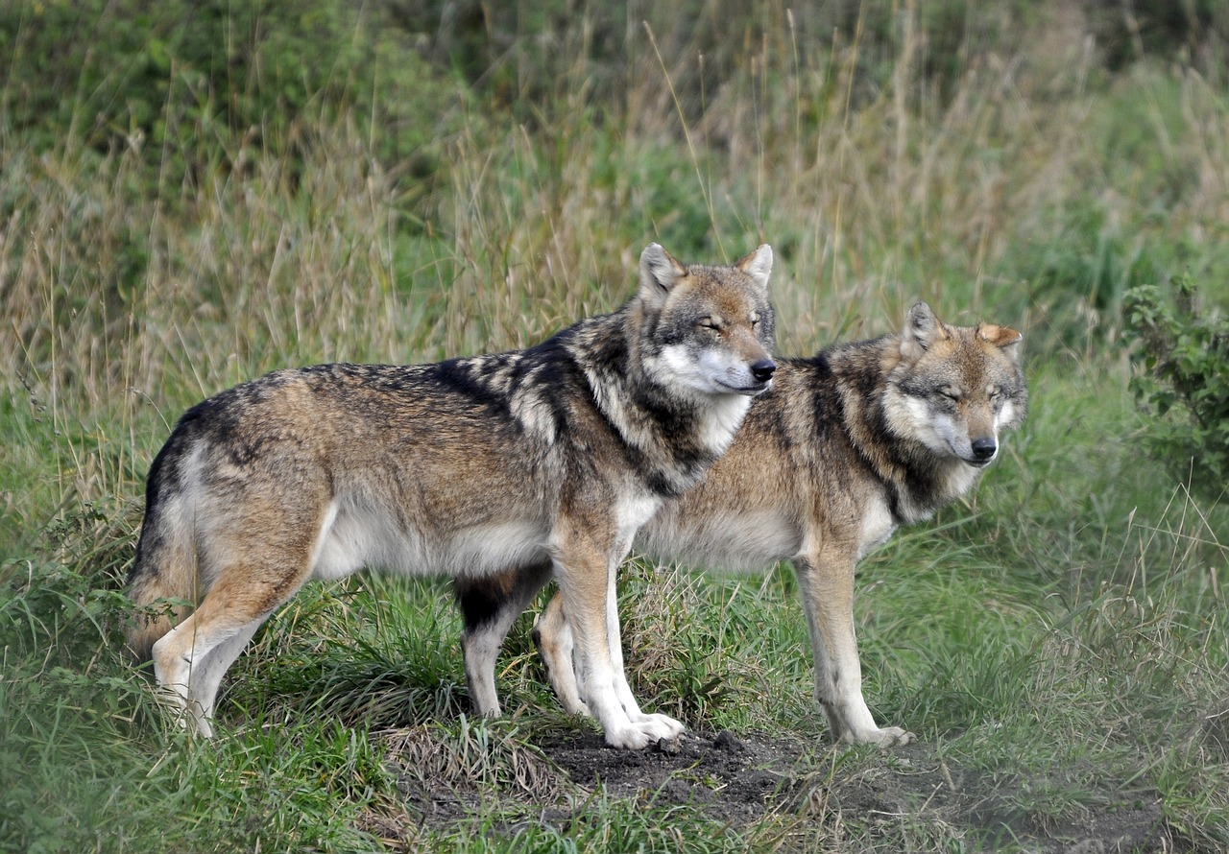
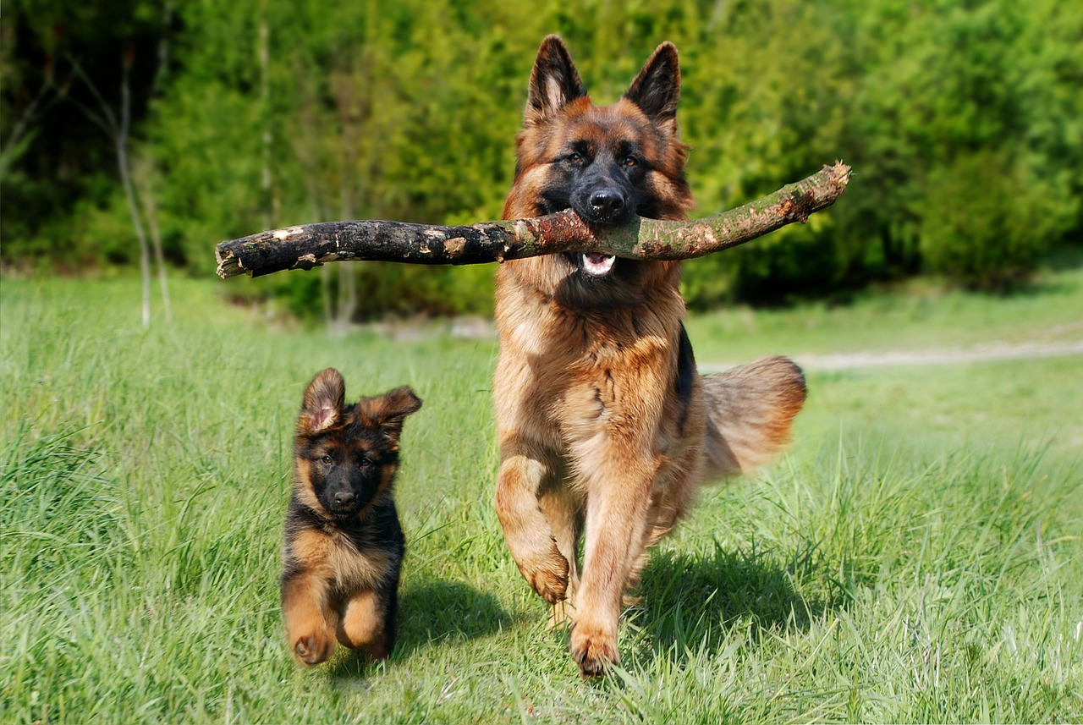
Dogs Vs Wolves
What makes dogs different from wolves?
Why do these differences exist?
In your table groups, make a venn diagram comparing dogs and wolves

Slide 3
Wolf pup behavior vs dog pup behavior
This difference in appearance and behaviour is due to a process known as domestication! Watch 19:35 – 20:54

Slide 4
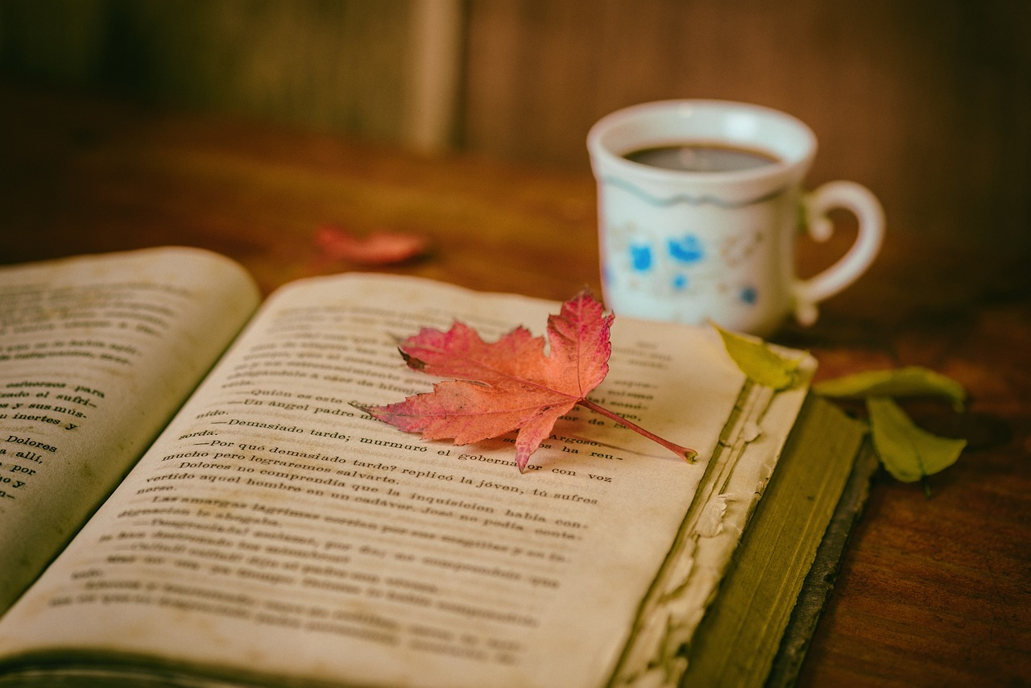
Time to read!
Quietly read the “From wolf to dog” article and attempt to answer the questions
In your table groups, spend a few minutes discussing the reading and the questions

Slide 5
Wolf Vs Dog
Wolf Dog
Relatively shy
Longer snout
Stronger bite
Snarls and growls to communicate
Prefers to solve problems on their own
Very outgoing
Shorter snout
Barks to communicate
Prefers to ask humans for help
Can perform various different tasks for humans
Both
Canine
Carnivore
Pack mentality
Relies on smell
Social Animal

Slide 6
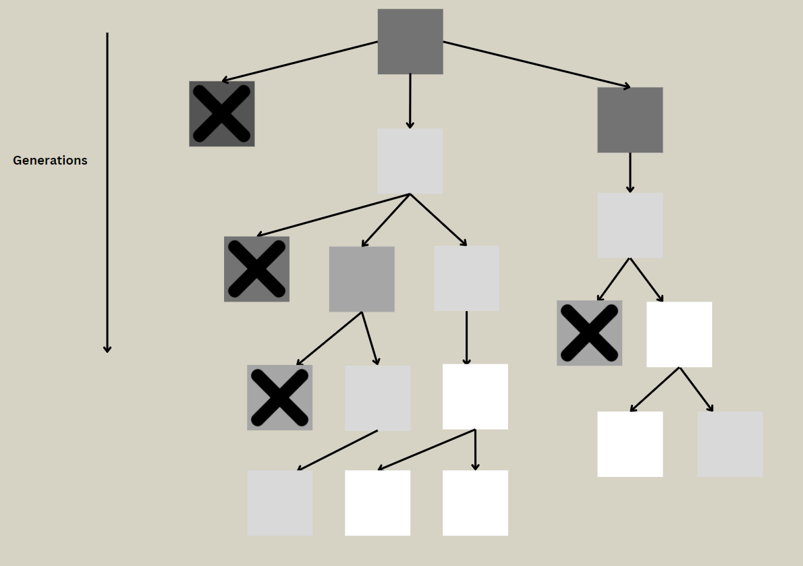
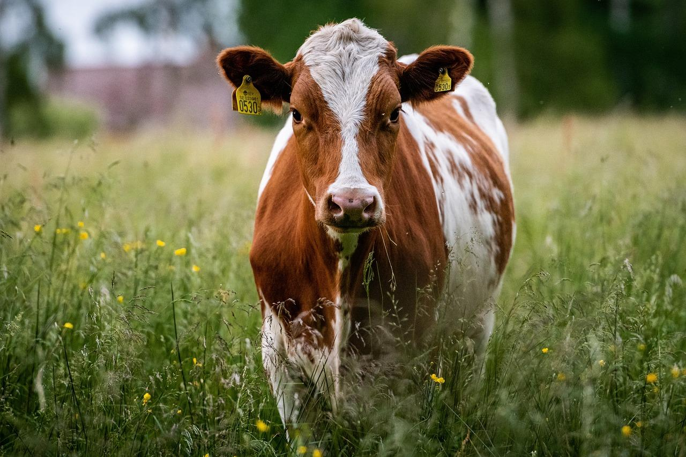
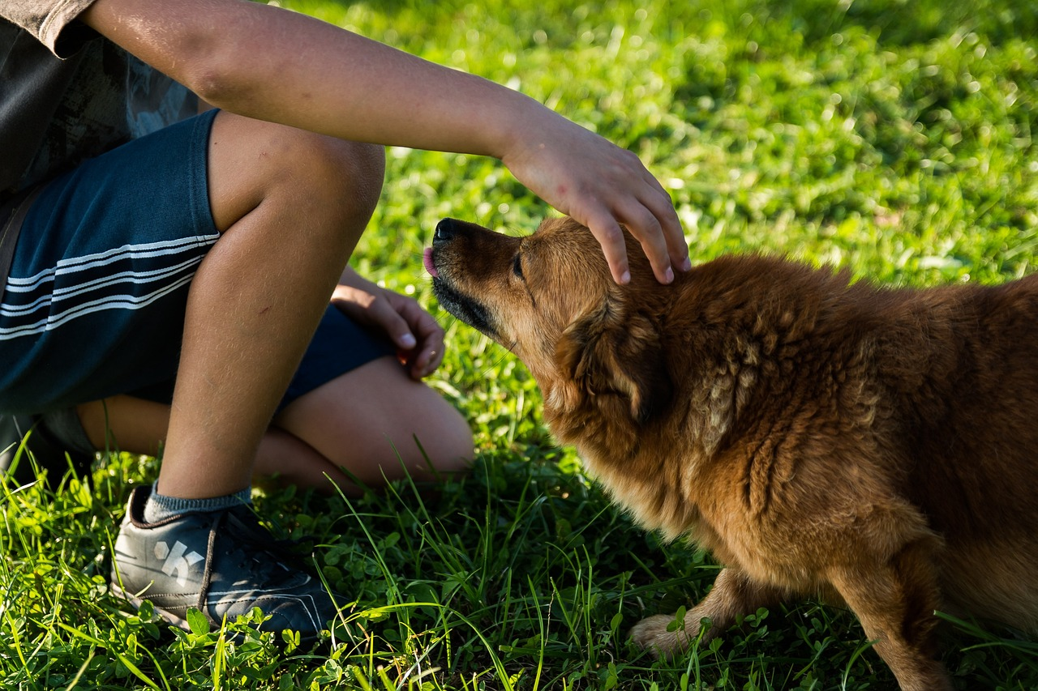
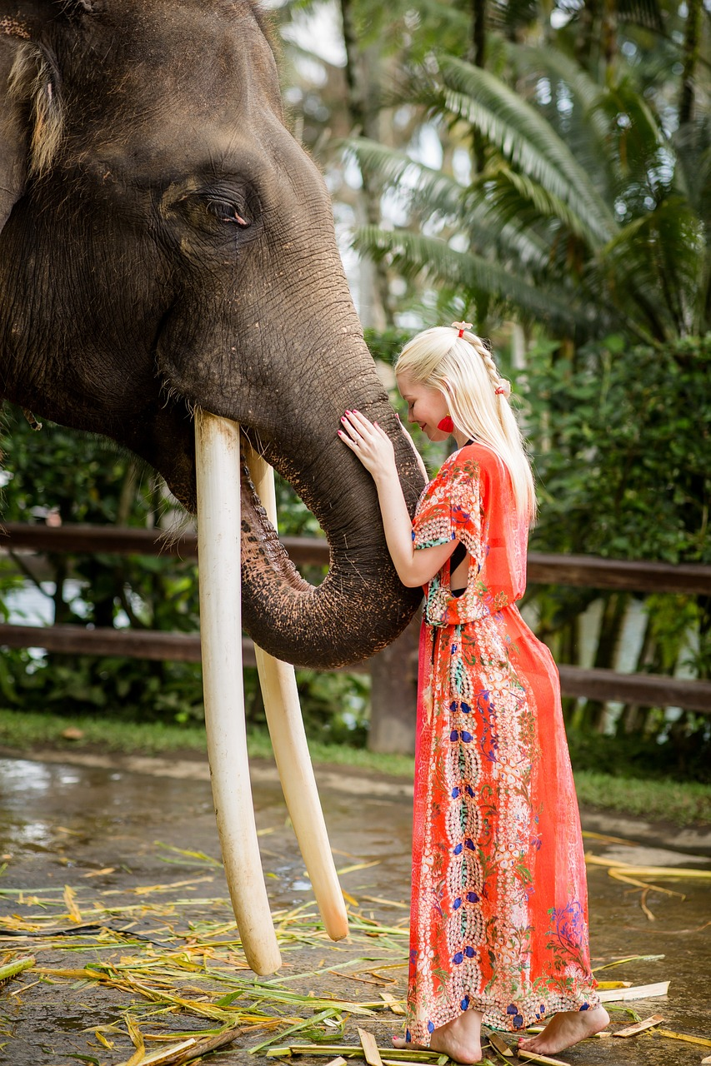
Terminology
What do you think the following terms mean?
Natural selection
Artificial Selection
Domestication
Tame
The process whereby organisms better adapted to their environment tend to survive and produce more offspring.
The process by which humans select which traits get passed on in an organism's population.
The process by which one species completes takes complete control of another in order to create a mutualistic relationship.
A tame animal is a wild animal who has become used to humans.

Slide 7
Domestication!
For a species to be domesticated, it must display most of the following characteristics. This typically takes at least 12 generations of selective breeding
Plants | Animals
Humans determine when and were its seeds are planted. I.e: Does not disperse seeds on its own | Primarily relies on humans for food, water and shelter
Less affected by environmental factors than its wild counterpart | Significantly friendlier than its wild counterparts, especially towards human beings. Some even prefer interacting with humans more than interacting with their own species
Fruits and grains grow more rapidly and are easier to remove | Innately capable of reading human body language and social cues.
Growth is limited and consistent | Performs tasks for the benefit of humans instead of tasks beneficial to themselves
We choose which plants get re-planted | Mates are chosen by humans, not the organism

Slide 8
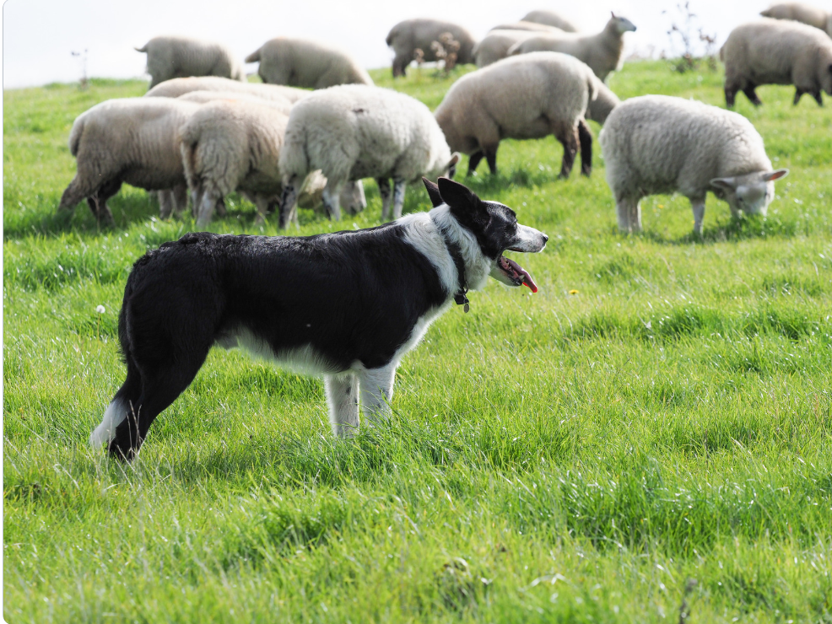
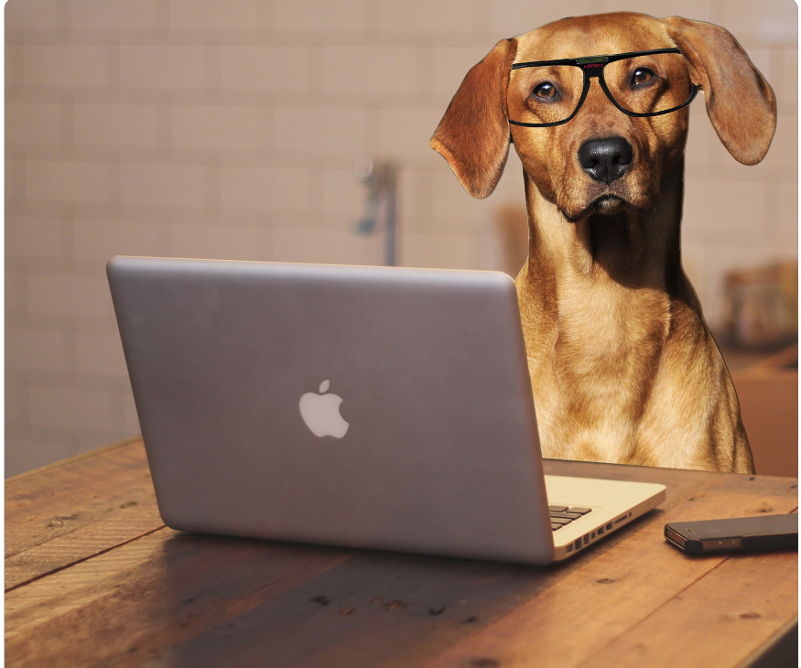
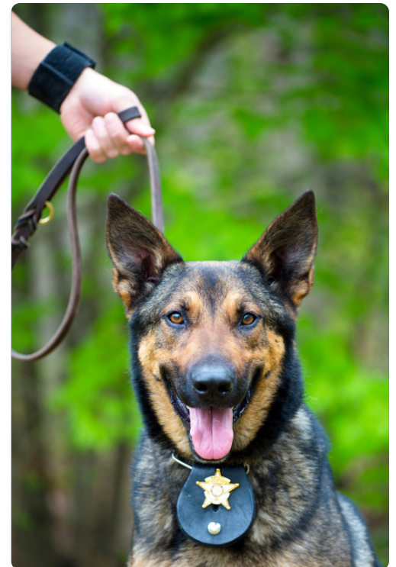
Service Dogs
Dogs are so smart that some of them even have jobs! Can you name a few jobs that dogs can have?
These jobs often require dogs with specific traits and behaviors. Can you list some traits that dogs would need to perform the special tasks you came up with?

Slide 9
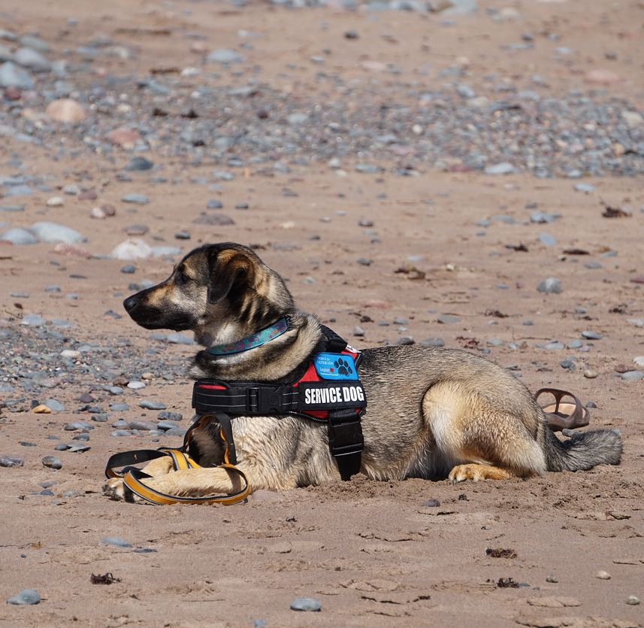
Service Dogs Continued
Many of the traits that we look for in service dogs are actually just the traits of domestication taken to their extreme.
Friendliness: Many service dogs need to be able to comfortable interacting with dozens of different people. This is especially important for therapy dogs.
Trainability: All service dogs need to be able to understand and follow human commands. Guard dogs, for example need to be able to go from attack mode to play mode on command.
Communication: Service dogs need to be able to understand human body language. This is especially important for dogs who need to pick up on unconscious body language, like medical service dogs.

Slide 10
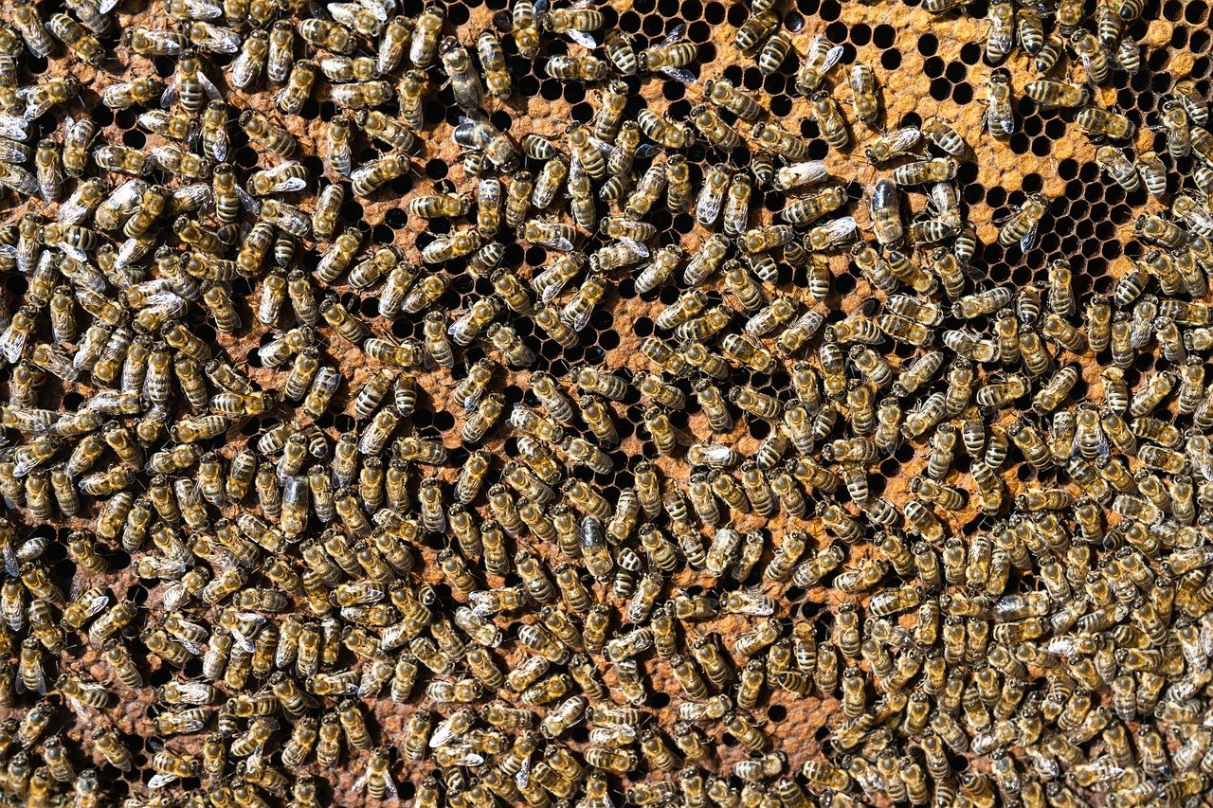
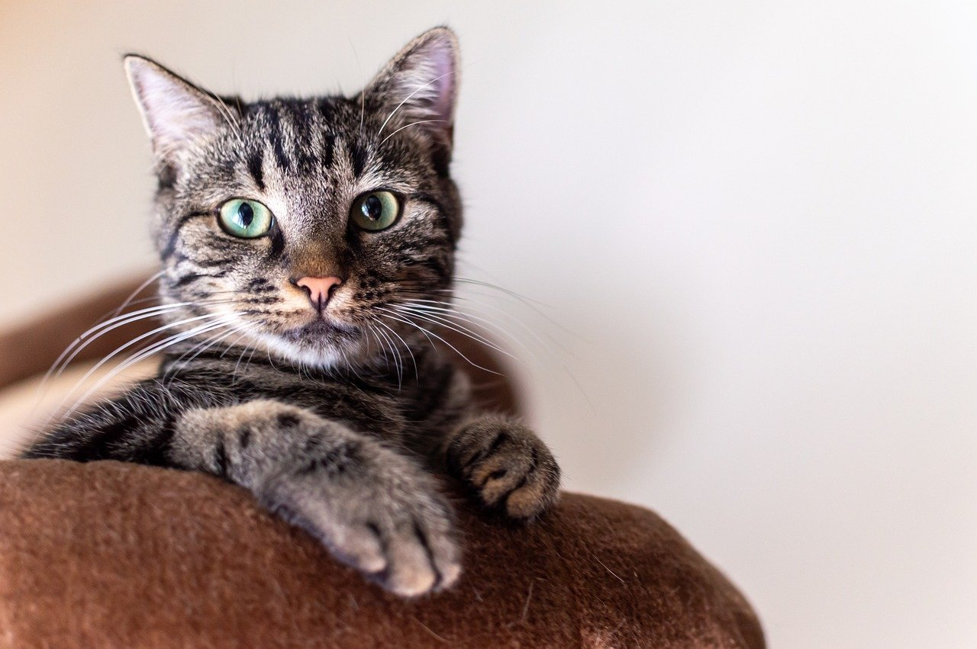
Project time
In your groups chose a domesticated organism(plant or animal) to research.
The following is a non exhaustive list of domesticated species to choose from. : Honey Bees, Cows, Bananas. Fancy mice, Camels, Cats and Cabbages
Your group may chose to research an organism not from this list
In your groups you will work to find the information required for the “ Domestic Research” worksheet. If time allows, you will also be required to create a presentation on your chosen organism that goes over the information from the sheet.

Slide 11
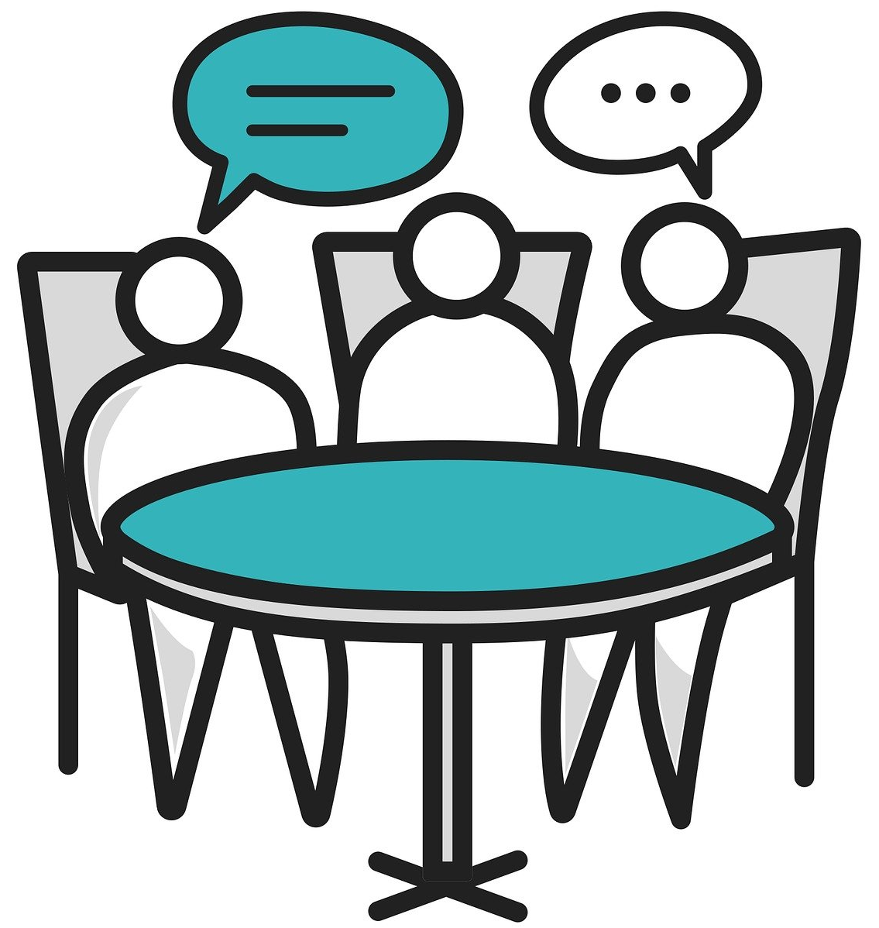
Exit Ticket
Share your knowledge!
Partner up with someone from another table group
Take turns asking your partner the following questions:
How was your animal domesticated?
What jobs does your animal do for humans?
What does it mean for an animal to be domesticated?

