Slide 1
Hypothesis about chimps
Learning to write hypothesis about animal behaviors

Slide 2
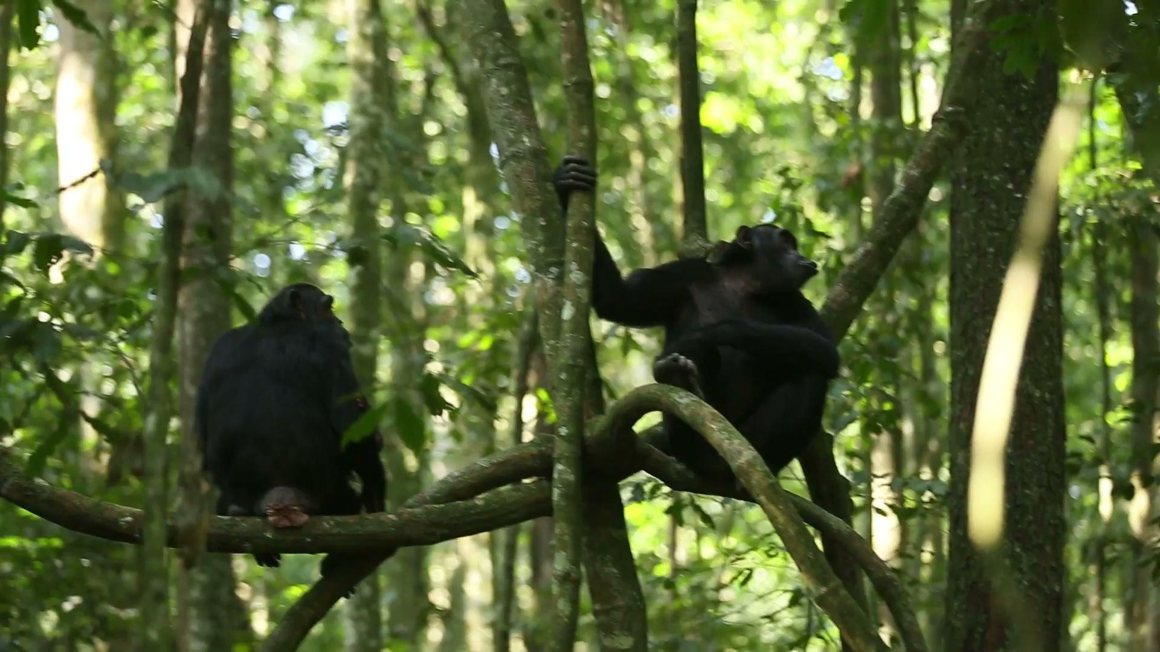
Chimp video 1:
Write down anything that stands out to you about this behavior
What do you think is happening here?
Note that these sounds can be heard from well over a mile away, even over the other noises of the jungle!
Notes:
Sound warning: Chimps are loud, test audio before hand.

Slide 3
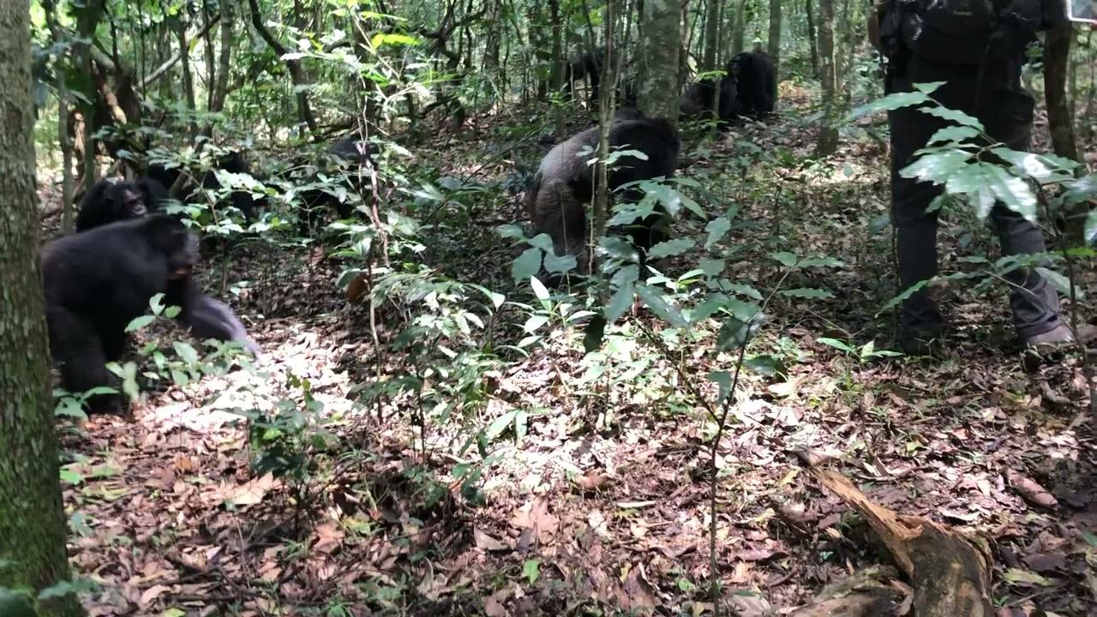
Chimp video 2:
Write down anything that stands out to you about this behavior
What do you think is happening here?

Slide 4
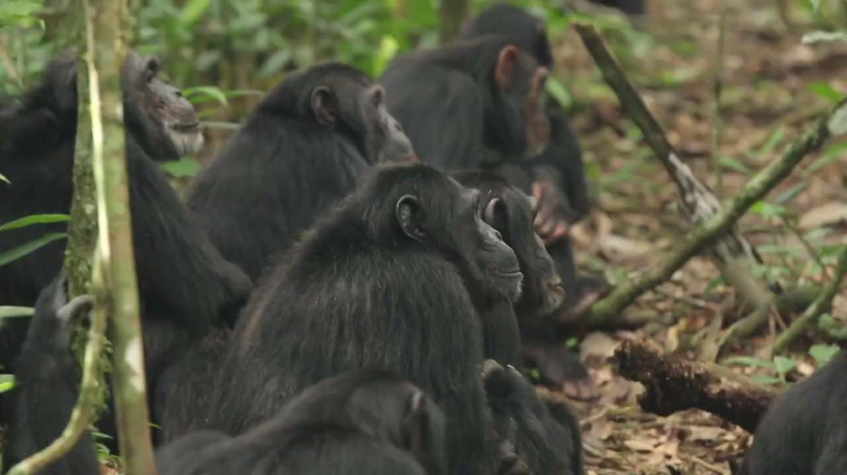
Chimp video 3:
Write down anything that stands out to you about this behavior
What do you think is happening here?

Slide 5
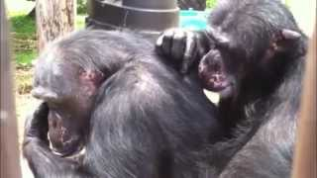
Chimp video 4:
Write down anything that stands out to you about this behavior
What do you think is happening here?
Notes:
Video from Chimpanzee Sanctuary Northwest

Slide 6
What is a hypothesis?
In your own words, what do you think a hypothesis is?
What should be included in a good hypothesis?

Slide 7
Stations
You'll have 7 minutes at each station
Each station has a piece of paper in the middle containing directions for the station,
Make sure to fill out your individual worksheets

Slide 8
Applying our knowledge: The split at Ngogo
Now that you know how to write a proper hypothesis, lets try to apply this knowledge to an event that scientists still struggle to understand.
On a blank sheet of paper (or a google document), create table with 2 columns.
Label the first column: Facts about chimps
Label the second column, facts about the split.
Facts about chimps | Facts about the split

Slide 9
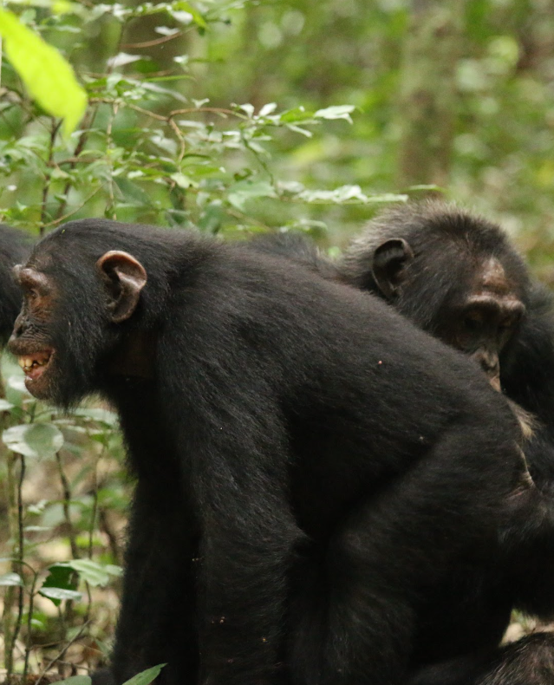
Facts about chimps!
Like humans, chimps are a social species forming large groups in order to survive.
Gender and hierarchy:
Males in chimp colony operate under a hierarchy, with one chimp serving as the Alpha.
Females typically avoid each other and are not a part of the hierarchy system. Interestingly, they will intermingle and form their own hierarchy when food is plentiful.
Male chimps will stay in one group for their entire life while females will leave to join another group once they become adults. This allows chimps to avoid inbreeding.
Male chimps are incredibly territorial, consistently patrolling their borders for other chimp colonies. If two chimp colonies interact, the result is often violent.
Male chimps tend to groom each other before a stressful event like hunting or patroling

Slide 10
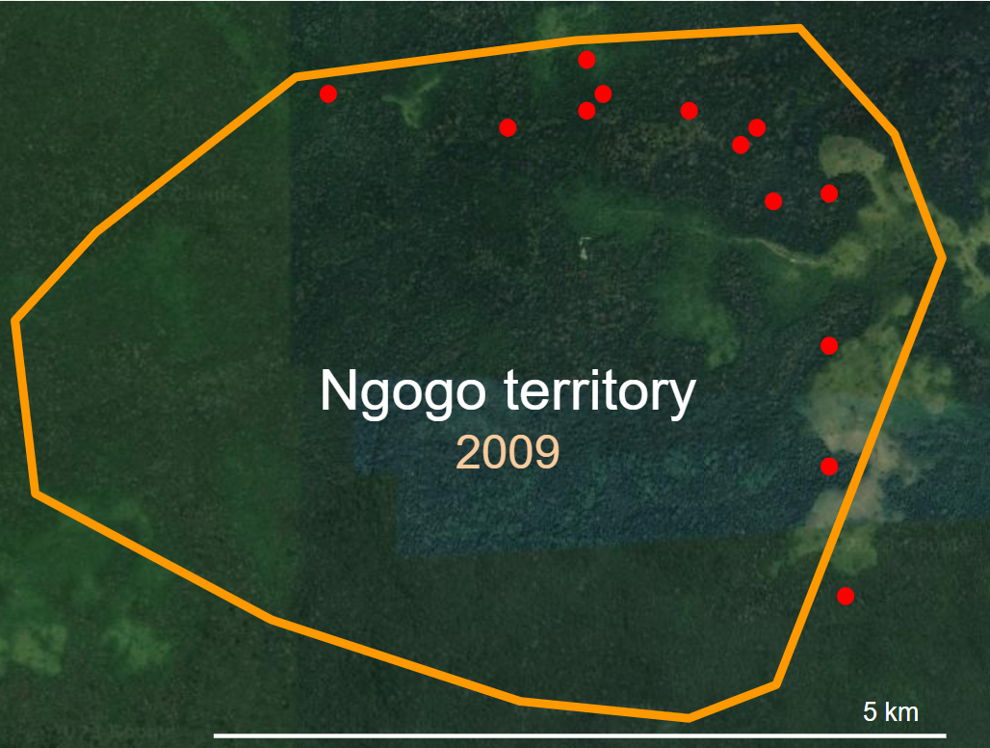
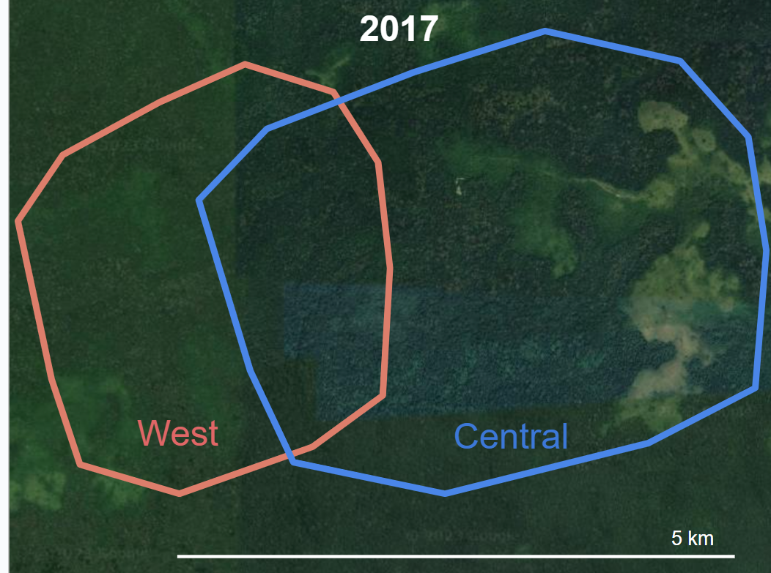
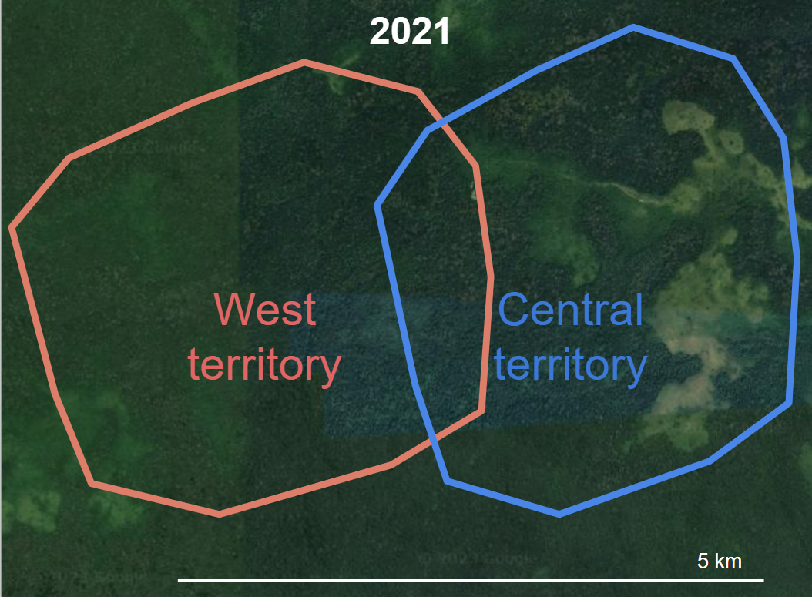
Facts about the split
The largest natural colony of chimpanzees in the world is the Ngogo colony located in Uganda. Once totaling over 200 members (Most colonies have around 60)
In 2015, this colony slowly began to split into 2 groups, the Western Ngogo and the Central Ngogo.
After the split, the 2 groups started to treat each other like foreign chimps, despite the fact that many of them had grown up and patrolled together.
One particularly old chimp was able to travel between the 2 groups without issue. Notably, another chimp followed him to the opposite territory and got killed.
Even after the split became obvious, researchers were not expecting violence between the groups. (A few researchers were traveling with one of the groups during the first sign of violence)

Slide 11
Do your own research
Now that you have some basic information about chimp behavior and the split and Ngogo, it's time to delve deeper. On your device spend some time looking for information that you can use to write a hypothesis about the potential cause of the split at Ngogo.
It may also help to open this slideshow on your own device and rewatch the videos at the beginning.
You should also revisit the hypothesis in station 4.

Slide 12
Create a hypothesis
Now that you know a little but about the split at Ngogo, it’s time for you to write a testable hypothesis about how or why it occurred!
On a blank sheet of paper (or online document, your choice), use the information that you have gained throughout this lesson to draft a hypothesis.
You will most likely need to create multiple drafts before arriving at a good hypothesis.

Slide 13
Peer review
Share your hypothesis with one of your tablemates. While listening to your partners, give them the feedback on the following points:
Does it match the facts?
Is it testable/observable?
What would be the null hypothesis?
Can it be tested ethically?
What are the implications? (What would it mean for the hypothesis to be true?)

Slide 14
Drafting an experiment!
Now that you have a working hypothesis, it’s time to design a method for testing.
Open the Testing the Hypothesis on your device (or ask for a hardcopy) and review the rubric before starting.
You may need to edit your hypothesis in order to come up with a good test.
If you get stuck, try asking a table mate for help!

