Slide 1

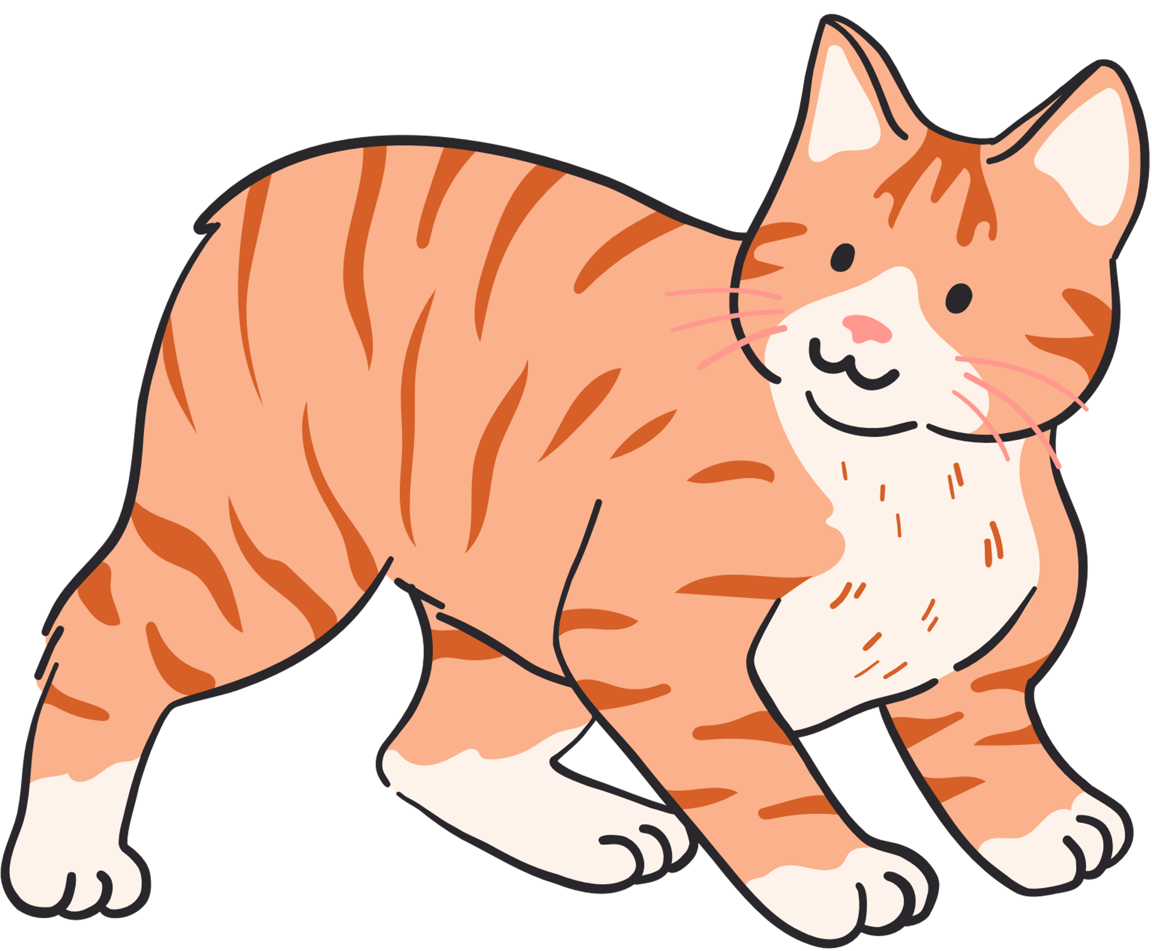

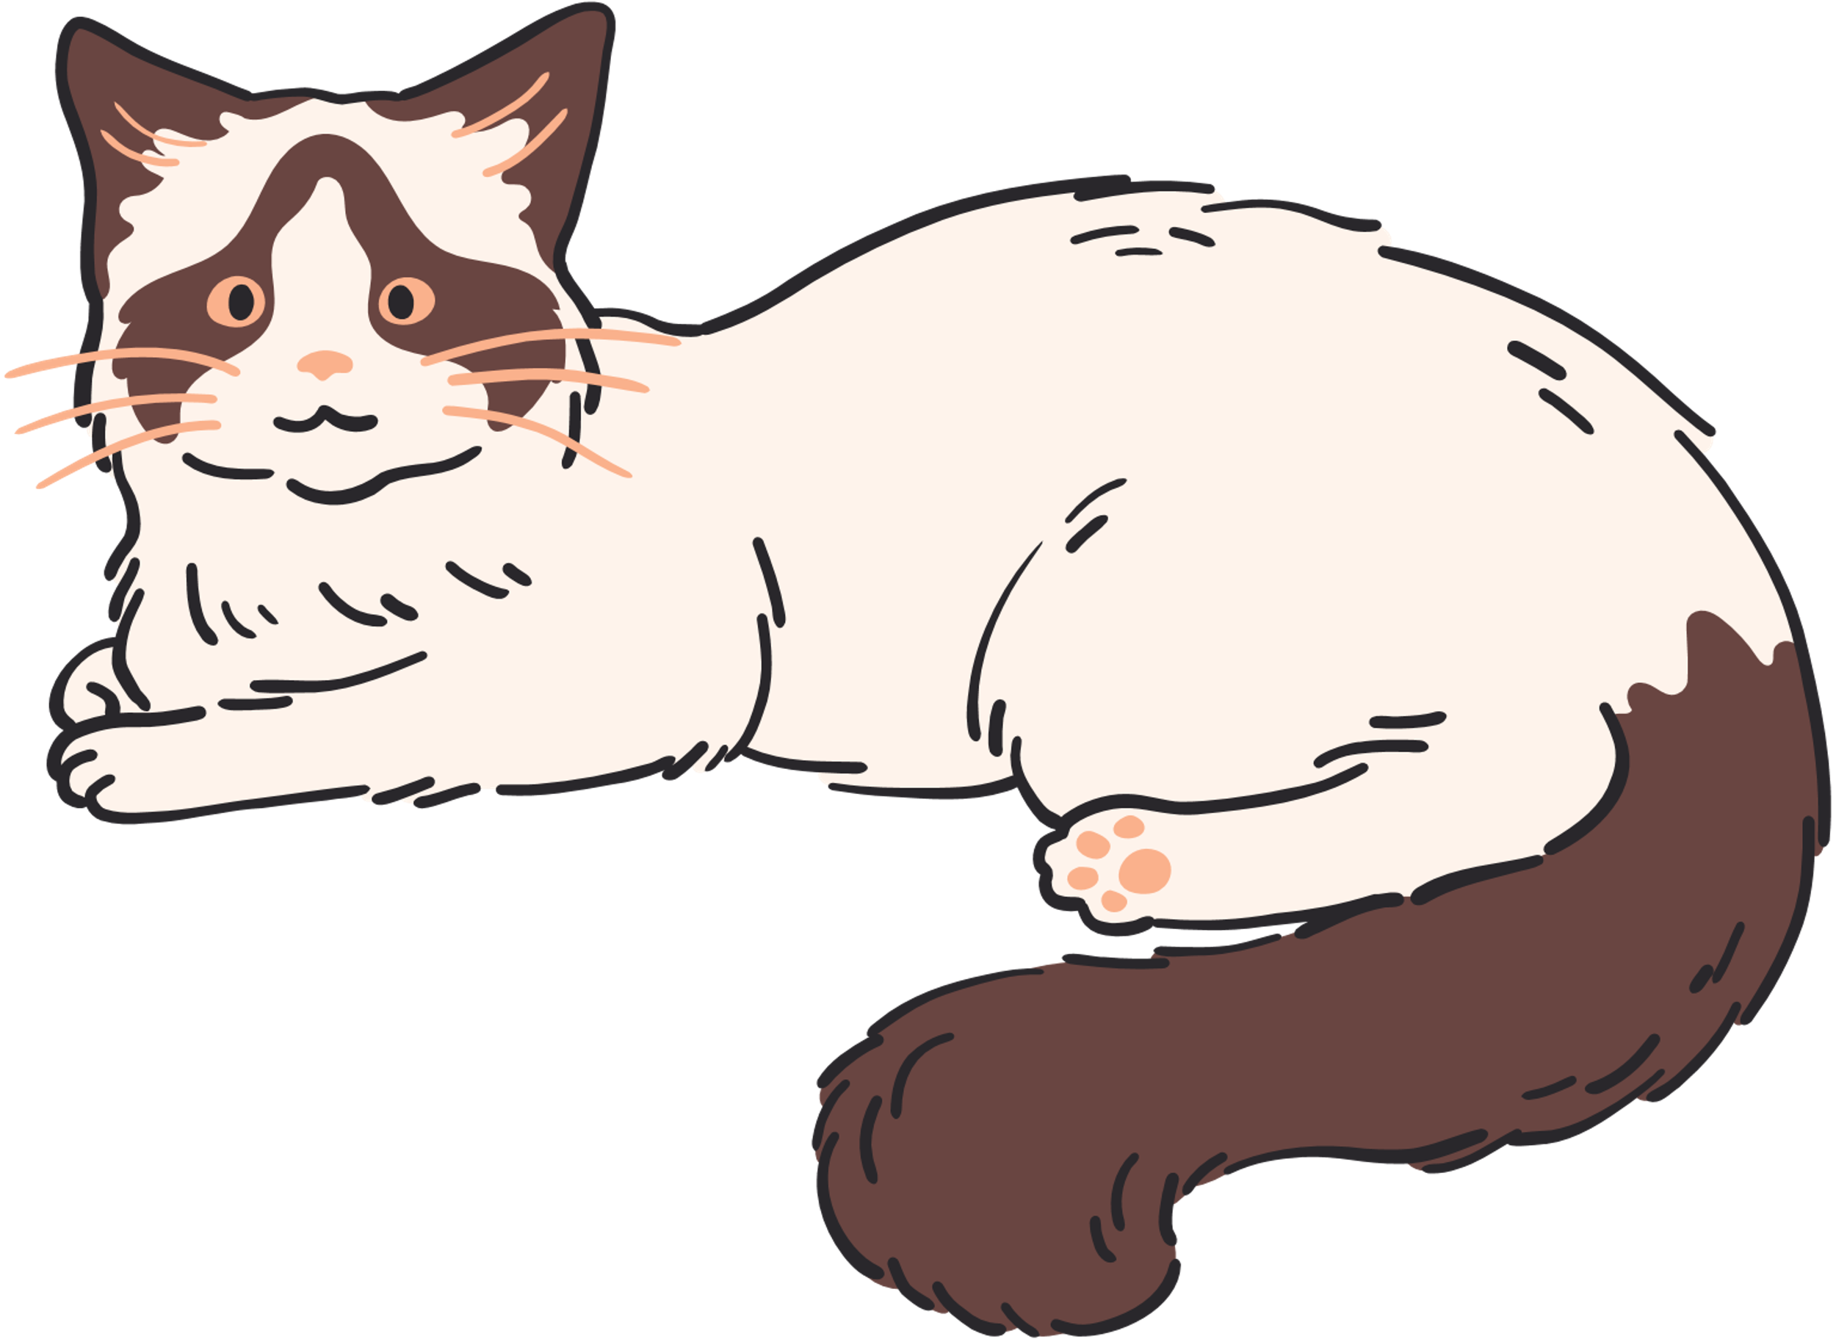
Organisms & Environments:
Cats

Slide 2
What are we doing today?
We will...
By the end of class you will be able to...
Draw dream your cat
Activity sheet
Fossil Activity
Trashketball
Describe the traits of plants and animals and explain how they help them survive.
Explain how environmental changes can help or harm living things.
Identify and describe the stages in a plant or animal life cycle.
Explain how fossils show evidence of living things from long ago.

Slide 3
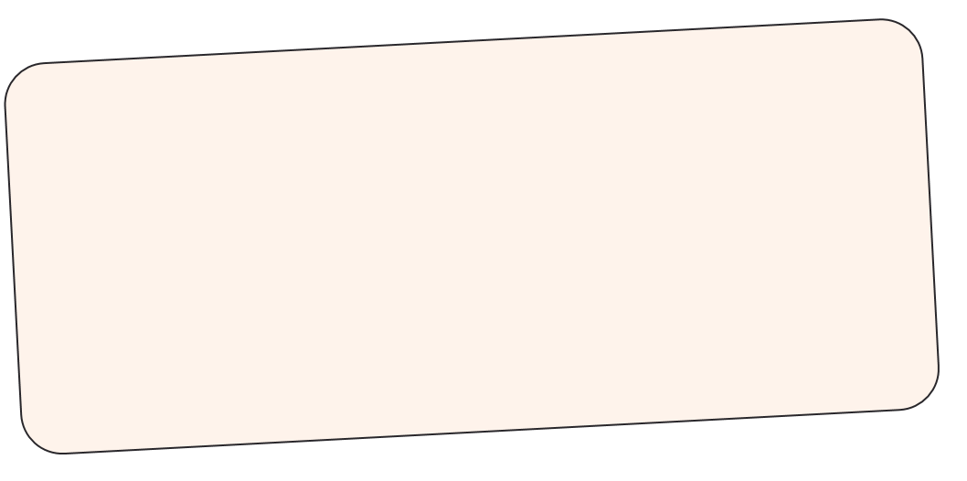
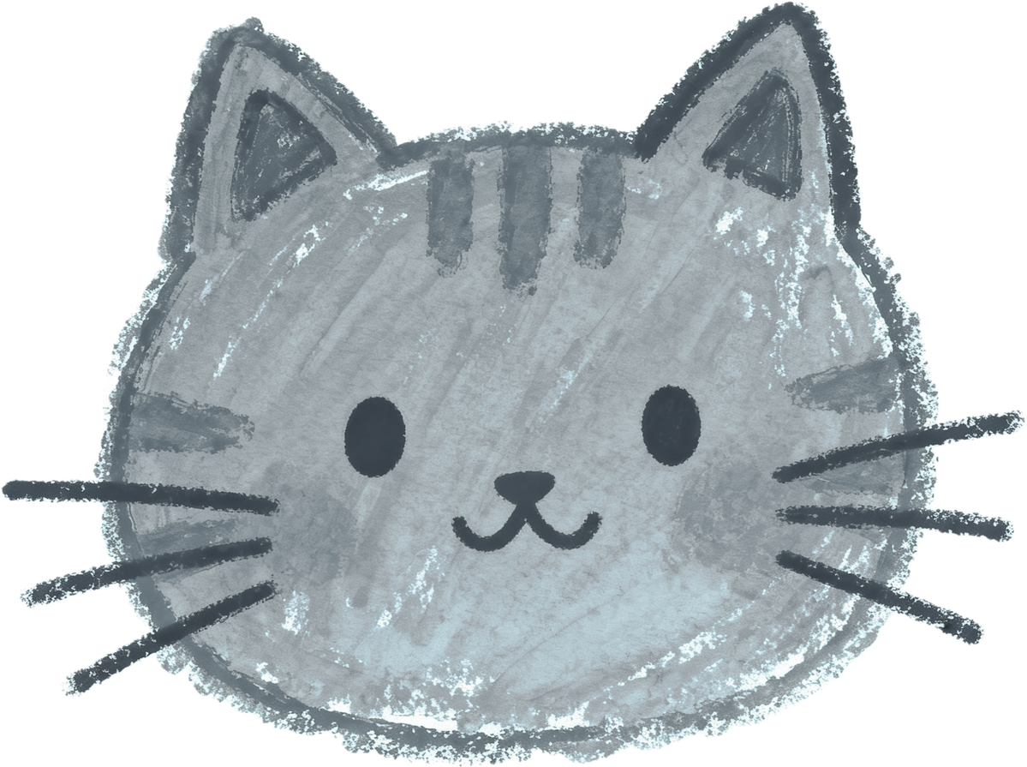


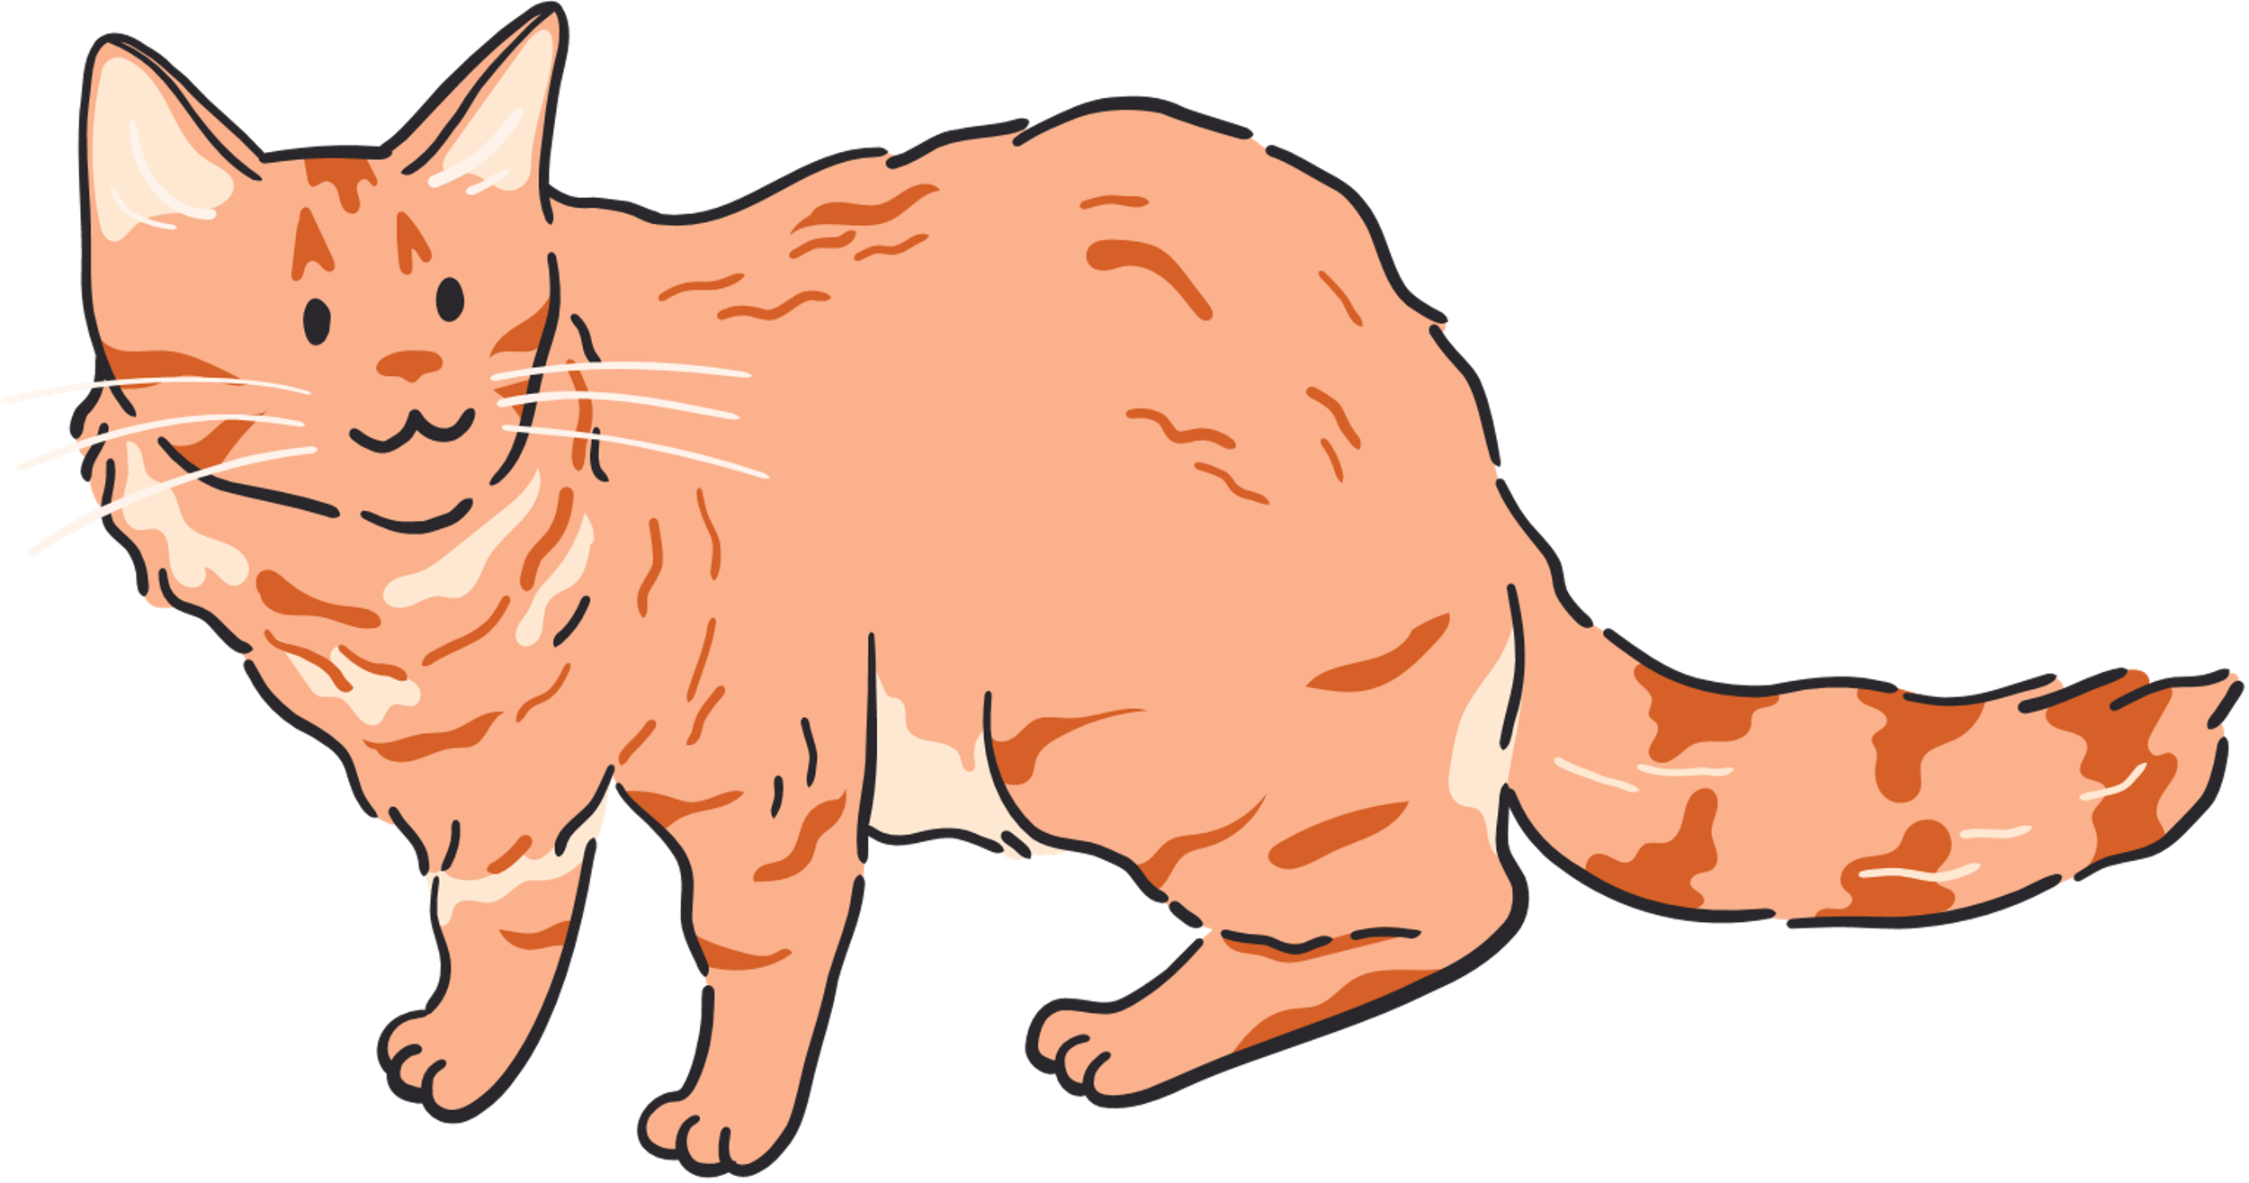

Draw a picture of your dream cat
Label your cat’s body parts. Include what each body part helps the cat do.

Slide 4
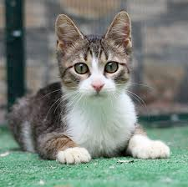
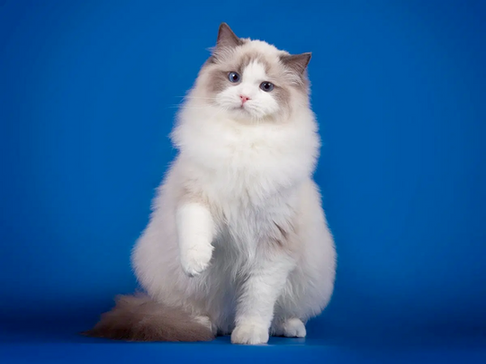
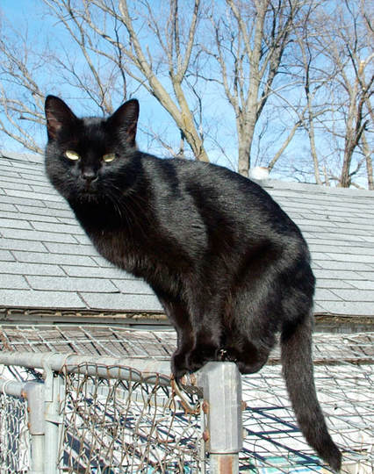

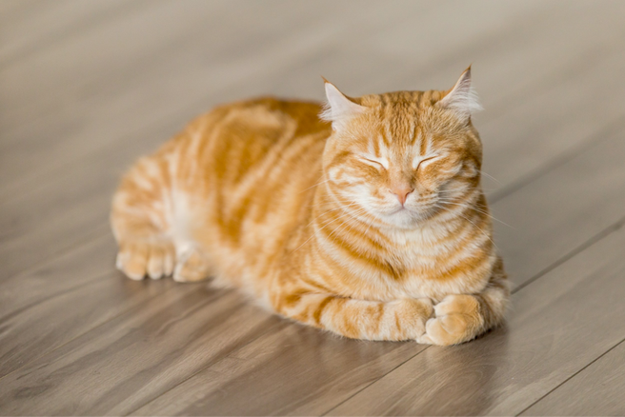
Let’s share our dream cats

Slide 5

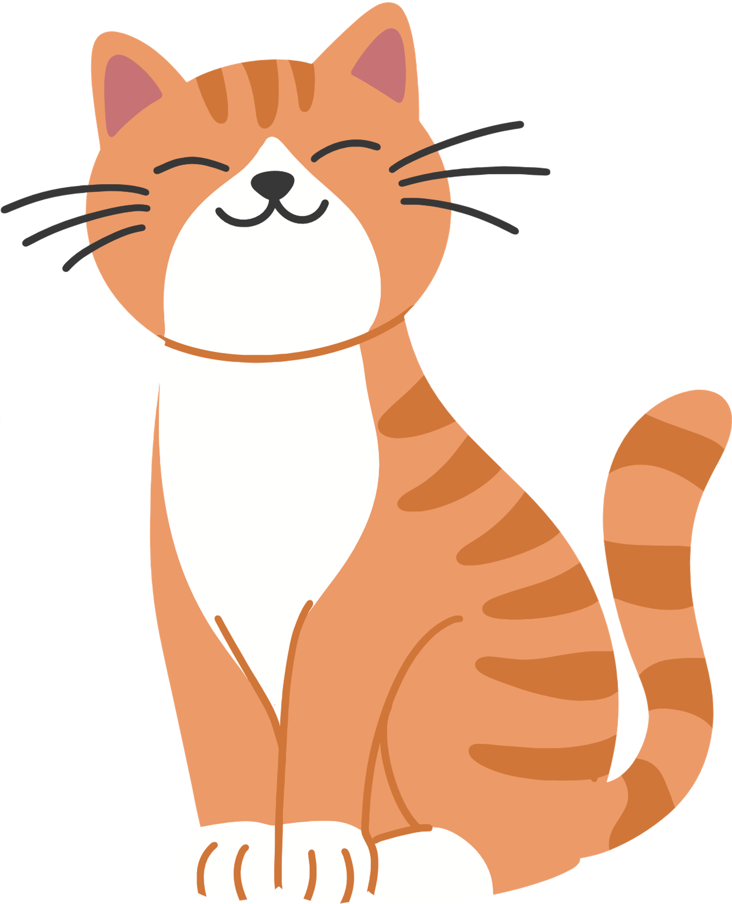
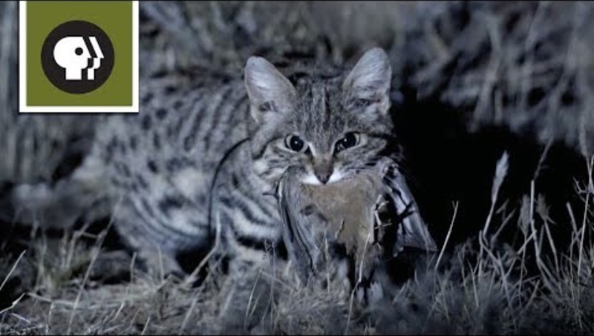
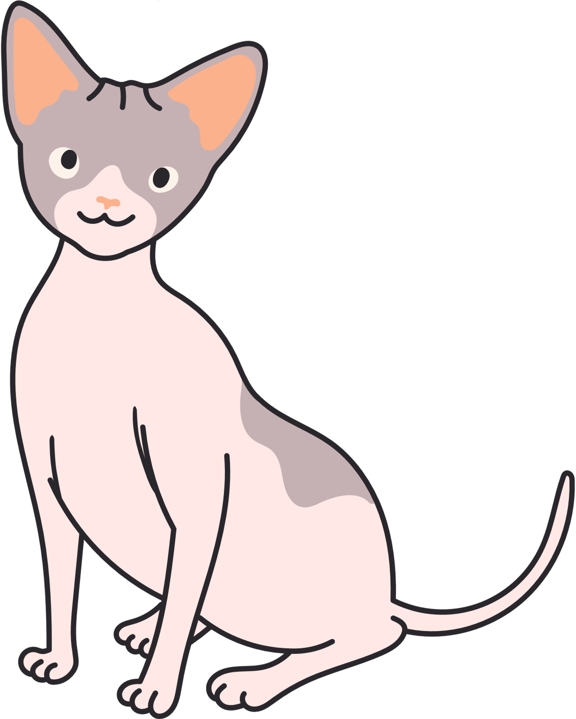

Let’s learn more about cats!
While watching the video think about: What did the cat do to stay alive?

Slide 6


Fill out ...
What did the cat do to stay alive?
Write two things you noticed.

Slide 7

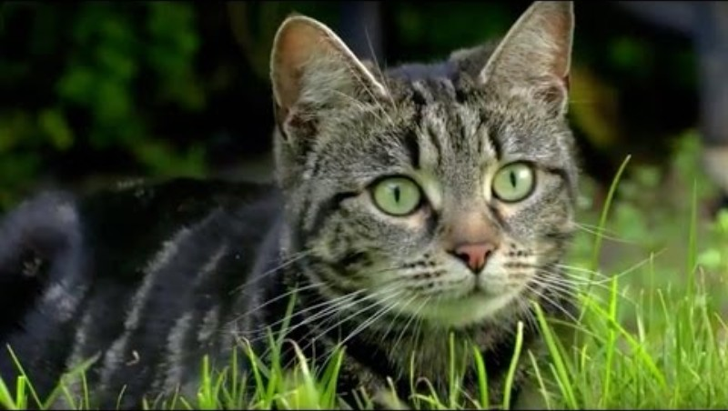
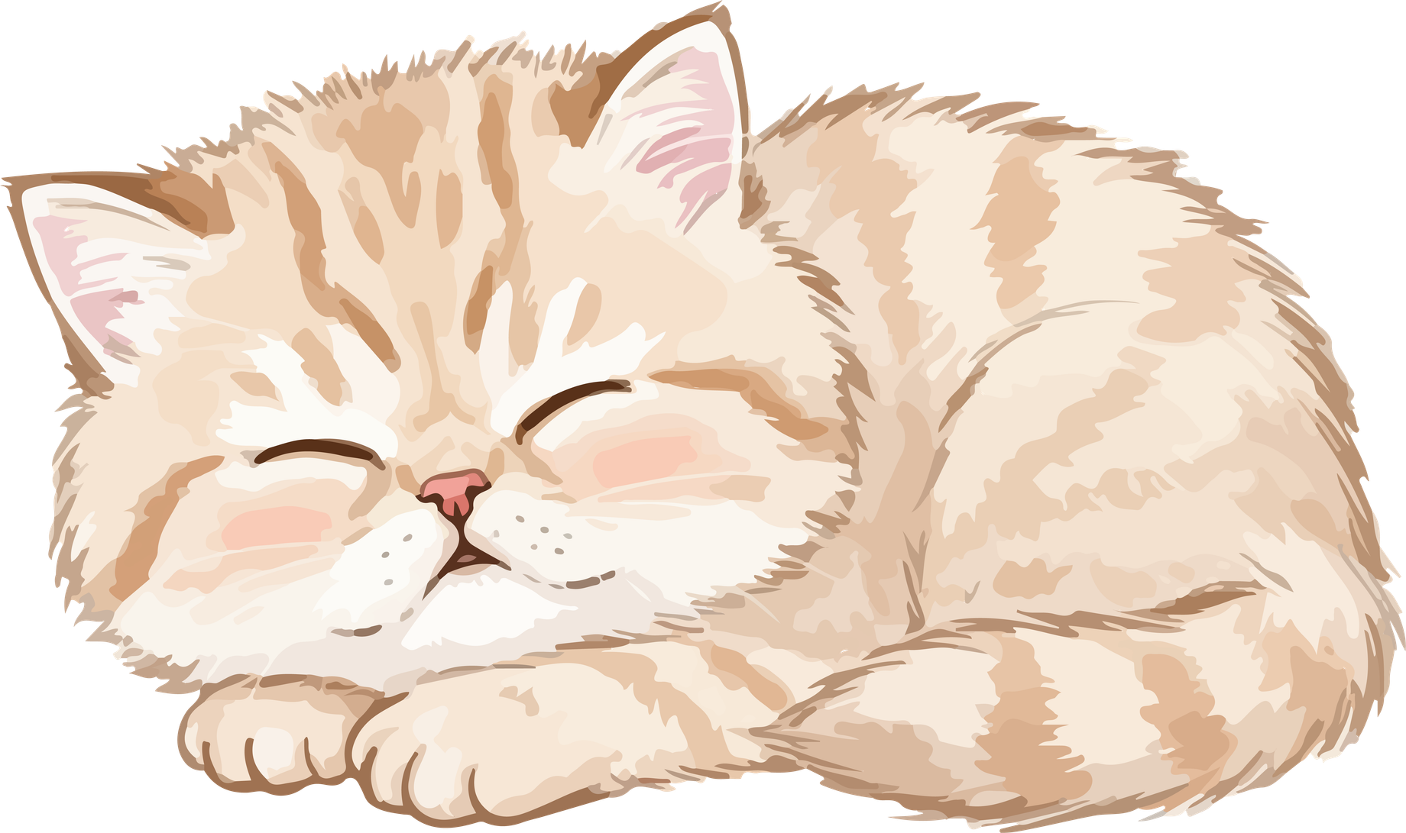
Cat Behavior
While watching this video: Identify the behaviors shown by the cat in this video.

Slide 8
Fill out ...
Pick ONE behavior. How does it help the cat survive?

Slide 9
Cat Sense Matchup
Draw a line from the cat's body part to the sense it uses.

Slide 10




Cat Sense Matchup Answers
SIGHT
SMELL
HEARING
TOUCH

Slide 11


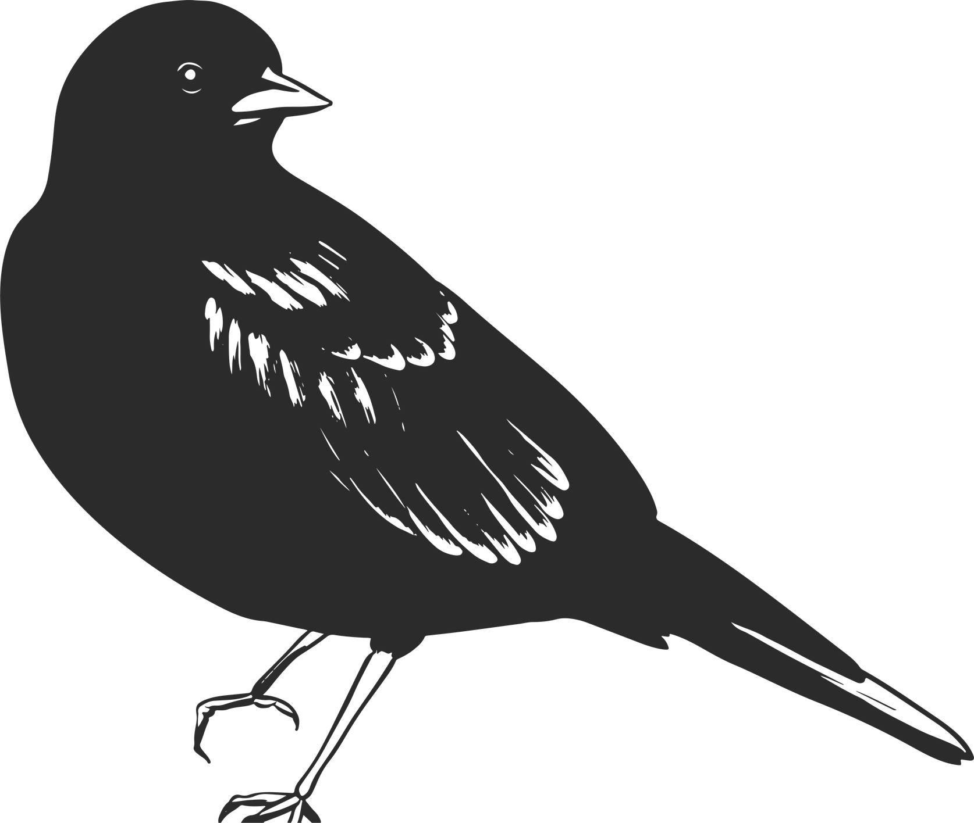
Structural Trait:
Behavioral Trait:
A structural trait is a body part or physical feature that helps a living thing survive. Example: A bird’s beak.
A behavioral trait is something a living thing does (an action) that helps it survive. Example: Birds migrating.

Slide 12


Fill out ...
STRUCTURAL
BEHAVORIAL

Slide 13
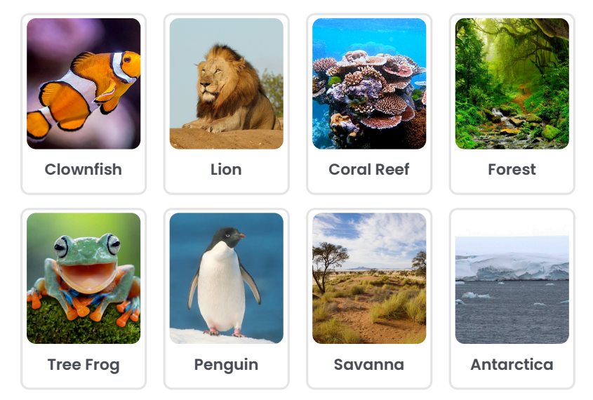
Card Matching
Match the animal to its ecosystem.

Slide 14

Card Matching Answers

Slide 15
Fill out
Pick ONE match you made
Animal:
Habitat:
Why does this animal do well there?
Use a trait (body part or behavior).
What might happen if this animal had to live in a different environment?
Fill in the box.
☐ It might survive
☐ It might get sick
☐ It might not survive
Why?

Slide 16
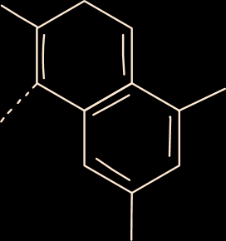
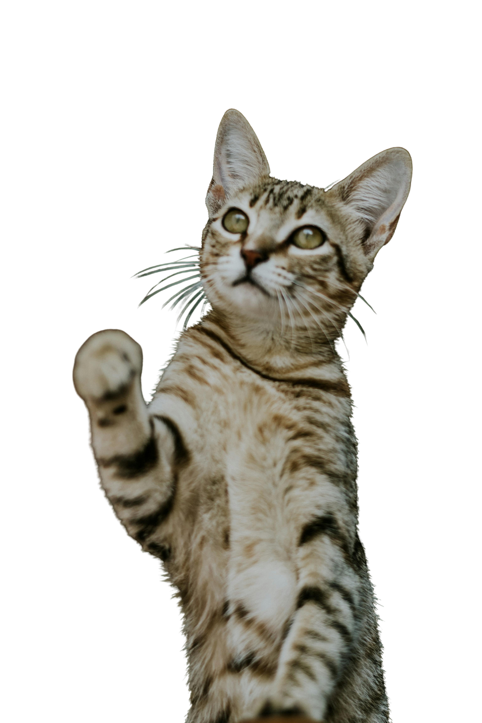
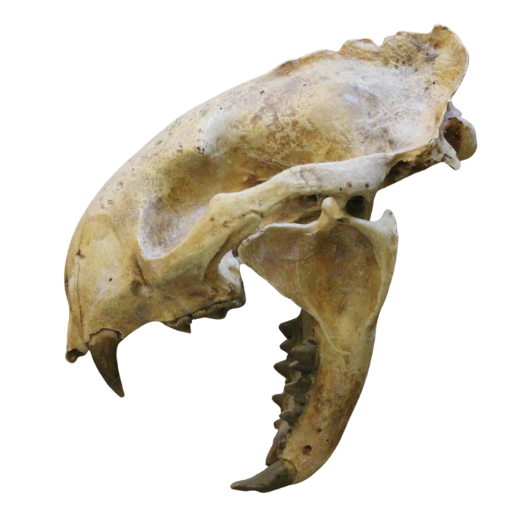
Scientists like to use long words, but we can break them into small, easy parts!
Pro–ai–lu–rus
Let’s break it apart:
Pro = first
ailur = cat
us = a word ending scientists use

Slide 17

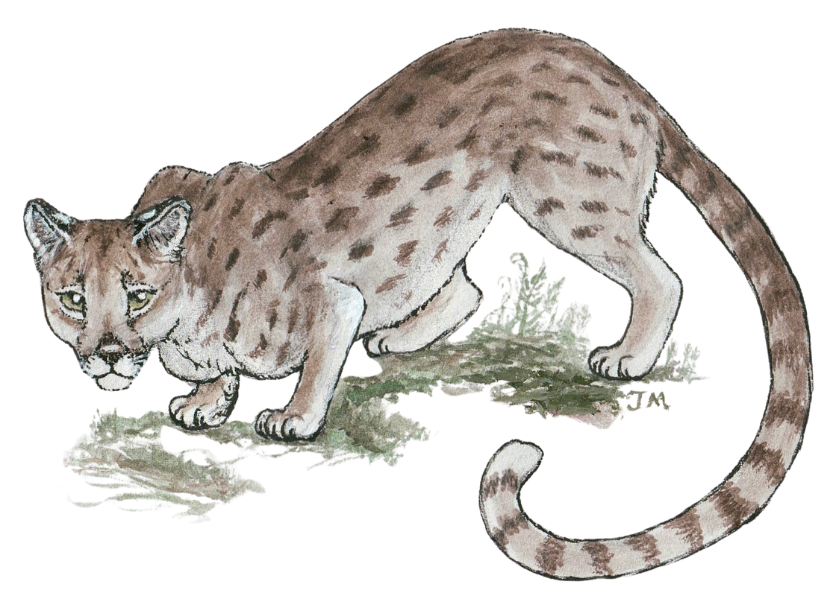
Long, long ago, cats looked different than they do today!
Meet the Early Cats, Proailurus
It lived 25–30 million years ago.
It climbed trees and had sharp claws and teeth

Slide 18

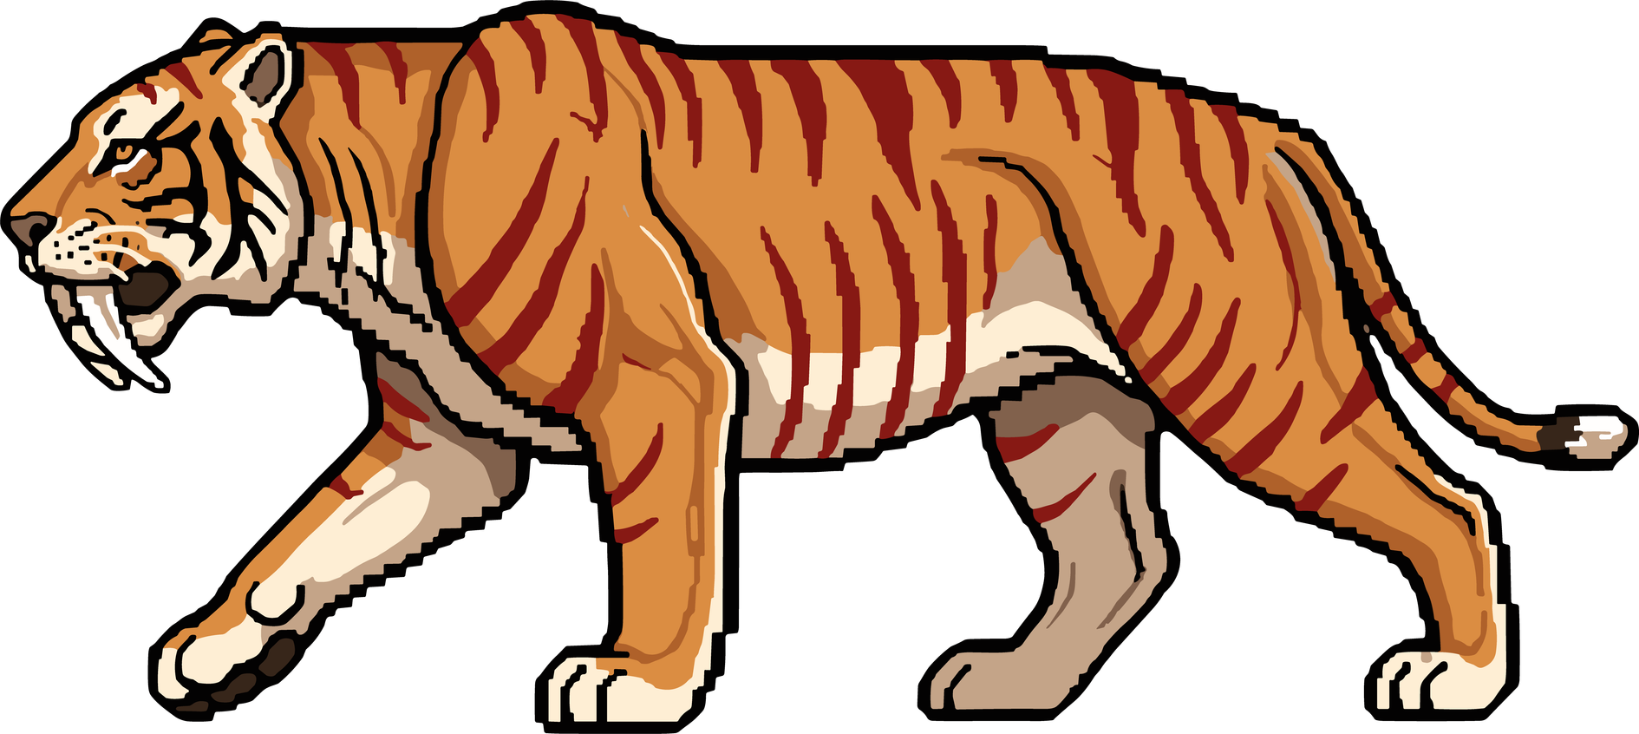
Proailurus did not look much like the cats we see today. Pseudaelurus, however, looked more like modern cats. Pseudaelurus was another early cat that lived after Proailurus.

Slide 19
Scientists think that over millions of years, Pseudaelurus changed into different groups. These groups later became modern cats, like cheetahs, lions, and house cats, as well as saber-toothed cats, which are now extinct.

Slide 20

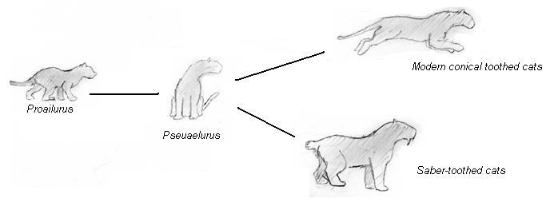
Fill out
CIRCLE PROAILURUS
DRAW A SQUARE AROUND PSEUDAELURUS

Slide 21
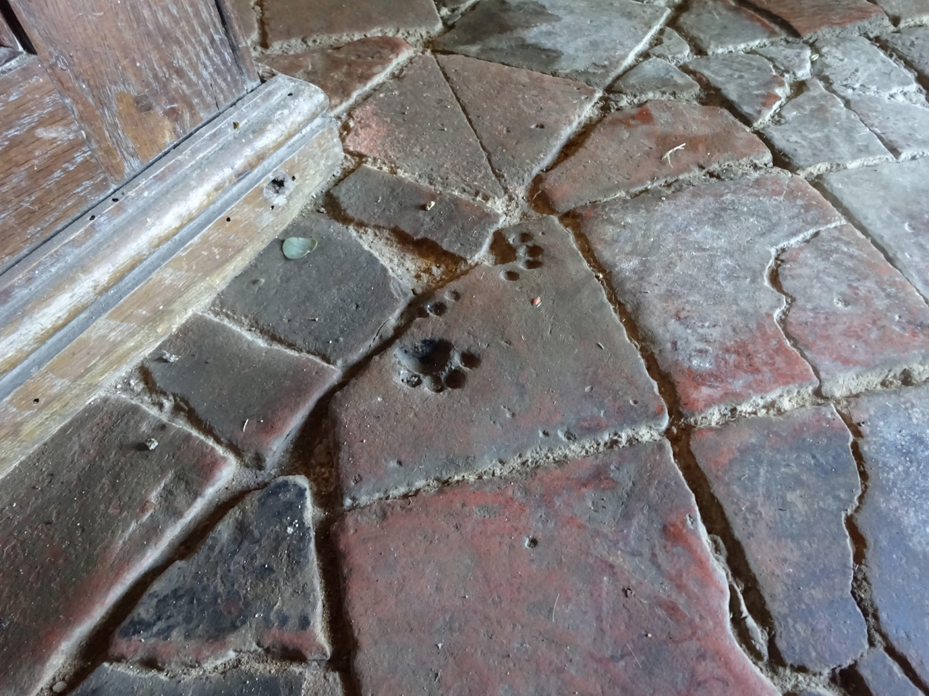
What do you notice about this picture?
What animal do you think made this mark?

Slide 22
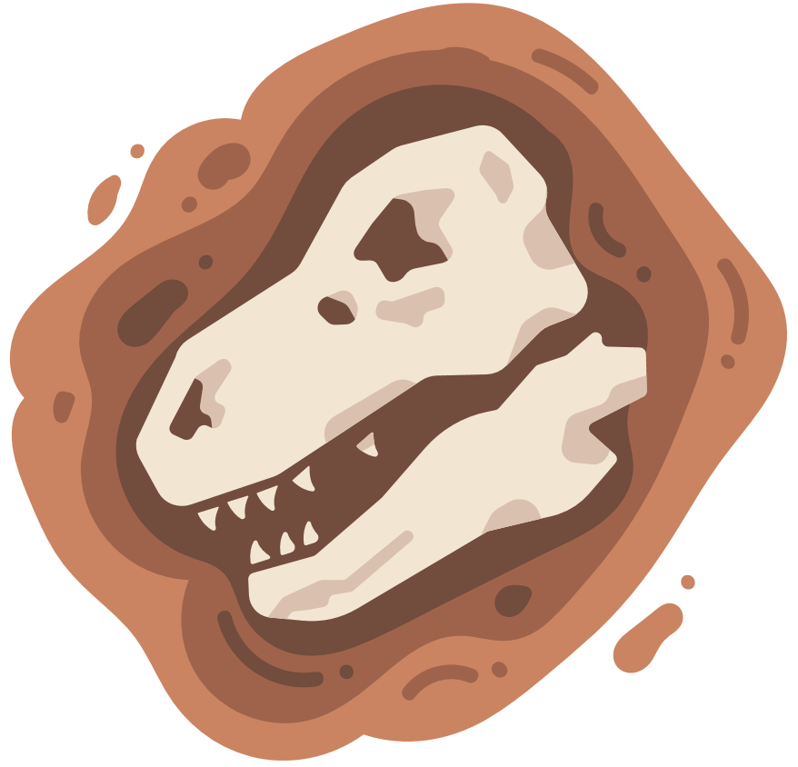
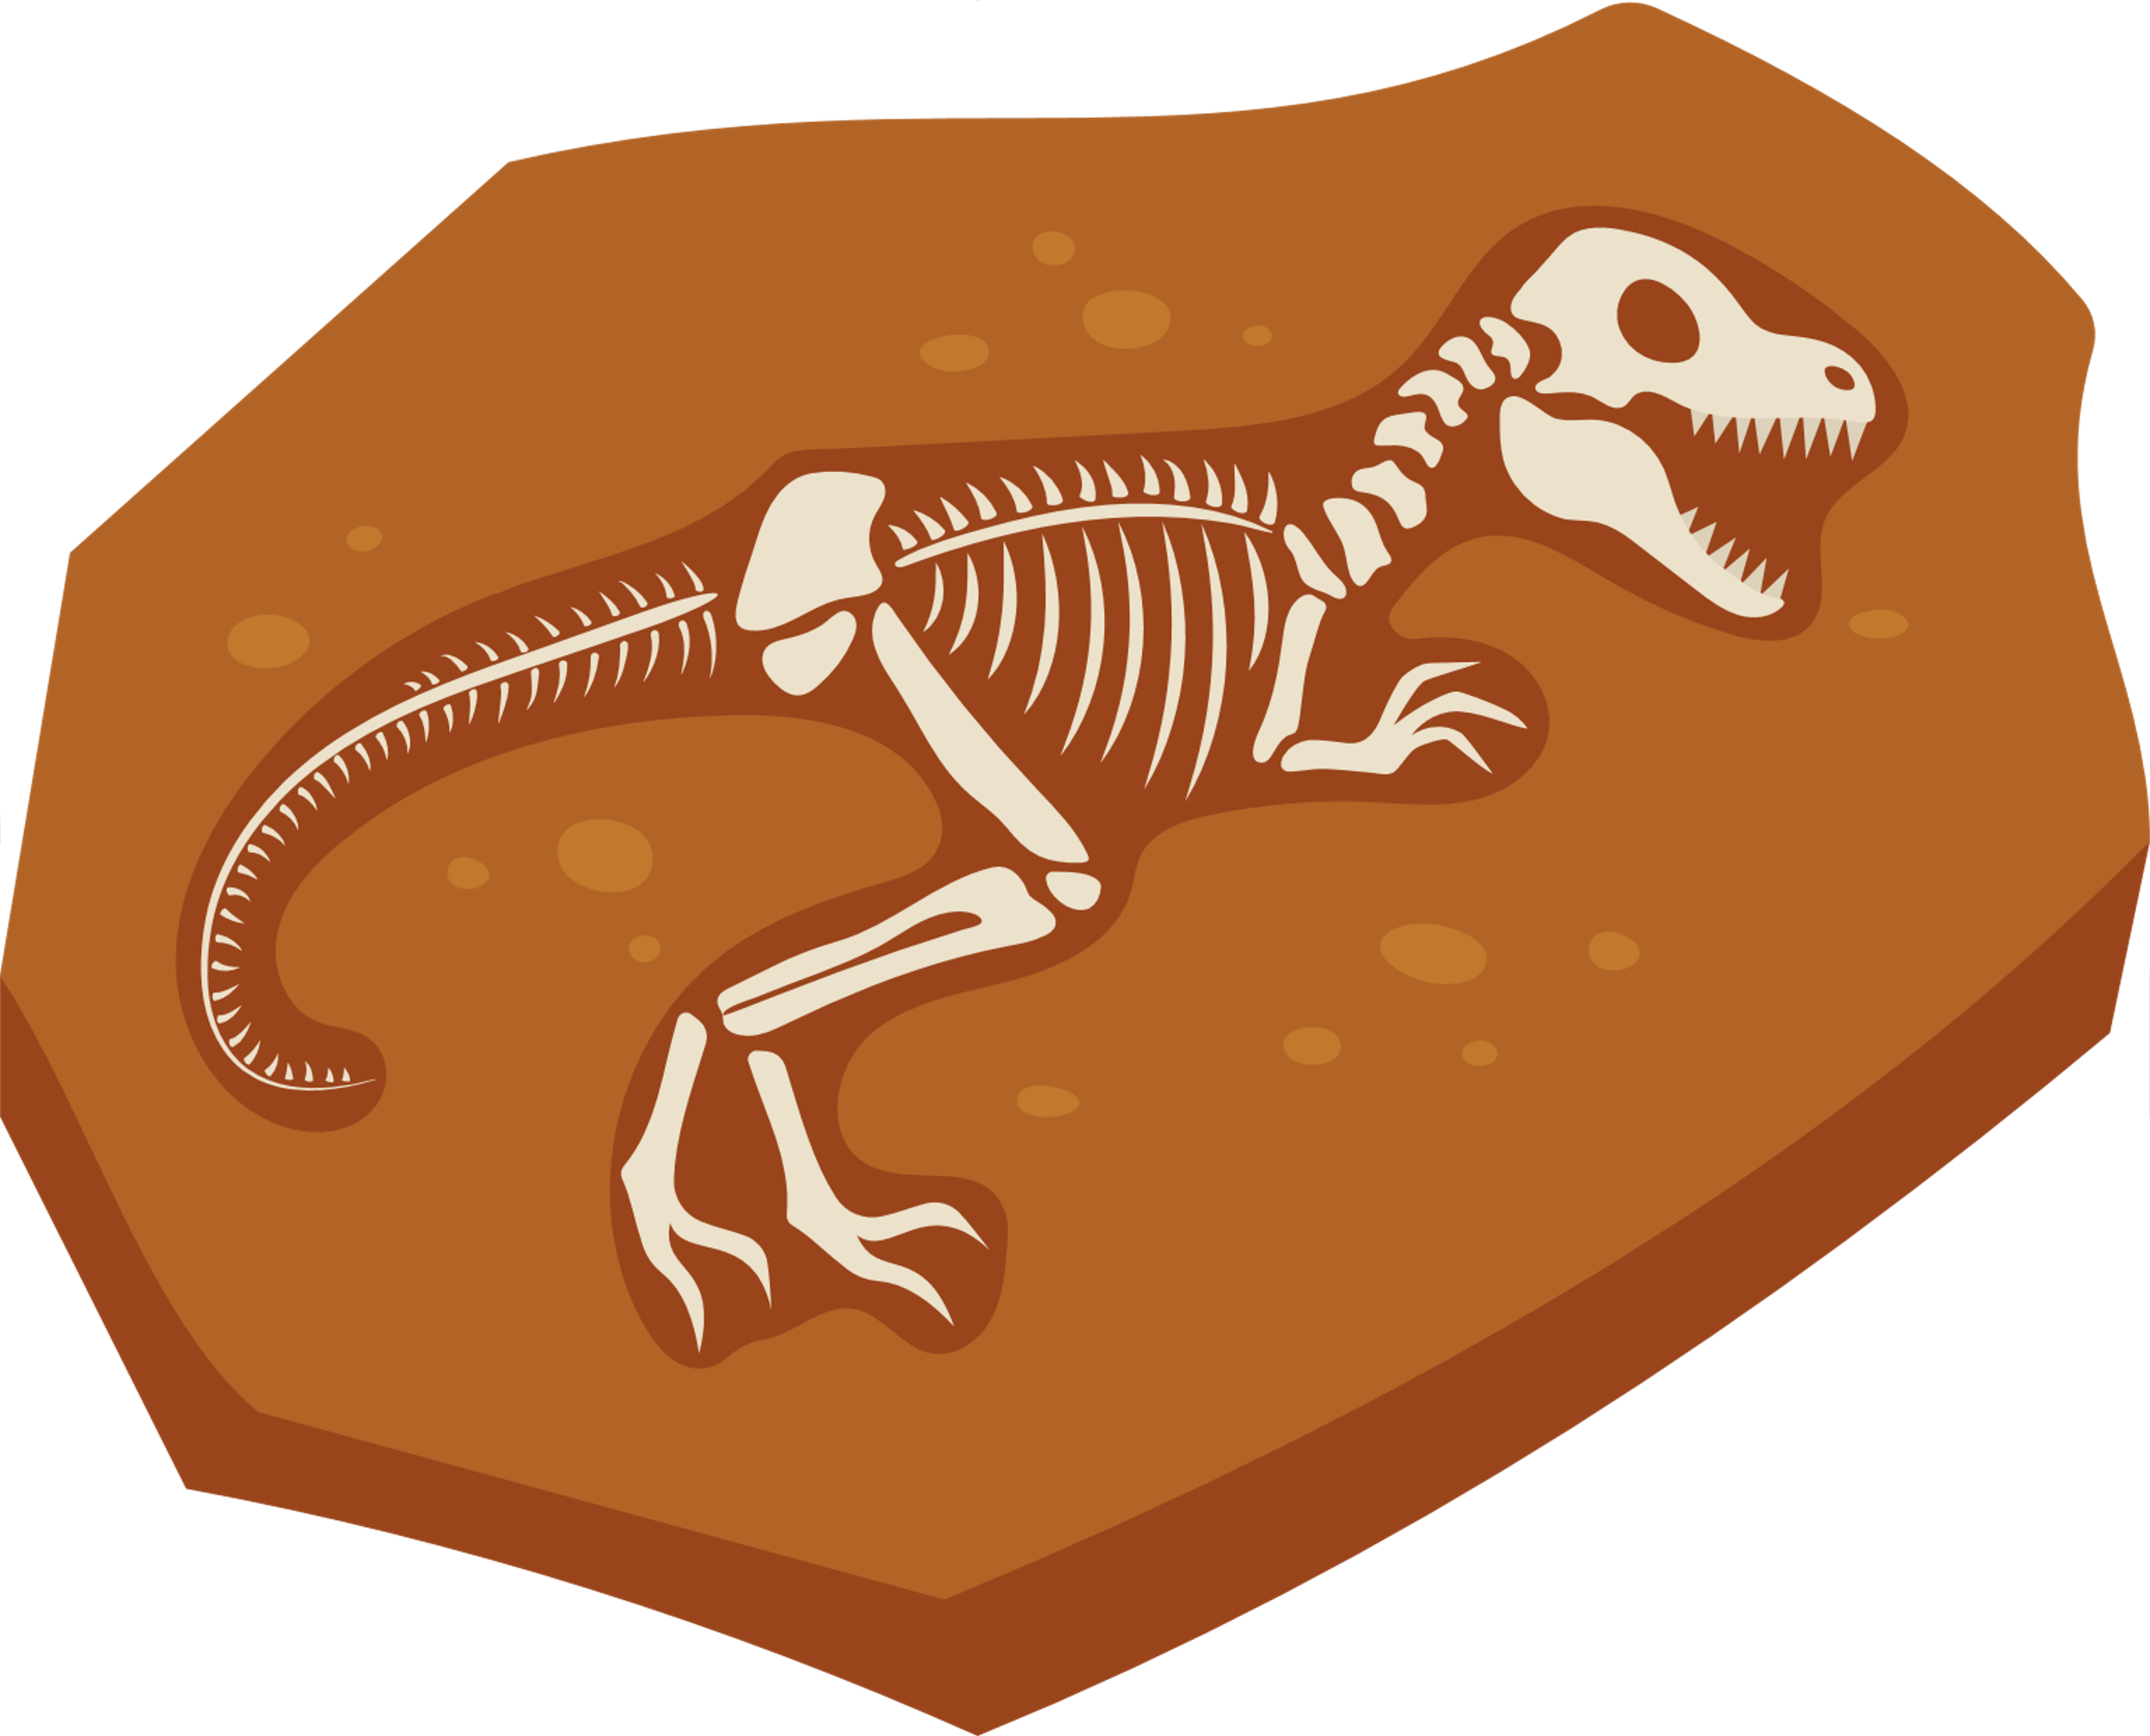
Share your ideas with your partner.
Brainstorm with your partner:
What can this print tell us about the animal that left it?

Slide 23
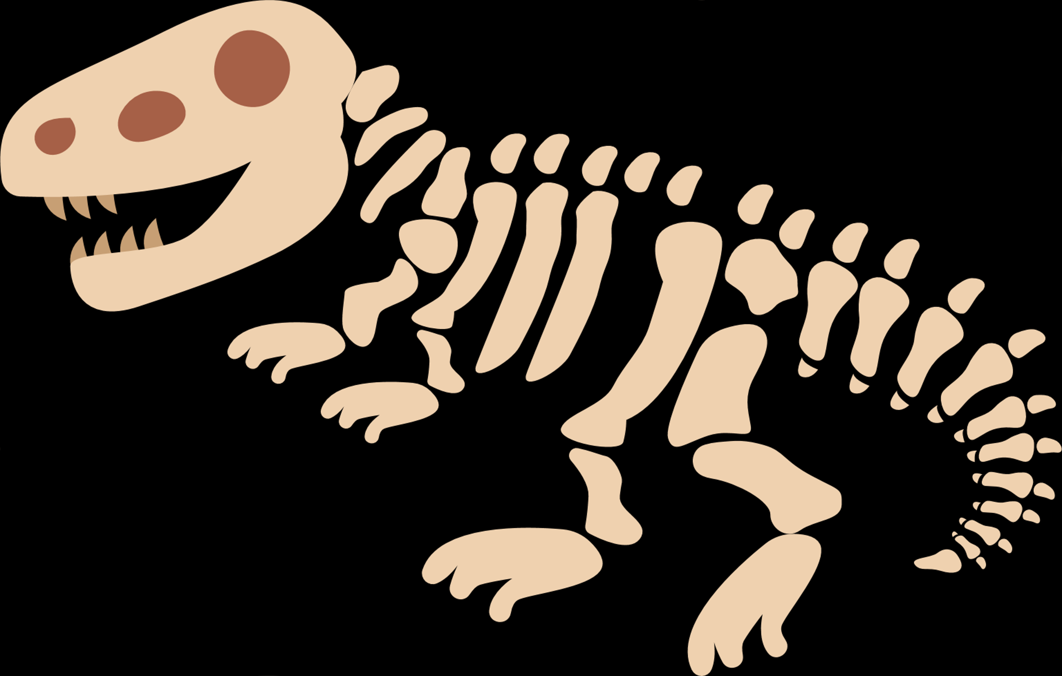
Fossil Activity!

Slide 24


Safety
To keep everyone safe and responsible during our fossil activity:
Use materials correctly.
Only press the objects into the clay. Do not throw clay or objects
Keep objects out of your mouth.
Small items (coins, shells, caps) are not toys and should never go in your mouth.
Be gentle when pressing.
Press objects firmly but slowly to avoid clay breaking or objects snapping.
No horseplay.
Stay seated and work at your table space to avoid bumping into others.
Clean up carefully.
Put objects back in the container and throw away paper plates if directed.

Slide 25



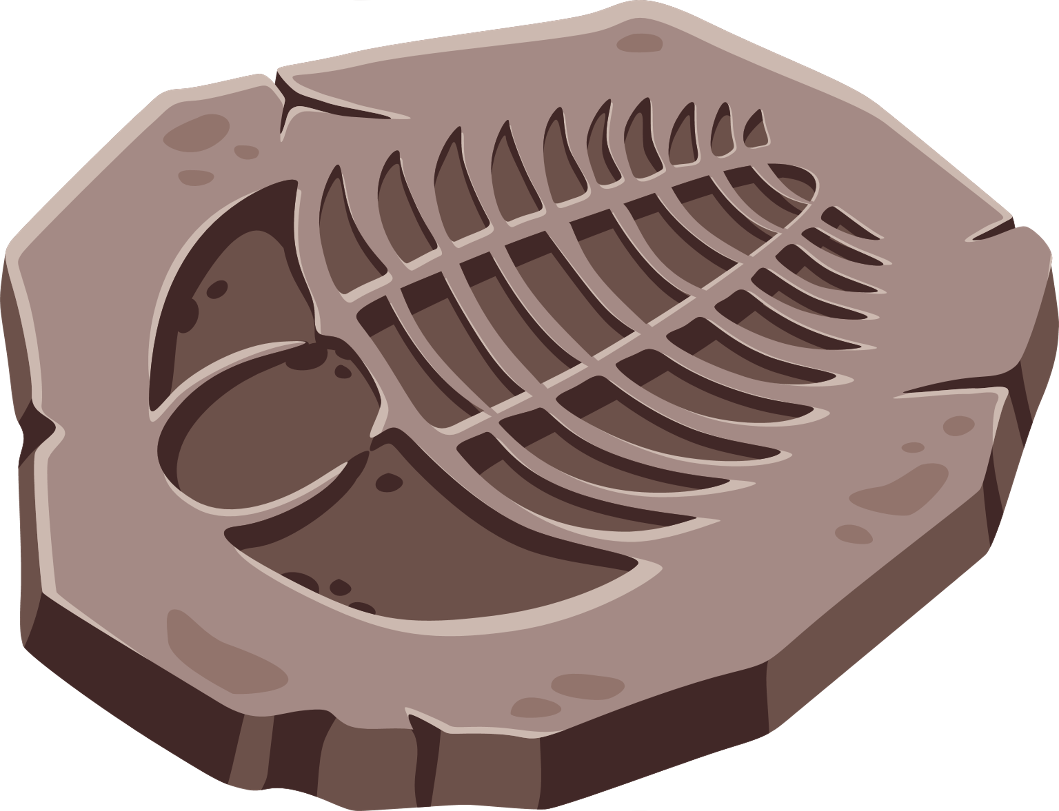
Fossil Activity
Flatten the clay.
Choose one object.
Press it firmly into the clay.
Carefully remove the object.

Slide 26

Moths
What kinds of moths have you seen? What were the color or pattern of their wings?

Slide 27
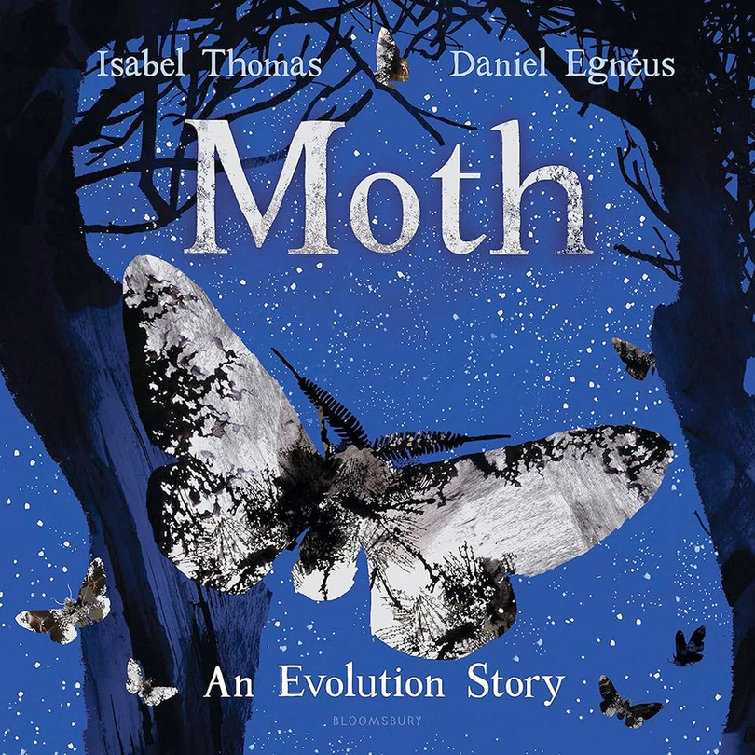

Moth: An Evolution Story
Think while reading:
How do the moths and environment change as the story progresses?

Slide 28
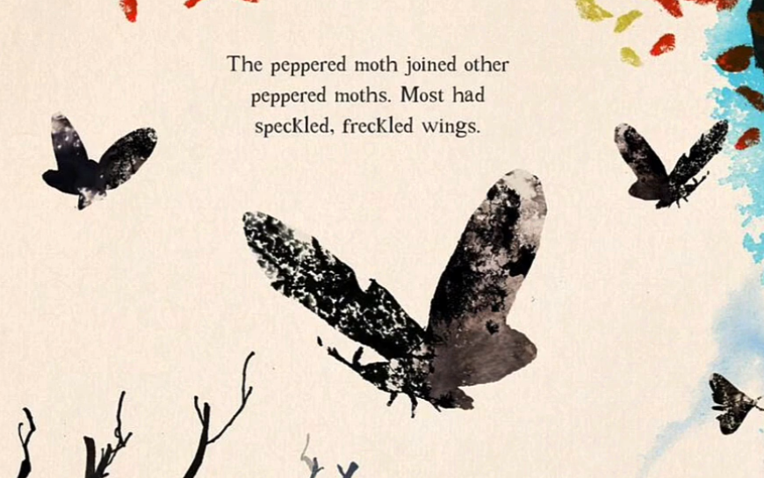
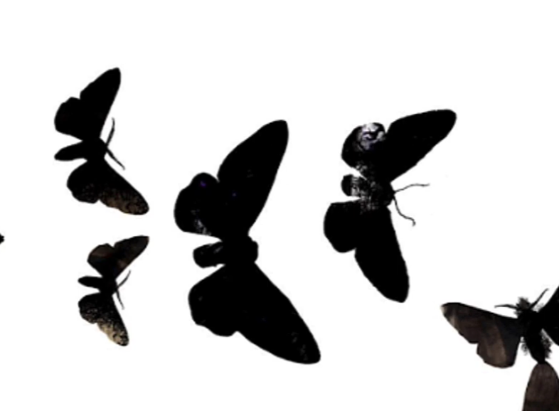

Peppered Moths Black Moths
What did you notice about these moths?

Slide 29
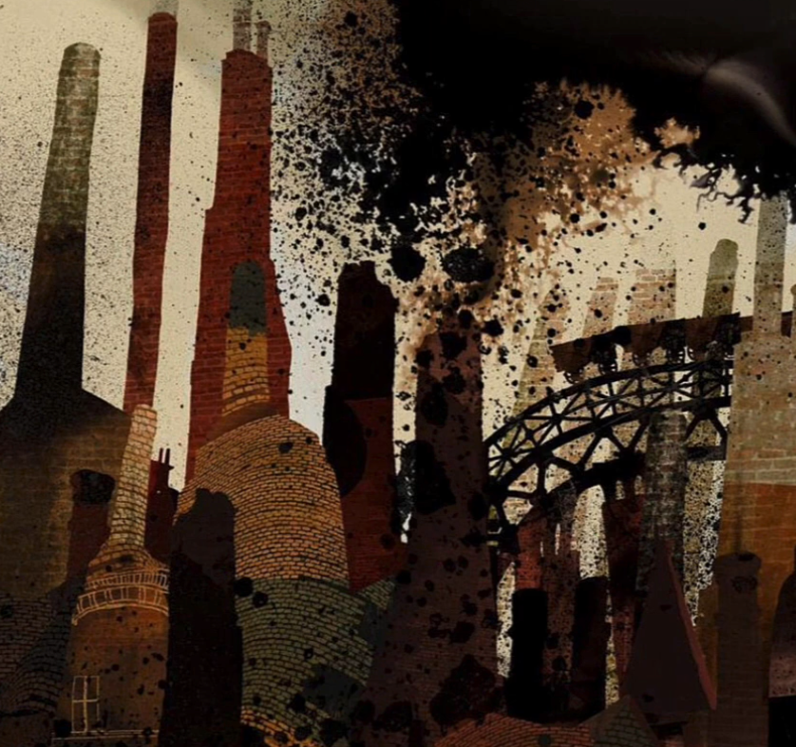
Which moth is better suited for this environment?

Slide 30
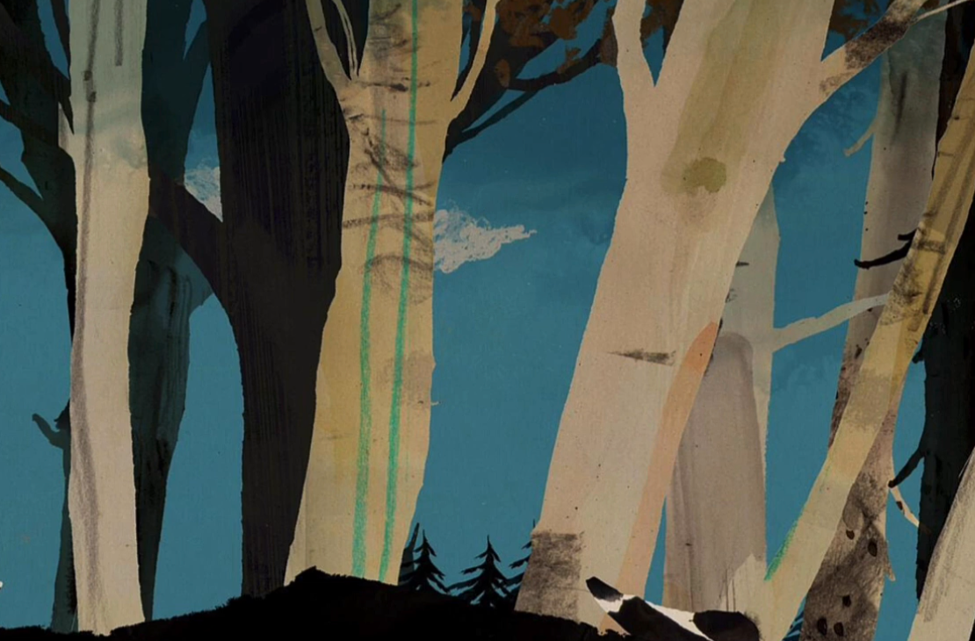
Which moth is better suited for this environment?

Slide 31
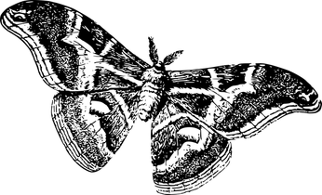
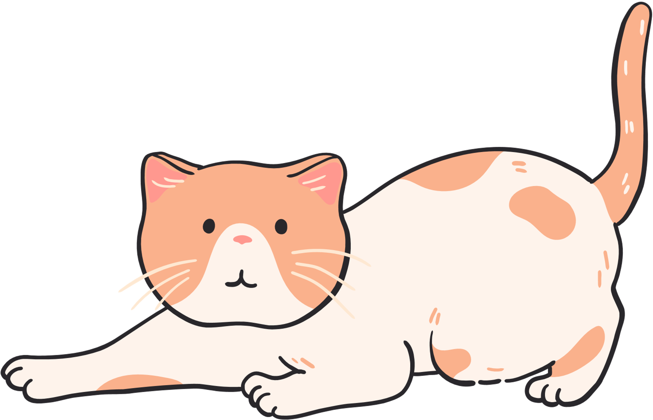

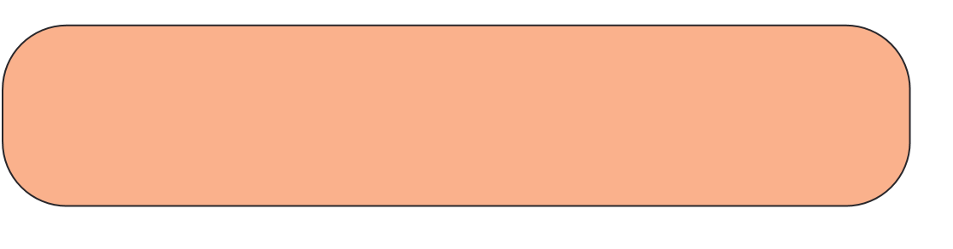
How does this story apply to cats?
Think:
Just like moths, cats also have special body parts and behaviors that help them survive in their environment.

Slide 32
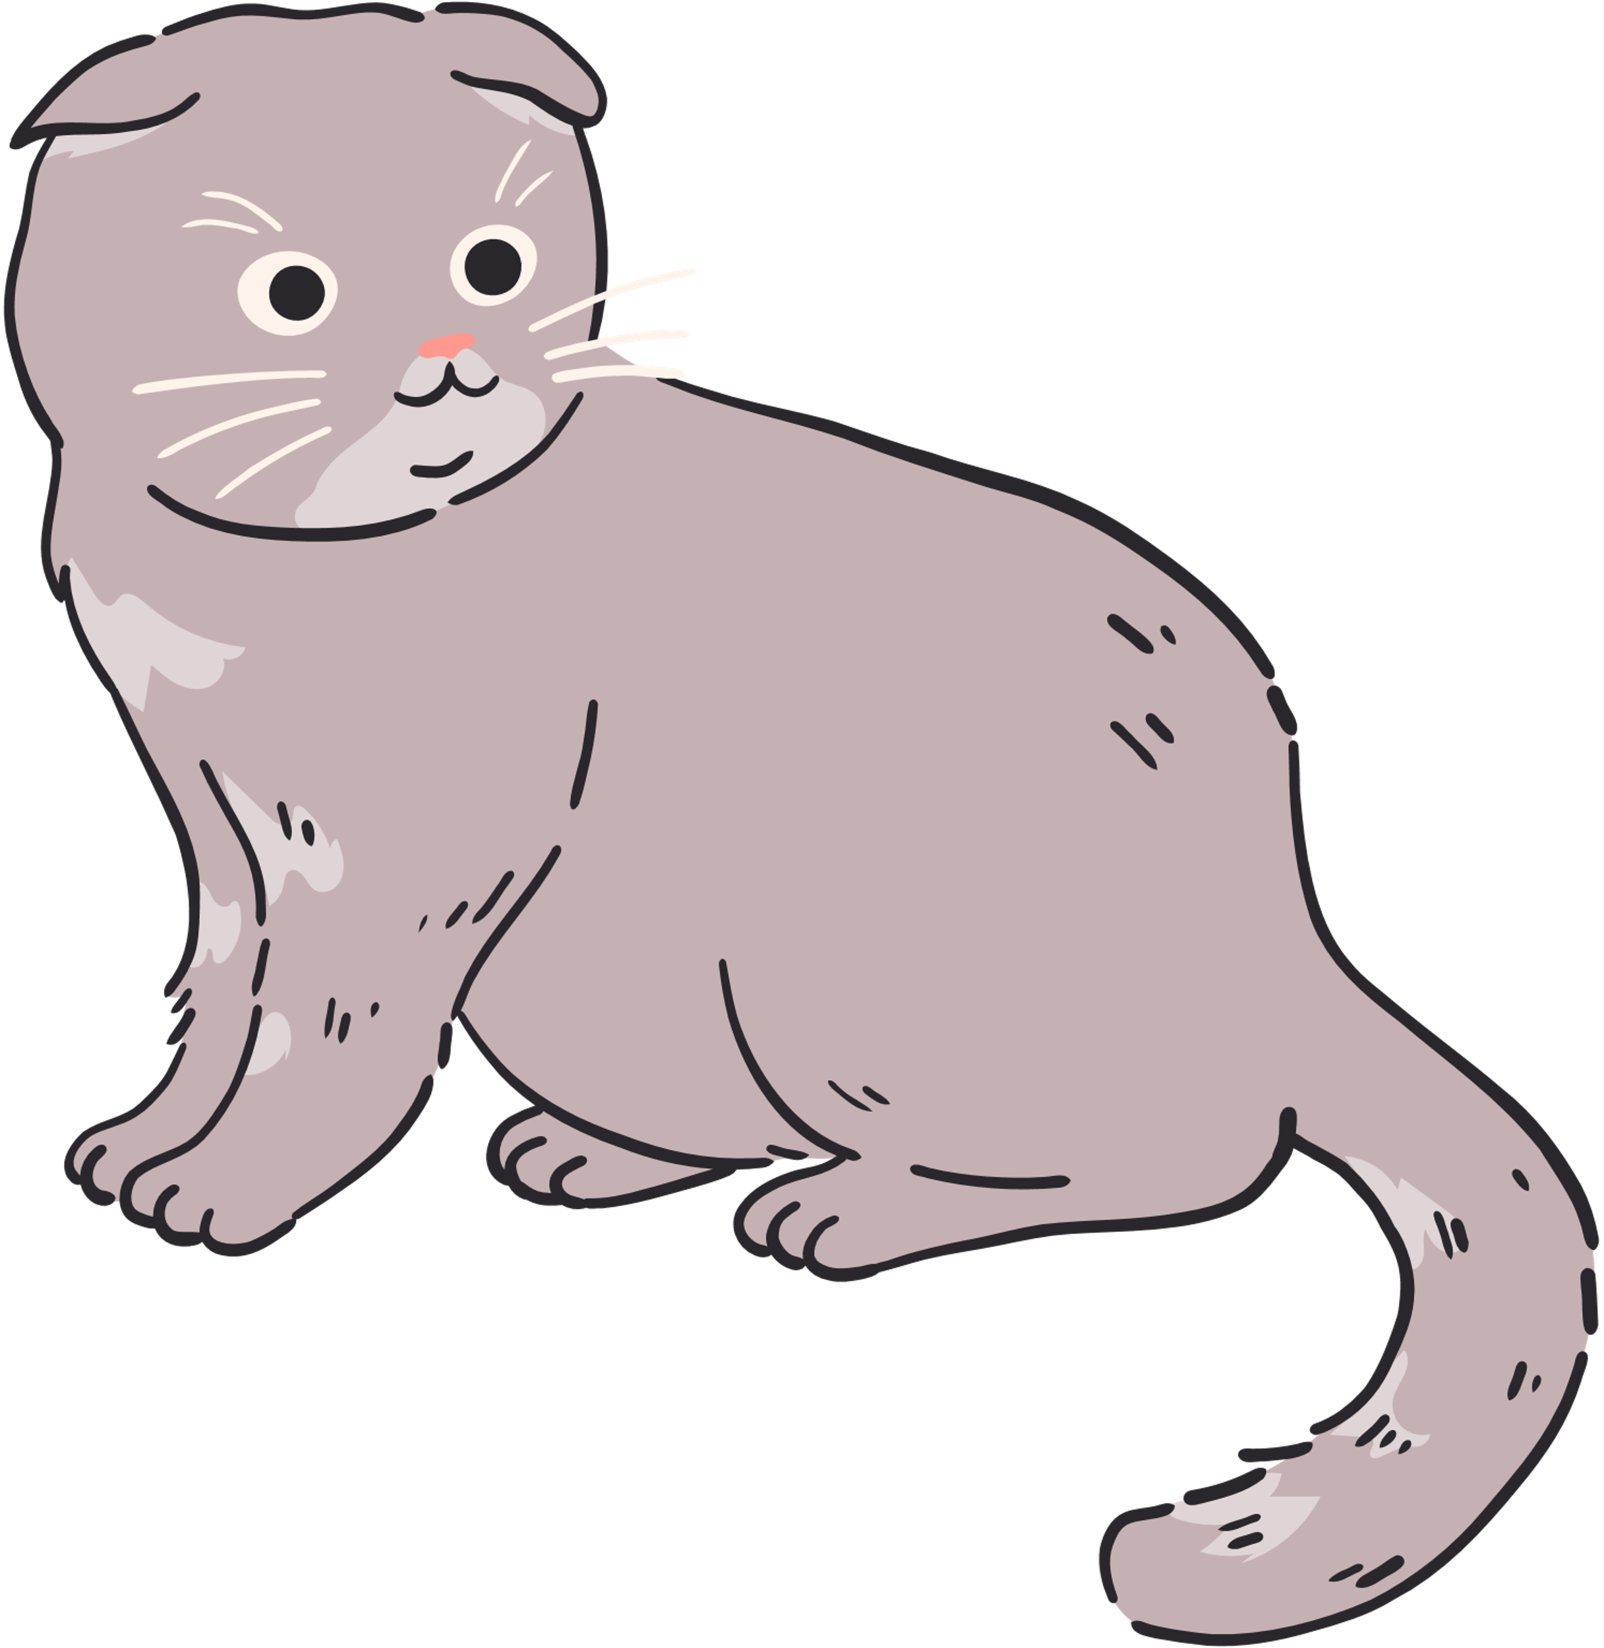
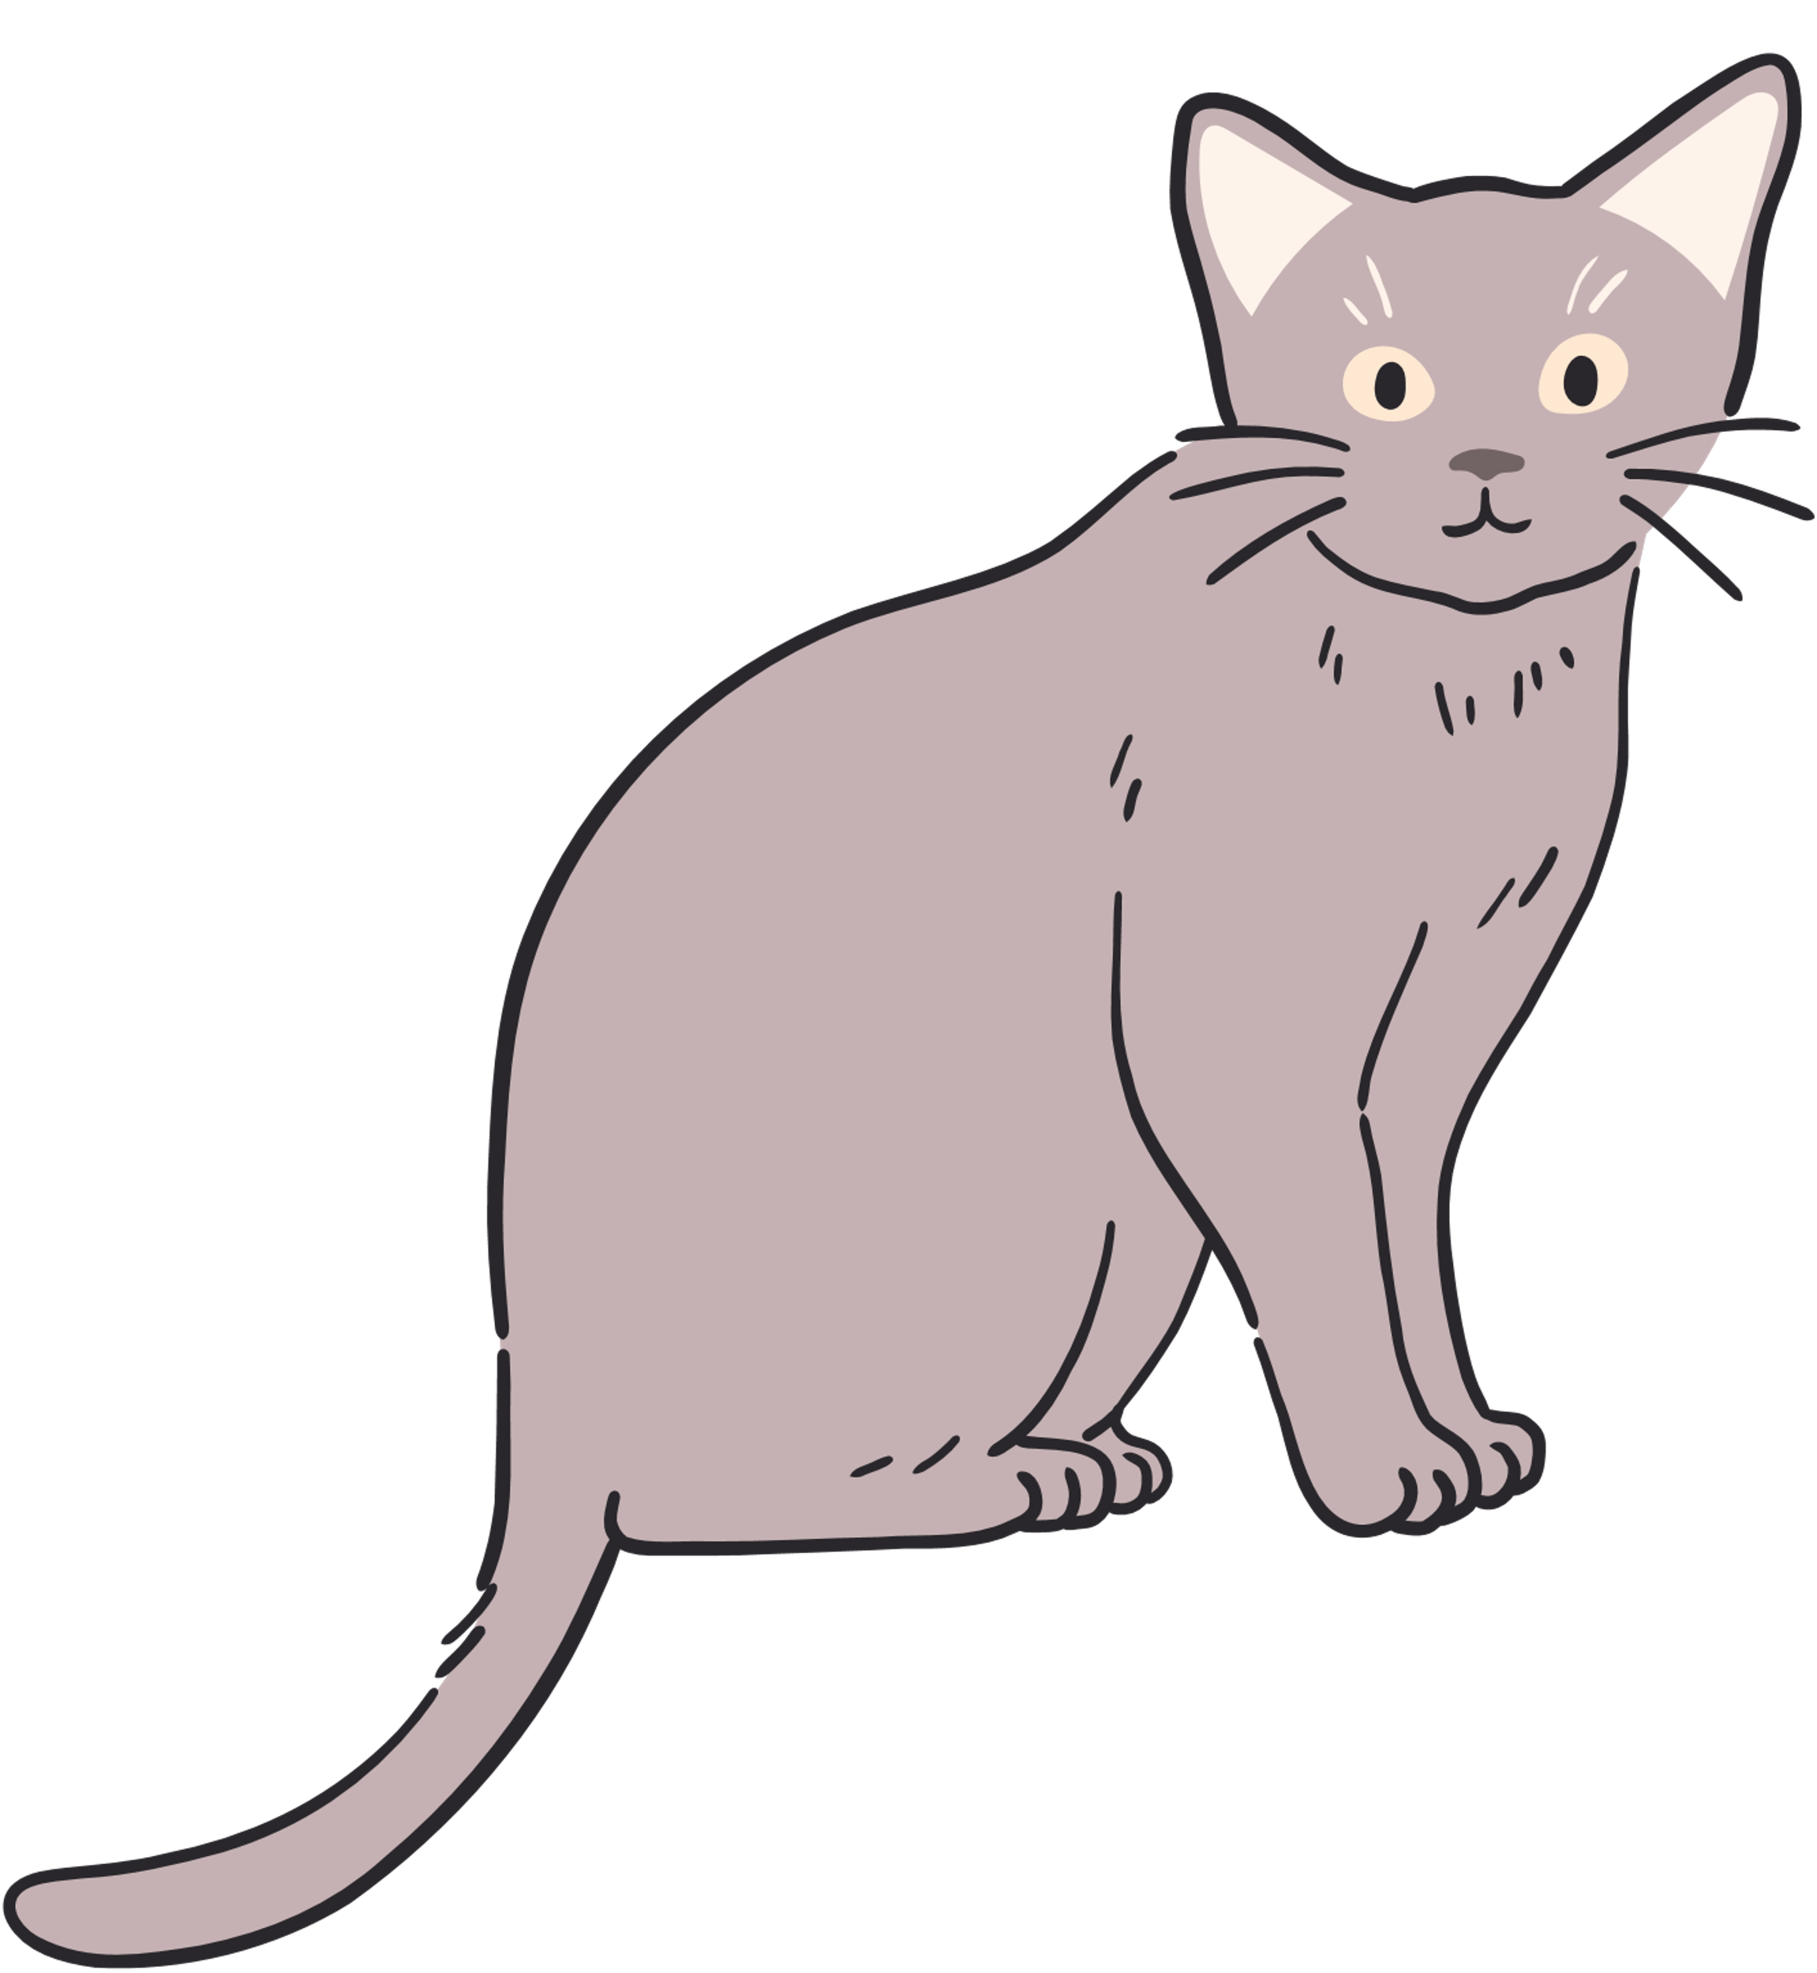
Let’s redraw our dream cat.
What changes will you make?

Slide 33
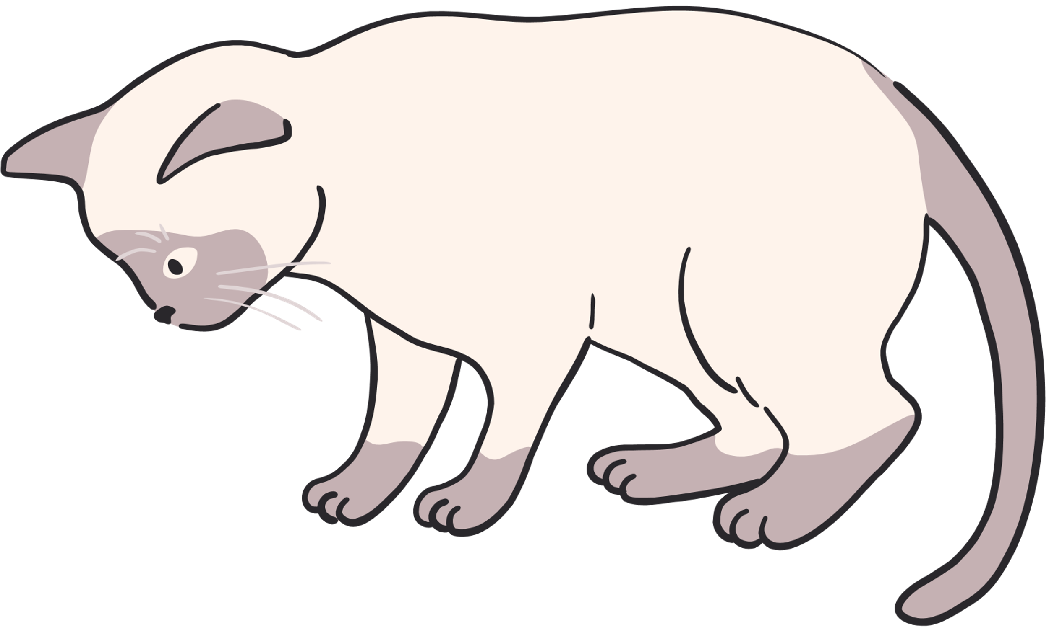
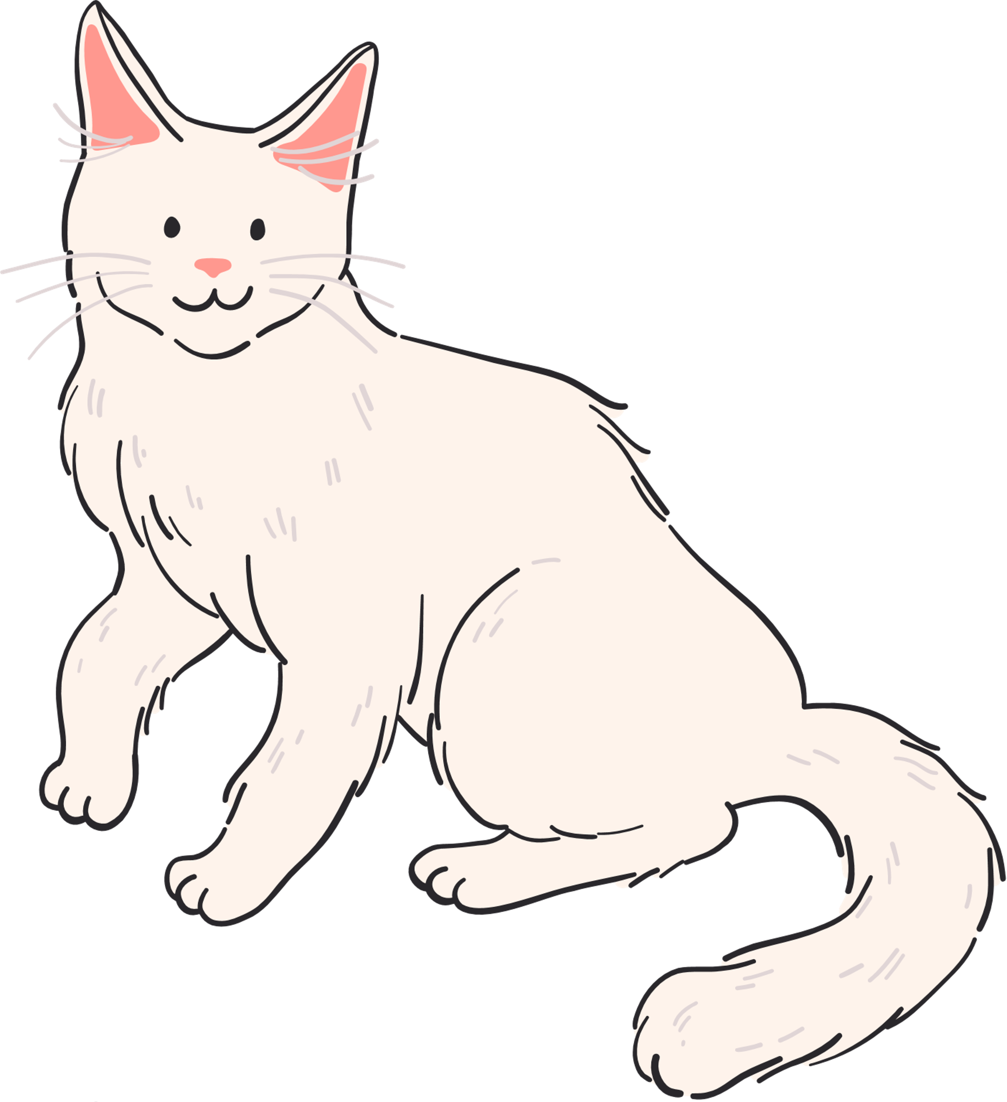

Trashketball
Rules
In teams, you will work together to solve problems on the slide.
The first team to raise their hand and share the correct answer will have a chance to shoot at the basket for points.
The team with the most points wins.

Slide 34

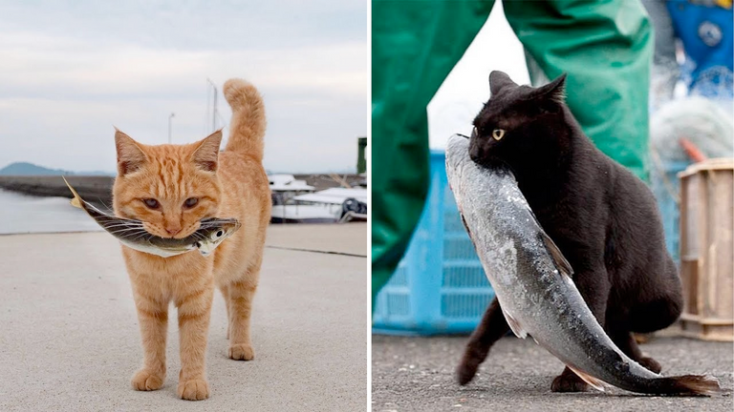

Cats need to find food to survive. What is a trait that cats use to help it hunt fish?

Slide 35
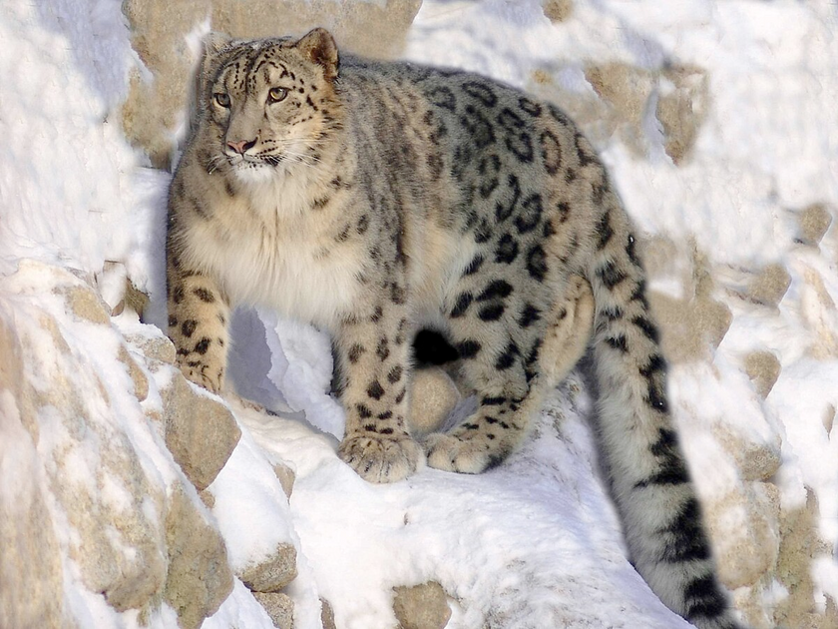
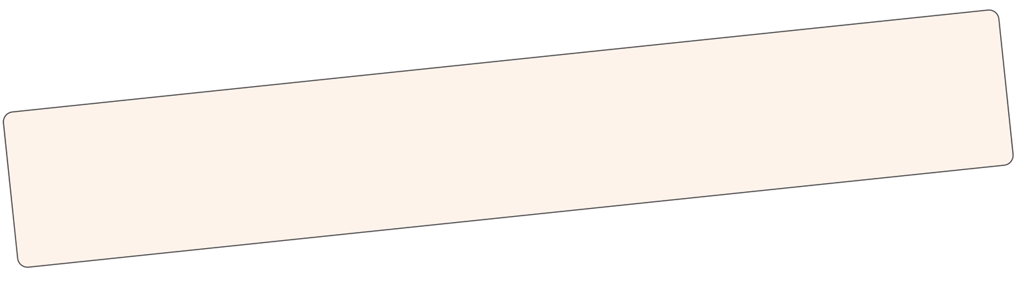
A snow leopard lives in the cold, snowy mountains. What is one difference between a cat and a snow leopard?
BONUS QUESTION: Why might this difference helps each animal survive in its environment?

Slide 36
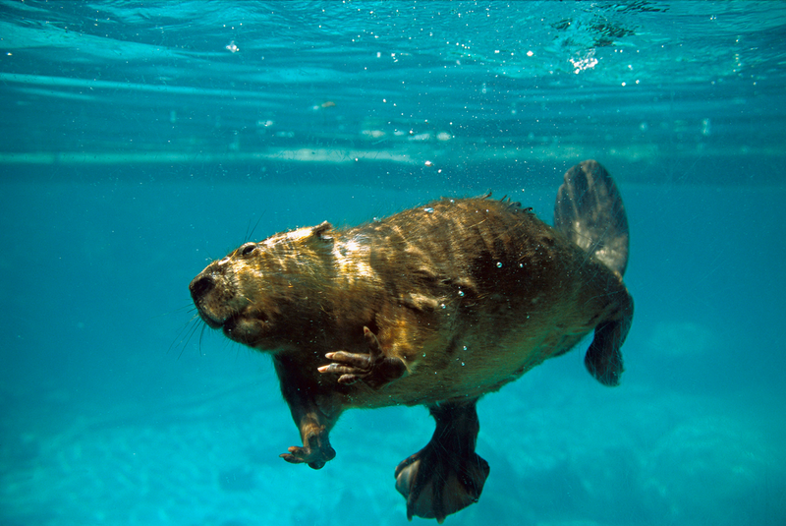
A beaver lives near rivers and ponds. What’s a body part that helps a beaver swim and move through water?

Slide 37
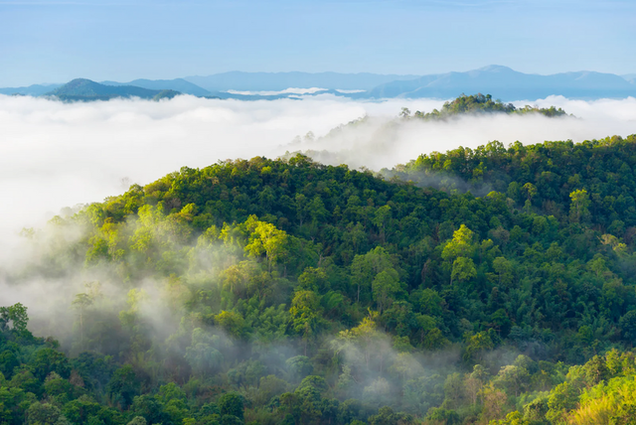
A forest fire burns down all trees and plants. What might happen to animals who get their food from the forest?

Slide 38
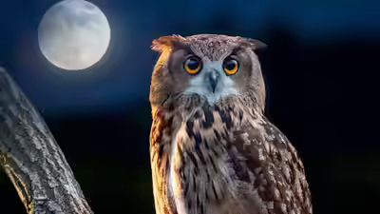
Most owls are nocturnal. What body part helps them hunt well at night?

Slide 39
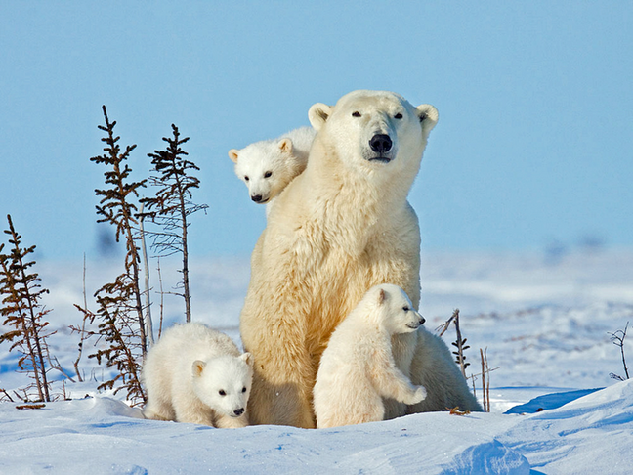
Double or Nothing!
Polar bears have white fur. How does this help them survive in the snowy arctic?

Slide 40
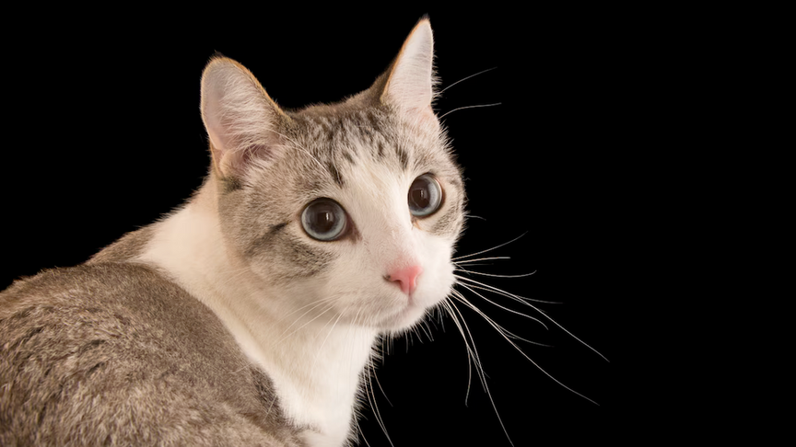
Exit Ticket
What is one thing you added or changed to your cat drawing after today? Why?

