Slide 1


NAME: _________________
DATE: ___________
EXPLORATION WORKSHEET
CAT EXPLORERS!

Slide 2




NAME: _____________________
DATE: ___________
Video 1:
1. WHAT DID THE CAT DO TO STAY ALIVE?
Write two things you noticed.
Behavior 1:_______________________________
Behavior 2: ______________________________
Video 2:
1. PICK ONE BEHAVIOR. HOW DOES IT HELP THE CAT SURVIVE?
Cat Senses Match-Up
DRAW A LINE TO MATCH THE SENSE TO THE BODY PART THE CAT USES.
SIGHT
SMELL
HEARING
TOUCH

Slide 3

Your Turn!
DRAW ONE OF EACH TRAIT THAT HELPS A CAT SURVIVE.
STRUCTURAL
BEHAVORIAL
Animals & Their Homes
With you table group, match each animal card to the environment it survives best in.
Pick ONE match you made
Animal:
Habitat:
Why does this animal do well there?
Use a trait (body part or behavior).

Slide 4
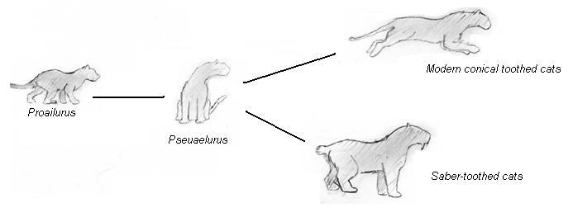
What might happen if this animal had to live in a different environment?
Fill in the box.
☐ It might survive
☐ It might get sick
☐ It might not survive
Why?
CIRCLE PROAILURUS
DRAW A SQUARE AROUND PSEUDAELURUS

Slide 5
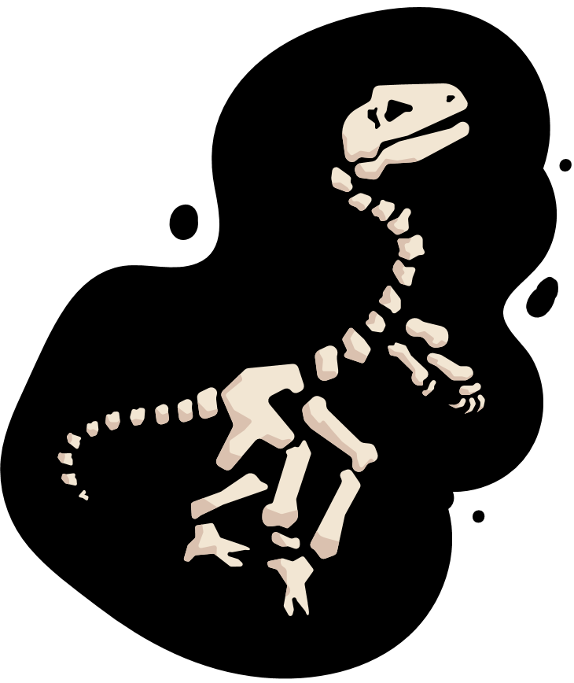


NAME: _____________________
DATE: ___________
FOSSIL ACTIVITY
Fossils are clues from long ago, like bones or footprints, left by plants and animals that lived a very long time ago.
FOSSIL ACTIVITY
HOW DO FOSSILS HELP SCIENTISTS LEARN ABOUT THE PAST?
Scientists found fossils of cats that climbed trees and fossils of cats that ran fast on land.
WHERE DO YOU THINK THESE CATS LIVED?

