Slide 1
NATURAL SELECTION

Slide 2

Agenda:
please grab the intro worksheet and lab paper!
  Introduction videos on bird intelligence
  Crow evolution activity
  Class discussion on competition

Slide 3
write down: how smart do you think birds are

Slide 4
as you watch the videos, write down your observations

Slide 5
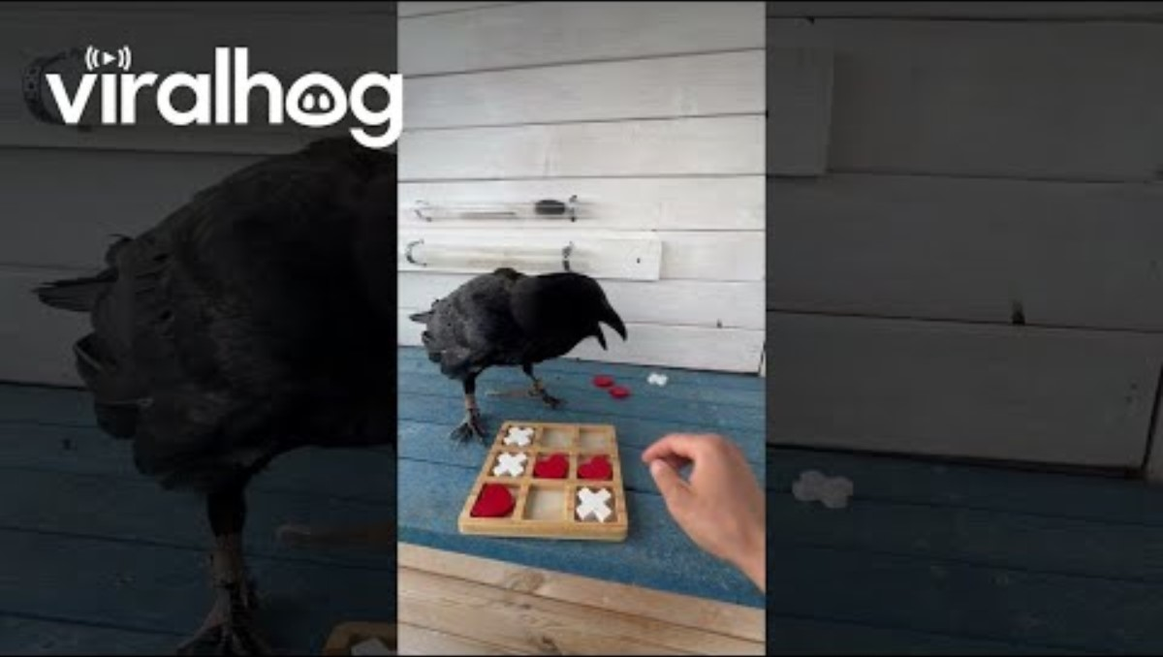

Slide 6
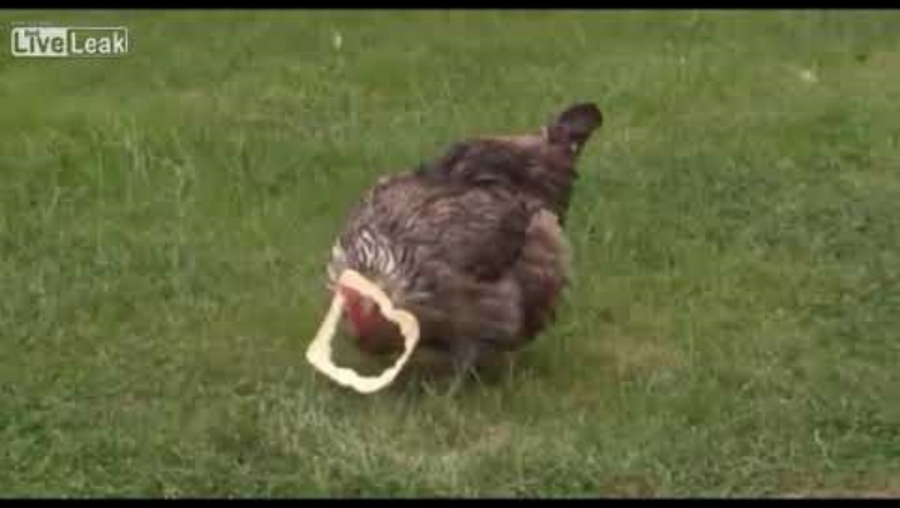

Slide 7
write down: do you think all birds have the same intelligence? WHy or why not?

Slide 8

Instructions
Materials
  With your shoulder partner, choose one person to be the crow and one person to be the timer
  Have the timer come up and collect all necessary materials
  Two narrow clear cylindrical containers: one filled with sand, one filled with water
  Large tweezers or other clasping tool
  Rocks
  Foil/waterproof paper
  Stopwatch

Slide 9

Crow activity!
  Use the tools in front of you to try to get the paper out of the cylinders!
  Follow the instructions on the worksheet
  Record all observations
  When you’re finished, please clean up and take a seat

Slide 10
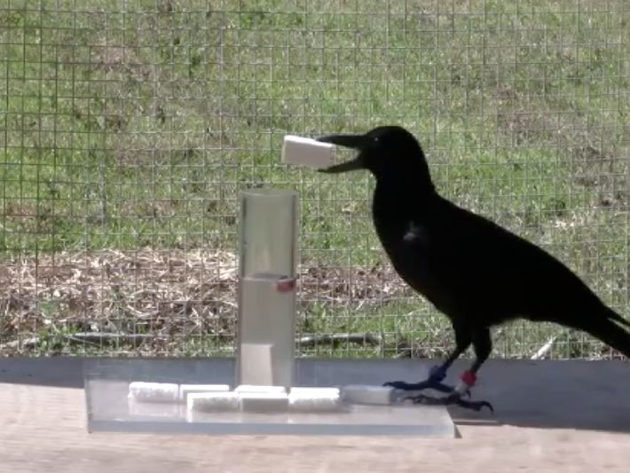
Reflection
  Were you able to get the paper out of the cylinder with water in it?
  How long did it take you?
  What about the cylinder with sand in it?
  Do you think crows in the wild know that this won’t work with sand?

Slide 11
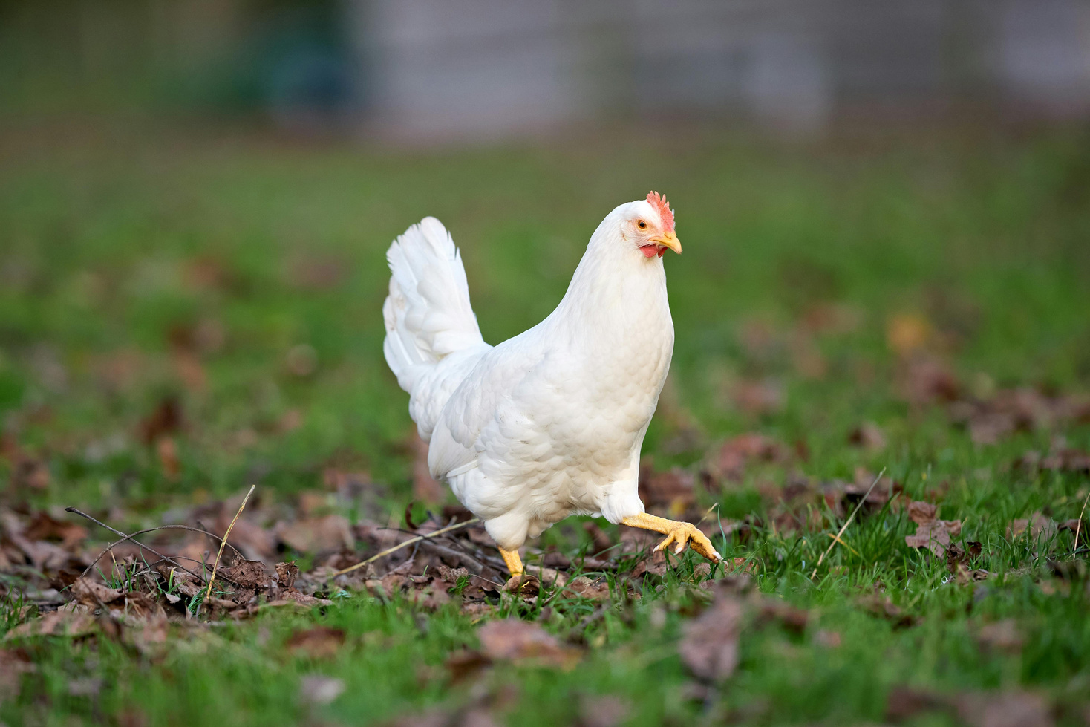
Reflection
  Do you think the chicken from the beginning video would know how to do this? Why or why not?
  Why would the crow’s intelligence be advantageous?
  What resources would the crow get easier than the chicken?
  Why are crows intelligent but chickens are not?

Slide 12
Materials
  Send one person from each table to get whiteboards and expo markers
  One for each person!

Slide 13
draw what an individual looks like

Slide 14
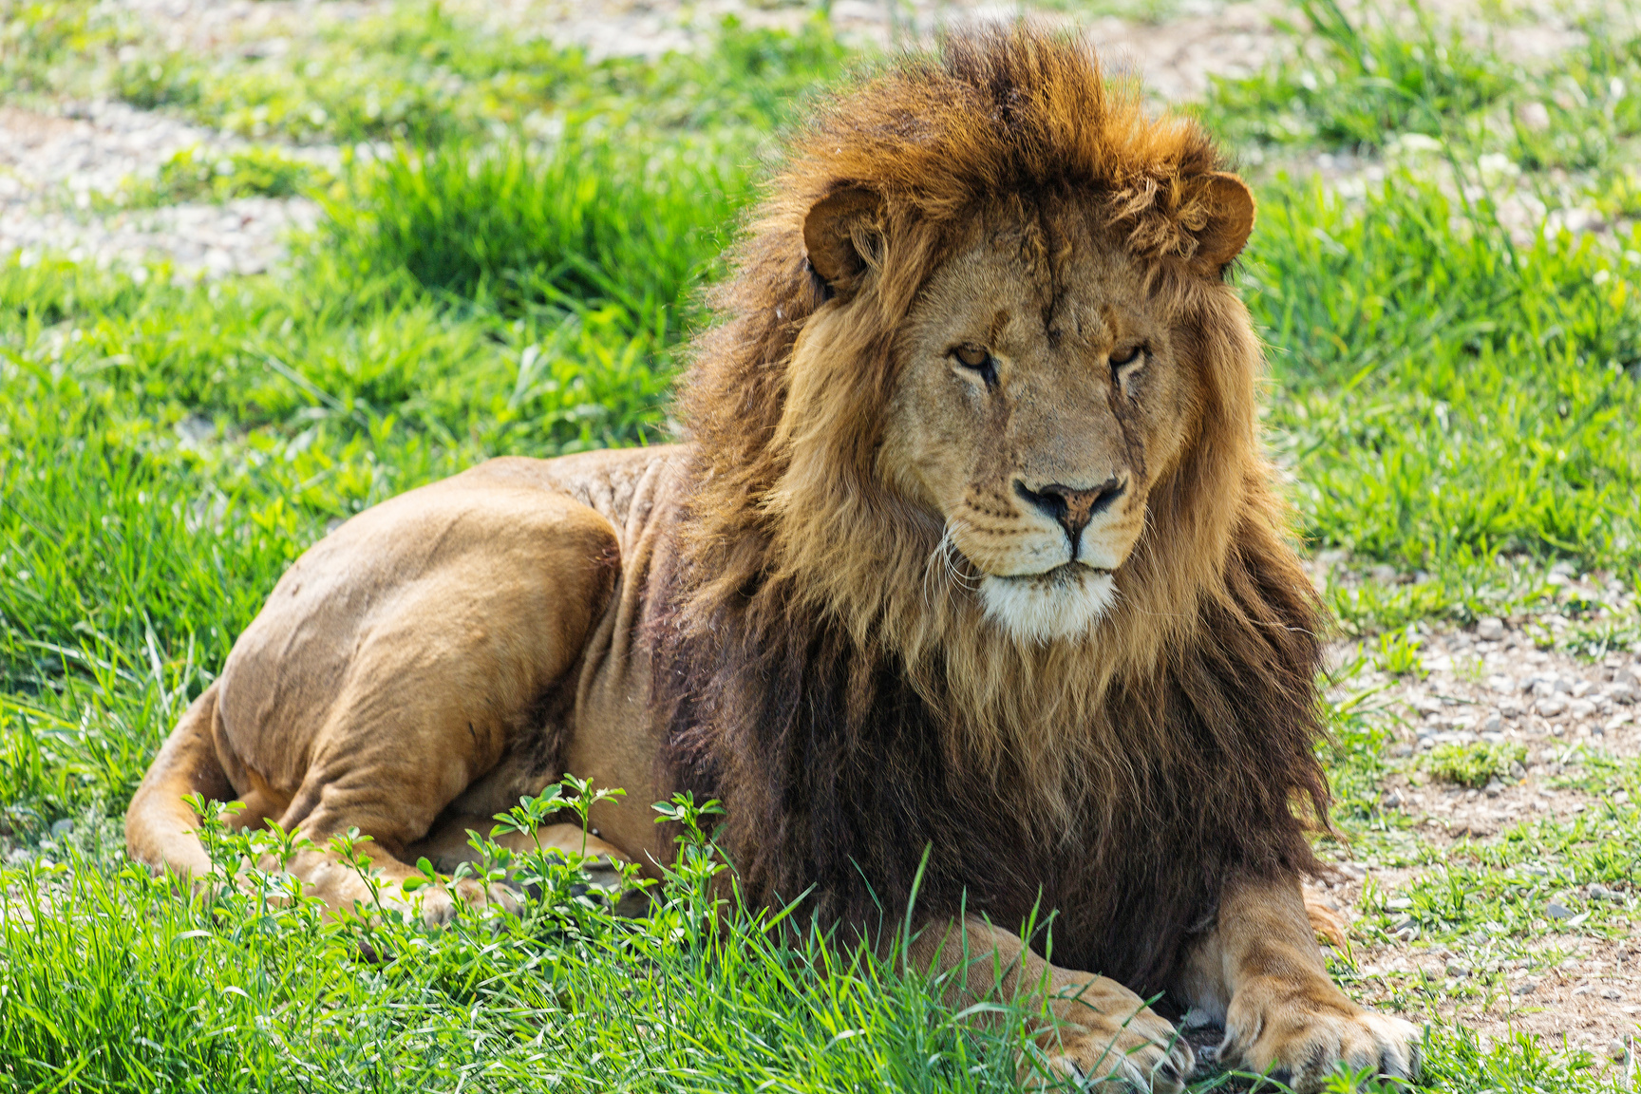
Individual:
A single animal of a species

Slide 15
draw what a population looks like

Slide 16
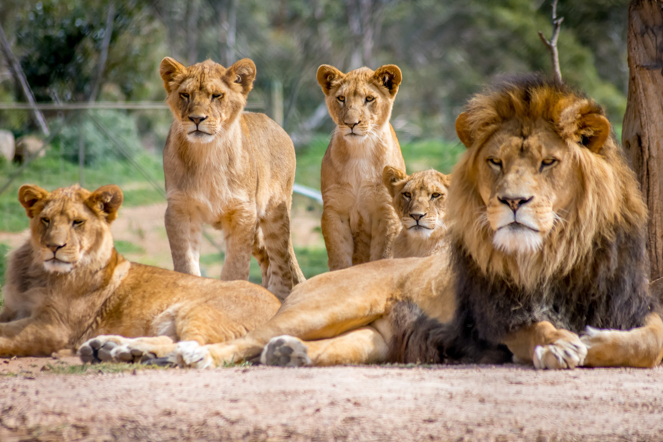
Population:
Multiple animals of the same species living in the same location

Slide 17
draw what a Community looks like

Slide 18
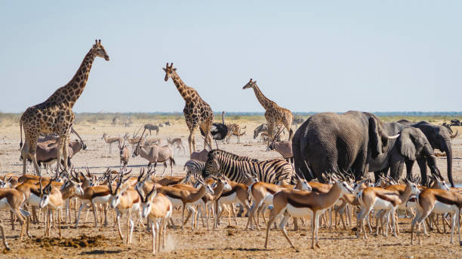
Community:
All the different populations in an area interacting

Slide 19
WHAT ARE SOME RESOURCES ANIMALS NEED TO SURVIVE?

Slide 20

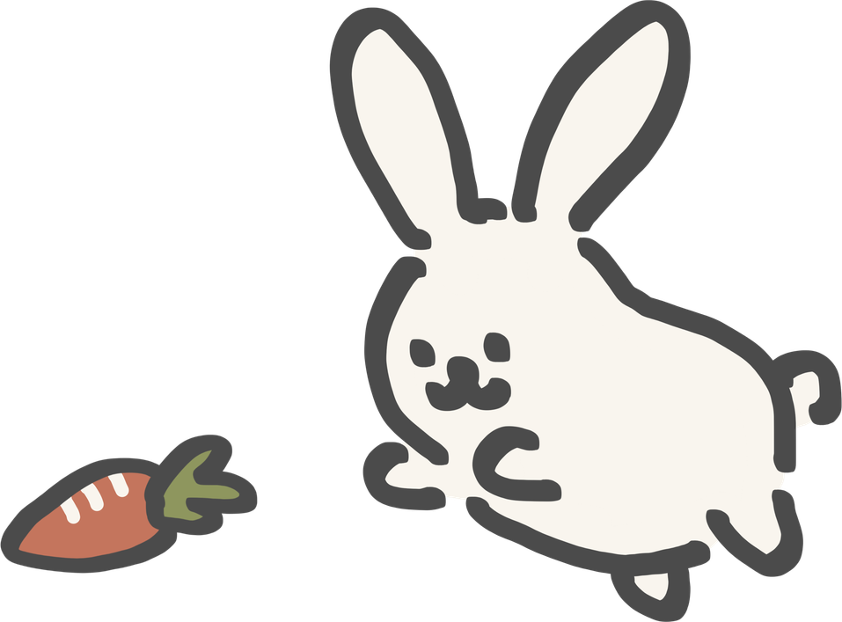



BIOTIC FACTORS
ABIOTIC FACTORS
  Factors that are/once were living
  Factors that are NOT living and never were
Examples:
  Animals
  Trees
  Plants
  Fungi
  Detritus (decomposed organisms)
  Bacteria
Examples:
  Sun
  Water
  Air
  Rocks
  Dirt
  Temperature

Slide 21
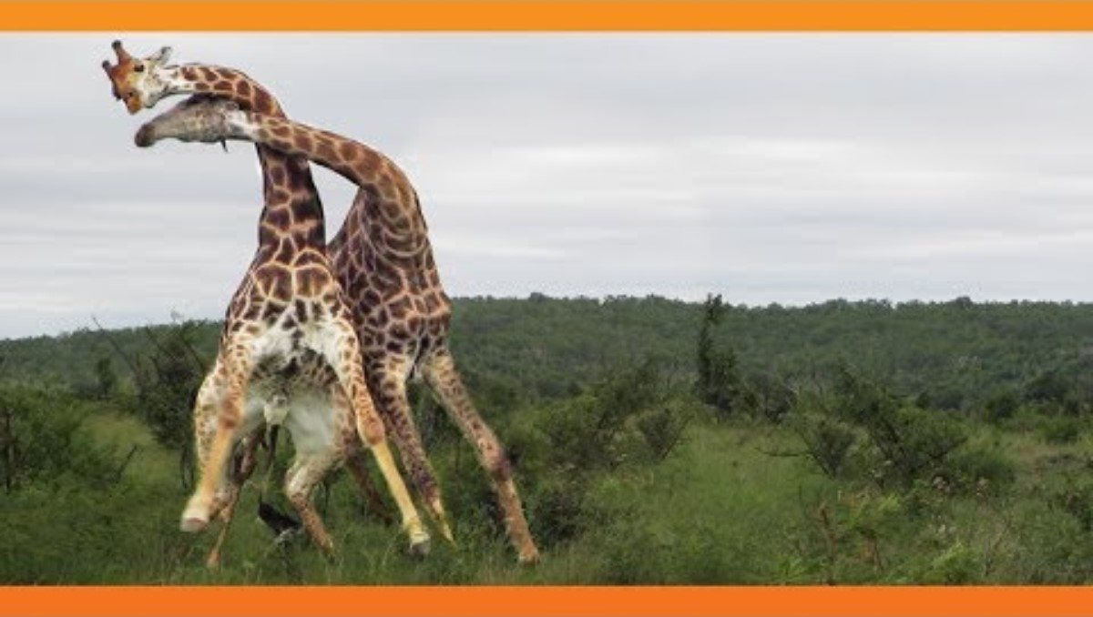

Slide 22
write down every interaction between factors in that video

Slide 23
What Was happening in the video? Why was it happening?

Slide 24
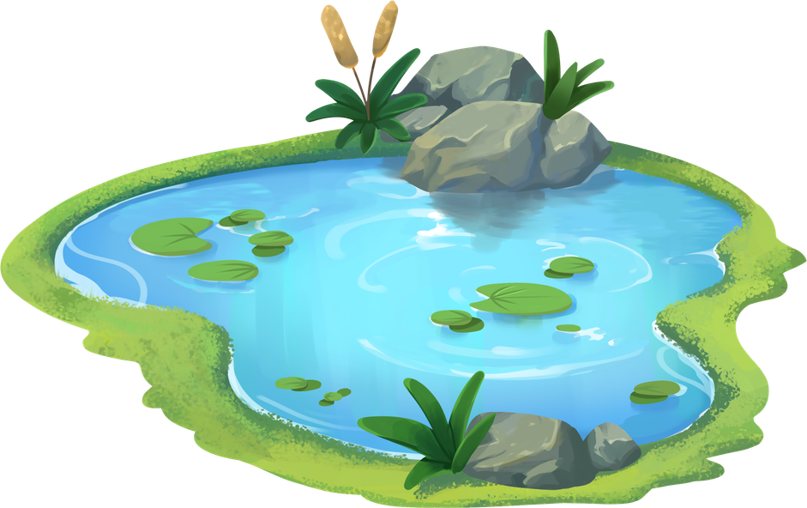
Why could the giraffes have been fighting?
  Biotic factors
  Abiotic factors
The giraffes could have been fighting over food or mates
They also could have been fighting over water or land

Slide 25
true or false: There are unlimited resources for all animals

Slide 26
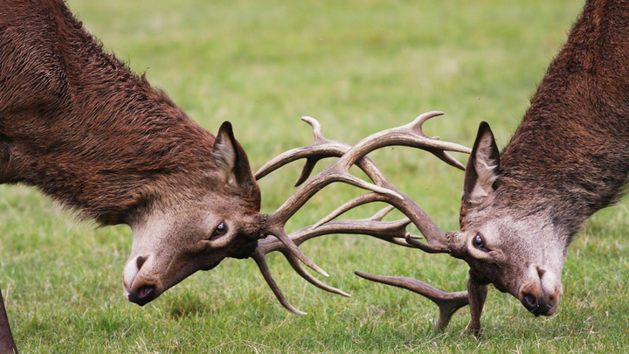
False! Most Resources are finite
D
  There are not enough resources for every animal to get an equal amount!
  As a result, animals compete for resources
  The two giraffes were using their necks to fight over the limited resources available to them
  The winner of the fight got access to the resource while the other had to continue searching
D

Slide 27
What trait would make winning the fight easier for the giraffe?

Slide 28
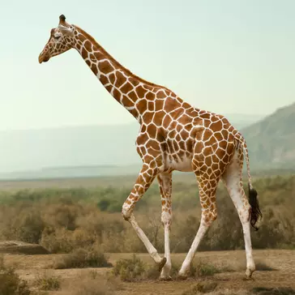
Traits come from natural selection
  The giraffe with the longer, stronger neck would be more likely to win the fight
  As a result, that would be more likely to reproduce as well
  This passes down the trait, causing more giraffes to have longer and thicker necks
  Traits that increase likelihood of survival will be more common in the next generation

Slide 29
Exit ticket!
  Send someone from your table group to grab the exit ticket from the front
  When completing the exit ticket, try to focus on using the vocabulary words introduced today!
  Turn the worksheet in when finished

Slide 30
THANK YOU SO MUCH!

