Slide 1





Genetics

Slide 2


Agenda
1.
Discussion
2.
Stations
3.
Practice
4.
Exit ticket
Students will be able to...
  Define homozygous, heterozygous, recessive, and dominant traits
  Create and use monohybridcrosses to calculate the probability of various genotypes and phenotypes

Slide 3
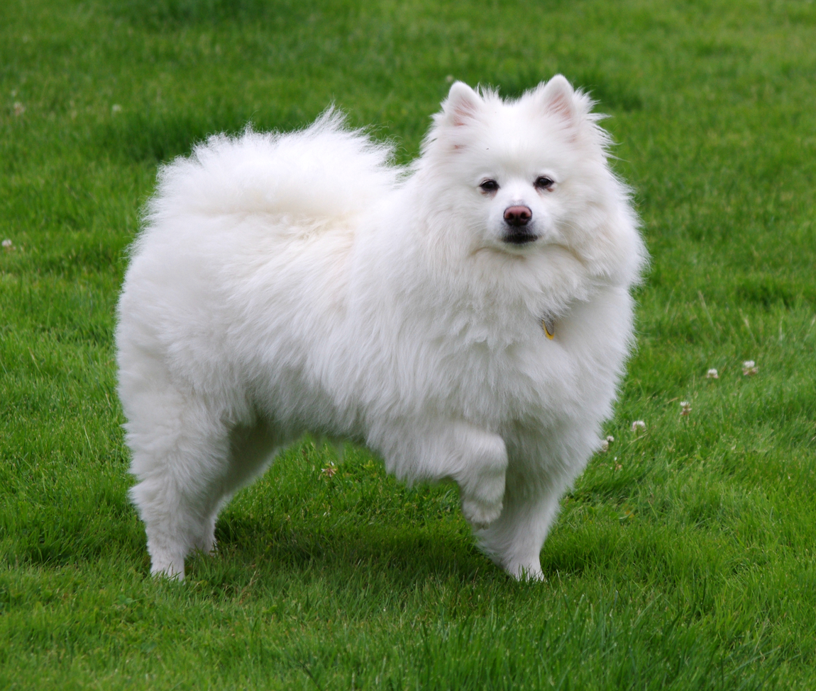
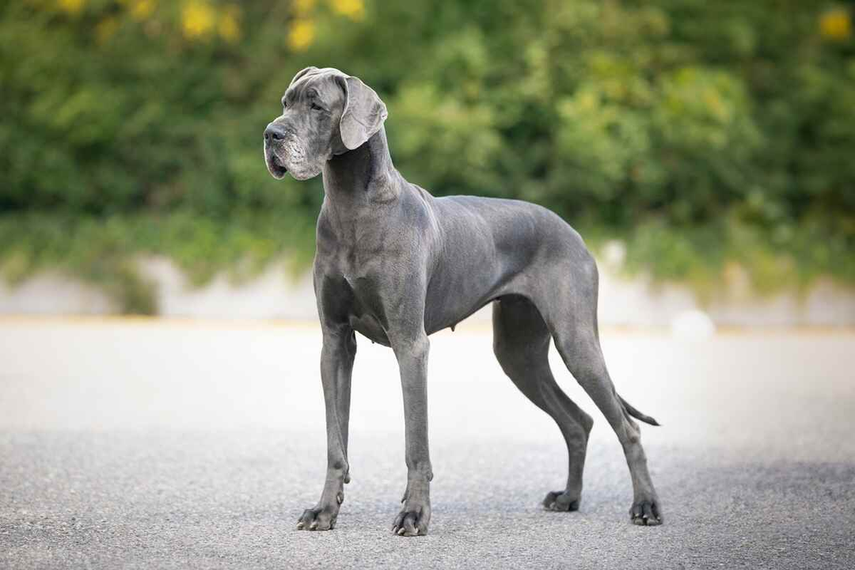
What do these animals have in common? What’s different? Do you think they are the same species?

Slide 4
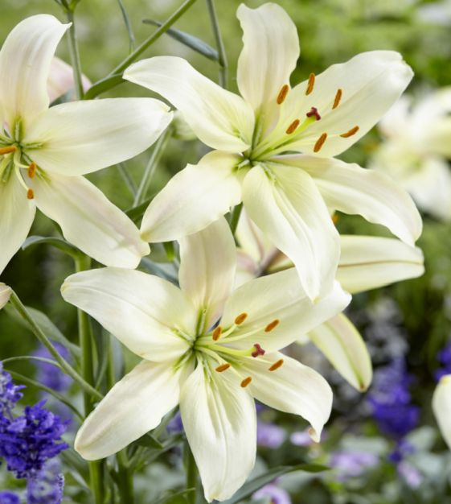
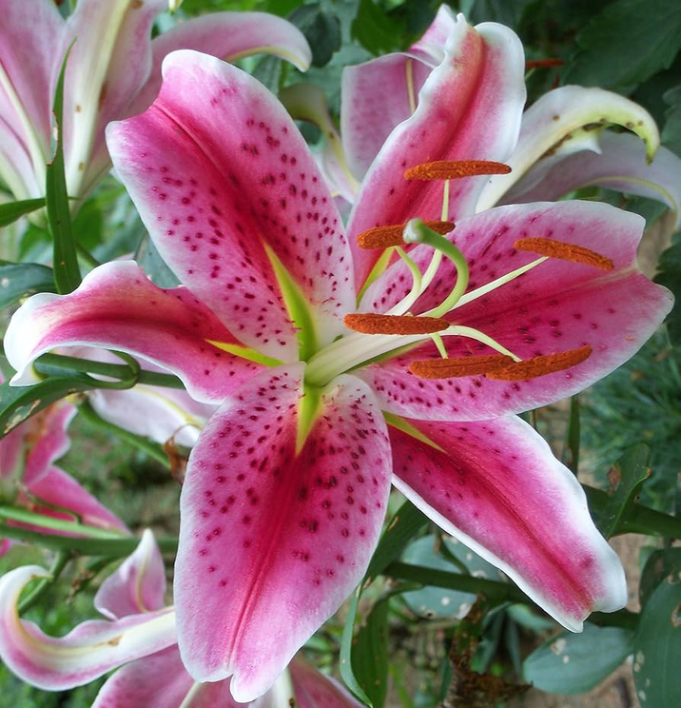
What do these plants have in common? What’s different? Do you think they are the same species?

Slide 5
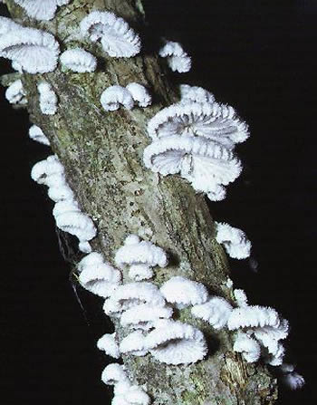
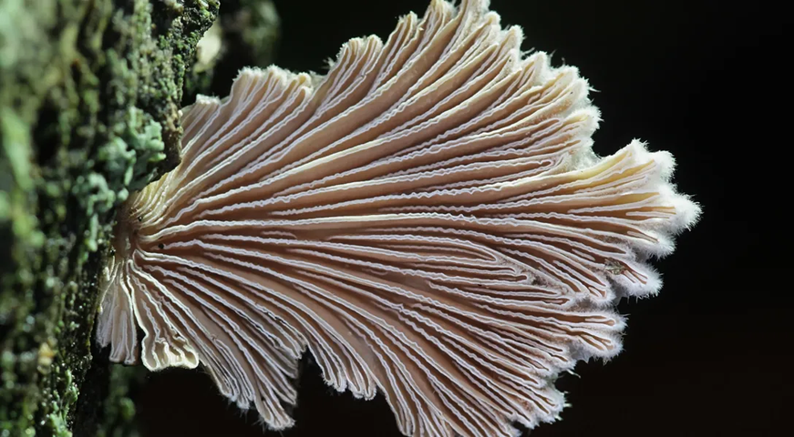
What do these fungi have in common? What’s different? Do you think they are the same species?

Slide 6
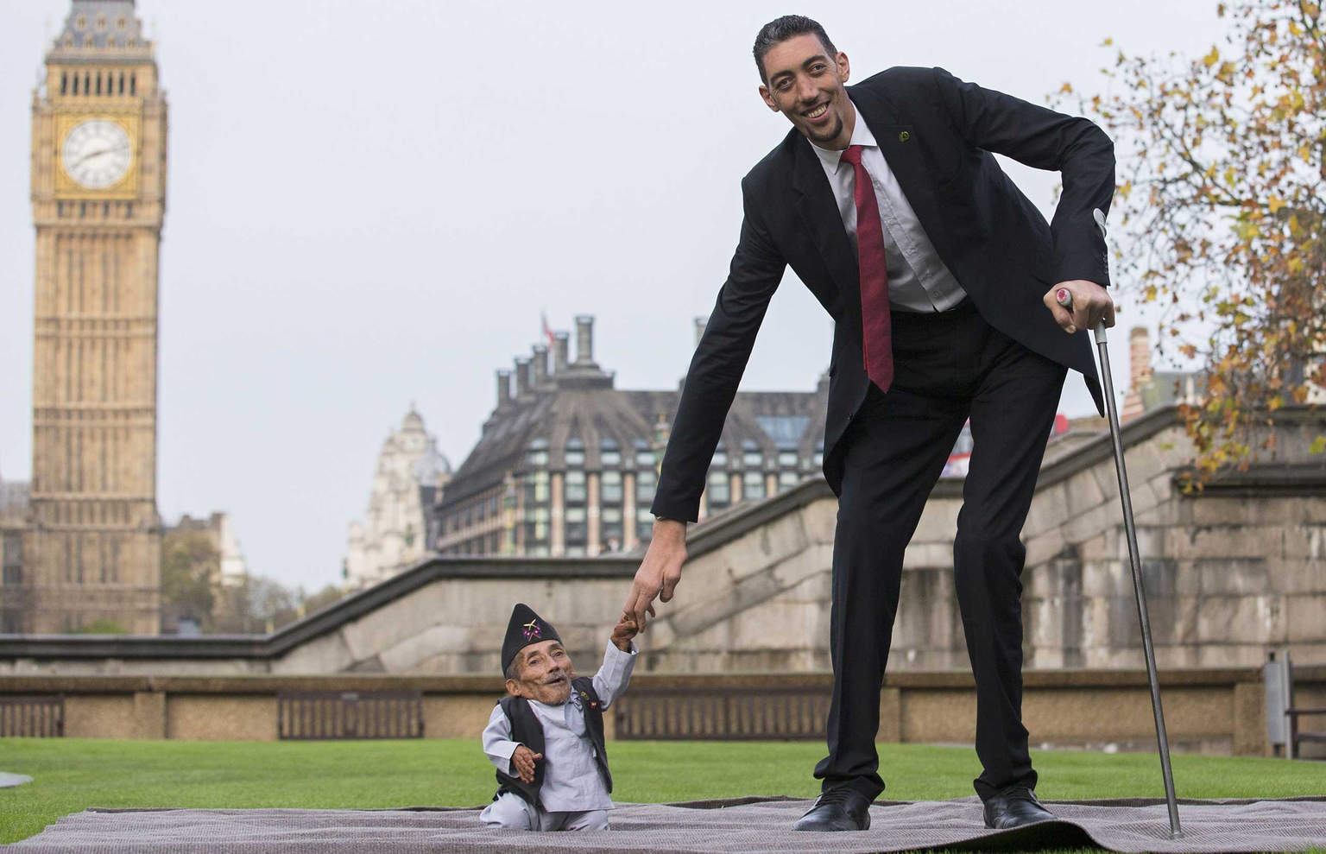
What do these animals have in common? What’s different? Do you think they are the same species?

Slide 7
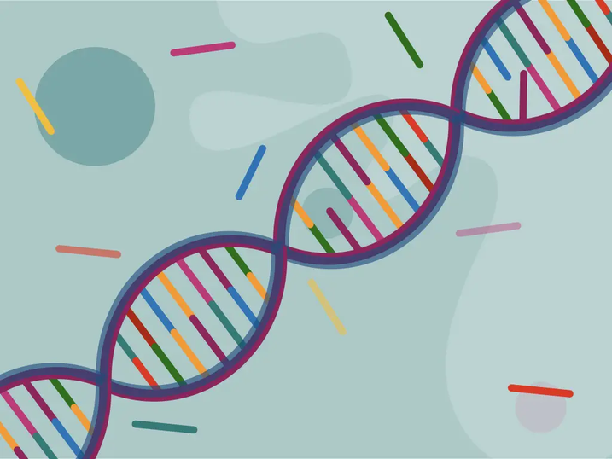
Genetic diversity
  All of the previous slides featured two individuals of the same species!
  This is due to genetic diversity: different individuals contain different genes that they express!
  When two organisms sexually reproduce, their genes cross over to exchange genetic code for the offspring

Slide 8
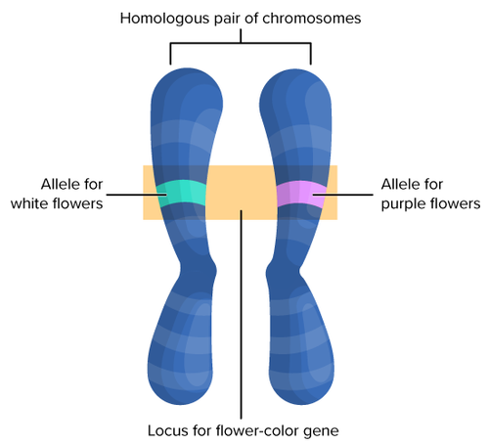
Genetic diversity
  An allele is a variant of a gene for a trait
  Organisms inherit one allele from each parent for a monohybrid trait
  The resulting characteristic the offspring inherits is up to chance, but we can still calculate the probability of each outcome!

Slide 9
How can we use genetics to predict what offspring (kids) will look like?

Slide 10
Station activity:
  In order to answer this question, we will be completing 5 stations!
  Everyone will work with a partner to complete each station in order
  Try to spend no more than 6 minutes on each station
  Once finished, raise your hand to get it checked
  When checked off you can continue on to the next station!

Slide 11

Stations!
Station one:
Mendelian Genetics
Station two:
Dominant and Recessive traits
Station three:
Heterozygous and homozygous traits
Station four:
Calculations
Station five:
Amoeba Sisters
Notes:
Youtube video: https://youtu.be/i-0rSv6oxSY?si=S634xNqO_JWR7GSz

Slide 12
Lets discuss!
Notes:
Switch to doc cam to have students discuss the stations worksheet. Then, work through the class discussion worksheet with the students as a class

Slide 13
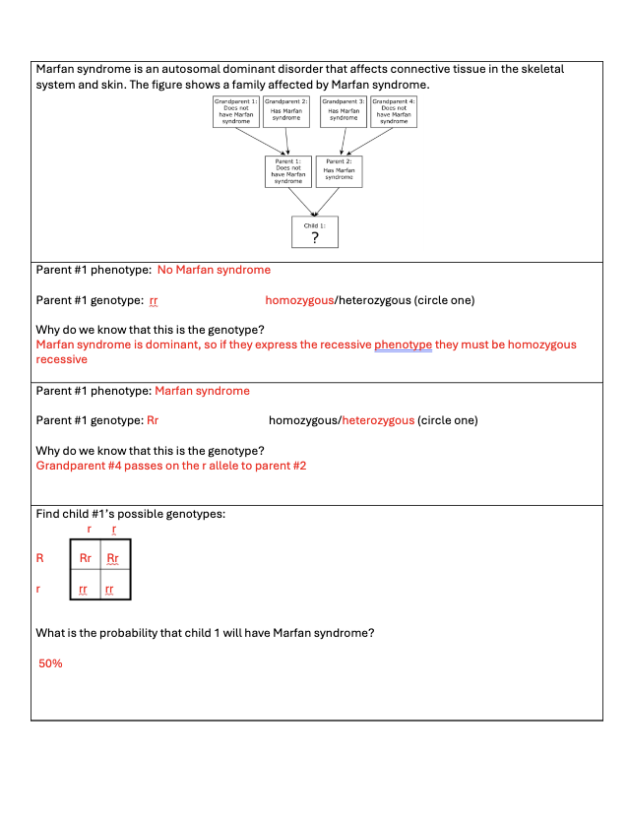
Discussion answer key
Notes:
Answer key for class discussion

Slide 14

Exit ticket
Using the exit ticket given to you, fill out a full punnett square given the phenotypes of the parents

