Slide 1

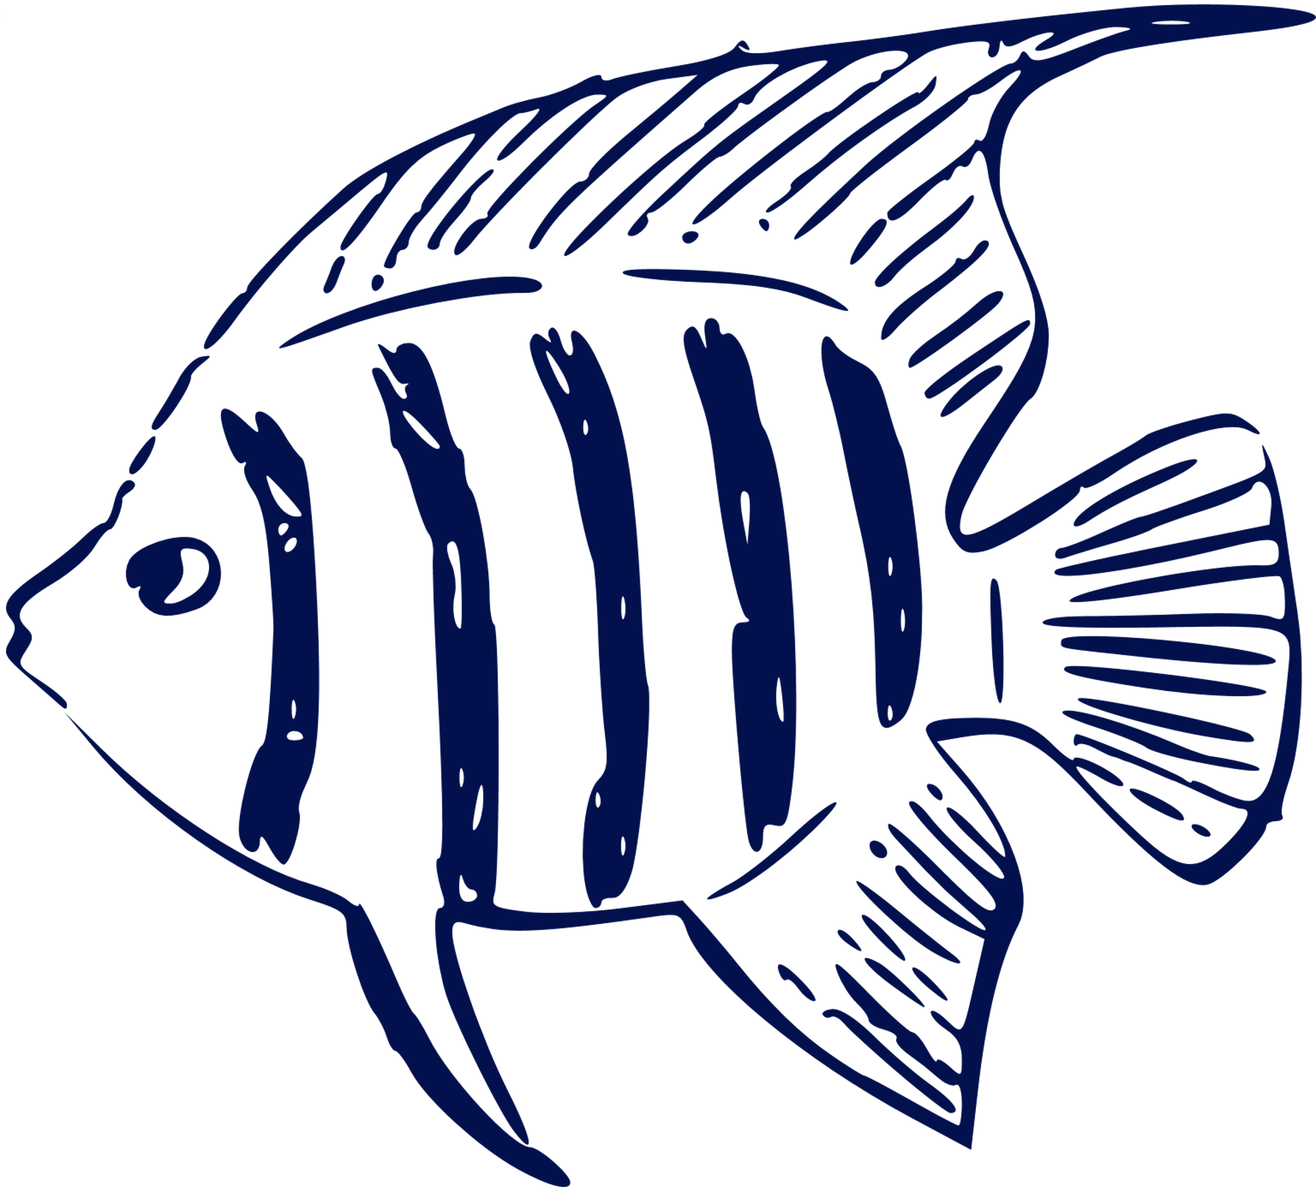
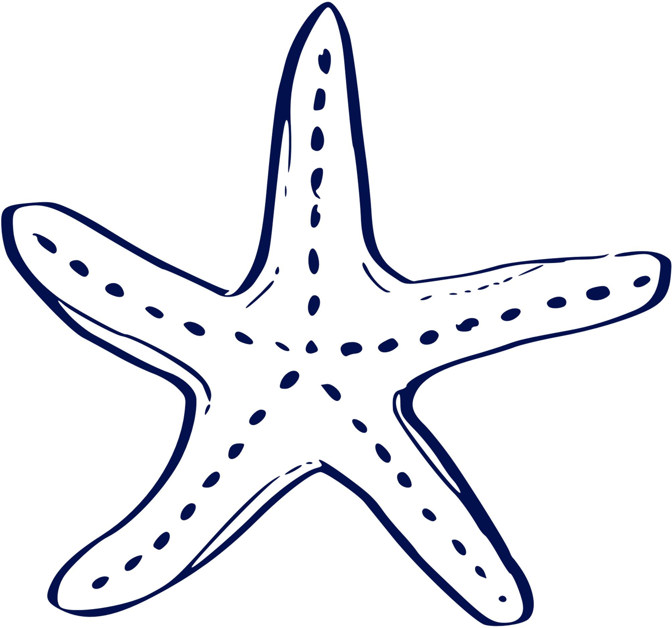
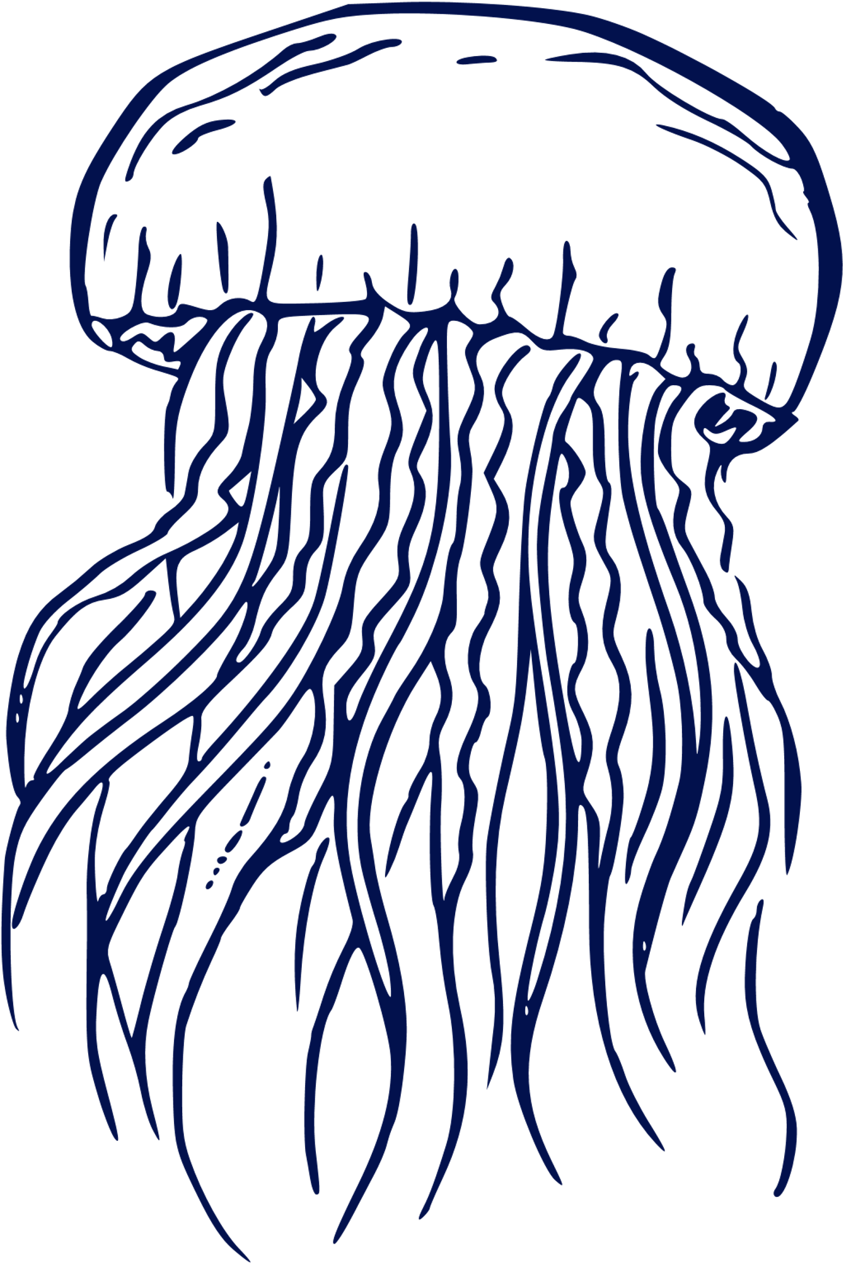
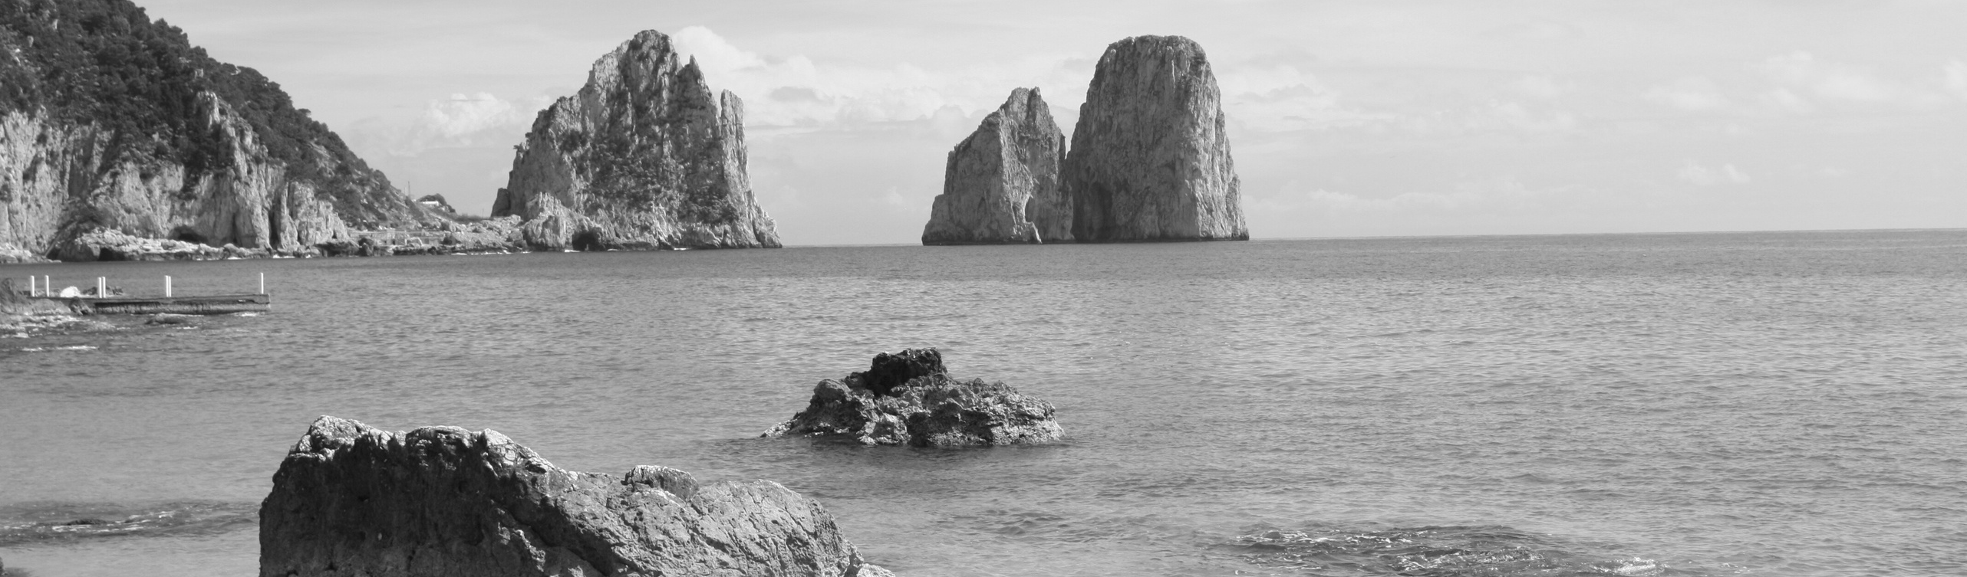
Biodiversity and Ecological Relationships

Slide 2
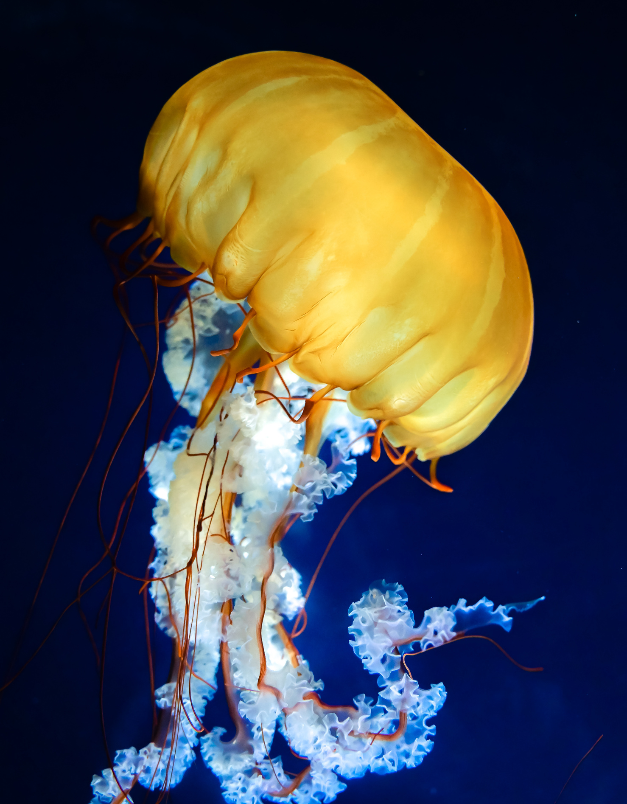


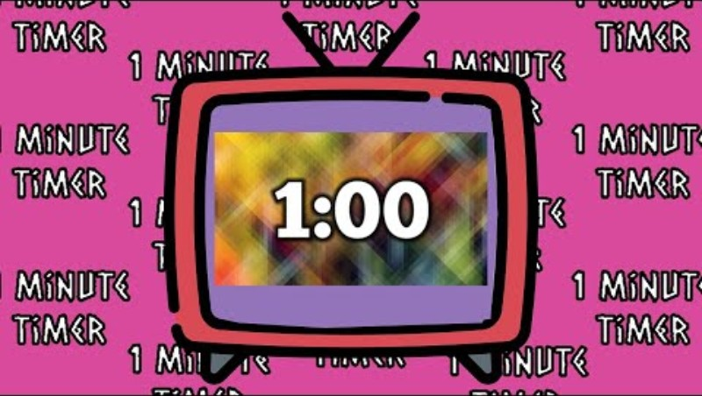
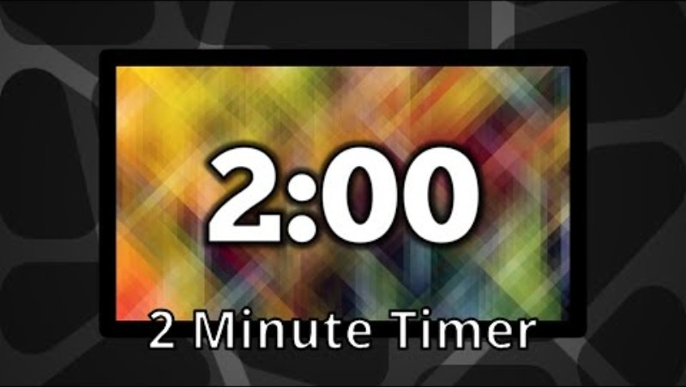
Imagine you are a scientist studying a coral reef—what clues would tell you the ecosystem is healthy?

Slide 3

What are we doing today?
GUIDED READING
FOLDABLE
MINI RESEARCH PROJECT
JEOPARDY

Slide 4

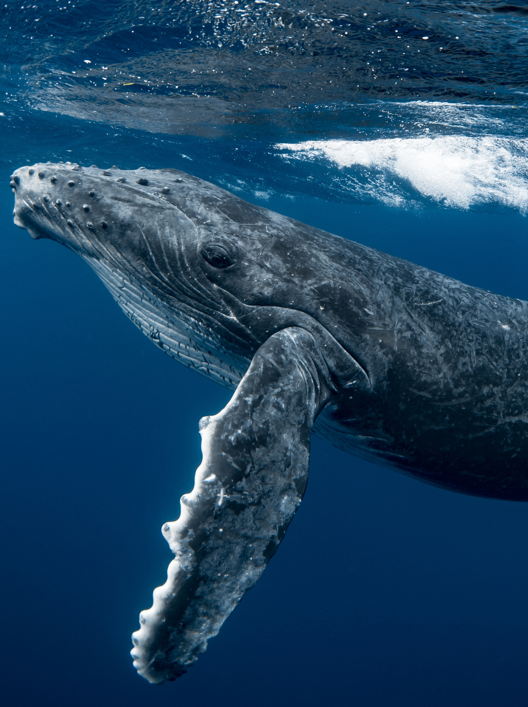
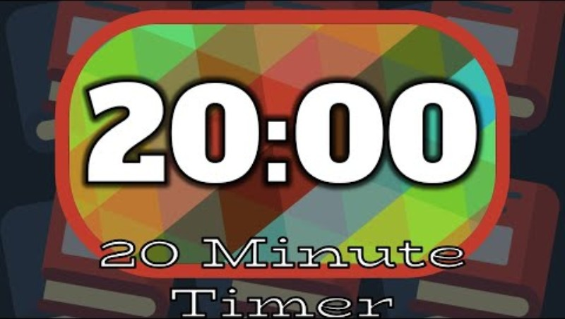
20 MINUTES TO READ AND ANSWER QUESTIONS
Guided Reading
Notes:
20 minute timer: https://youtu.be/kxGWsHYITAw?si=s69lEl5I7TbbO6Zt

Slide 5
CORAL REEF READING ANSWER KEY
Zooxanthellae give the coral its color and, most importantly, provide up to 90% of its energy through photosynthesis. What is the relationship between zooxanthellae and coral?
Mutualism
A grouper is seen chasing and eating a small fish. What is the relationship between the grouper and the small fish?
Predation
Using your answer to the question above, how would a reduction in the population of small fish impact the overall stability of the ecosystem? Why?
A reduction in the small fish population would decrease the overall stability of the ecosystem. Why? Small fish are a vital food source for groupers and other predators. Their decline would cause less food for predators. Therefore, they may starve, decline, or shift to unsustainable food sources. Additionally, organisms eaten by small fish would increase, disrupting balance in lower levels of the food web.
A tiny barnacle anchors itself to the surface of a large whale giving the barnacle a stable place to live without impacting the whale. What is the relationship between the barnacle and the whale?
Commensalism
Given that many marine species rely on coral reefs, how would a global bleaching event affect the overall biodiversity and stability of oceans?
The overall biodiversity would decline leading to a decrease in stability of marine ecosystems. Loss of species leads to disruption of food webs.
The text states that the process of predation and competition are driving forces that shape the Identify two major environmental changes that negatively affect coral reefs.
Global Change: warming of the ocean due to increased greenhouse gases (climate change).
Local stressors: Presence if rats on nearby islands, which disrupts the nutrient link from sea birds.

Slide 6
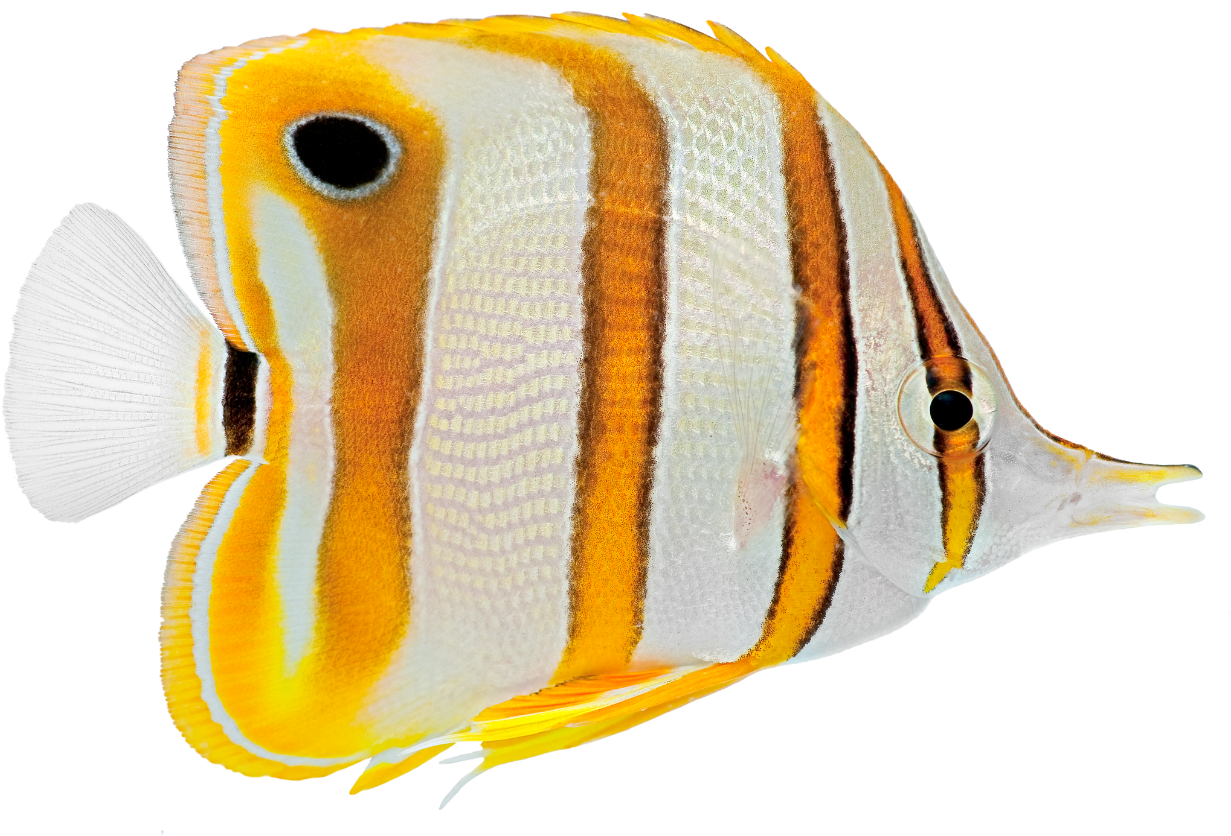
FOLD ALONG THE SOLID LINES AND CUT ALONG THE DOTTED LINES.
IN THE TWO SIDE BY SIDE BOXES, DRAW EMOJIS THAT REPRESENT THE ECOLOGICAL RELATIONSHIP
WRITE A BRIEF DEFINITION NEXT TO THE BOXES THAT EXPLAINS THE ECOLOGICAL RELATIONSHIP.
CUT OUT THE IMAGES AND PASTE EACH ONE NEXT TO THE ECOLOGICAL RELATIONSHIP IT REPRESENTS.
FILL IN THE MIDDLE SECTION OF THE PAGE. EACH LETTER CORRESPONDS TO A DIFFERENT ECOLOGICAL RELATIONSHIP.
Foldable
Instructions

Slide 7


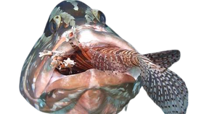
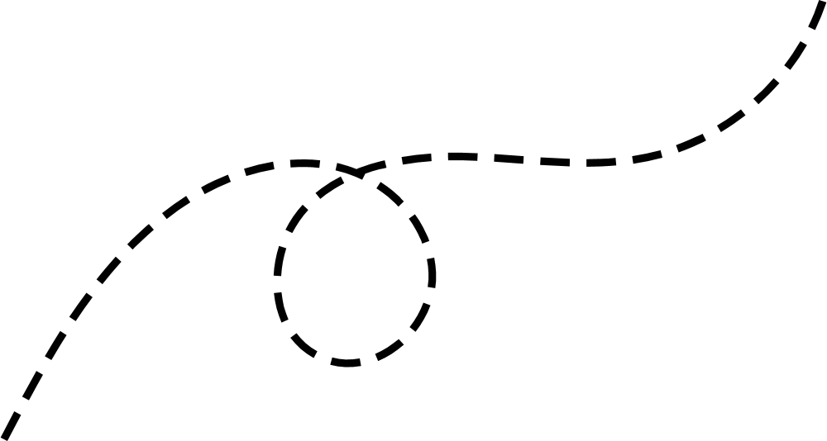

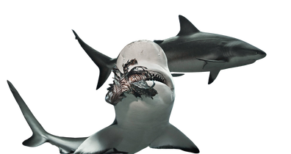
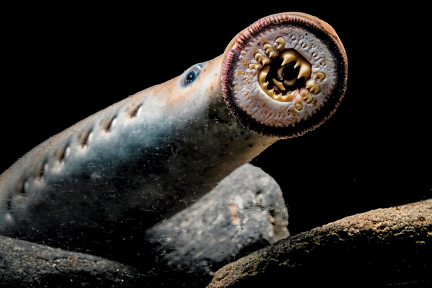

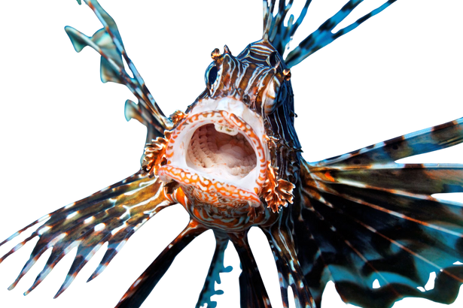
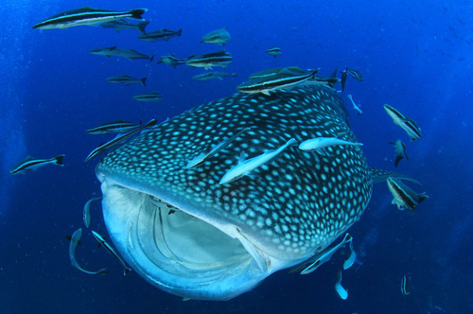
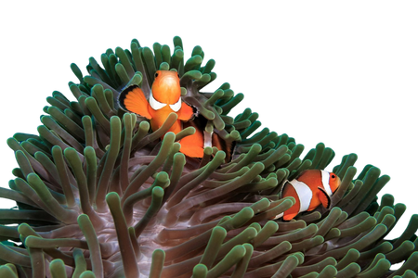
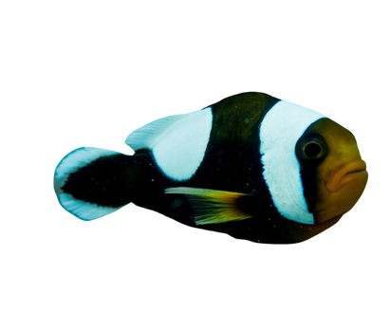
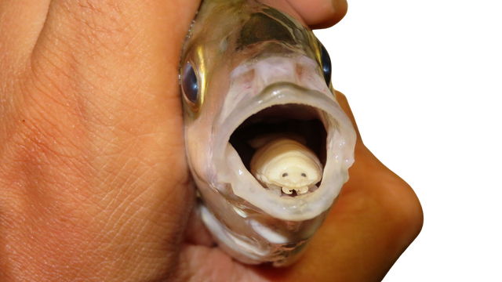


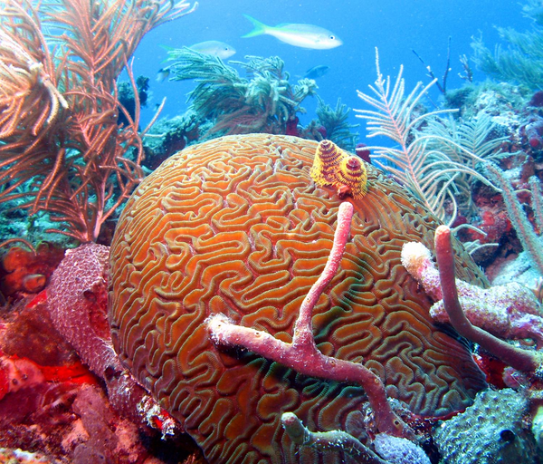
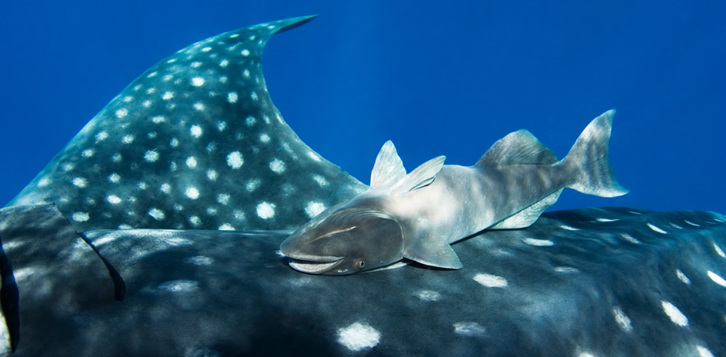
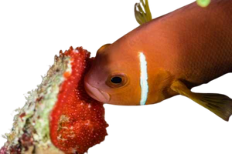
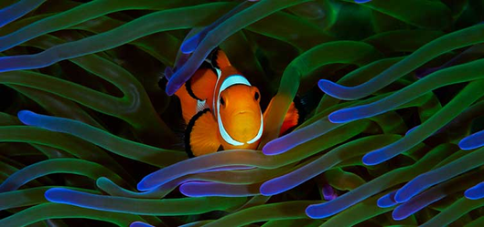
One species (the parasite) benefits, while the other (the host) is harmed.
grouper fish eats lionfish
Shark Eats Lionfish
One organism kills and eats another.
A
Sea Lamprey Latch onto fish, scraping skin and feeding on blood
whale sharks eat small fish and krill
Lionfish eats small fish
Clownfish find shelter in sea anemones; anemones receive food from clownfish's Waste
tongue-eating isopod enters a fish’s mouth, destroys its tongue, and replaces it
One species benefit, and the other is neither helped nor harmed.
Two or more organisms fight over the same limited resources
remora fish attach to a shark for transportation and food scraps
B
clownfish
Coral and sponges fight for space in the reef
Define the Relationship:
Each letter corresponds to a different ecological relationship.
C
D
clownfish Eats Zooxanthellae
Break down the word biodiversity
A_________________
B_________________
C_________________
D_________________
Both species benefit from the relationship.
Competition
bio
diversity
Mutualism
life
variety
parasitism
Clownfish find shelter in sea anemones; anemones receive food from clownfish
predation
when biodiversity decreases, stability _____________
Decreases
If the population of clownfish decreased due to overfishing the stability and biodiversity of this food system would ____________
when biodiversity
Increases, stability __________
Increases
Decrease
Notes:
Biodiversity foldable answer key

Slide 8
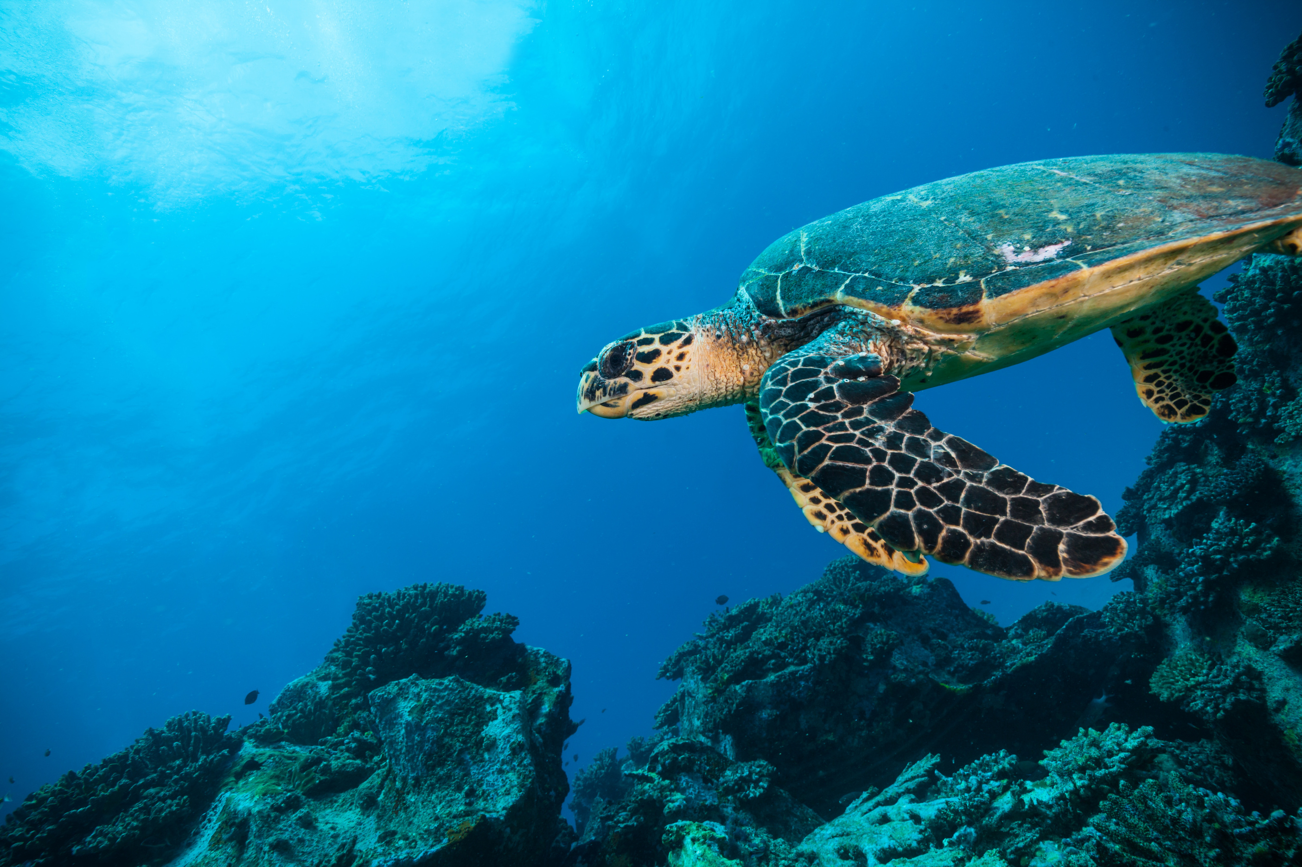
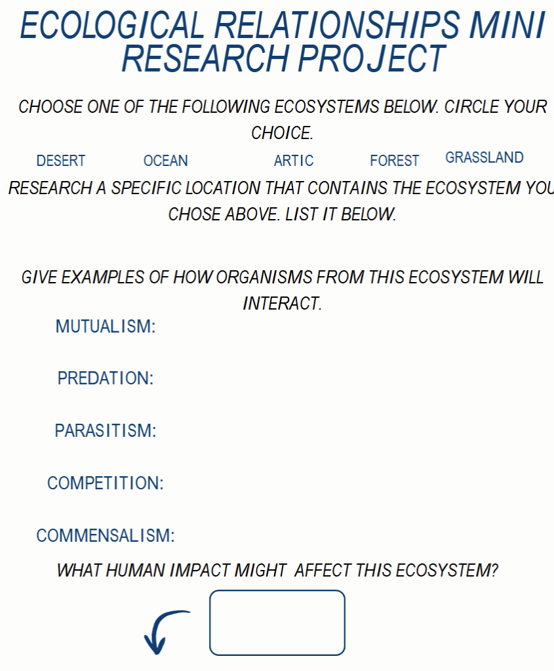
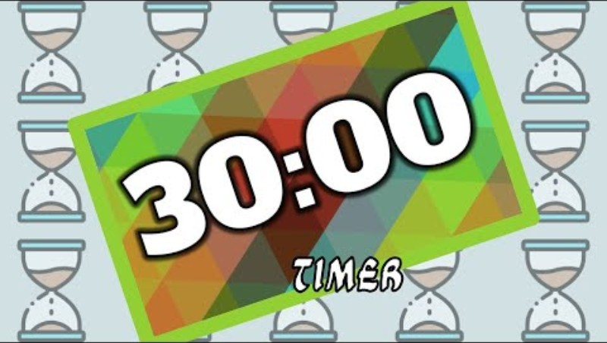
MINI RESEARCH PROJECT
RESEARCH EXAMPLES FOR YOUR PROJECT USING TRUSTED WEBSITES OR BOOKS.

Slide 9



ECOLOGICAL RELATIONSHIPS MINI RESEARCH PROJECT
CHOOSE ONE OF THE FOLLOWING ECOSYSTEMS BELOW. CIRCLE YOUR CHOICE.
DESERT
OCEAN
ARTIC
FOREST
GRASSLAND
RESEARCH A SPECIFIC LOCATION THAT CONTAINS THE ECOSYSTEM YOU CHOSE ABOVE. LIST IT BELOW.
Sonoran Desert
GIVE EXAMPLES OF HOW ORGANISMS FROM THIS ECOSYSTEM WILL INTERACT.
MUTUALISM:
PREDATION:
PARASITISM:
COMPETITION:
COMMENSALISM:
The yucca moth and yucca plant: the moth is the plant's sole pollinator and the larvae feed on some seeds
Coyotes hunt small mammals, birds, and reptiles.
Desert mistletoe: a plant that attaches to woody hosts like mesquite and ironwood trees, from which it absorbs water and minerals.
Scorpions compete for warmer shelters.
The cactus wren nesting in a cholla cactus: the wren benefits from the protection cactus provides for its nest and young, while the cactus itself is unaffected by the interaction.
WHAT HUMAN IMPACT MIGHT AFFECT THIS ECOSYSTEM?
urban expansion
WILL THIS INCREASE/DECREASE BIODIVESRTY AND ECOSYSTEM STABILITY. (CIRCLE ONE)
Notes:
Mini Research Project Example

Slide 10
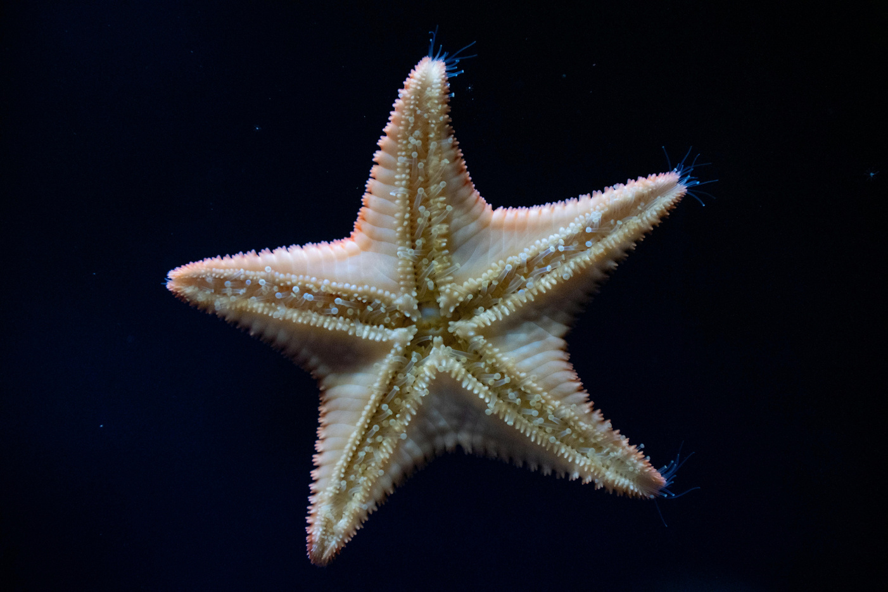
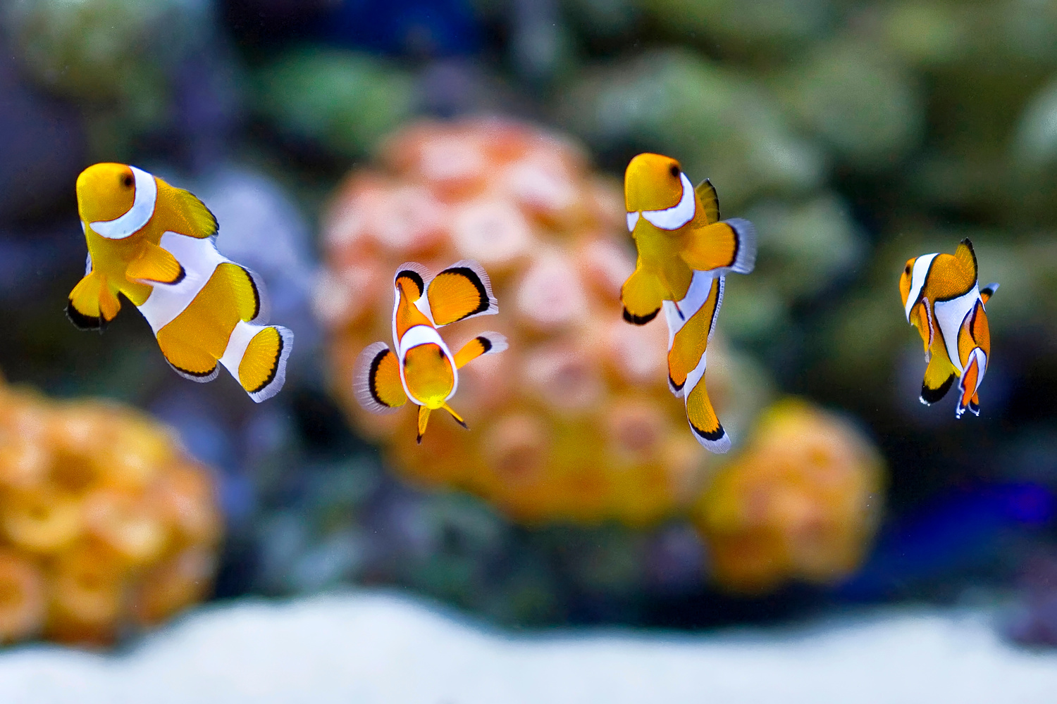
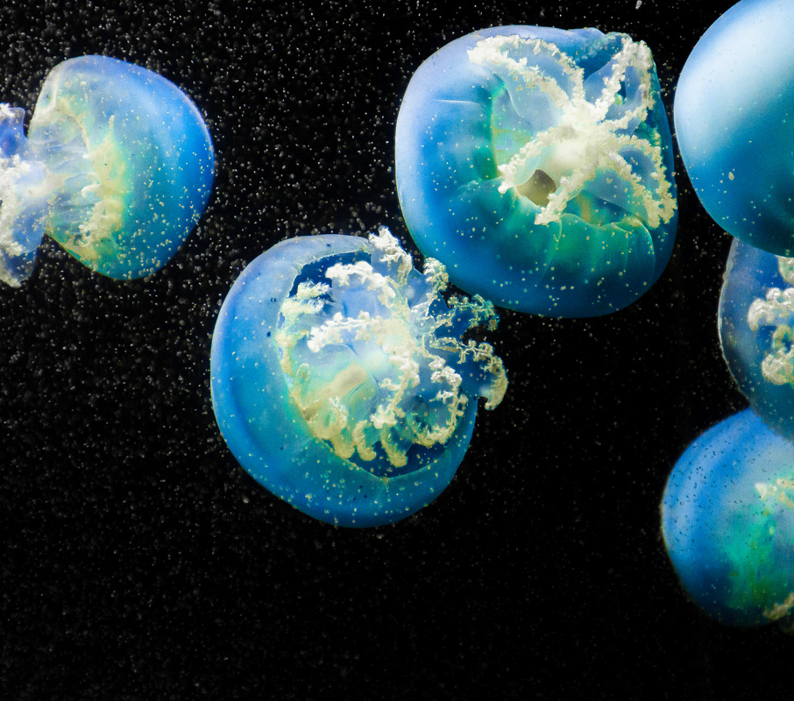
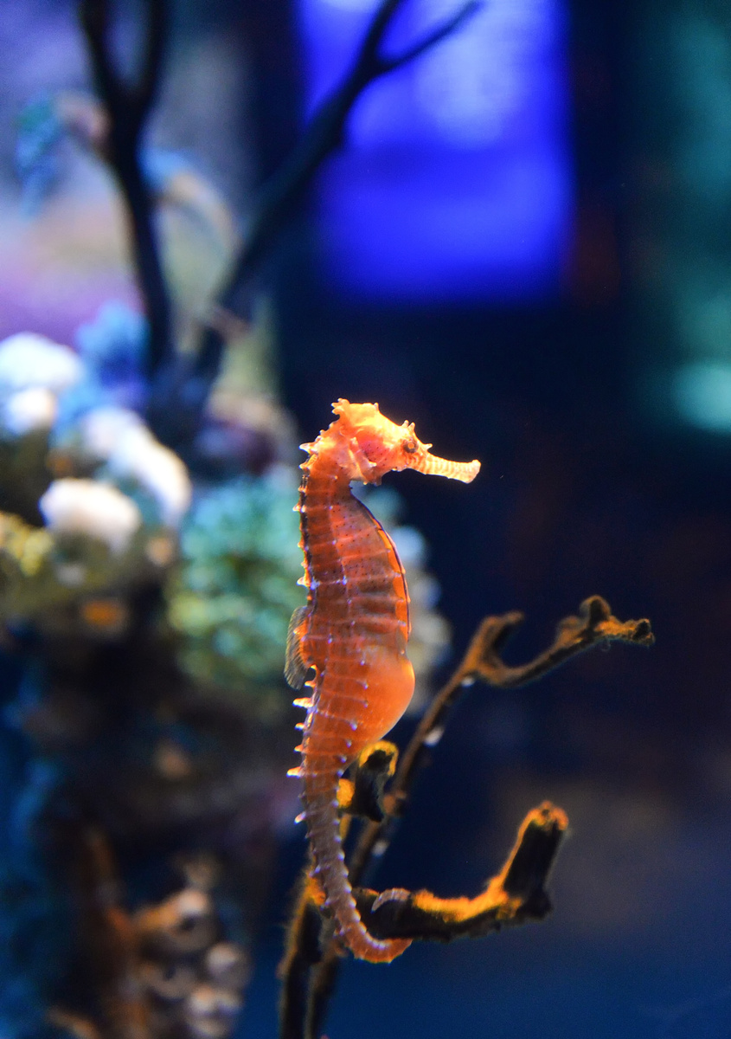
JEOPARDY
Work in teams to answer questions.
Take turns picking a category and point value.
Correct answers earn points; wrong answers let other teams try.
The team with the most points wins!
Notes:
https://jeopardylabs.com/play/ecological-relationships-and-environmental-impacts

