Slide 1


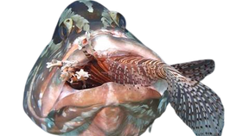


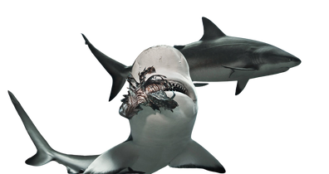
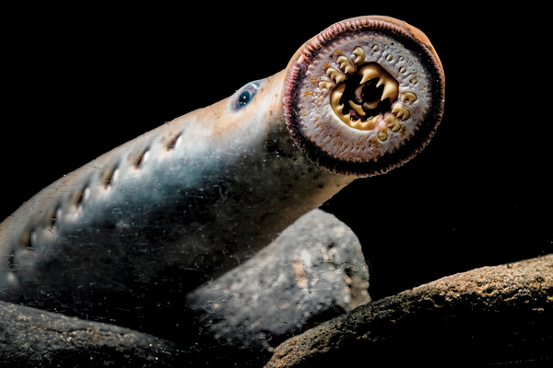

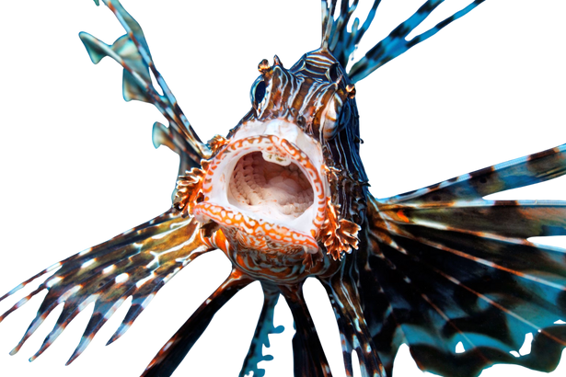
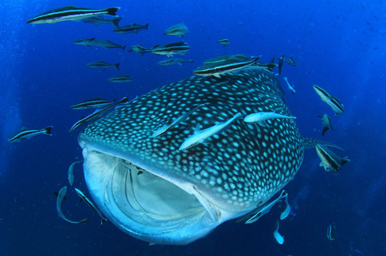
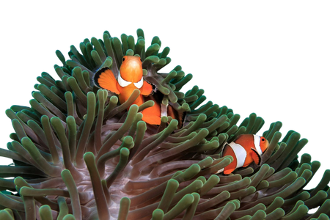
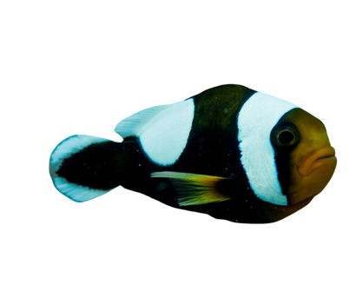
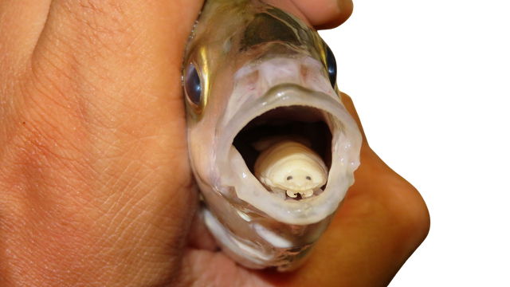


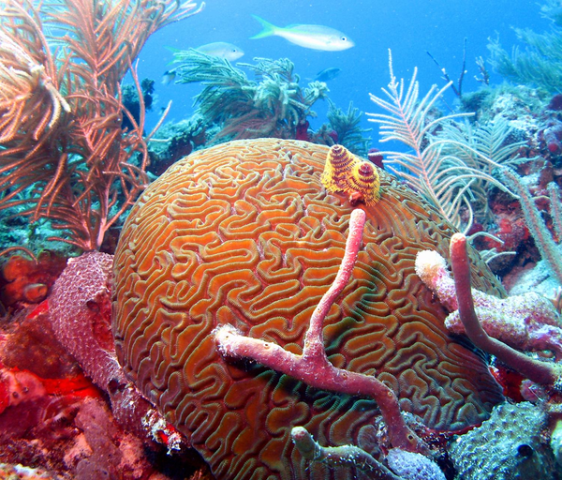
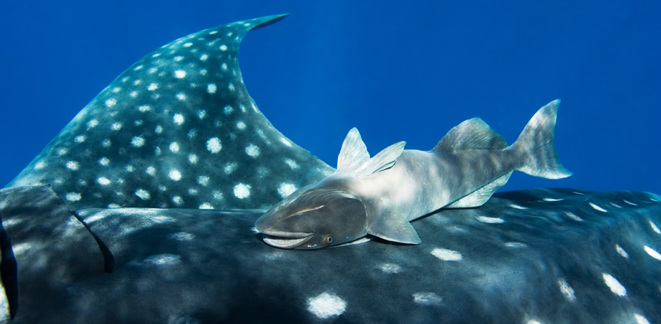
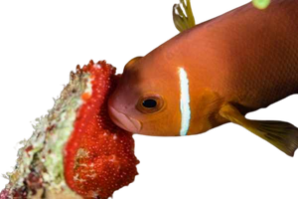
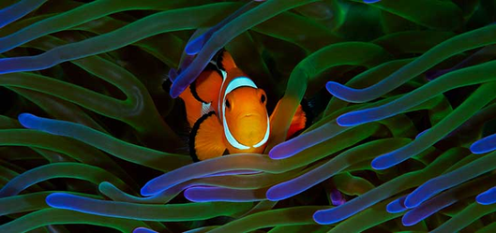
One species (the parasite) benefits, while the other (the host) is harmed.
grouper fish eats lionfish
Shark Eats Lionfish
One organism kills and eats another.
A
Sea Lamprey Latch onto fish, scraping skin and feeding on blood
whale sharks eat small fish and krill
Lionfish eats small fish
Clownfish find shelter in sea anemones; anemones receive food from clownfish's Waste
tongue-eating isopod enters a fish’s mouth, destroys its tongue, and replaces it
One species benefit, and the other is neither helped nor harmed.
Two or more organisms fight over the same limited resources
remora fish attach to a shark for transportation and food scraps
B
clownfish
Coral and sponges fight for space in the reef
Define the Relationship:
Each letter corresponds to a different ecological relationship.
C
D
A_______________________
B_______________________
C_______________________
D______________________
Competition
clownfish Eats Zooxanthellae
Break down the word biodiversity
Mutualism
Both species benefit from the relationship.
bio
diversity
parasitism
life
variety
predation
Clownfish find shelter in sea anemones; anemones receive food from clownfish
when biodiversity decreases, stability _____________
Decreases
If the population of clownfish decreased due to overfishing the stability and biodiversity of this food system would ____________
when biodiversity
Increases, stability __________
Increases
Decrease

