Slide 1
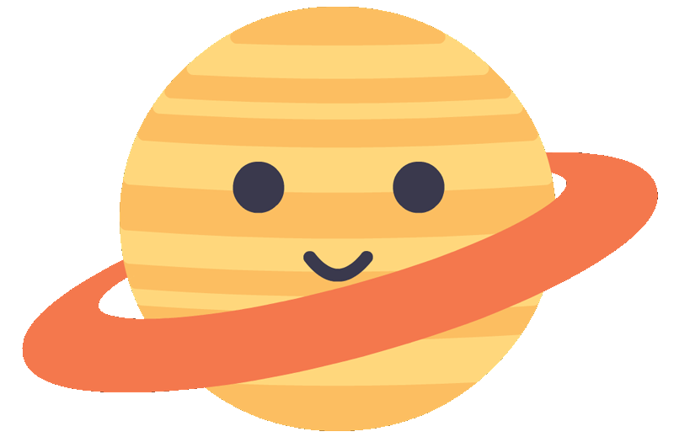
THE ORIGINS
OF THE
UNIVERSE
Exploring Space with Time

Slide 2
WARMING UP
The universe beyond is vast, and we’re learning more and more about it everyday. On your post-it note, explore the following idea:
“What did the universe look like at its very beginning?
Here’s a sentence starter:
“I think the universe looked like...because...”

Slide 3
SO WHAT DID THE UNIVERSE LOOK LIKE?
Well, scientists believe that the universe might have looked like soup.

Slide 4
SOUP???
Yes! Soup! Everything started with the Big Bang, and afterwards the universe was a big hot mess of particles (i.e. protons, neutrons, and electrons.).
That’s why we like to say that at the beginning of the universe, it was like a bowl of cosmic soup.

Slide 5
UNIVERSE BUILDERS
We know that following the Big Bang, the universe looked like a big bowl of cosmic soup, but how did we get there? In fact, how did we get where we are now?
In your groups, complete the Universe Builders card sort by matching each phase with a description and an image in order of events.

Slide 6
GALAXY
FORMATION
How are galaxies alot like cities?
Galaxies form out of immense clouds of gas that collapse and rotate.
As these galaxies develop stars are formed, they collide, they change, and they evolve
Just like human cities, looking at galaxies tell us a lot about how the “area” (the universe) has developed.

Slide 7
HOW DO WE KNOW ALL THIS?
Telescopes! Due to the finite speed of light, telescopes act almost like time machines. When we look at distant objects (like galaxies) we are seeing them as they were in the past because the light takes time to reach us.
This means that we can look at distant objects (the most distance objects) and look closer and closer to the “time” of the Big Bang, which helps us
study how we got here.

Slide 8
What is the James Webb Space telescope?
The James Webb Space Telescope (JWST) is a space telescope designed to conduct infrared astronomy. It’s high-resolution and high-sensitivity intruments allow it to view objects too old, distamt, or faint for previous telescopes. This enables investigation of things like the first stars, formation of the first galaxies, and potentially habitable exoplanets.
Click here to hear an
explanation of the JWST from Dr. Caitlin Casey!
Notes:
Timestamp – (22:57)

Slide 9
JOURNEY THROUGH TIME
In your groups or individually, complete the journey through time activity.
In this we will be exploring how we can look “back in time” at different objects and what that means for how we explore our universe.,

Slide 10
DISCUSS
Was there anything that surprised you during the activity?
What was the furthest object that was researched?
How far away is the oldest observable object in the known universe to us?

Slide 11
The Little Red Dots
The little red dots are images from the JWST which are believed to be distant galaxies as they would have appeared more than 13 billion years ago which are impossibly large and dense for their relatively young age. (Think of it like walking into a kindergarten class to find they’re all six feet tall)
But why?
Scientists aren’t sure exactly, but the running theory currently is that these aren’t stars in the galaxies that we’re seeing--but quasars!,
or, in other words, supermassive
black holes.

Slide 12
STAY CURIOUS
Thank You!

