Slide 1

Human Mating Behavior:
An Evolutionary Perspective
Hot Science - Cool Talk # 109
Dr. David M. Buss
October 27, 2017
Produced by and for Hot Science - Cool Talks by the Environmental Science Institute. We request that the use of these materials include an acknowledgement of the presenter and Hot Science - Cool Talks by the Environmental Science Institute at UT Austin. We hope you find these materials educational and enjoyable.

Slide 3
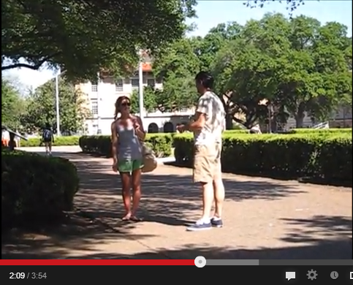
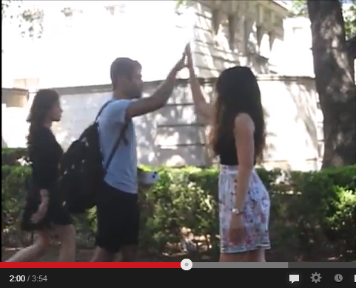
Florida Study
Guy propositions a Girl:
Girl propositions a Guy:

Slide 4
What is Evolutionary Psychology?

Slide 5

Evolution by Natural Selection
Notes:
Source: Wikimedia Deutschland. Artist: Johanna Pung

Slide 6
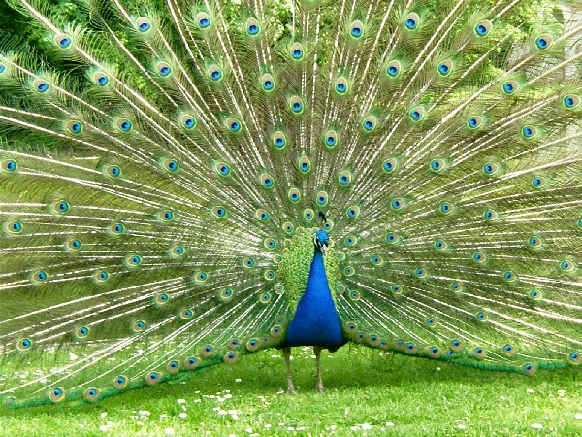

Slide 7
“The sight of the peacock gives me nightmares”
– Charles Darwin

Slide 8
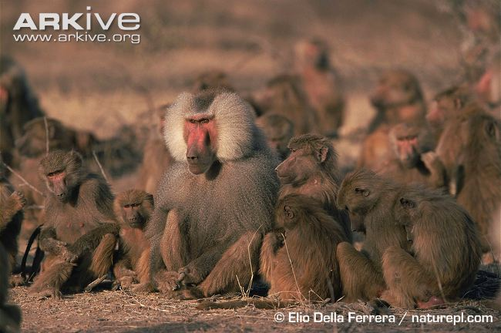
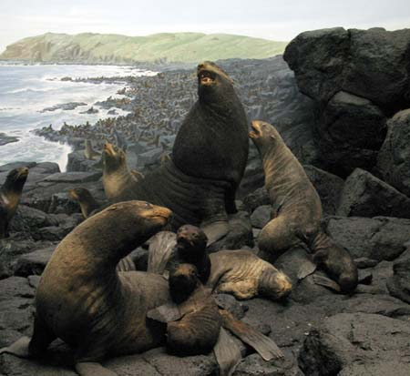
Hamadryas Babboos
Red Fur Seals
Notes:
Red Fur Seals, Image source: www.nhm.org
Hamadryas Baboons, Image source: www.naturepl.com

Slide 9
Sexual Selection
Same-Sex Competition
Intersexual Selection

Slide 10
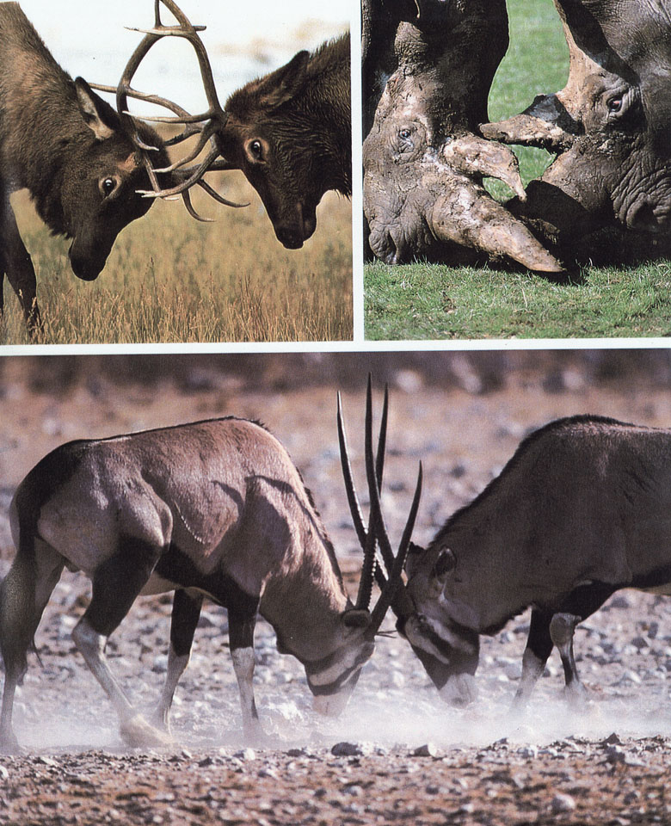

Slide 11
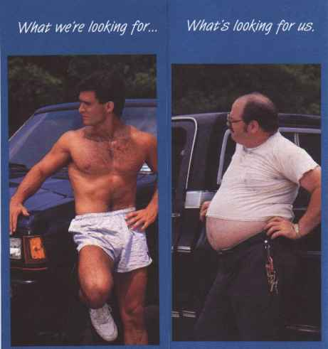
Intersexual Selection:
Preferential Mate Choice

Slide 12
Humans Have a Complex Menu of
Mating Strategies
Long-term committed mating
Short-term opportunistic mating
“Cheating”: Extra-pair copulating (EPC)
Serial mating over time
Mixed mating strategies

Slide 13
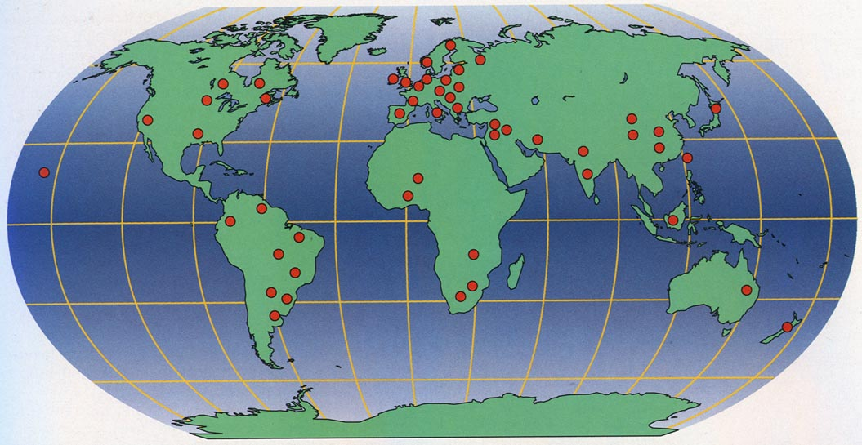
Locations of 37 Cultures in International Mate Selection Project:
Total # of People = 10,047

Slide 14
Universal Desires
Love
Exciting personality
Good health
Kindness
Intelligence
Sociable
Easy going

Slide 15
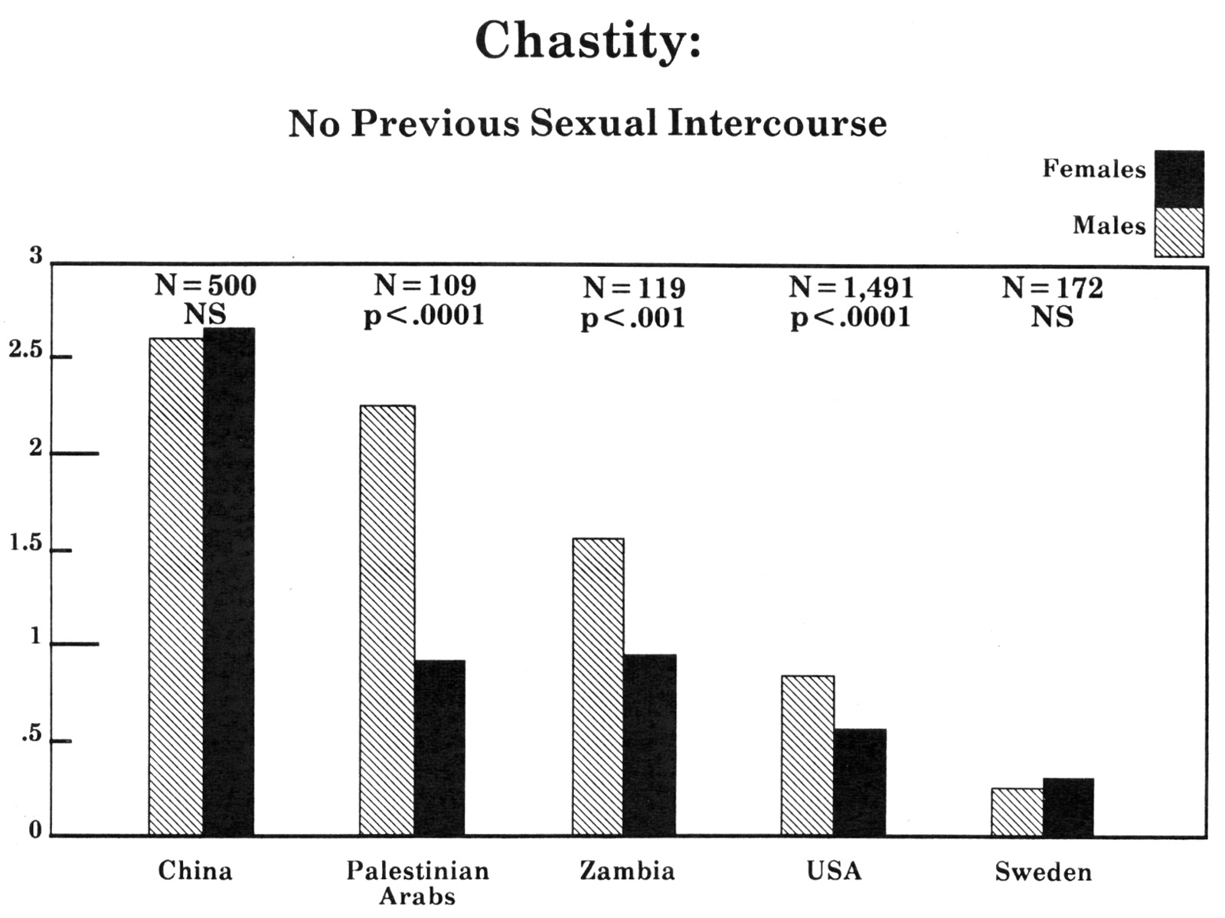
Culturally Variable Desires
Indispensable
Rating
Irrelevant

Slide 16
Meta-Theory of Sex Differences
Men and Women Are Similar: When there exists a recurrent evolutionary history of similar adaptive problems.
Men and Women Are Different: When there exists a recurrent evolutionary history of different adaptive problems.

Slide 17
Recurrently Different Adaptive Problems of the Sexes
Internal female fertilization
Paternity uncertainty
Misdirected parental investment
Obligatory parental investment
Fertility curve over the lifespan
Breast feeding
Concealed ovulation
Cyclic ovulation

Slide 18
So What do Men Want?

Slide 19
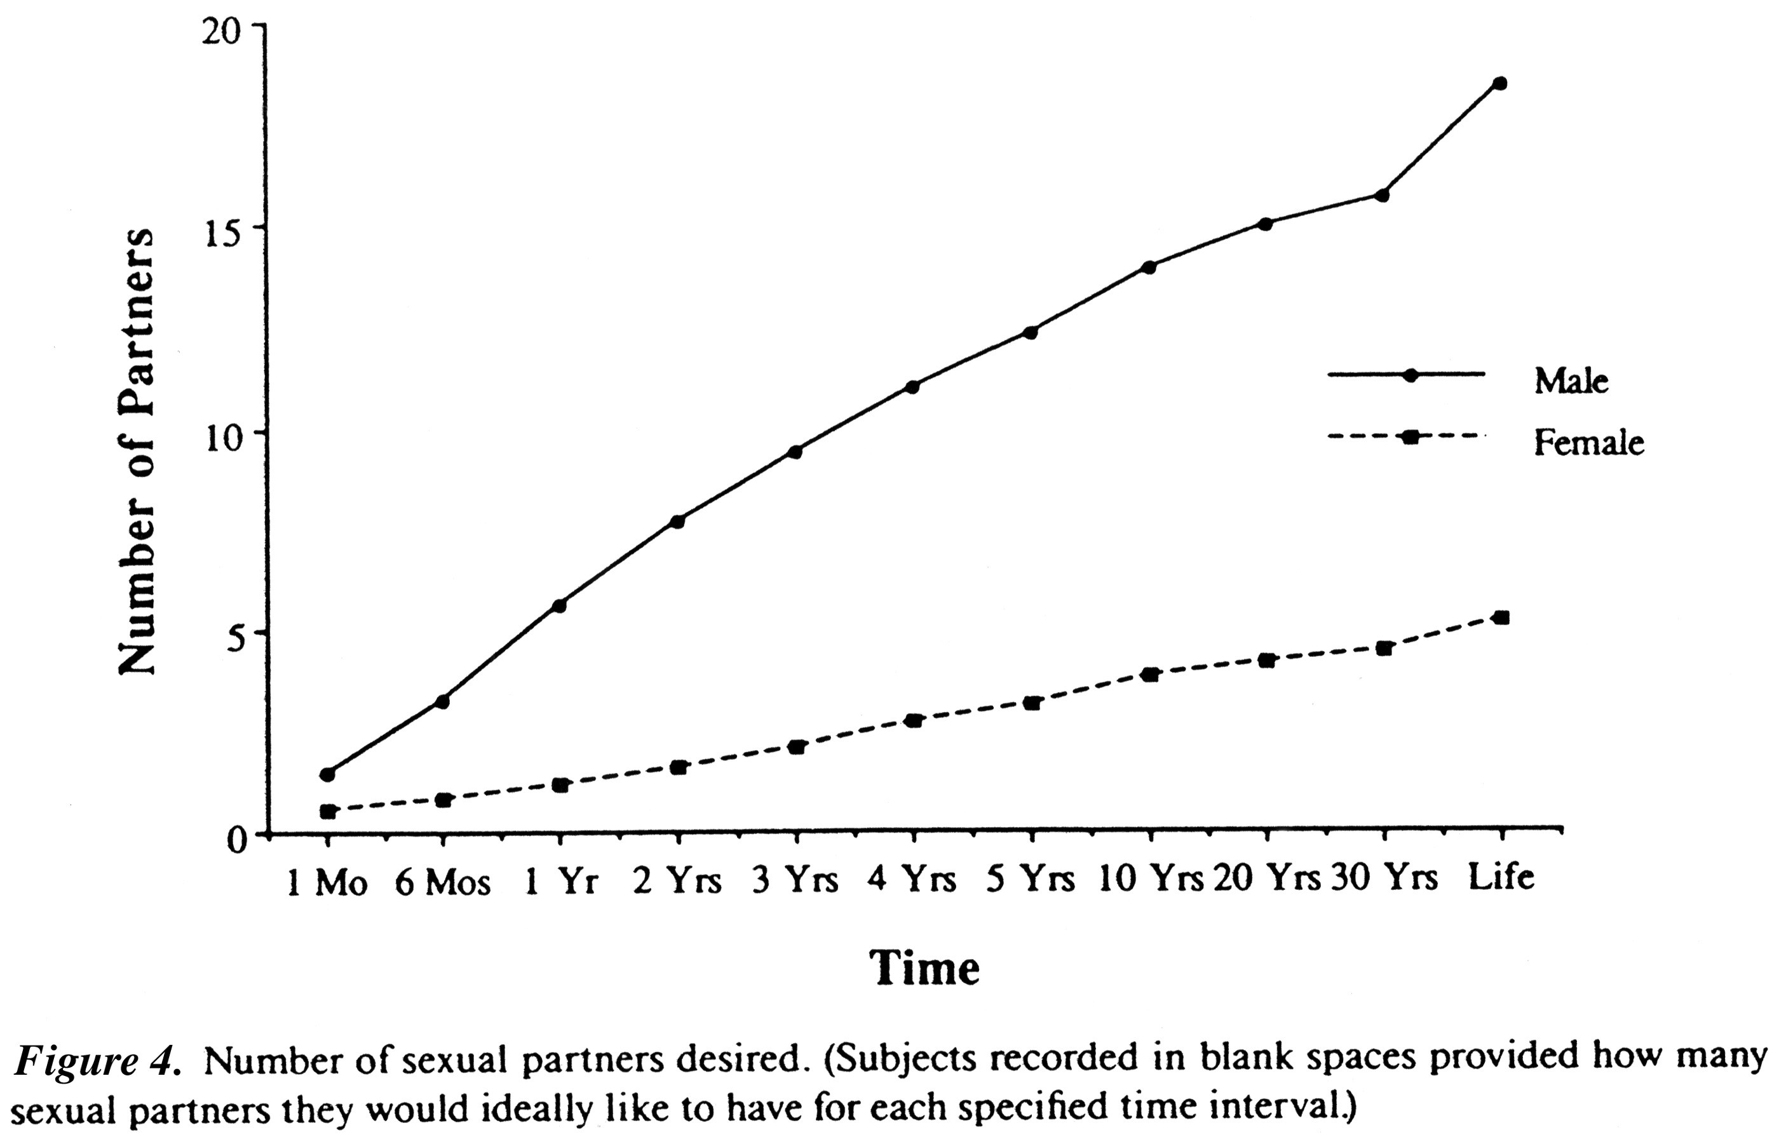
Ideal Number of Sex
Partners Desired

Slide 20
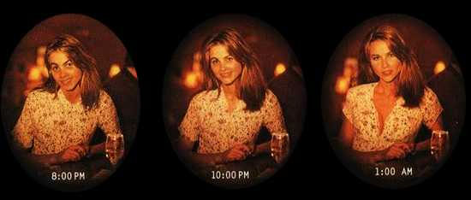
More Psychological Evidence for
Short-Term Mating
The “closing time phenomenon”

Slide 21
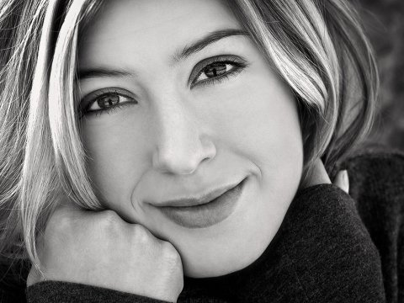
Male Sexual Over-Perception Bias
(Perilloux, Confer, & Buss, 2012)

Slide 22
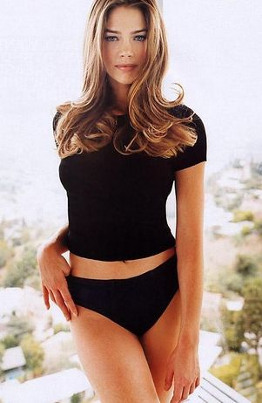
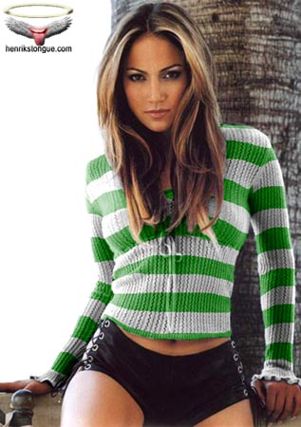
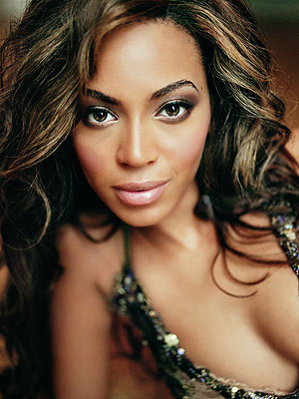
The Assessment Problem
People.com
Rottentomatoes.com
Notes:
Image Source: photobucket.com

Slide 23
Logic of the Evolution of Standards of Attractiveness
Fertility
Cues
Full lips
Clear skin
Clear eyes
Lustrous hair
Muscle tone
Sprightly gait
Symmetry
Health
Youth
Etc.
Standards of
Attractiveness

Slide 24
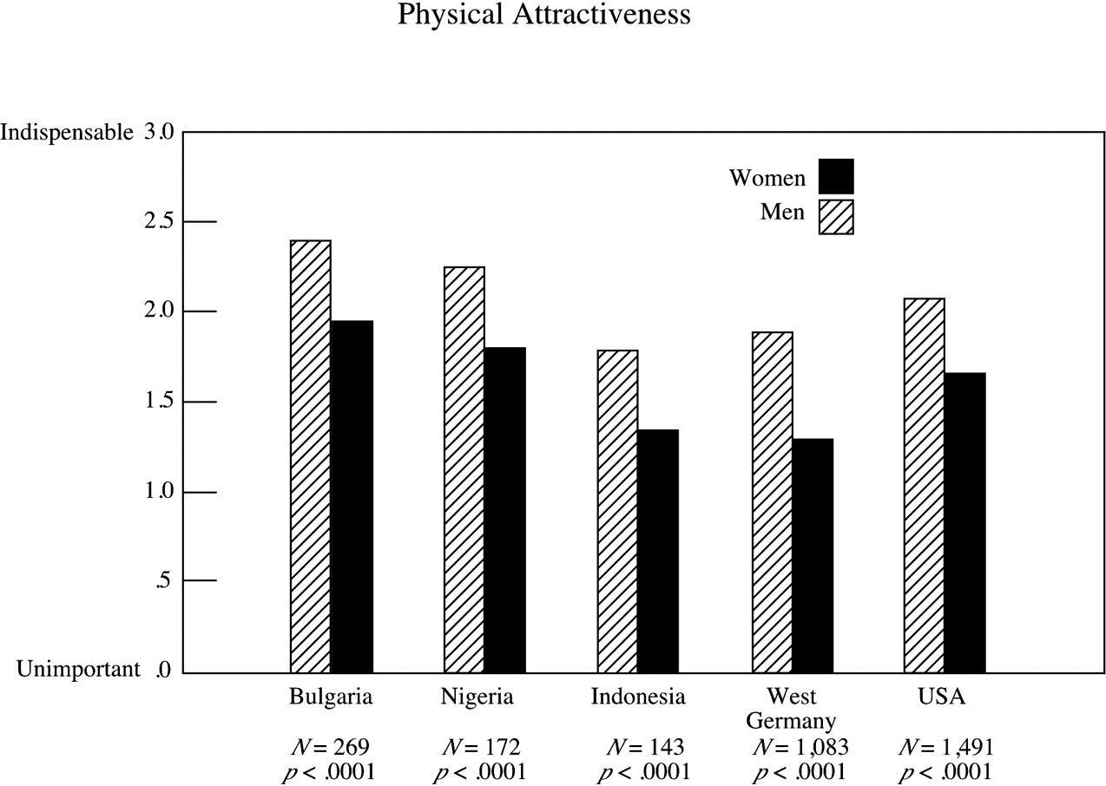
Physical Attractiveness

Slide 25
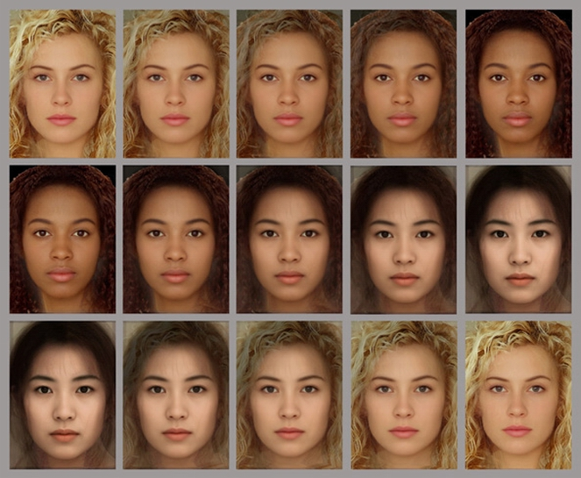
Standards of Beauty are
Consistent Across Cultures

Slide 26
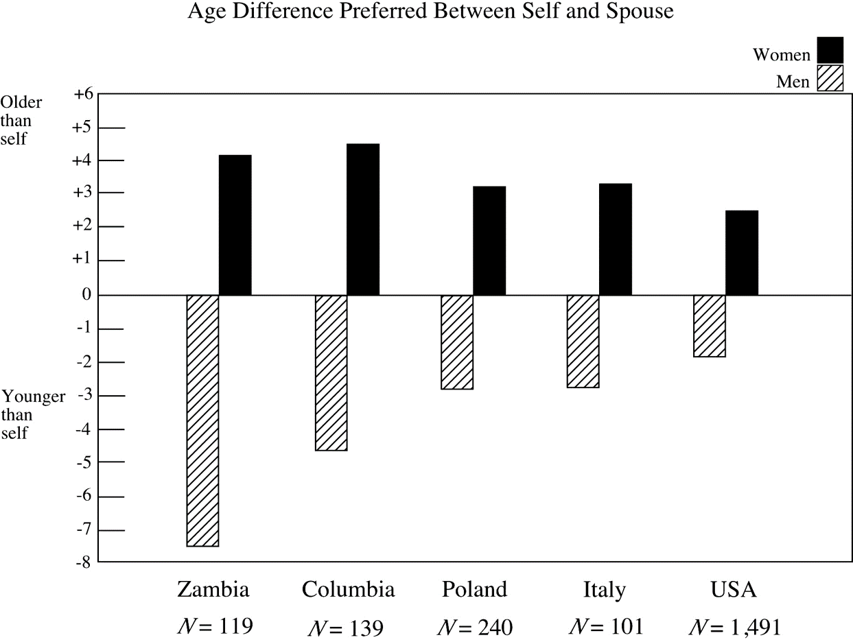
Age Difference Preferred
Between Self and Spouse
Older than self
Younger than self

Slide 27
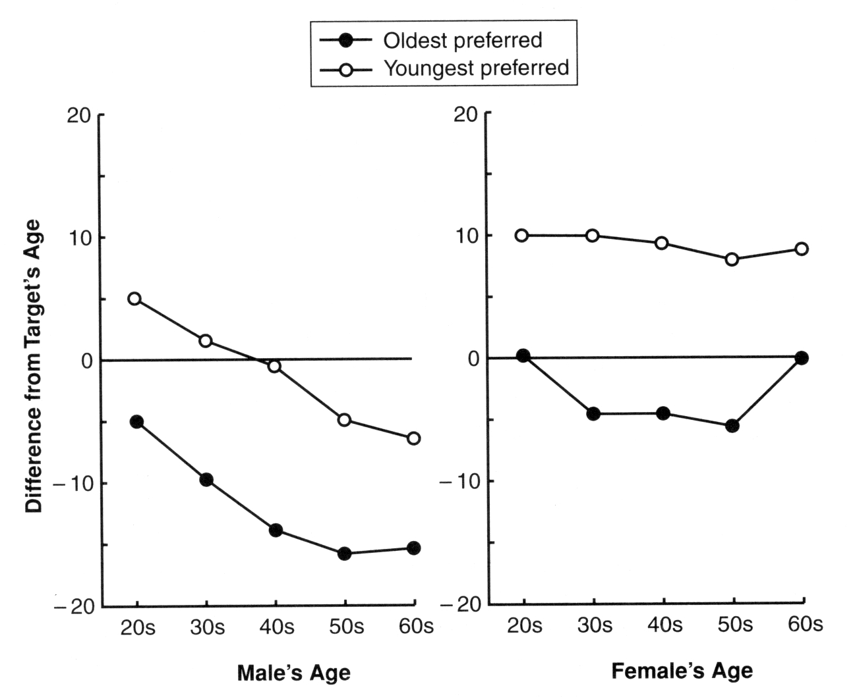
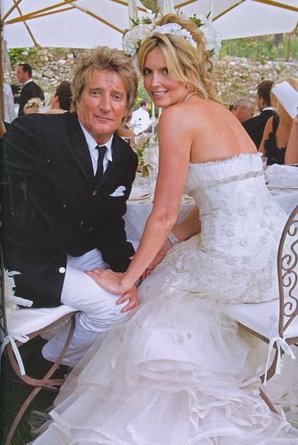
Men’s Age Preference as
They Get Older

Slide 28
So What do Women Want?

Slide 29
Economic Resources
Source: iwallscreen.com

Slide 30
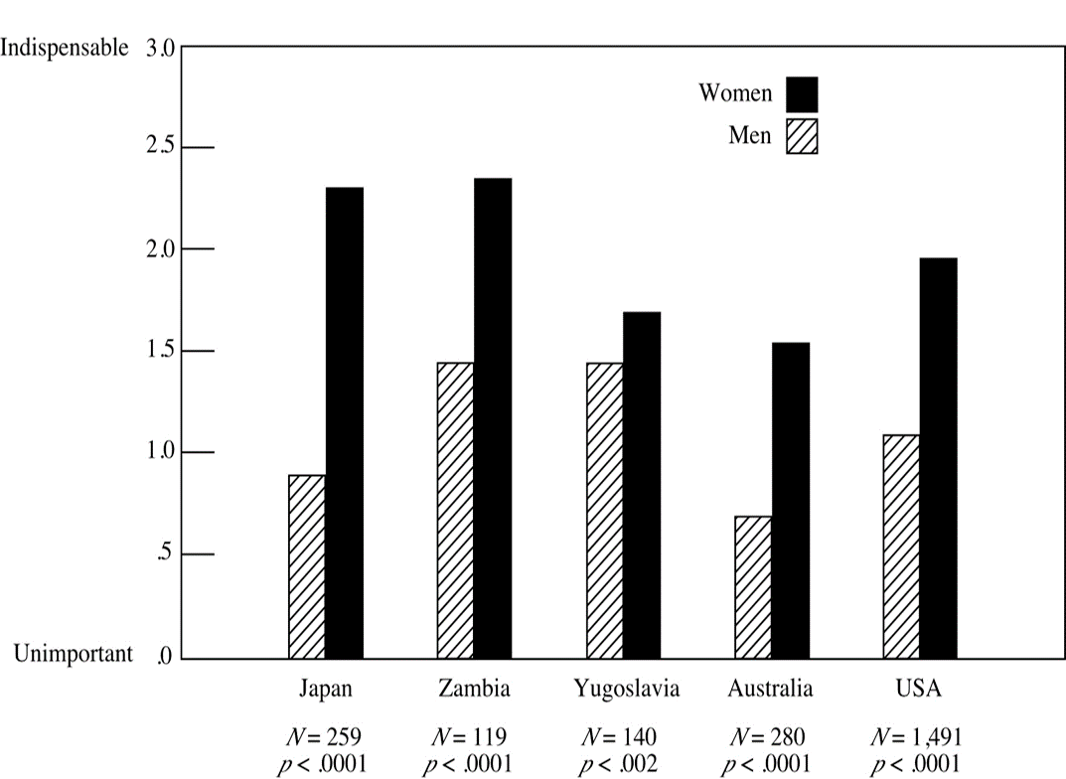
Good Financial Prospects
Indispensable
Unimportant

Slide 31
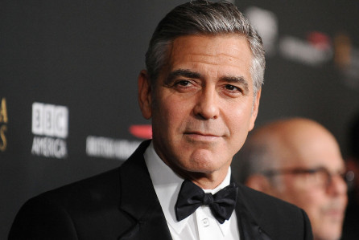
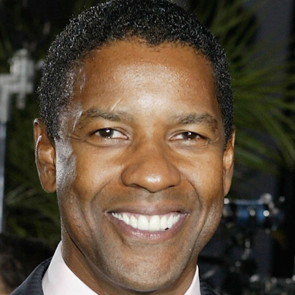
Social Status
Source: blog.starcam.com
Notes:
Image Sources: biography.com, imdb.com

Slide 32

Confidence
Cue to status

Slide 33
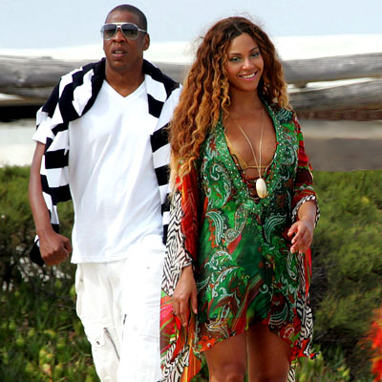
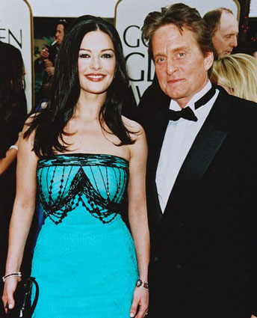
Who Gets What They Want?

Slide 34
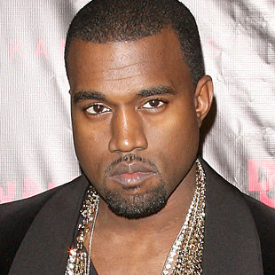

Ambition and Industriousness
Notes:
Image source: job-before-success.blogspot.com

Slide 35
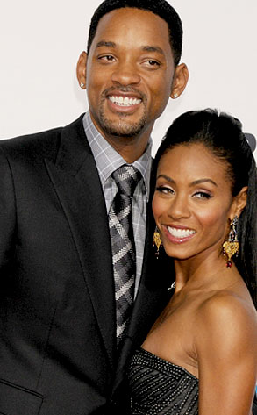
Preference for
Dependence and Stability
Notes:
Image source: eonline.com

Slide 36
Athletic Prowess
A Cue to Protection

Slide 37
Love and Commitment

Slide 38
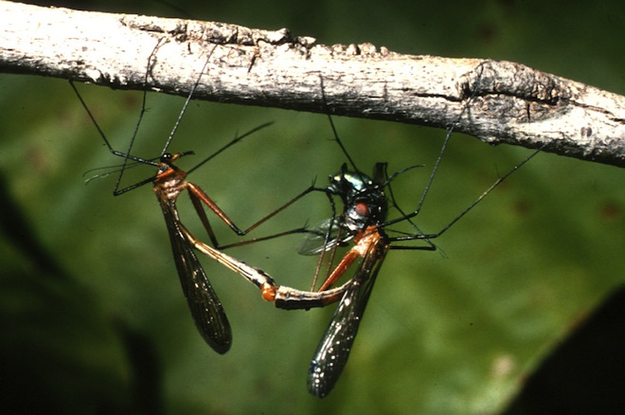
Sexual Conflict in Human Mating

Slide 39
Sexual Conflict Pervades All
Aspects of Mating
Before
During
After

Slide 40
Male optimum
Female optimum
Zone of
Conflict
Time elapsed before seeking intercourse

Slide 41
Male MV
Female MV
Zone of
Conflict
Parental Effort

Slide 42
Sexual Conflict Adaptations
Function to influence other sex to be closer to actor’s optimum

Slide 43
Male-Initiated Deception
Male Deception About Depth of Feelings
Decline in Female Fitness
Female Defenses Against Deception
Decline in Male Fitness

Slide 44
Female Resistance Adaptations
Impose longer time for accurate evaluation
Lower levels of indiscriminant lust

Slide 45
Emotional Upset About Deception:
Pre- and Post-Copulation

Slide 46
Upset Over Sexual Deception

Slide 47
Sexual Regret About Missed
Sexual Opportunities
(Galperin et al. 2013; Kennair et al.2016; Bendixen et al., 2017)

Slide 48

Sexual Regret About Errors of
Sexual Commission
(Galperin et al. 2013; Kennair et al. 2016;Bendixen et al. 2017)

Slide 49
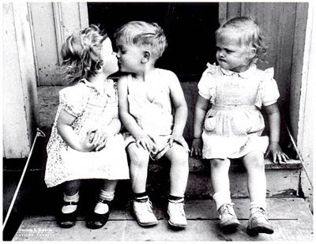
Triadic Antagonistic Sexual Conflict

Slide 50
Optimal Mate Switching Level
Current
Male Mate
New
Male
Female
Low
High
Optimal Inclination to Mate Switch

Slide 51
Infidelity
Kinsey et al:
  50% of married men
  26% of married women

Slide 52
Mate Poaching Tactics
Driving a wedge
False friendship
Opportunistic waiting in the wings

Slide 53
Mate Poaching Experiences
(Schmitt & Buss, 2001; Schmitt et al., 2004)
Experiences Men Women
Attempted to Poach 60% 53%
Received Poaching 93% 82%
Been Successfully
Poached Away 67% 41%
Experienced Someone
Trying to Poach
Your Partner 87% 88%
Had a Past Partner
Successfully Poached
From You 53% 41%

Slide 54
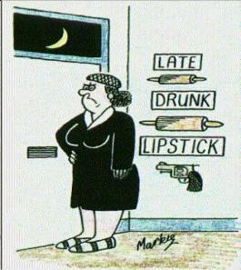
When Jealousy Turns Violent

Slide 55
Homicidal Ideation Trigger –
Mate Poaching

Slide 56
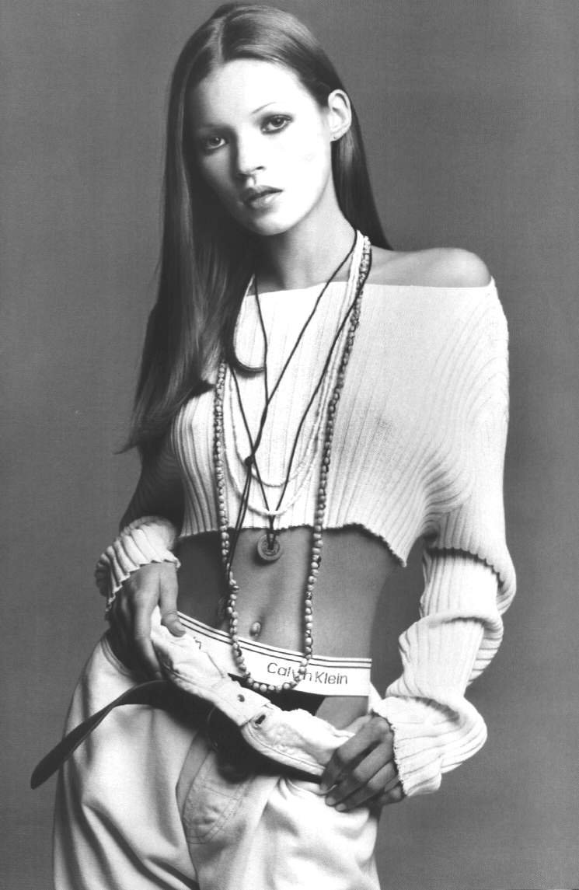

Slide 57
Female Intrasexual Rival:
Homicidal Ideation
“My boyfriend is always telling me how gorgeous he thinks Kate Moss is. Really, she is just a skinny, drug addict b*tch. The method: I thought about taking a wire coat hanger and putting it through her eye to make her brain dead. Then I would hang her skinny body up in my closet and show my boyfriend that she isn’t so gorgeous after all.”

Slide 58

Stalking as a Mating Strategy
(Duntley & Buss, 2012)
Notes:
Image source: middleearthnj.wordpress.com

Slide 59
Conclusions

Slide 60
Sexual conflict pervades all aspects of mating: Before, During, and After

Slide 61
Sexually Antagonistic
Co-evolution
For every sexual conflict adaptation in one sex, there exists at least one co-evolved defense in the other sex

Slide 62
Triadic Antagonistic
Co-evolution
For every triadic zone of sexual conflict, there exist adaptations to manipulate both other players to be closer to actor’s optimum

Slide 63
“We are walking archives of
ancestral wisdom”
– Helena Cronin

Slide 64
A modern gazelle carries with it ‘knowledge’ of its ancestral predators.

Slide 65
Women Living Today Carry With Them
Knowledge of their ancestral mating environments
Knowledge of sexual deception, stealth, persistence, and coercion perpetrated by ancestral men
Memory of the sexual conflict problems of their ancestral mothers
And the inherited wisdom to solve them, at least sometimes, in the never-ending co-evolutionary sexual arms race.

Slide 66
Thank you!

Slide 68
For More Info:
www.davidbuss.com

