Slide 1
How a Salamander Saved a City: The Politics and Science of Endangered Species
# 101
Dr. David Hillis
April 22, 2016
Produced by and for Hot Science - Cool Talks by the Environmental Science Institute. We request that the use of these materials include an acknowledgement of the presenter and Hot Science - Cool Talks by the Environmental Science Institute at UT Austin. We hope you find these materials educational and enjoyable.

Slide 2
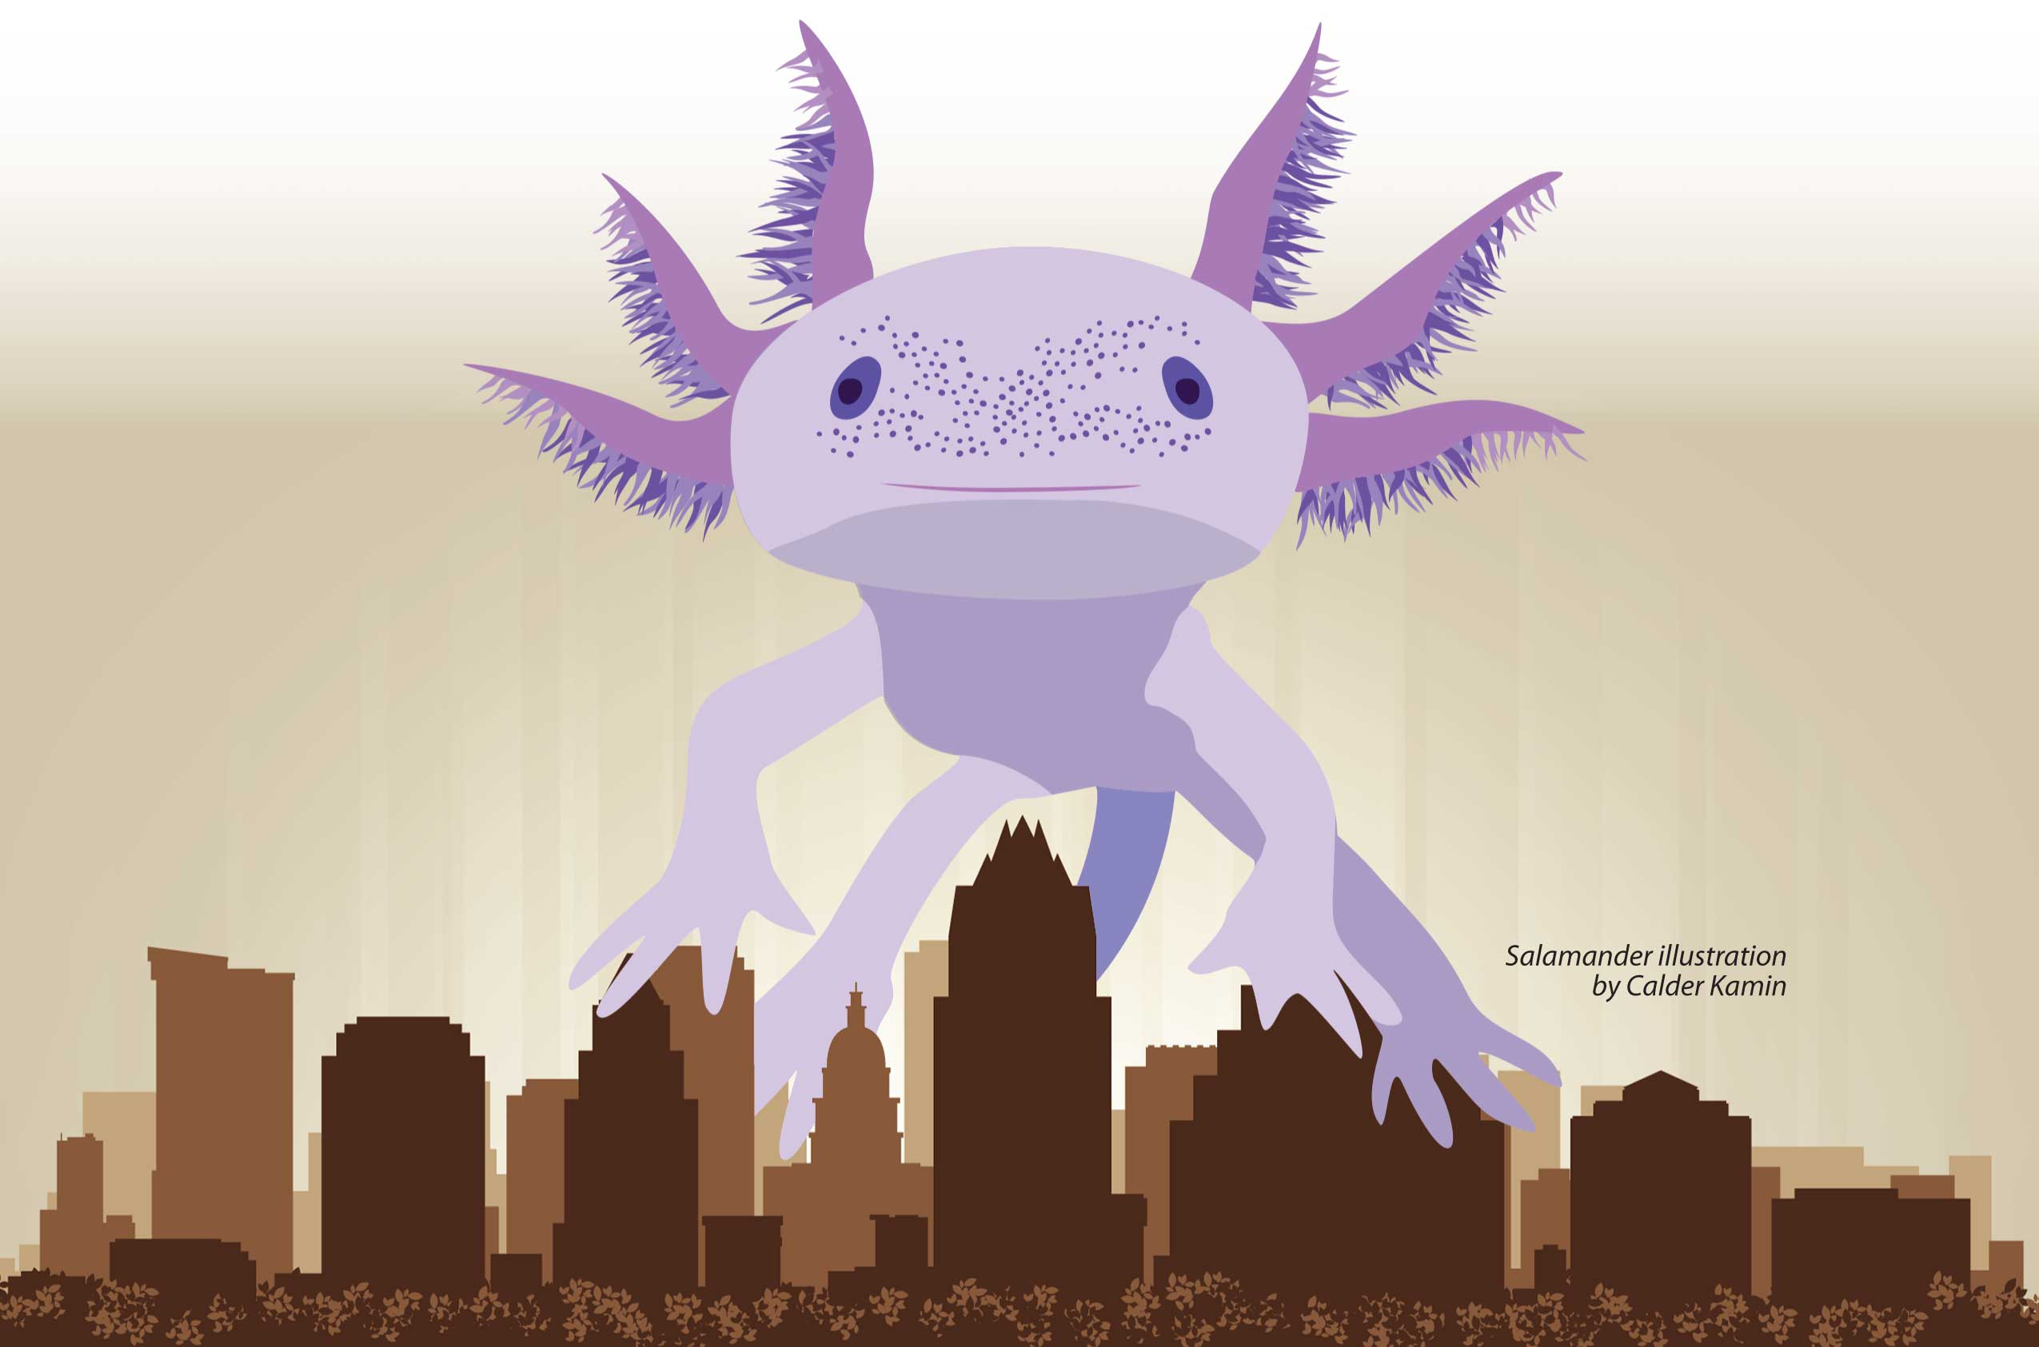
How a Salamander Saved a City
The Politics and Science of Endangered Species
David M. Hillis
The University of Texas at Austin
April 22, 2016
Notes:
.

Slide 3
If you could return to 1990 from today, how would you advise Austin’s City Council about the future?
Economic development
Population growth
Water supply protection
Increase green spaces, parks & wild areas
Notes:
Today, those of us who live in Austin live in a vibrant, exciting city. But imagine that you could travel back in time, to 25 years ago. How would you advise the City Council about the future?
Need more economic development (too low in the future to support a vibrant city)
Need more population growth (not enough people to support a vibrant city in 25 years)
Need to protect quality and quantity of water supply (water needed to support a vibrant city)
Need more green spaces, parks, and wild areas (quality of life for residents)

Slide 4
“For fifth year, 5-county area is U.S.’s fastest growing…”
Austin American Statesman (2016)

Slide 5
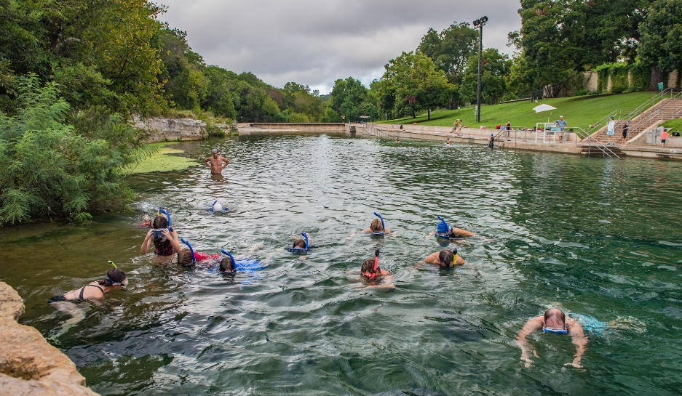
Why is Austin on nearly every Top-Ten list as a place to live?
Quality of Life
Strong economy
Vibrant diverse city
Excellent entertainment
Great parks and recreation
“Weirdness” factor
Image Courtesy of Save Our Springs (2016)
Notes:
Environment/Quality of Life
Strong economy without heavy industry (information technology, education, government, service industries)
Vibrant, diverse city
Excellent live music, restaurants, cultural activities
Great aquatic resources (spring, creeks, rivers, and lakes): Boating, swimming, snorkeling, water sports
Parks: Outdoor activities, running trails, biking trails, music festivals
“Weirdness” factor (= diversity)

Slide 6
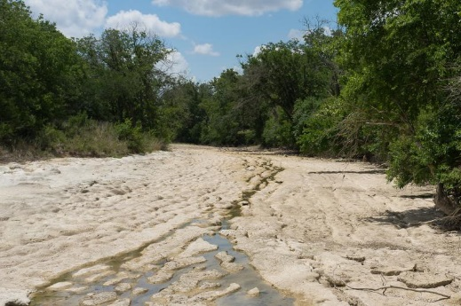
What are the top complaints about Austin?
Traffic
Crowds
Cost of living
Weather
Allergies
Water shortages
Colorado River drought
KUT (2014)
Notes:
Too much traffic
Too many people
Parks and recreation areas are too crowded
Too expensive (too many people want to live here)
Climate (too hot in the summer) and allergies
Water shortages: Drought-prone and water limited

Slide 7
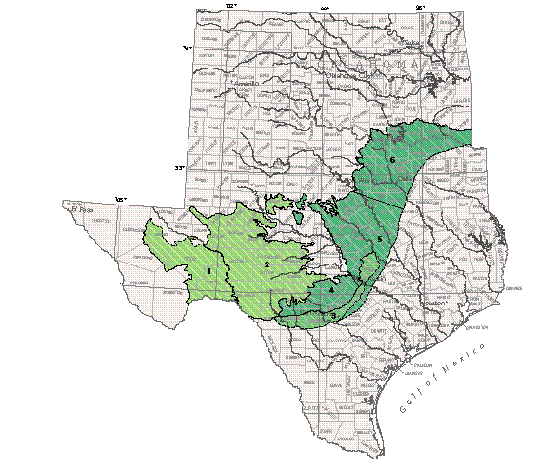
Austin
San Antonio

Slide 8
Settlement of Central Texas
Salado
Georgetown
Austin
San Marcos
San Antonio
Springs
Edwards aquifer
New
Braunfels
Del Rio
Brackettville
Uvalde
Sharp (2003) Hot Science – Cool Talks
Notes:
These springs led to the development of major towns along the aquifer: Salado, Georgetown, Austin, San Marcos, New Braunfels, San Antonio, Uvalde, Brackettville, and Del Rio. All of these towns are sited where major springs discharge from the Edwards aquifer.

Slide 9
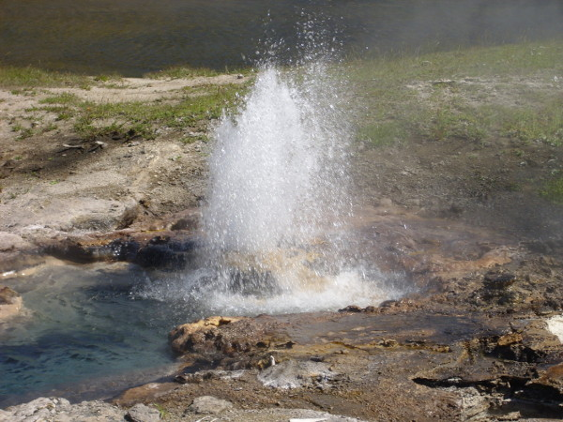
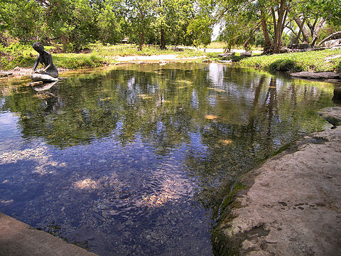
Then and Now…
Salado Springs Today
What Salado Springs looked like in the 1870s
Notes:
In the days of Chisholm Trail cattle drives (1870s), the water in Salado Springs “rose in a fountain more than six feet high.” A stone wall had to be built to keep the cattle from drowning.

Slide 10
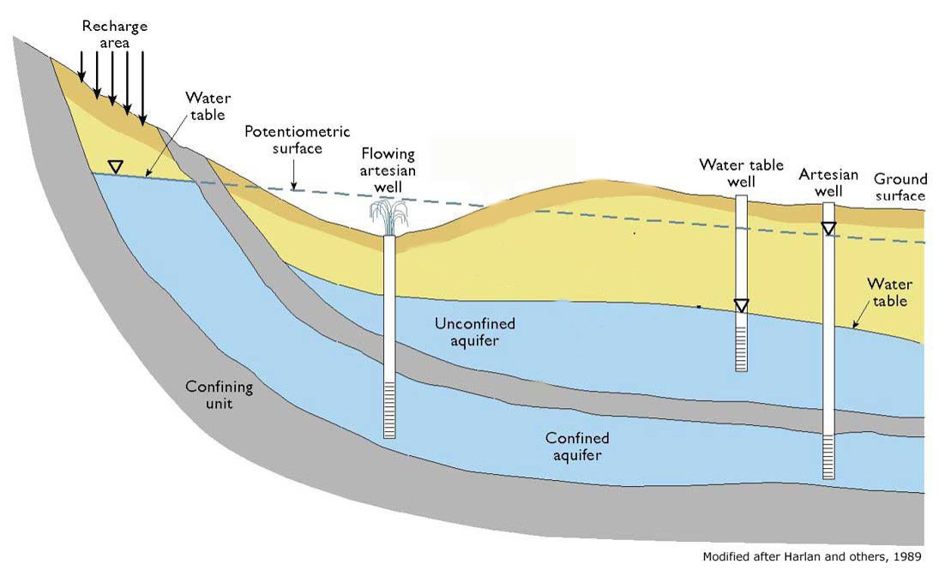
Artesian Springs and Wells

Slide 11
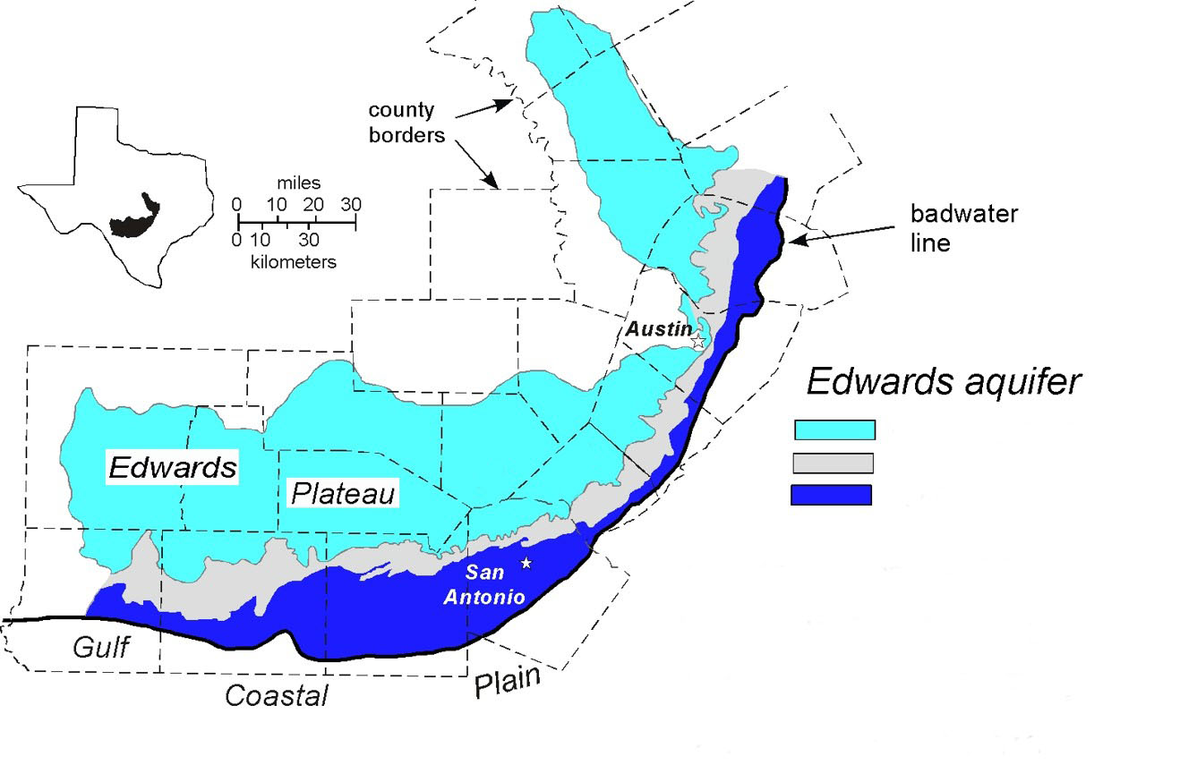
The Edwards Aquifer
5
Drainage zone
Recharge zone
Artesian zone
Musgrove (2000)
Musgrove et al. (2001)

Slide 12
Central Texas is a biodiversity hot spot
Typical Terrestrial Salamander
Salamander sent to Stejneger in 1896
Plethodon albagula,
White-throated Slimy Salamander
Eurycea rathbuni,
Texas Blind Salamander
Notes:
1896: Stejneger receives and describes Typhlomolge rathbuni from artesian well
at U.S. Fish Hatchery in San Marcos, Texas. But he isn’t even sure what family of salamanders
to place it in.
2007: Students at Danbury Elementary School petition the state legislature to designate the
Texas Blind Salamander as the state amphibian. HCR30 introduced and passed by Texas House and Senate in May 2007. Bill then vetoed by Governor Rick Perry.

Slide 13
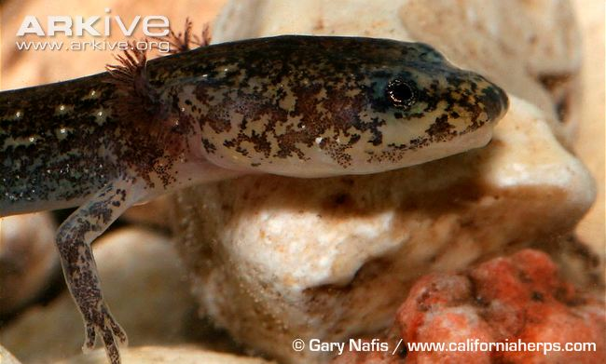
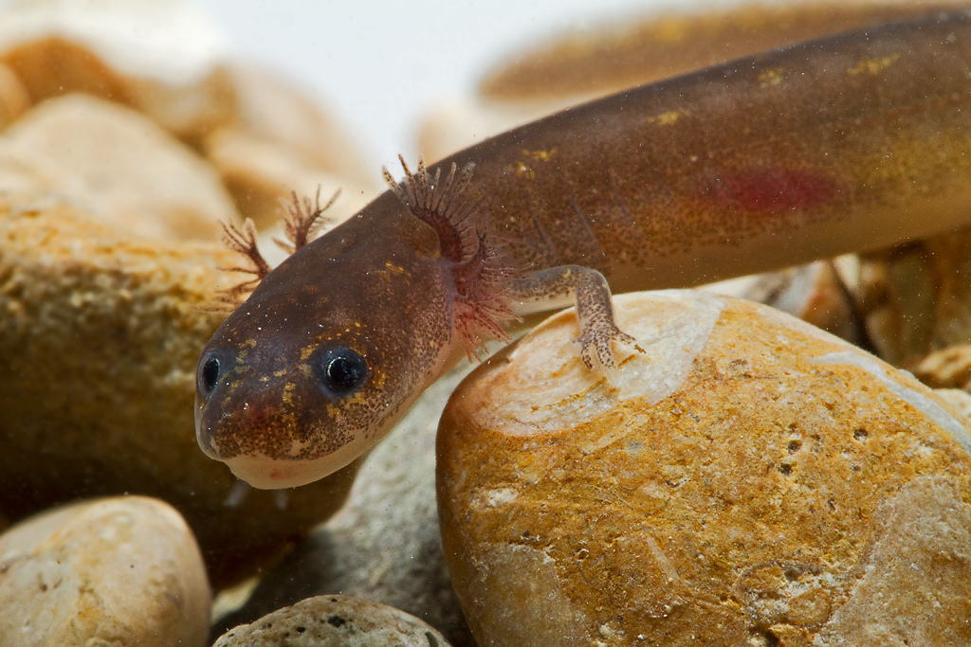
Salamanders in Texas
Texas Spring Salamander
Discovered in 1937 by Bishop & Wright
Eurycea neotenes
San Marcos Salamander
Discovered in 1941 by Bishop
Eurycea nana
Notes:
1896: Stejneger receives and describes Typhlomolge rathbuni from artesian well
at U.S. Fish Hatchery in San Marcos, Texas. But he isn’t even sure what family of salamanders
to place it in.
2007: Students at Danbury Elementary School petition the state legislature to designate the
Texas Blind Salamander as the state amphibian. HCR30 introduced and passed by Texas House and Senate in May 2007. Bill then vetoed by Governor Rick Perry.
•1966: David Wake writes dissertation on evolution of the lungless salamanders
(Plethodontidae), and argues that Typhlomolge and Eurycea represent two
different invasions of the Edwards Plateau, separated by tens of millions of years.
•1978: Sam Sweet completes dissertation under Wake on “Evolutionary Development of the Texas Eurycea.” Reports larvae of Eurycea at Barton Springs,
but does not report or describe any adult specimens.

Slide 14
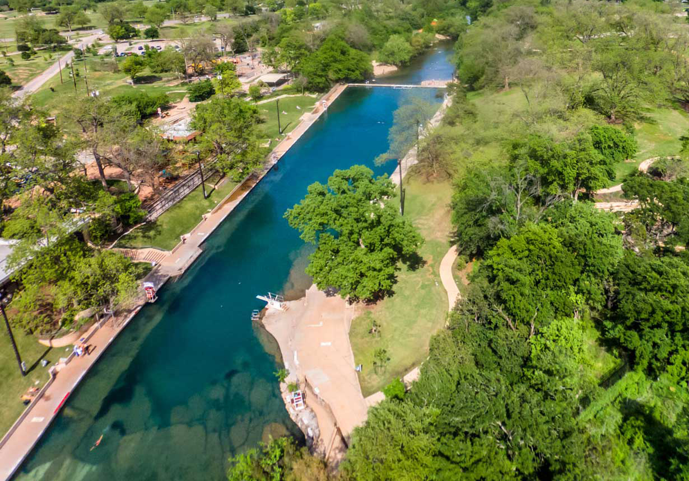
Barton Springs
Image Courtesy of Save Our Springs
Notes:
This is Barton Springs in downtown Austin. It is a spot that is visited by hundreds of Austinites virtually every summer day, and dozens of professional herpetologists who received their graduate degrees at the University of Texas have been swimming here. So it was something of a surprise when we described a new species of salamander from Barton Springs in the early 1990s.

Slide 15
Barton Springs
Image Courtesy of Save Our Springs (2016)

Slide 16
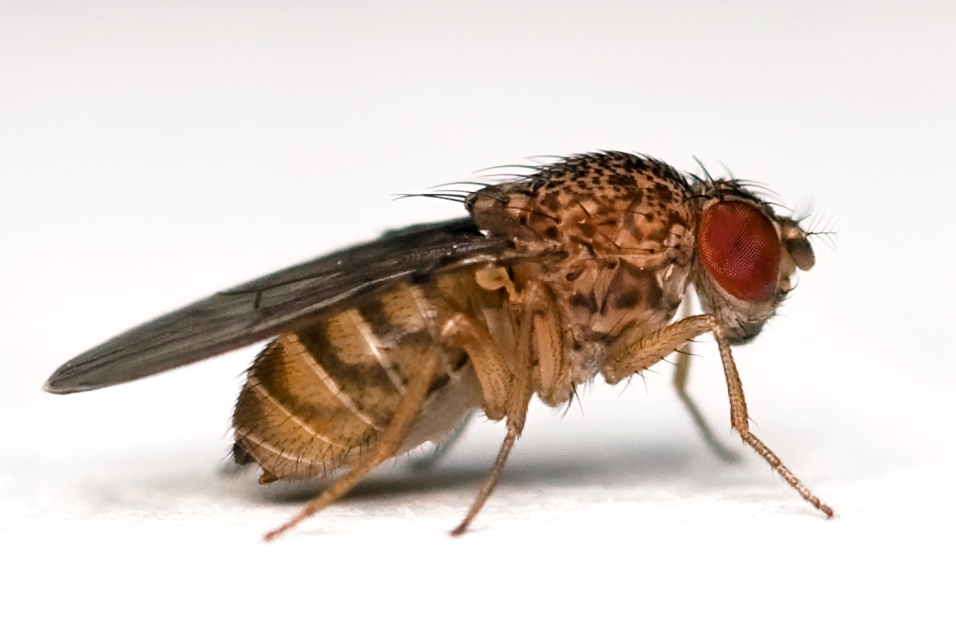
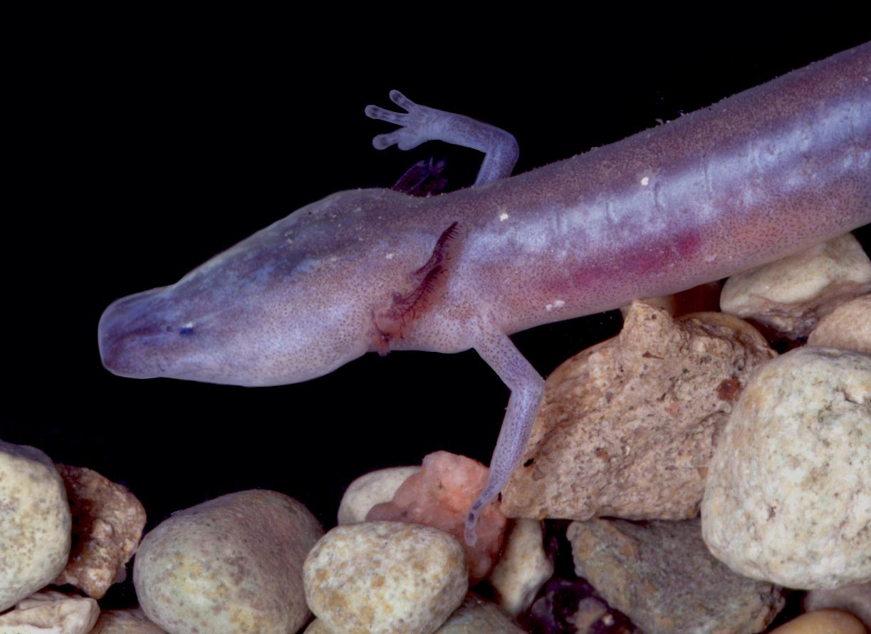
Ideal Model Organisms
Ideal Model Organisms
(e.g., fruit flies, yeast, bacteria)
Texas Spring and Cave Salamanders
Abundant
Easily cultured
Easy to collect and observe
No permits required
Rapid growth, short generation time
Small, easily sampled genome
Endangered and rarely seen
Difficult to raise
Difficult to collect & observe
Many permits & regulations
Slow growth, long generation time
Giant genome; no genome sequenced

Slide 17
Barton Springs
Image Courtesy of Save Our Springs

Slide 18
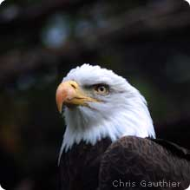
What is an Endangered Species?
Endangered Species Act (ESA) created in 1973
A species likely to become extinct throughout all or a large portion of its range
Receives special protections by federal government to help it recover
Must be evaluated and meet certain criteria to be listed as “endangered”

Slide 19
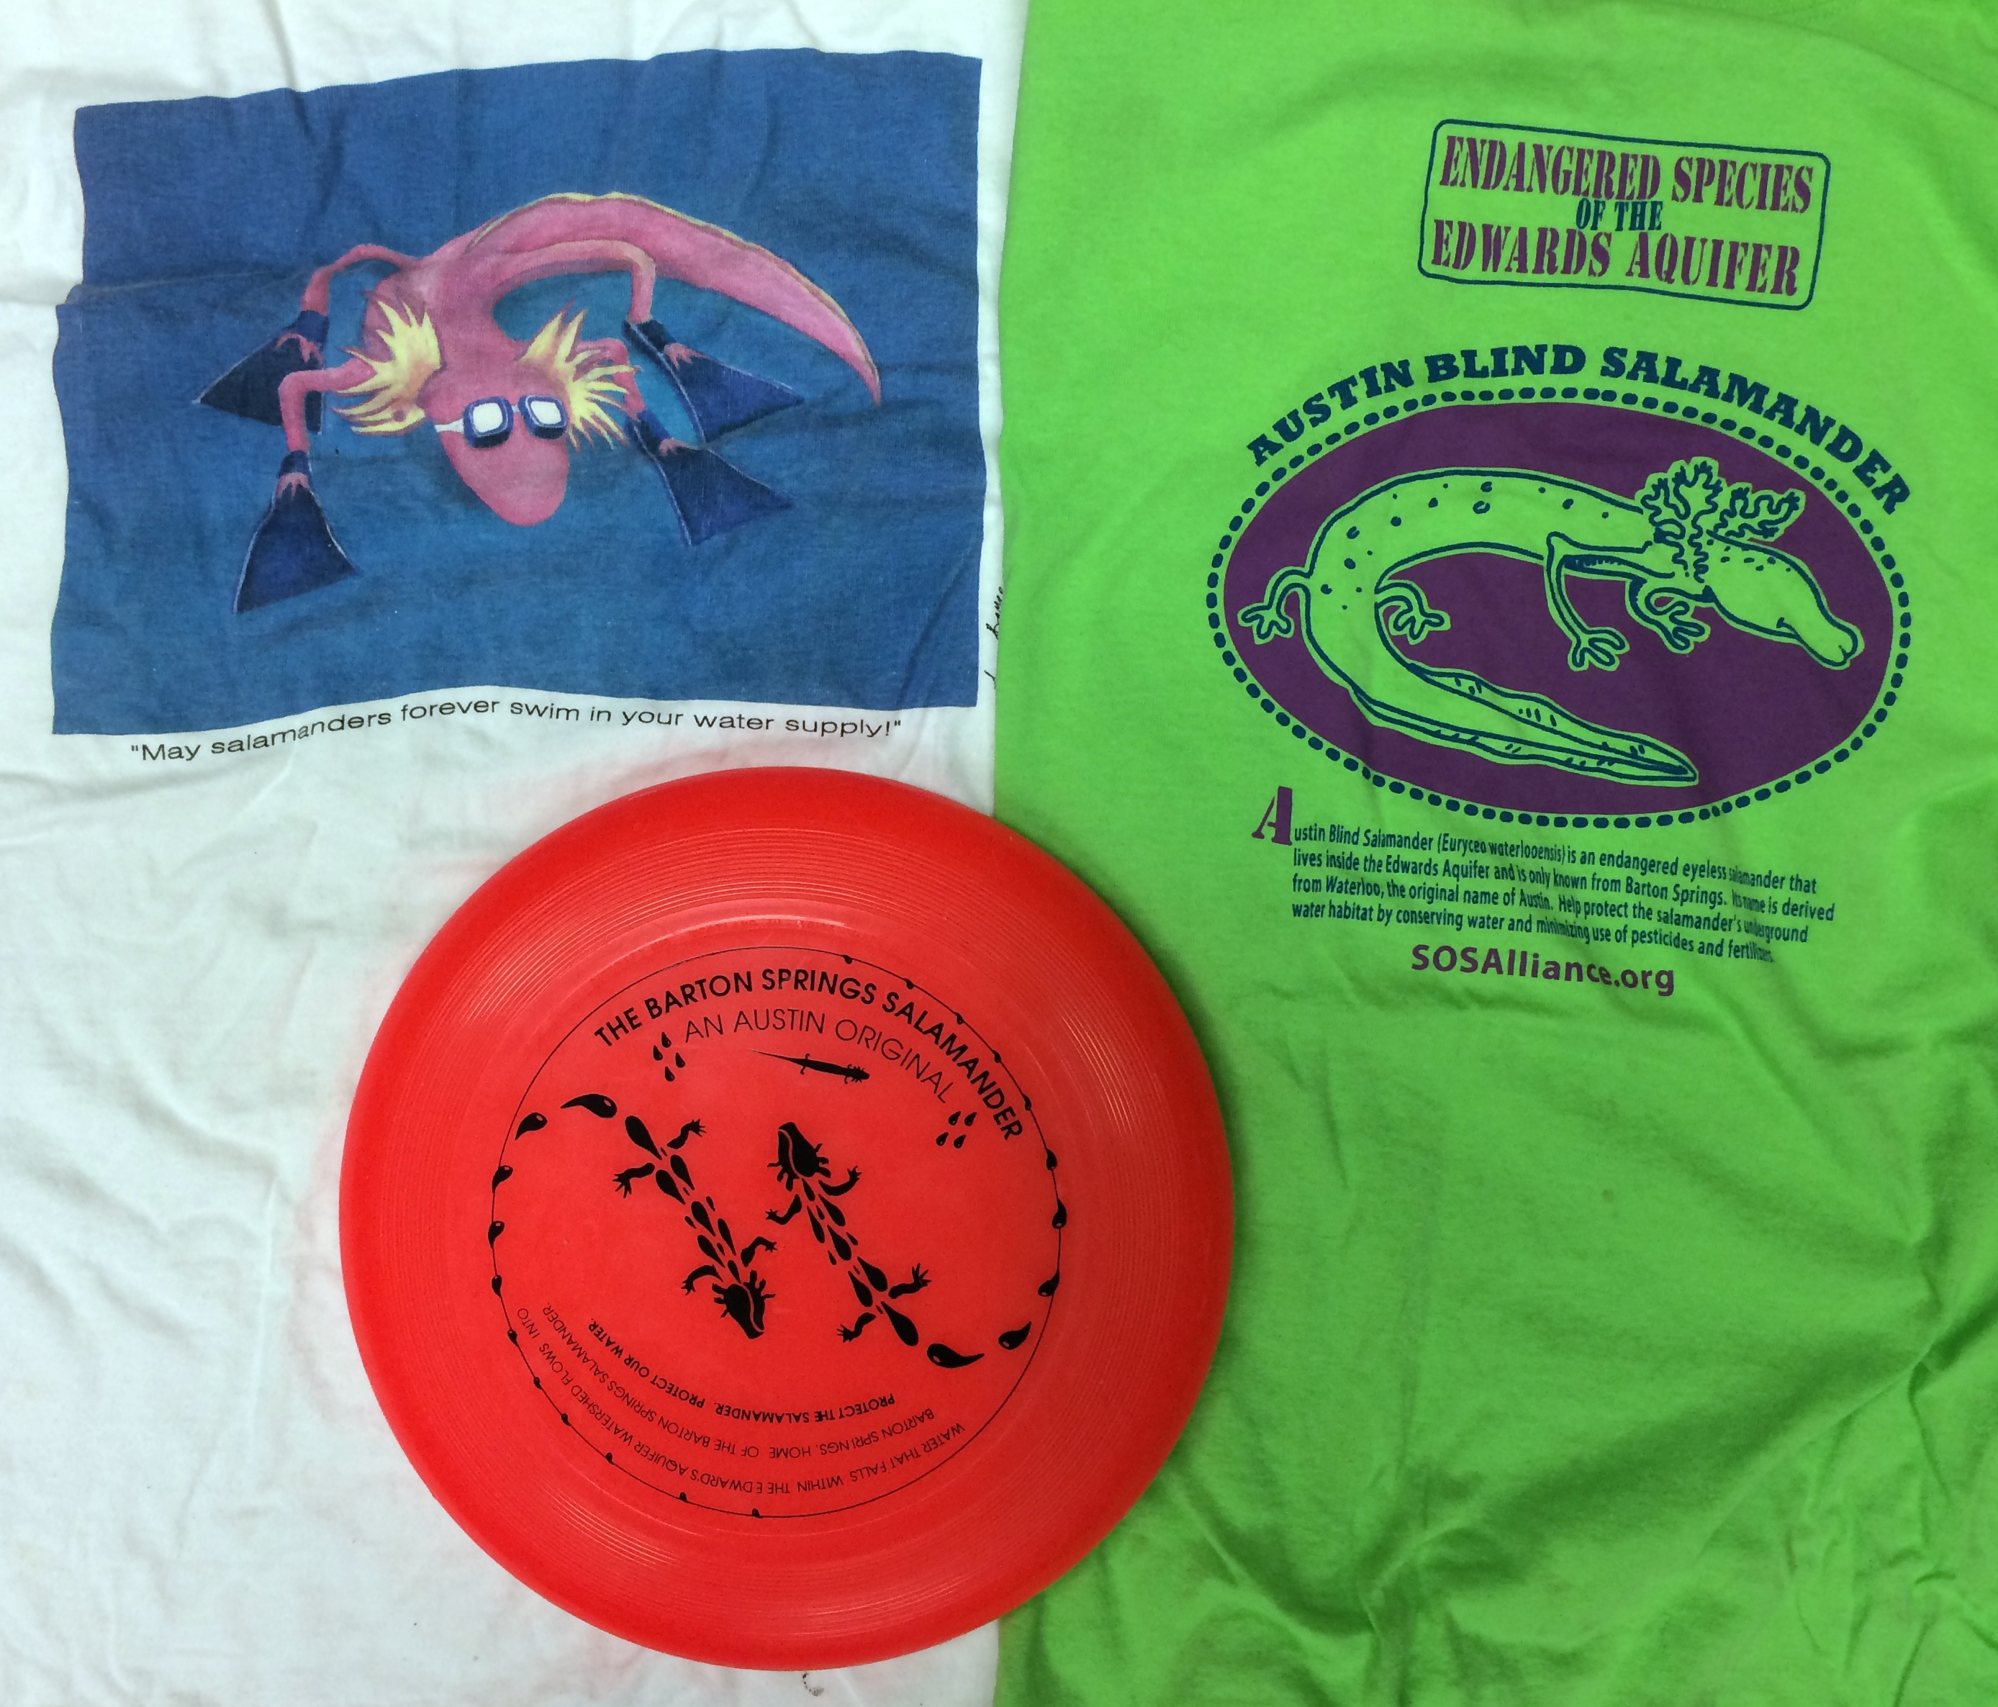
Late 1980s…
Pool cleaning methods nearly eliminate salamanders
“Liaison Committee” created between city and UT to develop “salamander friendly” cleaning methods
Memorabilia from
conservation groups

Slide 20
New methods adopted to clean Barton Springs Pool
Notes:
Before the Barton Springs Salamander can be described and named, Barton Springs Pool staff nearly eliminates salamander populations with copper sulfate and high-pressure hose cleaning of the “swimming pool” (Barton Springs)
I formed a “Liaison Committee” between City of Austin and UT to reform pool cleaning; huge volunteer support from local citizens; pool staff participated reluctantly; cleaning practices changed and salamanders increased in abundance.
Austin City Council (at the time) was very pro-development and not very interested in environmental protection.

Slide 21
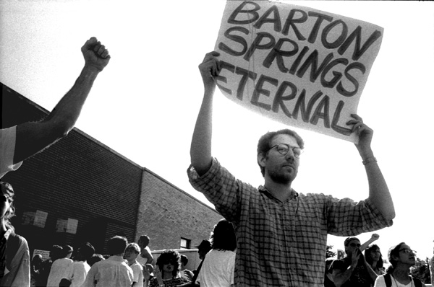
1990s…Citizens stand up for the springs
“Barton Creek backers savor council vote”
Austin American Statesman, June 9, 1990
1990 hearing opposing McMoran Inc.’s proposal
Save Our Springs (SOS) Coalition forms
Formal proposal to USFWS to list Barton Springs salamander as endangered
Opposition: claimed listing would be “catastrophic” to the economic development of Austin
Pogue (2012) Austin Chronicle
Notes:
The Austin City Council holds an all-night hearing at which 800 people sign up to speak, most in opposition to Freeport-McMoRan Inc.'s proposal to build a 4,000-acre development on Barton Creek. The council votes unanimously to reject the development proposal. Citizens’ input is heard!
The Save Our Springs Coalition forms to gather signatures needed to put the Save Our Springs Ordinance on the ballot. Regulates development in recharge zone of Barton Springs. Constant demand through Texas Freedom of Information Act for “all data, field notes, correspondence, analyses, and other related information related to work on Texas salamanders” from various developers.
(UT’s Vice President of Legal Affairs helped me retain some information as privileged until it was published in scientific journal articles.)
1992-1996: Texas Attorney General Dan Morales repeatedly ruled against the University of Texas and in favor of developers who requested unpublished research data on Eurycea through the Freedom of Information Act, despite clear provisions in the act for privacy of unpublished research data.
Morales was later indicted on twelve counts that included conspiracy and using political money for private purposes (unrelated to Eurycea). He pled guilty in 2003 and was sent to jail.

Slide 22
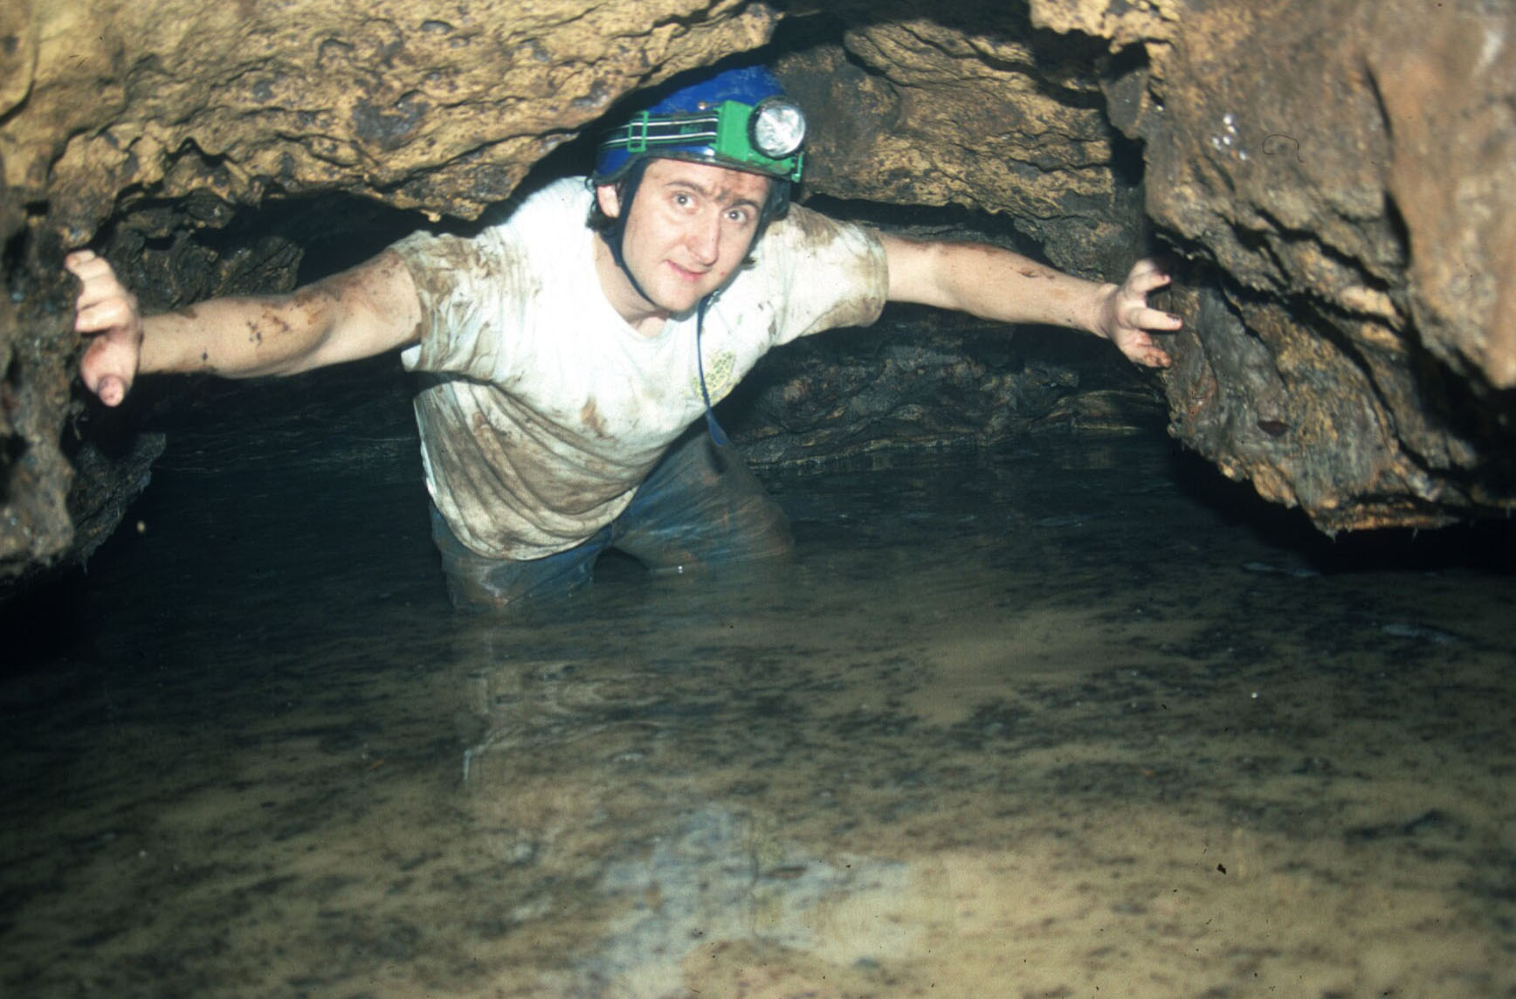
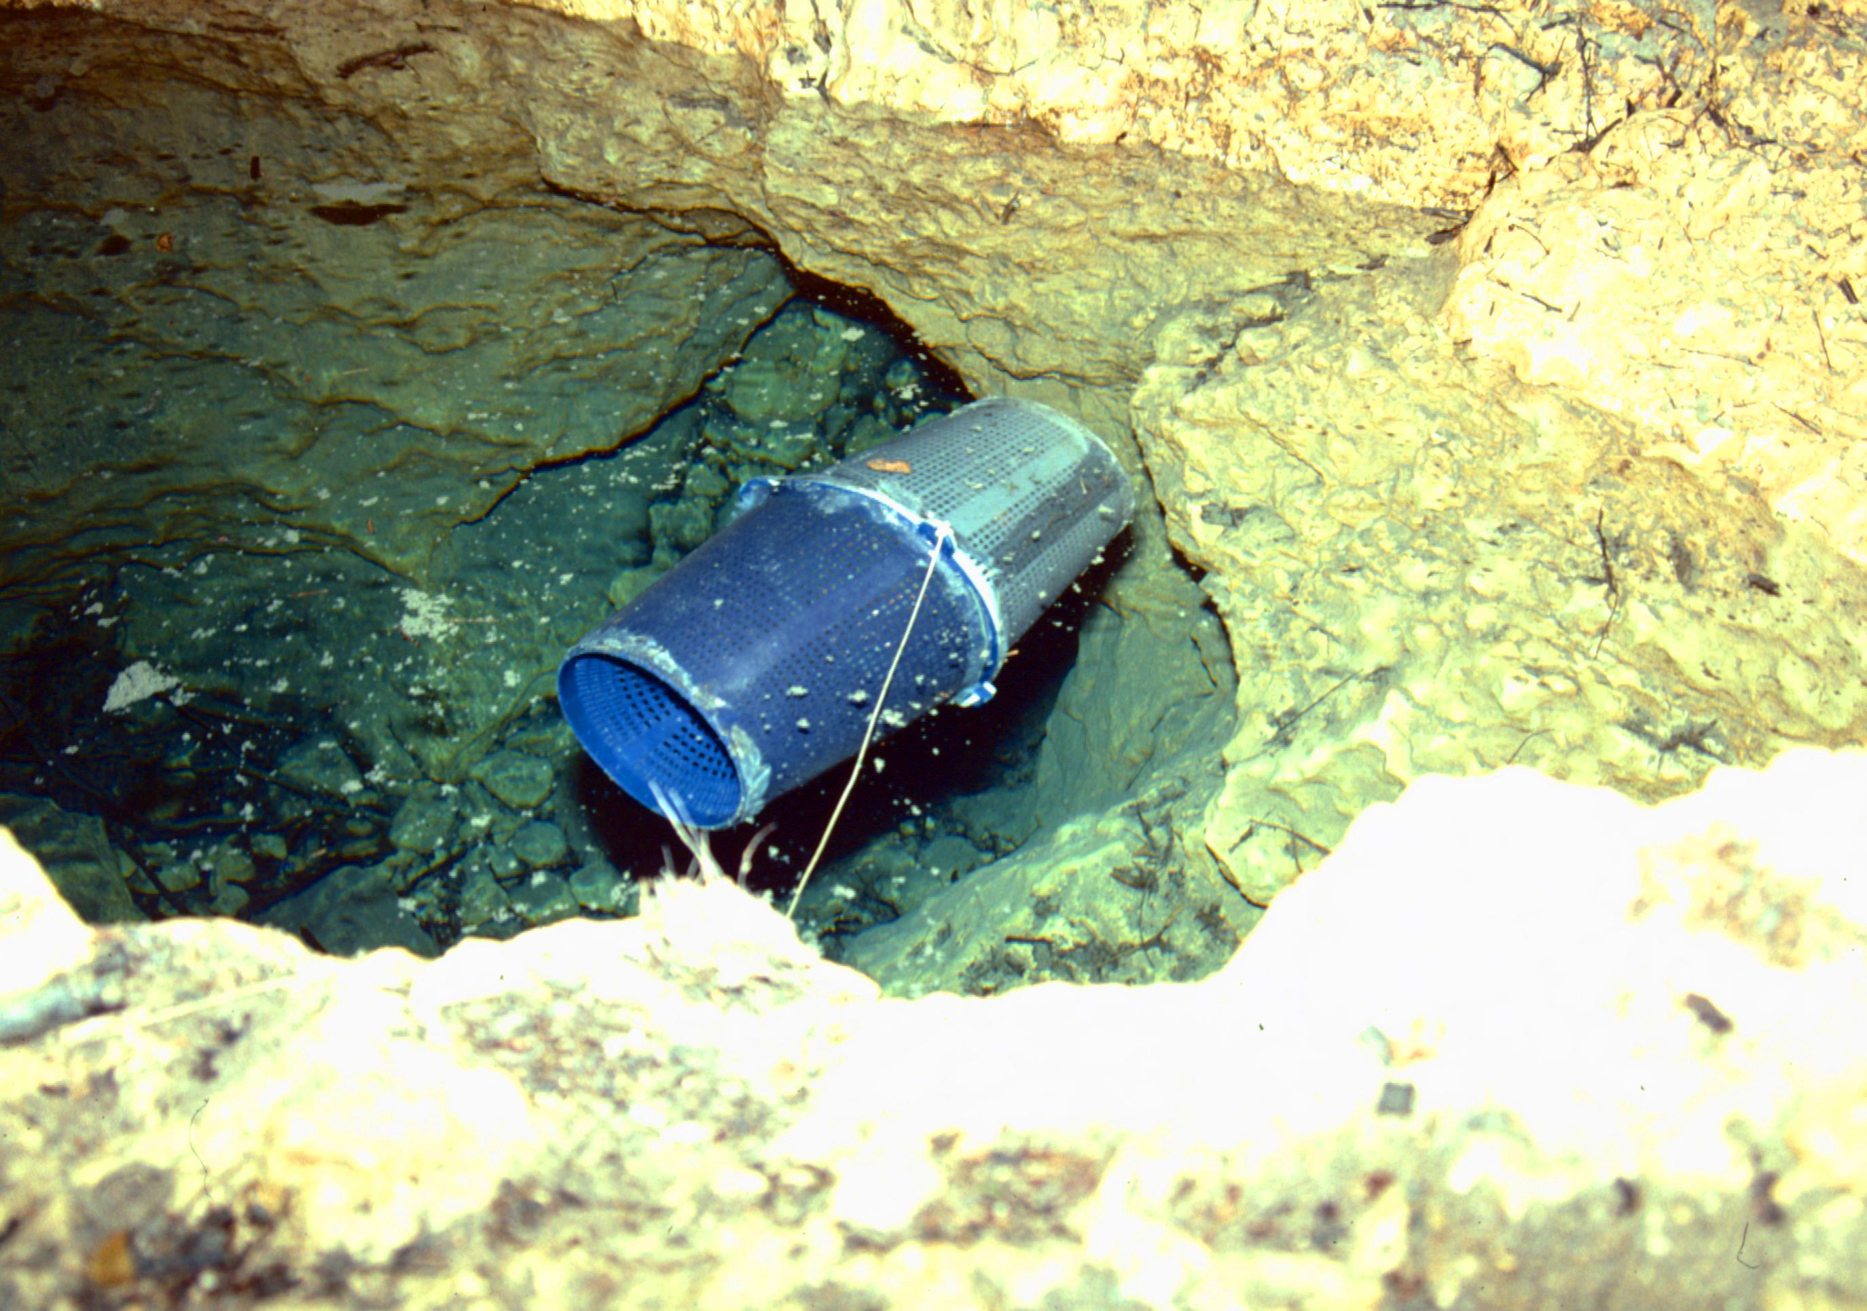
Looking for salamanders
Salamander Trap

Slide 23
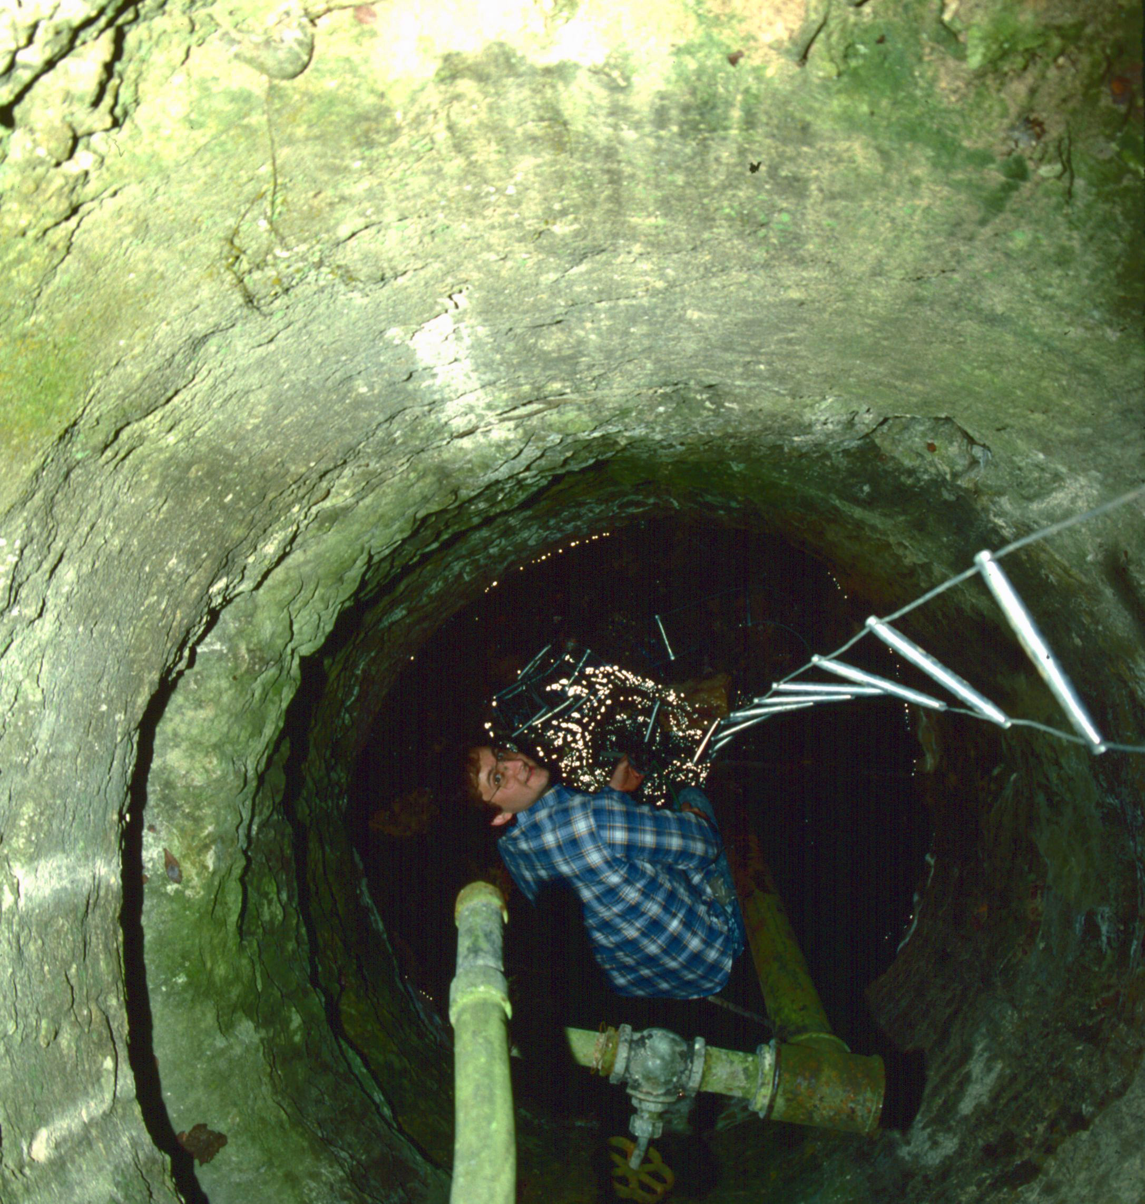
Exploring wells

Slide 24
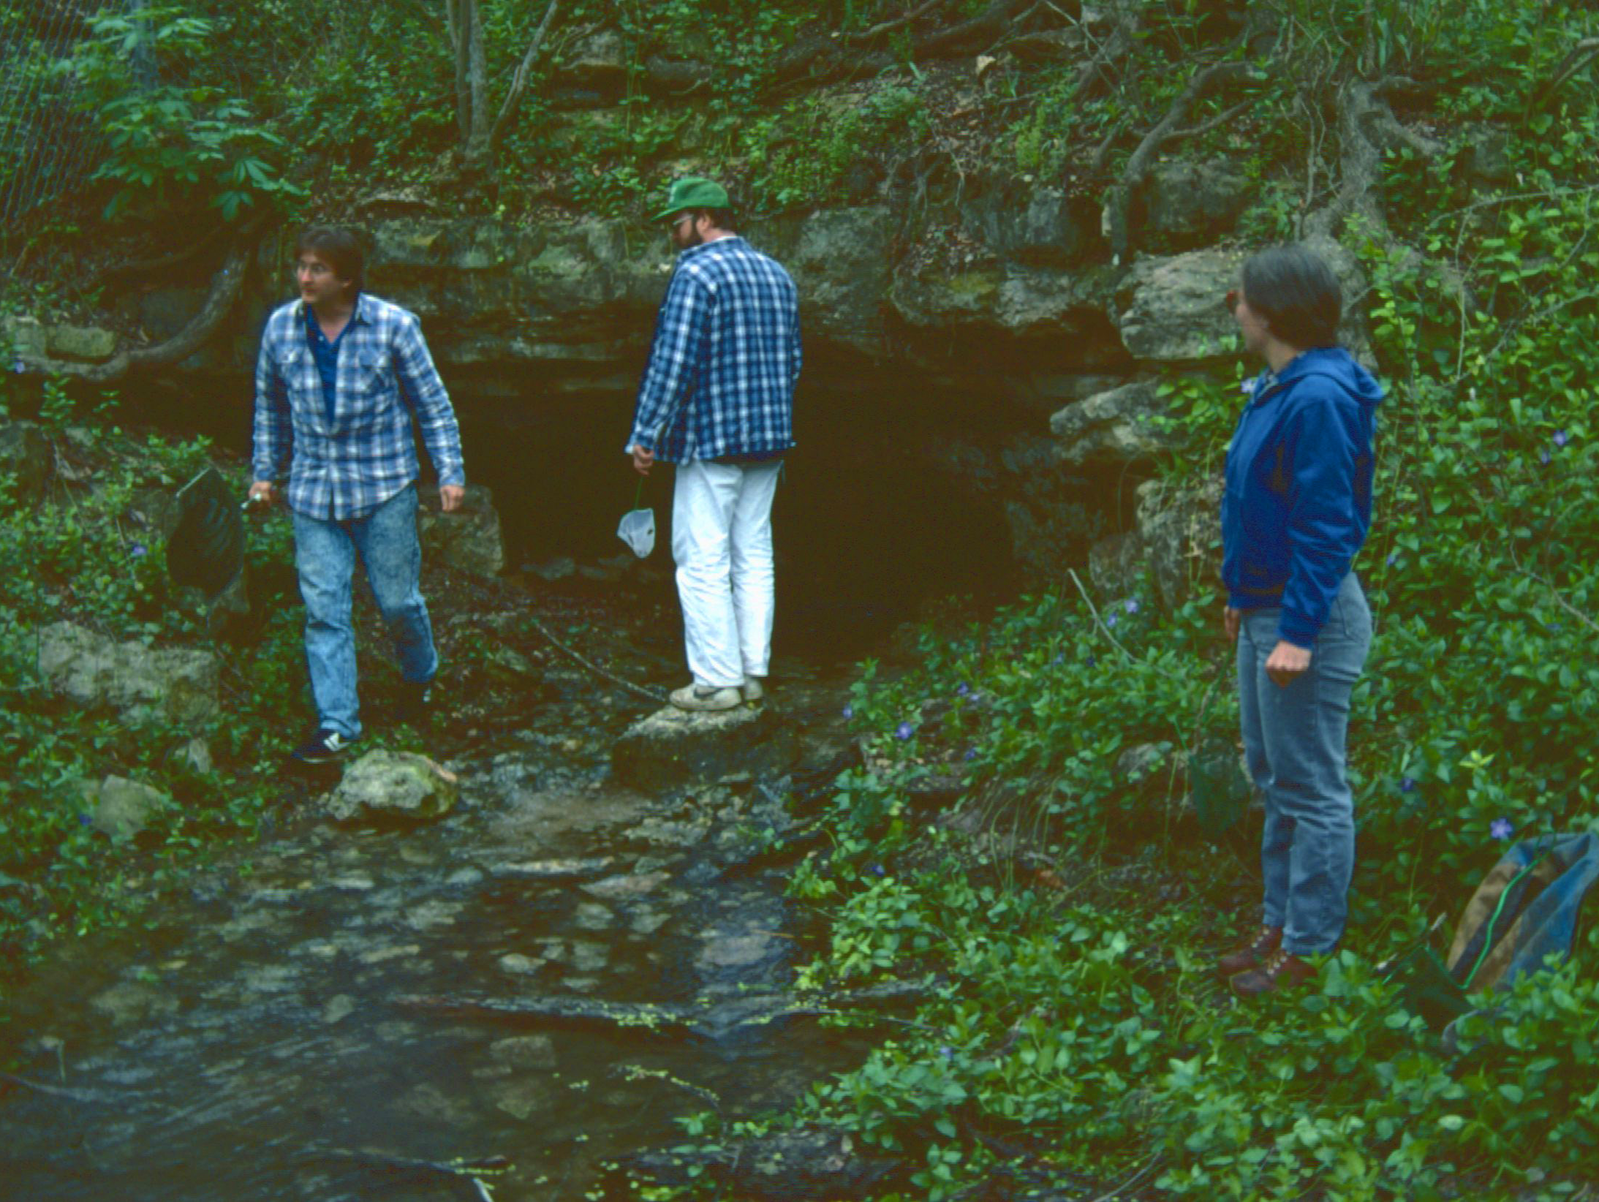

Slide 25
1992…You CAN fight City Hall
Save Our Springs Ordinance approved (42,246 to 26,187)
Pro-environment candidates elected to Austin City Council
USFWS preliminary finding of Barton Springs salamanders as an endangered species
Pogue (2012) Austin Chronicle

Slide 26
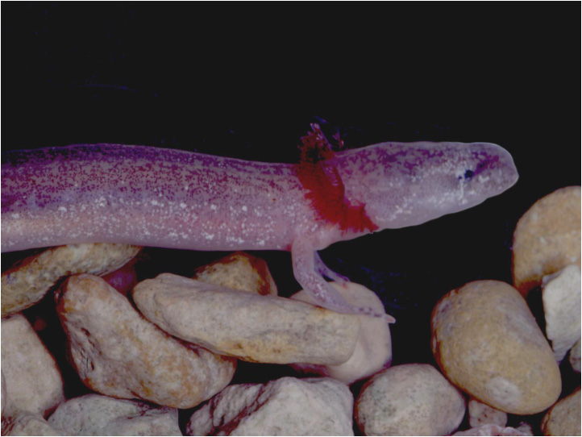
But with lots of negative press…
“New cry for springs: ‘Save the salamander’
Pool may be off-limits if U.S. agrees”
Austin American Statesman, January 25, 1992
“Save the springs for swimming by sizzling the salamanders”
Editorial, Austin American Statesman, January 30,1992
“Parks board recommends chlorine for Barton pool”
Austin American Statesman, December 20,1994

Slide 27
A New Species is Described…
New species description published in 1993, authored by Paul Chippindale, Andrew Price, and David Hillis
Barton Springs Salamander
Eurycea sosorum
Notes:
“The species is named in honor of the citizens of Austin, Texas, whose efforts to protect
the quality of Barton Springs resulted in the passage of a citizens’ aquifer-protection
initiative. This initiative is known locally as the SOS (Save Our Springs) Ordinance, and its
supporters are known as SOSers. The specific name sosorum is the plural mixed-gender
genitive form of the acronym SOS.”

Slide 28
…with a name to honor Austinites
“The species is named in honor of the citizens of Austin, Texas, whose efforts to protect the quality of Barton Springs resulted in the passage of a citizens’ aquifer-protection initiative.
This initiative is known locally as the SOS (Save Our Springs) Ordinance, and its supporters are known as SOSers. The specific name sosorum is the plural mixed-gender genitive form of the acronym SOS.”
Notes:
“The species is named in honor of the citizens of Austin, Texas, whose efforts to protect
the quality of Barton Springs resulted in the passage of a citizens’ aquifer-protection
initiative. This initiative is known locally as the SOS (Save Our Springs) Ordinance, and its
supporters are known as SOSers. The specific name sosorum is the plural mixed-gender
genitive form of the acronym SOS.”

Slide 30
Politicians begin to weigh in…
“State calls for more study of Travis salamanders”
Austin American Statesman, July 29, 1993
“U.S. delays rule on protection of salamander”
Austin American Statesman, March 8, 1995
“Gov. Bush opposes salamander protection”
Austin American Statesman, July 26, 1995
“Salamander stirs calls of morality, communism”
Austin American Statesman, July 26, 1995
“Salamander pulled from endangered consideration”
Austin American Statesman, August 29, 1996
“In a surprising announcement, Secretary of the Interior Bruce Babbitt said on Wednesday that his agency would withdraw its proposal to list the Barton Springs salamander as an endangered species.”
Notes:
“In a surprising announcement, Secretary of the Interior Bruce Babbitt said on Wednesday that his agency would withdraw its proposal to list the Barton Springs salamander as an endangered species.”

Slide 31
“It ain’t over till it’s over”
Yogi Berra
Yankees baseball player, coach
1925 - 2015
Washington Post (2015)

Slide 32
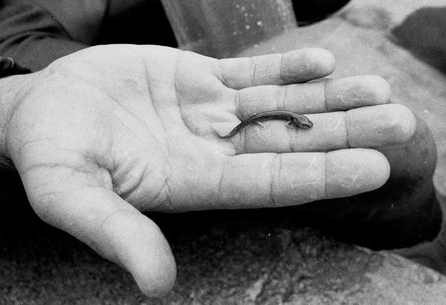
September 1996… State of Texas and USFWS convene a panel to make recommendations
“In my professional opinion, the Barton Springs salamander is the most endangered species of vertebrate in the United States.”
Vic Hutchinson,
1996 Salamander Panel
Pogue (2012) Austin Chronicle
Notes:
The State of Texas and USFWS convene a “panel of experts” to come up with
“solutions” for protecting the salamander outside the Endangered Species Act. The panel is told “not to address whether or not the Barton Springs Salamander is endangered.” Before they issue their report, they are presented to the press and public for questioning, at 8 AM on Saturday, September 28, 1996.
•Panel consists almost entirely of engineers, developers, and political appointees.
•No one who has ever worked on the salamanders is a part of the panel. There are no residents of central Texas on the panel (“to avoid local bias”).
•There is one biologist on the panel, Vic Hutchinson of the University of Oklahoma.
His expertise in in amphibian physiology.
My question to the committee:
“I’ve looked at the credentials of the committee
members, and I see that Dr. Hutchinson is the person
with the most appropriate background to answer this question, so I would like to address it to him. In your professional opinion, is the Barton Springs Salamander an Endangered Species? And could you please explain and summarize the data that you considered to support your answer?”
Hutchinson’s response: He first summarized the existing data on the range, population size, historical declines, and habitat threats to the species. He then said, “In my professional opinion, the Barton Springs salamander the most endangered species of vertebrate in the United States.”
The crowd erupted in cheers and applause for several minutes before order could be restored. The press reported this comment far more than any other “finding” of the committee.

Slide 33
“Suit seeks review for salamander”
Austin American-Statesman, October 30, 1996
“Interior Secretary Bruce Babbitt bowed to politics and ignored science when he refused at the last minute to list the Barton Springs salamander as endangered, it was alleged in a lawsuit Tuesday.”
“Babbitt rejected advice on salamander”
Austin American-Statesman, December 5, 1996
“U.S. Interior Secretary Bruce Babbitt rejected the advice of his own scientists in deciding not to list the Barton Springs salamander as an endangered species, newly disclosed records show.”

Slide 34
The salamander gets its day in court!
U.S. District Judge Lucius D. Bunton ruled:
Interior Department violated federal law
Interior Department must base decisions solely on best scientific data
“Judge rules salamander deal broke the law”
Austin American Statesman, March 27, 1997
Barton Springs salamander listed as an endangered species in April 30, 1997
You know what happened next…
Notes:
Austin American-Statesman, October 30, 1996
“Suit seeks review for salamander” “Interior Secretary Bruce Babbitt bowed to politics and ignored science when he refused at the last minute to list the Barton Springs salamander as endangered, it was alleged in a lawsuit Tuesday.”
Austin American-Statesman, December 5, 1996
“Babbitt rejected advice on salamander” “U.S. Interior Secretary Bruce Babbitt rejected the advice of his own scientists in deciding not to list the Barton Springs salamander as an endangered species, newly disclosed records show.”
Austin American-Statesman, March 27, 1997
“Judge rules salamander deal broke law”
“A judge [Bunton] has ruled that Interior Secretary Bruce Babbitt violated federal law when he withdrew a proposal to list the Barton Springs salamander as an endangered species…”
“The court finds that the Governor of Texas [G. W. Bush] letter dated February 14, 1995, in which he expressed 'deep concerns because the proposed action by the federal government may have the potential to impact the use of private property' is not an appropriate justification….”
Judge Bunton found that Babbitt (Secretary of the Interior) had acted "arbitrarily and capriciously" when he had considered political factors in making the decision not to list the salamander. Bunton's ruling concluded that the Endangered Species Act requires the secretary to disregard politics and to make listing decisions based solely on the best scientific data available.
As a result of Bunton's ruling, the Barton Springs Salamander was listed as Endangered by the USFWS on April 30, 1997, entitling it to federal protection under the Endangered Species Act.

Slide 35
“No one goes there nowadays – it’s too crowded”
Yogi Berra
Protection of the salamander meant protection of Austin’s water supply
Notes:
As predicted, after the listing, all economic activity in Austin came to standstill. The population of Austin crashed, and today Austin
is in economic ruins, barely able to survive as a ghost town…a mere remnant of its former glory.

Slide 36
Since 1997, the City of Austin has:
Partnered with TPWD & USFWS
Built a captive breeding facility
Hired four full-time biologists to work in watershed protection
Restored habitat at Barton Springs
Protected Austin’s water resources!
Barton Springs breeding facility
Notes:
Since the 1997 and the listing, the Austin City Council has become pro-salamander and works to protect its aquatic resources. The City of Austin has partnered with biologists, the USFWS, and TPWD to build one of the most successful species protection and recovery projects in the history of the Endangered Species Act. The City built a dedicated captive breeding facility for its endangered salamanders, and employs four full-time salamander biologists to study, conserve, and recover the three protected species of salamanders that live in Austin. And Austin’s economy and population have boomed.

Slide 37
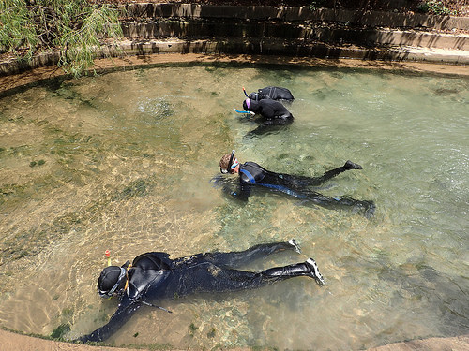
Eliza Spring salamander SCUBA survey
Austin Watershed Protection Department (2015)
Notes:
After the listing of the Barton Springs salamander, City of Austin biologists began weekly SCUBA surveys of the springs, to monitor the populations of salamanders. They restored habitat, revised cleaning procedures, and established a captive breeding population. This is the Barton Springs salamander, which was listed as an Endangered Species shortly after it was described. At that point, the City of Austin began a weekly SCUBA survey of Barton Springs to help track the populations of these salamanders.

Slide 38
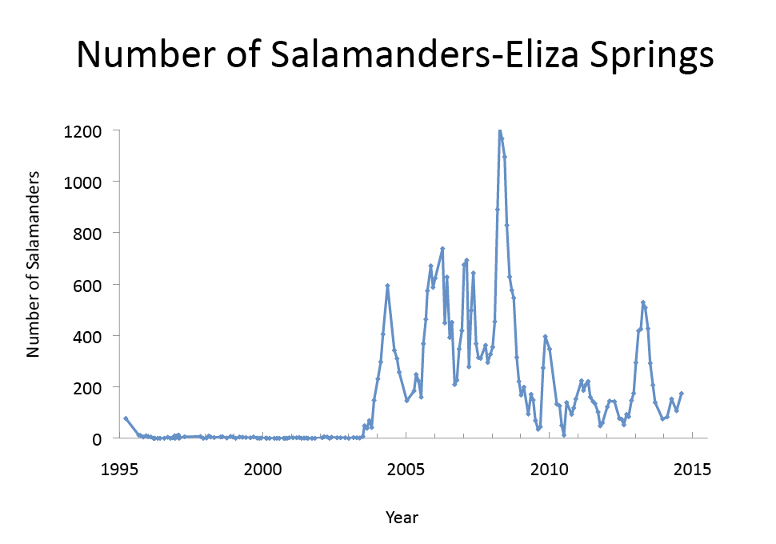
Restoration of habitat
in Eliza Springs (2003)
Donelle Robinson, City of Austin Watershed Protection Department (2016)

Slide 39
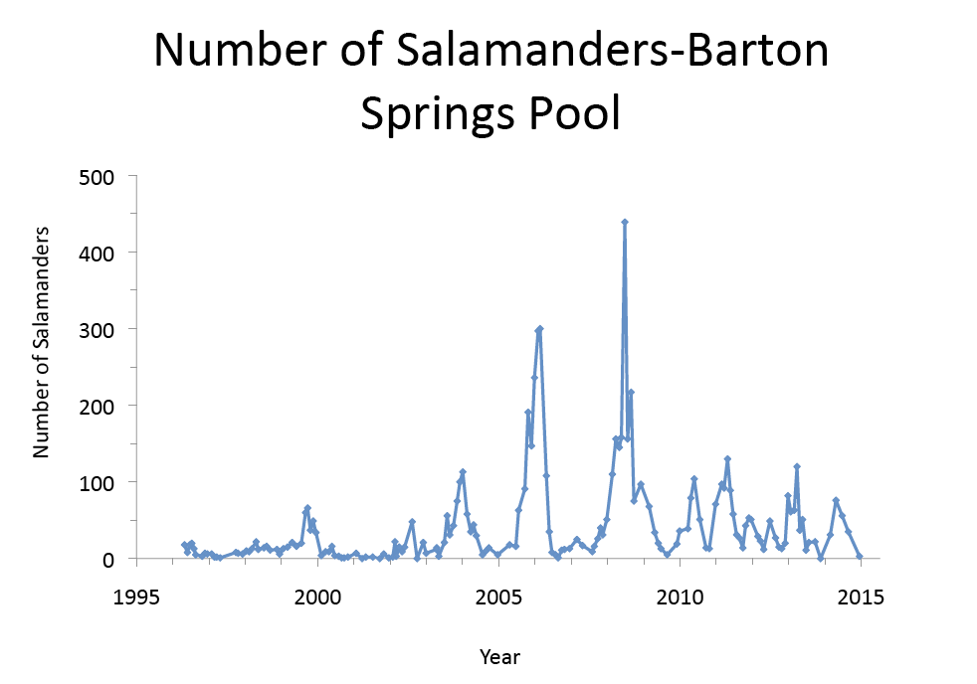
Donelle Robinson, City of Austin Watershed Protection Department (2016)

Slide 40
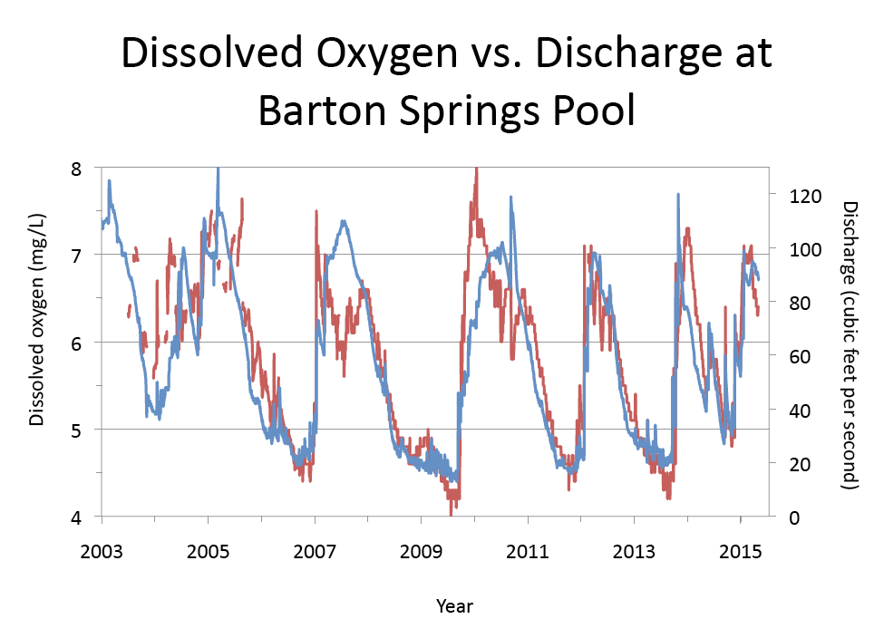
Donelle Robinson, City of Austin Watershed Protection Department (2016)

Slide 41
Dee Ann Chamberlain
City of Austin
Watershed Protection Department

Slide 42
Is this a new species of salamander?
Notes:
After about 10 years of that survey, Dee Ann Chamberlain, one of the biologists with the City of Austin, brought in another salamander that looked very different from Barton Springs salamanders.
This salamander looked very different from Barton Springs salamanders, but could two species of salamanders really be endemic to this intensely studied park in the middle of the City of Austin? The sequences from this species quickly answered this question.

Slide 43
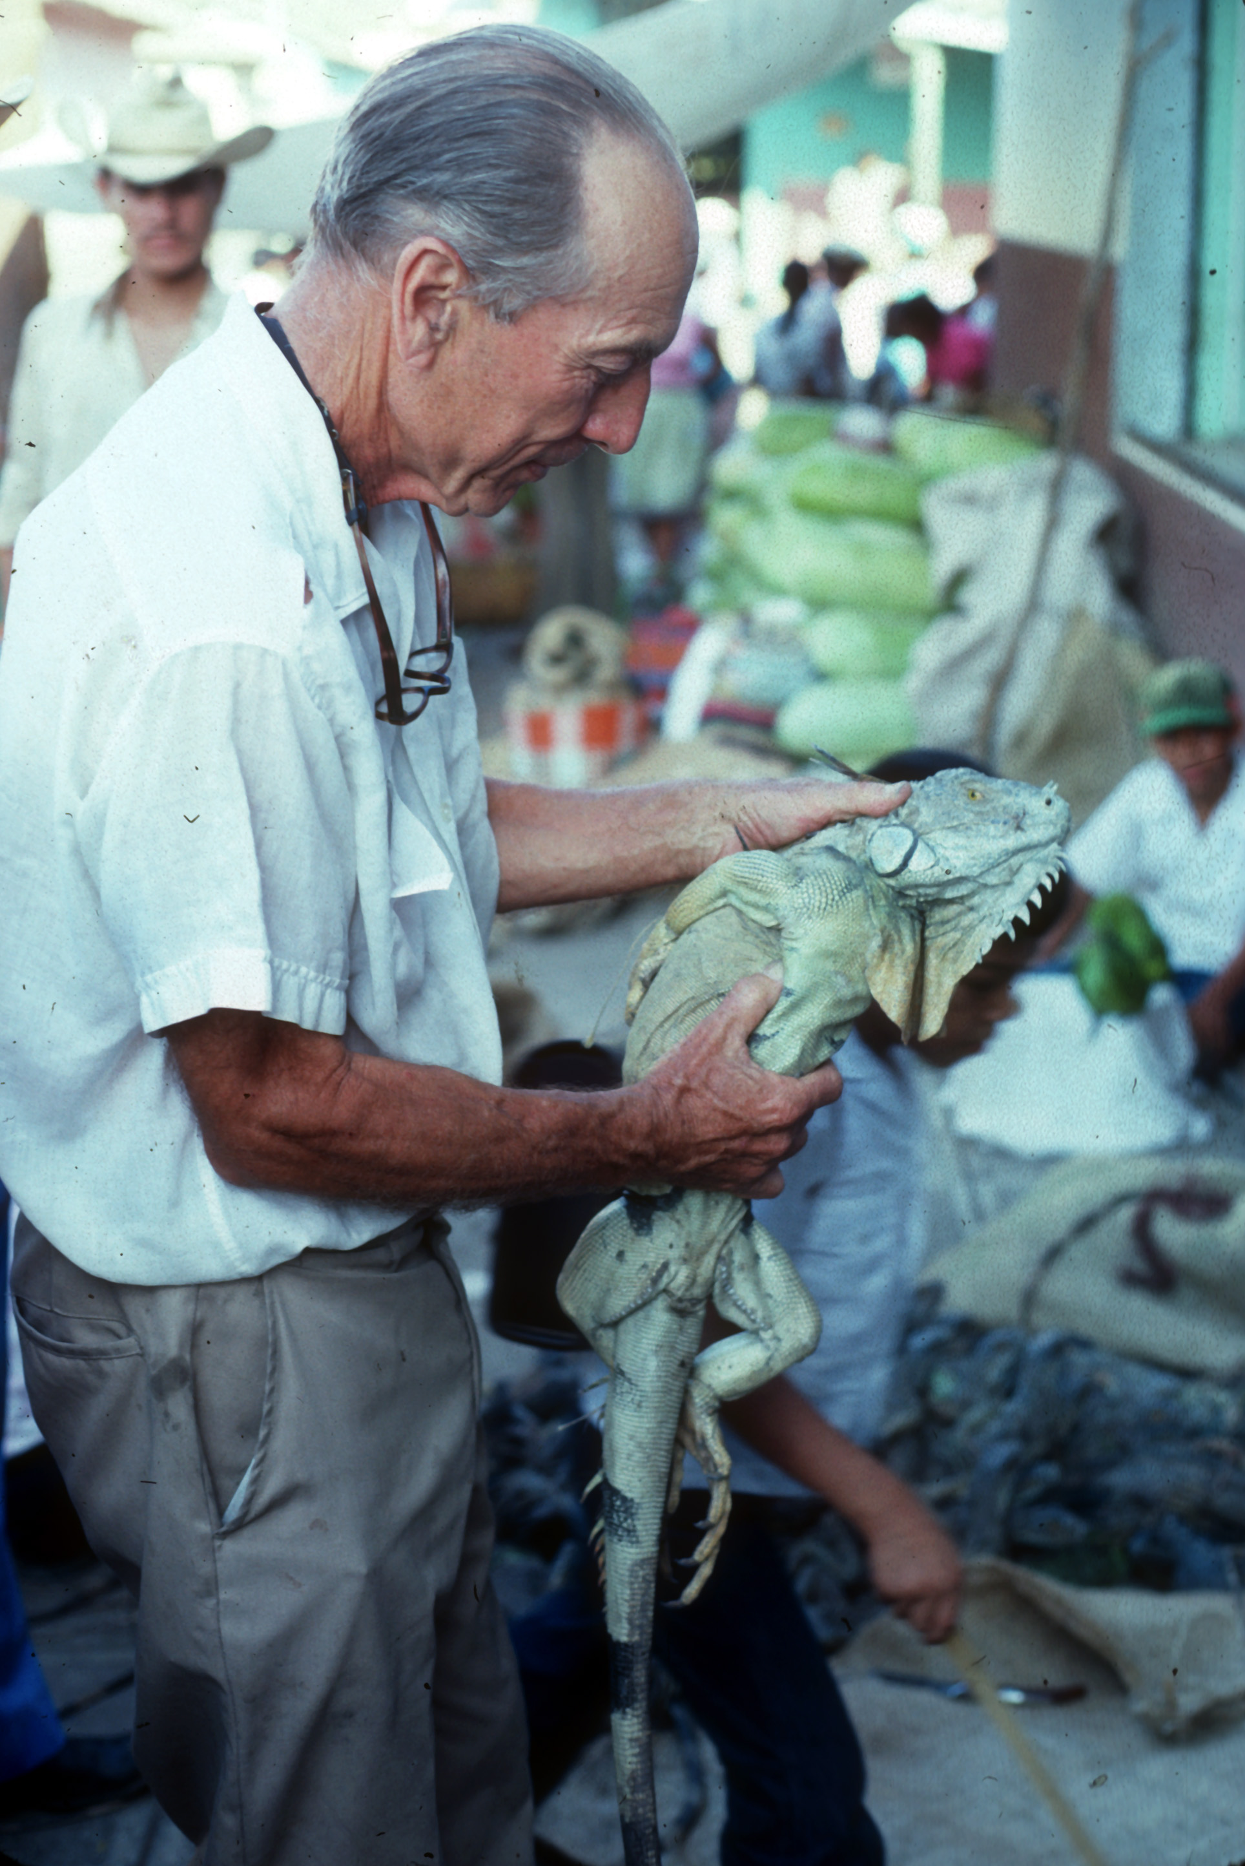
“You can observe a lot by just watching”
- Yogi Berra
Henry Fitch (1909 – 2009)
Tricorder, version TR590
Star Trek TV series
Notes:
The Tricorder was given this name in the Star Trek series because it has biological, geological, and meteorological channels. Since we will just consider the biological channel for now, I’ll call the dream device of biologists a “Biocorder”.

Slide 44
Is a “Biocorder of Life” Possible?
Step One
DNA isolation and amplification of a series of target genes
Step Two
Rapid sequencing of amplified genes
Step Three
Placement of unknown within the Tree of Life
Notes:
Is a the development of a “Biocorder” feasible? If we could rapidly isolate DNA from a sample, amplify a few target genes, sequence those genes, and then place the sequences into the context of the Tree of Life, then the problem would be solved. Unknown samples would either be placed within known species (which would immediately identify the sample), or else they would be placed in phylogenetic context to known species, but outside of any known genetic variation. In the latter case, the phylogenetic relationships would immediately classify the unknown species and highlight it as a new species to be named and described.
Today, all of these steps are carried out on a regular basis by biologists, but they require relatively expensive labs, highly trained personnel, and lots of time. The trick is to make all of this possible with small, inexpensive, mass-produced, and portable devices. Then anyone, anywhere could quickly identify any species he or she encountered. This would not only change the face of biological research, it would also allow other interested individuals to identify organisms of all kinds. Imagine testing yourself to see which pathogen is making you sick, and then sending this information to our family physician so that he or she can prescribe a treatment. Or perhaps you want to test some mushrooms that are growing in your yard to see if they are deadly poisonous or edible delicacies. Or military personnel might carry such a device to identify potential agents of biowarfare that were being released against troops. These are all examples of applications of a device that can quickly identify any organism on the planet.
It is technologically feasible to conduct all of these steps in a very small device. The DNA isolation and amplification steps can be carried out on specialized microfluidics chips that are about the size of a dime. The sequencing of the amplified DNA can be conducted using a process called sequencing-by-hybridization, in which the target sequence is hybridized to a microarray of short, synthetic nucleotide sequences on a glass microscope slide. (Other micro-scale sequencing techniques are also being developed.) Once the sequence has been obtained, placing the new sequence within the existing Tree of Life database is a fairly simple computational problem. Thus, all of these steps could be placed in a single, hand-held device. There are current development efforts aimed at producing such a device, so this will probably move from science fiction to science fact in the near future.

Slide 45
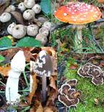
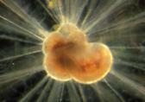
Notes:
This tree of life has 3,000 species. That’s less than 0.2% of the species currently on the planet, which in turn are less than 1% of the species that have lived on this planet over the last 540 million years.

Slide 46
Projected
Described species
Species with sequences
in GenBank
Hillis (2010) in Evolution Since Darwin: The First 150 Years.

Slide 47
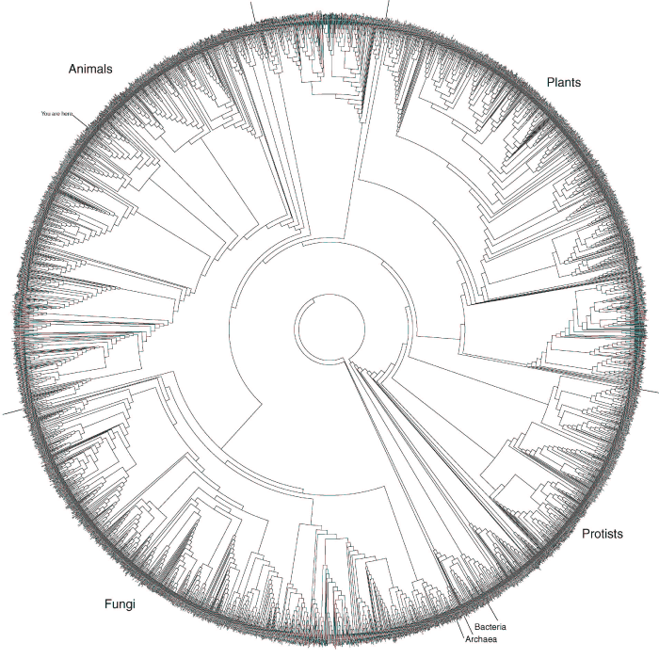
Tree of Life
You are here!
Amphibia Tree
(salamander)
Hillis, Guttell & Zwickl Science 300:1692-1697
Download from: http://www.zo.utexas.edu/faculty/antisense/DownloadfilesToL.html
Notes:
Now biologists are working to fill out the tips of the Tree of Life. For instance, one group of biologists (including biologists at the University of Texas) is working on the Amphibian Tree of Life project, which aims to build a phylogenetic tree of all known amphibians. These databases are critical for many applications, including the development of rapid methods of identification, such as the Biocorder.

Slide 48
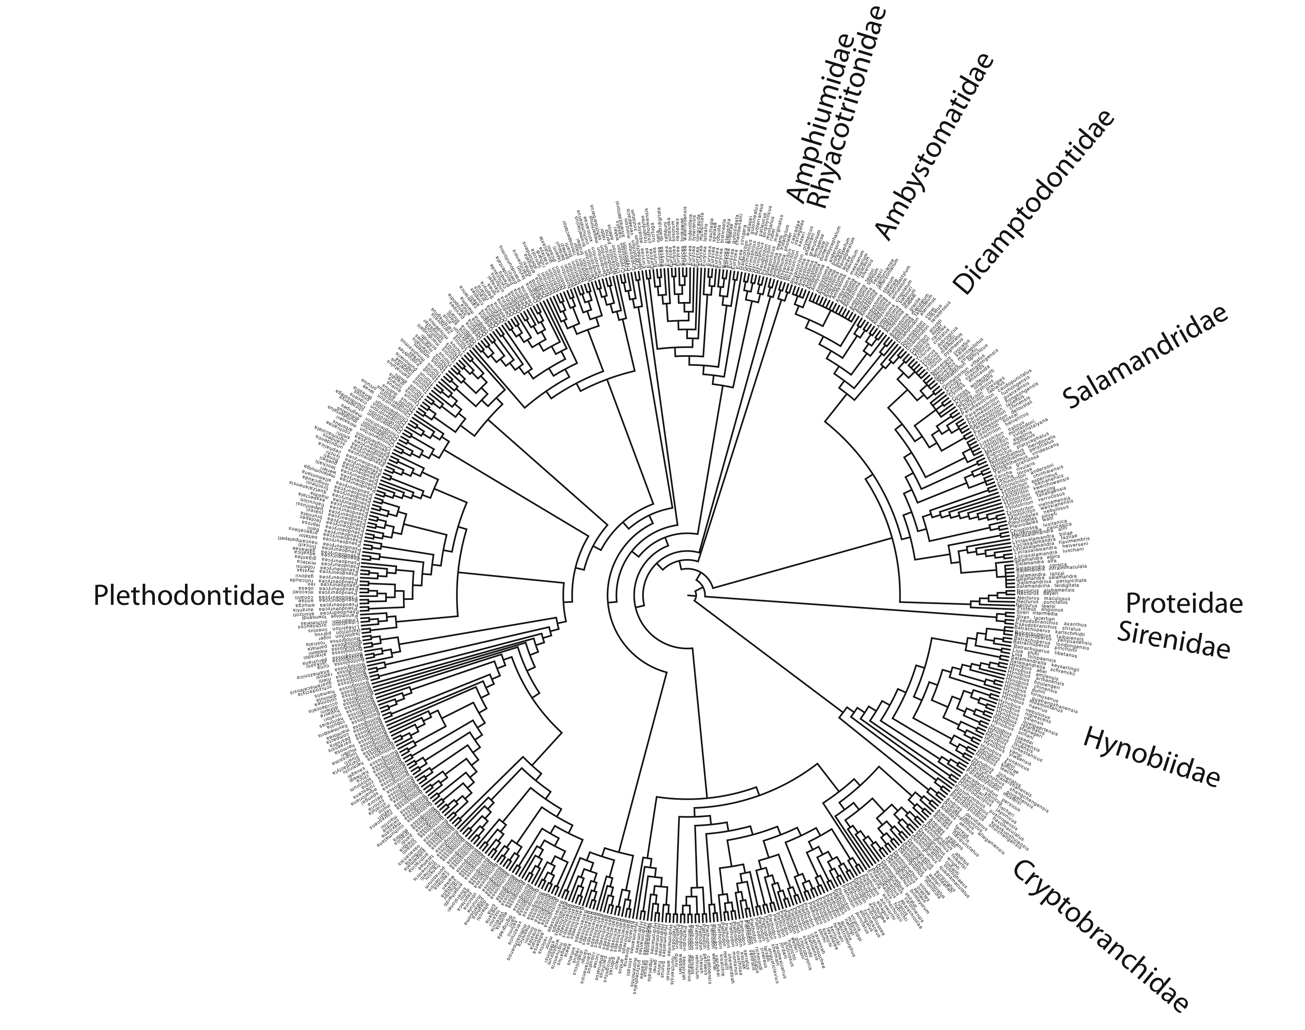
Tree of Life –Tree of all known salamanders
Lungless
Salamanders
Hillis (2010) in Evolution Since Darwin: The First 150 Years.
Notes:
This graph shows the progress in the discovery of amphibian species through time (in blue), and the progress of sequencing genes from amphibian species (in red). Not that we are still discovering lots of new species of amphibians (even as many species of amphibians are also being lost to extinction). But, biologists are collecting DNA sequences at a very rapid rate, and in 2007 about half of all species of amphibians have at least one region of DNA sequenced and deposited in GenBank, the public database for DNA sequences.

Slide 49
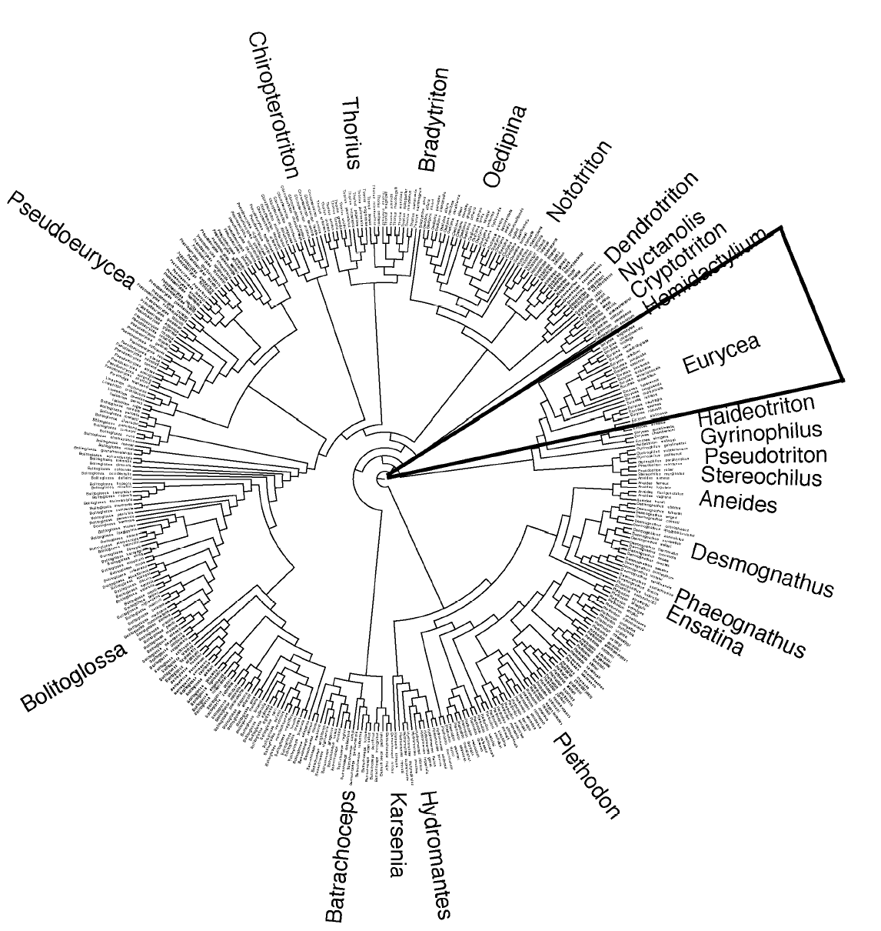
Tree of Life – Lungless Salamanders
Hillis (2010) in Evolution Since Darwin: The First 150 Years.

Slide 50
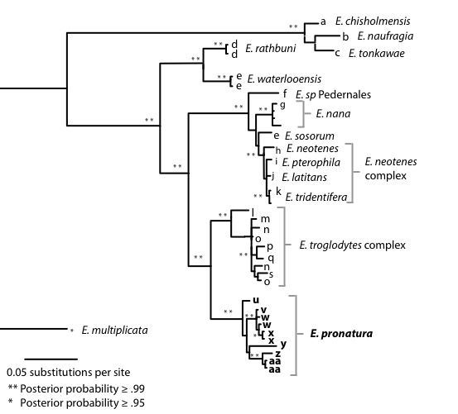
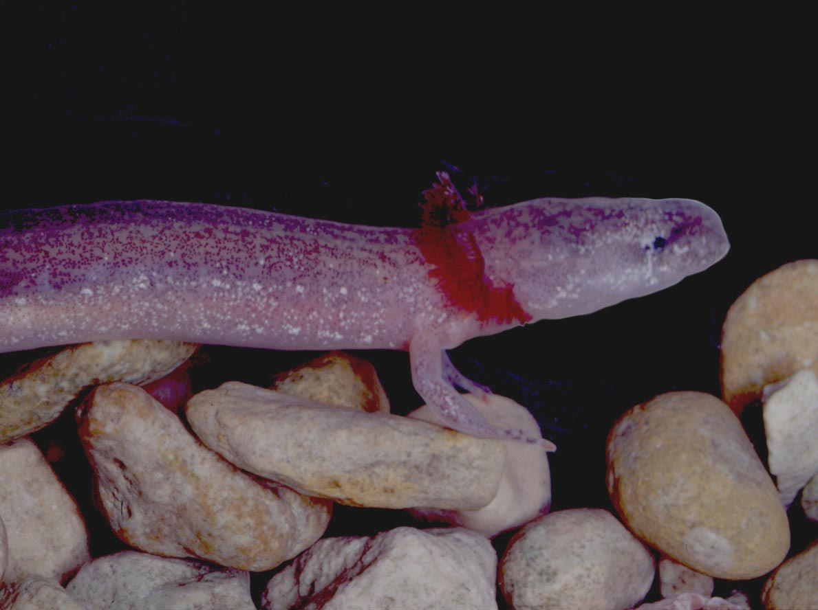
Spring and cave salamanders of Texas
Austin Blind salamander
Barton Springs salamander

Slide 51
We’ve continued to discover new species in other regions of the aquifer:

Slide 52
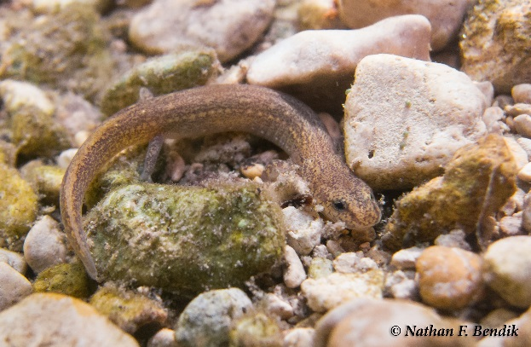
“It’s like déjà vu all over again” -Yogi Berra
“Different salamander, same goal”
Austin American Statesman, June 14, 2005
“An Austin environmental group has asked officials to add the Jollyville salamander to the list of endangered species, potentially creating new development controversies along the Travis-Williamson county line.”
“Williamson County officials oppose federal protection of salamander”
Austin American Statesman, January 22, 2014
Notes:
Austin American-Statesman, June 14, 2005
“Different salamander, same goal” “An Austin environmental group has asked federal officials to add the Jollyville salamander to the list of endangered species, potentially creating new development controversies along the Travis-Williamson county line.”
Austin American-Statesman, October 19, 2011
“Salamander's survival at odds with development”
Austin American-Statesman June 19, 2012
“Carter to fight listing of salamanders” “Standing under a Texas 45 overpass in southwestern Williamson County, just a few yards from a natural spring, U.S. Rep. John Carter said Monday that he will introduce federal legislation aimed at stopping any proposals to add four species of Central Texas salamanders - including one living in the spring - to the endangered species list.”
(Note: deleted slides 87-93)
Austin American-Statesman, October 9, 2012
“Travis County commissioners asked to back staff recommendation to list salamanders as endangered”
“Travis County staffers said Tuesday that they support the listing of four species of salamanders in Central Texas on the federal government’s endangered species list.
If the county commissioners vote in favor of the staff recommendation they would join the City of Austin, which voted on the issue Sept. 27, in supporting the listing. In Williamson County, cities, school districts and the county have passed formal resolutions against the listing, saying more research needs to be done and citing concerns about the impact a listing would have on development.”
Austin American-Statesman, January 22, 2014
“Williamson County officials oppose federal protection of salamander” “GEORGETOWN - A day before public comment ends on whether the Georgetown salamander should be federally protected, Williamson County commissioners threw in their two cents.”

Slide 53
But Austin and Travis County have learned to embrace their inner salamanders!
“Travis County commissioners asked to back staff recommendation to list salamanders as endangered”
Austin American-Statesman, October 9, 2012
“Travis County staffers said Tuesday that they support the listing of four species of salamanders in Central Texas on the federal government’s endangered species list…[joining] the City of Austin, which voted on the issue Sept. 27, in supporting the listing.”
Notes:
Austin American-Statesman, June 14, 2005
“Different salamander, same goal” “An Austin environmental group has asked federal officials to add the Jollyville salamander to the list of endangered species, potentially creating new development controversies along the Travis-Williamson county line.”
Austin American-Statesman, October 19, 2011
“Salamander's survival at odds with development”
Austin American-Statesman June 19, 2012
“Carter to fight listing of salamanders” “Standing under a Texas 45 overpass in southwestern Williamson County, just a few yards from a natural spring, U.S. Rep. John Carter said Monday that he will introduce federal legislation aimed at stopping any proposals to add four species of Central Texas salamanders - including one living in the spring - to the endangered species list.”
(Note: deleted slides 87-93)
Austin American-Statesman, October 9, 2012
“Travis County commissioners asked to back staff recommendation to list salamanders as endangered”
“Travis County staffers said Tuesday that they support the listing of four species of salamanders in Central Texas on the federal government’s endangered species list.
If the county commissioners vote in favor of the staff recommendation they would join the City of Austin, which voted on the issue Sept. 27, in supporting the listing. In Williamson County, cities, school districts and the county have passed formal resolutions against the listing, saying more research needs to be done and citing concerns about the impact a listing would have on development.”
Austin American-Statesman, January 22, 2014
“Williamson County officials oppose federal protection of salamander” “GEORGETOWN - A day before public comment ends on whether the Georgetown salamander should be federally protected, Williamson County commissioners threw in their two cents.”

Slide 54
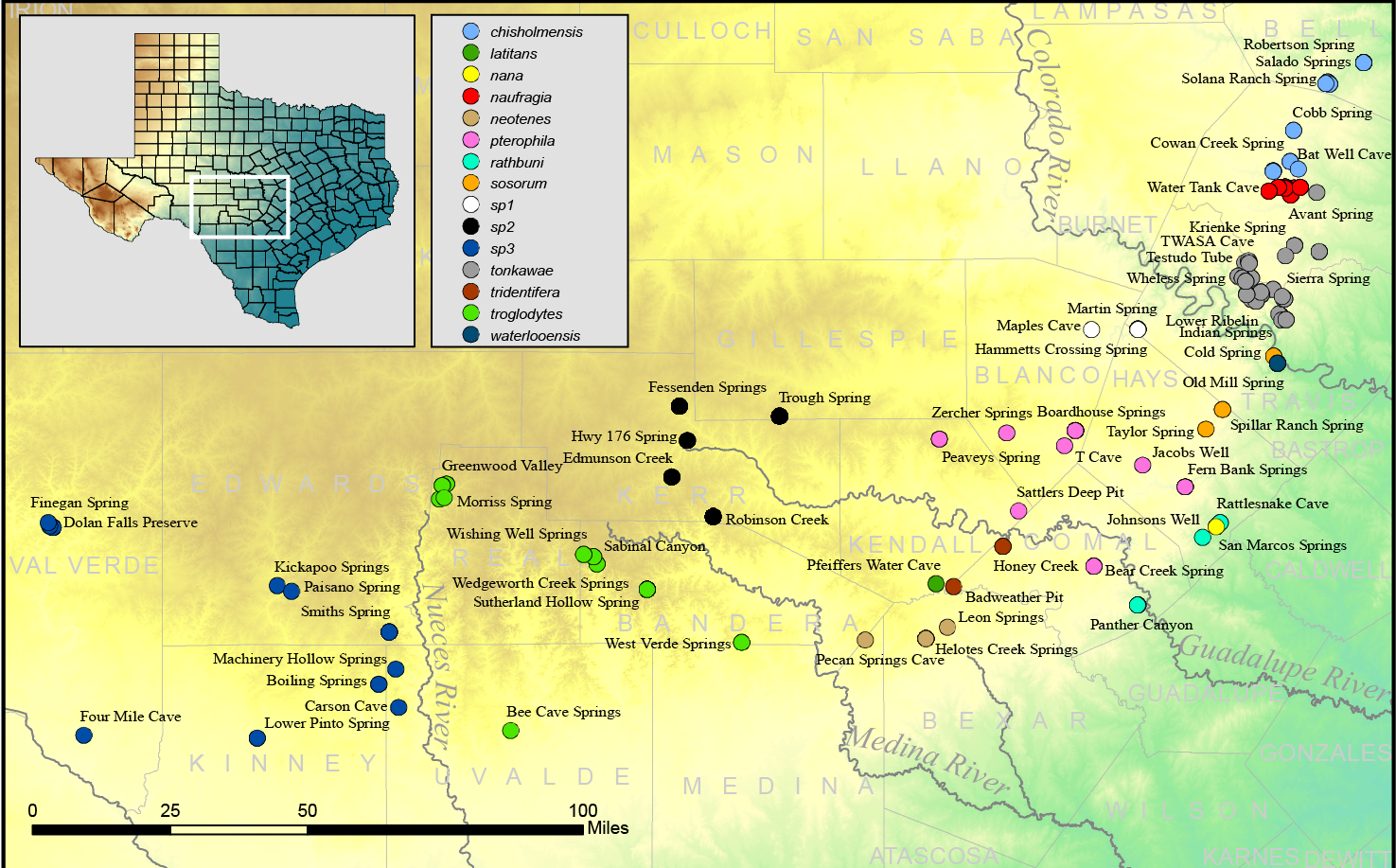
Salamander Species Unique to Central Texas

Slide 56
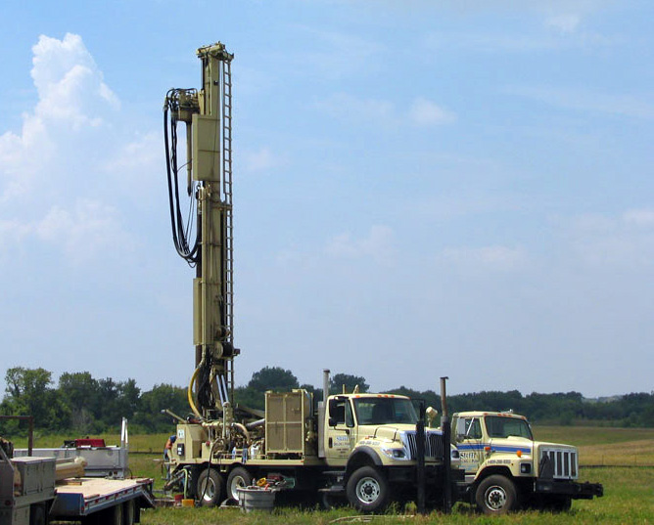
Drilling for salamanders

Slide 57
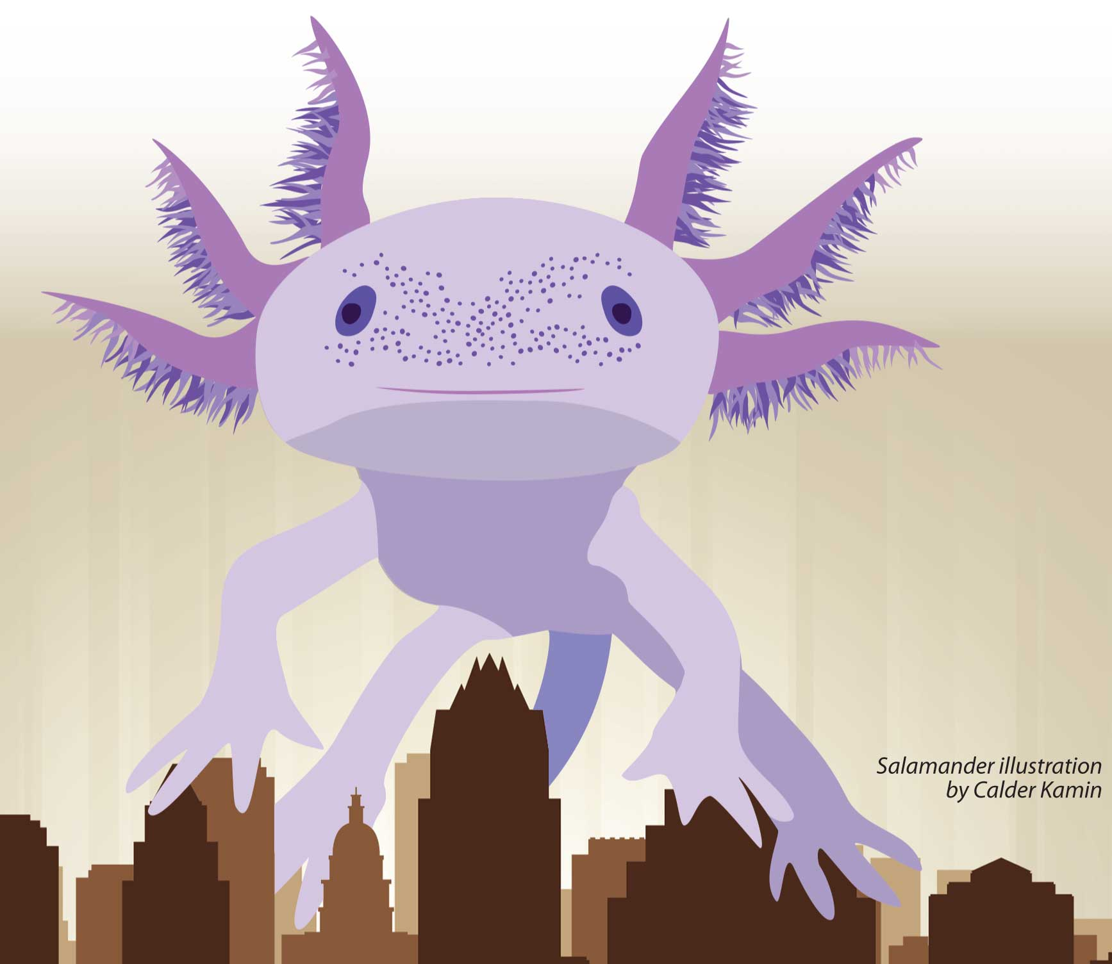
Have the salamanders done enough to save the humans?
It is not humans versus salamanders.
Saving salamanders =
Saving humans
(and the water supply that we all need to survive)
Notes:
It is not humans versus salamanders.
Both species require clean, abundant
water for survival.

Slide 58
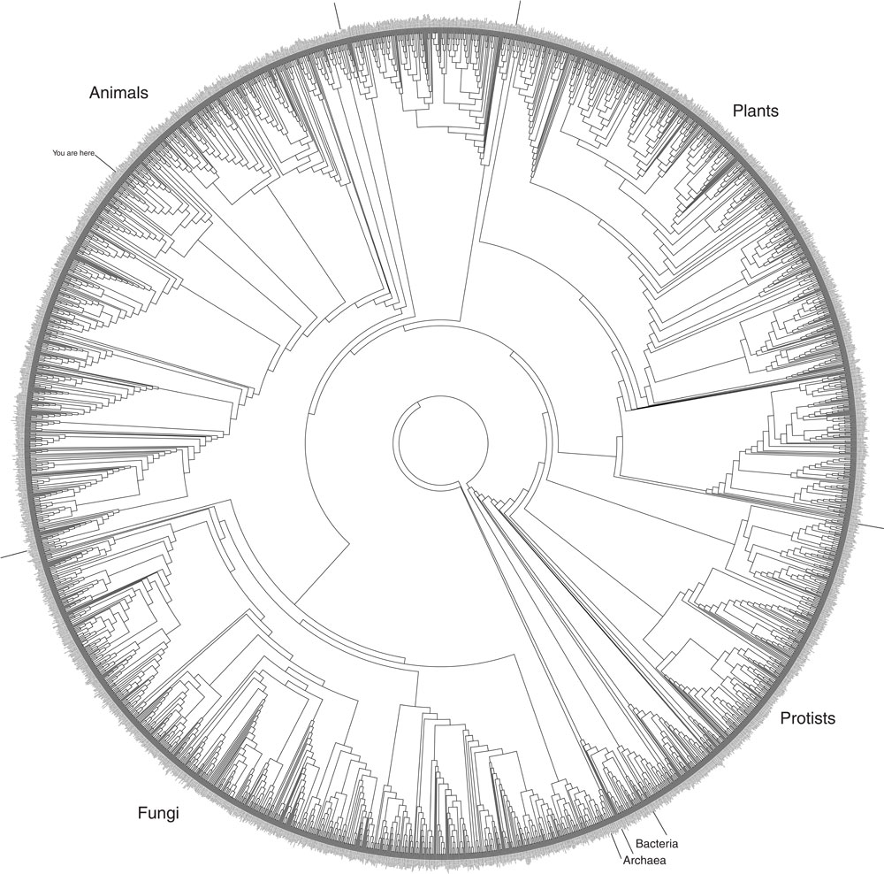
“It all boils down to this: that all life is interrelated. We are all caught in an inescapable network of mutuality, tied into a single garment of destiny. Whatever affects one destiny, affects all indirectly.”
Martin Luther King, Jr.

Slide 60
Acknowledgements
Former graduate students: Paul Chippindale, Emily McTavish, April Wright
Former postdocs: Tom Wilcox and Tom Devitt
UT Collaborator: David Cannatella
City of Austin: Dee Ann Chamberlain, Lisa O’Donnell, Laurie Dries, Nathan Bendik, Tom Devitt, Donelle Robinson
Texas Parks and Wildlife Department: Andy Price, Chad Norris, and Andy Gluesenkamp
NSF for funding through Presidential Young Investigator Award; USFWS for Section 6 funding through the Endangered Species Act (via the TPWD)
The late Yogi Berra for a lifetime of wonderful contributions to the American idiom
The moral, communist salamanders of the Edwards Plateau
Questions?

Slide 61
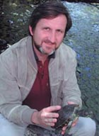
Dr. David Hillis
David M. Hillis received his B.S. degree (with honors) from Baylor University in 1980, and M.A., M.Ph. and Ph.D. (all with honors) from The University of Kansas in 1983, 1984, and 1985, respectively. After two years on the faculty at the University of Miami, he joined the Department of Zoology at UT Austin in 1987 and was awarded a prestigious National Science Foundation Presidential Young Investigator Award the same year. In 1992, he was appointed to the Alfred W. Roark Centennial Professorship in Natural Sciences, and in 1998 became the first Director of the School of Biological Sciences at the University of Texas - Austin. In 1999, Hillis was one of 32 people chosen to receive a prestigious MacArthur Foundation fellowship, known informally as the “genius award”.
David Hillis’ research interests span much of biology, from development of statistical and computational methods for analyzing DNA sequences, to molecular studies of viral epidemiology, to studies of the diversity and phylogeny of life (particularly vertebrates), to the origin and behavior of unisexual organisms. He has published over 130 scholarly articles and two technical books, and has served as Editor or Associate Editor of a dozen scientific journals. He is an active member of many scholarly societies and national research panels, and has served as the President of the Society of Systematic Biologists. In the past decade, the 23 graduate students and 12 post docs in his laboratory have produced an additional 120 independent scholarly articles.

