Slide 1

Space Exploration: From Science
Fiction to the Texas Spacecraft
Laboratory
# 89
Dr. Glenn Lightsey
March 1, 2014
Produced by and for Hot Science - Cool Talks by the Environmental Science Institute. We request that the use of these materials include an acknowledgement of the presenter and Hot Science - Cool Talks by the Environmental Science Institute at UT Austin. We hope you find these materials educational and enjoyable.

Slide 2

Space Exploration:
From Science Fiction to the Texas Spacecraft Lab
Texas Spacecraft Laboratory
E. Glenn Lightsey
Professor
Dept. of Aerospace Engineering
and Engineering Mechanics
March 1, 2014

Slide 3
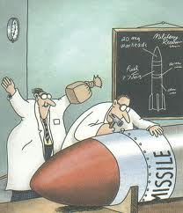
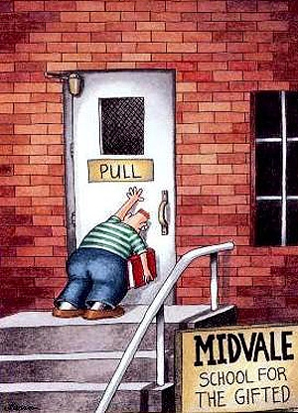
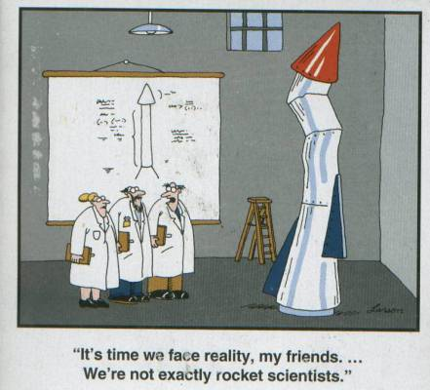

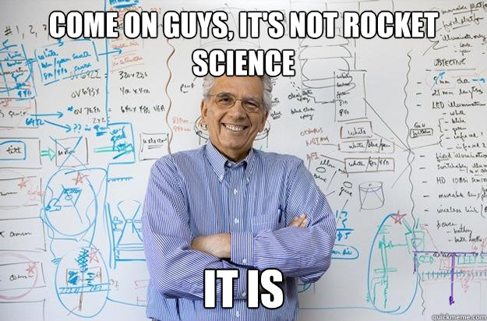
Yes, This Is Rocket Science!
Texas Spacecraft Laboratory
Images: G. Larson, Big Bang Theory, internet meme

Slide 4
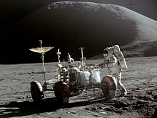
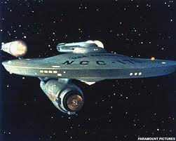


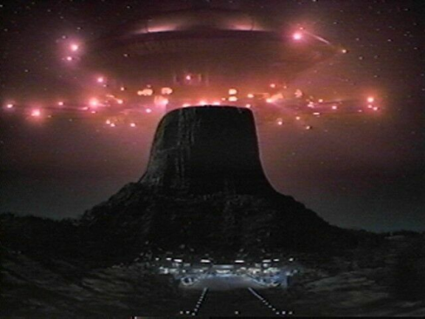
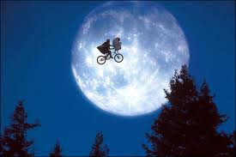
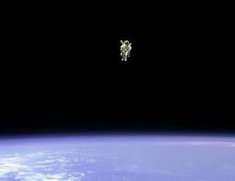
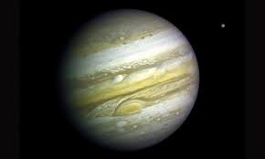
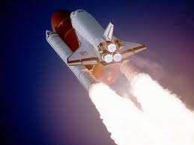
Images I Watched Growing Up
Texas Spacecraft Laboratory
Notes:
Grew Up Watching Space Media and Science Fiction
Apollo, Star Trek, Voyager, Star Wars, Space Shuttle, Carl Sagan’s Cosmos, Alien, Bladerunner, Contact, International Space Station
Passionate about Space Exploration and Development
By Any Means: Scientific, Commercial, Security

Slide 5
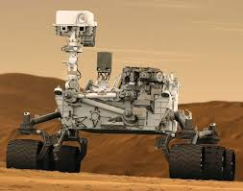


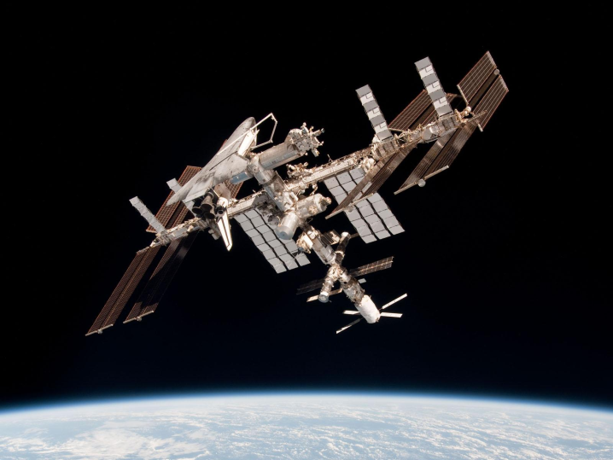
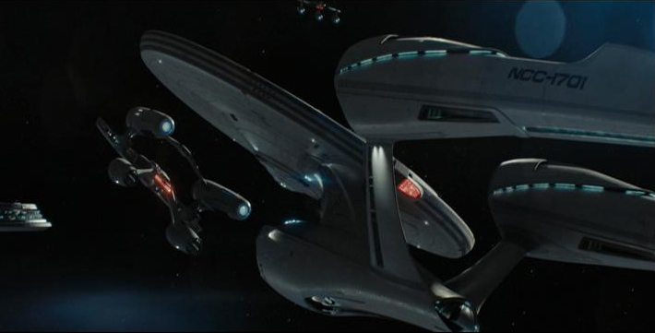
Space Images Today
You May Have Seen
Texas Spacecraft Laboratory
Notes:
Top row, L-R: Mars Rover Curiosity (NASA Wikimedia Commons); Star Wars Episode 1 (fan art from AndrewSS7 on deviantart.com); Gravity, Dr. Ryan Stone (Gravity fan art from Mewax42 on deveiantart.com).
Bottom row, L-r: USS Enterprise Star Trek 2009 (from Bill Lile via Flickr); Neil Degrasse Tyson, Bill Nye, and NASA people, 2012 Space Conference group portrait (Wikimedia commons).

Slide 6
Today’s Talk
Texas Spacecraft Laboratory
Space Myths
  Some interesting facts about space
Are We There Yet?
  Some basic information about space travel
The Texas Spacecraft Lab
  A description of my research lab and the projects my students and I are working on

Slide 7
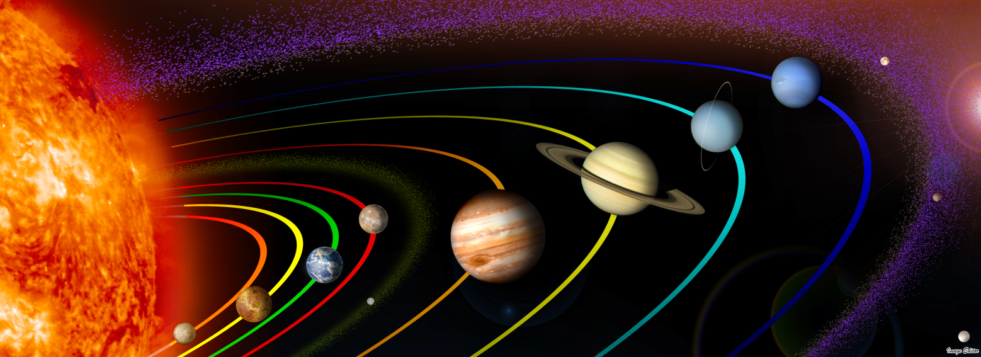
Space Myths
Texas Spacecraft Laboratory
Myth #1: “The Earth orbits around the…”
  25% of Americans could not correctly answer this question in a 2013 survey
All of the planets in our solar system orbit the Sun.
Flickr: Image Editor, for SciTech Lab blog post

Slide 8
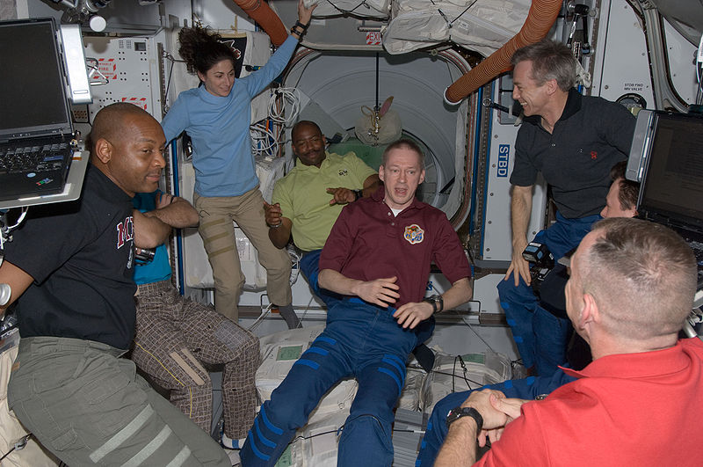
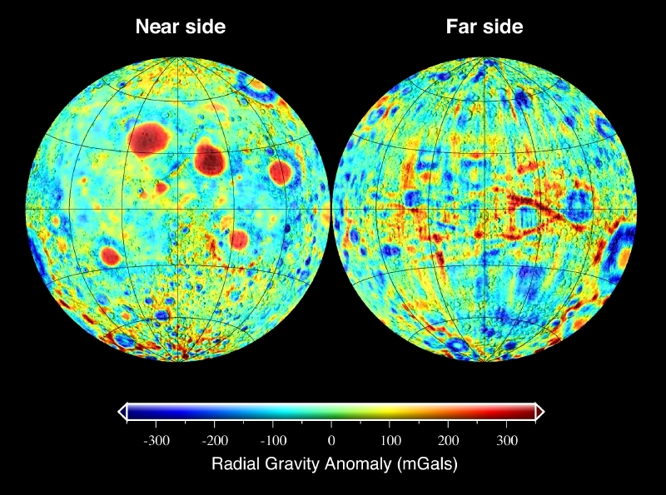
Space Myths
Texas Spacecraft Laboratory
Myth #2: “There is no gravity in space.”
All objects have mass and gravity, even in space.
Wikipedia: STS-129 and Expedition 21 crew members shortly after Atlantis and the ISS docked.
Wikipedia: Gravitation of the Moon

Slide 9
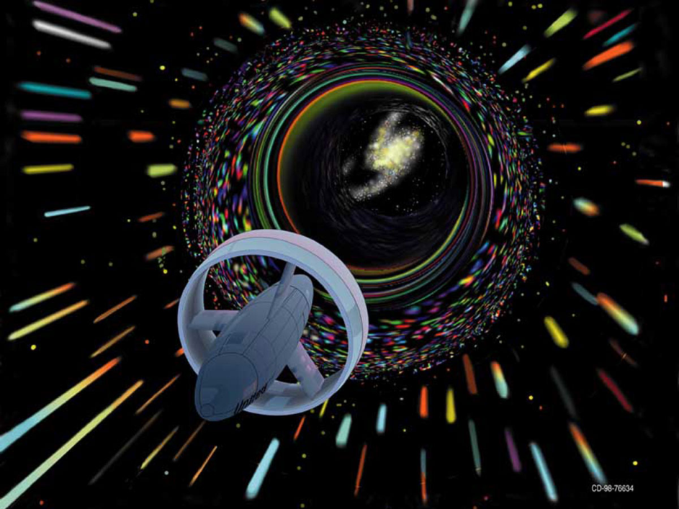

Space Myths
Texas Spacecraft Laboratory
Myth #3: “Faster Than Light travel is possible.”
FTL travel breaks physics as we understand it today.
Wikipedia: Faster Than Light
Wikipedia: Interstellar travel

Slide 10
Space Myths
Texas Spacecraft Laboratory
Myth #4: “NASA consumes 25% of the US Budget.”
  Most common response in a 2006 survey.
It’s actually <0.5%, the lowest level since 1959. NASA founded in 1958.

Slide 11
Today’s Talk
Texas Spacecraft Laboratory
Space Myths
  Some interesting facts about space
Are We There Yet?
  Some basic information about space travel
The Texas Spacecraft Lab
  A description of my research lab and the projects my students and I are working on

Slide 12

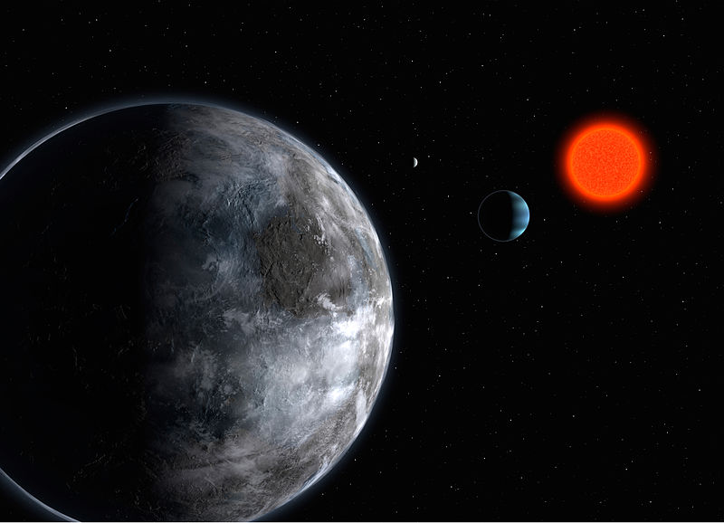
What is Space?
Texas Spacecraft Laboratory
Look around you—you are in space! We evolved to live here.
Human Habitable Zone = 2 miles above sea level on Earth
Most of space is not habitable.
No other place is known where humans might live.
Image: Wallcoo.net
But, we do see evidence for other Earth-like planets
Image: Wikipedia, Planetary system in Gliese 581

Slide 13
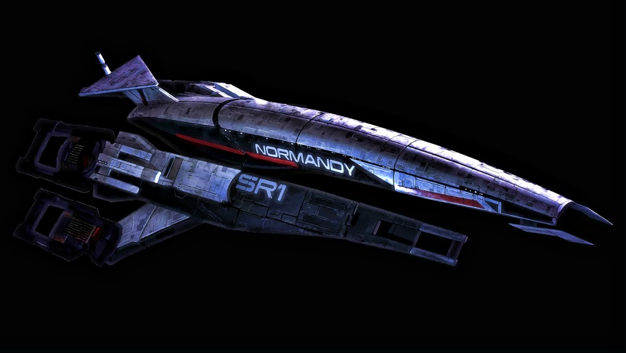

What Is a Space Ship?
Texas Spacecraft Laboratory
If we can build space ships to leave the Earth’s atmosphere, what do they look like and what can they do?
Surrounds and protects its cargo
Your car is a space ship!
The Earth is one example of a space ship, but we can’t maneuver it
Image: TehnologyBloggers.org
Image: www.wallconvert.com

Slide 14
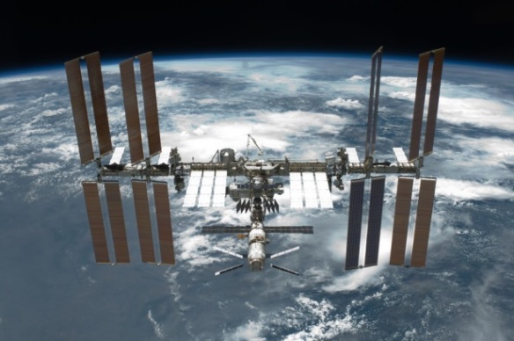
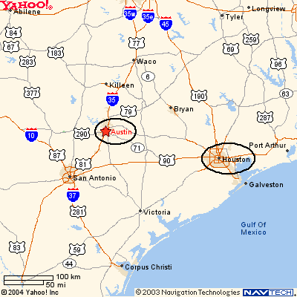
Space Is Not That Far Away…
Texas Spacecraft Laboratory
Most of space is an empty void, sparsely populated with atoms and molecules.
But it exists. We have to move through it if we want to go somewhere else.
Image: NASA
“Space” is only 400 km above our heads. That’s the altitude of the International Space Station.
It’s just one trip from Austin to Houston in the vertical direction.
Image: hillaryanddavid.com

Slide 15
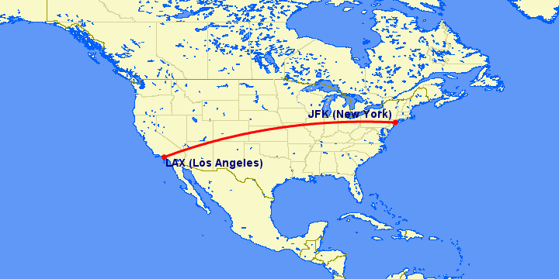
…But Space Is Really Big
Texas Spacecraft Laboratory
One cross country flight from NYC to LA is 4,000 km
Image: gcmap.com

Slide 16
How Far Away Is The Moon?
Texas Spacecraft Laboratory

Slide 17
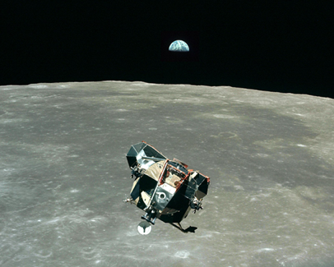
How Far Away Is The Moon?
Texas Spacecraft Laboratory
Image: freemars.org
The Moon is 400,000 km from Earth
  — 100 cross country trips in the vertical direction
  — Trip can be made in a few days
The Moon can be (and has been) visited by humans with current technology.
Image: NASA

Slide 18
How Far Away Is Mars?
Texas Spacecraft Laboratory

Slide 19
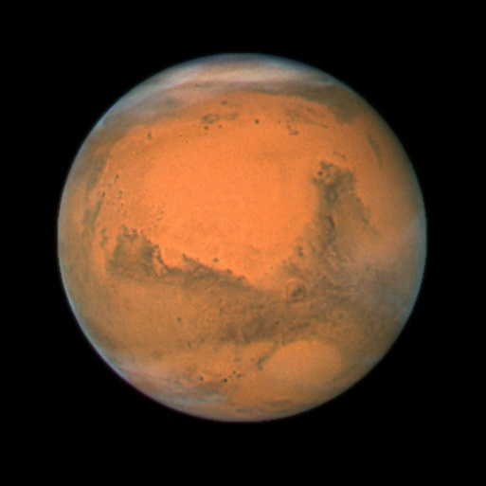
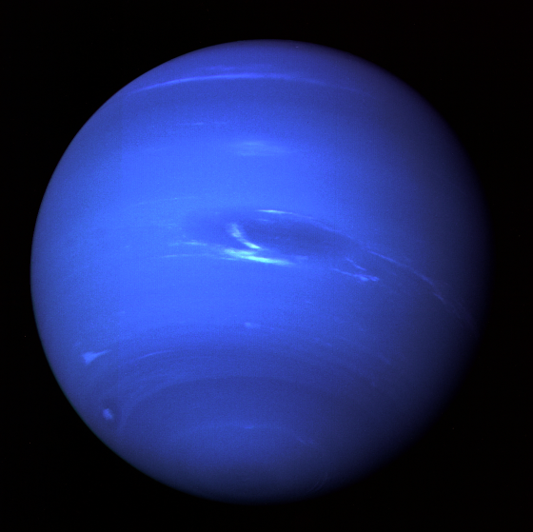
How Far Away Are The Planets?
Texas Spacecraft Laboratory
Mars
  500,000,000 km away
  133,000 cross country flights
  Trip takes months/years
  How do we keep astronauts alive the whole time?
Image: NASA
Neptune
  4,500,000,000 km away
  A million+ cross country flights
  Trip takes years in our solar system
Image: NASA

Slide 20
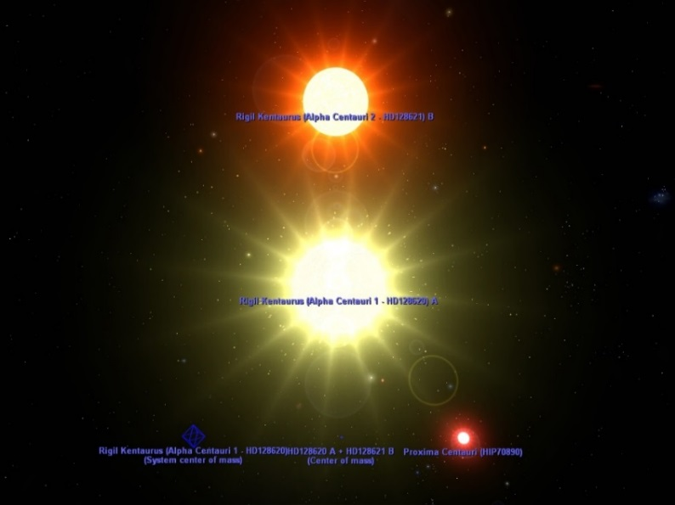
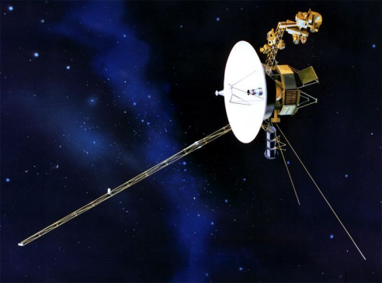
Our Nearest Star
Texas Spacecraft Laboratory
Alpha Centauri
  4.5 light years away
  Light travels 300,000 km per second
  8,400,000,000 cross country trips!
Voyager probe
  Travels 38,000 miles per hour = 17 km per second
  75,000 years to reach 4.5 light years
  History of civilization = 10,000 years
Image: mpl3d.com
Image: spacetoday.org

Slide 21
Today’s Talk
Texas Spacecraft Laboratory
5 Space Myths
  Some interesting facts about space
Are We There Yet?
  Some basic information about space travel
The Texas Spacecraft Lab
  A description of my research lab and the projects my students and I are working on

Slide 22
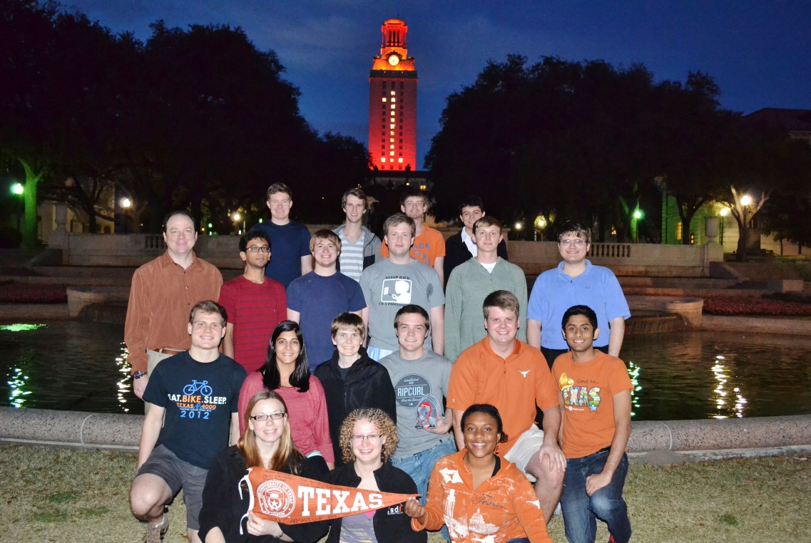
Who We Are
Texas Spacecraft Laboratory
UT Tower is lit orange for ARMADILLO as winner
of the national University Nanosatellite Program, 2013

Slide 23
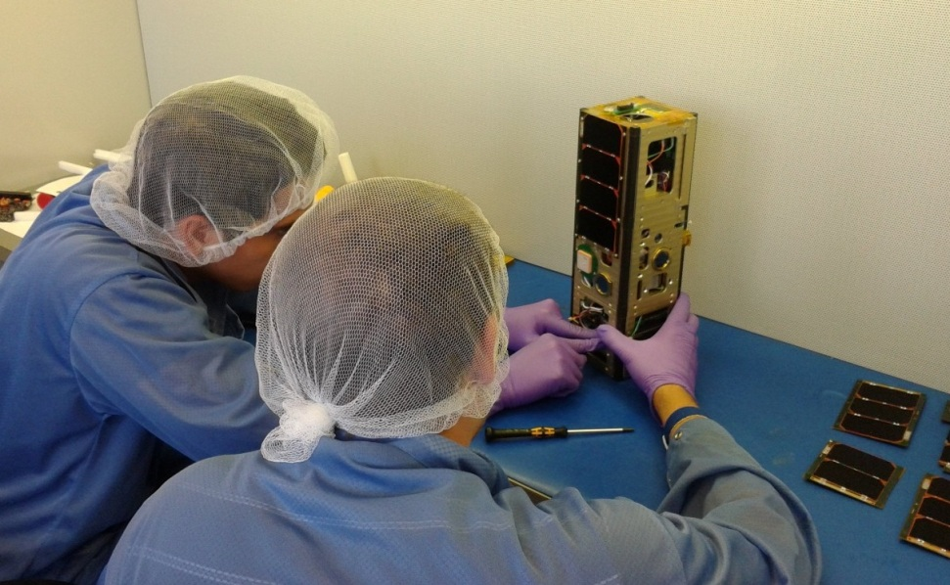
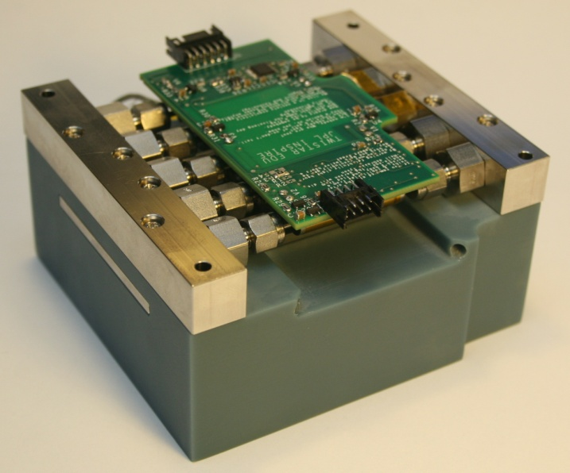
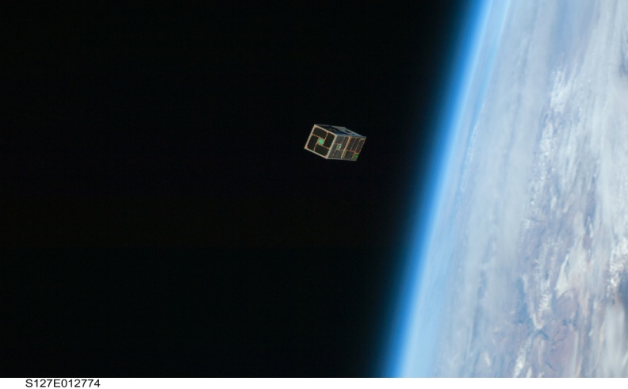
What We Do
Texas Spacecraft Laboratory
3D Printed Thruster
Bevo-2 Satellite Integration
LoneStar-1 Launch

Slide 24
Why Our Research Matters
Texas Spacecraft Laboratory
We are advocates for space exploration, and for conducting science and human operations in space.
But, getting to space is hard.
With our research, we hope to create a future where space is more accessible and routine for everyone.

Slide 25
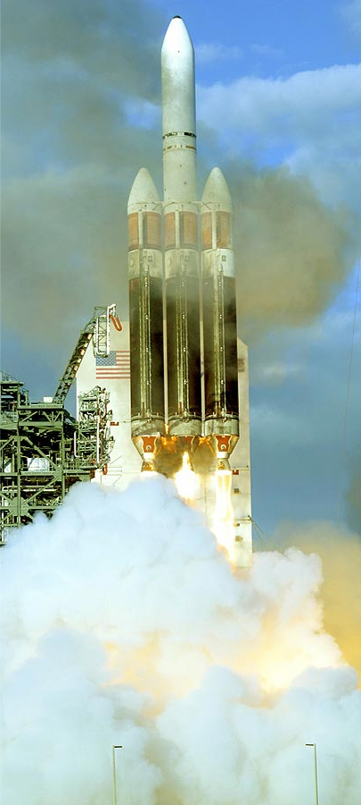
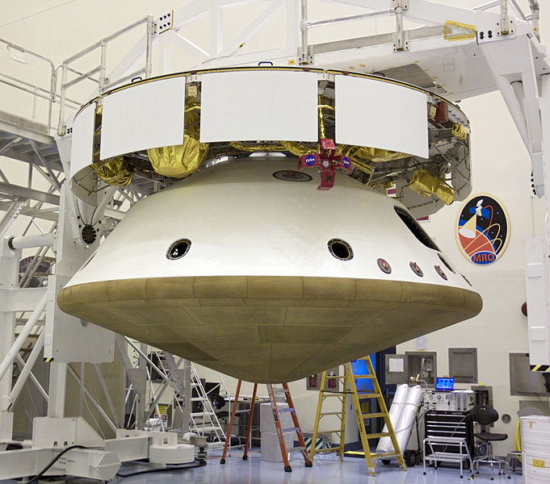

Why Going To Space Is Hard
Texas Spacecraft Laboratory
Mars Curiosity Rover
Image: NASA
Costs as much as:
(roughly)
Image: spaceflightnow.com
Image: mohammaedjewelers.com

Slide 26
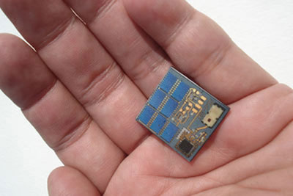
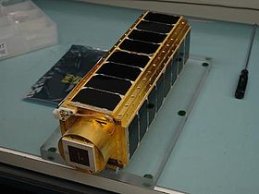

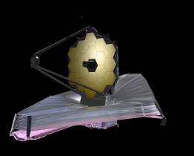
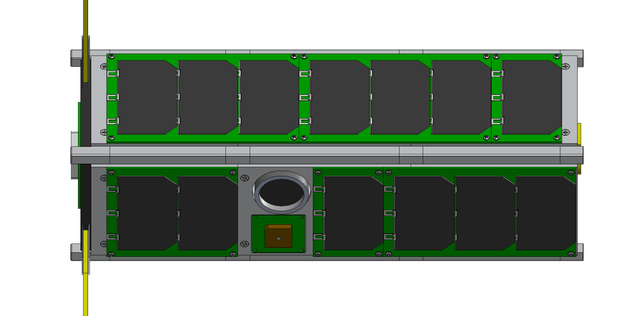
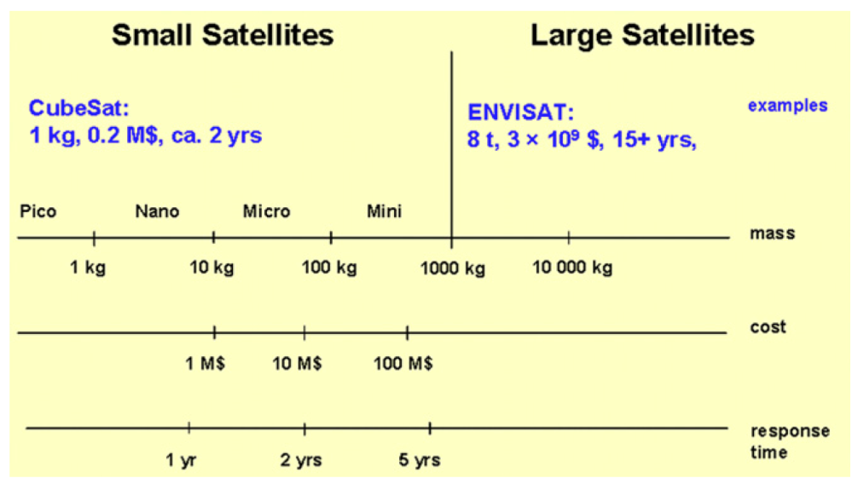
Small Satellites, The Enabler
Texas Spacecraft Laboratory
Standard 3-Unit CubeSat
Chipsat
Cubesat
Curiosity
James Webb ST
Images: NASA
~30 cm
~10 cm
Small Satellites Mass-Cost-Time Relation
(from: Sandau et al., ISPRS Journal of Photogrammetry and Remote Sensing, 65, 2010)

Slide 27
Small Satellites To Scale
Texas Spacecraft Laboratory
Mars Curiosity Rover
CubeSat
30 cm,
4 kg
(10 lbs)
Image: NASA
4.5 m, 3900 kg (9000 lbs)

Slide 28
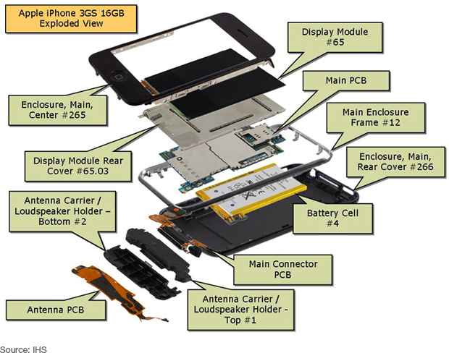
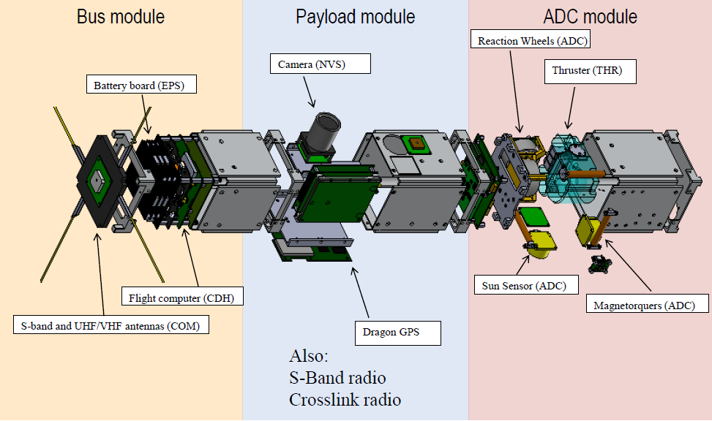
Your Cell Phone-A Satellite?
Texas Spacecraft Laboratory
Our Satellite (ARMADILLO):
Your Cell Phone:
Image: electronics360.globalzone.com

Slide 29
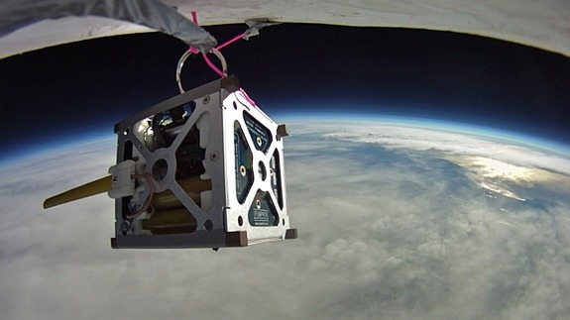
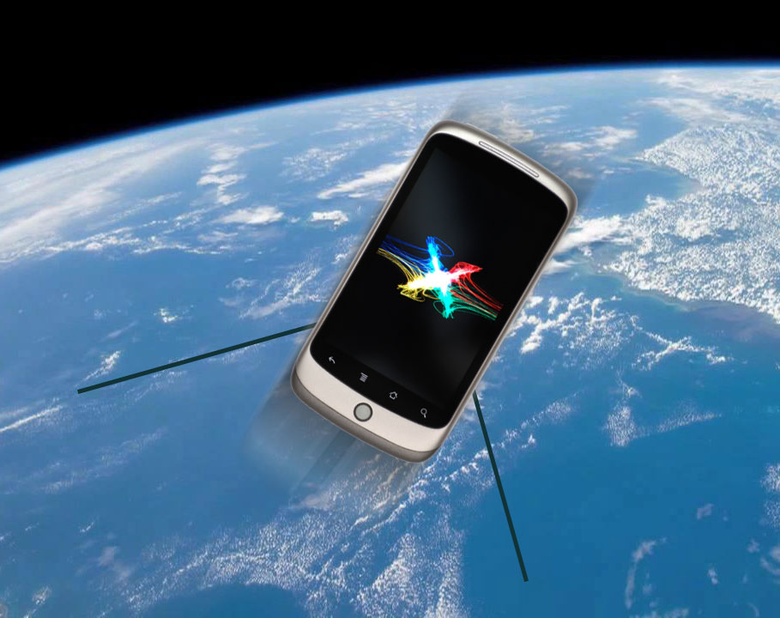
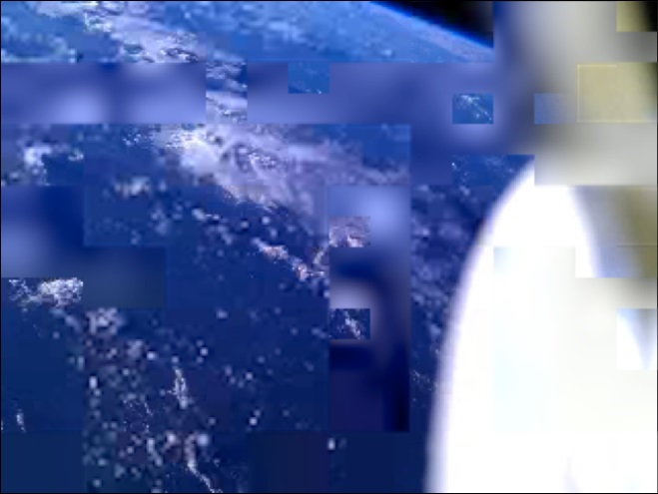
NASA’s PhoneSat Missions
Texas Spacecraft Laboratory
Launched on April 2013, November 2013
Image received
from PhoneSat
Image: vrzone.com
Cost of PhoneSat: $7,500
Images: NASA

Slide 30
Commercial Ventures
Using Small Satellites
Texas Spacecraft Laboratory

Slide 31
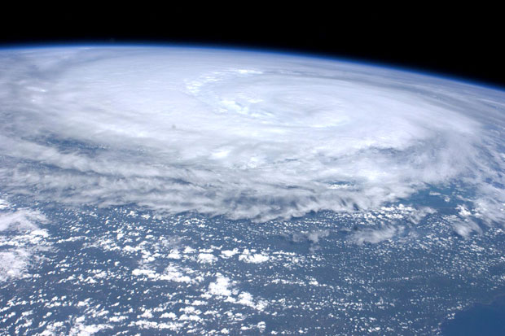
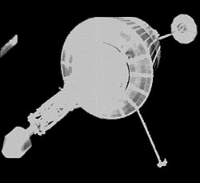
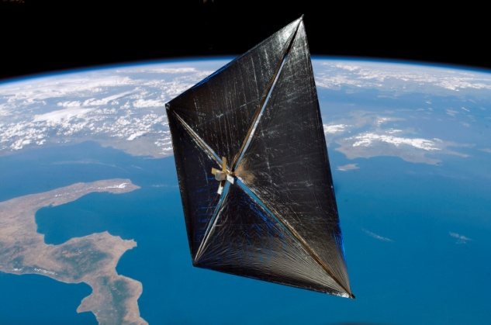
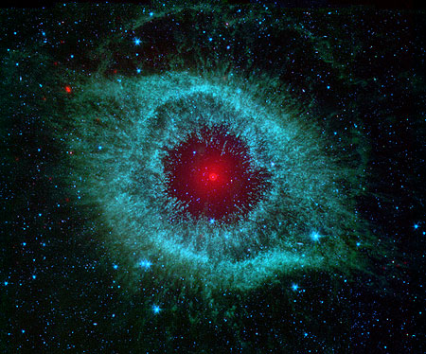
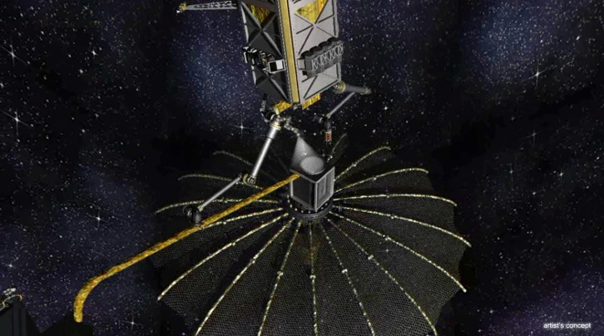
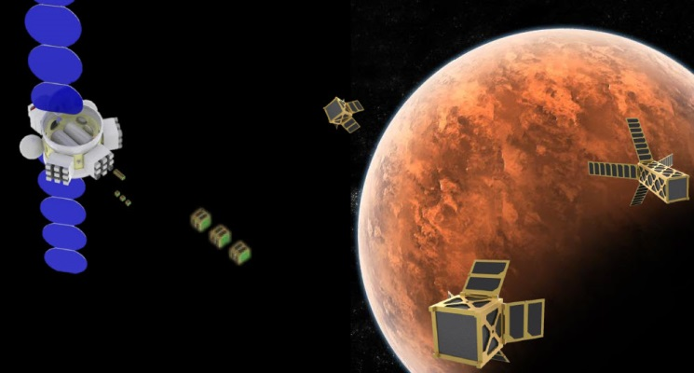

What Other Missions
Are Possible With Small Satellites?
Texas Spacecraft Laboratory
Image: SSTL
Image: Lunarsail
Images: NASA
Image: DARPA
Image: Busek Inc.
Image: Lithuania World

Slide 32













Texas Spacecraft Lab
Flight Project Activity Timeline
Texas Spacecraft Laboratory
Sponsor 2003 ’05 ’07 ’09 ’11 ’13 ’15 ’17 ’19
FASTRAC
ARMADILLO
LONESTAR-1
Bevo-2
LONESTAR-2
JPL Signed Strategic University Partnership With UT-Austin in October 2012
RACE
INSPIRE
We Are Here

Slide 33




FASTRAC
Formation Autonomy Spacecraft with Thrust, RelNav, Attitude & Crosslink
Texas Spacecraft Laboratory
2005 Univ. Nanosatellite Program Winner (first time entry)
Mission Success Objectives Were Achieved
Total Univ. Grant Award: <$250k
FASTRAC 1
“Sara Lily”
FASTRAC 2
“Emma”
Crosslinked Position Solutions
Both Satellites Are Still Operational Today After ~3 Years In Space

Slide 34

2004 FASTRAC Environmental Test Team
Where Are They Now?
Texas Spacecraft Laboratory
NASA Goddard
Space Flight Center, MD
Married
Formerly NASA Ames
Research Center
Completing PhD, CA
Started Aerospace Company, TX
Employee 6 at
Aerospace Company
PhD, CO
Lab for
Atmospheric
And Space Physics, CO
Lockheed-Martin, CO
NASA Johnson Space Center
PhD, TX

Slide 35




LoneStar-1
Texas Spacecraft Laboratory
Launched from Space Shuttle July 2009, re-entered atmosphere March 2010

Slide 36



LoneStar-2
Texas Spacecraft Laboratory
Scheduled for Launch in 2014 (This Year!)
Bevo-2 CubeSat
LoneStar-2 Mission Concept
Satellite Inspection by NASA engineers

Slide 37





RACE
Texas Spacecraft Laboratory
Instrument: 183 GHz Radiometer
RACE Flight Unit
Satellite
Satellite Delivery: February 2014
10 months from program start!
Example Science Result

Slide 38





The Making of RACE
Texas Spacecraft Laboratory

Slide 39






ARMADILLO
Texas Spacecraft Laboratory
Atmosphere Related Measurements And Detection of sub-mILLimeter Objects
2013 University Nanosatellite Program winner
UT-Austin only two time winner (2005 & 2013, FASTRAC & ARMADILLO)
ARMADILLO Deployed Configuration
Engineering Model

Slide 40

INSPIRE
Texas Spacecraft Laboratory
INSPIRE
Interplanetary NanoSpacecraft Pathfinder In a Relevant Environment
Low-cost mission leadership with the world’s first CubeSat beyond Earth-orbit
PI: Dr. Andrew Klesh, Jet Propulsion Laboratory, California Institute of Technology
PM: Ms. Lauren Halatek, Jet Propulsion Laboratory, California Institute of Technology
University Partners:
U. Michigan – Ann Arbor
Cal Poly - San Luis Obispo
U. Texas – Austin
Collaborator:
Goldstone-Apple Valley Radio Telescope (GAVRT)
Will Fly In 2015-16!
Our Contribution:
In House Developed 3D Printed Thruster

Slide 41




3D Printed Spacecraft Thruster
Texas Spacecraft Laboratory
Notes:
Title Slide

Slide 42



Suborbital Rocket Flight
To Measure Aurora Emission
Texas Spacecraft Laboratory
Launched into aurora borealis at Poker Flat, AK on Feb. 19, 2012
7 minute flight with 325 km peak altitude
Ionospheric E-layer emission clearly present at 100 km altitude indicates strong absorption for nighttime aurora
GPS receiver integrated on sounding rocket
Sounding rocket launched into aurora
Electron density measurements obtained from FOTON

Slide 43



Constrained Pointing for Small Satellites
Texas Spacecraft Laboratory
Example pathfinding solution

Slide 44




Solar Sails
Texas Spacecraft Laboratory
Using sunlight
to move a spacecraft
Images: NASA
Sunjammer planned trajectory

Slide 45


The Future:
On-Orbit Servicing and Assembly
Texas Spacecraft Laboratory
Small satellites can be building blocks that are assembled on-orbit to form functional groups
Such satellite groups may or may not be physically connected
On-orbit assembly of large apertures and satellite lifetime extension by consumables servicing are two possible applications

Slide 46

Explore UT Events
Texas Spacecraft Laboratory
Interactive Fair: Student Activity Center Ballroom
  Austin Discovery Dome Planetarium Shows
  Float in space with the Green Screen
  Build and Launch Paper Rockets
  Model Solar Systems
  DIY Planispheres
  Environmental Sustainability Games
  … and much more!
Department of Aerospace Engineering and Engineering Mechanics: W. R. Woolrich Building
(24th & Speedway)
  Designing, Building, and Flying Airplanes
  Longhorn Rocket Activity
  Balloon Rocket Racers
  Texas Spacecraft Lab (That’s Us!)
  Aerospace Engineering Prospective Student Session
  On Target to Mars
  Paper Airplane Contest
  Bio-Integrated Electronics
  Sounds of Space

Slide 47

Conclusion
Texas Spacecraft Laboratory
Space is more accessible than ever before with small satellites
The University of Texas at Austin’s Texas Spacecraft Lab supports a wide range of CubeSat, small satellite and related space missions from design through operations
Research topics are integrated with and motivated by satellite experiments
Contact information:
  E. Glenn Lightsey
  lightsey@mail.utexas.edu
  (512) 471-5322
Additional information:
  Faculty Research page:
    http://lightsey.ae.utexas.edu
    Downloadable papers and presentations
  Lab Facebook page:
    https://www.facebook.com/UTSatLab
    Lots of pictures and videos of hardware and lab activities
    (be sure to ‘Like’ us for updates!)

Slide 48

Dr. Glenn Lightsey
Glenn Lightsey is the Fellow of the W. R. Woolrich Professor in Engineering in the Department of Aerospace Engineering and Engineering Mechanics at The University of Texas at Austin. He is the Founder and Director of the Satellite Design Lab at UT Austin, which designs, builds, and operates satellites with undergraduate and graduate students. His research program focuses on the technology of small satellites, including: guidance, navigation, and control systems; attitude determination and control; formation flying, satellite swarms, and satellite networks; cooperative control; proximity operations and unmanned spacecraft rendezvous; space based Global Positioning System receivers; radio navigation; visual navigation; propulsion; satellite operations; and space systems engineer.
Prior to joining UT in 1999, Dr. Lightsey worked for 13 years as an aerospace engineer in the Guidance, Navigation, and Control Branch at NASA’s Goddard Space Flight Center. He participated in the SOAR Space Shuttle Detailed Test Objective (DTO) experiment. In 1999 he received NASA’s Manned Flight Awareness Award and GSFC’s Center of Excellence Individual Award. In 2004 he received the Institute of Navigation’s Tycho Brahe Award which recognizes outstanding contributions to the science of space navigation, guidance, and control.
Dr. Lightsey instructs undergraduate and graduate students in courses in orbital mechanics, navigation, and control. He has twice served as the Space Representative of the Institute of Navigation’s National Council (1998-2000, 2012-2014) and he is an Associate Fellow of the AIAA. He served on the AIAA’s Guidance and Control Technical Committee (1999-2008), and he was an associate editor of the Journal of Guidance, Control, and Dynamics (2005-08). In 2008, he was General Chair of the AIAA’s Guidance, Navigation, and Control Conference. He has authored more than 100 technical publications in peer-reviewed journals and conference proceedings. He currently serves as the Cockrell School of Engineering’s Strategic Planning Area Champion for Space and Earth Engineering; and since 2009 he has been the Graduate Advisor for Aerospace Engineering. In 2010, Dr. Lightsey became Associate Director of NASA’s Texas Space Grant Consortium. In 2011, Dr. Lightsey received the American Society for Engineering Education’s John Leland Atwood Award for outstanding aerospace engineering education, and the William David Blunk Memorial Professorship for outstanding undergraduate teaching at The University of Texas at Austin. Dr. Lightsey was inducted in The University of Texas at Austin’s Academy of Distinguished Teachers in Fall 2012.

