Slide 1

Now You See Me, Now You Don’t:
Colorful Strategies for Surviving in Nature
# 88
Dr. Molly Cummings
November 22, 2013
Produced by and for Hot Science - Cool Talks by the Environmental Science Institute. We request that the use of these materials include an acknowledgement of the presenter and Hot Science - Cool Talks by the Environmental Science Institute at UT Austin. We hope you find these materials educational and enjoyable.

Slide 2
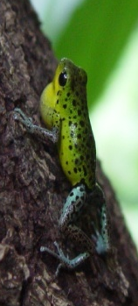
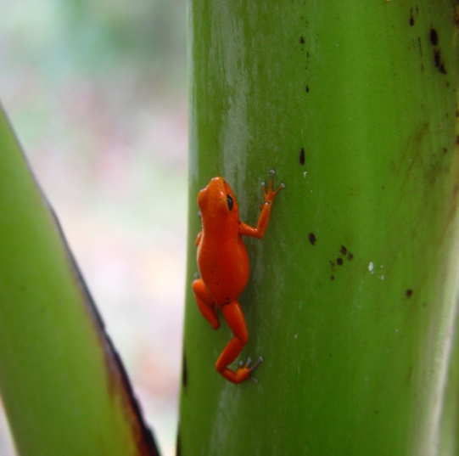
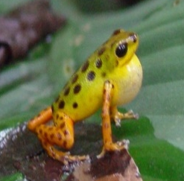
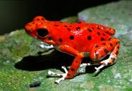
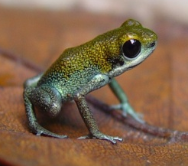
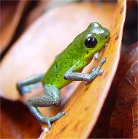
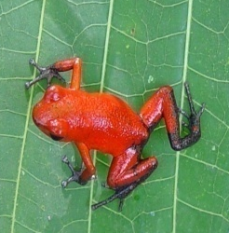
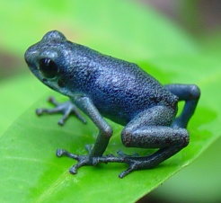
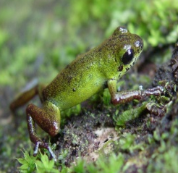
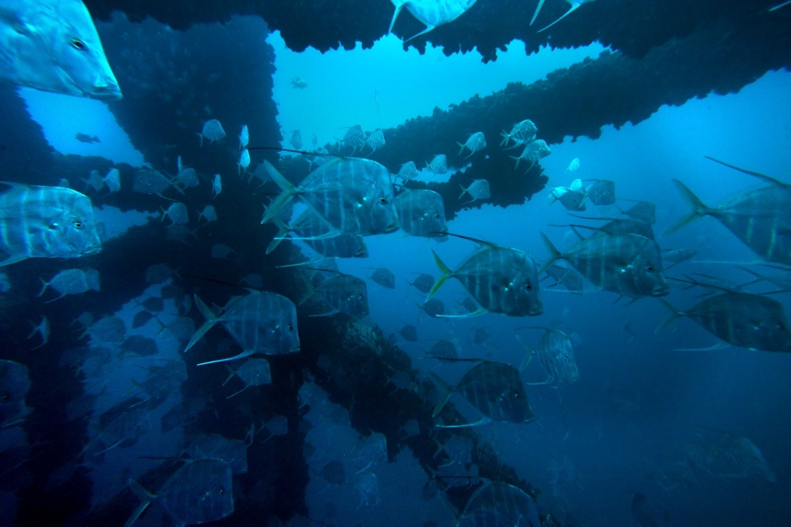
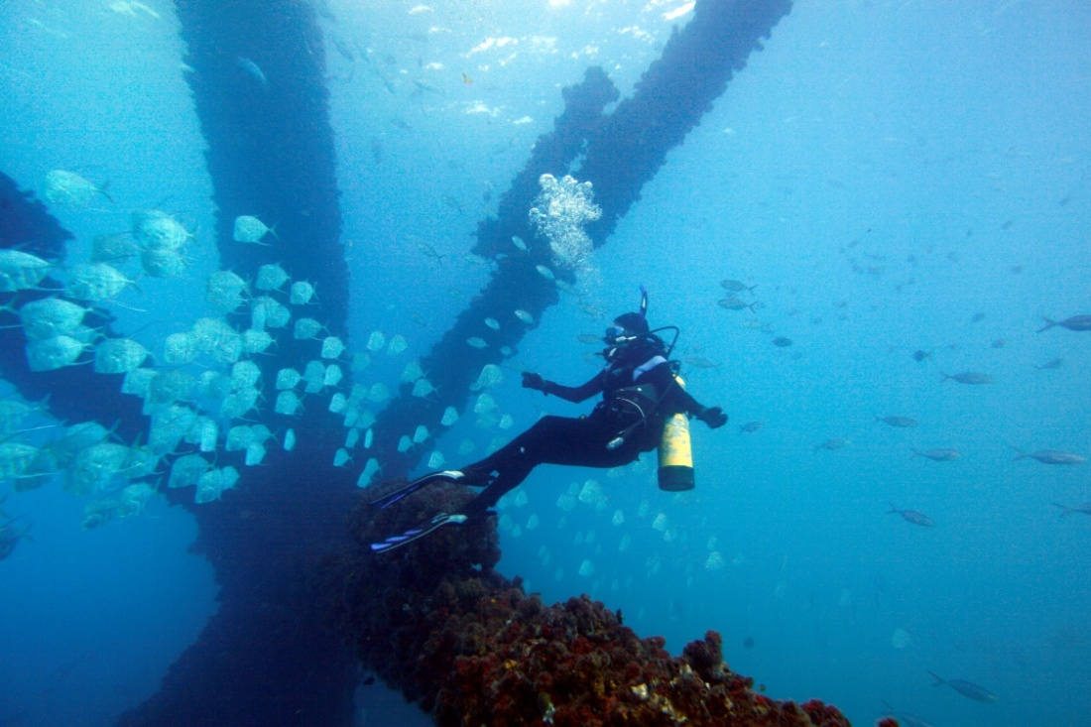
Now You See Me:
Now You Don’t
Dr. Molly Cummings
Notes:
Poison Frogs: Martine Maan (from our lab)
Lookdown images: Our own (photo credit: Erich Schlegel; copyright/ownership: Molly Cummings)
MAKE MOLLY’S NAME MORE PROMINENT (LARGER, HIGHER)
ADD ESI/HSCT BRANDING, PLEASE SEE PREVIOUS HSCT PPT’S FOR EXAMPLE

Slide 3
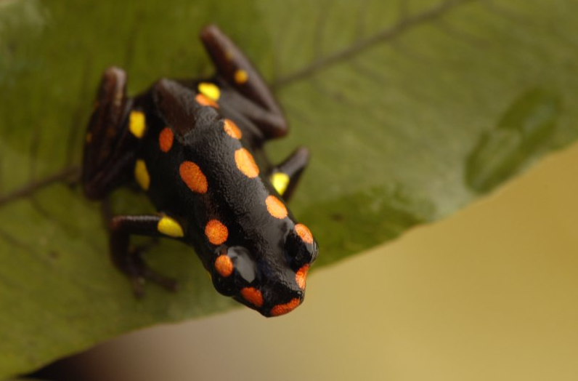
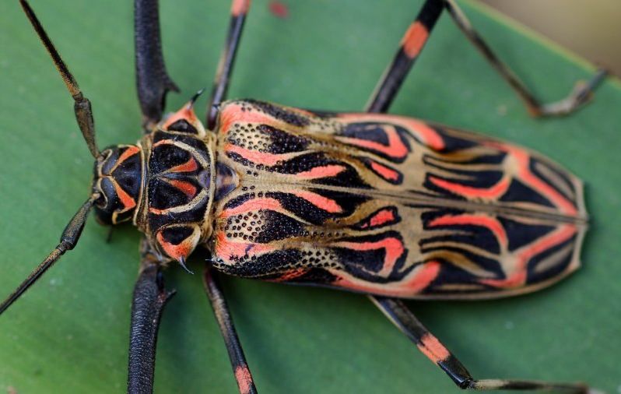
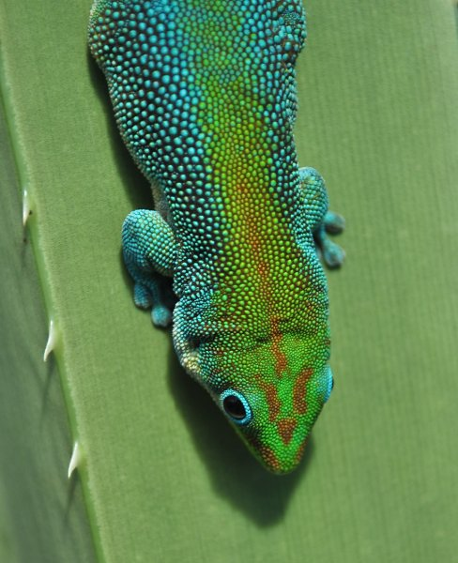
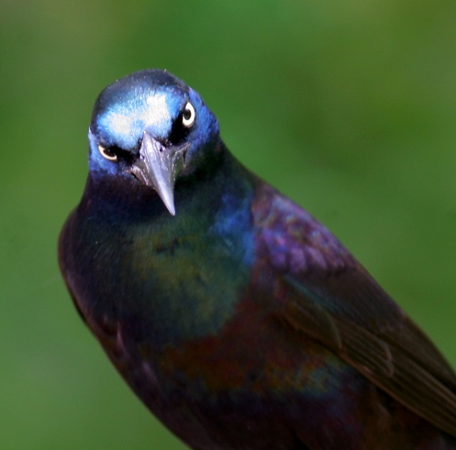
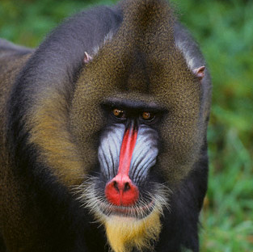
Why the grand diversity in color?
To communicate with Predators?
To hide from Predators?
To communicate to others of its own kind?
Some combination of all three?
Photos by J.L. Brown
Notes:
SECOND PREDATORS HARD TO READ
SPELL OUT THREE
Common names of creatures?

Slide 4
Why the grand diversity in color?
To communicate with Predators?
Natural
Selection
To hide from Predators?
Sexual
Selection
To communicate to others of its own kind?
Some combination of both Natural & Sexual Selection?
Photos by J.L. Brown
Notes:
Common names of creatures?

Slide 5
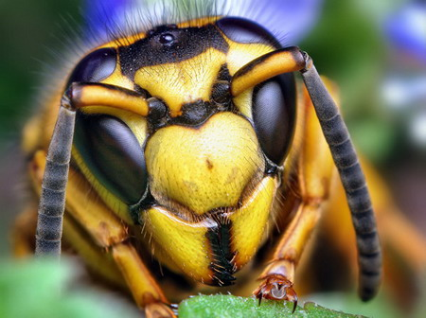
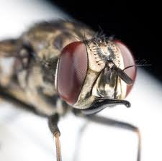
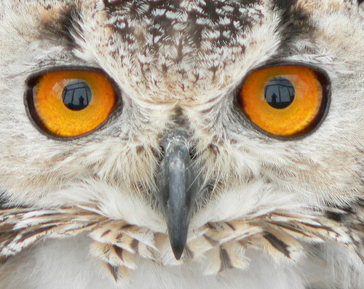
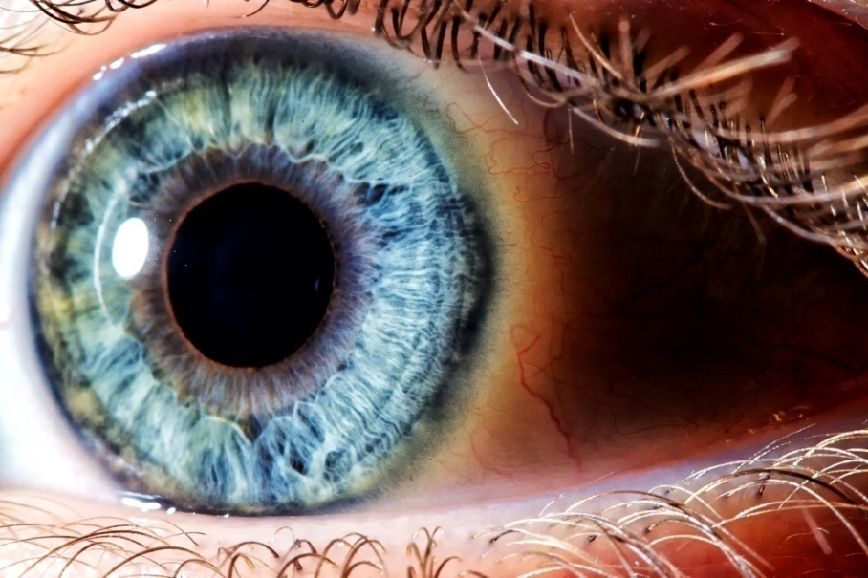
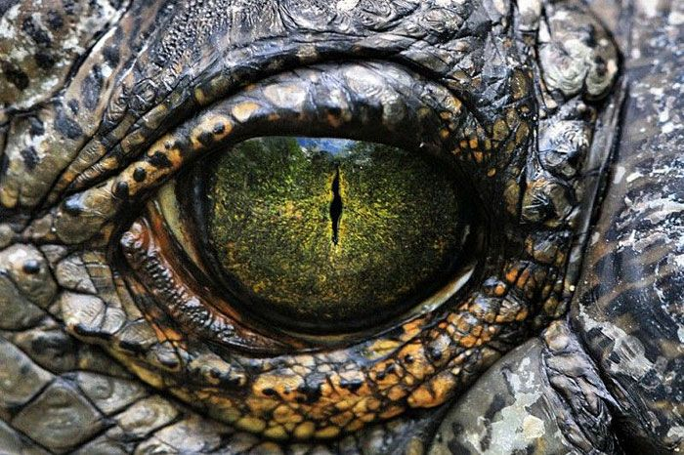
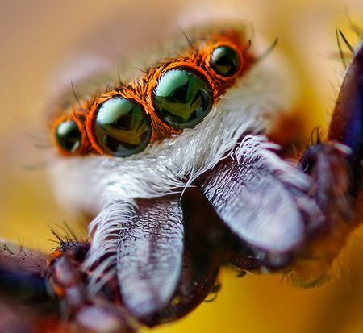
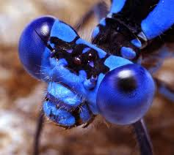
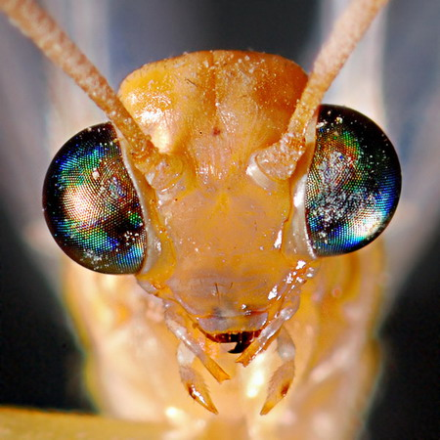
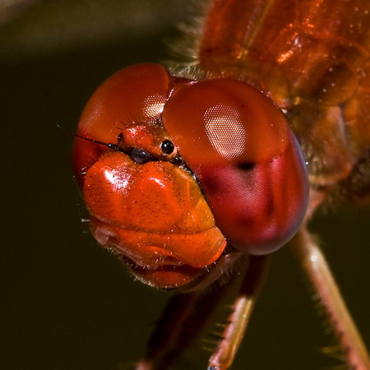
Image of all sorts of Animal Eyes
Yellowjacket
Fly
Fly
Owl
Jumping Spider
Jumping Spider
Crocodile
Dragonfly
Ant Lion
Notes:
http://www.designswan.com/archives/beautiful-animal-eyes.html
Human eye : photo credit: Luke Mislinski

Slide 6
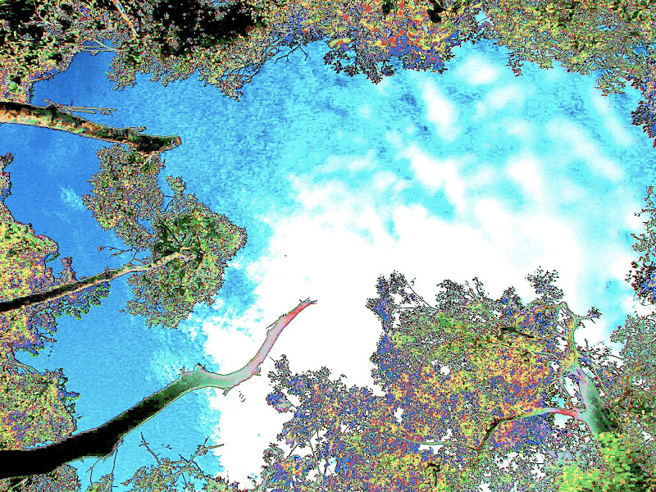
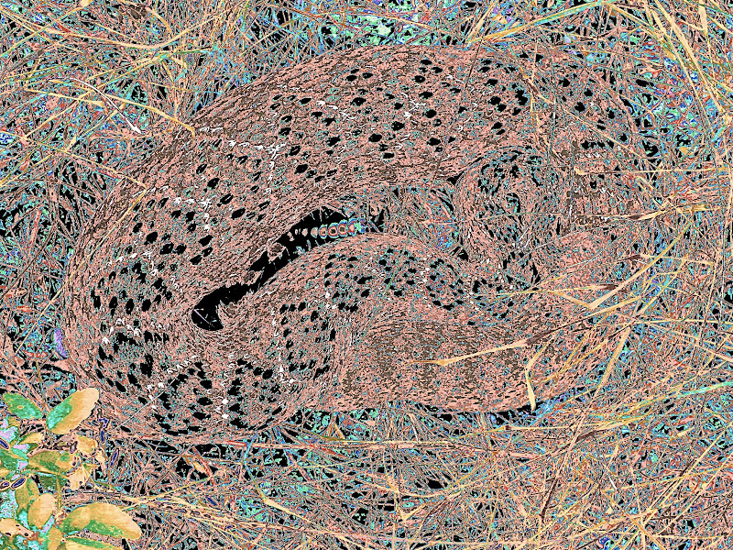
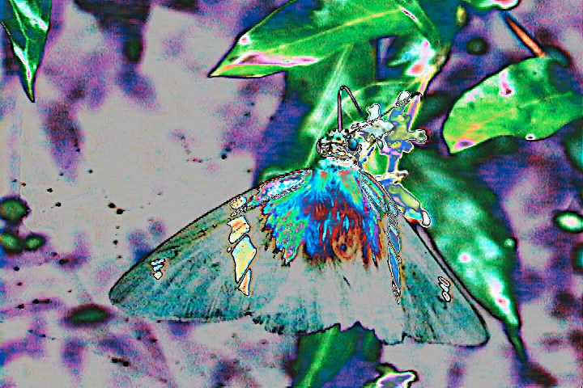
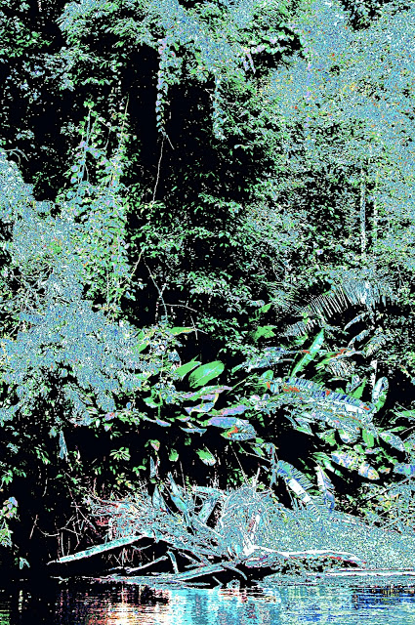
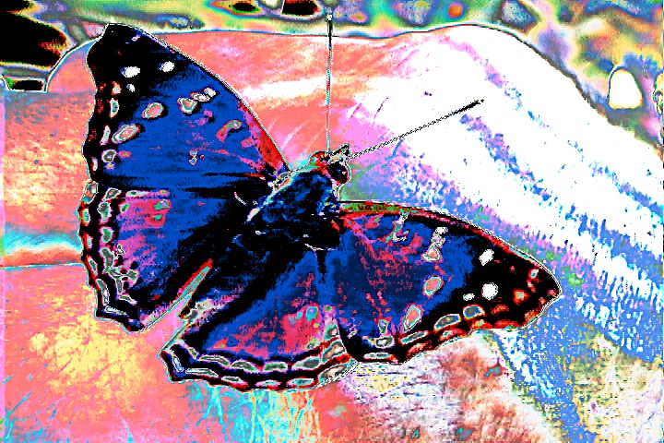
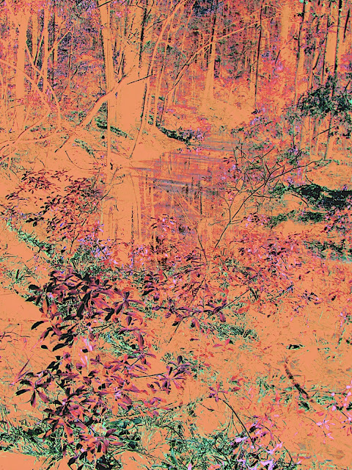
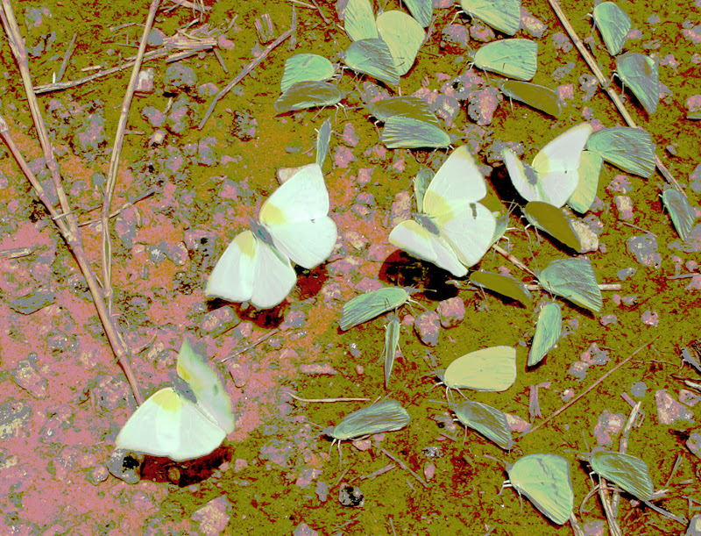
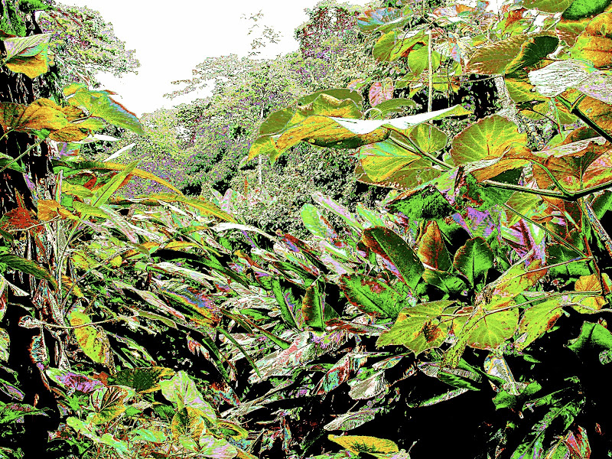
Larry’s Photos
Photos: Larry Gilbert
Notes:
ALL Photos: credit: Larry Gilbert
WE SUGGESTED SHOWING EACH SEPARATELY, NAMING THE ANIMAL FROM WHOSE POINT OF VIEW WE ARE LOOKING

Slide 7
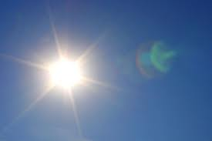
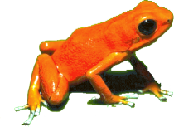
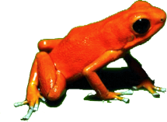
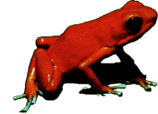

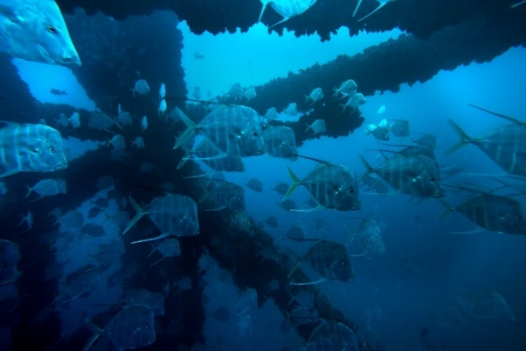
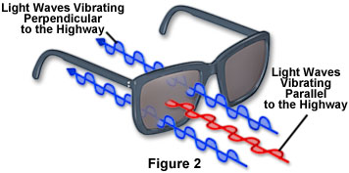
Dynamics of Light
Brightness: How much light there is
Color: Wavelengths of light
Polarization: Direction of vibrating light waves

Slide 8
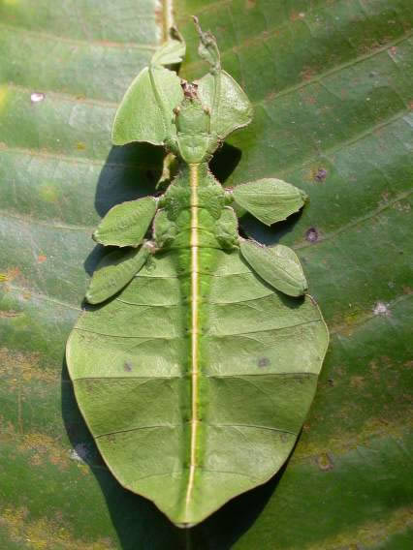
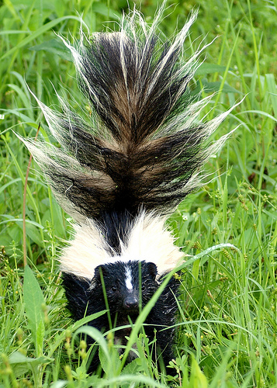
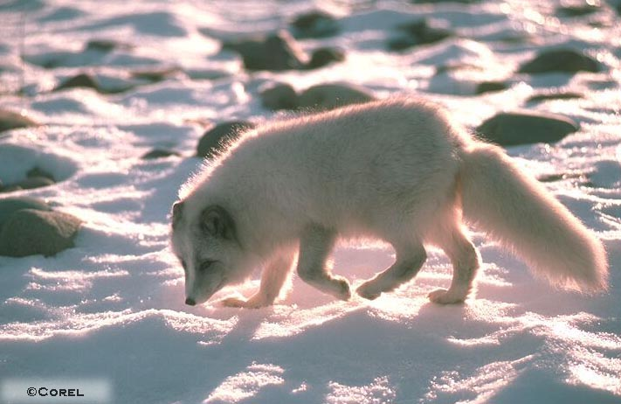
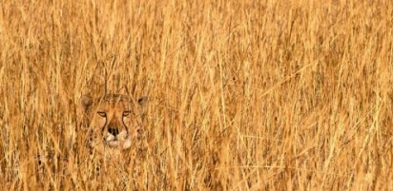
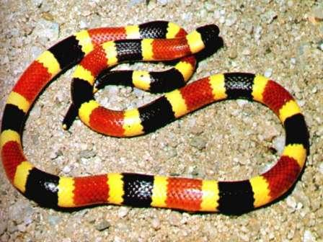
To Hide or Not to Hide….
Why the grand diversity in color?
Is it to communicate with Predators?
Natural
Selection
Is it to hide from Predators?
Leaf Insect
Skunk
Arctic Fox
Lion
Coral Snake
Hide (not be detected)
  Advertise your Nastiness
Notes:
HARD TO READ ‘FROM PREDATORS, SUGGEST SCREEN BOX BEHIND
SAME FOR ‘BE DETECTED’
WE DISCUSSED SHOWING EACH IMAGE FULL SCREEN
Common names of creatures?

Slide 9

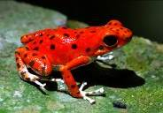
Poison Dart frogs use their bright colors to communicate to predators that they are toxic
(“aposematism” or warning coloration)
How do poison dart frogs get their name?
Notes:
9

Slide 10
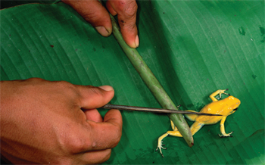
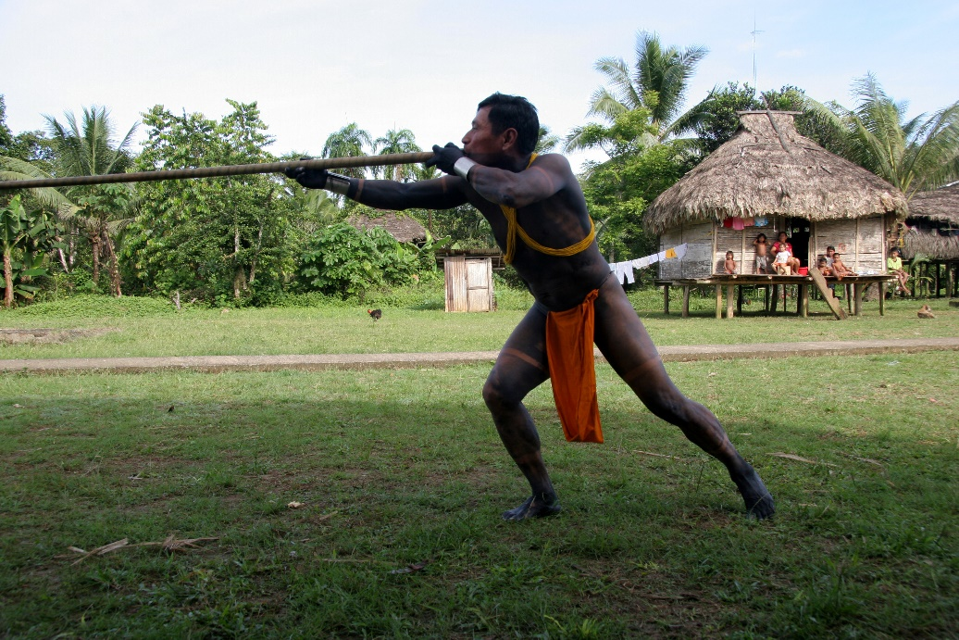
Capt. Charles Cochrane described the effect (1825): “A tiger when hit, runs ten or a dozen yards, staggers, becomes sick, and dies in 4 or 5 minutes.”
Notes:
10
SAME COMMENT ABOUT ITALICS HERE AS IN PREV SLIDE
USE CONSISTENT CASE WITH POISON DART FROGS

Slide 11
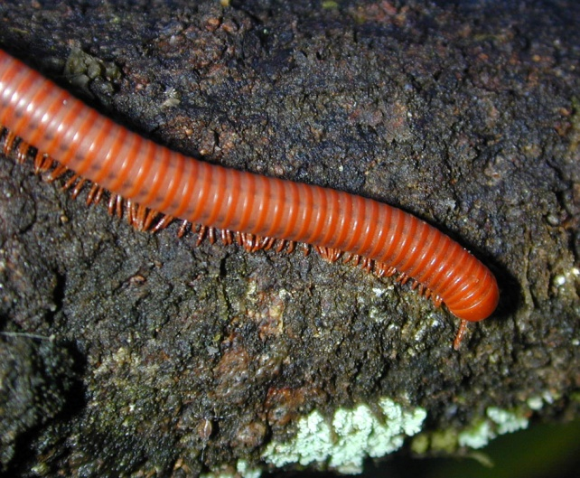
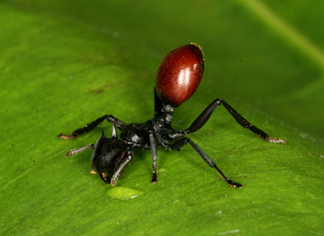
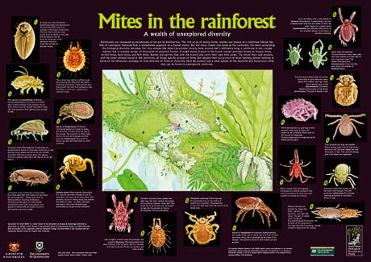
How do poison dart frogs get their poisons?
By eating toxic Bugs!
Notes:
11
MIXING ITAL, UNDERLINE HERE IS DISTRACTING, DON’T NEED EITHER
Common names of creatures?
Photo websites:
millipede: https://www.google.com/search?q=tropical+millipedes&client=firefox-a&hs=esp&rls=org.mozilla:en-US:official&channel=np&tbm=isch&tbo=u&source=univ&sa=X&ei=1wd9UsjcHcLUkQejwoGwDQ&ved=0CDkQsAQ&biw=1255&bih=936#facrc=_&imgdii=_&imgrc=kovZd7raWfup3M%3A%3BryEJHn8TE6fLiM%3Bhttp%253A%252F%252Fupload.wikimedia.org%252Fwikipedia%252Fcommons%252F9%252F92%252FMillipede.jpg%3Bhttp%253A%252F%252Fen.wikipedia.org%252Fwiki%252FMillipede%3B950%3B784
Ant:
https://www.google.com/search?q=tropical+ants&client=firefox-a&hs=8up&rls=org.mozilla:en-US:official&tbm=isch&tbo=u&source=univ&sa=X&ei=cQh9UvfADbW2sASp6YDACA&ved=0CCsQsAQ&biw=1255&bih=936#facrc=_&imgdii=_&imgrc=97MkMVxdx8xJEM%3A%3Bs1qSuIcjtQESwM%3Bhttp%253A%252F%252Fwww.butterfly-insect.com%252Fblog%252Fwp-content%252Fuploads%252F2008%252F01%252Fants-that-look-like-berries.jpg%3Bhttp%253A%252F%252Fbutterfly-insect.com%252Fblog%252Fever-seen-ants-that-look-like-berries%252F%3B461%3B336
Mites:
https://www.google.com/search?q=tropical+mites&client=firefox-a&hs=mHV&rls=org.mozilla:en-US:official&tbm=isch&tbo=u&source=univ&sa=X&ei=6gh9UqjtGaetsASv_oG4Bg&ved=0CEQQsAQ&biw=1255&bih=936#facrc=_&imgdii=_&imgrc=sgAXzwiepv4KrM%3A%3BNGJxTk5Y8qL41M%3Bhttp%253A%252F%252Fwww.environment.gov.au%252Fsystem%252Ffiles%252Fpages%252Fc895202d-4aed-4531-84b6-5ceb32958956%252Fimages%252Fposter-mites-lg.jpg%3Bhttp%253A%252F%252Fwww.environment.gov.au%252Fnode%252F13896%3B460%3B325

Slide 12













The famous strawberry poison frog
Bastimentos
Solarte
Aguacate
Nancy
Pastores
Bastimentos
Dolphin Bay
Isla Colon
One of the most colorful animals on earth
Dolphin Bay
Escudo de Veraguas
Escudo de Veraguas
Aguacate
Notes:
WE SUGGESTED FILLING SLIDE WITH INDIVIDUAL IMAGES, THE RESOLUTION LOOKS GOOD ENOUGH TO DO THAT
Blue jeans on frog or just blue jeans image?
All Photos: Laura Crothers
(with permission—in my lab)

Slide 13


Strawberry Poison Frog
Are the different colors communicating
different information?
Notes:
13
Image from Rudh et al 2007: Molecular Ecology

Slide 14


NATURAL SELECTION
Birds (major predators) can see this relationship.
Toxicity
BRIGHT
Dull
Crypsis
Brighter populations are more toxic.
Maan & Cummings 2012
Notes:
NO NEED TO ITAL THE CITATION OR MAKE IT AS LARGE AS THE TEXT IN THE SLIDE
Remove Saline (control)?
My boss has looked at many of the different populations of frogs in Bocas del Toro. The frogs on the left of this plot stand out a lot, they are especially brightly colored. The frogs on the right are very dull, and may almost be camouflaged in the right conditions in the forest.
What my boss has found is that brighter populations, like Solarte and Bastimentos, are very toxic. While duller, more camouflaged populations, like Colon, Popa, and Pastores are not very toxic.
We are still trying to figure out what the major predators of these frogs are. Birds seem to be one of the most important predators, and my boss has shown that the birds can see this relationship between toxicity and crypsis especially well.

Slide 15













Brightness is an indicator of Toxicity
Frog populations on islands with few toxic prey, became less toxic, and became less bright.
Frog populations on islands with LOTS of toxic prey, became MORE toxic, and BRIGHTER.
Hide
  Advertise
Notes:
15
REPLACE ‘MORE CRYPTIC’ WITH ‘LESS BRIGHT’

Slide 16




Do birds really pay attention to these warning colors?
Notes:
16
Chicken & frog: Christian Ziegler

Slide 17


Slide 18













*
*
Notes:
Non-toxic icon: from sailingsimplicity.com

Slide 19


Slide 20





Naïve Chickens (unfamiliar with poison frogs)
don’t avoid the poison frog
Notes:
20

Slide 21


But experienced chickens. . .
1.0
0.8
Pastores Chickens
0.6
Proportion Pecks
0.4
0.2
0.0
Notes:
21
EXPERIENCED LOWER CASE, PARALLEL CONSTRUCTION WITH NAÏVE IN PREVIOUS SLIDE

Slide 22
But experienced chickens
do avoid their local poison frogs
1.0
0.8
Pastores Chickens
0.6
Proportion Pecks
0.4
0.2
**
0.0
Notes:
22
EXPERIENCED LOWER CASE, PARALLEL CONSTRUCTION WITH NAÏVE IN PREVIOUS SLIDE

Slide 23




















Experienced chickens also avoid novel, bright colored frogs
Notes:
23
ALSO LOWER CASE; BRIGHT LOWER CASE; ITAL WOULD BE OK HERE

Slide 24
Why are there so many different colors?
Natural
Selection
Brightness informs predators how nasty the frogs are
Once they’ve learned that one bright color is nasty, they also avoid OTHER bright colors
Notes:
24
For aposematic signals—Divegence is NOT predicted if you have the same community of predators, because you are then faced with retraining predators to avoid a novel signal. So, This system is breaking with tradition by exhibiting immense diversity. So from a NS perspective, a natural hypothesis is that
WHY LOWER CASE, NO ITAL; OTHER CAN BE ITAL

Slide 25



SEXUAL SELECTION
Animals have to attract mates
Animals evolve traits that make them attractive
Notes:
Common names of creatures?
Well, this question brings us to the counterpart of natural selection. Called sexual selection.
Animals don’t just have to avoid predators. They also need to attract mates. Sometimes this involves fighting off competitors for mates too.
Because of this, many animals have evolved traits that make them attractive to mates. Lighting bugs and peacocks come to mind. A lot of crazy weapons like horns and antlers are used to fight off competitors too.

Slide 26

Notes:
THIS WAS SUGGESTED
Common names of creatures?

Slide 27



Frog Mate Choice Arena
Notes:
I think we wanted to put this song here, http://www.televisiontunes.com/Dating_Game.html.

Slide 28



SEXUAL SELECTION
Mi amor!
Hola Chica
Hola Chica
Females prefer brighter males
Notes:
REMOVE POLYGON IN UPPER RIGHT
My boss has also shown that females prefer mates that are especially bright and stand out.
The fact that females are especially attracted to brighter males may have actually contributed to the early changes in color in this species. There are a lot of different ways to be bright. A frog could be bright orange, bright yellow, bright green, bright blue, and so on.

Slide 29


Natural & Sexual Selection Operating Together
Colors/Brightness indicate Toxicity
  Less Toxic Frogs-> HIDE
  More Toxic Frogs -> ADVERTISE
Predators GENERALIZE their avoidance to new colors
Mates may drive the evolution of Brighter colors
Less Toxic
& Cryptic
More Toxic
& Conspicuous
Notes:
29

Slide 30

Now You See Me:
Now You Don’t
Notes:
Lookdown images: Our own (photo credit: Erich Schlegel; copyright/ownership: Molly Cummings)

Slide 31



Dynamics of Light
Brightness
Color
Polarization
Notes:
Bet with friend joke… here’s my Paypal account info for my cut…?

Slide 32





Two places on earth where light is LARGELY polarized
Notes:
Common names of creatures?
Water photos from:
http://www.apaulodesign.com/blog/category/polarization
Swordtail: Erich Schlegel photo credit (Molly Cummings, copyright)
Salmon: https://www.google.com/search?q=salmon&client=firefox-a&rls=org.mozilla:en-US:official&channel=np&source=lnms&tbm=isch&sa=X&ei=ZwR9UqHdB9SosAS13oCQCQ&ved=0CAcQ_AUoAQ&biw=1255&bih=936#facrc=_&imgdii=_&imgrc=kaGmP7T4BLaG0M%3A%3BXR6pCoQlRvQ3xM%3Bhttp%253A%252F%252Fwww.geneticliteracyproject.org%252Fwp%252Fwp-content%252Fuploads%252F2012%252F05%252FKhake-salmon.jpg%3Bhttp%253A%252F%252Fwww.geneticliteracyproject.org%252F2013%252F05%252F31%252Ftransgenic-salmon-can-breed-with-brown-trout-if-you-make-them%252F%3B500%3B342

Slide 33


What if YOU could see polarized light?
Notes:
POImagine if YOU had polarizing filters in your eyes such that you could detect certain orientations of the vibrating light plane?
Tonight, let’s pretend you can….
So…if you have your glasses on now…you might be able to see a secret message up here on the TV screens
Now close your LEFT eye, then your RIGHT eye…
Tilt your head ☺
LARIZED LIGHT LOWER CASE

Slide 34



Many animals can see polarized light
and some use it to communicate
Notes:
LOWER CASE MANY
Common names of fish?

Slide 35

MANY animals can see polarized light
& some use it to communicate
Video: Viktor Gruev
Notes:
SAME AS PRIOR
Our own video

Slide 36





SEXUAL SELECTION
Degree of Linear Polarization
85%
25%
Diffusion
Tank
Diffusion
Tank
Polarizer
Polarizer
Diffusion
Tank
Diffusion
Tank
Notes:
REMOVE POLYGON

Slide 37


SEXUAL SELECTION
Degree of Linear Polarization
85%
25%
Diffusion
Tank
Diffusion
Tank
Polarizer
Polarizer
Diffusion
Tank
Diffusion
Tank

Slide 38

SEXUAL SELECTION
Degree of Linear Polarization
85%
25%
Diffusion
Tank
Diffusion
Tank
Polarizer
Polarizer
Diffusion
Tank
Diffusion
Tank

Slide 39


SEXUAL SELECTION
What a Handsome
Polarized Gentleman!
Hey Baby
Hey Baby
Females prefer males with polarized ornamentation
Notes:
My boss has also shown that females prefer mates that are especially bright and stand out.
The fact that females are especially attracted to brighter males may have actually contributed to the early changes in color in this species. There are a lot of different ways to be bright. A frog could be bright orange, bright yellow, bright green, bright blue, and so on.

Slide 40

To hide……....
Natural
Selection
Why the grand diversity in color?
  Hide (not be detected)
Notes:
Common names of creatures?

Slide 41


To hide……....but in the ocean?
Natural
Selection
Why the grand diversity in color?
Notes:
LOWER CASE HIDE
We ‘drew this sketch of a shark’ and an anemone
Photo to the Right: Our own (photo credit: Erich Schlegel; copyright/ownership: Molly Cummings)

Slide 42



NATURAL SELECTION
Notes:
My boss has looked at many of the different populations of frogs in Bocas del Toro. The frogs on the left of this plot stand out a lot, they are especially brightly colored. The frogs on the right are very dull, and may almost be camouflaged in the right conditions in the forest.
What my boss has found is that brighter populations, like Solarte and Bastimentos, are very toxic. While duller, more camouflaged populations, like Colon, Popa, and Pastores are not very toxic.
We are still trying to figure out what the major predators of these frogs are. Birds seem to be one of the most important predators, and my boss has shown that the birds can see this relationship between toxicity and crypsis especially well.

Slide 43

Notes:
OUR data
Photo : Our own (photo credit: Erich Schlegel; copyright/ownership: Molly Cummings)

Slide 44

How do you hide in the polarized light field of the open ocean?
High Noon=== Easy==act like a mirror
Notes:
LOWER CASE HIDE, SENTENCE CASE FOR THE SLIDE TITLE
Remove “C” and “D.” Remove non-color graph?
Graphics: our own (Brady et al 2013 PNAS)

Slide 45

How do you hide in the polarized light field of the open ocean?
Sunset=== More Complex==Mirror won’t work
Brady et al 2013
Notes:
SAME AS PRIOIR
Remove “E” and “F.” Remove non-color graph?
Graphics: our own (Brady et al 2013 PNAS)

Slide 46

Notes:
OUR data
Photo : Our own (photo credit: Erich Schlegel; copyright/ownership: Molly Cummings)

Slide 47

Methods
Has nature conquered this problem?
(1) Build a Videopolarimeter
(Dr. Parrish Brady)
(2) Go SCUBA diving with it
(2) Measure fish & light in the ocean

Slide 48

Notes:
Photo : Our own (photo credit: Erich Schlegel; copyright/ownership: Molly Cummings)

Slide 49



Notes:
Photos: Our own (photo credit: Erich Schlegel; copyright/ownership: Molly Cummings)

Slide 50


Mirror
Lookdown
Notes:
OUR data
Photo : Our own (photo credit: Erich Schlegel; copyright/ownership: Molly Cummings)

Slide 51







Field measurements in the Florida Keys and in Curaçao
Notes:
Our photos

Slide 52

Notes:
Our video

Slide 53

Notes:
OUR data
Point out that the diver in the background is you, Molly Cummings!

Slide 54




We took 1000s of measurements
camera
ψ
φ
200
500
α
100
0
0
0
100
200
0
300
Angle (degrees)
Angle (degrees)
Notes:
Our Data

Slide 55



NATURAL SELECTION
Who is going to win the Camouflage Contest? Mirror vs Fish
Notes:
, http://www.hark.com/clips/mynjsztfdf-rocky-theme-song.
Rocky’s theme
Wrestling Cartoon:
We have purchased this cartoon from
Jantoo cartoons:
http://www.jantoo.com/cartoon/73931557

Slide 56

NATURAL SELECTION
Who is going to win the Camouflage Contest? Mirror vs Fish
Fish
Mirror
Background
Notes:
Wrestling Cartoon:
We have purchased this cartoon from
Jantoo cartoons:
http://www.jantoo.com/cartoon/73931557

Slide 57


NATURAL SELECTION
Who is going to win the Camouflage Contest? Fish vs Mirror
Fish WINS!
Mirror Man WINS!
Notes:
Wrestling Cartoon:
Need to buy from Jantoo cartoons:
http://www.jantoo.com/cartoon/73931557

Slide 58


NATURAL SELECTION
And the Winner is......

Slide 59



NATURAL SELECTION
And the Winner is...... The FISH!!!
Bigeye Scad
Lookdowns

Slide 60


Why the grand diversity in color?
To communicate with Predators?
To hide from Predators?
To communicate to others of its own kind?
Some combination of all three!
Notes:
MAKE TEXT/FORMAT SIMILAR WITH CHANGES AT BEGINNING OF TALK
One of the things that I find most interesting is why there is so much diversity in the animal kingdom. Many plants and animals are extremely colorful, and the source of the evolution of these colors is not always known.
One of the most colorful parts of the world is the tropics, like here in Bocas del Toro. And one of the most colorful animals in the world, if not the most colorful, can be found right here.

Slide 61














THANK YOU

Slide 62

Dr. Molly Cummings
Molly Cummings is a professor at UT Austin. Her research examines how communication traits evolve in animals, using fieldwork and behavior experiments to discover what drives such communications. She has initiated studies examining how animals achieve crypsis in a dynamically changing aquatic environments at a molecular level, and with particular emphasis on the polarized light field. Her lab is also developing experimental techniques to characterize real-time dynamic camouflage in the lab and field as well as identify the internal coordination of the cells involved in orchestrating camouflage (melanophores, chromatophores and iridophores) along with the neutral color of their movements.

