Slide 1
Curiosity’s First Year of Exploration on Mars
# 87
Dr. John Grotzinger
October 18, 2013
Produced by and for Hot Science - Cool Talks by the Environmental Science Institute. We request that the use of these materials include an acknowledgement of the presenter and Hot Science - Cool Talks by the Environmental Science Institute at UT Austin. We hope you find these materials educational and enjoyable.

Slide 2
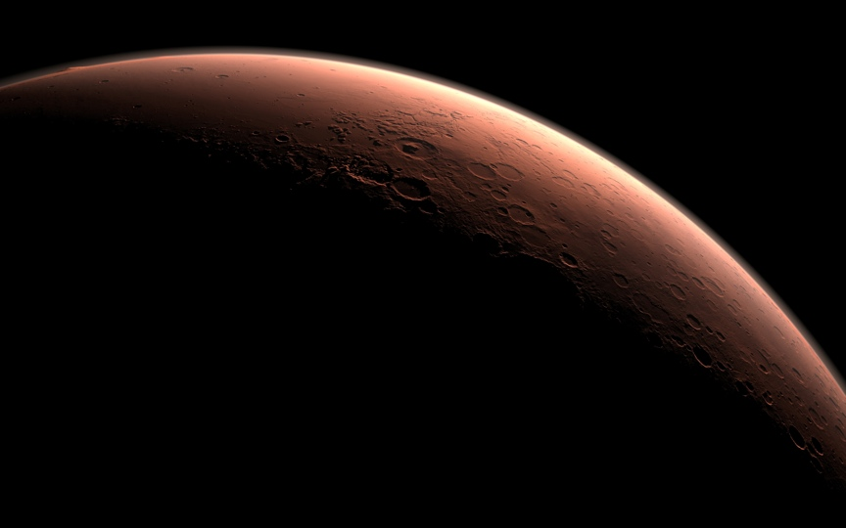
Curiosity’s First Year of Exploration on Mars
John Grotzinger On behalf of
Mars Science Laboratory Mission Team
Notes:
Grotzinger opens by introducing Gale Crater, the landing site of Curiosity. Material on Gale Crater is freely available through NASA Mars Science Lab. (http://mars.jpl.nasa.gov/msl/mission/timeline/prelaunch/landingsiteselection/galecrater2/).
Next, Dr. Grotzinger plays NASA’s famous Seven Minutes of Terror, (http://www.jpl.nasa.gov/video/index.php?id=1090) which dramatize’s the team’s complications in landing the Curiosity rover on Mars.

Slide 3
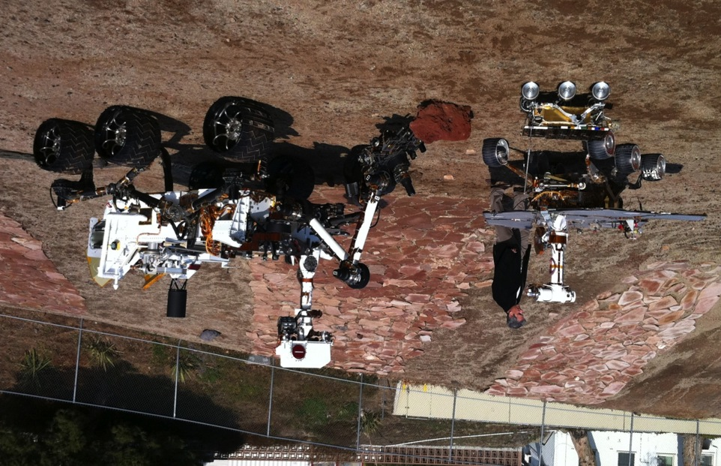
Heritage Counts
Notes:
Before this slide, Grotzinger talks about things that went right, and things that need to be considered from a technical standpoint for the Mars rover.
Grotzinger reviews the innovations from Sojourner to Spirit/Opportunity, to Curiosity, including the ability to manage differential terrain, and the use of solar power.
Grotzinger: “If I have seen farther it is because I have stood on the shoulders of giants.”
Pathfinder paves the way, Opportunity and Spirit provided that Mars had a very ancient history involving water.
Now, Curiosity explores for habitable environments and organics.
Note continuity of 6 wheel rocker bogie suspension, but change in energy source from solar to nuclear, and the absence of a mast in Pathfinder.
Curiosity is big because it carries a laboratory in its belly.

Slide 4
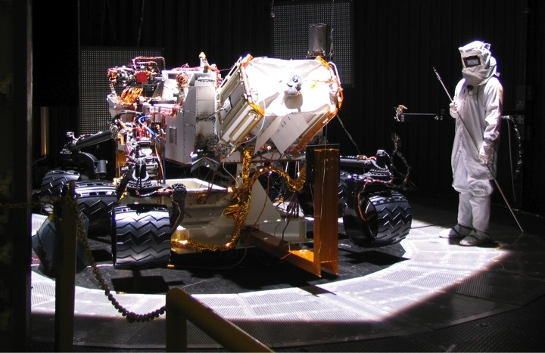
Test as you fly, fly as you test
Notes:
This is an image of the first integrated systems test of Curiosity. That is, the first time that all components of the robot are assembled and tested for the first time as a whole. The wand held by the engineer has a thermometer, and measurements on the robot are compared to the temperature recorded by the wand.
Testing, testing, testing.
Thermal expansion/contraction
Wheel actuator failure at cold temps

Slide 5
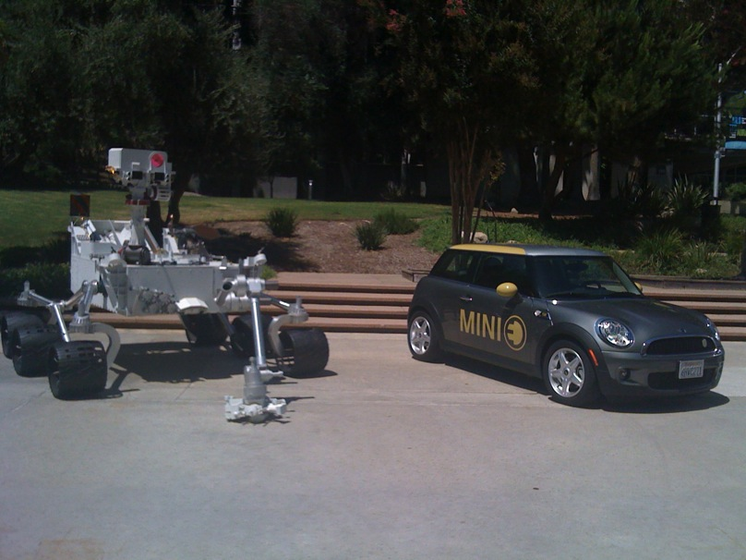
Grand Challenge – Land a car on Mars
2011
Curiosity Rover
2011
Mini Cooper
Notes:
Grotzinger: “This rover literally weighs a ton.”
The increased mass is required because of Curiosity’s science objectives. This leads to a redesign of landing system.

Slide 6
Pushing Limits to Meet the Grand Challenge
10,000 mph
1000 mph
Entry
100 mph
Powered Descent
Parachute Descent
1-10 mph
Landing or Touchdown
Notes:
Grotzinger’s “Powers of Ten” slide, showing the major events during landing.
The friction from the atmosphere and the heat shield dissipates the momentum of the vehicle from 10,000 mph down to ~100 mph.
Then, a powered descent leads to an impact speed of only a few miles per hour, about the fastest speed walked on a side walk.

Slide 7
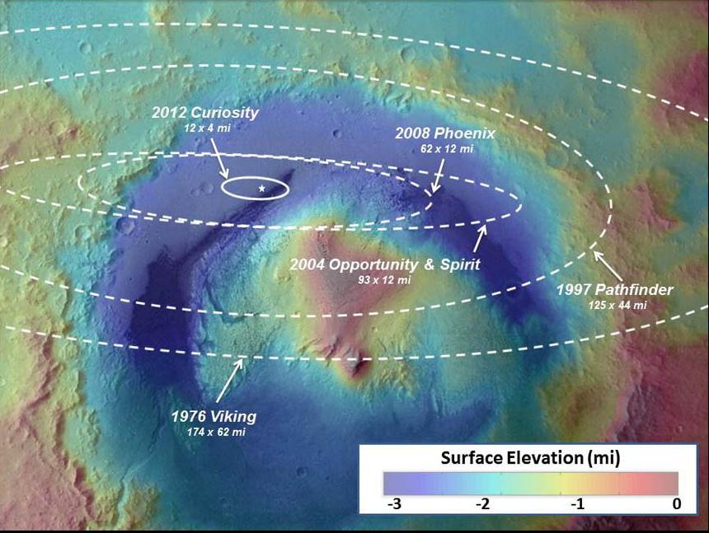
NASA/JPL-Caltech/ESA
Notes:
These are all landing ellipses, dating back to Viking in 1976, superimposed onto Gale crater.
As one can see, the semi-major axes get smaller with time, and Curiosity is much more precise.

Slide 8
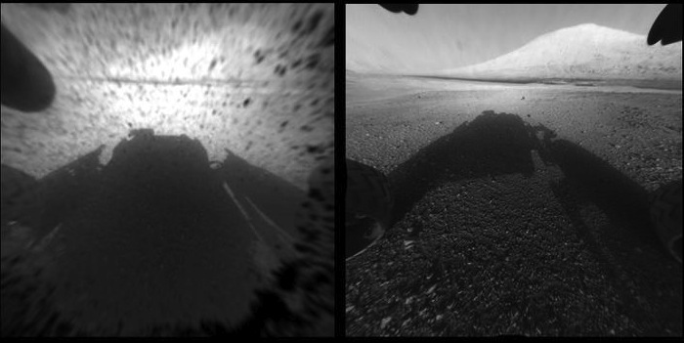
Notes:
Before this, Grotzinger shows more excerpts from Seven Minutes of Terror. The image on the left is taken 10 seconds after landing.
Thirty-nine minutes later, Curiosity confirms that the object in the background is indeed the targeted Mt. Sharp.

Slide 9
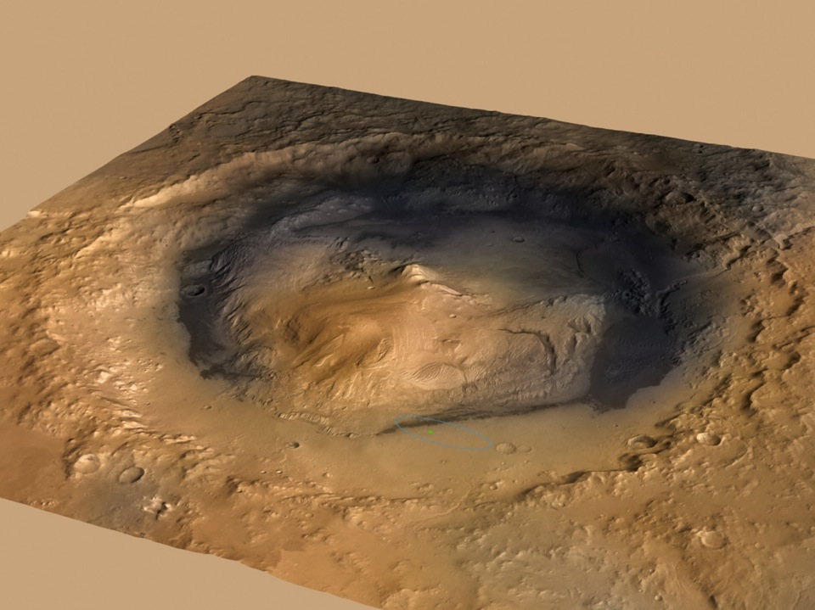
Gale Crater and Mt. Sharp
24
Notes:
Mt. Sharp, a topological map. The light blue ellipse on the bottom is the targeted area, and the small green dot is the actual landing site.

Slide 10
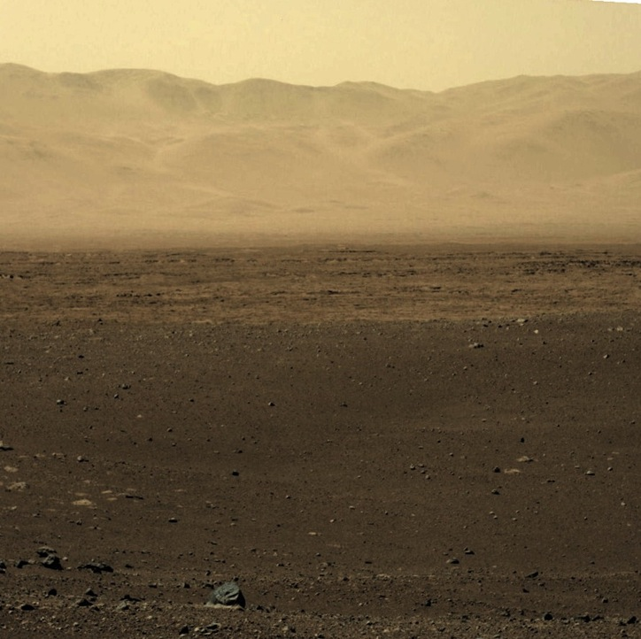
Looking North to Crater Rim
Notes:
Grotzinger describes the mountains the background as carved out by water.

Slide 11
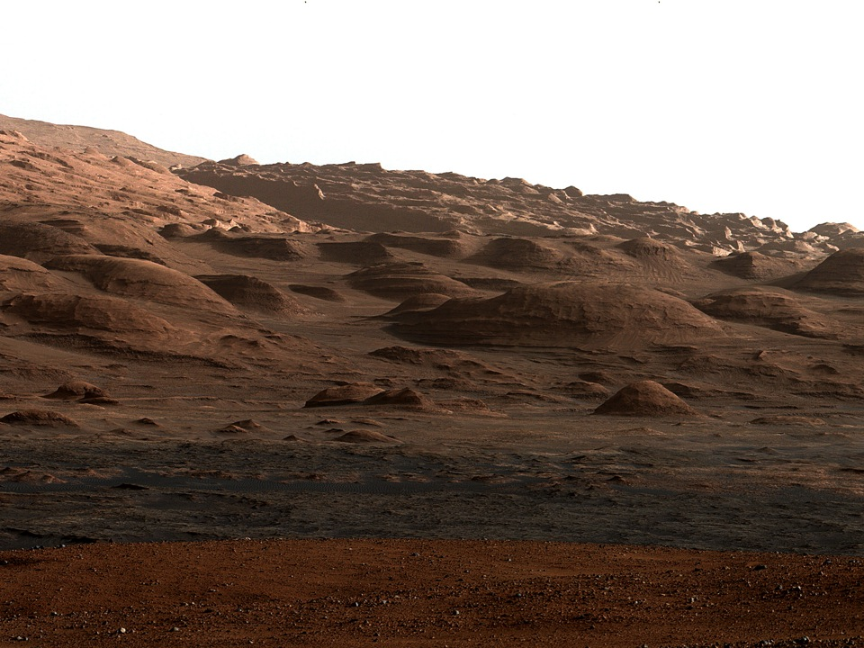
Looking South to Mount Sharp
Notes:
The other half of a panorama on Mars. Buttes and mesas now visible, resembling the American Southwest.
Grotzinger describes these as the next area for Curiosity to travel in the next 6 months.

Slide 12
“Coronation” Laser Target
Notes:
The small circle is where the Curiosity first shot its powerful laser for chemical analysis.

Slide 13
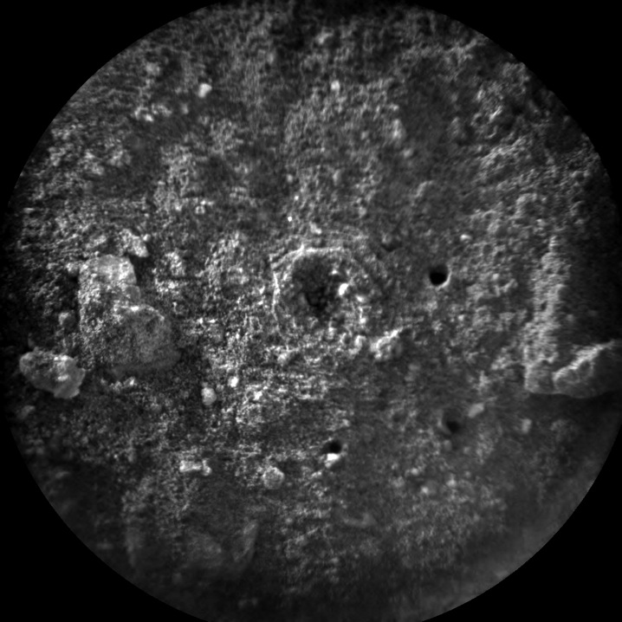
8 cm(3”)
NASA/JPL-Caltech/LANL/CNES/IRAP/LPGN/CNRS
Notes:
A photograph of the shot rock, the hole made by the laser is about 1 mm deep. The central hole looks like a crater or explosion, possibly due to volatiles.

Slide 14
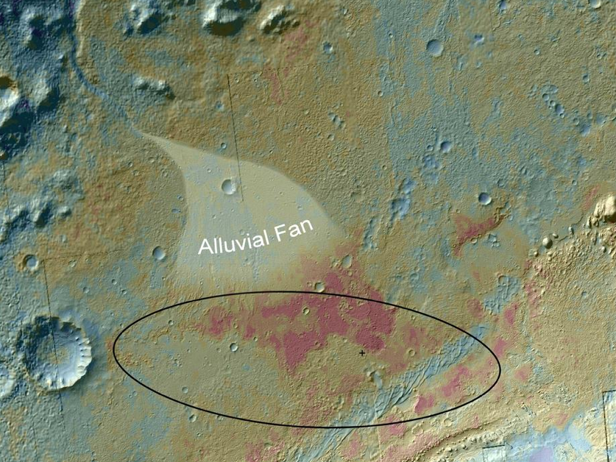
Planning is everything, but…
Notes:
Alluvial represents a region where flow of water spreads out sediments. The cross represents where the rover landed. The dark region seemed like an interesting region from its thermal properties.

Slide 15
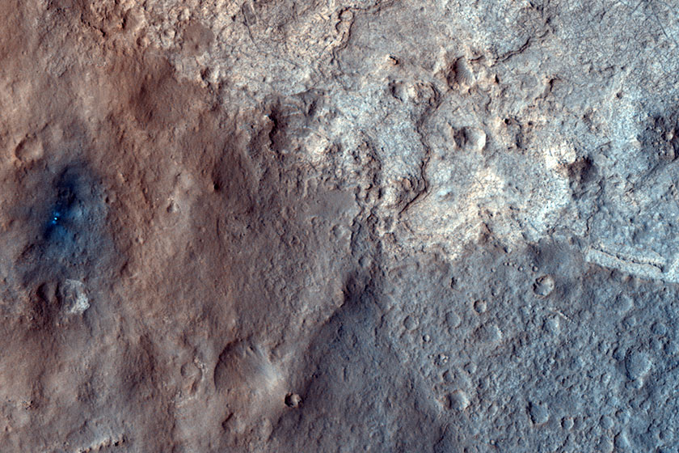
5 Football Fields
Notes:
Grotzinger zooms in to Curiosity landing and the distance to the region of interest.
He points out that there three different types of terrain converging at this point.

Slide 16
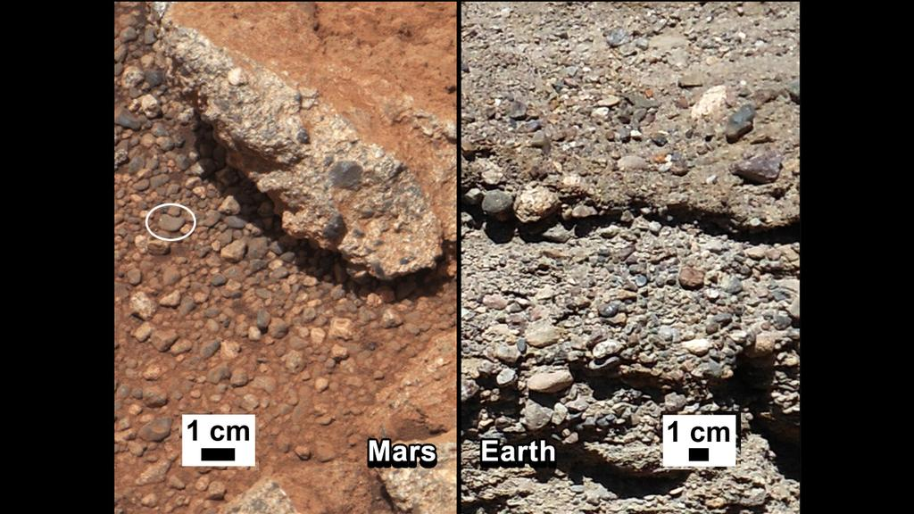
Notes:
Image on the left is a rock from Curiosity. Grotzinger compares it to concrete on Earth, rounded pebbles cemented together.

Slide 17
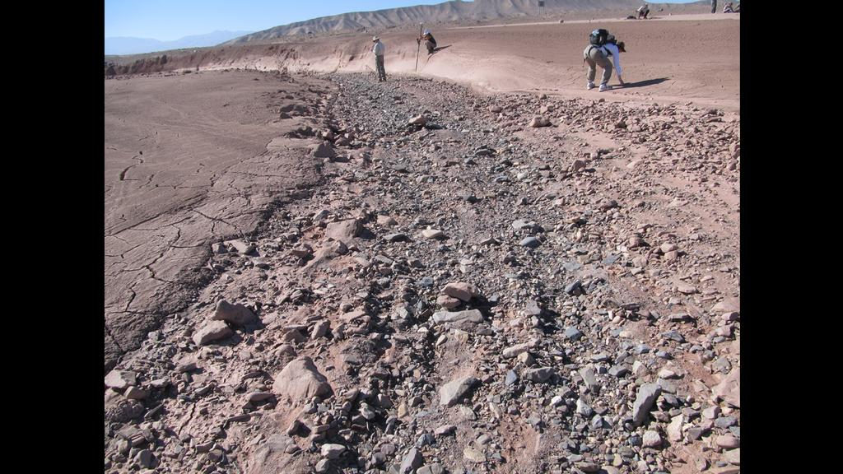
Notes:
The Atacama desert, regions on Earth that contain smashed (rounded) rocks that result from rare flash floods.

Slide 18
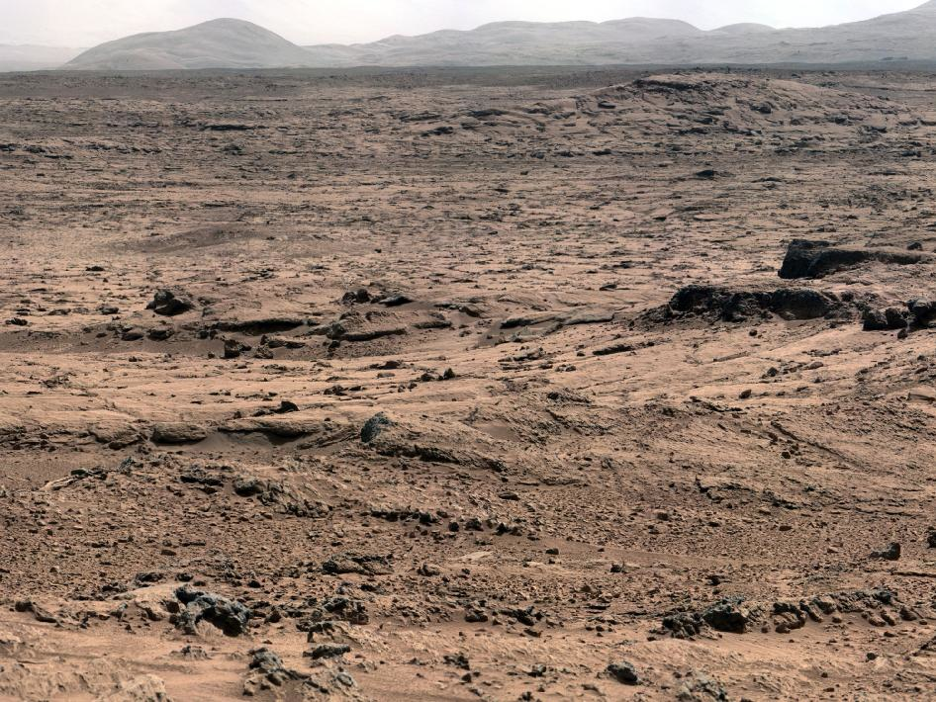
Notes:
Before there was loose rocks and gravel, and not the terrain looks vastly different. Grotzinger compares this to terrain in Moab, Utah, USA.

Slide 19
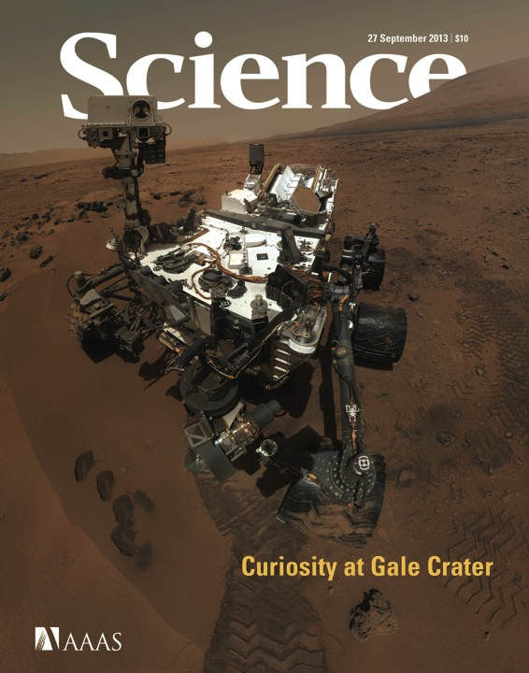
MAHLI
“Selfie”
Rocknest Sampling Campaign
Scoop 1 – Sol 61 – 07 Oct 2012
Scoop 2 – Sol 66 – 12 Oct 2012
Scoop 3 – Sol 69 – 16 Oct 2012
Scoop 4 – Sol 74 – 21 Oct 2012
Scoop 5 – Sol 93 – 09 Nov 2012
Notes:
The right image is a self-portrait made from several images. The left contains a list of sand samples from this terrain on Mars.

Slide 20
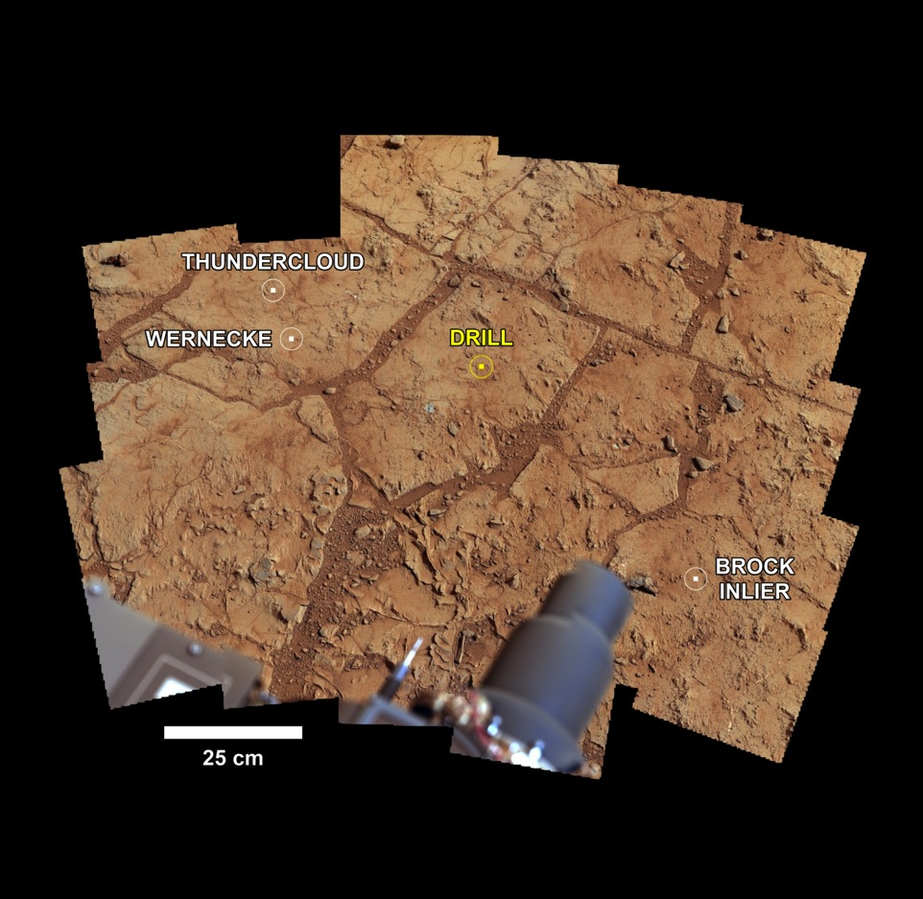
Notes:
Curiosity comes equipped with a drill. These are target areas for potential drilling. The yellow area is the final location.

Slide 21
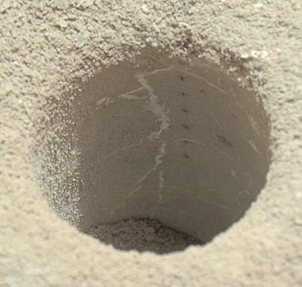
Notes:
This is a close-up of the drilled hole. In only 7 min, Curiosity drilled a hole of ~7cm. This rock is SOFT, and the color is GRAY. The white veins are Calcium Sulfate.

Slide 22
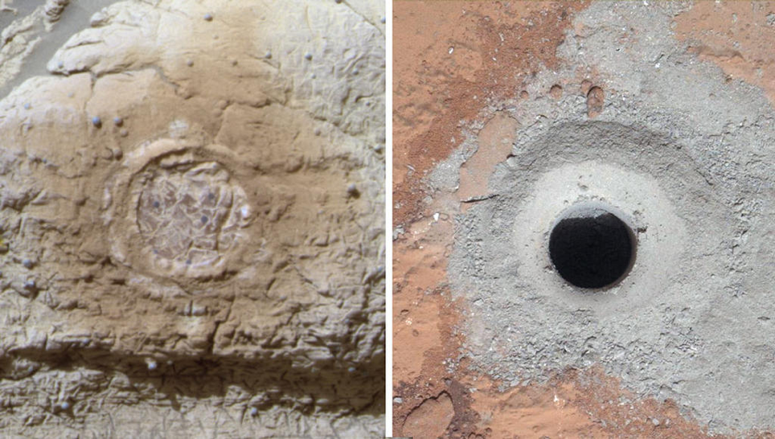
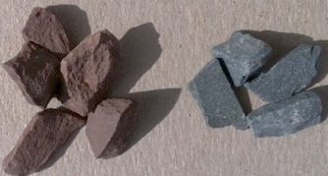
Red Mars --> Gray Mars
Opportunity, 2004
Curiosity, 2013
Notes:
Left: Opportunity findings (2004) from shaving down rock. The rock is red, and the shaved part is red. This is a scratch test for Hematite (iron oxide).
Right: “Gray hematite”, new rock still contains iron, but is gray.
Red rock shows ancient river deposits, and gray rock shows ancient lake deposits.

Slide 23
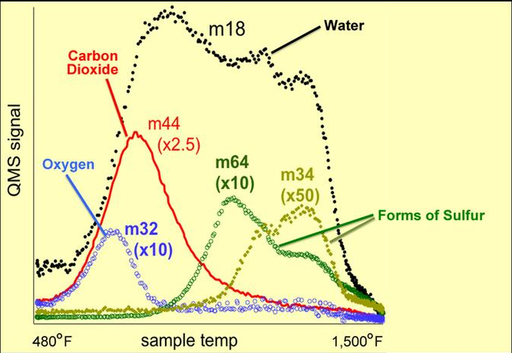
Notes:
“Bake a Cake”: Grotzinger describes the chemical analysis of the mass spectrometer.
Basically, the samples go into the instrument and is heated up. Like a cake, the first thing noticed is smell.
The room feels feels humid because water has boiled off, sugar has caramelized, and bread has risen due to carbon dioxide.
The graph shows how compounds “come off” the sample as it is heated up.
The water does not come off as it is heated.
There is a separate “peak” that indicates the presence of confirmed clay minerals.
Also, there are special forms of sulfur (in two different oxidation states).

Slide 24
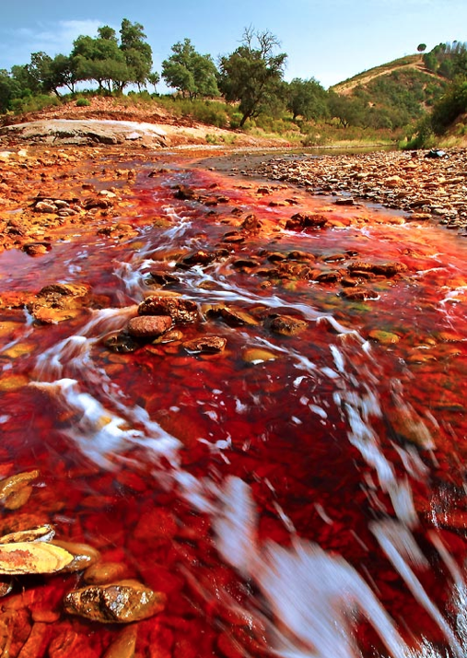
Notes:
In the past, Opportunity found evidence of an acidic Mars, like this image from a river in Spain.

Slide 25
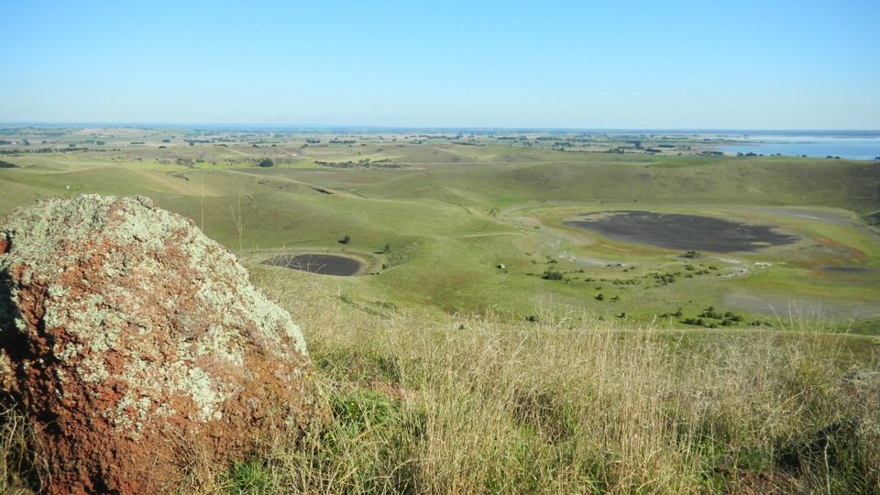
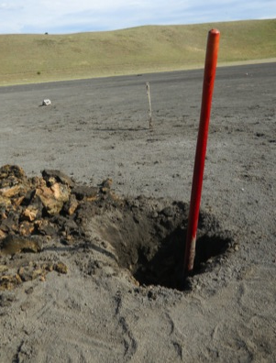
Notes:
Today, we find that Mars may have looked something like this place in Australia. The rock is Basalt, black because the sulfur is reduced.

Slide 26
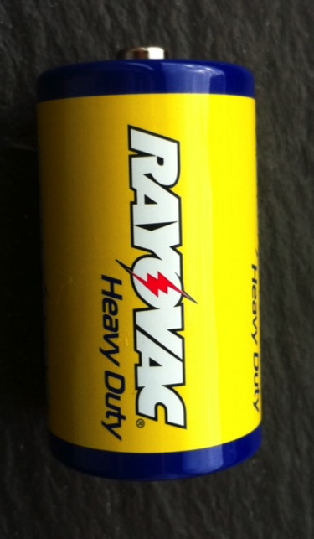
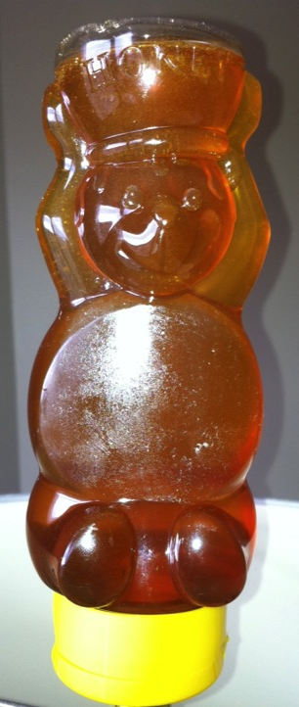
Notes:
Before, Mars also seemed saline (based on Opportunity discoveries) in addition to acidic.
These images are an analogy for Grotzinger. Yellowknife discoveries (where the gray rock was found) was found to not be this saline.
As for the battery, it is a reference to the mechanisms by which chemolithotrophs live on Earth. That is, they thrive on the principle of reduction-oxidation reactions (as they do near deep sea vents on Earth).

Slide 27
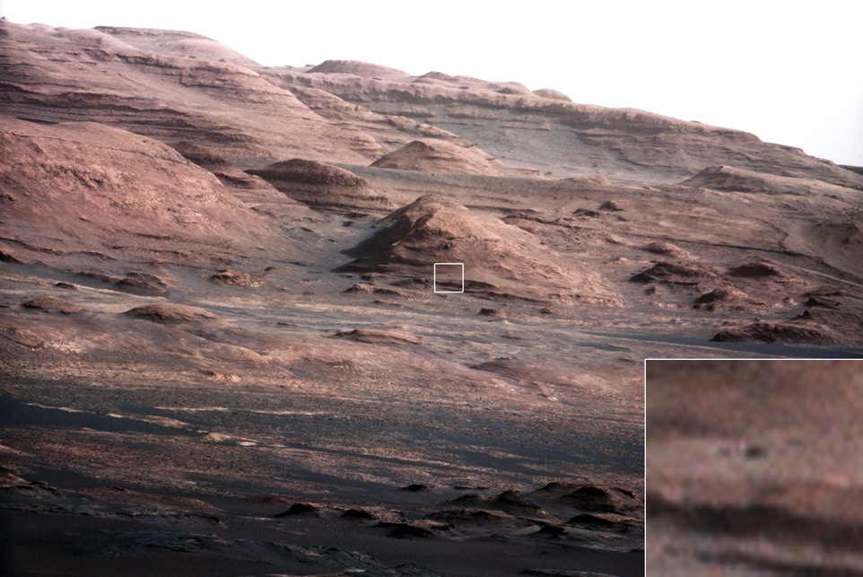
Foothills of Mt. Sharp is next
Notes:
Grotzinger points out where Curiosity is headed next.

Slide 28
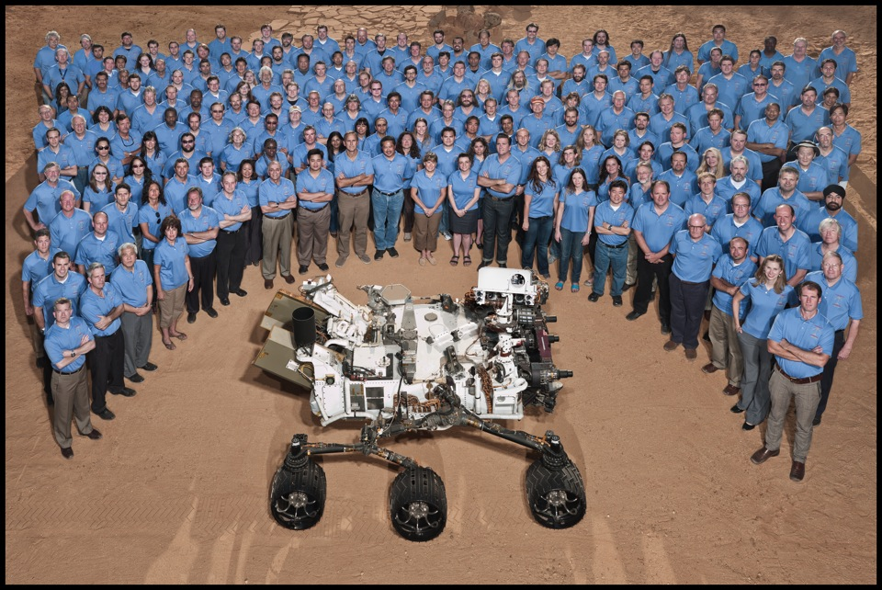
/DATA/ADS Personal/2012 Mars Talks/PDS Talk 12-17-12/PIA16141.jpg
Notes:
The full team of the Curiosity Mission.

Slide 29
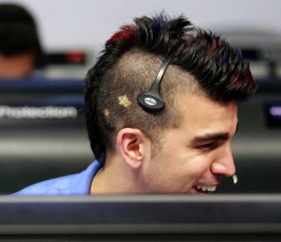
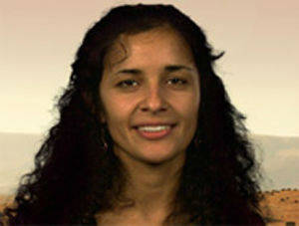
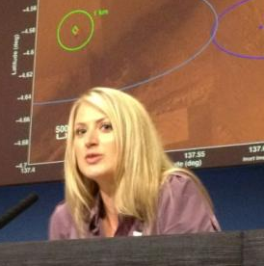
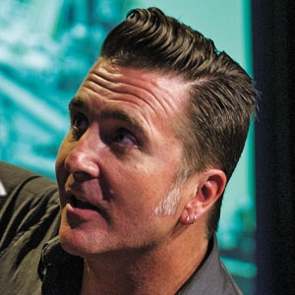
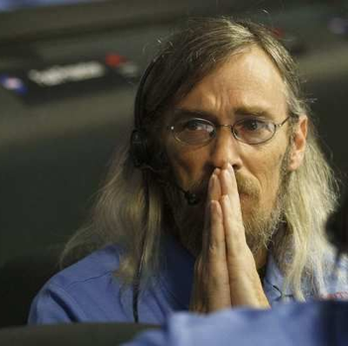
Notes:
Jodie Davis, Steve Collins, Adam Stelzner, Anita Sengupta, Bobak Ferdowski, all colleagues of Grotzinger and members of the Curiosity team.

Slide 30
Dr. John Grotzinger
Dr. John Grotzinger is a field geologist, and he is interested in the evolution of Earth's surficial environments and biosphere. His research addresses the chemical development of the early oceans and atmosphere, the environmental context of early animal evolution, and the geologic factors that regulate sedimentary basins. In his studies, Dr.Grotzinger tries to create the basic geological framework for sedimentary basins and orogenic belts in northwest Canada, northern Siberia, southern Africa, Oman, and the western United States. These field mapping studies are the starting point for more topical laboratory-based studies involving geochemical, paleontological, and geochronological techniques.

