Slide 1

Human Mating Strategies
# 86
Dr. David Buss
September 6, 2013
Produced by and for Hot Science - Cool Talks by the Environmental Science Institute. We request that the use of these materials include an acknowledgement of the presenter and Hot Science - Cool Talks by the Environmental Science Institute at UT Austin. We hope you find these materials educational and enjoyable.

Slide 2
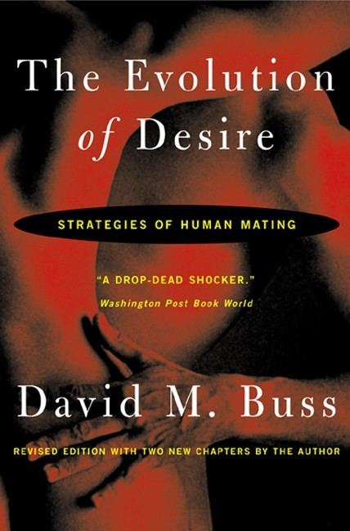

Slide 3

Human Mating Strategies
David M. Buss
Department of Psychology
University of Texas
September 6, 2013

Slide 4
Talk Outline
Diverse Mating Strategy Contexts
What Men Want
What Women Want
Etc., Etc.,

Slide 5
Mating Strategies Have Diverse Contexts
Different species
Various Cultures
Ecologies
Unique experiences (father absence)
Surplus of one gender
Different genders (male, female)
Different mate values
Notes:
Mating Strategies Have Diverse Contexts
Different species – Different species have different mating strategies.
For example, even chimpanzees, who share 93% of their DNA with us, have very different strategies than that of humans. Female chimpanzees have an estrus period, when they are in heat, and this is when male chimpanzees go in a sexual frenzy. Alpha males get the majority of matings during this period. Males and females are indifferent to one another otherwise.
Various Cultures
Ecologies – The prevalence of parasites, for example, affects mating strategies.
Unique experiences (father absence) – During development, a father’s presence or absence will influence their child’s desire for long- or short- term relationships. Generally, father absence leads to desire for short-term relationships.
Surplus of one gender – This is a sex-ratio imbalance.
Different genders (male, female)
Mate Values – The different ways in which mates are valued influences the ability to enact mating strategies.

Slide 6
Windows on Desire
DESIRE
Harmony
Between
Sexes
Keeping a Mate
Causes of
Divorce
“Breaking Up”
Conflict
Between the
Sexes
Intra-Sexual
Competition
“Putting Down”
Competitors
Attraction
Tactics
Notes:
Desire is the foundation of our mating system.
If we understand desire, then we have a recipe or a key fro successful tactics for attracting mates.
Mate retention, mate guarding involves the fulfillment of desire.
The ways we compete, using verbal signals, gossip or slander, to make competitors less desirable—here, we are impuning our rivals on qualities.
The context in which mates are desired are also important to look at, for example whether or not they are desired for long- or short- terms.

Slide 7
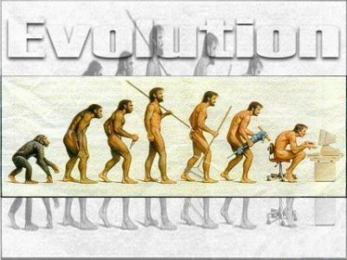
Evolution By Natural Selection
Source: www.puffin.com

Slide 8
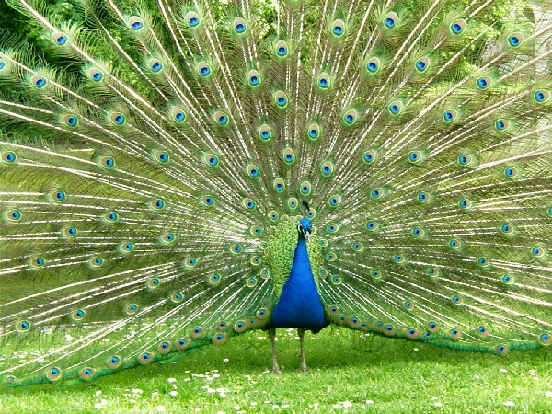
Source: noahunt.org

Slide 9
“The sight of the peacock gives me nightmares”
– Charles Darwin
Notes:
9

Slide 10
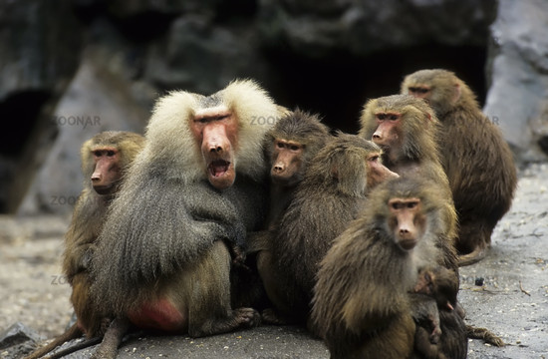
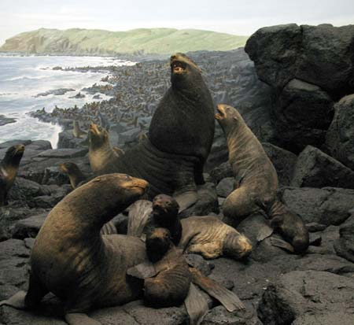
Hamadryas Baboons
Source: www.puffin.com
Red Fur Seals
Source: www.nhm.org

Slide 11
Sexual Selection
Same-Sex Competition
Intersexual Selection

Slide 12
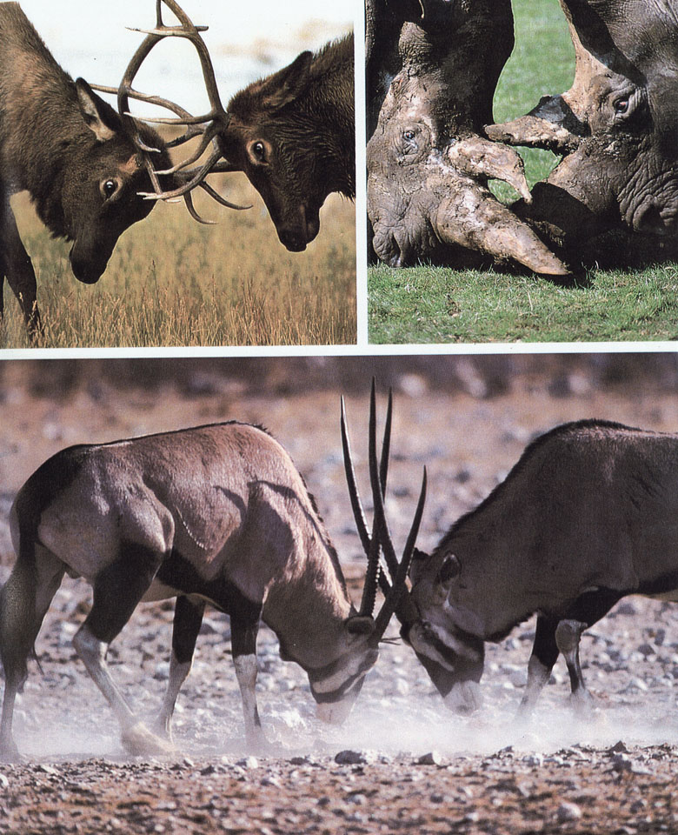

Slide 13
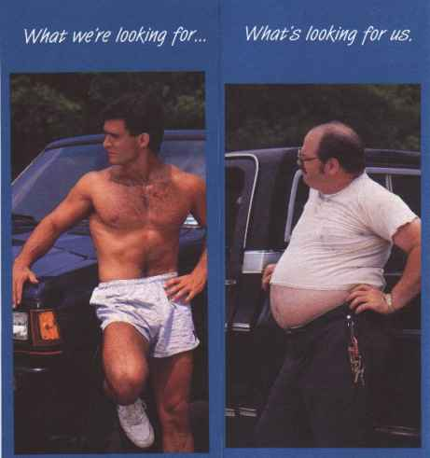
Intersexual Selection:
Preferential Mate Choice

Slide 14
Humans Have a Complex Menu of Mating Strategies
Long-term committed mating
Short-term opportunistic mating
“Cheating”: Extra-pair copulation (EPC)
Serial mating over time
Mixed mating strategies

Slide 15
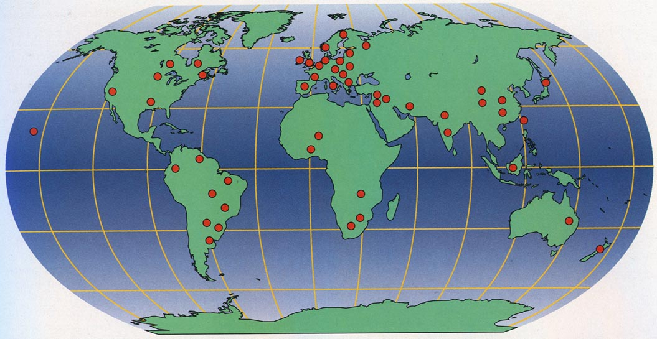
Locations of 37 Cultures in International Mate Selection Project:
Total # of People = 10,047

Slide 16
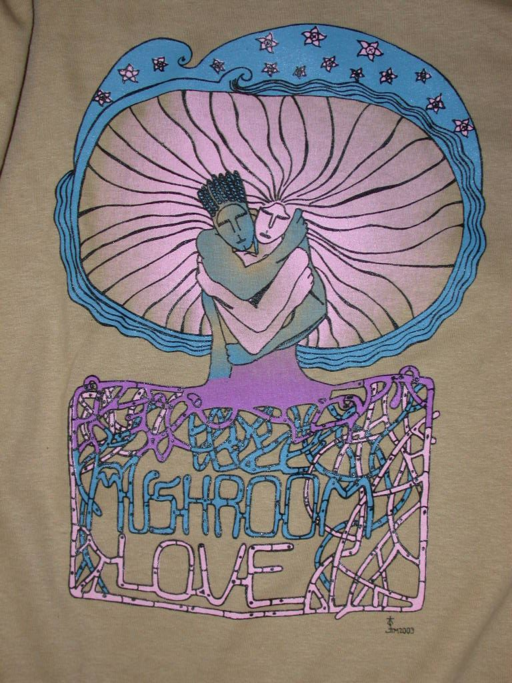
Universal Desires
    Love
    Exciting personality
    Good health
    Kindness
    Intelligence
    Sociable
    Easy going
botit.botany.wisc.edu
Notes:
Now let’s discuss those that differ from men…

Slide 17
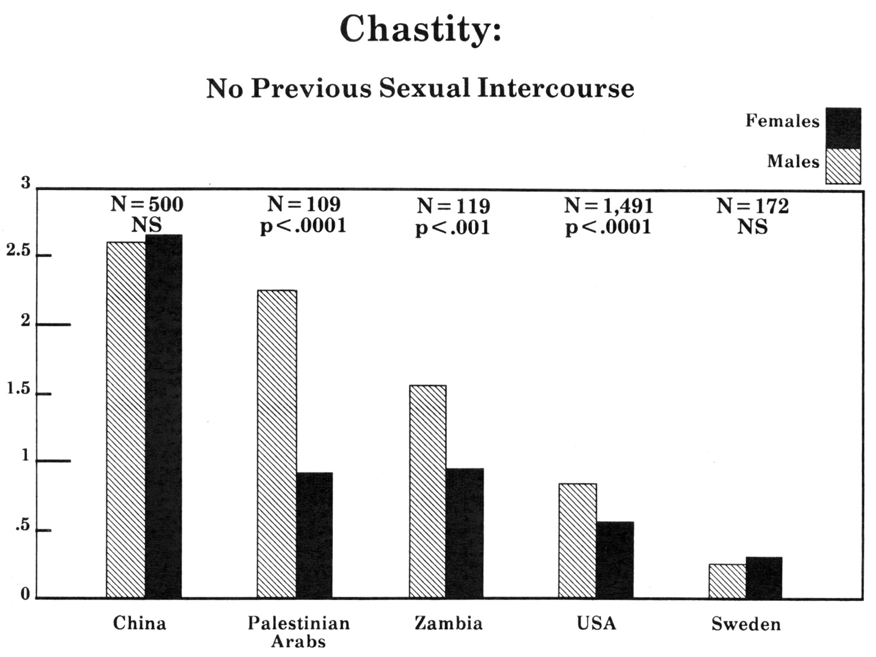
Culturally Variable Desires
Virginity:
Rating
Indispensable
Irrelevant
Source: Buss (1989)

Slide 18
Cultural Change in China:
Importance of Virginity
Gender 1983 2009
Male 2.54 1.70
Female 2.61 1.36
0 = irrelevant
3 = indispensable
Source: XXXX & Buss (2011) TO BE UPDATED

Slide 19
Meta-Theory of Sex Differences
Adaptive pressures dictate similarities and differences between men and women

Slide 20
Recurrently Different Adaptive
Problems of the Sexes
  Internal female fertilization
  Paternity uncertainty
  Parental investment (men vs. women)
  Misdirected parental investment
  Breast feeding
  Concealed ovulation
  Cyclic ovulation

Slide 21
Have Humans Evolved Psychological Adaptations to Sex-Linked
Adaptive Problems?
What is the empirical evidence?

Slide 22
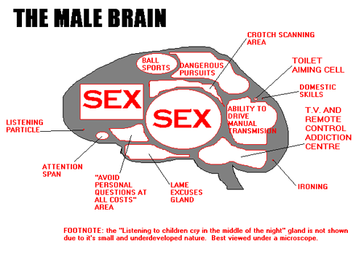
Source: paklinks.com

Slide 23
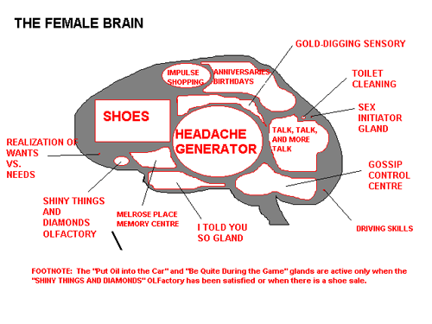
Source: alyhawkins.com

Slide 24
So What Do Men Want?

Slide 25
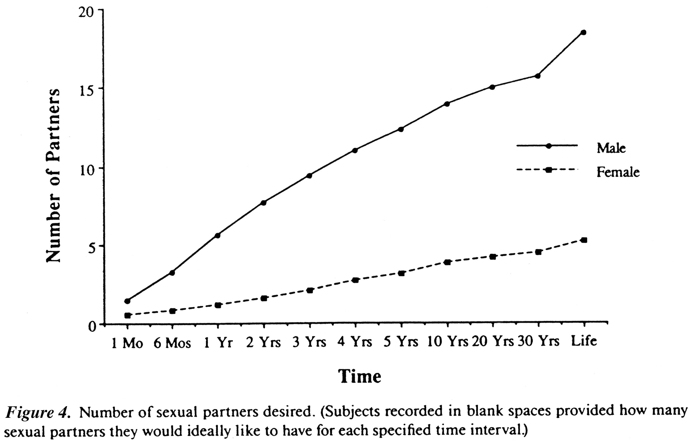
Ideal Number of Sex
Partners Desired
Men
Women
Source: Buss & Schmidt (1993)

Slide 26
Likelihood of Agreeing to Have Sex With Someone You Find Attractive as a
Function of Time Known
“100% Sure!”
“Absolutely
Not!”
Source: Buss & Schmidt (1993)

Slide 27
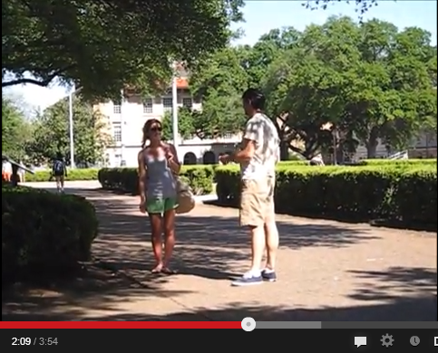
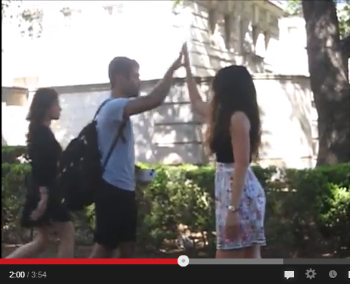
Florida Study: Clarke & Hatfield (1989)
Informal re-enactmen on UT’s Campus:
“Want to go back to my place?”
Guy propositions a Girl:
Girl propositions a Guy:
“No”
“YES” and a High-Five!!!!
http://www.youtube.com/watch?v=qkkQxv9m0R8

Slide 28
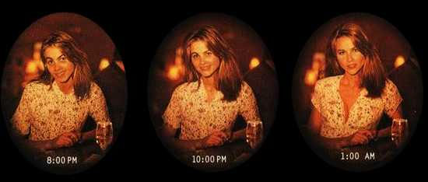
More Psychological Evidence for Short-Term Mating
The “closing time phenomenon”
Source: Pennebaker (1989)

Slide 29

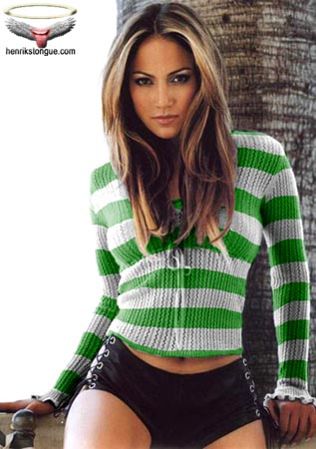
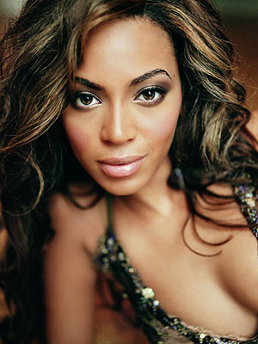
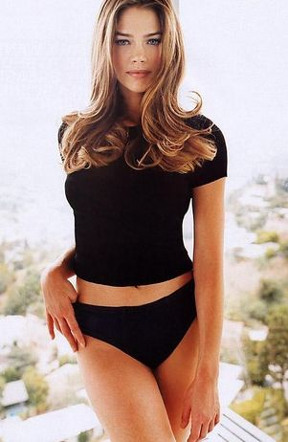
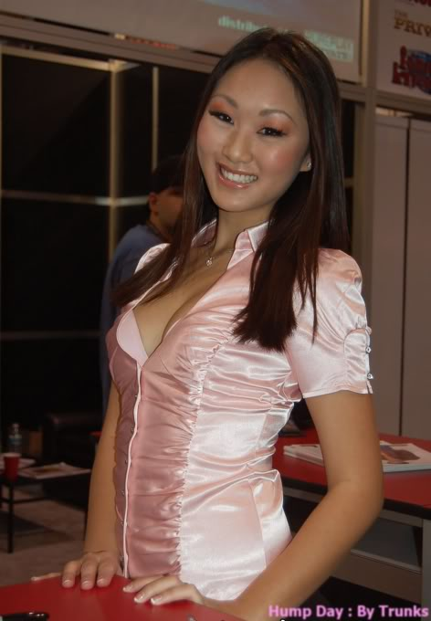
The Assessment Problem
People.com
Rottentomatoes.com
photobucket.com, by Trunks

Slide 30
Logic of the Evolution of Standards of Attractiveness
or
RV
Cues
Full lips
Clear skin
Clear eyes
Lustrous hair
Muscle tone
Sprightly gait
Symmetry
Health
Youth
Etc.
Fertility
Standards of
Attractiveness

Slide 31
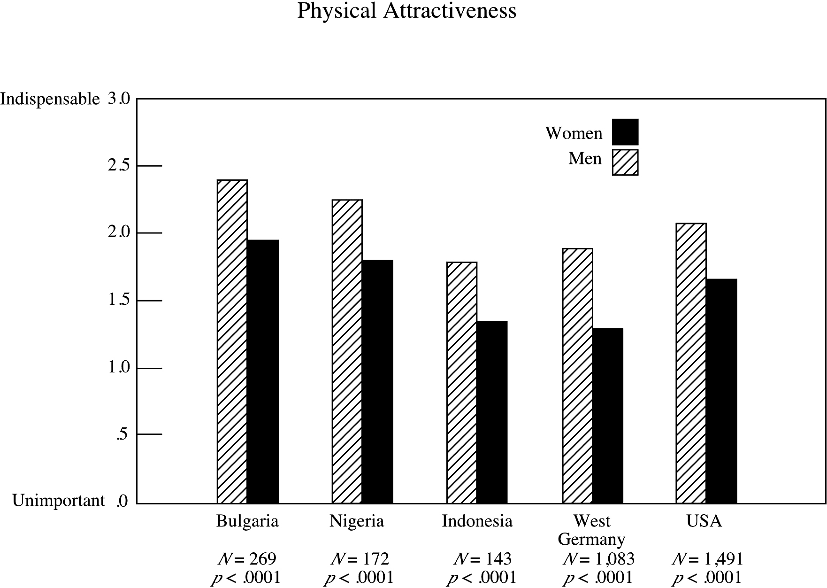
Source: Buss (1989)

Slide 32
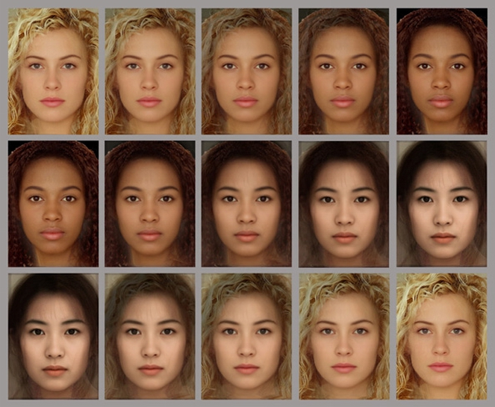
Standards Of Beauty Are Consistent Across Cultures
Source: TBD

Slide 33
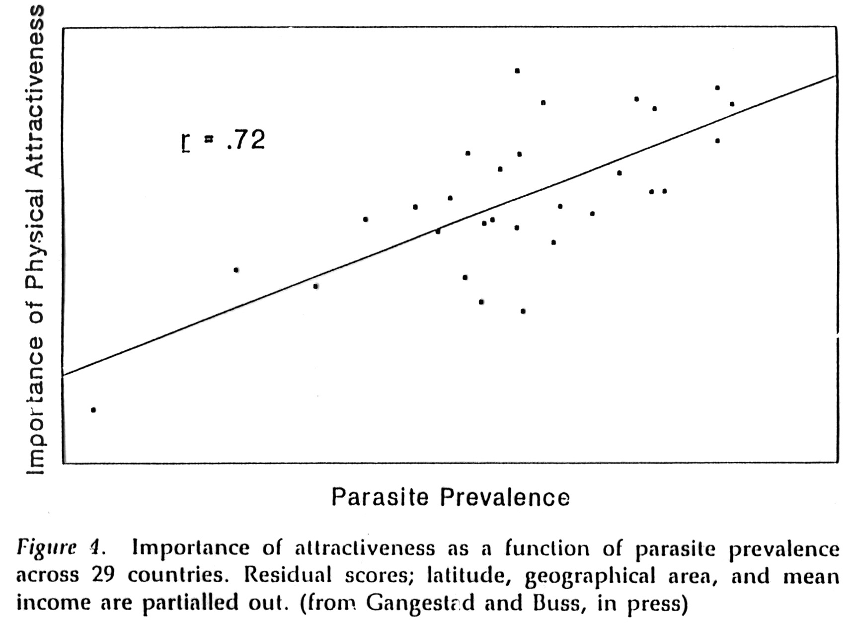
Ecological Diversity
0
in local environment
1993)

Slide 34
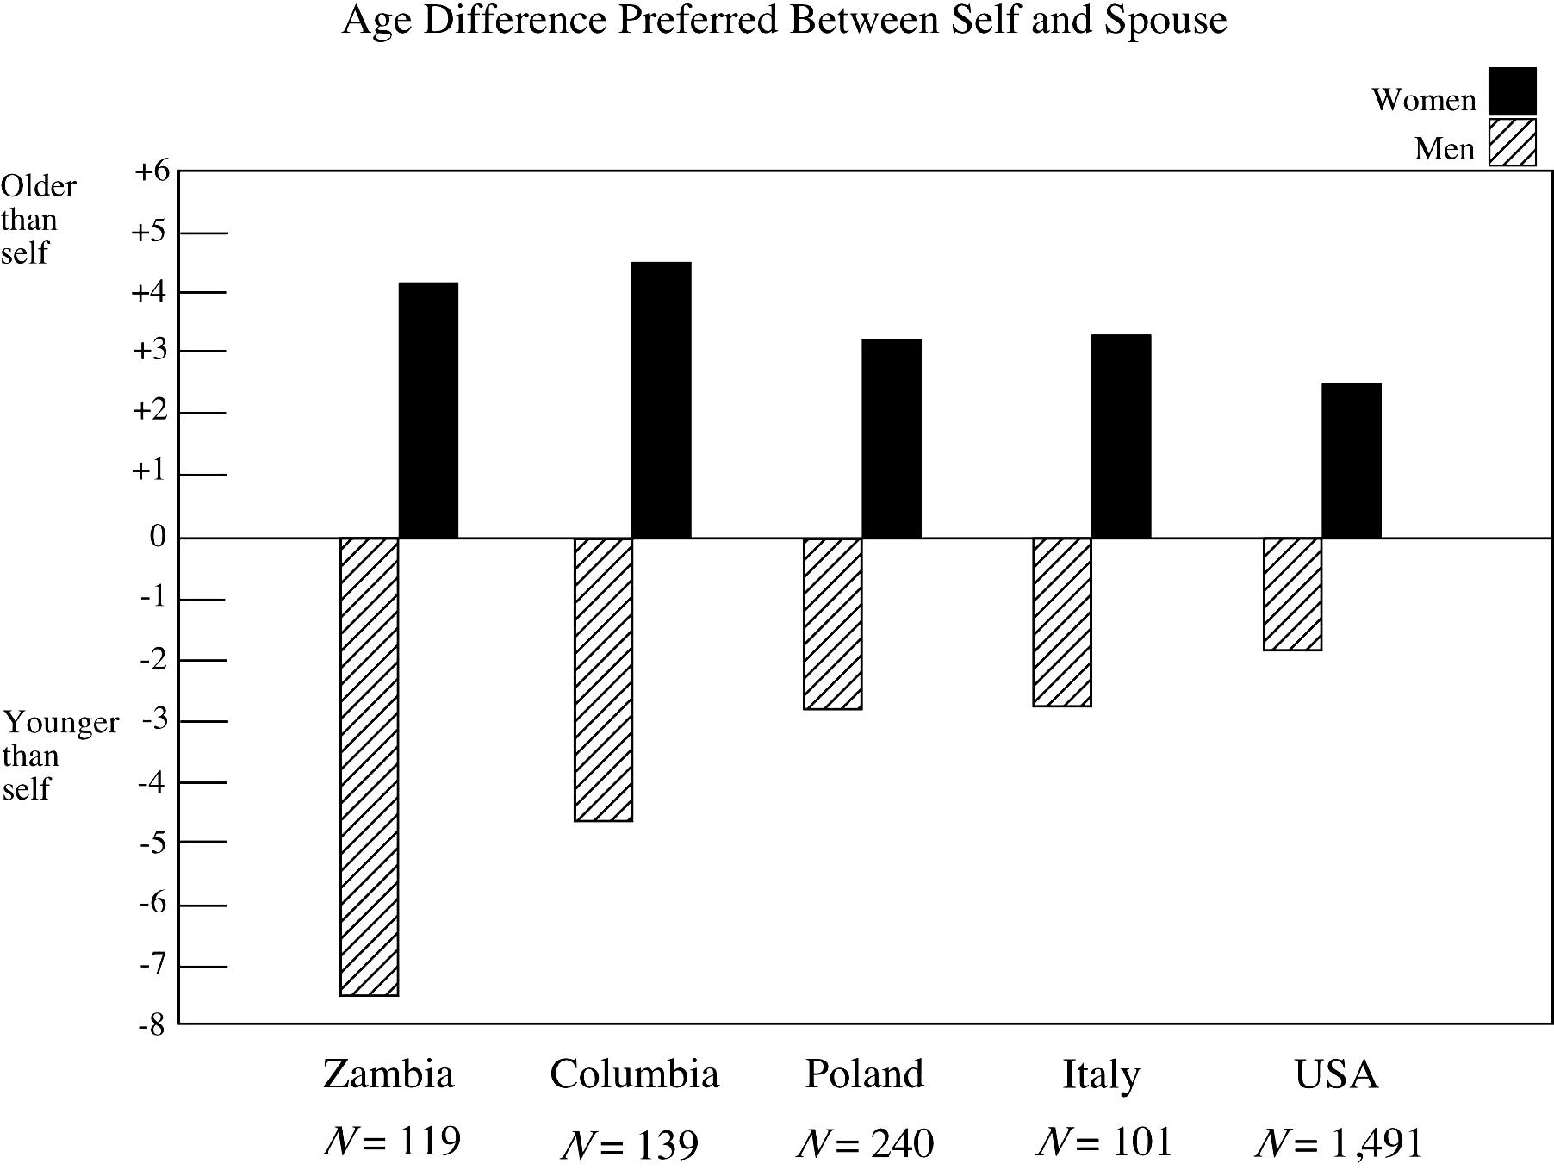
Colombia
Source: Buss (1989)

Slide 35
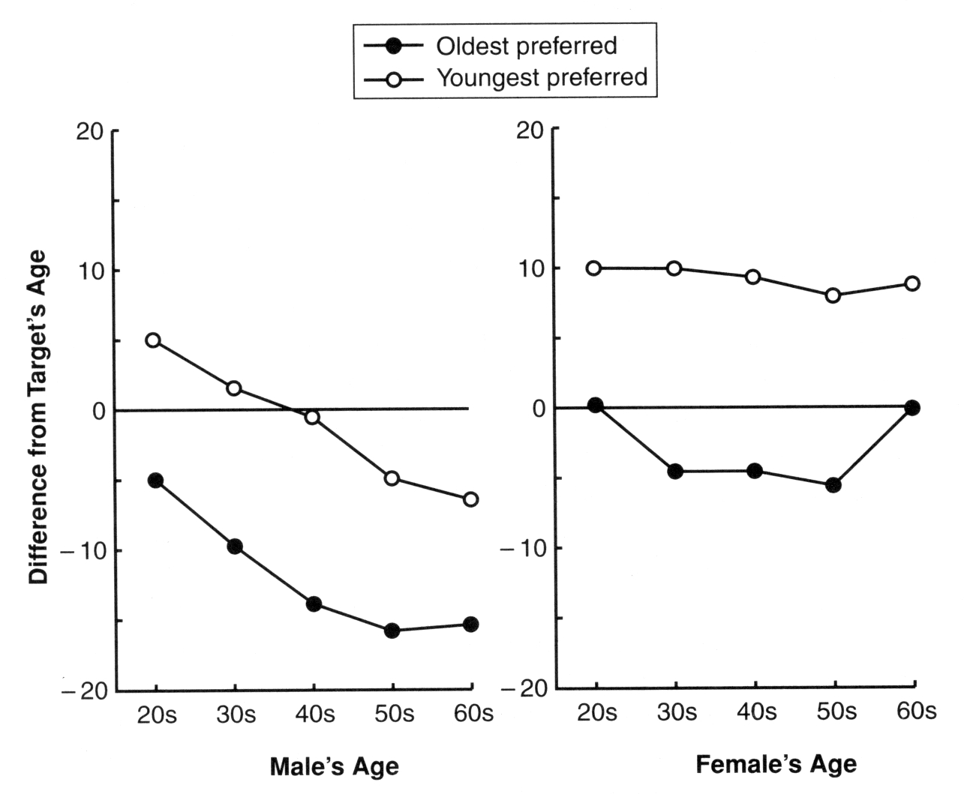
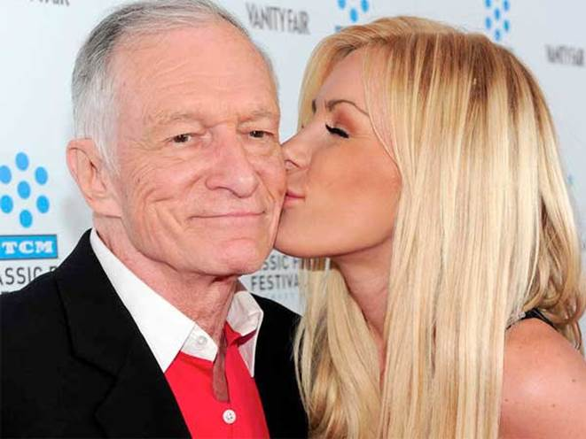
Men’s Age Preferences As
They Get Older
Photo: blogs.lowellsun.com

Slide 36
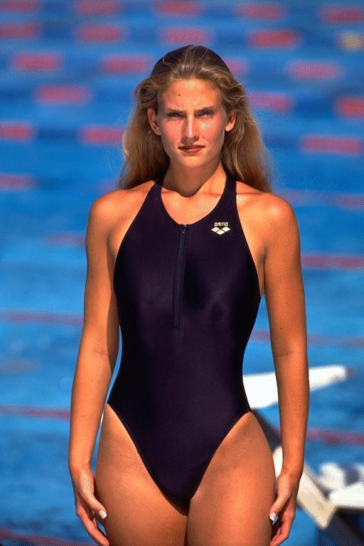
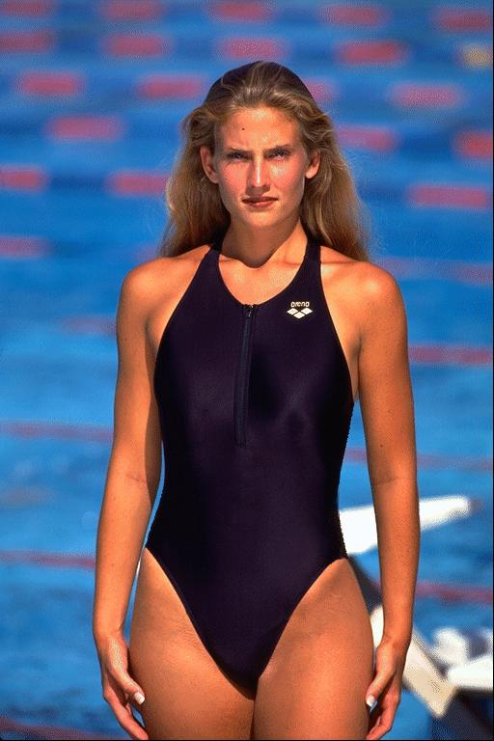
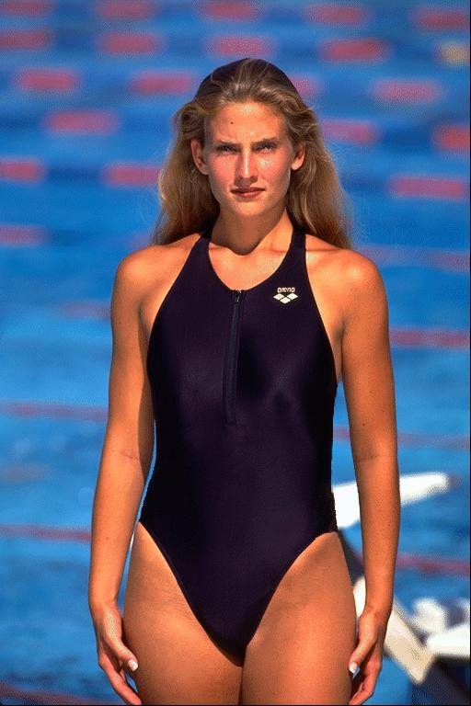
Body Shape: Waist-to-Hip Ratio
Cue to: youth, health, fertility, and non-pregnancy [~.70 = ideal]
.70
TBD
TBD

Slide 37
So What Do Women Want?

Slide 38
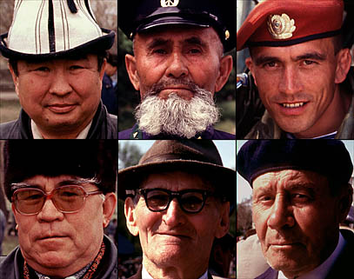
Mate Preferences
Thousands of dimensions of differences
Constants do not count

Slide 39
Problems Women Face in Mating
1. Identifying relevant attributes
2. Assessing men on relevant attributes
3. Accurate self-evaluation of mate value
4. Targeting men in mate-value range
5. Avoiding male deception: “players”

Slide 40
Commitment-Related
Deceptive Experiences
Source: Haselton & Buss (2005)

Slide 41
Emotional Upset About Deception:
Pre- and Post-Copulation
7 = extremely upsetting
Source: Haselton & Buss (2005)

Slide 42
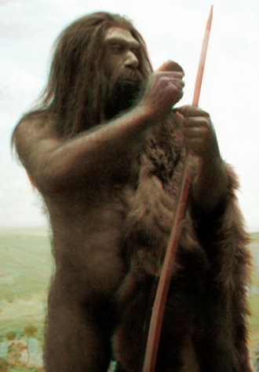


Preference For
Economic Resources
Source: iwallscreen.com
Source: colourschool.org

Slide 43
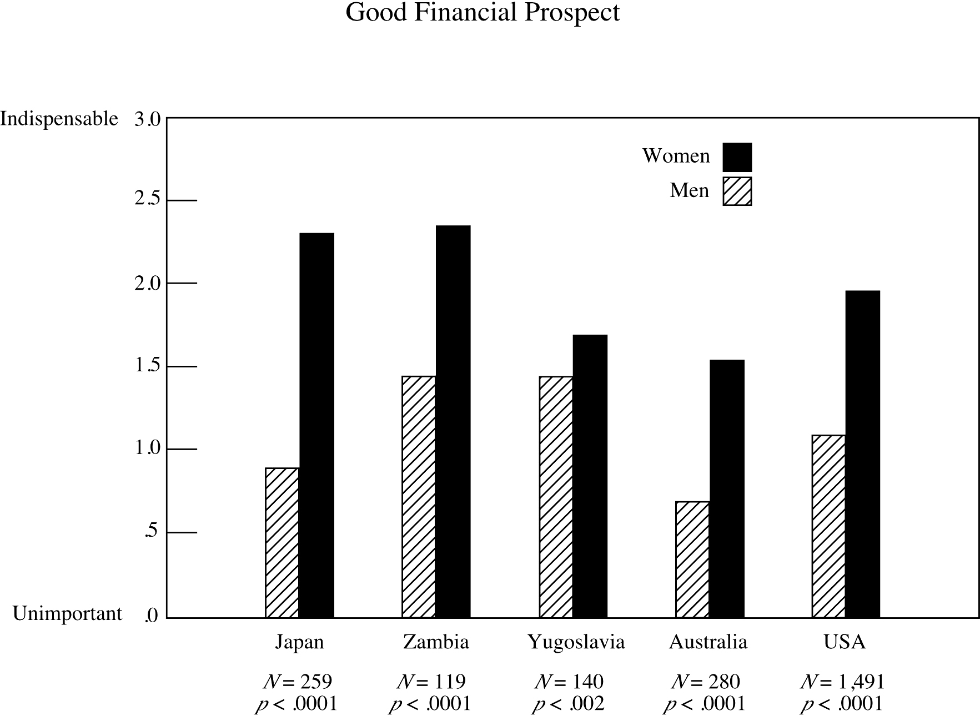
Good Financial Prospects
Croatia
Source: Buss (1989)

Slide 44
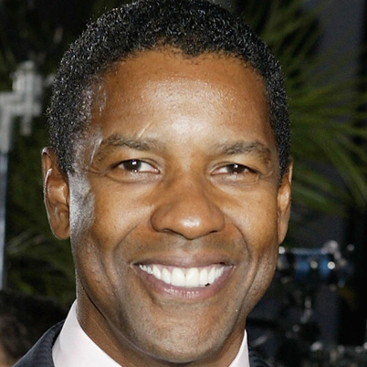

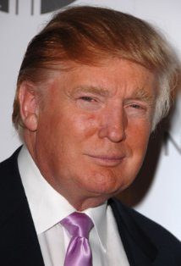
Preference For Social Status
Source: biography.com
Source: blog.starcam.com
Source: imdb.com

Slide 45
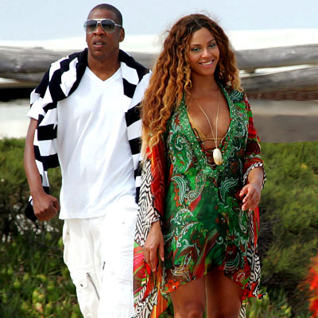
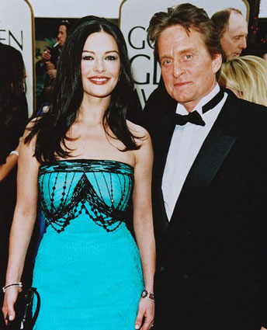
Men in Positions of Power: Do They Get What They Want?

Slide 46
Deception about
Status and Resources
Source: Haselton & Buss (2005)

Slide 47
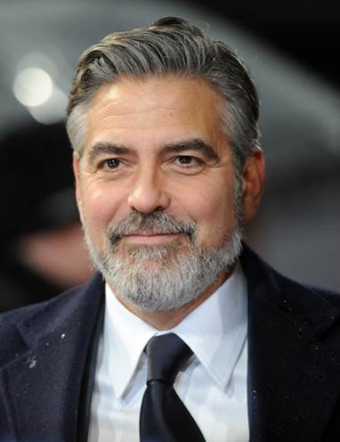
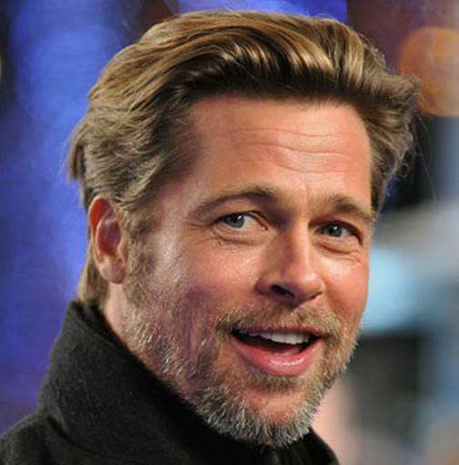
Preference For Slightly Older Men
Source: aces.showbiz.com

Slide 48
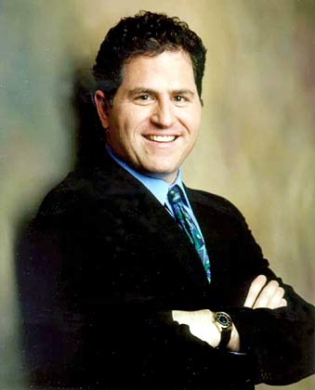
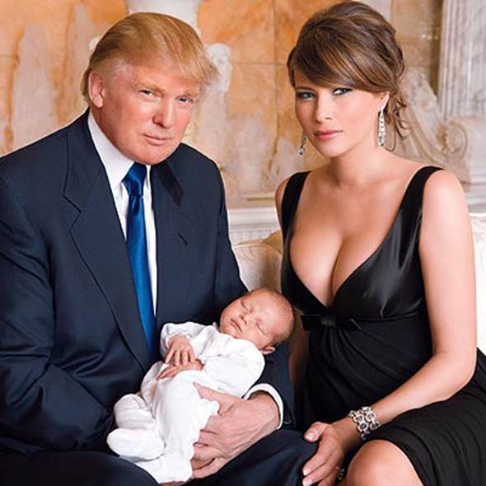
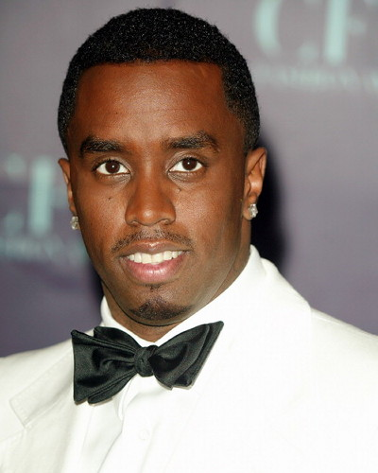
Preference For
Ambition and Industriousness
Source: job-before-success.blogspot.com
Source: people.com
Source: victorstuff.com

Slide 49
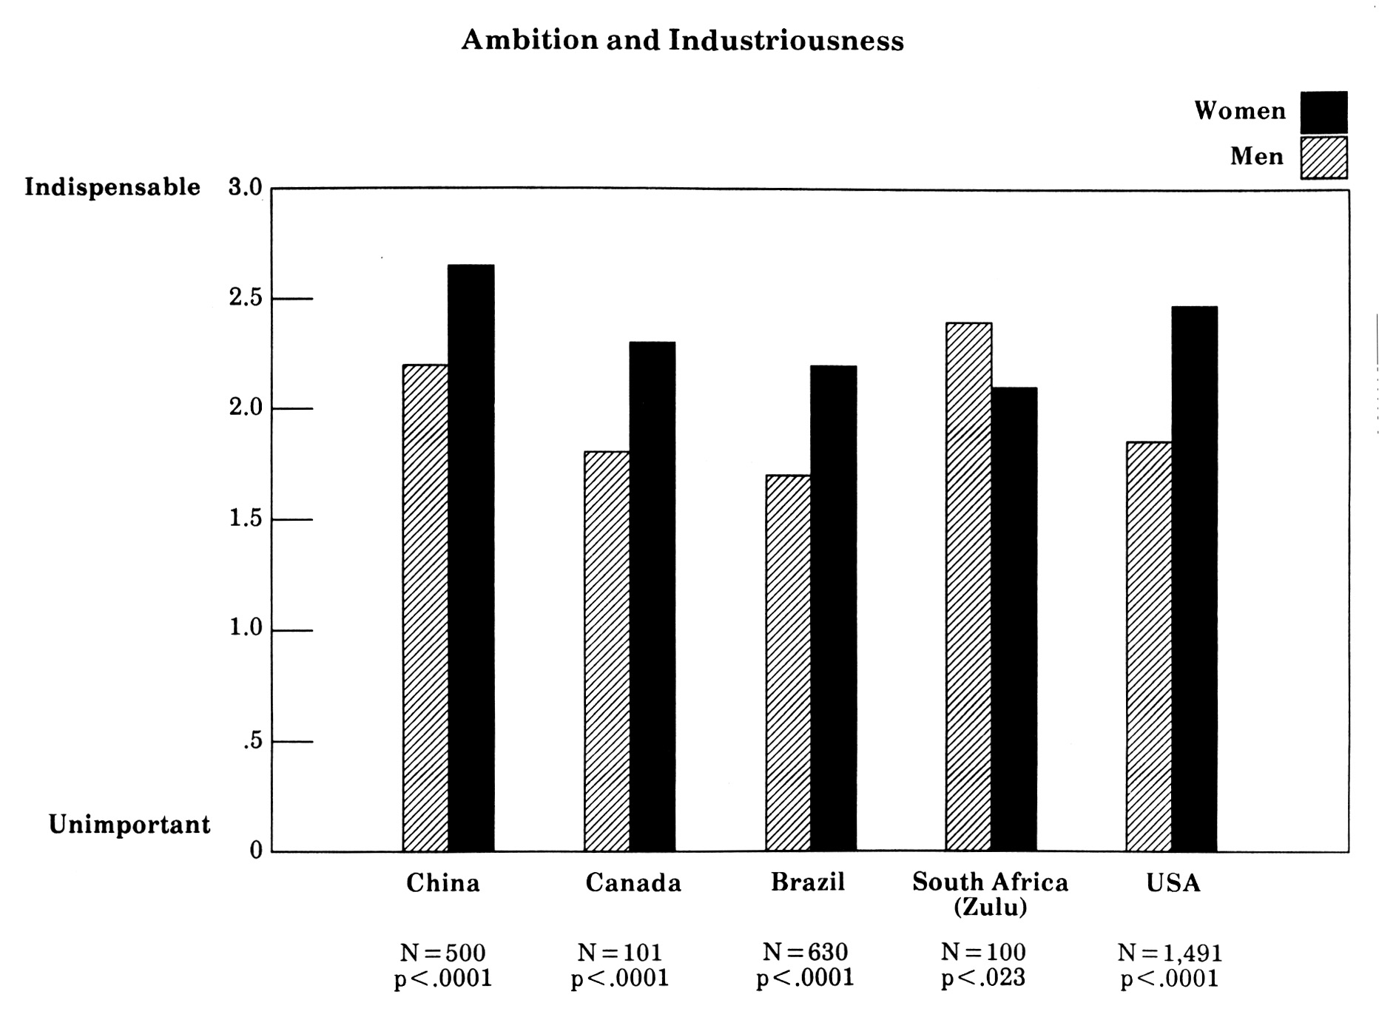
Ambition and Industriousness
Source: Buss (1989)

Slide 50
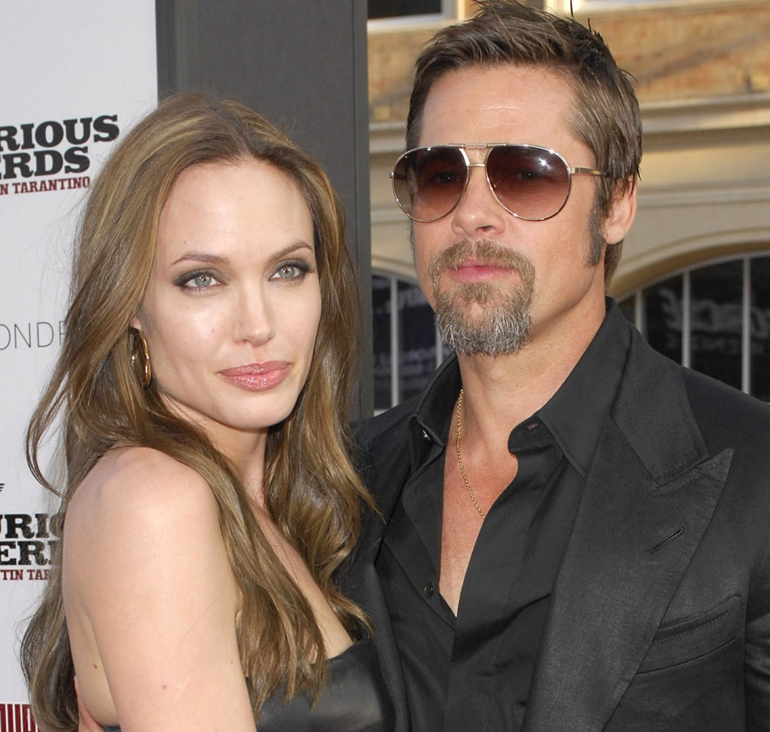
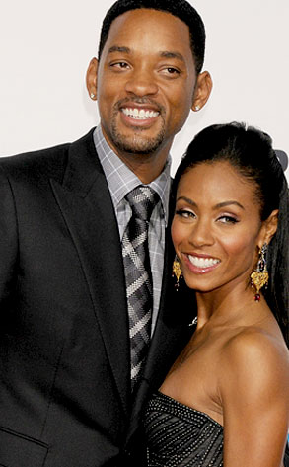

Preference For
Dependability and Stability
Source: collider.com
Source: eonline.com

Slide 51
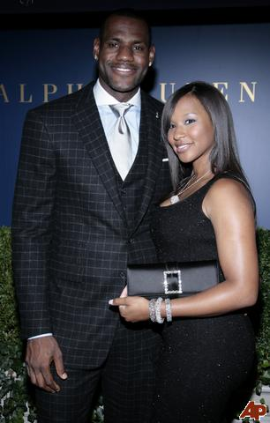
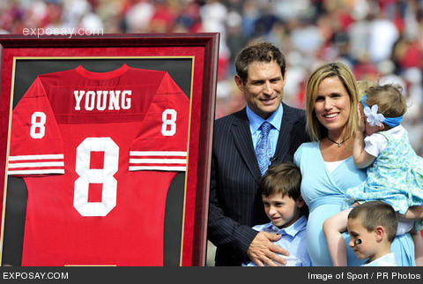
Preference For Athletic Prowess
A Cue to Protection
Source: athleteswives.com

Slide 52
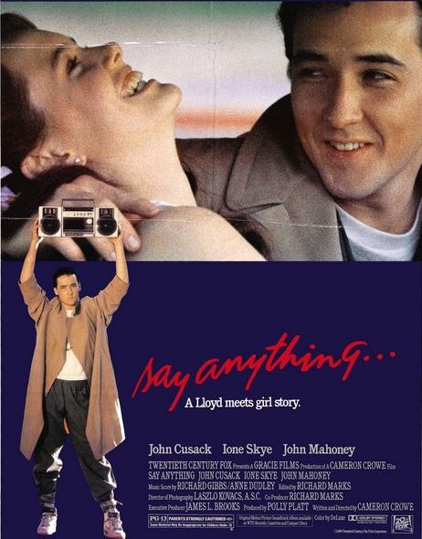
Preference For
Love and Commitment
Source: impawards.com

Slide 53

Willingness to Invest in Children
La Cerra Study

Slide 54
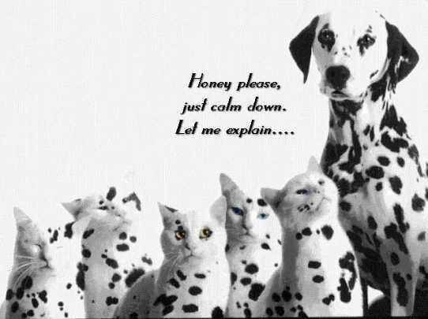
The Hidden Side of Female Sexuality:
Female Short-Term Mating
Source: ruthless.zathras.de

Slide 55
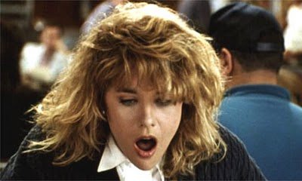
Hypotheses About Potential
Benefits of Infidelity for Female
Low fertility of current mate
Access to additional
resources
Access to superior genes
Mate switching: trading up
cookingwiththemovies.blogspot.com

Slide 56
Sexual Infidelity Tactics
She smiled at another guy in the presence of her mate.
She told the other guy to “call me” when her regular mate was out of town.
She told her partner she was going to attend a lecture on human mating strategies.

Slide 57
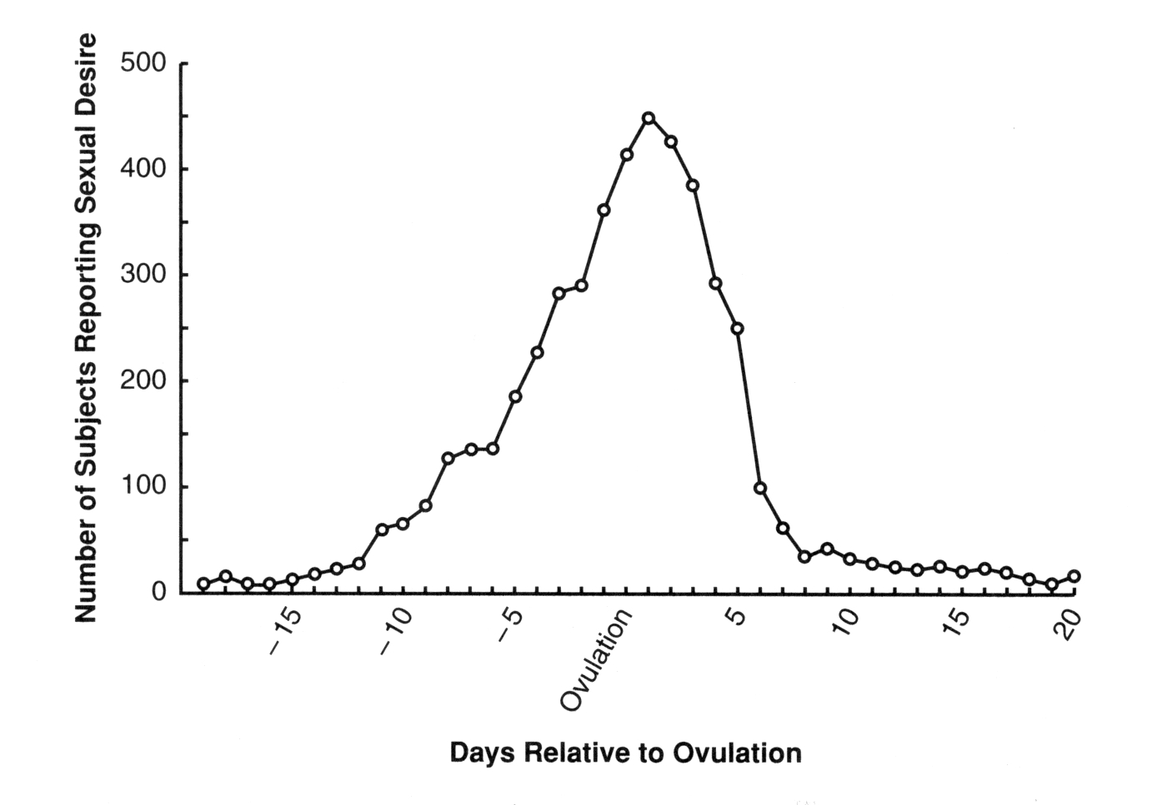
Women’s Sexual Desire as Function of Ovulation Cycle
Pillsworth, Haselton, & Buss, (2004); Rice (1988)

Slide 58

Ovulation and
Women’s Preferences
Hormone
Levels
Source TBD

Slide 59

Masculinity in Men’s Faces
Who is most attractive?
Source TBD

Slide 60
Benefits to Women of EPC Mating
Hypotheses Most Supported Across Different Studies
Mate switching
Resource acquisition
Good genes

Slide 61

Men Don’t Always Know What Women Want

Slide 62

What Women Want:
There’s Much More Research to Do

Slide 63
Thank you!

Slide 64


Slide 65
What About Homosexual Orientation?
Origins (Vasey, 2010)
Mate preferences (Lippa, 2007)
Mating strategies (gender differences)

Slide 66
Origins of Homosexual
Orientation: Theories
Kin selection
Byproduct of unknown modern conditions
Sexually antagonistic gene selection
  Reduces reproduction when in males
  Increases reproduction when in females

Slide 67


Context Effects of
Women’s Preferences
Effects of women’s mate value--high MV
women more choosy, discriminating
Notes:
longer list of traits

Slide 68

Dr. David Buss
Dr. David Buss is an evolutionary psychology researcher and professor at The University of Texas at Austin. He is also a leading author and speaker at universities, corporations, and public forums. He is currently head of the Individual Difference and Evolutionary Psychology Area at UT, and supervises a lab of evolutionary psychology Ph.D. students. Members of his lab receive advanced training in evolutionary psychology, social psychology, personality psychology, comparative psychology, research methods, and statistics.

