Slide 1

Space Telescopes as Time Machines:
Hubble’s Legacy and the Future Through the James Webb Space Telescope
# 84
Dr. Jason Kalirai
March 6, 2013
Produced by and for Hot Science - Cool Talks by the Environmental Science Institute. We request that the use of these materials include an acknowledgement of the presenter and Hot Science - Cool Talks by the Environmental Science Institute at UT Austin. We hope you find these materials educational and enjoyable.

Slide 2
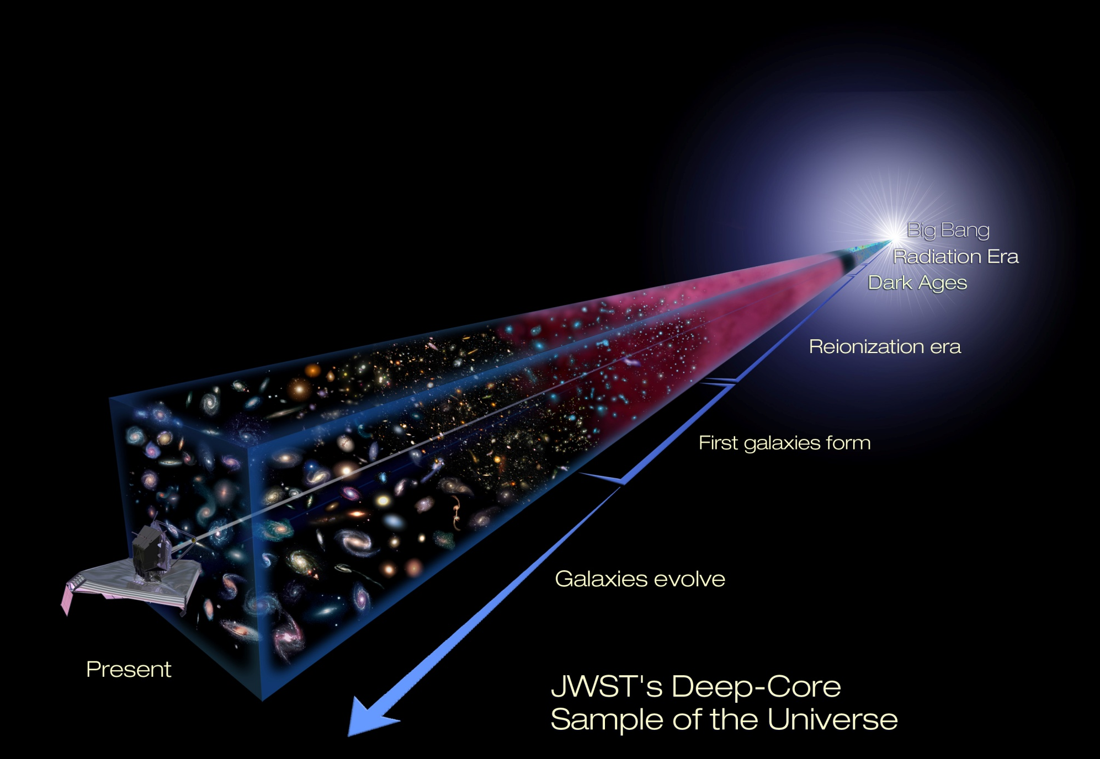
Telescopes as Time Machines
The Legacy of Hubble & The Future with the
James Webb Space Telescope
jason kalirai (stsci)
@jasonkalirai

Slide 3
Notes:
Galileo shows his benefactor, the Dodge of Venice, the power of a telescope to spot enemy ships from the distant horizon
What changed the world was when Galileo pointed it to the sky.

Slide 4
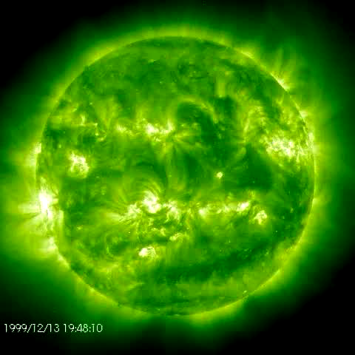

Slide 6
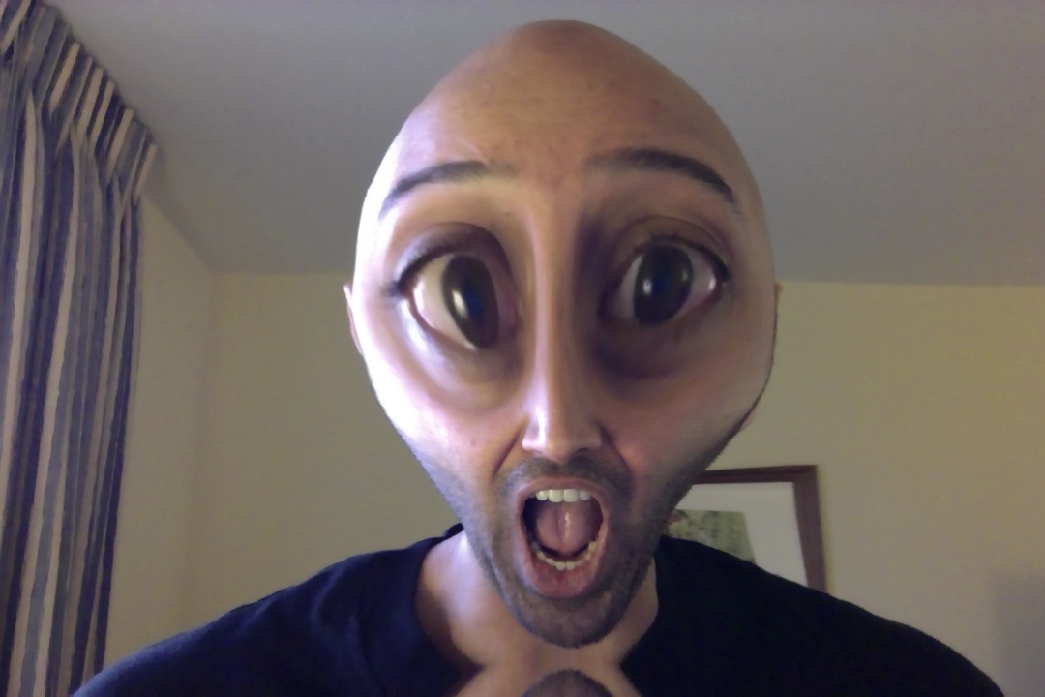
Dude, can you get to the time machine part?
…am I a space alien?

Slide 7
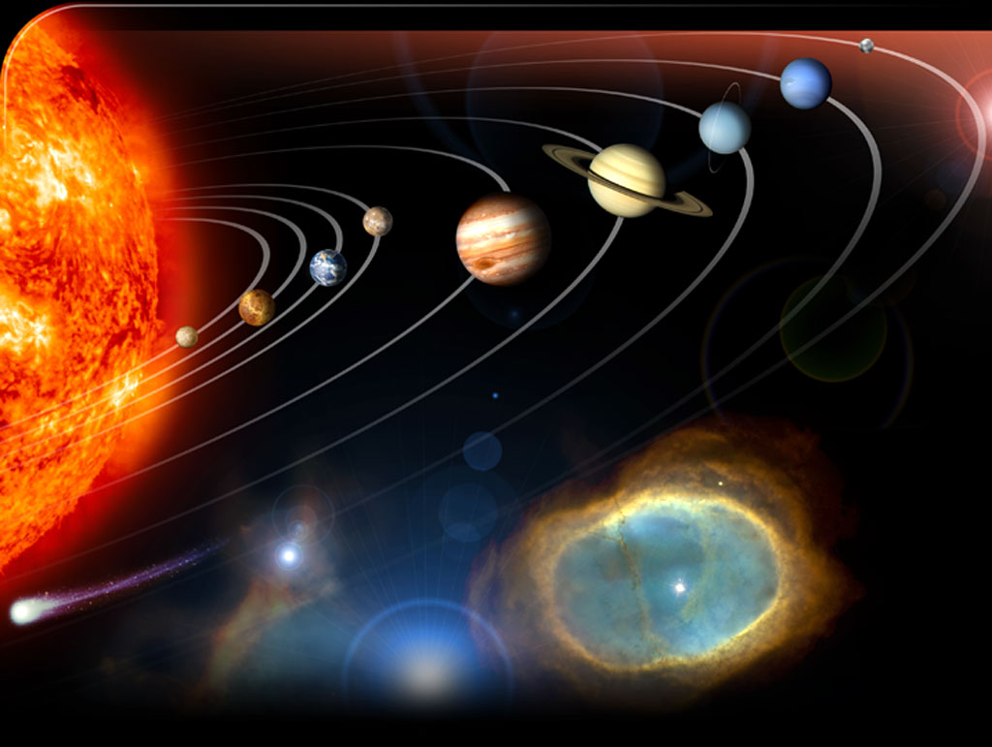
Time Traveling in Astronomy
Earth - 100 million miles
Saturn - 1 billion miles
Pluto - 40 billion miles
Solar System
the Sun is 100 million miles from Earth
light travels 11 million miles in one minute
conclusion
huh??? so, then does light take 8 minutes to get to us from the Sun?

Slide 8
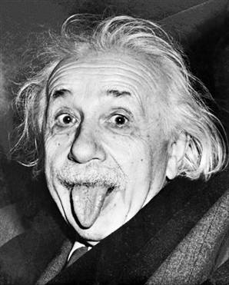
Time Traveling in Astronomy
yes, yes…indeed, light takes precisely 8.33 minutes to get from the Sun to the Earth.
Jason’s astronomer friend #1
(Albert Einstein)

Slide 9
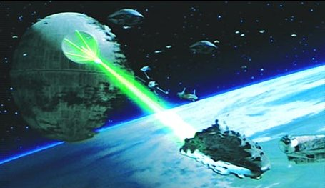
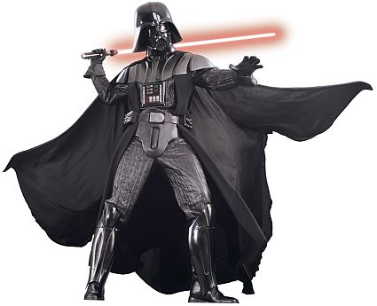
Time Traveling in Astronomy
ha ha…my death star destroyed your Sun…
7.5 minutes ago!
Jason’s astronomer friend #2
(Darth Vader)

Slide 10
Time Traveling in Astronomy
Pluto – 40 billion miles
light takes 1 hour to go from the Sun to Pluto
nearest star to the Sun?
question: how long does it take light to reach us from that star?
answer: 4 years

Slide 11
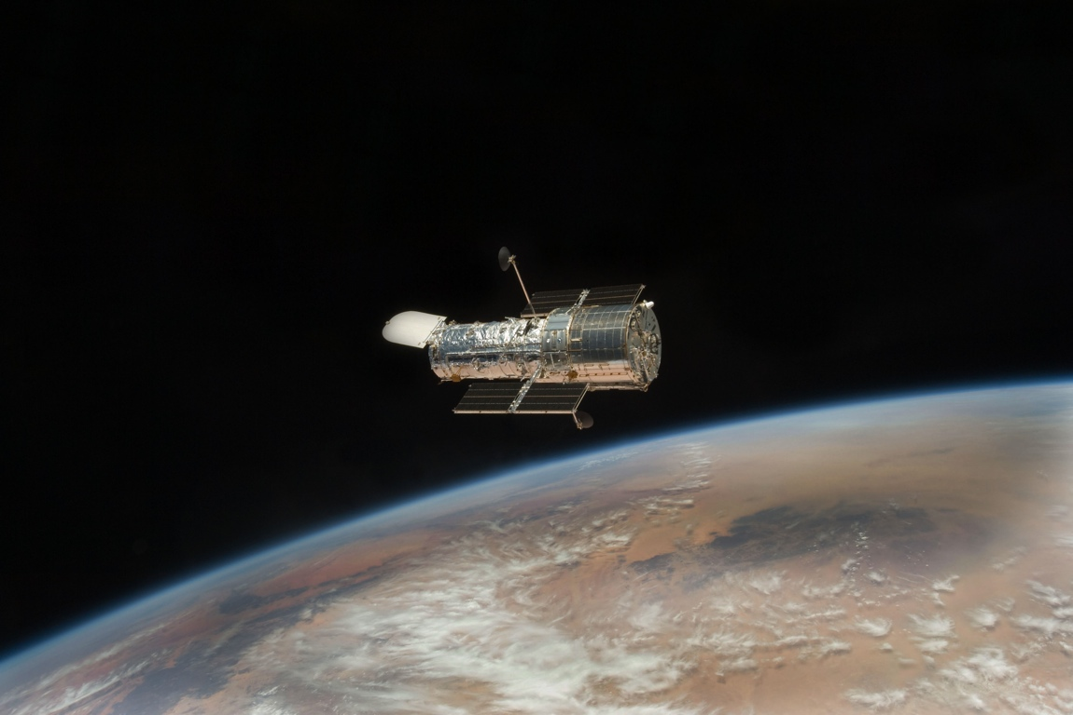
the greatest time machine ever built
Notes:
The result.
- talk about big science from flagships and compare/contrast with diversity from smaller missions.
- highlight the support of grad students and postdocs…countless people have built their careers on HST
- engineering/jobs?

Slide 12
the Universe’s first
stars formed
1
10
100
1
10
100
1
10
(thousand years)
(million years)
(billion years)

Slide 13
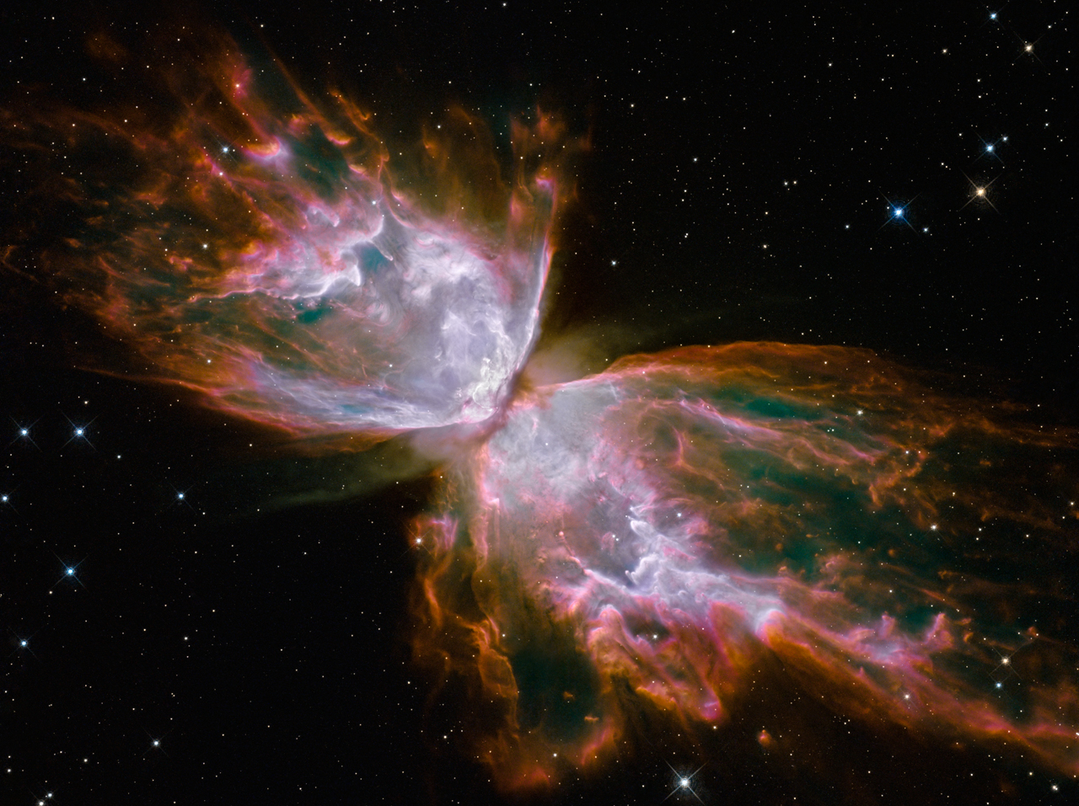
pictures from Hubble – a little dying star
the Universe’s first
stars formed
cosmic time line
1
10
100
1
10
100
1
10
(thousand years)
(million years)
(billion years)

Slide 14
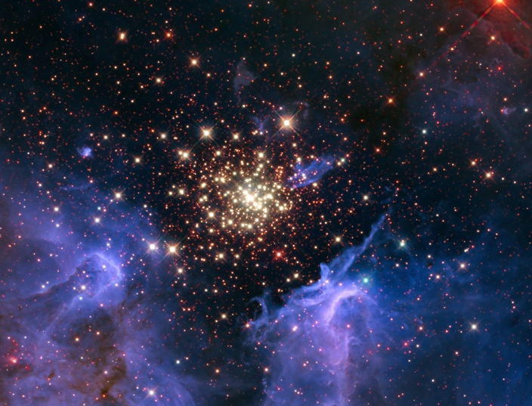
pictures from Hubble – a cluster of stars
cosmic time line
1
10
100
1
10
100
1
10
(thousand years)
(million years)
(billion years)

Slide 15
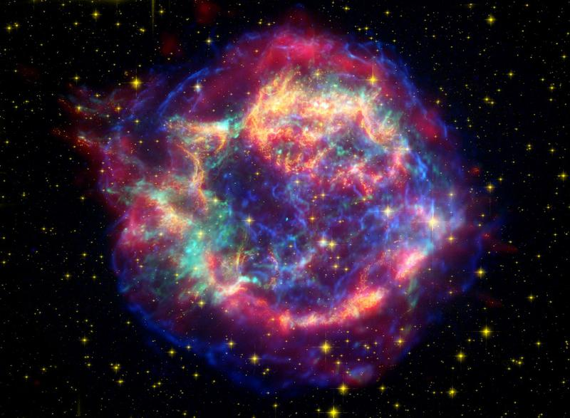
pictures from Hubble – a BIG dying star
cosmic time line
1
10
100
1
10
100
1
10
(thousand years)
(million years)
(billion years)

Slide 16
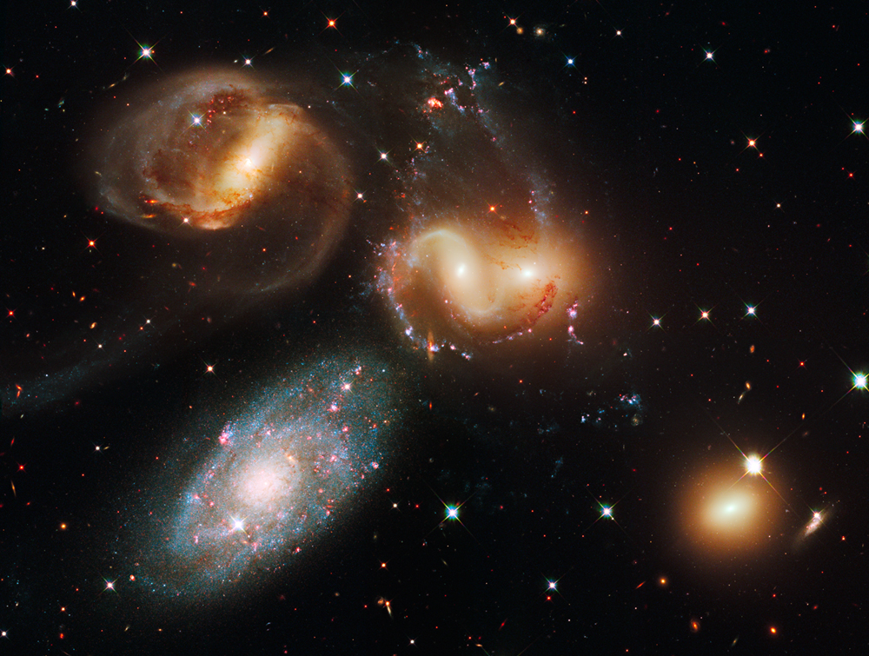
pictures from Hubble – interacting galaxies
cosmic time line
1
10
100
1
10
100
1
10
(thousand years)
(million years)
(billion years)

Slide 17
Hubble discoveries
supermassive black holes
the age of the universe
gravitational lensing of galaxies
dark energy and the expansion of the Universe
influence of dark matter
imaging and spectroscopy of giant exoplanets
intensities of supernovae
Notes:
The technology behind Great Observatories allows for a breadth of science that serves the broader community.

Slide 18
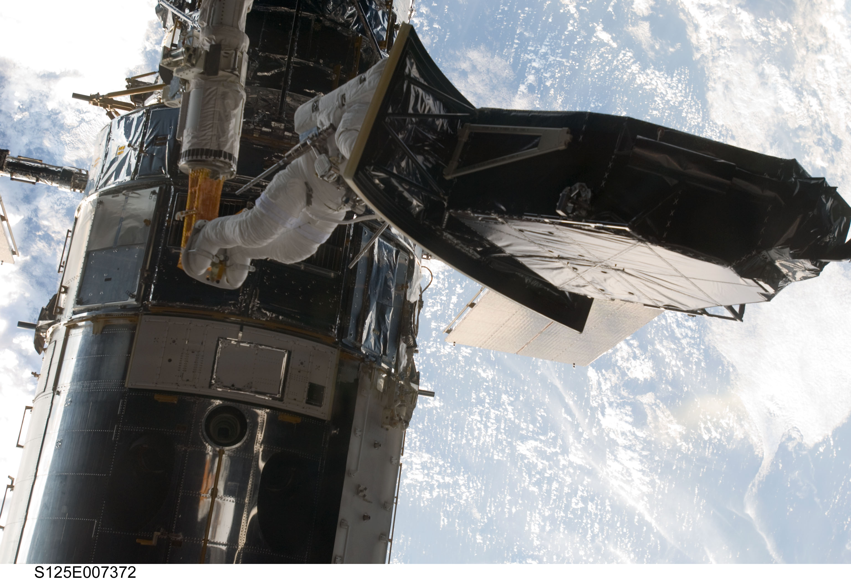
the new and improved Hubble!
Notes:
The importance of technology in enabling HST’s success is echoed in the Servicing Missions.
1.) HST is young because of the servicing missions
2.) Each servicing mission provided astronomy with new discovery potential because of new capabilities in the science instruments
3.) In 2011, there were 3923 authors on published papers based on Hubble data
4.) In 2012, Hubble received more observing proposal requests than in any of the past five years.
→ Could show plot here correlating proposal pressure with servicing missions.

Slide 19
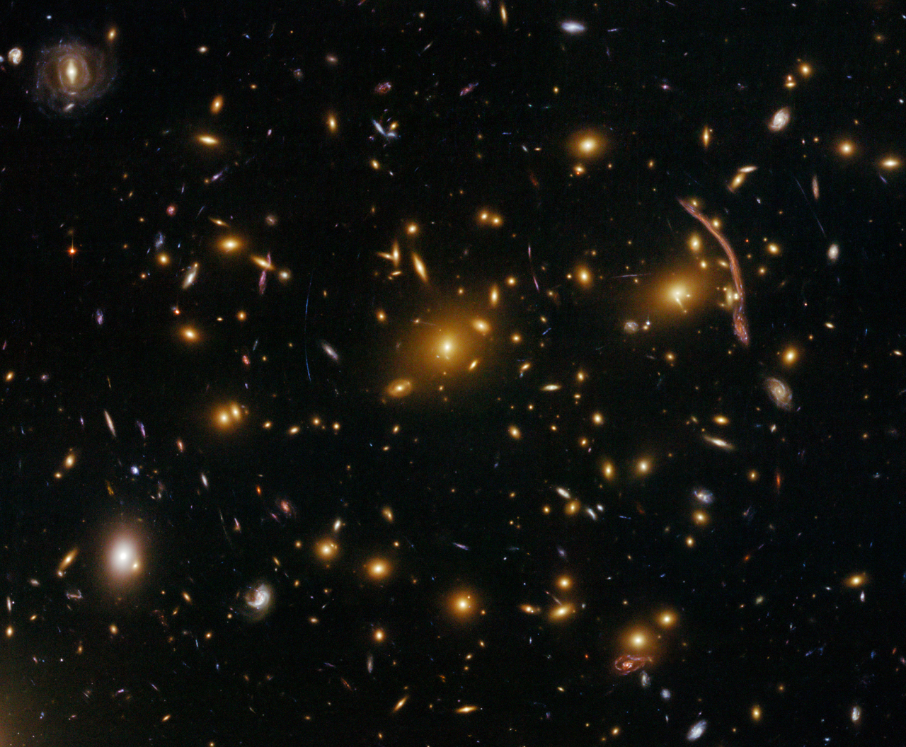
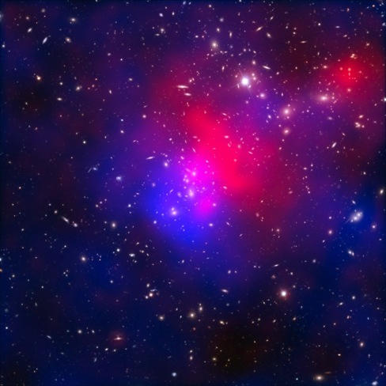
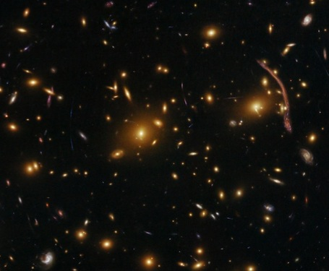
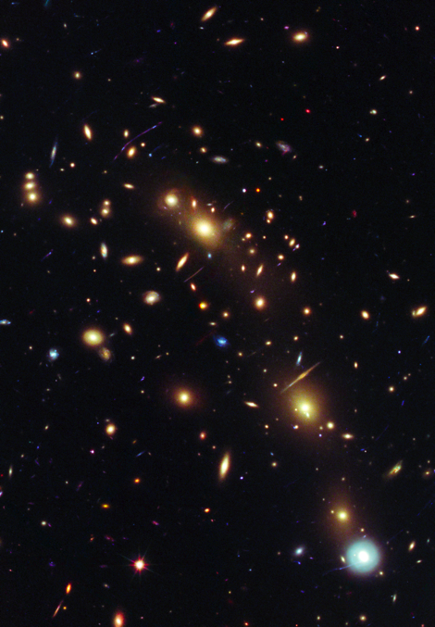
Hubble’s ‘frontier fields’ (2013 – 2016)
cosmic time line
1
10
100
1
10
100
1
10
(thousand years)
(million years)
(billion years)

Slide 20
what’s next?
Notes:
The result.
- talk about big science from flagships and compare/contrast with diversity from smaller missions.
- highlight the support of grad students and postdocs…countless people have built their careers on HST
- engineering/jobs?

Slide 21
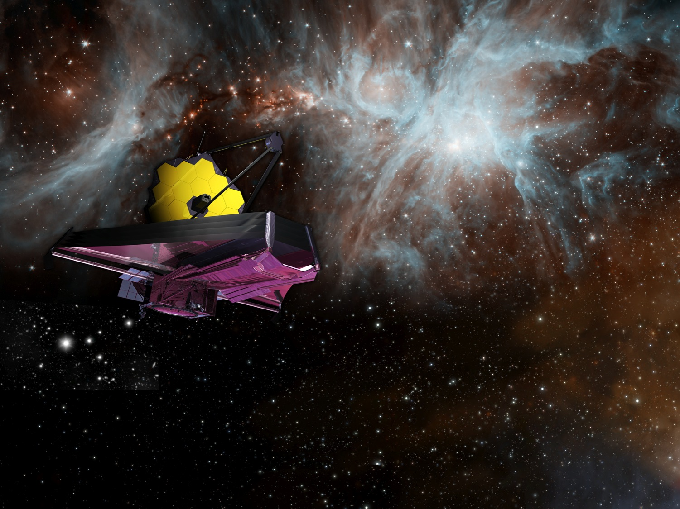
James Webb Space Telescope
JWST organization
Mission Lead: NASA’s Goddard Space Flight Center
International Collaborators: European and Canadian Space Agencies
Prime Contractor: Northrop Grumman Aerospace Systems
Operations Center: Space Telescope Science Institute

Slide 22
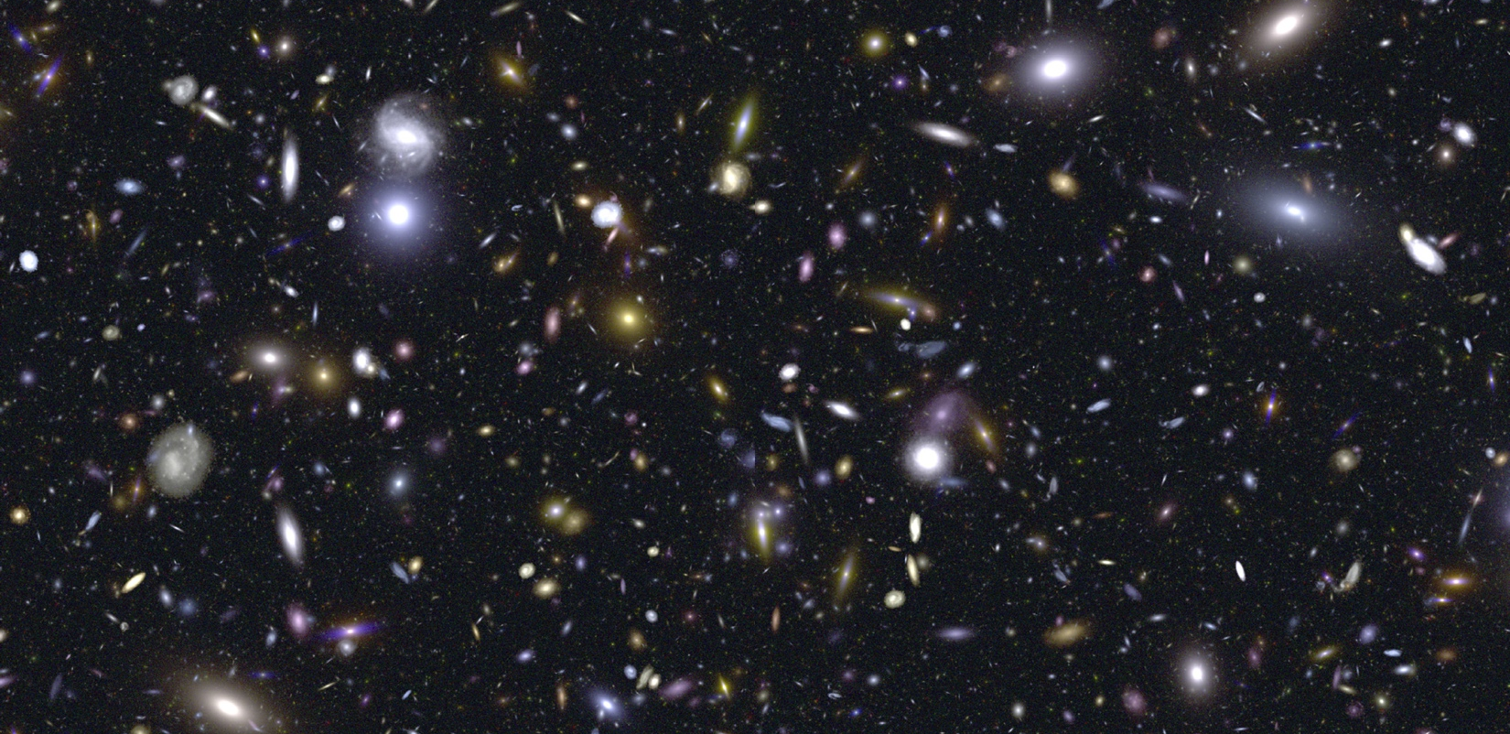
science challenge #1
to seek the Universe’s first stars and galaxies

Slide 23

science challenge #2
to determine how galaxies evolve from the early Universe to the present (stars, gas, metals, dark matter)

Slide 24
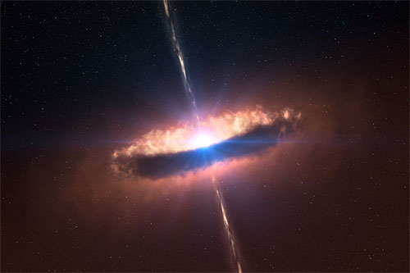
science challenge #3
to solve the mysteries of star formation and reveal the birth of planetary systems

Slide 25
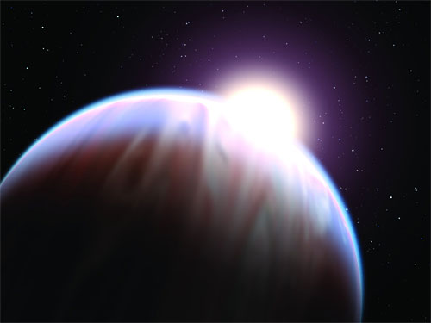
science challenge #4
to measure the chemistry of Solar Systems (including our own) and probe the building blocks of life

Slide 26
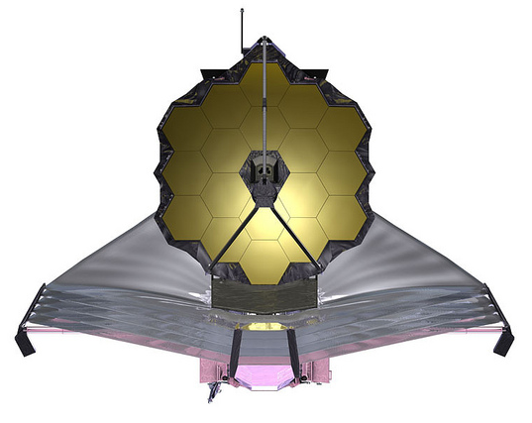
astronomy’s next great observatory
answering the challenges – James Webb Space Telescope
>100x more power than Hubble and other telescopes
>50x the resolution of Spitzer; near & mid-infrared wavelengths
comparable in size to the largest ground-based telescopes, yet light weight
launches out to 1 million miles, deployable in space
operates at cryogenic temperatures
contains a new generation of complex instrumentation to ensure diverse
modes of operation without servicing
Notes:
Keck 36 mirrors weight 14,400 kg – each segment weighs 400 kilograms
JWST 18 mirrors (total) weigh 600 kg – each segment weighs 20 kilograms

Slide 27
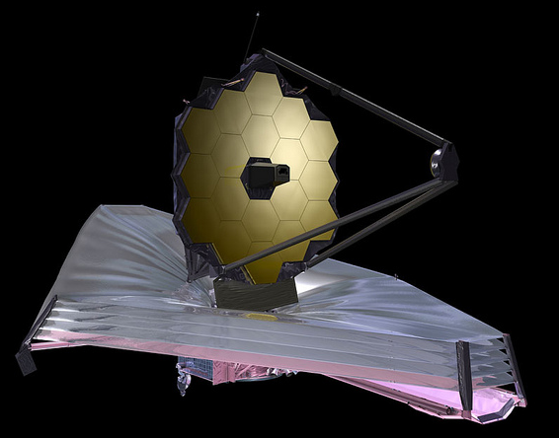
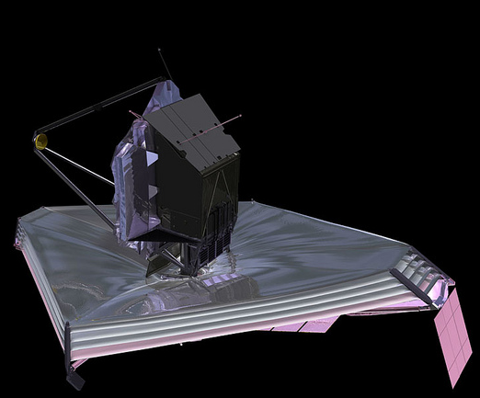
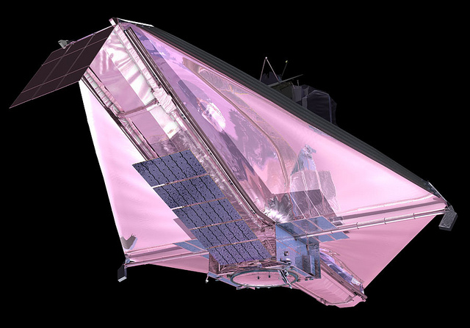
it’s a bird, it’s a plane, it’s…
multi-layer sunshield
(protects telescope by blocking heat from Sun)
cameras and spectrographs
(collect scientific data – i.e., images)
need
21 foot segmented mirror
(capture infrared light)
momentum trim flap
(stabilize observatory)
spacecraft
(electronics, control systems)
solar panels
(power)

Slide 28
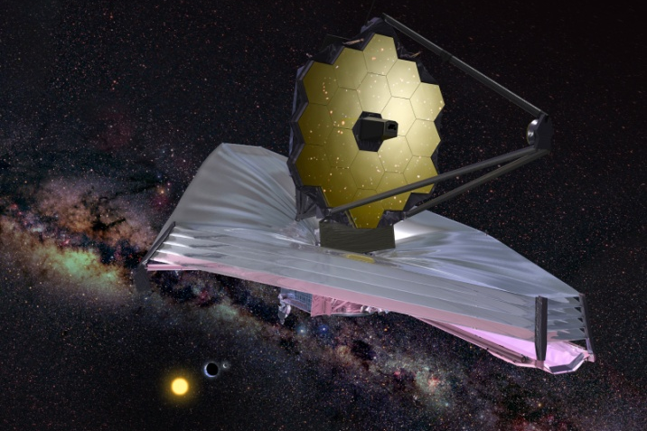
the JWST concept
technological firsts to achieve this mission
segmented beryllium primary mirror
composite backplane structure
mirror phasing and control software
application specific integrated circuit
microshutters
sunshield membranes
mid-infrared detectors
cryo-cooler for mid-infrared instrument
other “inventions” (e.g., tinsley’s shack-hartmann technique for mirror
surface measurement, SSHS)
Notes:
- all of these technologies have been developed. Some are even paying dividends beyond astronomy (later).

Slide 29
the JWST concept
technological firsts to achieve this mission
segmented beryllium primary mirror
composite backplane structure
mirror phasing and control software
application specific integrated circuit
microshutters
sunshield membranes
mid-infrared detectors
cryo-cooler for mid-infrared instrument
other “inventions” (e.g., tinsley’s shack-hartmann technique for mirror
surface measurement, SSHS)
Notes:
- all of these technologies have been developed. Some are even paying dividends beyond astronomy (later).

Slide 30
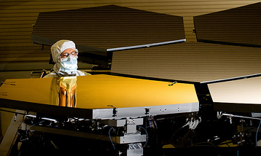
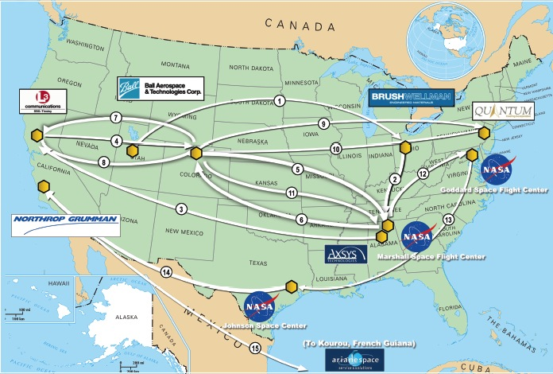
the JWST mirrors journey
Beryllium Across the Country
1.) Brush Wellman Inc’s Mine (Powder – Utah)
2.) Brush Wellman Fac. (purification – Ohio)
3.) Axsys Tech (Honeycomb/shaping – Alabama)
4.) Tinsley Lab (Grind/Polish/testing at room temp – California)
5.) Ball (Mounts/Actuators/testing – Colorado)
6.) X-ray and Cryogenic Facility (Cold vacuum testing – Alabama)
7.) Ball (Remove mounts/actuators – Colorado)
8.) Tinsley Lab (Fine tune polish based on cryogenic testing – California)
9.) Ball (Cleaning and preparation for coating – Colorado)
10.) Quantum Coating Inc. (Gold coating – New Jersey)
11.) Ball (Reassemble segments with mounts and actuators / Vibration testing – Colorado)
12.) X-Ray and Cryogenic facility (Final cryogenic acceptance testing on segments – Alabama)
13.) NASA GSFC (Assembly and ISIM integration / Acoustic and vibration testing – Maryland)
14.) NASA JSC (Final cryogenic testing of JWST – Texas)
Notes:
This is nice since it highlights the complexity of the mirrors, and can be followed up with the nice gold coated images in your talk.

Slide 31
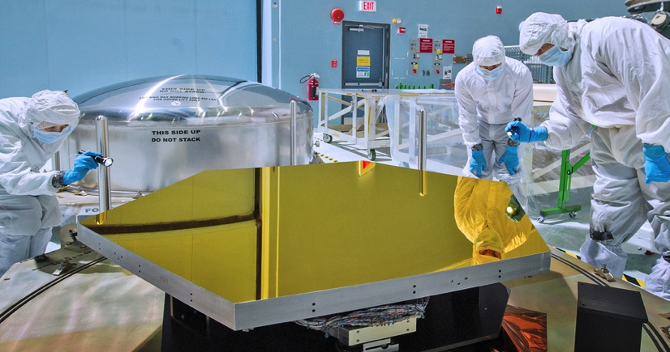
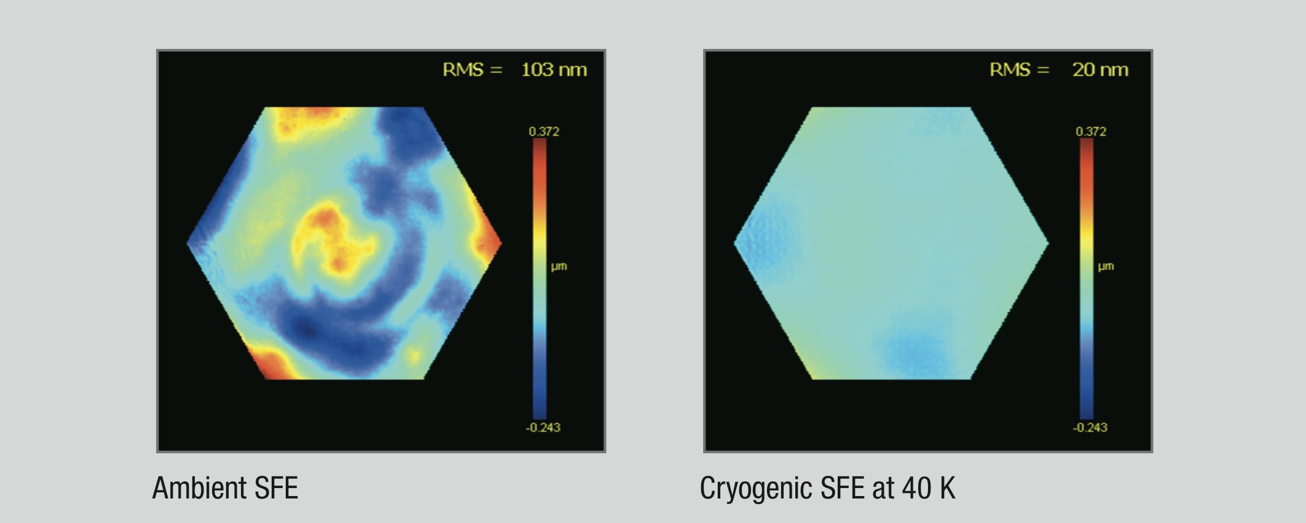
we’re talking smooth…
each 1.3 meter JWST mirror segment has surface aberrations measuring ~20 nanometers.
37 nm
1.3 meters
if this mirror was stretched in proportion to the size of the Texas, the bumps would only be 1 centimeter high.
-24 nm

Slide 32
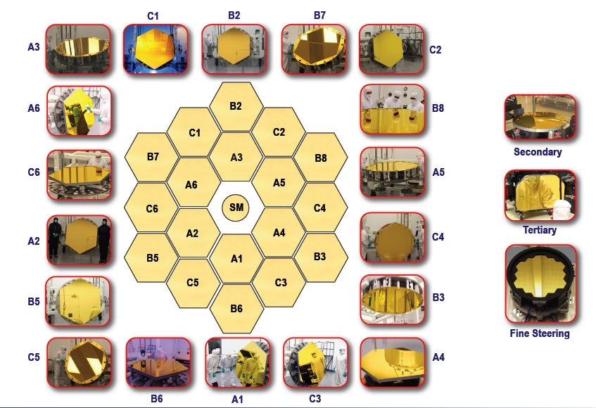
21 foot mirror in space
Notes:
Tell the Mirror Story
--------------------------
- STATUS: ALL DONE!

Slide 33
the JWST concept
technological firsts to achieve this mission
segmented beryllium primary mirror
composite backplane structure
mirror phasing and control software
application specific integrated circuit
microshutters
sunshield membranes
mid-infrared detectors
cryo-cooler for mid-infrared instrument
other “inventions” (e.g., tinsley’s shack-hartmann technique for mirror
surface measurement, SSHS)
Notes:
- all of these technologies have been developed. Some are even paying dividends beyond astronomy (later).

Slide 34

tennis-court sized 5-layer sunshield
Notes:
COULD SHOW VIDEO OF SUNSHIELD TESTING FROM ONE OF NGAS
----------------------------------------------------------------------------------------------------
- JWST’s most visual subsystem is the sunshield
- Sunshield is composed of five separate layers to ensure the optics and instruments of the telescope remain cold.
- Sunshield always pointed towards the Sun, Earth, and Moon.
- The hot side of JWST will reach 185 degrees F, but the cold side must be -388 degrees F.
- Sunshield provides a thermally stable environement for JWST.
- Update: Sunshield template layer 3 and 5 shape measurements are completed and within spec (as of SWG meeting).

Slide 35
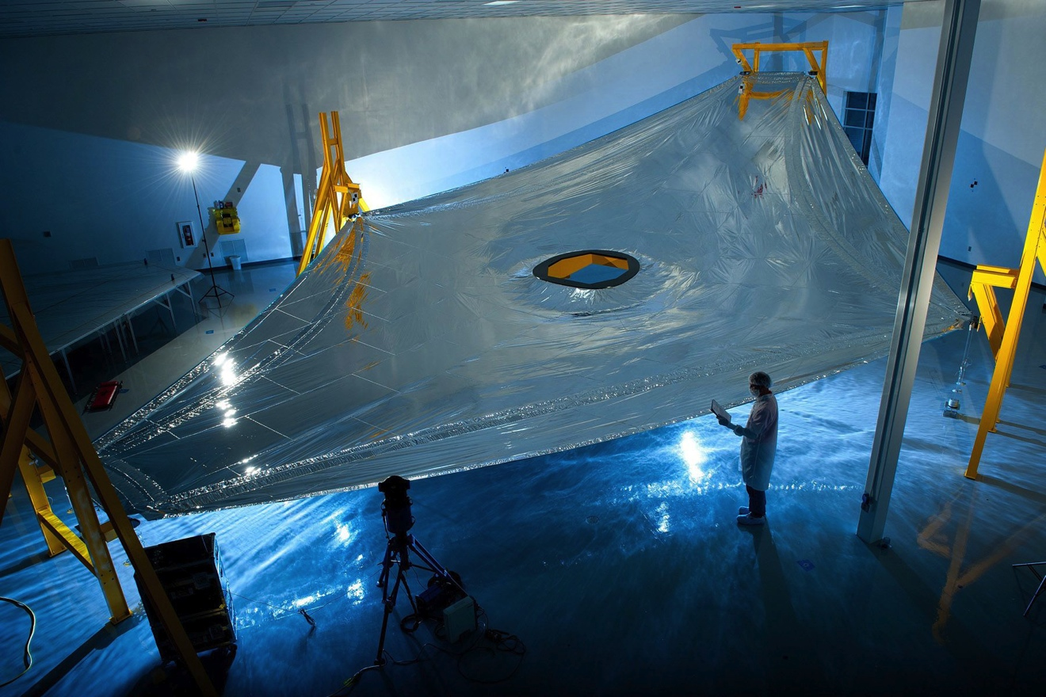
tennis-court sized 5-layer sunshield
JWST sunshield cold side, -388 F
JWST sunshield hot side, 185 F
Notes:
COULD SHOW VIDEO OF SUNSHIELD TESTING FROM ONE OF NGAS
----------------------------------------------------------------------------------------------------
- JWST’s most visual subsystem is the sunshield
- Sunshield is composed of five separate layers to ensure the optics and instruments of the telescope remain cold.
- Sunshield always pointed towards the Sun, Earth, and Moon.
- The hot side of JWST will reach 185 degrees F, but the cold side must be -388 degrees F.
- Sunshield provides a thermally stable environement for JWST.
- Update: Sunshield template layer 3 and 5 shape measurements are completed and within spec (as of SWG meeting).

Slide 36
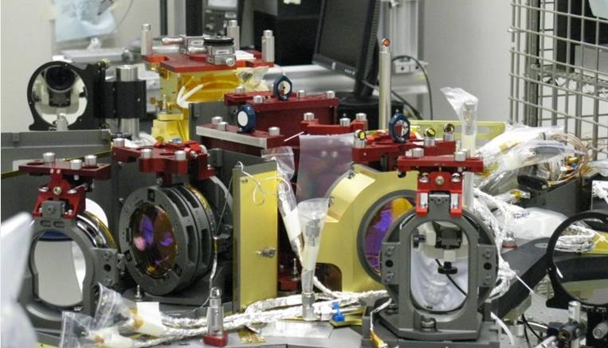
one of JWST’s “cameras”
Notes:
- Talk about the opportunity for multiobject spectroscopy at high *spatial* resolution (0.1 pixels).
- With Hubble, we’ve been able to image some of the densest environments that the Universe offers.
- With JWST, we’ll get spectra of hundreds of stars in those environments.
- Set this up, the example is on the next slide.

Slide 37
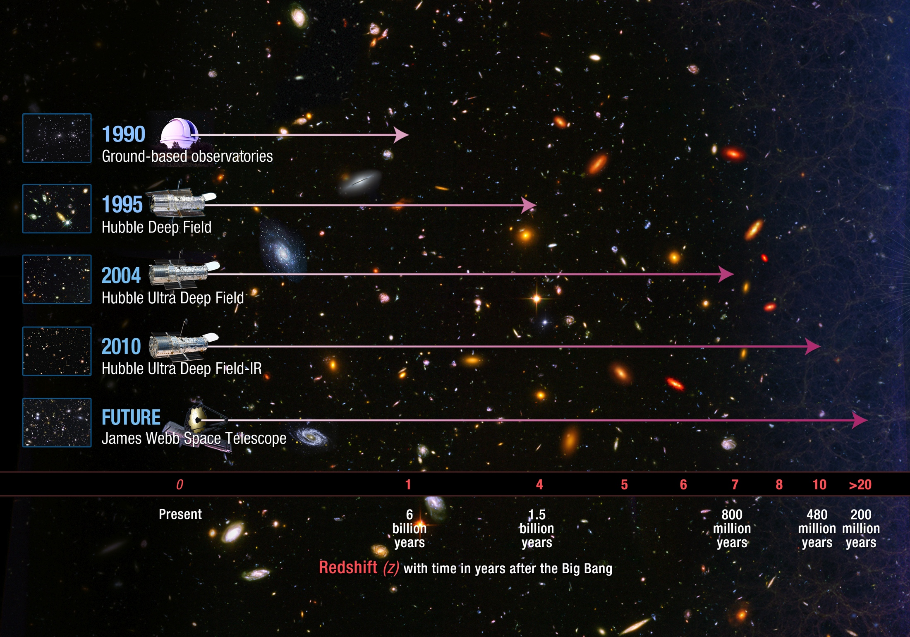
JWST and the first galaxies
Notes:
- NIRCam diffraction limited at 2 microns.
- Pixels are 0.0317”
- Dual channel imager, get <2.5 microns and > 2.5 microns simultaneously.
Bigger field of view than Hubble’s cameras
Smaller pixels in the IR than Hubble’s pixels in the visible (4 times smaller than HST WFC3/IR pixels)
Dual channel to offer short and long wavelengths simultaneously
Wide range of narrow, medium, and broad band filters covering 0.6 – 5 microns
Superb sensitivity

Slide 38
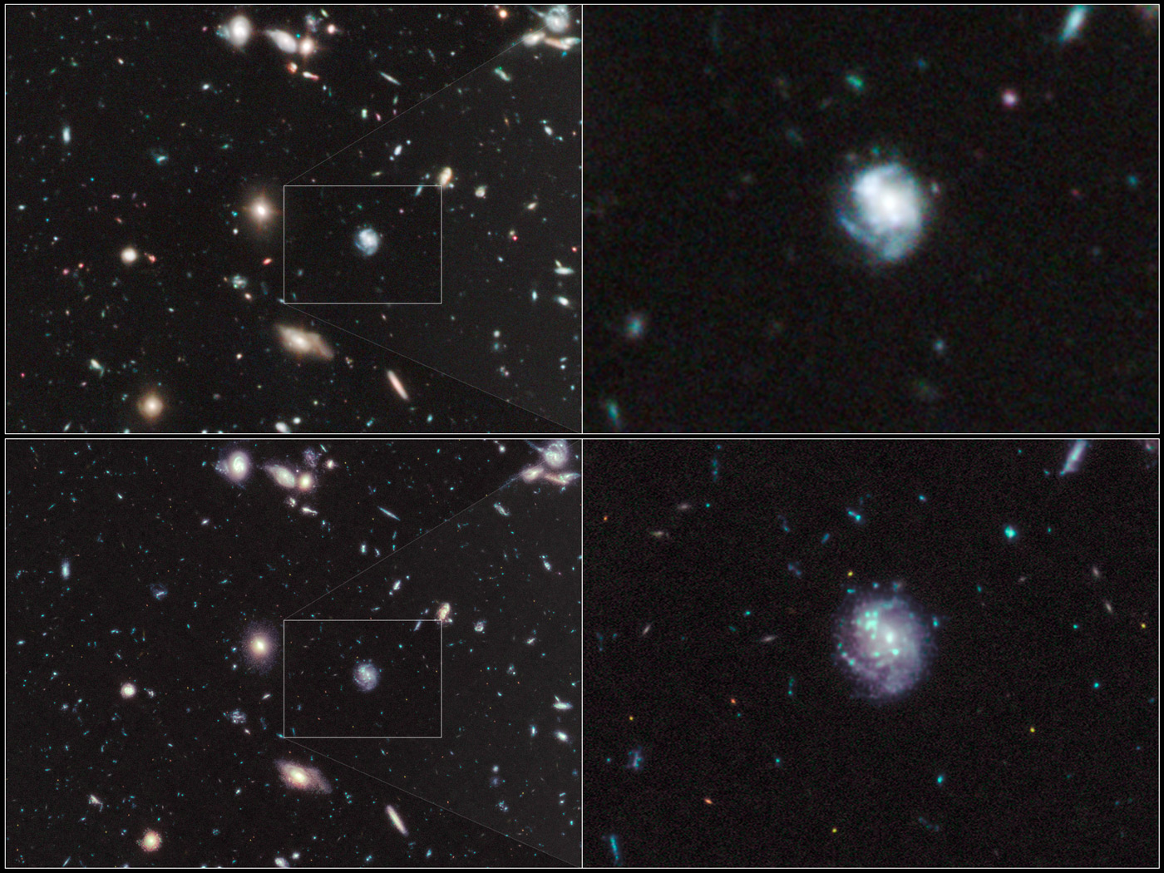
The Hubble UDF/IR
(F105W, F125W, F160W)
Simulated JWST NIRCam
the Universe’s first
stars formed
cosmic time line
1
10
100
1
10
100
1
10
(thousand years)
(million years)
(billion years)
Notes:
The deepest image ever taken, as seen by JWST.
The HST PSF was backed out of the HUDF/IR, and the JWST PSF was convolved into the image.
Talk about image sharpness and the detection of first galaxies.

Slide 39

“Mr. Hubble says that trophies are for people with self-esteem issues.”
Notes:
The technology behind Great Observatories allows for a breadth of science that serves the broader community.

Slide 40
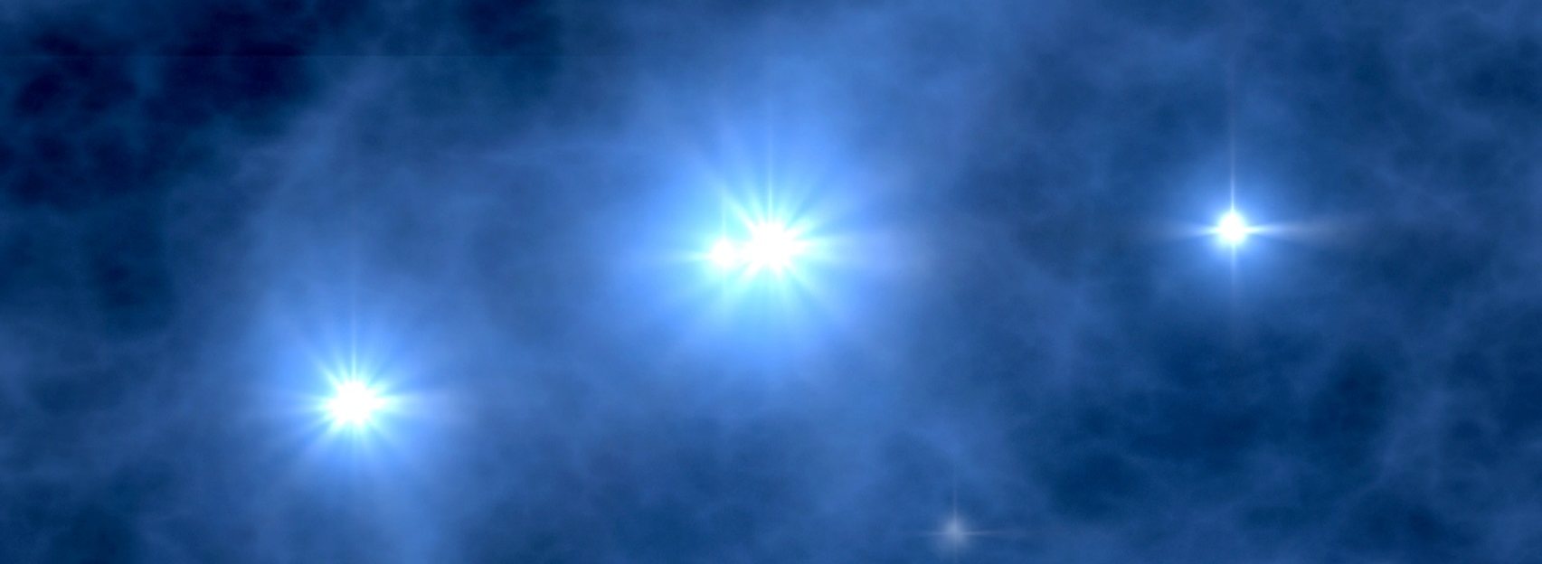
JWST and the first stars
first stars thought to be very massive (25 – 500 mass of Sun)
form in isolation
very, very hot = 100,000 K
luminous sources of lots of ionizing photons (> 10⁵⁰ /s)
very short lifetimes = 2-3 million years
new simulated light curves show late time rise over more than 100 days
infrared energy diffuses out through dense ejecta of supernova
can be measured with JWST to the Universe’s earliest epochs
ground based follow up with 30-m telescopes will help distinguish progenitors
calculations by Dan Whalen
Notes:
strong break out with 10⁴² – 10⁴³ (transient), then a decline down to 10⁴⁰, and then a rise again due to Ni⁵⁶ radioactive decay.

Slide 41
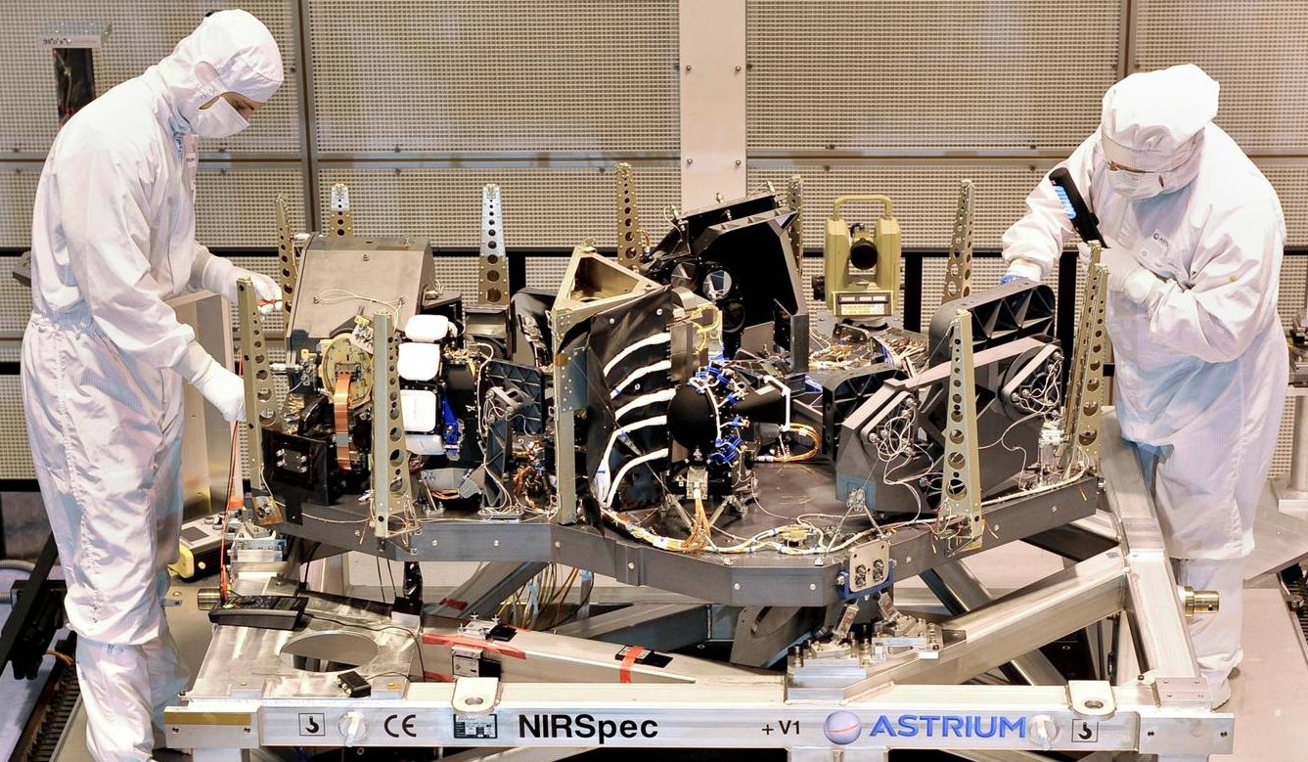
another one of JWST’s “cameras”
Notes:
- Talk about the opportunity for multiobject spectroscopy at high *spatial* resolution (0.1 pixels).
- With Hubble, we’ve been able to image some of the densest environments that the Universe offers.
- With JWST, we’ll get spectra of hundreds of stars in those environments.
- Set this up, the example is on the next slide.

Slide 42
JWST – finding life-bearing planets
searching for the goldilocks planet
Notes:
Maggie Masetti, Goddard
- Picture on bottom is their fridge.

Slide 43
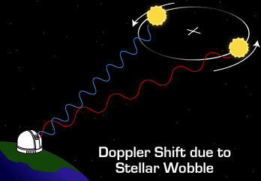
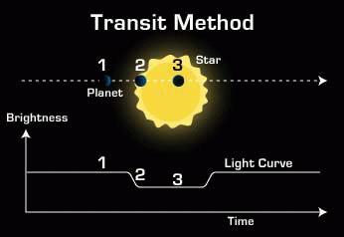
determining robust physical parameters
JWST – finding life-bearing planets
doppler method
determine planet mass
transit method
determine planet diameter
calculate planet density and infer composition:
gas giant (Jupiter), ice giant (Neptune), or rocky planet (Earth)

Slide 44
JWST – finding life-bearing planets
transits allow studies of atmospheres
secondary eclipse
see thermal radiation and reflected light from planet disappear and
reappear
see radiation from star transmitted through the planet’s atmosphere
transit
detection of:
-atoms, molecules
-stratospheres
-clouds
-winds

Slide 45
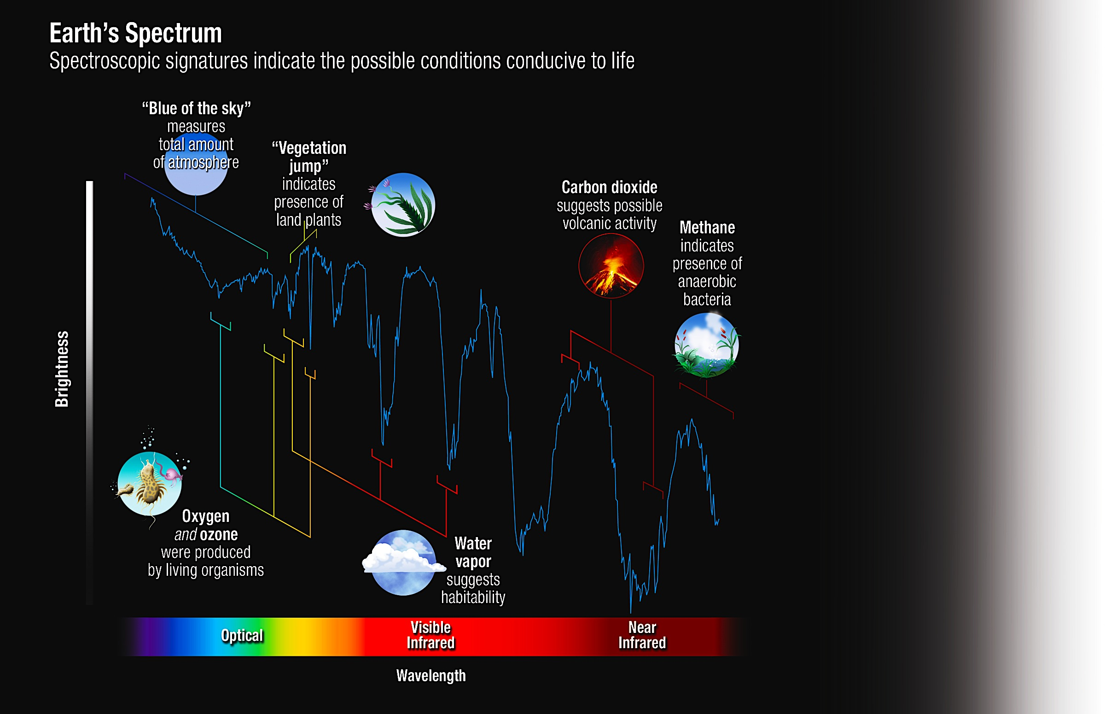
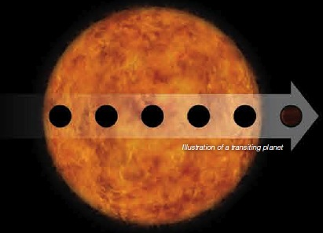
JWST – finding life-bearing planets
what would the Earth’s spectrum look like?
JWST WILL PENETRATE THE ATMOSPHERES OF EXOPLANETS
O₂ ,O₃
H₂O
CO₂
CH₄

Slide 46
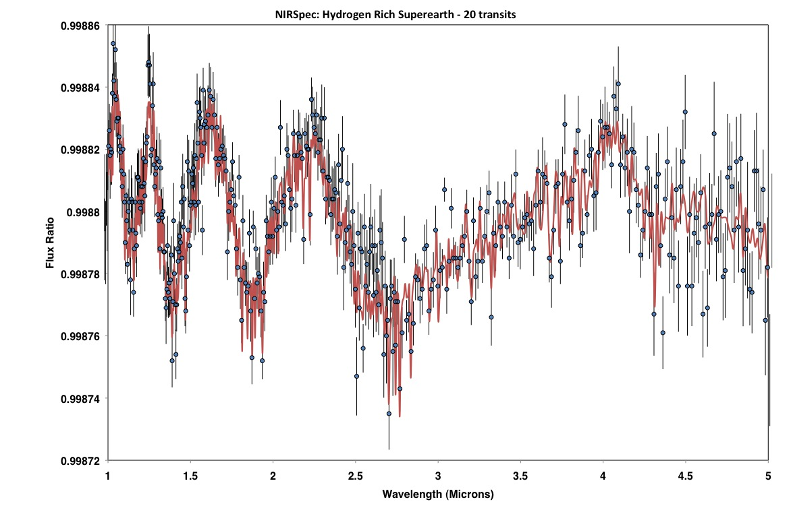
JWST – finding life-bearing planets
simulated JWST/nirspec observation
hydrogen-rich super earth (1.4 R_{EARTH}, 5 M_{EARTH})
nirspec – 20 transits
(binned to R ~ 300)
M. Clampin – Model by E. Kempton

Slide 47
this brings us to
the biggest and
most profound
question facing all
of astronomy today

Slide 48


Slide 49
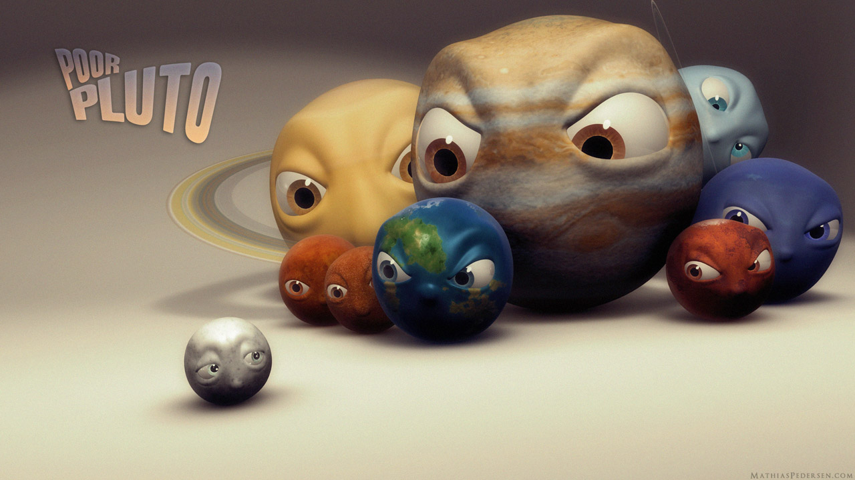
DADA…why did miss jamie say that you
kicked out pluto because you’re a scientist!

Slide 50
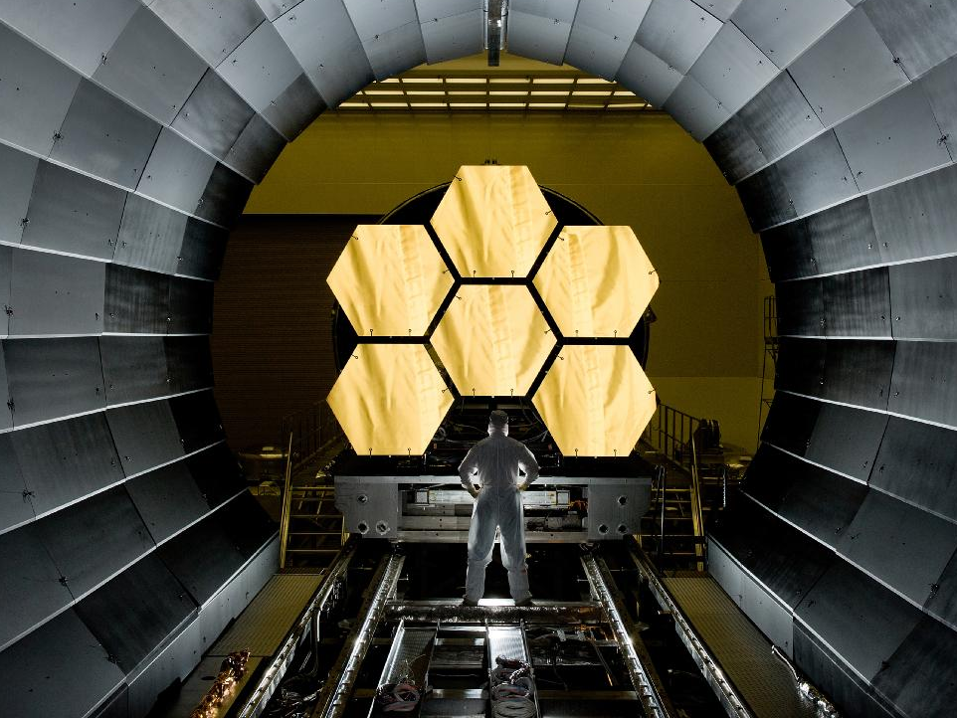
present status
Notes:
This is nice since it highlights the complexity of the mirrors, and can be followed up with the nice gold coated images in your talk.

Slide 51
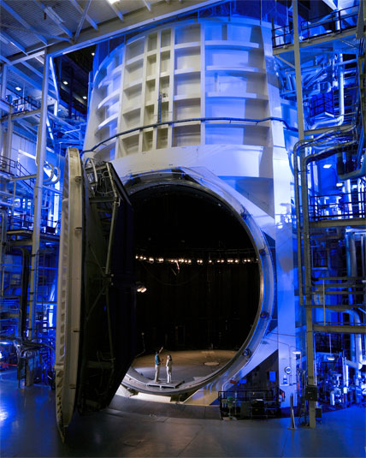
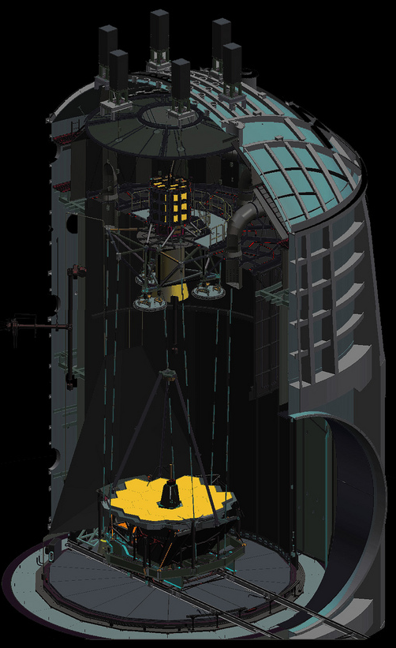
integration and testing
Thermal Vacuum Chamber A – JSC, Houston Texas
Notes:
Show deployment video

Slide 52
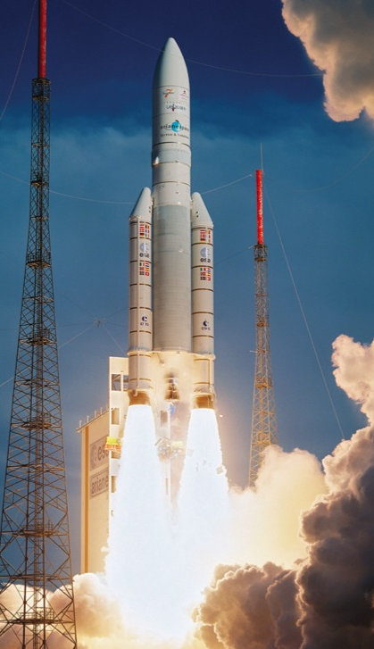

JWST – launch

Slide 53
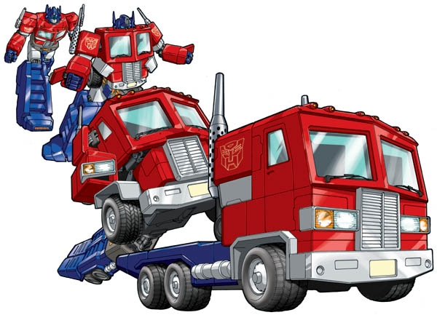
JWST – launch

Slide 54
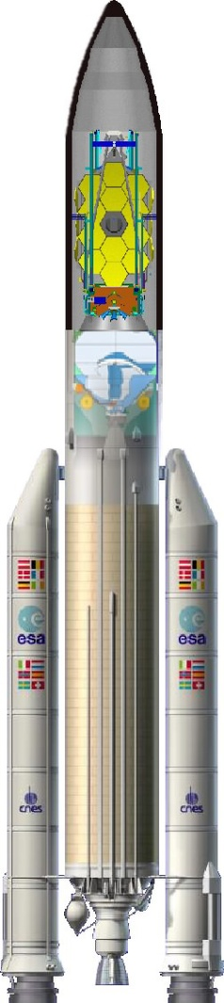
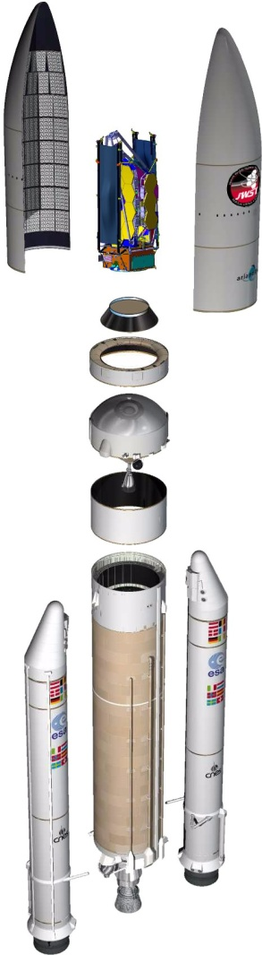


JWST – launch
Arianespace – ESA - NASA

Slide 55

Notes:
A look forward – discuss importance of I&T and getting it right through extensive tests.

Slide 56

come see us at South by Southwest
Friday – Sunday, Long Center for Performing Arts
Schedule: http://www.nasa.gov/externalflash/JWSTSXSW/
Twitter: #JWST
Notes:
This is nice since it highlights the complexity of the mirrors, and can be followed up with the nice gold coated images in your talk.

Slide 57






come see us at South by Southwest
Friday – Sunday, Long Center for Performing Arts
follow #JWST on twitter
Schedule: http://www.nasa.gov/externalflash/JWSTSXSW/
Notes:
This is nice since it highlights the complexity of the mirrors, and can be followed up with the nice gold coated images in your talk.

Slide 58

James Webb
James Webb (1906 – 1992)
second administrator of NASA (1961 – 1968)
oversaw 1st manned spaceflight program (mercury)
oversaw 2nd manned spaceflight program (gemini)
oversaw mariner planetary exploration program
oversaw pioneer planetary exploration program
oversaw apollo program

Slide 59
Hubble’s ‘frontier fields’ (2013 – 2016)
Pandora’s Cluster
Abell 2744
Abell 370
MACS0416-24
dark matter
gas
innovative design (6 fields)
first deep lensed IR images
+
new “blank” deep fields
follow the STScI blog: https://blogs.stsci.edu/hstdfi/
Notes:
The technology behind Great Observatories allows for a breadth of science that serves the broader community.

Slide 60

Dr. Jason Kalirai
Dr. Jason Kalirai is an award-winning astrophysicist at the Space Telescope Science Institute in Baltimore MD. His research program is aimed at studying the formation and evolution of stars in nearby galaxies, including our own Milky Way galaxy. Jason’s research is based on establishing new insights on these populations, through ultra-sensitive imaging and spectroscopic observations with the world’s best telescopes. He is a frequent user of the 10-meter Keck Telescope on Mauna Kea in Hawaii, as well as the Hubble Space Telescope in orbit around Earth. By measuring the detailed properties of these local stars, Jason is able to establish critical dependencies between the stellar characteristics (e.g., mass, age, metallicity) and the output observables (e.g., luminosities and colors). This astrophysical connection represents an important anchor in our ability to interpret light from the Universe. In addition to his research program, Jason is also the Deputy Project Scientist for the James Webb Space Telescope. Dr. Kalirai was recently awarded the 2013 American Astronomical Society Newton Lacy Pierce Prize in astronomy for his achievements in observational research.

