Slide 1

Your Eye, My Eye, and the Eye of the
Aye – Aye: Evolution of Human Vision from 65 Million Years Ago to the Present
# 75
Dr. Christopher Kirk
December 2, 2011
Produced by and for Hot Science - Cool Talks by the Environmental Science Institute. We request that the use of these materials include an acknowledgement of the presenter and Hot Science - Cool Talks by the Environmental Science Institute at UT Austin. We hope you find these materials educational and enjoyable.

Slide 2
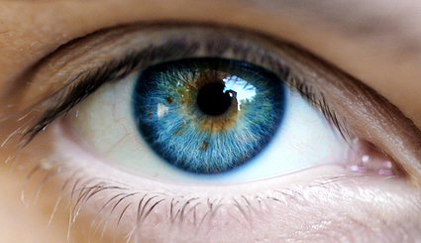
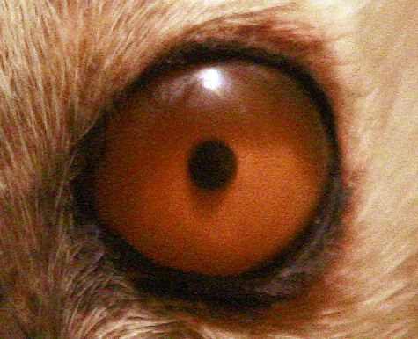
Your Eye, My Eye, and the Eye of the Aye-Aye
Evolution of human vision from 65 million years ago to the present
Notes:
Aye aye - http://commons.wikimedia.org/wiki/File:Daubentonia_madagascariensis_mg_0197.jpg

Slide 3
Your Eye, My Eye, and the Eye of the Aye-Aye
Two main topics: Evolution of our visual perception of depth and detail
Notes:
Aye aye - http://commons.wikimedia.org/wiki/File:Daubentonia_madagascariensis_mg_0197.jpg

Slide 4
Your Eye, My Eye, and the Eye of the Aye-Aye
??
??
But first…
Notes:
Aye aye - http://commons.wikimedia.org/wiki/File:Daubentonia_madagascariensis_mg_0197.jpg

Slide 5
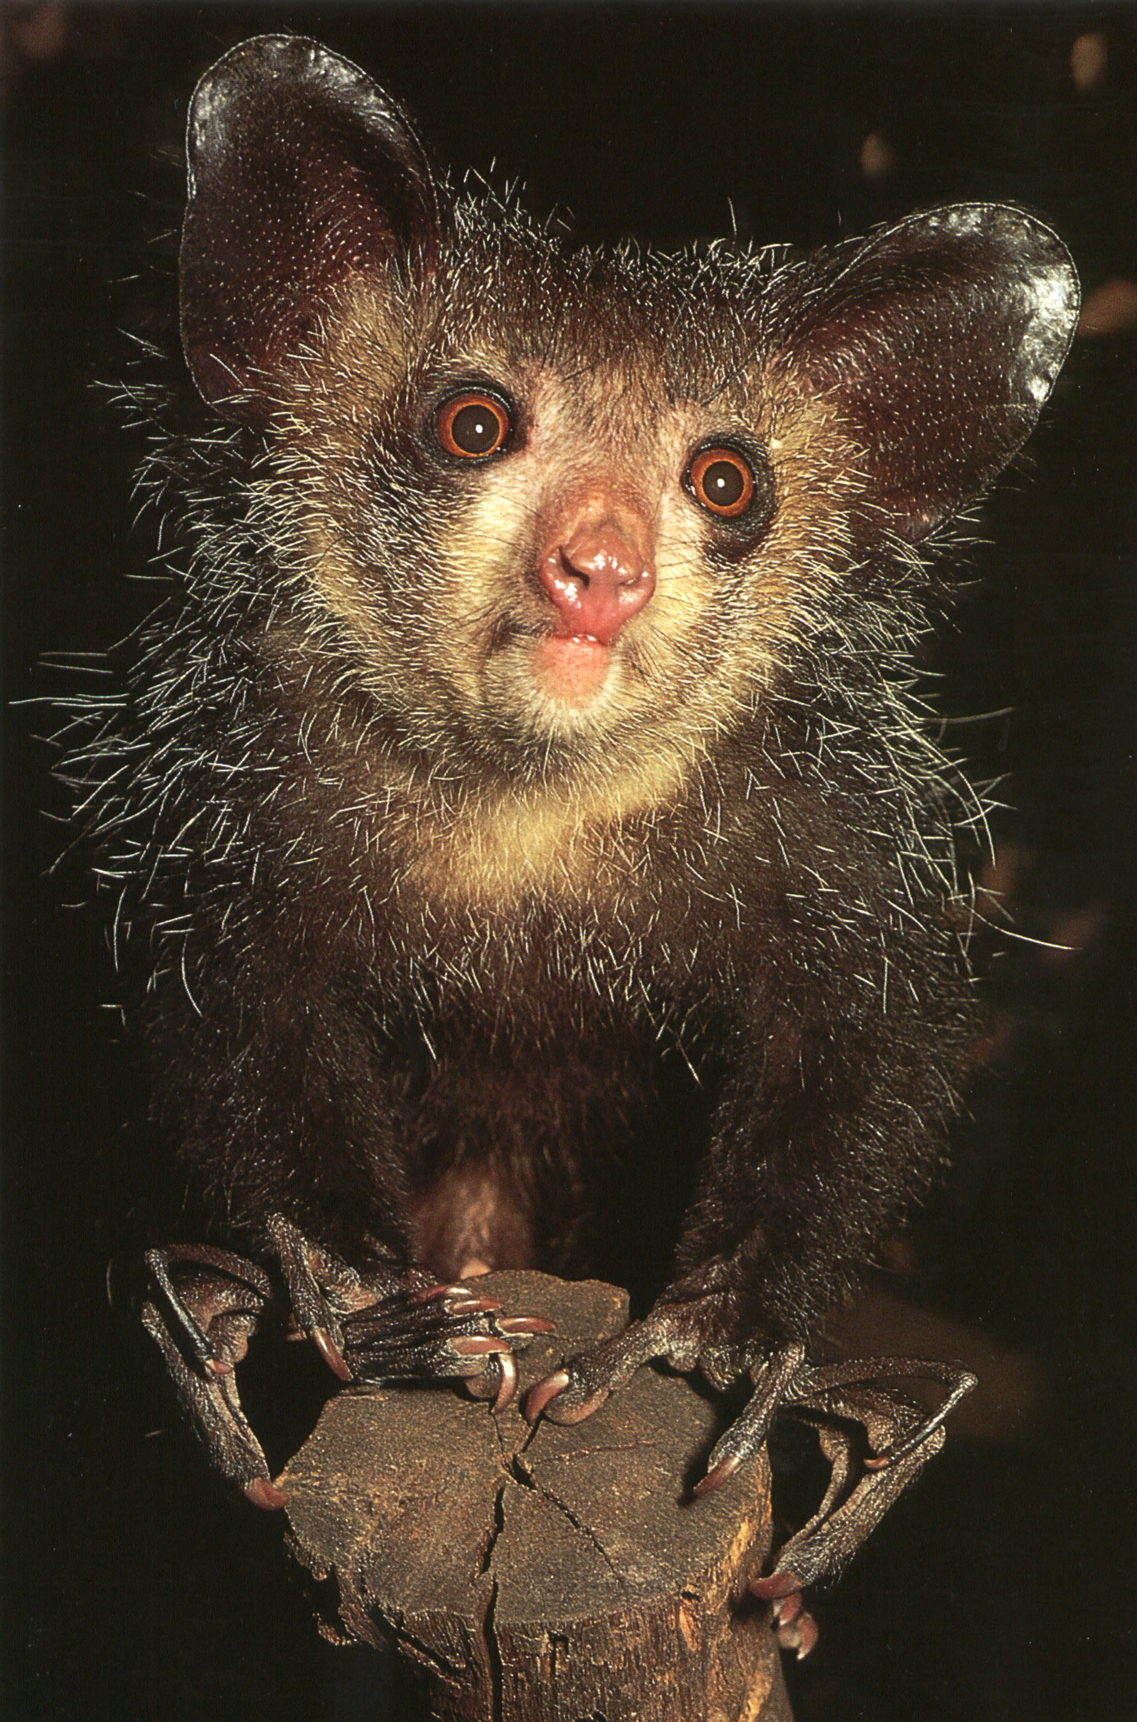
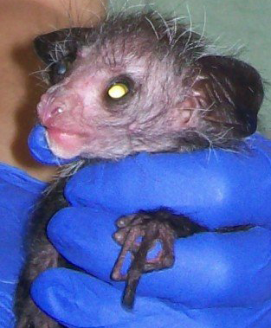
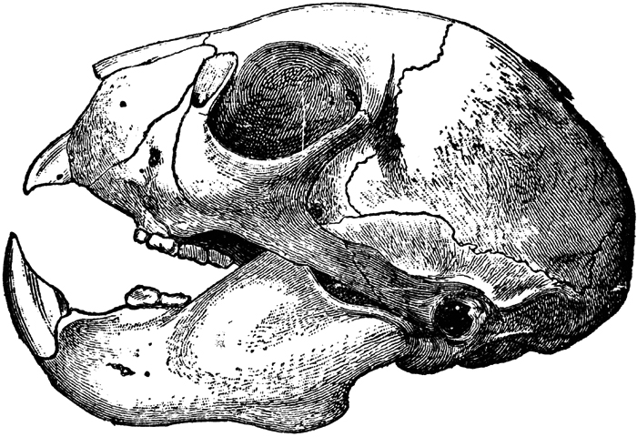
Meet the Aye-Aye: your weirdest primate relative
Notes:
Left – Mammals of Madagascar by Nick Garbutt, 1999
Top Right – Duke Lemur Center
Bottom Right - http://etc.usf.edu/clipart/28100/28114/aye-aye_28114.htm (Encyclopedia Britannica, 1910)

Slide 6
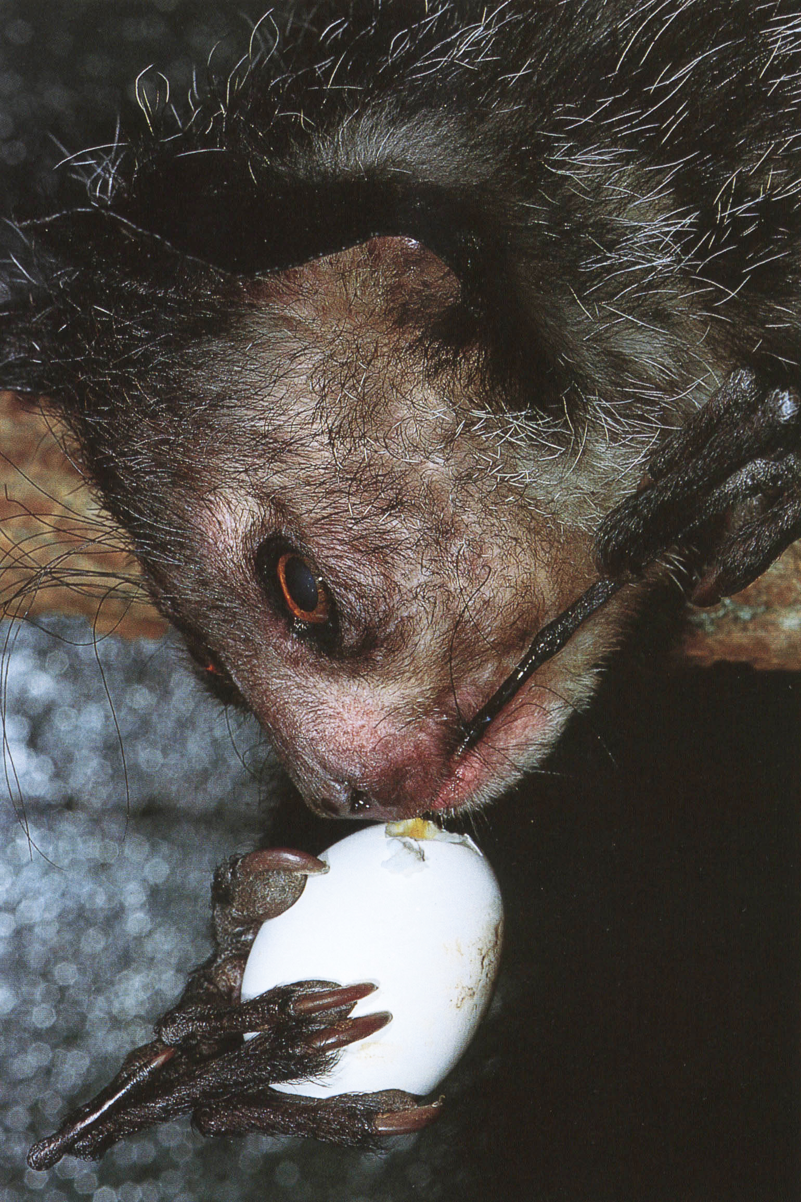
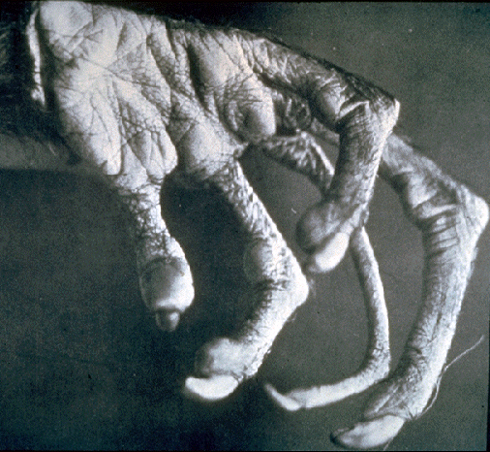
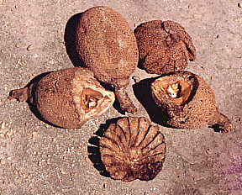
Aye-Aye:
Notes:
Left – Mammals of Madagascar by Nick Garbutt, 1999

Slide 7

Aye-Aye Grub Foraging
Notes:
http://www.arkive.org/aye-aye/daubentonia-madagascariensis/video-17.html

Slide 8
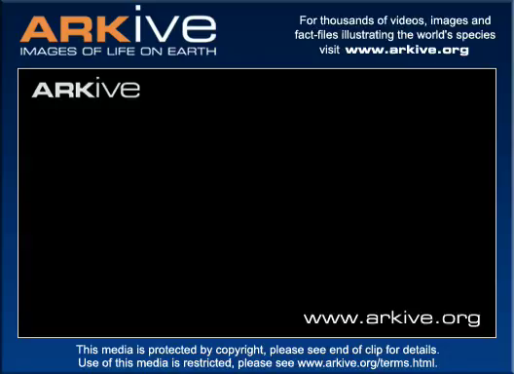
Aye-Aye Grub Foraging
Notes:
http://www.arkive.org/aye-aye/daubentonia-madagascariensis/video-08d.html

Slide 9
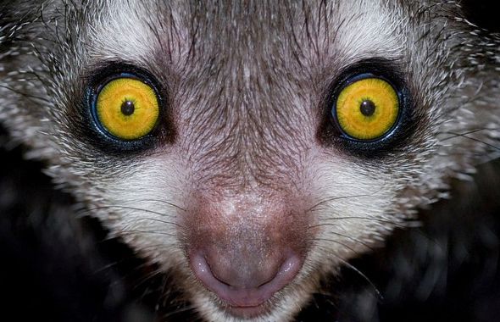

What could human and aye-aye visual systems possibly have in common?
Would you like a hint?
Notes:
Aye aye - http://www.arkive.org/aye-aye/daubentonia-madagascariensis/image-G113585.html
Heidi Klum - http://actress.glowclick.com/heidi-klum/

Slide 10
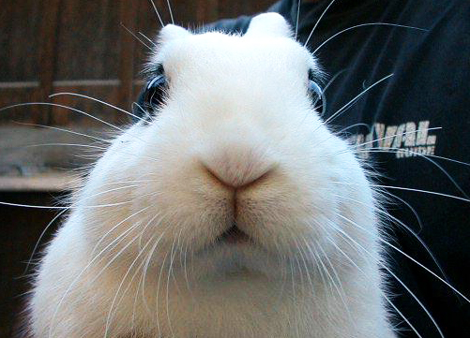
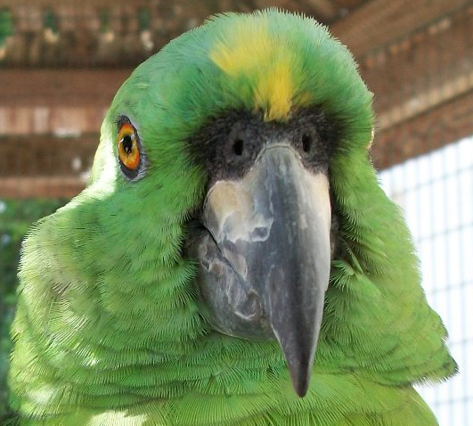
What could human and aye-aye visual systems possibly have in common?
Notes:
Aye aye - http://www.arkive.org/aye-aye/daubentonia-madagascariensis/image-G113585.html
Heidi Klum - http://actress.glowclick.com/heidi-klum/
Rabbit - http://foolery.typepad.com/foolery/2007/03/youre_telling_m.html
Parrot -http://www.freepicturesforwebsites.com/2010/10/12/face-to-face-with-parrot/

Slide 11

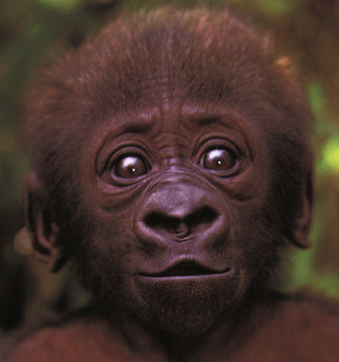
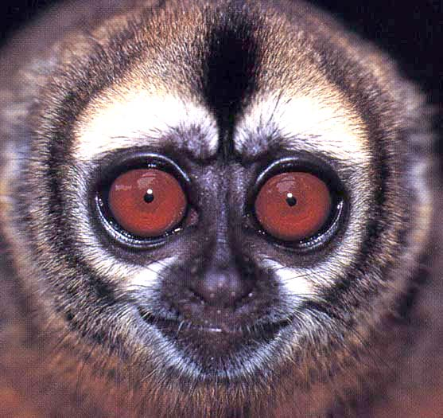
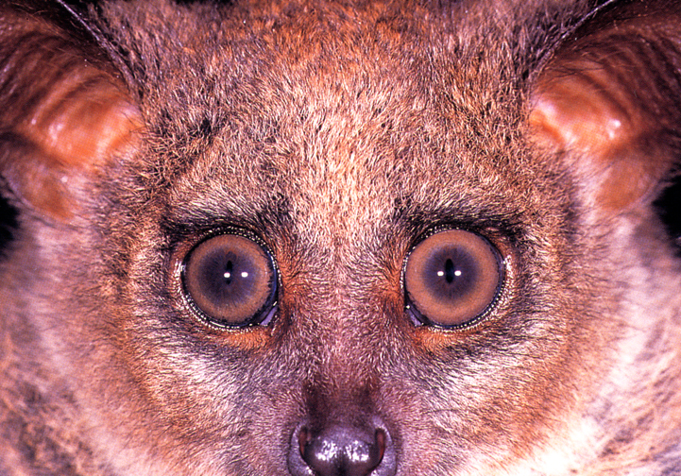
All living primates have forward-facing eyes!
Human
Gorilla
Owl Monkey
Bushbaby

Slide 12
Why?
[several ways to answer this question…]

Slide 13
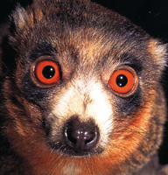
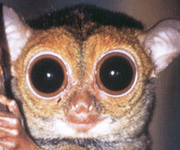
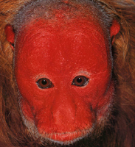
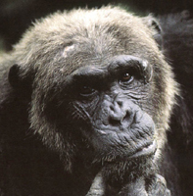
1. Phylogenetic Answer: Forward-facing eyes were present in the last common ancestor of living primates
Strepsirrhines Tarsiers Platyrrhines Catarrhines

Slide 14
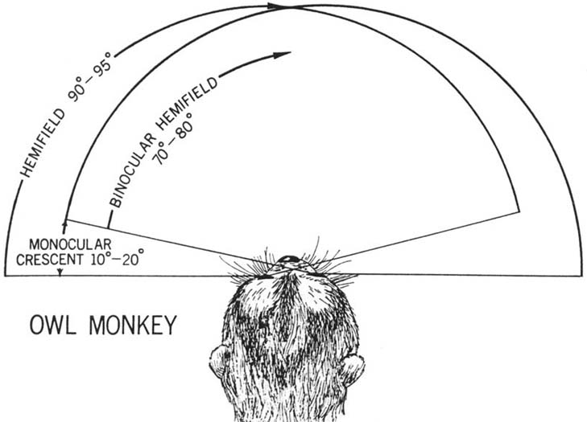
2. Functional Answer: Forward facing eyes give you a wider field of binocular vision and stereopsis

Slide 15
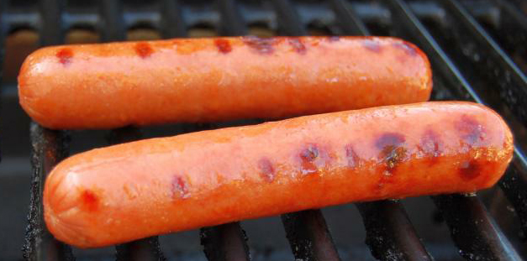
Who has Stereopsis?
Demo:
Floating Hot Dog
(binocular fusion)
Binocular Vision and Stereopsis
Critical for Fine Depth Judgement
Demo

Slide 16
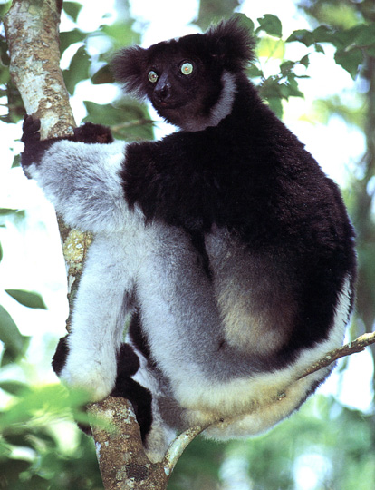
3. Ecological Answer:
Much less obvious
Q: Why might primates benefit from having improved depth perception?

Slide 17
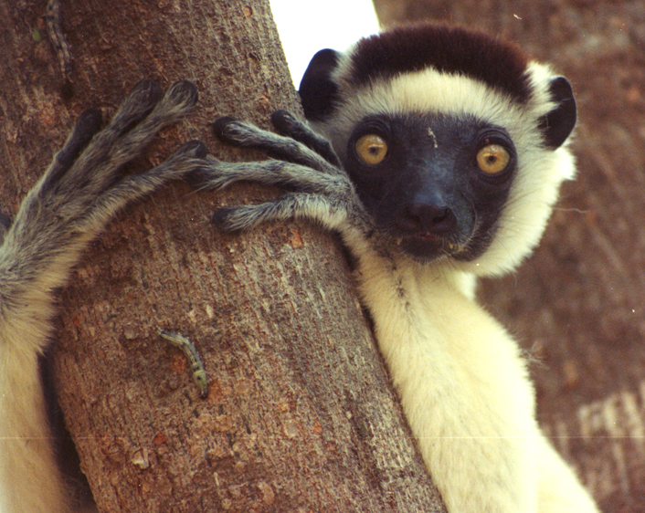
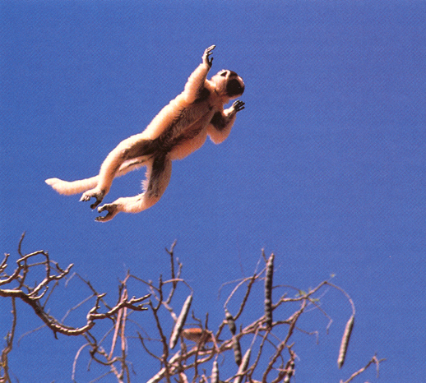
The Older Idea:
Forward-facing eyes and improved depth perception necessary for life in the trees

Slide 18
Can anyone think of any problems with this hypothesis?
Hint: Something here on campus…

Slide 19
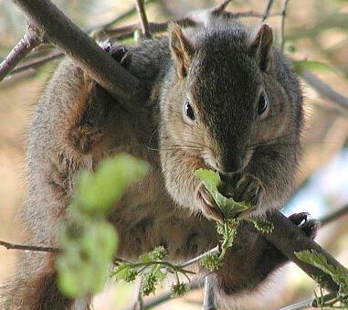
Can anyone think of any problems with this hypothesis?
Hint:

Slide 20
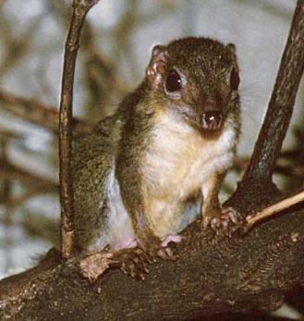
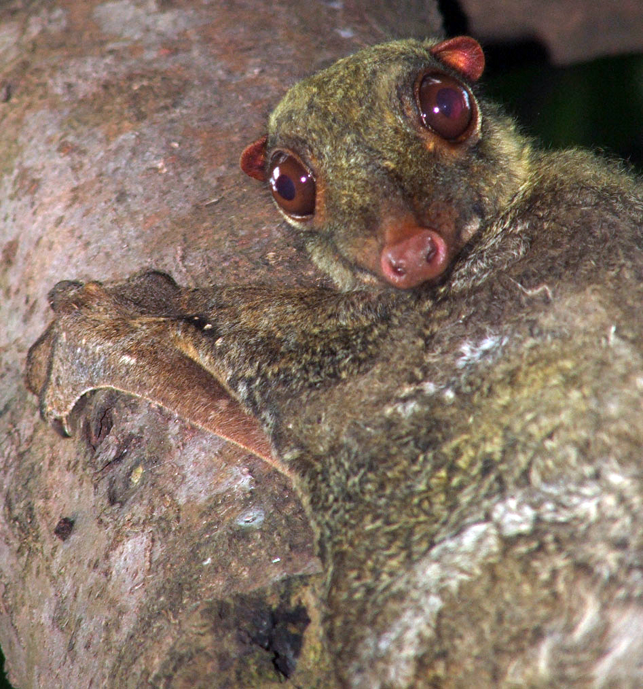
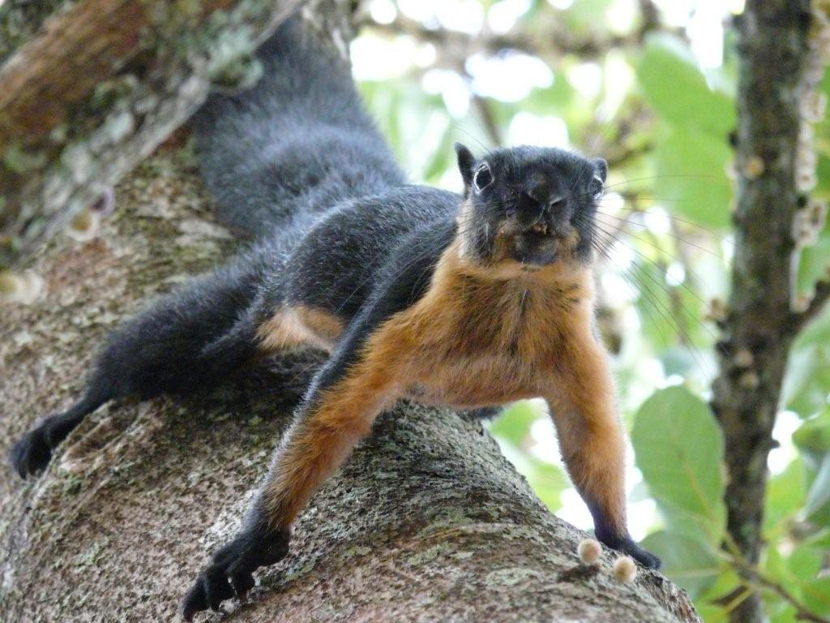
Tree Shrew
In fact: Most arboreal mammals don’t have forward-facing eyes
Squirrel
Colugo

Slide 21
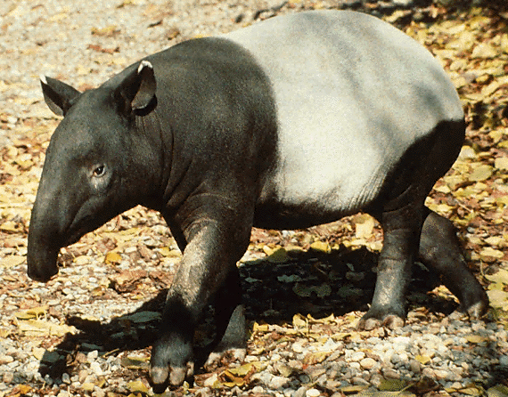
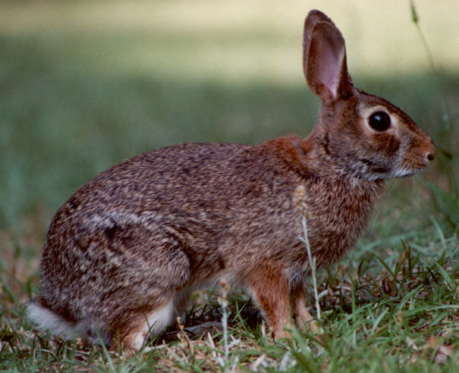
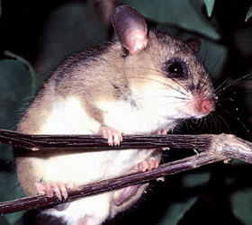
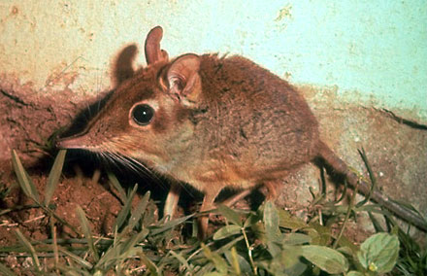
Also true for mammals generally
Rabbit
Tapir
Tree Rat
Elephant Shrew

Slide 22
Q: So who does have forward-facing eyes?

Slide 23
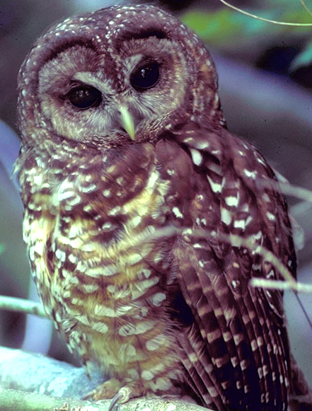
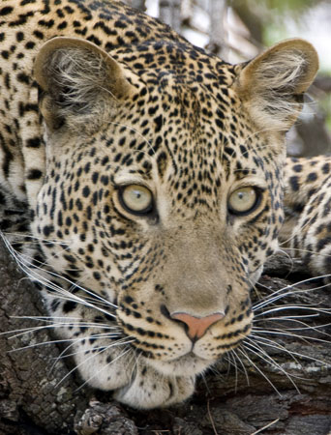
The big two: Owls and Cats
Predators that hunt at night & reliant on vision

Slide 24
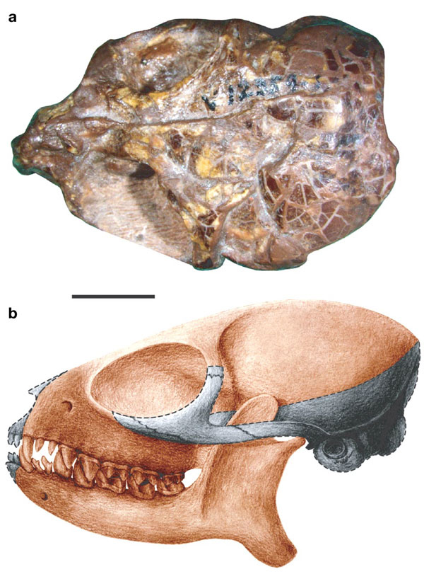
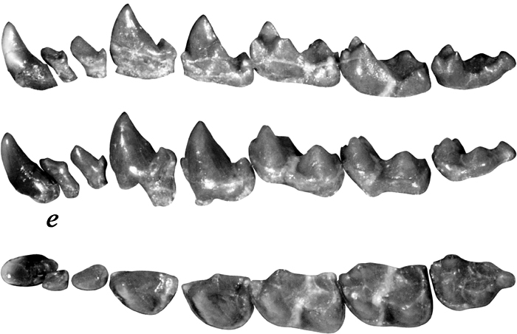
Like owls and cats, the earliest fossil primates were nocturnal, predatory, and had big forward-facing eyes…
Teilhardina asiatica

Slide 25
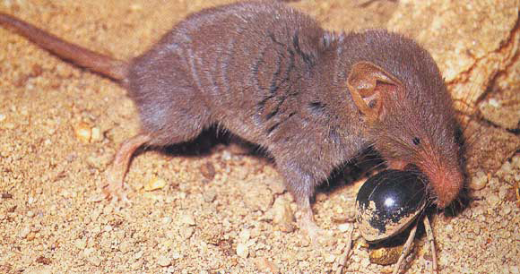
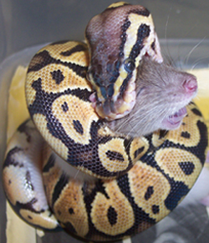
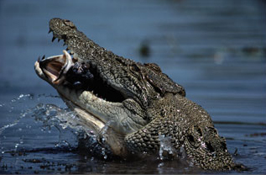
Key: Many predators capture prey with their mouths…
… But some predators do things very differently

Slide 26
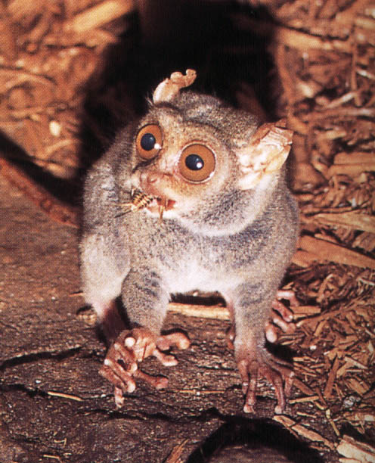
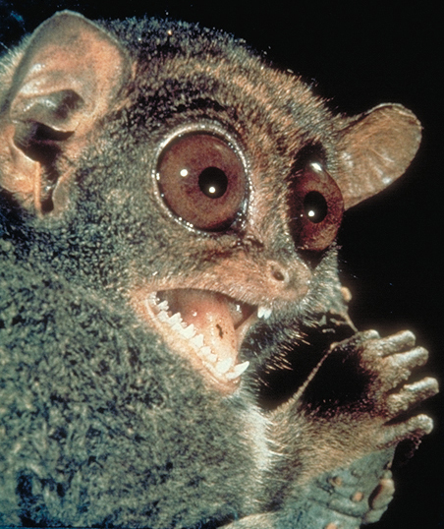
Meet the Tarsier – a small, nocturnal, predatory primate

Slide 27
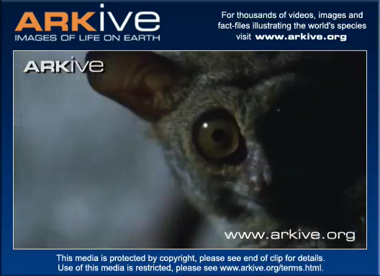
Tarsier Hunting

Slide 28
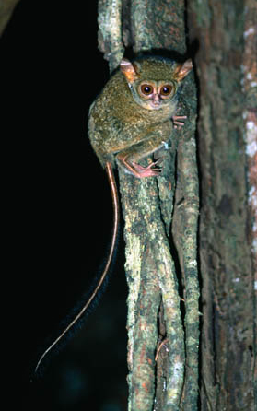
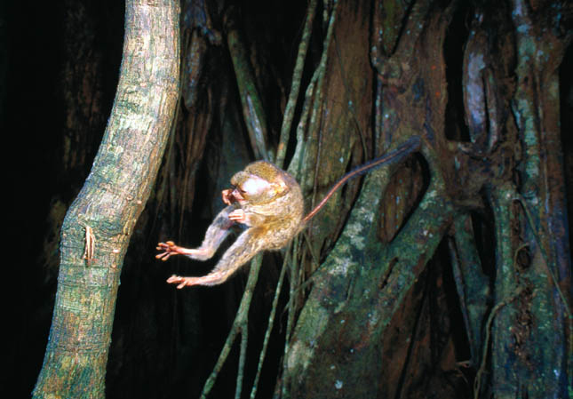
How primate predators get the job done:
Scan
Pounce

Slide 29
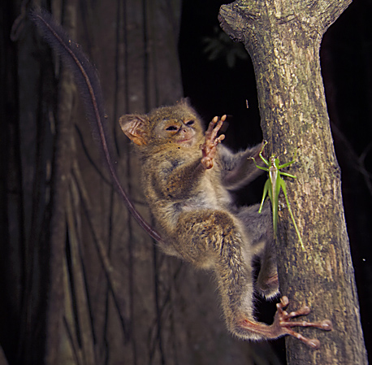
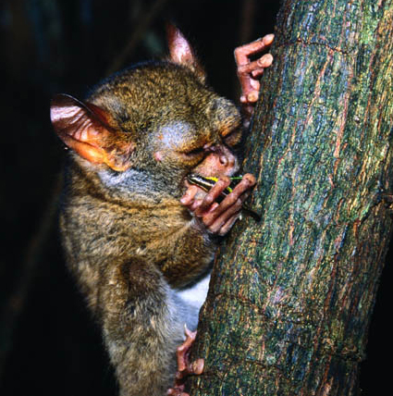
How primate predators get the job done:
Snatch
Bite

Slide 30
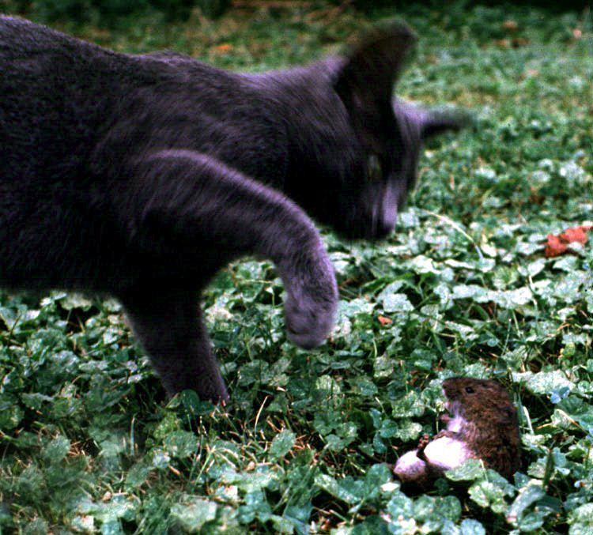

Similar to primates:
Cats stalk & nab with a paw…

Slide 31
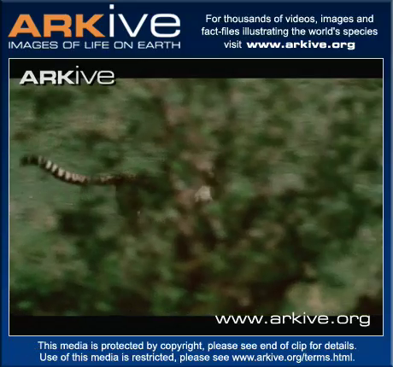
… or trip their prey

Slide 32
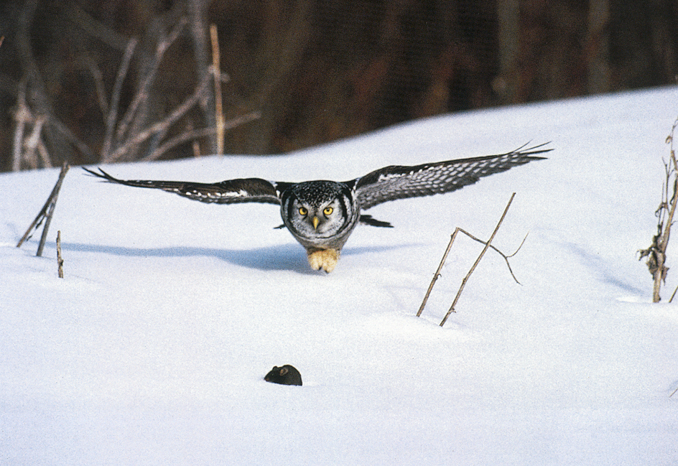
Owls: Swoop…

Slide 33
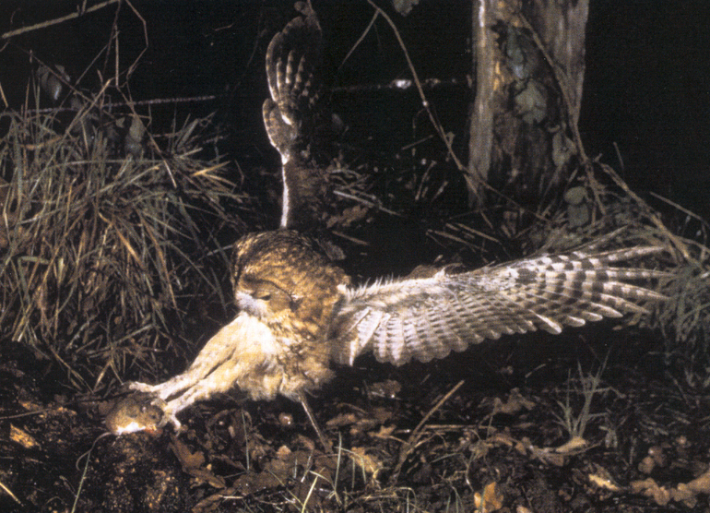
… and snatch with talons

Slide 34


Slide 35

By the way…

Slide 36


Slide 37

Each of these species requires fine visual depth perception to catch prey with an appendage

Slide 38
These comparisons show that forward-facing eyes present in the last common ancestor of primates as a predatory adaptation; F-F eyes are retained by the living descendants of that common ancestor
Strepsirrhines Tarsiers Platyrrhines Catarrhines

Slide 39

So the next time you see someone doing this:

Slide 40

Or this:

Slide 41

Or anything that requires fine depth perception

Slide 42

Remember that the ability to precisely judge distance using vision first evolved for this:

Slide 43
Part 2 - an amazing ability that evolved in the last common ancestor of tarsiers, monkeys, apes, and humans:
Strepsirrhines Tarsiers Platyrrhines Catarrhines

Slide 44


Slide 45

Saccades -
Reflexive,
ballistic eye
movements
Tracks of the retinal FOVEA

Slide 46

FOVEA - Pit in the center of the retina
Macaque Monkey Fovea
- What you use to “look at” things
- Adaptation that provides an unobstructed path for light to reach photoreceptors

Slide 47



Fovea has its own yellow filter to screen out (blurring) blue light: Macula Lutea

Slide 48

And in the center of the fovea - a dense hexagonal lattice of cone photoreceptors
What does all of this do for you??

Slide 49
With all due respect to the benefits of peripheral vision, without your fovea you cannot perform most tasks involving visual details
Can I have another volunteer please?
(preferably with 20/20 vision)

Slide 50
Here’s the most astonishing consequence of having a fovea:

Slide 51
Foveas give humans the highest visual acuity of any living mammal:
NONPRIMATES
Horse: 23
Camel: 10
Carnivorans: 1-9
Cetaceans: 0.6-5
Marsupials: 0.5-5
Elephant: 4
Rodents: 0.5-4
Flying Fox: 3.5
Rabbits: 1.5-3
Tree Shrew: 1-2
Microbat: 0.05-2
PRIMATES
Anthropoids (D): 40-80
Owl Monkey: 10
Tarsier: 9
Ringtailed Lemur: 6-7
Bushbaby: 5-6
Mouse Lemur: 5
ALL PRIMATES: 5-80

Slide 52

Q: Anyone know the only vertebrates with higher visual acuity than humans?

Slide 53

Q: Anyone know the only vertebrates with higher visual acuity than humans?
A: Large eyed diurnal birds of prey

Slide 54
So what are foveas and extremely high acuity good for?

Slide 55




Low acuity limits your options

Slide 56




High acuity enhances them

Slide 57


Many living non-primates with foveas are:
diurnal
predatory
hunt by sight
Foveas evolved as another predatory adaptation?

Slide 58



Two very important consequences of
high acuity in primates:
1. - High acuity requires more visual
input to the brain
- Brain has to process all the added input
Opossum
Bushbaby
Squirrel Monkey

Slide 59

Van Essen, Anderson, & Felleman, 1992

Slide 60

ANTHROPOIDS
*Anthropoidea
includes all haplorhines
(monkeys, apes, humans) except tarsiers
PROSIMIANS
~ 50% of variation in primate encephalization can be explained by differences in visual input alone

Slide 61

Two very important consequences of
high acuity in primates:
2. High acuity readily co-opted for other other functional contexts, esp. social communication based on visual signals

Slide 62



In most mammals, social communication dominated by olfactory signals

Slide 63




Visually-mediated signals fundamental for social communication in monkeys, apes, & humans

Slide 64

Anthropoid primates even have a complex set of superficial facial muscles that have evolved mainly for the purpose of social communication

Slide 65

The Big Picture: Just as you learned that this ability related to nocturnal predation...

Slide 66


The next time you use a facial expression to tell that a toddler is happy...

Slide 67


That someone is angry...

Slide 68


Or you sense that something is slightly amiss...

Slide 69


Recall that this ability stems from the fact that you have eagle eyes

Slide 70

Because your distant anthropoid ancestors liked to wake up during the day to eat bugs

Slide 71

Thanks
Very
Much!

Slide 72

Dr. Christopher Kirk
Dr. Chris Kirk is an Associate Professor in the Department of Anthropology at The University of Texas at Austin. Dr. Kirk teaches undergraduate and graduate courses in physical anthropology, is a member of the American Association of Physical Anthropology and Society of Vertebrate Paleontology, and is the author of numerous professional publications, including papers published in the Journal of Human Evolution, the American Journal of Primatology, and Proceedings of the National Academy of Sciences.
Dr. Kirk has a broad array of research interests in physical anthropology, including sensory ecology, functional morphology, and paleontology. His primary research interest is the evolution of primate sensory systems, important to physical anthropology because many of the major adaptive shifts that occurred during the course of primate evolution involved key changes in sensory anatomy and ecology.

