Slide 1

Astronauts, Robots, and Rocks: Preparing for Geological Planetary
Exploration
# 74
Dr. Mark Helper
October 27, 2011
Produced by and for Hot Science - Cool Talks by the Environmental Science Institute. We request that the use of these materials include an acknowledgement of the presenter and Hot Science - Cool Talks by the Environmental Science Institute at UT Austin. We hope you find these materials educational and enjoyable.

Slide 2
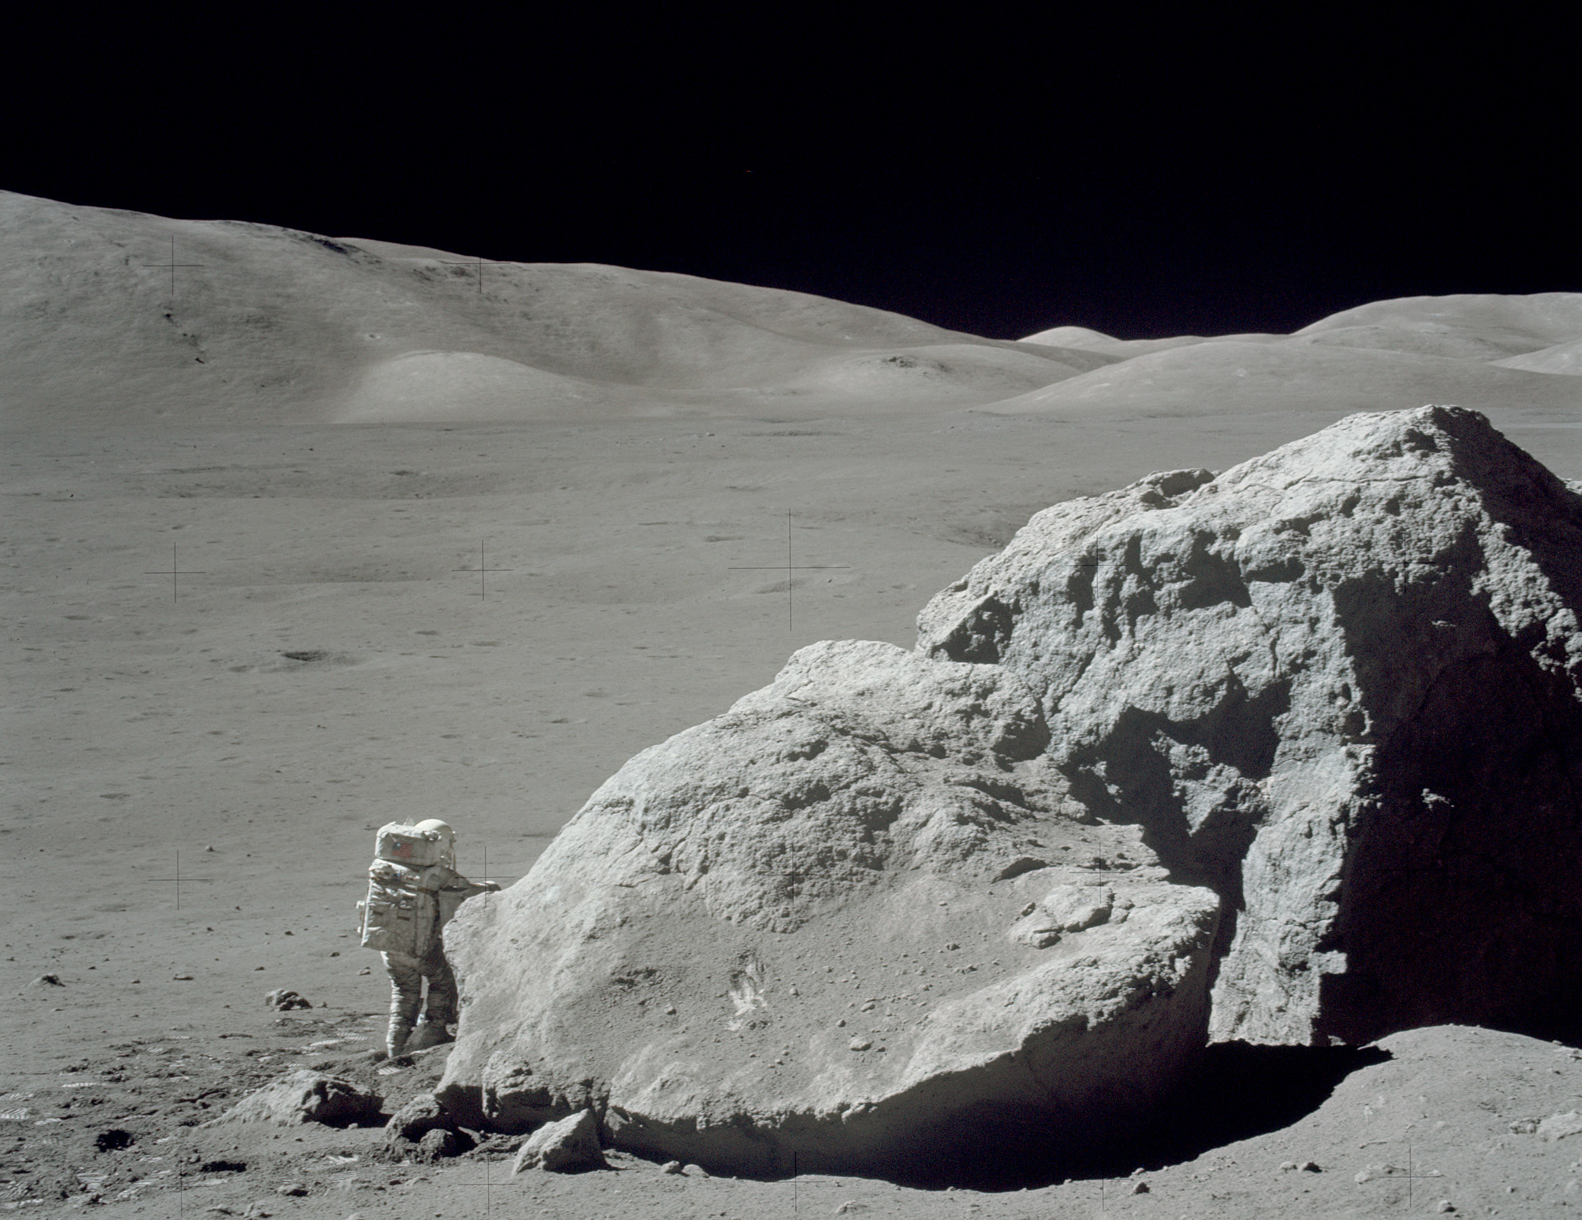
Astronauts, Robots and Rocks:
Preparing for Geological Planetary Exploration
Dr. Mark Helper
Department of Geological Sciences
Jackson School of Geosciences
University of Texas at Austin
Notes:
Open this with my story, Muehlberger
NASA photo AS17-140-21497HR: Harrison H. Schmitt at Tracy's Rock, an Apollo 17 sampling site, East Massif, Bear Mountain, Taurus-Littrow valley.

Slide 3
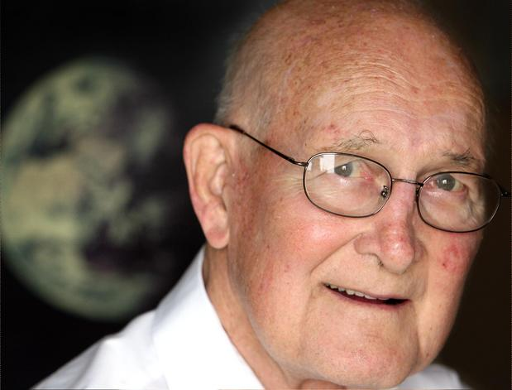
Dr. William R. Muehlberger
1923 - 2011
Notes:
As P.I. for the “Geology Field Experiment” for Apollo 16 and 17, Bill designed an implemented the first highly successful astronaut field geology training program in 1967. As the principle link to the past he was instrumental in seeing a similar program started in 2007. The program as it exists today is largely his legacy. My involvement stems from being in the right place at the right time… Bill asked me to participate because I am a field geologist experienced in teaching the subject. Like him, I had very little background in lunar geology and planetary science. He did not see this as a deterrent, nor do I.

Slide 4
Human Space Flight:
What Are The Goals?
“Fifty years after the creation of NASA, our goal is no longer just a destination to reach. Our goal is the capacity for people to work and learn and operate and live safely beyond the Earth for extended periods of time, ultimately in ways that are more sustainable and even indefinite.”
- President Barack Obama, April 15, 2010
Notes:
Further details are available in the National Space Policy of the United States of America, dated June 28, 2010:
http://www.whitehouse.gov/sites/default/files/national_space_policy_6-28-10.pdf

Slide 5
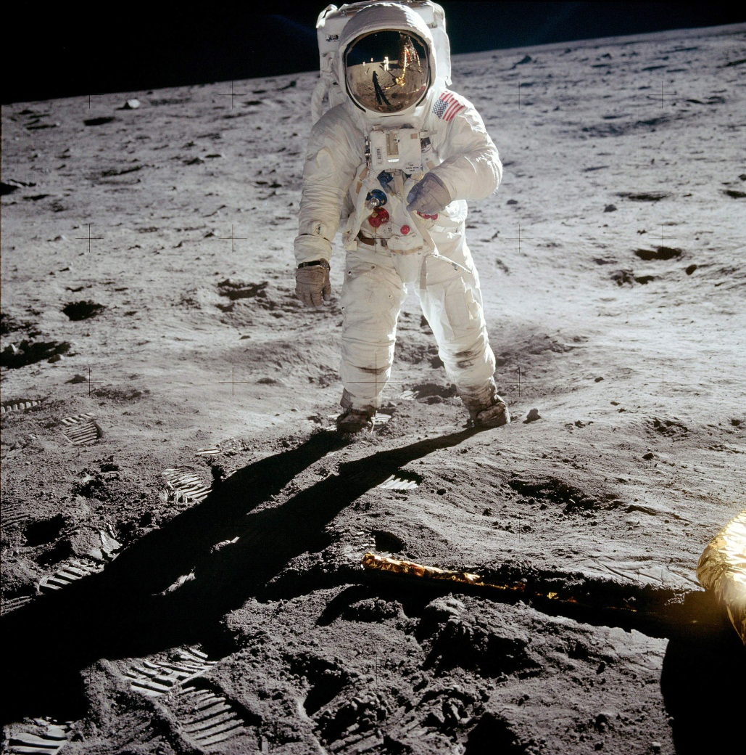
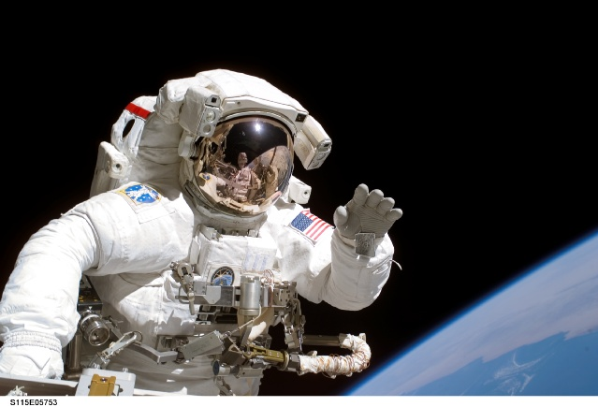
Why Human Space Exploration?
It is part of what makes us a great nation
Notes:
We lead the world in human space exploration, demonstrating a remarkable capacity to organize and safely carry out highly risky, complex, cutting edge missions. It is one of our great strengths and has shaped the image of the US as a preeminent society among nations.
“Throughout history, the great nations have been the ones at the forefront of the frontiers of their time. …For the next generations, the frontier will be space. ….Other countries will explore the cosmos, whether the United States does or not. And those will be Earth's great nations in the years and centuries to come. I believe America should look to its future – and consider what that future will look like if we choose not to be a spacefaring nation.” Michael Griffin, former NASA Administrator
http://www.jsc.nasa.gov/jscfeatures/photos/115EVAs/s115e05753.jpg – “Astronaut Joseph R. Tanner, STS-115 mission specialist, waves toward the digital still camera of his space walk colleague, astronaut Heidemarie M. Stefanyshyn-Piper as the two share extravehicular activity (EVA) duties during the first of three scheduled spacewalks.”
Apollo 11: Buzz Aldrin, photographed by Neil Armstrong. NASA image.

Slide 6
Why Human Space Exploration?
There are discoveries that await us:
  Can humans survive elsewhere?
  How did the planets form and evolve?
  Is there (or was there) life elsewhere?
Notes:
Could add such questions as:
Where did earth’s water and carbon come from?

Slide 7
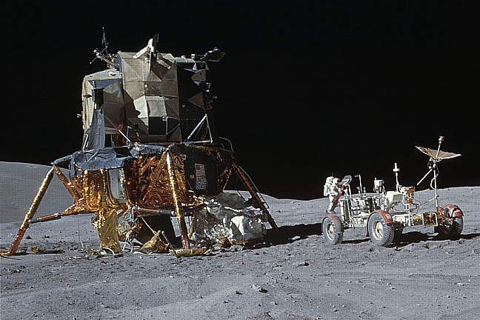
Don’t we already know how to do this?
Apollo Moon Landings: 1969-1972
  6 moon landings,
  12 astronauts
  walk on the Moon
Notes:
Returning to the earlier slide, one might rightly ask if we don’t already know how to live and work for extended periods off-earth. We went to the moon and returned safely six times. We did experiments and science to successfully answer many questions about the origin of the moon and solar system. As we shall see the circumstances and tasks today are far different than they were 40 years ago.

Slide 8
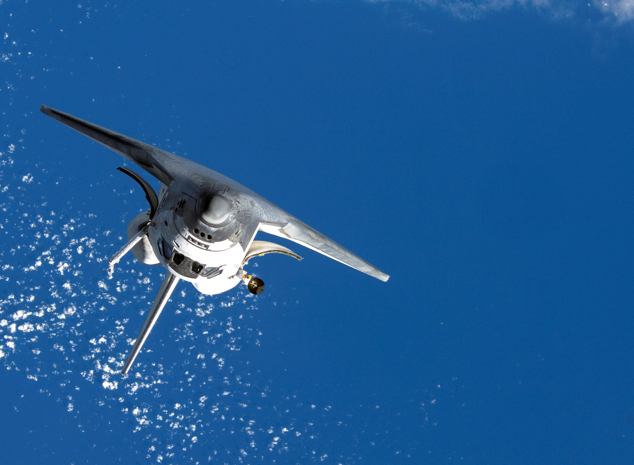
Space Shuttle Era:
1981-2011
135 missions to low earth orbit
Goal: simple, safe and cheap space flights
Platform for science and observing earth
Satellite emplacement and repair (HST)
Ferrying large objects to space – build ISS
Notes:
Apollo was followed by short NASA orbital programs – e.g. Sky Lab, Apollo/Soyuz – until the first Space Shuttle flew in 1981.
The Space Shuttles were supposed to make space flight cheap, simple and safe. They didn't accomplish that. But they were the best way to get big items — such as satellites and the Hubble Space Telescope— into orbit and fix them if needed. For the space station, they were a combination moving van and construction crane. What made the shuttle unique was its ability to do all kinds of things. Prior to 2000 and the advent of the space station, for 20 years they were used for science experiments and for looking back at earth with a variety of sensors. They were a test bed for spacewalks, spacesuits, flight controlling, and a variety of techniques and equipment.
With 135 flights, Shuttles did make flights to low earth orbit a more routine adventure. Of the original 5 shuttles, 2 were lost in accidents and 3 are slated to be housed in museums. President Bush in 2004 decided to retire the program and instead spend the ~$5 billion/year on developing the ability to return to the Moon and eventually send people to Mars. Congress has never fully funded NASA budgets that would have allowed flights to the Moon by 2020 and Mars by ~2030.

Slide 9
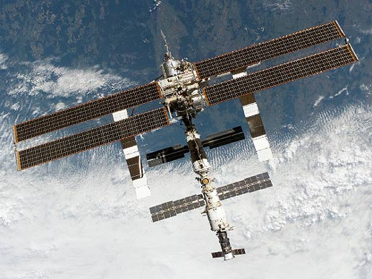
International Space Station: 2000-present
  ~400 km orbit
  Continuous occupation for 11 years ~300 visitors for up to 196 days
Notes:
Perhaps the Shuttle Program’s most significant contribution was in constructing the ISS. A remarkable international collaboration.
ISS gives us knowledge of: 1) living and working in low earth orbit; 2) Effects of extended stays in space, particularly medical research; 3) International collaboration; 4) a laboratory for testing off-earth. US has about $100 billion invested. “The life of the space station has been extended to at least 2020 and it could continue on even longer. It's now big enough for six people. They conduct science research, from astronomy to zoology, and help scientists understand what is needed for longer missions in space, such as going to Mars.”
“NASA will continue to buy seats on Russian Soyuz capsules to ferry space station residents. The $56 million price per head will go up to $63 million, which is still cheaper per person than the space shuttle.” “Two companies predict they could fly astronauts to the space station within three years. NASA is under orders to build a giant rocket to go beyond Earth orbit.”
“The International Space Station serves as a national laboratory for human health, biological, and materials research, as a technology test-bed, and as a stepping stone for going further into the solar system. On the International Space Station we will improve and learn new ways to ensure astronauts are safe, healthy and productive while exploring, and we will continue expand our knowledge about how materials and biological systems behave outside of the influence of gravity.” Without plans to return to the moon, the ISS assumes a greater role as a stepping stone in training and testing concepts and equipment for deep space exploration.

Slide 10
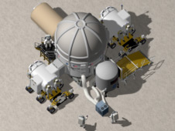
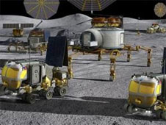
Our experience gained is substantial but…
~40 years since humans have ventured beyond low earth orbit
New technologies and strategies for extended missions in deep space are untested
Notes:
Photos show notional plan for a lunar habitat and for surface science equipment, drawn prior to the 2010 plan to visit an asteroid. Left image shows two pressurized rovers docked to a habitat. Right shows rovers and the Athlete vehicle transporting a habitat module. Large solar collectors are shown on the horizon. These are two architectures that are being presently tested in experiments conducted annually in northern Arizona.
Right image: The X-Hab loft at the top of the Habitat Demonstration architecture under evaluation for 2011.
Image credit: NASA . Obtained from http://www.nasa.gov/exploration/analogs/hdu_DRATS2011.html
Left image: Rendering of proposed Habitat Demonstration architecture being tested at 2010 Desert RATS. Image credit: NASA
Obtained from http://www.nasa.gov/exploration/analogs/hdu_DRATStesting.html

Slide 11
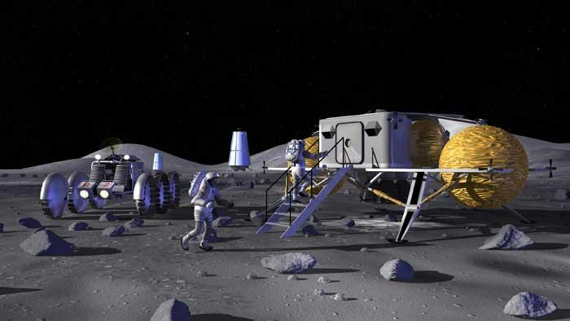
How will we do it ?
2004: A Vision for Space Exploration:
“Goals of human spaceflight should be worthy of the cost, risk and difficulty”
Use Moon as a laboratory and stepping stone to:
  Learn to live and work for extended periods off-earth
  Develop and test techniques to “live off the land”
  Test new surface science exploration tools
Notes:
After the Columbia accident in 2003, the Bush administration and NASA took a hard look at the future of human space exploration. “…space travel is going to be expensive, difficult and dangerous. …if we are going to send humans into space, the goals ought to be worthy of the cost, the risk and the difficulty. A human spaceflight program with no plan to send people anywhere beyond the orbiting space station certainly did not meet that standard.” former NASA administrator Michael Griffin
No longer a plan to build a base on the Moon – present administration believes it is too ambitious a project in the near term given budget constraints and NASA’s original time frame. A no less ambitious plan is for extended space travel to a very small object, an astroid, where science can be conducted in a totally new setting. The 2004 plan included retirement of the Shuttles to allow funds for the “Vision”.

Slide 12
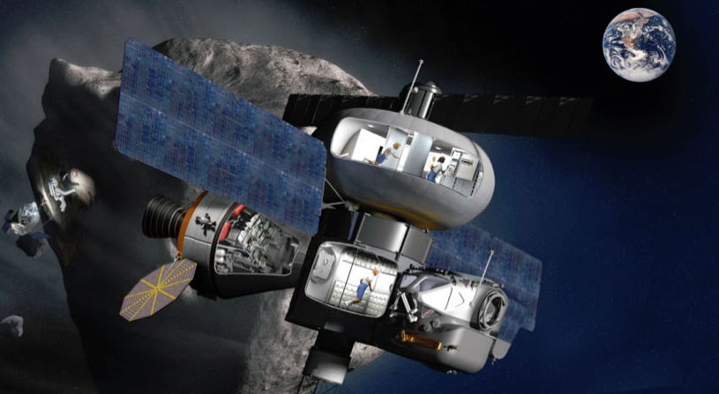
2010 Revisions
Larger role for private enterprise
Greater emphasis on international collaboration
Near-Earth asteroid instead of the Moon
Goals for human exploration the same:
Learn to live and work for extended periods away from Earth
Notes:
Larger role for private enterprise in low earth orbit – payloads to and from International Space Station by contract with private aerospace companies. Extending free enterprise to space should ultimately lower the flight costs. Elon Musk (SpaceX) uses the 20th century development of commercial airline as an analogy. NASA awarded ~$5 billion in contracts this 2010-11 (?) to support development of private space ventures. Only market right now is space tourism, resupply of the ISS and as lauch platform for commercial satellites.
Use ISS as model for international cooperation with European, Russian, Japanese space agencies. Invite others to participate.
“Asteroids are believed to have formed early in our solar system's history–about 4.5 billion years ago–when a cloud of gas and dust called the solar nebula collapsed and formed our sun and the planets. By visiting these near Earth objects to study the material that came from the solar nebula, we can look for answers to some of humankind's most compelling questions, such as: how did the solar system form and where did the Earth's water and other organic materials such as carbon come from?
In addition to unlocking clues about our solar system, asteroids may provide clues about our Earth. By understanding more about asteroids we may learn more about past Earth impacts and possibly find ways to reduce the threat of future impacts.
Future robotic missions to asteroids will prepare humans for long-duration space travel and the eventual journey to Mars. Robotic missions will provide reconnaissance information about asteroid orbits, surface composition, and even return samples to Earth for further evaluation. These robotic missions are a critical step in preparing humans to visit asteroids where we will learn about the valuable resources available in space, and further develop ways to use them in our quest for more efficient and affordable exploration.”
Background is artist concept that shows a method to explore an asteroid. Artist concept credit: NASA
Source: http://www.nasa.gov/exploration/analogs/desertrats/dratskennedy.html
See the National Space Policy of the United States of America, 2010:
http://www.whitehouse.gov/sites/default/files/national_space_policy_6-28-10.pdf

Slide 13
Apollo: A “Playbook” for Human Exploration?
~8 years of precursor data gathering and flight testing
Longest stay 3 days; ~9 days per mission
Moon walkers: 11 pilots, 1 geologist
Last 3 missions devoted to geoscience
~380 kg (840 lbs.) of rocks returned
Amazing successes, very few failures
Notes:
Selected statistics:
What did we learn: What is the moon made of? Igneous rocks (no sedimentary or metamorphic except those generated by meteorite impact) very similar to those found on earth.
How old is the moon? ~4.5 billion years old, the same as the earth
Where did the moon come from? Created when a Mars-sized body collided with earth very early in its history. Pieces coalesced to form the moon.
What are dark and light areas on the moon; why does the moon look the way it does? Dark areas (lunar lowlands) are extensive lava flows, light areas (the lunar highlands) are a feldspar-rich igneous rocks (anorthosites) created from a magma ocean
Was there ever life on the moon? No, the main ingedient, water, has always been to scarce to support life as we know it.
Many, many other questions answered.
Amount of rock - draw on comparison with audience to 840 pounds = 5-6 average people by weight

Slide 14
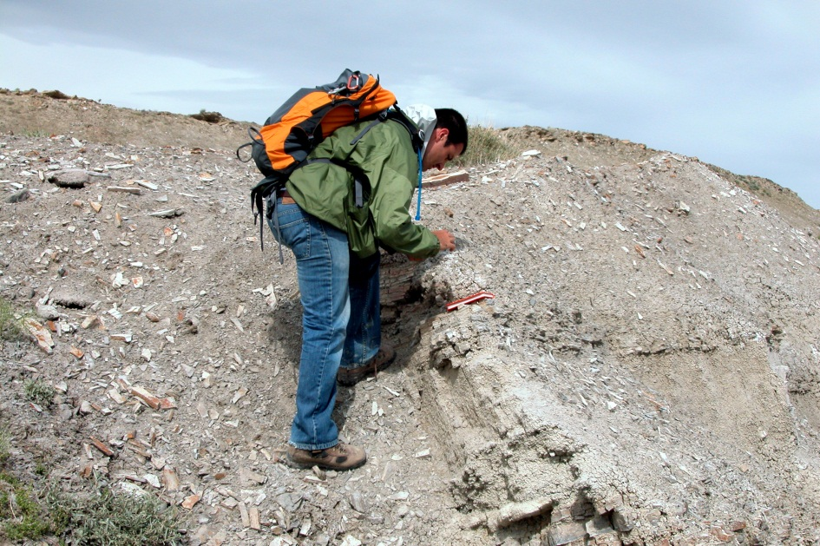
Can’t anybody take photos and pick up rocks?
Yes but…
What kind of rocks should you collect?
What are the most important observations needed to document a geologic history?
Answer:
Ask a Field Geologist
An expert at interpreting landscapes and rocks to deduce geologic processes and histories
Notes:
Photo: Student field geologist enrolled in UT Austin’s summer Field Geology class. Photo from the authors collection.
Returning to the 380 kg of rock collected…. This question is what drove field geologic training of the Apollo astronauts. Can’t bring everything back, and there is very little time for exploration and observation. Solution was to train astronauts in field geological techniques and keep them on very tightly scripted traverses to maximize scientific return. This was difficult because the geology of the landing sites was only know from telescopic observation and orbital photography at before landing.
…”interprets landscapes and rocks to deduce geologic processes and histories.” : What happened to produce the landscape we see today? What was the sequence of events that led to rocks being where they are today?

Slide 15
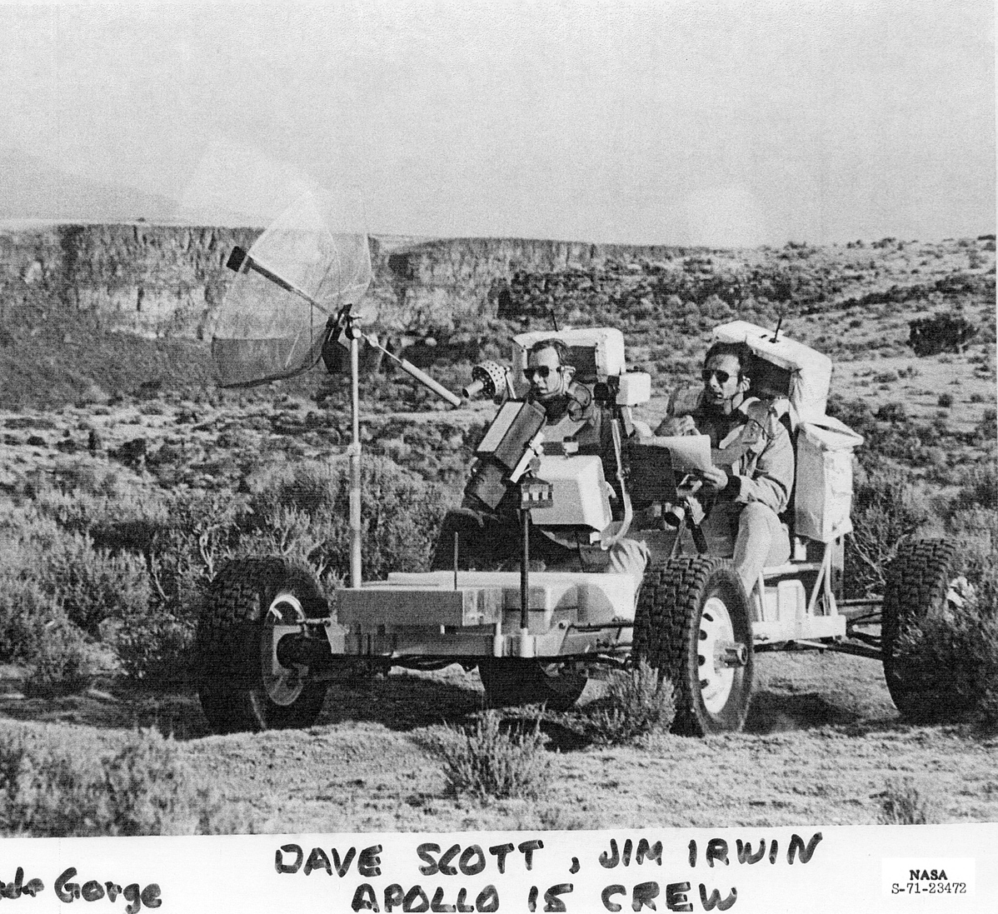
Apollo Astronaut Geology Training
General Geology
Field Trips and Field Geology Exercises
Practice with Tools and Equipment
Apollo: 800-900 days of classroom and field training
Notes:
Photos from the personal collection of W. R. Muehlberger.
It’s estimated that Apollo 15, 16, 17 pilot astronauts had been trained in geology to about the equivalent of Masters degree. Roughly 800-900 days of classroom and field training before going to the moon. There field trainers were field geologists, many at the top of their profession. Astronauts were not just trained rock collectors, they were taught skill of scientific observation. “When all you have is a hammer, everything looks like a nail”. A corollary for scientific observation is that we mainly observe and take note of only the things we are prepared to see. Without training in the observation of field geologic relationships much is ignored and subjective decisions about how best to spend precious time for observations and what samples to bring home are uninformed. Some of the training was done without consideration of the geology of the Moon (poorly known at the time) with the belief that methods and techniques of geologic observation could be applied anywhere. This turned out to be mostly true, though some astronauts complained that their training did not adequately prepare them for what they saw.
Note scrub brush, not exactly lunar… nevertheless sites were selected to be as analogous as possible to lunar sites that were to be explored. E.g. Rio Grande River gorge in N. New Mexico pictured above has the same dimensions and similar geology to the Apollo 15 landing site. Astronauts visited and studied impact craters, volcanoes, lava flows as the best places for earthly preparation of what they would encounter on the moon. Once landing sites were selected, astronauts spent months practices with tools and equipment in a setting analogous to their landing site.
Story of how new training program came into being – consensus among academic comm., former astronauts and the few geologists at JSC that program had to be expanded to more closely resemble the model from apollo.

Slide 16
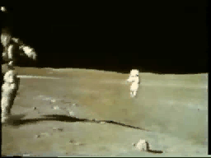
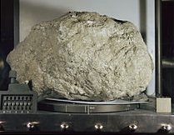
How was it done?
Apollo 16: Collecting “Big Muley”
3.97 billion years old
Impact melt rock (igneous rock melted by meteorite impact)
Largest moon rock collected, ~12 kg (~26 lb)
Notes:
Video from Apollo 16 Video Library (http://next.nasa.gov/alsj/a16/video16.html)
Big Mulley photos from http://www.lpi.usra.edu/lunar/samples/atlas/detail/?mission=Apollo%2016&sample=61016 1 cm cube for scale.
The astronaut speaking is Charlie Duke.
The sample is named after Dr. William R. Muehlberger, former professor at UT Austin and the principle investigator for Apollo 16 and 17 missions. A consummate field geologist, he trained Apollo 16 and 17 astronauts in geologic field methods. After Apollo, he went on to teach nearly all Shuttle and Space Station astronauts geologic principles and how to observe and photograph earth from space.
Knowledge before and after collection of rock: Apollo 16 astronauts were sent to investigate what was thought to be an area covered by volcanic deposits. What astronauts found instead was an area composed of meteorite impact debris; there was no evidence for the hypothesized volcanic rocks, which were thought to be there from satellite and telescope observations. The astronauts were well enough trained in geology to recognize this immediately, and original plans for the geology traverse were modified accordingly. This was still a highly successful mission with rocks like Big Muley, which is still studied today, yielding dates and information about the pre-, syn-, and post impact history of the moon.

Slide 17
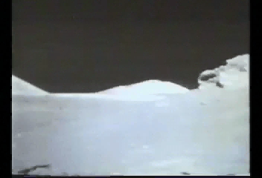
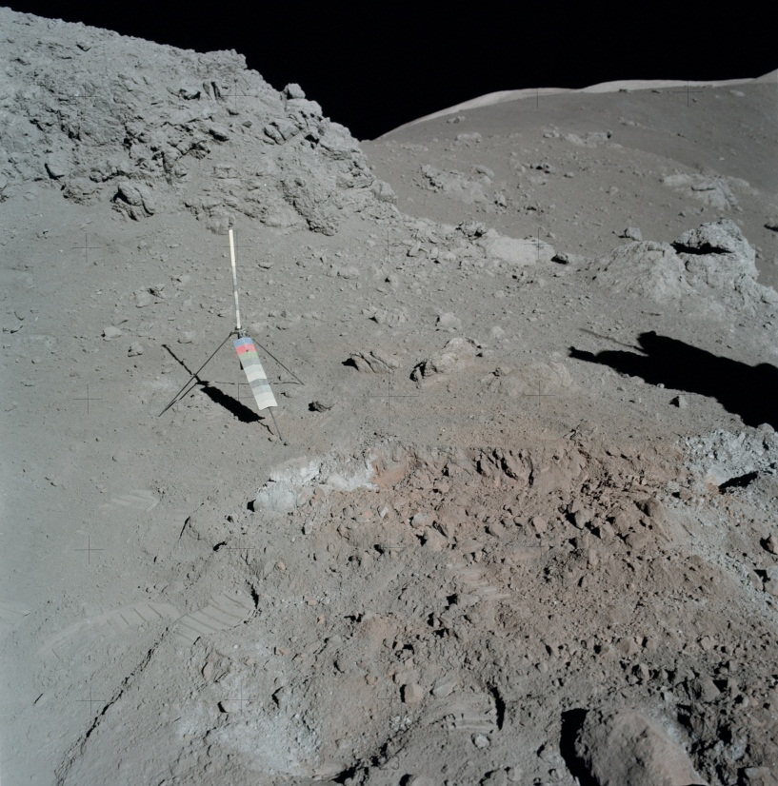
How was it done?
Apollo 17: Discovery of Orange Soil
Site of “orange soil” discovery
Harrison Schmitt collecting sample
Notes:
Contrast the commentary of Harrison Schmitt, a Ph.D. geologist, with that in the previous video of Charlie Duke a pilot with astronaut field geology training. Harrison Schmitt recognized the significance of what he was seeing as unusual, described what he saw, and devised a strategy on the spot for collecting both a sample and a control sample for comparison. Schmitt noticed that the gray soil rested against and on top of the orange soil, thus the orange soil was older.
Video is from http://next.nasa.gov/alsj/a17/a17v.1453058.mpg. It was shorted in QuickTime from its original 3 min 10 sec length.

Slide 18
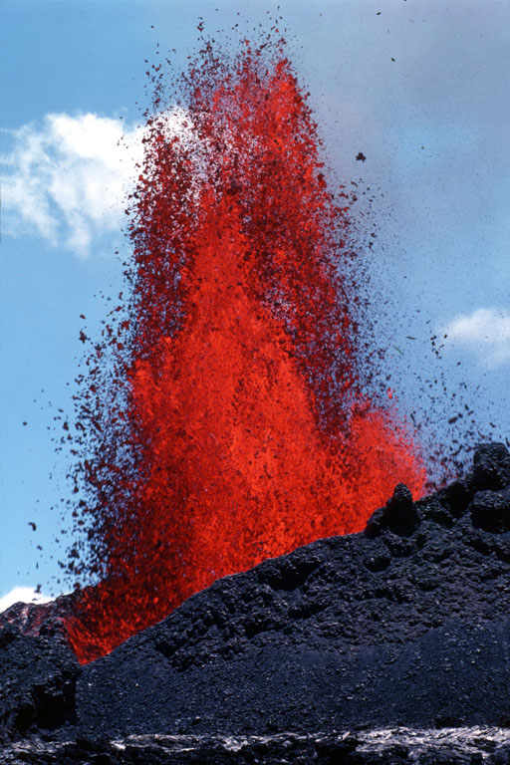
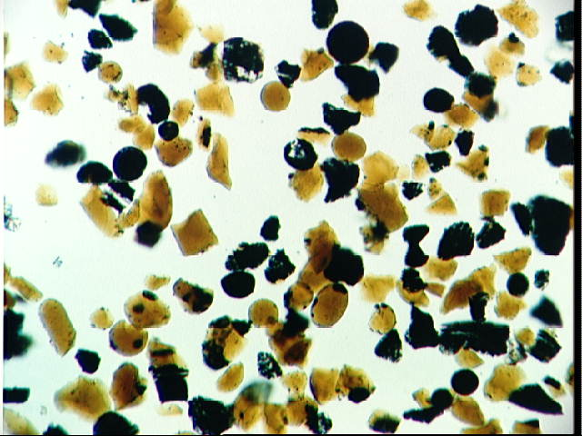
How was it done?
Apollo 17: Discovery of Orange Soil
~1 mm
Orange soil sample, magnified
Droplets of glassy lava
~3.6 billion years old
Evidence for fire fountain eruption
Fire fountain, Hawaii
Notes:
Photomicrograph of orange soil from http://apod.nasa.gov/apod/image/0105/lunarsoil_apollo17_big.jpg
Quoting from the photo description: “The orange soil contains particles less than 0.1 millimeter across, some of the smallest particles yet found on the Moon. Lunar geologists now think that the orange soil was created during an ancient fire-fountain. Detailed chemical and dating analyses indicate that during an explosive volcanic eruption 3.64 billion years ago, small drops of molten rock cooled rapidly into the nearly spherical colored grains. The origin of some of the unusual elements found in the soil, however, remains unknown. “ The sample is described in http://curator.jsc.nasa.gov/lunar/lsc/74220.pdf.
Fire fountain: http://pubs.usgs.gov/dds/dds-80/images/JPG/large_screen/RIFT_016.jpg : Pu‘u ‘O‘o fountain, Hawaii, approximately 100 m high.

Slide 19
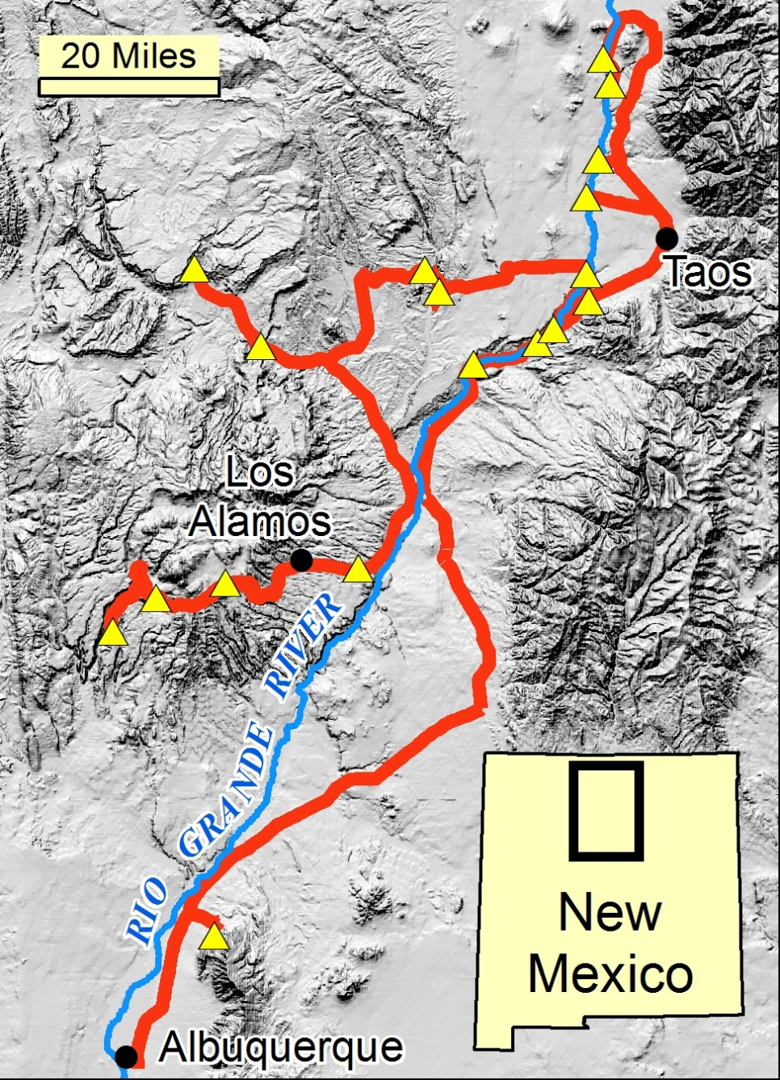
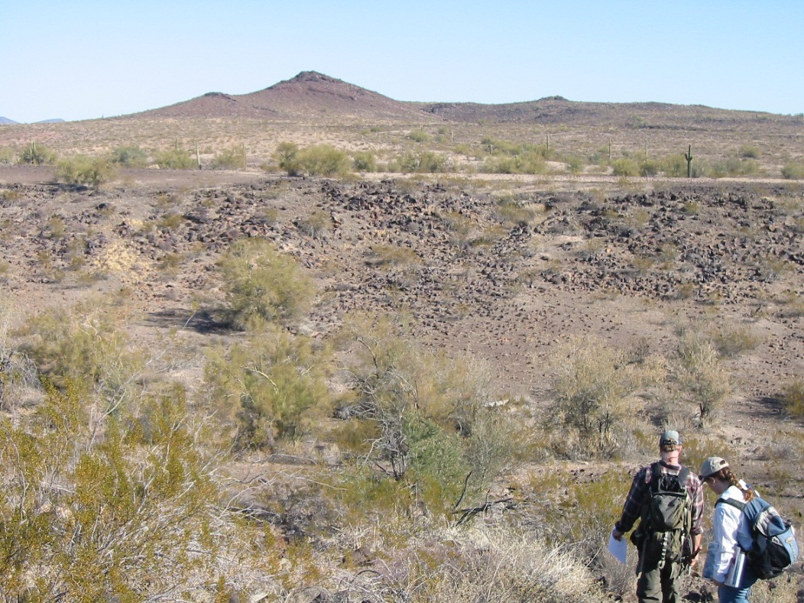
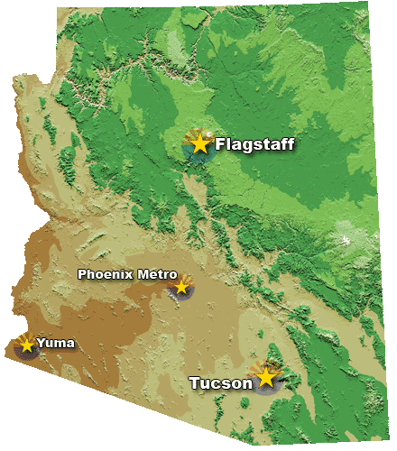
2010 Astronaut Training Sites, NM & AZ
Rio Grande
Gorge site
Notes:
Story of how new training program came into being – by 2008 a consensus among a few academic comm., former astronauts and the few geologists at JSC that the existing training program had to be expanded to more closely resemble the model from Apollo.
After Apollo, there was no longer a need to train astronauts as extensively in field geology. They were instead taught how to observe and photograph the geology of earth from low earth orbit (shuttle and space station). With the 2004 Vision, it became clear there needed to be a program devoted to more extensive training in field geology. Over a period of about 4 years a new program was devised and implemented. I am a part of that new program. The program takes the best of the Apollo experiences and adds to them. Astronaut candidates receive classroom geology courses and in year 2 of their training are taught beginning field geology. Field training includes a 6 day field trip to sites in northern New Mexico (left slide) and 3 days of mapping a small volcano in SW Arizona.
1999 to present – astronaut
Arizona sites – 1) 3 days mapping a small volcano using satellite images and field work west of Phoenix to determine the geologic history; 2) Test equipment and simulate EVAs at annual Desert RATS (research and technology simulations) near Flagstaff.
New Mexico site – field trip, field mapping, field geophysics over 6 days

Slide 20
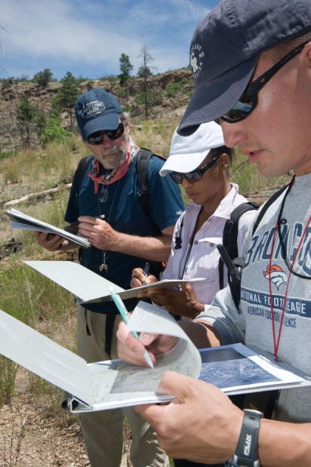
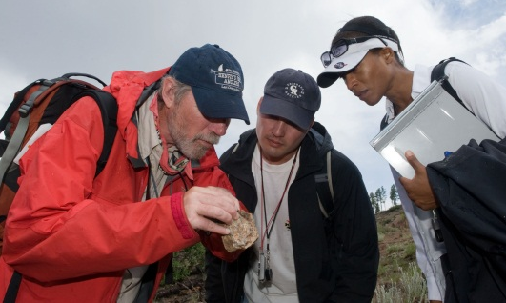
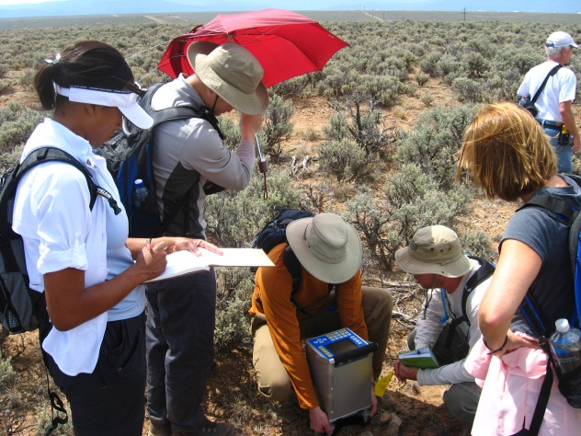
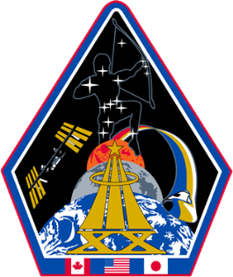
Geology Training Today
Classroom Training
Field Training & Mentoring
2009 Astronaut Candidate Class
Group 1
Notes:
A new curriculum began in 2010. Astronauts get about 60 hours of classroom training in Planetary Science, Geology of the Moon, Geochemistry, Rock Identification and Mineralogy, Volcanology, Impact Cratering and other topics. Field training has been lengthened – a week long field trip in northern New Mexico revisits some of the Apollo training sites and includes geological mapping and geophysical exercises.
Photos are by the author. Pictured are astronauts of the 2009 Candidate Class, Jeanette Epps and Kjell Lindgren, with the author near Los Alamos, New Mexico in June, 2010.
The group is a mix of military and civilians that includes: a technical intelligence officer with the Central Intelligence Agency (CIA) (Epps), two NASA flight surgeons (including Lindgren), a space station flight controller, a sprint-running molecular biologist, as well as two Navy test pilots, a U.S. Air Force test pilot and the special assistant to the Vice Chairman of the Joint Chiefs of Staff at the Pentagon. Training with the class are 2 Japanese and 2 Canadian Space Agency astronauts.

Slide 21
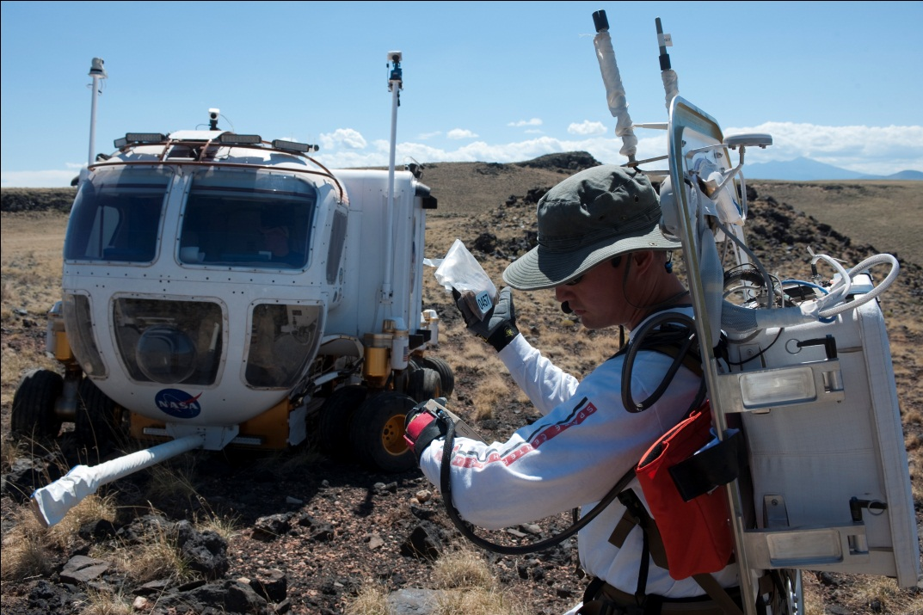
Testing Concepts, Tools and Equipment
Desert Research and Technology Studies northern Arizona
Astronaut Kjell Lindgren
Notes:
Left: Sept., 2011: Astronaut Kjell Lindgren checks the wrist display of his Advanced Extravehicular Activity Information System during a simulated spacewalk during the 2011 Desert RATS mission at the Black Point lava flow near Flagstaff, AZ. The rover is called the Space Exploration Vehicle (SEV). Photo credit: NASA/Regan Geeseman. Downloaded from http://www.nasa.gov/images/content/593052main_dratsspacewalk.jpg
Right: Sept., 2010: Astronaut Stan Love talks to scientists at base camp and describes one of the rocks he finds on Mission Day 6 at D-RATS. Image from http://blogs.nasa.gov/cm/blog/analogsfieldtesting/posts/post_1284061767399.html .
D-RATS = NASA's Desert Research and Technology Studies, experiments that are conducted annually at sites that can partially simulate other surfaces in space, in this case at Black Point lava flow, a dusty, rough terrain with extreme temperature swings.
One slide

Slide 22
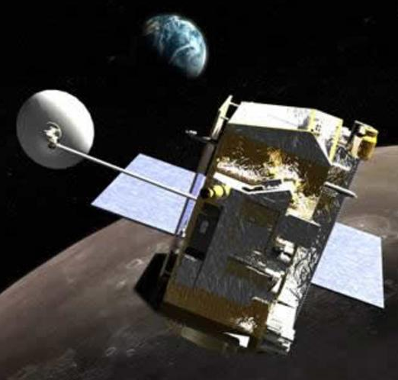
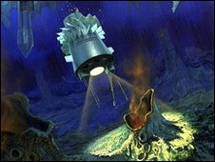
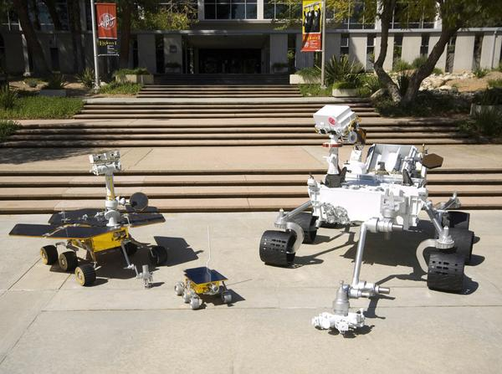
What else has changed since Apollo?
Notes:
Answer: Exploration tools. Use of robotic rovers and sophisticated satellites sensors. Mars rovers include “Curiousity” rover, a model of the Spirit and Opportunity Rovers and Sojourner, the rover of the Mars Pathfinder mission.
Since the last Apollo mission in 1972, we’ve made MANY advances in remote sensing, 3D modeling and simulation, and planetary robotics. All these advances mean that the way we explore the Moon and conduct surface science in the future can (and should!) be different than the past.
Lunar surface systems will be different from Apollo. How? How best to prepare for a return to the surface?
3 images cryobot MER satellite only

Slide 23
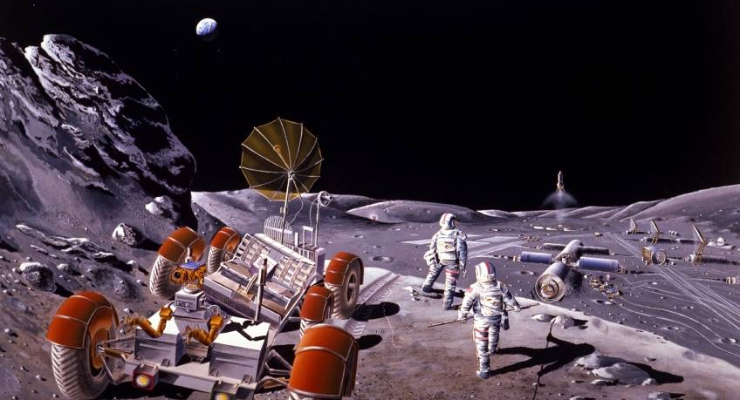
How will robots be used?
Reconnaissance prior to human landings
Side-by-side human assistants
Autonomous investigators e.g. Mars rovers
Follow-up to human exploration
Utility functions - maintenance, construction, etc.
Notes:
Remove all but middle image, animate text

Slide 24
Robotic Follow-up Research Project
To study how an astronaut geologist might do a field geology study with robotic follow-up in mind
To discover how best to pair human and robotic geologic investigations
Use a setting that is analogous (in as many ways as possible) to that on Moon or Mars
Notes:
NASA Ames Research Center Intelligent Robotics Project goals for this study.
Analog Site = Field setting that has characteristics of interest analogous to those on another planetary surface

Slide 25
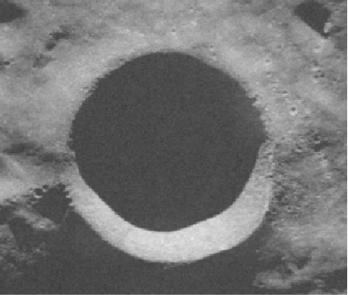
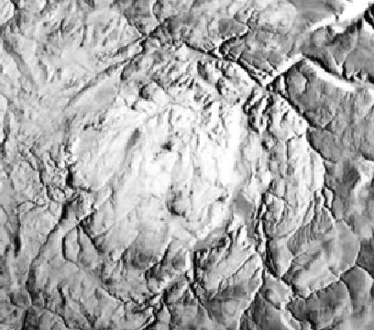
Haughton Crater As A Lunar Analog
Moon
Shackleton Crater,
19 km diameter
Earth
Haughton Crater, 20 km diameter.
(Devon Island, Canada)
Potential lunar outpost site
Best preserved crater of this size on Earth
Rocky, polar desert with H₂O ground ice
Notes:
Diameter spell
Remove radar image, h20 shaded regions, range of impact related features
Boloid image

Slide 26
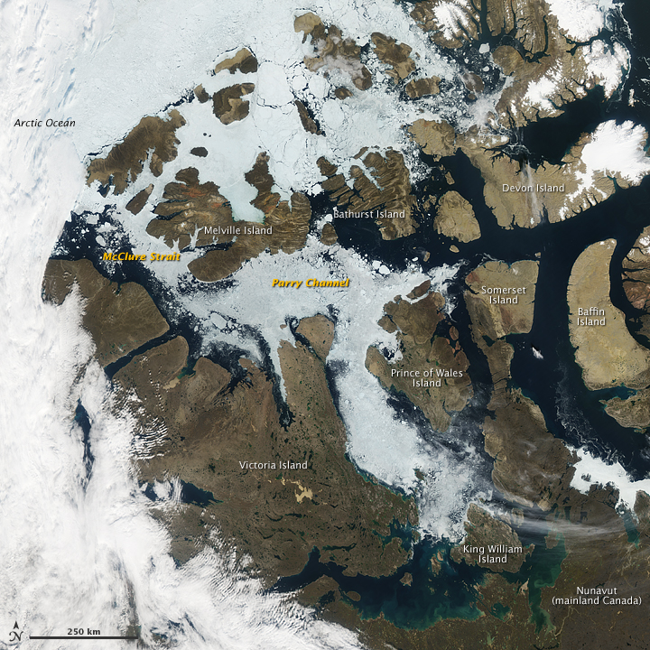
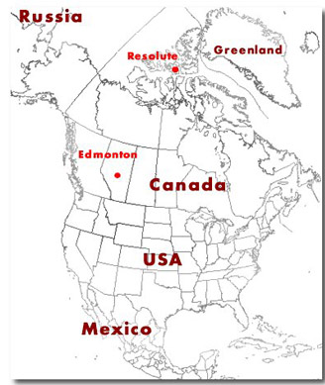
Haughton Impact
Crater Location
Aqua/MODIS image, 8/27/09
Haughton Crater
Resolute
Devon Island
Austin
Notes:
Blow up Modis image, location map as inset, Plane as next slide

Slide 27
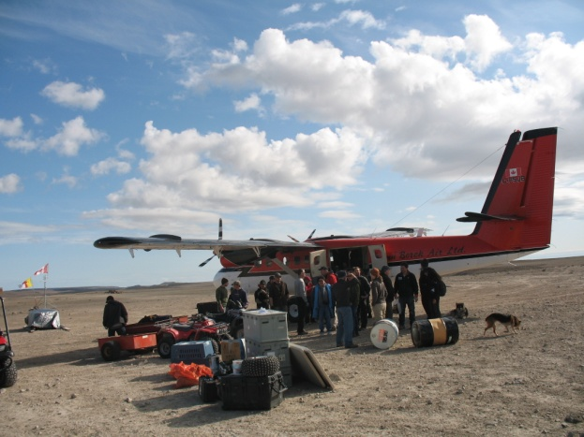
Notes:
Landing strip for small planes at HMPRS. Gear here is both coming and going. Flights are infrequent and dictated by weather and flying conditions.

Slide 28
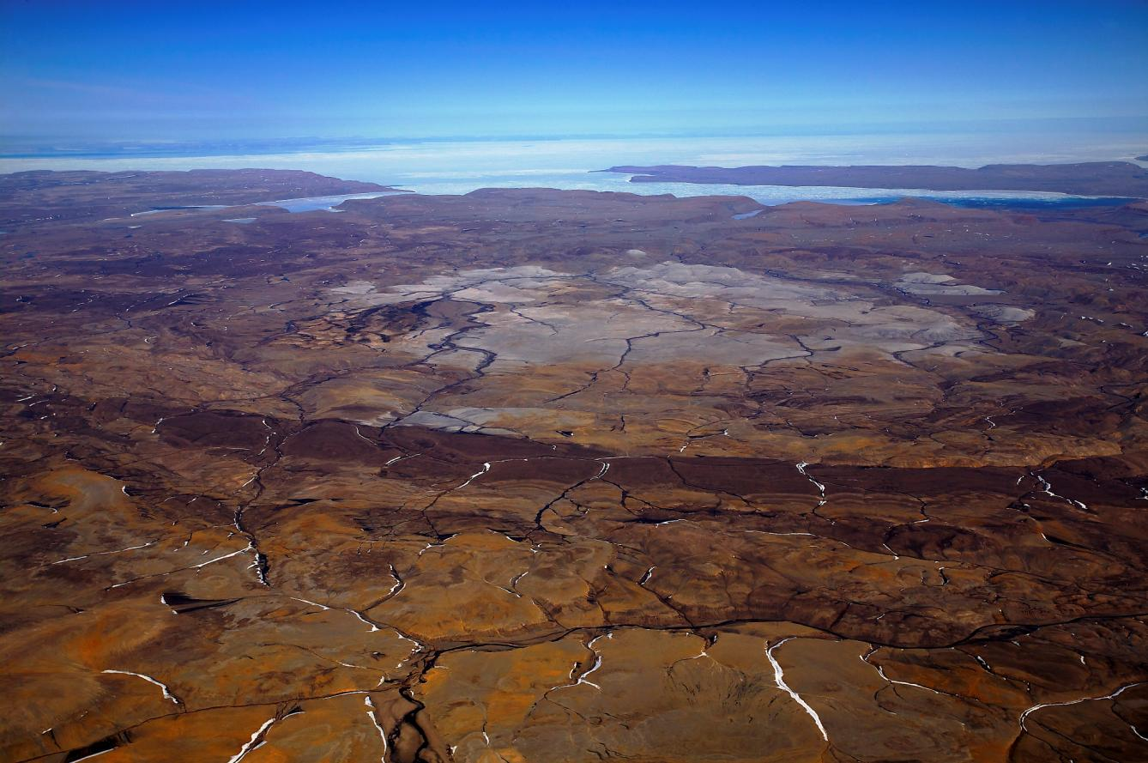
Haughton Crater, Devon Island
Base Camp
Courtesy M.E. Lipman, 2007
Notes:
Note lack of vegetation, circular rings, rock colors. Next photo of the white rock in the interior.

Slide 29
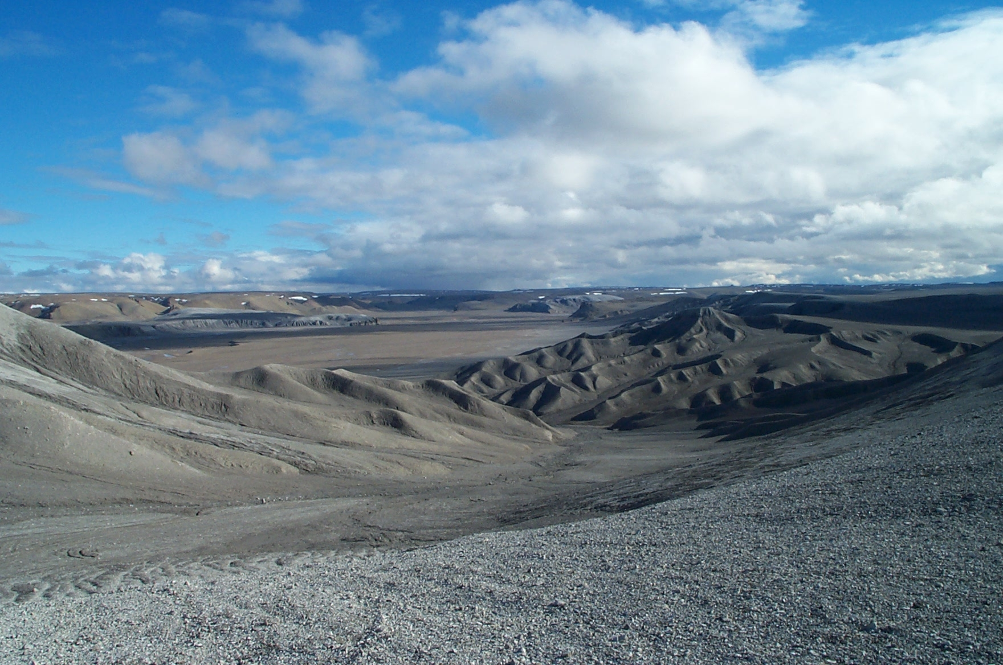
Crater Interior – Impact Melt & Breccia
Notes:
Photo from GSA online source. Gray material and most brown are carbonate melt breccia in crater interior.

Slide 30
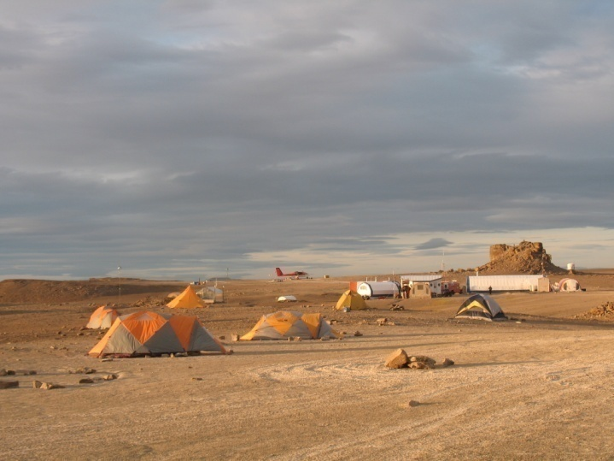
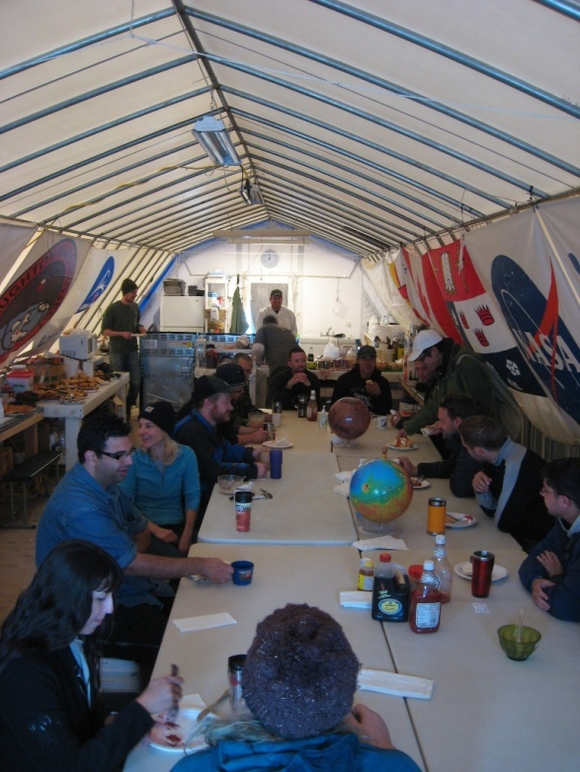
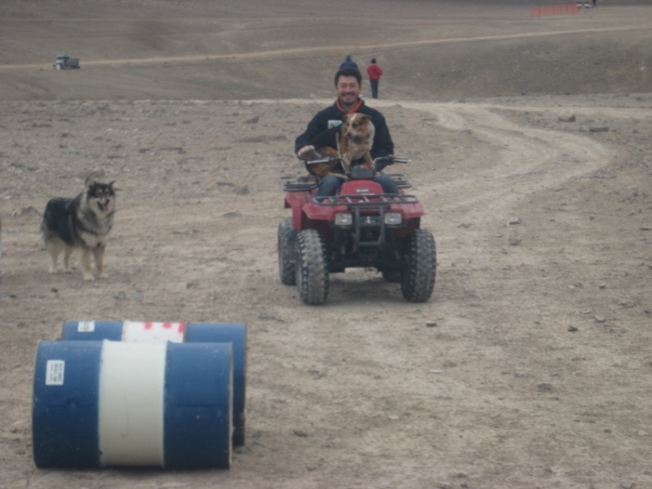
Base Camp
Notes:
Dining tent were scientist from several research projects gather for dinner and breakfast. “Tent city”, central research station and landing strip. Travel by ATV. Camp director and his dog, plus “Fluffy” the polar bear watch dog.

Slide 31
Ground Rules for Experiment
No prior knowledge except that obtained from remote sensing
Travel by rover or walk in simulated space suit
Traverse restrictions on time, distance, speed; emulate a real lunar traverse
Notes:
Asked stay to stupid, space between bullets

Slide 32
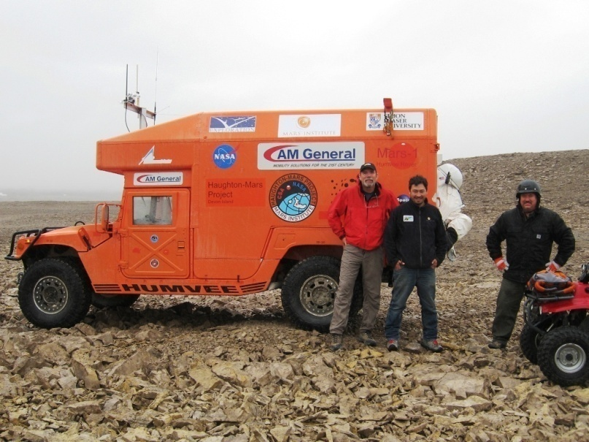
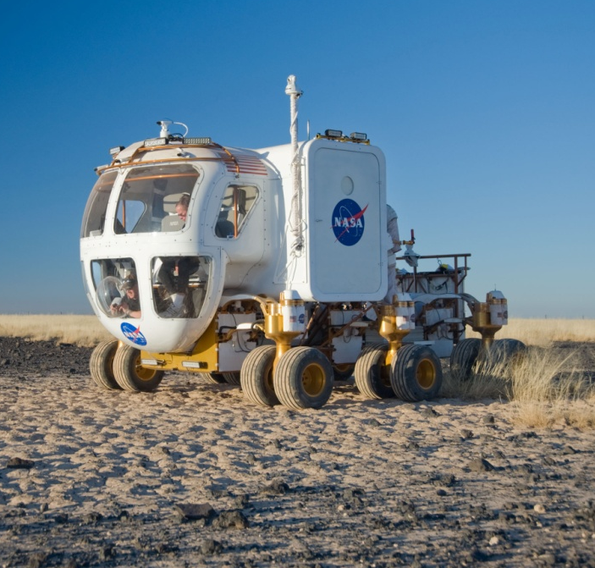
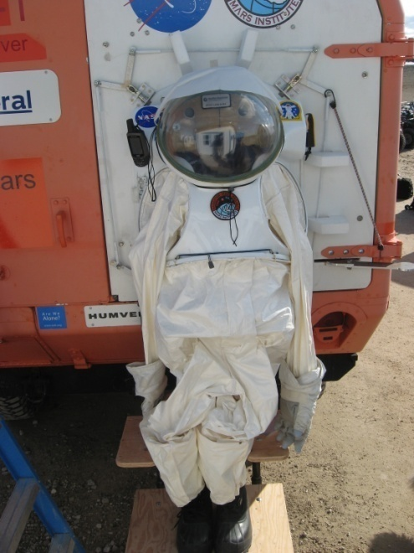
Analog Traverse Equipment & Rules
HumVee with Suit Port
NASA Space Exploration Vehicle
Notes:
Ground rules designed to simulate lunar geologic traverse condition
Wake time, time outside, roving speed, number of EVAs, etc. Closely controlled

Slide 33
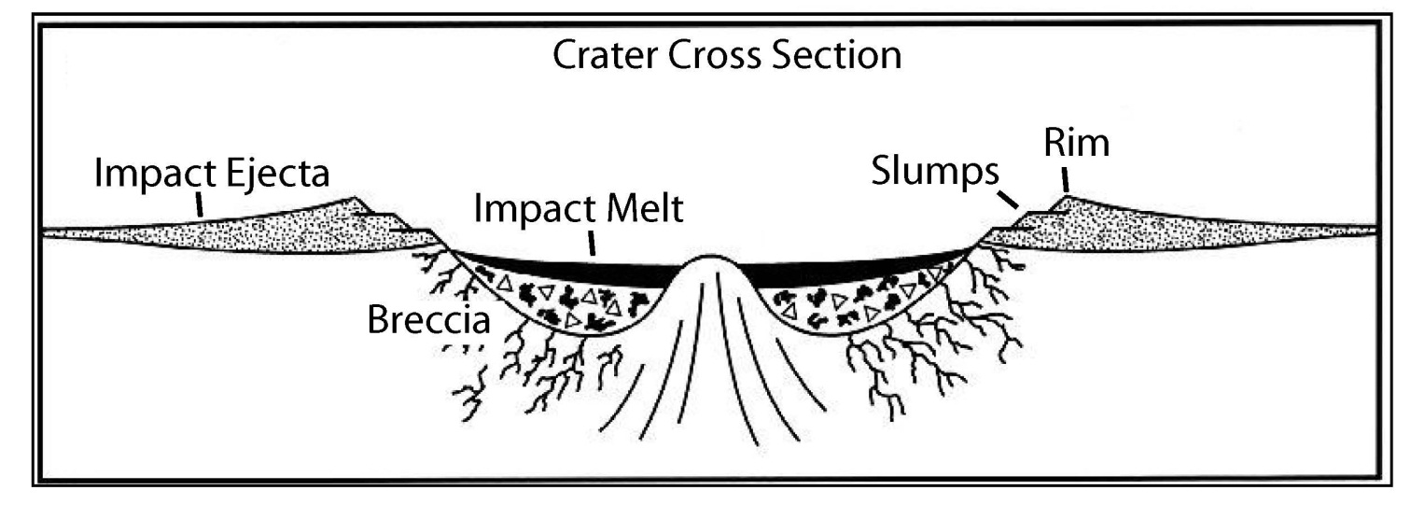
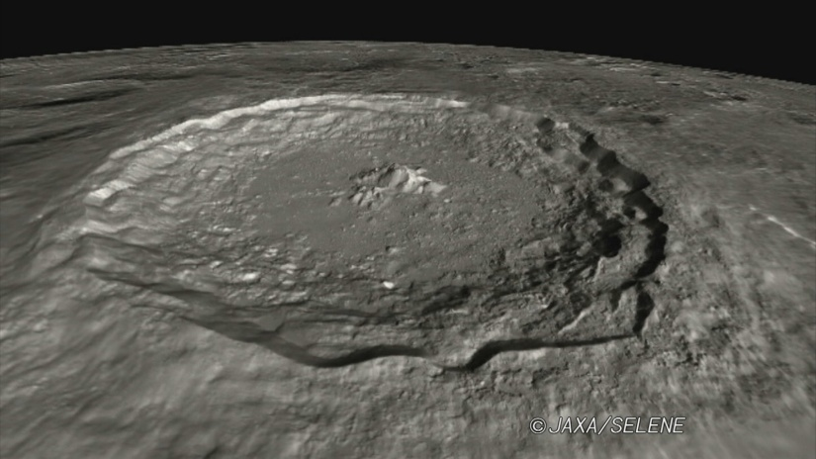
(Tycho crater, 85 km in diameter)
Notes:
Haughton crater is an impact crater and the geology must reflect that. How much of that geology is still preserved and what parts correspond to different crater deposits? How old is the crater? How much of the geology we see post-dates impact? How has glaciation affected the crater?
The simplified cross section through an impact crater shows several types of deposits and can be compared to the Tycho, a young crater on the Moon. The red boxes outline “terraces”, flat benches on the crater wall produced by slumping shortly after the crater forms. The tops of the terraces tilt toward the crater rim. An uplifted central peak, visible in both the diagram and photograph, is produced by rebound of the floor material immediately after impact. The rocks below the crater are intensely fractured, and the crater is filled by impact debris and rock that has been melted by the shock of the impact. The crater rims are capped by deposits of the material blown out of the crater.
This is a highly schematic diagram that shows some but not all of what might be expected. We still have a lot to learn about the geology of impact craters and the cratering processes. A well exposed crater like Haughton provides a unique opportunity to do so.

Slide 34
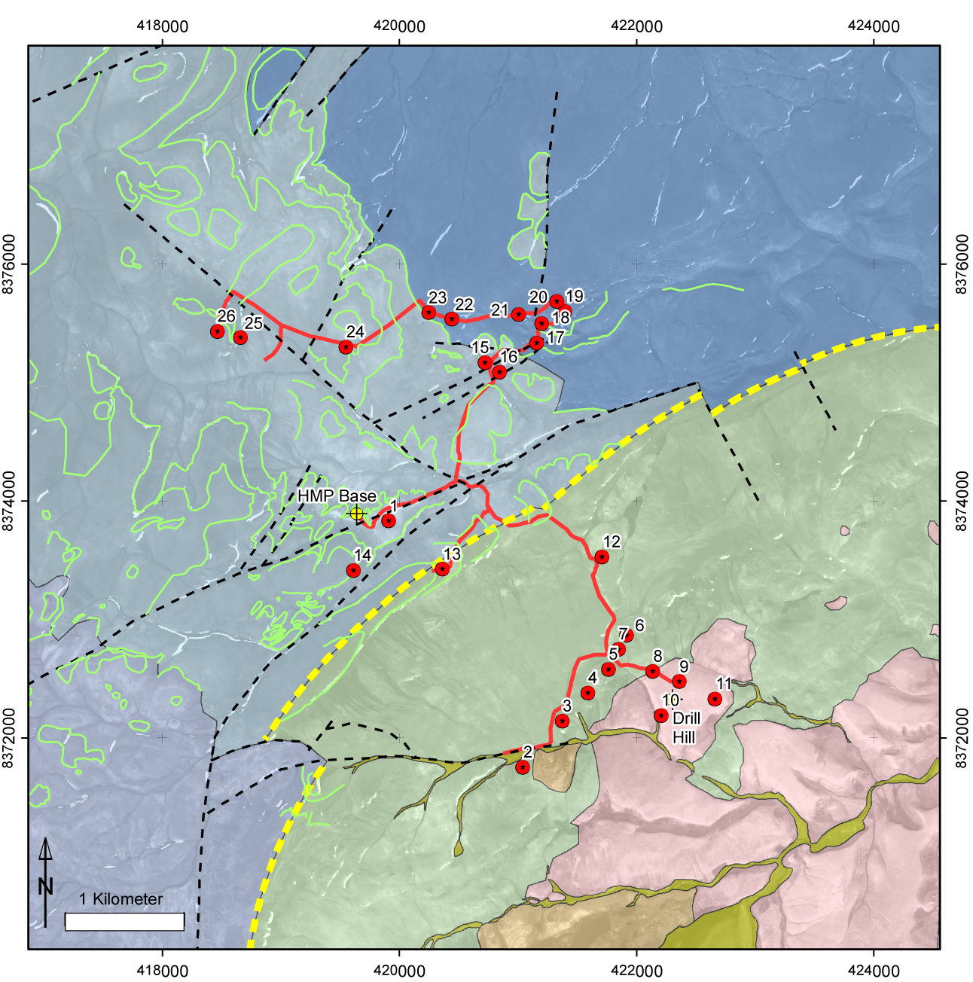
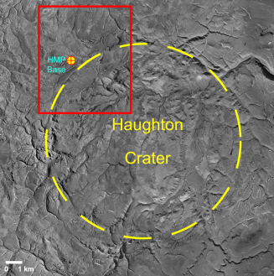
Geologic Map from Remote Sensing with Traverse Route/Stations
Carbonate 1
Proposed Traverse
Carbonate 2
Unstratified
Carbonate 3
White Crater Fill
Stratified
Notes:
Map prepare before doing field work. Constructed from satellite photography (barely visible beneath the colors) and a few other remotely sensed data. This represented my best guess at what I would see. It is my hypothesis of the geologic history. The red line and the labeled red dots are my proposed route with stops. I chose a route that would let me explore all of the major rock types and structures in the 2, 8 hour days originally allotted. The dashed yellow line is the topographic rim of the crater. Rocks shown in shades of blue are sedimentary rock (Carbonate 1, 2, 3) units with green lines showing bedding planes and dashed black lines faults. Inside the crater are three distinctly different kinds of deposits. Note that in comparison to the previous slide, with these data I failed to identify any material blown out of the crater, terraces along the crater walls and crater fill rocks like those in the diagram.

Slide 35
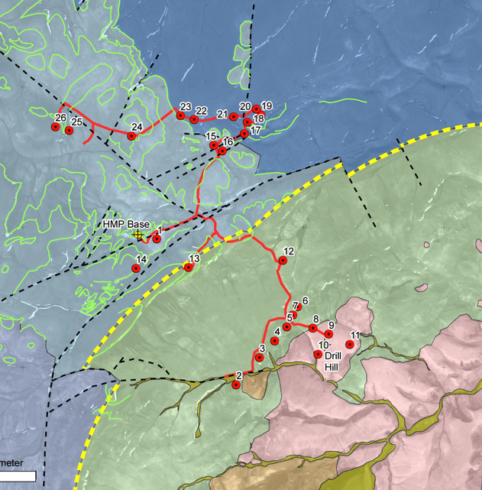
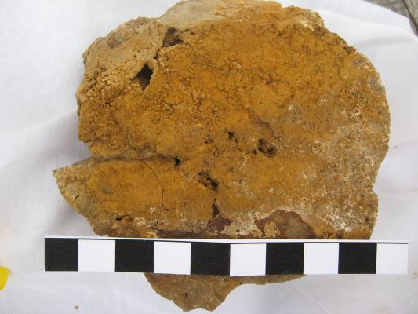

Geological Objectives
Geologic Mapping
  Discover and document
  geologic history, cratering or otherwise
Sampling
  Sample all major units, with
  focus on impact rocks
Notes:
Aside from knowing this was an impact crater and the area had likely been glaciated I knew little else – I was to try and discover the history. A map, however crude, gave me a place to start.

Slide 36



Traverses and EVAs
Notes:
EVA = Extra-Vehicular Activity

Slide 37



Photo Pans and Samples
Notes:
Two of the biggest surprises, demonstrating remote sensing can’t do it all. Subtle features can have great significance. Tie to orange soil observations at Apollo – two different things that are superficially similar.
Top left with adjacent diagram illustration of lake in crater

Slide 38

Revised GeologicMap
Notes:
Now know what rocks are. Green dots are sample sites. Did not have chance to visit any rocks outside the crater except those nearest the rim.

Slide 39

A Lot Was Left for Robotic Follow-up
Courtesy T. Fong, IRG, NASA ARC
Notes:
Go through fast

Slide 40

Crater Rim – what are large blocks?
W and SW crater wall – ejecta blocks? vs. down-faulted section? vs. megabreccia? vs. younger glacial deposits
Notes:
For example, what are these; other objectives specific to geology not visited that had to be narrowed down

Slide 41


K10 Robot
GigaPan
Sun
tracker
Wi-Fi
3D Lidar
GPS
IMU
Hazcams
Ground
Penetrating
Radar
Rockers
Microscopic
Imager
XRF
Spectrometer
Front
Back

Slide 42

The “Science Backroom”:
Analyzing Rover Results
Notes:
The science backroom at Ames Research Center, August, 2010, where a team of UT geology senior undergraduate students and NASA robotics personal assisted in compiled and analyzed the data streaming back from the K-10 robot at Haughton Crater.

Slide 43

Accessing Robotic Data - Web Browser
Notes:
How many know what GE is?

Slide 44



Robotic GigaPan, Crater Wall (Site B1)
B3
B2
B1
B1
B3
B2
(Quickbird on DEM)
Down-faulted section from crater rim !
(Tycho crater, 85 km in diameter)

Slide 45

Results, Crater Wall (Site B2)
B3
B2
B1
B1
B3
B2
Ejecta blocks !

Slide 46
Conclusions
Human exploration coupled with robotic data collection maximizes scientific return.
The training of astronauts in field geology is as important today as it was 40 years ago.
Geologic explorations provide an important foundation for understanding the history of our solar system.
Notes:
Human exploration coupled with robotic data collection maximizes scientific return. Robots are best at doing rote, time consuming tasks that would otherwise slow exploration and discovery. They can flesh out details and extend an area of exploration. Humans are best at weighing observations, making decisions, and rapidly innovating/improvising, all critical skills for doing effective field geology.
2) Despite great technological advancements, the training of astronauts in field geology is as important today as it was 40 years ago.
3) Geologic explorations provide the foundation for understanding the history of planets and asteroids. True whether human or robotic. We must continue to explore space if we are to understand our origins and our solar system.

Slide 47

Dr. Mark Helper
Dr. Mark Helper is a Distinguished Senior Lecturer in the Department of Geological Sciences at the University of Texas Jackson School of Geosciences. He teaches undergraduate courses in introductory and advanced Field Geology, GIS and GPS Applications in the Earth Sciences, and Gems and Gem Minerals, and lectures and leads fieldtrips for other undergraduate and graduate classes. His current research explores geochemical and Isotopic similarities of Proterozoic and Archean crust in East Antarctica and the southwestern U.S. As co-chair of FEAT (Field Exploration and Analysis Team), Dr. Helper is also involved in the geological field training of astronauts and allied activities, in preparation for NASA's return to

