Slide 1
Creative Conservation in a Changing Climate
# 72
Dr. Camille Parmesan
April 22, 2011
Produced by and for Hot Science - Cool Talks by the Environmental Science Institute. We request that the use of these materials include an acknowledgement of the presenter and Hot Science - Cool Talks by the Environmental Science Institute at UT Austin. We hope you find these materials educational and enjoyable.

Slide 2
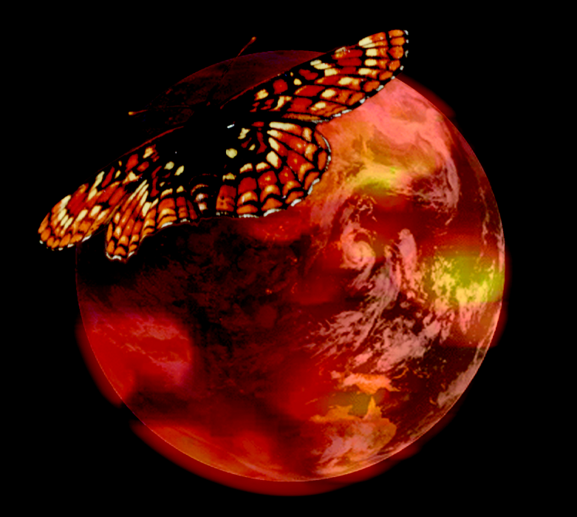
Camille Parmesan Professor of Global Change Biology, National Marine Aquarium Chair in Public Understanding of Oceans and Human Health, Marine Sciences Institute, University of Plymouth, England Professor of Conservation Biology Section of Integrative Biology, UT - Austin
Creative Conservation in a Changing Climate
April 22, 2011
Notes:
This talk will focus on what climate change means for conservation of biodiversity, particularly areas of hope.

Slide 3
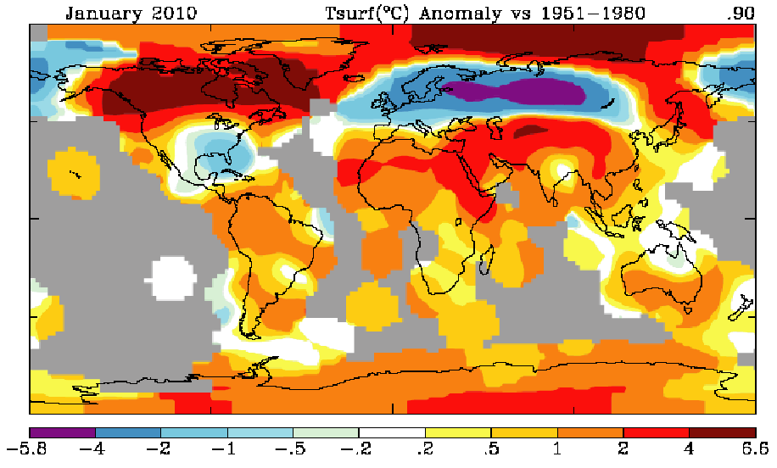
Jan. 2010; departures from regional average temperatures (1951-1980)
National Climatic Data Center / National Oceanic and Atmospheric Administration 2009
Notes:
Data graphically represented from a January 2010 report from the National Climatic Data Center/National Oceanic and Atmospheric Administration. Note that the blue to purple colors on the map are indicative of temperatures that are cooler than normal, and the yellow to orange to red colors indicate temperatures that are warmer than normal. Temperatures in the arctic were recorded as being hotter than normal, even though temperatures for the eastern United States and northern Europe were reported cooler than normal.
What has happened is a phenomenon climate scientists predicted a decade ago: greenhouse gases are causing changes in atmospheric dynamics, destabilizing the Arctic Circumpolar Current’s circulation and pushing the cold arctic air down to lower latitutudes (called arctic excursions).

Slide 4
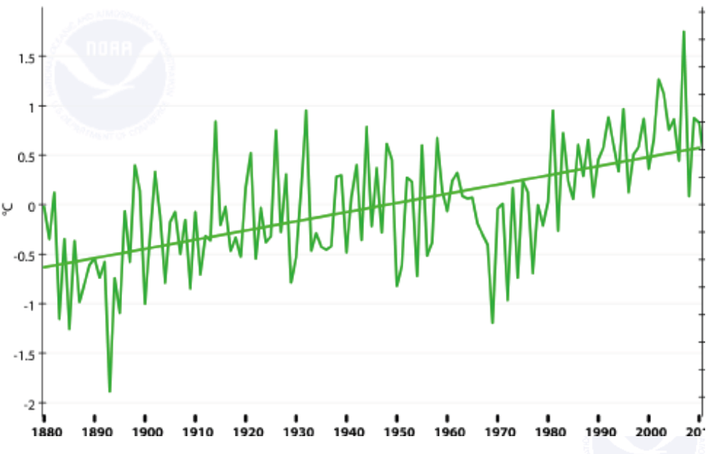
Departures from global average temperatures for all Januaries (1880-2010)
colder hotter
1880 1900 1920 1940 1960 1980 2000 2010
National Climatic Data Center / National Oceanic and Atmospheric Administration 2009
Notes:
The yellow line indicates average recorded temperatures from 1880-2010. The last 2 to 3 decades have seen a higher than average global mean for recorded temperatures.

Slide 5
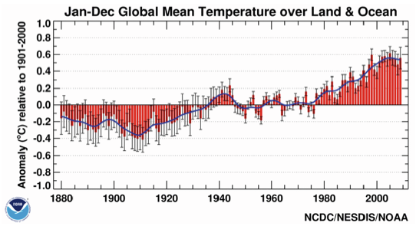
National Climatic Data Center: Report 2010
2010: ties with 2005 for hottest year on record
2009: fifth hottest year on record
2001-2010: warmest decade on record
Each year in 2000’s hotter than 1990 average
Notes:
This graph shows global year-round average temperatures. While there is variation, there has been a strong global warming trend since 1972. Every decade has been warmer than the previous decade, with our contemporary decade being the warmest on record. This past decade has set additional records: 2010 tying with 2005 for the hottest year on record, in spite of some locations where data show very cold records, in places such as in Boston, MA and in England. The fifth hottest year on record was recorded in 2009. Climate change is happening, and the world in general is getting warmer.

Slide 6
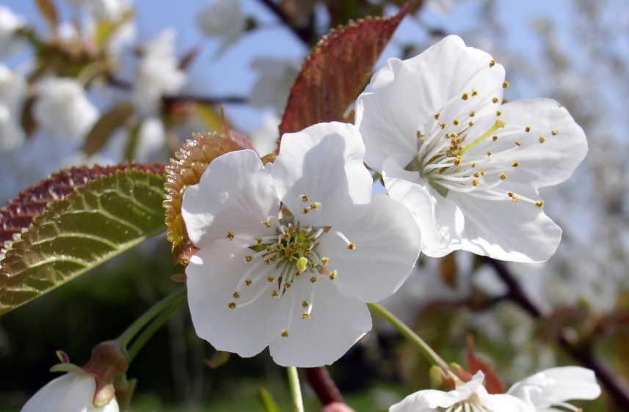
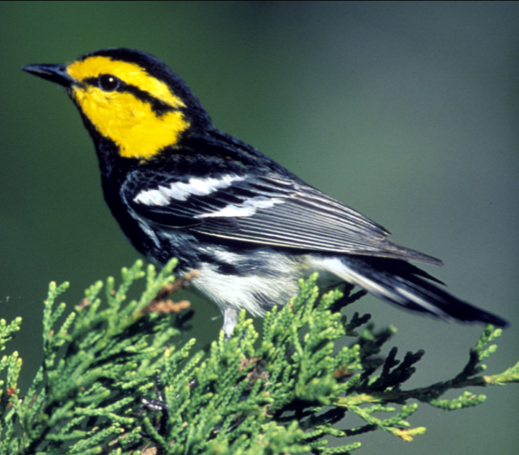
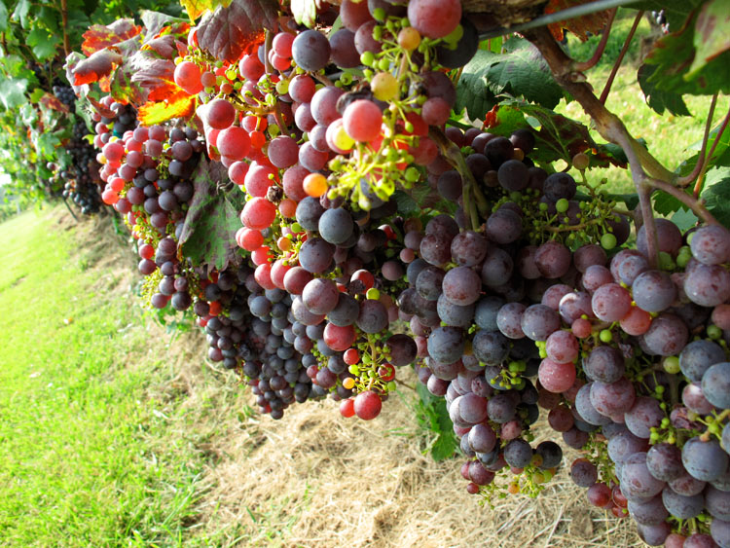
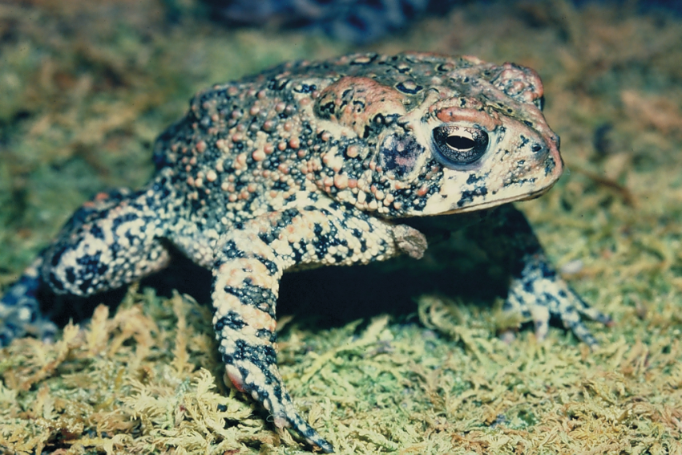
Notes:
(Sound for warbler toad playing in background. –LRS)
In the Northern latitudes, winters can be very dark and cold, and people love to look for signs of Spring and record them. We have an enormous amount of data on the timing for Spring events, such as with the emergence of cherry blossoms (top left image); example: there are 800 years worth of data on when the cherry trees blossom, recorded in Japan. We also know when bird and frog calls begin in Spring due to both scientist’s and amateur’s records. In addition, dates of grape harvests across Europe has been recorded for 400 years in the Fall by the wine industry.
6

Slide 7
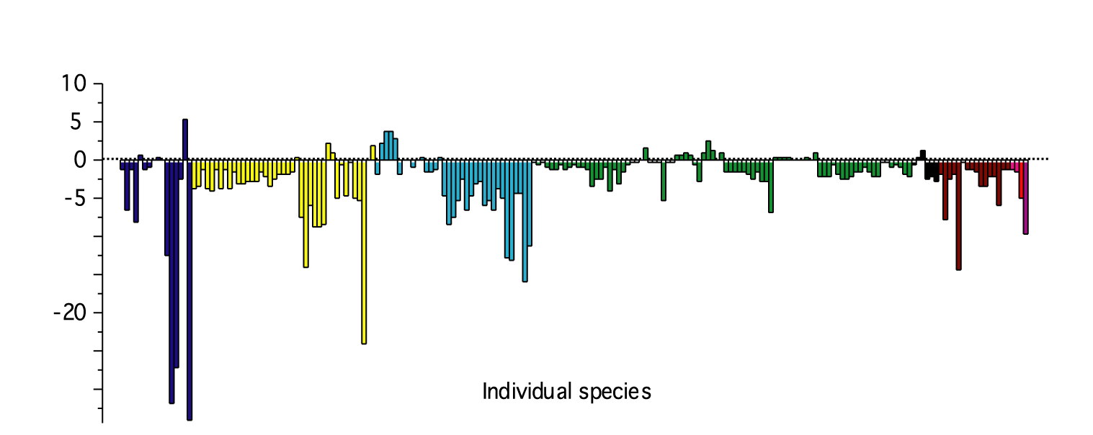
Trends in timing of spring events among northern temperate species
later
amphibian
fish
fly
mammal
bird
butterfly
herbs and grasses
shrub
tree
Average 2.8 days / decade advance
earlier
n = 203 Time span = 17 to 99 years
Parmesan (2007)
Notes:
7
Each bar on the graph represents a different animal or plant species. Bars pointing down below the 0 line indicate earlier spring events. In general, Spring days have been arriving earlier by about three days per decade, especially over the last 30 years.
Different types of organisms are responding in different ways:
Amphibians (frogs, toads, newts & salamanders) breed in the Spring, and are responding 8 times stronger than any of the other groups.
Birds and butterflies are responding three times more strongly than are herbs and grasses. This is of concern to biologists because butterfly larvae (caterpillars) use plants to feed. The possibility of starvation is highly likely if the timing of animal emergence does not coincide with plant emergence. This study showed that butterflies are emerging in spring on average 3.7days/decade earlier over the past 30 years, while herbs and grasses are emerging only 1.0 day/decade earlier in spring – this could cause some butterfly species to get out of sync with their host plants.
Image from: Parmesan (2007) Global Change Biology
References: Parmesan, C (2007). Influence of species, latitudes and methodologies on estimates of phenological response to global warming. Global Change Biology 13:1860-1872.

Slide 8
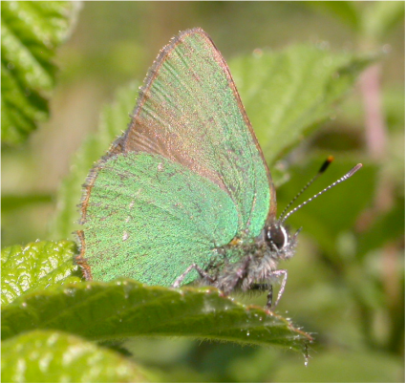
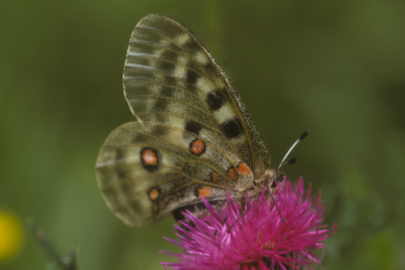
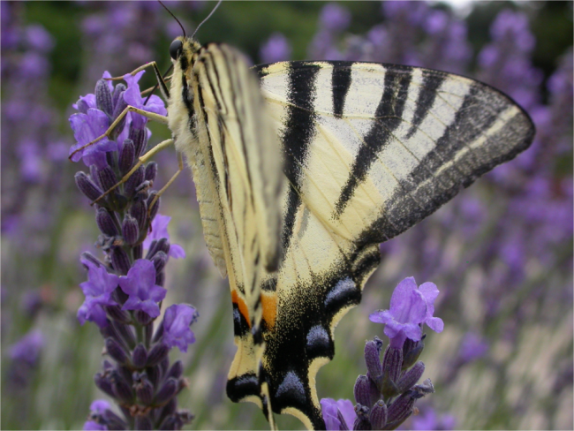
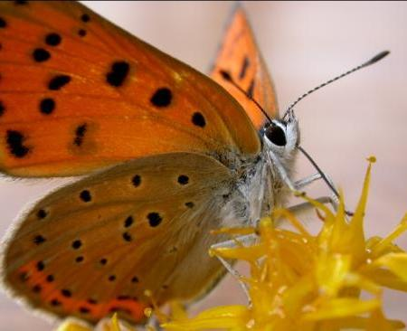
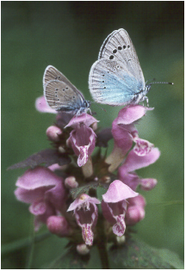
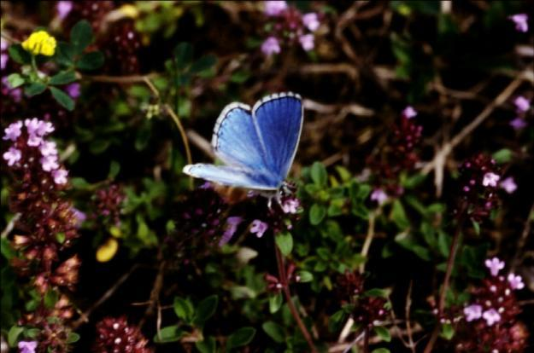
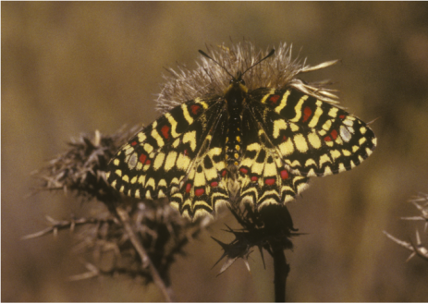
Whole Range Study of 57 Species Across Europe
Parmesan et al. 1999
Notes:
Another big change observed by biologists and naturalists is where species live geographically. Most species live in a very small geographic space – perhaps even a single USA county. As the climate warms, the common response by species is to move towards the poles in latitude, or higher in altitude. Robust data has been collected on butterfly species in European countries – records as far back as 1760 AD – documenting where each species was found in particular years.
Two-thirds of 57 species studied by Professor Parmesan in Europe have expanded their habitat ranges northward 50-300 miles (30-480 km) over the past 30 years. We have had only about a one-degree Fahrenheit (0.7 degree Centigrade) temperature increase over the 20th c, and temperature change is expected to be greater in the coming decades. Many of these butterfly species (about one-third) are also contracting their ranges in southern Europe and northern Africa, as populations in those regions go extinct due to the local climate becoming too extreme for these species to live in.
References: Parmesan, C, N Ryrholm, C Stefanescu, JK Hill, CD Thomas, H Descimon, B Huntley, L Kaila, J Kullberg, T Tammaru, J Tennent, JA Thomas, M Warren (1999). Poleward shift of butterfly species’ ranges associated with regional warming. Nature 399:579-583

Slide 9
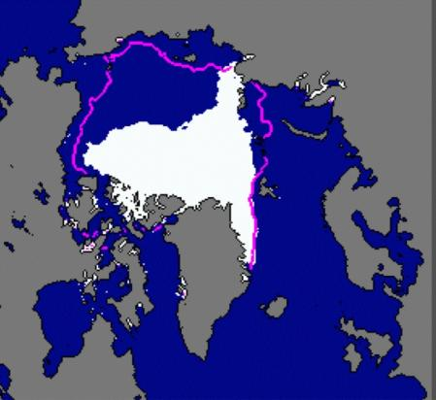
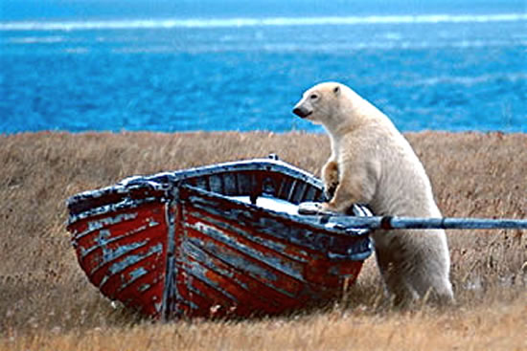
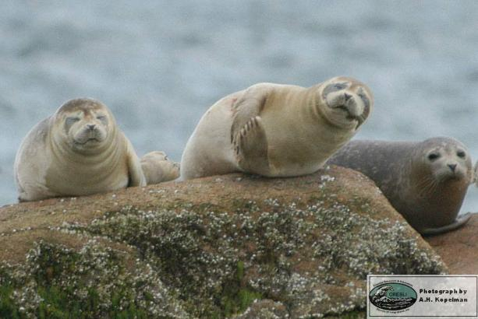
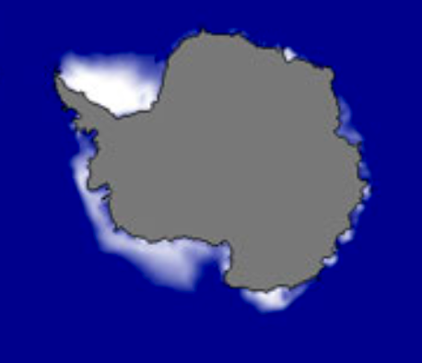
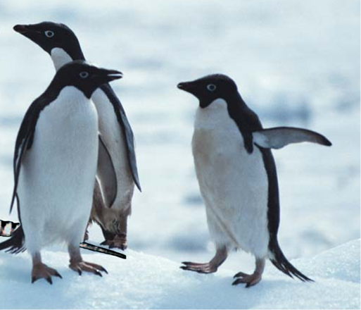
Declines and Range Contractions of Sea Ice-Species in Arctic and Antarctic
2007
NOAA
Ringed Seal
Arctic
2002-2007
NOAA
Ice-dependent
penguins declining
by 70 - 95%
Adelie & Emperor penguins
Ice-dependent
penguins increasing or
smaller declines (<20%)
Antarctic
Smith et al., 1999; Fraser et al., 1992; Emslie et al.,1998
Notes:
9
Biodiversity in northern Europe is increasing in some places, as species move north into countries like Sweden and Finland. However, all species in the coldest areas of the globe, particularly those in the Arctic and Antarctic for whom sea ice is their habitat, are declining as sea ice is retreating, lowering biodiversity. Species that are declining include many ice-dependent seals, sea lions and penguin, as well as the more familiar polar bear.
There have been several record lows in sea ice formations since 2007; the pink line in the top figure (Arctic) represents former ice formation extent. Sea ice formation is not expected to reach former levels (pink line) again.
References:
Smith RC, Ainley D, Kaber K, Domack E, Emslie S, et al. 1999. Marine ecosystem sensitivity to historical climate change in the Antarctic Peninsula. Bioscience 49:393—404;
Fraser WR, Trivelpiece WZ, Ainley DC, Trivelpiece SG. 1992. Increases in Antarctic penguin populations: reduced competition with whales or a loss of sea ice due to environmental warming? Polar Biol. 11:525—3;
Emslie SD, Fraser W, Smith RC, Walker W. 1998. Abandoned penguin colonies and environmental change in the Palmer Station area, Anvers Island, Anatarctic Peninsula. Antarct. Sci. 10:257—68.

Slide 10
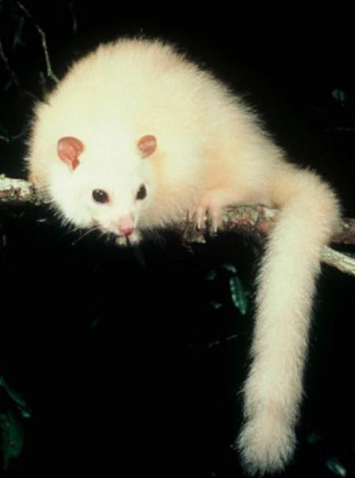
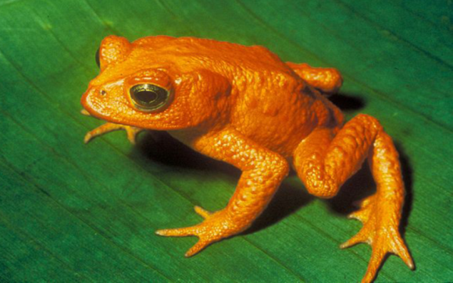
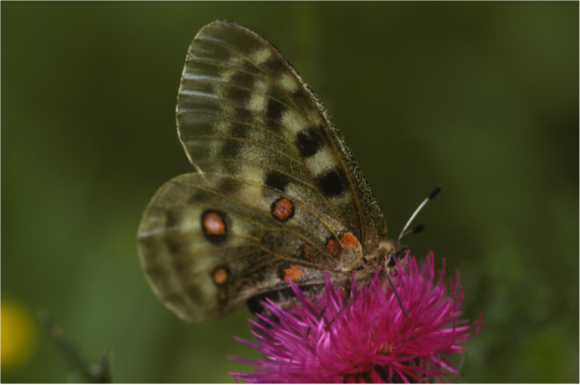
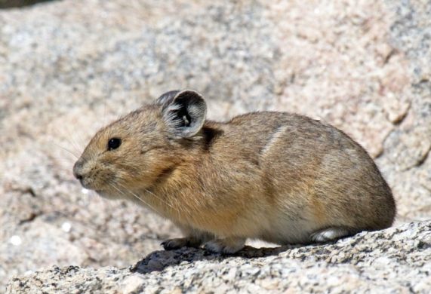
Mountaintop Species
Many species have contracted upward
First extinctions
golden toad, Costa Rica
white lemuroid possum , Australia
pika,
USA & Nepal
apollo, Europe & Nepal
IUCN: 23% amphibians at risk of extinction from climate change (1431 sp)
Parmesan, 2006
Notes:
Australian white lemuroid possum (Hemibelideus lemuroides); Apollo butterfly (Parnassius apollo); American pika (Ochotona princeps), Nepal pika; Golden toad (Bufo periglenes).
Isolated species that only exist on mountaintops (colder/lower temperature habitats) around the world are having a very hard time and are becoming extinct. The golden toad (Bufo periglenes) disappeared about 15 years ago at the same time that cloud forests were experiencing hotter, drier events.
The Australian white lemuroid possum (Hemibelideus lemuroides), an Australian marsupial that lives only in the higher altitude rainforests of far north Queensland, may be the first species of mammal to go extinct because of global warming. This animal resembles a furry, snow-white lemur, with a prehensile tail and large eyes for nocturnal vision, and cannot survive sustained temperatures above 86°F. It has not been observed since a heat wave in 2005 struck the cloud forests of the Mount Lewis forest reserve.
References: Parmesan C (2006) Ecological and evolutionary responses to recent climate change. Annual Reviews of Ecology, Evolution and Systematics, 37, 637–669.

Slide 11
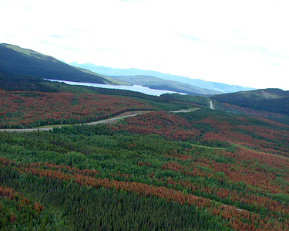
Longer growing season, warm winters & pests
Warmer winters, northward ranges shifts of moths and beetles, and extended growing seasons have resulted in increased pest outbreaks, tree deaths, and associated loss of productivity in forests
Photo: © D.J. Huber
Mountain pine beetle (Colorado, British Columbia)
Spruce bark beetle (3.8 million acres killed in Alaska)
Pine Processionary moth (Italy, France)
Beetles in Siberia
Parmesan & Yohe 2003; Root et al. 2003; Parmesan 2007
IPCC 2001; Logan et al. 2003; Battisti et al. 2005
Notes:
In many regions, much of the yearly warming is occurring in winter instead of summer, especially in North America. This has led to greater winter survival of many pest species, as there are fewer hard freezes to kill them off. Earlier onset of Spring and later onset of Fall also means a longer growing season, allowing many insects to shorten the number of years it takes to develop. Lowered winter die-off and a shorter generation time has lead to many insect forest pests having population booms and killing large numbers of trees.
The spruce bark beetle used to take two years to reach maturity, and now only takes one year to mature. It used to get killed off because it couldn’t survive in the - 40°F temperatures experienced in the interior of Alaska, and would be pushed back to the coasts. It is now a year-round resident in Fairbanks, Alaska and has killed 3.8 million acres of vegetation in the interior of Alaska in one year alone.
The orange colors in this picture are dead trees in a forest in British Columbia, where mountain pine beetles exploded and killed off large swatches of forest..
Aerial image of forest with lakes: D.J. Huber, Flickr account - http://www.flickr.com/photos/dezeneandjoyel/.
References:
Parmesan C, Yohe G (2003) A globally coherent fingerprint of climate change impacts across natural systems. Nature, 421, 37–42.
Parmesan C, (2007) Influences of species, latitudes and methodologies on estimates of phenological response to global warming. Global Change Biology (2007) 13, 1860–1872
Battisti, A., M. Stastny, S. Nether̀er, C. Robinet, A. Schopf, A. Roques, and S. Larsson. 2005. Expansion of Geographic Range in the Pine Processionary Moth Caused by Increased Winter Temperatures. Ecological Applications 15:2084-2096. Retrieved April 15, 2011, .
Root, T. L., J. T. Price, K. R. Hall, S. H. Schneider, C. Rosenzweig, and J. A. Pounds. 2003. Fingerprints of global warming on wild animals and plants. Nature 421: 57-60.
Intergovernmental Panel on Climate Change Third Assessment Report (2001b) Climate Change 2001: Impacts, Adaptation, and Vulnerability (eds McCarthy JJ, Canziani OF, Leary NA, Dokken DJ, White KS), Cambridge University Press, Cambridge, UK.
Logan, J. A., J. Régnière, and J. A. Powell. 2003. Assessing the impacts of global warming on forest pest dynamics. Frontiers in Ecology and the Environment 1:130-137

Slide 12
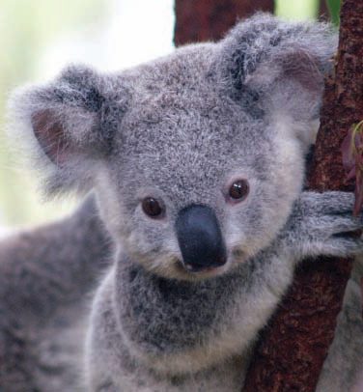
Koalas and climate change
Responses to decreases in plant nutritional value
Iconic Australian marsupial. Both a habitat and a food specialist.
Increased atmospheric CO₂ causes Eucalyptus leaves to be tougher and less nutritious.
Koalas losing weight, likely culprit is malnutrition.
Courtesy: Wendy Foden, International Union for Conservation of Nature
Notes:
Plants take up carbon from carbon dioxide (CO₂). With increasing levels of CO₂, plants are taking in more carbon and encouraging more rugged structural growth, such as woody parts and leaves that are tougher to eat and digest. Increased woody growth depletes other types of available nutrients, resulting in less nutritional value for insects and herbivores. (see reference below)
Koalas only eat a dozen species of Eucalyptus, a strong-smelling plant that is well-defended and of low nutritional value. Koalas also sleep 22 hours a day because the plant takes a lot of energy to digest. The plant is believed to be more difficult for koalas to digest due to increases in CO₂ , causing koalas to lose weight in the wild. There is not much we can do about this.
Reference: PETER S T I L I N G and TATIANA CORNELISSEN (2007). How does elevated carbon dioxide (CO2) affect plant–herbivore interactions? A field experiment and meta-analysis of CO2-mediated changes on plant chemistry and herbivore performance. Global Change Biology 13, 1–20.

Slide 13
Global Coherence of Observed responses to climate change (0.7°C)
~ 52 % of species studied have shifted their ranges poleward (by 50 - 1600 km) and/or upward (by up to 400 m)
~ 62 % of species studied have shifted towards earlier spring breeding, migrating, leafing, blooming, etc.
Every major group studied has been affected - trees, herbs, butterflies, birds, mammals, amphibians, marine corals, invertebrates, fish & plankton
Impacts have occurred on every major continent and in every major ocean
Parmesan & Yohe 2003; Parmesan 2006; IPCC 2007
Notes:
References:
Parmesan C, Yohe G (2003) A globally coherent fingerprint of climate change impacts across natural systems. Nature, 421, 37–42.
Parmesan C (2006) Ecological and evolutionary responses to recent climate change. Annual Reviews of Ecology, Evolution and Systematics, 37, 637–669.
Intergovernmental Panel on Climate Change (IPCC) (2007). Climate Change 2007: Impacts, Adaptation, and Vulnerability, Contribution of Working Group II to the Intergovernmental Panel on Climate Change Fourth Assessment Report. Eds. M.L. Parry, O.F. Canziani, J.P. Palutikof, P.J. van der Linden and C.E. Hanson, Cambridge University Press, Cambridge, UK

Slide 14
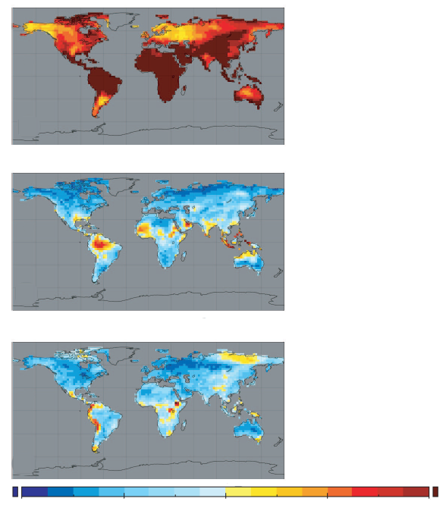
Local Change
Novel Climates
Disappearing Climates
0.22
1.72
3.22
4.72
6.22
Williams et al. 2007
Notes:
Local Change (top image): indicating overall recorded warmer temperatures.
Novel Climates (middle image): taken as a whole, climate is made up of combinations of temperature, precipitation, evaporation, humidity, etc. Areas in red have emerging new climates that have not existed on Earth before, and are happening in areas of high diversity, such as Indonesia, in the Amazon basin, and parts of Africa. Note that even the gulf coast in North America is shown to be one of the areas with a changing climate – one that is becoming something new.
Dissappearing Climates (bottom image): some climate spaces are disappearing completely – in the Arctic and in high mountain regions (Andes, Himalayas, etc.).
Reference: Williams, J. W., S. T. Jackson, and J. E. Kutzbach. 2007. Projected distributions of novel and disappearing climates by 2100 AD. Proceedings of the National Academy of Sciences 104:5738 -5742. doi: 10.1073/pnas.0606292104.

Slide 15
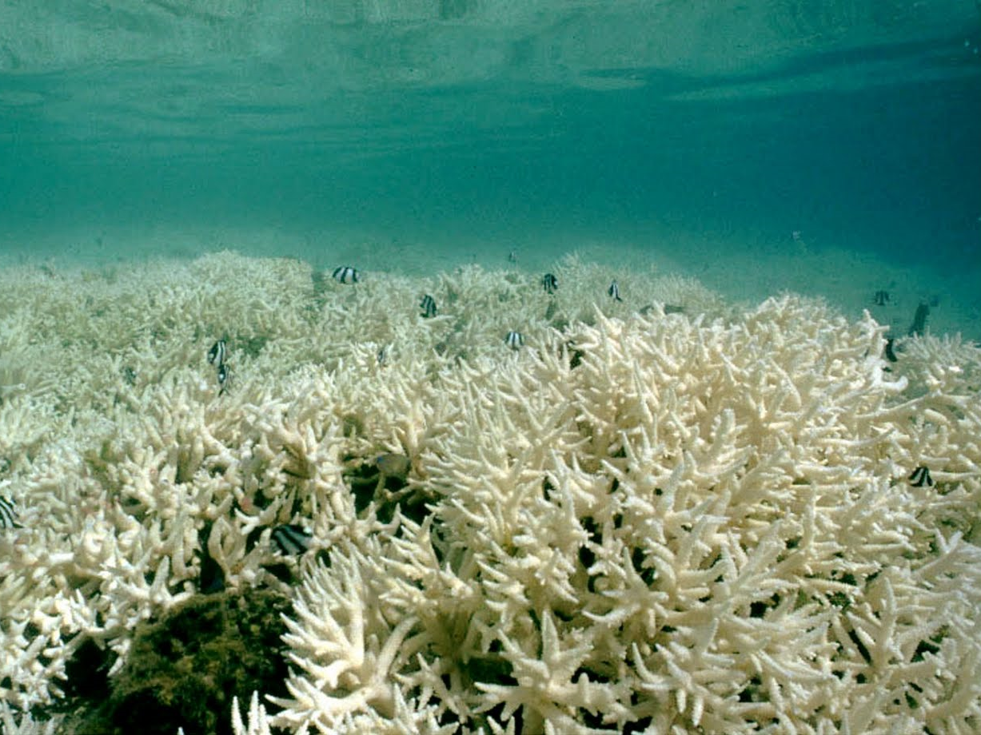
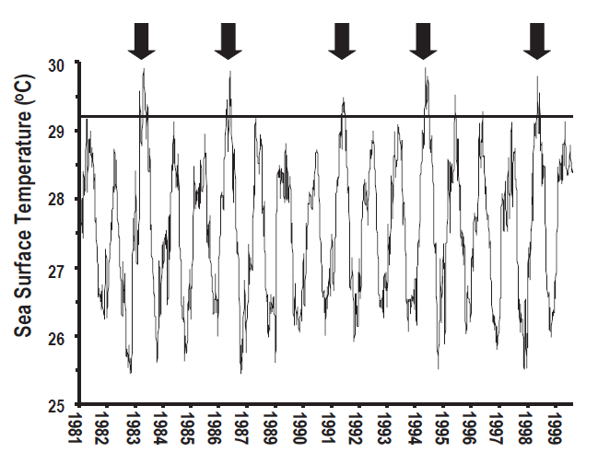
Exceeding sea surface temperature thresholds (SST) causes bleaching
Hoegh-guldberg Marine Freshwater Research 1999
~30 % of world’s coral reefs have disappeared after multiple extreme SST events
Stressed reefs - lower recovery after bleaching
How much would we have lost if all reefs had been healthy?
Notes:
Here is some hopeful information:
Corals are very sensitive to sea surface temperature (SST). SST does go up and down seasonally. This image is of a reef in Tahiti. (Upper left image) This graph depicts SST (on the y-axis) over time (the x-axis). The big black arrows indicate bleaching events that occur with high sea surface temperatures, i.e. temperatures above the threshold for this reef (shown as a solid line aroung 29.2 degrees C). Some reefs are very disturbed and degraded, especially with fisherman and diver disturbances, pollution, etc. However some reefs are still pristine and untouched by humans. All reefs bleach; the difference is that healthy reefs recover better compared to unhealthy reefs. With effective laws, education and conservation policies, restricting tourists and pollution and stopping dynamite fishing will help reefs become healthier. Conservation methods are important and can work toward sustaining coral reefs.
Reference: Hoegh-Guldberg, Ove (1999) . Climate change, coral bleaching and the future of the world's coral reefs. Marine and Freshwater Research 50 , 839–866.

Slide 16
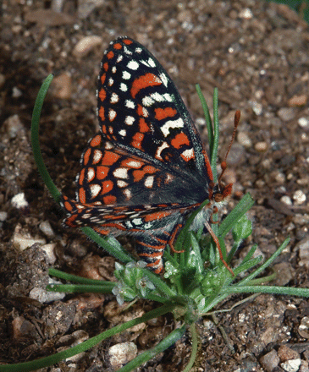
Endangered species
Bay checkerspot
(E.e. bayensis)
San Francisco Bay
Serpentine outcrops
Annual host plant Plantago erecta
Notes:
The plant in this picture (Plantago erecta) is a fully mature plant, and therefore as large as it will ever become. In the photo you can see the Bay Checkerspot (Euphydryas editha bayensis) butterfly laying her eggs on the plant that is smaller than she is. You have to have a really healthy habitat in order to have this species of butterfly present, as this butterfly species will need a lot of these plants for her offspring as a food resource.

Slide 17
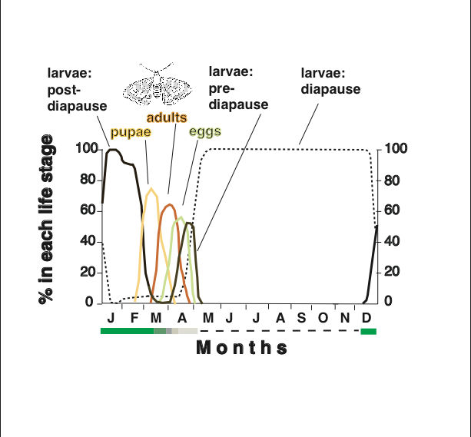
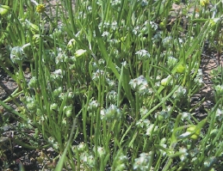
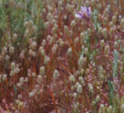
The life of Edith’s Checkerspot butterflies
Plant edibility
months
Notes:
This image shows the life cycle of a butterfly over the whole year. Notice that all active life stages of Edith’s Checkerspot (Euphydryas editha) are squeezed into one small quarter of the year (late January to mid-March). The rest of the year the caterpillar undergoes diapause, which is a period of suspended development (like hibernation, only for much longer – 9 months of late spring, summer, fall and early winter). Adults only live a couple of weeks while the plants are green; the adult female lay their eggs during this period. The plants begin to dry up while the eggs are developing, and then dry up when the caterpillars hatch. Plant edibility is shown at different seasons, with green being a living, healthy plant, dark grey depicting when some plants are starting to dry up, and pale grey showing when all individuals of this annual plant have died. Statistically, an estimated 95% of the caterpillars are killed because the plants they are on dry up. This is a normal cycle that is a result of complex evolution. The next slide discusses the effects of climate change on this system.

Slide 18
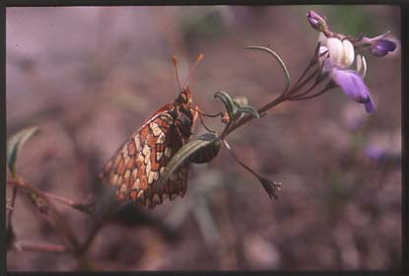
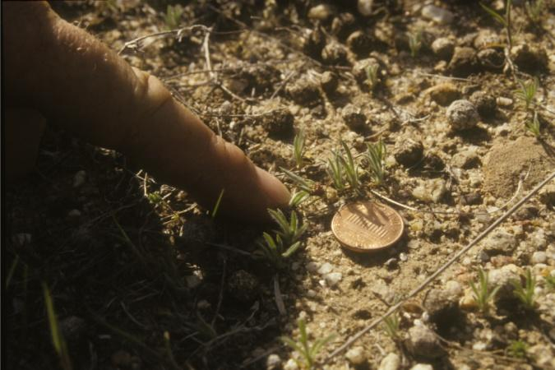
Changes in spring timing driving range shift in Edith’s Checkerspot (Euphydryas editha)
----- Warming Increases Asynchrony
2° C experimental warming increases timing mismatch (3 independent field experiments)
Host plants dry up 3-7 days earlier
caterpillars starve
‘normal’ 90-95% mortality goes to 100%
whole populations go extinct
Singer 1972; Parmesan 1996; Weiss et al. 1988, 1993; Boughton et al. 1999; Hellman et al. 2004
Notes:
Due to climate variability in the butterflies’ habitats, the host plant is drying up too quickly, so that instead of 95% (normal) of the caterpillars dying before reaching maturity, 100% of the caterpillars are not surviving and populations are going extinct.
References:
Singer MC (1972) Complex components of habitat suitability within a butterfly colony. Science, 173, 75–77.
Parmesan C (1996) Climate and species range. Nature, 382,765–766.
Hellmann, J. J., Weiss, S. B. McLaughlin, J. F. et al. 2004. Structure and dynamics of Euphydryas editha populations. In: On the wings of Checkerspots: a model system for population biology (eds. P.R. Ehrlich & I. Hanski), pp 34-62. Oxford: Oxford University Press.
Boughton, D. A. 1999. Empirical evidence for complex source-sink dynamics with alternative states in a butterfly metapopulation. Ecology 80, 2727-2739.
Weiss, S. B., Murphy, D. D., Ehrlich, P. R. & Metzler, C. F.. 1993. Adult emergence phenology in checkerspot butterflies – the effects of macroclimate, topoclimate and population history. Oecologia 96, 261-270
Weiss, S. B., Murphy, D. D. & White, R. R. 1988. Sun, slope and butterflies: topographic determinants of habitat quality for Euphydryas editha. Ecology 69, 1486-1496.

Slide 19
Extinction of Bay Checkerspot in a Preserve
Global warming
Beginning in 1971: Rainfall increased in variability.
1998: Jasper Ridge at Stanford (JR) populations go extinct
Habitat loss
1960s & 70s: Massive habitat loss caused many populations to go extinct. JR becomes isolated.
Nitrogen rain
1980s & 90s: N-fertilization allows invasive plants to spread into butterfly habitat. Preserved areas degraded.
Last nail in coffin was climate change, but population already in poor health and no other populations around to ‘rescue’ it
Harrison et al. 1988; Weiss 1999; McLaughlin et al. 2002
Notes:
Jasper Ridge hosts habitat that is a completely preserved/ in an isolated area. When an area and associated plants and animals become isolated, they cannot get help/ cannot be colonized from neighboring species emigrating into new habitats.
Environmental stress recorded at Jasper Ridge (1980’s and 1990’s): Automobile exhaust causes an increase in nitrogen in the air. When rain flows through that air, the ground below is fertilized with excess nitrogen, providing an opportunity for invasive plants to spread into the habitat. This means there are less of the butterflies’ host plants in the area; the invasive plants are outcompeting the host plants for space.
Higher butterfly mortality is associated with plant loss; remember that populations of this butterflies host plant needs to be fairly robust/dense for species survival.
Conclusion: combined with habitat loss and degradation due to pollution, climate change was the “last nail in the coffin” leading to population extinction in 1998 at Jasper Ridge.
References:
Harrison, S., Murphy, D. D. & Ehrlich, P. R. 1988. Distribution of the Bay Checkerspot butterfly, Euphydryas editha bayensis. Evidence for a metapopulation model. Am Nat 132, 360-382.
STUART B. WEISS (1999). Cars, Cows, and Checkerspot Butterflies: Nitrogen Deposition and Management of Nutrient-Poor Grasslands for a Threatened Species. Conservation Biology, 13(6); 1476–1486
McLaughlin JF, Hellman J, Boggs CL, Ehrlich PR (2002) Climate change hastens population extinctions. Proceedings of the National Academy of Sciences USA, 99, 6070–6074.

Slide 20
Complexity and Conservation
Ultimately, impacts of anthropogenic climate change depend on:
current health of the population
specific species or system (how sensitive is it?)
environmental context (what else is going on?)
Moral?
Think globally about what climate change means for your region
Act locally to reduce stressors and improve species’ or systems’ health
Parmesan et al. 2011
Notes:
Ultimately, impacts of “human induced” climate change depend on:
current health of the population
the sensitivity of the species to climatic change
the environmental context; other dependant factors
Moral: Think globally about what climate change means for your region. Act locally to reduce stressors and improve species’ or system health
Reference: Parmesan, C, C Duarte, E Poloczanska, AJ Richardson, MC Singer (2011). Overstretching attribution. Nature Climate Change 1:2-4.

Slide 21
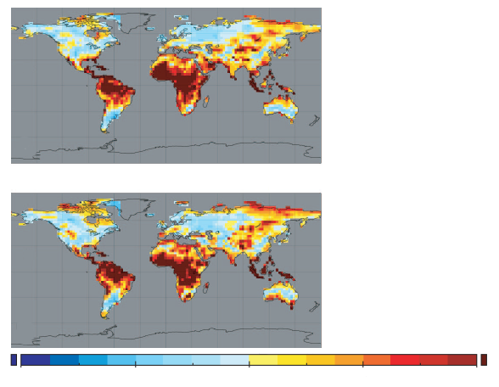
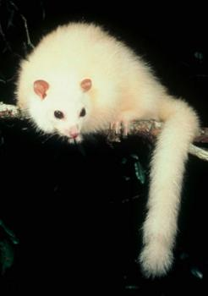
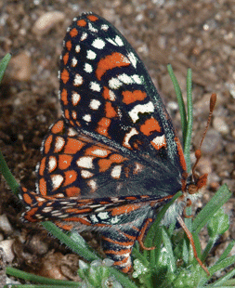
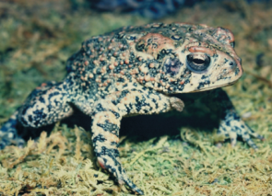
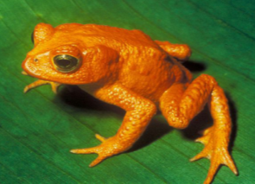
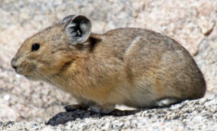
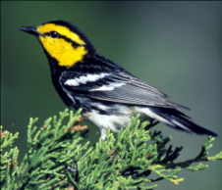
Novel and Disappearing climates by 2100 - calculated within 500 km
Novel Climates
Disappearing Climates
0.22
1.72
3.22
4.72
6.22
Williams et al. 2007
Notes:
21
Species aren’t distributed globally and instead live in relatively small areas. They are limited in the amount / how much they can move. If we look at spaces within 500 kilometers (~350 miles), which is how far a species can realistically move, many more areas of species are going to be experiencing disappearance of the climates they are adapted to and can live in. Species that are already rare and endemic (ie ones that only live in a very small geographic area and are already rare) will struggle with having some place available to move to. Moving from one mountaintop to another could be difficult.
Williams JW et al 2007 PNAS 104(14): 5738-5742

Slide 22
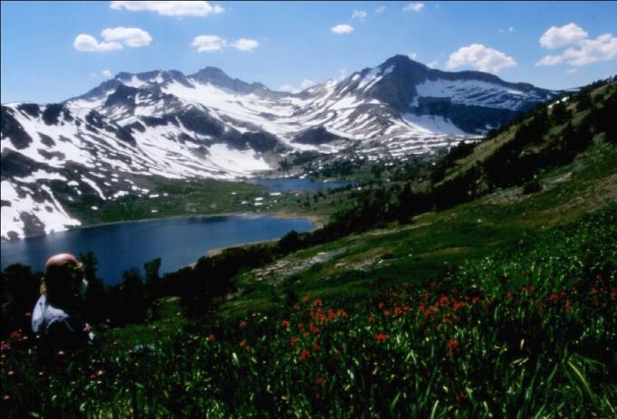
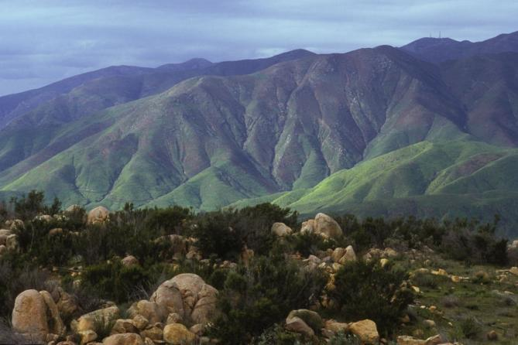
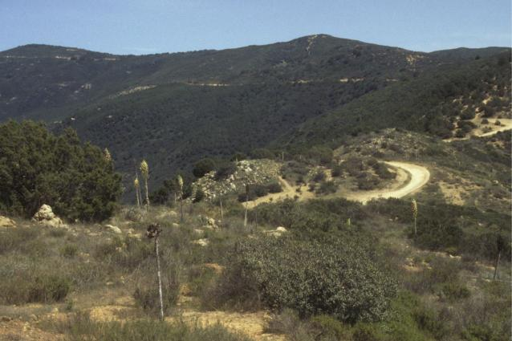
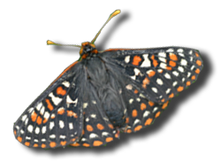
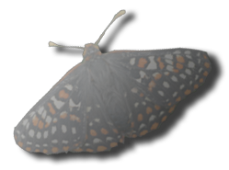
Assisted Colonization
Notes:
Assisted colonization, Also called “assisted migration” or “assisted translocation”: The idea is to take a species, such as the endangered quinoCheckered butterfly pictured (Euphydryas editha quino), and help it to move from it’s original habitat where there are no healthy populations to higher elevations, or another mountain range further north. This is controversial because it is moving the species to a place it has never lived. The quino checkerspot butterfly depicted here is rapidly getting to the point of having its only healthy populations now being outside its historic range at higher elevations.
Preserving areas that are predicted to have appropriate climate and habitat for endangered species need to be protected so that animals can move naturally into that range if need be.
References: Hoegh-Guldberg, O., Hughes, L, McIntyre, S., L., Lindenmayer, D.B., Parmesan, C., Possingham, H. P., Thomas, C.D (2008). Assisted colonization and rapid climate change. Science 321:345-346.
22

Slide 23
Assisted Colonization? A Decision Framework
Decisions
Options
Low
1
Continue and improve conventional conservation approaches.
1
Is there a high risk of decline or extinction under climate change?
Moderate
(i) Improve landscape connectivity in required direction of colonization; (ii) genetically enhance to improve climate robustness of populations within existing geographic range; and (iii) reduce local stressors on population.
High
2
2
Are translocation and establishment of species technically possible?
No
Invoke ex situ conservation practices (eg. store eggs/sperm/seed).
3
No
Yes
Is it possible to create habitat (eg. Artificial reef, wetlands) at higher latitudes to accommodate “natural” movement?
4
Do benefits of translocation outweigh the biological and socioeconomic costs and constraints?
No
Yes
3
Will the organisms arrive on their own to a new habitat?
No
Yes
Yes
5
Wait and facilitate establishment (protect organisms as they arrive).
Go to options 2 and 3.
6
Undertake translocation (assisted migration).
Hoegh-Guldberg et al. 2008
Notes:
Assisted colonization is a radical concept because conservation biologists have worked against invasive species for five decades. Typically, invasive species lower biodiversity when they establish robust populations in an ecosystem.
This decision tree provides options to review when considering assisted colonization as a strategy.
References: Hoegh-Guldberg, O., Hughes, L, McIntyre, S., L., Lindenmayer, D.B., Parmesan, C., Possingham, H. P., Thomas, C.D (2008). Assisted colonization and rapid climate change. Science 321:345-346.

Slide 24
Best Candidates for Assisted Colonization / Migration /Translocation
High risk of extinction if nothing done
Low probability of doing harm to recipient community
NOT a predator / parasite
Relatively poor competitor
non-aggressive (behavior or growth)
Resource specialist
Easy & cheap to capture, culture & move
High inherent biological or societal value
Hoegh-Guldberg et al. 2008
Notes:
Criteria to assist in determining “best candidates” when considering assisted colonization.
There are not many species that will fit this criteria. Specific butterfly species can be a considered to meet all or most of this criteria.
Assisted colonization is already being done with fish in Great Britain and even with corals in coral reefs.
References: Hoegh-Guldberg, O., Hughes, L, McIntyre, S., L., Lindenmayer, D.B., Parmesan, C., Possingham, H. P., Thomas, C.D (2008). Assisted colonization and rapid climate change. Science 321:345-346.

Slide 25
Notes:
(movie of Edith’s Checkerspot laying eggs on host plant. –LRS)
This butterfly species (Edith’s Checkerspot; Euphydryas editha) does not care if a human touches her and moves her to a new plant; she is manipulated by humans quite easily. This video shows a female being placed onto her host plant, she tastes the plant (with her two front feet) and likes it, she ignores the human, and she then lays an egg on the plant. Only a few individuals need to be moved to start a new butterfly population in the wild.

Slide 26
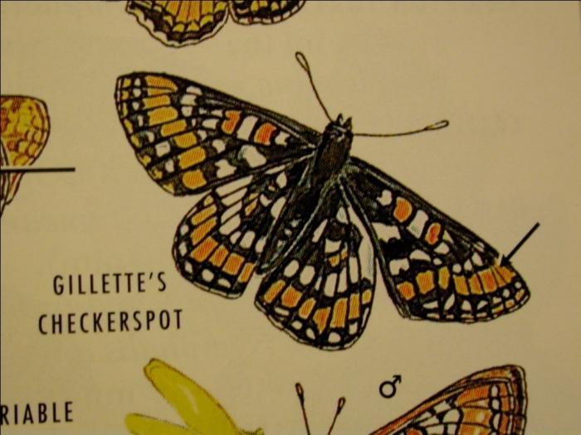
Euphydryas gilletti:
successful ‘assisted colonization’
In 1977, Ehrlich moved from native Wyoming to outside of range in Colorado
Same climate, same host plant (honeysuckle)
Established with few egg clusters
No recorded negative impacts on native ecosystem
Range has been contracting northward and upward
Boggs et al. 2006; Ernest Williams unpublished
Notes:
Successful assisted colonization: A population of Gillette’s Checkerspot (Euphydryas gilletti) that was originally dispersal limited has undergone translocation and has recorded healthy populations since 1977. Currently, Gillete’s Checkerspot species in the original southern populations are being affected by climate change and are going extinct rapidly.
Reference: CAROL L. BOGGS, CHERYL E. HOLDREN, IPEK G. KULAHCI, TIMOTHY C. BONEBRAKE, BRIAN D. INOUYE, JOHN P. FAY, ANN MCMILLAN, ERNEST H. WILLIAMS and PAUL R. EHRLICH (2006). Delayed population explosion of an introduced butterfly. Journal of Animal
Ecology 75 , 466–475

Slide 27
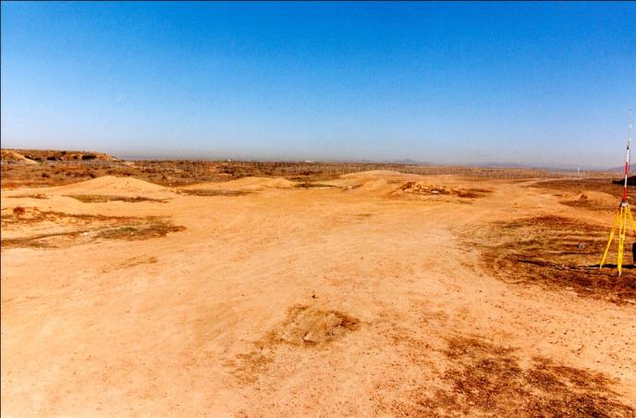
Restoration of Vernal Pool Habitats in California
USFWS & Recon Environmental Inc.
Year 0; project start
Year 1
Landscape topography molded (shallow depression created)
Appropriate soils brought in (clay lens)
Water storage, filtration & flow altered
Photos: Mark Dodero
Notes:
What other tools besides assisted colonization do we have as conservation biologists? Landscape restoration.
The land on the left was destroyed by all terrain vehicles (ATV’s). A biologist went in to restore vernal pools. Vernal pools are areas that hold winter rains, providing water into the dry Californian springtime. These winter pools house a lot of endangered species. The hole had to be dug, lined with clay soil to hold water, native plants had to be planted by hand, and then invasive species weeded out the next year. Three years later, the vernal pool ecosystem is home to 5 endangered species.

Slide 28
YEAR 3
Self-sustaining
Occasional weeding needed to keep out exotics
Habitat for 5 endangered vernal pool species
Cost: $ 1m/acre
Notes:
Restoring habitat in wildlife corridors help species to shift their ranges naturally, moving poleward and upward in elevation to track a shifting climate.

Slide 29
Native systems store more carbon than degraded systems
~ 1/6 global CO² from degradation /destruction
Native tropical lowland rainforest
406 tons C/hectare
Native sea grass 710 tons C/hectare
Mahli & Grace 2000; H. Joosten COP15
Notes:
Natural ecosystems store a lot more carbon than artificial, agricultural or degraded ecosystems. A hectare is about 2 acres.
Reference: Mahli & Grace 2000; H. Joosten COP15

Slide 30
Native systems store more carbon than degraded systems
~ 1/6 global CO₂ from degradation /destruction
Peatlands
7x-10x C-storage of other ecosystems
Native
Little bluestem
Native bunchgrasses
Deep Root system
C-storage (by 52%)
Water storage
Resistance to drought and heat waves
Nutritional value
10 ft
Mahaney WM et al 2008 Oecologia 157:295-305.H. Joosten COP15
Notes:
Peatlands store 7-10 times the carbon as any other ecosystem. Peatlands have been degraded and depleted by draining for human development or for burning as fuel. Restoration of peatlands can occur fairly rapidly by discontinuing water draining and development. Just put the water back, and they will recover!
Native prairie ecosystems in the continental United States: huge rootmasses of native bunchgrasses (~10 feet deep), store an estimated + 50% carbon than shallow rooted grasses, specifically non-native grasses. Challenge: when land is heavily disturbed and cleared, the soil is exposed, the plant matter decomposes and carbon is released. Large scale restoration would help store excess carbon out of the atmosphere.
References:
Mahaney WM et al 2008 Oecologia 157:295-305.

Slide 31
Full carbon budget shows prairie carbon-neutral Conversion of lands to biofuel production
Fargione et al. 2008 Science
Emission of carbon from soil
Loss of carbon above ground
Indonesia
Brazil
USA
Notes:
The top portion of the graph shows the amount of carbon lost by plowing up grassland or cutting down trees. From the bottom portion of the graph, it shows that it can take more than 400 years to repay the carbon debt from palm biodiesel production grown in a former peatland rainforest ecosystem.
An example: if you cropland / crop production in Illinois were abandoned, one would immediately begin to see carbon sequestration. Planting corn for ethanol production continues to sustain a carbon debt, emitting more carbon into the atmosphere. It can take approx. 50 years to revert to a “zero carbon debt”.
What kind of crop is truly carbon neutral regarding biofuel production? Native grasses found and cultivated on the great American prairie, like prairie found in Minnesota. This would be a great restoration project. And it can still function as grazing pasture.
Reference: Joseph Fargione, Jason Hill, David Tilman, Stephen Polasky, Peter Hawthorne (2008). Land Clearing and the Biofuel Carbon Debt. Science 319:235

Slide 32
Restoration of Native American Prairie
Better adapted to climate extremes than invasives
Creates corridors - helps biodiversity cope with rapid shifts in climate
Helps mitigate climate change
Native bunchgrasses
Deep Root system
C-storage (by 52%)
Water storage
Resistance to drought and heat waves
Nutritional value
Adapted to grazing
Only carbon-neutral biofuel
Franzluebbers 2005; Fargione et al. 2008; Poteet unpublished
Notes:
Most of the cost of restoration is for labor.
Community projects with volunteer labor could be the solution – communities helping with planting and weeding.

Slide 33
Society for Ecological Restoration International Primer on ER (2004):
“Restoration attempts to return an ecosystem to its historic trajectory.”
A reference system expresses “one of many potential states that fall within the historic range of variation of that ecosystem.”
Material for seeding/planting/colonizing should come from genetically similar, or geographically close populations

Slide 34
Pinyon Pine Die-Offs after Drought + Heat Wave + Beetles
Restoration?
12,000 sq km area
40% - 90% of trees died
Photo: Craig Allen (USGS)
Notes:
One very hot and very dry summer, when the trees were already stressed, allowed the beetles to destroy the trees. With climate predictions indicating that the climate will remain hot and dry in Southwestern North America, and only become hotter and drier, would you want to restore the area by planting more Pinyon Pines that are stressed by the hotter and drier weather in just one summer?

Slide 35
Global changes in set of climates available for species to inhabit 4 - 48 % area loss of existing climate 4 - 39 % area gains of novel climate
Restoration Creation
Existing communities no longer stable due to different responses to changed and novel climates
A new goal? - maximize specific services, e.g. carbon sequestration - Re the “Blue Carbon” initiative
Calls for flexible conservation approaches
Notes:
Calls for flexibility and creativity, but for more science than we know right now at this point.

Slide 36
Changes in temperature and precipitation by 2099
21 global climate models
A1B emission scenario (less than current emissions)
Notes:
What we have done over the last 10 years in emissions has exceeded the worst levels that were projected 10 years ago. Notice that in all of the 21 models on the left, none predict that Texas will be any cooler. It might get a little warmer or a lot warmer. Only a couple of models predict a little more rainfall for Texas, but most predict a decrease in rainfall. If we plan on Texas being drier and hotter, we will do better than if we plan on being the same or becoming cooler or wetter.
From IPCC 2007, WGI, Chapter 11 “Regional Climate Models”, supplementary information.
Left hand figure: Figure S11.8. The annual mean temperature response in North America in 21 MMD models. Shown is the temperature change from the years 1980-1999 to 2080-2099 under the A1B scenario, averaging over all available realizations for each model. The change averaged over all models is shown in the lower right hand corner.
Right hand figure: Figure S11.16. The annual mean precipitation response in North America in 21 MMD models. Shown is the per cent change in precipitation from the years 1980-1999 to 2080-2099 under the A1B scenario, averaging over all available realizations for each model. Brown indicates a reduction in precipitation and green an increase. The per cent change in the precipitation averaged over all models is shown in the lower right hand corner.

Slide 37
Diversity of European meadows driven by traditional human management
Notes:
These are not traditional views for conservation biology and represent out-of-the-box thinking. These ideas receive stronger reaction from audiences in the United States than they do in Europe because western Europe has no wilderness anymore. Every space is managed in one form or another, yet there exists incredible biodiversity. While unthinking, extreme management can destroy biodiversity, smart management developed in the context of the plant and animal’s own evolutionary histories can enhance biodiversity.

Slide 38
Notes:
These lands in western Europe have been managed for thousands of years. If you don’t manage these lands using traditional methods (like roaming sheep herds and mowing for hay once a year), you will lose biodiversity. Strong management is not opposed to biodiversity. You can have both if done appropriately. If, however, you attempt to use modern management methods, like building fences and forcing sheep to eat in only one place, or adding fertilizer to the meadows to try to boost productivity of hay production, you then destroy biodiversity and are left with just a few species of hardy plants.

Slide 39
Problem: Species’ Forced Out of Traditional Homelands and Protected Areas
Solutions:
Assisted Colonization
Restoration to create habitat corridors & improve C-sequestration
Creation of new habitats adapted to future climate
Impediments: Conservation laws & tools focus on return to historic state
Hoegh-Guldberg et al. 2008
Notes:
Our main impediment is our mindset.

Slide 40
Acknowledgements
General support and funding: University of Texas, The Marine Biological Association of UK, The University of Plymouth Marine Institute, Aspen Global Change Institute, Department of Energy, National Science Foundation.
Material and Images partly from: * Environmental Sciences Institute, University of Texas * United Nations Intergovernmental Panel on Climate Change * NASA / NCDC / NOAA
* U.S. Fish and Wildlife Service
* Stephen Brueggerhoff, Eric James (animations & graphics) * Kristina Schlegel (title page art)
Notes:
Acknowledgements: Much of the material for this slide presentation was prepared by the Union of Concerned Scientists (UCS). UCS is a nonprofit partnership of scientists and citizens combining rigorous scientific analysis, innovative policy development and effective citizen advocacy to achieve practical environmental solutions. UCS website: http://www.ucsusa.org.
Many of the facts and projections of the future presented here come from the following:
The Intergovernmental Panel on Climate Change, Third Assessment Report (TAR), published over the course of 2001. IPCC website: http://www.ipcc.ch.
Working Group I - science of the climate system
Working Group II - impacts and adaptation
Working Group III - mitigation options
Climate Change Impacts on the United States: the Potential Consequences of Climate Variability and Change, 2000, U.S. National Assessment Synthesis Team, U.S. Global Change Research Program. USGCRP website: http://www.globalchange.gov.
Climate Change and Texas, 1997, Environmental Protection Agency. EPA website: http://www.epa.gov/climatechange/index.html.
The following were extremely helpful in putting this presentation together:
Environmental Science Institute, University of Texas
Nelson Guda
Kristina Schlegel
** The material in this presentation and notes is for educational use only. No part may be duplicated or sold.

Slide 41
Dr. Camille Parmesan
Professor Camille Parmesan is a Professor of Ecology, Behavior and Conservation in the Section of Integrative Biology at the University of Texas. In addition, Parmesan is a member of the Intergovernmental Panel on Climate Change, an international body of highly respected scientists chosen to report to the world governments on the subject of climate change. Parmesan has given seminars in DC for the White House, government agencies, and NGOs (e.g., International Union for Conservation of Nature and World Wildlife Fund). As a lead author, she was involved in multiple aspects of the Third Assessment Report of the IPCC.

