Slide 1
Remarkable Creatures
# 66
Dr. Sean B. Carroll
April 30, 2010
Produced by and for Hot Science - Cool Talks by the Environmental Science Institute. We request that the use of these materials include an acknowledgement of the presenter and Hot Science - Cool Talks by the Environmental Science Institute at UT Austin. We hope you find these materials educational and enjoyable.

Slide 2
Notes:
Thank you
I hope that short film put you in the mood for some adventure..
The search for the origins of species, both in general and of specific kinds of creatures, has entailed a series of truly epic adventures over the past 200 years.
I have had a great time chronicling those stories in my new book
Tonight, I want to share with you some of those adventures and to celebrate the explorers who undertook them

Slide 3
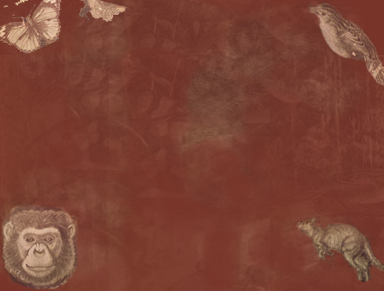
Adventure:
“A mixture of spirit and deed”
- C.W. Ceram
Notes:
I think Author C.W. Ceram described adventure best -- as “a mixture of spirit and deed.” My hope is that you will be inspired by their spirit and take away a greater appreciation for the magnitude of their deeds.
Throughout the past year, the world marked the achievements of Charles Darwin, our greatest naturalist and the leader of a far-reaching scientific revolution. My talk tonight is, in part, a continuation of that party, but my agenda is a bit broader than that. Darwin’s great voyage and works are well known and rightly so.
SLIDE

Slide 4
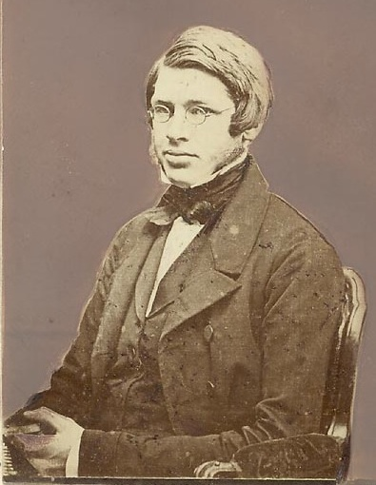
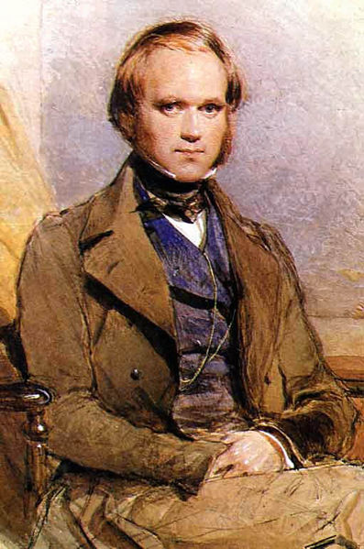
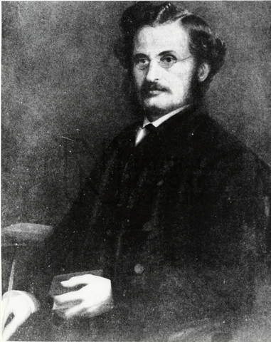
Alfred Wallace
Charles Darwin
Henry Walter Bates
Amazon 1848-1852
Malay Archipelago 1854-1862
Around the world 1831-1836
Amazon 1848-1859
Notes:
But the making of the theory of evolution and its early growth and acceptance also owe a considerable debt to two other men CLK, Alfred Wallace and Henry Walter Bates, who undertook even longer voyages under yet more difficult conditions. CLK
The three men had a lot in common (young men, eager to escape gray drab England for the glories of the Tropics) –they were prodigious collectors. I suspect they had some form of OCD (obsessive collecting disorder) for they grabbed, pinned, or pickled just about every bug, bird or other critter they spied. Most importantly, as collectors, they developed an appreciation for the variety each species exhibited From this very hard-earned knowledge, they evolved from collectors into scientists, who asked not just what creatures existed in a given place but how they came to be, and these questions led each man to unique discoveries

Slide 5
The first golden age :
The Making of a Theory
Notes:
In the first part of my talk, to understand how the theory of evolution by natural selection was born and how it gained traction, we’re going to walk in the shoes of these three pioneers – and see how the creatures they encountered led them to their respective insights. Their voyages and discoveries mark the first golden age of evolutionary biology
.
Then, In the last part of my talk, I will briefly explain why I believe we are presently in a second golden age of evolutionary biology.

Slide 6
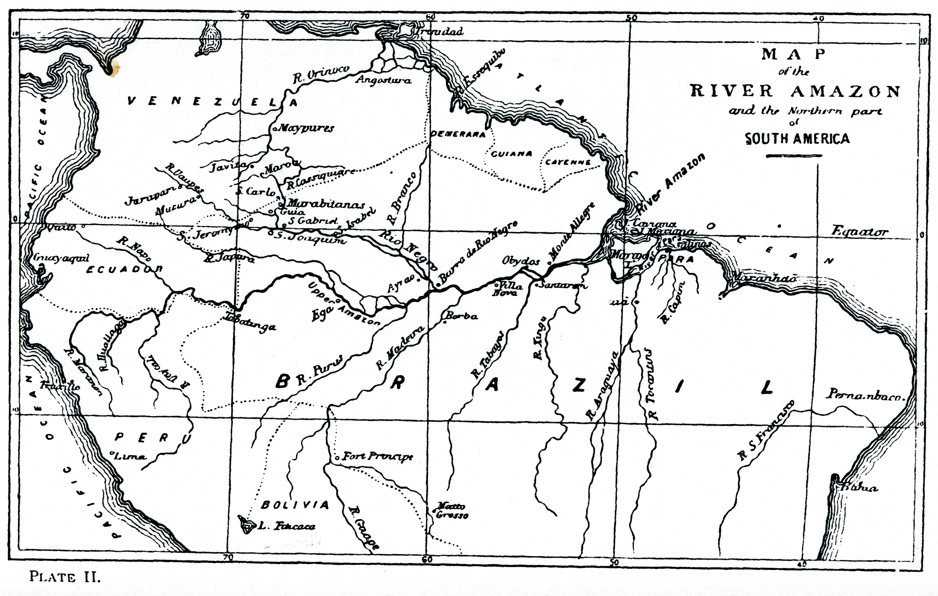
1852
1848
Alfred Russel Wallace (c. 1848)
Notes:
No one’s adventures better fit that description of spirit and deed than Alfred Wallace’s - my tales begin with Wallace in the Amazon jungle …CLK
Wallace had several purposes in exploring the Amazon– in 1847 he proposed to his friend and fellow collector Henry Walter Bates that they go to there :
- to explore the Natural History- hated their day jobs - broke
- make a collection for themselves-sell the duplicates
- and to “gather facts towards solving the problem of the origin of species”
It was a problem on many minds IMMUTABLE - SPECIALLY CREATED BY GOD OR CHANGEABLE, THE PRODUCT OF NATURAL LAWS ? CLK
Voyaged up the Rio Negro further than any European had ever gone
By 1852 he had had enough.

Slide 7
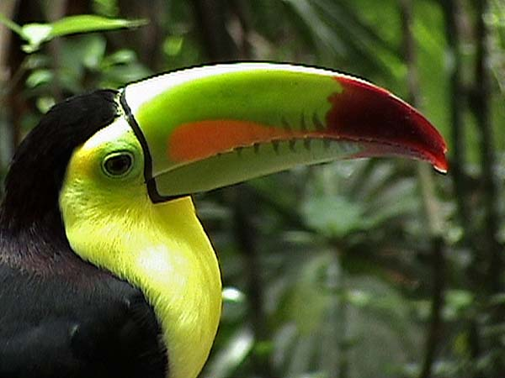
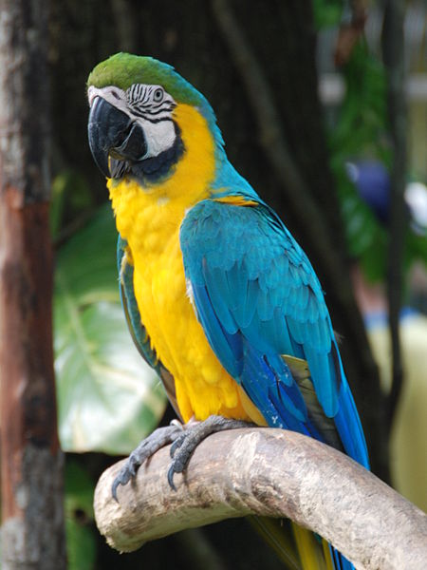
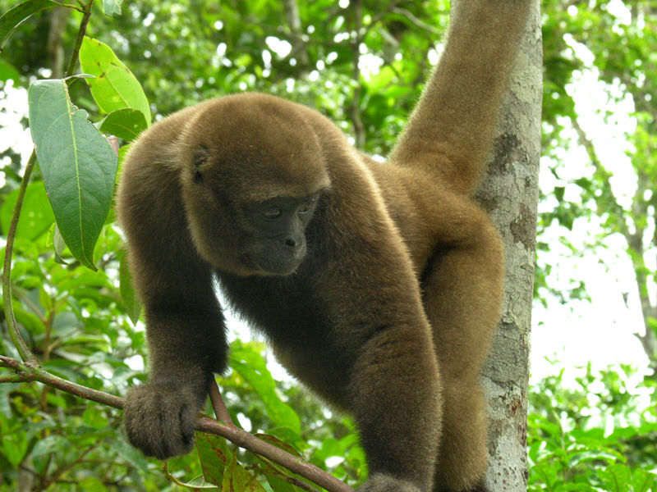
Notes:
In addition to thousands of preserved specimens, he wanted to bring back live animals for the London Zoo. Their upkeep was killing him.
He boarded the brig Helen and sailed for home
What happened next ? Well, Wallace tells his story in this letter to a friend

Slide 8
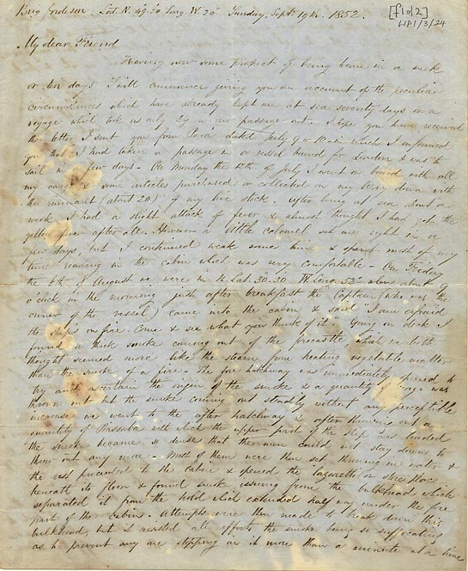
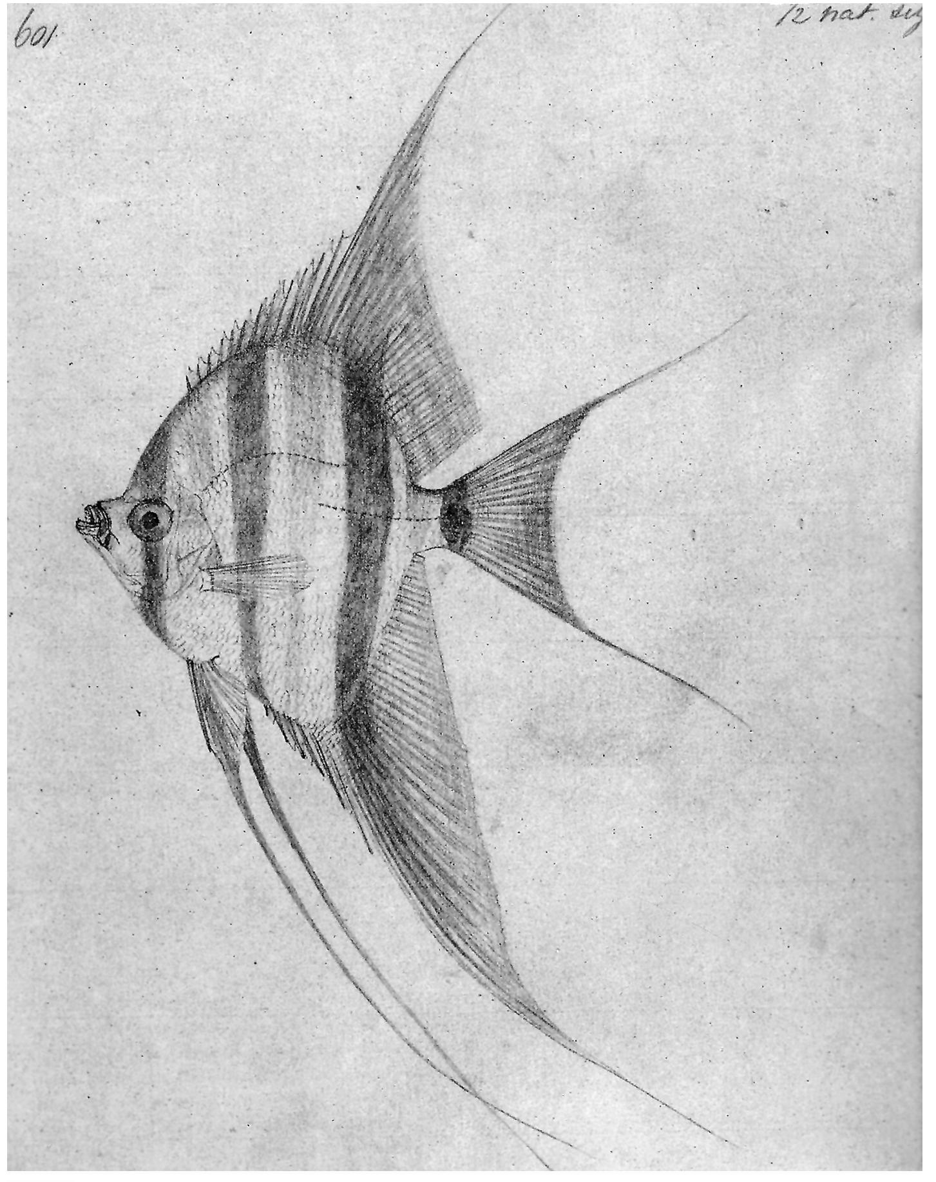
August 6, 1852
1130 km east of Bermuda
“I am afraid the ship’s on fire. Come & see what you think of it.”
“I got up a small tin box with a few shirts in it & put in my fish drawings…
Notes:
In this letter, he explains that he was four weeks out of port when the Captain came to his cabin: CLK
Wallace retrieved his tin box CLK and grabbed the rope to descend into a lifeboat, slipped and seared his hands, then hit the stinging salt water. He clambored into the lifeboat, only to discover it was leaking

Slide 9
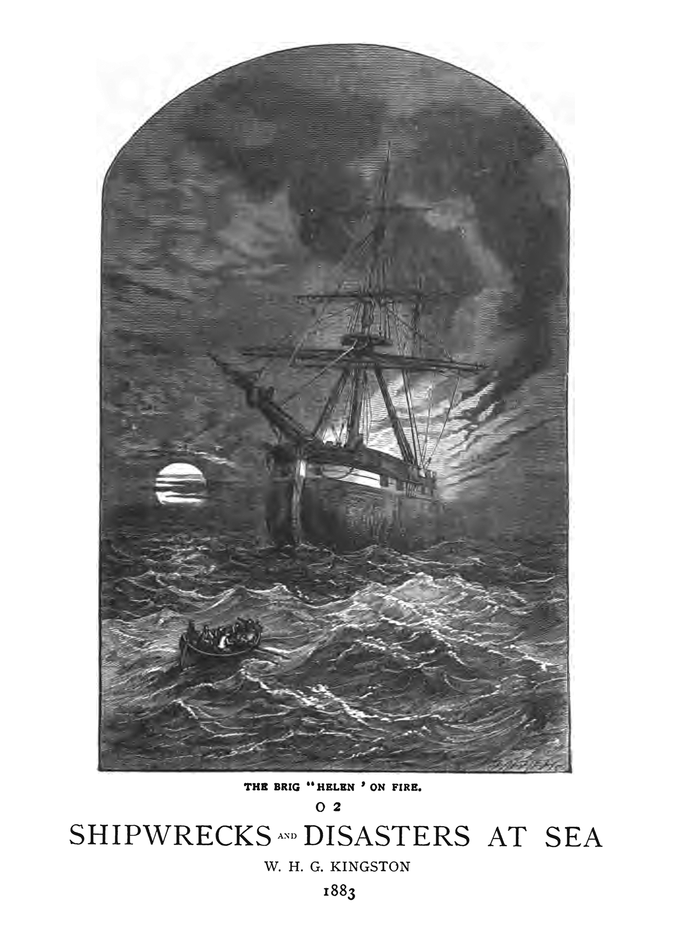
My collections however were in the hold …all the reward of my four years of privation & danger were lost….
Notes:
And then he watched all of his animals perish
and his collections sink to the bottom of the sea
Quote
PAUSE let it sink in
(Wallace’s disaster was even chronicled in a book on shipwrecks)

Slide 10
…Day after day we continued in the boats. - We were scorched by the sun, my hands nose & ears being completely skinned, and drenched every day by the seas & spray. We were constantly wet & had no comfort at night. We had [a] short allowance of water, which left us constantly thirsty.”
Notes:
His focus then had to turn to rescue
Quote
And so there he was in the middle of the ocean, unsure if he would survive. He had to wonder how he wound up in such a predicament??
Well, since a key part his quest to understand the origin of species…
One person he could have blamed was… Darwin
SLIDE

Slide 11
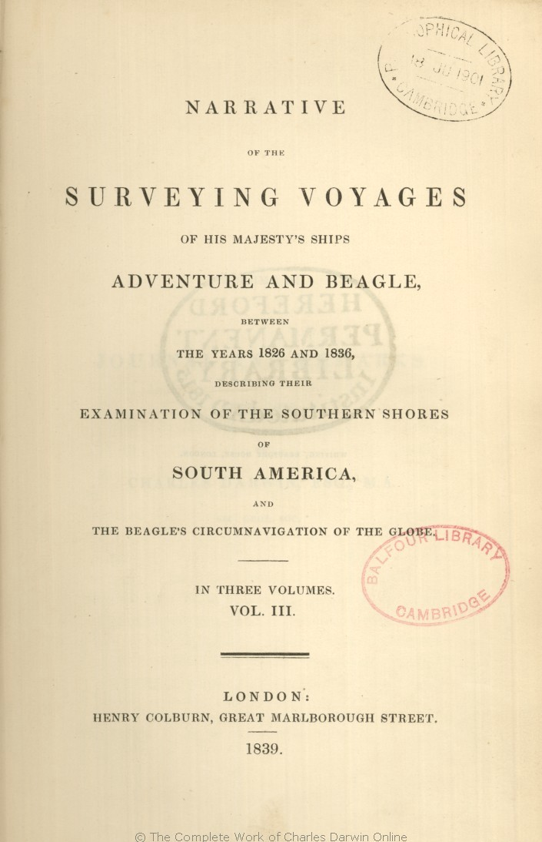
Notes:
The irony of the situation was that, unknown to Wallace, Darwin already knew the answers to the mystery of origins,
Oh he definitely knew, from his voyage FIFTEEN YEARS EARLIER. that species changed, but he just did not say so.
How did he know and how do we know he knew ? Let’s retrace some key stops on his voyage…
Divinity student Left England just after Christmas 1831

Slide 12
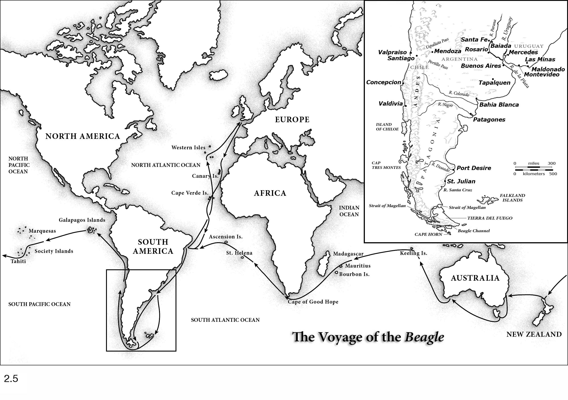
1833
Notes:
Some of the first evidence, that he would come to recognize much later, he discovered early in the voyage on the coast of Argentina

Slide 13
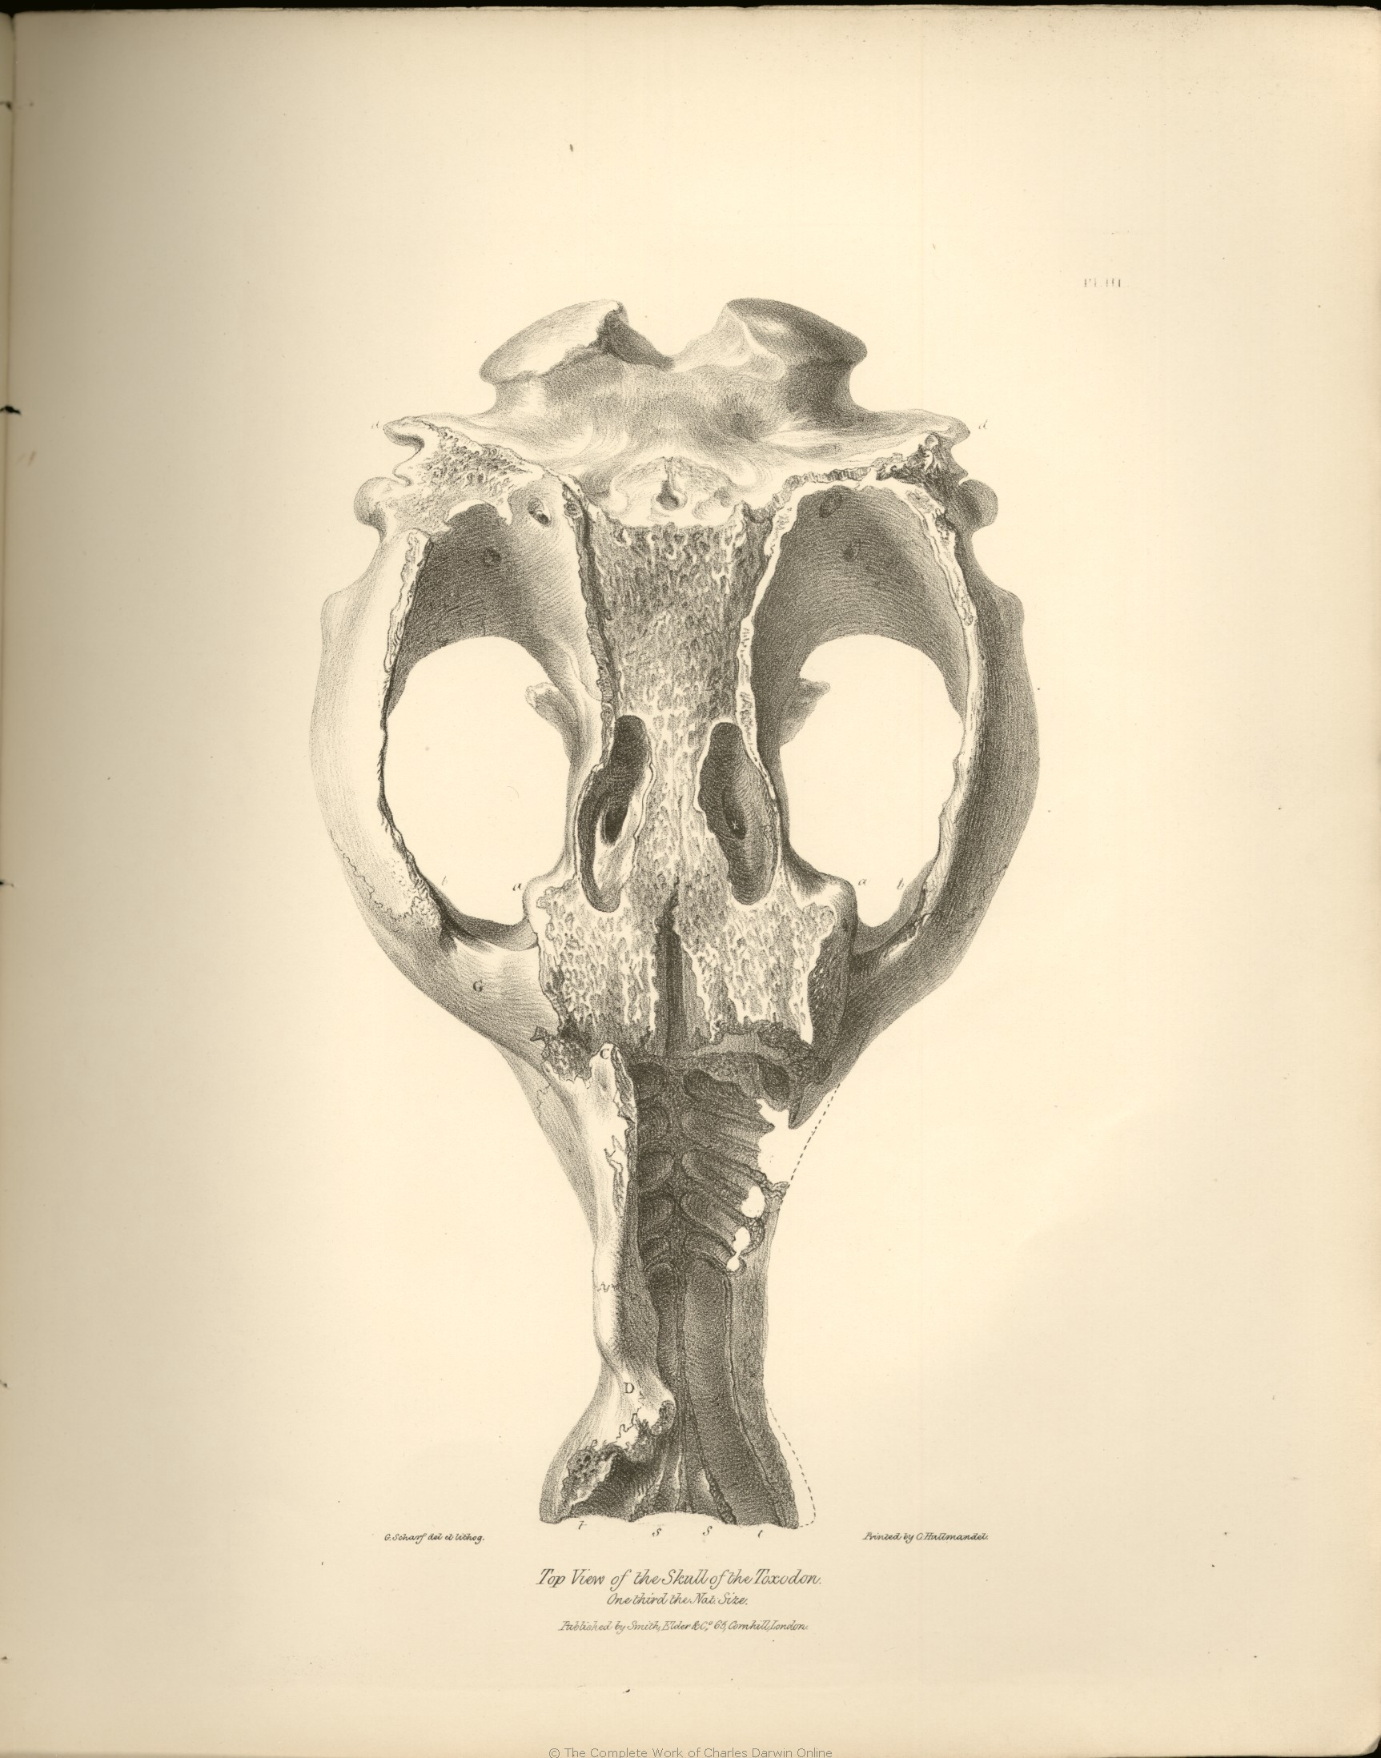
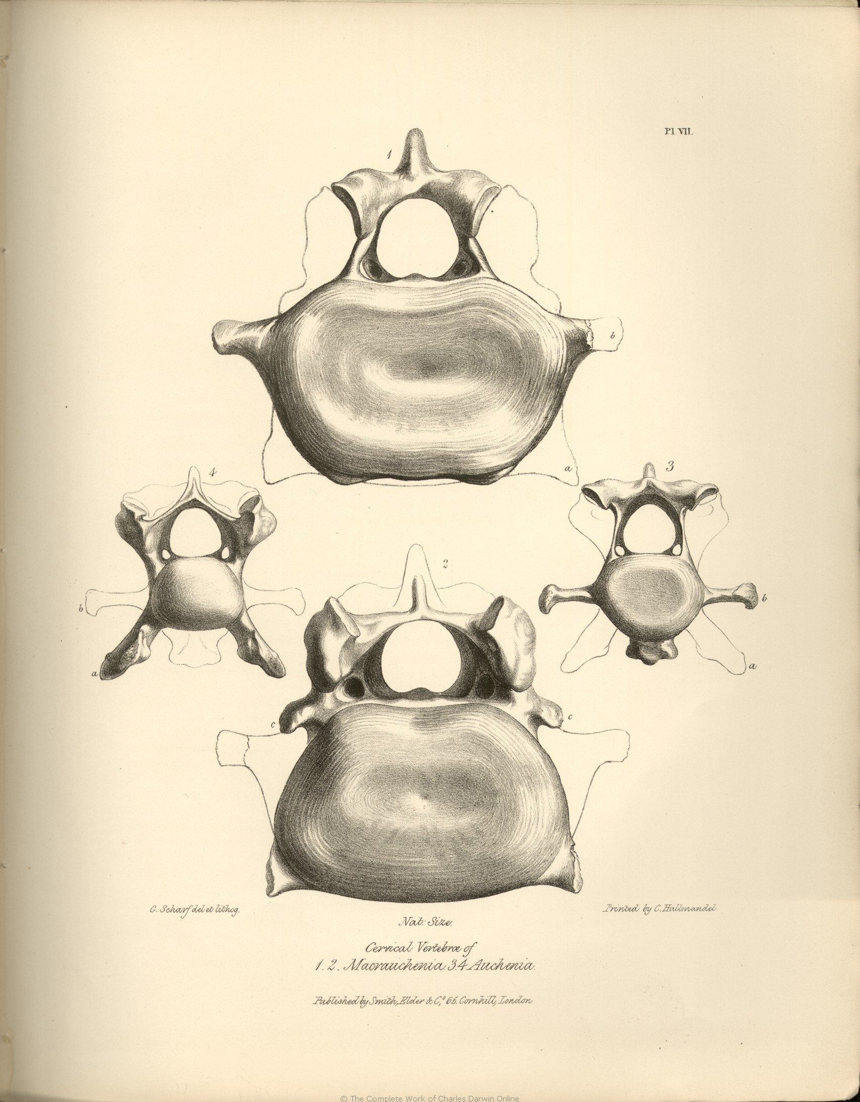
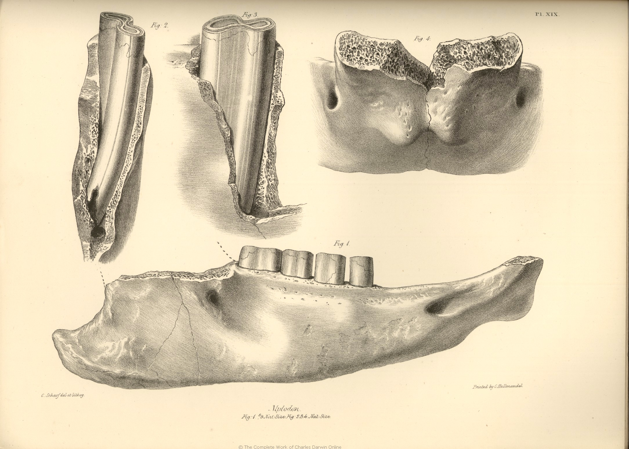
South American mammal fossils
Notes:
Darwin discovered fossils of what turned out to be seven species of large mammals

Slide 14
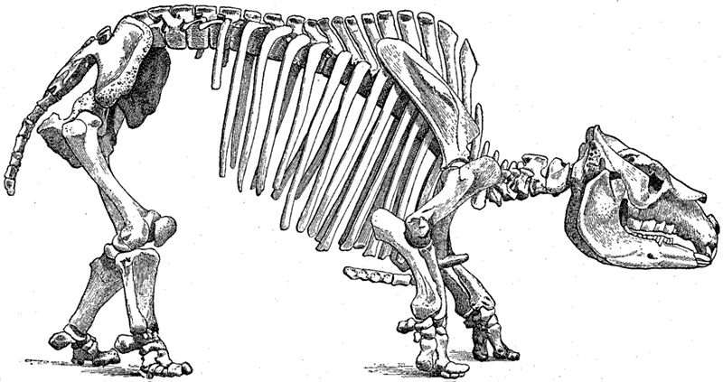
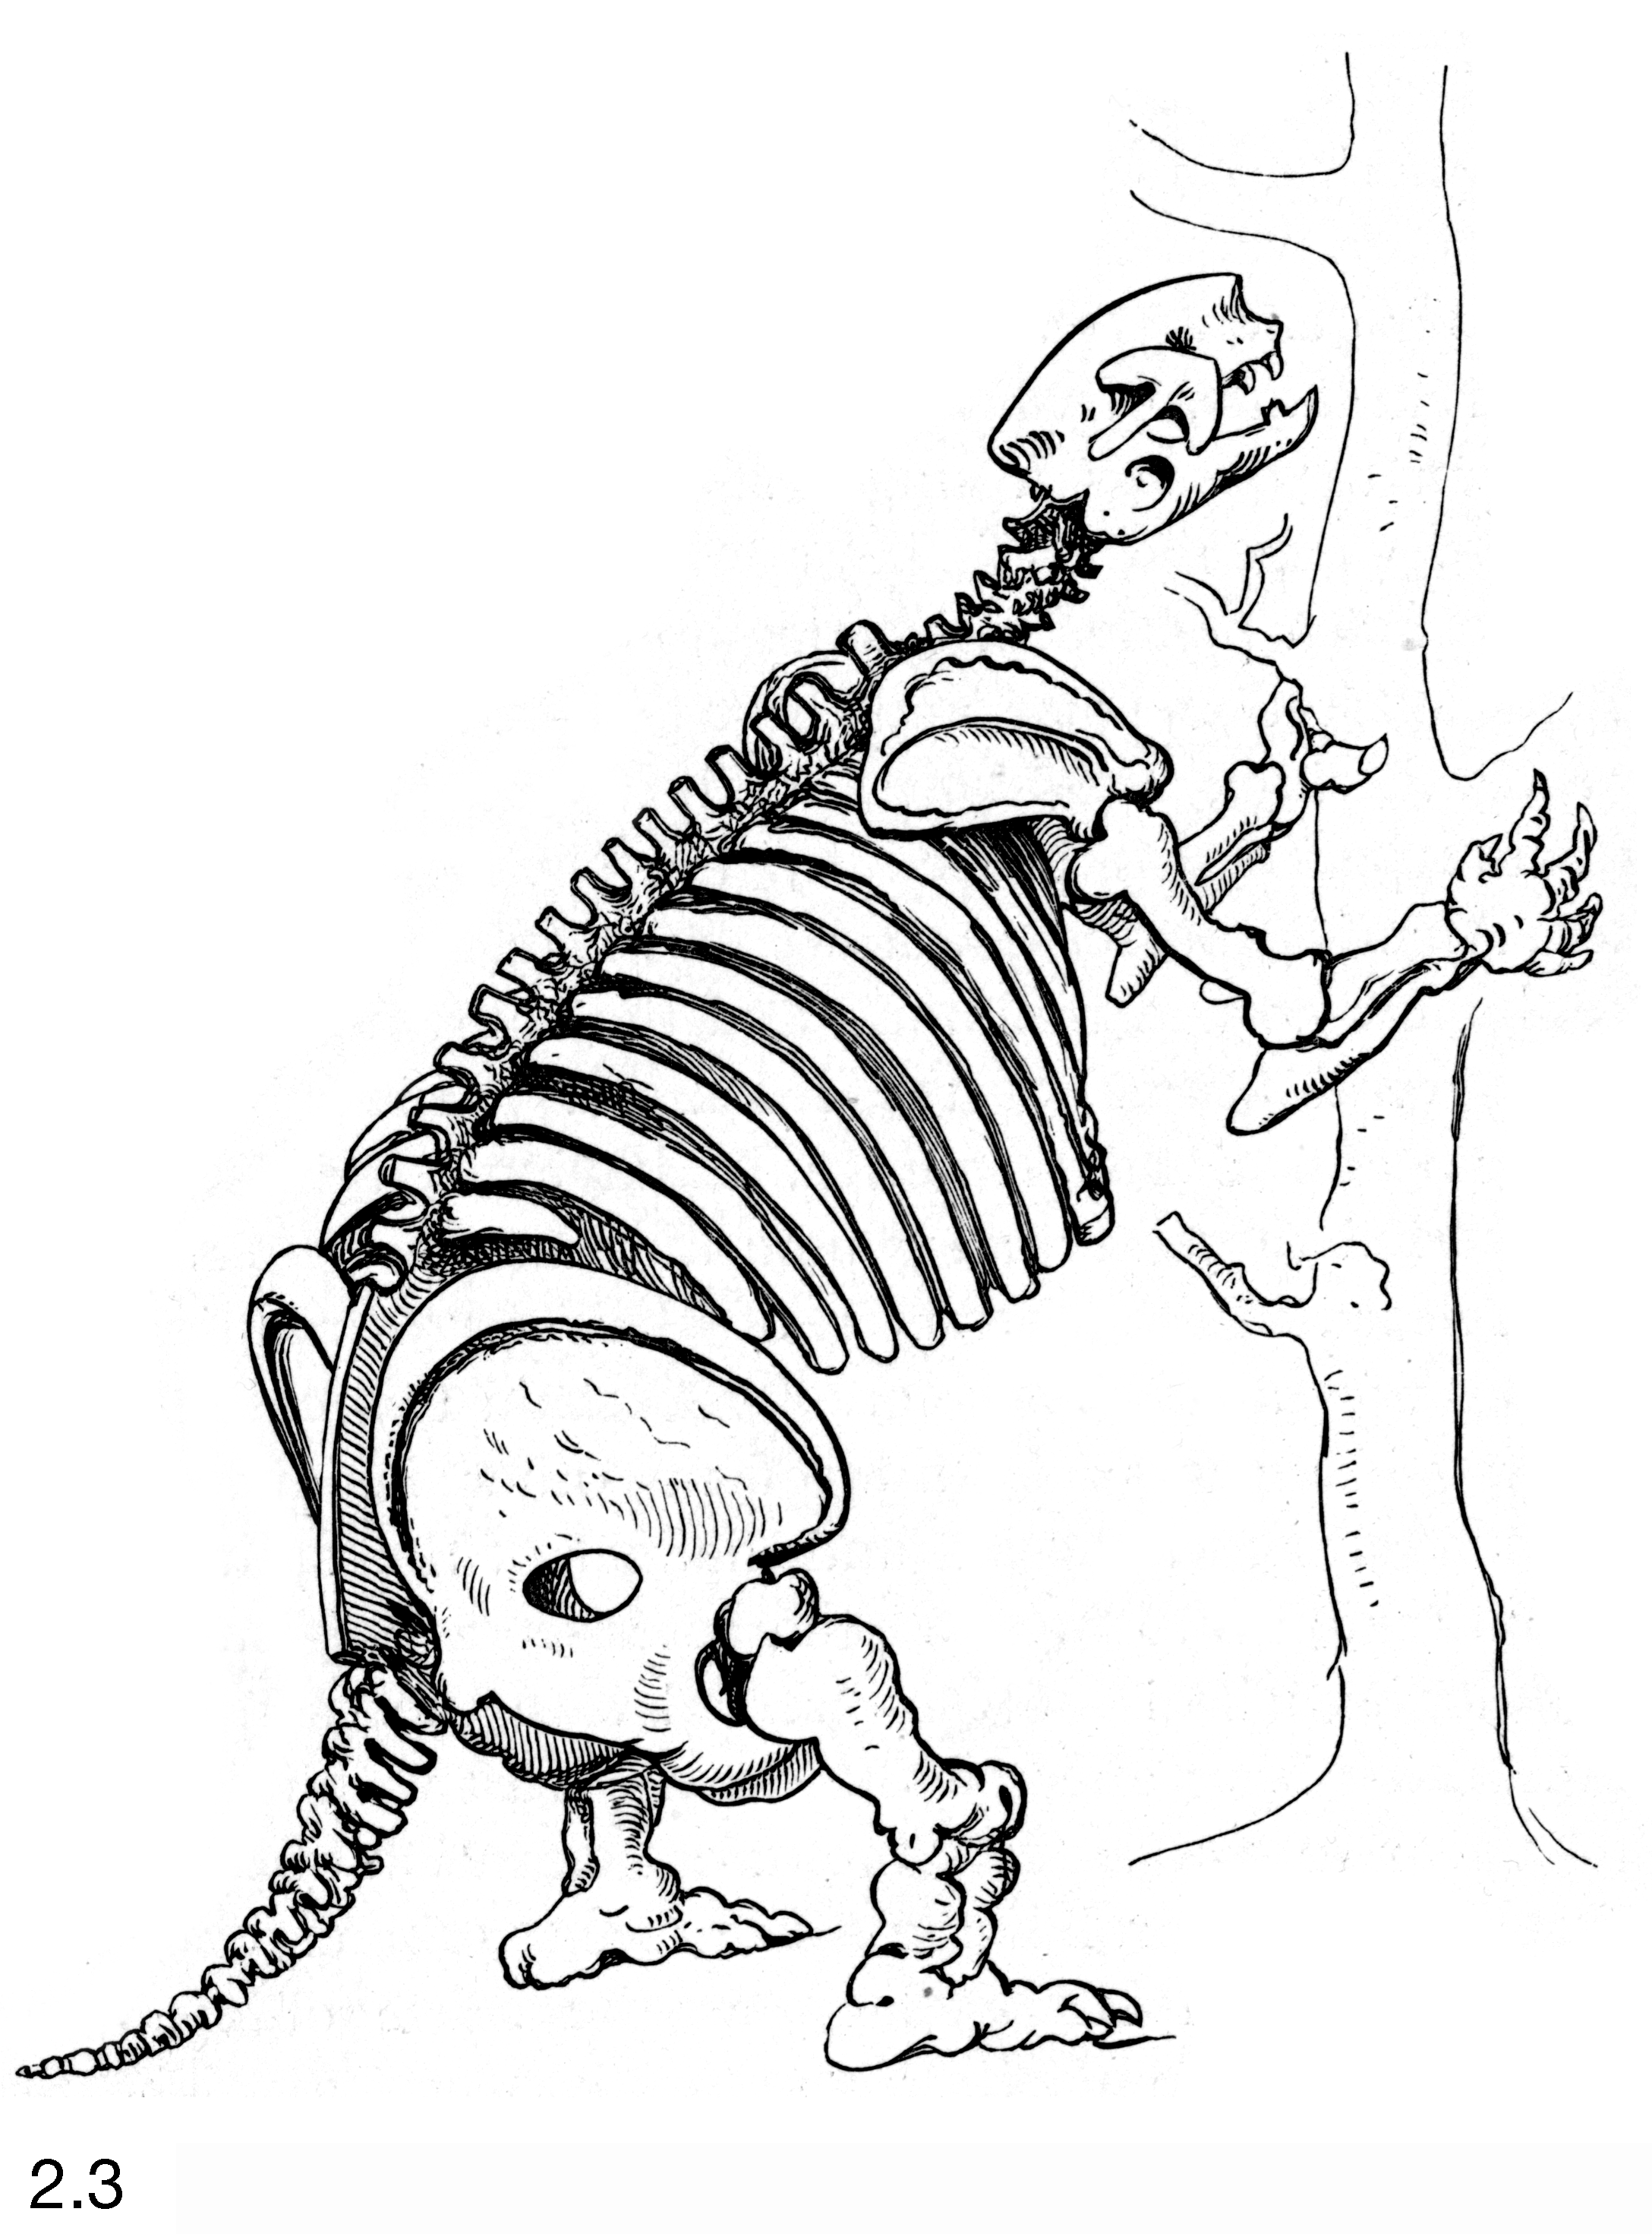
South American Megafauna - mammal fossils
Toxodon platensis
Mylodon darwinii
Notes:
These so- called megafauna, such as this giant ground sloth Mylodon that would be named for the young geologist, appeared to be related to, but much larger than living forms such as sloths, armadillos and llamas.
“Geological relations” between the extinct and the living??
More than 2 years
“I know not how I will endure it”

Slide 15
1835
Notes:
The second major body of evidence, that again he would only realize later, emerged as he visited the Galapagos.
It wasn’t the creatures that Darwin was anticipating,
He had looked forward to seeing his first volcanoes,

Slide 16
Notes:
He found what he described as a reptilian paradise.
With giant tortoises and oceangoing lizards – imps of darkness
There were also some humdrum birds like this mockingbird, similar to what he had seen on the continent.
He was happy to leave. Paradise for reptiles perhaps, but temperatures could reach over 130 degrees, Darwin compared the islands to Hell.

Slide 17
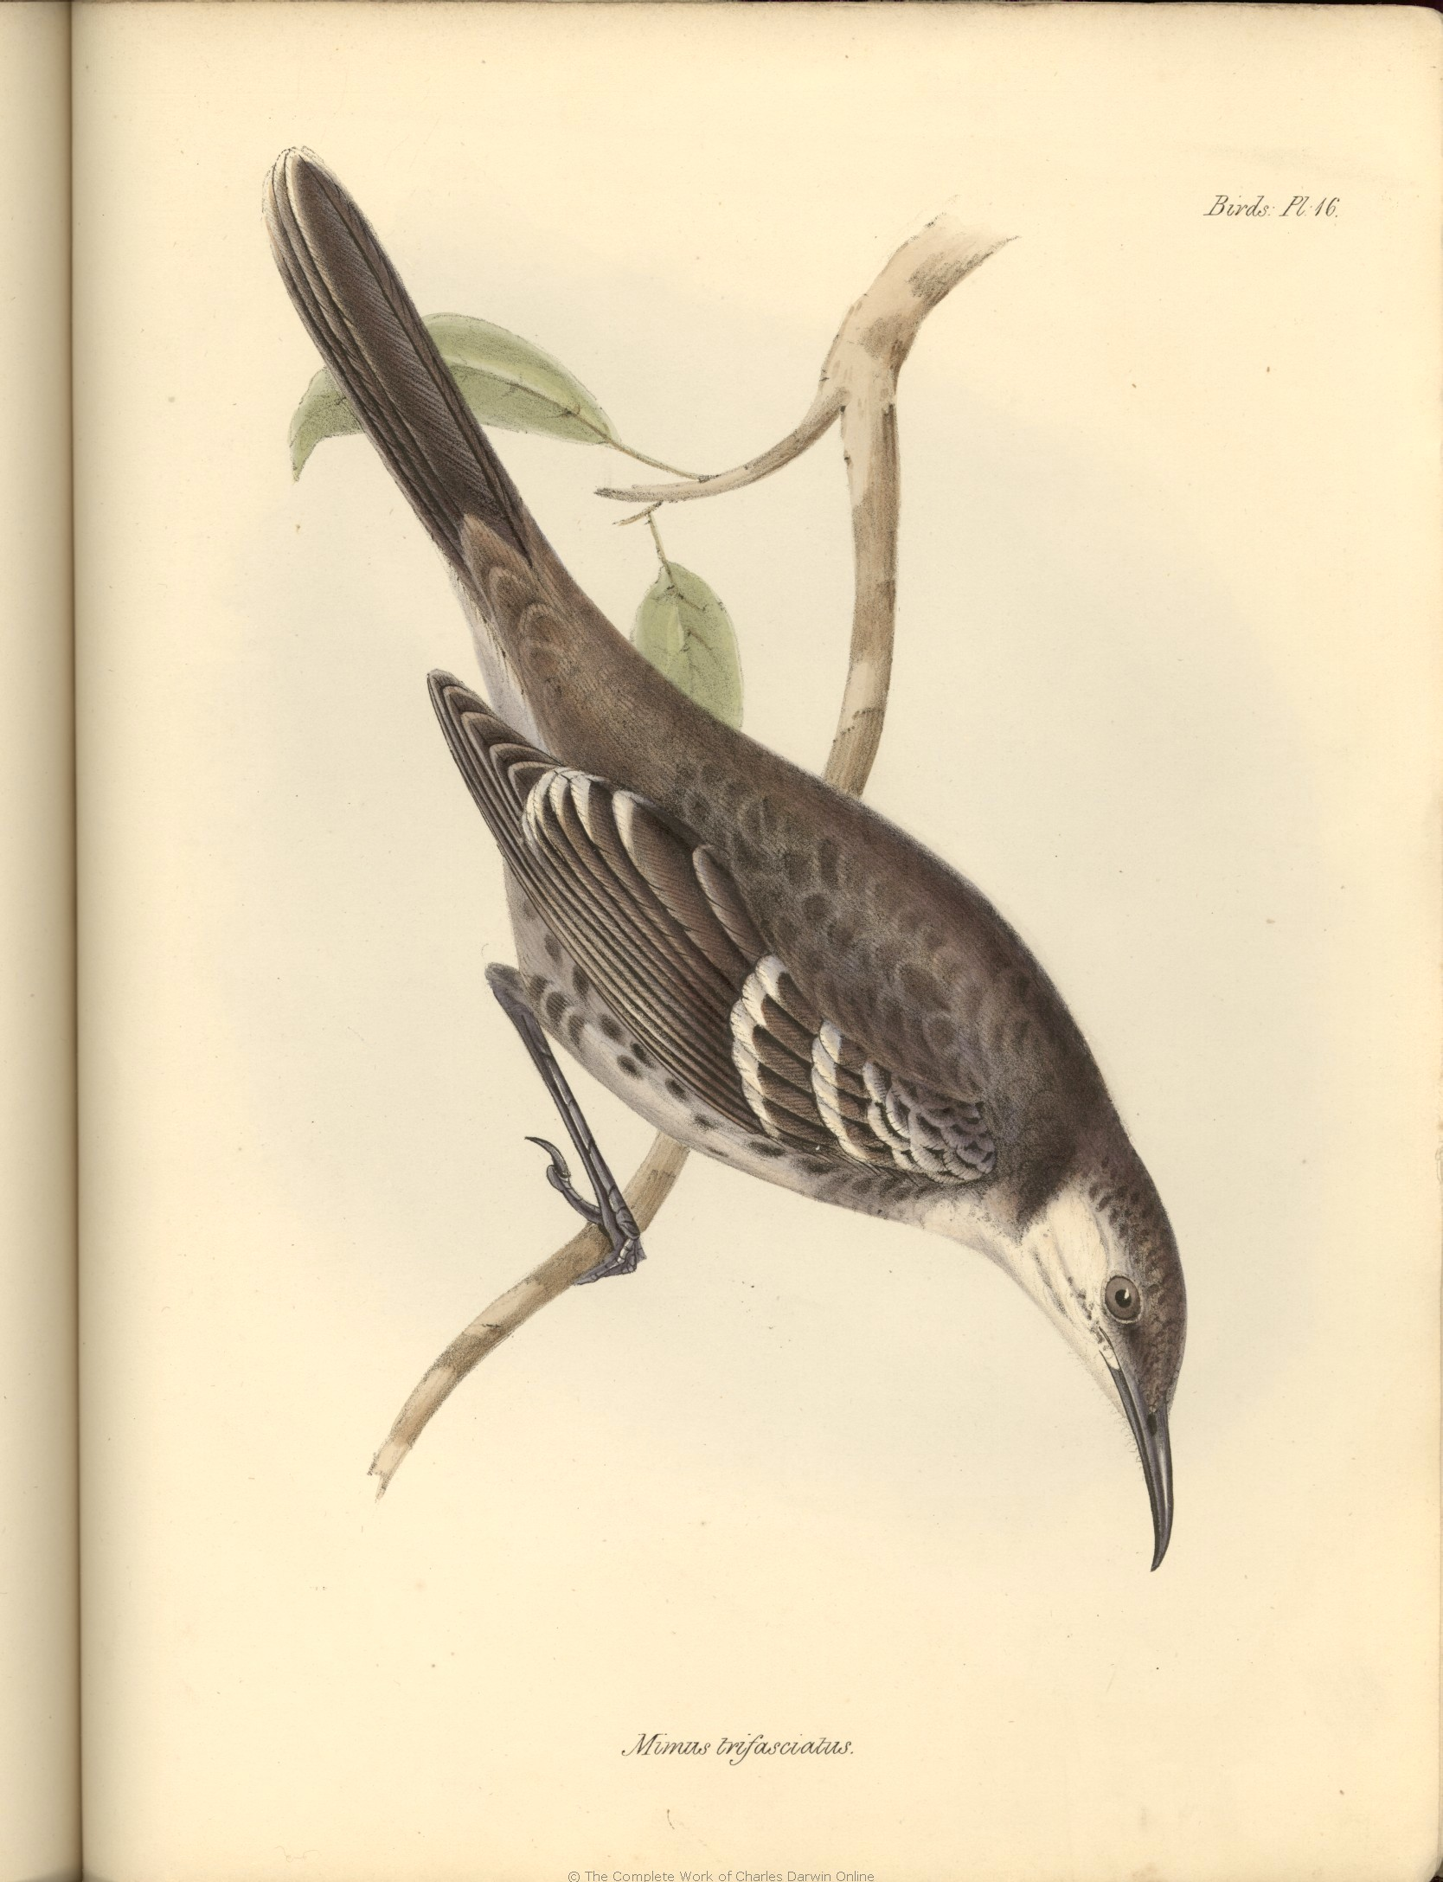
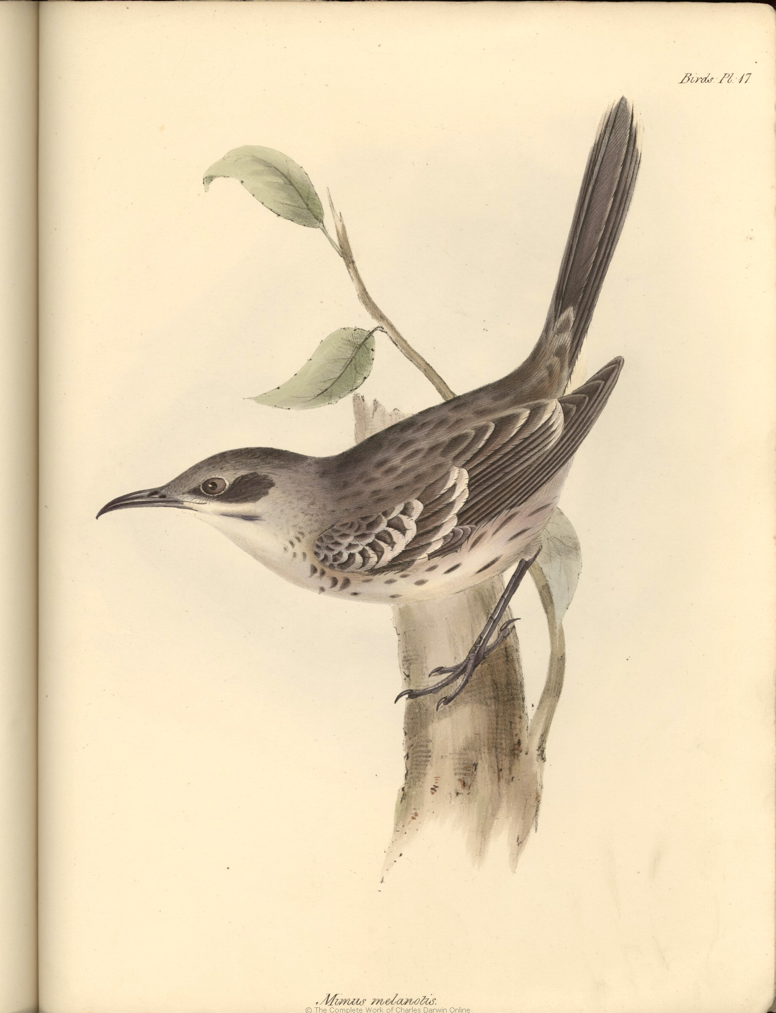
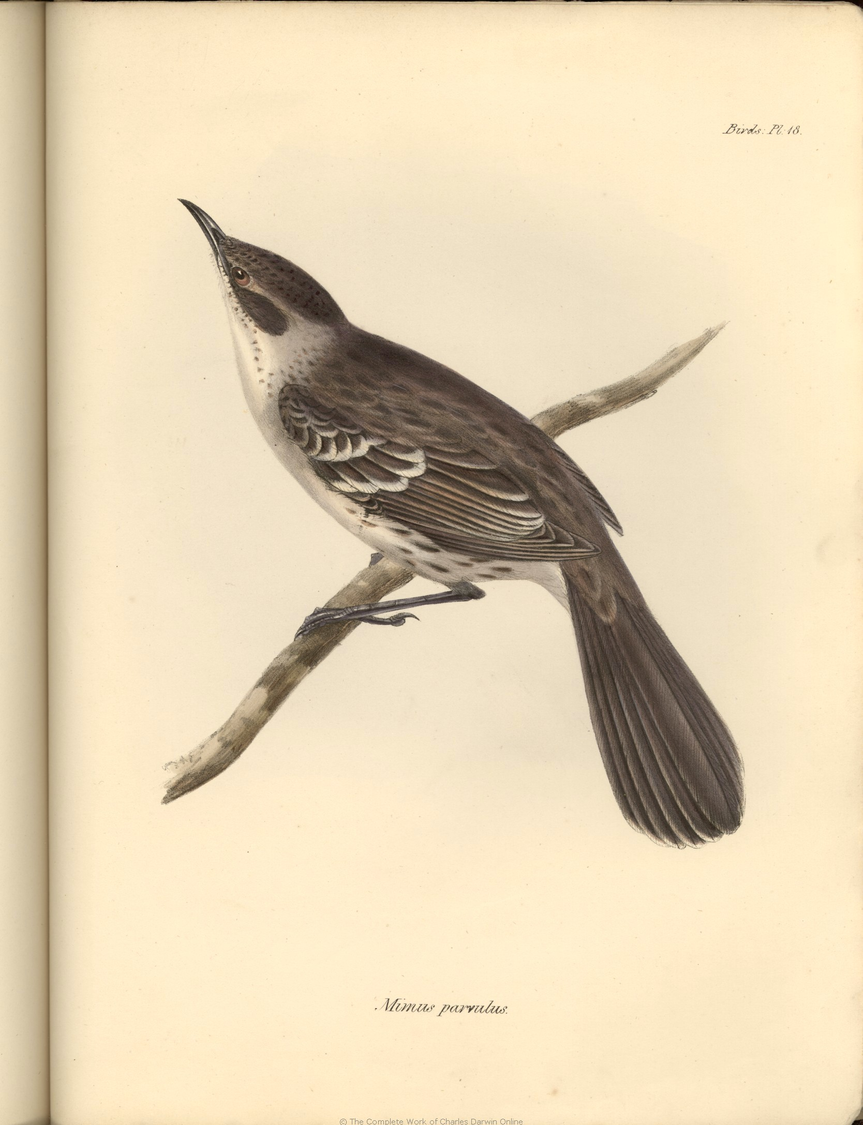
Galapagos Mockingbirds
Notes:
But those unspectacular mockingbirds presented a puzzle
Very similar but slightly different forms occurred on three different islands
Only many months later did he realize their significance…
Tahiti, Australia, Africa – home – NO
Darwin never overcame his seasickness
“I loathe, I abhor the sea, & all ships which sail on it.”

Slide 18
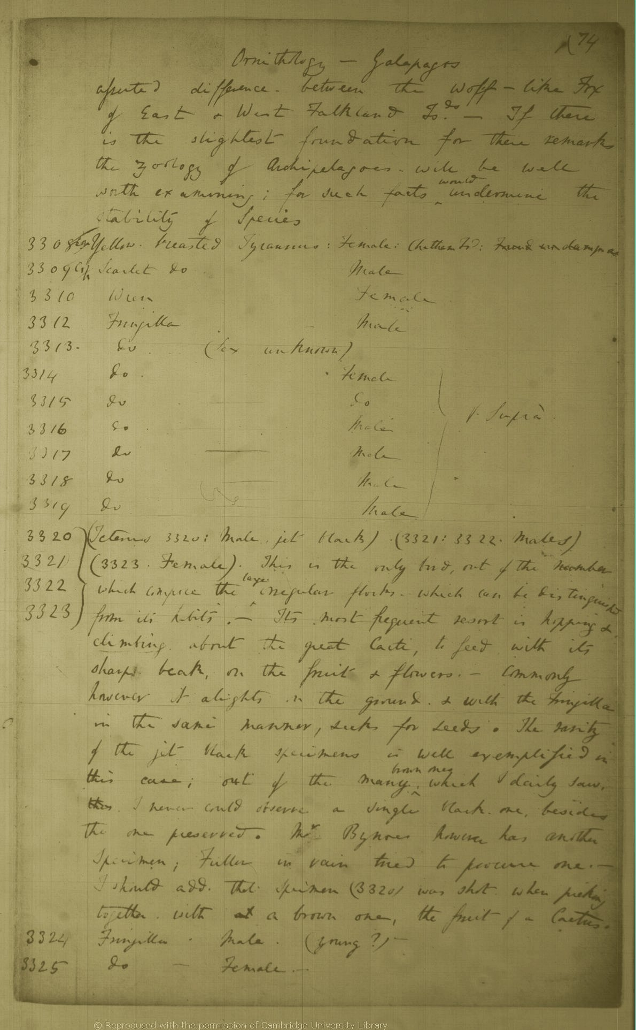
“When I see these Islands in sight of each other, & possessed of but a scanty stock of animals, tenanted by these birds, but slightly differing in structure & filling the same place in Nature, I must suspect they are only varieties…
– If there is the slightest foundation for these remarks, the zoology of Archipelagoes – will be well worth examining; for such facts would undermine the stability of species.”
- Ornithology Notes (1836)
Notes:
On the long and zig-zagging voyage home, he began to organize his notes
And as he reflected on the Galapagos mockingbirds , it dawned on him …
First eureka moment
(This is a page from his ornithology notebook)
QUOTE

Slide 19
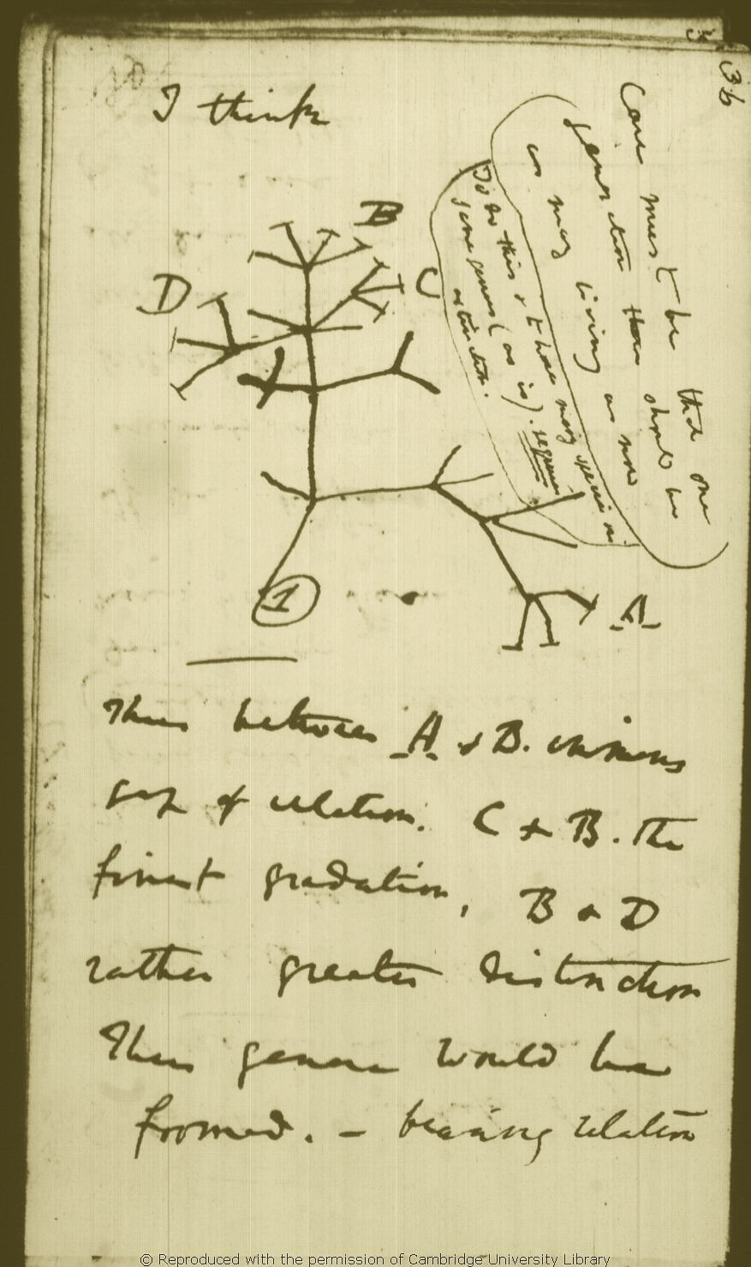
Darwin’s Notebook “B” 1837
On Page 20
“We may look at Megatherium, armadillos, and sloths as all offsprings of some still older type …”
On page 21:
“Organized beings represent a tree irregularly branched some branches far more branched –- As many terminal buds dying as new ones generated…”
On page 35:
“similarity of animals in one country owing to springing from one branch…”
Page 36
Notes:
After he reached home he began to develop his thoughts on species and to connect the dots… Mental Rioting
And on page 36, he invented a new system of natural history with organisms related by descent from ancestors, as children are descended from parents and grandparents
This was the end of Special Creation for Darwin
But he did not tell anybody

Slide 20
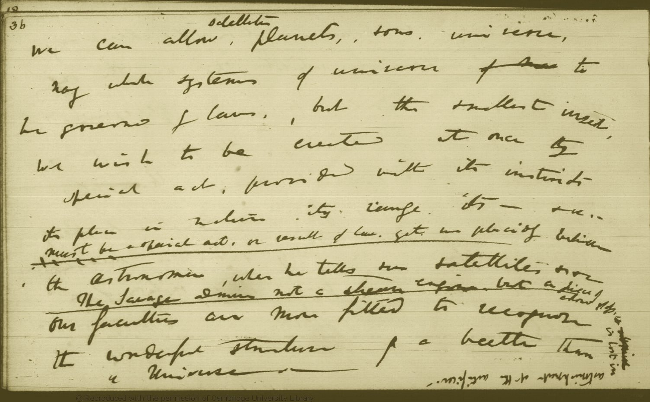
: “we can allow satellites, planets, suns, universes, nay whole systems of universes to be governed by laws, but the smallest insect, we wish to be created at once by special act...”
Notebook “N” October 30, 1838
Notes:
(Natural Selection in 1838)
Exasperated, As he wrote in his notebook… QUOTE
But again he did not tell anybody
He had a great opportunity to spill the beans - While he was developing his ideas and having such private thoughts, he was putting the finishing touches on his account of the Voyage of the Beagle

Slide 21
THE DODGE
“…It is clear, that if several islands have each their peculiar species of the same genera, when these are placed together, they will have a wide range of character. . . But there is not space in this work, to enter on this curious subject.”
(composed in 1837, published 1839)
Notes:
So - He knew – he knew that species changed.
He dodged the matter here because it would have been heresy to say so
He continued to work on his species theory, he wrote a 35 page sketch in 1842
And a 230 page essay in 1844, upon completing that he left instructions with his wife to publish it should he die
But Wallace was privy to none of that. When Wallace later read these words he concluded that the great Darwin had left the question of the origin of species wide open….
Had Darwin disclosed what he thought in 1839, or 1842, or 1844, Wallace might not have been in an open lifeboat in the middle of the Atlantic in 1852, and we might never have heard of Wallace….. PAUSE
SLIDE

Slide 22
…Ten days & ten nights passed … when a vessel was seen and by night we were on board her, much rejoiced to have escaped a death on the wide ocean whence none would ever have come to tell the tale…
Fifty times since I left Para have I vowed if I once reached England never to trust myself on the ocean.
But good resolutions soon fade…”
Notes:
But Darwin didn’t and so there Wallace was.
And of course, had he not been rescued, we might never have heard of Wallace
But he was rescued QUOTE (continues in his letter to Richard Spruce…)
And had he stuck to that vow, we would have never heard of Wallace
He broke his vow within days of arriving home CLK
Despite his loss, near death experience, he had nothing to show for the lands he had visited, great question was still open, and as soon as he could get his affairs in order he was off again.. Spirit and Deed , indeed
And, it was Wallace who would eventually make Darwin go public
WHERE TO?
SLIDE

Slide 23
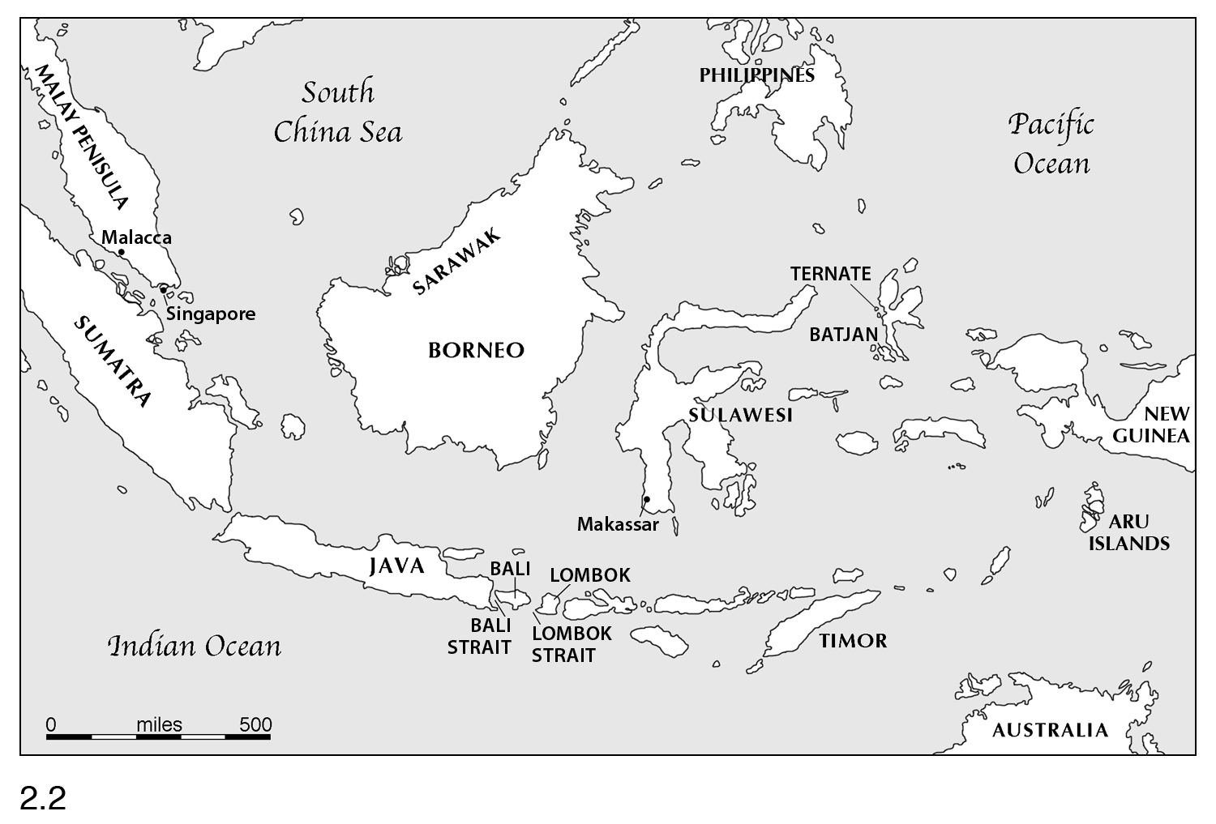
Arrived in Singapore April 1854
The Malay Archipelago
Made 96 crossings totaling 14,000 miles; Collected 120,660 specimens
Notes:
To the Malay Archipelago
Where he would make 96 crossings and gather over 120,000 specimens that, this time, would be secure.
Off he went in search of treasure…. SLIDE

Slide 24
Notes:
Like this magnificent birdwing butterfly, named for its large wingspan

Slide 25
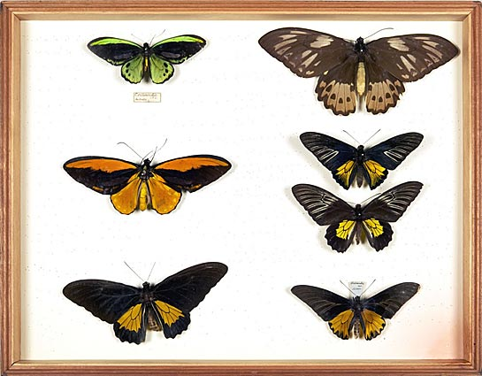
Birdwing butterflies
NHM
Notes:
Wallace was not just collecting treasures, but thinking about WHERE he found them.
These birdwings from the Malay jungle were entirely different from the butterflies he collected in the Amazon. Some forms restricted to particular islands
These birdwings signaled to Wallace what Galapagos birds signaled to Darwin
Wallace put his thoughts to paper… (no inhibitions)

Slide 26
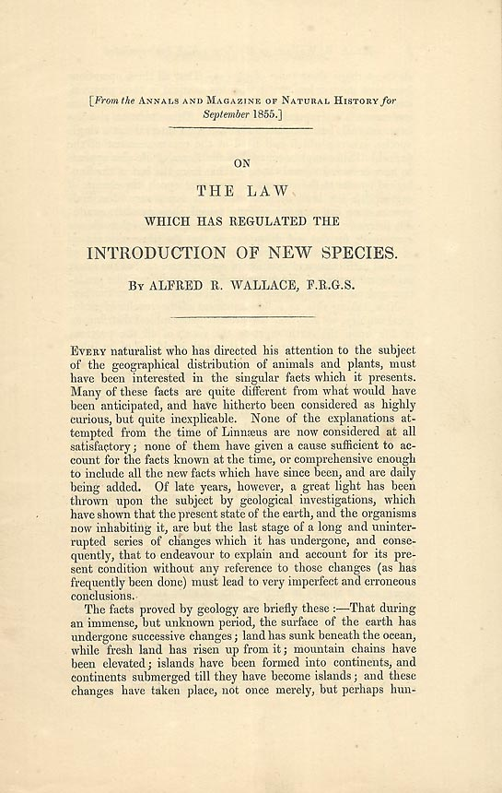
“Sarawak Law” (1855)
“ The most closely allied species [are] found in geographical proximity…
Every species has come into existence coincident both in space and time with a pre-existing closely allied species…
the best mode of representing the natural arrangement of species…a branching tree”
Notes:
He formulated a ‘Law” – Sarawak Law -regarding the introduction of new species CLK
And saw that species were arranged as branches on a tree – CLK Sound Familiar?
No reaction He kept going
He often relied on the help of local natives in tracking fauna SLIDE

Slide 27
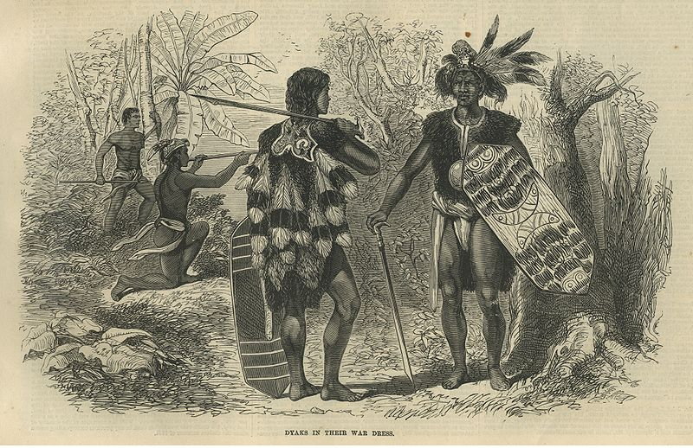
Notes:
Such as the Dyak’s of Borneo
Known to be fierce, they had their own hobby of collecting….. SLIDE

Slide 28
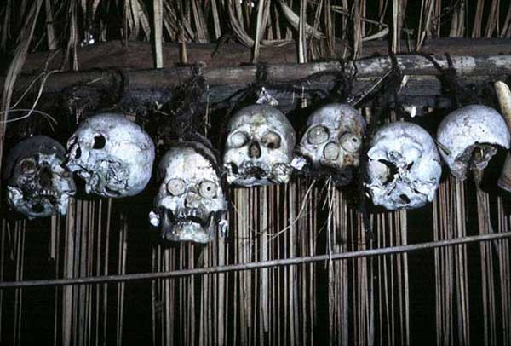
Dyak trophies
Notes:
Quaint, huh ?
Despite their reputation, they helped Wallace find elusive creatures

Slide 29
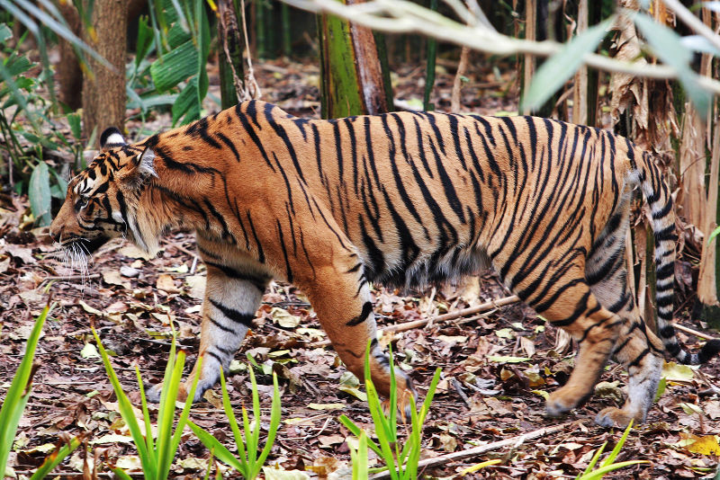
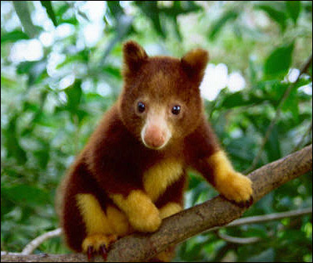
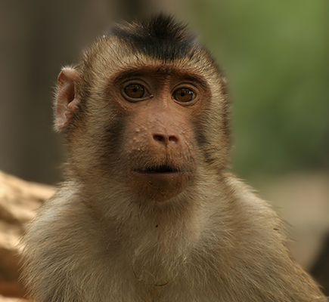
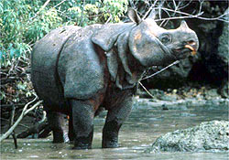
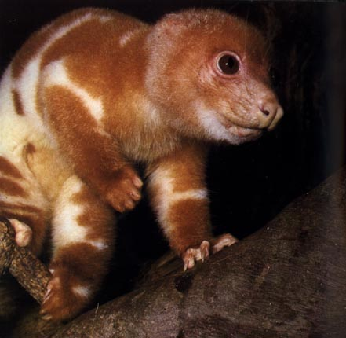
The Wallace Line
Asiatic fauna
Australian fauna
Notes:
Wallace hopped from island to island, but as he made his way to Eastern islands, such as Lombok CLK, he noticed a dramatic changeover in fauna
While the Western islands held mammals such as tigers, rhinos, and monkeys, in the East he found tree kangaroos and cuscus – ONLY MARSUPIALS
It was as though there was a LINE running across the Archipelago – what became known as THE WALLACE LINE
What could explain this distribution (despite similar habitats)? His Sarawak Law.
Wallace surmised that the Eastern islands were never a part of Asia but that New Guinea, the Aru islands and Australia were once connected and so shared animal types that then adapted to conditions on different islands. Wallace was right (founder of “biogeography”) END OF CREATIONISM for WALLACE
So species did evolve, but the next question was HOW ?

Slide 30
Wallace
February 1858, Ternate
Darwin
February- March 1857, Down
“Chapter 5. The Struggle For Existence as Bearing on Natural Selection
“The life of wild animals is a struggle for existence…and to provide for their infant offspring…
Perhaps all the variations…must have some definite effect, however slight, in the habits or capacities of the individuals…a variety having slightly increased powers…must inevitably in time acquire a superiority in numbers.”
All Nature…is at war. The struggle very often falls on the egg & seed, or on the seedling,
…any variation, however infinitely slight, if it did promote during any part of life even in the slightest degree, the welfare of the being, such variation would tend to be preserved or selected.”
- On the Tendency of Species to Depart Indefinitely from the Original Type
Notes:
Lying in a malarial fever on the island of Ternate, the answers occurred to him (veteran of the jungle). CLK
He sent it to ..whom else ? Darwin – with whom he had been corresponding and who, unknown to Wallace , had been writing along amazingly similar lines as he worked on a long form of his species theory (joke about Wallace’s verbose title vs. Natural Selection)
Darwin was shocked, but he should not have been, had he been paying closer attention to Wallace’s previous dispatches
Why ? Look at language
ISLAND SPECIES --- NATURE AS BATTLE ---- BOTH READ MALTHUS
Similar observations >> Great Minds Think Alike !
Gave the paper to Lyell, Hooker arranged joint publication

Slide 31
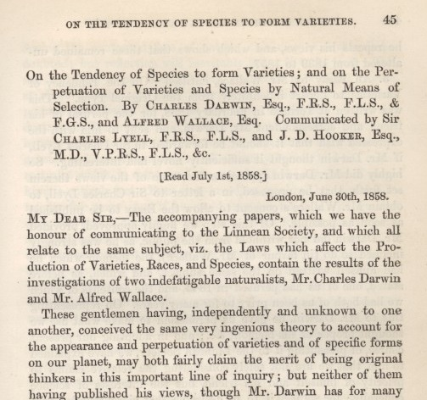
The Darwin-Wallace Joint Papers to the Linnean Society
July 1, 1858
Notes:
And so this was the debut of the theory of natural selection !!!!
PAUSE - But no one paid any attention
Darwin hurled himself into finishing his book

Slide 32
The Origin Set the Agenda
November 24, 1859
Is natural selection strong and sensitive enough to shape the fine differences among species ?
Notes:
Now people paid attention
A Great Synthesis , accessible to the layman
Marshalled and analyzed all kinds of evidence
Argued clearly and persuasively
Phrased eloquently
Heralded the end of creationism and a revolutionary new view of nature
And set the agenda for the next 150 years and beyond
One of the immediate questions was whether this new idea natural selection ..Clk Clk

Slide 33
Returned from the Amazon in summer of 1859, after eleven years
Collected 14,712 species in all, more than 8000 new to science
Henry Walter Bates
Notes:
Fortunately, Henry Walter Bates had just returned in what turned out to be great timing- CLK
His health nearly broken
As Bates began to sort out his collections and his years of observations,
Darwin’s great book appeared and gave him a framework for all he had seen.
Bates realized he had some pearls for the great Darwin
Slide

Slide 34
Henry Walter Bates to Darwin:
“I think I have got a glimpse into the laboratory where Nature manufactures her new species.”
Notes:
Bates struck up a correspondence.
Darwin had relied heavily on analogy to domestication, Bates had evidence from nature
.

Slide 35
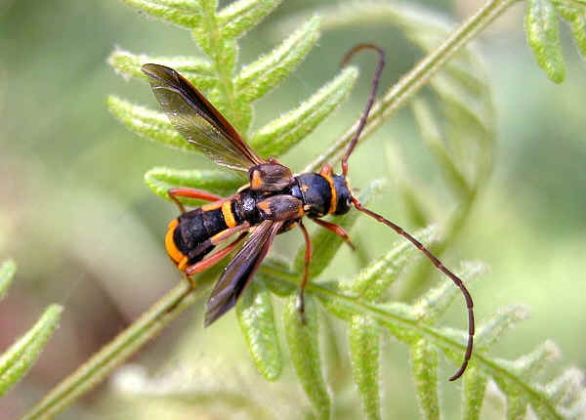
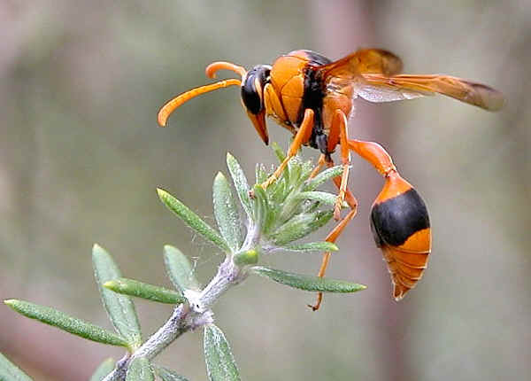
Longicorn beetle
Wasp
Notes:
What Bates observed was that harmless animals often resembled more noxious forms in their vicinity
Like this beetle that resembled a wasp
Slide

Slide 36
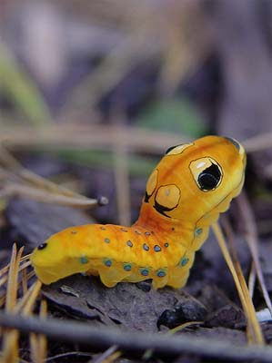
Spicebush caterpillar
Photo by Mary Jo Fackler
Notes:
Or this caterpillar whose head resembled a small viper
When Bates had carried a specimen like this into a village, it frightened everyone.
Bates had been feeling a bit discouraged about not securing any scientific position, he lived at home with his family in Leicester for three years after returning.
But Darwin rooted him on, encouraging him to publish his work and to write a narrative of his travels.

Slide 37
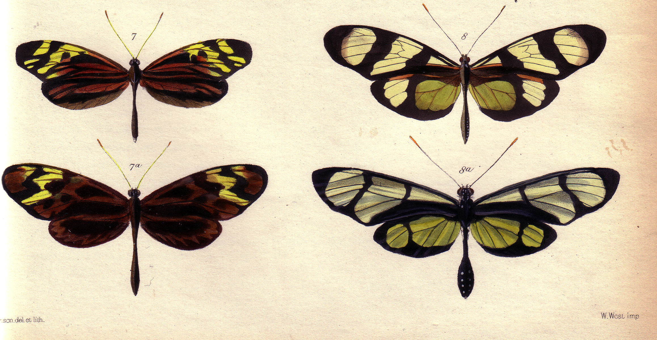
“To exist at all in a given locality, our Leptalis… must wear a certain dress and those of its varieties that do not come up to the mark are rigidly sacrificed… I believe the case offers a most beautiful proof of the theory of natural selection.”
- Mimics-
L. amphione
L. orise
- Models -
M.polymnia
M. psidii
Batesian Mimicry
(Bates, 1862)
Notes:
No Amazonian creatures made a greater impact on Bates than butterflies.
In one area alone Bates catalogued 550 species – more than in all of Europe.
And when it came to mimicry, butterflies were the champions.
Here, two forms Leptalis (Pierids) mimic two species belonging to another family (Nymphalids).
Bates explained that the mimic gained an advantage by resembling noxious species
this was not a coincidence the mimic was only ever found where the model resided
The degree of resemblance varied so Bates reasoned some natural process was at work – natural selection QUOTE

Slide 38
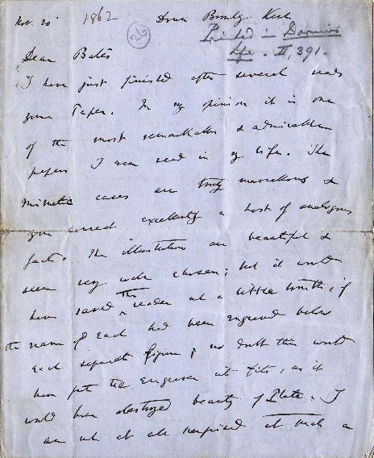
Darwin to Bates :
“In my opinion it is one of the most remarkable and admirable papers I ever read in my life.”
Courtesy Stecher Collection, Case Western
Notes:
Bates thought he had a great proof of natural selection…So did Darwin
- in this letter, (one I had the thrill of holding in my hands at Case Western Reserve University and can now show you) – Darwin offers his strongest compliments.
Batesian Mimicry – the imitation of one species by another became crucial evidence in support of the theory
Slide

Slide 39
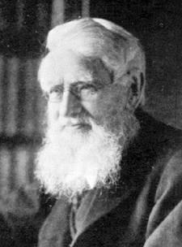
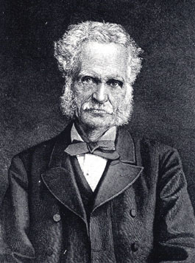
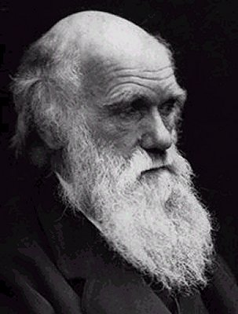
Notes:
Wallace finally returned to England this same year
The three explorers had great mutual admiration for one another, and were lifelong friends who together promoted the theory of evolution
Their voyages, their work, and their insights mark a golden age of evolutionary science CLK
But the last thing I would want to suggest is that the great adventures were over, far from it…
There was much more to explore and to be discovered, particularly in expanding the FOSSIL RECORD and for around $20 you can read about another 150 years of great adventures
Moreover I submit that we are now in a NEW, SECOND GOLDEN AGE of evolutionary science

Slide 40
The SECOND golden age :
Glimpses FROM The Laboratory into HOW new species are made
Notes:
AMP UP PASSION- NO LETDOWN
We are no longer restricted to just looking at remarkable creatures, but can see how they are made and have evolved.
Modern biologists are collectors too, putting together menageries much like the one Wallace tried to bring home from the Amazon

Slide 41
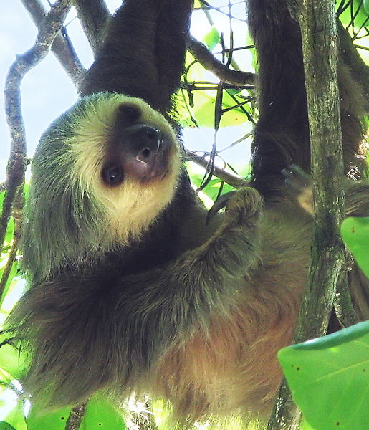
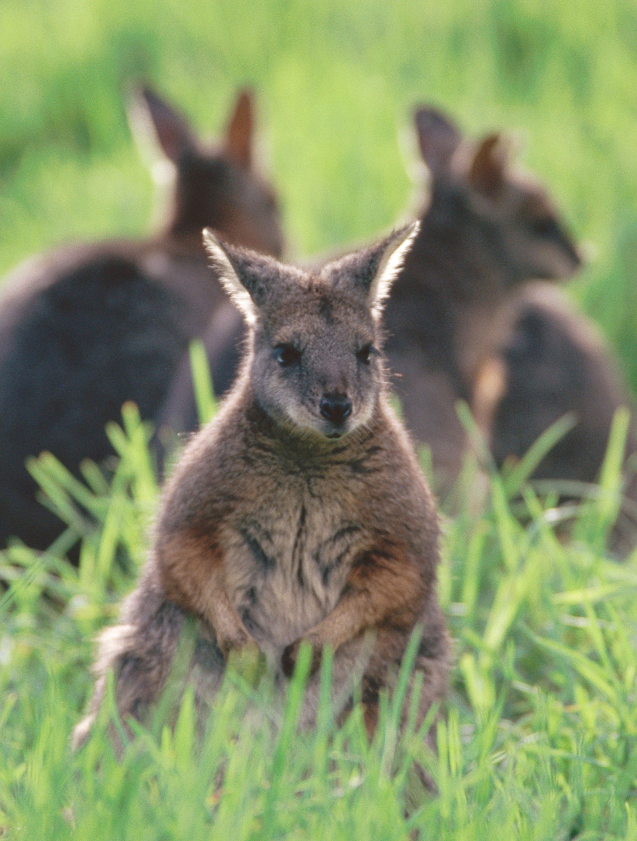
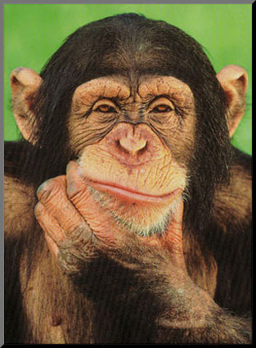
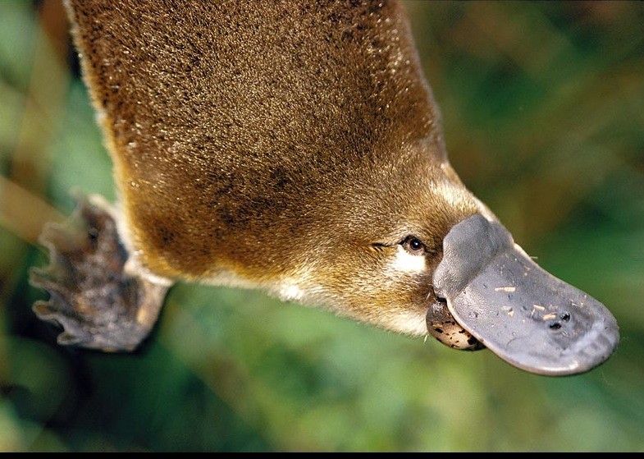
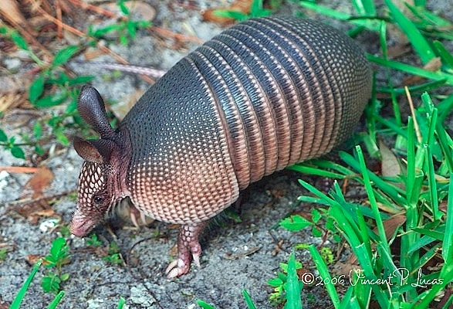
Notes:
There’s a sloth , armadillo, platypus, wallabies, a chimpanzee
only we aren’t putting them in a zoo…..

Slide 42
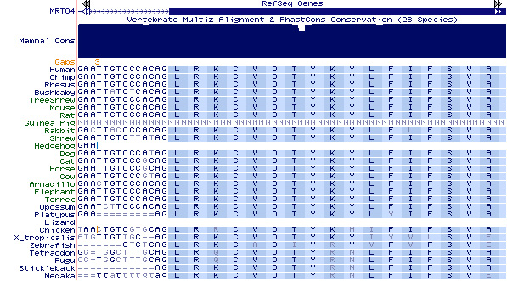
52 mammals and counting…
Notes:
We are putting together the NEW DNA RECORD OF EVOLUTION that reveals HOW THE FITTEST ARE MADE and how ENDLESS FORMS HAVE EVOLVED . 52 mammals and 2000 species so far
As we mine this massive record, we share that same sense of wonder, surprise, and discovery, as the pioneers, only we don’t have to barf our way through the work day, or cope with malaria, or headhunters – just peer review ( speaking of cannibals)
We no longer stare at creatures CLK

Slide 43
Photo by Paul Brakefield
Notes:
Like this butterfly, as Bates did, merely dazzled by its external beauty.
For we now can see

Slide 44
Movie ?
Notes:
The genes in action that produce these beautiful patterns

Slide 45
Partial DNA sequence of Mylodon darwinii
Notes:
And what could be better than fossils like these collected by Darwin?
How about DNA from fossils…) CLK
new ways of peering into the past that not only Darwin could not think of, but that few modern biologists even thought possible, until recently.
But those tales are for another day
My task was to highlight where this all started, and among the past adventurers the one we celebrate above all is Darwin. Why ?

Slide 46
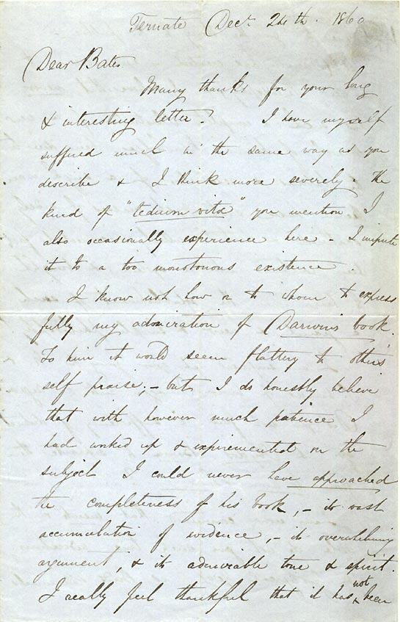
Wallace to Bates
Ternate, Dec. 24, 1860
“I know not how or to whom to express fully my admiration for Darwin’s book. …- its overwhelming argument, & its admirable tone & spirit.
“Mr Darwin has created a new science and a new philosophy, & I believe that never has such a complete illustration of a new branch of human knowledge been due to the labours & researches of a single man.”
Notes:
I’ll let Wallace have the last word on that - see what he says in a private letter to Bates
Speculation about his feelings – true reaction here
CLK
CLK
And Darwin produced much more
The descent of Man, Sexual selection
Variation under domestication, orchids, earthworms, coral reefs
OUR greatest naturalist…so that is why we celebrate

Slide 47
Notes:
For Darwin’s birthday, I offer two wishes (HOUSE LIGHTS DOWN)
First - that more people will appreciate the great spirit that drove young Charles, Alfred, Henry and many other men and women to leave behind loved ones and to risk their health and safety in order to follow their dreams and to explore the unknown
And second- that many more people will embrace the grandeur and beauty in the story of life they have revealed
(I hope you FEEL as I do)
And if so, then this birthday card we have composed is for you, too.
Happy Birthday Charles / It was a beautiful day, thank you all for coming.

Slide 48
Dr. Sean Carroll
Sean B. Carroll is an award-winning scientist, author, and educator. He is currently Professor of Molecular Biology and Genetics and an Investigator with the Howard Hughes Medical Institute at the University of Wisconsin. His research has centered on the genes that control animal body patterns and play major roles in the evolution of animal diversity. Major discoveries from his laboratory have been featured in TIME, US News & World Report, The New York Times, Discover, and Natural History.

