Slide 1
Pecan Street Project: Smart Grids and Austin’s Energy Future
# 65
Brewster McCracken, Karl Rabago & Dr. Michael Webber
April 30, 2010
Produced by and for Hot Science - Cool Talks by the Environmental Science Institute. We request that the use of these materials include an acknowledgement of the presenter and Hot Science - Cool Talks by the Environmental Science Institute at UT Austin. We hope you find these materials educational and enjoyable.

Slide 2
Pecan Street Project – Smart grids and Austin's energy future
Brief presentations from our panelists:
Karl Rabago: Austin's energy & Smart grid technology
Brewster McCracken: The Pecan Street Project & the Mueller Experiment
Michael Webber: Austin, TX as an Energy Laboratory
Questions & Discussion
Closing Remarks

Slide 3
Hot Science – Cool Talks March 26, 2010 Smart Grid Intro & Austin Energy by the Numbers
Karl R. Rábago
Vice President, Distributed Energy Services

Slide 4
What Drives the Smart Grid in Austin, TX?
Best Managed Utility in the US
2010 Goals
Get AA bond rating
Get to 83% in customer satisfaction index
Get SAIDI to 40, SAIFI to 0.5 and SALTPI to 3
2020 Goals
Get to 700 (800) MW of energy efficiency
Get to 30% (35%) mix of renewable energy in our generation
Get to 100 (200) MW of Solar generation
© 2003 - 2009 Austin Energy. All Rights Reserved

Slide 5
What is the Smart Grid?
Our Smart Grid definition unites the Utility Grid, Buildings and Vehicles into one grid
Smart Grid = Electric Grid + Communications Network + Hardware + Software
The Smart Grid monitors, controls, and manages the creation, distribution and consumption of energy
The Smart Grid of the future is distributed, interactive, self-healing and reaches every device
© 2003 - 2009 Austin Energy. All Rights Reserved
Notes:
We at Austin Energy pride ourselves for being one of the most progressive electric utilities in the world. We are the number one seller of green energy in the US six years in a row, while also managing nuclear, coal, and natural gas power plants. We have already saved the equivalent of a 600mwh power plant with conservation and Disaster Recovery programs since 1985 and we have a new goal to save another 700mwh by 2020. We are leaders in distributed generation. And we are leaders in the use of information technology solutions to further increase our ability to deliver clean, affordable, reliable energy and excellent customer service.
Austin Energy has been working on the Smart Grid building blocks for the past five years and has made great progress. The building blocks for the Smart Grid include the electric grid itself, a telecommunications network (a combination of fiber, wireless and/or broadband over power line as needed), hardware infrastructure (meters, sensors, network gear, servers, storage), and software (applications, databases, and integration and management tools).

Slide 6
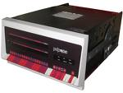
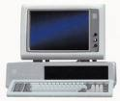
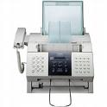
Why Do the Smart Grid?
Computer
Industry
Evolution
Mainframe
Minicomputer
PC
Laptop
Telecom
Industry
Evolution
SS7 Switch
PBX
Fax / phone
Wireless phone
Electric
Industry
Evolution
Power plant
Co-gen plant
Solar Roof Top
Electric Car
© 2003 - 2009 Austin Energy. All Rights Reserved
Notes:
We at Austin Energy pride ourselves for being one of the most progressive electric utilities in the world. We are the number one seller of green energy in the US six years in a row, while also managing nuclear, coal, and natural gas power plants. We have already saved the equivalent of a 600mwh power plant with conservation and Disaster Recovery programs since 1985 and we have a new goal to save another 700mwh by 2020. We are leaders in distributed generation. And we are leaders in the use of information technology solutions to further increase our ability to deliver clean, affordable, reliable energy and excellent customer service.
Austin Energy has been working on the Smart Grid building blocks for the past five years and has made great progress. The building blocks for the Smart Grid include the electric grid itself, a telecommunications network (a combination of fiber, wireless and/or broadband over power line as needed), hardware infrastructure (meters, sensors, network gear, servers, storage), and software (applications, databases, and integration and management tools).

Slide 7
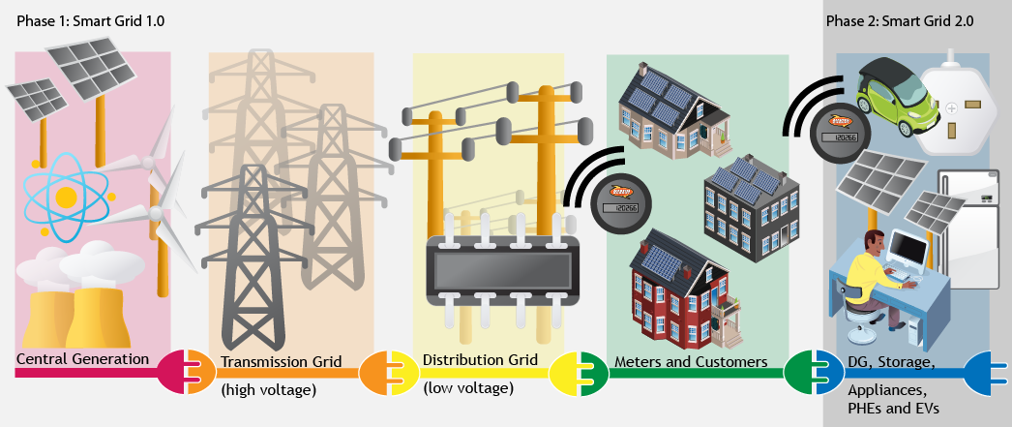
Austin Energy Smart Grid
© 2003 - 2009 Austin Energy. All Rights Reserved

Slide 8
FY 2009 Numbers
Customer Class | Revenue | kWh Sales | Customer Bills
Residential | $406 million | 4,218 million | 363,217
Commercial | $402 million | 4,480 million | 43,050
Industrial | $133 million | 2,218 million | 80
Street & Highway | $8 million | 48 million | 4
Other Gov’t Sales | $83 million | 1,137 million | 1,575
TOTAL | $ 1,032 million | 12,103 million | 407,926
2009 Population: 774,000

Slide 9
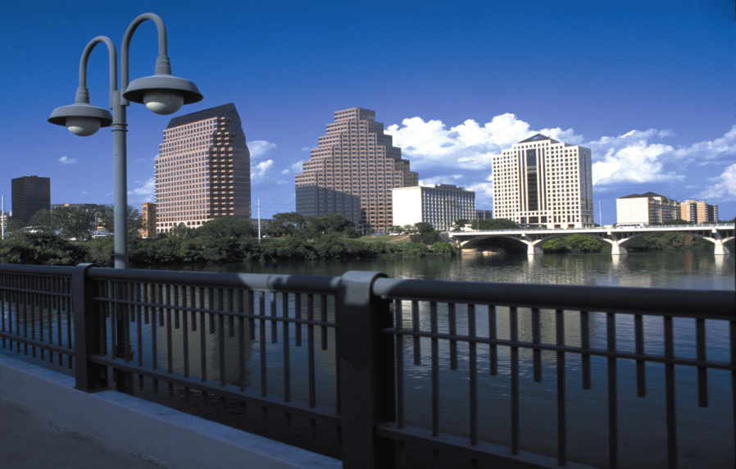
Questions
Contact Information:
Karl R. Rábago
Distributed Energy Services
512.322.6098
karl.rabago@austinenergy.com

Slide 10
The Pecan Street Project
The Pecan Street Project is a collaboration of –
Austin Energy
University of Texas
Environmental Defense Fund
Greater Austin Chamber
City of Austin
technology advisory committee
ERCOT • Bluebonnet Electric Coop
CPS Energy San Antonio • Pedernales Electric Coop

Slide 11
The Pecan Street Project
an open platform Energy Internet
integrating
distributed solar
smart grid water
demand response
electric vehicles
energy storage
dynamic pricing
smart appliances
green building
built on Austin’s advanced smart grid platform

Slide 12
The Pecan Street Project

Slide 13
The Pecan Street Project

Slide 14
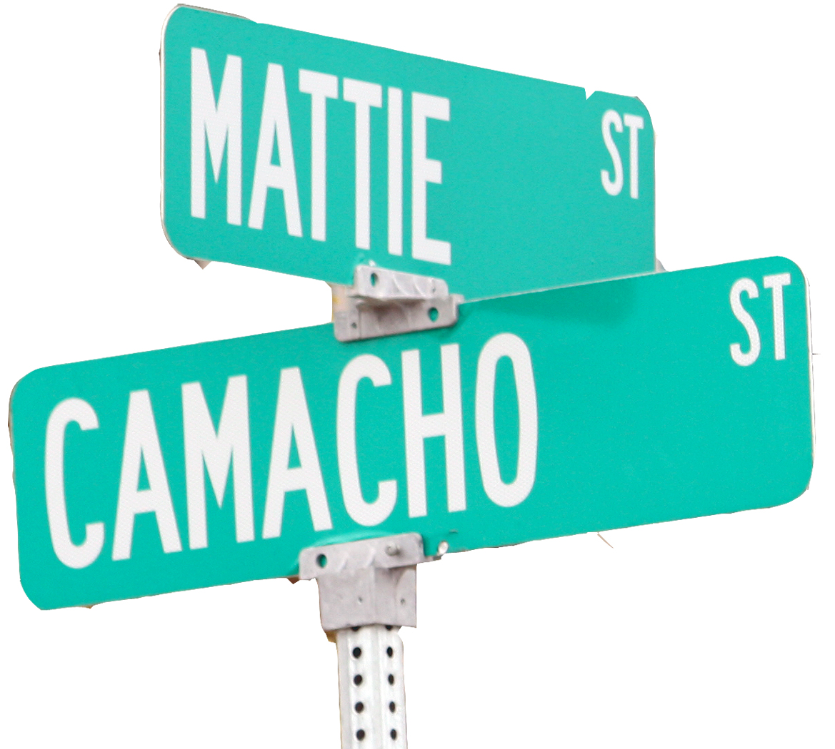
The Pecan Street Project
A Day in the Life
Opening an app on her mobile phone one summer afternoon in 2014, Mueller resident Mattie Camacho receives a real-time report on energy usage inside her home. She learns that her electricity usage will cause her to exceed the energy and carbon budget she had set at the beginning of the month.
But, her home energy gateway informs her, the software linked to her smart appliances can adjust settings on her air conditioner and washer/dryer while she is at work during the day to take advantage of peak pricing.

Slide 15
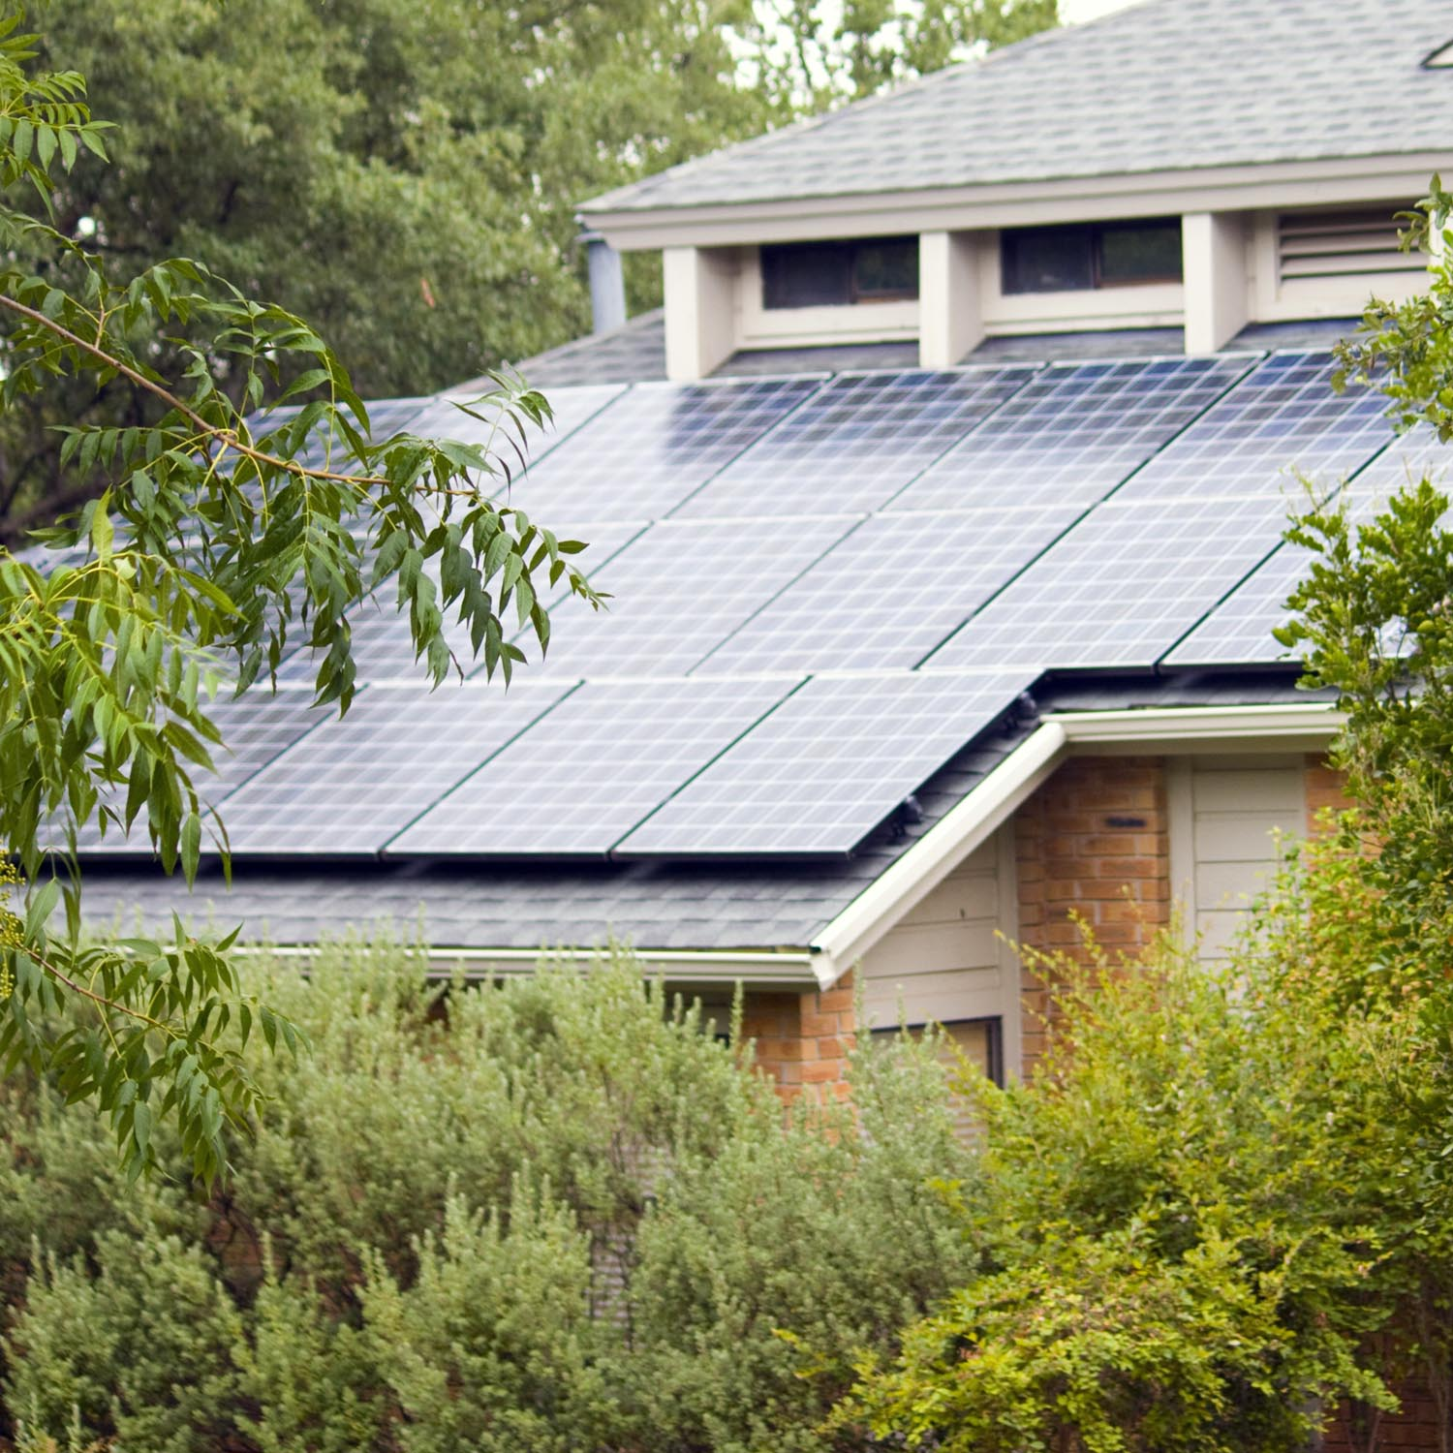
The Pecan Street Project
It won’t just be to take advantage of peak pricing for the energy she uses.
It will also be to take advantage of peak pricing…
…for the power coming from the solar panels on her roof.
She touches a button on her phone screen. Instantly, she sees that electricity from the solar panels on her roof is now feeding into the Energy Internet and reducing her electric bill.

Slide 16
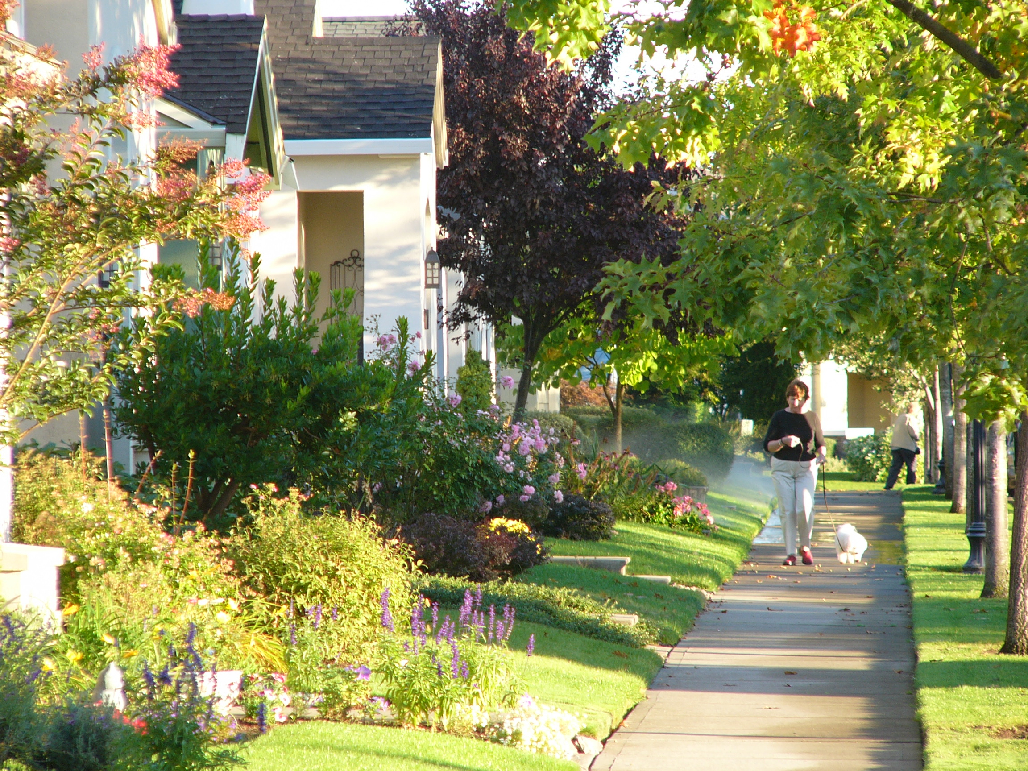
The Pecan Street Project
Her monthly water bill is also on track – thanks to her smart sprinkler system, which detected a leak at a sprinkler head earlier this month.
Earlier in the summer, her smart grid water system had detected a leak in her toilet while she was at work.
It had automatically shut off the leak and alerted her.

Slide 17
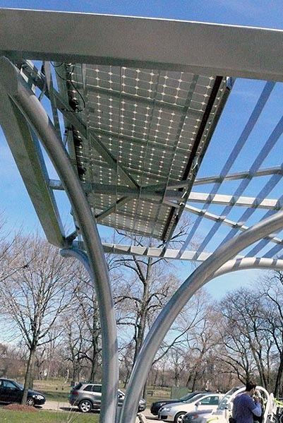
The Pecan Street Project
She had stopped by the
green built Home Depot at Mueller on the way home.
She had even charged her
electric car at a Mueller
solar-powered car charging station while she shopped.

Slide 18
The Pecan Street Project
The Energy Internet… has the potential to give us more growth with fewer power plants, better energy efficiency, and more renewable energy.
Thomas Friedman, Hot, Flat and Crowded

Slide 19
The Pecan Street Project

Slide 20
Questions & Discussion

Slide 21
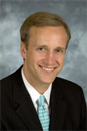
Brewster McCracken
Executive Director of the Pecan Street Project
This project supports clean-energy
technology for Austin.
Experience:
Mayor pro tem,
Austin City Council
UT-Austin Law and MPA degrees
Prosecutor, Harris County D.A.
Notes:
Brewster McCracken serves as the executive director of the Pecan Street Project, a coalition of business leaders, academics, and government officals supporting clean-energy technology for Austin.

Slide 22
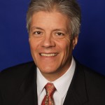
Karl Rábago
Vice President of Distributed Energy Services
at Austin Energy
Experience:
Deputy Assistant Secretary, US Department of Energy
Commissioner, Texas Public Utility Commission
Sustainability Leader, NatureWorks
Judge Advocate General’s Corps
Notes:
Karl Rábago is the Vice President of Distributed Energy Services at Austin Energy. His professional experience includes the U.S. Department of Energy, a Texas public utility, and the Environmental Defense Fund.

Slide 23
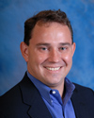
Michael Webber
Associate Director,
Center for International Energy and Environmental Policy
Mechanical Engineering Professor
Experience: Energy and environmental policy Alternative and renewable energy Combustion; gas sensors; oil and gas
Notes:
Michael Webber is a professor of mechanical engineering at UT Austin and the Associate Director of the Center for International Energy and Environmental Policy.

