Slide 1

Angels & Demons:
Physics, Antimatter, and Armageddon
# 64
Dr. Sacha Kopp
February 19, 2010
Produced by and for Hot Science - Cool Talks by the Environmental Science Institute. We request that the use of these materials include an acknowledgement of the presenter and Hot Science - Cool Talks by the Environmental Science Institute at UT Austin. We hope you find these materials educational and enjoyable.

Slide 2
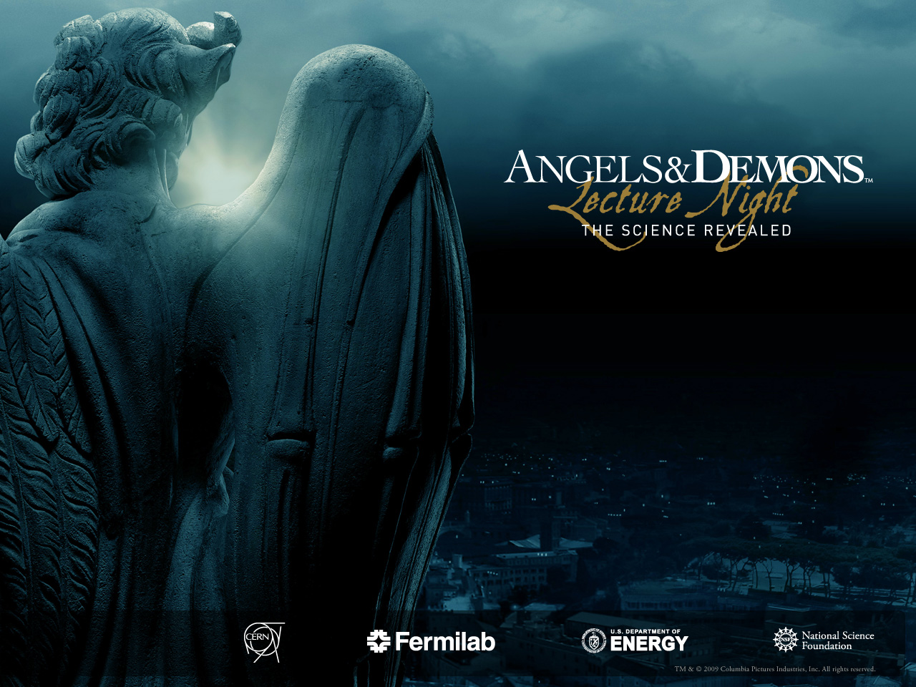

Hot Science - Cool Talks #64
Presented by the Environmental Science Institute, the College of Natural Sciences and the Jackson School of Geosciences at The University of Texas at Austin
Angels &Demons
Physics, Antimatter &Armageddon
Sacha Kopp
The University of Texas at Austin
19 February 2010
University
of Texas

Slide 3

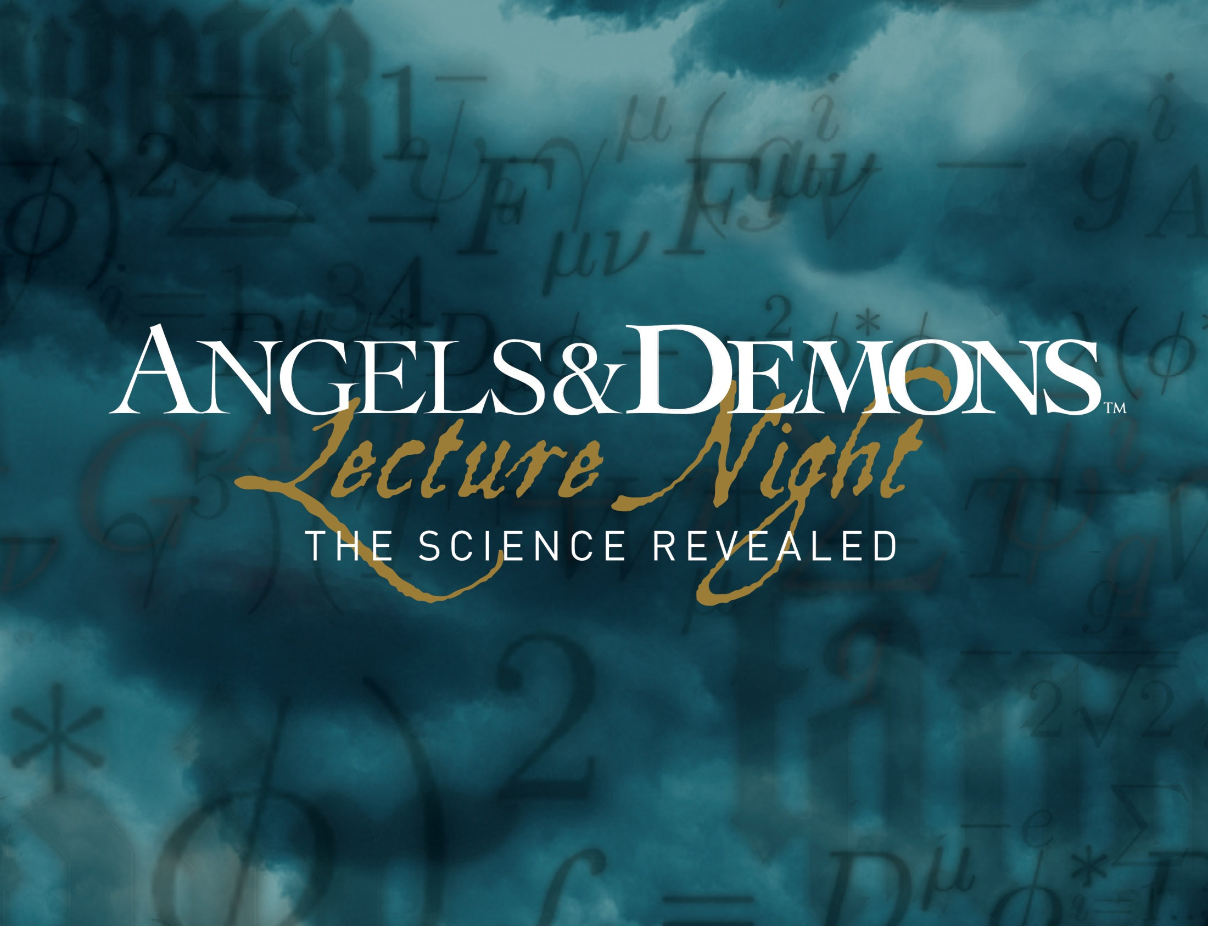

Slide 5
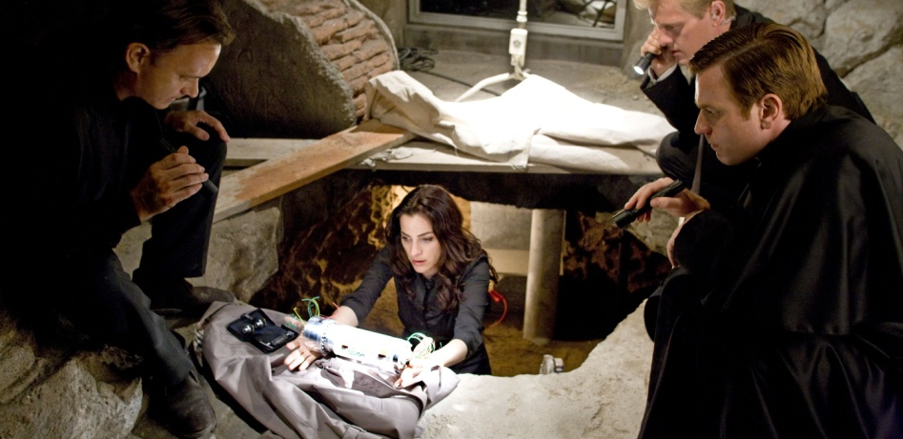
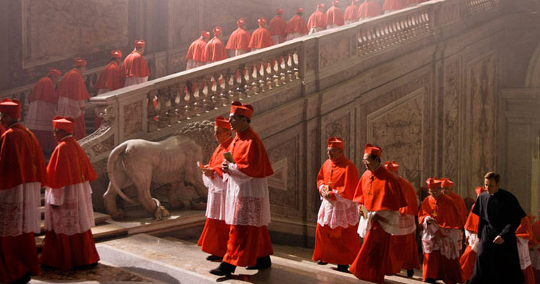
The Plot
Antimatter is stolen from CERN’s Large Hadron Collider and hidden in Vatican City.
Countdown to Vatican annihilation begins.
Race through Rome to avert death and destruction.
Notes:
Top image is of Ayelet Zurer as Vittoria Vetra looking at the canister containing antimatter.
Image found at: http://blog.screenweek.it/2008/10/quattro-nuove-foto-da-angeli-e-demoni-23810.php
Bottom image (not in high resolution) was taken from the Angels & Demons Web site.
Image found at: http://www.sonypictures.com/homevideo/angelsanddemons/

Slide 6
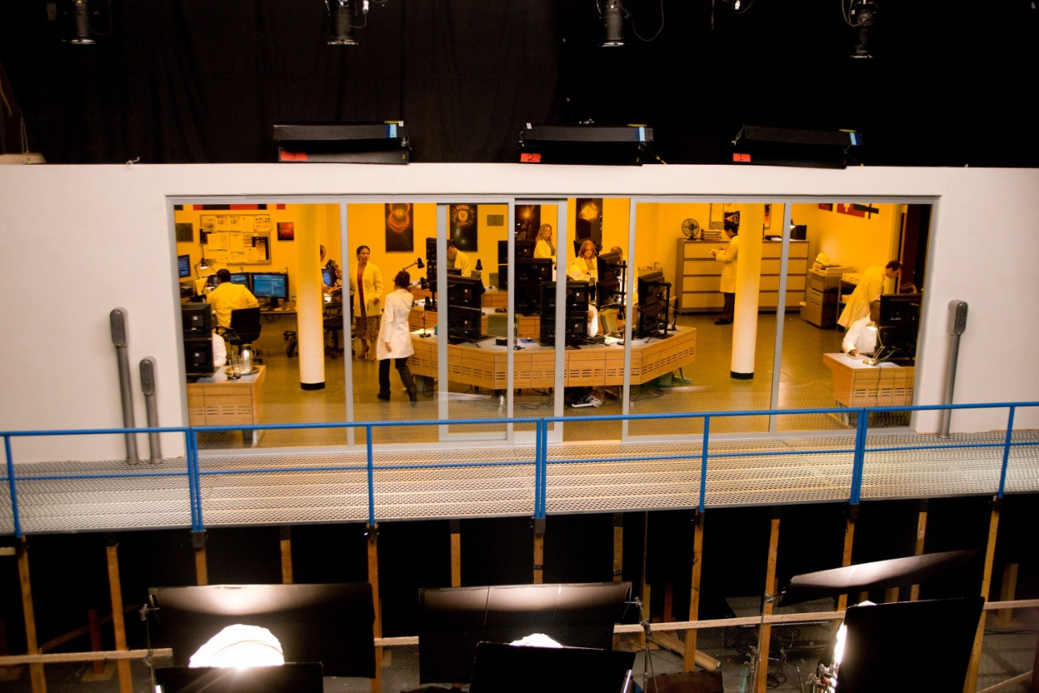
Hollywood’s CERN
photo credit: Sony Motion Pictures
Notes:
Image of the ATLAS control room set for Angels & Demons.
Image can be found at:<http://atlas.ch/angels/images.html>

Slide 7
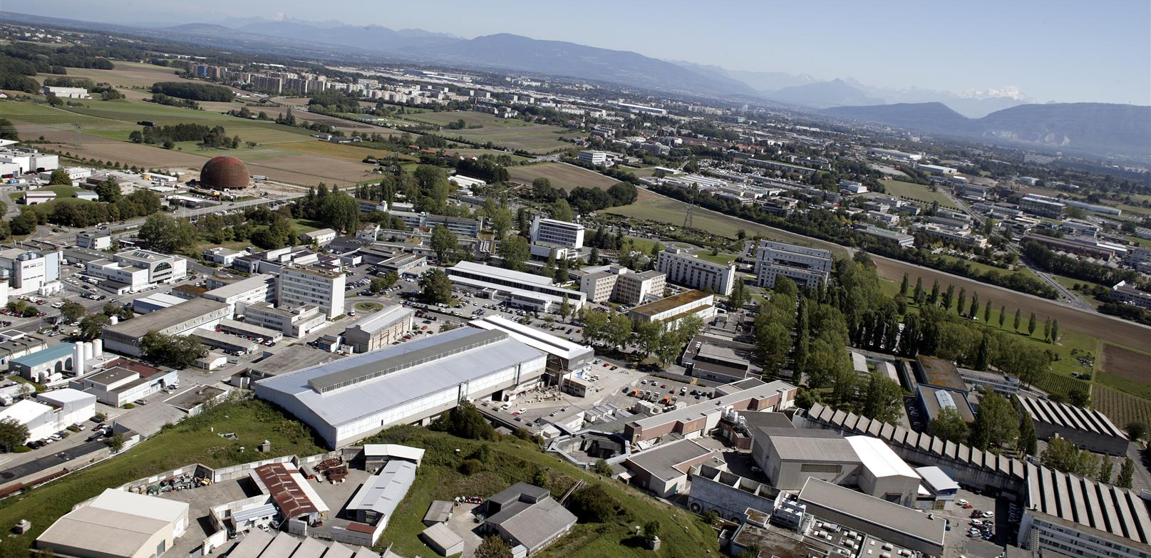
Real-life CERN
Near Geneva, Switzerland
Not top secret
© CERN
Notes:
Image found at: http://cms.web.cern.ch/cms/Media/Publications/CMStimes/2007/03_26/index.html

Slide 8
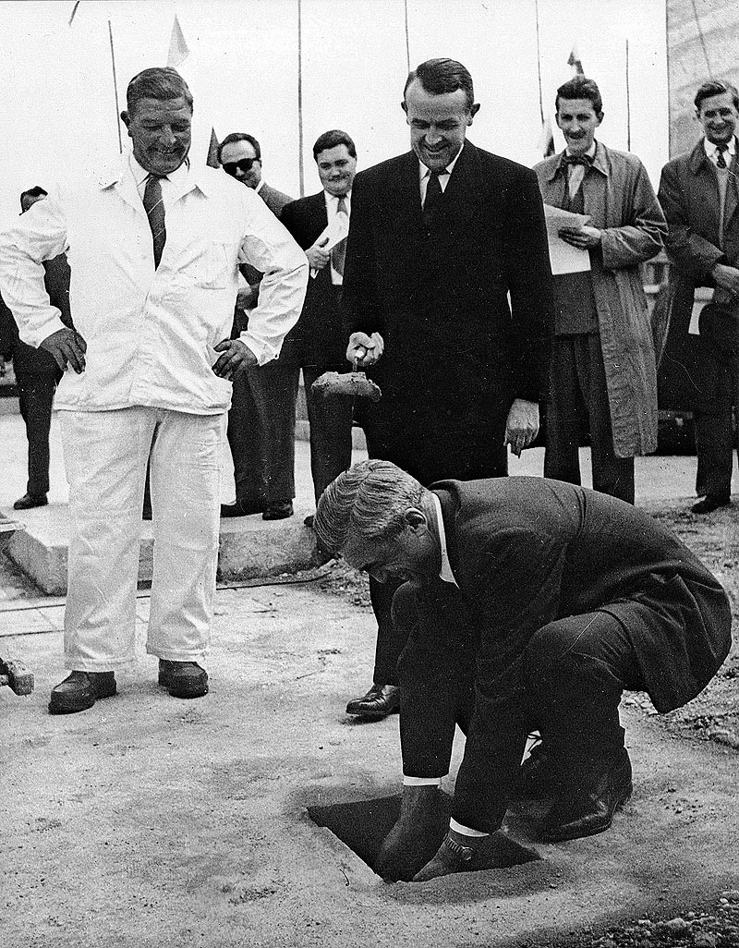
Towards international collaboration
First proposed by Louis deBroglie, Neils Bohr, Pierre Auger, and others
Founded 1954
Bring together nations of Europe in spirit of scientific collaboration (aftermath of World War II)
photo credit: CERN
Notes:
The Foundation Stone: Setting up a laboratory for pure research at CERN
Image found at: cerncourier.com/cws/article/cern/29162
January/February 1960

Slide 9
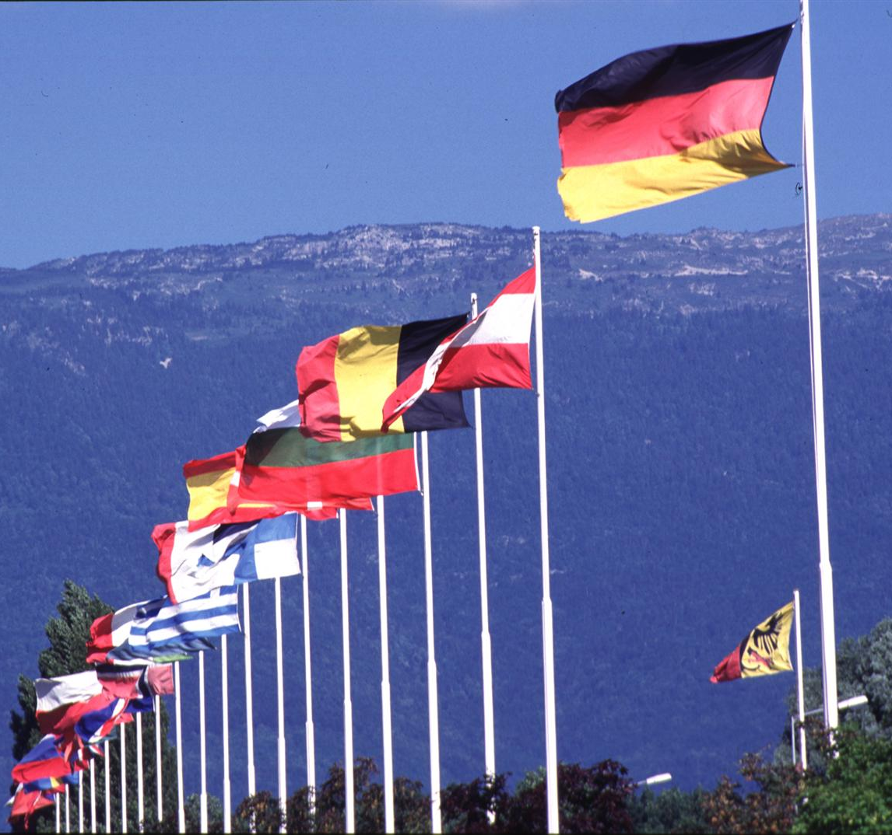
CERN
European Laboratory for Particle Physics
20 member countries
More than 9,000 scientists
Over 100 nationalities
More than 1,000 from U.S. universities and labs
© CERN
Notes:
One of Europe’s first joint ventures
Image found at: http://www.particlephysics.ac.uk/news/picture-of-the-week/picture-archive/now-we-are-20--cern-s-member-states.html

Slide 10
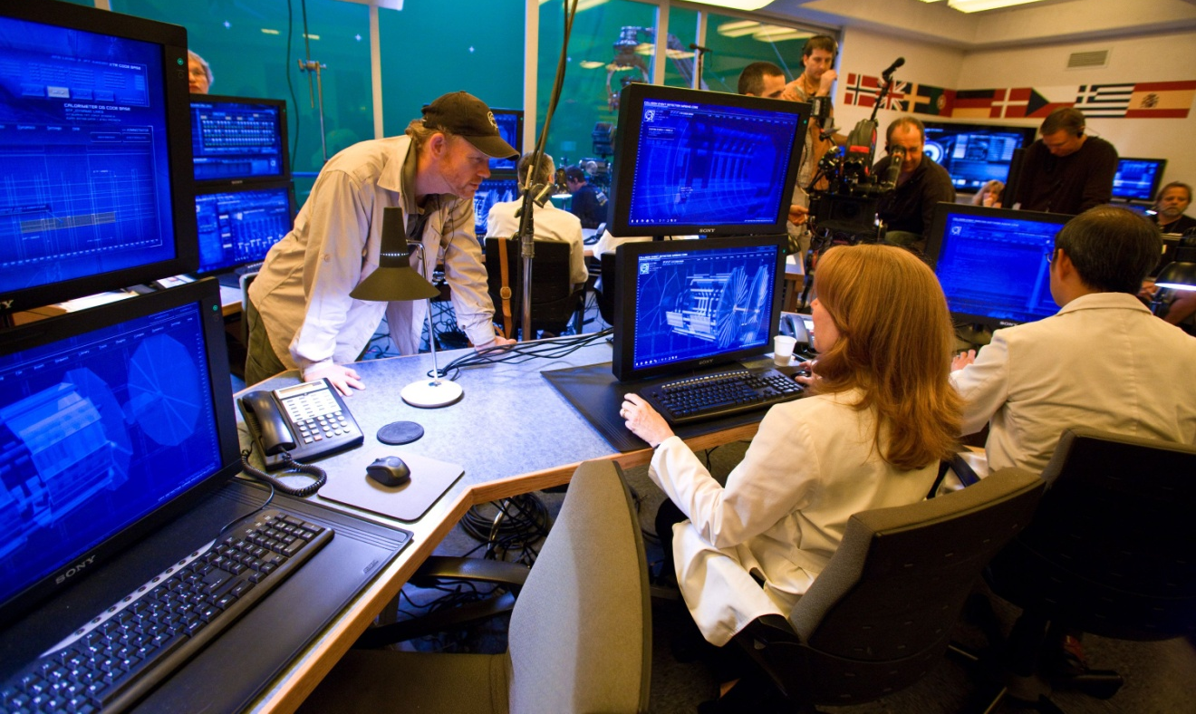
Hollywood’s Large Hadron Collider
photo credit: Sony Entertainment
Notes:
Image of Ron Howard in the ATLAS control room set for Angels & Demons.
Image can be found at: <http://atlas.ch/angels/images.html>

Slide 11
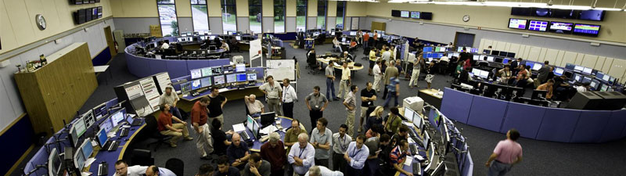
The Real LHC Control Room
TRUE: large array of computers, links to experiments
FALSE: not right next to LHC detectors
photo credit: CERN

Slide 12
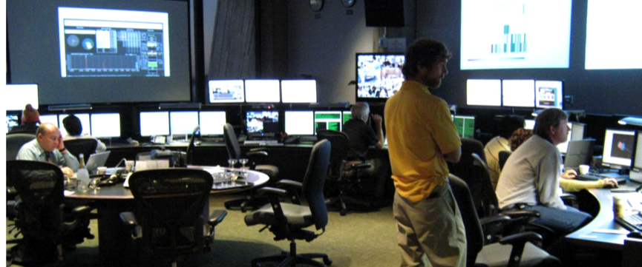
Remote LHC Control Room in U.S.A.
Sun will never set on LHC. Daytime USA = night in Switzerland
Modern internet and computing ==> remote monitoring of LHC.
photo credit: Fermilab

Slide 13
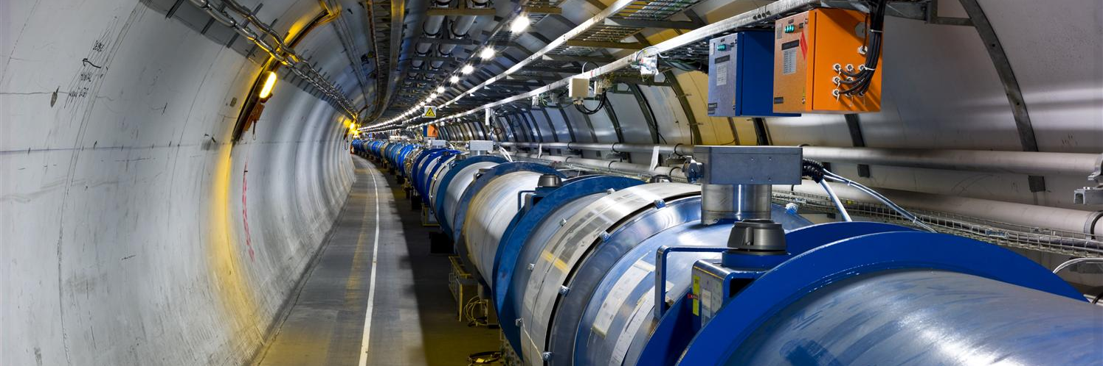
The real LHC
The world’s most powerful particle accelerator – 14 TeV
16.8 miles around, 330 feet underground
© CERN
Notes:
TeV: trillion electron volts

Slide 14
The cern accelerator complex
image credit: CERN

Slide 15
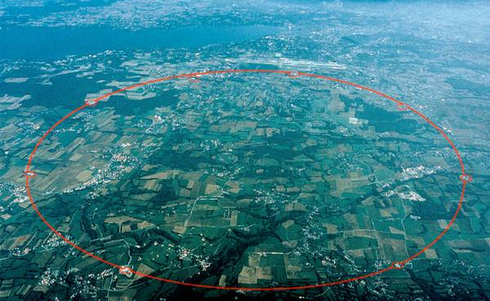
The Large Hadron Collider…
photo credit: CERN
Notes:
Those interested in researching into the smallest building blocks matter is made up of need the largest instruments. CERN, near Geneva, Switzerland, is where the most powerful circular accelerator in the world is being built: the Large Hadron Collider (LHC) for proton collisions. It has a circumference of 26.7 km. The subterranean tunnel of the accelerator is indicated by the large circle. (image source: CERN)

Slide 16
… is really LARGE!!
UT
Time for fast marathon runner to sprint around once: 2 hours?
Time for the proton beam: 1/10,000th of a second
Town Lake
Austin-Bergstrom Airport

Slide 17
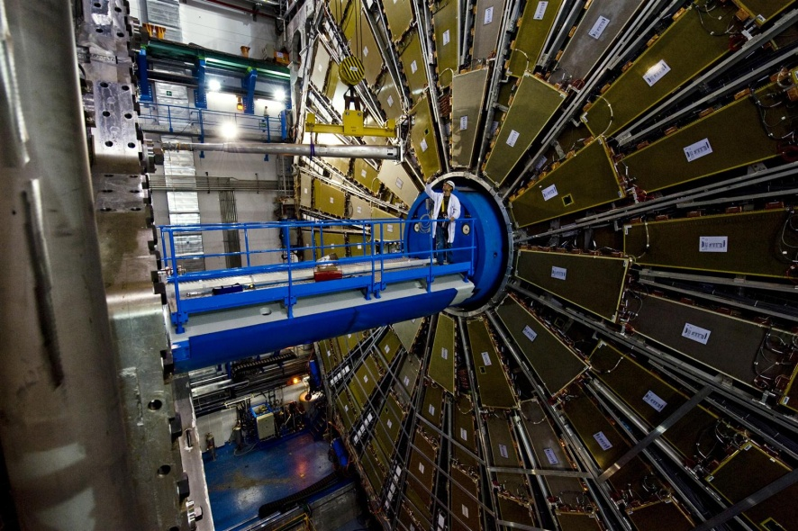
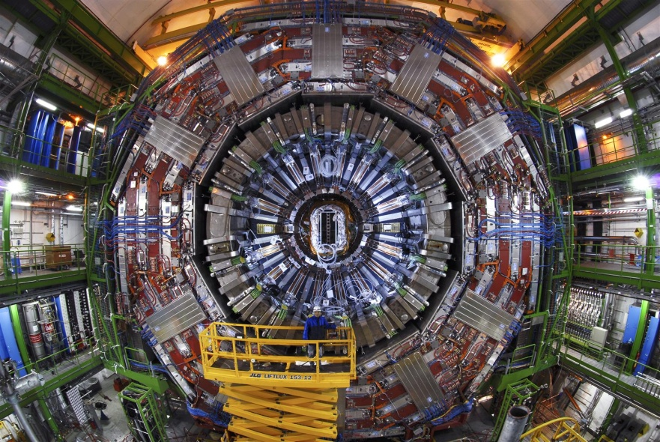
The LHC
Will smash particles into each other…
…to re-create the conditions of the early Universe
© CERN
© CERN
Info. from LHC detectors will equal ENTIRE world telecommunications traffic!
Notes:
Two large general-purpose detectors built on the LHC underground
On left: ATLAS detector - (A Toroidal LHC ApparatuS). That is a person standing on the blue platform!
On right: CMS detector - (Compact Muon Solenoid)

Slide 18
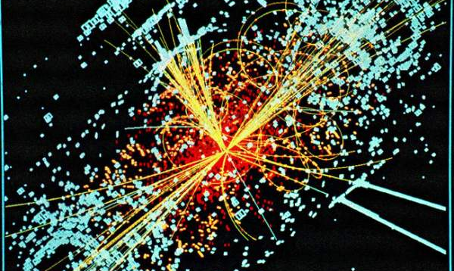
Computer simulation of proton-proton collision
Notes:
Image found at: http://cdsweb.cern.ch/record/628469

Slide 19
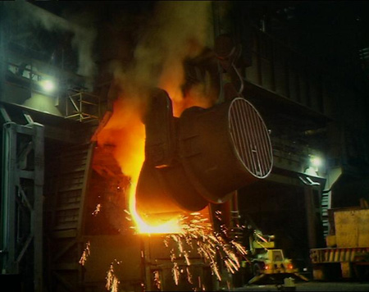
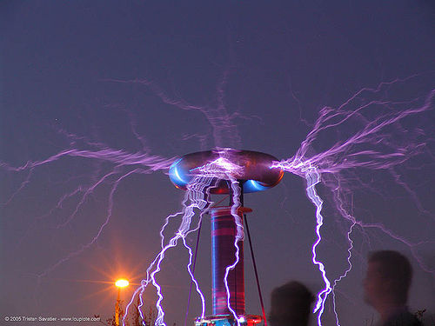
Just how much energy …
Blast Furnace ~ ¼ eV
Tesla coils – 250,000 eV
Notes:
Blast Furnace image can be found at: <http://www.bbc.co.uk/schools/gcsebitesize/science/aqa/rocks/metalsrev2.shtml>

Slide 20
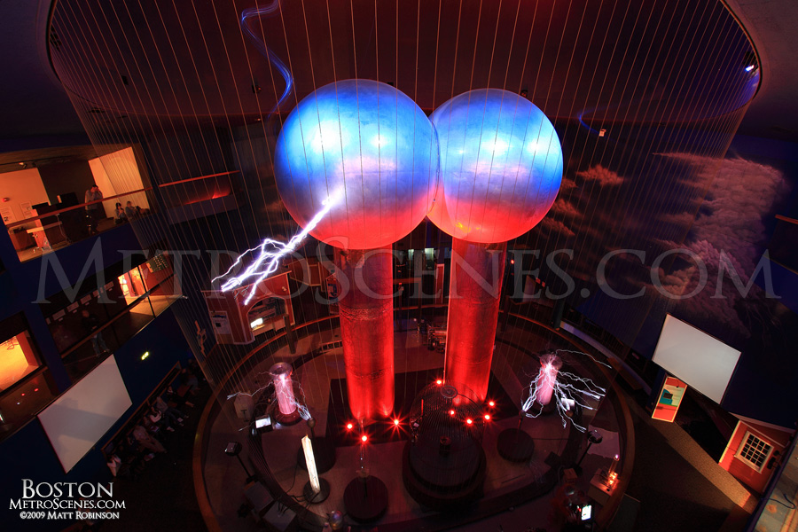
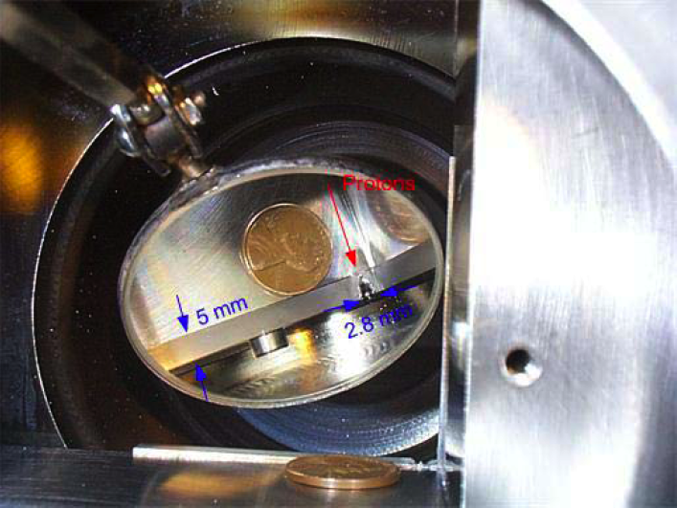
…is 14 TeV anyway??
Van de Graaf – 5,000,000 eV
Fermilab – 1,000,000,000,000eV
Notes:
Left Image at left can be found at Boston metrosciences.com
Right Image credit: Fermi National Accelerator Laboratory

Slide 21
Can the LHC really destroy the world …
put newspaper clippings about black holes
put video clip of black hole
Notes:
“Doomsday fears spark lawsuit over collider” http://www.msnbc.msn.com/id/23844529/
“Asking a Judge to Save the World, and Maybe a Whole Lot More” New York Times http://www.nytimes.com/2008/03/29/science/29collider.html

Slide 22
… As seen on the “Daily Show”
Notes:
Video/webpage image can be found at: http://www.thedailyshow.com/watch/thu-april-30-2009/large-hadron-collider

Slide 23
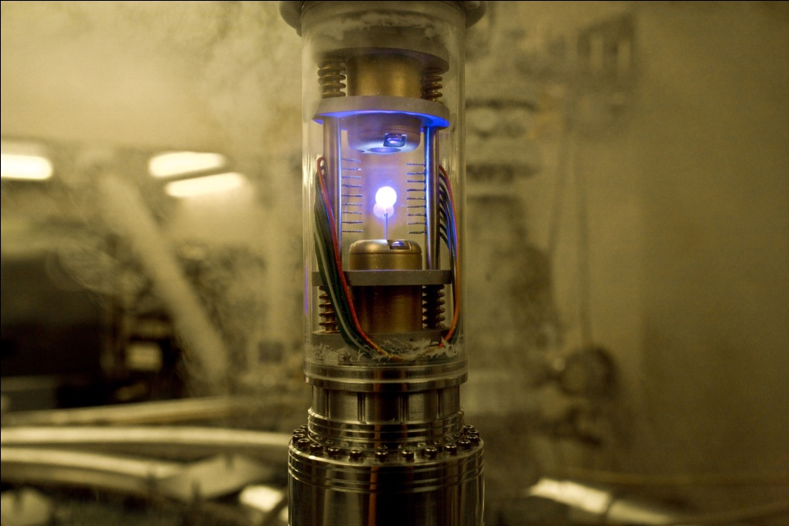
Antimatter
It’s real
It’s produced at the Large Hadron Collider
Enough of it could destroy Rome
What is it?
?
photo credit: Sony Motion Pictures
Notes:
Image is of the antimatter canister from the movie.

Slide 24

ANTIMATTER
Suggest inserting “The God particle” movie clip
Notes:
Angels and Demons movie clip about antimatter.

Slide 25












What is matter?
Particles in various combinations
Quarks
Leptons
up
charm
electron
muon
tau
top
down
strange
bottom
electron neutrino
muon neutrino
tau neutrino
Notes:
We often learn of the periodic table of the elements in chemistry class. These 100+ chemical elements are billed as the fundamental building blocks of all matter. But that’s only partially correct. The atoms are not fundamental in the sense of being indivisible. In fact they are composites of much smaller particles.
Today we know there are 12 fundamental particles – the particle physicists call this periodic table the “Standard Model” of particle physics. All matter is in fact made of these 12 particles.

Slide 26
Building a universe
electron
proton
neutron
Multiply by billions and billions and billions and billions…
Notes:
This diagram shows how three quarks (up+up+down) make up a proton, and three quarks (down+down+up) make up a neutron. An atom consists of a nucleus made of protons and neutrons, and as shown in the diagram, the nucleus is orbited by electrons.

Slide 27

Where does antimatter fit?
For every particle
There is an antiparticle
up
electron
anti-up
positron
down
electron neutrino
anti-down
Anti-electron neutrino
Particles and antiparticles have opposite electric charge

Slide 28
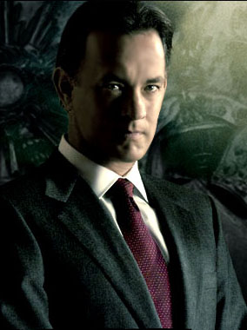
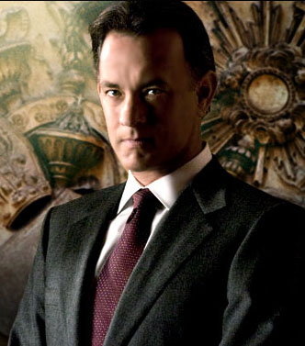
Matter vs. Antimatter
Anti-Tom Hanks
Tom Hanks
Would look very much like
Notes:
There’s nothing inherently evil about antimatter
If it’s common, it was called matter
If it’s uncommon, it was called antimatter
Images of Tom Hanks as Robert Langdon are from the Angels & Demons Web site.

Slide 29
Matter vs. Antimatter
But were they to meet…
E=mc²
Notes:
Images of Tom Hanks as Robert Langdon are from the Angels & Demons Web site.

Slide 30
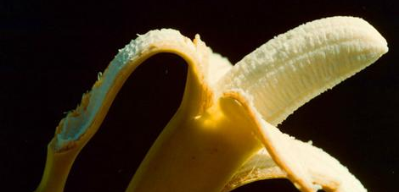
Our first introduction to Antimatter
Notes:
The simplest place to find antimatter is in a banana. It has lots of potassium, some of which is radioactive and emits anti-electrons. You would, in the time your body is digesting a banana, be exposed to about 1000 antiparticles annihilating in your body.

Slide 31

K⁴⁰ is antimatter producer
KCl is salt substitute
K⁴⁰ is 0.012% of all Potassium
Has too many neutrons compared to stable K³⁹.
Transmutes one proton by ejecting a positron from nucleus:
K⁴⁰→Ar³⁹+e⁺+ν_{e}
Notes:
Image found at: http://theodoregray.com/periodictable/Elements/019/index.s7.html#sample1

Slide 32
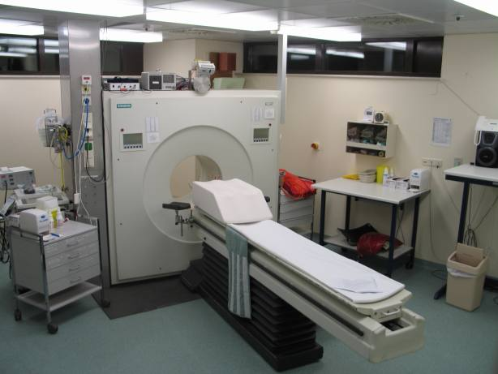
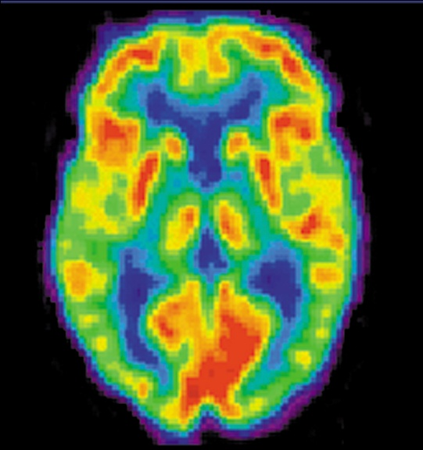
Antimatter can be used for
PET Scans
Courtesy NIH
Notes:
Photo on left is a typical PET facility equipped with an ECAT Exact HR+ PET scanner. (Photo from http://commons.wikimedia.org/wiki/File:ECAT-Exact-HR--PET-Scanner.jpg)
Photo on right is a PET scan of a 20-year-old adult’s brain
PET Scan Defined: A positron emission tomography (PET) scan is a unique type of imaging test that helps doctors see how the organs and tissues inside your body are actually functioning. The test involves injecting a very small dose of a radioactive chemical, called a radiotracer, into the vein of your arm. The tracer travels through the body and is absorbed by the organs and tissues being studied. Next, you will be asked to lie down on a flat examination table that is moved into the center of a PET scanner—a doughnut-like shaped machine. This machine detects and records the energy given off by the tracer substance and, with the aid of a computer, this energy is converted into three-dimensional pictures. A physician can then look at cross-sectional images of the body organ from any angle in order to detect any functional problems.
How is a PET scan different from a CT or MRI scan?
One of the main differences between PET scans and other imaging tests like CT scan or magnetic resonance imaging (MRI) is that the PET scan reveals the cellular level metabolic changes occurring in an organ or tissue. This is important and unique because disease processes often begin with functional changes at the cellular level. A PET scan can often detect these very early changes whereas a CT or MRI detect changes a little later as the disease begins to cause changes in the structure of organs or tissues.

Slide 33
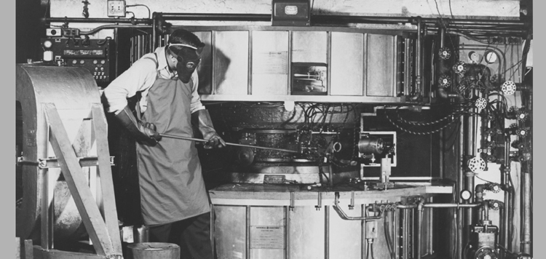
Making isotopes for PET (C¹¹, N¹³, O¹⁵, F¹⁸)
Harvard cyclotron, 1955

Slide 34
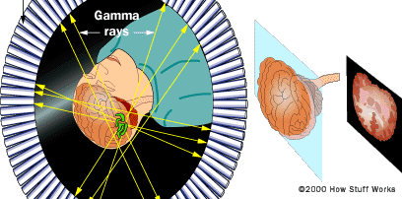
Detecting simultaneous gamma rays
Notes:
Gamma rays are electromagnetic radiation of high frequency (very short wavelength). They are produced by sub-atomic particle interactions such as electron-positron annilation, neutral pion decay, radioactive decay, fusion, fission or inverse Compton scattering in astrophysical processes. Gamma rays typically have frequencies above 10¹⁹ Hz, and therefore have energies above 100 keV and wavelength less than 10 picometers, often smaller than an atom. Gamma radioactive decay photons commonly have energies of a few hundred keV, and are almost always less than 10 MeV in energy. (Source: Wikipedia)
Gamma-rays have the smallest wavelengths and the most energy of any other wave in the electromagnetic spectrum. These waves are generated by radioactive atoms and in nuclear explosions. Gamma-rays can kill living cells, a fact which medicine uses to its advantage, using gamma-rays to kill cancerous cells.
Gamma-rays travel to us across vast distances of the universe, only to be absorbed by the Earth's atmosphere. Different wavelengths of light penetrate the Earth's atmosphere to different depths. Instruments aboard high-altitude balloons and satellites like the Compton Observatory provide our only view of the gamma-ray sky
Gamma-rays are the most energetic form of light and are produced by the hottest regions of the universe. They are also produced by such violent events as supernova explosions or the destruction of atoms, and by less dramatic events, such as the decay of radioactive material in space. Things like supernova explosions (the way massive stars die), neutron stars and pulsars, and black holes are all sources of celestial gamma-rays. (SOURCE: http://science.hq.nasa.gov/kids/imagers/ems/gamma.html)

Slide 35
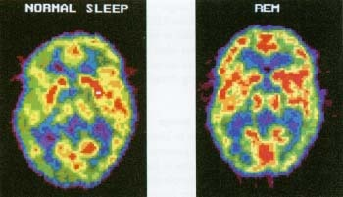
Assessing brain activity
Normal Sleep REM Sleep
Notes:
Image found at: http://www.humanillnesses.com/Behavioral-Health-Sel-Vi/Sleep.html

Slide 36
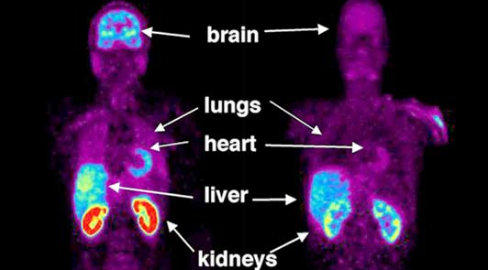
Reduced blood flow to organs of smokers
Non Smoker
Smoker
Proc. Nat’l Acad. of Sciences, 9/28/03, "Low Monoamine Oxidase B in Peripheral Organs in Smokers."
Notes:
Image from Proc. Nat’l Acad. of Sciences, 9/28/03, "Low Monoamine Oxidase B in Peripheral Organs in Smokers."

Slide 37
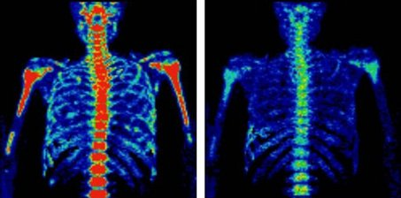
Assessing CHEMO effectiveness
Before chemotherapy
After chemotherapy
Notes:
Image found at: http://www.msnbc.msn.com/id/29513672/ns/health-cancer/

Slide 39
“Cat scans are for Felines.
I’ll give your dog a Pet scan.”
Notes:
Image can be found at: http://www.cartoonstock.com/directory/c/cat_scans.asp

Slide 40
You didn’t wash the matter with the anti-matter again, did you?

Slide 41
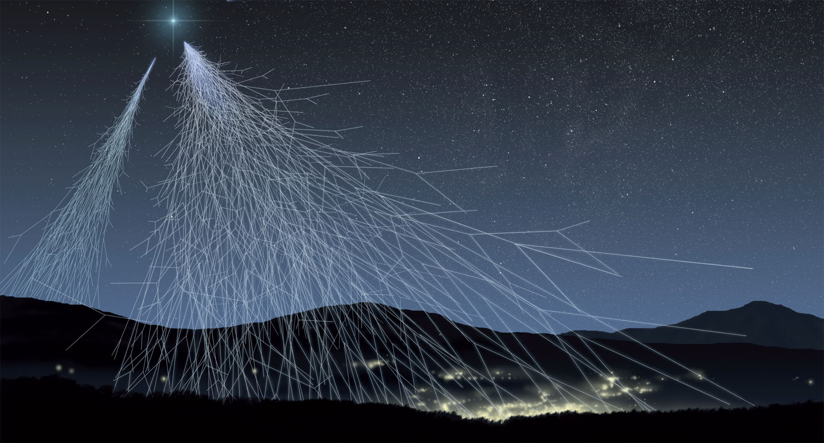
CAN WE MAKE ANTIMATTER?
Nature does, all the time!
© L.Bret / Novapix /ASPERA
Notes:
The picture is an “artistic view of a cosmic rays shower.” (SOURCE: http://www.aspera-eu.org/index.php?option=com_content&task=view&id=290)

Slide 42
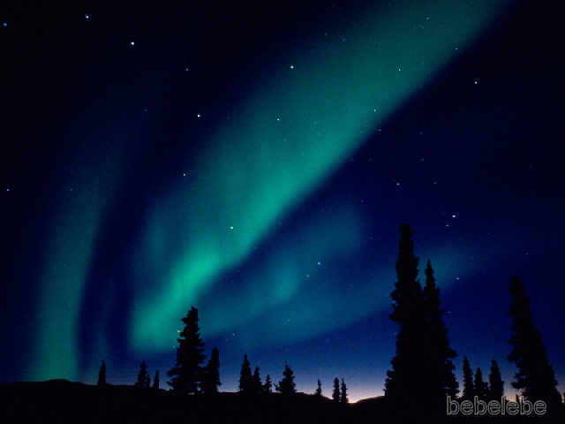
Example of cosmic rays: Aurora Borealis
Notes:
Image taken from The Particle Explosion, by Close, Schwartz, and Sutton

Slide 43
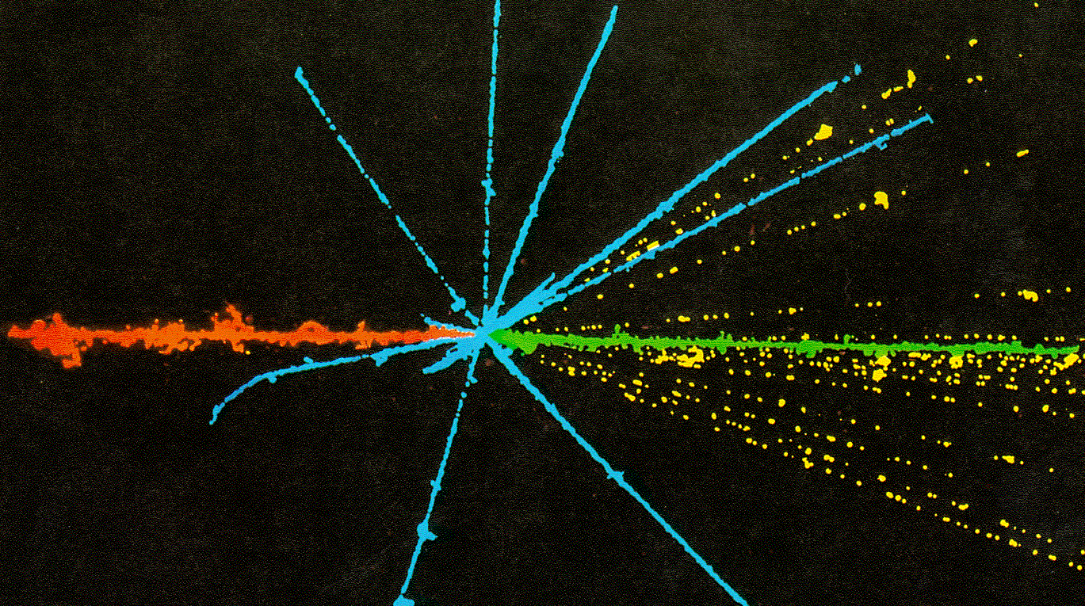
Incoming cosmic ray breaks up a nucleus
Notes:
Image taken from The Particle Explosion, by Close, Schwartz, and Sutton

Slide 44
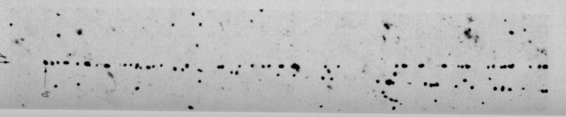
Quantum of Energy splits into matter-antimatter
γ
e⁺
e⁻
Notes:
Image taken from The Study of Elementary Particles by the Photographic Method. An account of the principal techniques and discoveries illustrated by an atlas of photomicrographs. C. F. Powell, P. H. Fowler, and D. H. Perkins. Pergamon Press, New York, 1959

Slide 45
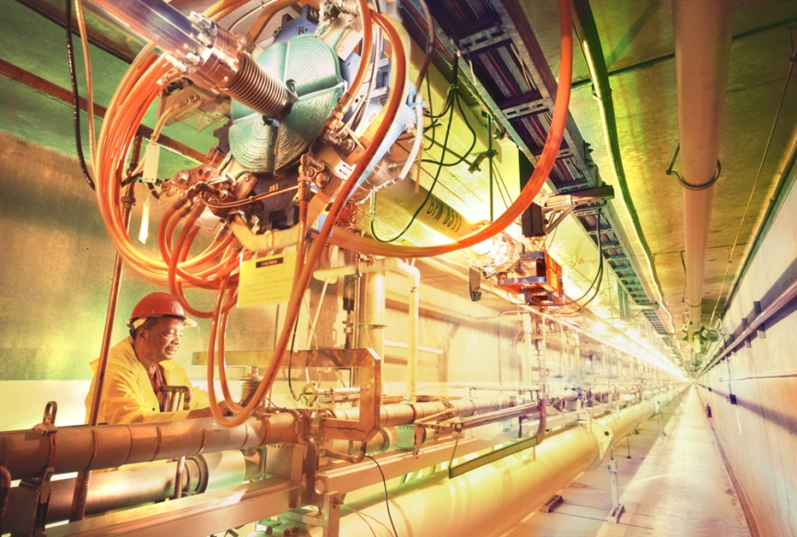
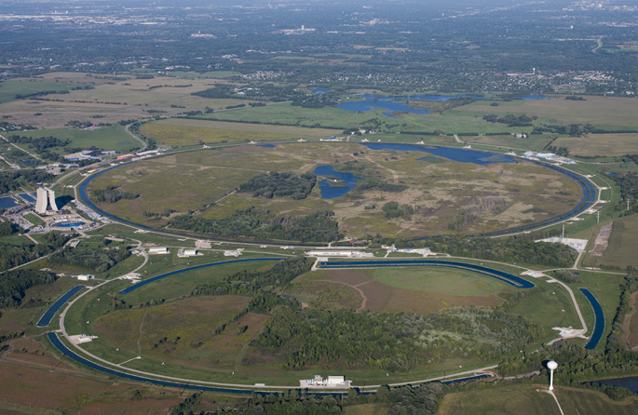
Can we make antimatter?
We can, and do …
SLAC National Accelerator Laboratory
Fermilab
In particle accelerators
Notes:
Photo on left is the linear accelerator at SLAC (accelerated electrons and positrons)
Photo on right is Fermilab’s Tevatron proton-antiproton collider

Slide 46
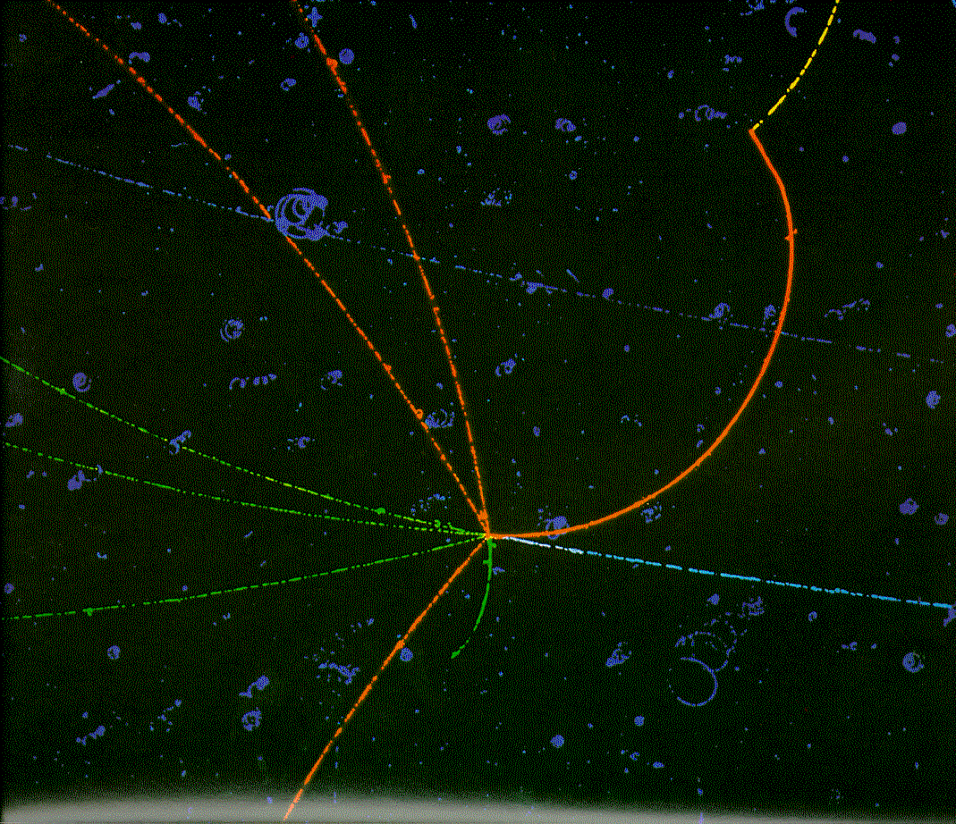
μ
+
π⁺
π⁺
-
π⁺
π
π
-
p
π
-
π⁻
π⁺
Notes:
Image taken from The Particle Explosion, by Close, Schwartz, and Sutton

Slide 47
Proton-antiprotons at 2 TeV: make t quark
jet
jet
jet
jet
muon
Image credits: Fermilab
neutrino

Slide 48
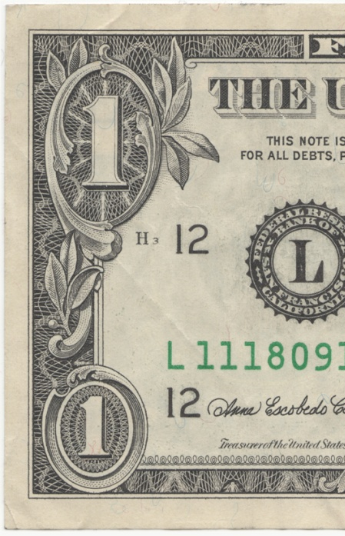
Angels & Demons & Antimatter
Rome is threatened by ¼ gram of antimatter
Annihilation of ¼ g matter + ¼ g antimatter = 10 kilotons of TNT
More than enough to destroy the Vatican
¼ gram
Notes:
Atomic bomb that destroyed Nagasaki was estimated to yield 20 kilotons of TNT.
Hiroshima bomb estimated at 14 kilotons of TNT.
NOTE: Amount of antimatter is from BOOK, do not know amount in movie.

Slide 49
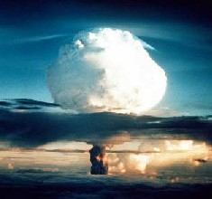
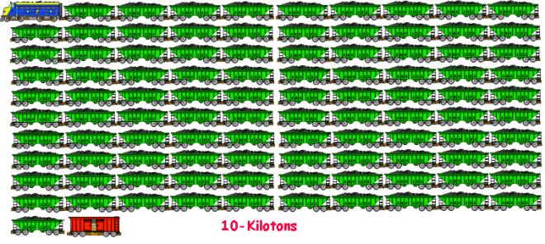
Hiroshima atomic bomb was equivalent to 15kton of TNT
To actually haul 10 kton of TNT would require a cargo train with 100 cars.

Slide 50
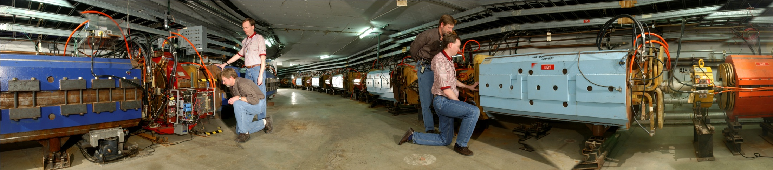
Antimatter’s no threat
We make very little antimatter
Fermilab creates 2.3 nanograms of antiprotons per year
It would take 109 million yrs to make ¼ gram (longer @ CERN)
Energy required to make ¼ gram would equal entire world’s energy consumption for 30 years!
Notes:
Photo is of Fermilab’s Antiproton Source, P-Bar, Accumulator and Debuncher
Real Fermilab rate is 2.3 ng/year (2008 total). Number of years was calculated using 2.3 ng.
Equivalent numbers for CERN’s Antiproton Decelerator are: Maximum rate of 3.6x10^14 antiprotons per year, thus 0.43 billion years to make 0.25 g. (more realistic rate more like <5x10^12 antiprotons per year)

Slide 51
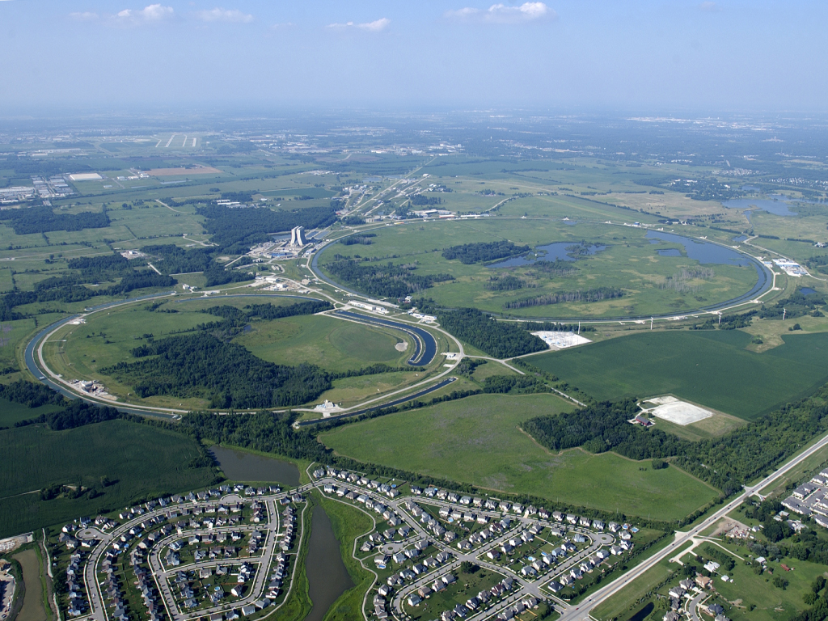


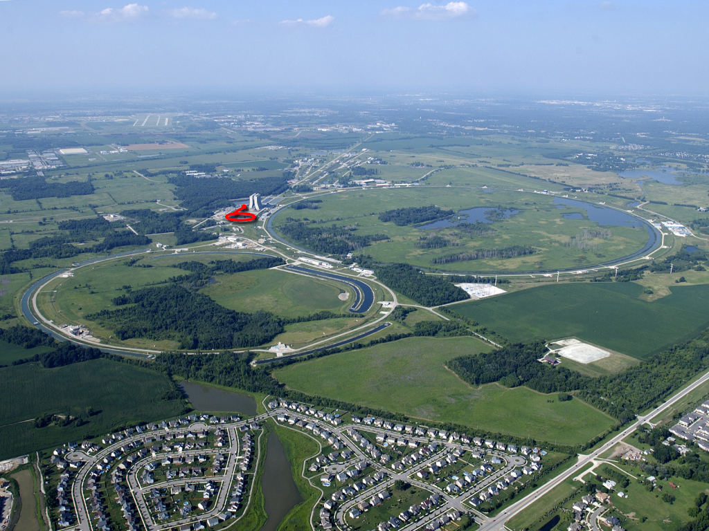
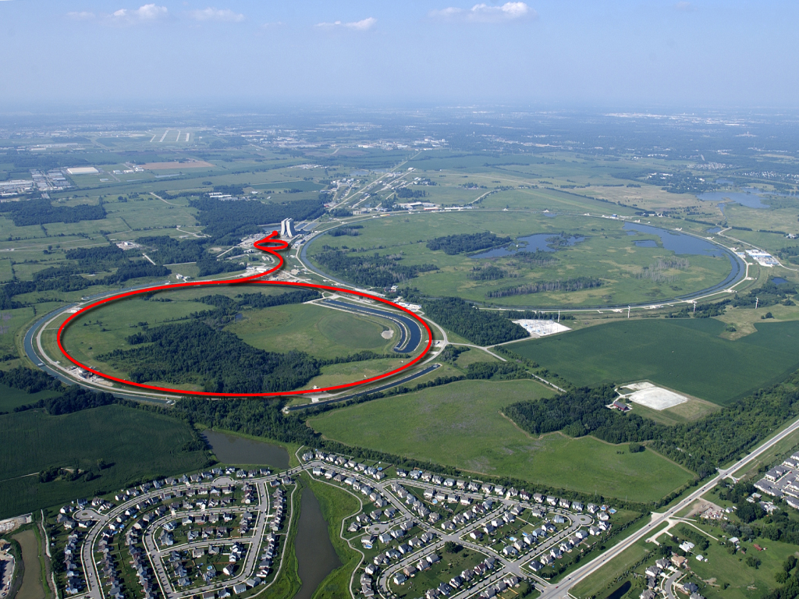
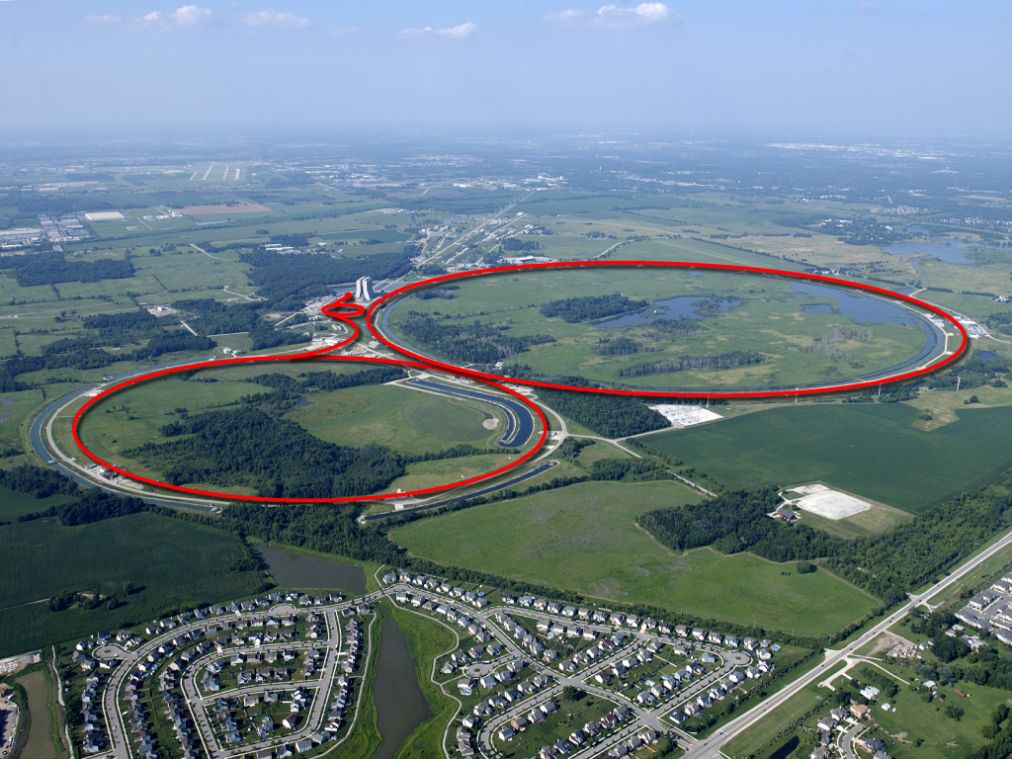
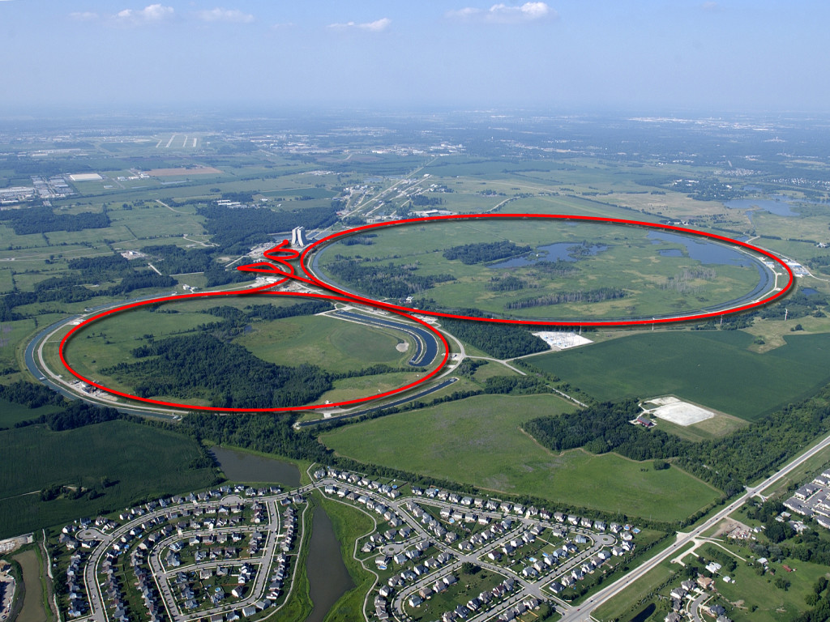

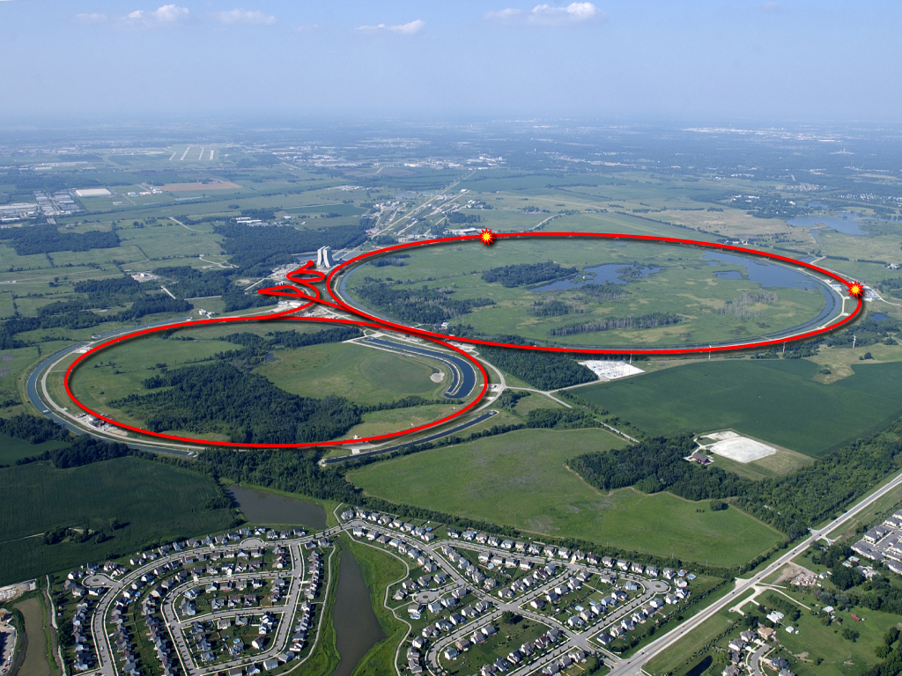
Fermilab: the anti-matter factory!
Image credit: Fermilab

Slide 52
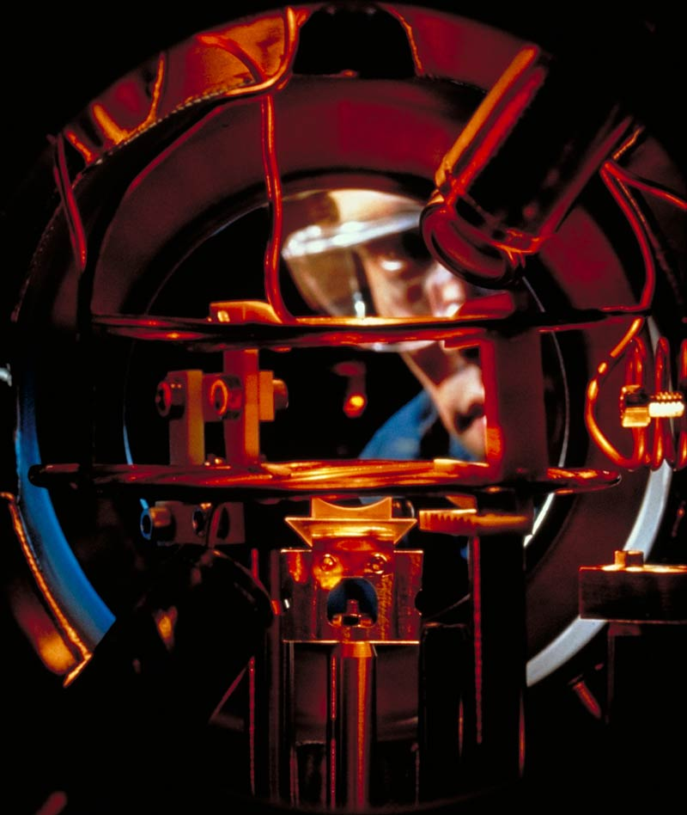
Actual trapping of particles
Laser-trapping of atoms
Nobel prize 1997 (Steven Chu, current Secretary of Energy!)
Research here at UT! (Profs. Dan Heinzen, Mark Raizen)
photo American Physical Society/NIST

Slide 53

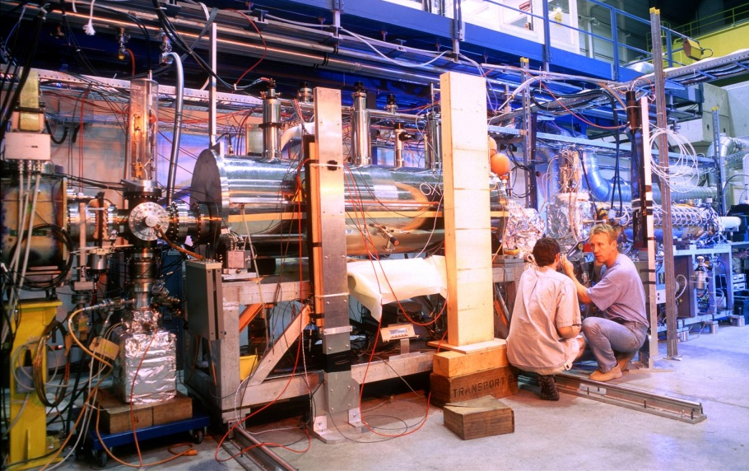
Antimatter’s no threat
It’s not portable
© CERN
Notes:
Photo on left is from movie. Image: © Columbia Pictures Industries, Inc. - all rights reserved. Reproduced with permission.
Photo on right is of ATHENA experiment at CERN, which studied antihydrogen (since replaced by ALPHA experiment).
ATHENA picture: http://cdsweb.cern.ch/record/41576
NOTE: It has been noted by some lecturers that portable antimatter traps for positrons, and possibly also antiprotons, may be feasible at the current time. However, they would not be hand-held as shown in Angels & Demons. They also wouldn’t hold a significant enough amount of antimatter to create a bomb.

Slide 54
Actual trapping of particles
Laser-trapping of atoms
Nobel prize 1997 (Steven Chu, current Secretary of Energy!)
Research here at UT! (Profs. Dan Heinzen, Mark Raizen)
photo American Physical Society/NIST

Slide 55

Antimatter can’t be used for
Power
  Have to make every single antiparticle
  More energy goes in than is produced – 1 in 10^6
Spaceships
  need an amount of antimatter like your fist
Notes:
NOTE REGARDING THE SECOND BULLET:
One lecturer points out that, while it does currently seem entirely impractical to use antimatter to propel a spaceship like in Star Treak, NASA has funded research on antimatter space propulsion and it is a topic of serious R&D for miniaturized space probes. The concept is not obvious and involves a sail coated with a fissionable material, which gets bombarded with antiprotons released from a magnetic bottle. Antiprotons are expensive to produce, but theoretically they pack the most thrust in the least mass of any possible propulsion technique, which is important in outer space.

Slide 56

book suggests cern has x33 spacecraft

Slide 57

more typical cern vehicle
Image credit: Prof. Trisha Vahle
More typical of a “Mr. Bean” television episode than of space vehicle.

Slide 58

The mystery of antimatter
We exist because there is almost no antimatter around
It wasn’t always that way
NASA/STScI/G.Bacon
Notes:
Animation is of the “Big Crunch”, one possibility of an ending to the universe. Included to provide a bridge to talking about the Big Bang. Original video can be downloaded from Chandra (scroll down for “The Big Crunch”):
http://chandra.harvard.edu/photo/2004/darkenergy/animations.html

Slide 59


The Big Bang
14 billion years ago, the Big Bang produced equal amounts of matter and antimatter
Everything should have annihilated
Instead…
Hitoshi Murayama

Slide 60

Solving the mystery
With quarks
SLAC National Accelerator Laboratory
Particle accelerators produce matter (quarks) and antimatter (anti-quarks)
Study the difference between them
Prof. Jack Ritchie and Roy Schwitters
Notes:
The photo is BaBar, which ran at SLAC until April 2008.

Slide 61

Solving the mystery
With neutrinos
Neutrinos come in three types
They can spontaneously switch
Could provide answers to diff in matter, antimatter
Prof. Karol Lang and S.K.
Fermilab
Notes:
The photo is the MINOS far detector, located in the Soudan mine in Soudan, northern Minnesota. The detector uses a beam of neutrinos produced from the Tevatron at Fermilab.

Slide 62


The search is on
Tevatron
Large Hadron Collider
Fermilab
© CERN
Notes:
Make the link to antimatter here – have to analyze all the tracks to search for patterns indicating Higgs boson decay. Half the tracks are antimatter particles.
Left: simulated Higgs decay in CDF; Right: simulated Higgs decay in CMS

Slide 63

“the god particle”
Phrase coined by Leon Lederman
Nobel prize winner in 1988
Former director of Fermilab
Actually called it the “goddamned particle” because it’s difficult to find
Higgs boson gives other particles their mass (predicted 1964!)
Central goal of the LHC!

Slide 64

CERN 1986
Brookhaven
CERN 1990
FNAL CDF
ALICE
CMS
FNAL 1975
CERN 1976
CERN 1992
Brookhaven
ALICE
Presentation of Results
Num. Charged Particles
Dr. Fabiola Gianotti, 18 Dec. 2009
Accelerator Center-of-Mass Energy (GeV)
Notes:
The figure at left is taken fro ma recent article submitted to European Physics Journal C by the CMS collaboration, available on the Cornell preprint server arXiv:hep-ex/10020621, Feb. 2010
The image at the right is from CERN and shows a presentation by the ATLAS Scientific Spokesperson, Dr. Fabiola Gionotti (CERN), showing first results from the ATLAS experiment at the LHC in December 2009.

Slide 65
So Why do ‘Big science’
The thrill of discovery
Today’s science is tomorrow’s technology
International collaboration
Seeing your own ideas brought to life
“Game changers” of science that re-write the textbooks
PET imaging
Proton accelerator cancer therapy
High-speed computers
World Wide Web
Detectors for national security

Slide 66


Slide 67
Thank you
For more information www.uslhc.us www.fnal.gov www.cern.ch
University
of Texas

Slide 68
Resources from
Department of Physics
Request a visit from the
Physics Circus
Come to a Saturday
Physics Workshop
Hands-On-Science™
Inquiry-Based Curriculum
University
of Texas

Slide 69

Dr. Sacha Kopp
Dr. Sacha Kopp’s research is in the field of elementary particle physics. He studies the collision of subatomic particles at accelerator laboratories at Cornell University and the Fermi National Accelerator Laboratory. His current research addresses the question: Do particles known as neutrinos have mass?

