Slide 1
ENERGY BINGO

Slide 2
ABILITY TO DO WORK DESCRIBES ______
ENERGY

Slide 3
DEFINE KINETIC ENERGY
ENERGY OF MOTION

Slide 4
TYPES OF ENERGY
Notes:
https://www.teacherspayteachers.com/Product/Types-of-Energy-Poster-MELTS-2510345

Slide 5
LIST THE TYPES OF NON-RENEWABLE ENERGY
Notes:
https://sites.google.com/a/pvlearners.net/nicholas-leto/blog/nonrenewableandrenewableenergyoverview

Slide 6
LIST THE TYPES OF RENEWABLE ENERGY

Slide 7
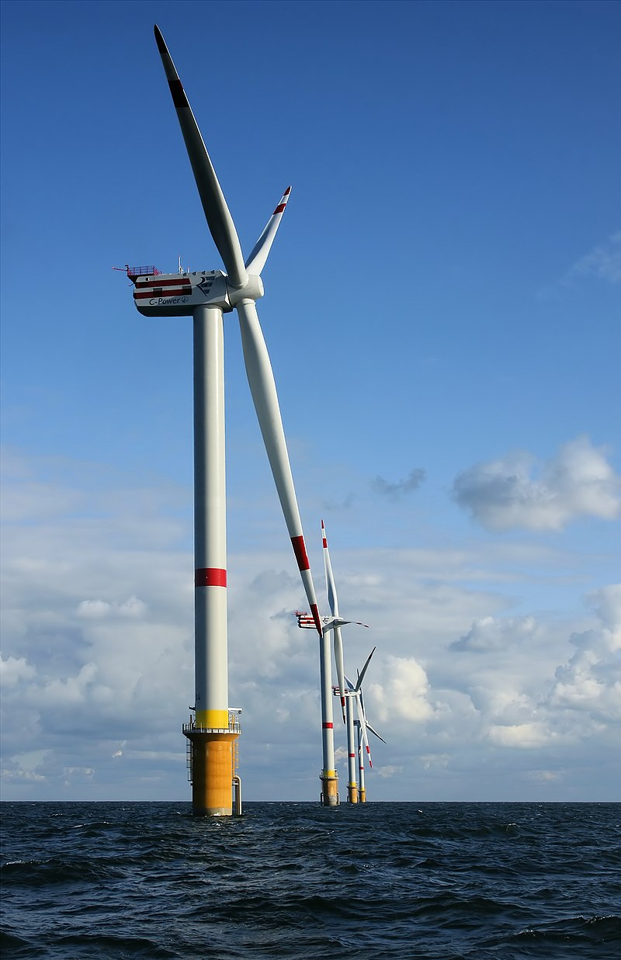
NAME THE ENERGY TRANSFORMATION
MECHANICAL -> ELECTRICAL
Notes:
By © Hans Hillewaert, CC BY-SA 4.0, https://commons.wikimedia.org/w/index.php?curid=6361901

Slide 8
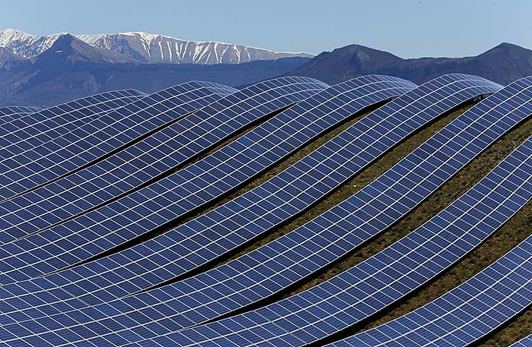
NAME THE ENERGY TRANSFORMATION
RADIANT -> ELECTRICAL
Notes:
https://offgridworld.com/112780-solar-panels-frances-largest-solar-energy-farm/

Slide 9
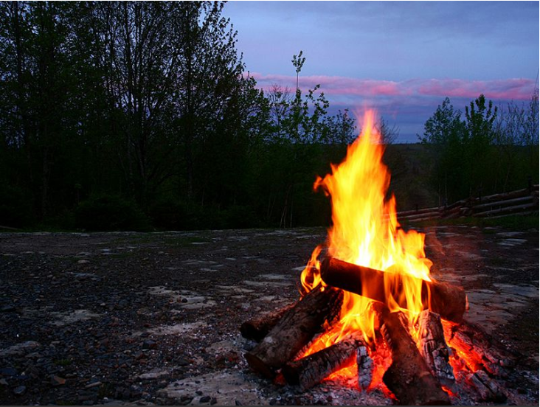
NAME THE ENERGY TRANSFORMATION
CHEMICAL -> HEAT
Notes:
https://www.smithsonianmag.com/smart-news/how-build-perfect-campfire-180955564/

Slide 10
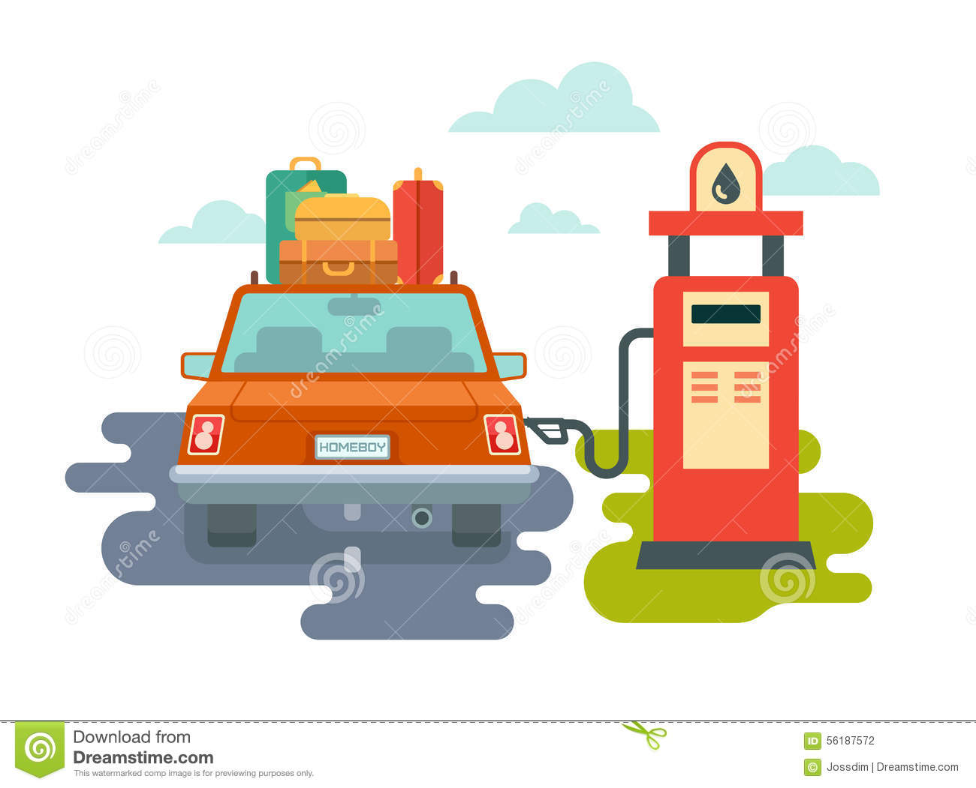
NAME THE ENERGY TRANSFORMATION
CHEMICAL -> MECHANICAL
Notes:
https://www.dreamstime.com/stock-illustration-refuel-car-gas-station-concept-flat-illustration-image56187572

Slide 11
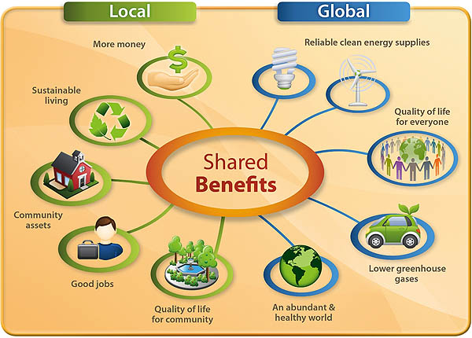
PAUSE BINGO! WHY IS IT IMPORTANT TO CONSERVE ENERGY?
Notes:
This slide is for a short discussion. The teacher should pose questions that draw students to conclusions regarding energy consumption and environmental quality.
Examples:
Energy is not unlimited!
What might happen if your town’s population grew too high, and there wasn’t enough energy for every home and school?
Prices would increase significant
Power shortage would increase in frequency
Schools may have a difficult time functioning
Energy creates pollution!
What might happen to the air we breath if more/increased rates of coal (for heat) or oil (for transportation) is burnt into the atmosphere?
Increases in particulate matter will cause visibility and breathability problems.
Do you think this changes the quality of water in our streams? What might happen to the fish and aquatic organisms if the quality degrades through increased energy consumption?
Particles in the streams might increase, causing difficulty in aquatic life to breath and live.
What happens when you keep your vehicle idling for several minutes at a time? What if 100,000 people idled for these few minutes, what would the air quality look like?
[open question]
Our energy consumption is really poorly managed – how might we control this as population continues to grow?
[open question… transition to next slide]
Lower electricity bills and service costs. Exhaustible sources of energy.
https://www.green-modeling.com/sustainability/benefits-of-energy-conservation-in-our-lives.html

Slide 12
WHAT IS THE CURRENT POPULATION IN AUSTIN
930,000 PEOPLE
Notes:
http://sciencefacultymagazine.com/natural-sciences-en/biology-en/population/

Slide 13
WHAT IS THE PROJECTED POPULATION FOR AUSTIN IN 2050
1,900,000 PEOPLE
A 51% INCREASE!
Notes:
http://sciencefacultymagazine.com/natural-sciences-en/biology-en/population/

Slide 14
WHAT IS THE CURRENT GLOBAL POPULATION
7,6000,000,000 PEOPLE
Notes:
http://sciencefacultymagazine.com/natural-sciences-en/biology-en/population/
https://fr.123rf.com/photo_17887941_silhouettes-de-gens-de-diff%C3%A9rentes-couleurs-autour-de-la-plan%C3%A8te-terre.html

Slide 15
WHAT IS THE PROJECTED GLOBAL POPULATION FOR 2050?
9,000,000,000 PEOPLE
A 29% INCREASE!

Slide 16
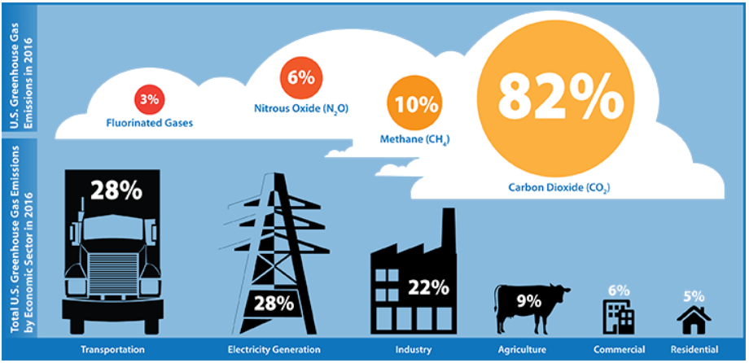
WHAT ARE THE FOUR GREENHOUSE GASES?
Notes:
https://www3.epa.gov/climatechange/ghgemissions/inventoryexplorer/

Slide 17
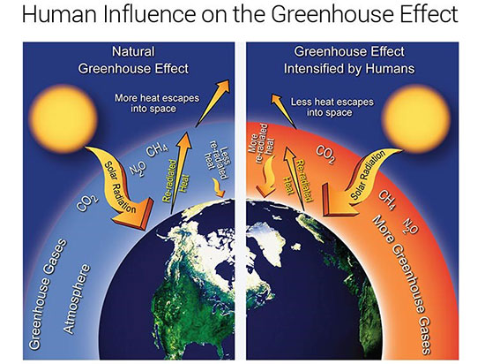
WHY DO WE CARE ABOUT GREENHOUSE GASES?
PAUSE BINGO!
Notes:
https://www.massaudubon.org/our-conservation-work/climate-change/why-we-care/greenhouse-gases

Slide 18
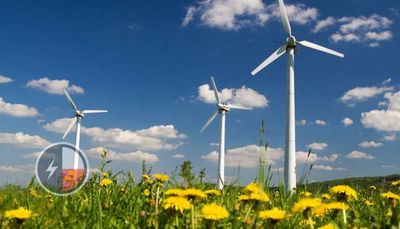
WHICH U.S. STATE GENERATES THE MOST WIND POWER?
Notes:
https://www.choosetexaspower.org/the-current/texas-wind-power-continues-to-pick-up-speed/

Slide 19
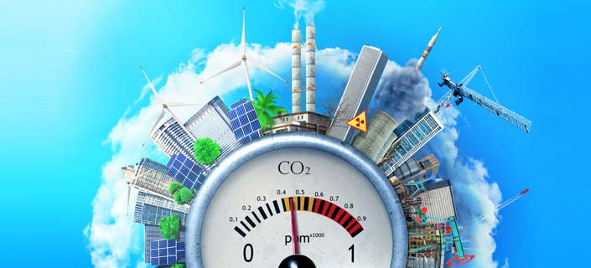
WAYS TO CONSERVE AIR EMISSION/POLLUTION
Notes:
https://www.consumerhealthdigest.com/health-news/air-pollution-still-killing-americans.html

Slide 20
WHAT SYSTEM USES THE MOST ENERGY IN OUR HOMES AND SCHOOLS?
HEATING AND COOLING
Notes:
http://www.levineandsons.com/blog/local-heating-cooling/

Slide 21
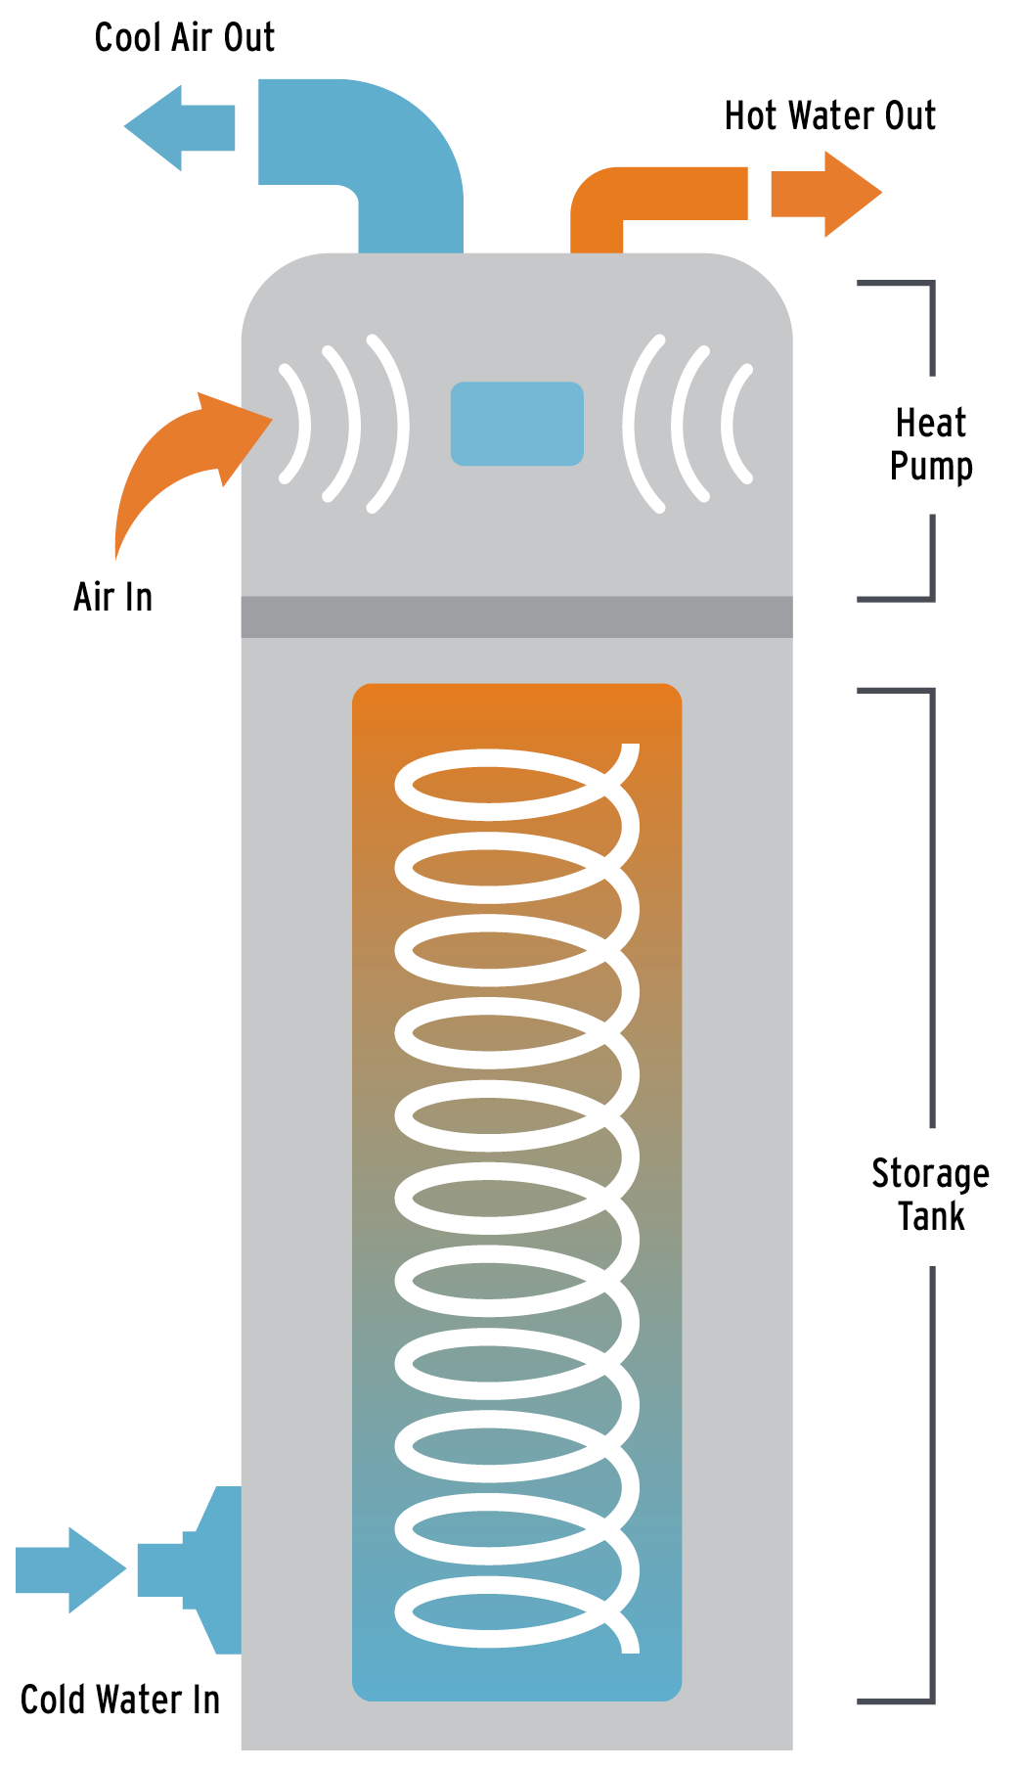
WHAT SYSTEM USES THE SECOND MOST ENERGY IN OUR HOMES AND SCHOOLS?
WATER HEATING SYSTEMS
Notes:
https://www.theenergychallenge.org/take-action/next-level-saving/hpwh/hpwh-faq/

Slide 22
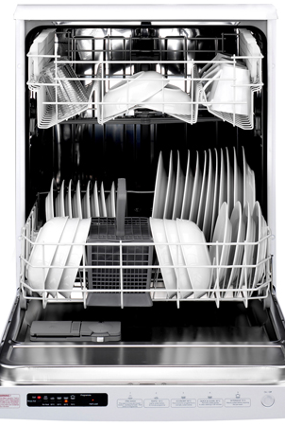
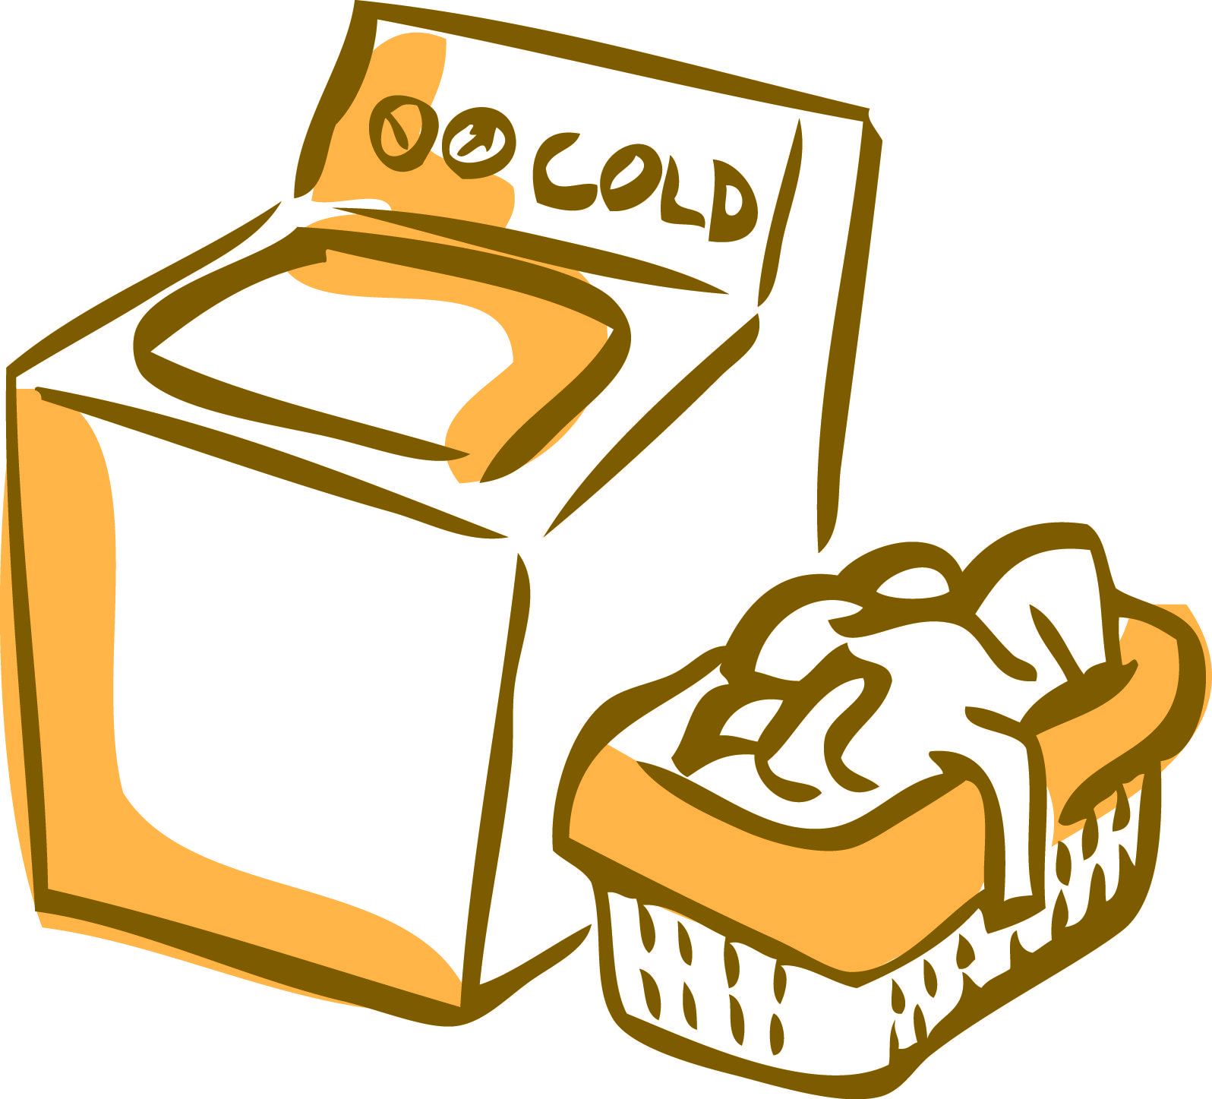
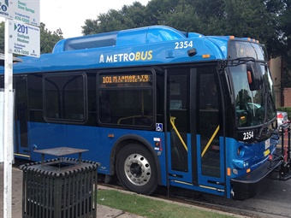
WHAT ARE WAYS YOU CAN SAVE ENERGY?

Slide 23
WHAT ARE THE TWO APPLIANCES YOU SHOULD RUN ONLY WHEN THEY’RE FULL?

Slide 24
Note: FOLLOWING 4 SLIDES ARE FOR >8TH GRADE LEVEL

Slide 25
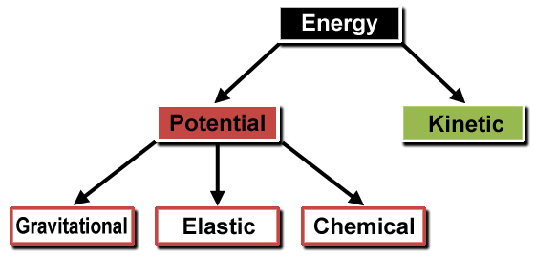
WHAT ARE THE TWO KEY TYPES OF ENERGY?

Slide 26
DEFINE POTENTIAL ENERGY
ENERGY STORED IN POSITION

Slide 27
WHAT ARE THE THREE TYPES OF POTENTIAL ENERGY?

Slide 28
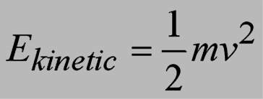
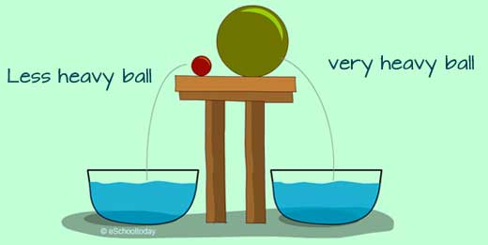
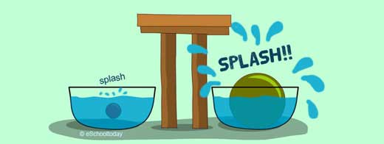
Notes:
http://www.eschooltoday.com/energy/kinds-of-energy/what-is-kinetic-energy.html

Slide 29
