Slide 1
Advanced Water Purification in El Paso
Gilbert Trejo
Chief Technical Officer, El Paso Water
May 31, 2019

Slide 2
Topics for Today
El Paso’s history of reuse, conservation, diversification
El Paso’s Advanced Purification project
  Regulatory context
  Advisory Panel
  Pilot Project
  Operational Protocols
Timeline

Slide 3
1950s Drought: A Clarion Call for El Paso
El Paso Headlines from 1951:
Reclamation Bureau Cuts E.P. Water Supply (March 2)
Water Rationing in the City for the Summer (March 9)
Serious Water Shortage Faces City (March 11)
Independent Water Board Suggested (June 10)
River Drops Leaves Areas Waterless (June 23)
Notes:
1950s became a game changer for El Paso and Texas overall. The news headlines reflects the seriousness and urgency of the drought.
This was a scorching drought that plagued the state day after day for seven long, blistering years from 1950 to 1957.
Statewide, the drought devastated farms and ranches and caused agricultural workers to leave the farm and find jobs in the city. But on the positive side, it set in motion a push for reliable water supplies and caused the creation of the Texas Water Development Board in 1957.
And here in El Paso, it was a true game changer.
It led to the establishment of the Public Service Board to oversee water planning
It spurred major land acquisitions in outlying areas that would enable drilling of wells and serve as future source of revenue
Conversations began in earnest around conservation and water reuse
The city first recognized that brackish underground water resources must be part of solution
The City and utility aggressively chased grants and federal dollars… many of which are now gone
In sum, the 1950s drought created the urgency for change. And El Paso answered the call.

Slide 4
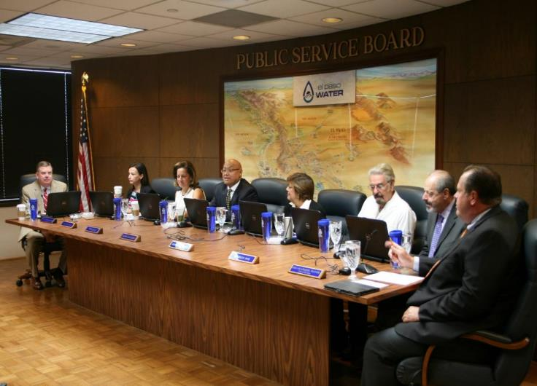
Independent Board governance enables City to meet long-term needs
Created in 1952
7 members including Mayor
Controls four utilities: water, wastewater, reclaimed water and stormwater
Provides water service to 97 percent of El Paso County (750,000+ residents)
Notes:
The Public Service Board was created through city ordinance adopted in May of 1952. It established a board of trustees – separate from the City Council – to remove it from politics and political cycles. Each of seven Board positions has a defined expertise to ensure that qualified professionals are at the table to help shape our water future.
Currently, our board consists of an attorney, an engineer, a developer, two financial experts and two PHD’s. The Mayor is also a de facto member of the Board.
At that time, the Board was given the complete management and control of the city’s water system. It has oversight of the operation and maintenance of the water, wastewater and stormwater systems and all assets including real estate. The Public Service Board approves the budget, and sets rates and fees. We do invite public comment, and we listen with care to anyone who brings an issue. And there have been a number of times where the public voice has influenced our decision.
But we are ultimately accountable – not to voters – but to serving in the city’s best interest on El Paso’s water projects, planning and challenges.

Slide 5
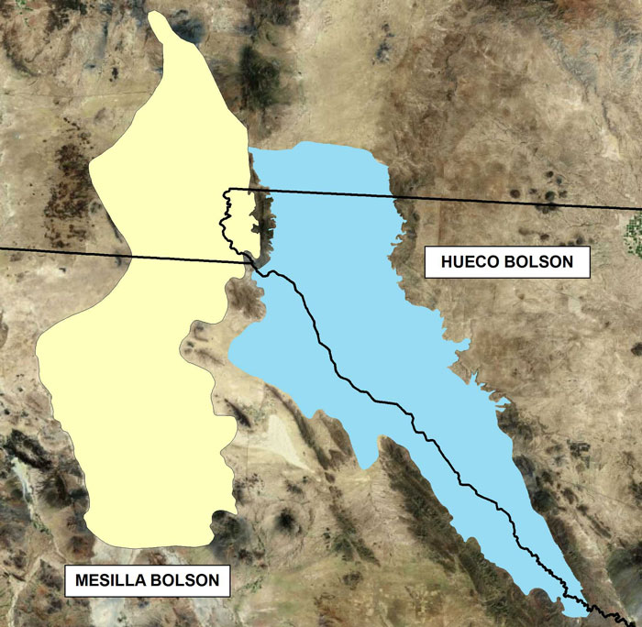
Three states, two countries, one vital resource
Notes:
One unique challenges is that we share water resources with Mexico
Most of the demand in Juarez is met through the Hueco-Mesilla Bolson aquifer, which is also the primary aquifer serving El Paso.
There are multiple compacts, treaties, and shared projects ensure equitable distribution
We also share water resources with the state of New Mexico.
Elephant Butte Dam and Reservoir in New Mexico help meet irrigation demands in Texas.
The Rio Grande and Pecos River Compacts administer river flow distribution.
Another unique challenge is that we are a minority water rights holder of Rio Grande water. The Rio Grande project was constructed for flood control and irrigation. The municipal water supply from the Rio Grande is treated like an irrigation customer of the Rio Grande Project. [in other words, we do not control the conveyance and release of our surface water supply]

Slide 6
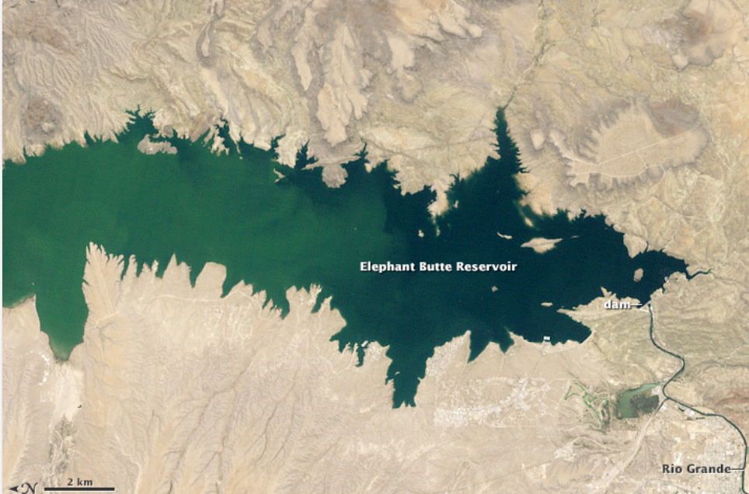
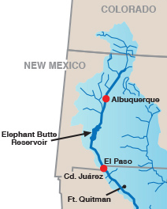
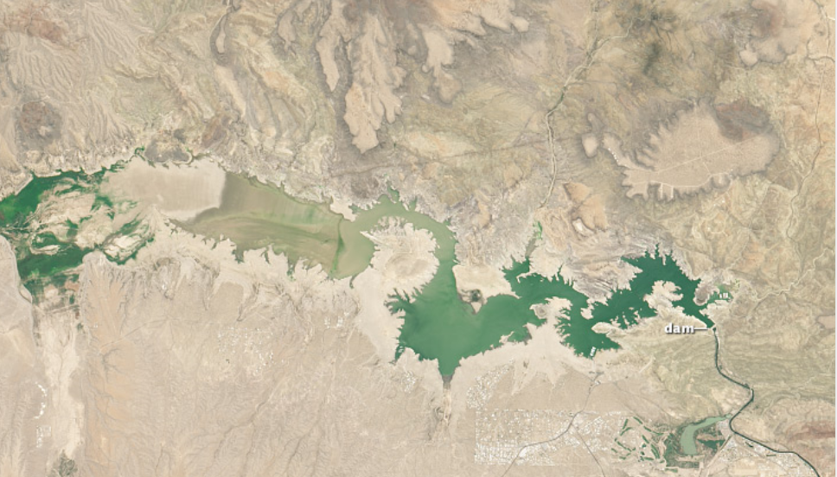
Rio Grande flows to Elephant Butte Reservoir
Elephant Butte Reservoir -
June 1994 - A “normal” year
Elephant Butte Reservoir
July 2013 – Drought year
Source of Image: TCEQ
Source of Images: NASA Website
Notes:
Called the Rio Bravo in Mexico, the Rio Grande originates with snowpack and snowmelt from Southern Colorado and Northern New Mexico. To meet the needs of the water allocations, the U.S. Department of Interior’s Bureau of Reclamation built the Rio Grande Project, capturing spring runoff and summer rains to be held in one of the world’s largest man-made lakes – Elephant Butte – and a major infrastructure system for water delivery.
The snowpack must first travel hundreds of miles downstream. In some years, it may look like a great year for snowpack, but the flows can be can be diminished with a warm, windy spring. (In Northern NM, it is sometimes called the hair dryer effect). And then, of course, there are diversions.
Along the way to Elephant Butte, the Rio Grande supplies thousands of acres of irrigated farmland, some Native American Pueblos, and cities like Albuquerque, New Mexico.
The flows to the Rio Grande are stored in the Elephant Butte Reservoir until irrigation season. The Rio Grande Project has a system of assigning irrigation rights, and El Paso Water acts as a farmer and holds water rights that we use for our municipal supply.
Even after it leaves Elephant Butte to come to El Paso, the delivery system is hardly efficient with evaporation and a river channel that is barely maintained.
This image shows what is considered a normal year – NOT a “full” year.

Slide 7
New water sources are needed to meet demands of increasing population
POPULATION

Slide 8
El Paso’s Water Sources:
Today vs. 2070
TODAY - 2018
Water Supply: 158,000 AF
Normal (Non-drought) Conditions
2070 Estimates
Water Supply: 210,000 AF
Normal (Non-drought) Conditions
Notes:
The ratios of the different supply sources both now and in 2070 are based on concepts developed in state water plan.
Rio Grande is about half of current supply during non drought
Current desalt of KBH is about 8000 acre feet
Current Mesilla is close to 26000 acre feet
2070- Rio Grande at full allocation with expanded Jonathan Rogers plant.
2070- KBH production has increased to 21000 acre feet
2070 importation is about 30,000 acre feet.
2070 other includes ASR and APW totaling 23,000 acre feet.

Slide 9
Water conservation has reduced per person consumption by 35%
GPCD
Water Conservation
Ordinance Adopted
1985: 205 gallons per person per day (GPCD)
Current: 128 GPCD
2030: 125 GPCD (Target)
Notes:
El Paso Water officially celebrated 25 years of its city-wide conservation program in 2016, a program that has effectively cut water consumption in El Paso by 30 percent.
In 1991, the City Council adopted the Water Conservation Ordinance, which makes wasting water a violation. The plumbing code was also changed to require the installation of low flow models for all new indoor plumbing fixtures, including showerheads, faucet aerators and toilets. The Water conservation ordinance specifies watering restrictions by days of the week according to odd/even addresses and seasonally by time of day
In 1995, the city established landscape requirements for commercial properties, including water conservation restrictions and beautification guidelines.
Over the years, we have had a number of incentives and rebates programs that yielded success: These include:
Turf Replacement Rebate
Cash for your Commode
Free low-flow showerheads
Clothes washing machine rebate
Central refrigerated air system rebate
Many of these programs have now ended. They were essentially victims of success.
Our programs today focus primarily on education and public outreach. We reach nearly 40,000 students every year through our TecH2O Center and its programs.

Slide 10
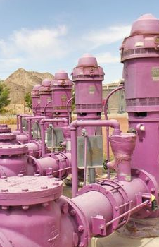
El Paso was early mover on reclamation; reuse still important but emphasis will shift
El Paso launched water reclamation efforts in 1963
El Paso Water produces 2.2 billion gallons annually of recycled and treated wastewater for irrigation, industrial, and construction uses
Since 1985, we have used set quantities of reclaimed water to recharge the aquifer
Notes:
For many years, we have had our Purple Pipe program. We were an early mover in the 1960s when we launched the program. The purple pipe infrastructure was heavily subsidized by the federal government. Today, we produce 2.2 billion gallons of reclaimed water that goes to parks, cemeteries, golf courses, El Paso Electric, construction sites, schools and other destinations. However, at this point, and as we look to the future, we are not looking to expand this program further. For one, there simply isn’t the federal funding that there used to be. But also, we think it makes more sense economically to pursue other reuse options rather than develop parallel piping infrastructure for a program that doesn’t pay for itself. Additionally, with reclamation, we are essentially selling the resource at below its market value. We would rather treat it the extra step and sell it for it’s real value.

Slide 11
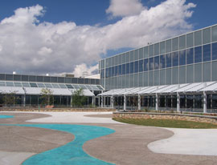
KBH Desalination Plant enables use of brackish portions of aquifer
Current production capacity: 27.5 mgd
Phase 1 expansion planned to increase capacity to about 33 mgd
Phase 2 expansion down the road could increase production capacity to 42.5 mgd
Notes:
El Paso is also the site of the world's largest inland desalination plant.
A joint project of El Paso Water Utilities and Ft. Bliss, El Paso's desalination facility can produce up to 27.5 million gallons of fresh water daily (MGD) making it a critical component of the region's water portfolio. We have vast brackish groundwater resources as part of our aquifer that were previously unusable. The Kay Bailey Hutchison Desalination Plant filters out the salts and creates a new supply of water.
The facilities provide other important benefits too. It serves as a model for other inland cities facing diminishing supplies of fresh water.
It also protects El Paso's and Ft. Bliss' fresh groundwater supplies from brackish water intrusion by capturing the flow of brackish water toward freshwater wells.
And the desalination process not only removes salts, it also is the most comprehensive water treatment technology available today, removing other potential pollutants from the water.
Most important, it provides an insurance policy to make sure El Paso and Ft. Bliss have sufficient water resources for decades to come.

Slide 12
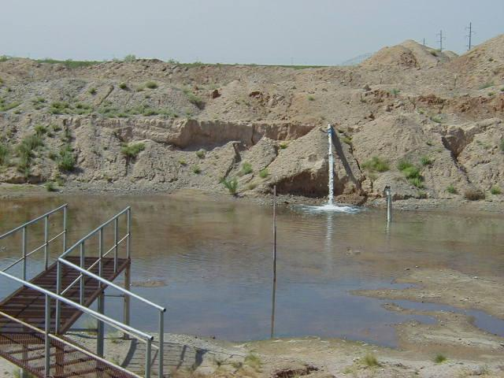
Expanded aquifer storage and recovery (ASR)
For 30 years, our Fred Hervey Reclamation Plant has treated reclaimed water to drinking water standards and used it to recharge the aquifer through injection wells and infiltration basins.
Feasibility study completed to use water from the Rio Grande in non-peak periods to expand aquifer storage and recovery.

Slide 13
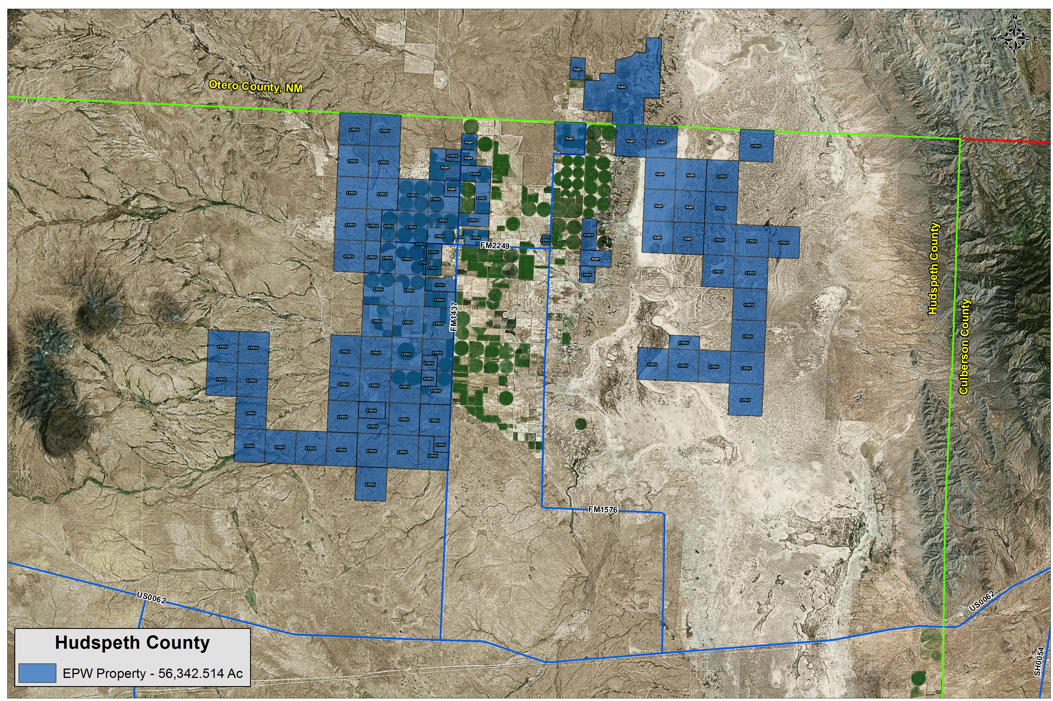
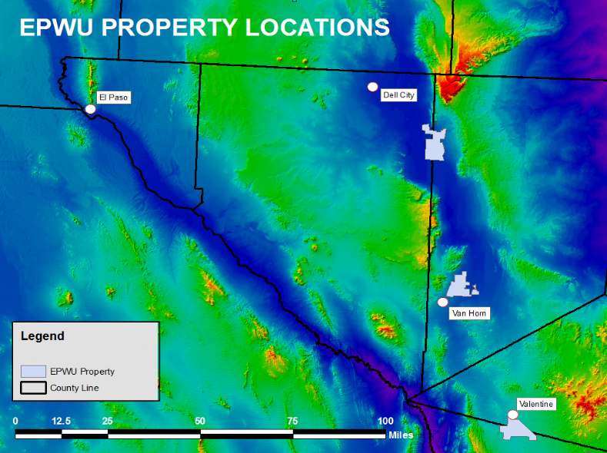
Major land and water acquisitions completed for importation projects supplying water in 2040 or later
Importation
Dell City properties

Slide 14
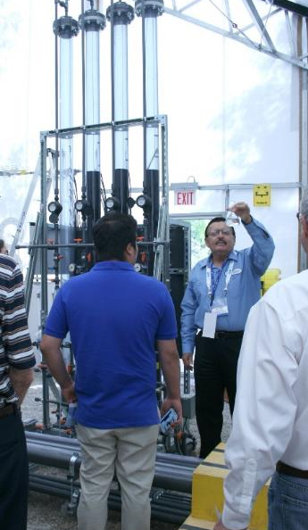
Advance Water Purification will convert treated wastewater directly into drinking water
Proposed as first pipe-to-pipe direct potable reuse facility of its scale in the nation.
Pilot successful
TCEQ has provided permit
Design underway
Potential to provide 2-10 million gallons per day upon completion
Notes:
In late 2015/early 2016, El Paso Water had a successful pilot project for what is likely to be one of the very first pipe-to-pipe direct potable reuse projects in the country.
I’m sure many of you have followed this pilot with interest. Several months ago, TCEQ provided a green light with a series of conditions for moving forward. The Utility begins design this year.
To spread out costs, the project will likely be phased with ultimate production capacity of 7.5 million gallons per day.
It’s worth mentioning that we developed broad public support for this project, and survey results show 84 percent support from the community. I understand that there is a panel discussion here at this conference on the public outreach aspect, so I won’t steal any thunder and encourage you to attend.

Slide 15

Evolution of Water Reuse
Disposal Reclaimed Water Indirect Advanced
Potable Reuse Water Purification

Slide 16

TCEQ Takes a Case-by-Case Regulatory Approach
History of working with public water systems and tailoring solutions
  Finding interconnections with other water systems
  Identifying other sources of water or treatment
    Design rules exist for public water systems but “exceptions” are allowed
DPR is approved using an exception for the source of water
  Not groundwater or surface water
  WW effluent as a source
Exceptions for innovative technology
  Pilot studies
  Full scale verification testing

Slide 17
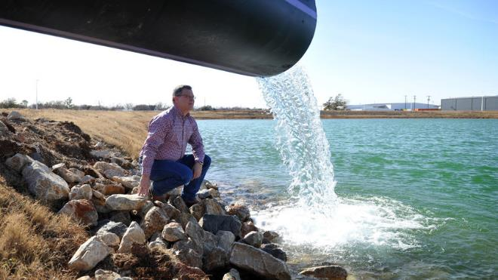
Why Case-by-Case works
Emergency Situations
The city of Wichita Falls built a pipeline that mixed advanced treated wastewater and lake water, which pumped into a water treatment facility.
Exception enabled this city of over 100,000 people to utilize DPR and provide water during the drought when there were no other options for drinking water.

Slide 18
Why Case-by-Case works
Allows a customized treatment, monitoring and operations for each situation
Exceptions provide conditions for site specific design, operation, maintenance, and reporting requirements
Allows innovation in new projects based on research
Pilot studies provide water quality results before water reaches customers
Downside: Case-by-Case is more work

Slide 19
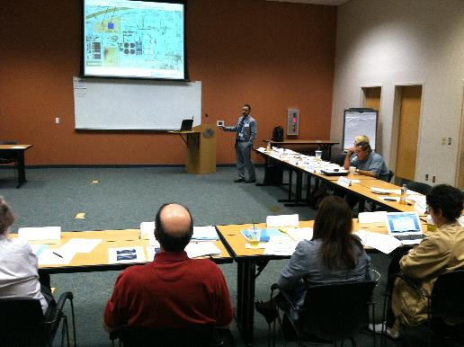
Independent Expert Panel Review
Administered by the National Water Research Institute
  Expertise:
  Treatment engineering
  Reuse regulatory criteria
  Chemistry, microbiology
  Public health risk assessment
  Source control
  Public outreach and engagement
  Input provided on:
  Design of Pilot, developing test plan
  Operating the pilot to test various treatment technologies
  Monitoring strategies
  Components of the DPR system
Notes:
Advisory panel – doing an independent review of project. Their findings are considered by TCEQ in their approval.
They come from many different areas.
Having NWRI administer the meetings and compile the panel’s findings provides an independent and objective process. NWRI also has this incredible institutional knowledge of so many worldwide projects. Often times questions would come like “how did Singapore decide to go full oxidation? Etc.
I am honored to be a part of El Paso’s panel. It has been and enlightening experience to be on the other side. Usually my staff and I are the ones preparing for the GWRS IEP and in the hot seat getting ready to be grilled about our outreach. It was an eye-opening experience.
What does an advisory panel do and what are the benefits?
We create more work for staff – no seriously -
The panel provides on-going scientific peer review and documents its findings and recommendations to the utility agency and its consultants.
Analyze El Paso’s studies and reports and discuss maximizing communication and efficiencies between the wastewater side of operations and the drinking water delivery side of operations
Review and reports are mostly scientific and technical in nature, written mainly for the health and regulatory community, but also include review and reports related to outreach and communication activities and messaging.
IEP reports are available for review by any interested member of the public.
At OCWD, when tour guests are surveyed about the most influential supporters, IEP ranks high. It matters to the general public.
There is a difference between an IEP and Community Advisory Panel. Both are equally important. The IEP is more technical in nature. A Community Advisory Panel is made up more of community stakeholders, such as local business owners, service organizations and community leaders. The latter is more grassroots. IEP is more like bringing experts from the outside to look in and give its honest opinions and suggestions.
Sharing IEP findings with the advisory groups and customer base is meant to help generate confidence in the project.
I’ve been asked the question before, “if budget or resources are constrained and you only had to choose one, the IEP or community/citizens advisory panel – which would you choose?” I’d chose the IEP. Once you have the IEP info it’s a stamp of approval that is impressive and that you can share when you are doing outreach to the general public and local stakeholders.
The proposed technical process which Christina described earlier was a result of robust discussions by the IEP. The panel wanted to see El Paso produce the highest quality water in a cost effective manner that made the best sense for the community.
The IEP also made outreach recommendations.
El Paso has a great program to build upon for its project. The TECH2O center, which Christina mentioned earlier, is amazing. If you haven’t been there yet, I strongly encourage you to visit. The IEP hosted its meetings there and every time we did there were always very large groups of visitors touring the exhibits and taking part in interactive sessions. There were also families visiting, just like they would take time to visit a zoo or museum. The TECH20 center draws thousands of people year-round – El Paso has this great built-in audience and community presence to build upon and start talking about this and other projects it may consider.
Their source control program and communication they have with their main wastewater dischargers was also one of the strengths acknowledged by the IAP. They demonstrated a long history of coordination which also helps elicit confidence from customers who may be leery of the source of water.
Even with these exceptional pre-existing outreach programs and name recognition, the IEP made the following recommendations to El Paso.
-additional surveys
-focus groups
-scheduled public visits to the pilot plant when completed
Surveys were conducted in the past, but it was suggested that a wider net be cast to get additional feedback. Chances are the results would be similar, but worth investing in to get gauge opinions from more groups. You should never take it for granted that your “base” is on board with what you are doing. You need to circle back regularly, even during times when you don’t have an “ask”. It will be make the “ask” go a lot smoother.

Slide 20
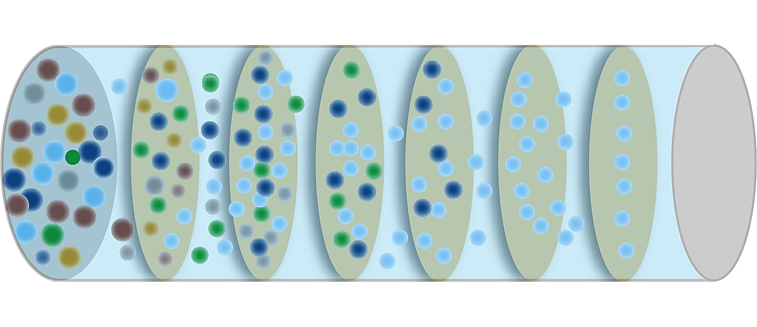
Purification technologies proposed and piloted
Treated
Source
Water
Microfiltration
or
Ultrafiltration
RO
Chlorine
Disinfection
Final Stabilization
UV w/
Advanced
Oxidation
GAC
Notes:
Rigorous and proven treatment technologies, these processes are already being used in our treatment plants.
Redundant steps are taken.
Water is tested after every step.
Water is kept and tested in storage before it goes out to customers.
This is the same technology that is used on the International Space Station.
This is not very different than what we are already doing at the Fred Hervey Plant.

Slide 21
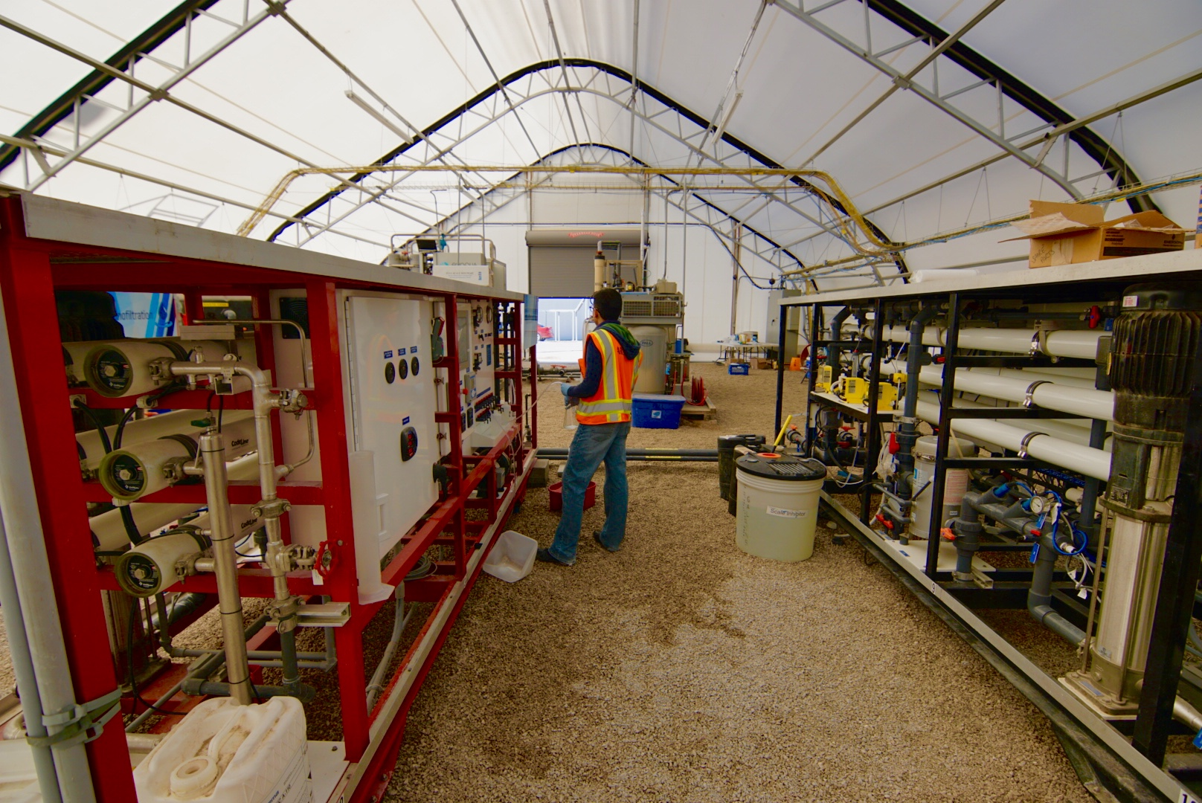
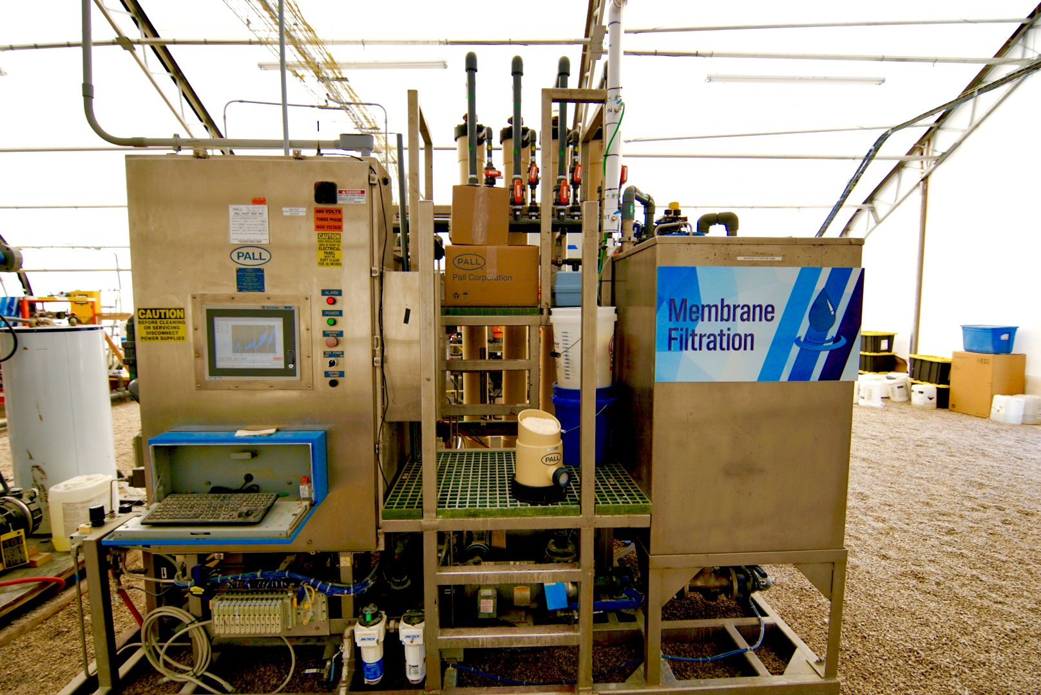
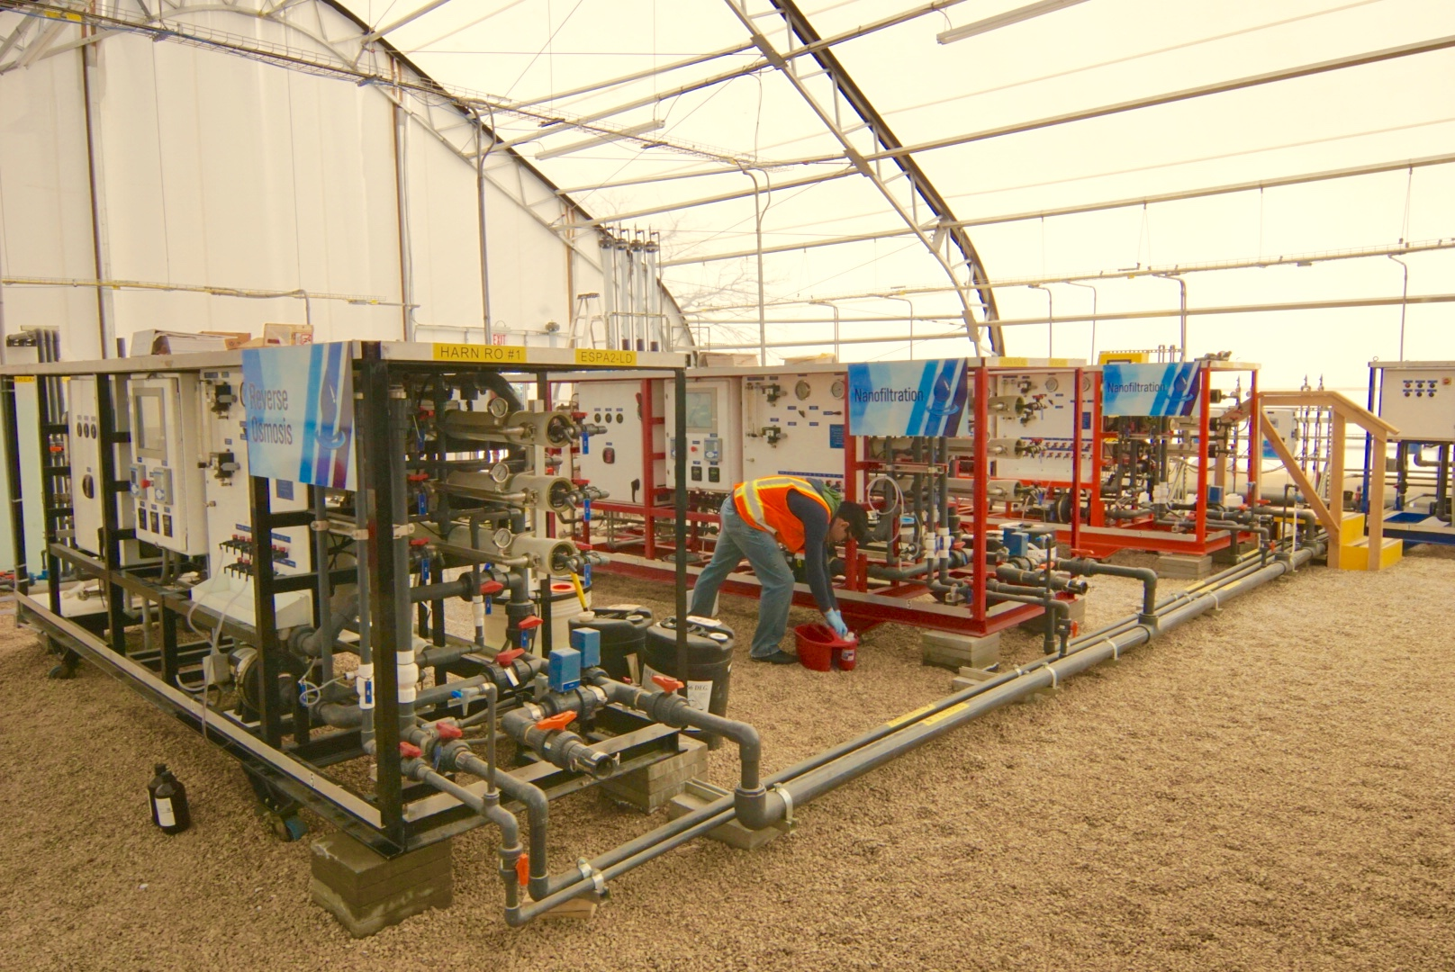
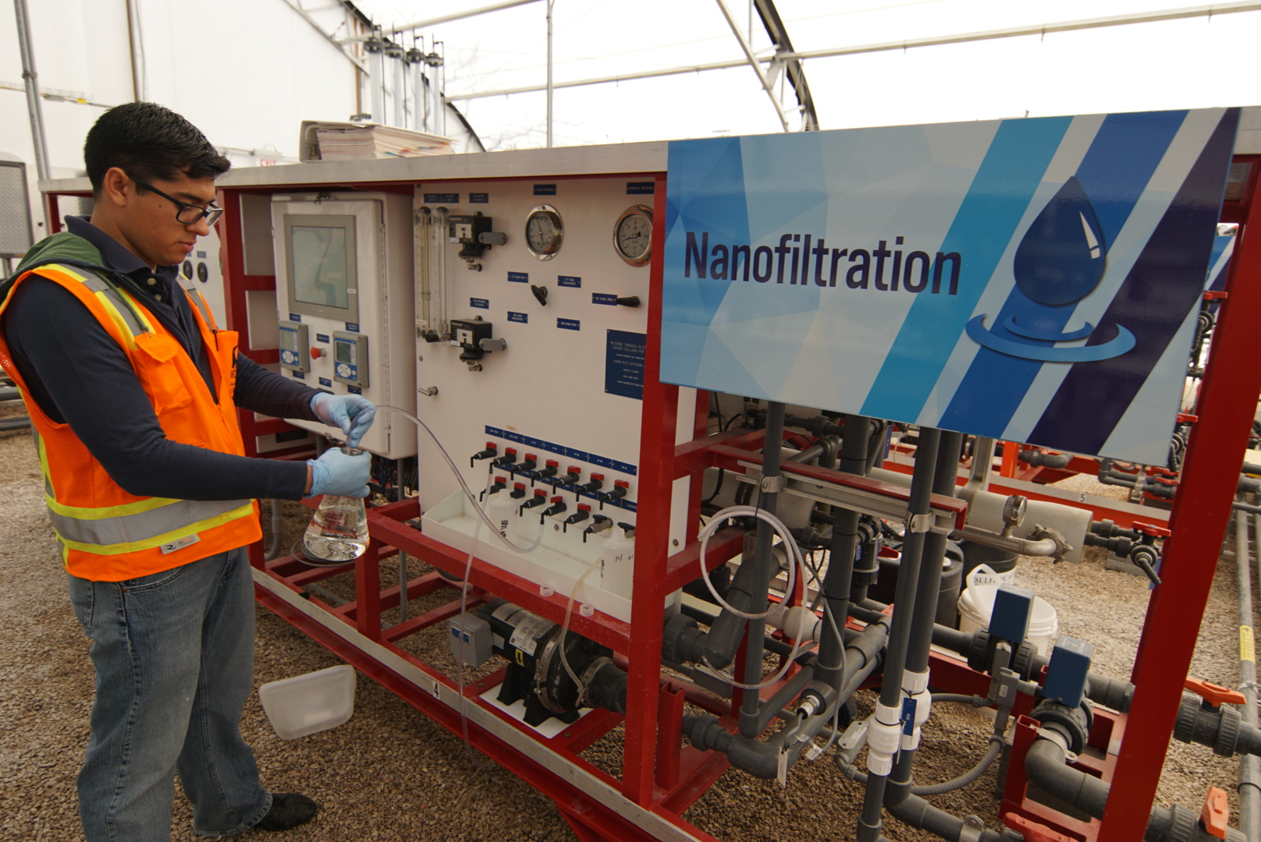
Pilot Project

Slide 22
Pathogen Removal through Treatment Train

Slide 23
Virus Concentrations are
Non-Detect in UV AOP Effluent
Parameter | Units | 6/10/15 | 7/8/15
Adenovirus | GC/L | Non-detect | Non-detect
Total Culturable Virus | MPN/L | < 0.0036 | < 0.053
Enterovirus | GC/L | Non-detect | Non-detect
Norovirus GIA | GC/L | Non-detect | Non-detect
Norovirus GIB | GC/L | Non-detect | Non-detect
Norovirus GII | GC/L | Non-detect | Non-detect
Rotavirus | GC/L | Non-detect | Non-detect
Viruses are non-detect in UV AOP effluent samples
Chlorine disinfection for full-scale treatment train will provide additional pathogen barrier

Slide 24
CEC Pilot Testing Results
Testing for 97 chemicals of emerging concern (CECs):
  Source water
  Each NF/RO Permeate stream
  UV AOP Influent
  UV AOP Effluent
  Each GAC Effluent stream
Examples: caffeine, ibuprofen, estradiol, sucralose, triclosan, BPA, atrazine

Slide 25
CEC Pilot Testing Results
ESPA2 Testing:
  Six sampling events, total of 16 data sets
  13 CECs detected in UV AOP influent
  84 CECs not detected in membrane permeate
  Large majority were non-detect!
Notes:
ESPA2-conventional RO
-13 detected at trace level.

Slide 26
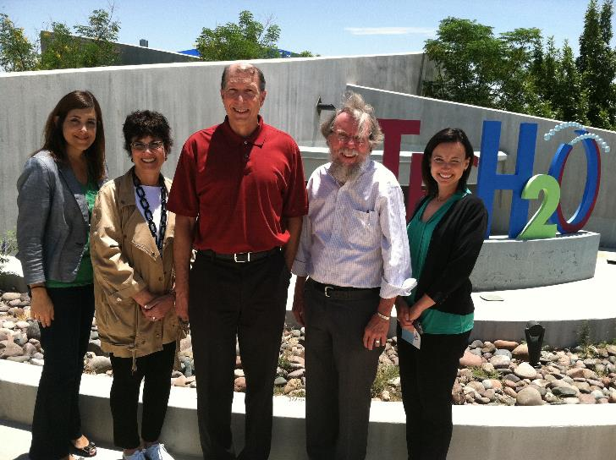
Panel endorsement
Key factors:
  Source water quality – secondary clarified water from WWTP
  Multiple barrier approach
  Water quality goals, including finished water goals for non-regulated constituents
  Protection of the potable water system
  Ongoing public outreach

Slide 27
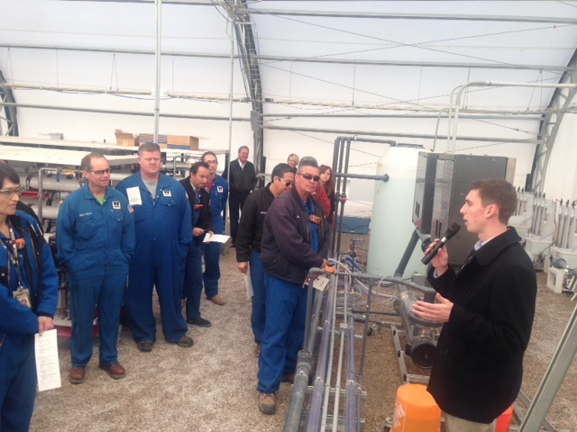
Partners in Purification
Engagement with industrial stakeholders – beyond permitting, inspections and enforcement
Identify and address source control dischargers into the wastewater collection system
Tours provided of pilot project
Given the importance of TCEQ’s emphasis on raw water quality, upstream industrial relationships are essential to get their buy-in on standards and controls.

Slide 28
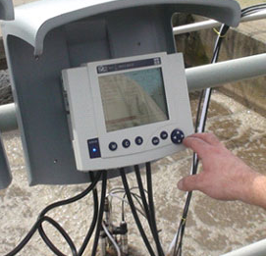

Operational protocol priorities
Real time water quality monitoring
  Water Research Foundation grant project underway currently
Continuous engagement with TCEQ regulators to build trust and confidence
Involvement of water and wastewater managers in training for pilot and future facility
Protection of distribution system to prevent corrosion

Slide 29

84%
El Paso’s Support for Advanced Purification
Public outreach required to build customer confidence

Slide 30
Timeline
TCEQ
approves
pilot plant
TCEQ
approves
results
TCEQ
approves
design of facility
Pilot Plant
Design &
Testing
Facility Design
Facility
Construction
NWRI Advisory Panel
Ongoing Raw Water Quality Monitoring (future source water)
2014 2015 2016 2017 2018 2019 2020 2021
Notes:
Before I get into more detail about how we communicate about the project, here is a look at the timeline.
EPWU will need approval from the Texas Commission on Environmental Quality (TCEQ) throughout the entire process of bringing the plant online. We will need their final approval before the plant is constructed and water is delivered to customers.
The pilot plant is a small-scale version of the purification plant. The purpose is to run the same kind of water that would be run through the plant to work out any issues or challenges ahead of time, it will also require TCEQ approval.
Public outreach is happening now through the plant design, construction and delivery to customers.

Slide 31
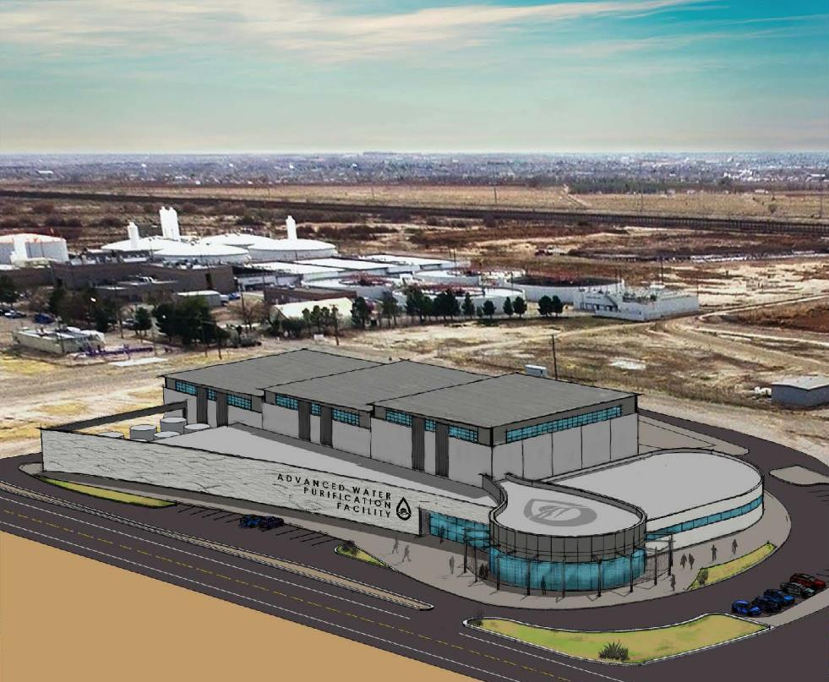
Rendering of Facility

Slide 32
Thank you!
Questions?

