Slide 1
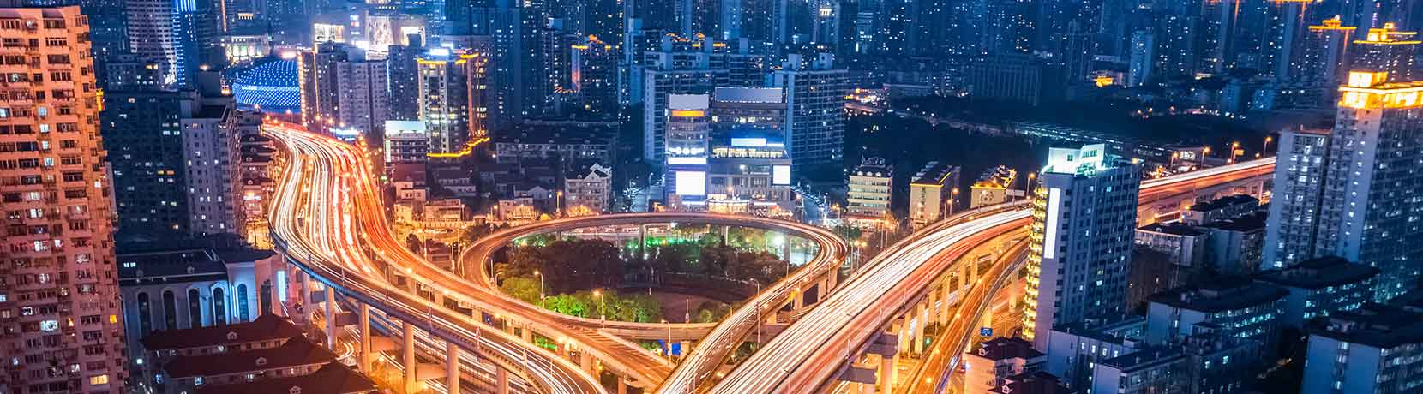
Challenges to and Opportunities for Developing Resilience in Rapidly Growing Urban Corridors in Semi-Arid Regions
NSF-Sustainable Urban Systems Conference
Jay Banner – UT Austin
Darrel Tremaine – UT Austin

Slide 2
Sustainable Urban Systems Program
Changing climate, rapid urbanization, and the projected addition of 2.5 billion humans over the next 25 years has delivered civilization into a new socio-ecological paradigm.
Although urban areas occupy only 3-4% of global land area, they exert disproportionate and confounding effects on the sustainability of the environment, economy, and social equity.
The world’s 50 largest cities draw upon watersheds that occupy 41% of the world’s land surface.
Notes:
Animate each point in.
I like these points from the proposal, let’s swap them in:
Changing climate, rapid urbanization, and the projected addition of 2.5 billion humans over next 25 years has delivered civilization into a new socio-ecological paradigm
Although urban areas occupy only 3-4% of global land area, they exert disproportionate and confounding effects on the sustainability of the environment, economy, and social equity²
world’s 50 largest cities draw upon 41% of the world’s watersheds
Need an additional slide that lists NSF’s goals for these conferences. i.e., what happens to the conference white paper that we write?

Slide 3
Sustainable Urban Systems Program
NSF SUS program is leading the charge of developing convergent research agendas to address challenges to creating resilience in engineered, natural, and social subsystems.
Developing new data and methods to understand the interactions among natural, built, and social systems in urban areas
Advancing comparative, typology, and scalability studies to develop generalizable theories of urban systems
Co-producing knowledge through engagement with communities and stakeholders and by leveraging real-world experimentation ongoing in urban areas
Developing the science model and make predictions about the future of sustainable urban systems
Notes:
Animate each point in.
I like these points from the proposal, let’s swap them in:
Changing climate, rapid urbanization, and the projected addition of 2.5 billion humans over next 25 years has delivered civilization into a new socio-ecological paradigm
Although urban areas occupy only 3-4% of global land area, they exert disproportionate and confounding effects on the sustainability of the environment, economy, and social equity²
world’s 50 largest cities draw upon 41% of the world’s watersheds
Need an additional slide that lists NSF’s goals for these conferences. i.e., what happens to the conference white paper that we write?

Slide 4
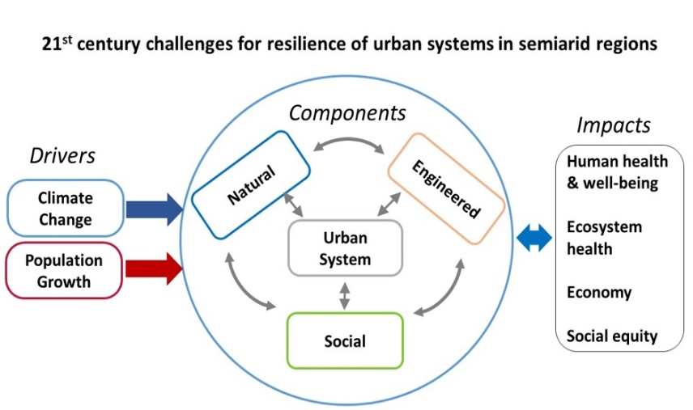
Grand Challenges

Slide 5
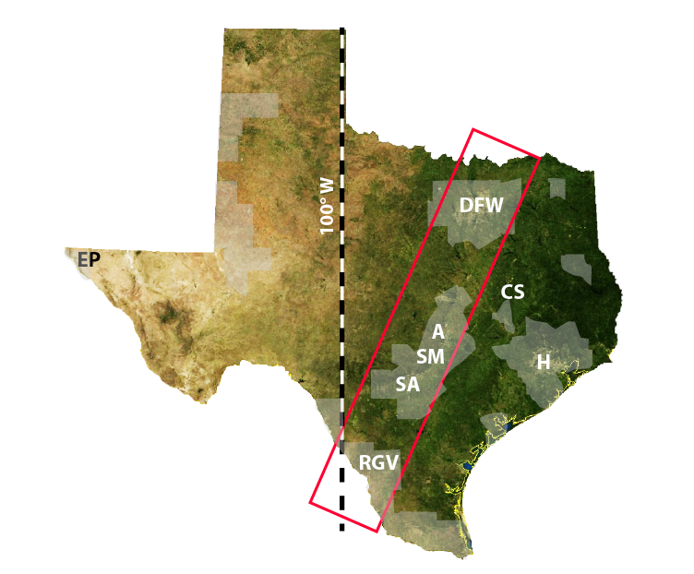
Grand Challenges
The New 100th Meridian?
Gray: Counties with > 75% population growth by 2050

Slide 6
Grand Challenges
As a logical extension of Planet Texas 2050, we proposed a 3-day conference to NSF-SUS focusing on four key themes:
  Processes and Feedbacks
  Big Data
  Integrated Modeling
  The Design of Co-Designed Research Initiatives

Slide 7


Formatted For Actionable Knowledge
We have partnered with social scientists, engineers, earth scientists, and policy influencers to organize a novel, transdisciplinary agenda.
Themed Talks
Facilitated Workshops
Scientists
Stakeholders
Community Members
Policy Influencers
Actionable Knowledge for
Urban Resilience
Notes:
Let’s define ‘Actionable…’ is this NSF’s term?

Slide 8
Formatted For Actionable Knowledge
Day 1
Day 2
Day 3
Theme Session:
Processes & Feedbacks and Big Data
Theme Session:
Processes & Feedbacks and Integrated Modelling
Theme Session:
Processes & Feedbacks and Big Data
Workshop 1:
Understanding Convergence and Divergence
Workshop 1:
Toolbox Dialogue Initiative
Workshop 1:
Design Thinking
Lunch
Lunch
Lunch
Theme Session:
Integrated Modelling and Co-Designing Research
Theme Session:
Co-Designing Research and Big Data
Workshop 2:
Whole Conference Synthesis
Workshop 2:
Synthesizing Collaborative Outcomes From Day 1
Workshop 2:
Synthesizing Collaborative Outcomes From Day 2
Workshop 3:
Outlining Research Prospectus
Notes:
Too much stuff, and the audience won’t be interested in all these details. Can it be simplified to show the sequence, irrespective of days, of what we hope to have happen and accomplish?

Slide 9
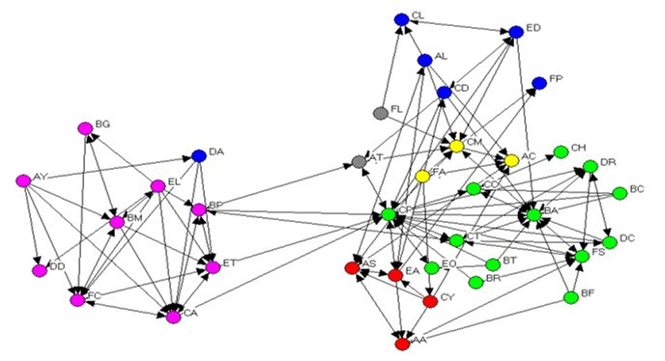

Conference Goals
The goals of the conference are to:
1. Establish a highly collaborative research network that is ready to lead the way in urban sustainability and resilience
2. Produce a conference report that serves as a convergent and integrative prospectus for the next decade of SUS research

Slide 10
SUS Conference Information
August 22-24, 2019, UT Austin Campus
Organizing Committee
  Jay Banner, University of Texas at Austin
  Ashlynn Stillwell, University of Illinois at Urbana-Champaign
  Steven Gray, Michigan State University
  Kasey Faust, University of Texas at Austin
  Auroop Ganguly, Northeastern University
  Dev Niyogi, Purdue University
  Jay Famiglietti, University of Saskatchewan
  Patrick Bixler, University of Texas at Austin
  Suzanne Pierce, University of Texas at Austin
  Darrel Tremaine, University of Texas at Austin

Slide 11
SUS Conference Information
For more information on how to become a participant of the Sustainable Urban Systems conference, please email Darrel Tremaine.
darrel.tremaine@jsg.utexas.edu

Slide 12
NSF SUS Conference as an example of
ideas incubated in TWRN

