Slide 1
Rosario Sanchez

Slide 5
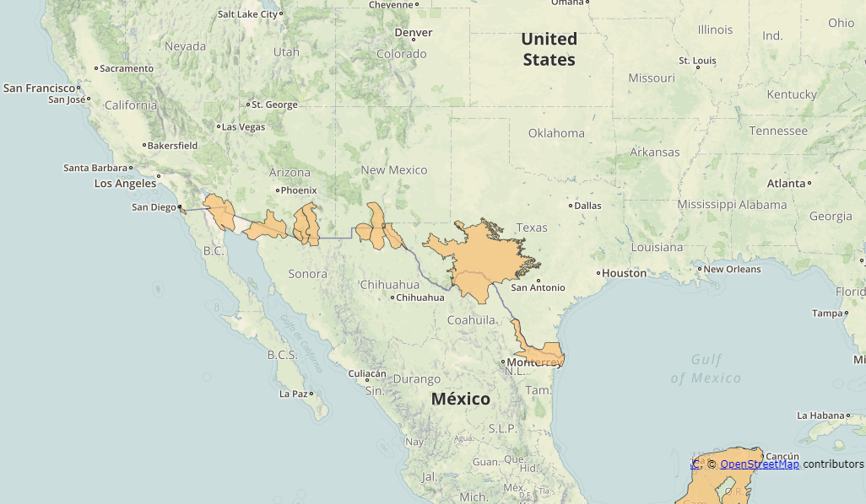

Slide 7
Officially there are 11 transboundary aquifers between Mexico and the US

Slide 8
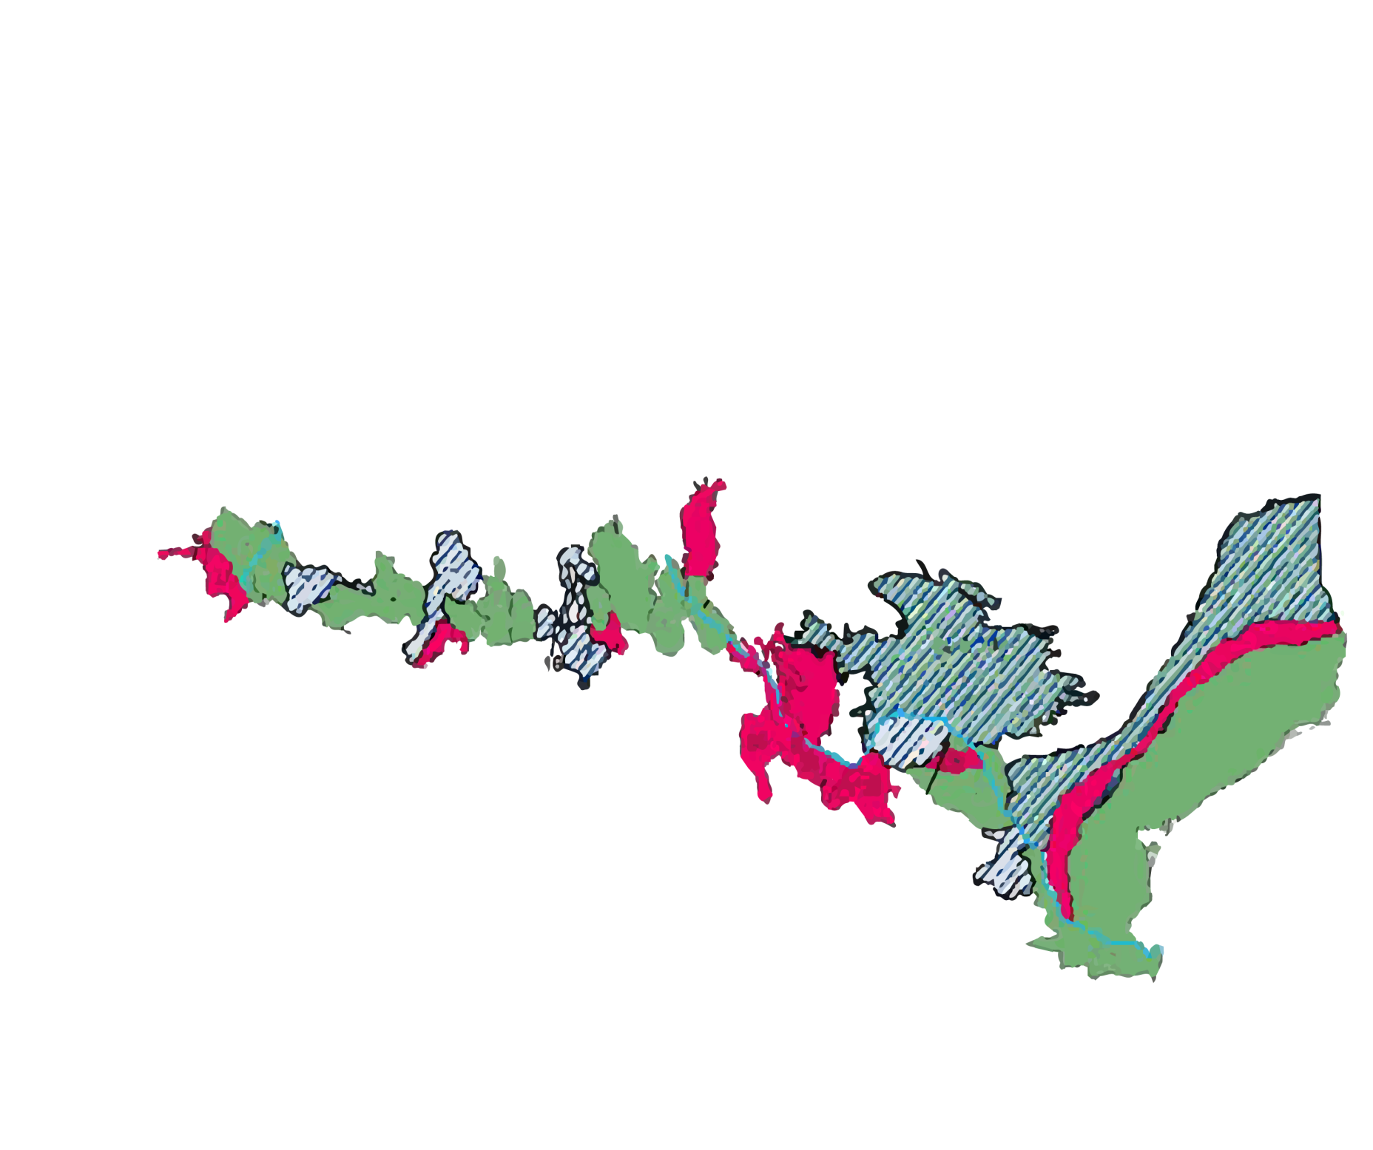
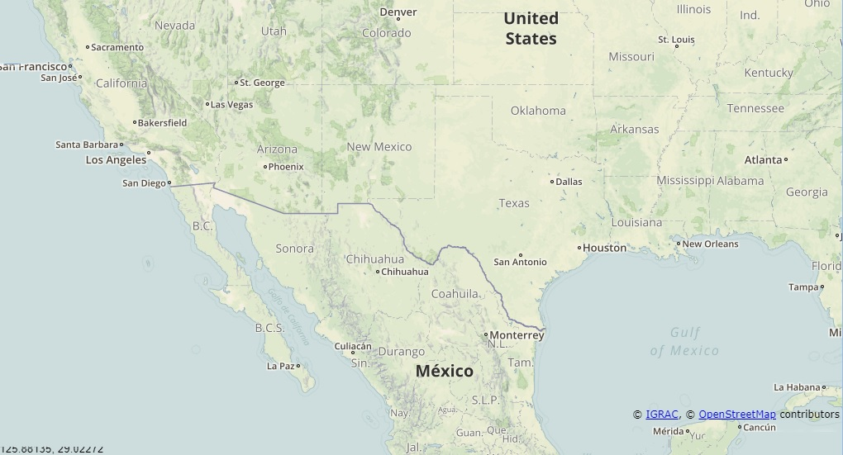
Current research shows
there can be 36

Slide 9
12 potential aquifers
with limited data

Slide 12
Mexico and Texas:
Current research shows…

Slide 13
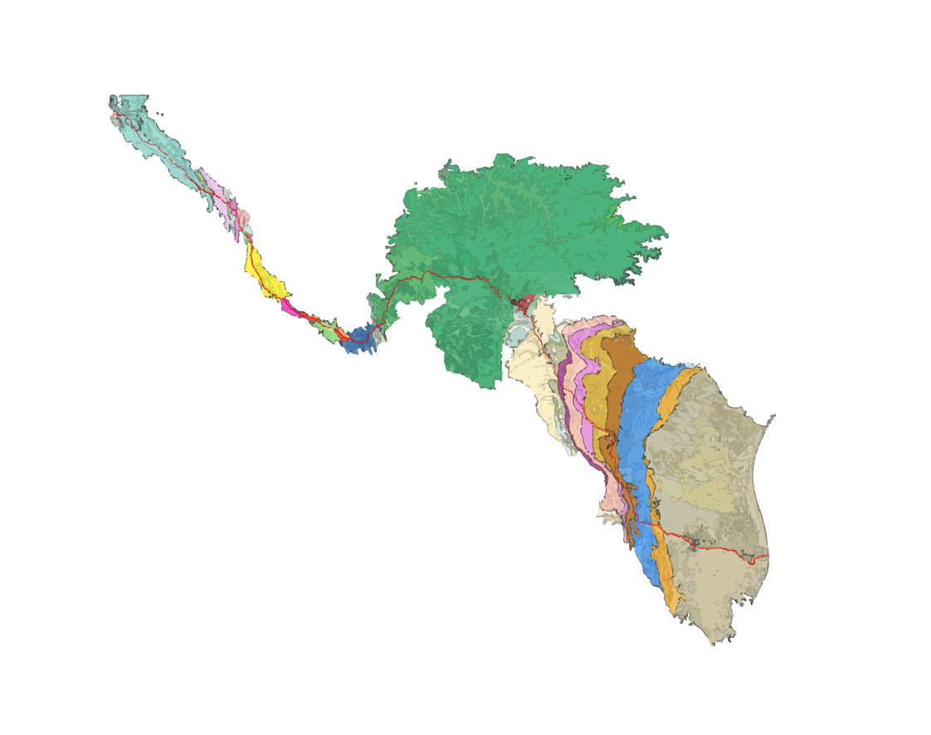
33 hydrogeological units

Slide 14
21 potential aquifers

Slide 16
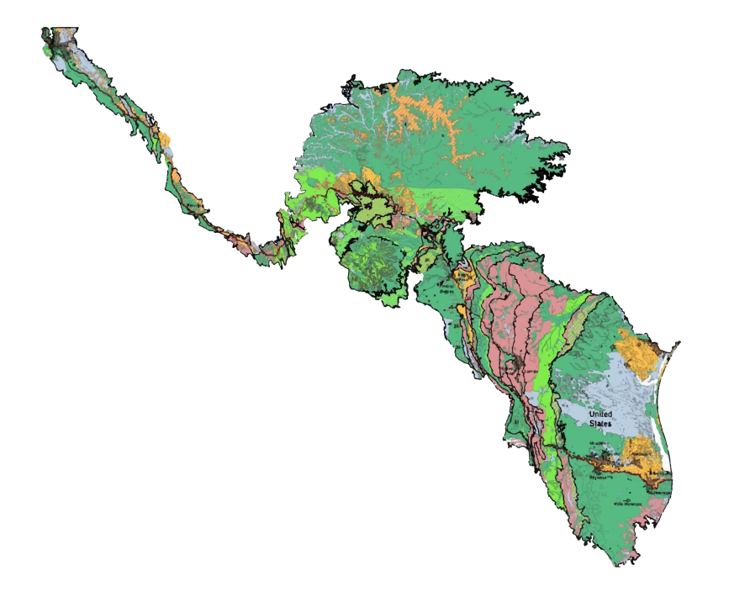
50% of the shareable land has
good aquifer potential

Slide 17
50% of the shareable land has
good aquifer potential

Slide 18
and good to moderate
water quality

Slide 19
and good to moderate
water quality

Slide 20
Red areas indicate zones of potential prioritization

Slide 21
Red areas indicate zones of potential prioritization

Slide 25
Another approach
beyond delimitation…

Slide 28
Identification of Effective Transboundary Aquifer Areas (ETAAs)

Slide 29
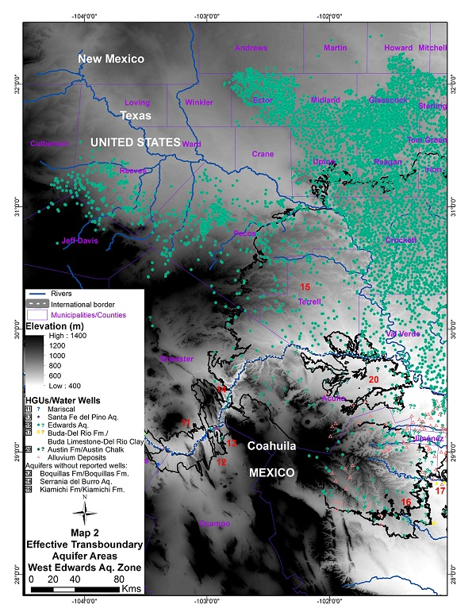
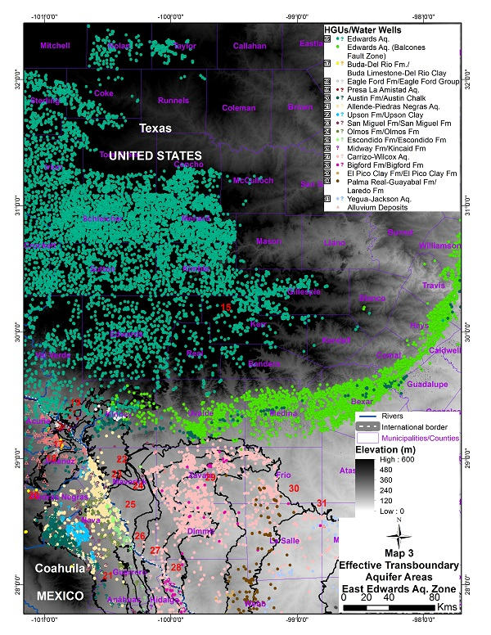
OBJECTIVES

Slide 30
- The ETAA approach offers an alternative way to assess priority areas within the natural boundaries of each HGU.

Slide 31
- The ETAA approach offers an alternative way to assess priority areas within the natural boundaries of each HGU.
- A more refined, practical and effective aquifer boundary can be delineated.

Slide 32
- The ETAA approach offers an alternative way to assess priority areas within the natural boundaries of each HGU.
- A more refined, practical and effective aquifer boundary can be delineated.
- A more comprehensive and local approach for governance and management options in a more feasible way.

Slide 33
- The ETAA approach offers an alternative way to assess priority areas within the natural boundaries of each HGU.
- A more refined, practical and effective aquifer boundary can be delineated.
- A more comprehensive and local approach for governance and management options in a more feasible way.
- Applicable not just at the binational level but also at the domestic level.

Slide 34
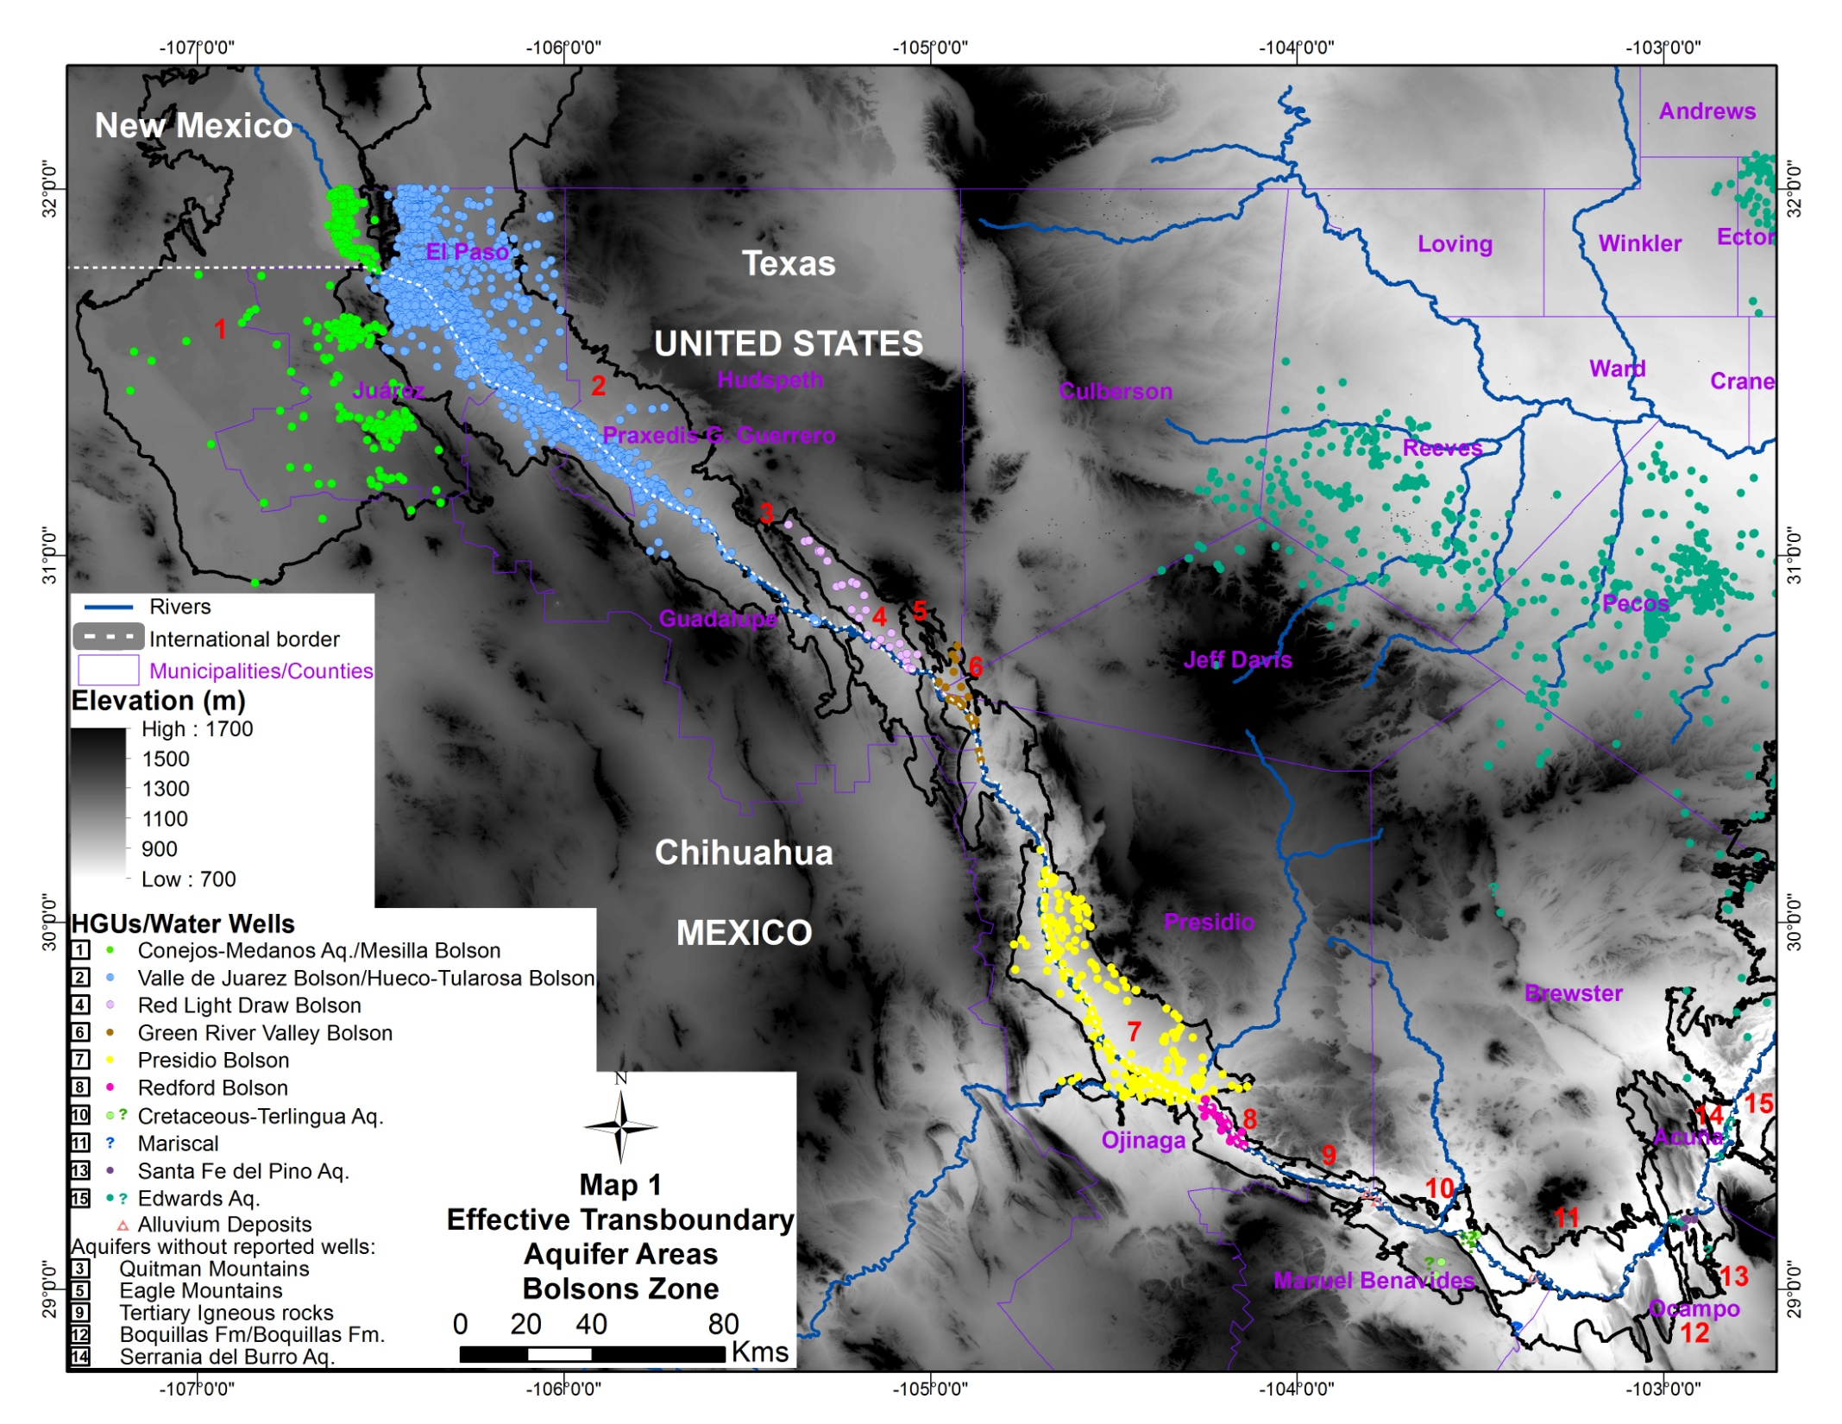

Slide 35
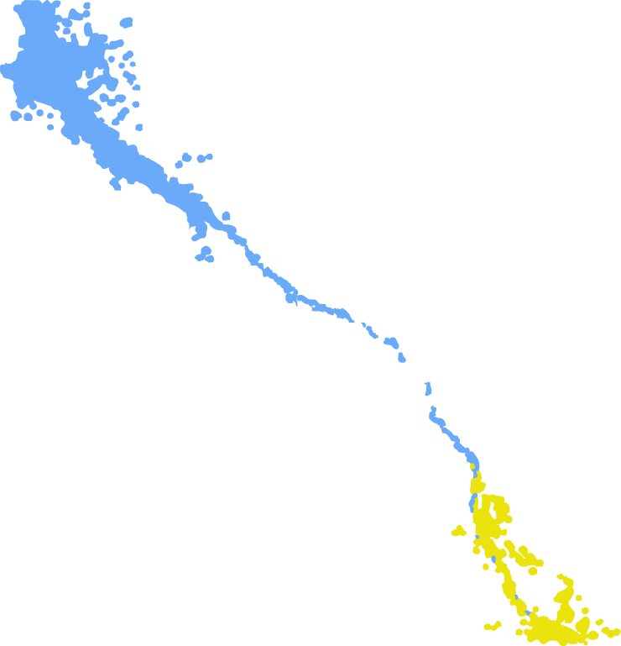

Slide 38
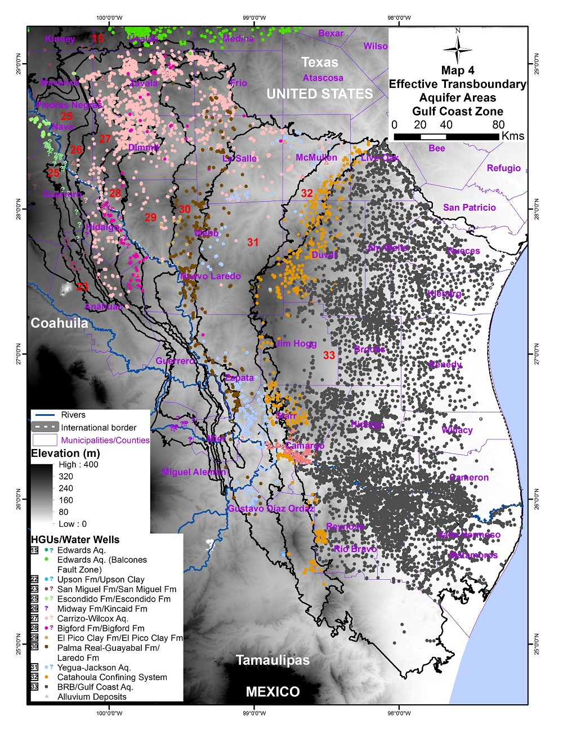
TBAs with potential ETAAs

Slide 39
TBAs with potential ETAAs
Carrizo-Wilcox

Slide 40
TBAs with potential ETAAs
Carrizo-Wilcox

Slide 41
TBAs with potential ETAAs
CARRIZO-WILCOX 2000

Slide 42
TBAs with potential ETAAs
Carrizo-Wilcox

Slide 43
TBAs with potential ETAAs
Carrizo-Wilcox
Laredo-Palma
Guayabal

Slide 44
TBAs with potential ETAAs
Carrizo-Wilcox
Laredo-Palma
Guayabal

Slide 45
TBAs with potential ETAAs
Carrizo-Wilcox
Laredo-Palma
Guayabal
Yegua -Jackson

Slide 46
TBAs with potential ETAAs
Carrizo-Wilcox
Laredo-Palma
Guayabal
Yegua -Jackson

Slide 47
TBAs with potential ETAAs
Yegua-Jackson Heads 1997

Slide 48
TBAs with potential ETAAs
Carrizo-Wilcox
Laredo-Palma
Guayabal
Yegua -Jackson

Slide 49
TBAs with potential ETAAs
Carrizo-Wilcox
Laredo-Palma
Guayabal
Yegua -Jackson
Lower Catahoula

Slide 50
TBAs with potential ETAAs
Carrizo-Wilcox
Laredo-Palma
Guayabal
Yegua -Jackson
Lower Catahoula

Slide 51
TBAs with potential ETAAs
Carrizo-Wilcox
Laredo-Palma
Guayabal
Yegua -Jackson
Lower Catahoula
BRB/Gulf Coast
Aquifer

Slide 52
TBAs with potential ETAAs
Carrizo-Wilcox
Laredo-Palma
Guayabal
Yegua -Jackson
Lower Catahoula
BRB/Gulf Coast
Aquifer

Slide 53
Accordingly,
priority TBAs:

Slide 54
BRB/Gulf Coast

Slide 55
Lower Catahoula

Slide 56
Yegua-Jackson

Slide 57
Laredo-Palma Guayabal

Slide 58
Carrizo-Wilcox

Slide 60
AND THE MANAGEMENT??

Slide 61
44 interviews (Mexico and Texas):
Categories | Texas | Mexico
State officials | 4 | 2
Federal officials | 2 | 5
City/District officials | 4 | 2
Agriculture users | 2 | 2
Academics/Experts | 7 | 5
NGOs | 1 | 1
Private/Industry | 4 | 3

Slide 62
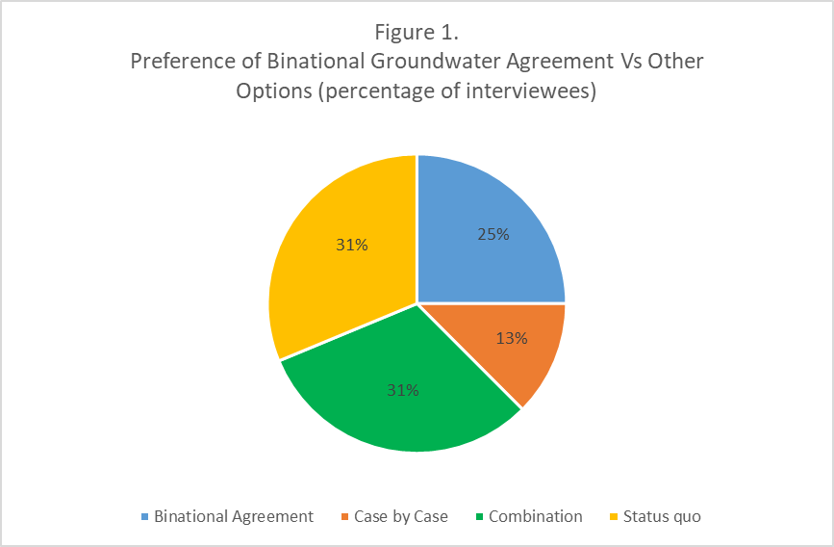

Slide 63
Maturity Process of Transboundary Groundwater Cooperation Efforts

Slide 64
Take home ideas

Slide 65
First, stakeholders support a binational groundwater agreement; however, the majority also suggest that short-term local or regional arrangements may be preferable over binational agreements as local/regional approaches may be more achievable or realistic.

Slide 66
First, stakeholders support a binational groundwater agreement; however, the majority also suggest that short-term local or regional arrangements may be preferable over binational agreements as local/regional approaches may be more achievable or realistic
- Second, participants identified leadership and individual personalities as key factors for success at the local level, but such influence had limited sustainability over time and limited regional-systemic effects.

Slide 67
First, stakeholders support a binational groundwater agreement; however, the majority also suggest that short-term local or regional arrangements may be preferable as local/regional approaches may be more achievable or realistic
- Second, participants identified leadership and individual personalities as key factors for success at the local level, but such influence had limited sustainability over time and limited regional-systemic effects.
- Third, water quality, rather than water quantity, is the main driver of transboundary cooperation efforts in the region.

Slide 68
So, what is the proposed MODEL?
Local-scale
Non-binding arrangements
Focused on water quality/environment
Leadership

Slide 69
Looking for data? We are too!
Transboundary.tamu.edu

