Slide 1
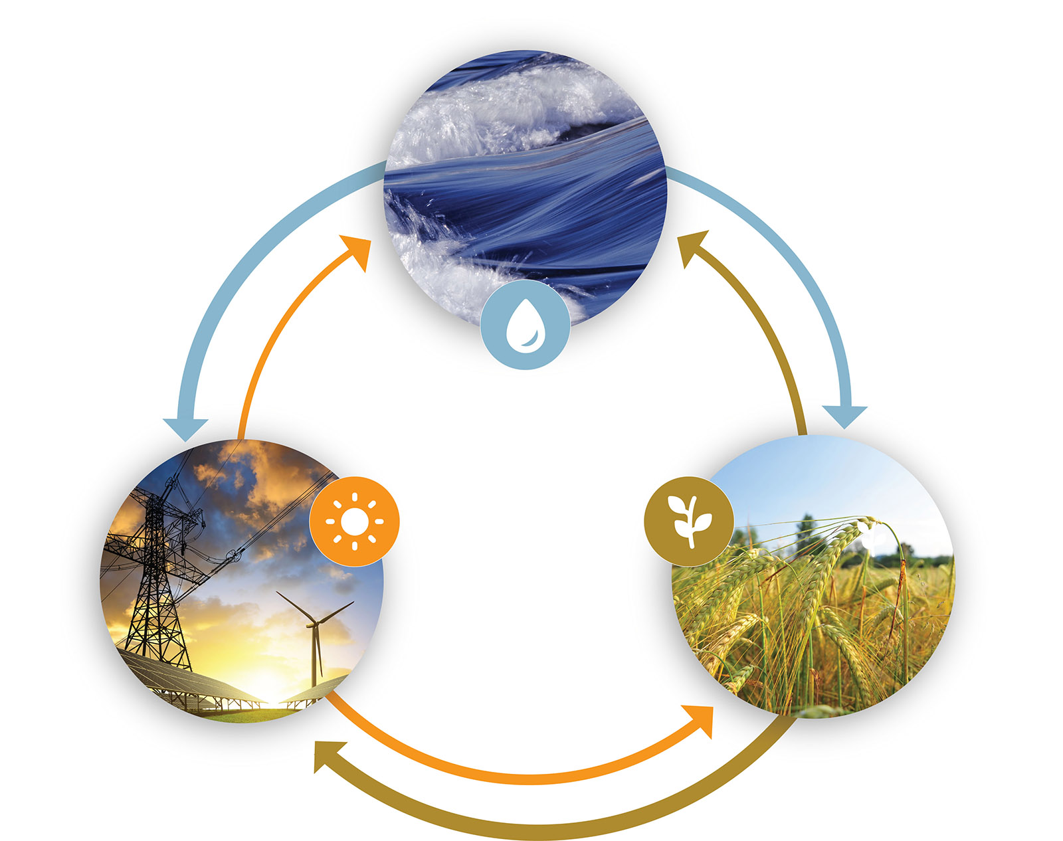

Governing the Water-Energy Nexus in the Metropolitan San Antonio Region
Kent Portney
Department of Public Service and Administration and Institute for Science, Technology, and Public Policy
Special thanks to Bryce Hannibal, Bassel Daher, Rabi Mohtar, and Rob Greer
Prepared for presentation to the Texas Water Research Network spring meeting, “Texas Water Policy session,” May 31, 2019

Slide 2
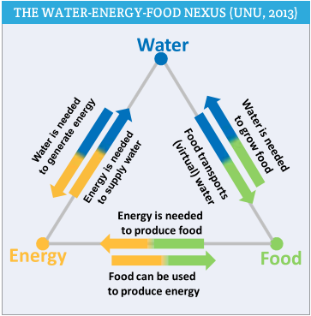
Introduction
Research on the linkages between Energy, Food, and Water challenges has been increasing
Much of this work has been conducted in the “hard” sciences and engineering
However, challenges inevitably lead to issues of how to efficiently and effectively allocate and protect these common pool resources, especially water
Policy initiatives may well need high levels of public support and policy reforms
Source: United Nations University. 2013. Water Security and the Global Water Agenda. A UN-Water Analytical Brief. United Nations University, 2013, p. 14.

Slide 3
“Nexus Governance”
Most of the engineering, science, and systems work on nexus is based on some notion that better knowledge will lead to greater (optimal) resource efficiencies
Often asserts expectations that if policy makers come to understand the linkages, they will act to alter policies, programs, and management to achieve more resource efficiency
Little or no attention to whether this might be true
Inevitably invokes issues of public policy and management – how policies and programs are made, implemented, and managed

Slide 4
Nexus Governance Research
Understanding nexus governance requires reference to various policymaking, policy management and administrative processes
The key question:
To what extent is there any sort of coordination, cooperation, collaboration, or conjoint management of energy and water resources?

Slide 5
Social Networks and Related Theories
Assumptions by the “science” include the idea that generating and sharing better information about nexus issues will produce “better” results
Gravitate toward theories that have something to do with contacting and “sharing” information
Numerous theories, including those involving cooperative, coordinated, and collaborative policy and management, including collective action
Includes conceptual work on “complex adaptive management” and “Institutional Collection Action”

Slide 6
Nexus Research at Texas A&M
About 200 researchers working on some aspect of nexus
Collectively shared research approaches and findings
Decided to concentrate on a single “case study” to see what can be learned about that case
Focus on the “San Antonio Region” as a Nexus Hot Spot
All of the problems with water you can find almost anywhere in the US, and all the “nexus” challenges – a hot and drought-prone geography, a large and growing population, not far from sources of energy (drilling and fracking for oil and natural gas), in a productive agricultural area

Slide 7
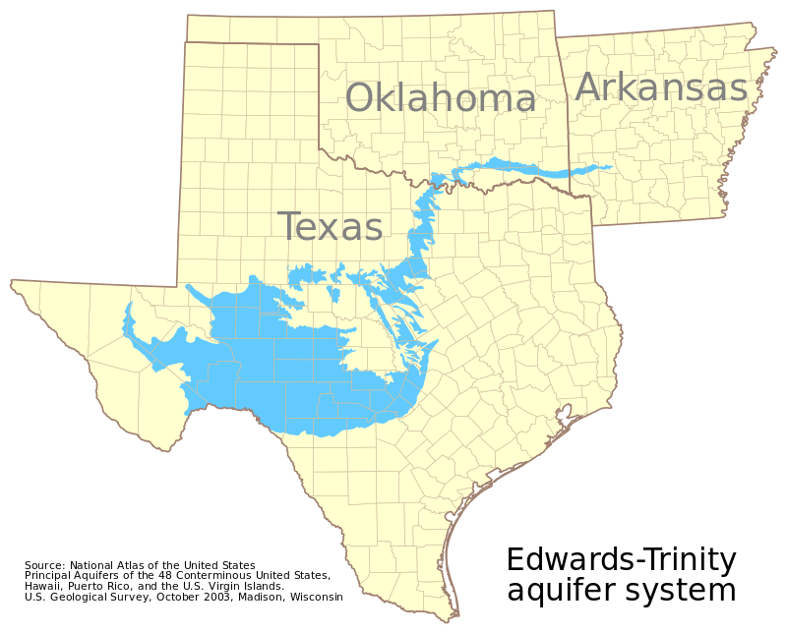
The Water Element
San Antonio City and Bexar County

Slide 8
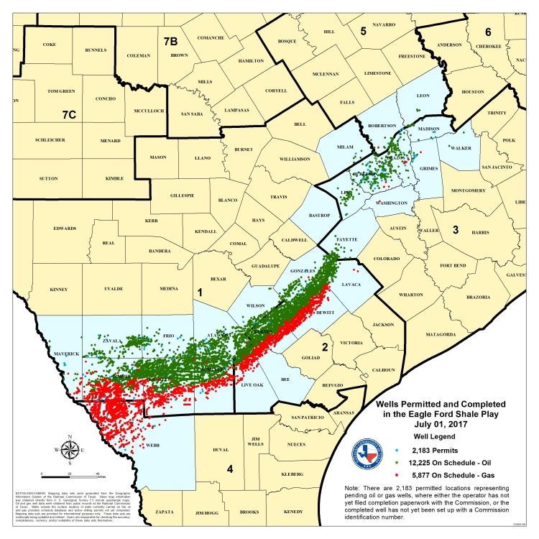
The Energy Element
San Antonio City and Bexar County
Eagle Ford Shale Play and it Wells

Slide 9
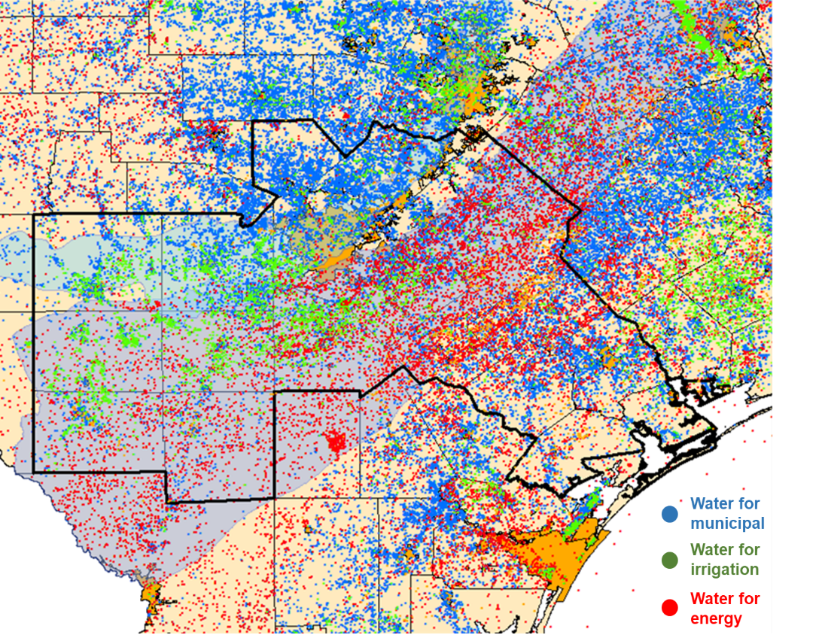
Anatomy of a
Water-Energy-Food Hot Spot
San Antonio and Bexar County
Water for municipalities
Water for agricultural irrigation
Water for energy extraction and production

Slide 10
58 Water Organizations and Agencies at Multiple Levels of Government
Edwards Aquifer Authority
Three Irrigation Districts
TCEQ Office in Austin
TCEQ Freshwater Supply Districts
Texas Water Development Board in Austin
Texas Water Development Board Region K Office
Texas Water Development Board Region L Office
San Antonio Water System (SAWS)
Live Oak Municipal Utility
Canyon Regional Water Authority
Two Stormwater or Flood Control Districts
Texas Water Resources Institute in College Station
Texas State Public Utility Commission
Texas General Land Office
Medina County Groundwater Conservation District
Pecan Valley Groundwater Conservation District
Two Drainage Districts
Bexar County Heritage & Parks Department
Bandera County River Authority & Groundwater Conservation District
Barton Springs/Edwards Aquifer & Groundwater Conservation District
Blanco-Pedernales Groundwater Conservation District
Comal Trinity Groundwater Conservation District
Cow Creek Groundwater Conservation District
Evergreen Groundwater Conservation District
Gonzales County Underground Water Conservation District
Hays Trinity Groundwater Conservation District
Texas State Soil and Water Conservation Board, Region 2 Office
South Texas Watermaster
Headwaters Groundwater Conservation District
Kinney County Groundwater Conservation District
McMullen Groundwater Conservation District

Slide 11
More Water Governance Organizations…
Plum Creek Groundwater Conservation District
Post Oak Savannah Groundwater Conservation
Uvalde County Underground Water Conservation District
Alamo Soil & Water Conservation District #330
Comal-Guadalupe Soil & Water Conservation District #306
Wilson County Soil & Water Conservation District #301
Brazos River Authority
Central Colorado River Authority
Guadalupe-Blanco River Authority
Lavaca-Navidad River Authority
Lower Colorado River Authority
Nueces River Authority
Trinity River Authority
Trinity River Vision Authority
San Antonio River Authority
Upper Colorado River Authority
Upper Guadalupe River Authority
Texas Groundwater Management Area #9 Office
Texas Groundwater Management Area #10 Office
Hill Country Priority Area Office
Trinity Aquifer Priority Area Office
Joint Base San Antonio, Office of Water

Slide 12
Energy Agencies and Stakeholders
Energy Agencies
City Public Service (CPS) Energy
San Antonio City Office of Sustainability
Texas Public Utility Commission
Texas Railroad Commission
Texas Comptroller, Office of Energy
Conservation
Electric Reliability Council of Texas
(ERCOT)
Energy Companies and Nonprofits
Exxon Mobil
Shell Oil
Duke Energy
Marathon Oil
Pioneer Energy
EOG Resources
Blue Wing Solar
GE Power and Water
Halliburton
Valero Oil
Association of Electric Companies of Texas
(nonprofit trade association)
Greenspaces Alliance of South Texas (nonprofit)

Slide 13
Food/Agriculture Agencies and Stakeholders
Food/Agriculture Agencies
  San Antonio Food Policy Council
  San Antonio Food Bank
  San Antonio Metro Health District
  Texas Farm Bureau
  Texas State Soil and Water Conser-
  vation Board, Region 2 Office
  Texas State Department of Agriculture
Food Processing/Distribution Companies
  HEB
  Kroger
  NatureSweet
  Sysco Central Texas
  Labatt Food Services
  Del Norte Foods
  Cargill Food Distributors

Slide 14
Project Survey
Identified 237 people in these “water” organizations
Created a questionnaire that, among other things, asked about contacts and interactions
Included questions about interaction with 16 energy and 12 food/agriculture organizations and agencies
Multimodal – paper, Qualtrics online
Initial questionnaire mailing, two email follow-ups, second questionnaire mailing
Total of 104 responses; 41% response rate

Slide 15
Contacts Among Water Agencies

Slide 16
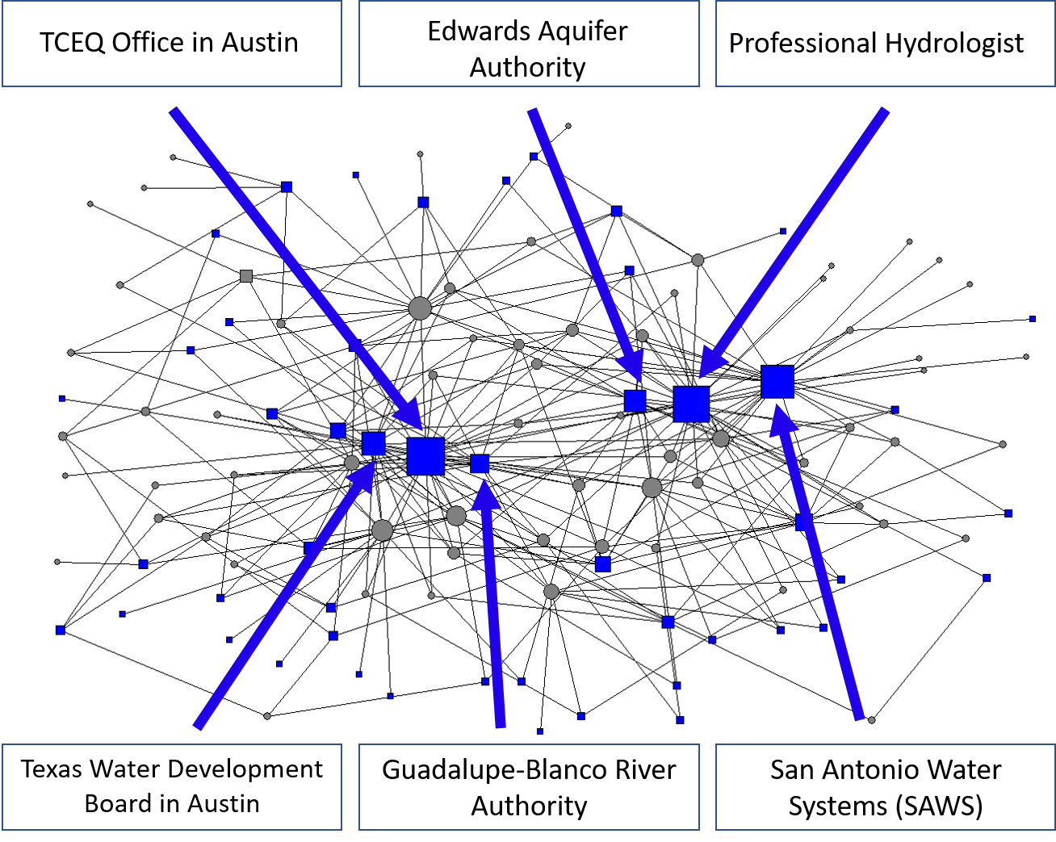
The “Water Governance” Network

Slide 17
Contacts of Water Agencies with Energy

Slide 18
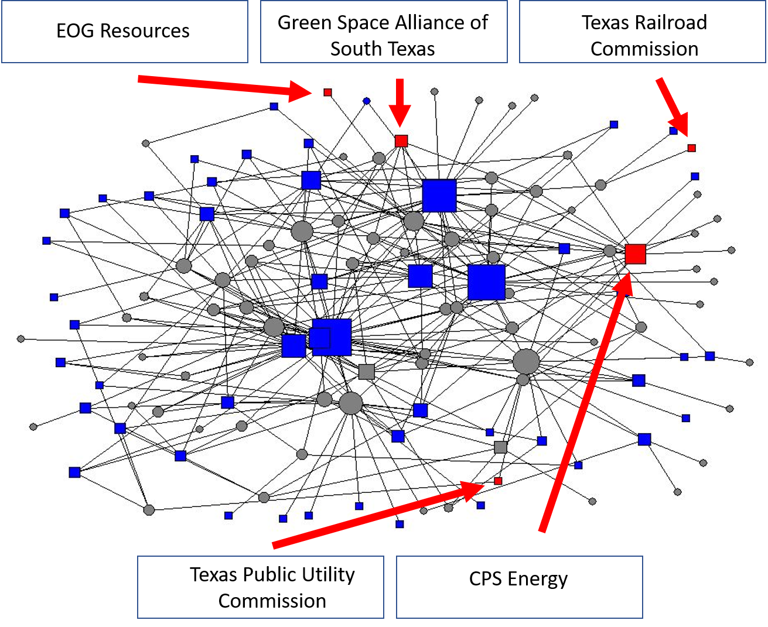
The “Water-Energy Governance” Network

Slide 19
Contacts of Water Agencies with Food/Ag

Slide 20
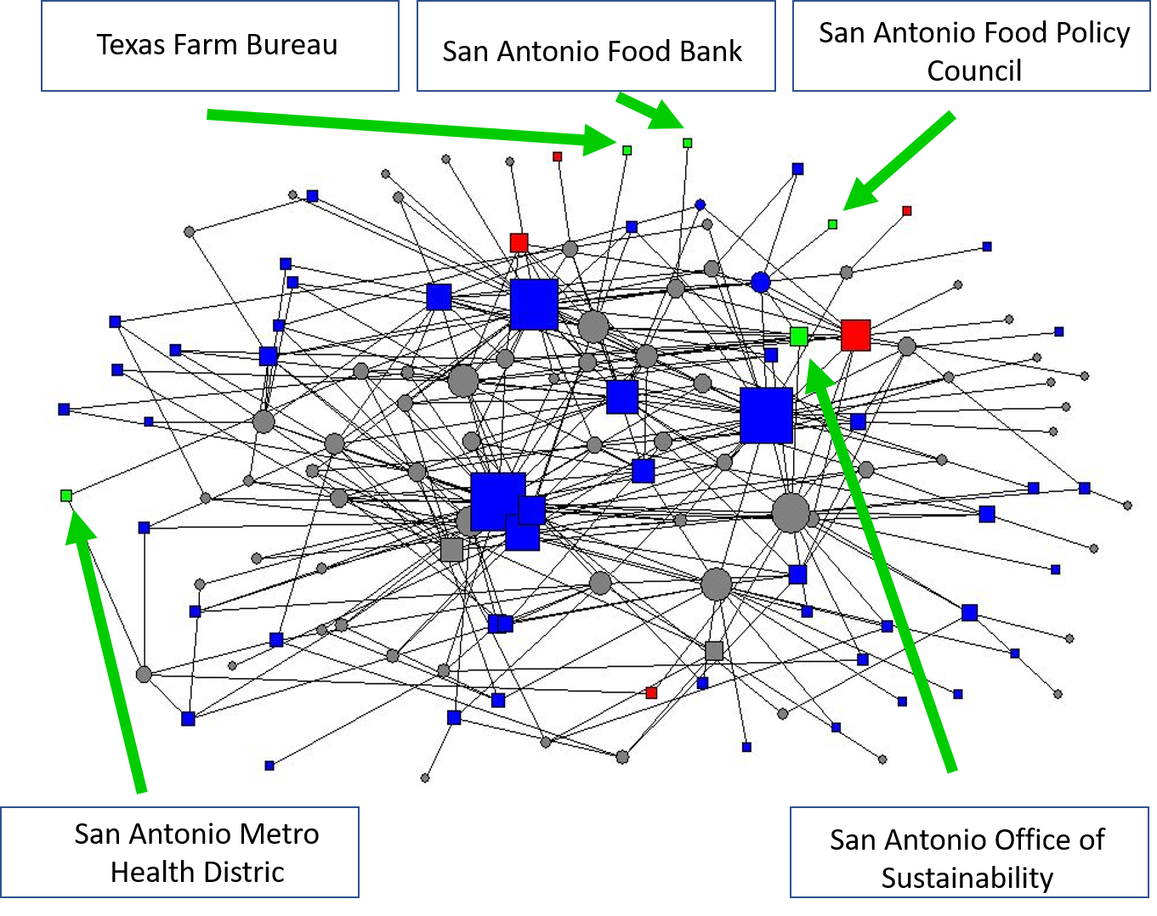
The “Water-Energy-Food Governance” Network
t

Slide 21
Conclusions
There is not much “Nexus Governance” apparent in the San Antonio Region
The Governance of Water is largely separate from Governance of Energy; Governance of Food/Ag is largely separate from Governance of Energy
Fragmentation, and associated lack of co-benefits, seems to be the norm
The implication is that much work needs to be done to try to achieve some level of “conjoint” Water Energy and Food management and policy and decision making
Key issue is whether the structure of governance is driven by the nature of decisions (i.e. the centrality of energy vis a vis water and food), or whether there is room to influence the decisions by altering the structure and formal relations among institutions

Slide 22
Some Policy and Legal Implications from Nexus Governance
If promoting greater coordination, cooperation, collaboration, and conjoint policy/management is a goal:
  How to reform the governance institutions?
  Is there a need to alter the statutes (Texas Water Code) under which the institutions are created and defined? Can the coordination function be made more explicit?
  Can new processes and institutions be defined to promote greater coordination? Mandate new stakeholder engagement processes? Create financial incentives? Provide greater public financing for collaborative efforts?

