Slide 1
Texas Water Research Network
Notes:
List room number instead of ‘main campus’

Slide 2
Texas Water Research Network
Future directions for the network?
Jay Banner, UT Austin

Slide 3
The talks are great… and we need to do more to advance the mission of the network.
Should we have breakout workshops at TWRN?

Slide 4
Example TWRN workshop projects
Research co-design between researchers and stakeholders
  Integrated modeling of Planet Texas 2050 and Austin Water 100 year plan
  Resacas of Rio Grande Valley need study, restoration, regulation.
    A Texas Metro Observatory for the Rio Grande Valley?
Design an NSF Research Experiences for Undergraduates program to connect our institutions
  Research synergy of connected faculty at undergraduate and host research institutions on collaborative projects. Enhanced continuity of student research
White paper on grand challenges we have identified and research and resources needed to address them

Slide 5
Workshop components
Organize ideas and people prior to network meeting
Workshop at TWRN meeting
Report out to group at TWRN meeting
Facilitated workshops

Slide 7
White House Strategy on Climate:
Try to Bury Its Own Scientific Report
NY Times, Nov. 25, 2018
1. National Climate Assessment (NCA) - the most comprehensive scientific study to date detailing the effects of warming on the US economy, public health, coastlines and infrastructure, projecting hundreds of billions of dollars of damage in coming decades.
2. Congress mandates that the NCA be published by the White House. Report released the Friday after Thanksgiving, 2018.
3. Steven J. Milloy (Trump’s E.P.A. transition team) called the NCA report a product of “the deep state”.

Slide 8
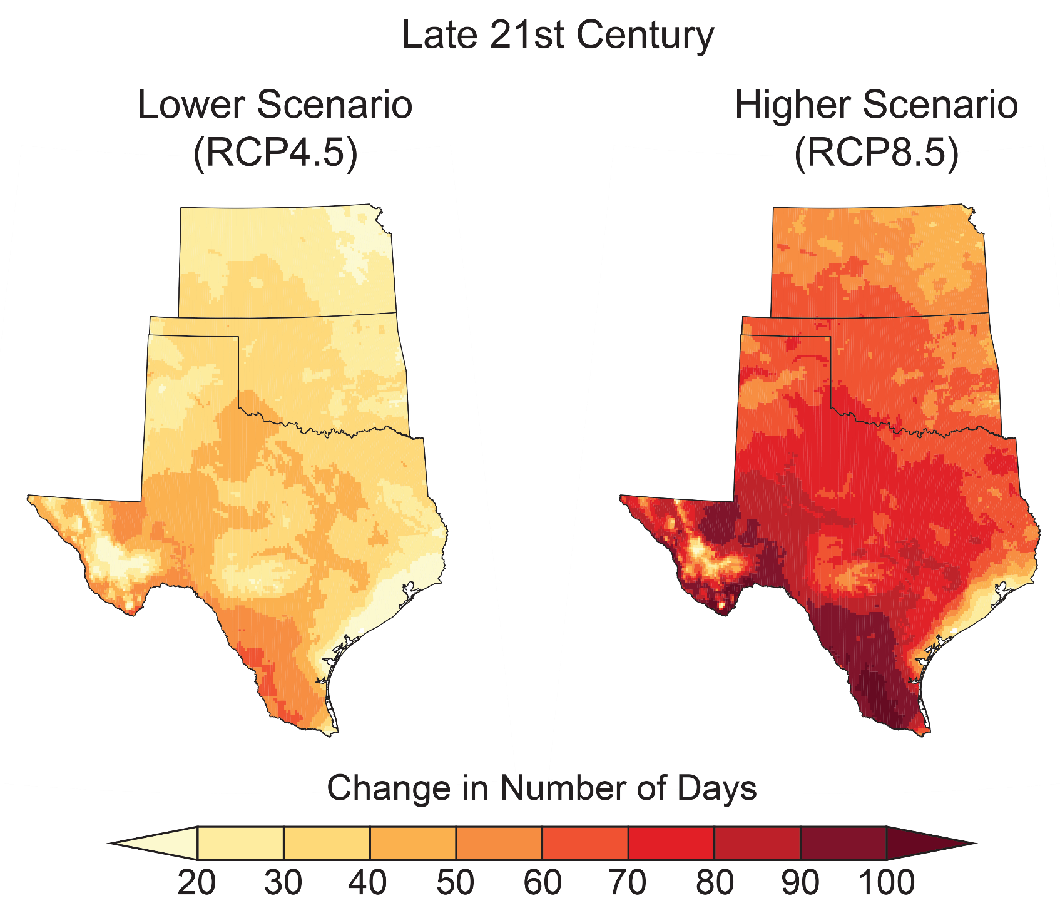
Projected Increase in Number of Days Above 100ºF
Fourth National Climate Assessment (2018)

