Slide 1
INVASIVE MUSSELS IN TEXAS
Stefan Schuster, P.G. & John Higley, CEO
May 31, 2019
TWRN Conference-University of Texas at Austin

Slide 3
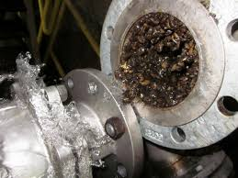
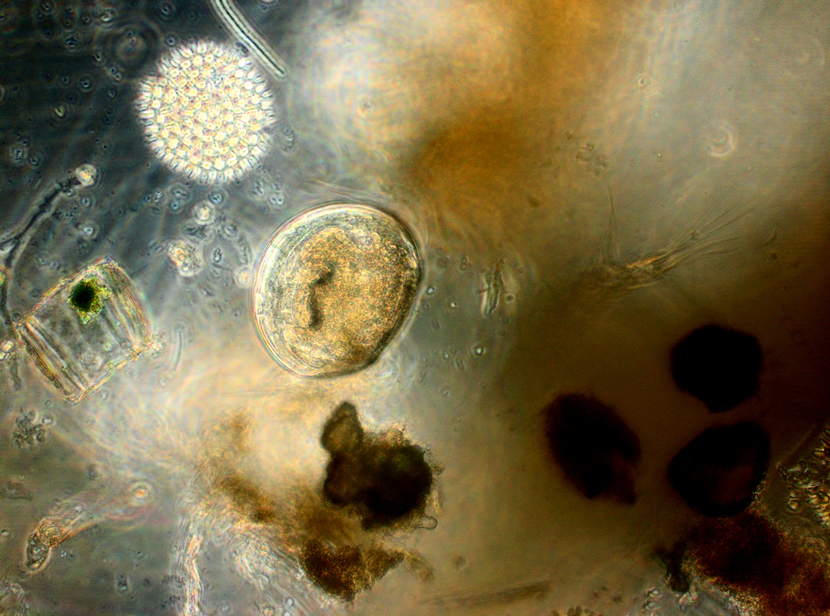
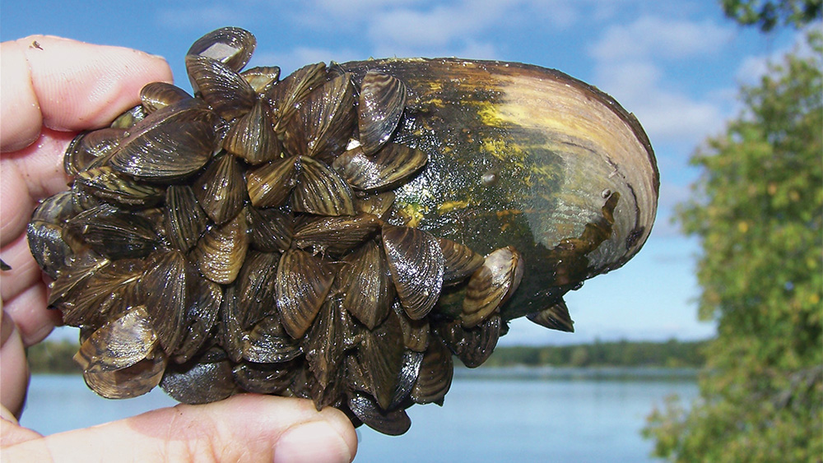
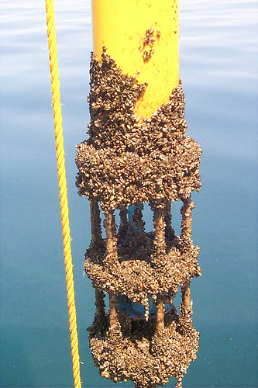
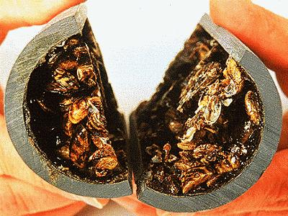
Confidential
Notes:
Impact!

Slide 4
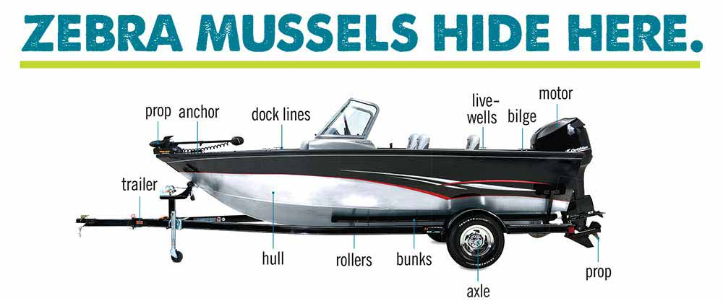

Slide 5
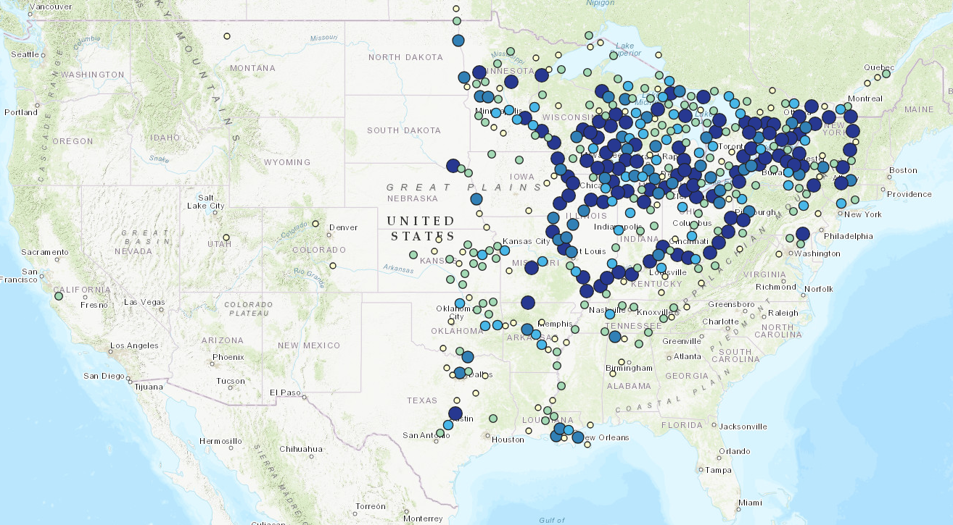
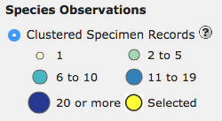
Confidential
Invasive mussels are making their way west with no end in sight.
Notes:
Spread
Quagga Mussels not included

Slide 6
IMPACTS OF INVASIVE SPECIES
FISCAL
1
Money used by agencies to fight infestation
PHYSICAL
2
Infrastructure or ecological damage caused by infestation
ENVIRONMENTAL
3
Filtering out nutrients and damaging local ecosystems
ECONOMIC
4
Physical removal
Infrastructure damage

Slide 7
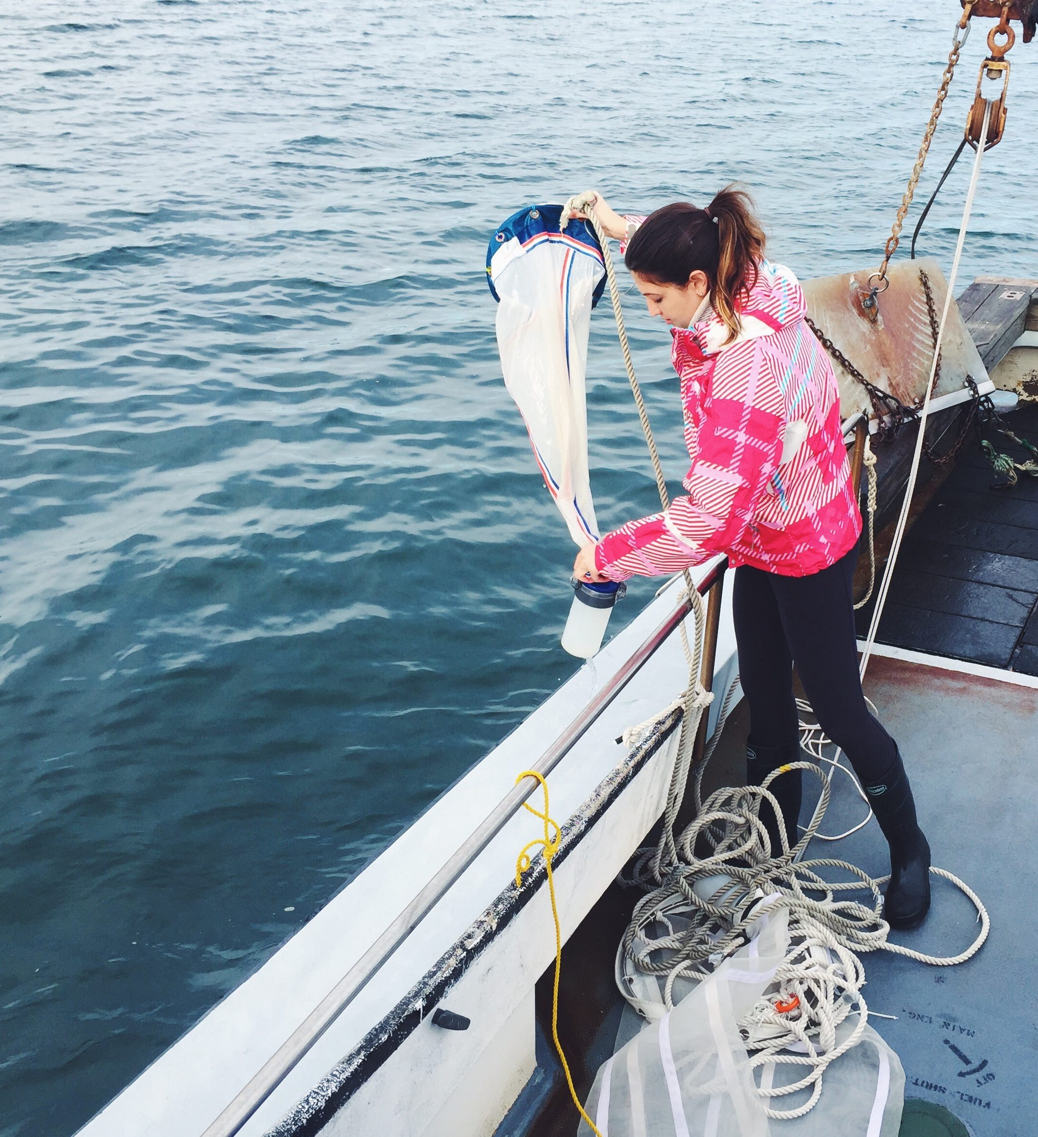
PROBLEM-Current Methods
Labor Intensive
Notes:
Why Elizabeth has to work so hard with limited results

Slide 8
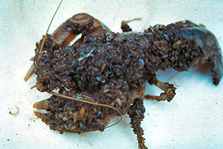
PROBLEM-Current Methods
Only Detects Populations
Already Breeding
Notes:
Why Elizabeth has to work so hard with limited results

Slide 9
PROBLEM-Current Methods
Error Prone
Notes:
Why Elizabeth has to work so hard with limited results

Slide 10
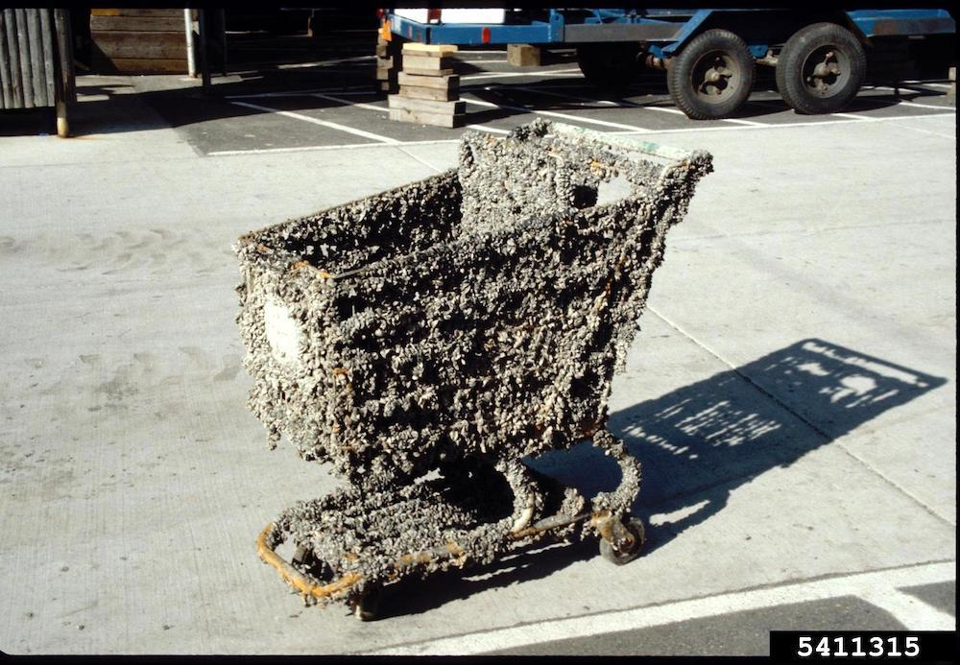
PROBLEM-Current Methods
No Ability to
Eradicate
Notes:
Why Elizabeth has to work so hard with limited results

Slide 11
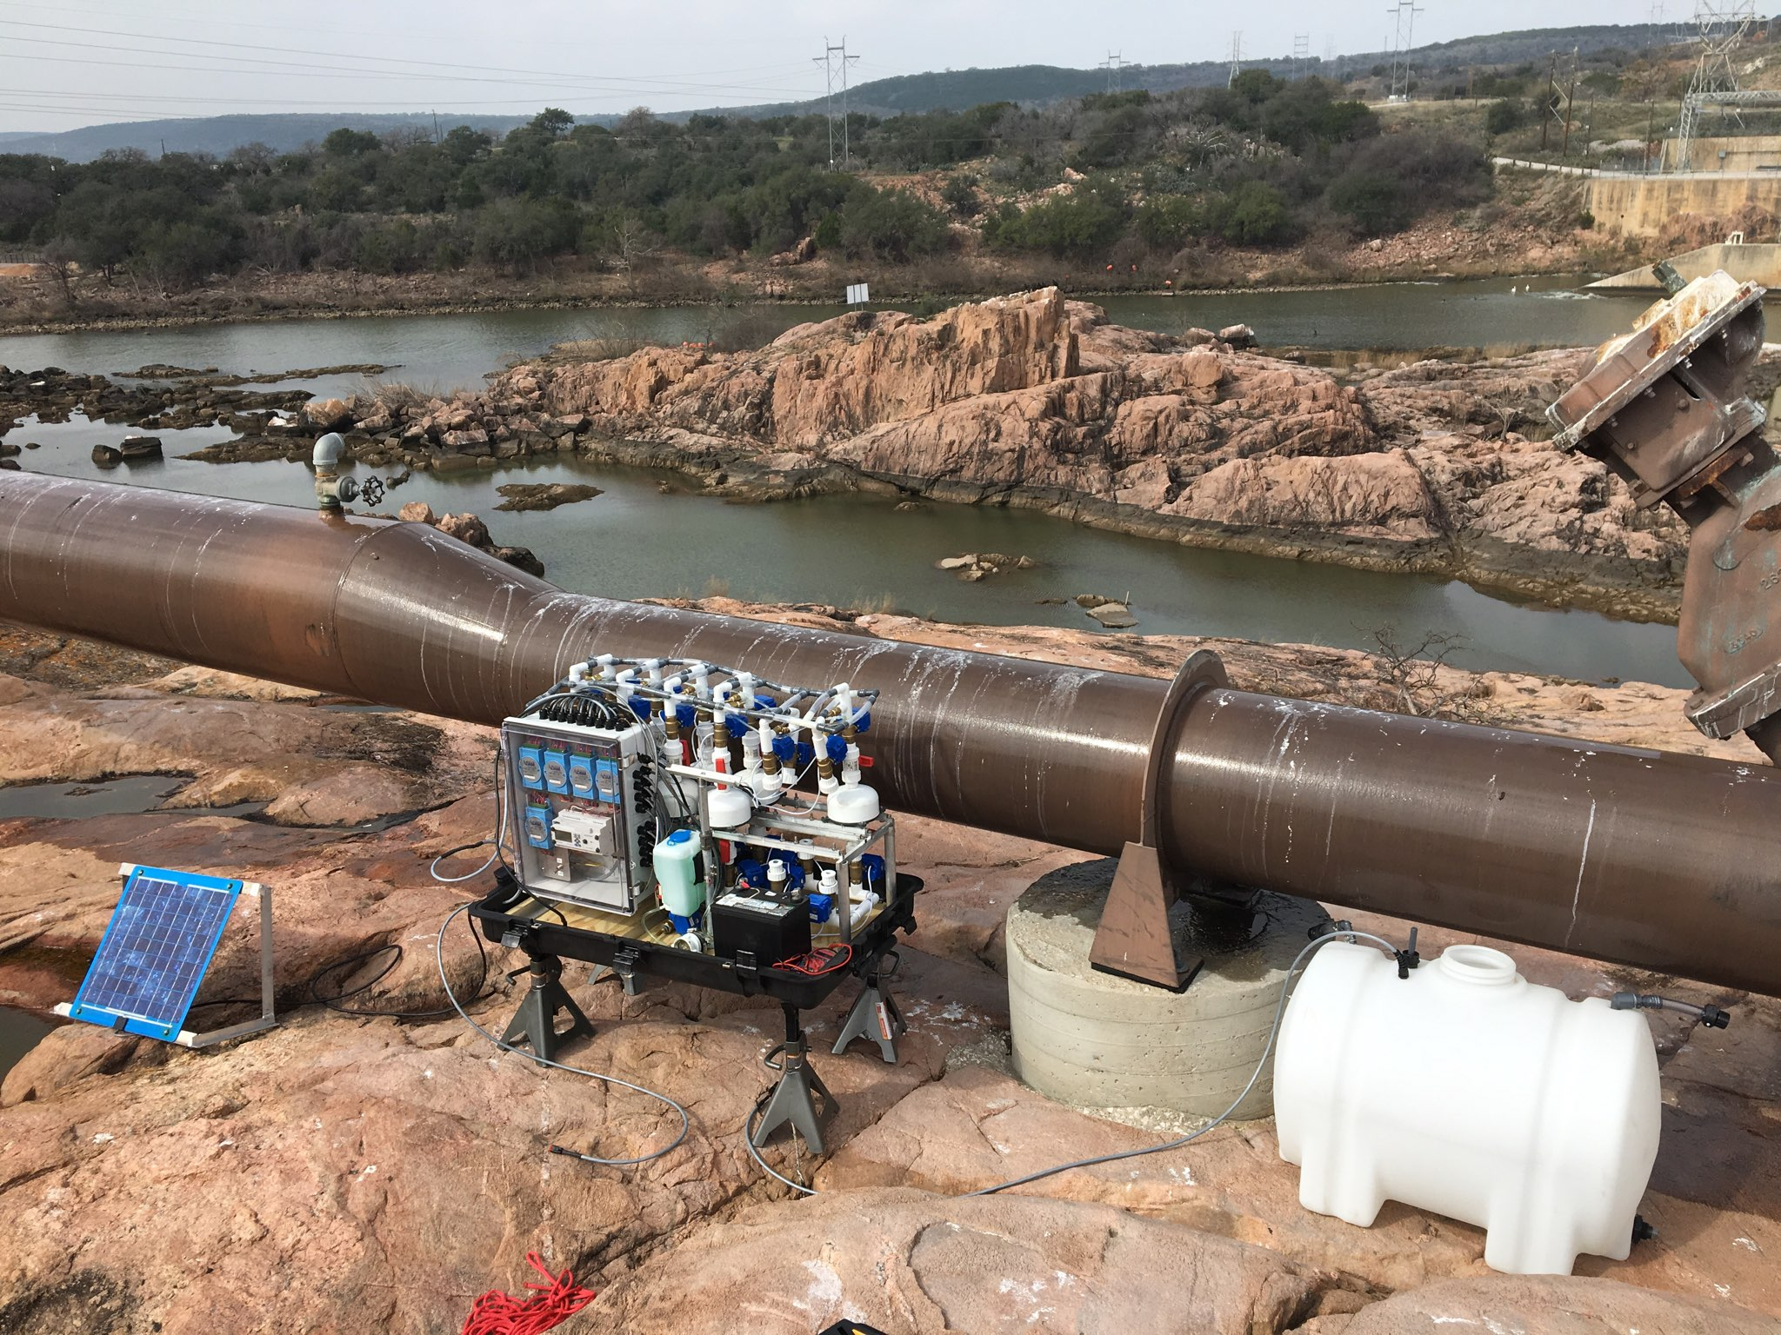
SOLUTION
Automated
Notes:
How our solution helps Elizabeth scale, expand, and protect
Automated collection let’s her sample more places more frequently
Multiple life cycle indicators allows for early detection and effective mitigation
Lab analysis is high through put
Working with Bureau of Rec on a cure (own the whole stack)

Slide 12
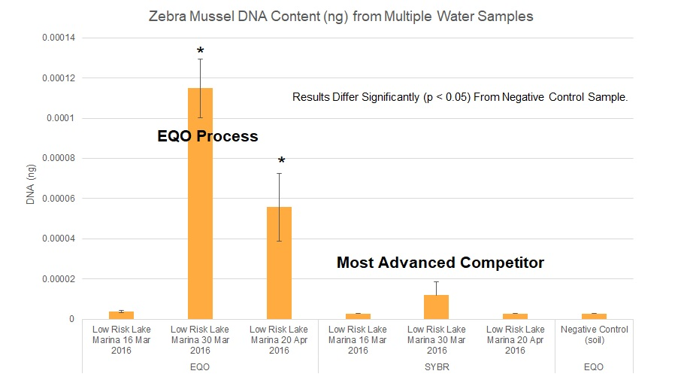
SOLUTION
True Early Detection
And Mitigation
Notes:
How our solution helps Elizabeth scale, expand, and protect
Automated collection let’s her sample more places more frequently
Multiple life cycle indicators allows for early detection and effective mitigation
Lab analysis is high through put
Working with Bureau of Rec on a cure (own the whole stack)

Slide 13
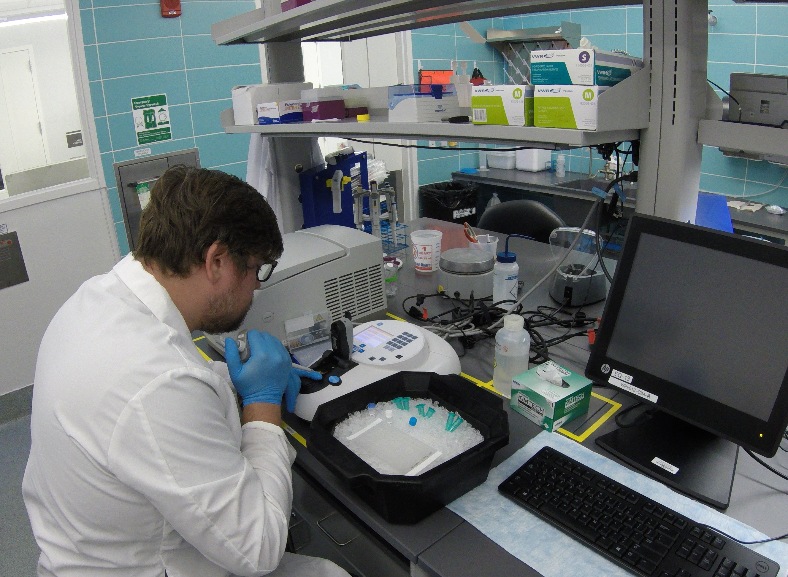
SOLUTION
High-Throughput
Analytics
Notes:
How our solution helps Elizabeth scale, expand, and protect
Automated collection let’s her sample more places more frequently
Multiple life cycle indicators allows for early detection and effective mitigation
Lab analysis is high through put
Working with Bureau of Rec on a cure (own the whole stack)

Slide 14
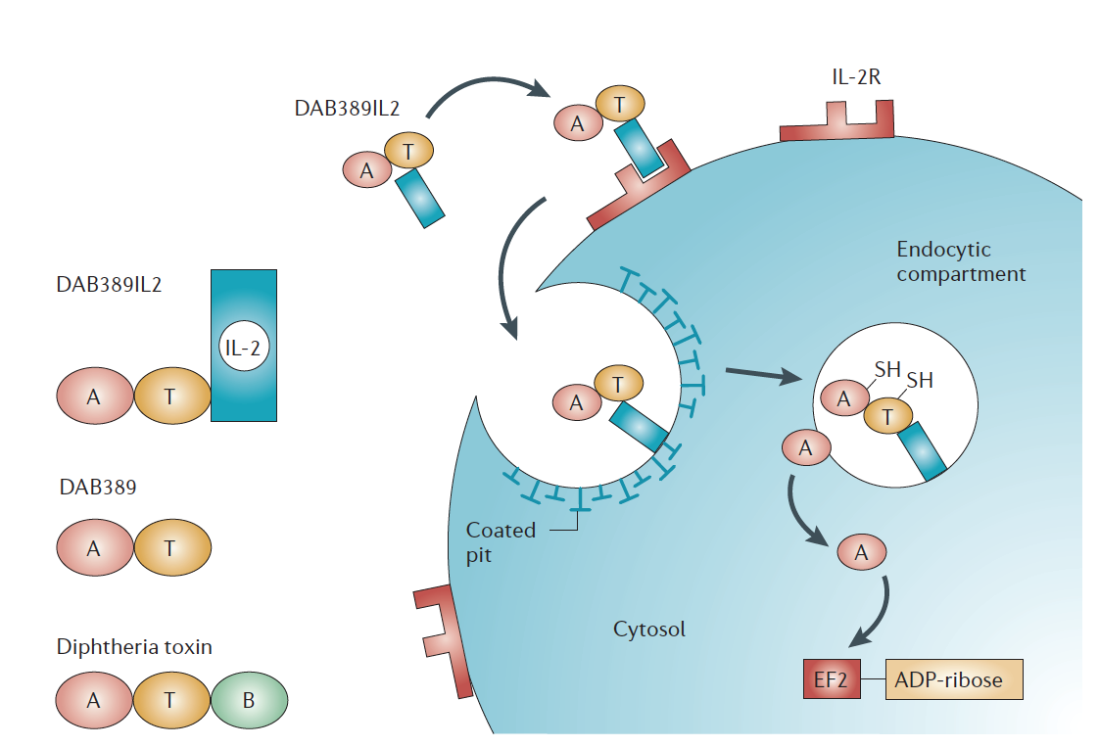
SOLUTION
Biotherapeutic Based
Eradication
Pastan et al., (2006)
Notes:
How our solution helps Elizabeth scale, expand, and protect
Automated collection let’s her sample more places more frequently
Multiple life cycle indicators allows for early detection and effective mitigation
Lab analysis is high through put
Working with Bureau of Rec on a cure (own the whole stack)

Slide 15
INVESTMENT
TPWD STUDY
Pilot Research Study on 3 Texas Lakes
Lake Sommerville
Canyon Lake
Lake Waco
TWPD validated EQO technology

Slide 16
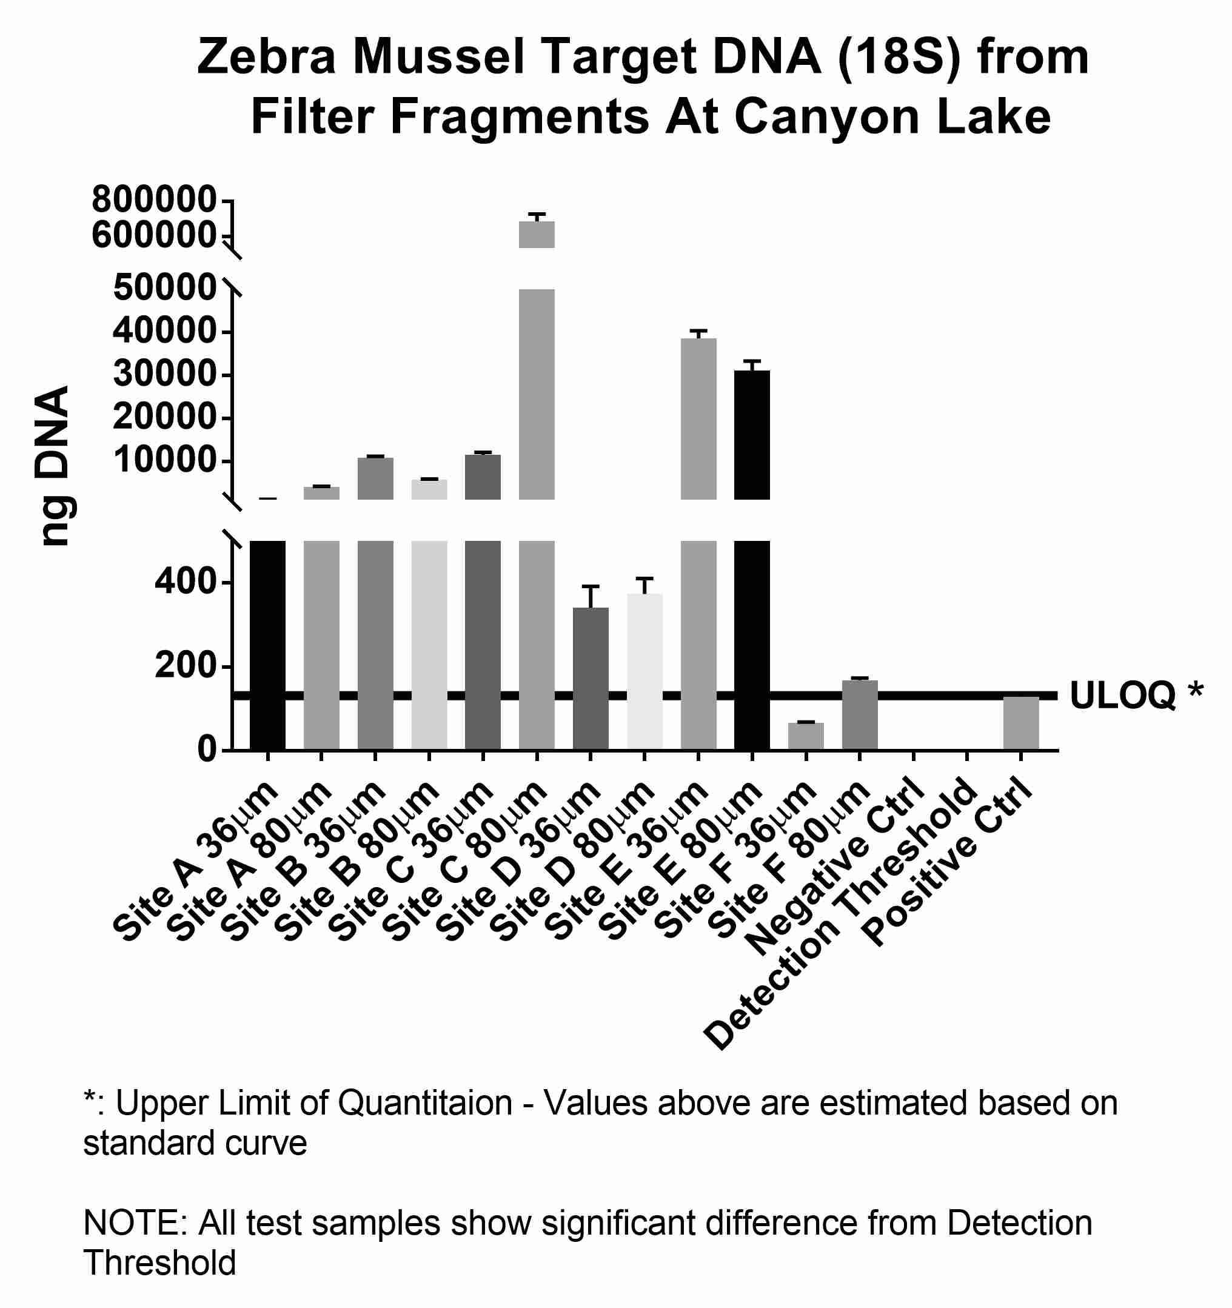
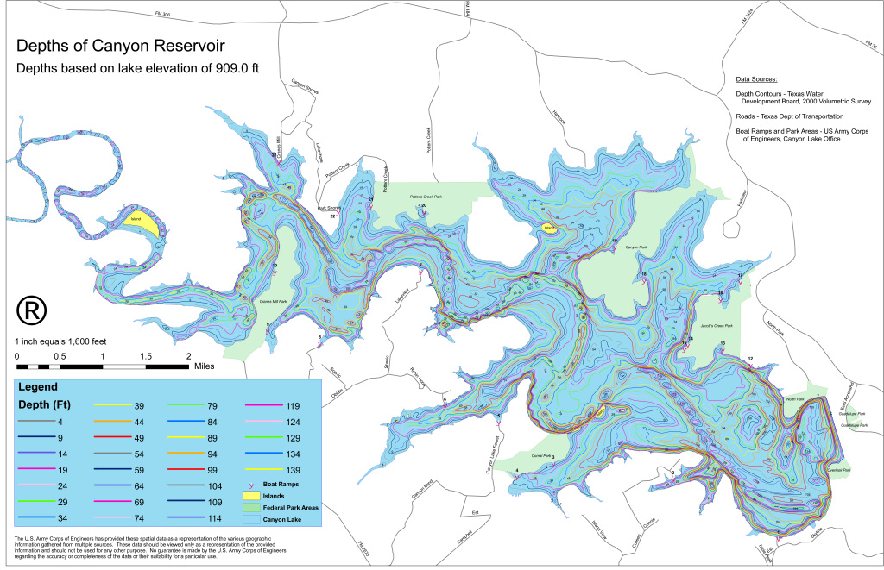
INVESTMENT
TPWD STUDY

Slide 17
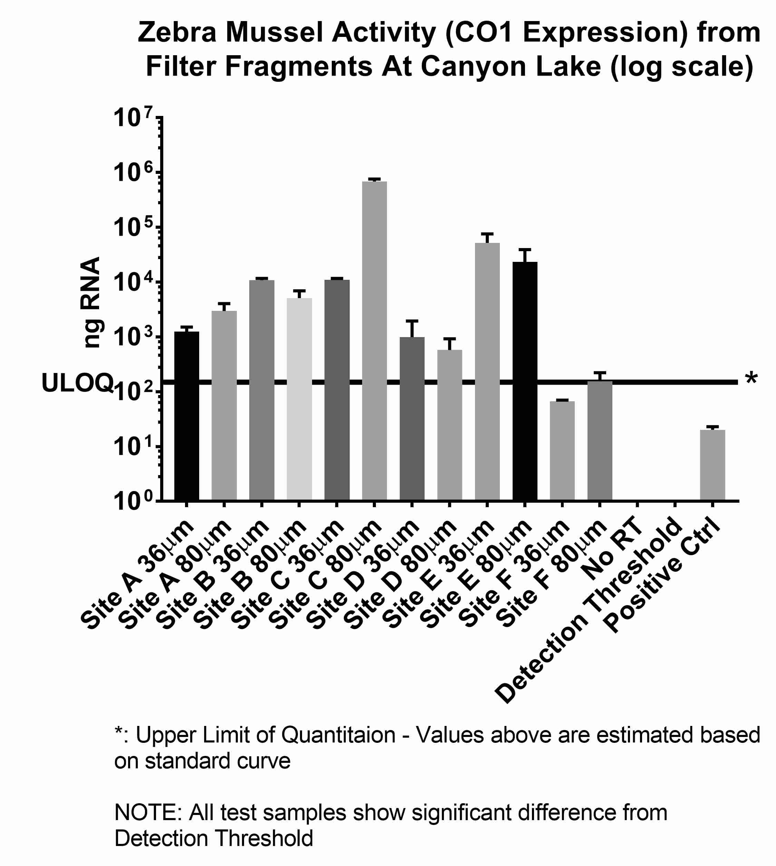
INVESTMENT
TPWD STUDY

Slide 18
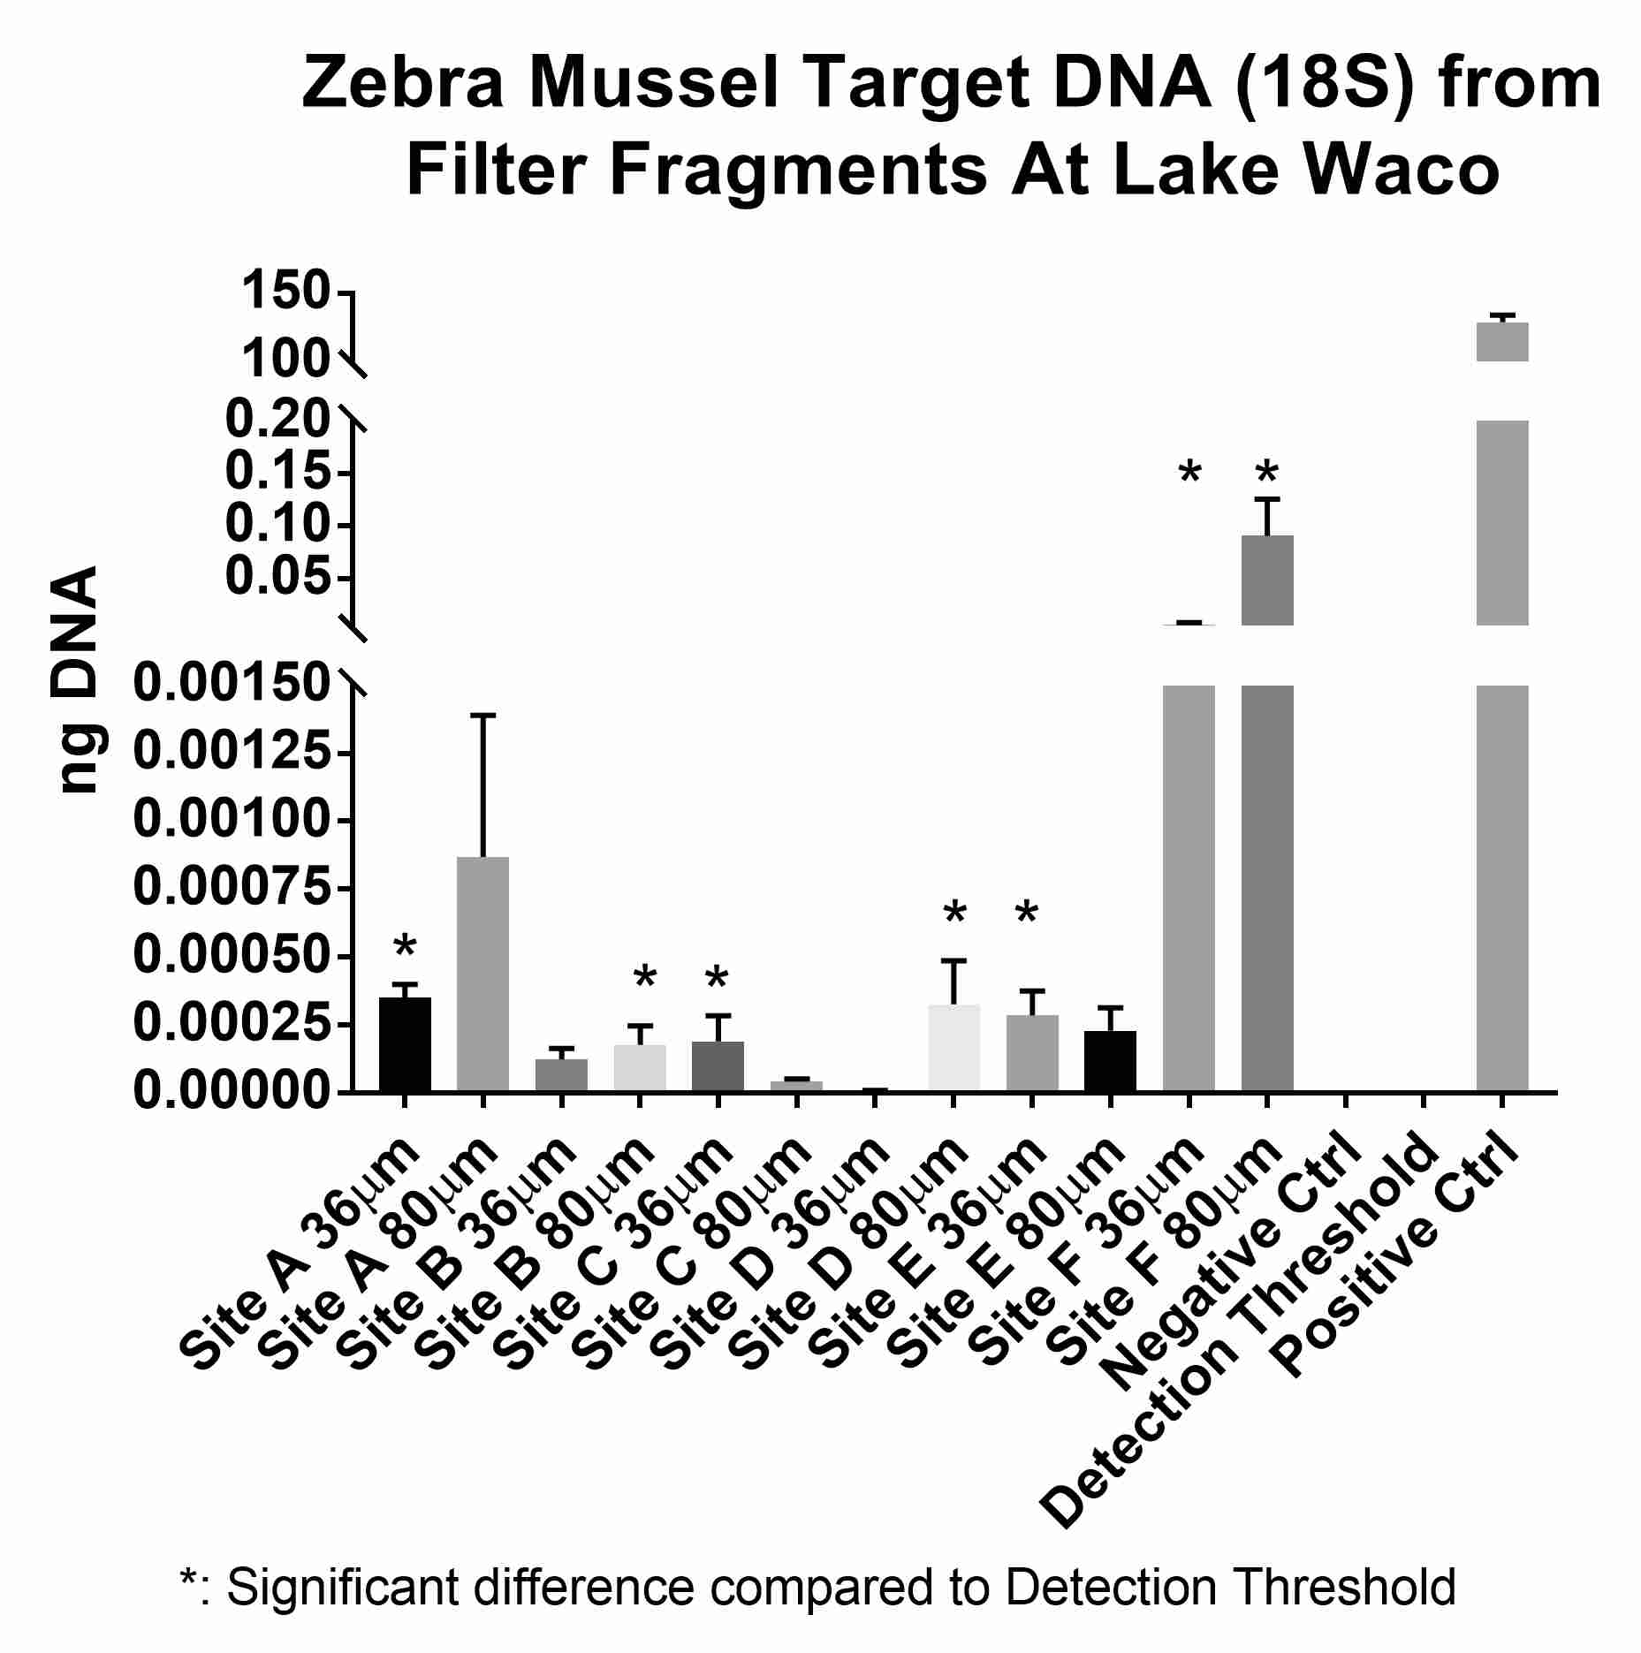
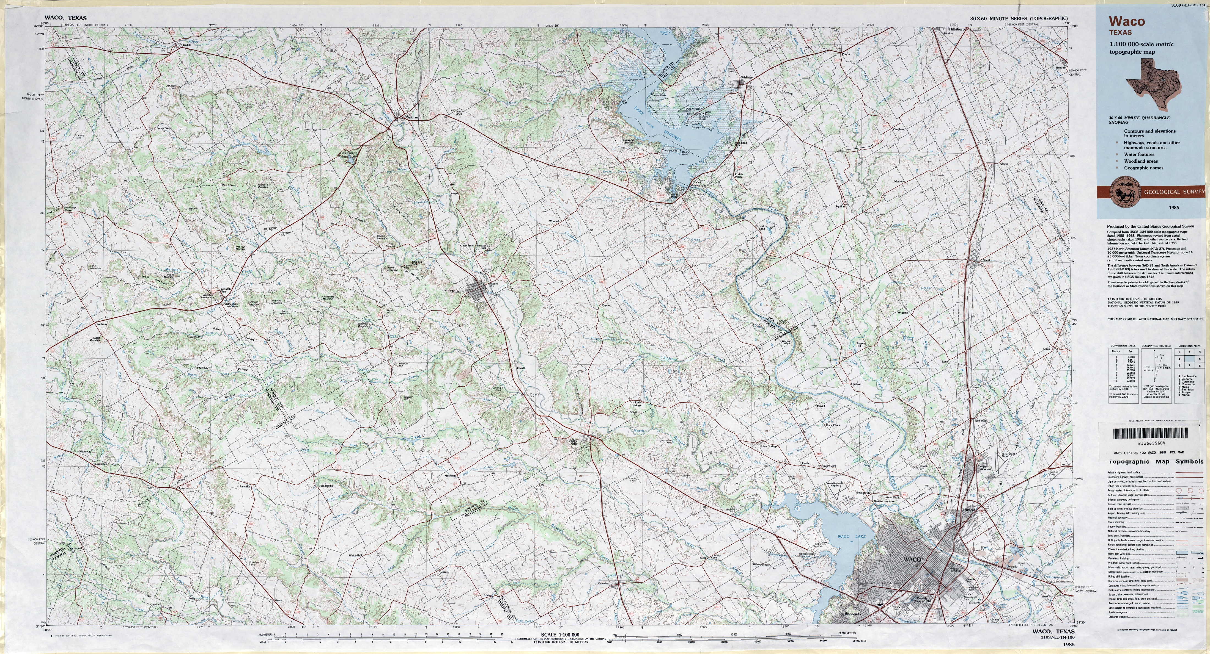
INVESTMENT
TPWD STUDY

Slide 19
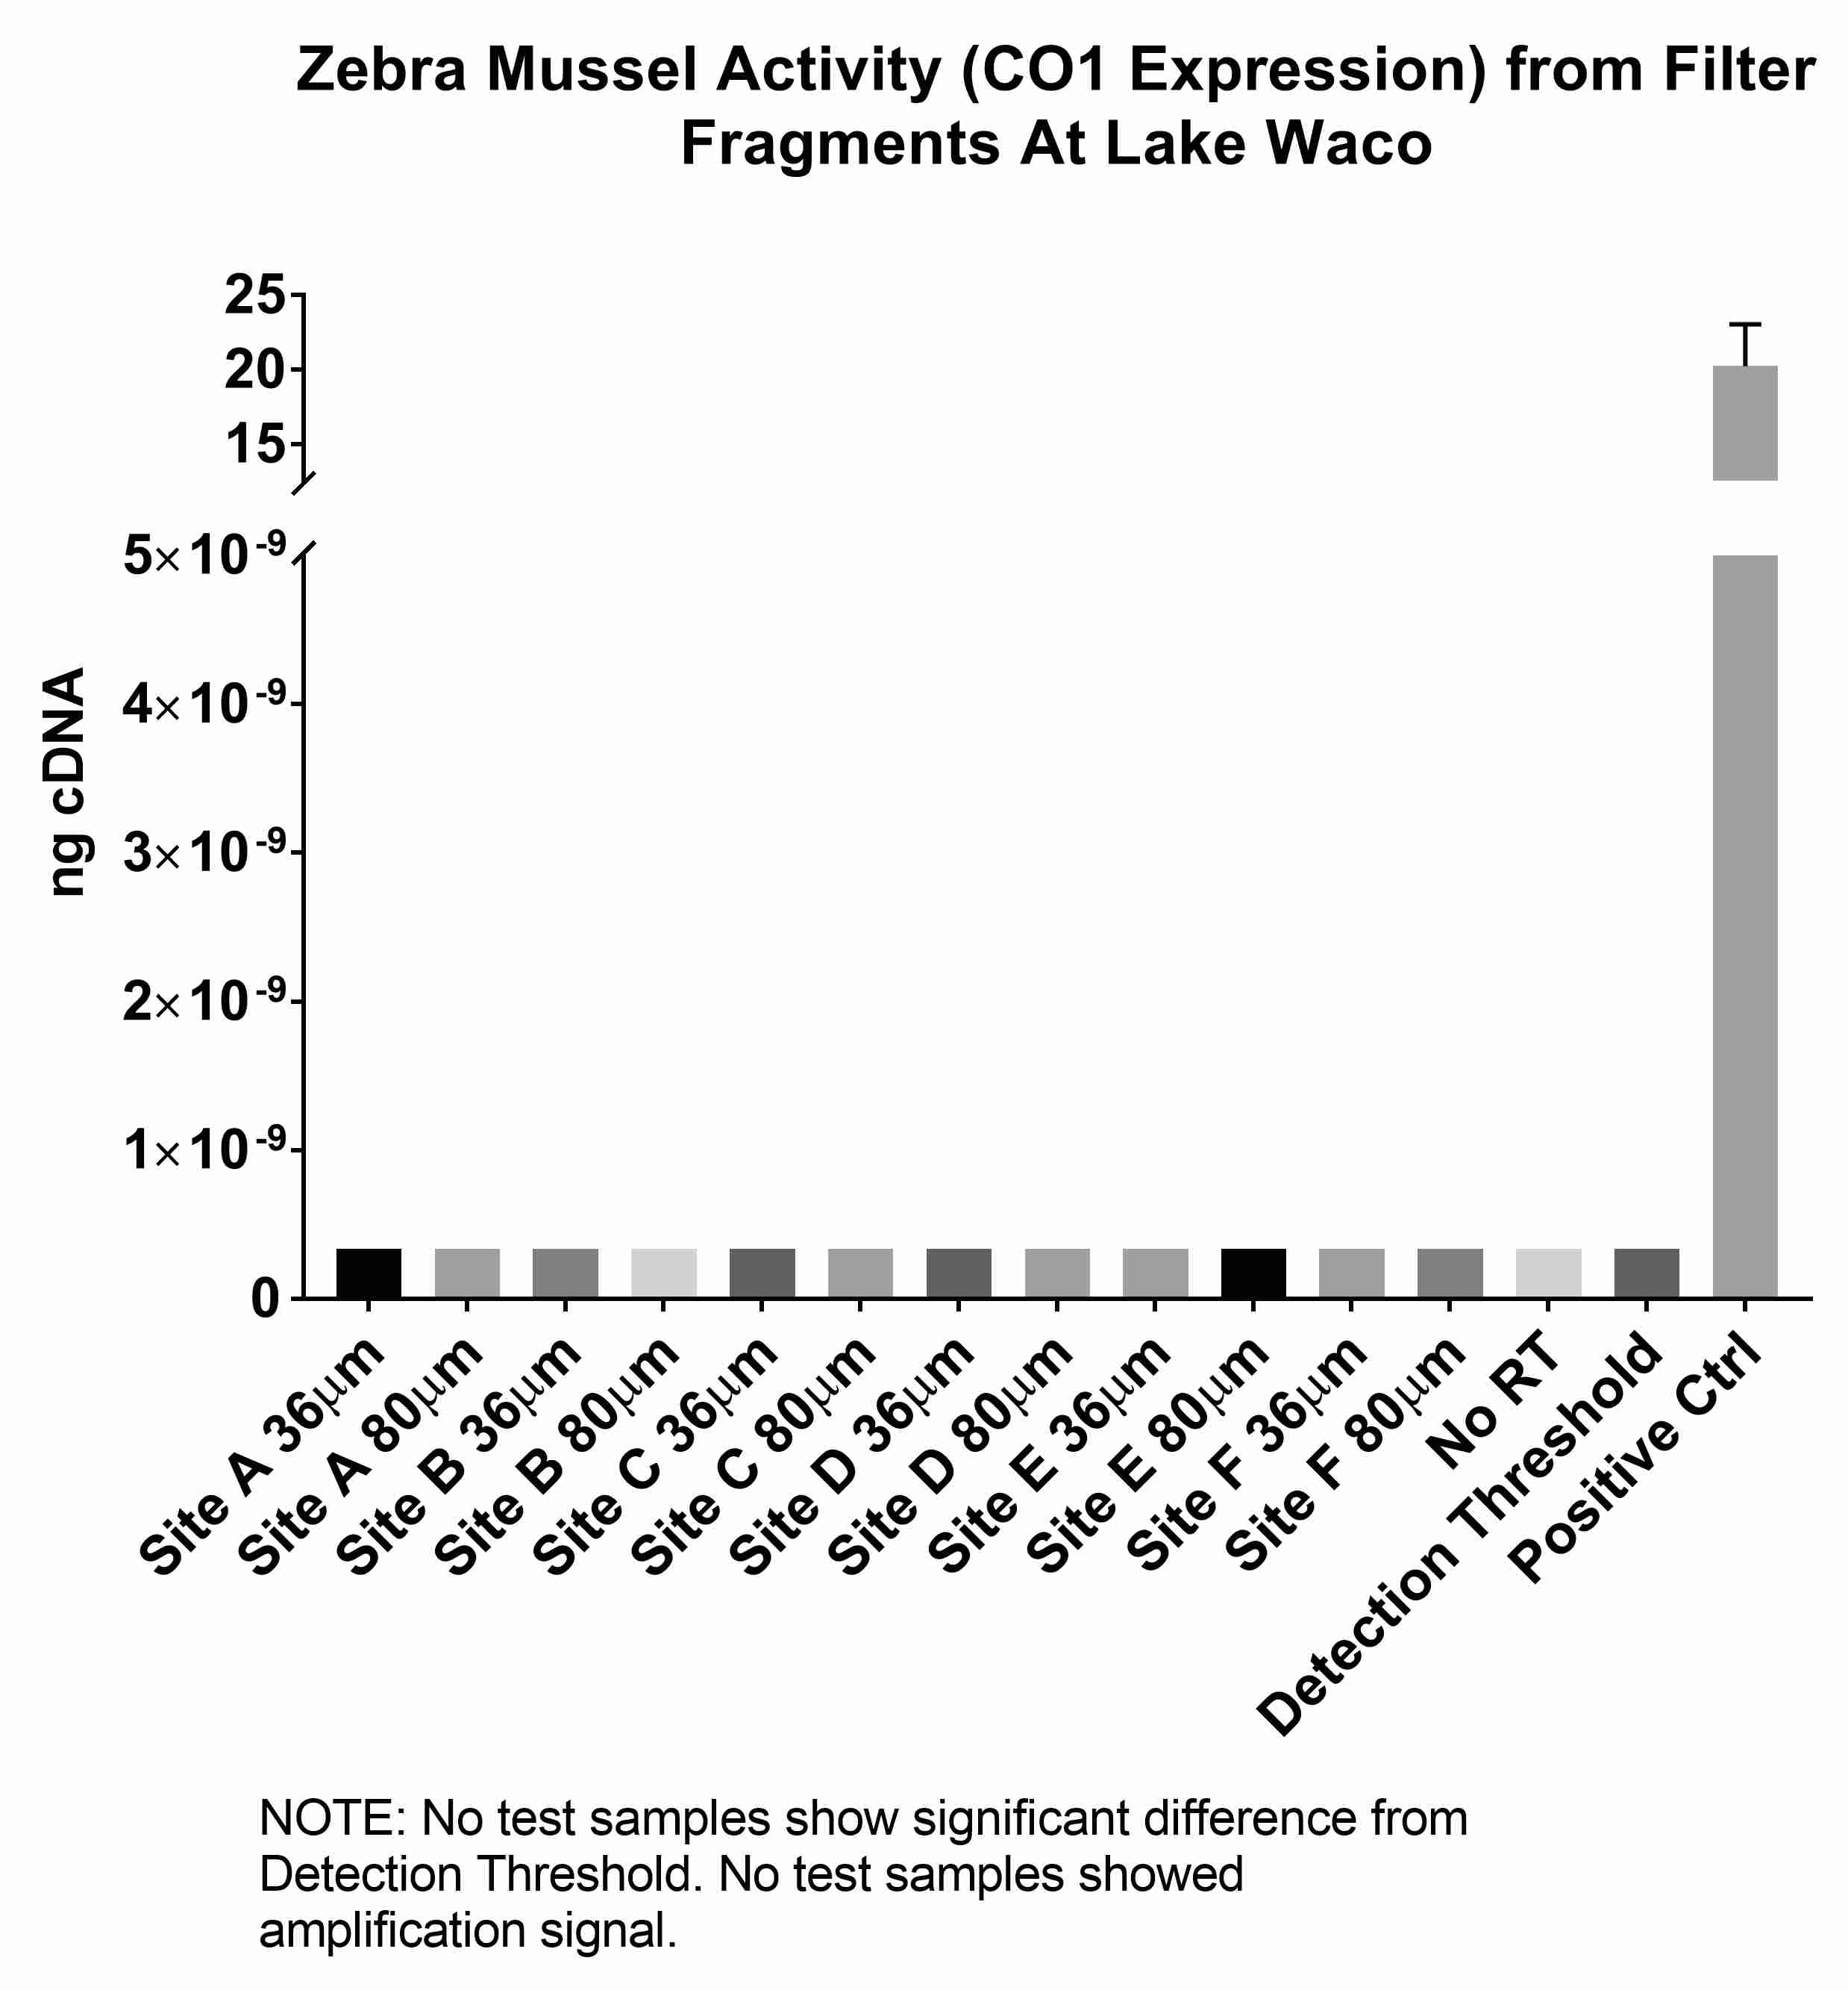
INVESTMENT
TPWD STUDY

Slide 20
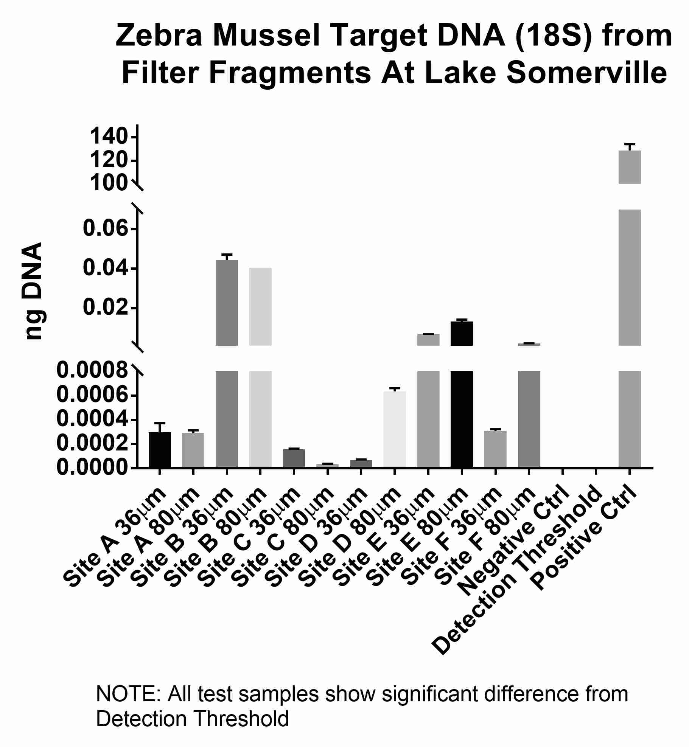
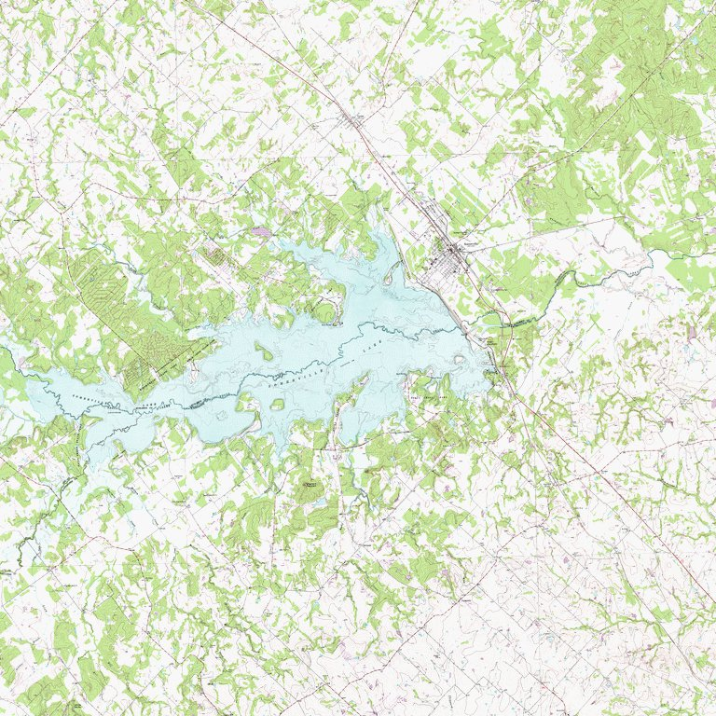
INVESTMENT
TPWD STUDY

Slide 21
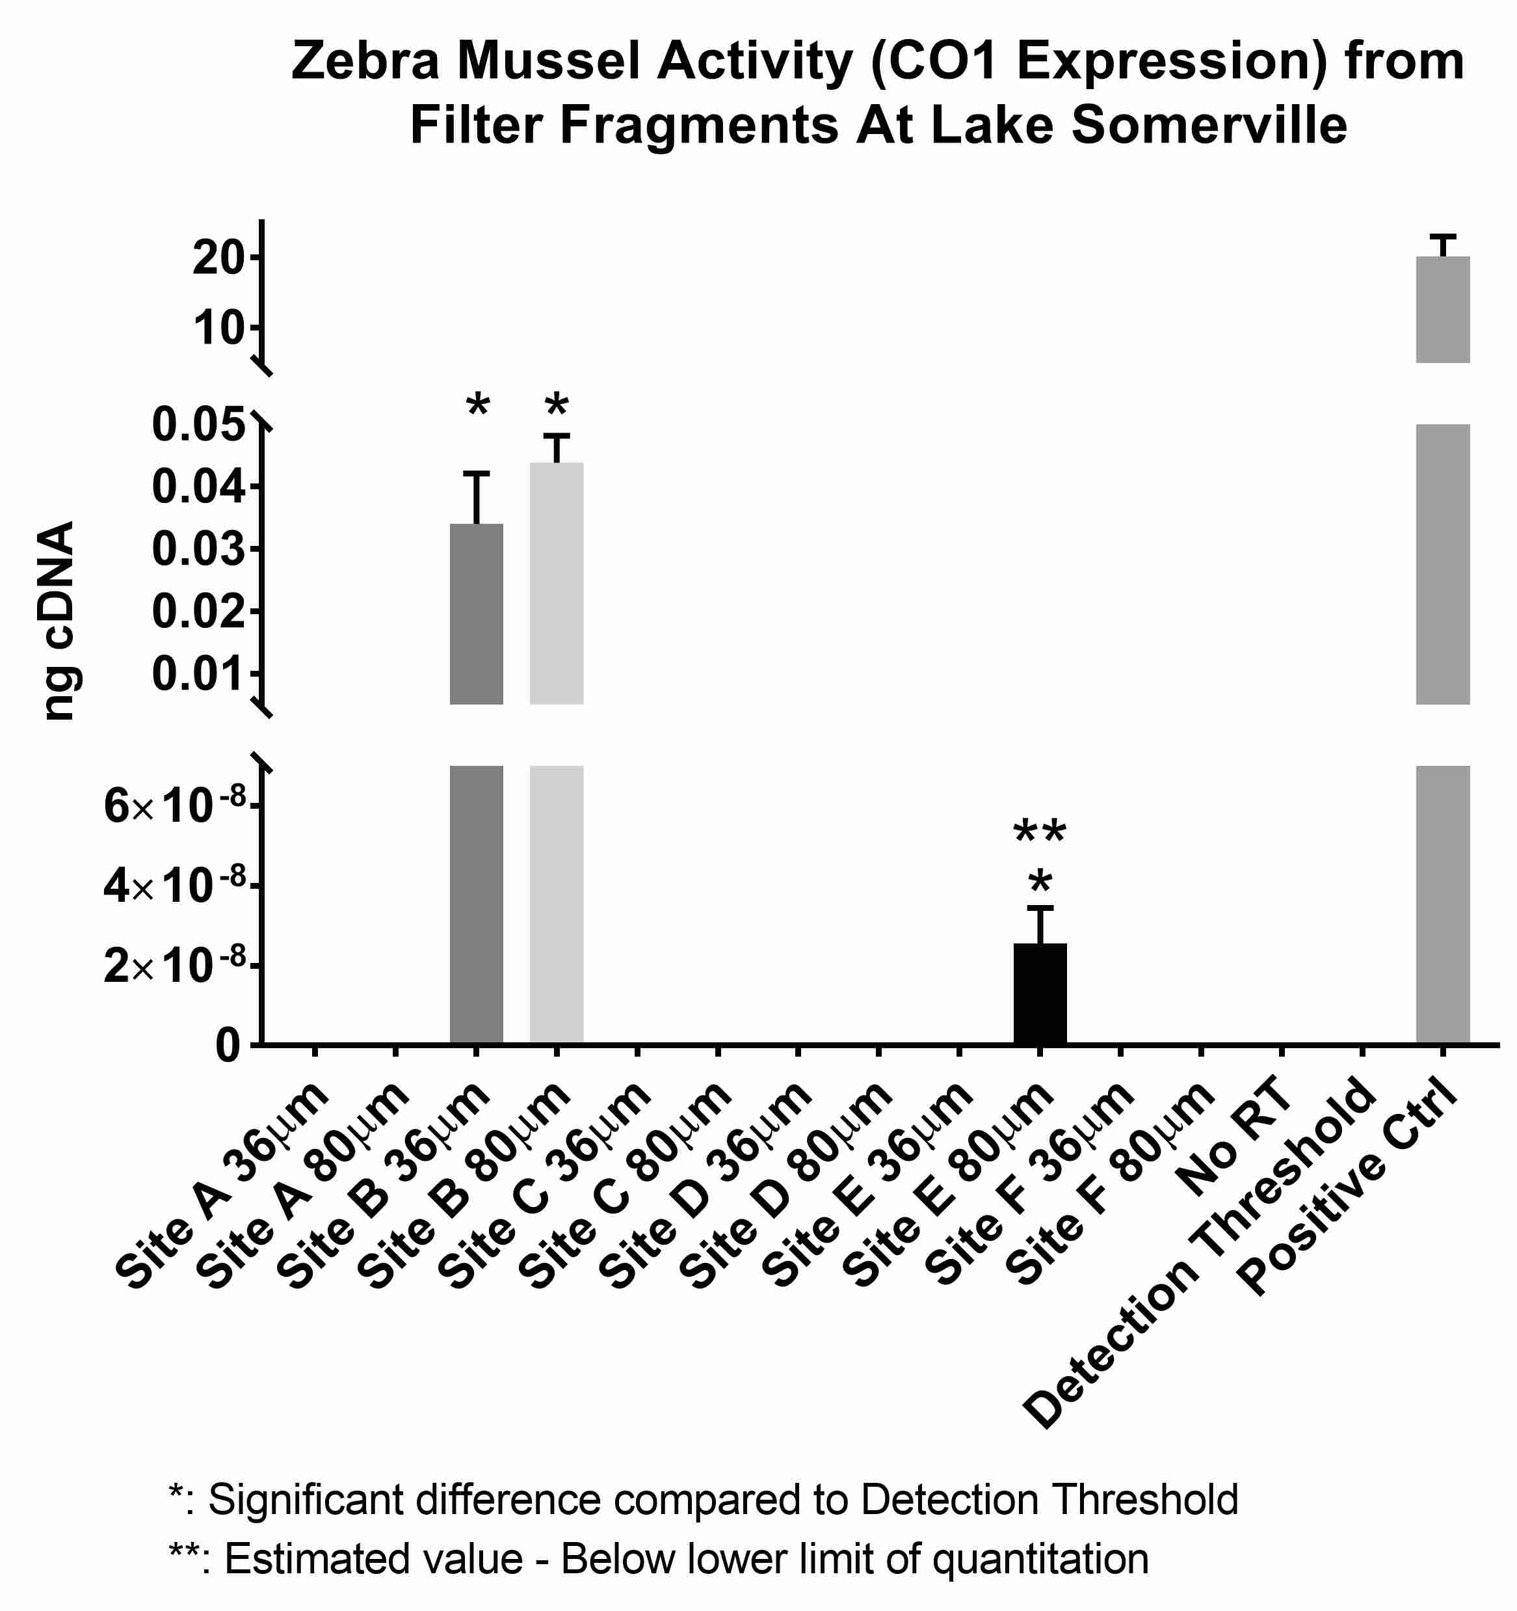
INVESTMENT
TPWD STUDY

Slide 22
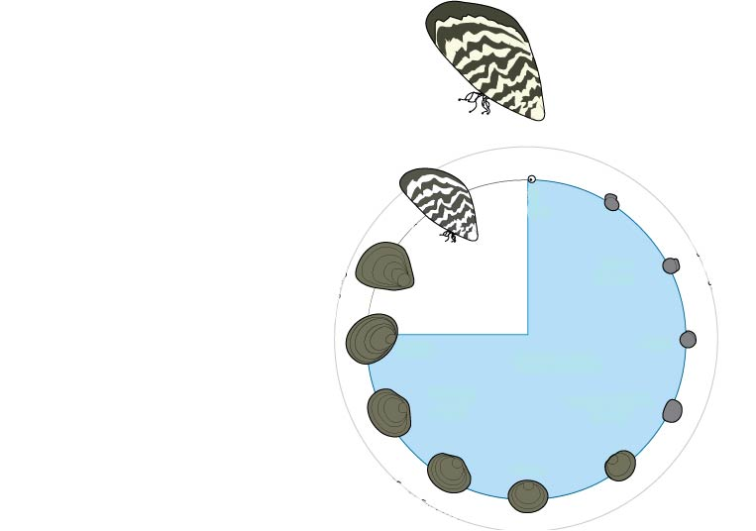
Mitigation
Eradication
Infestation
Monitoring
Diagnostics
Prevention
Notes:
EQO is in a position to own the whole stack. Effective prevention, diagnostics of early to late stage populations, applicable and effective infestation analytics, massive reduction in the cost of mitigation, increase in efficacy of mitigation, and, soon, effective eradication of infestations. What’s more, once treated, EQO prevention services are necessary to protect water resources going forward. EQO technologies protect and aide water resources at every stage. We own the stack, as they say in the pharmaceutical industry.

Slide 23
EQO = SOLUTIONS
Early Detection
Monitoring
Mitigation
Treatment Optimization
Notes:
Why Elizabeth has to work so hard with limited results

Slide 24
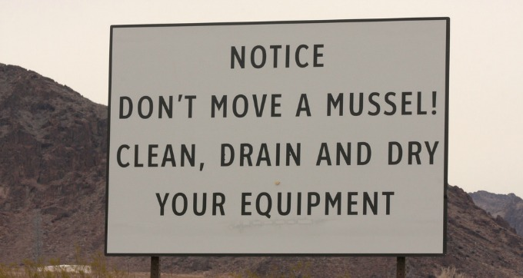
Questions

