Slide 1



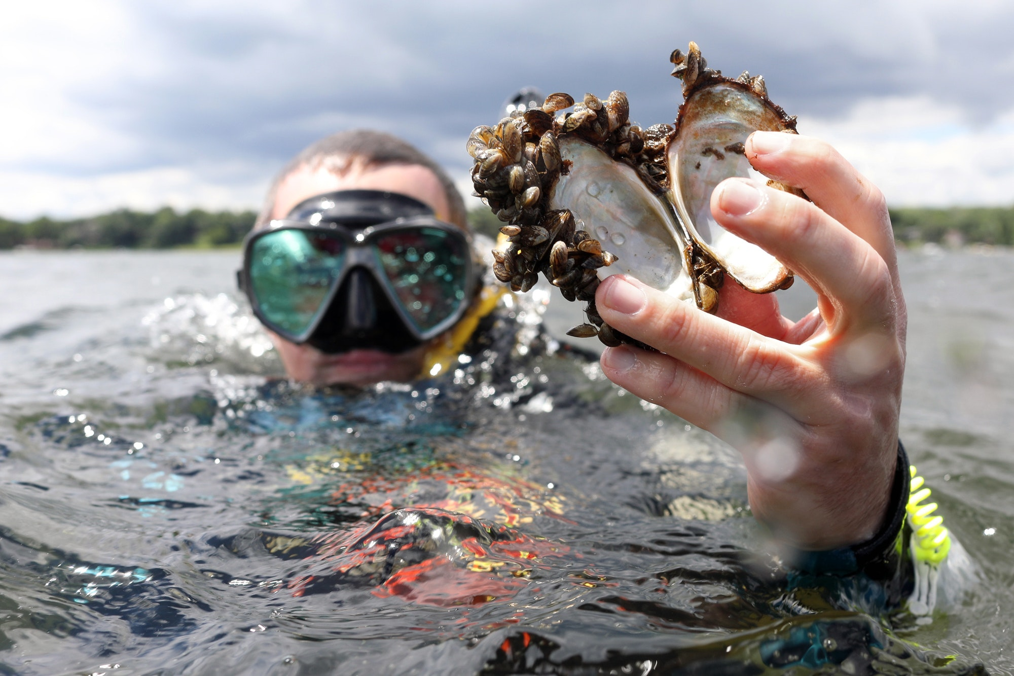
Reservoirs, groundwater, and eDNA
Is there something positive about zebra mussels
Joe C. Yelderman Jr.
Stephanie Wong
John Higley

Slide 2
Texas Reservoirs
November, 2018
188 major water supply reservoirs
Stillhouse Hollow Reservoir in central Texas

Slide 3
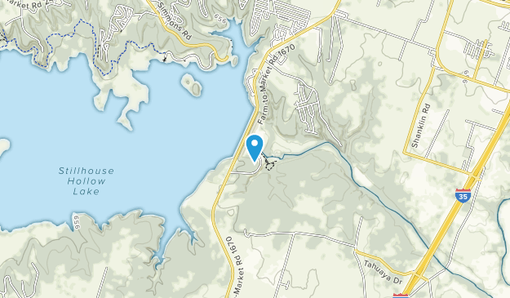
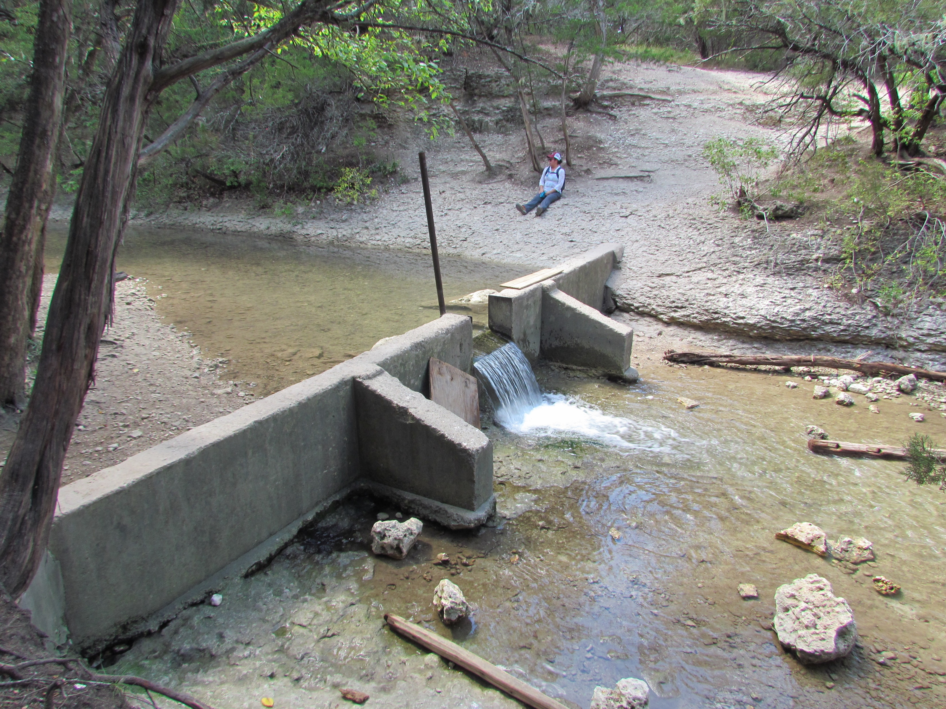
Does water leak around the dam?

Slide 4
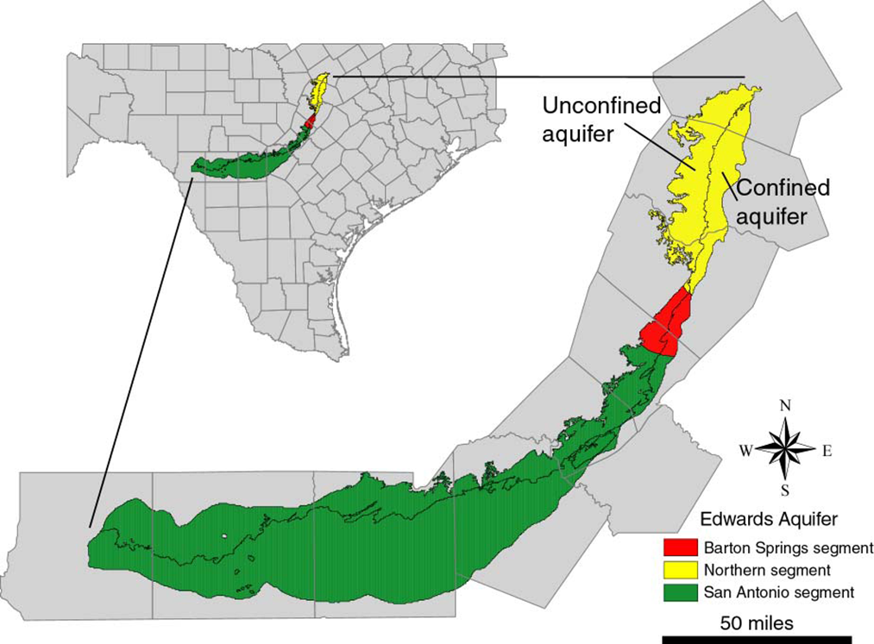
The Setting
Northern Segment of the Edwards Balcones Fault Zone (BFZ) aquifer

Slide 5
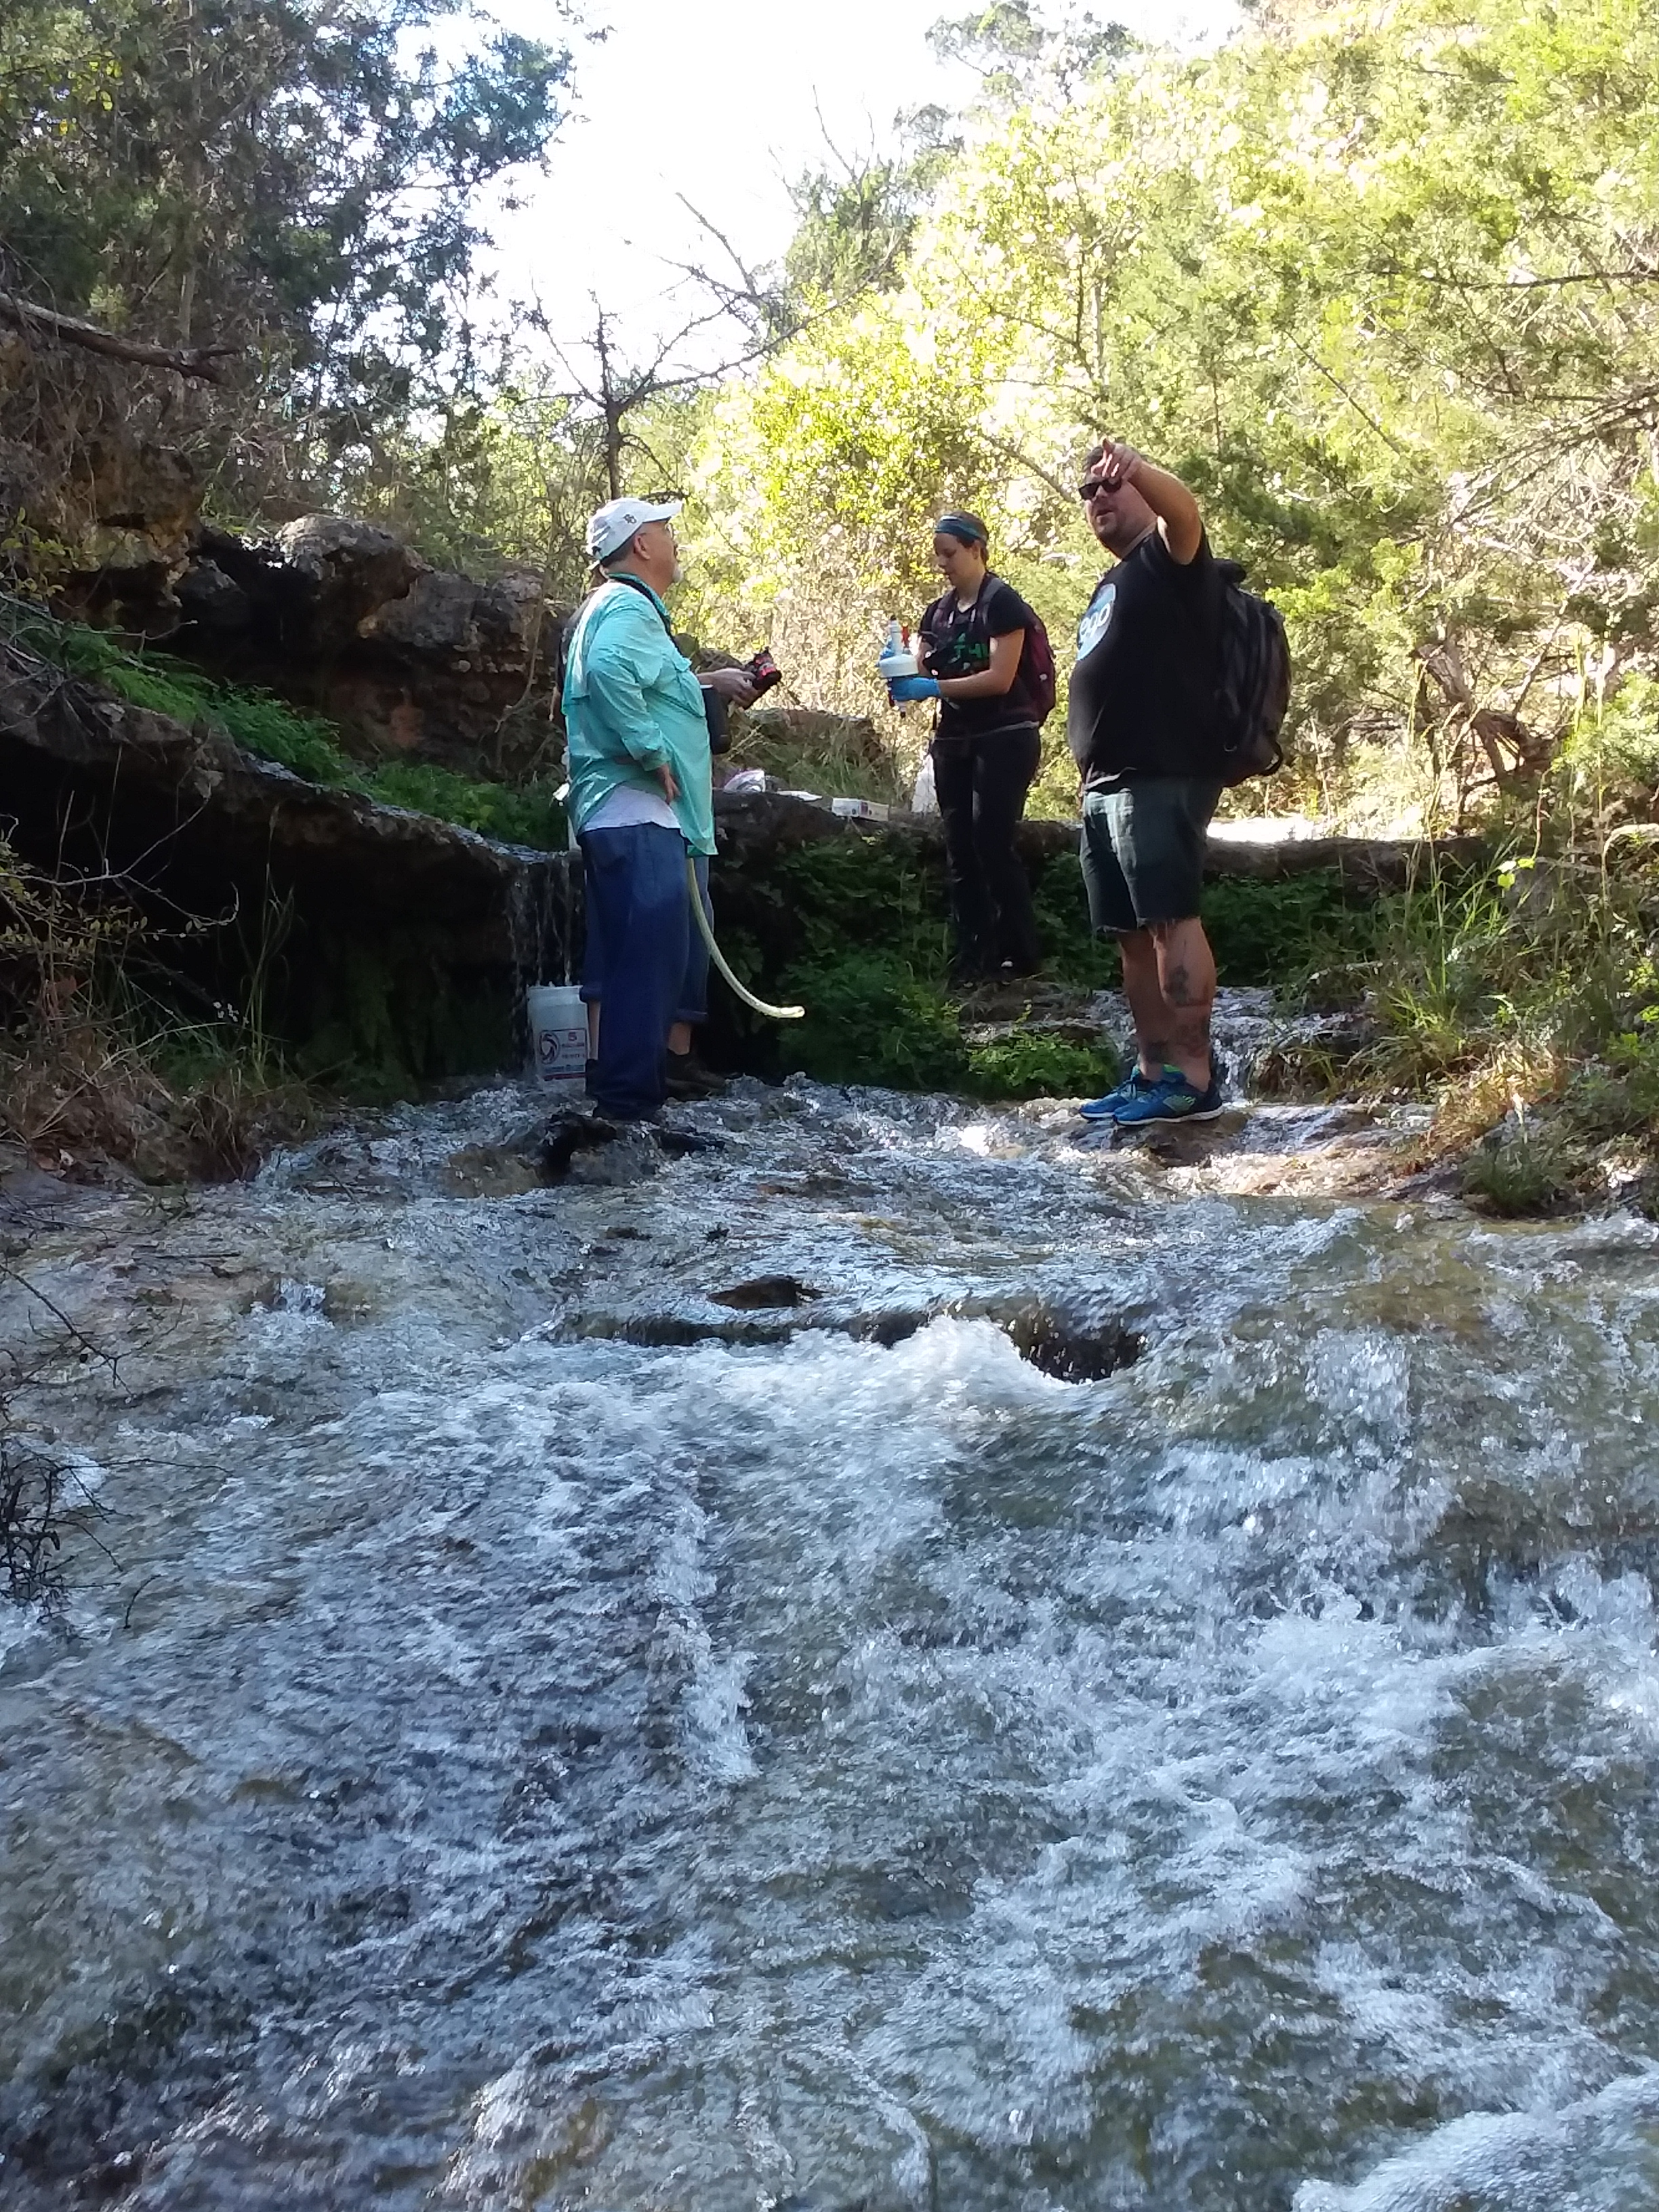
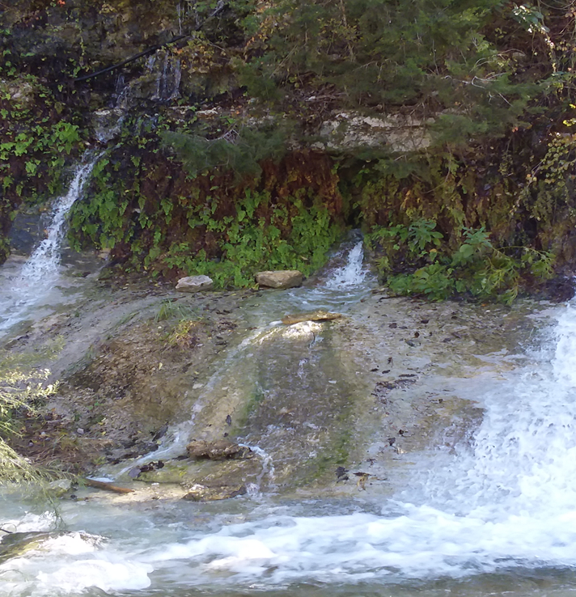

High Flow Observations

Slide 6
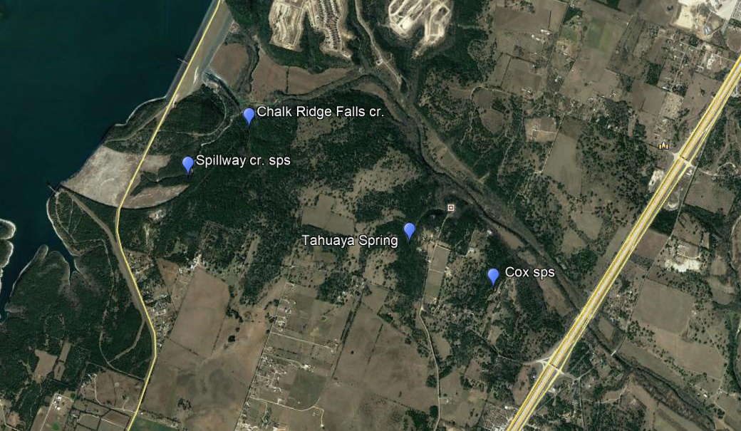
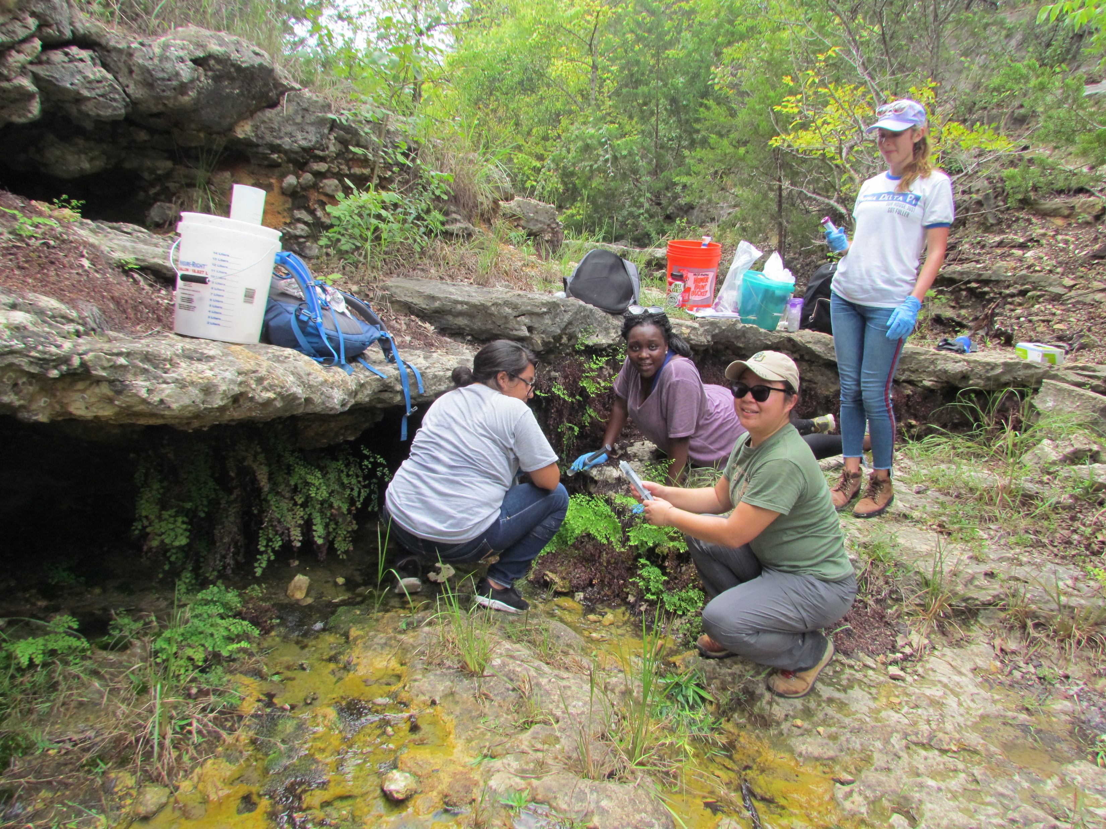
Sample Sites: chemistry and isotopes

Slide 7
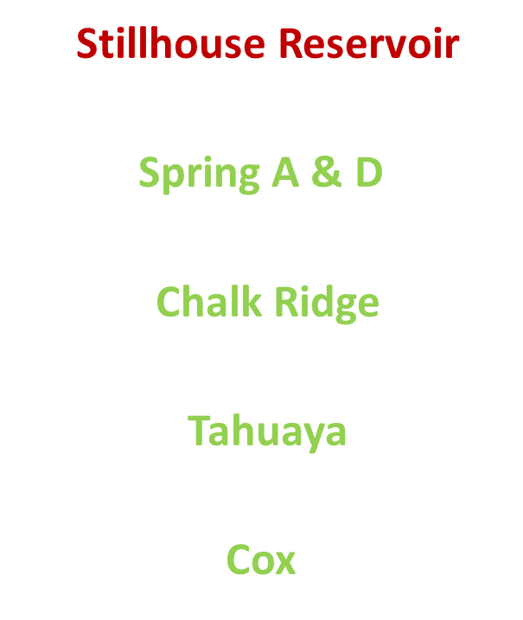
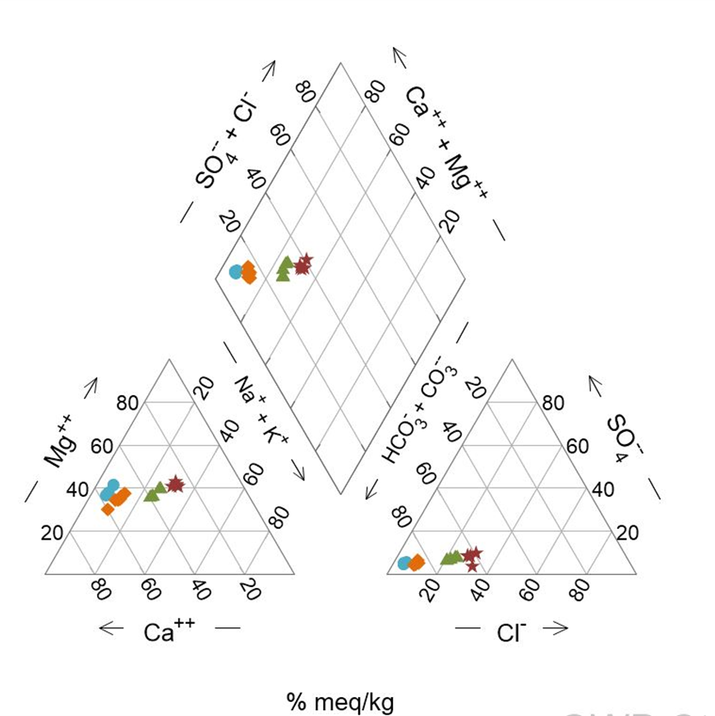
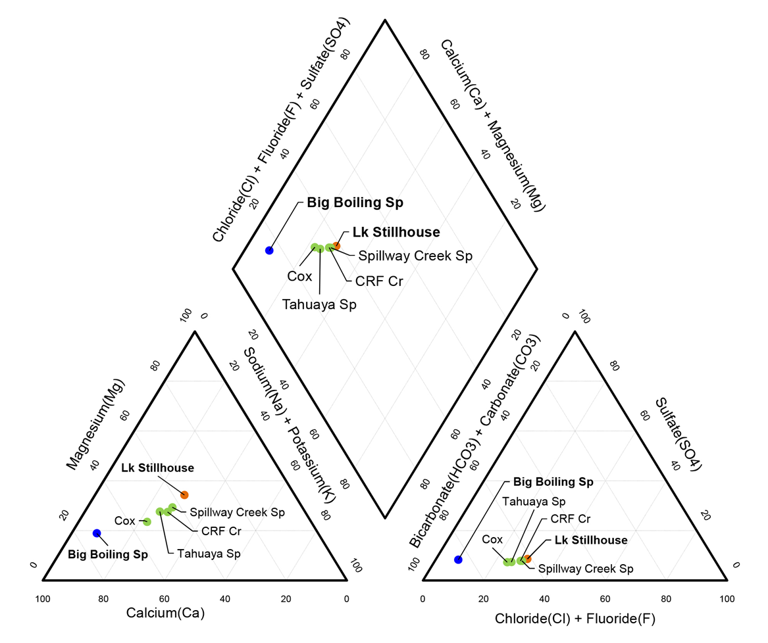
Ionic Chemistry

Slide 8
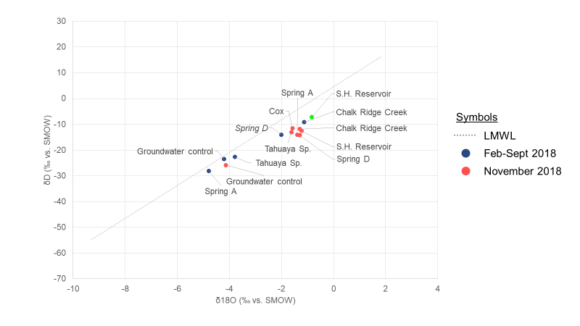
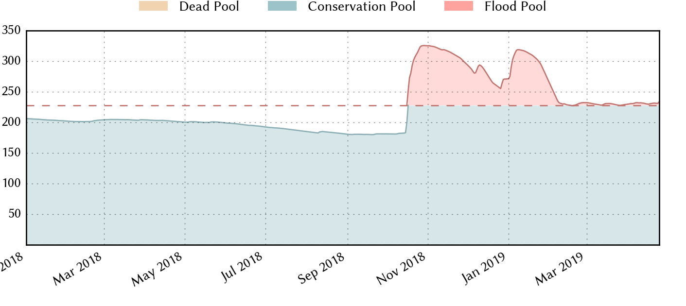


Isotopes

Slide 9
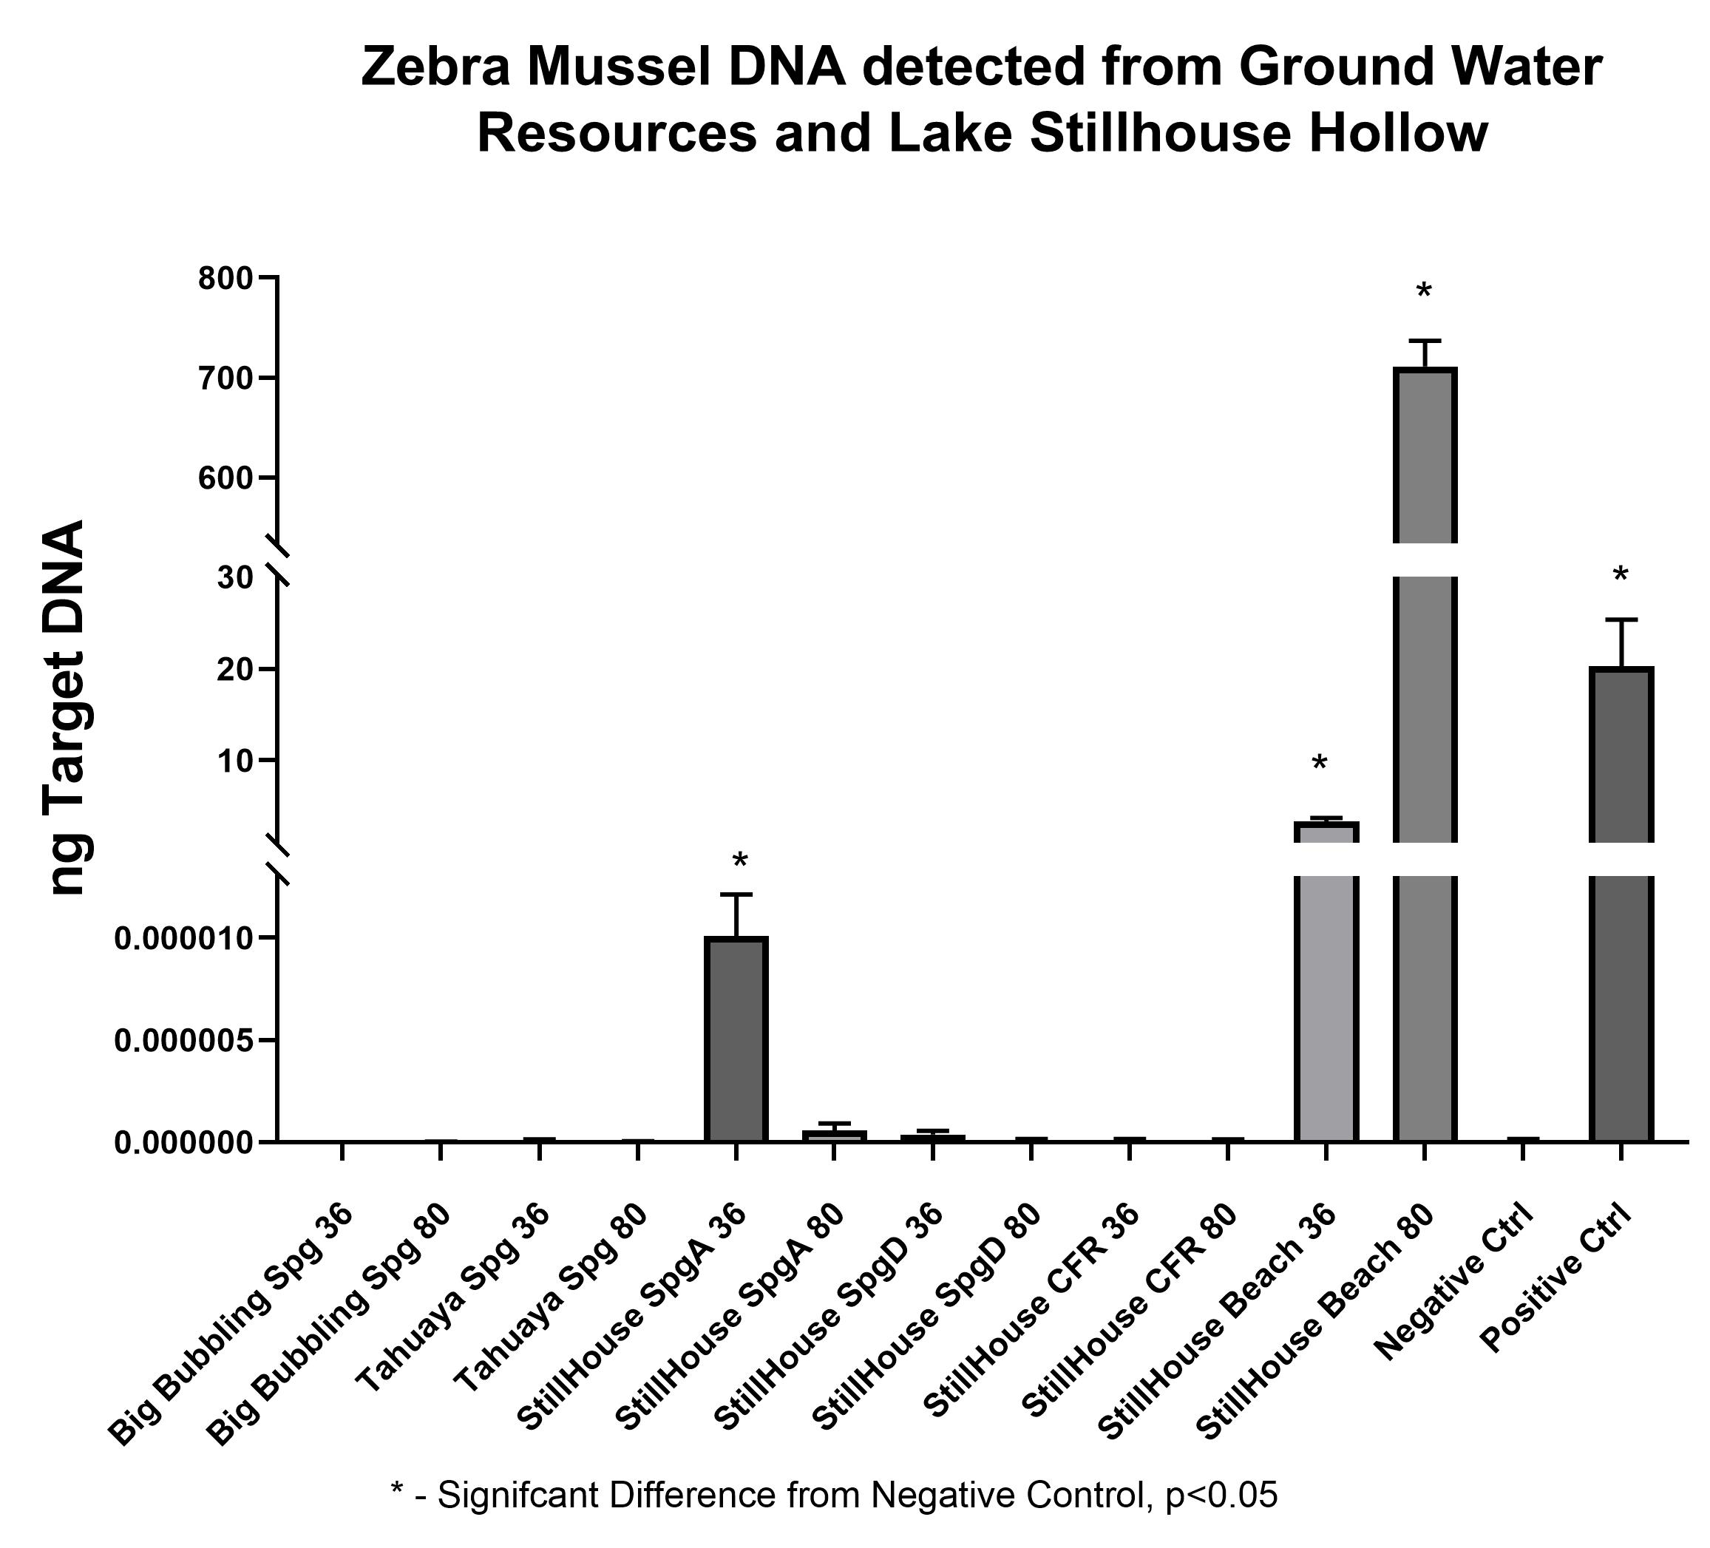
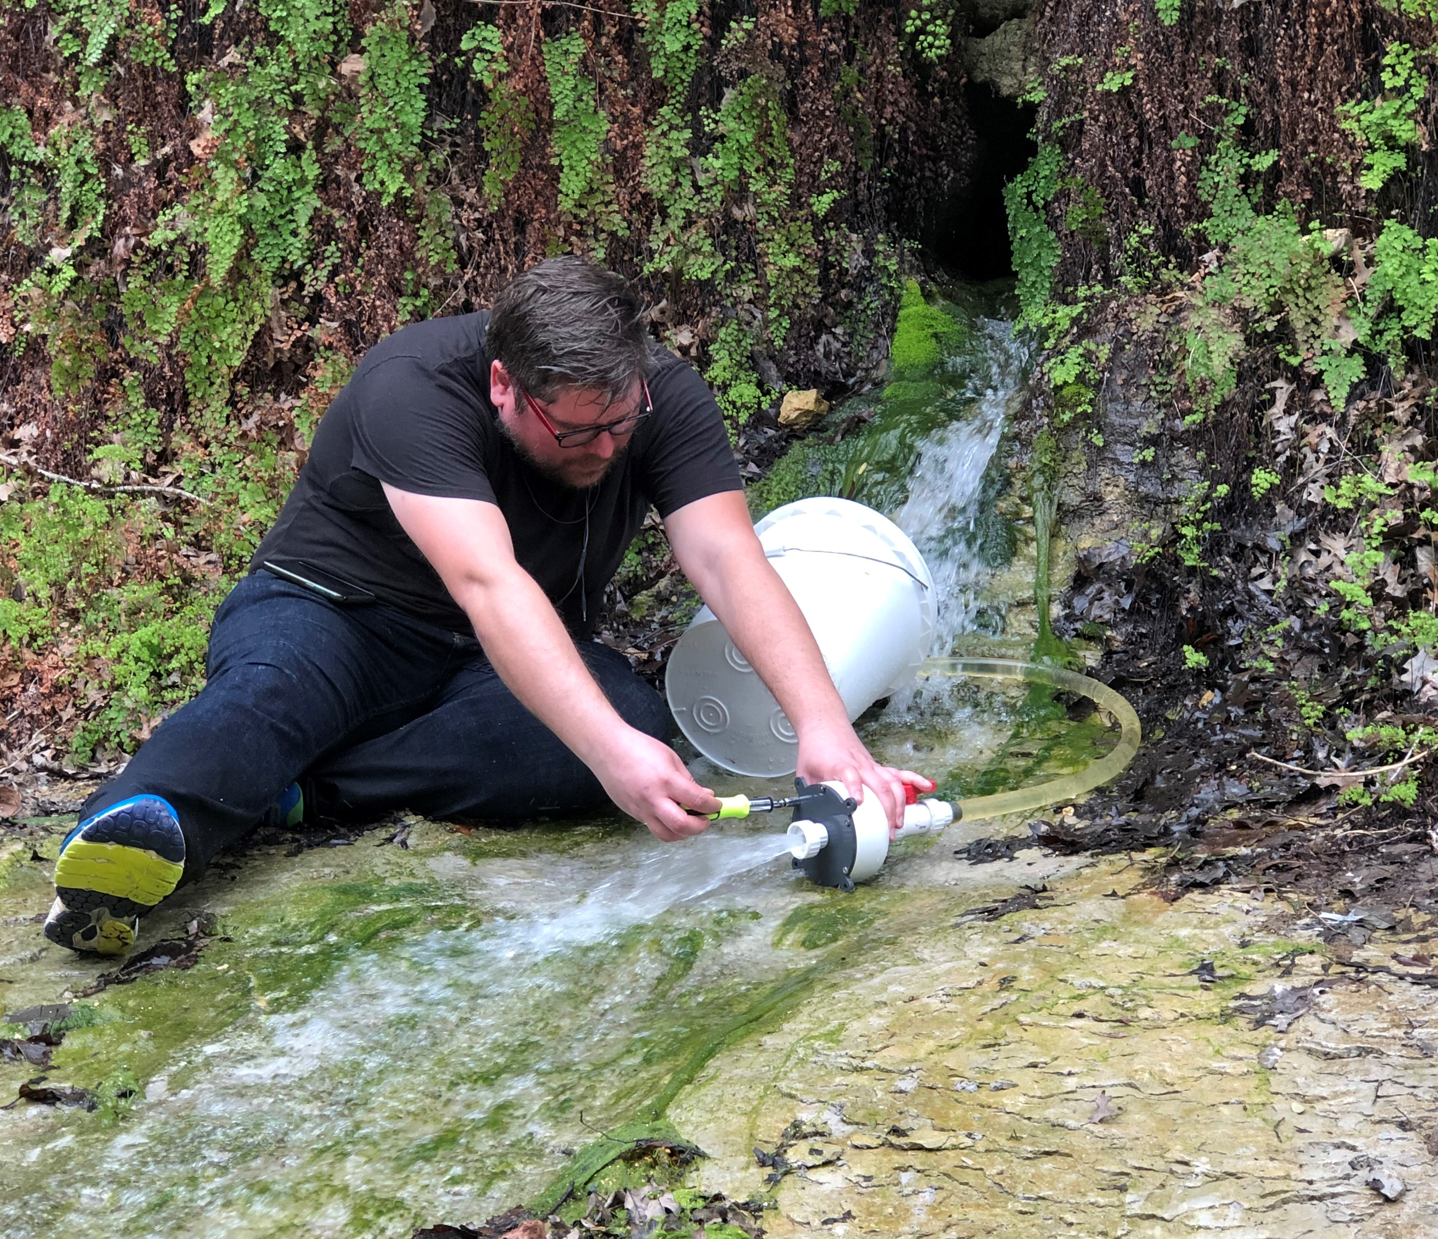
eDNA Results
Spring A - all flow conditions
Reservoir confirmation !
Different size fraction ?
Spring D – no detection ?
Flow path information !

Slide 10

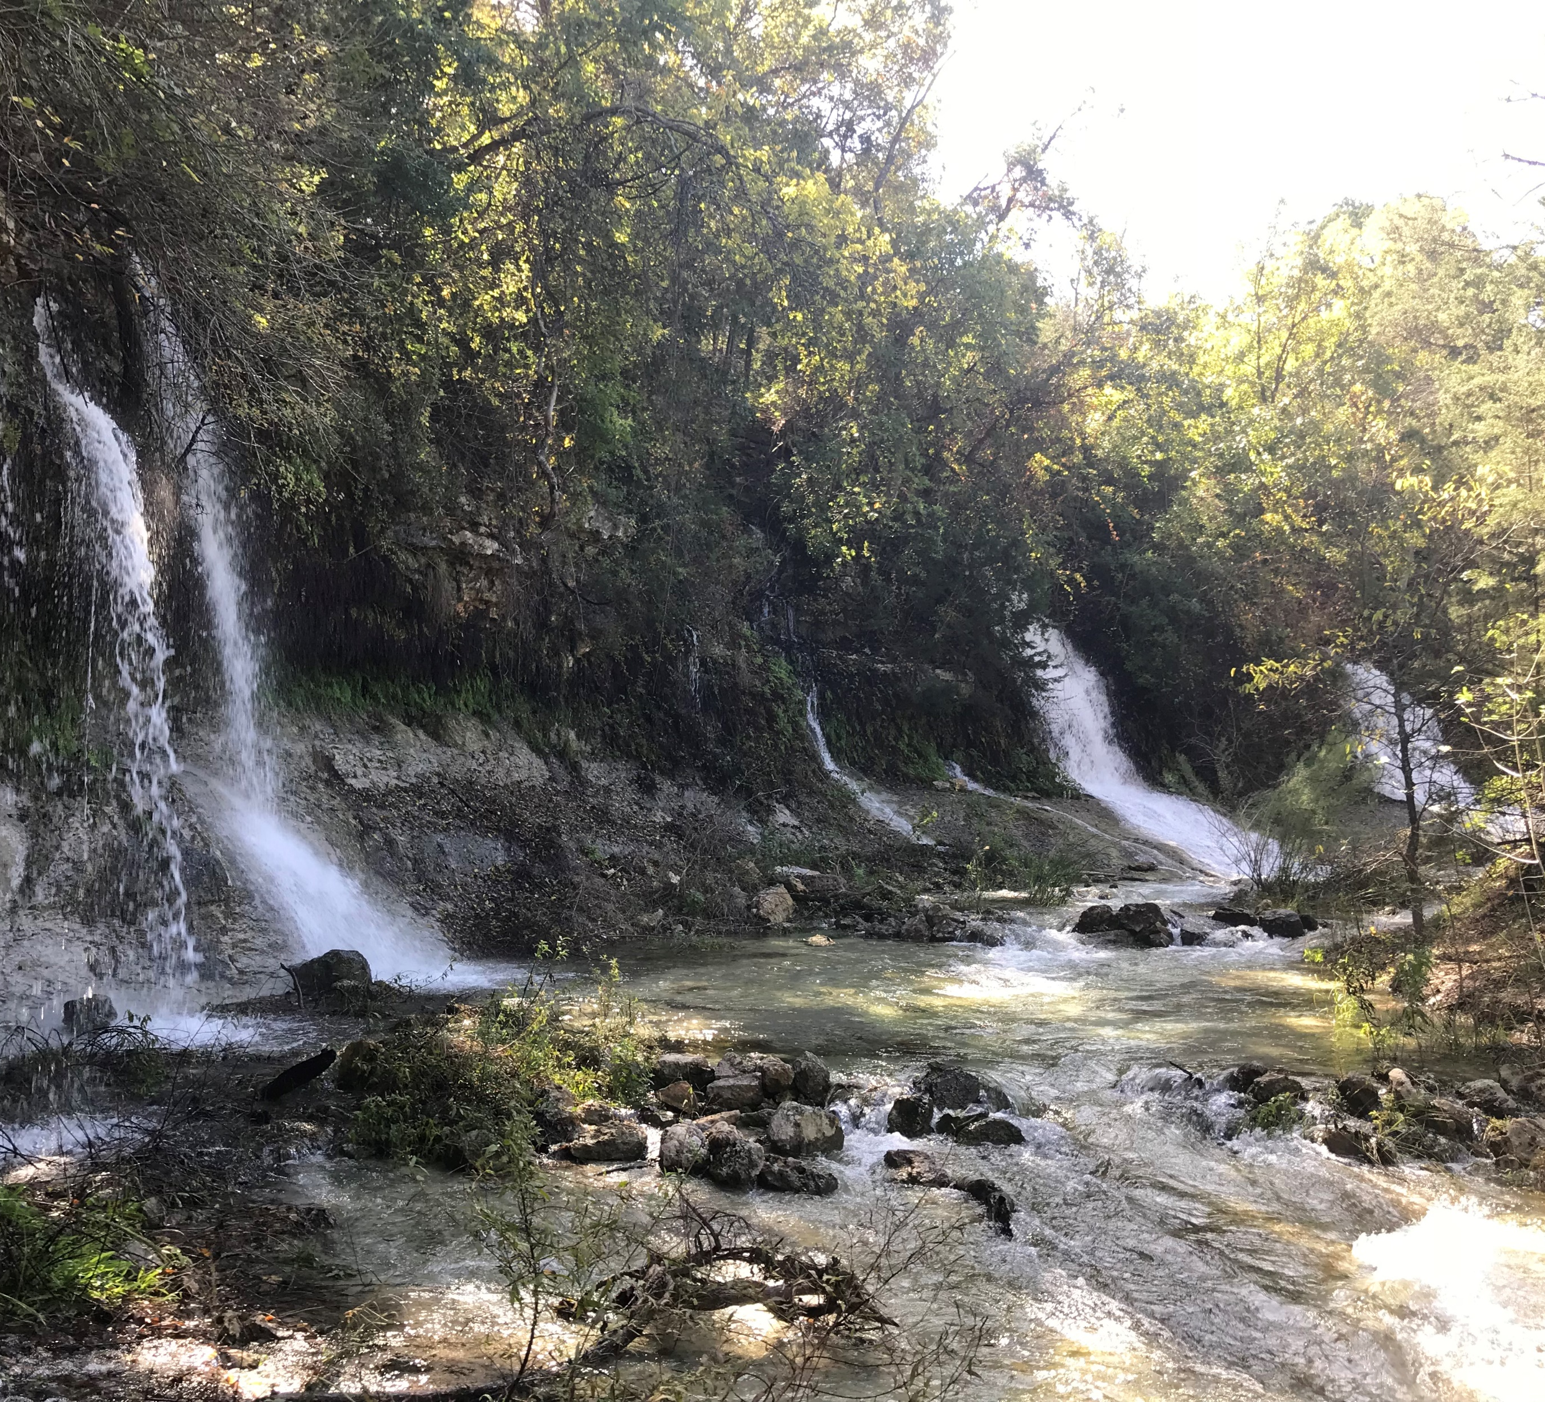
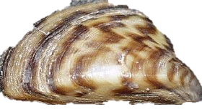
Conclusions
Reservoir effects GW
eDNA confirmation
Thank You
Questions?

