Slide 1
Hot Topics at the TWDB
Texas Water Research Network
John T. Dupnik, P.G.
Deputy Executive Administrator
Water Science and Conservation
May 31, 2019

Slide 2
All TWDB-tracked groundwater bills 69 total

Slide 3
Bills with committee hearings 46 remaining

Slide 4
Bills passed out of committee 33 remaining

Slide 5
Bills passed out of one chamber 25 remaining

Slide 6
Bills passed out of both chambers 15 remaining

Slide 7
Bills signed by governor 4 signed, 11 TBD
Governor has until June 16 to sign or veto

Slide 8
TWDB Priority 1 Bills Passed in Red

Slide 9
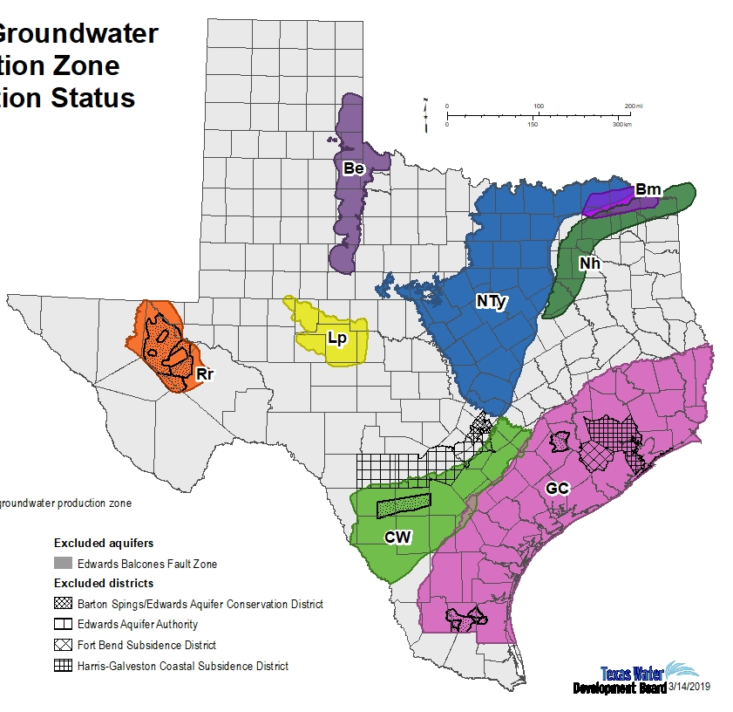
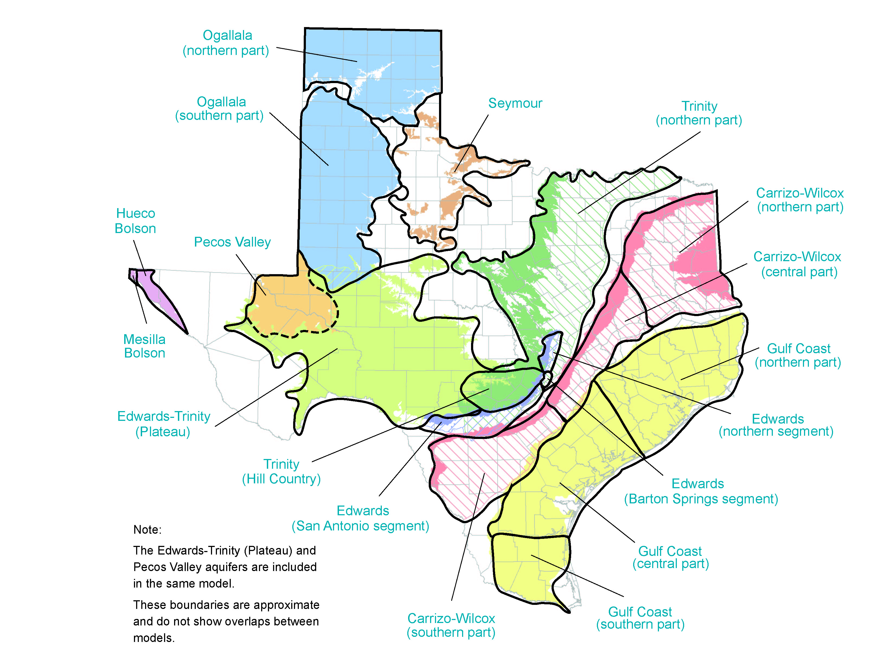
TWDB – Bill Implementation
HB 721
(ASR)
HB 722/SB 1041
(BRACS)
HB1 - LAR
($$ BRACS/GAMs)
SB 8/SB 500
(Flood)

