Slide 1
3, 5 or 7 Vs of big data and what they mean to water resource management?
V. Uddameri
Texas Tech University
M. Young, A. Sun, J. Banner, S. Pierce, D. Tremaine
University of Texas at Austin

Slide 2
What is Big Data
What is big data?
Large volumes of data
Moving target – In early 1990s 1TB was big data (average Hard Drive ~ 3 GB)
Today – zettabytes (10⁷ bytes) or more (average Hard Drive ~ 2 TB)
Datasets that are not amenable to traditional archival methods
Relational database model not suitable
Not all data is structured or the structure is too complex
Data analysis not possible with existing software engineering tools
Need for massive parallelization
Newer algorithms to mine insights from data (data analytics)
It is not the amount of data that is important – It is what you want to do with it

Slide 3
Big Data – Water Resources
What is Big (deal) about Water Resources Data?
Can quickly become very big if looking at large spatial scales
Global change studies
Can quickly become very big if data are being collected at a high temporal resolution
Flood forecasting, early warning systems
Data come from disparate sources
Soil, water, land use, public perceptions
Similar data can be collected from multiple sources
Ground measurements, Radar, Satellite
Direct measurements of what we really are after is many times not possible
Don’t know groundwater pumping, but know likely water budget changes from GRACE Satellite
Water Resources (big) data comes from sensors, devices, networks, log files, transactional applications, web, and social media — much of it generated in real time and at a very large scale.

Slide 4
Big Data – Water Resources
Data needs in water resources decision making varies widely across applications
Flood studies
Data in order of minutes, hours to days
Droughts
Data in order of weeks, months, years
Water Planning
Data in the order of years to decades

Slide 5
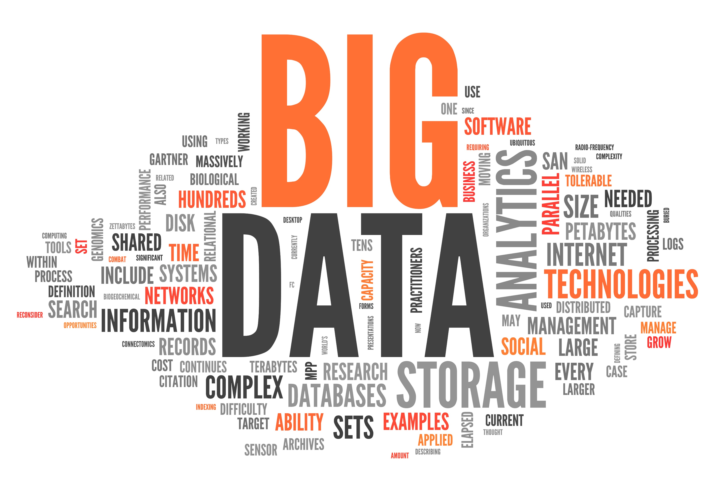
Big Data – 5V – 7V Model
Volume → Amount of data generated
High volume, if data generated is not amenable to analysis
Velocity → Rate at which data is generated and data is necessary
Real-time processing of data being generated by sensor networks.
Rate of data inflow >>> Rate of information generated
Variety → Diversity of datasets necessary for a water resources application
Structure of data, geospatial, temporal resolutions
Variability → Meaning of data is changing constantly
Public adaptation, public perception, Meaning of a 100 year flood?
Visualization→ How can data be presented to make decisions
Multivariate datasets, animation, balancing qualitative and quantitative data
Veracity → How certain or uncertain is the data?
Long-range climate projections, sensor accuracy
Value → How has big data helped?
Would our decisions be the same if we did not have this data?
Worth of additional data?

