Slide 1
Building Community-Based Sustainability and Resilience for Water Resource Management and Education:
Case Studies in Lower Rio Grande Valley
TWRN 2019
5-30-2019
Chu-Lin “Mike” Cheng
Assistant Professor
School of Earth, Environmental and Marine Sciences
Department of Civil Engineering
Notes:
Food-Energy-Water
Local cases (water-waste)

Slide 2
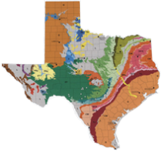
Chu-Lin “Mike” Cheng (2017) University of Texas – Rio Grande Valley
TWRN
Areas for potential collaborations:
Groundwater-Surface water interactions, conjunctive management
Water availability, resilience, security
Brackish groundwater
Aquifer storage and recovery
Submarine groundwater discharge (SGD)
Minority workforce training/building in geosciences/STEM
Transboundary water resources
Environmental justice

Slide 3
GP-EXTRA: “Stimulating Hispanic Participation in the Geosciences” (SHIP-GEO) (2016-2019)
PI team: C. Cheng, J. Gonzalez, J. Kang, C. Cintra, J. Benavides, and E. Heise
Partners: South Texas College, and industrial/community partners
“What’s" the issue being addressed (problem)?
Hispanic participation in the geoscience accounts for only ~3% nationwide. Hispanic geoscience students encounter skepticism when explaining their choice of major to their families, who do not easily see the value of the profession because of the relative lack of visibility of geoscientists compared to other science and engineering workforces.
“Why” is this project best suited to address the problem (answer)?
Combining two legacy institutions in 2015: UT-Pan American and UT-Brownsville, UTRGV became the nation’s 2nd-largest Hispanic-serving institution with ~29,000 students (~90% Hispanic).
UTRGV’s location, and its founding principles make it an ideal hub to nurture geoscientists from South Texas and cross border.
Diversity
Awareness
Life-changing

Slide 4
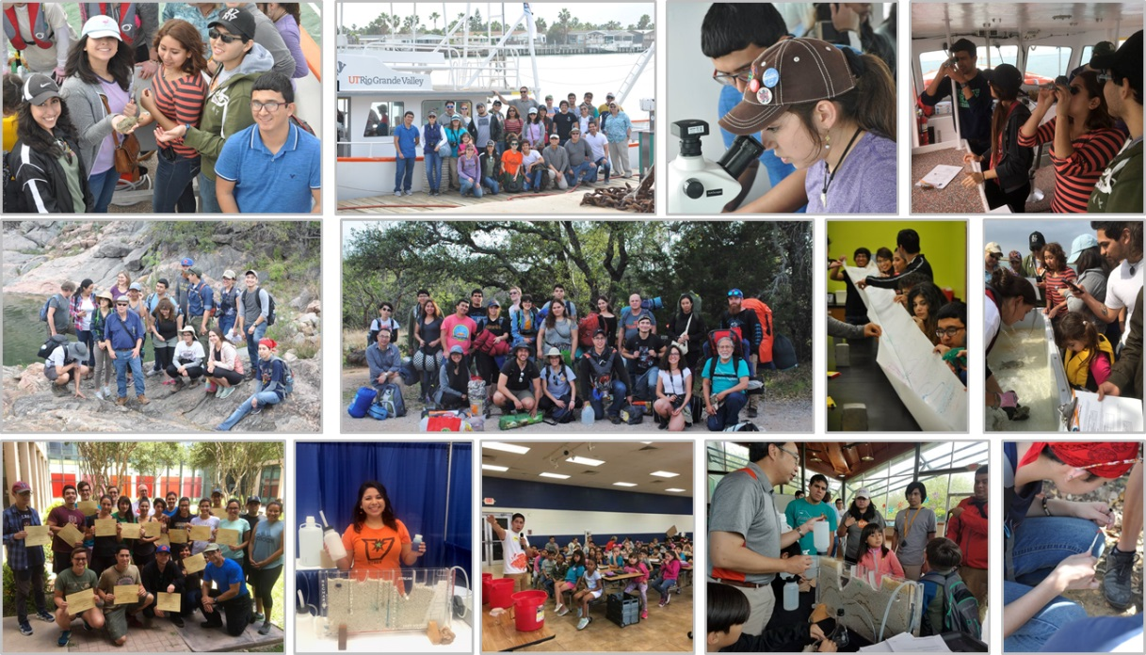
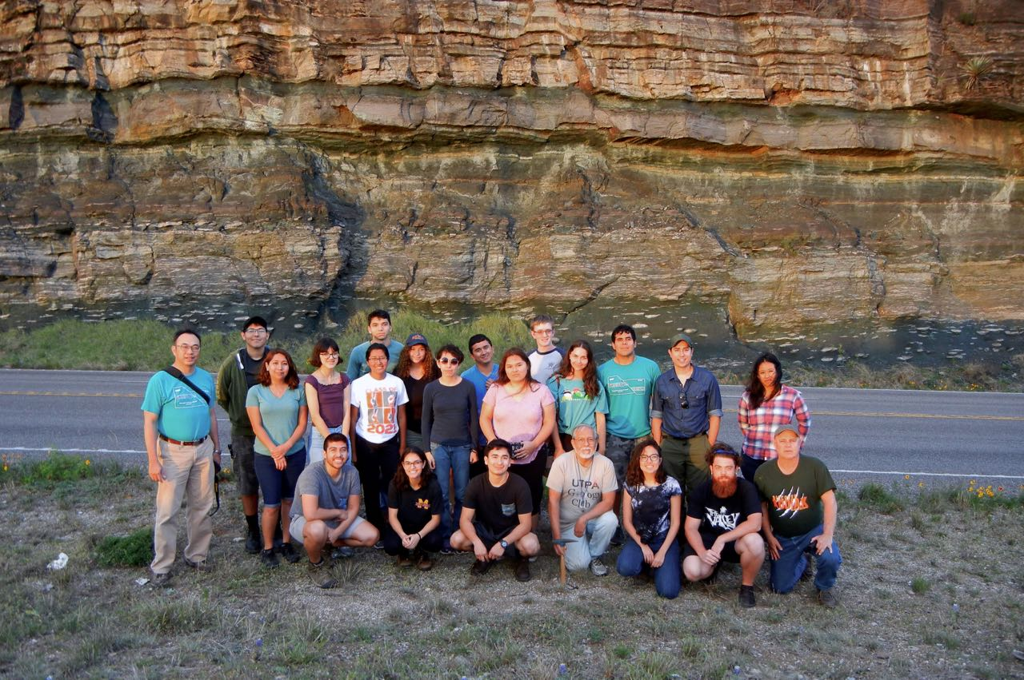
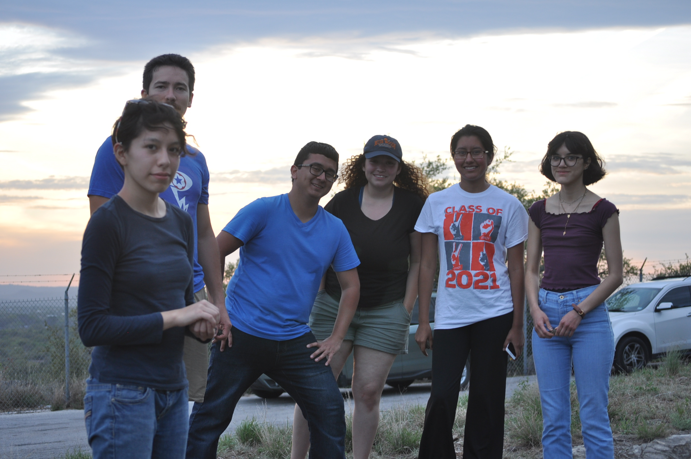
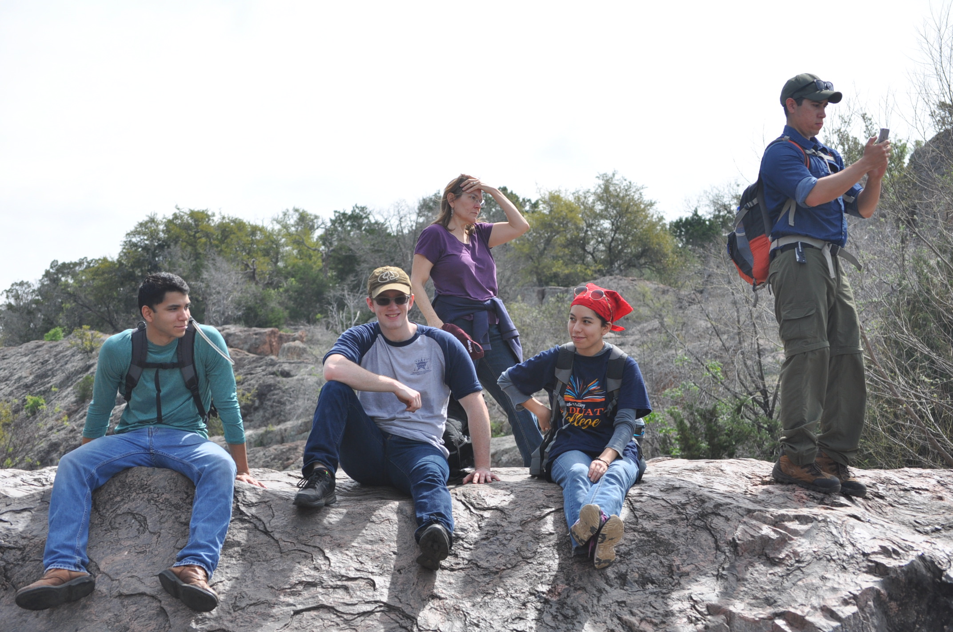
Success Story or interesting finding
Students love field trips, especially camping trip (first time for many)
Students appreciate financial support
Students appreciate career related events, information, connections to potential employers, graduate schools, and internship opportunities
Innovative mentoring and network building involving alumni and faculty
UTRGV infrastructure/program/platform building
Many students desperate for opportunities
Increasing numbers for 2019 summer internships, i.e., Stanford, MIT, federal/state/local agencies, and industry sectors.
Increasing numbers for undergrad research projects (conference posters and awards)
Increasing desires for certifications, i.e., GIS, OSHA, soil and water analysis.
More students admitted for advanced degree programs with support

Slide 5
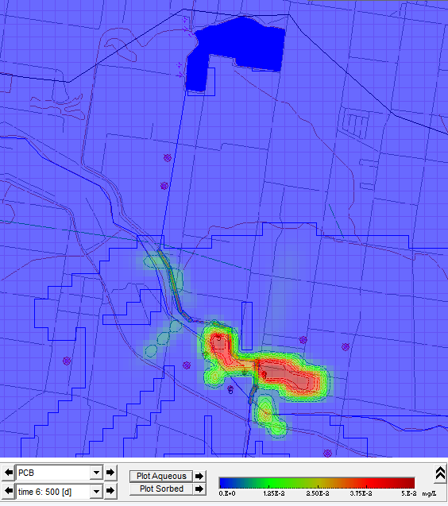
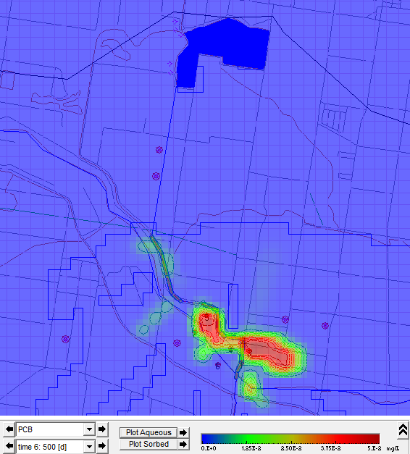
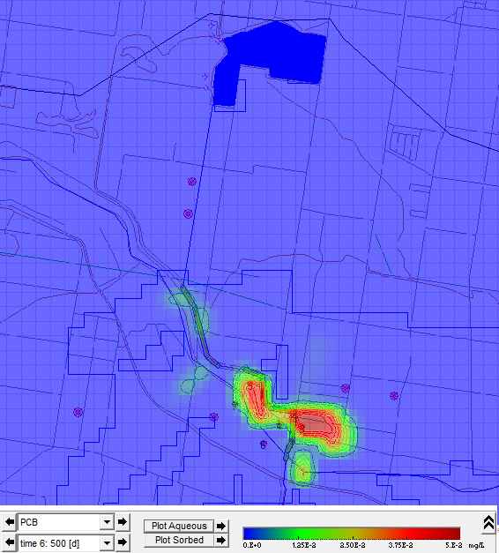
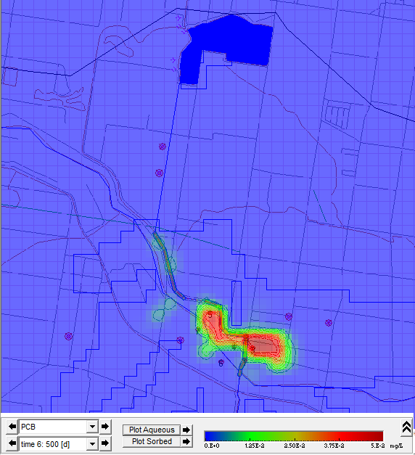
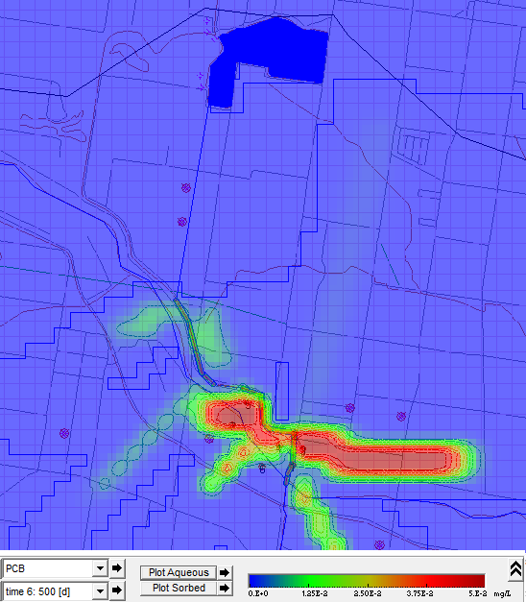
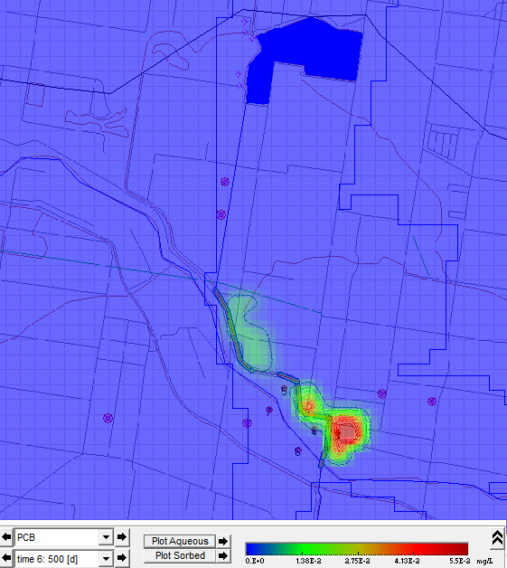
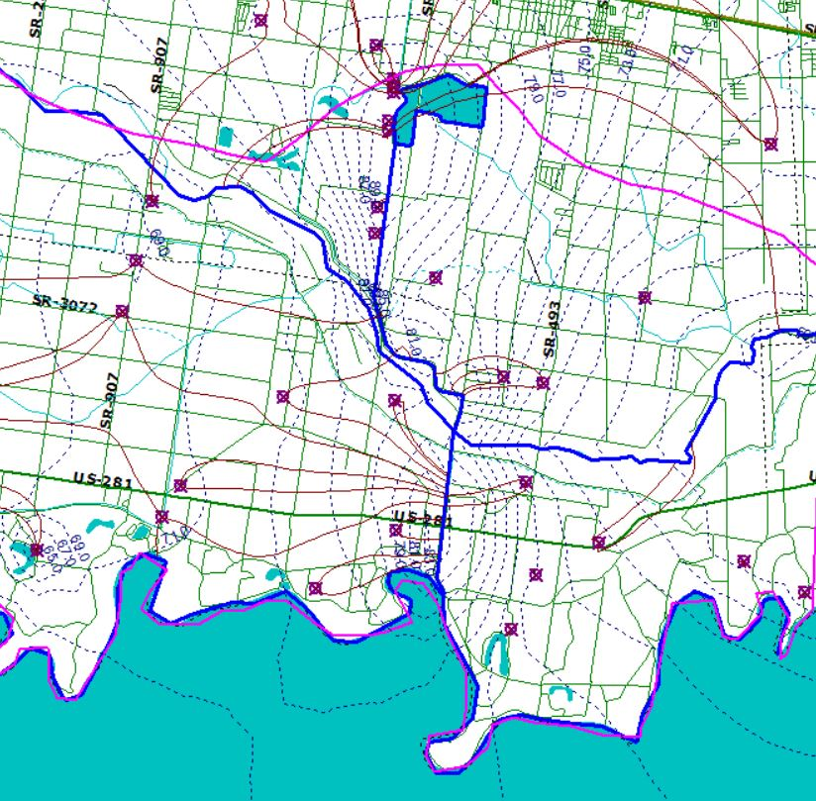
Integrating HydroDynamic Modeling and Risk Assessment for Threat Zoning Predictions: Environmental Health and Resilience Readiness for Texas-Mexico Borderland Colonias (2018-2019)
Conjunctive Water Resource Management and Contaminant Transport Simulations: A Case Study in Donna Reservoir
Jevon Harding, Andreas Guevara Nadeau, Leslie S. Sanchez, and Chu-Lin Cheng
Five different scenarios in Visual AEM Model showing the possible contaminant transport and concentration distributions. (a) base model-”Head Specified” at 500 days; (b) porosity set to 0.4; (c) porosity set to 0.04; (d) hydraulic head for all wells reduced by 10 feet; (e) hydraulic conductivity doubled; (f) hydraulic conductivity reduced by 50%.
(a)
(b)
(c)
5
(d)
(e)
(f)

Slide 6
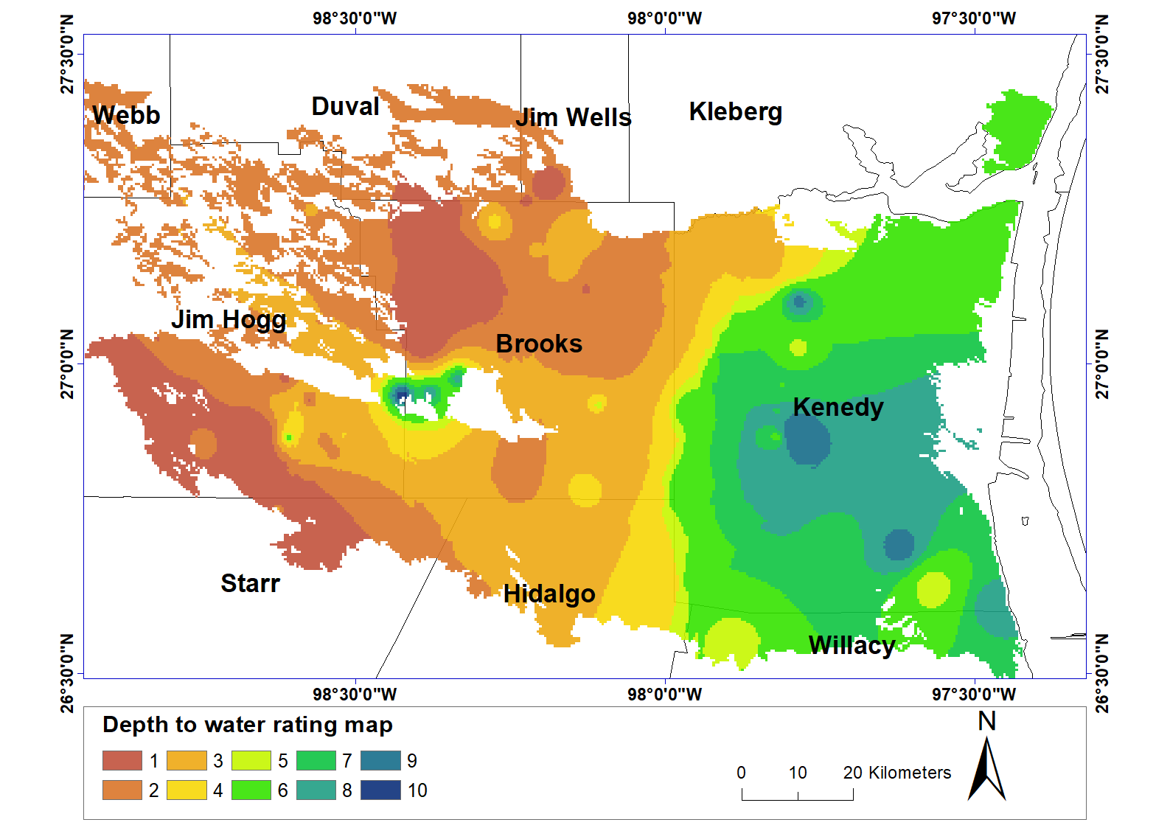
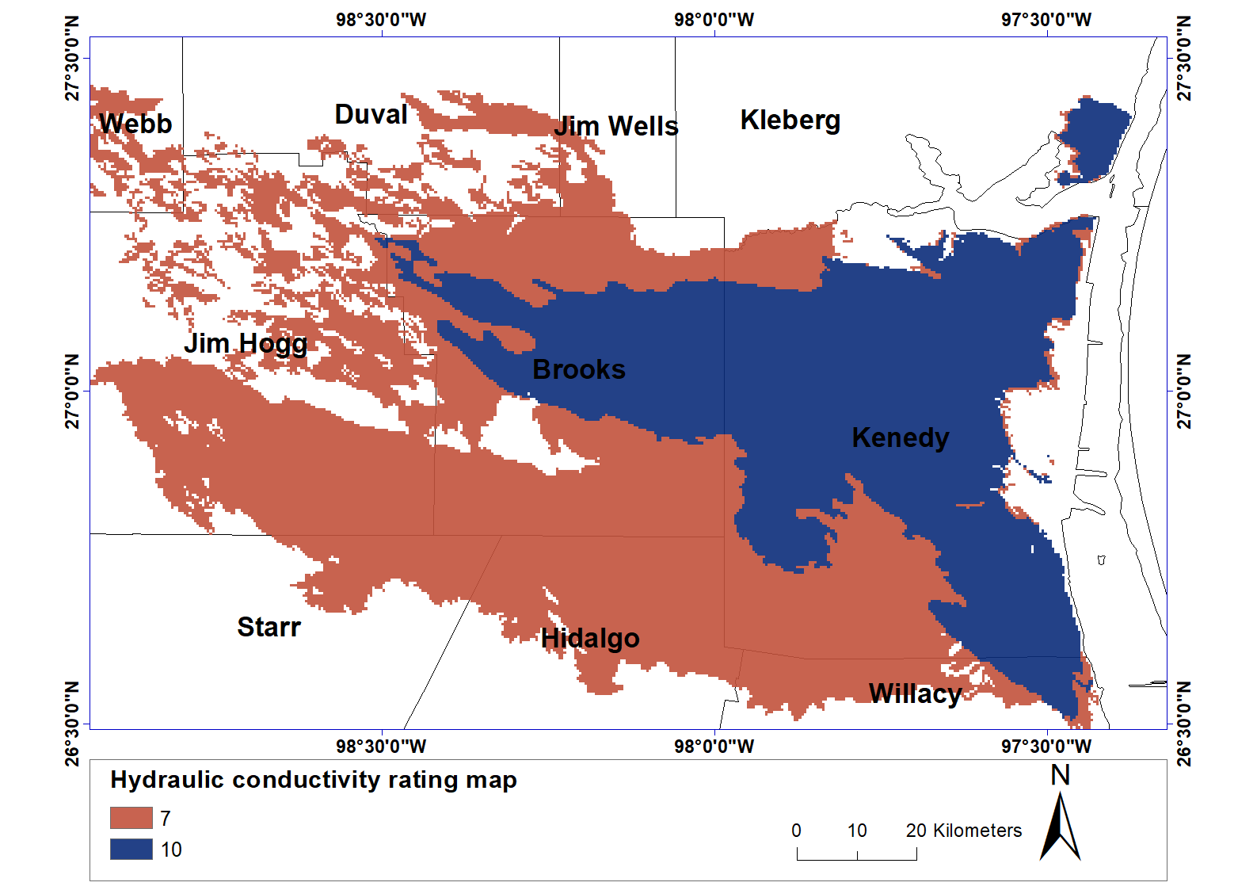
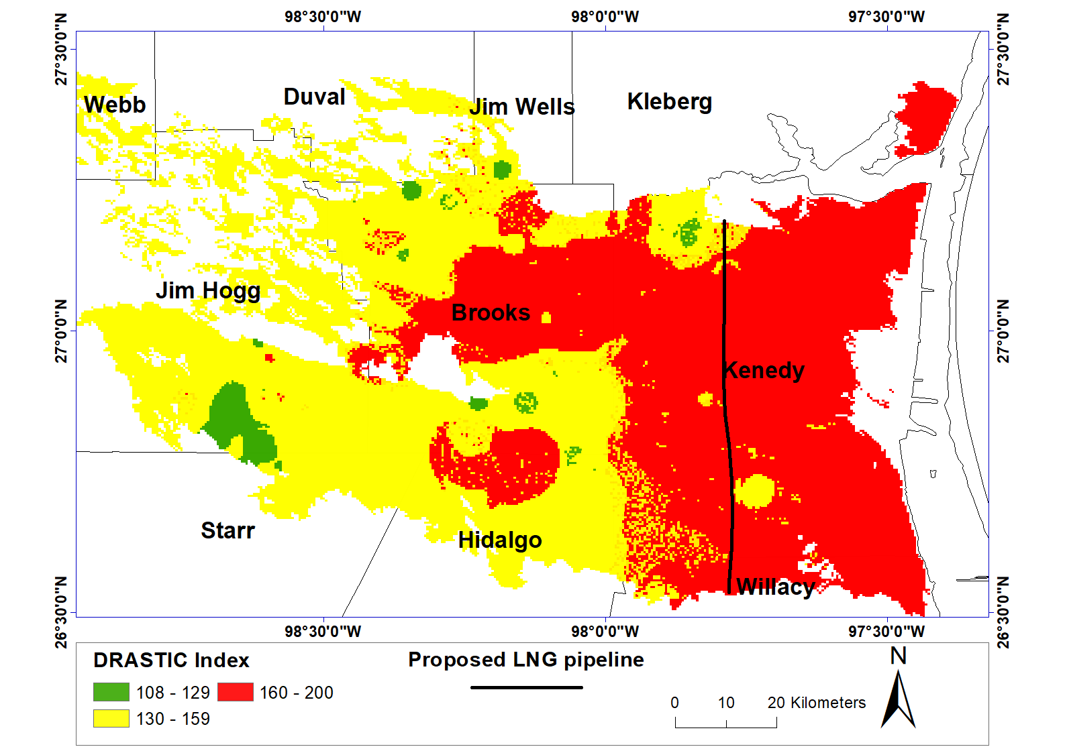
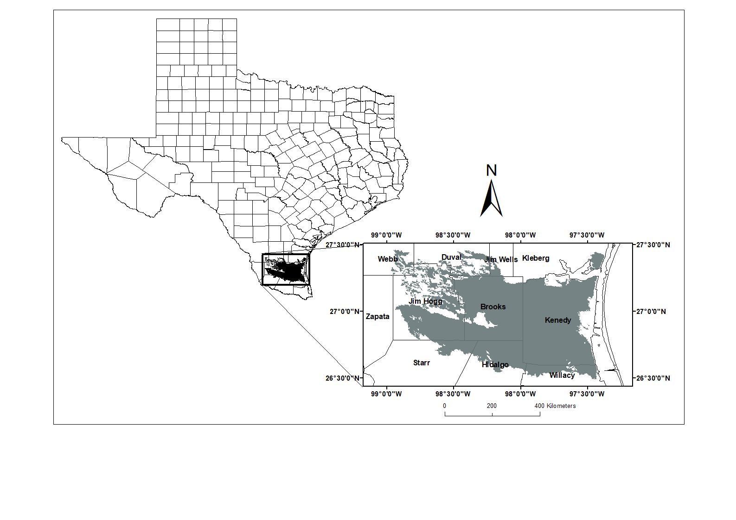
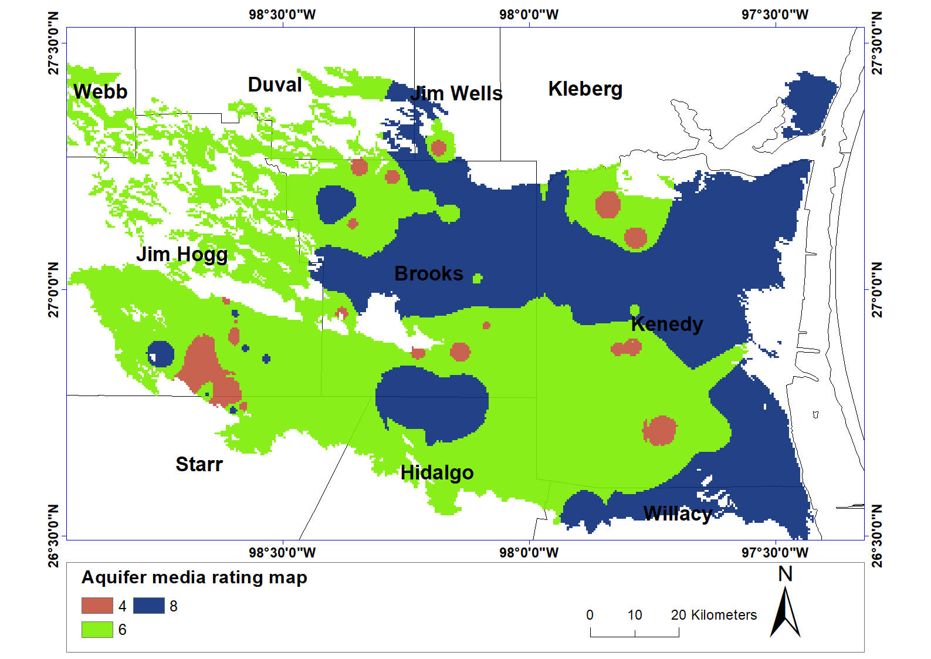
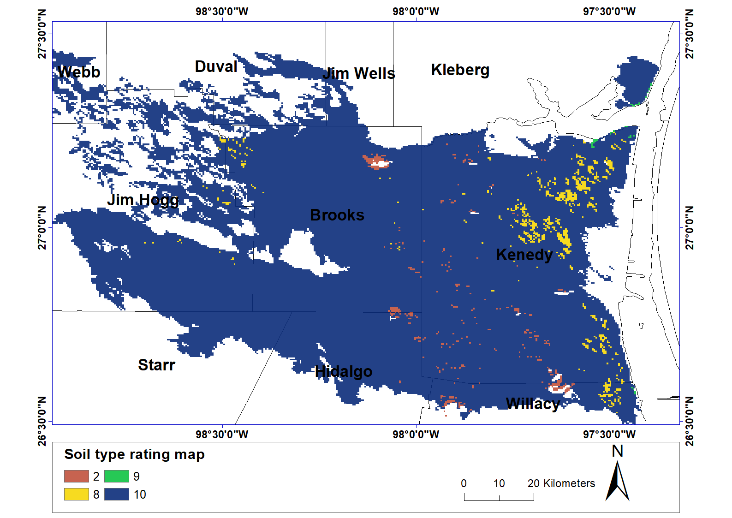
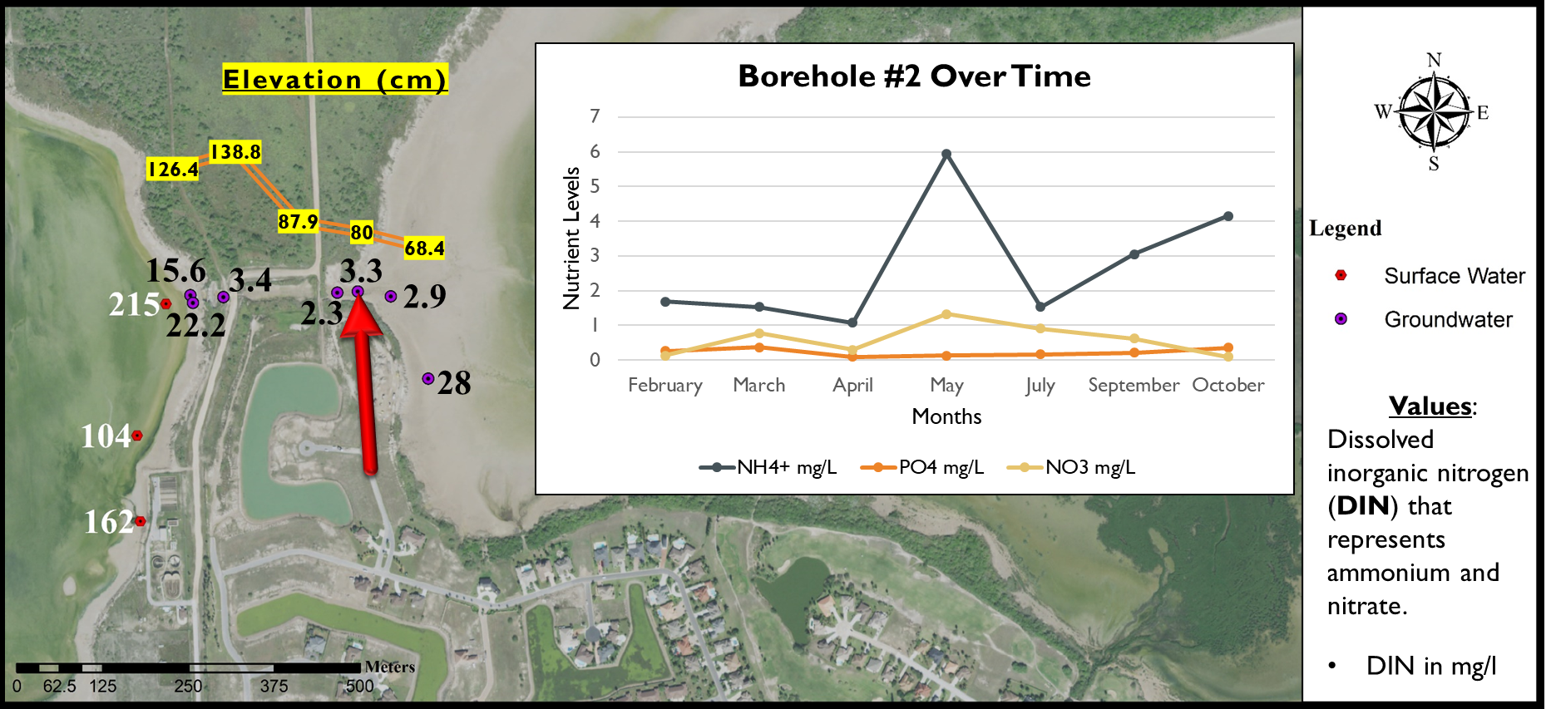
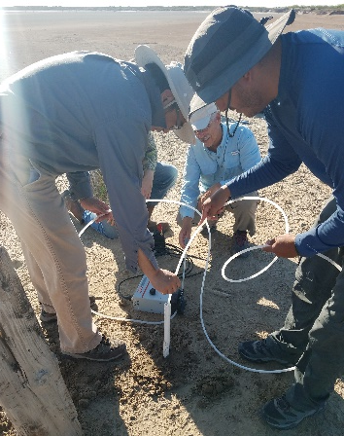
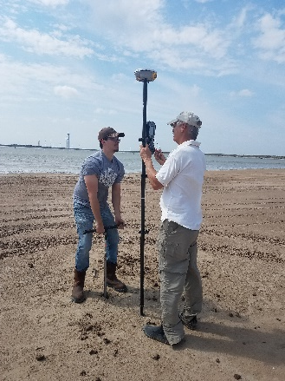
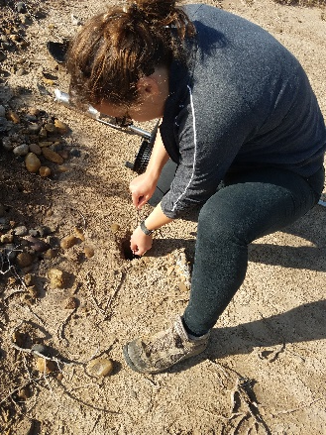
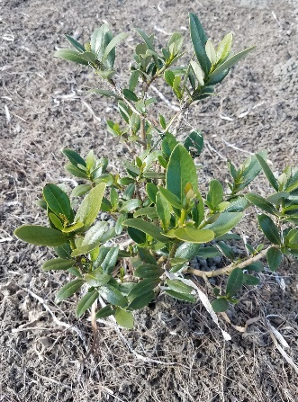
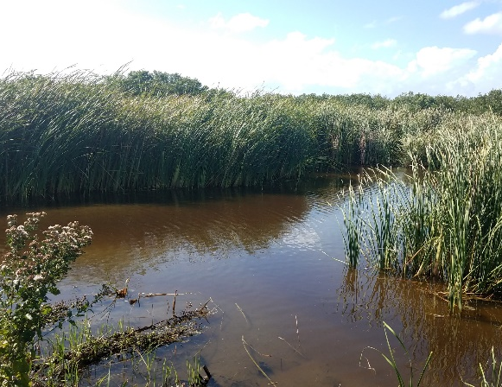
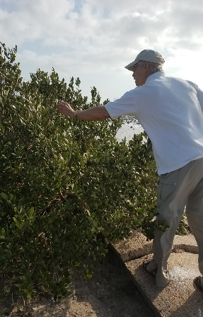
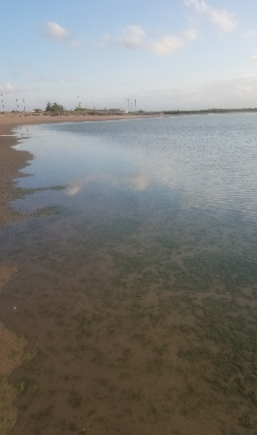
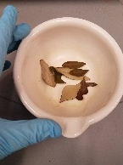
Assessing Shallow Groundwater Vulnerability in the
South Texas Sand Sheet Using a GIS-Based DRASTIC Model
Eli Gonzales, Jungseok Ho, and Chu-Lin Cheng
Hydrology, Water Chemistry & Biological Indicators Used To Assess Effects Of Treated Effluent On The Lower Laguna Madre
Rosamarie Perdomo, John Garcia, Chu-Lin Cheng, and Hudson R. DeYoe
Surface & Groundwater
Elevation & Depth
Vegetation δ¹⁵N
Chlorophyll
Nutrient Content
Flow Direction Correlation
Indicator of Nutrient Loading
Affecting Surface Vegetation

Slide 7
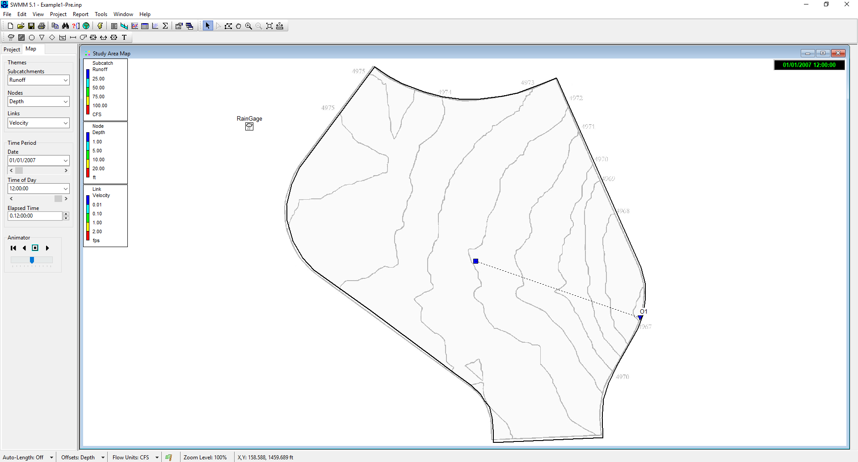
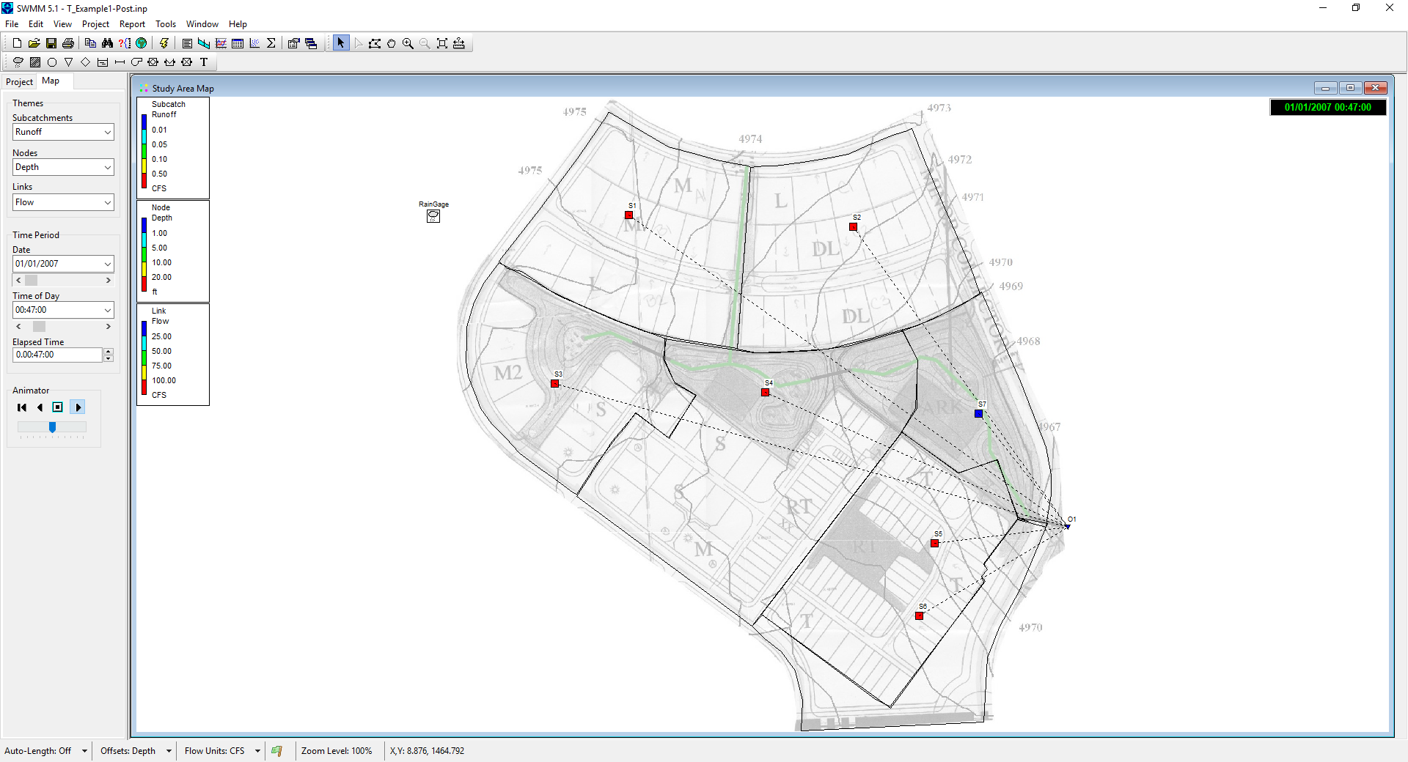
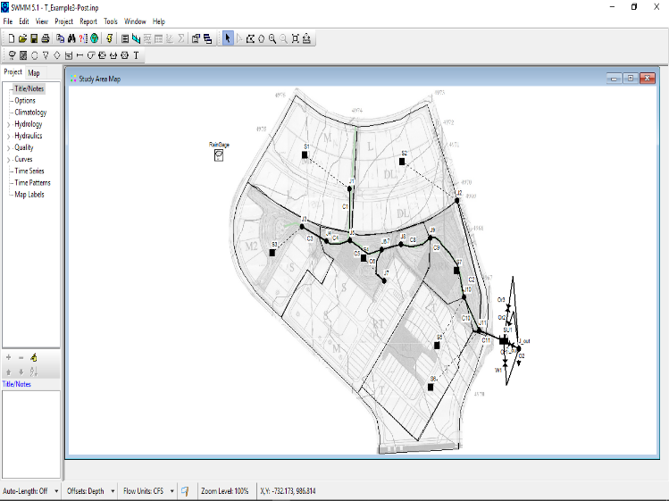
Comparison of the effectiveness of conventional and Low Impact Development (LID) stormwater management practices on watershed flood control using SWMM modeling
Abdullah A. Fatta, Jungseok Ho, and Chu-Lin Cheng

Slide 8
Other active projects
Chevron-DoS, "Energy and Water Resource Management", Argentina-Americas 100K Strong (2018-2019)
USDA, "Training, Research, and Education in Soil Science (TRESS)“ (2018-2022)
NSF, "Collaborative Research: Promoting Research-based Instructional Methods for STEM Education", (2018-2023).

Slide 9
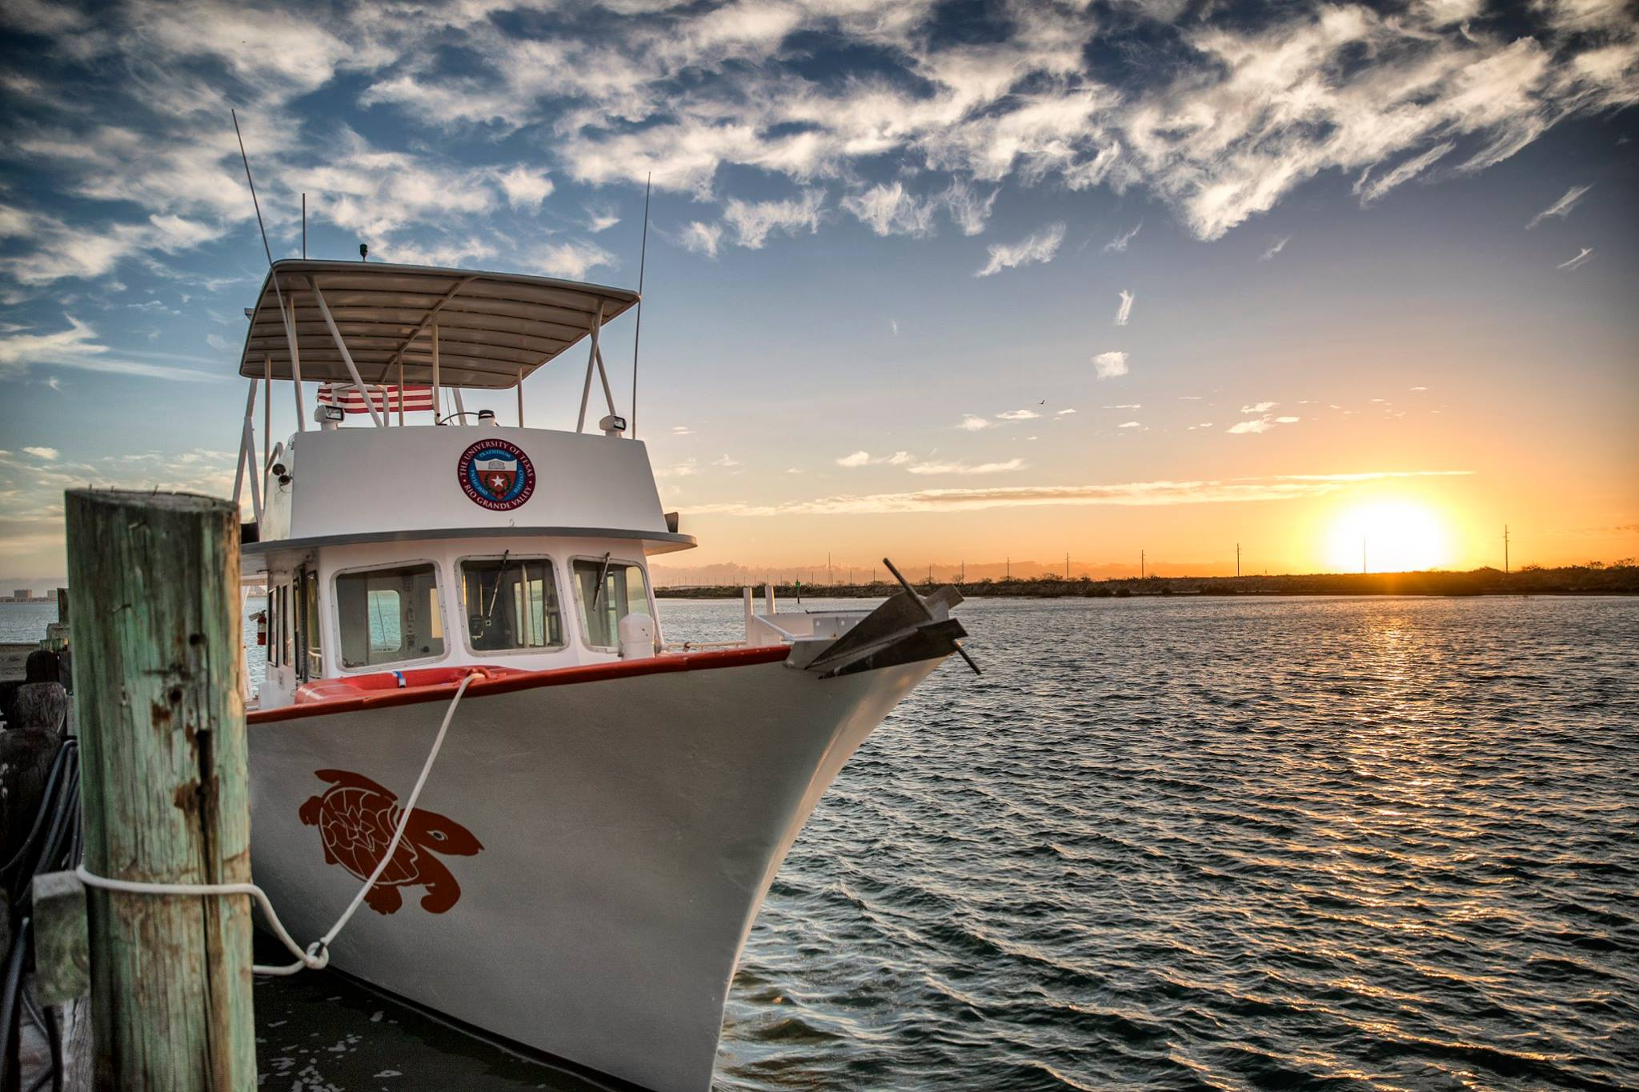
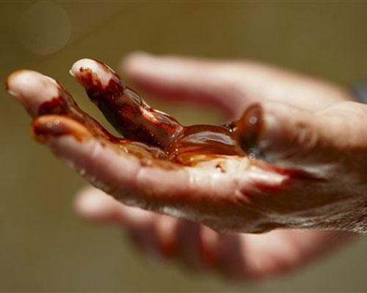
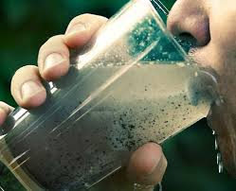
Chu-Lin Cheng, Ph.D.
Office: ESCNE 2.617
Phone: 956-665-2464
E-mail: chulin.cheng@utrgv.edu
Website: https://faculty.utrgv.edu/chulin.cheng/
Thank you!

