Slide 1
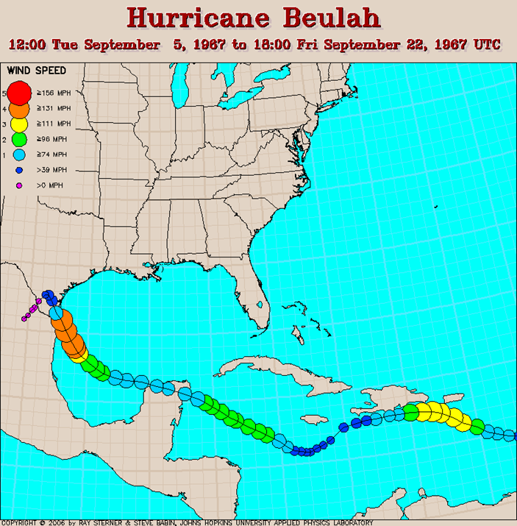
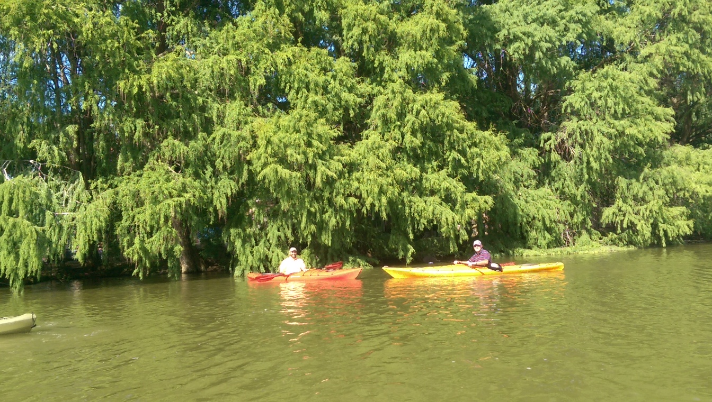
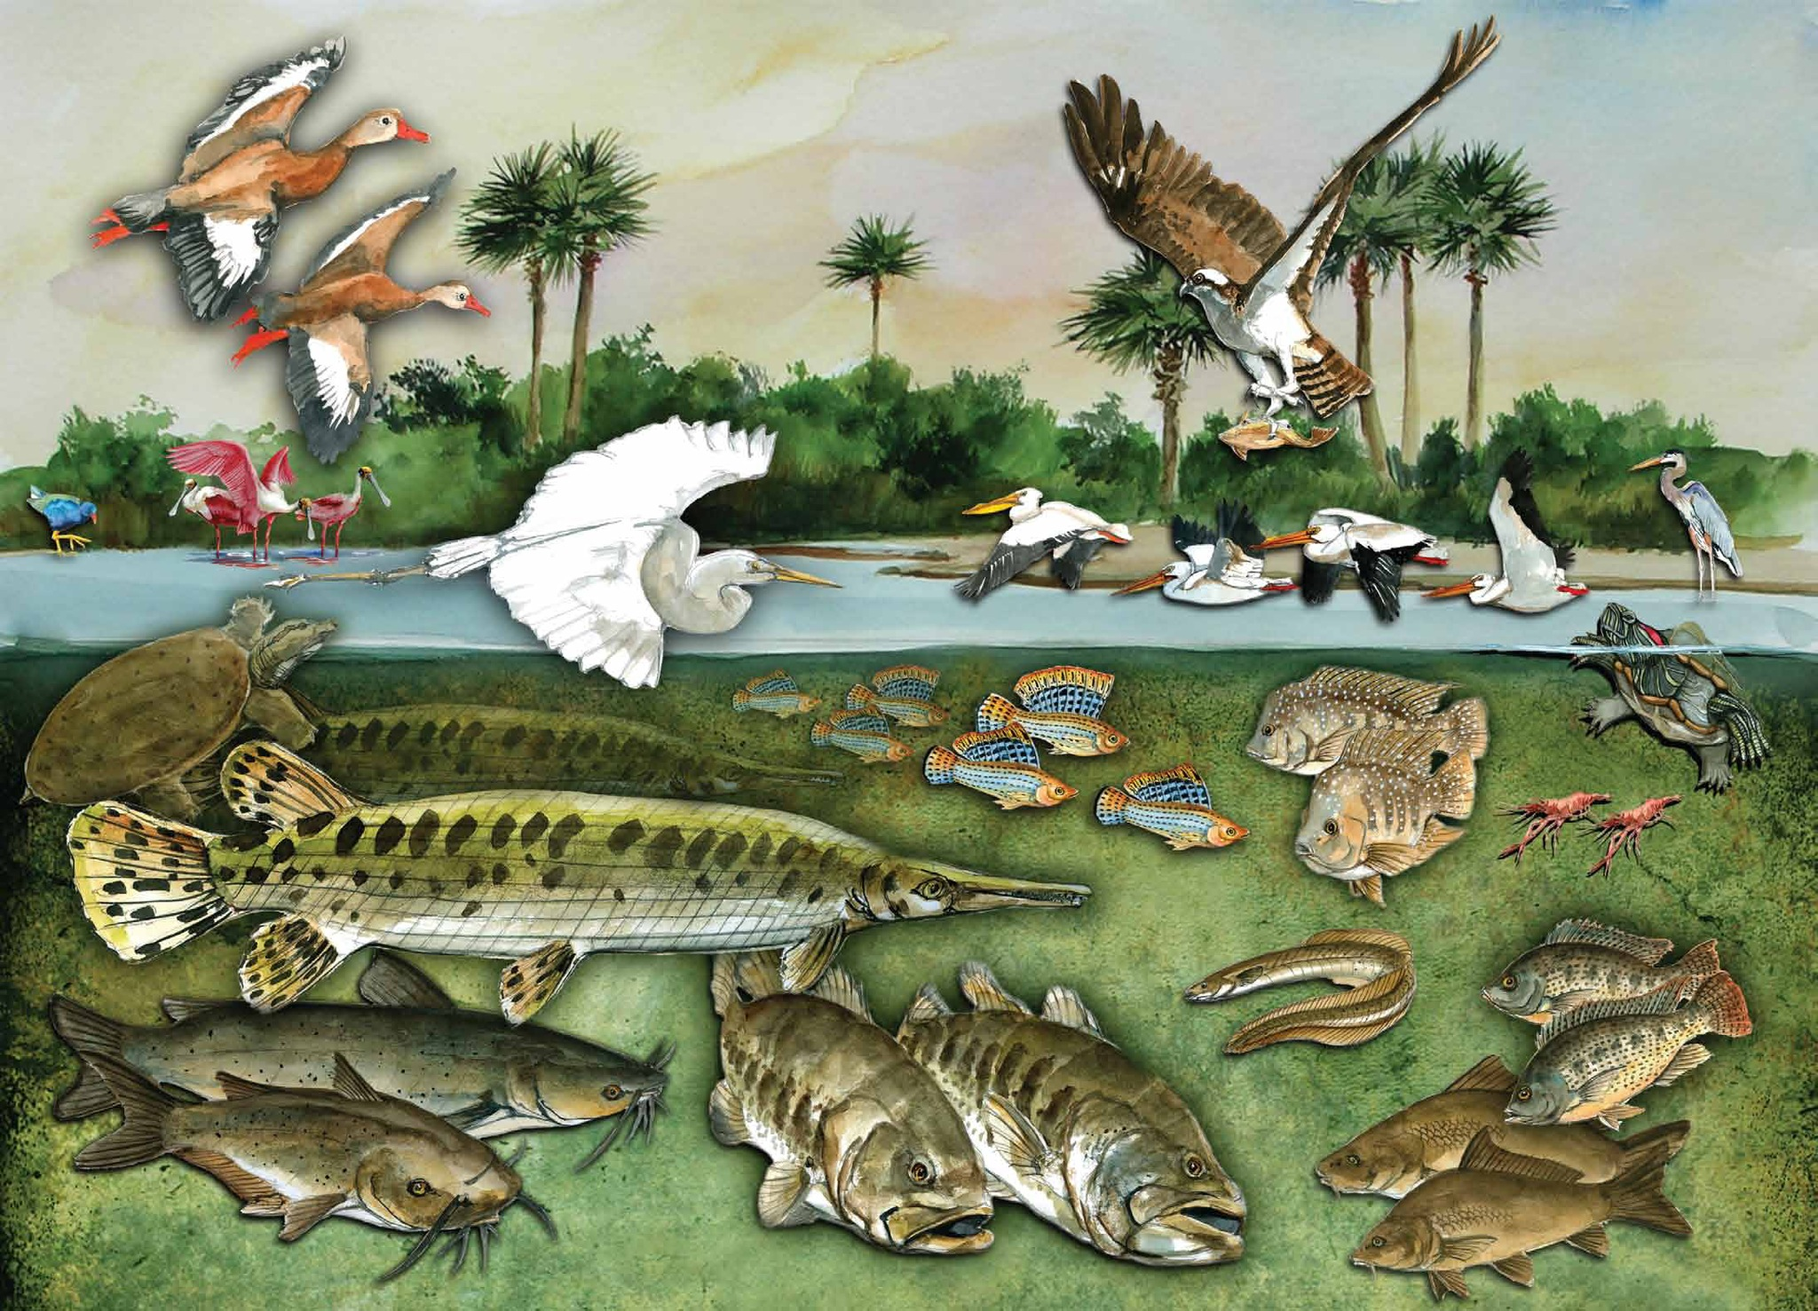
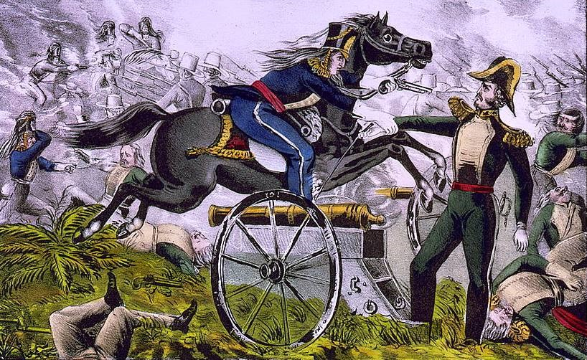
Resacas: The Varied and Vital Roles Played by Remnant Distributaries of the Rio Grande Delta
Jude A. Benavides, Ph.D.
Herman Ramsden
University of Texas - Rio Grande Valley

Slide 2
What are Resacas?
Isolated (abandoned) distributaries of the Rio Grande
Natural flow has been cut off
Ox-bows? Resacas include them, but not limited to ox-bows
Ox-bow vs “distributary”
Water levels and flow occasionally augmented via pumps

Slide 3
Notes:
Rio Grande.
U.S. - Pecos River
Mexico - mid and downstream - Rio Conchos, Rio Salado, Rio Pesqueria, Rio San Juan

Slide 4
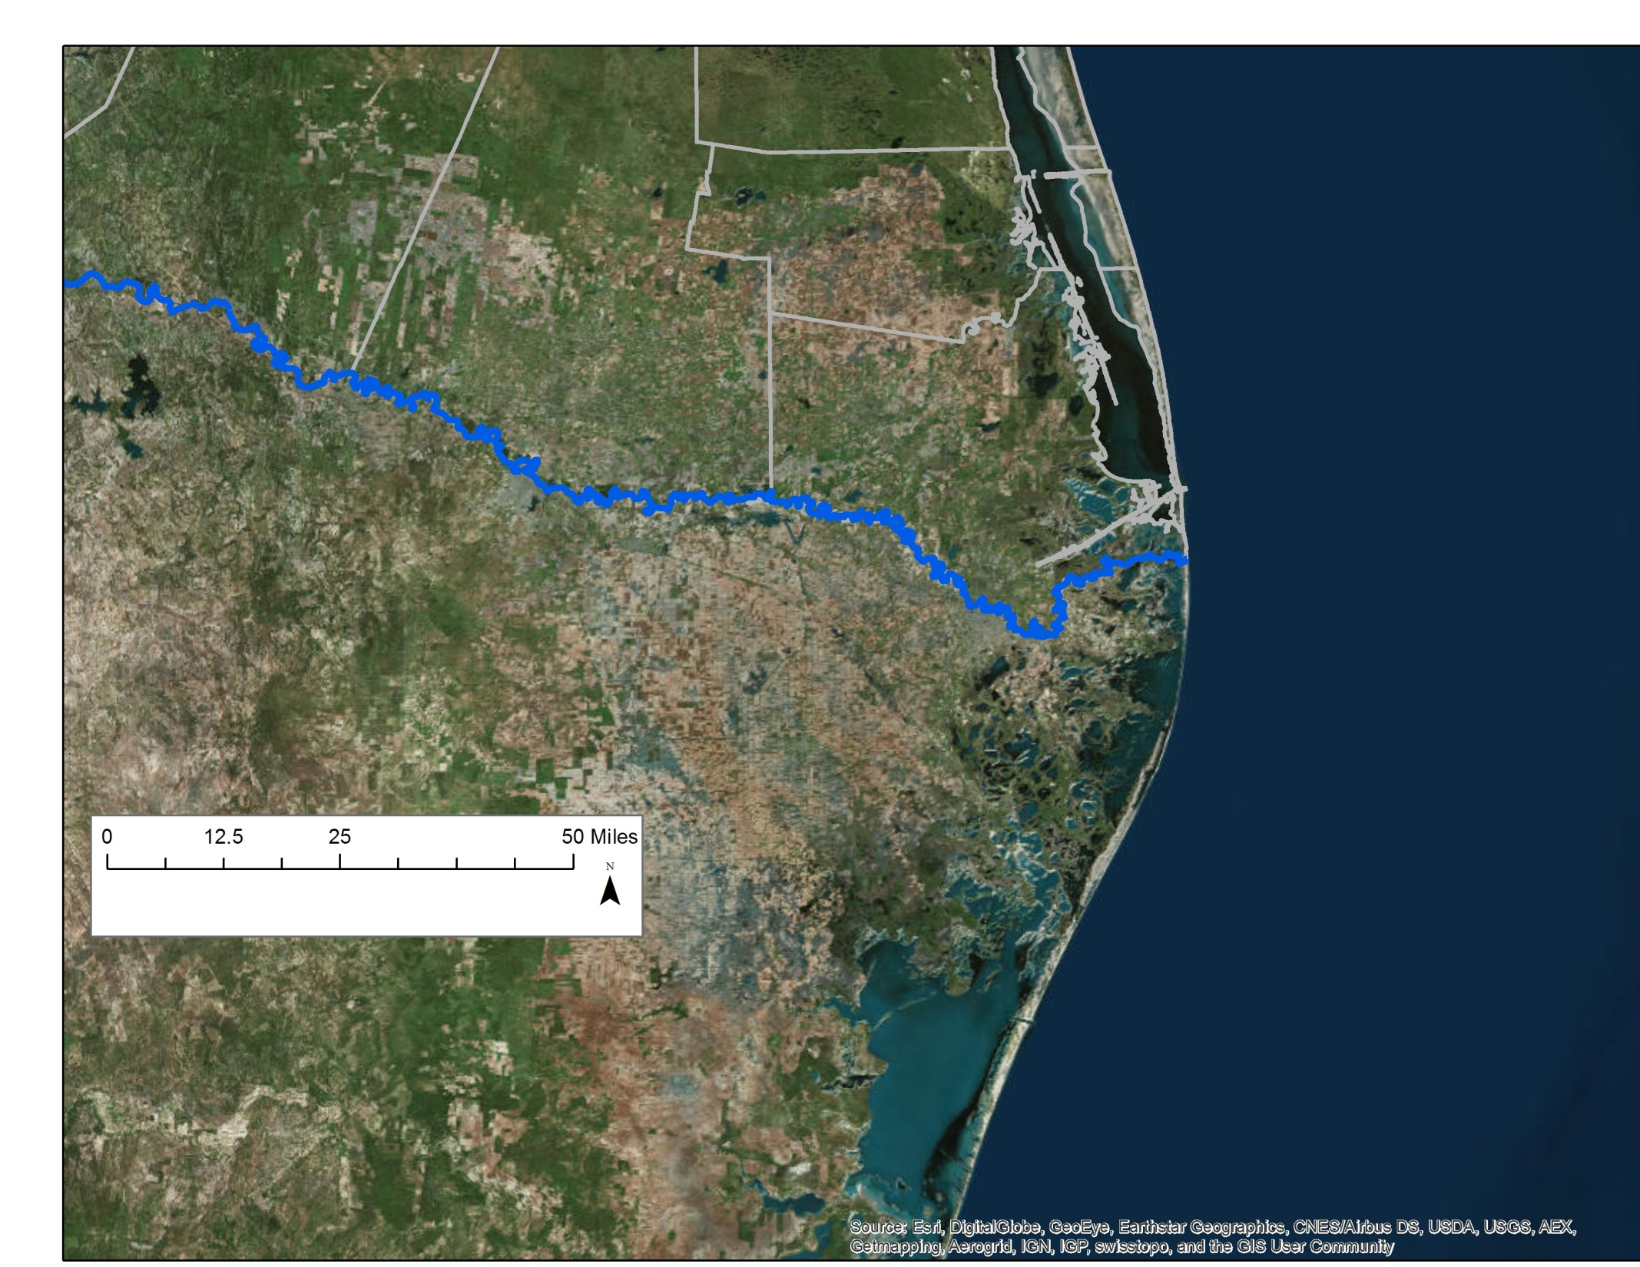
US Side
Rio Grande River
Mexican Side

Slide 5
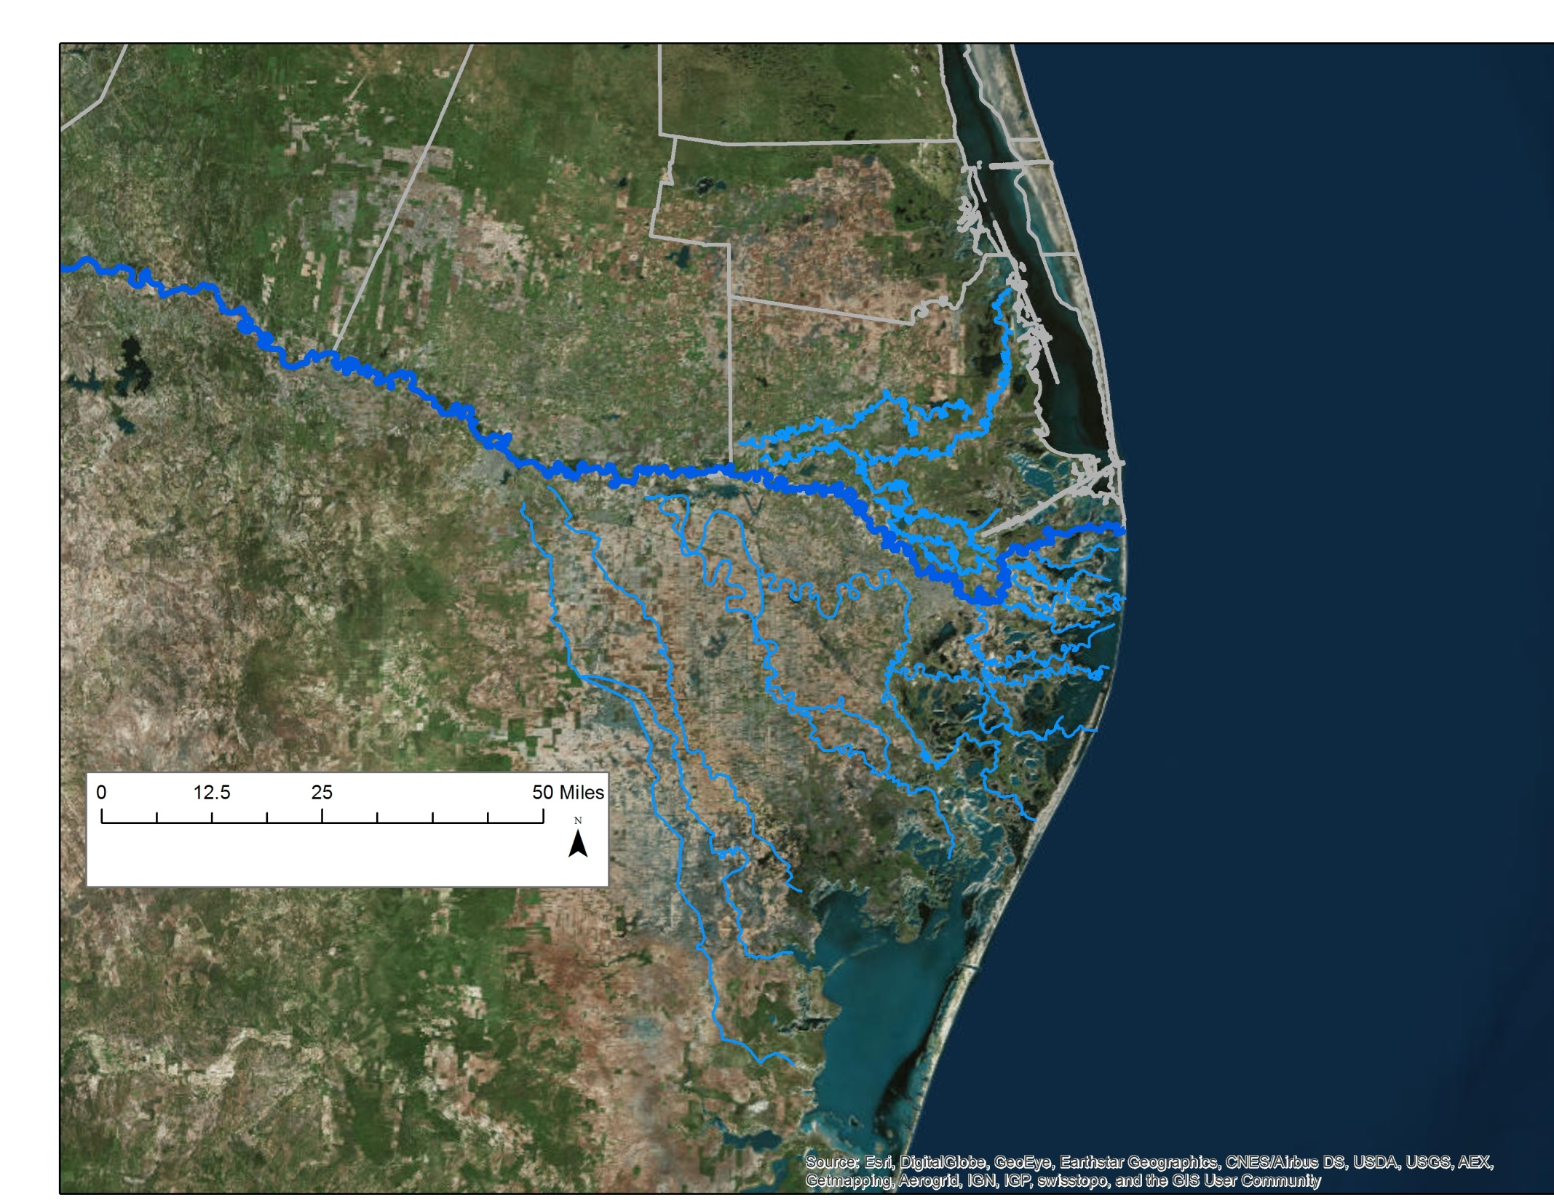
US Side
Rio Grande River
Distributary System
(Ancient and
Partially Abandoned)
Mexican Side

Slide 7
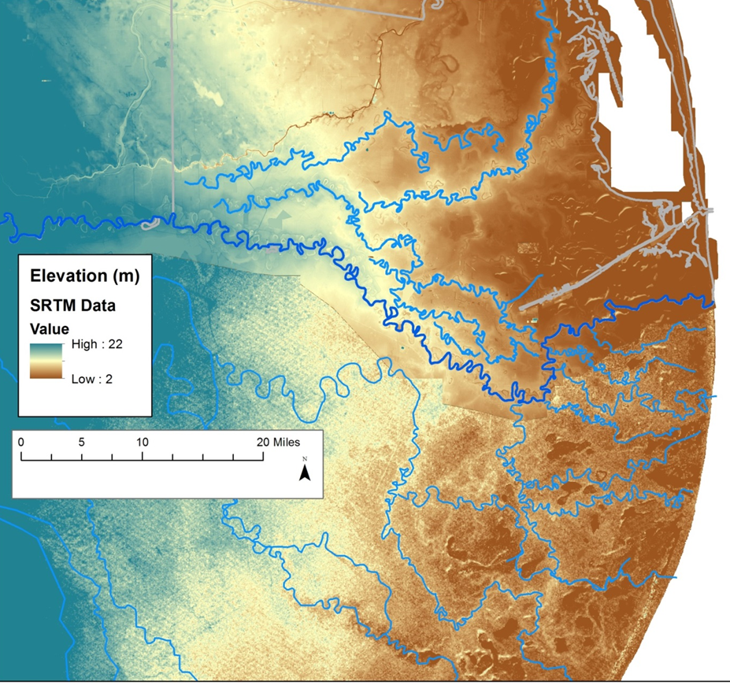
US Side
Rio Grande River
Distributary System
(Ancient and
Partially Abandoned)
Mexican Side

Slide 8
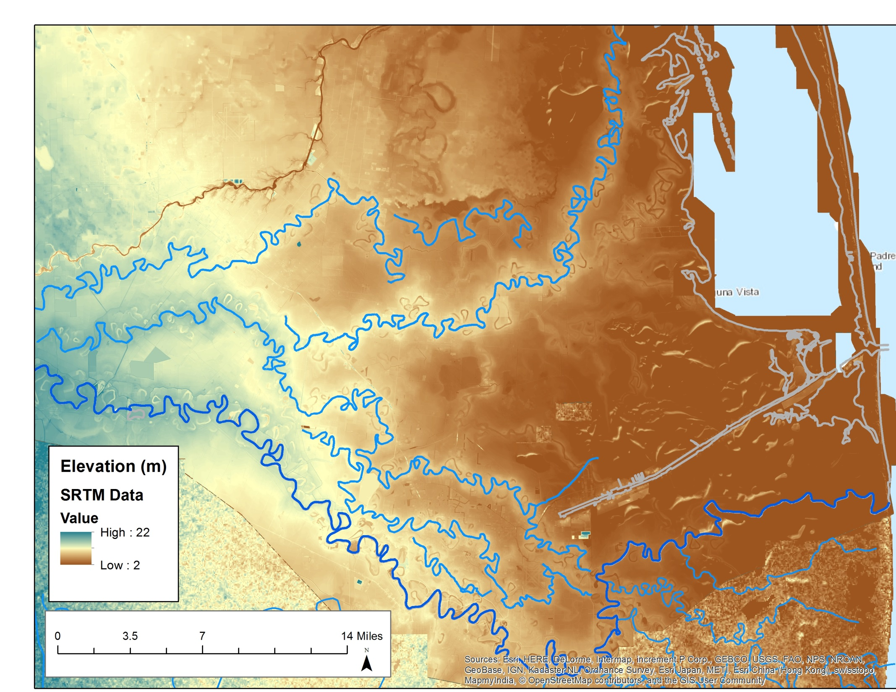

Slide 9
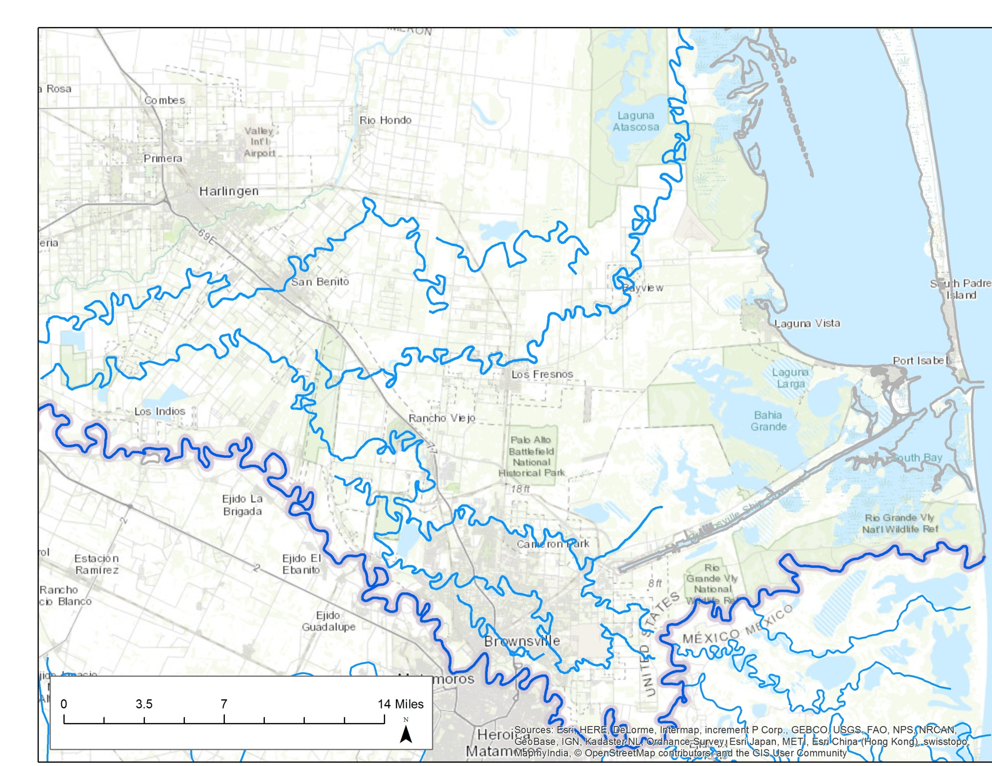

Slide 10
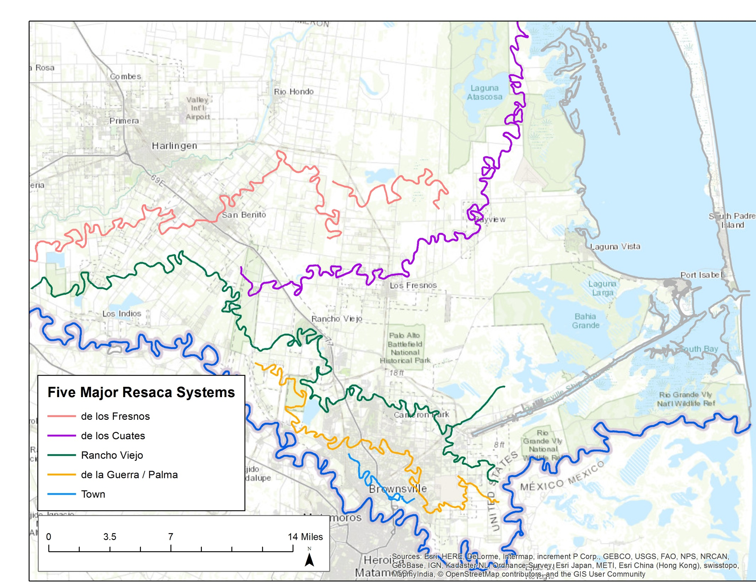

Slide 11
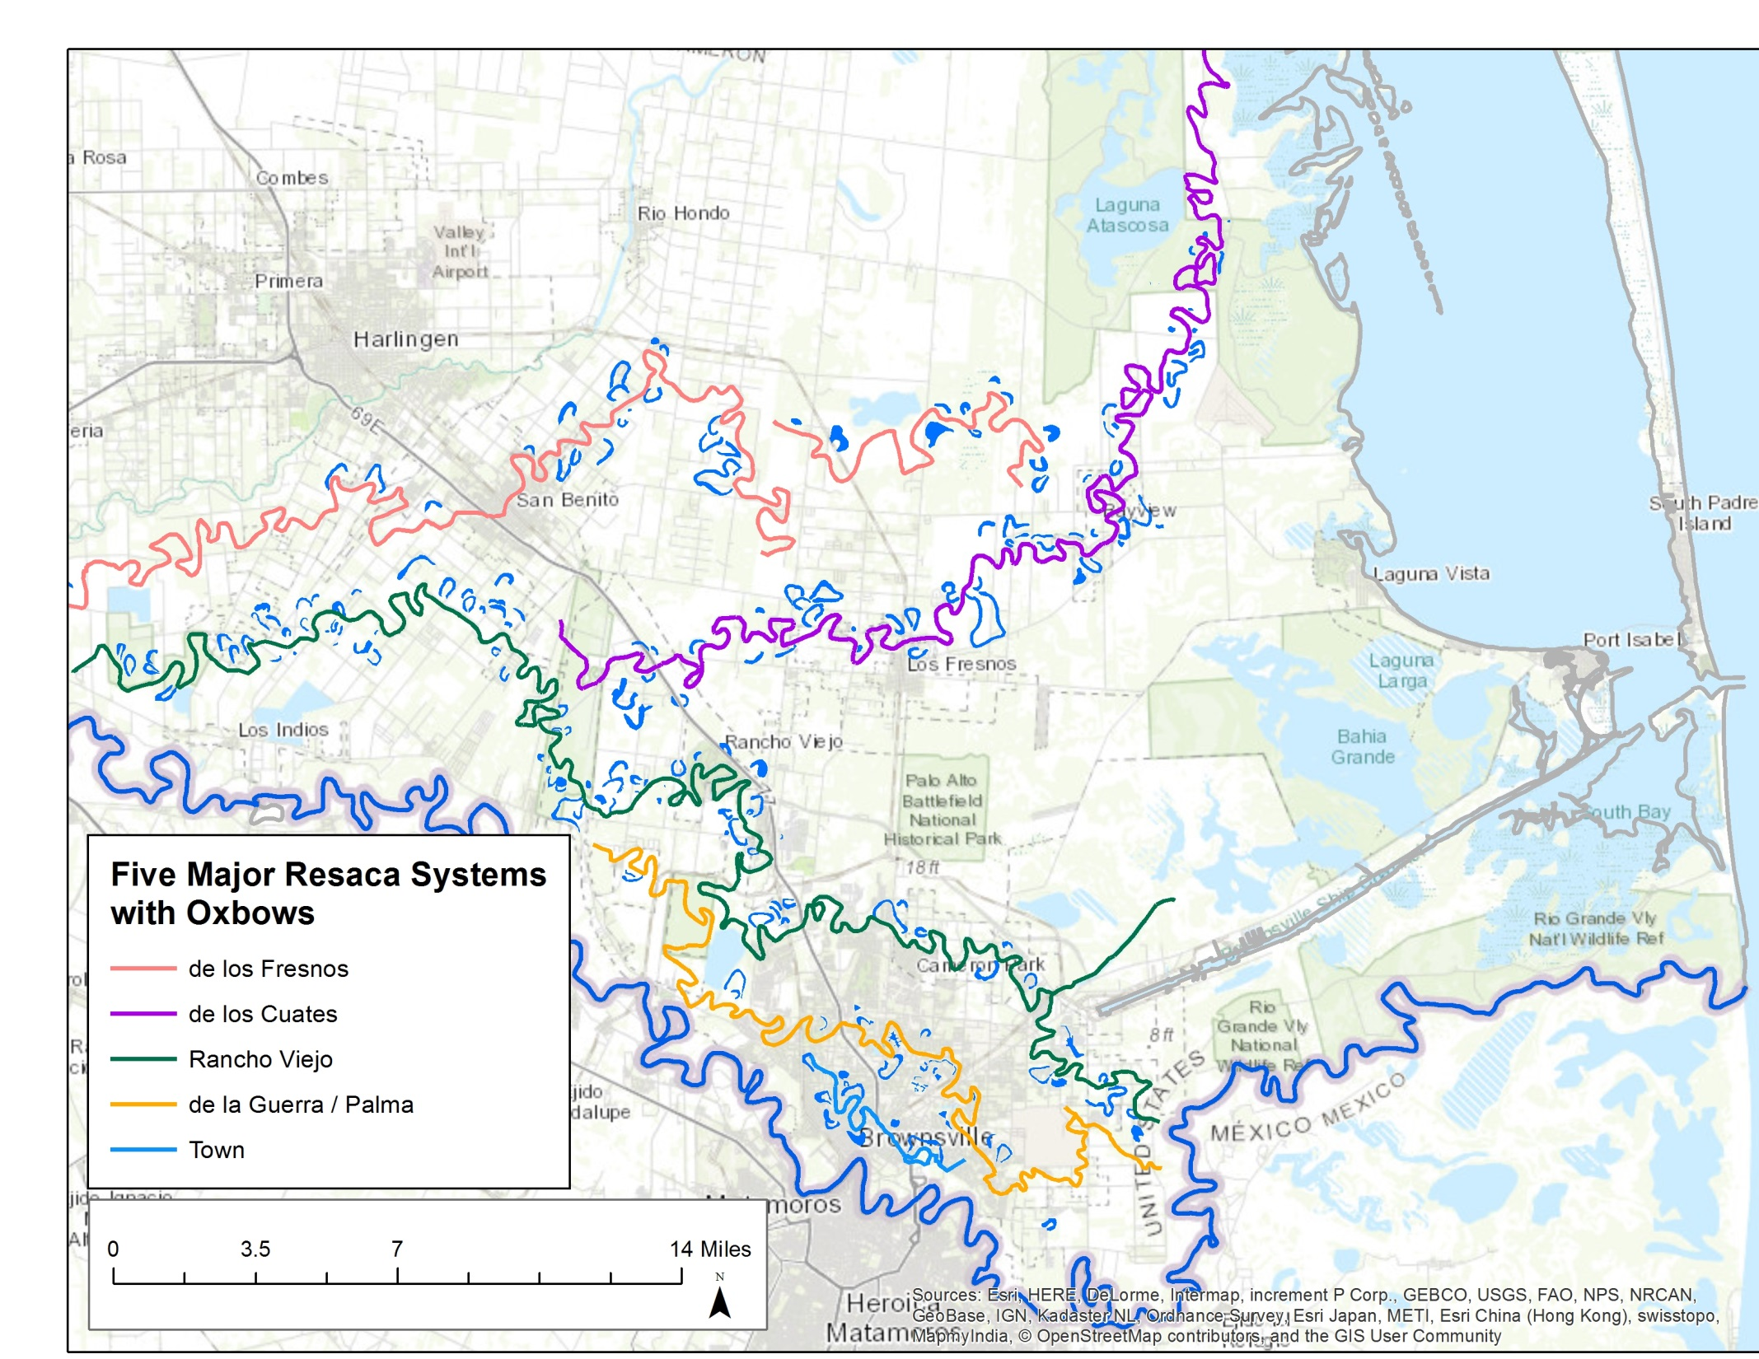

Slide 12
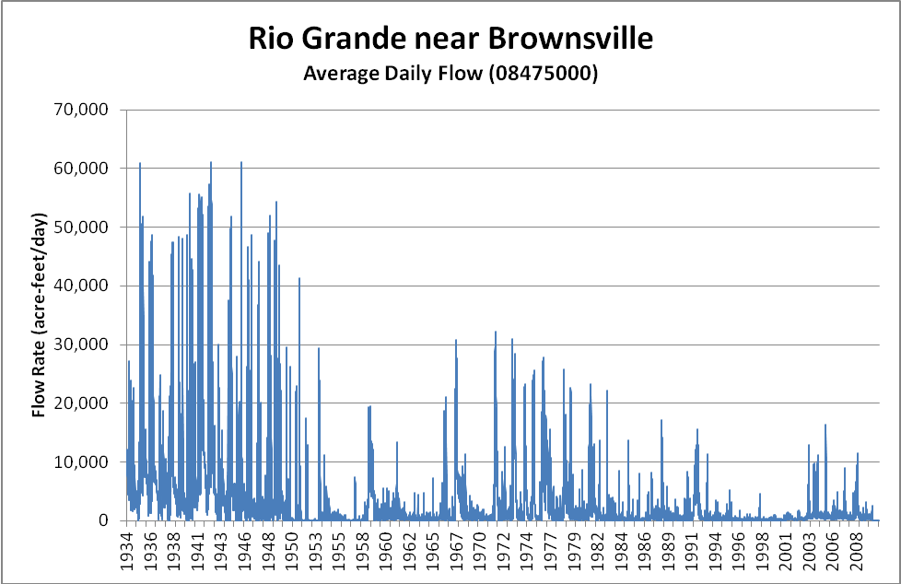
Lower Rio Grande Dams
# | Dam | Year Constructed
1 | Falcon Dam | 1954
2 | Anzalduas Dam | 1960
3 | Amistad Dam | 1969
4 | Retamal Dam | 1975

Slide 13
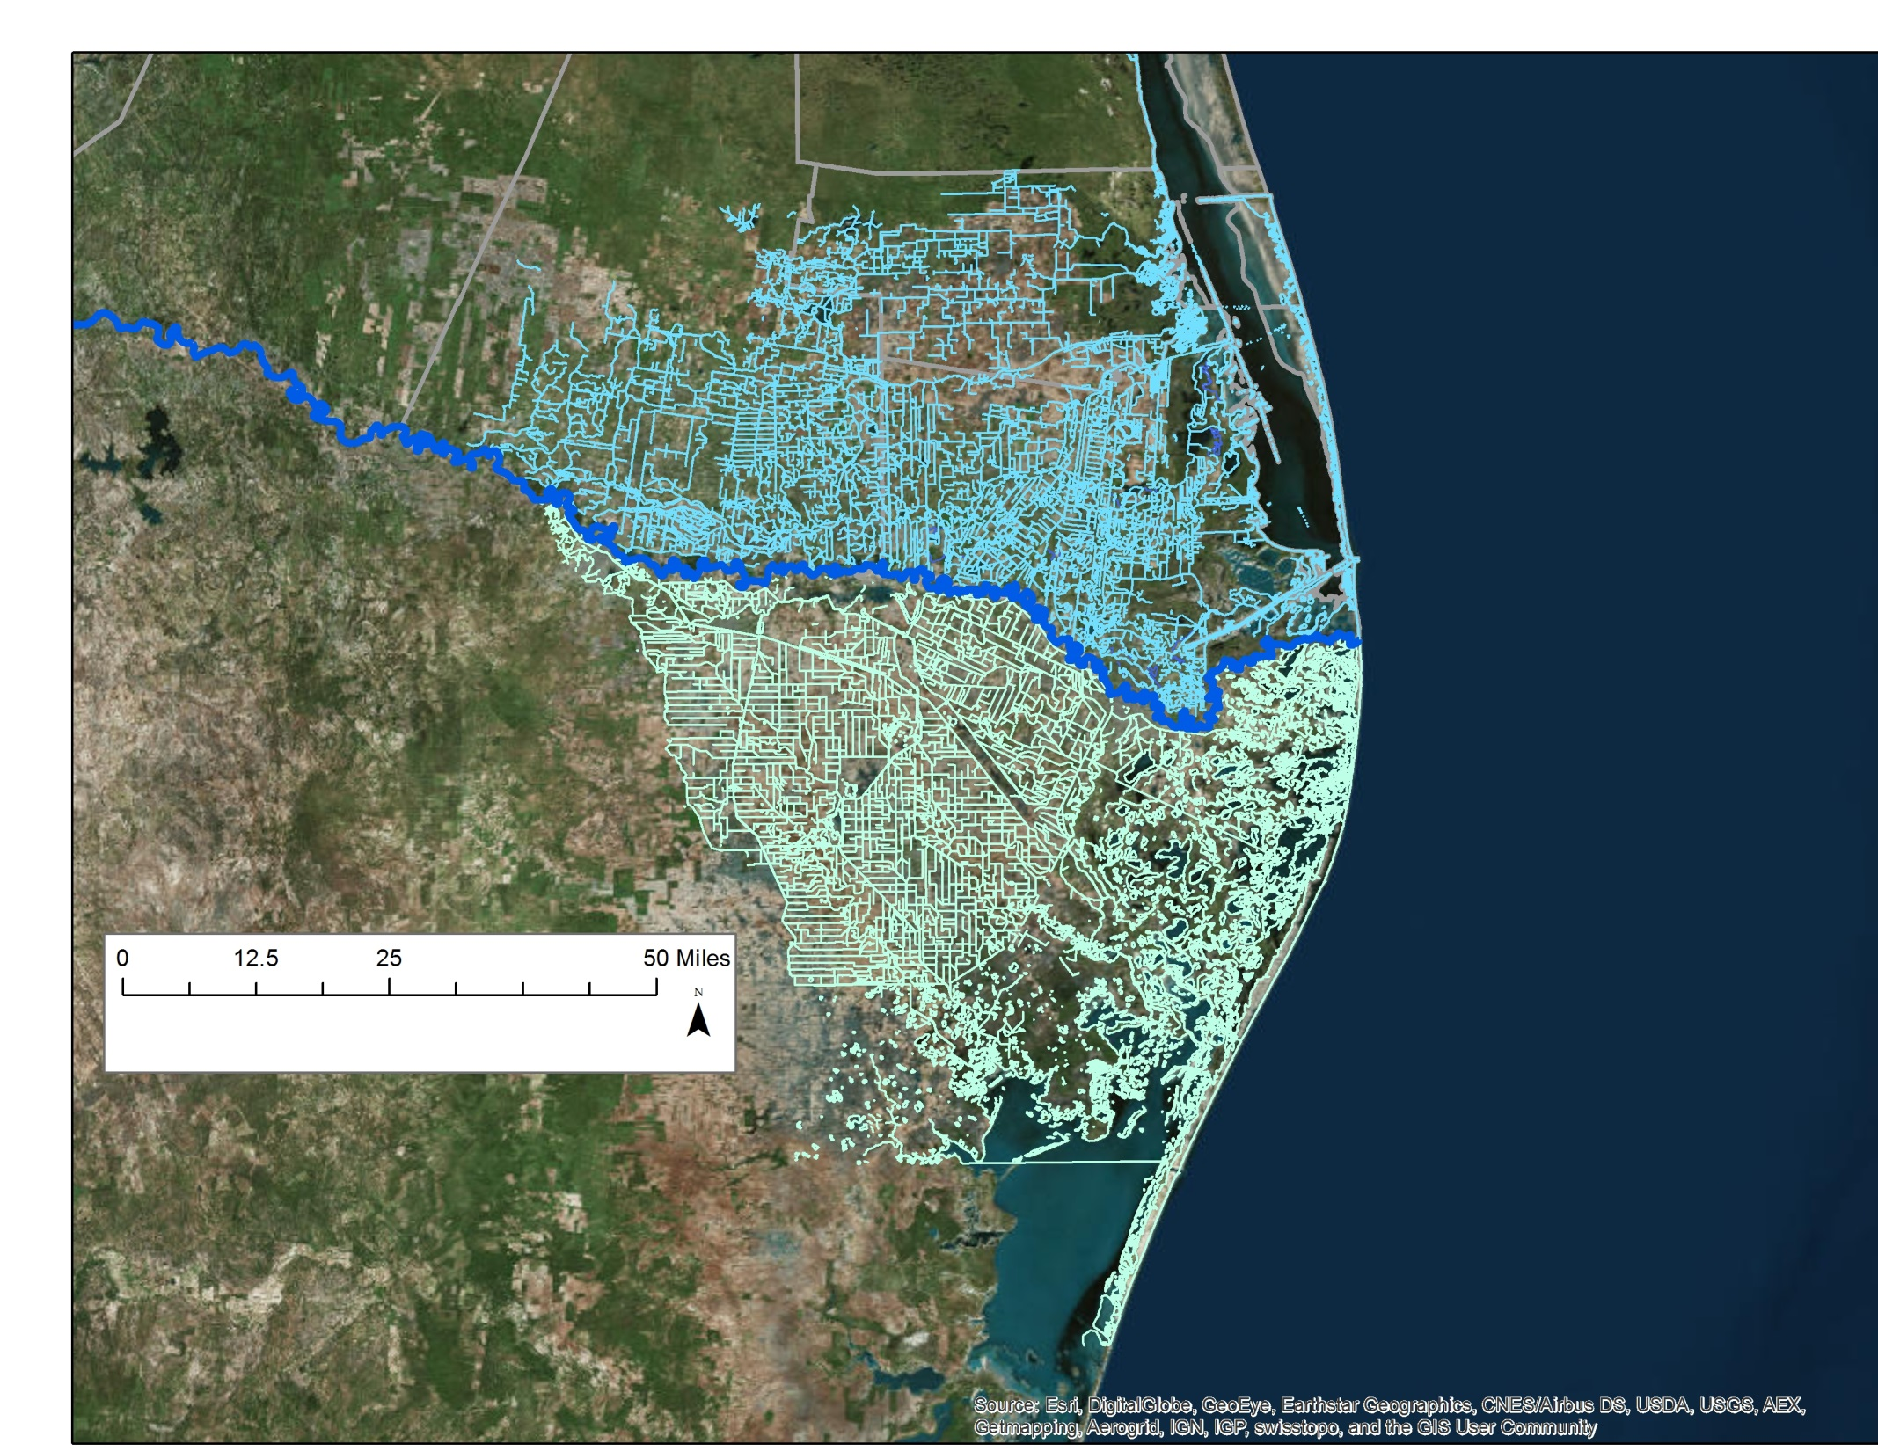
US Side
Flow Line Network
With all Features
Mexican Side

Slide 14
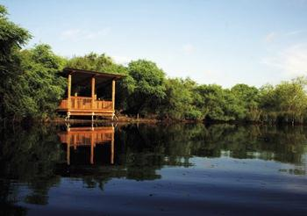
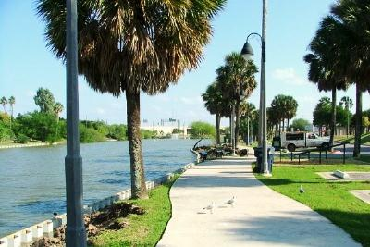
Resacas play vital and multiple roles – and are understudied in terms of the relative importance of these roles
Flood protection.
Raw water storage.
Irrigation conveyance.
Habitat for bird / wildlife species.
Improved aesthetics.
Park areas.
Opportunities for recreation and eco-tourism.
Economic development potential.
Represent a scarce commodity in South Texas – surface freshwater bodies
Resaca de la Palma State Park
Dean Porter Park

Slide 15
Fragmentation, sedimentation, ecological succession (natural vs. interrupted)
In order to sustain the services that resacas provide, it is vital that local and regional experts focus more carefully on their restoration and preservation. (Water rights vs. environmental flows)
To our knowledge there are only a handful of studies that have focused on the most basic of issues – delineation, wetland status, ecological health, flood damage reduction.
Resaca del Rancho Viejo, credit: Dr. Benavides
Notes:
Previous studies done by students and Dr. Fierro, Dr. Benavides, McInthosh. Buford Lesley
Add pictures of a drier and semi dry Resaca ecological succession

Slide 16
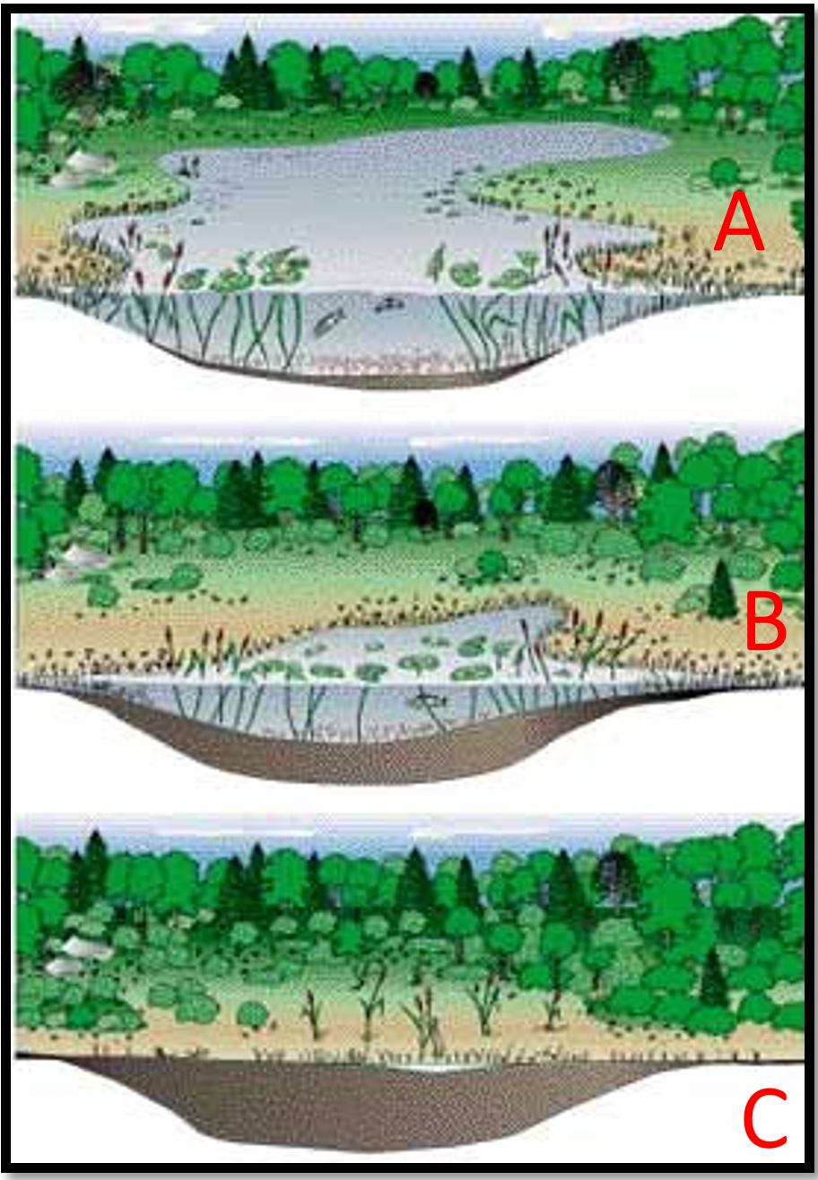
Ecological succession
Nowadays, with hydraulic structures, resacas function as small lakes and many of the resacas are at stage A and B
Before dams were built along the Rio Grande, resacas would go from wet to dry constantly and there was no way to hold water in the system.
Time
Sedimentation affects the water storage capacity, which deteriorates the ecosystem services that resacas provide. Stage C
Ecological succession of lakes

Slide 17
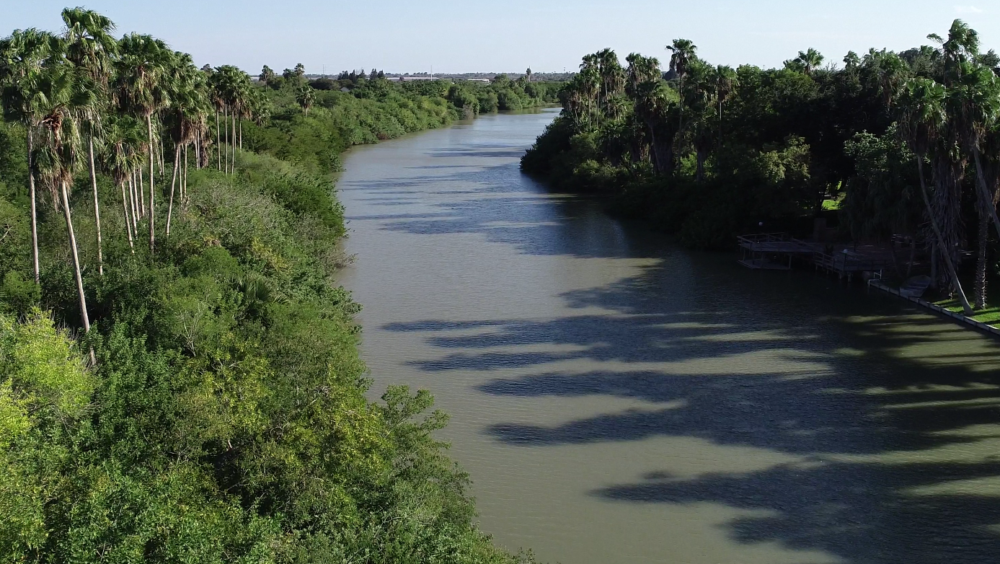
Water level controlled resaca
Resaca del Rancho Viejo.

Slide 18
Ephemeral resaca

Slide 19
Dry resaca Bed

Slide 20
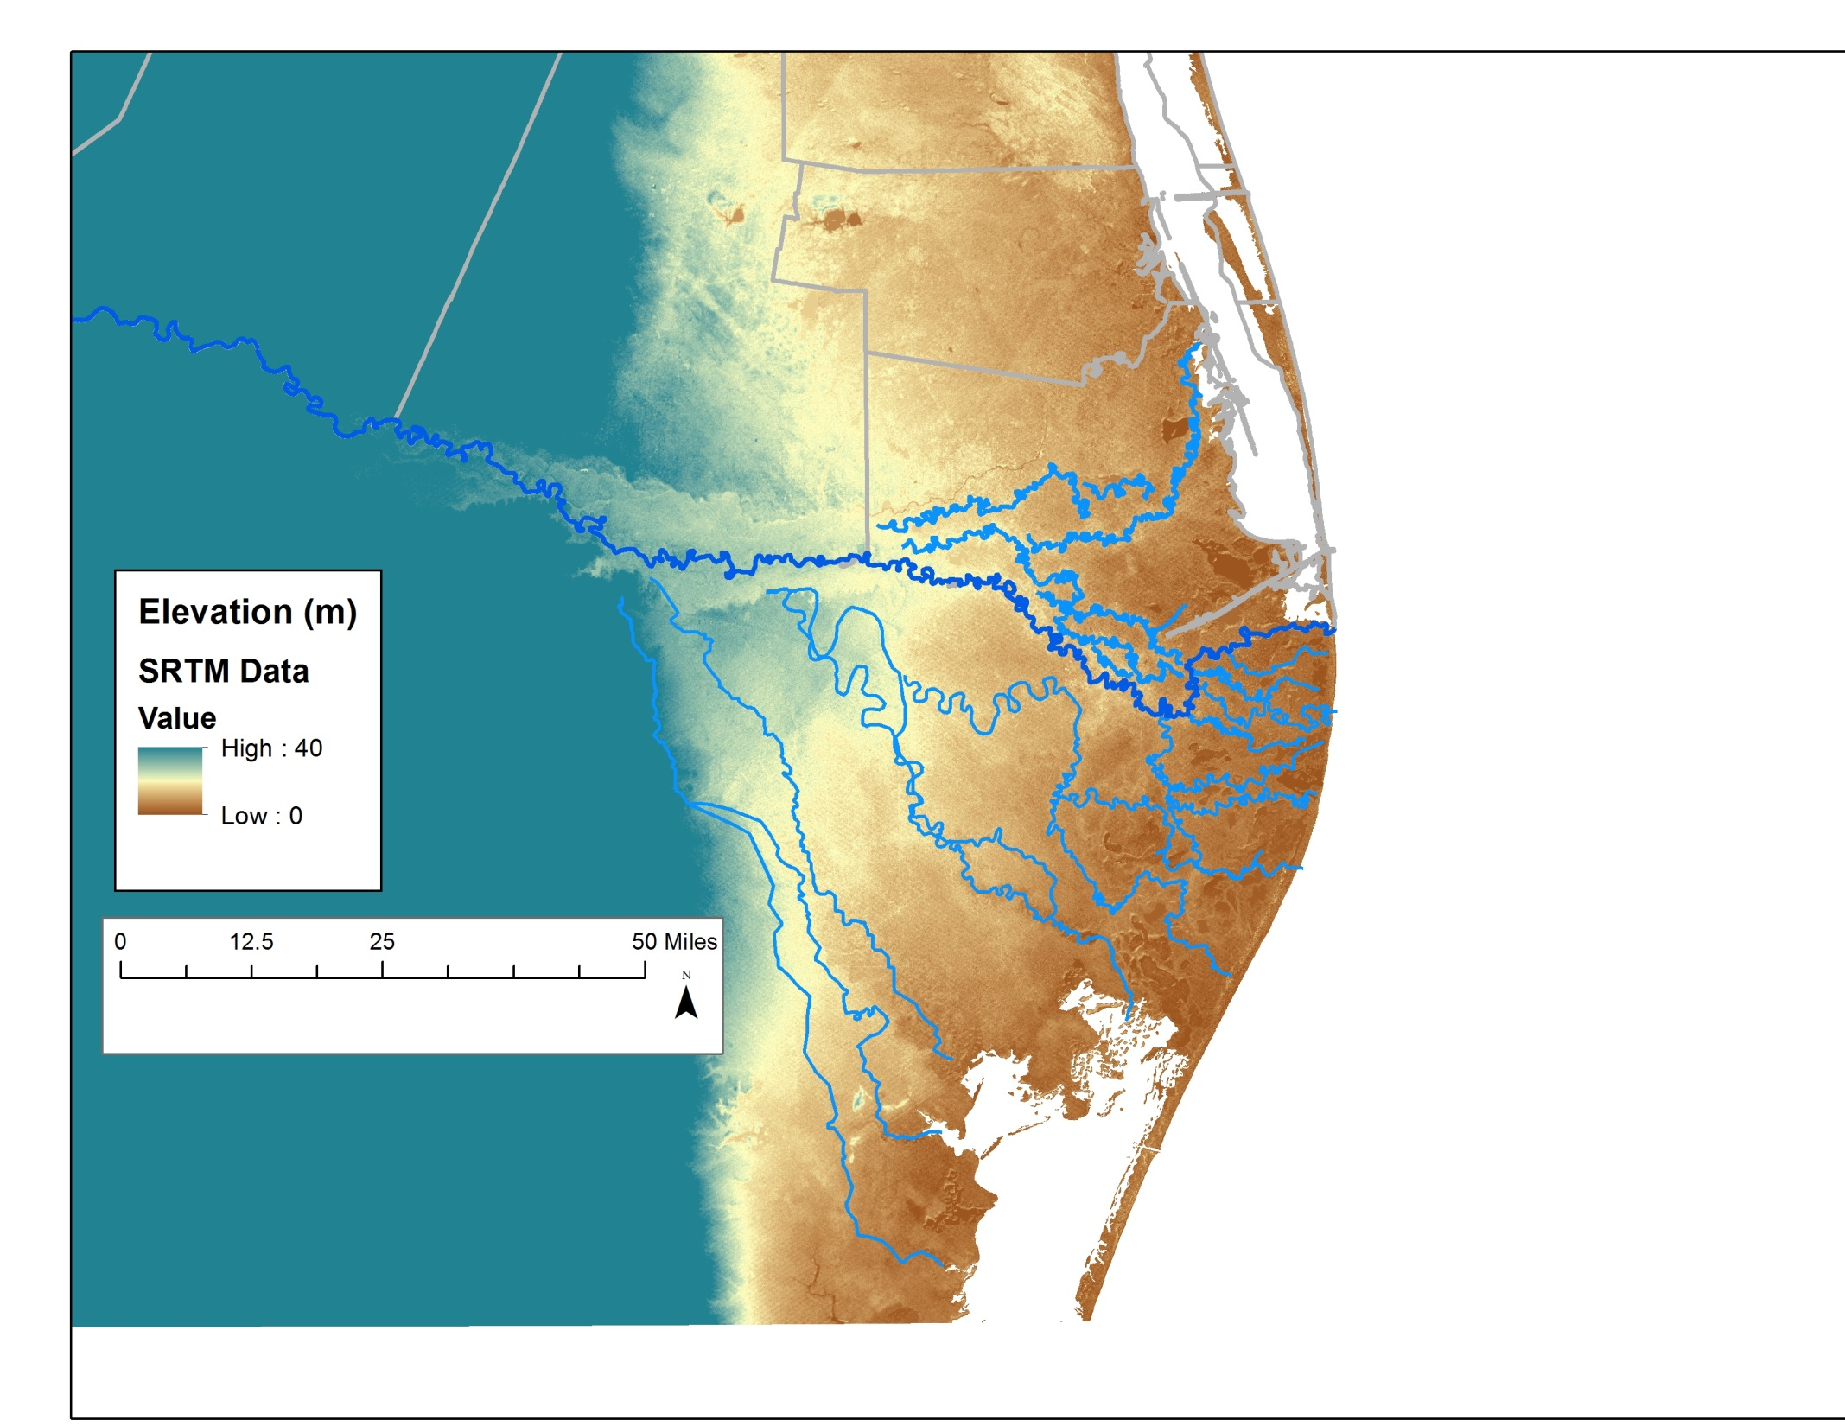
U.S. Side –
Over 250 river miles
of wet / wetland
Distributaries
Mexican Side -
Over 750 river miles
of wetland (drier) systems
Some principally drier
Systems have eroded away

Slide 21
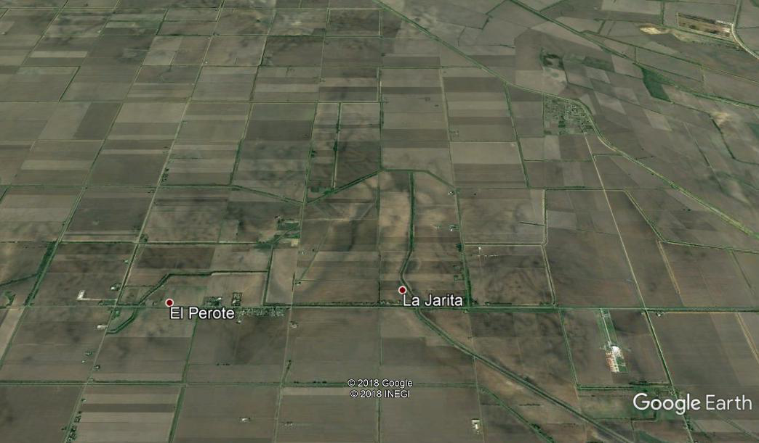

Slide 22
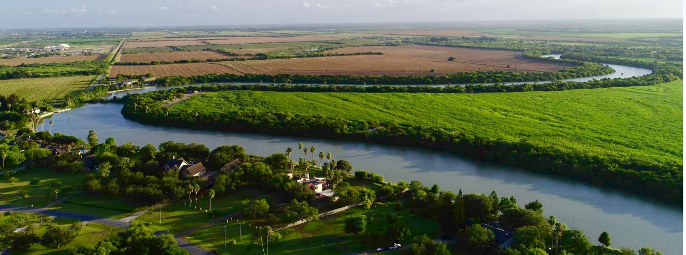
Questions????
Jude.Benavides@utrgv.edu
Cell: 956-572-6334

