Slide 1
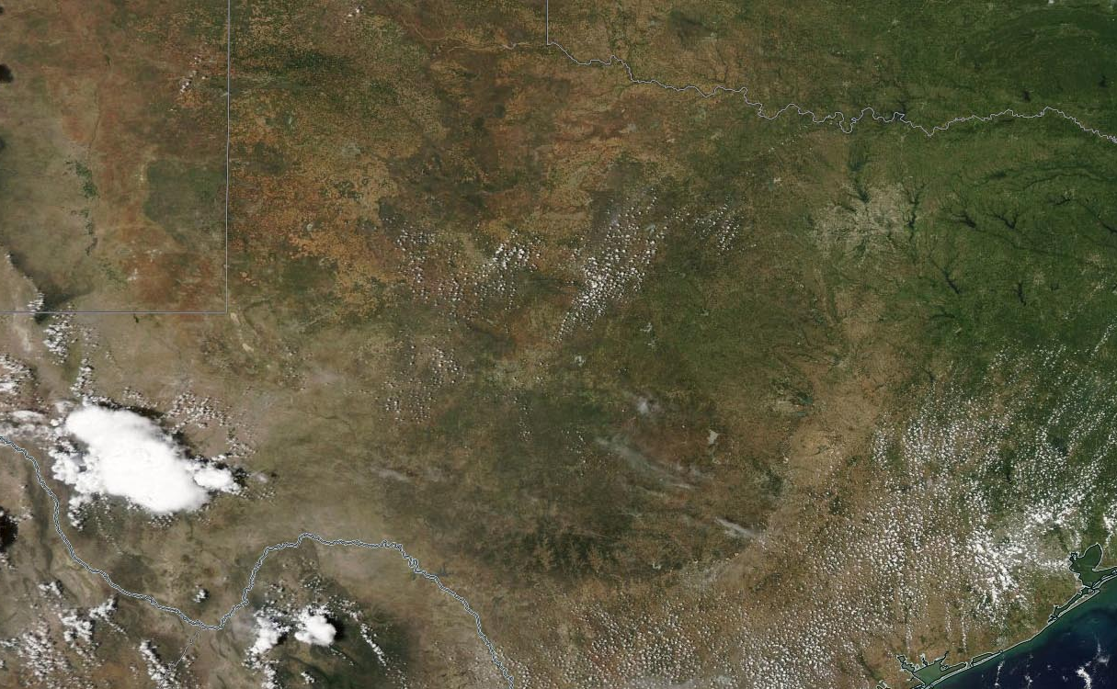
Texas Urban Land Change
Planet Texas 2050 - Texas Metro Observatory
Presented to TWRN on May 30th, 2019
Notes:
What is TMO?
What is Urban Land Change (ULC)?
ULC Patterns across US Metros

Slide 2
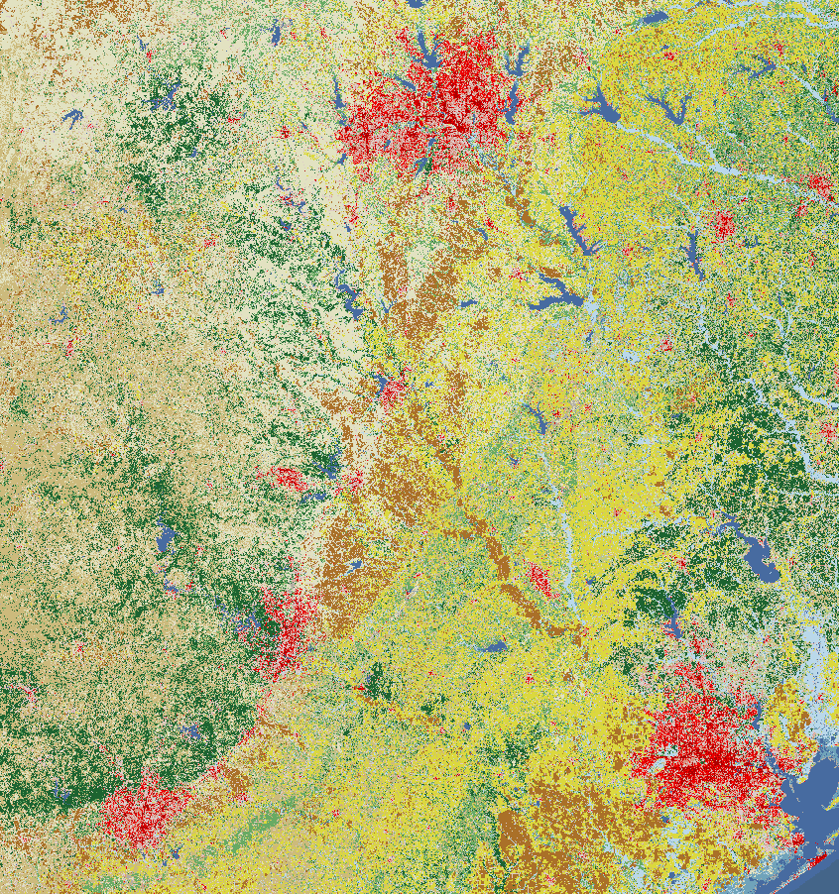
Texas Metro Observatory (TMO): a communication and data platform dedicated to:
sharing information and ideas about Texas’s communities &
understanding common problems related to urbanization processes in these communities &
developing solutions across the state’s metropolitan areas.
Dallas – Ft. Worth
Waco
Temple-Killeen
College Station-Bryan
Austin
Houston
San Antonio
Notes:
Looking at Urbanization from a Texan perspective.
Data and Communications Hub

Slide 3
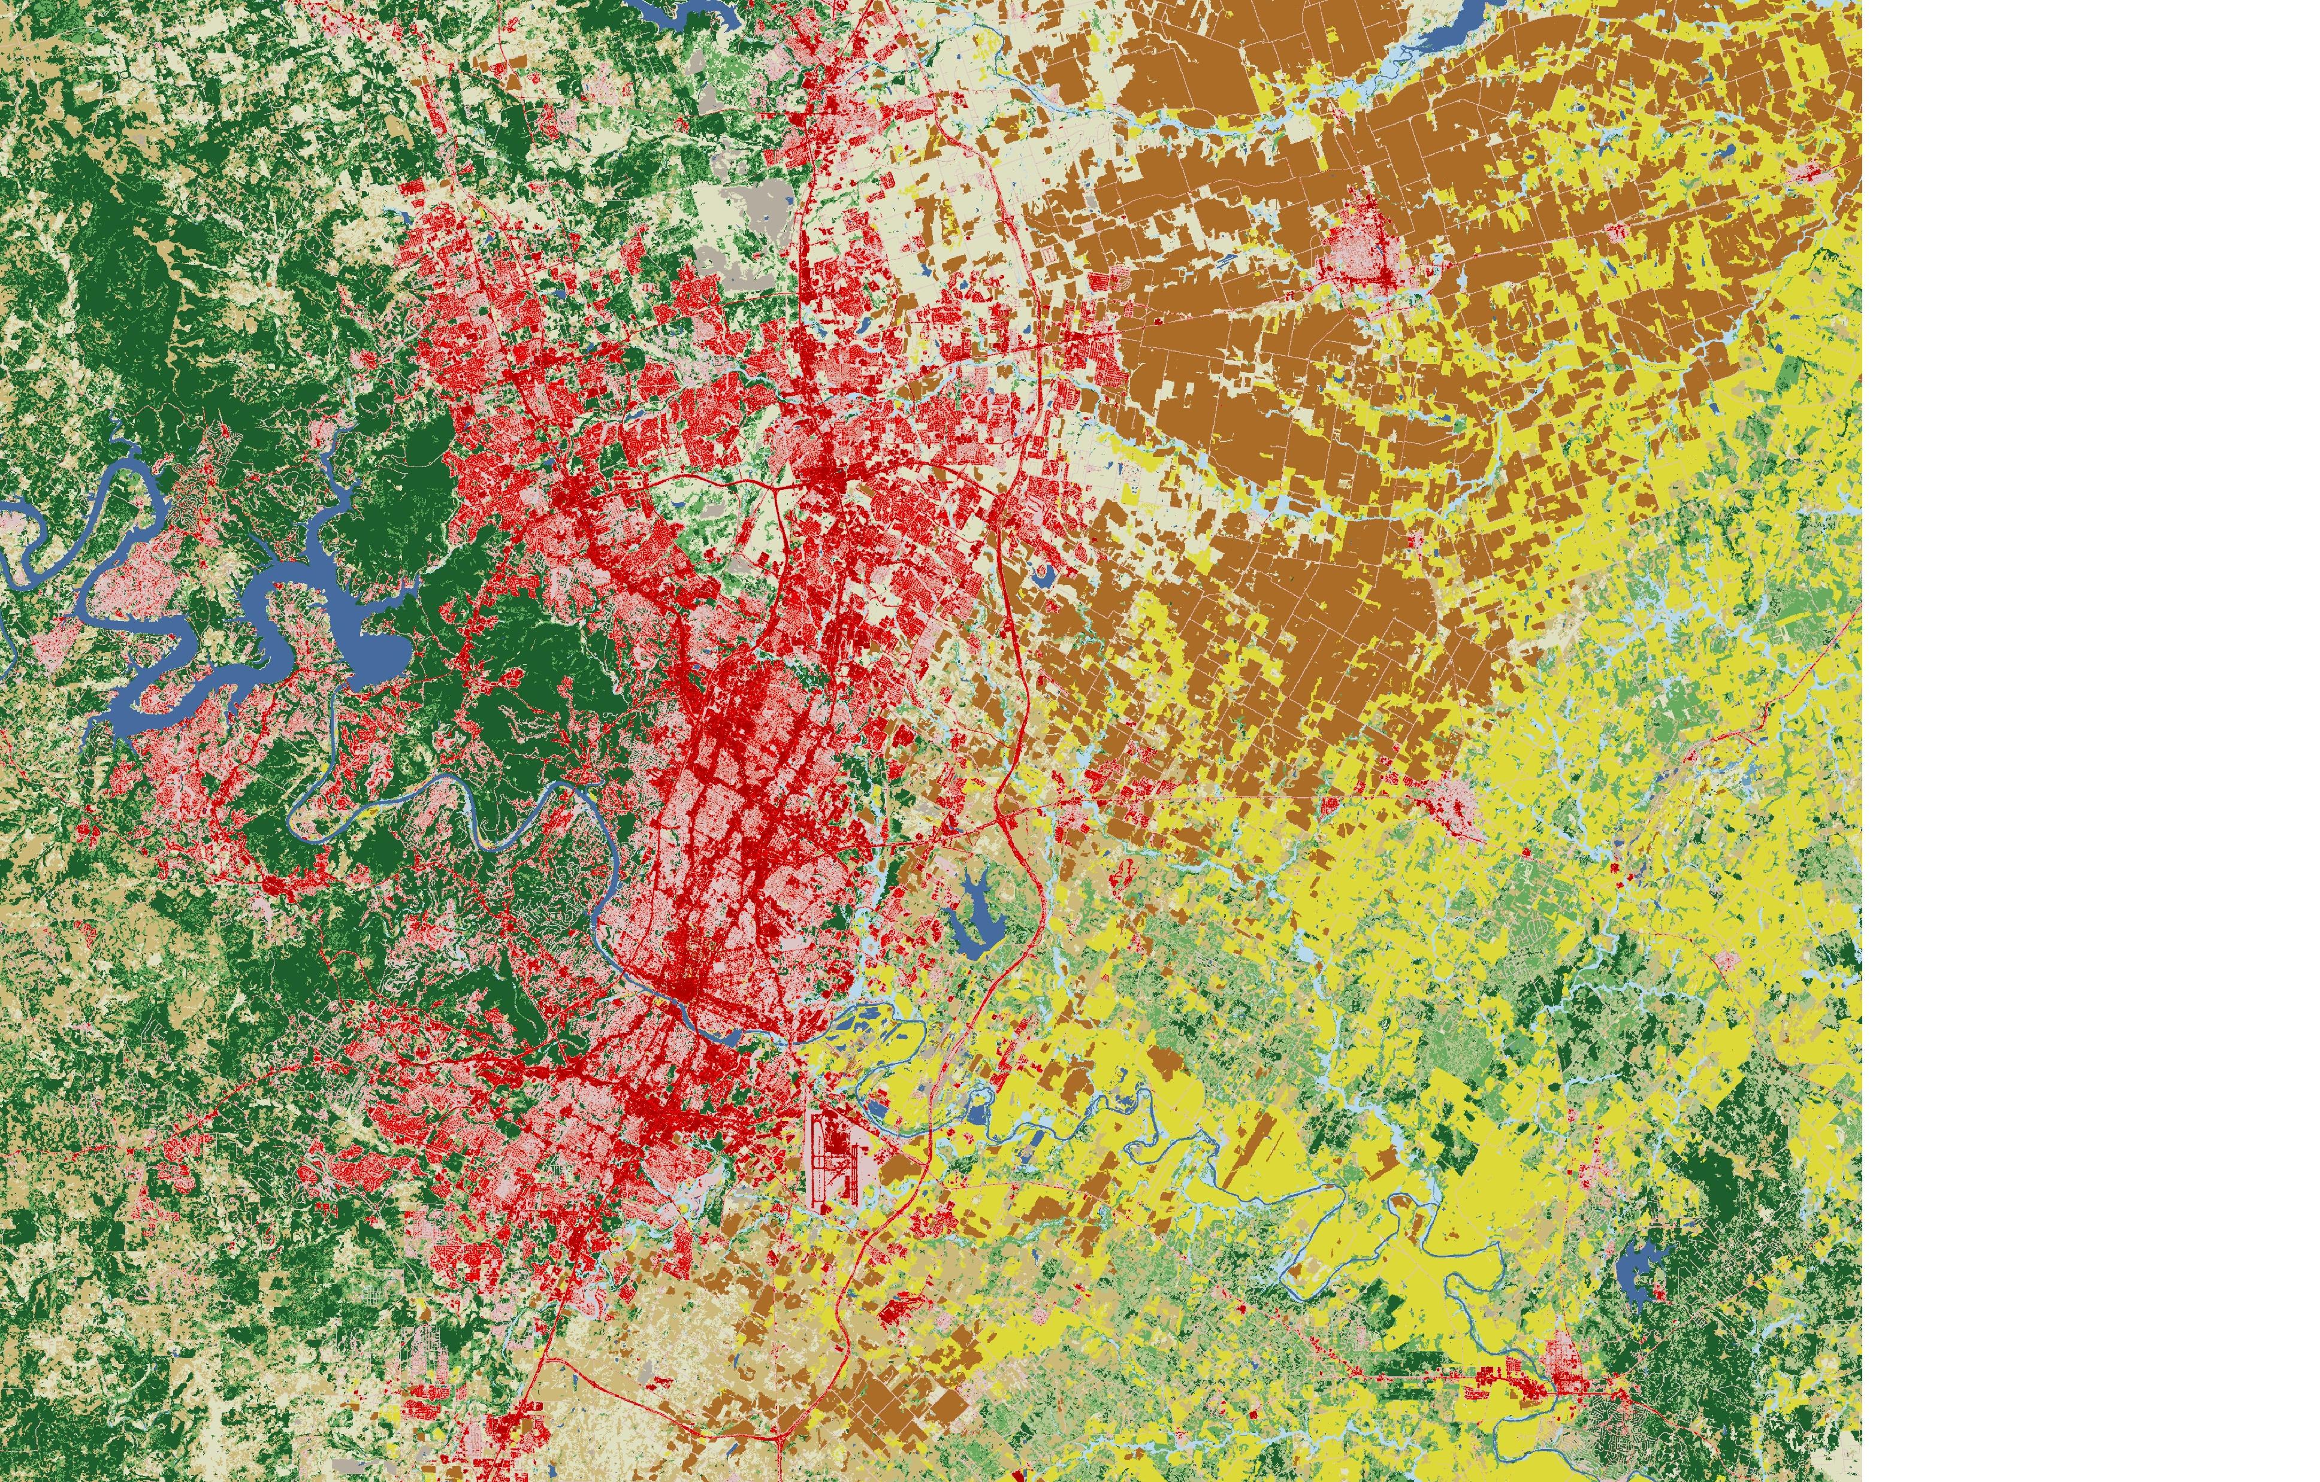
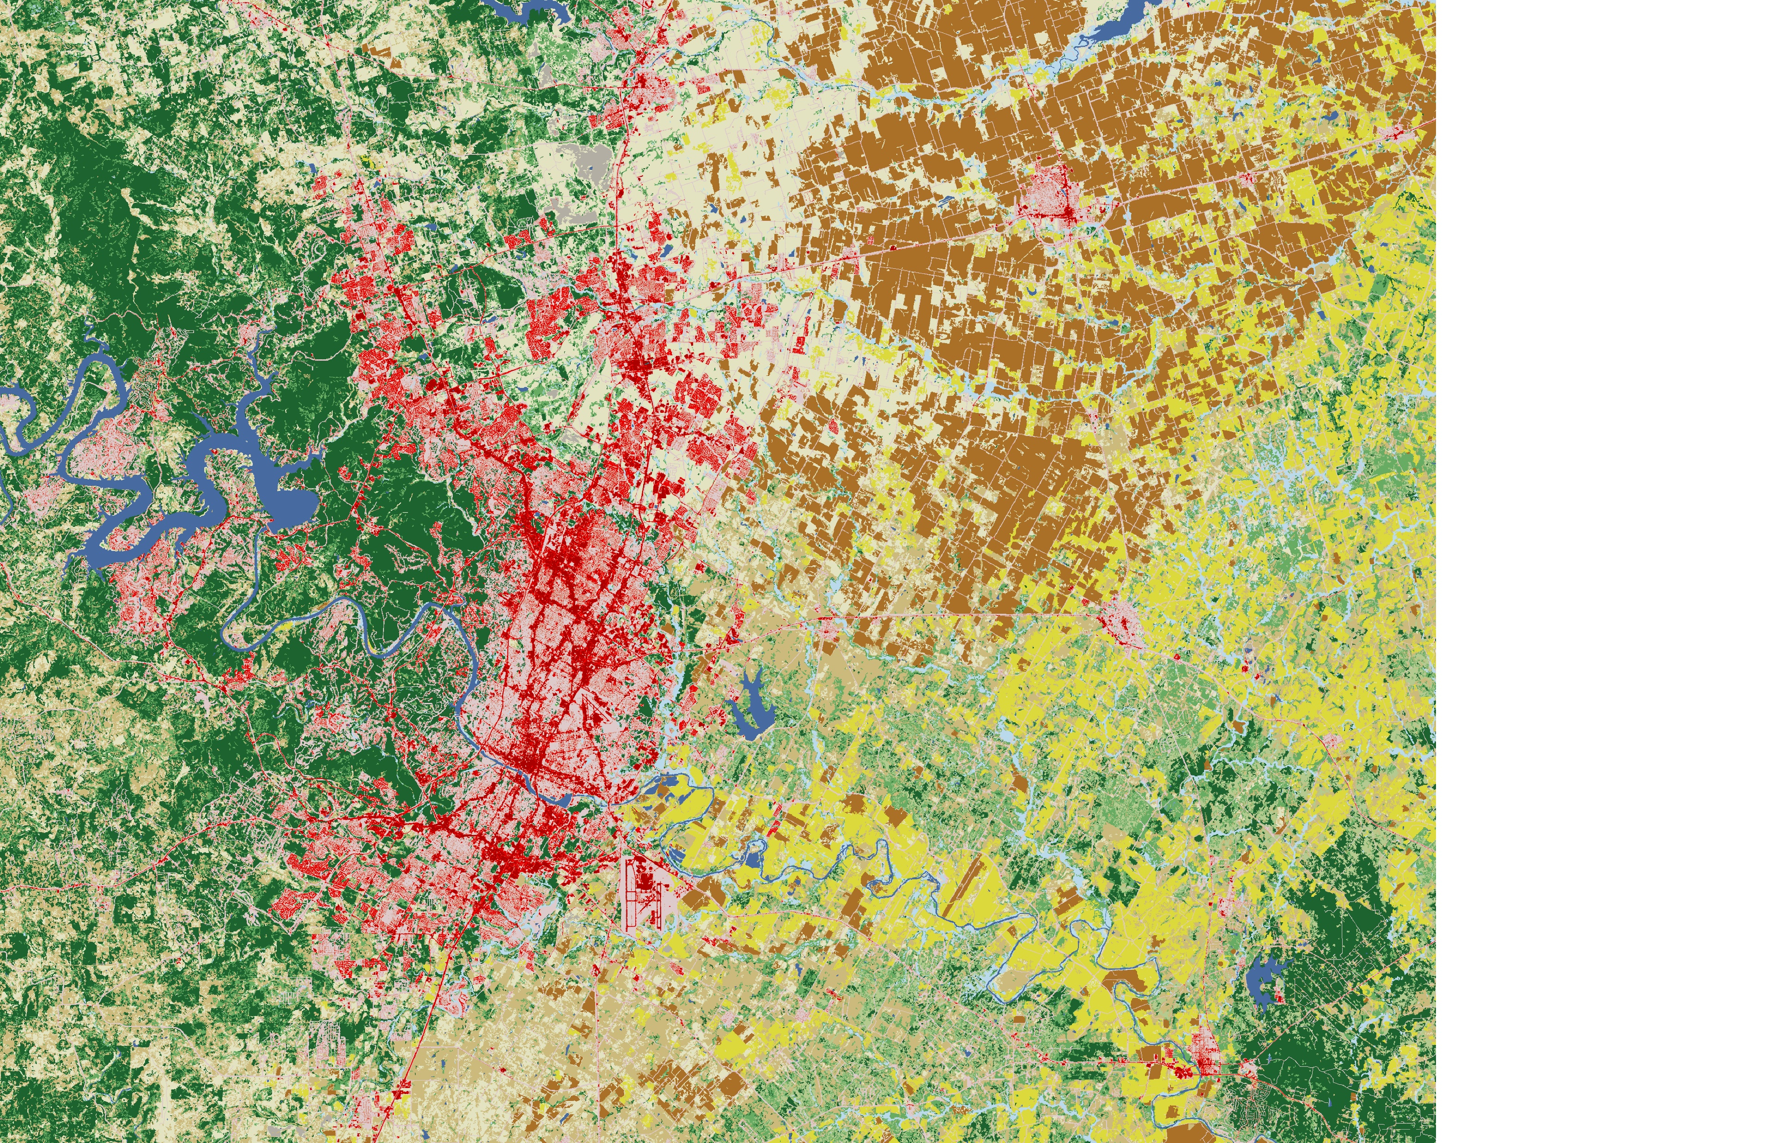
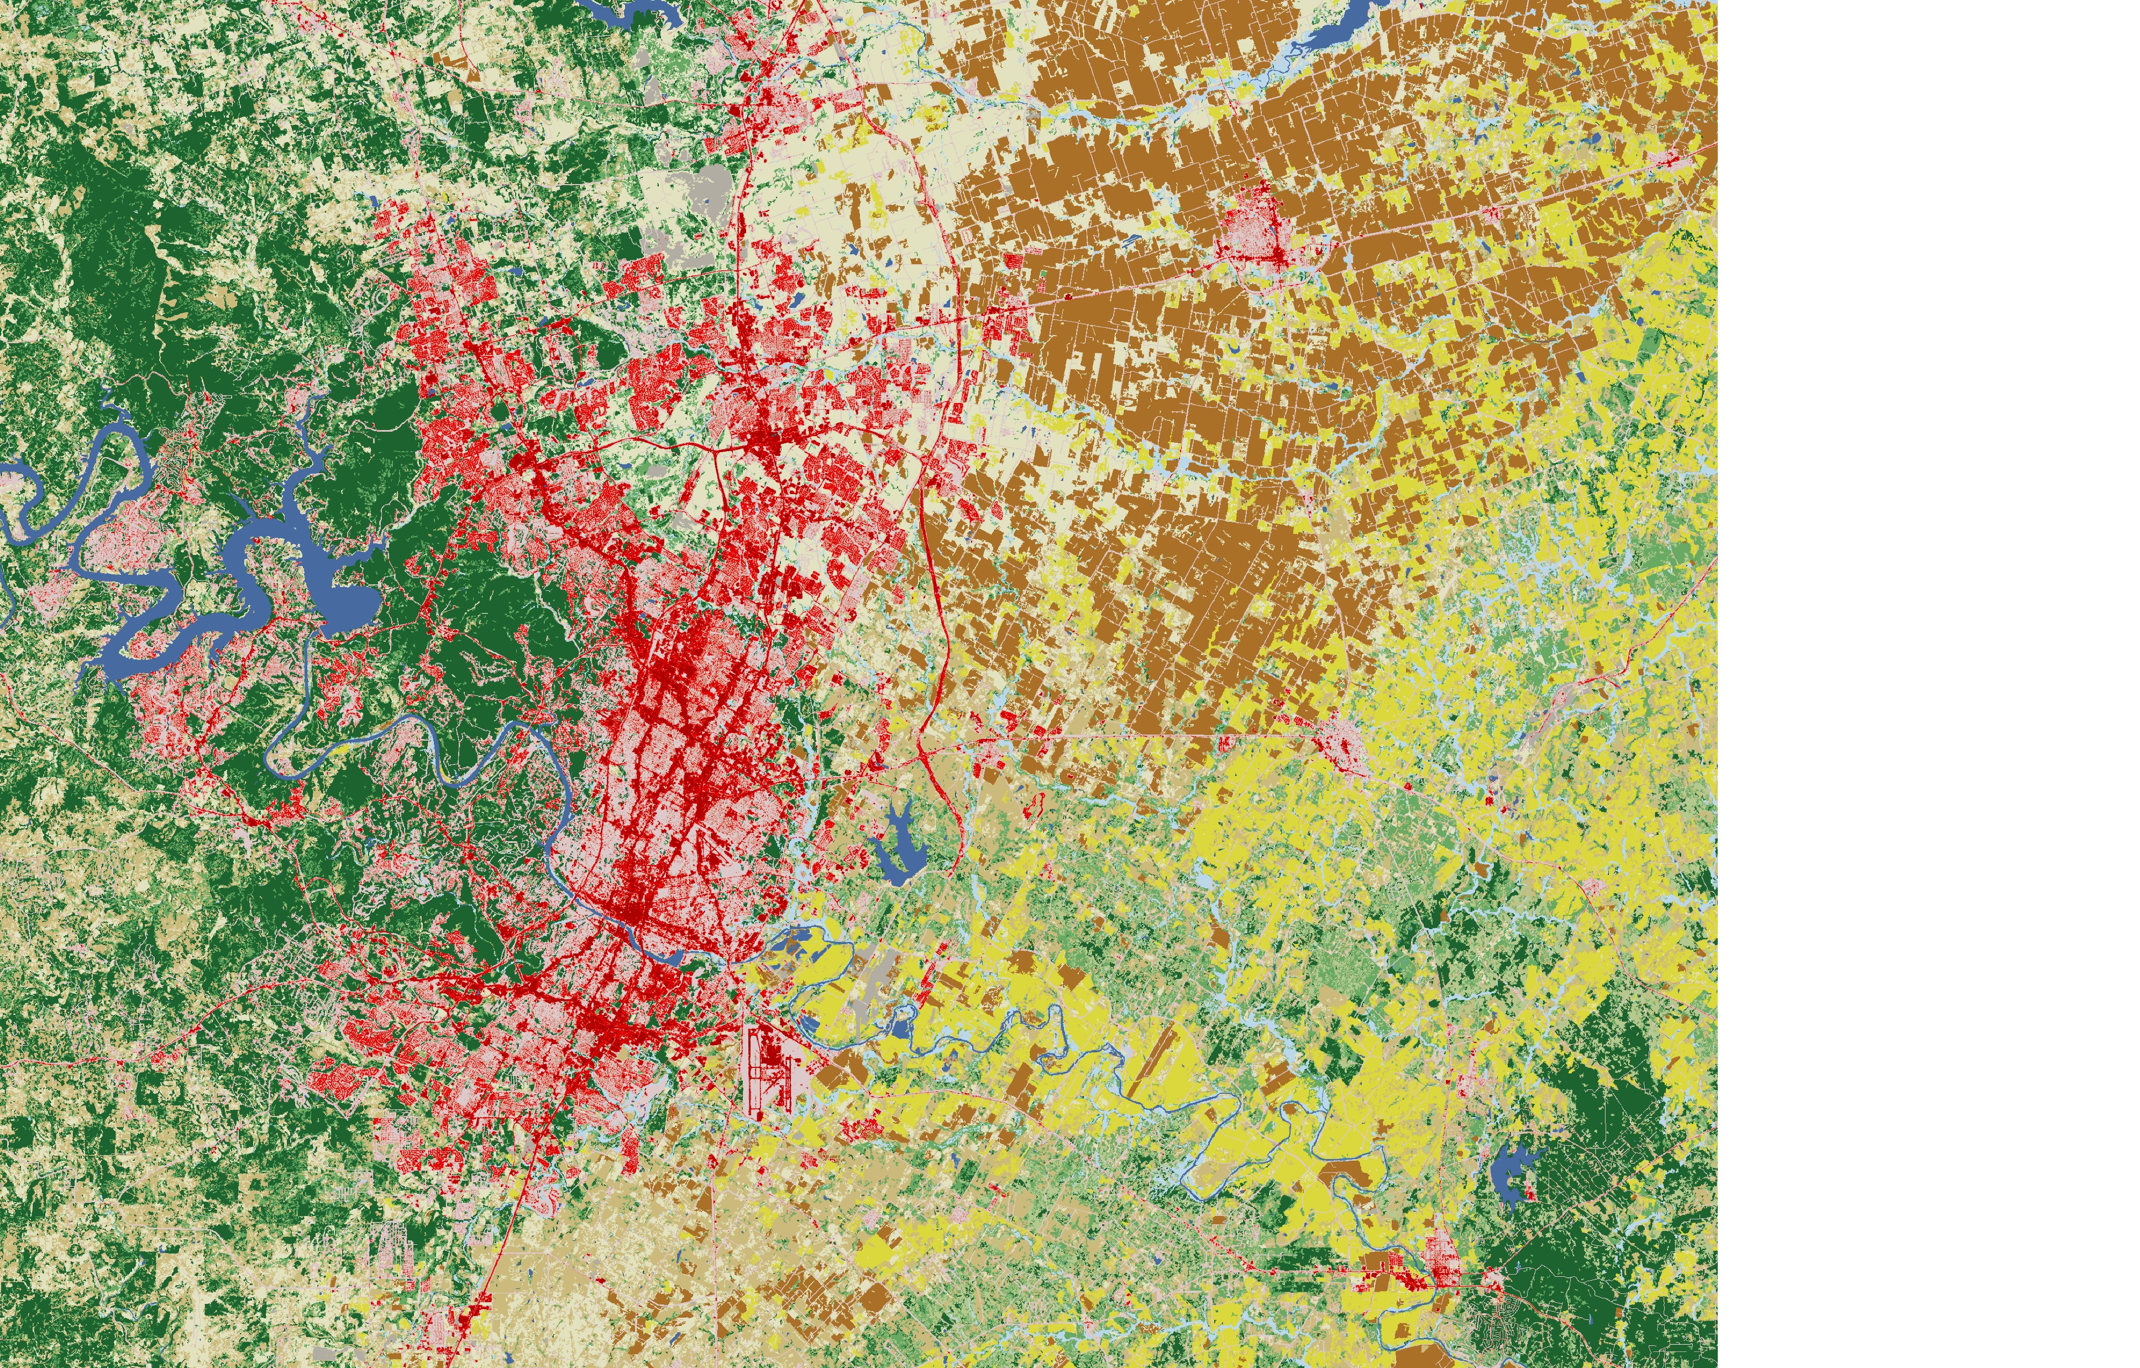
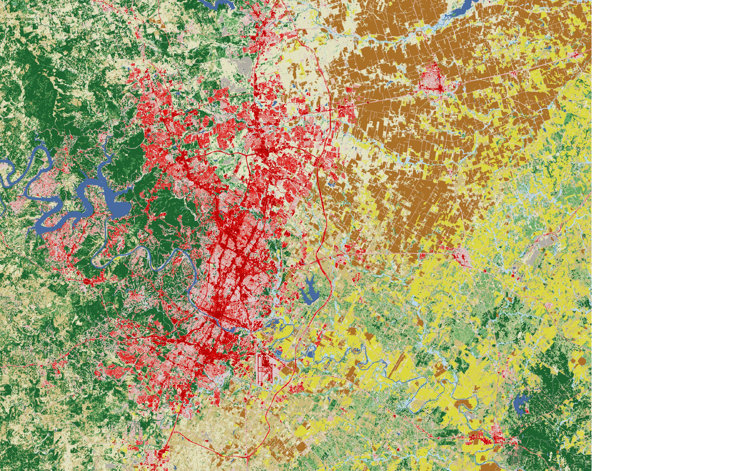
Urban Land Change (ULC):

Slide 4
Urban Land Change (ULC):
Data
National Land Cover Database (NLCD)
Available for ‘01, ’04, ‘06, ’08, ‘11, ‘13, ’16
16 Land Cover Classes + Imperviousness + Tree Canopy
ULC Metrics
Urban Expansion – physical conversion from undeveloped or natural land cover to developed.
Development Density – residential population over acres of developed land
Land Intensification – the qualitative change of developed landscapes based on imperviousness and tree canopy

Slide 5
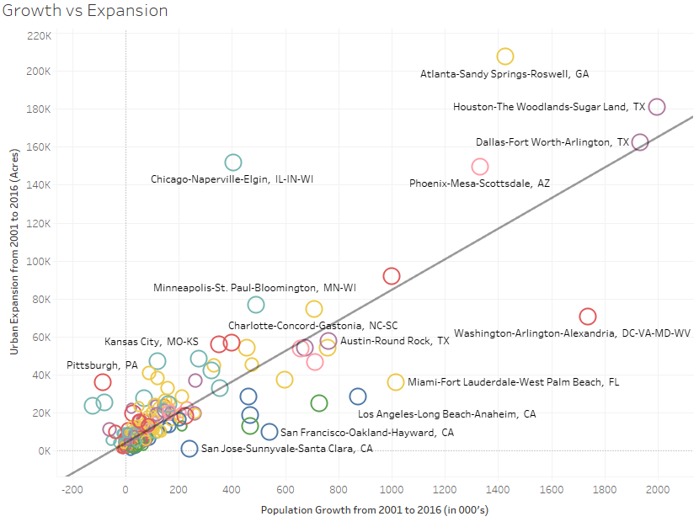
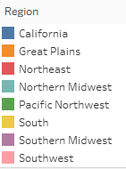

Slide 6
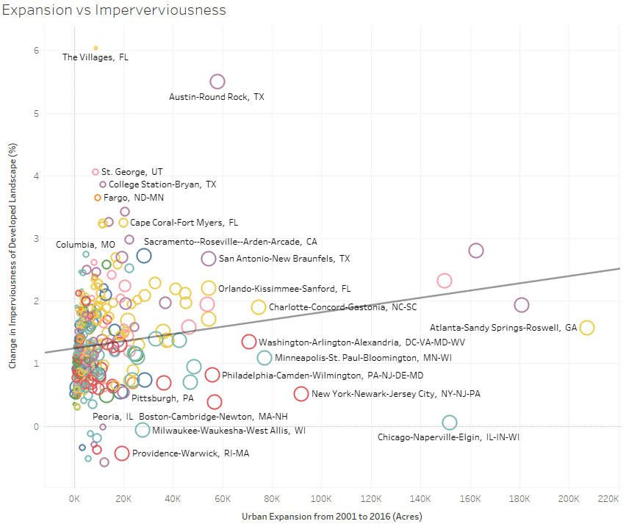

Slide 7
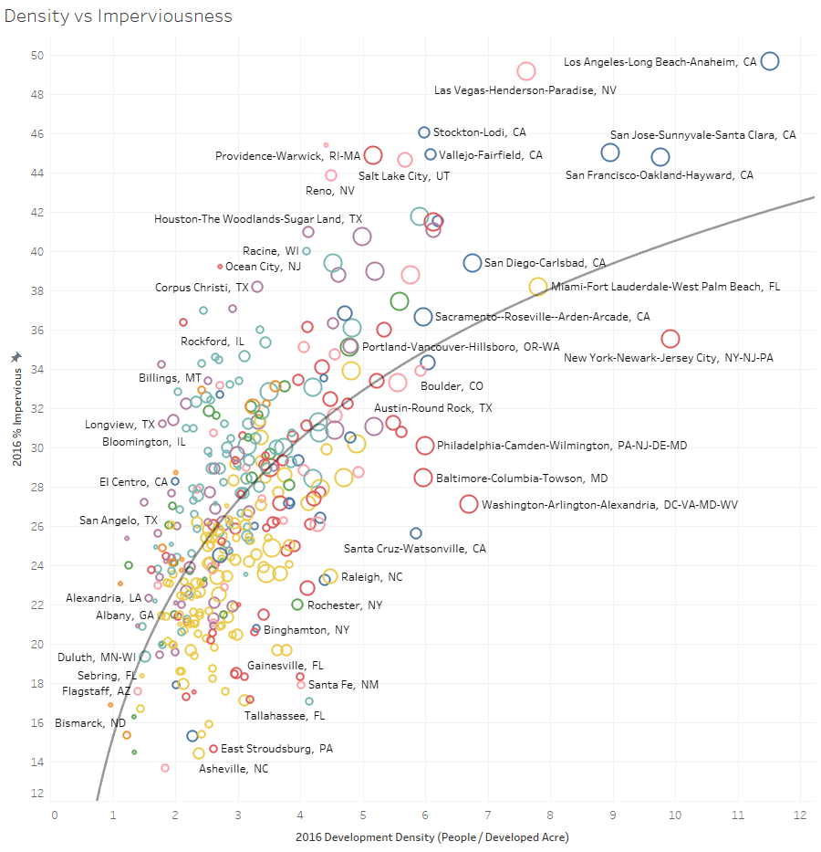

Slide 8
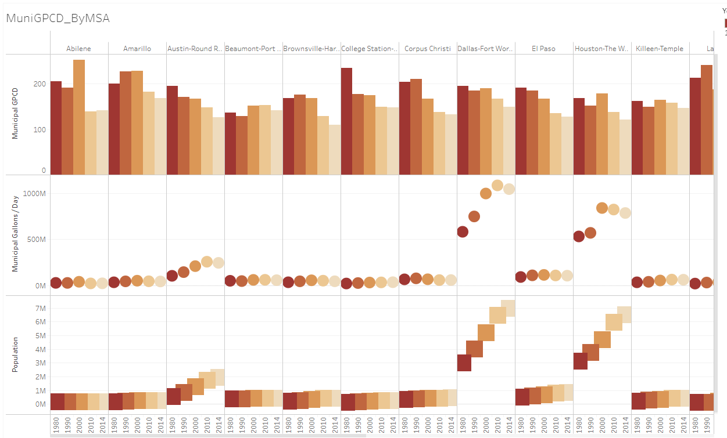
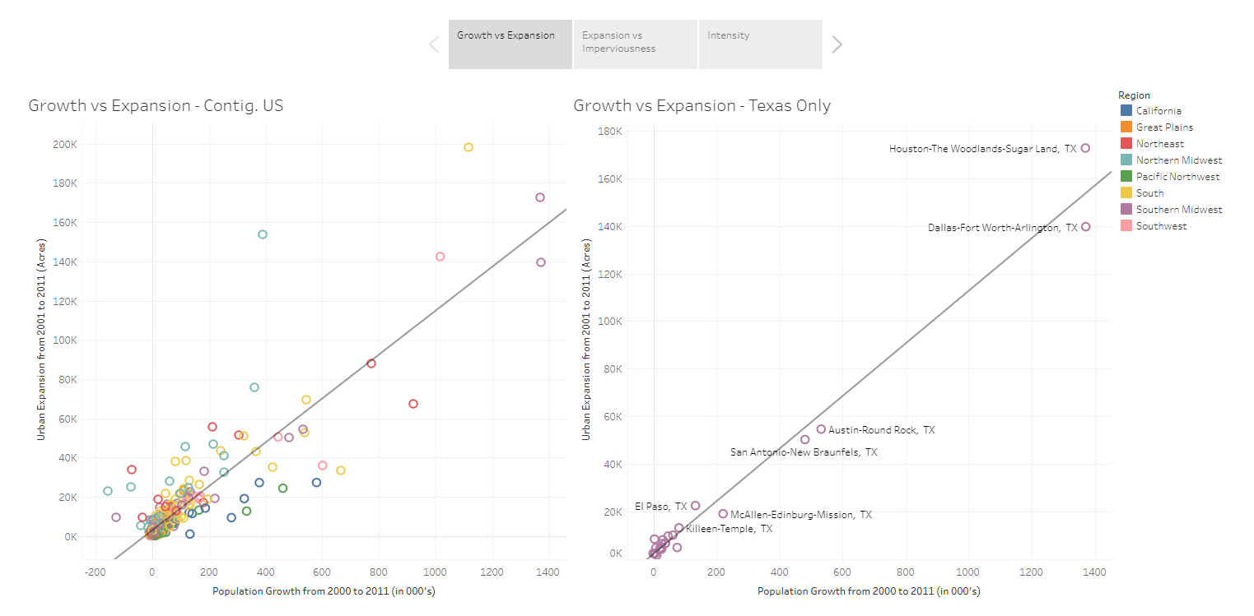
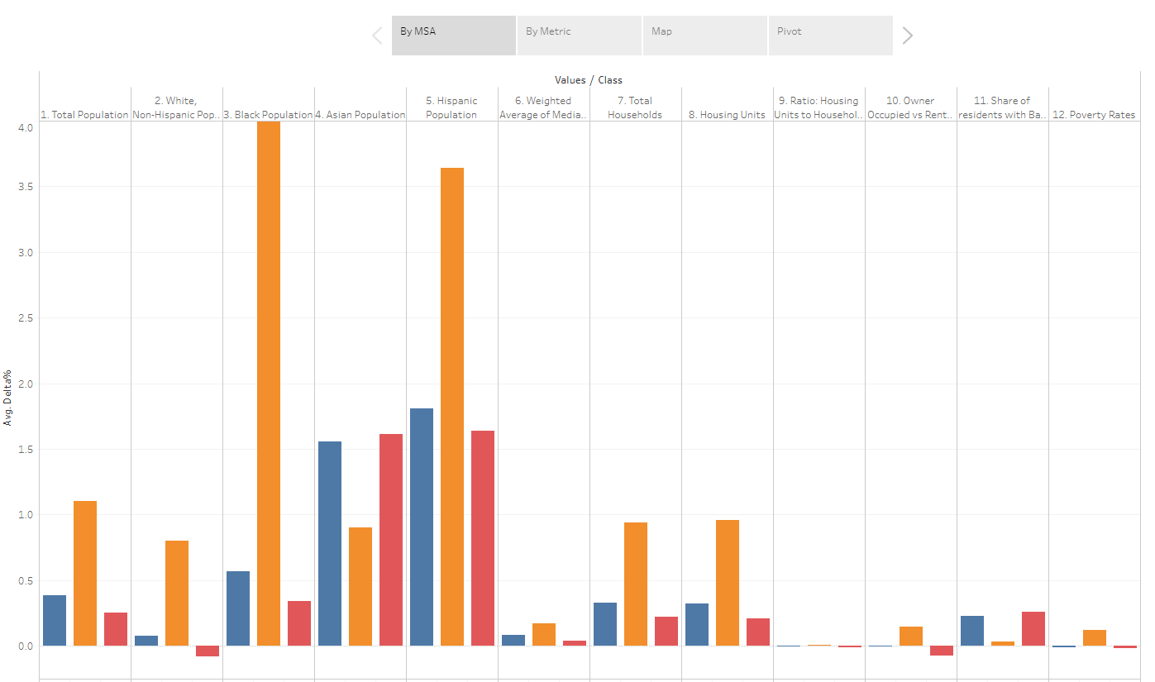
TMO Indicators Report – Coming Soon
What to expect:
Chapters on Water, Land, People, Governance, & Buildings
Interactive Web Dashboards
Integrated Database available via DataX
Thank you!

