Slide 1
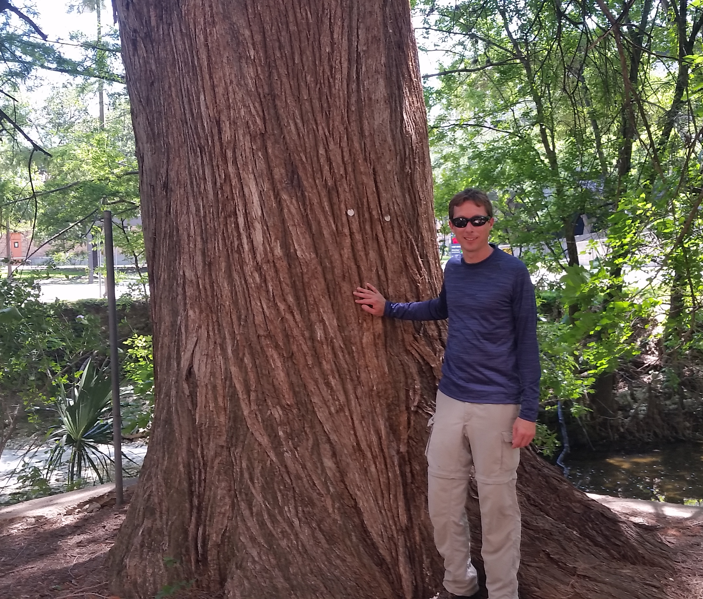
Dendrochronological indicators of drought and urbanization in riparian zones
Bryan Black¹, Jay Banner², Rosemary Burkhalter-Castro³, Lakin Beal², Julia Holland²
  ¹Laboratory of Tree-Ring Research
  University of Arizona
  ² University of Texas at Austin
  Jackson School of Geosciences
  ³ REU student, Eckerd College

Slide 2
Dendrochronological indicators of urbanization in riparian zones
Urbanization signal: leakage of city water into streams
Freshwater and riparian systems lack long-term observational records
Bald cypress: could provide spatial and temporal depth
-widely distributed and abundant
-provide at least 100 yr growth records

Slide 3
Dendrochronological indicators of urbanization in riparian zones
Hypothesis: At Waller Creek, city water buffers bald cypress from impacts of drought. These trees will become less sensitive to drought from 1900 to present as leakage increased over time. Also, trees are less limited by environmental variability (and thus asynchronous in growth) than trees at natural sites.

Slide 4
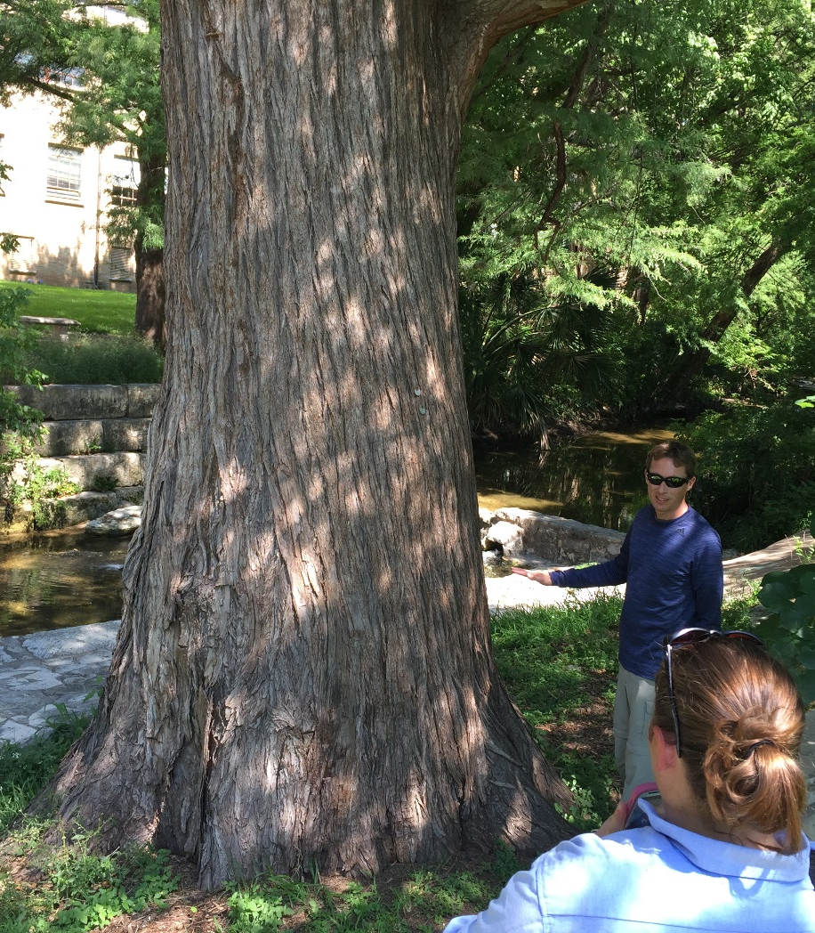
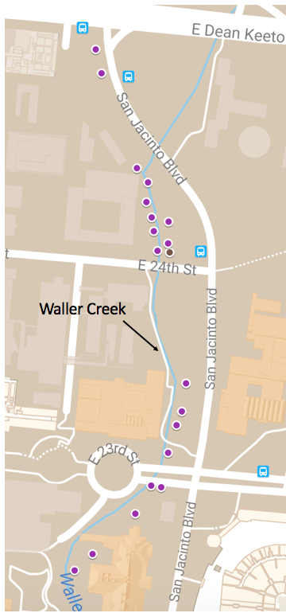
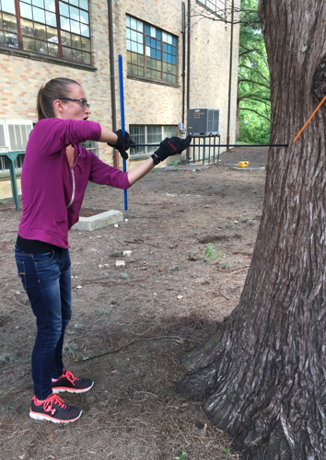
Waller Creek Sampling
Two cores from 20 trees

Slide 5
Crossdating
Critical for data quality
Trees cored in year 2009
most recent increment
(formed in 2009)
Tree 1
to tree center
1990
1995
2000
2005
2009
Tree 2
1995
2005
2009
1990
2000
Tree 3

Slide 6
Measure and remove age-related growth declines (detrend)

Slide 7
All detrended Waller Creek tree cores

Slide 8
Waller Creek chronology

Slide 9
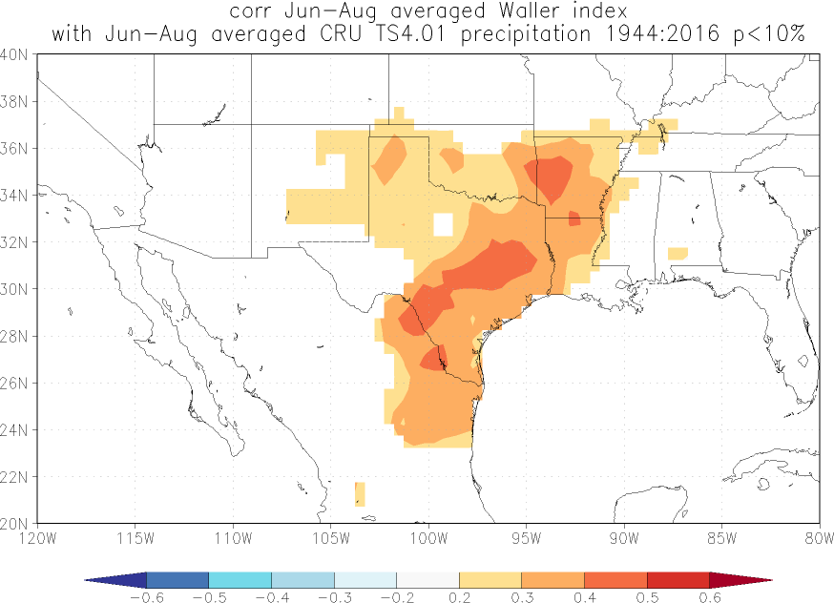
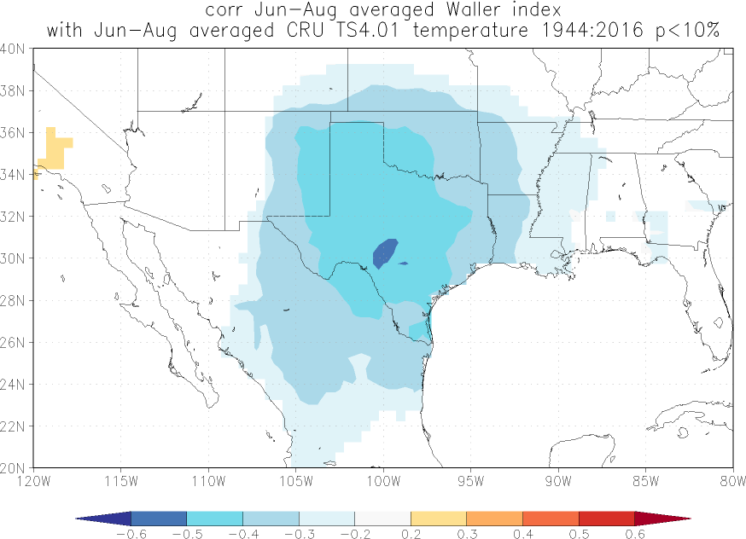
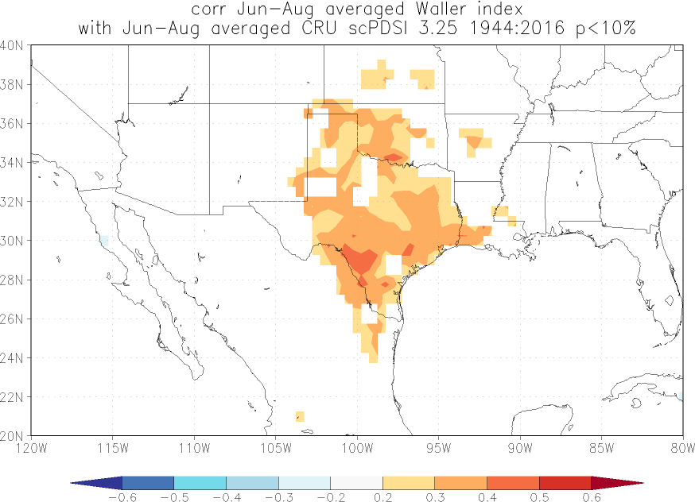
Waller cypress: correlation with summer (Jun-Aug) climate
Summer precipitation
Summer temperature
Summer drought (PDSI)

Slide 10
Hypothesis: correlation with climate will decrease over time
Running correlation between Waller chronology and regional drought; 21-year window

Slide 11
Waller and two other cypress chronologies

Slide 12
Hypothesis: correlation with other sites will decrease over time
Running correlation between Waller chronology and Krausse chronology; 21-year window

Slide 13
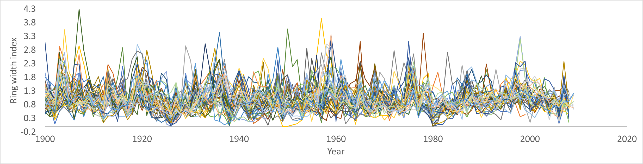
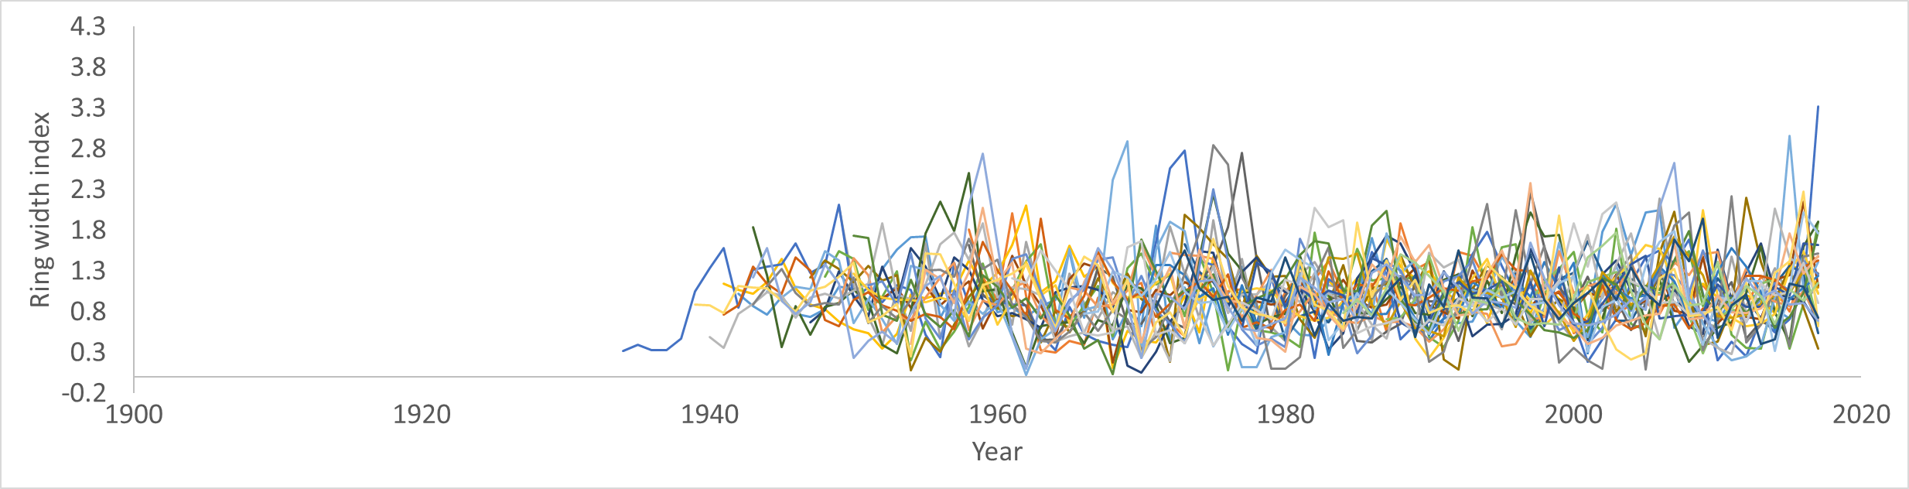
Waller Creek growth and Krausse Springs growth
Krausse (synchronous among trees)
Waller (asynchronous among trees)

Slide 14
Initial plan: sample cypress along Waller Creek (urban) and Onion Creek (control)
Hypotheses:
Waller Creek trees will become less sensitive to drought from 1900 to present
  2) Climate-growth relationships will be stable at Onion Creek
  3) Growth among trees will be much more synchronous at Onion Creek

Slide 15
Initial plan: sample cypress along Waller Creek (urban) and Onion Creek (control)
Going forward….
Could be broadly applied as indicator of urbanization
Are there urbanization strategies that minimize this effect?
Quantify the impacts of “urban leakage” on riparian forests
-may reduce susceptibility to drought and increase resilience

Slide 16
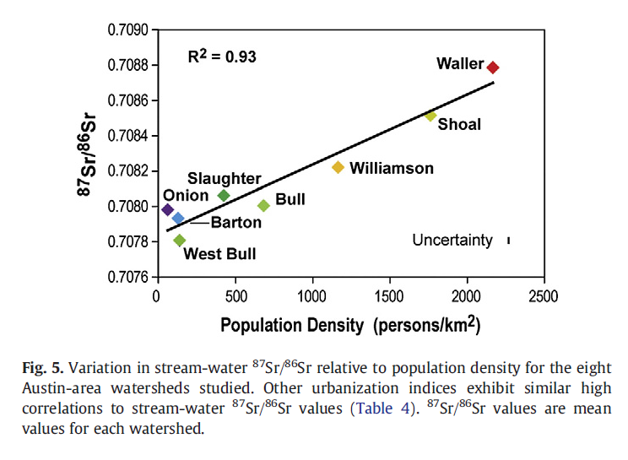
Additional steps….
Sr isotopes differ between ground water and city water
(Christian et al. 2011)
Are these signatures
evident in the tree
cores?
Is there are change
over time in urban
sites?

Slide 17
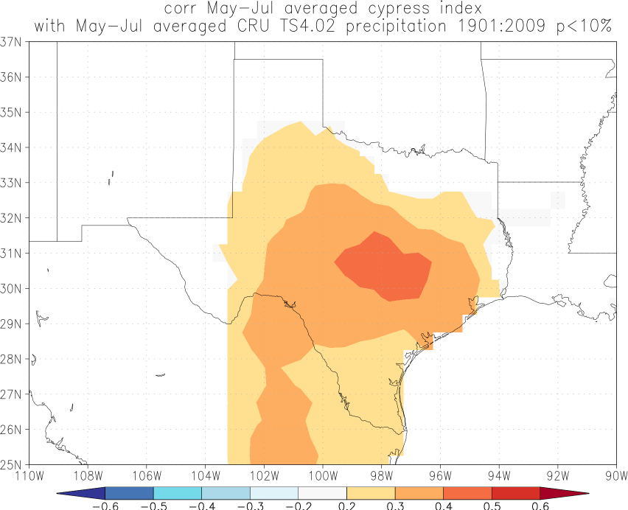
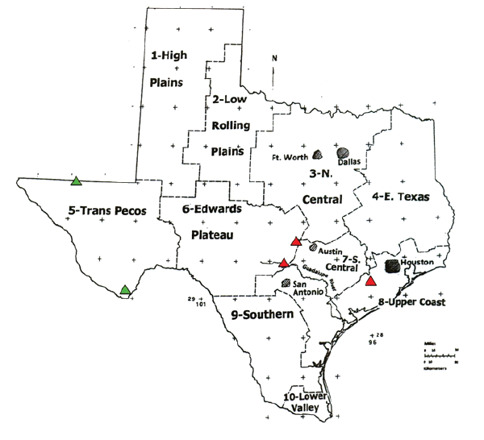
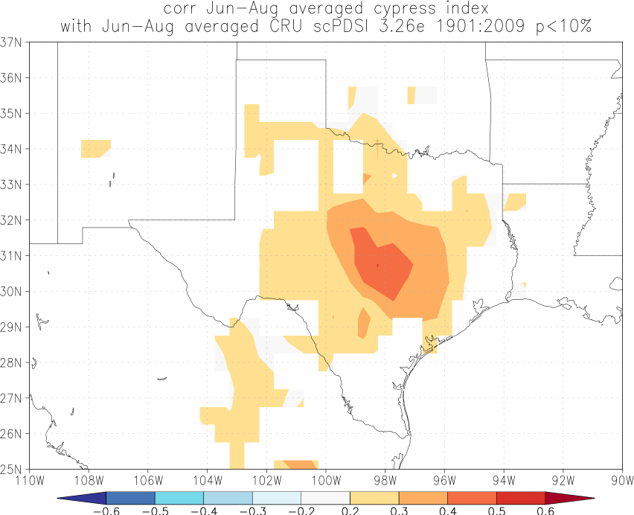
Tree-ring drought reconstructions in TX
Summer precipitation
Summer drought (PDSI)

Slide 18
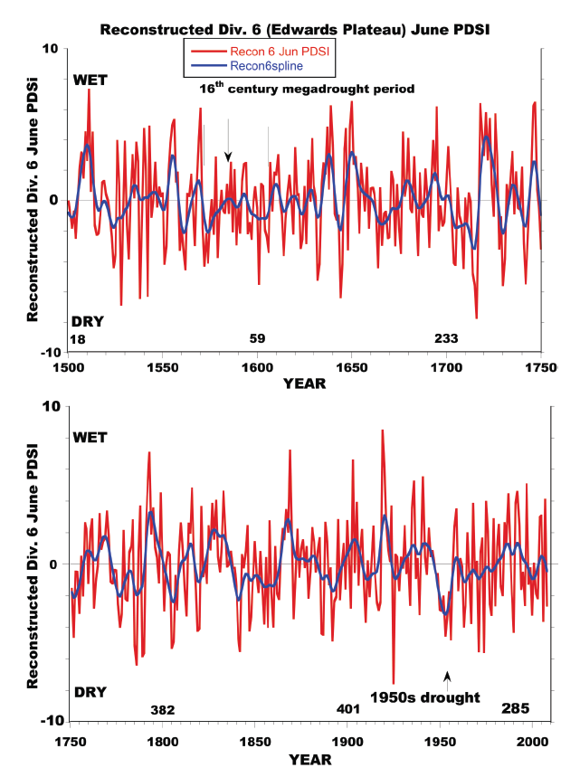
Tree-ring drought reconstructions in TX
Cleaveland, Votteler, Stahle, Casteel, and Banner. 2011. Extended Chronology of Drought in South Central, Southeastern and West Texas. Texas Water Journal 2:54-96.

Slide 19
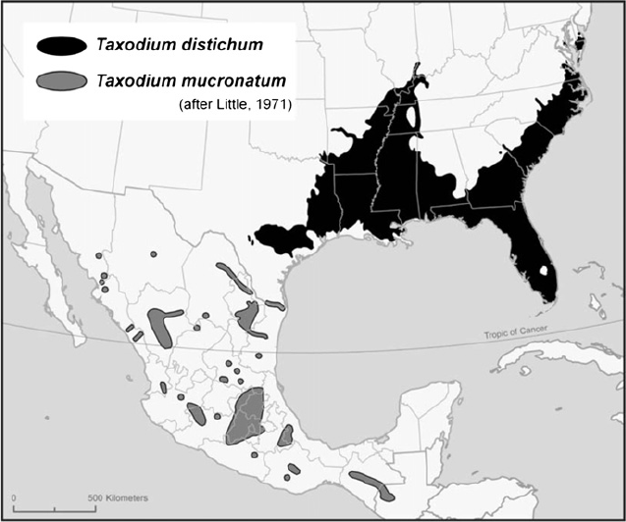
Natural distribution of bald cypress

Slide 20
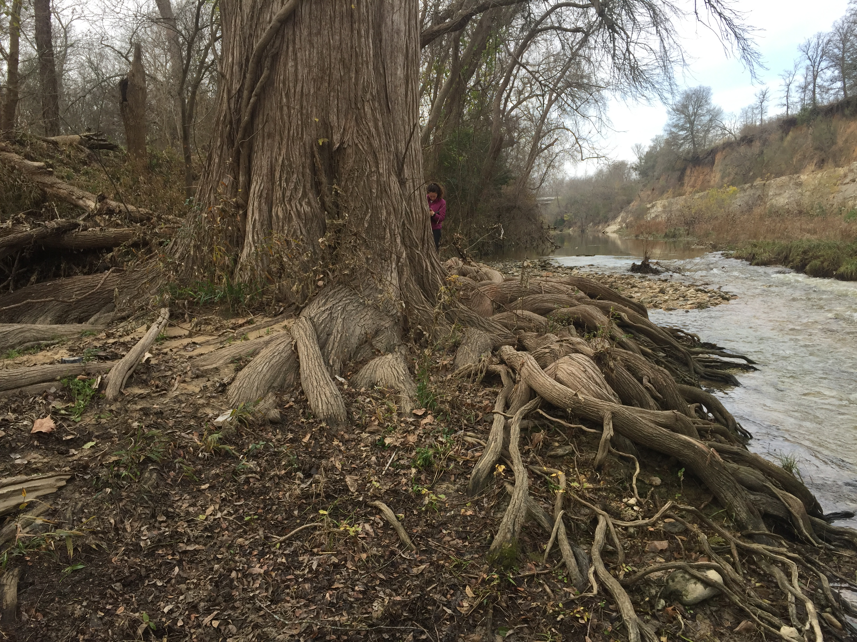
Future work
Onion Creek: extend back in time (2600 yr old bald cypress in North Carolina)
Other isotopes in trees: ¹⁸O
Earlywood and latewood widths
Maximum latewood density (blue light)
Integrate with speleothems

Slide 21
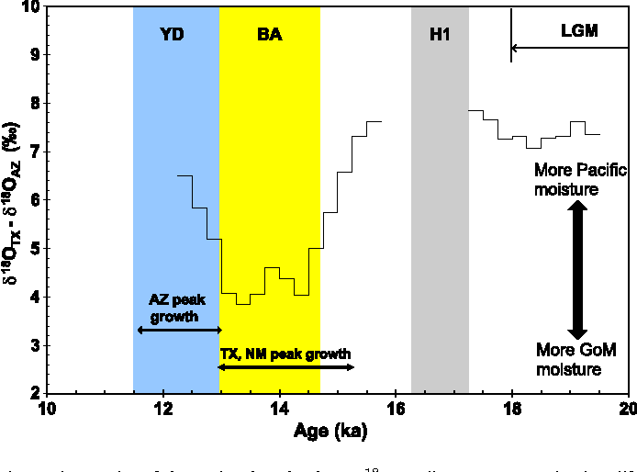
Source water into Texas: Pacific or Gulf of Mexico?
Feng et al. 2014. Changing amounts and sources of moisture in the U.S. southwest since the Last Glacial Maximum in response to global climate change. Earth and Planetary Science Letters. 401:47-56
Fig. 5. Time series of the regional speleothem δ18O gradient, constructed using differences between CWN-4 and COB-01-02 averaged δ18O values for 250-yr intervals. Temporal variations in the gradient are interpreted to reflect the changing balance between Pacific and GoM moisture sources. The reduced gradient during the period 15.5 to 13 ka indicates enhanced GoM moisture transfer to these regions.

