Slide 1
Prospects for Managed Aquifer Recharge Applications in Texas
JUNE Mirecki, Ph.D., PG
Us army Corps of engineers – Jacksonville fl
TEXAS WATER resource NETWORK CONFERENCE
30 May 2019

Slide 2
Managed Aquifer Recharge: Definitions
As proposed by the Texas Water Development Board:
Enhanced surface infiltration – raise surface water levels to enhance infiltration in surficial aquifers, or use spreading basins
Vadose zone well infiltration – recharging the surficial aquifer with wells
Well injection – Aquifer Storage Recovery (ASR) with recharge and recovery into (ideally) a confined permeable zone using one or more wells. Aquifer Storage Transfer Recovery (ASTR) is where water is transferred between two different areas or aquifers.

Slide 3
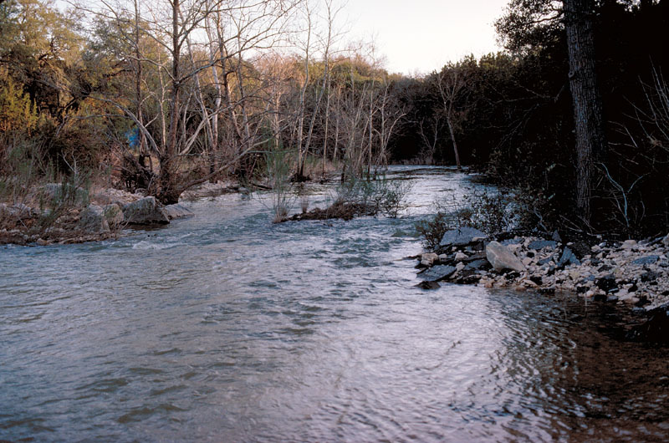
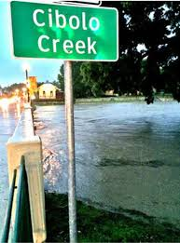
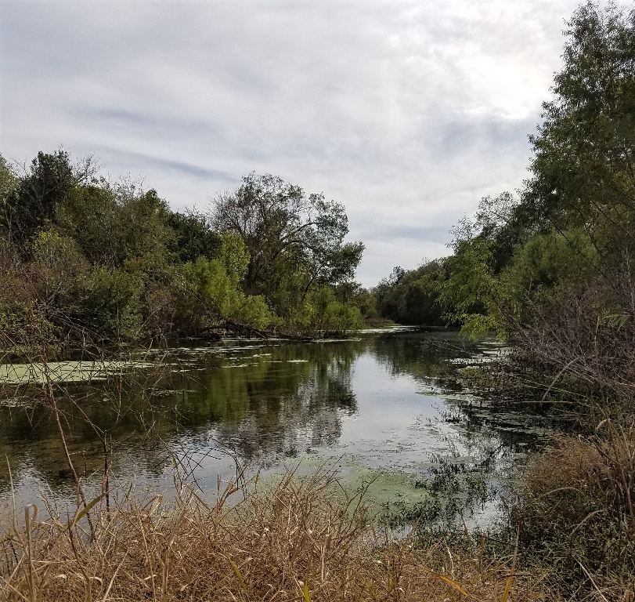
Enhanced Surface Infiltration: Cibolo Creek Watershed
Addition or improvement of water control structures on the creek to raise and impound surface water
Recharging the Trinity Aquifer and Edwards Aquifer in the outcrop areas north of San Antonio
Cibolo Creek in Edwards Aquifer recharge area
Near Boerne, TX
Near Cibolo, TX

Slide 4
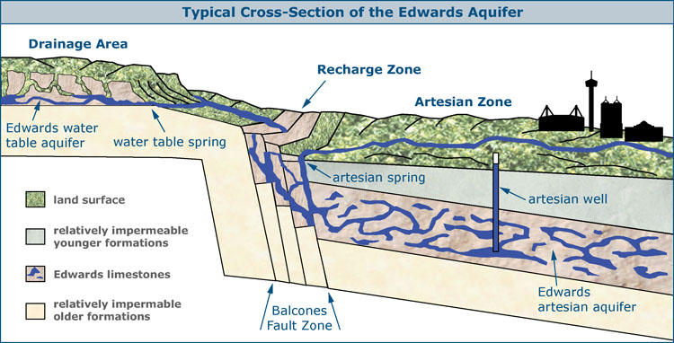
Enhanced Infiltration, Peak Flow Reduction, with Minimum Surface Inundation!
Dam structures in Edwards Aquifer outcrop area increase aquifer recharge
Dams will attenuate peak flow
Must ensure flood risk reduction in a larger inundated area

Slide 5
Simulations of Recharge Scenarios
Show Favorable Results
Hypothetical structures along main channel enhance recharge in the Trinity and Edwards Aquifer outcrop areas, upstream of Selma
  77% increase to the Trinity Aquifer
  13% to the Edwards Aquifer
  Structures along main channel reduce peak flow during storms
  This study is still in feasibility phase, not implemented.
Ockerman (2007) USGS SIR 2007-5202

Slide 6
ASR and ASTR Pros and Cons
Benefits
No evaporative losses
Real estate requirements are small in comparison to reservoirs
“Bank” wet season flows to maintain dry season requirements
  Ecosystem restoration
  Maintain surface water minimum flows and levels
Challenges
Water-rock interactions can exceed drinking water standards – arsenic, disinfection by-products
ASR alone cannot be used for flood control – need a “surge tank” to capture peak flows
Recharge occurs through wells with long screened intervals, lower recharge capacity
O & M costs are relatively high
Multiple permitting and compliance reporting required. TCEQ for surface water and groundwater conservation districts in Texas
Texas water law is unresolved regarding movement of groundwater and “ownership” of groundwater

Slide 7
Active and Proposed ASR and ASTR Systems in Texas
Active ASR Systems
El Paso ASR/Managed Aquifer Recharge (1985)
Twin Oaks ASR Facility at San Antonio
  Water System (2004)
  City of Kerrville ASR Facility (1993)

Slide 8
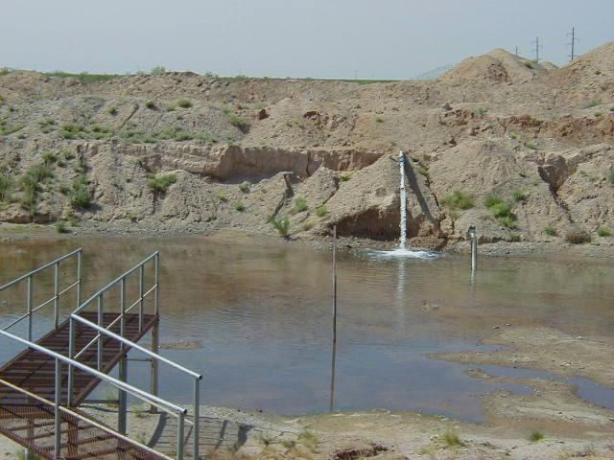
El Paso Water Hybrid ASR/MAR
Source water is reclaimed water treated to drinking water standards
Source water recharges the Hueco Bolson Aquifer
Recharge originally used injection wells, but system is now augmented with infiltration basins – 10 million gallons per day
Recovered water serves as cooling water for power generation
Bureau of Reclamation Feasibility Study (2019) to expand MAR using enhanced arroyo infiltration
  Expand wetland habitat in Chihuahuan desert
  4,500 ac-ft/year of new potable water supply
  Target is 3 to 10 percent of total water supply

Slide 9
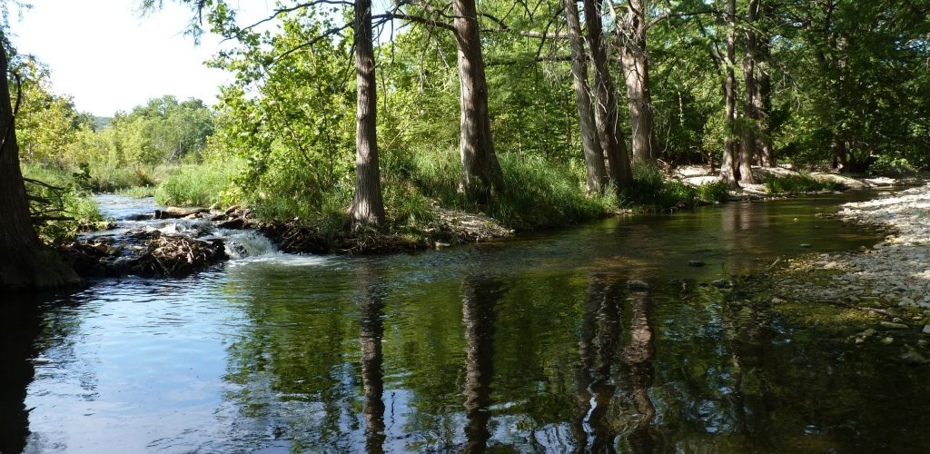
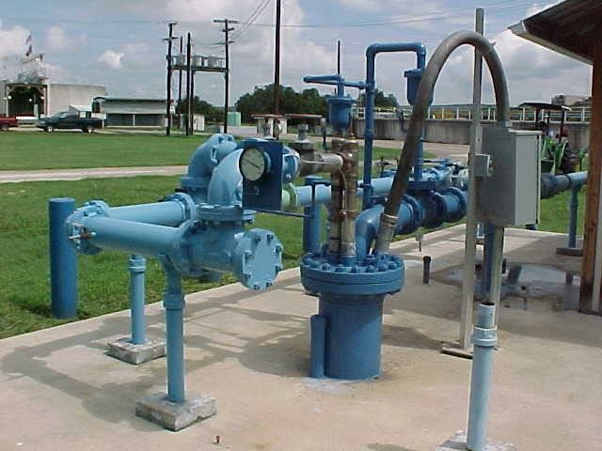
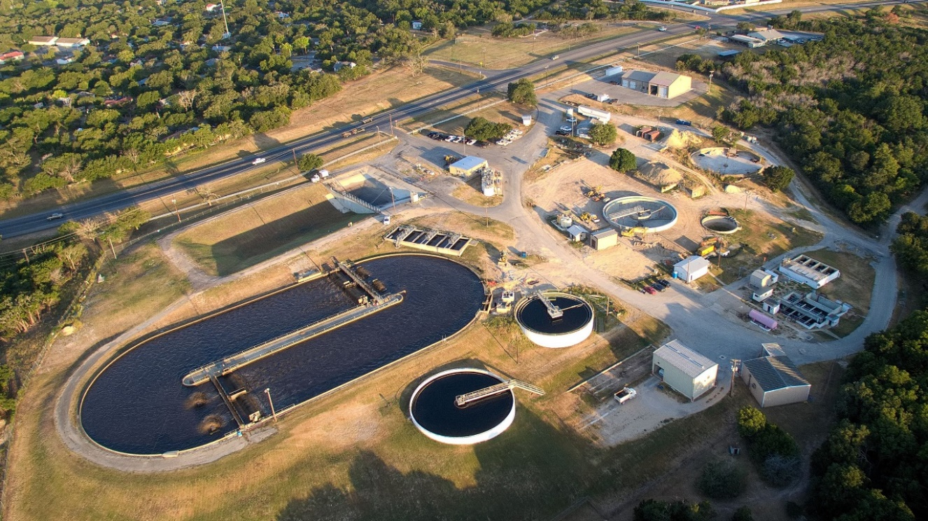
City of Kerrville ASR Facility
Source water is treated Guadalupe River surface water
Storage is in the Hosston-Sligo Formation of the Trinity Aquifer using three ASR wells having a well capacity of 3.65 million gallons per day (mgd)
Target storage volume is 4,600 ac-ft (1.5 billion gallons)

Slide 10
City of Kerrville ASR System Net Storage Volume
Recharge from September to May
Recover from May to September
ASR system is expanding to three wells
April 1, 2019 1.0 billion gallons in storage (300 days of water for Kerrville)
Approaching target storage volume in 2018 (1.5 billion gallons)
1 well system
1.7 mgd
2 well system
2.7 mgd
Net Storage September 1998 to September 2018 (from City of Kerrville)

Slide 11
H₂Oaks Facility at San Antonio Water Supply
Source water is excess treated groundwater from the Edwards Aquifer
  SAWS has 250,000 ac-ft (81.5 billion gallons) annual allocation
Edwards Aquifer groundwater is conveyed 38 miles to the H₂Oaks facility for recharge
Recharge occurs using 29 ASR wells (3rd largest ASR system in US)
  60 million gallons per day recharge capacity
Storage zone is the Carrizo Aquifer
Groundwater recovered from Carrizo Aquifer is treated for potability
SAWS H2Oaks Facility Wellfield in southern Bexar County

Slide 12
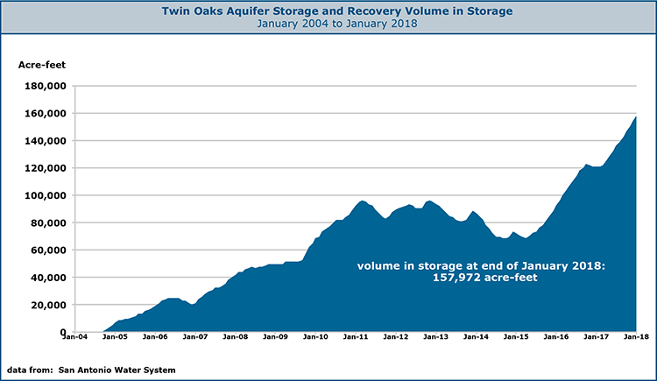
SAWS ASR System Performance
ASR system formerly used to meet peak seasonal demands
ASR system now used for long-term drought management.
Approximately 160,000 ac-ft in storage ( 51.5 billion gallons) as of January 2018
Net Storage January 2004 to January 2018

Slide 13
Future ASR System Projects in Development
Edwards Aquifer Authority: New Braunfels ASR Demonstration Project
Victoria County Groundwater Conservation District/City of Victoria Demonstration ASR Project
Corpus Christi Aquifer Storage and Recovery Conservation District
City of Buda ASR project

Slide 14
New Braunfels ASR Demonstration Project
Source water is a blended mix of treated ground and surface water sources (pending 2019 legislative approval)
Recharge will occur in the brackish portion of the Edwards Aquifer (TDS < 4,000 mg/L) near airport
ASR exploratory boreholes completed at the airport, as are monitoring well design and construction (April 2019)

Slide 15
Victoria County Groundwater Conservation District - City of Victoria Demonstration ASR
Source water is treated surface water from City of Victoria WTP
Recharge by converting an existing production well to an ASR well
Evangeline Aquifer of Gulf Coast Aquifer System is the storage zone
ASR system design and production well retrofit completed (April 2019)
Smith et al. (2017) Jour. Of Hydrology: Regional Studies 14: 92-108

Slide 16
Corpus Christi Aquifer Storage Recovery Conservation District Feasibility Study
Desktop study to evaluate ASR feasibility in the Gulf Coast Aquifer System
Evaluated locations for ASR systems
Evaluating aquifer characteristics for ASR
CCASRCD, 2016

Slide 17
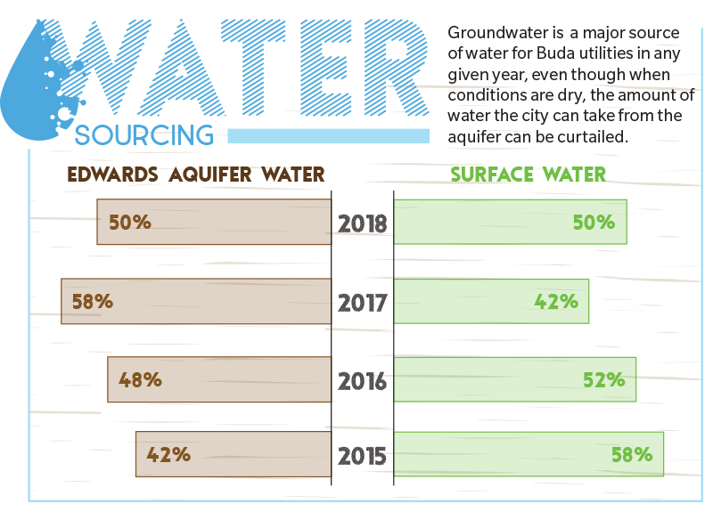
City of Buda ASR Pilot Study
Legislation approved to allow City of Buda to recharge water from Barton Springs portion of Edwards Aquifer to the Trinity Aquifer (May 22, 2019)
Source water will be a blend of treated Guadalupe River surface water and Edwards Aquifer groundwater
Evaluating aquifer characteristics of potential storage zones in the Trinity Aquifer
Exploratory boreholes to be constructed starting in October 2019
City of Buda, 2018

Slide 18

Summary
What is the secret to developing a successful ASR System?
“…Live a long time.”
- Professor Peter Dillon, CSIRO emeritus
Earliest ASR systems in Texas were proposed in the 1990s, but now are providing additional water supply and drought resilience
Texas legislation has been rapidly evolving since 2016 to encourage ASR implementation
Flexible legislation and streamlined permitting also encourage ASR implementation
Proposed ASR systems are becoming more diverse
  Inter-aquifer transfer and storage
  Blended source waters for recharge enable more flexibility for multi-year storage
  Combined ASR and desalinization in brackish aquifers

Slide 19
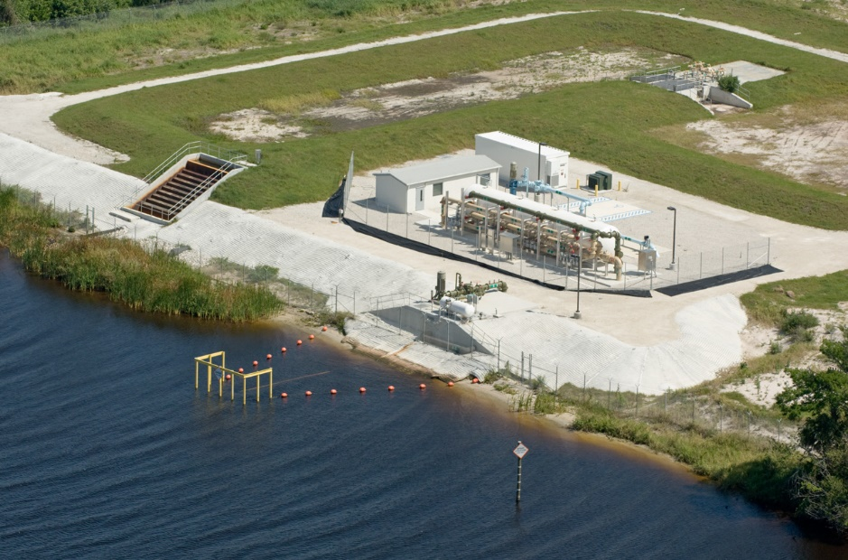
Thank you for your attention!
Kissimmee River ASR System near Okeechobee Florida
Comprehensive Everglades Restoration Project

