Slide 1
Knowledge-Centered Computing
Suzanne A Pierce, Jeaime Powell, Anna Dabrowski, Joe Stubbs with
Advanced Computing Interfaces, Data & Statistics, Visualization, & HPC
Texas Advanced Computing Center
Notes:
Successfully addressing the challenges to Texas’s resilience. Funding would allow PT2050 to incentivize researchers and students across disciplines, much as NSF does, to advance our research platform.

Slide 2
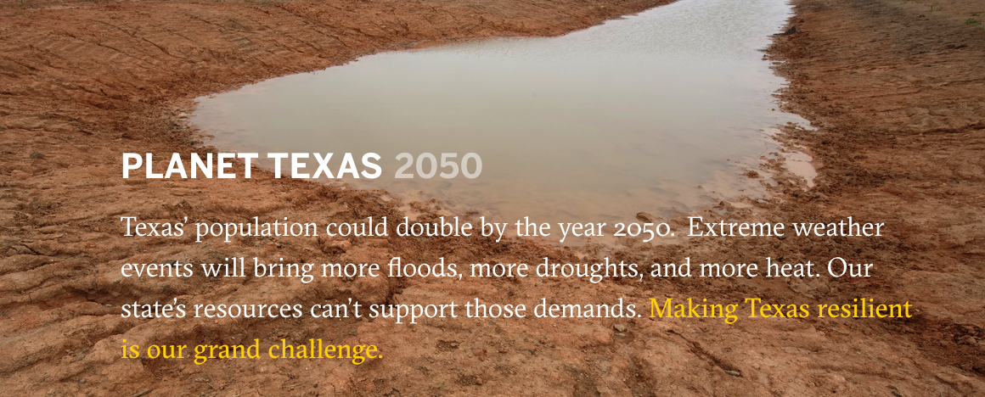
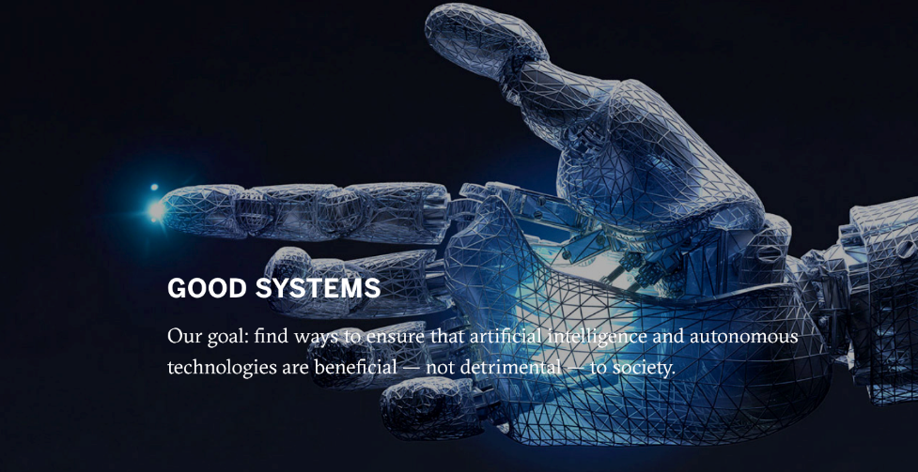
Bridging Barriers Program
initiative, which aims to bring together faculty and researchers from across campus to address critical and time-sensitive social, environmental, and humanitarian crises affecting our country and the world. (https://bridgingbarriers.utexas.edu/)
Planet Texas 2050
Others Projects To Be Announced
Whole Communities–Whole Health
Good Systems

Slide 3
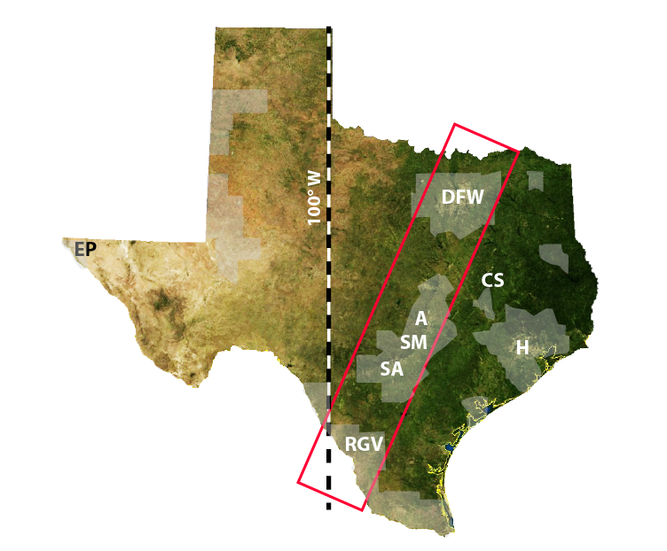
Texas' population will nearly double by the year 2050. We will experience more extreme weather events: more floods, more droughts, and more heat. We need to better manage our state’s resources to support these demands.
Making Texas resilient is our grand challenge.
Notes:
Successfully addressing the challenges to Texas’s resilience. Funding would allow PT2050 to incentivize researchers and students across disciplines, much as NSF does, to advance our research platform.

Slide 4
Challenges for Texas in 2050
Drivers
Scientific pillars
Quality of Life
Processes & feedbacks
Urbanization
Climate Change
Human health & well-being
Economy
Food security
Social equity
Water
Energy
Population
Growth
Ecosystem Services
The challenges are complex, vital, and not going away.
Addressing them requires an interdisciplinary approach.
Novel scientific approaches to processes, feedbacks, projections, planning.

Slide 5
Create a cyberinfrastructure ecosystem that is an integral part of a knowledge center
Web-based platform that provides access to tools
Integration of diverse data types
Support end-to-end research workflows and the full research lifecycle, including data sharing/archiving
Cloud-based tools that support streaming data
Analysis and visualization
PROJECT OBJECTIVES
Water
Energy
Urban
Ecosystems
Sharing knowledge and insights with researchers, partners and stakeholders
Notes:
This is we are creating a CI…oh wait…what is a CI?

Slide 6
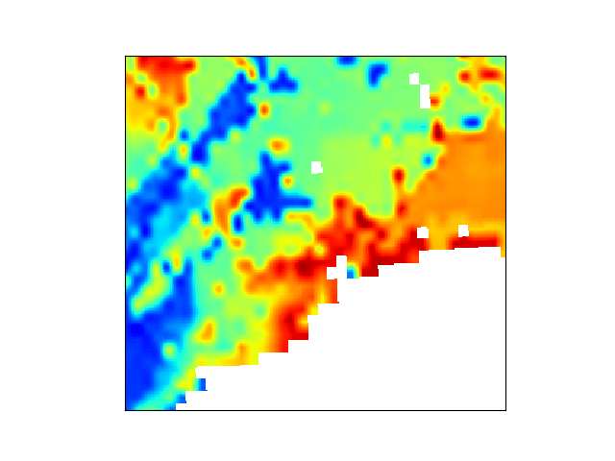
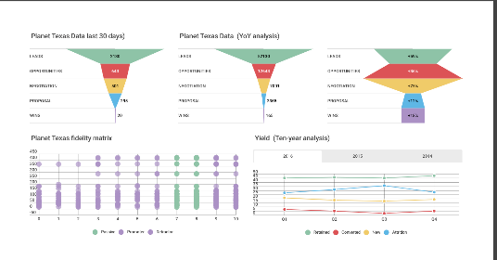
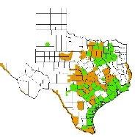
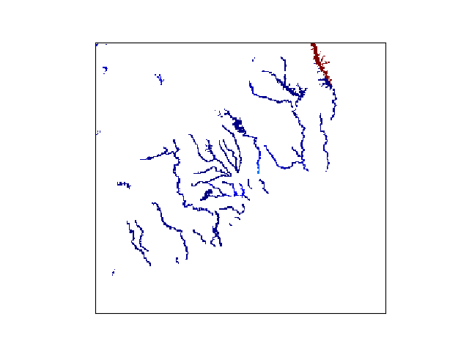
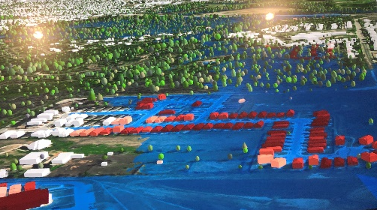
What is a Cyberinfrastructure?
A Digital Ecosystem
A Data Portal
Data Collection
Federated Services
Analysis Support
Workflow Utilities
HPC Queuing
Visualization
Archiving
Applications
Interfaces
Science Gateway
Advanced Computing Resources
Notes:
This is we are creating a CI…oh wait…what is a CI?

Slide 7
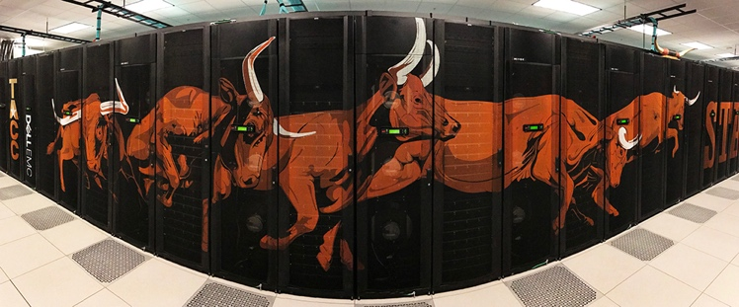
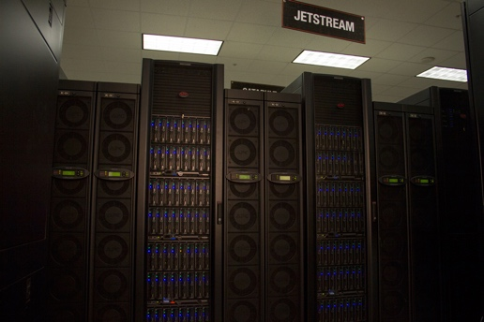
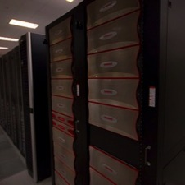
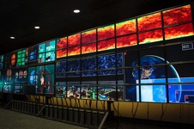
Advanced Computing Resources - TACC Systems
Lonestar 5
Texas-focused HPC/HTC XC40 30,000 Intel Haswell cores 1.25 PF
Hikari
Protected Data
Containers
10,000 Intel Haswell cores 400TF
Stampede-2
#12 HPC system, 18PF
Under Construction
Largest Academic system in the world, 41 PF
Jetstream
Science Cloud/HTC
VM Library
Rodeo
VM services for CI
Corral
Published Data,
Data services,
40PB Replicated Disk
Ranch
Archive
30PB Disk Cache,
0.5EB Tape
Stallion
Lasso
Notes:
This is simply “we have computational fire, fire good”. Also mention those are 8 foot tall racks…things really are bigger in Texas!!!
Present systems slide and to say hey look…machines…this one may be number 5 in the world next month. But machines need users and users need a cyberinfrastructure (slide 6) which is about people. And that’s what TACC is bringing to PT2050 and other Bridging Barriers based on experiences with DARPA, DesignSafe, CyVerse and many more…then speaking of PT2050…here is the CI going forward for researchers and what it will enable. Tada…

Slide 8
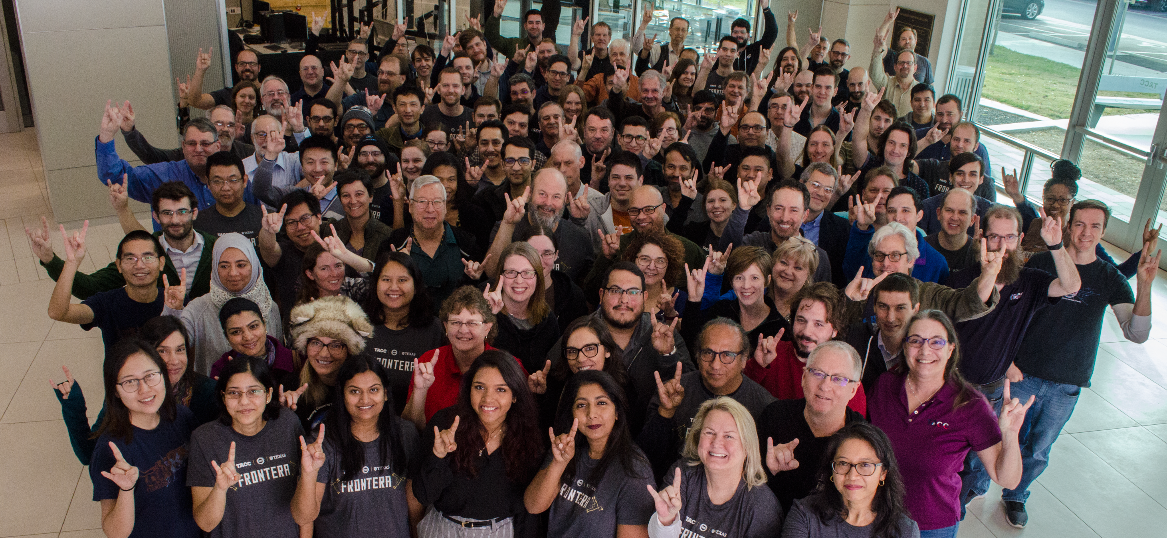
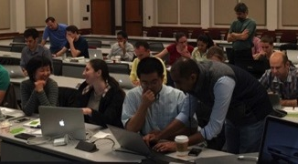
All of These parts make a CI
People – Not (just) CS but people with different backgrounds
Systems and Services (That’s often the easier part)
Capacity & Services
Large scale modeling, data storage, visualization, networks, cloud computing, code optimization
Consulting, Curation and analysis, Portals and Gateways, Web service APIs, Training and Outreach
Notes:
This is about the people to make this work, and that this included portals and gateways and modern user interfaces
But machines need users and users need a cyberinfrastructure (slide 6) which is about people. And that’s what TACC is bringing to PT2050 and other Bridging Barriers based on experiences with DARPA, DesignSafe, CyVerse and many more…then speaking of PT2050…here is the CI going forward for researchers and what it will enable.

Slide 9
Today its about all the orchestration of these parts which lead to discovery
Participatory Interfaces
Water
Urban
Energy
Ecosystems
Adaptive Sensing
DataX Science Gateway
Model Integration
Digital Objects of Research
Notes:
Successfully addressing the challenges to Texas’s resilience. Funding would allow PT2050 to incentivize researchers and students across disciplines, much as NSF does, to advance our research platform.

Slide 10
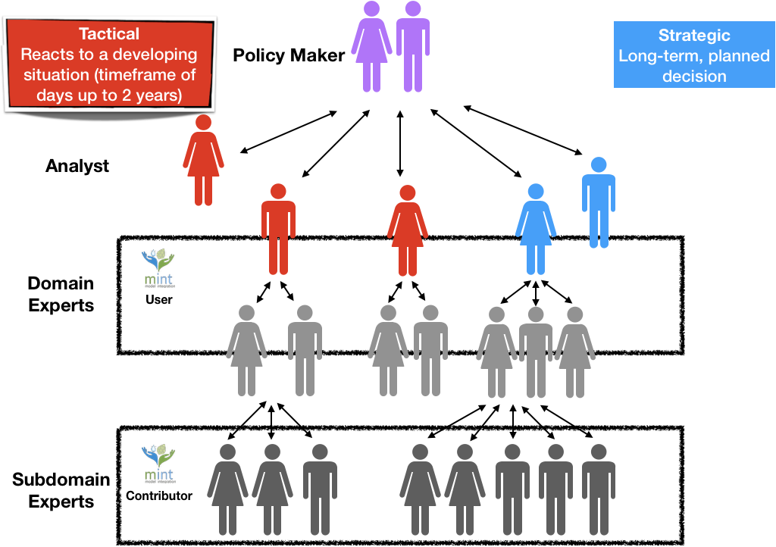
Different Users & Purposes
Stakeholders
Decision
Maker
Modeler
Expert
Notes:
Enabling Technology: MINT
http://mint-project.info/
The capstone for PT2050’s Cyberinfrastructure is an integrated modeling platform that is built in a highly flexible end-to-end computational workflow management system.
With the new integrated modeling platform, users will be able to build out complete decision support analyses rapidly.
This capability is the core technological innovation of PT2050 and it will serve as the foundation for integrating knowledge across every discipline and any application that helps Texas thrive.

Slide 11
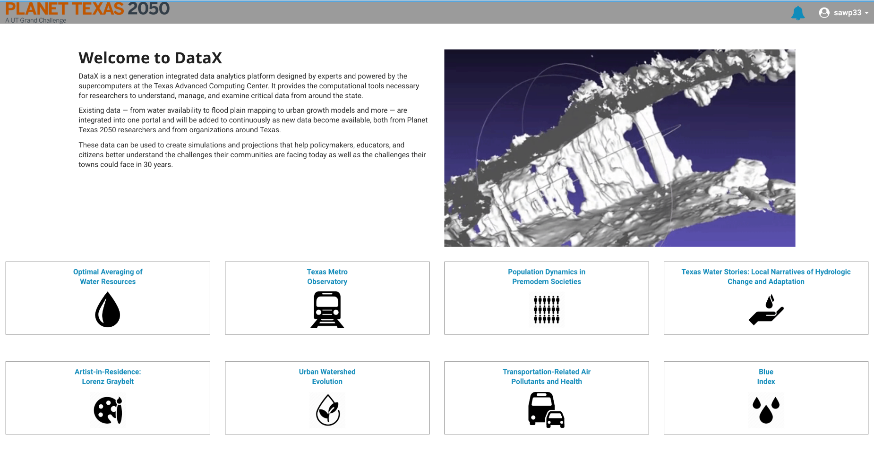
Core Data & Compute Capabilities
DataX is a cyberinfrastructure to enable sharing data, software, computing services, instruments, educational materials, and other resources for PT2050
Capabilities center on four areas that complement one another and build towards a cohesive system of services to accelerate knowledge generation & discovery.
Notes:
Capabilities for Planet Texas 2050 center on four areas that complement one another and build towards a cohesive system of services to accelerate knowledge generation and discovery.

Slide 12
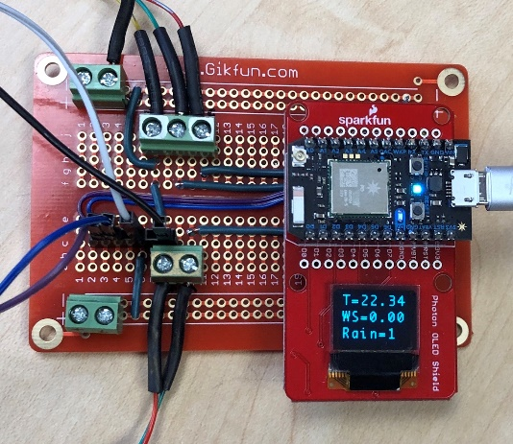
µP-STREAM - Adaptive Sensing & Edge Computing for Resilience
Ground truth observation networks connect to the edge
The open data-streaming effort connects real-time observation from edge nodes.
A Micro-controller Platform
for Sending Telemetry
Real-time for
Adaptive Models.
*Shared Research EarthCube IS-GEO RCN, NSF
award number 1632211 | http://is-geo.org
Notes:
Enabling Technology: CHORDS
This effort expands capabilities to both build out monitoring networks, but also opens up new directions for adding machine learning at the edge.
Enables collection of information & process it for use when we need it most, such as extreme event response efforts.

Slide 13
Faceted Frameworks – Organizing Concept
Search
Rank
Judge
Frame
Diagnose
Model
Analyze
Choice
Bargain
Recognize - Frame the Problem
Diagnose - Define the context, key variables, reference behaviors, decision problem
Model - Construct/Run Analysis Pipeline – run base case
Search- explore solution space, create solution catalog, set scenarios
Rank/Filter
Analyze
Adjudicate
Bargain
Recommendation/ Action / Decision
Iterate
Notes:
Enabling Technology: MINT
http://mint-project.info/
The capstone for PT2050’s Cyberinfrastructure is an integrated modeling platform that is built in a highly flexible end-to-end computational workflow management system.
With the new integrated modeling platform, users will be able to build out complete decision support analyses rapidly.
This capability is the core technological innovation of PT2050 and it will serve as the foundation for integrating knowledge across every discipline and any application that helps Texas thrive.

Slide 14
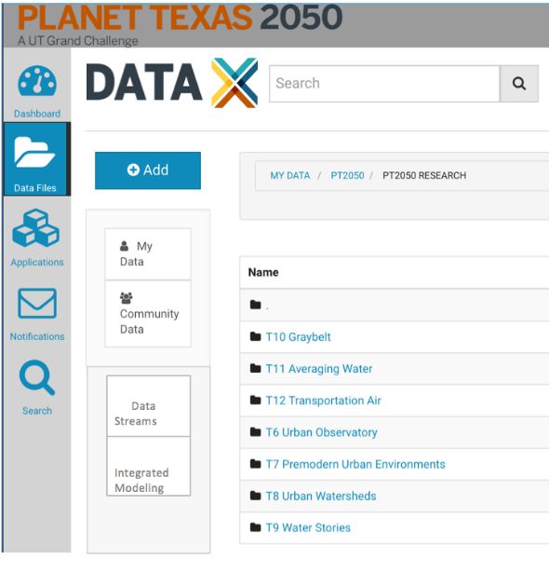
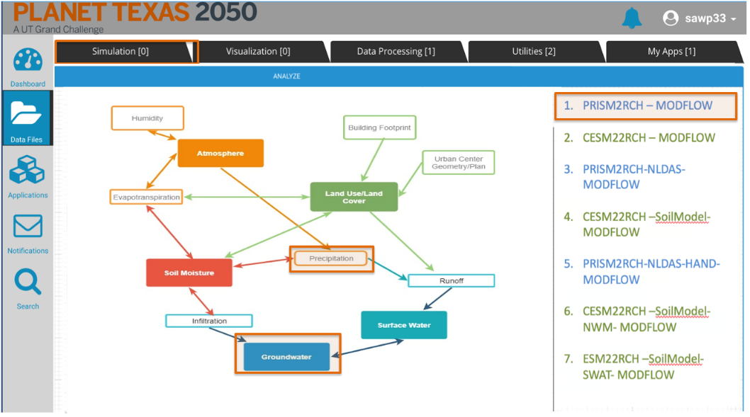
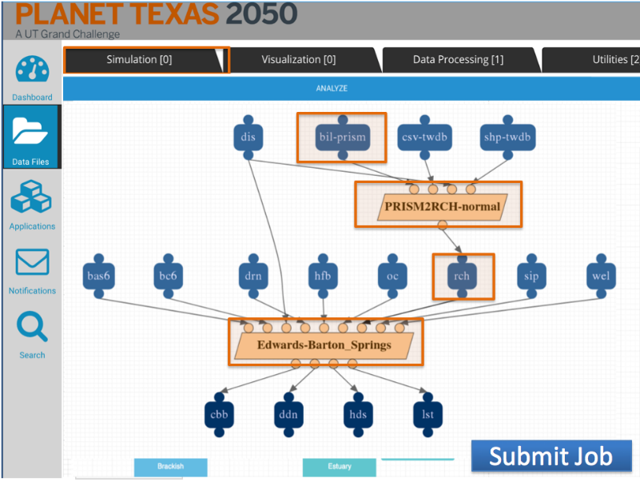
Integrated Modeling Service with Intelligent Reasoning
Connect Data
To Models
& Computing
*Shared research w/MINT| DARPA World Modelers Program
http://mint-project.info
Notes:
Enabling Technology: MINT
http://mint-project.info/
The capstone for PT2050’s Cyberinfrastructure is an integrated modeling platform that is built in a highly flexible end-to-end computational workflow management system.
With the new integrated modeling platform, users will be able to build out complete decision support analyses rapidly.
This capability is the core technological innovation of PT2050 and it will serve as the foundation for integrating knowledge across every discipline and any application that helps Texas thrive.

Slide 15
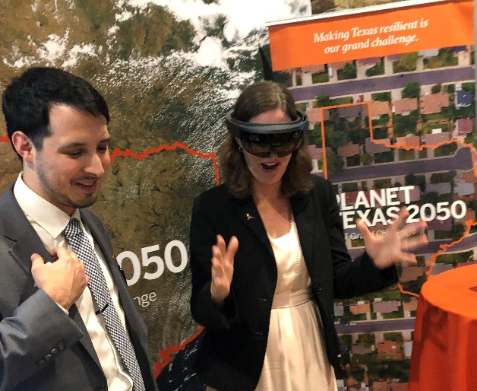
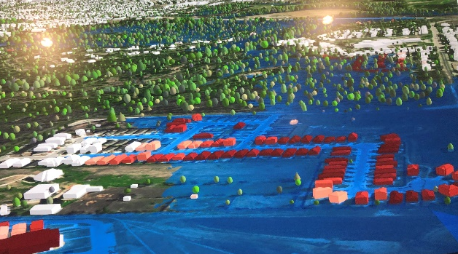
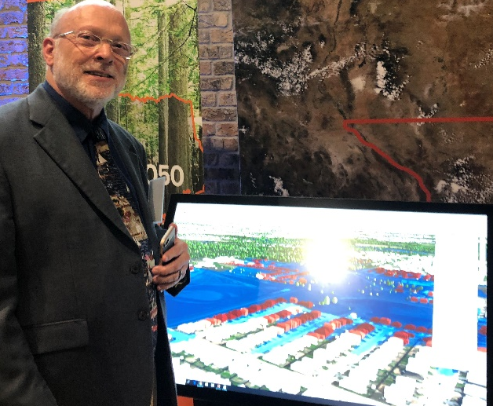
Participatory Interfaces
Knowledge comes in many forms and DataX is creating dynamic user interfaces to help understand & share it
Ushering in a new era of information delivery and interactivity by creating dashboard tools that combine science and informatics visualization.
Beginning with natural user interfaces and mixed reality technologies for delivering engaging and insight building interactions for groups of analysts and stakeholders.
Notes:
Enabling Technology: Apache Superset

Slide 16
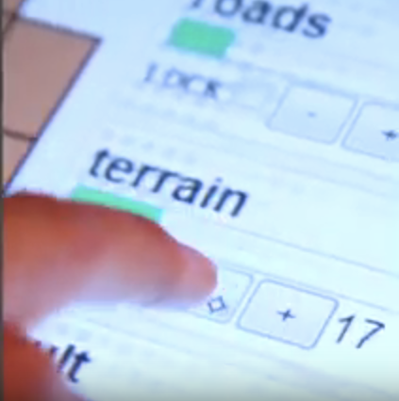
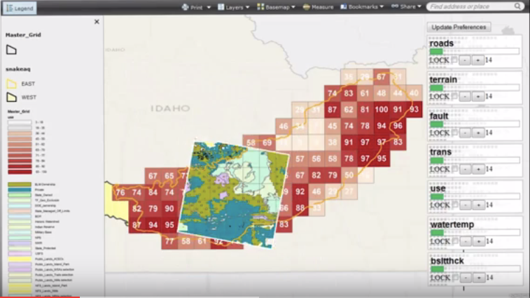
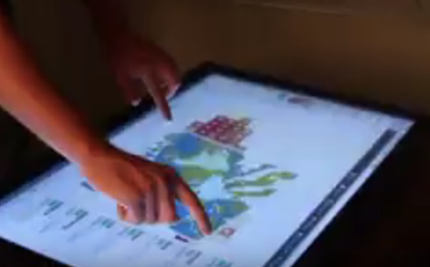
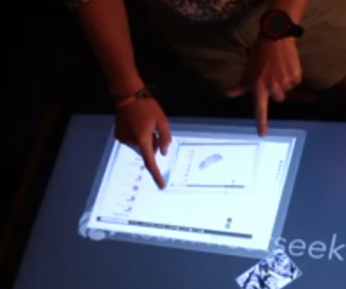
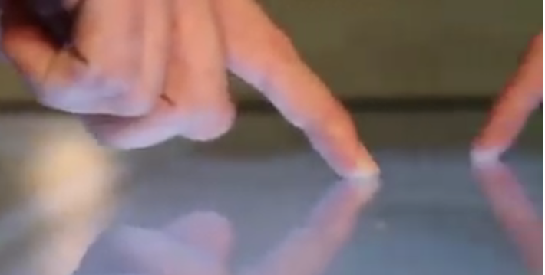
Participatory Interfaces
Index-Driven Exploration Interface Example
from [Pierce and Figueroa 2014]
User adjusts the weight of individual attributes to generate aggregate index
User can zoom in with lens to drill down through layered information
Interactive display allows user to manipulate the visualization
User can compose reports with diverse interactive visualizations
Several users can interact in the same screen

Slide 17
DOLCE – Digital Object Life Cycle Ecosystem
Knowledge resources to serve Texans today and in the future.
Establishing best practices and partnerships to make data and digital assets complete products that are accessible, discoverable, and reproducible.
Publishing PT2050 digital resources for use on current challenges & archiving of data products and processes for use by future generations.
Notes:
The digital object life cycle ecosystem, or DOLCE, looks at the present through the lens of future generations.
Enabling Technology: TBD - DMIC - Coordination with the Libraries and TNRIS planned

Slide 18
Participatory Interfaces
Open source,
Platform-as-a-service
for
hybrid cloud computing,
Integrated modeling,
data management
and
reproducible science.
Water
Urban
Energy
Ecosystems
Adaptive Sensing
DataX Science Gateway
Model Integration
Digital Objects of Research
Notes:
Successfully addressing the challenges to Texas’s resilience. Funding would allow PT2050 to incentivize researchers and students across disciplines, much as NSF does, to advance our research platform.

Slide 19
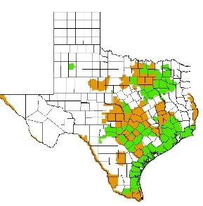
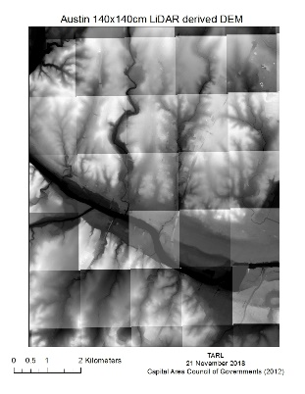
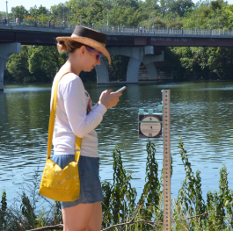
Water
Urban
Participatory Interfaces
Energy
Ecosystems
Combining
Computational
Capabilities
with Information
for
Resiliency
Digital Objects of Research
DataX Science Gateway
Data Transformations
Foundational Core
Analyses & Workflows
Model Integration
Many Data Types
Notes:
Successfully addressing the challenges to Texas’s resilience. Funding would allow PT2050 to incentivize researchers and students across disciplines, much as NSF does, to advance our research platform.

Slide 20
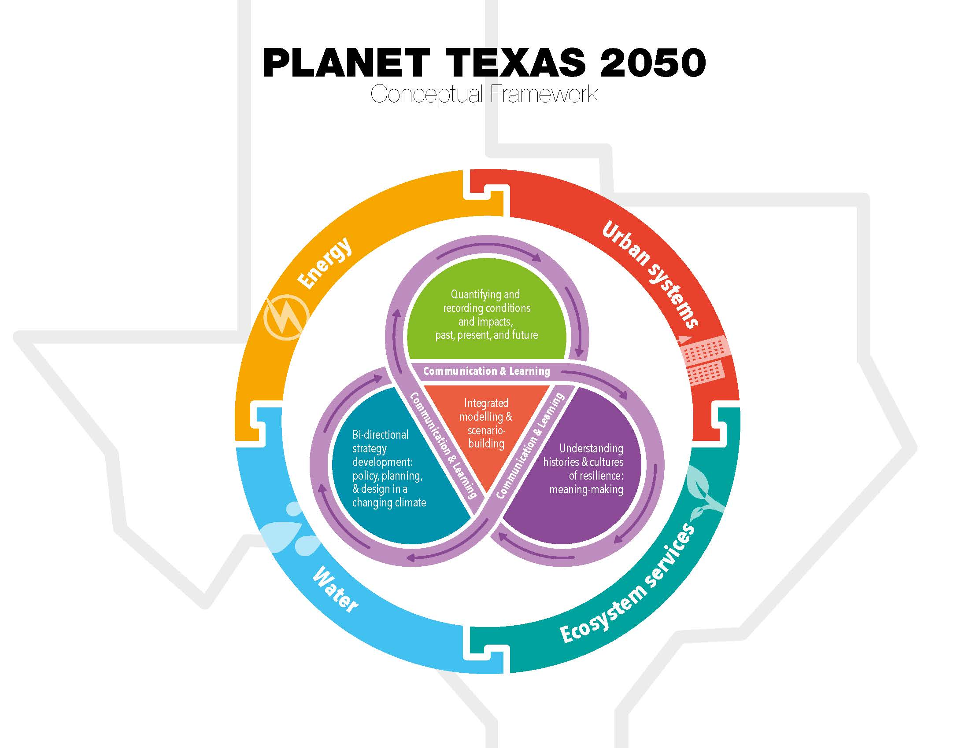
Cyberinfrastructure to accelerate knowledge-centered research
Learn more by contacting:
spierce@tacc.utexas.edu or jpowell@tacc.utexas.edu
Notes:
Accelerating discoveries and relevancy via scalable, flexible, and accessible approaches

Slide 21
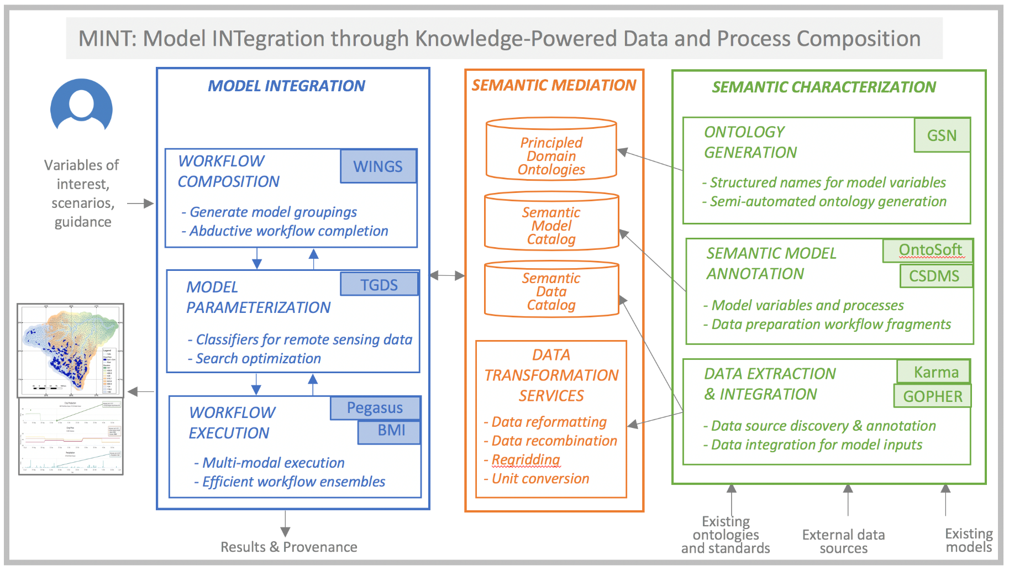
Integrated Modeling Service with Intelligent Reasoning
*Shared research w/MINT| DARPA World Modelers Program
http://mint-project.info
Notes:
Enabling Technology: MINT
http://mint-project.info/
The capstone for PT2050’s Cyberinfrastructure is an integrated modeling platform that is built in a highly flexible end-to-end computational workflow management system.
With the new integrated modeling platform, users will be able to build out complete decision support analyses rapidly.
This capability is the core technological innovation of PT2050 and it will serve as the foundation for integrating knowledge across every discipline and any application that helps Texas thrive.

