Slide 1
Welcome to the
Texas Water Research Network
May 30-31, 2019
Student Activity Center (SAC)
Legislative Assembly Room 2.302
University of Texas at Austin
  Sponsored by The Cynthia & George Mitchell Foundation, www.cgmf.org
Notes:
List room number instead of ‘main campus’

Slide 2
Texas Water Research Network
Thursday, May 30, 2019
Jay Banner, UT Austin

Slide 3
Goals for meeting
Provide a setting for new and existing members
to network
Provide learning opportunities on key issues related to Texas water resources
Promote effective interactions between researchers and stakeholders

Slide 4
Thursday’s Agenda
12:15 PM | Water Technology and New Approaches to Classic Problems Cyber Infrastructure: Suzanne Pierce, University of Texas at Austin Aquifer Storage: June Mirecki, U.S. Army Corps of Engineers Tree Rings & Drought: Bryan Black, University of Arizona Laboratory of Tree-Ring Research
2:15 PM | Coffee Break
2:45 PM | 2019 Texas Legislative Session Updates Ken Kramer, Sierra Club – Lone Star Chapter
3:15 PM | Lightning Talks Urban Expansion: Steven Richter, University of Texas at Austin Remnant Tributaries of the Rio Grande: Jude Benavides, University of Texas Rio Grande Valley Community-based sustainability: Mike Cheng, University of Texas Rio Grande Valley 5Vs of Big Data for Water: Venki Uddameri, Texas Tech University InSAR for Natural Hazard Prediction: Ann Chen, University of Texas at Austin
3:45 PM | Texas Climate Projections Report John Nielsen-Gammon, Texas A&M University
5:00 PM | Happy Hour (wine/beer, tapas) at Jackson School of Geosciences
Notes:
Adding a few words about each talk topic will serve the purpose of people knowing what’s coming.

Slide 5
TWRN: How did we get here?
NSF Coupled Natural & Human Systems grant:
The New 100th Meridian - Urban Water Resiliency
in a Climatic and Demographic Hot Spot
Parallel effort to pursue a research network
Six prior meetings: Key steps forward
  May 2015: Network purpose and niche
  December 2015: Grand challenges, mission
  August 2016: Nodes and network efficacy
  May 2017: Science of communication, key issues
  for policy makers and managers
  January 2018: Science-stakeholder interaction in producing research
  September 2018: Water markets, flood resilience
  http://www.esi.utexas.edu/research/texas-water-research-network

Slide 6
TWRN Mission
Bringing researchers together in addressing the resilience of Texas water resources to changes in natural and human systems, and to improve connections between science and policy

Slide 7
Grand Challenges
1. How can we address the complexities of the natural system wherein a changing climate is forced by external anthropogenic processes in a climatically-sensitive region?
2. Based on advancing our understanding of the complexities outlined by GC-1, how accurately can we project water availability on this regional scale?
3. What forcing factors and couplings between forcing factors drive the human system that comprises a rapidly-growing and demographically-shifting sentinel community in a water-stressed region?
4. How can we project the impacts of the natural and human systems on each other to produce a regional-scale assessment of urban water resiliency that can be used to inform effective solutions through education, policy and technology?

Slide 8
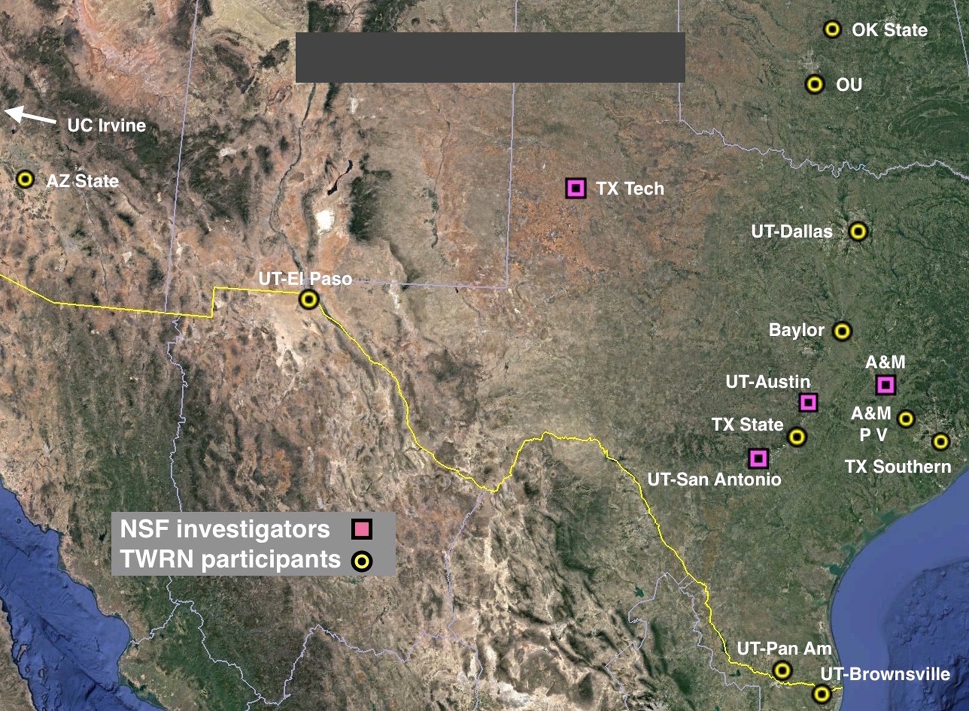
Universities Represented
UT Arlington
U of AZ

Slide 9
Network support
The New 100th Meridian
  National Science Foundation, Coupled Natural and Human Systems Program grant
Texas Water Research Network
  The Cynthia and George Mitchell Foundation, www.cgmf.org

Slide 10
Texas Water Research Network
  Facilitation Team
  Darrel Tremaine, Stefan Schuster, Patrick Bixler, Robert Mace, Sarah Williams, Jay Banner

Slide 12
Water Technology and New Approaches to Classic Problems
  Suzanne Pierce, UT Austin
June Mirecki, U.S. Army Corps of Engineers
Bryan Black, University of Arizona

Slide 14
2019 Texas Legislative Session Updates
Ken Kramer, Sierra Club – Lone Star Chapter

Slide 16
Lightning Talks
Steven Richter, UT Austin
Jude Benavides, UT Rio Grande Valley
Mike Cheng, UT Riot Grande Valley
Venki Uddameri, Texas Tech University
Ann Chen, UT Austin

Slide 18
Texas Climate Projections Report
John Nielsen-Gammon, Texas A&M University

Slide 20

  Jackson Geology Building (JGB)
  Room 6.218

Slide 21
Schematic of NSF CNH project
Water science:
Availability, demand
Stress and strain on social and industrial systems
Assessment of
water resiliency
Projections:
Climate, Urbanization, Demographics
Policy and action
Notes:
Move to extra slides at end

