Slide 1
Texas Climate Projections
John W. Nielsen-Gammon
Texas State Climatologist
Department of Atmospheric Sciences

Slide 10
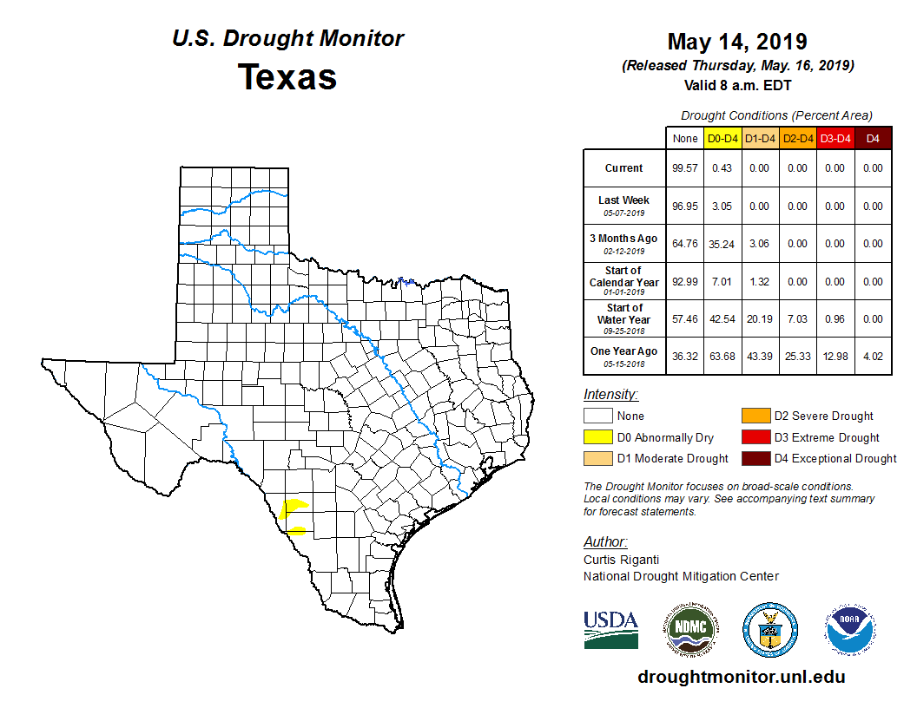

Slide 12
Drought Projection Considerations
SPI neglects temperature, PDSI overemphasizes it
Increased CO2 improves plant water use efficiency
Increased CO2 increases plant biomass
Increased efficiency leads to higher temperatures
Responses to CO2 differ across species
Global climate models that include CO2 fertilization project decreased soil moisture
Changes in topsoil moisture more severe than deep soil moisture
Greater paleoglobal plant growth from higher temperatures and CO2

Slide 13
Harvey: What If?

Slide 14
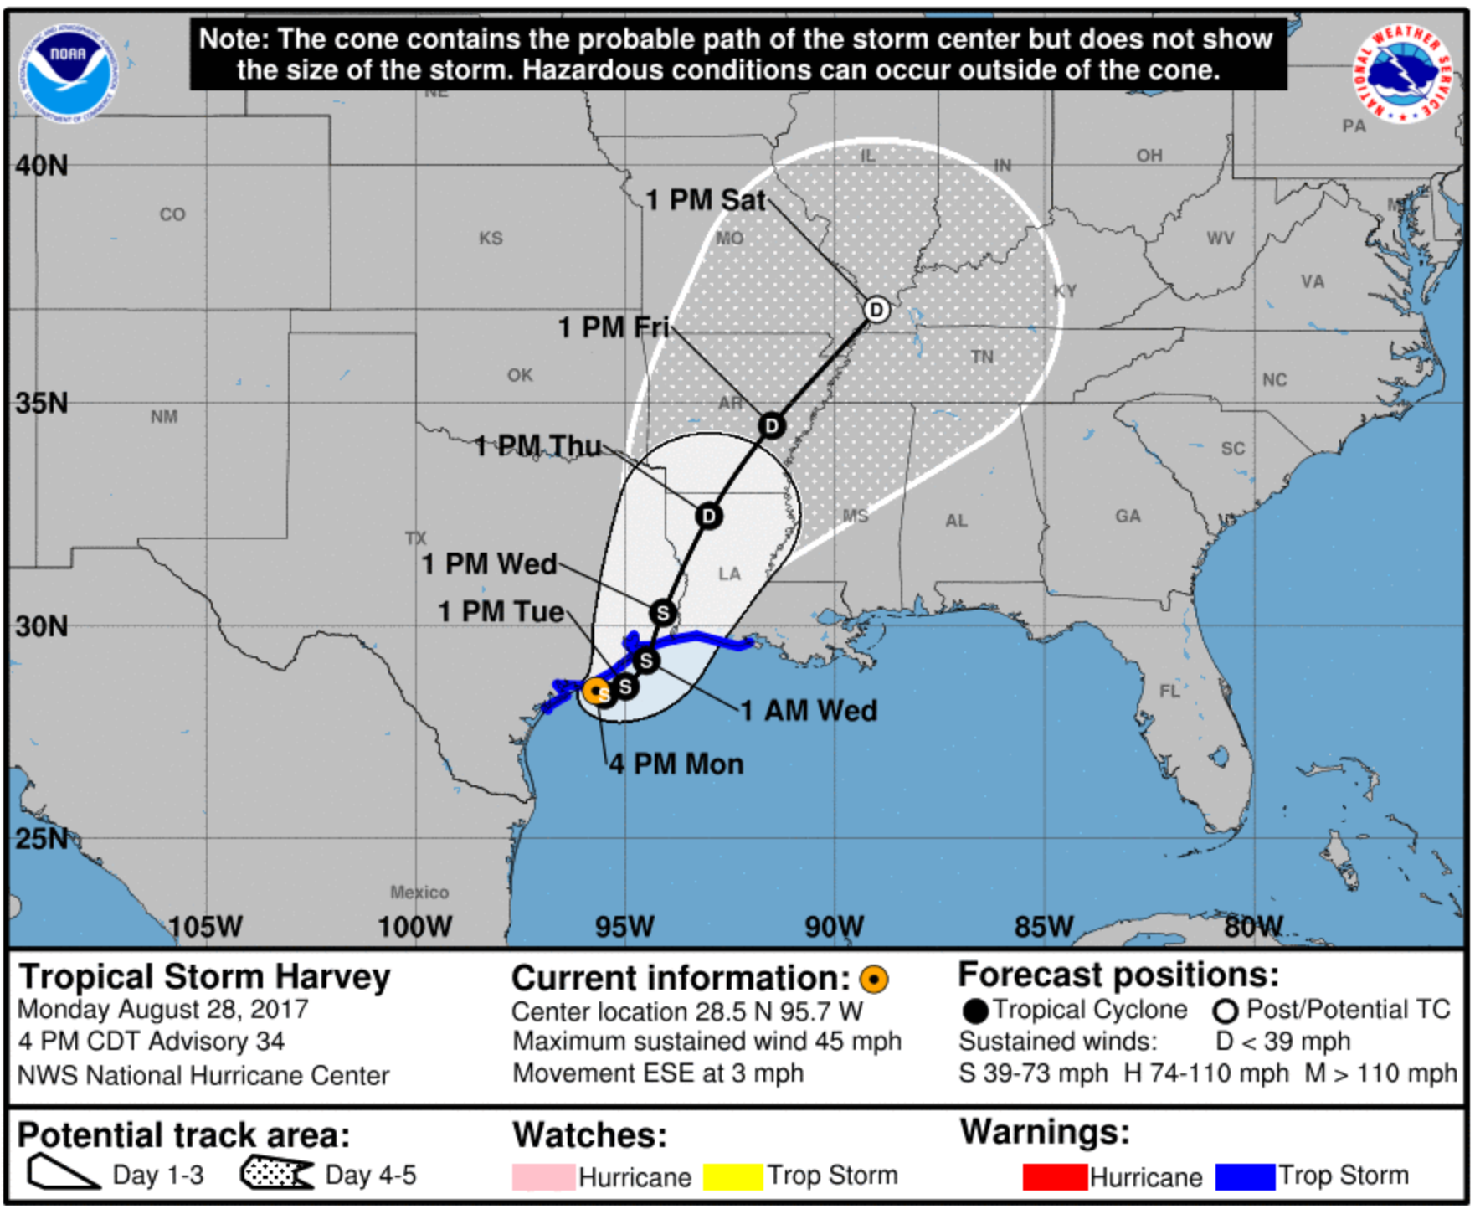

Slide 15
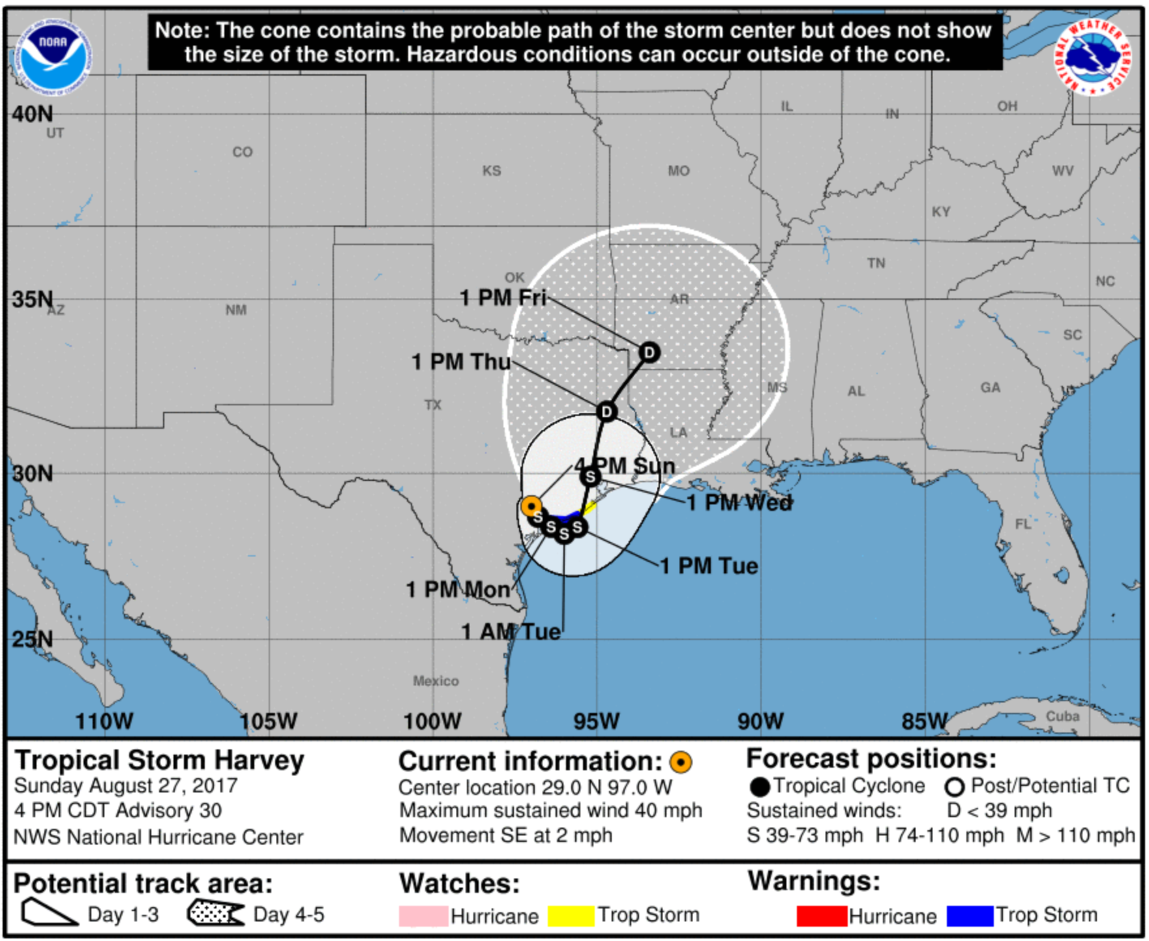

Slide 16
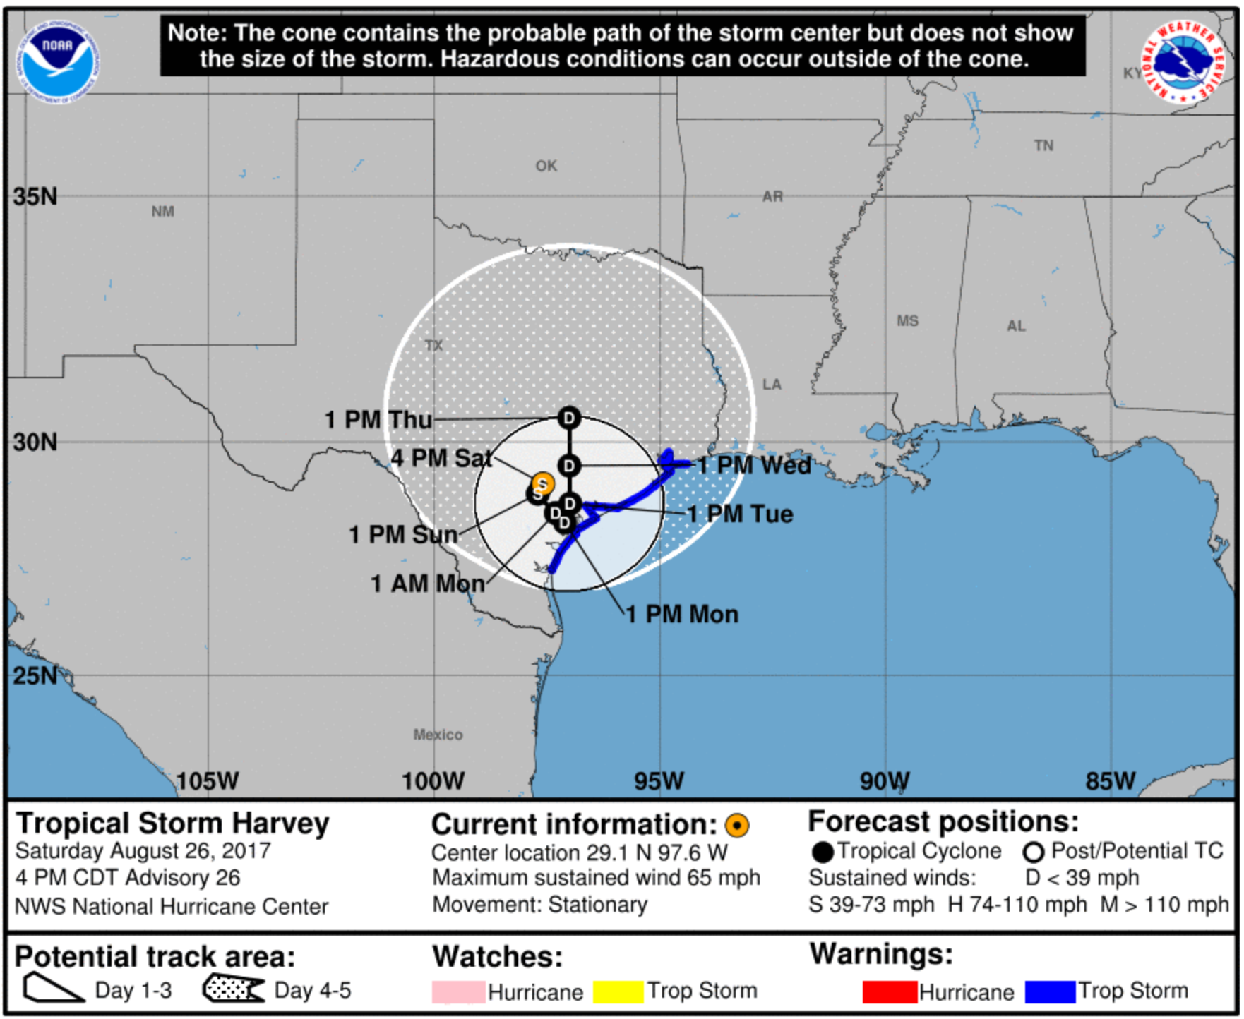

Slide 17
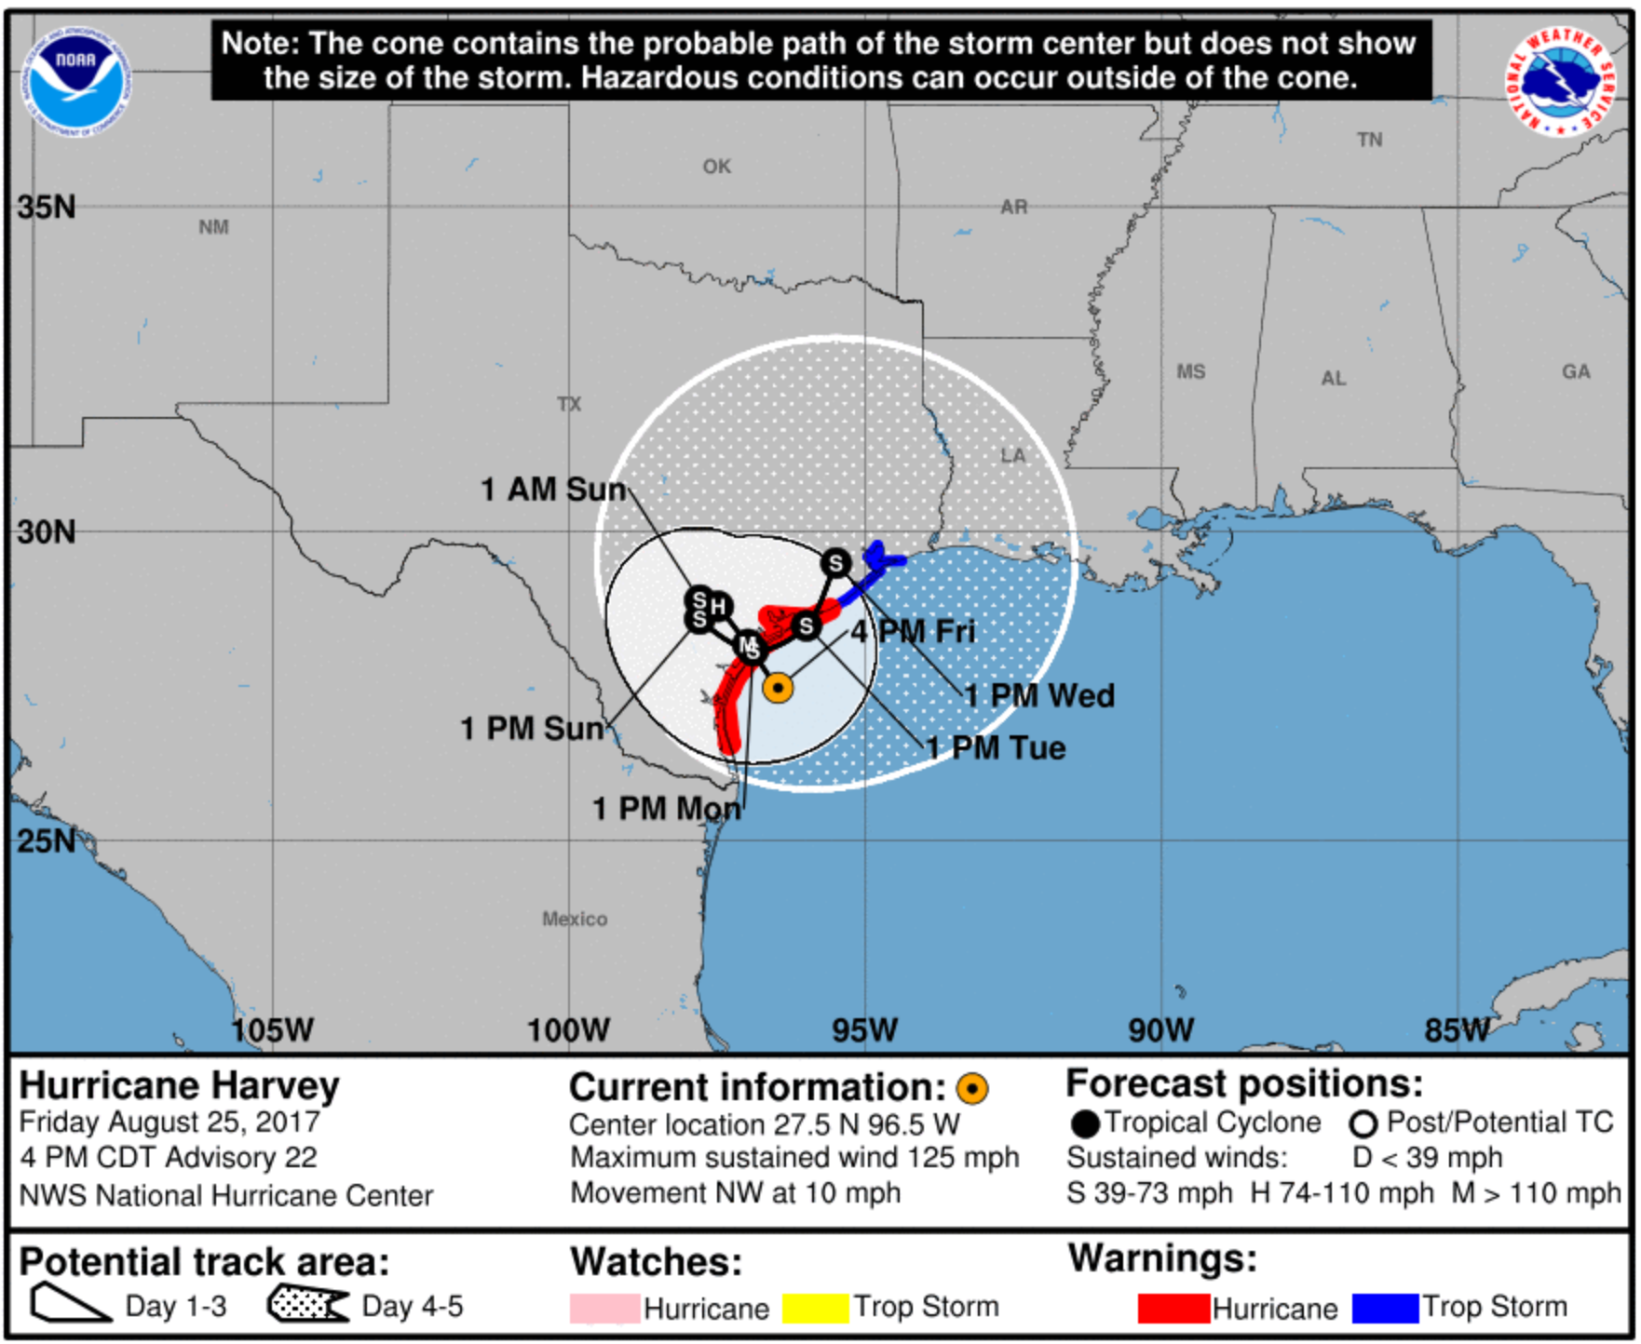

Slide 18
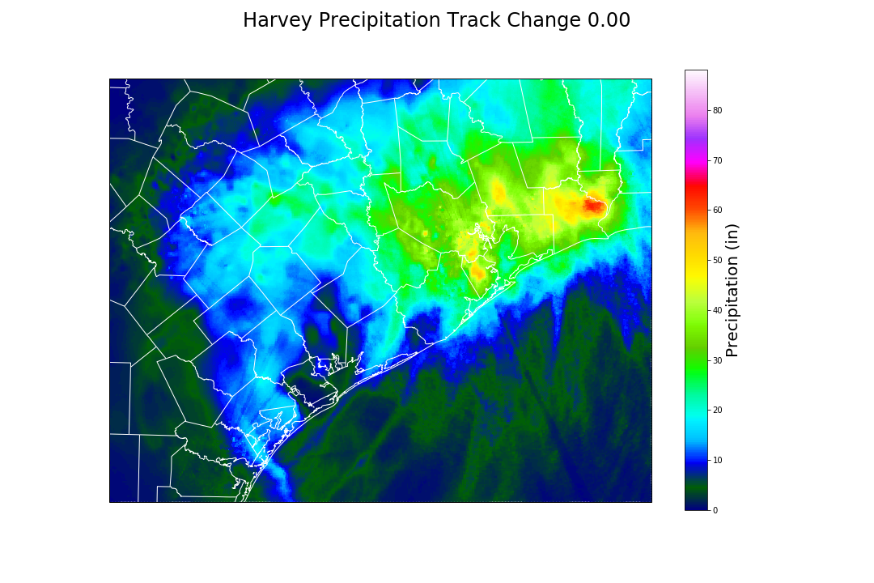

Slide 19
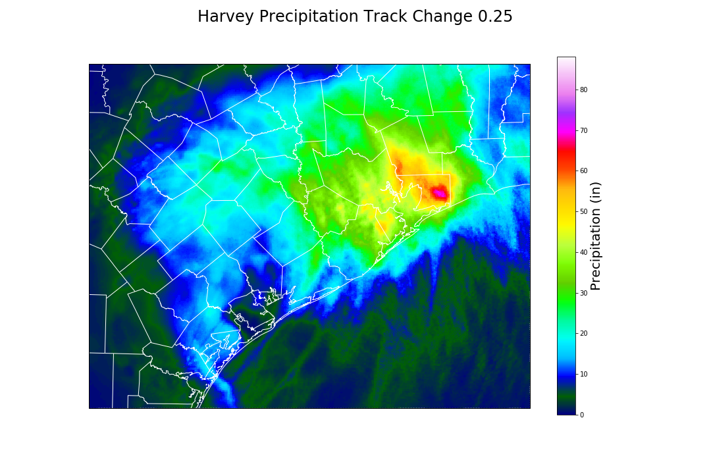

Slide 20
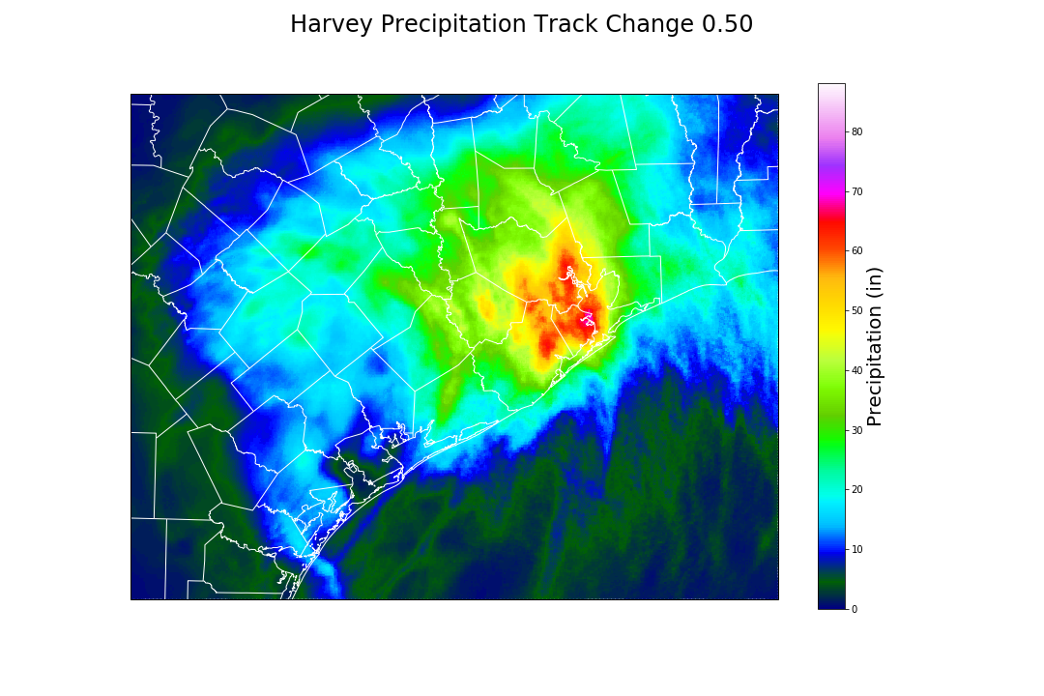

Slide 21
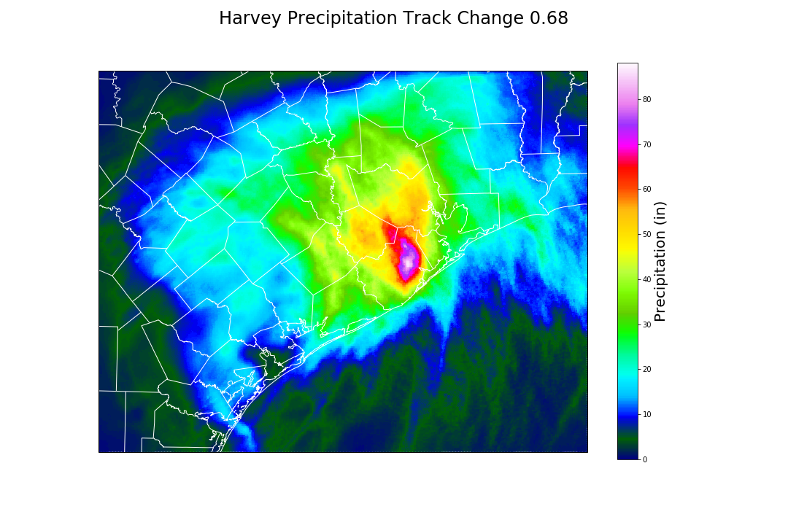

Slide 22
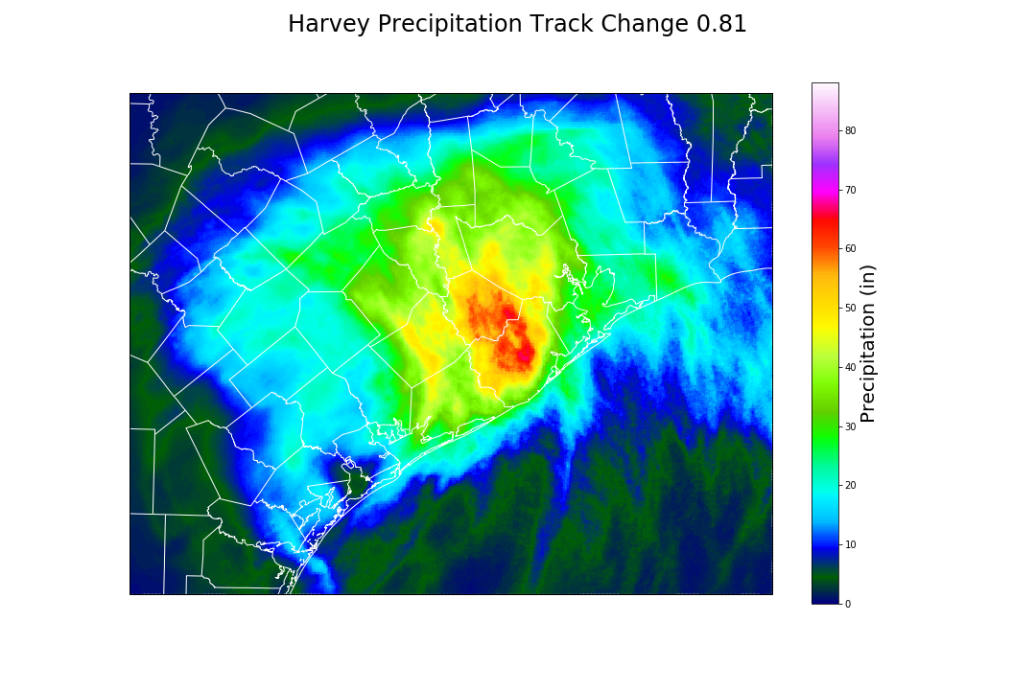

Slide 23
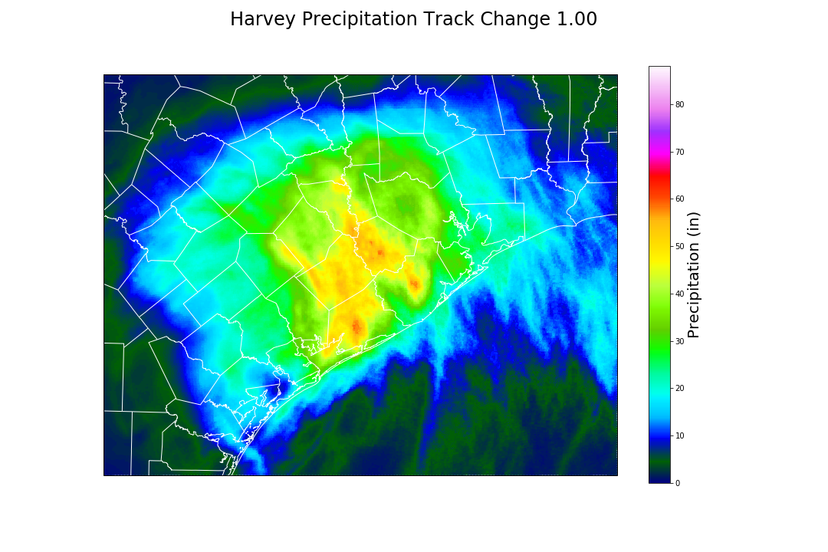

Slide 24
Email: n-g@tamu.edu
Web: climatexas.tamu.edu
Social media: climatexas

