Slide 1
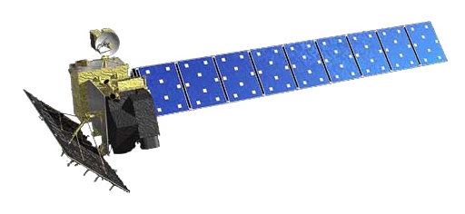
On use of InSAR for Natural Hazards Prediction and Risk Mitigation Ann Chen

Slide 2
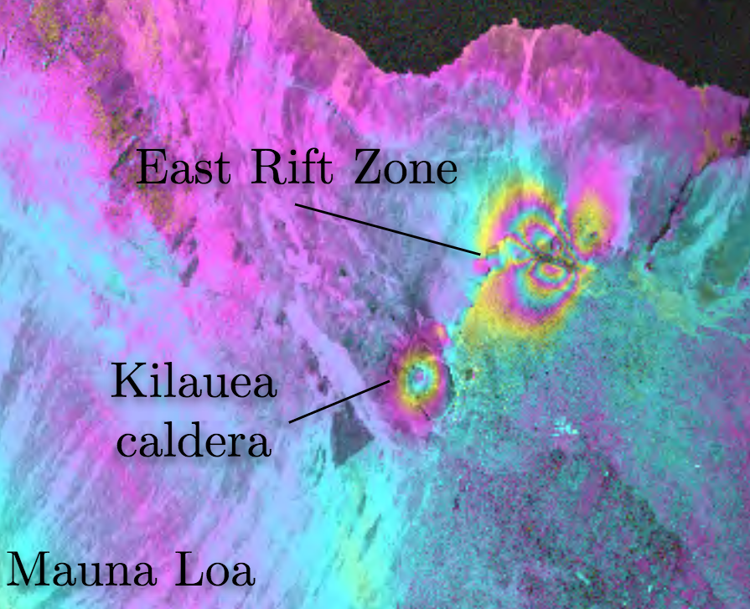
Radar Interferometry Group
Interferometric Synthetic Aperture Radar (InSAR) image processing algorithms
InSAR-based earth science applications
Centimeter-level volcanic deformation at Kilauea, Hawaii detected by an imaging radar satellite

Slide 3
InSAR applications
Tectonic and volcanic deformation
Permafrost
Induced seismicity
Atmospheric water vapor
Wastewater injection
InSAR
Infrastructure monitoring
Rain-induced Flood modeling
Glacial motion

Slide 4
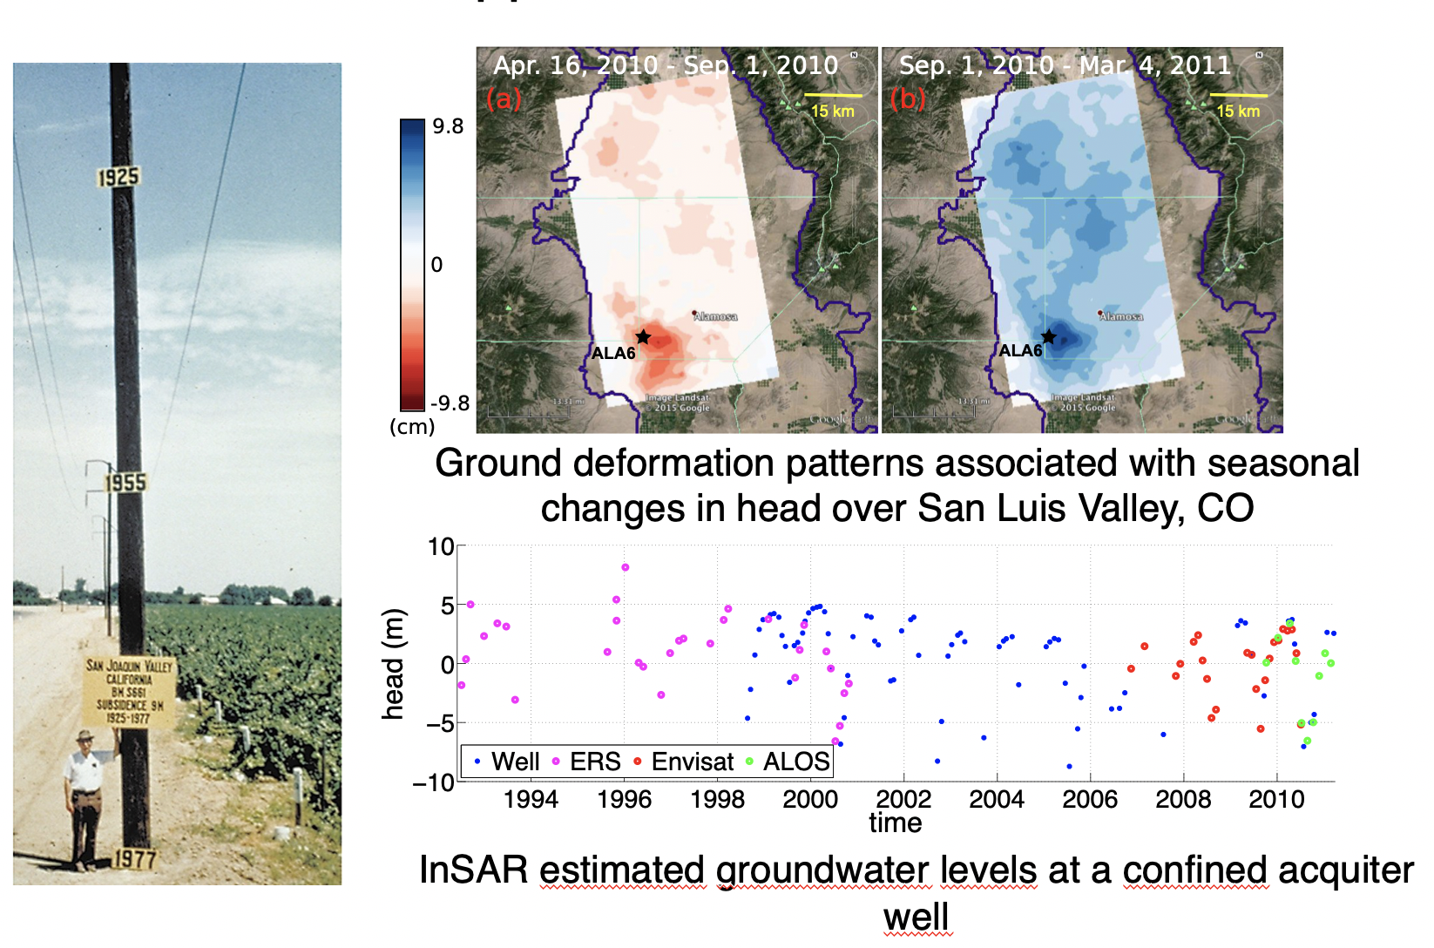
InSAR applications

Slide 5
InSAR applications
SAR/InSAR based Land-cover classification around Lake Houston

