Slide 1
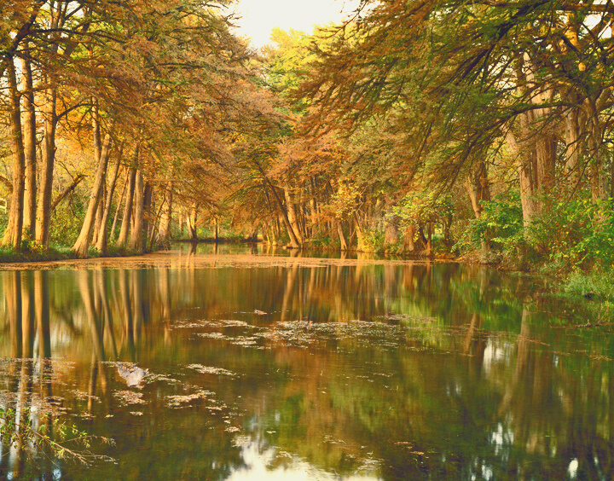
TEXAS LIVING WATERS PROJECT
Texas Water Conservation Scorecard
Jennifer Walker, National Wildlife Federation
May 19, 2021

Slide 2
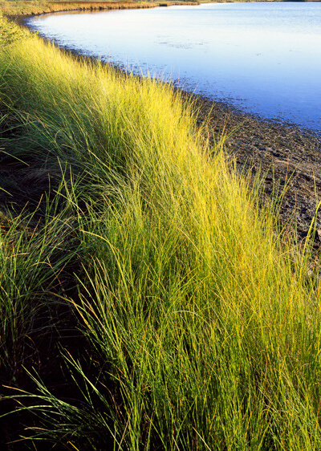
ACKNOWLEDGEMENTS
2020 Texas Water Conservation Scorecard
Produced with generous support from the
The Meadows Foundation
The Cynthia and George Mitchell Foundation
Special thanks to the
Texas Water Development Board &
Texas Commission on Environmental Quality

Slide 3
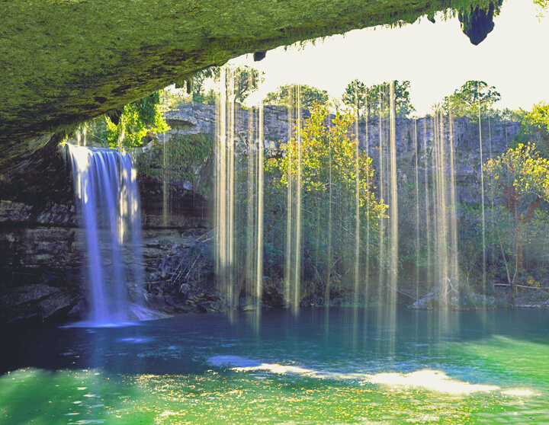
Texas Living Waters Project
We are a collaboration of conservation groups working to ensure Texas has the water it needs for thriving communities and abundant fish and wildlife.

Slide 4
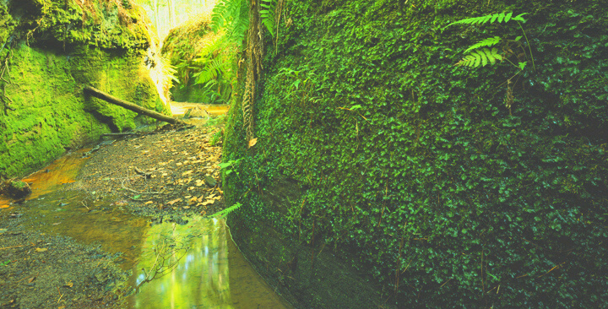
Texas Water Conservation Scorecard
AN IN-DEPTH ANALYSIS AND RANKING OF THE WATER CONSERVATION EFFORTS OF MORE THAN 350 WATER UTILITIES IN TEXAS
THE SCORECARD IS BASED ON PUBLICLY AVAILABLE INFORMATION

Slide 5
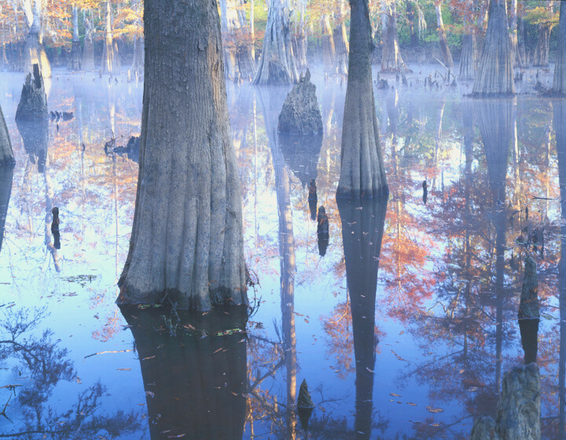
Reports Submitted?
Water Conservation Plans (submitted every 5 years)
Water Conservation Implementation Report
(submitted annually)
Water Loss Audit
(submitted annually)
Publicly Available?
Water Conservation Plan or Water Conservation Information
*5 points each
REPORTING:
Were required reports submitted and are they
publicly available?

Slide 6
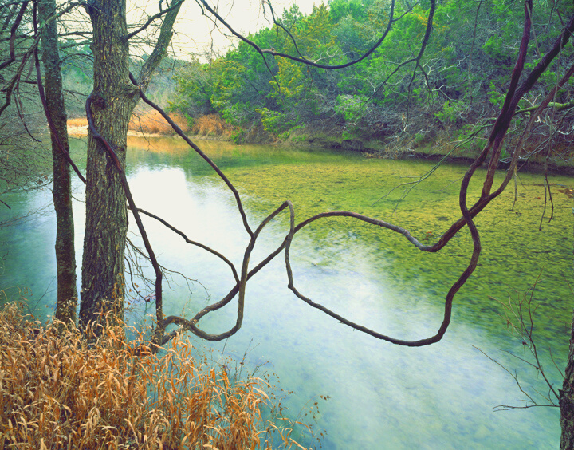
Has the utility set a strong 5-year water conservation goal?
Did the utility achieve the
5-year goal for water use reduction stated in it’s previous Water Conservation Plan?
Does the utility make use of Texas’ 23 Water Conservation BMPs?
*10 points each
WATER CONSERVATION GOALS and BEST MANAGEMENT PRACTICES

Slide 7
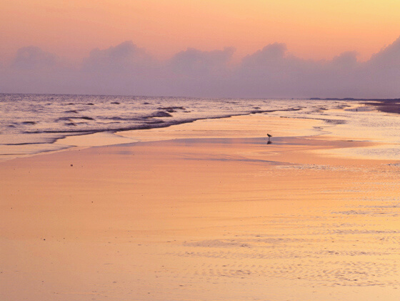
WATER LOSS, OUTDOOR WATERING and CONSERVATION ORIENTED RATES
What is the utilities most recent total precent water loss?
Has the utility implemented outdoor watering schedules on an ongoing basis?
Does the utilities water rate structure send a water conservation pricing signal?
*15 points each

Slide 9
TOP SCORES 2020
CITY OF HURST
AUSTIN WATER UTILITY
CITY OF FORT WORTH
CITY OF LUBBOCK
DALLAS WATER UTILITIES
CITY OF WYLIE
CITY OF FRIENDSWOOD
TEXAS WATER CONSERVATION SCORECARD
WWW.TEXASWATERCONSERVATIONSCORECARD.ORG
Matagorda Bay
Photo by Charles Kruvand

Slide 10
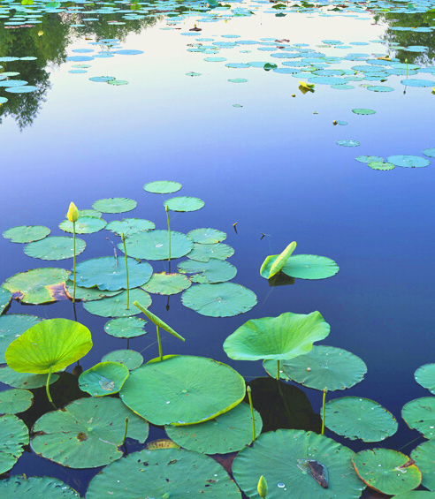
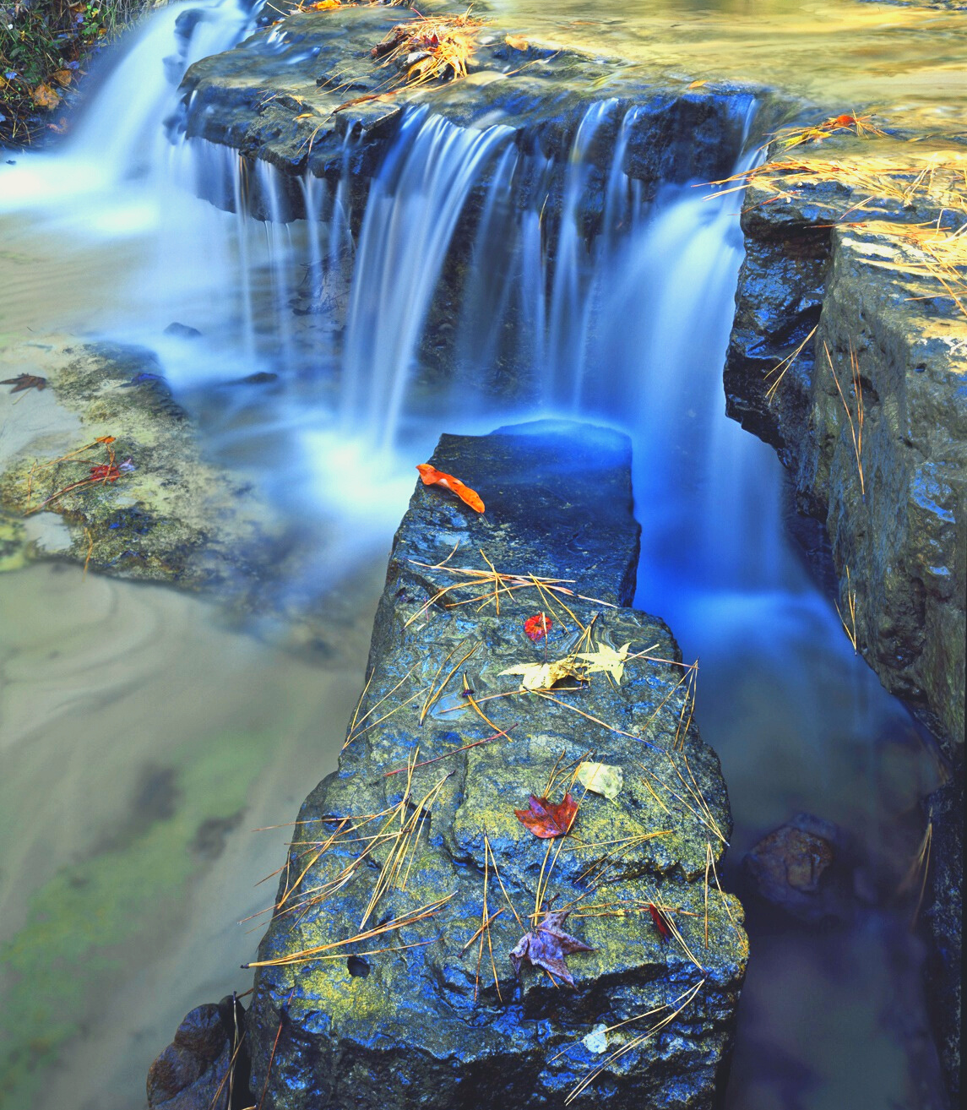
Please view the interactive Scorecard at http://www.texaswaterconservationscorecard.org/
Results, Recommendations, Annual Data, Full Report

Slide 11
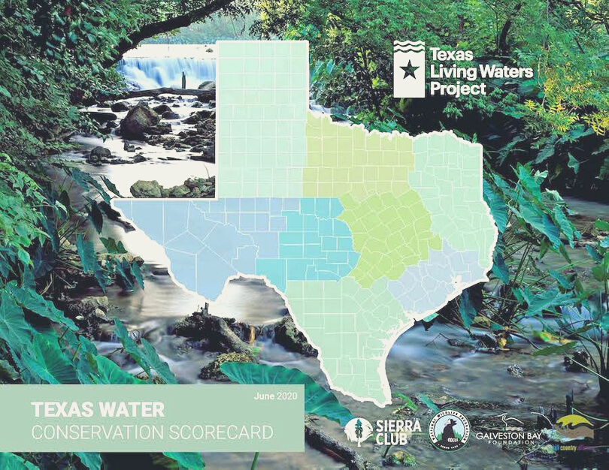
THANK YOU!
READ THE FULL REPORT AT:
http://www.texaswaterconservationscorecard.org/
Jennifer Walker - walkerj@nwf.org
Texas Living Waters Project

