Slide 1
Drones: Myths, Facts, Hacks and the Future
# 93
Dr. Todd Humphreys
November 21, 2014
Produced by and for Hot Science - Cool Talks by the Environmental Science Institute. We request that the use of these materials include an acknowledgement of the presenter and Hot Science - Cool Talks by the Environmental Science Institute at UT Austin. We hope you find these materials educational and enjoyable.

Slide 2
Drones: Myths, Facts, Hacks, and the Future
Todd Humphreys | Aerospace Engineering
The University of Texas at Austin
Nov. 21, 2014

Slide 5
Drones are Here!
Our lives will never be the same!

Slide 6
Drones are Here!
Our lives will never be the same!
What are drones?

Slide 7
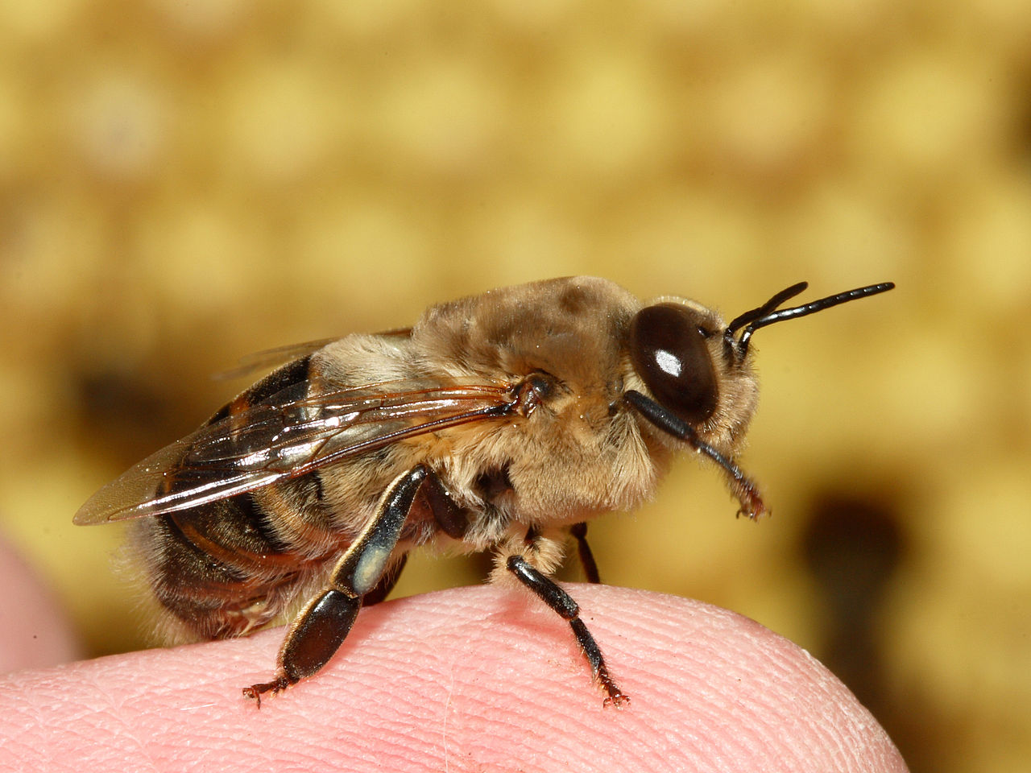

Slide 8
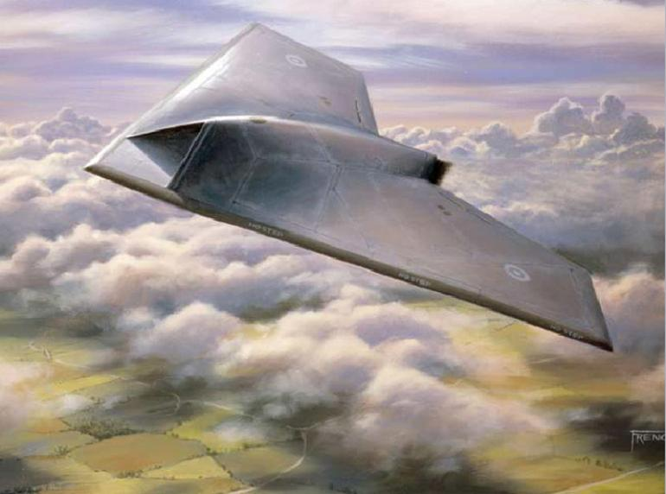

Slide 9
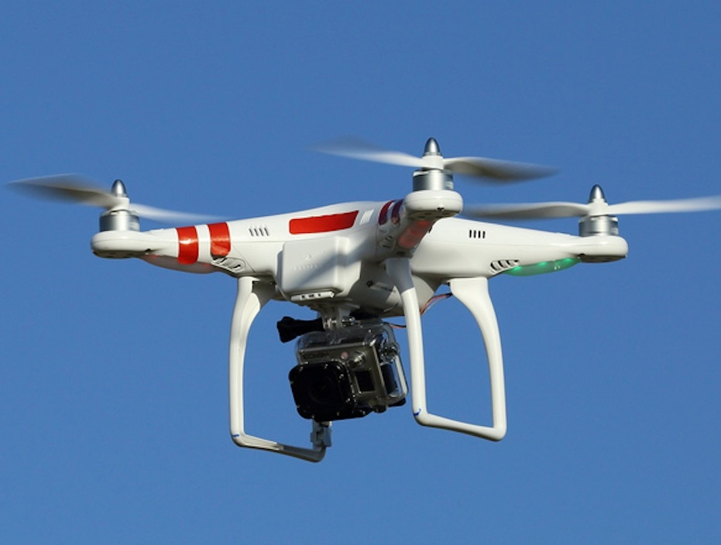

Slide 10
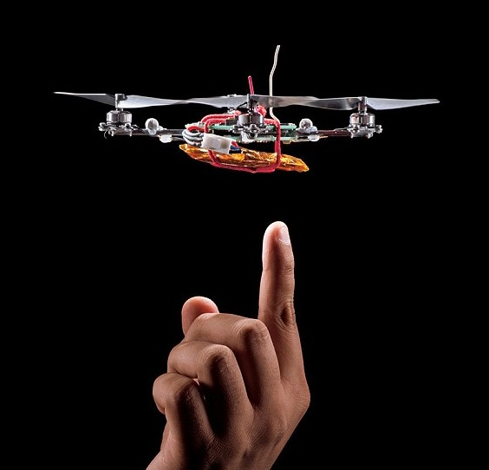

Slide 11
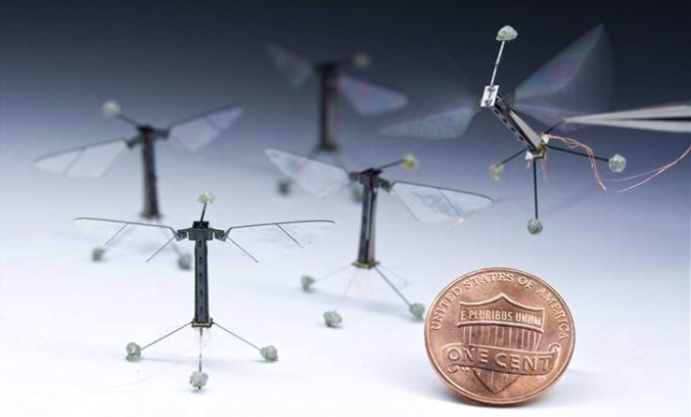

Slide 12
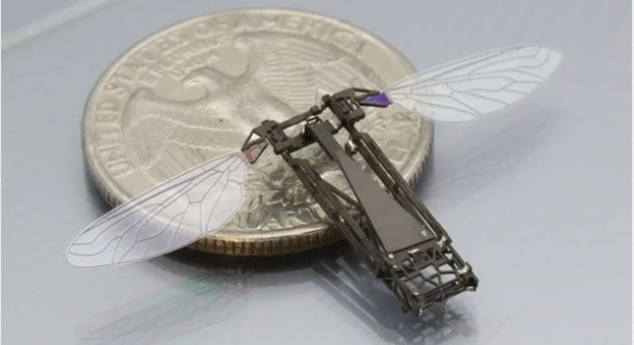

Slide 13
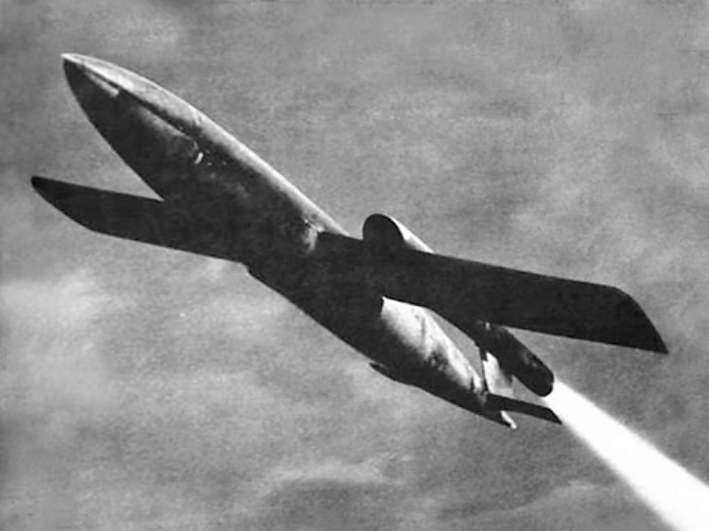

Slide 14
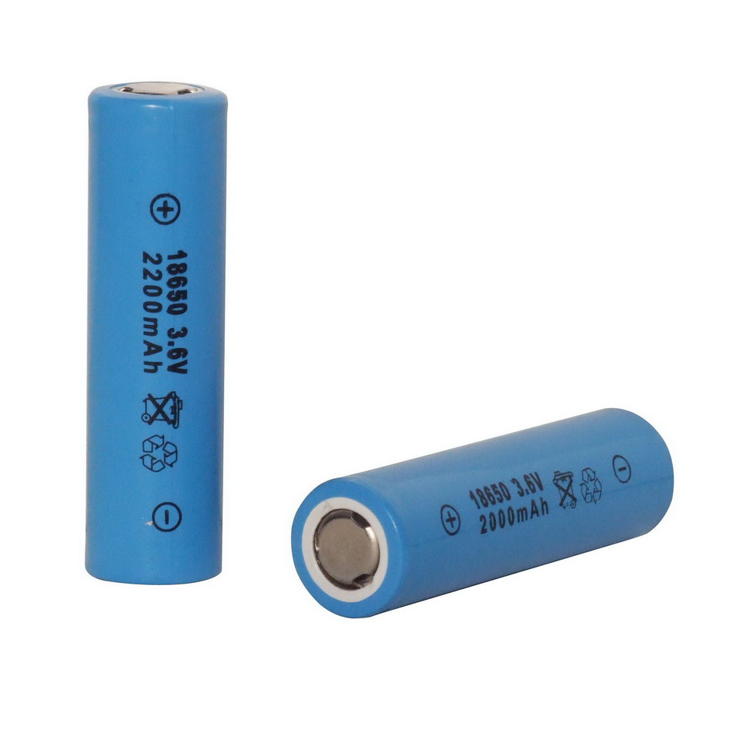
Lithium Ion Batteries
Commercialized in 1991
Twice the energy density and
smaller than NiCd or NiMH

Slide 15
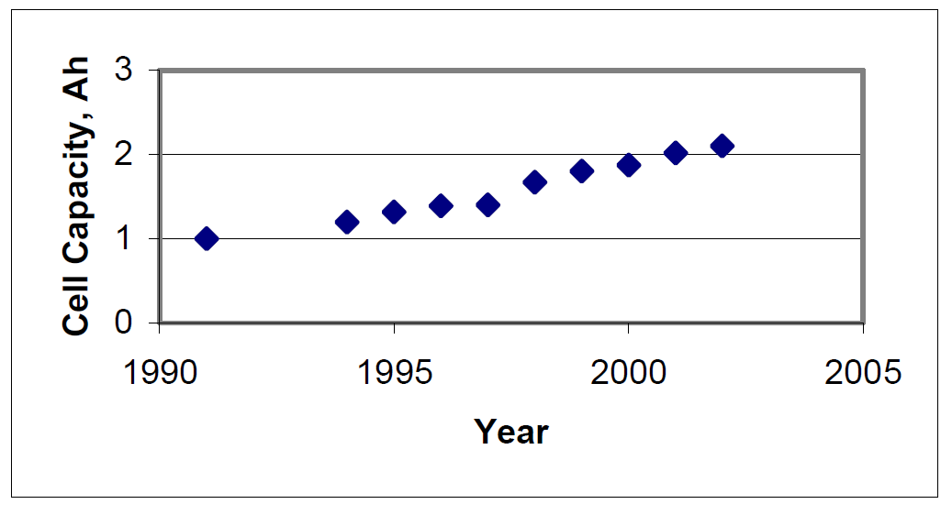
Lithium Ion Batteries
Ralph Brodd

Slide 16
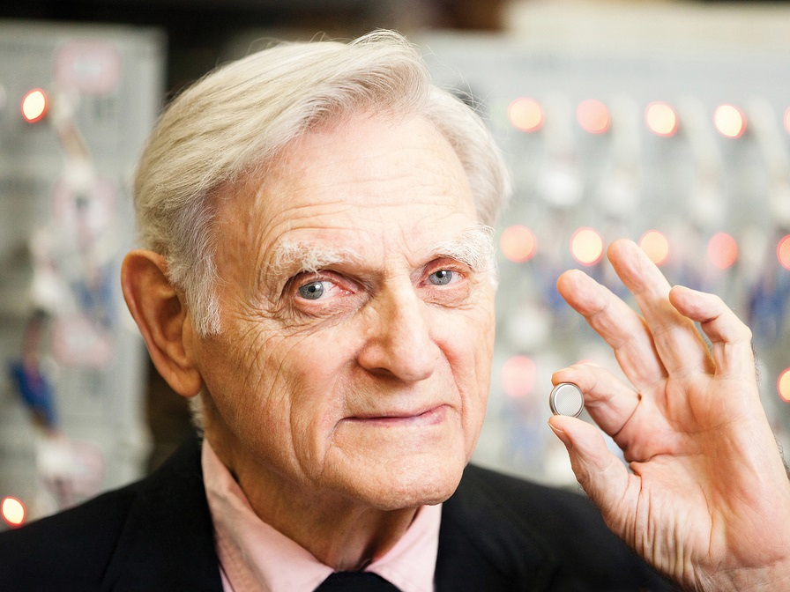
John Goodenough, UT Austin
2014 Draper Prize

Slide 17
Small, Low-Cost, High-Performance Computation

Slide 18
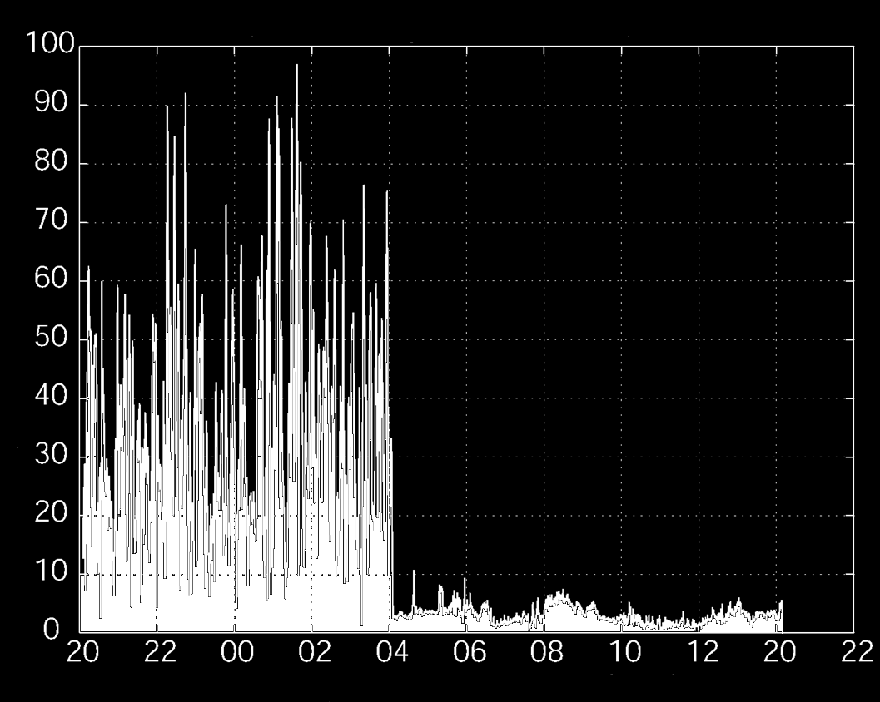
GPS “Selective Availability” Switched Off
4:00 AM
May 2, 2000
Meters Error
UTC Hours

Slide 19
Low-Cost, High-Resolution
Digital Cameras

Slide 20
Drone
Unmanned Aerial Vehicle (UAV)
Remotely Piloted Aircraft
Aeronaves pilotadas por control remoto
Unmanned Aerial System (UAS)
Autonomous Aircraft

Slide 21
Is it legal to fly a drone?
Notes:
The general secure control problem, in which we wish to detect and survive an attack that can arbitrarily manipulate y and u is insoluble: under these conditions, it’s game over. To see why, consider just half the problem – that of secure state estimation ...

Slide 22
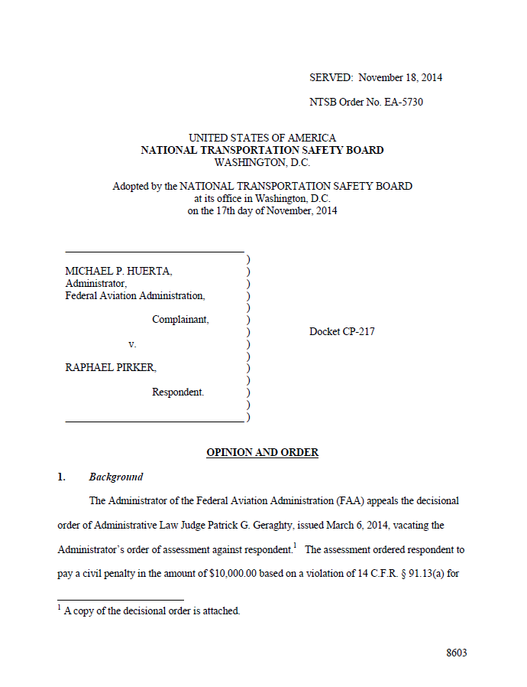
“An aircraft is any device used for flight in the air. This definition includes any aircraft, large or small. The prohibition on careless and reckless operation in 91.13(a) applies with respect to any aircraft other than [kites and balloons].”
Notes:
The general secure control problem, in which we wish to detect and survive an attack that can arbitrarily manipulate y and u is insoluble: under these conditions, it’s game over. To see why, consider just half the problem – that of secure state estimation ...

Slide 23
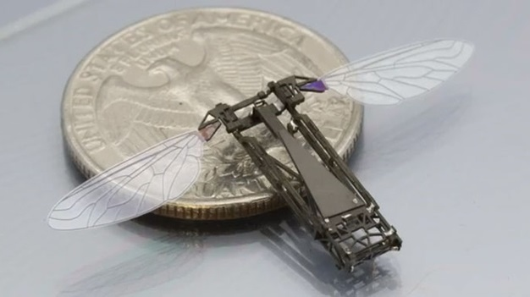
Notes:
The general secure control problem, in which we wish to detect and survive an attack that can arbitrarily manipulate y and u is insoluble: under these conditions, it’s game over. To see why, consider just half the problem – that of secure state estimation ...

Slide 24
The Rub:
The FAA considers flying an aircraft below 500 feet
reckless (except at takeoff and landing)
But ...
FAA guidance on model aircraft: “Don’t fly above 400 feet.”
So ... federal regulations on drones
are currently both absurd and inconsistent
Texas Law (HB 912): Need neighbor’s consent to capture
image by drone of him on his property
My advice:
Don’t fly near airports
Stay under 400 feet
Don’t fly for hire
No close-up pictures of people without consent
Don’t scare people
Notes:
The general secure control problem, in which we wish to detect and survive an attack that can arbitrarily manipulate y and u is insoluble: under these conditions, it’s game over. To see why, consider just half the problem – that of secure state estimation ...

Slide 25
What would I do with a drone?
Notes:
The general secure control problem, in which we wish to detect and survive an attack that can arbitrarily manipulate y and u is insoluble: under these conditions, it’s game over. To see why, consider just half the problem – that of secure state estimation ...

Slide 28
Notes:
The general secure control problem, in which we wish to detect and survive an attack that can arbitrarily manipulate y and u is insoluble: under these conditions, it’s game over. To see why, consider just half the problem – that of secure state estimation ...

Slide 29
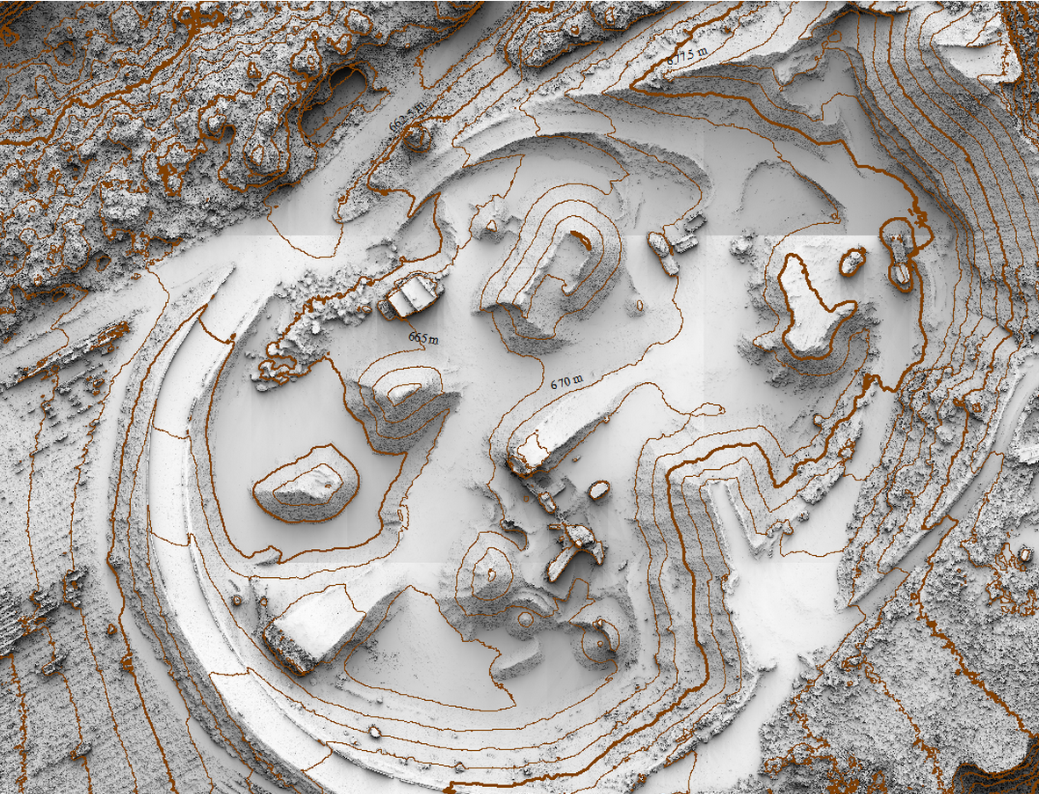
Notes:
The general secure control problem, in which we wish to detect and survive an attack that can arbitrarily manipulate y and u is insoluble: under these conditions, it’s game over. To see why, consider just half the problem – that of secure state estimation ...

Slide 30
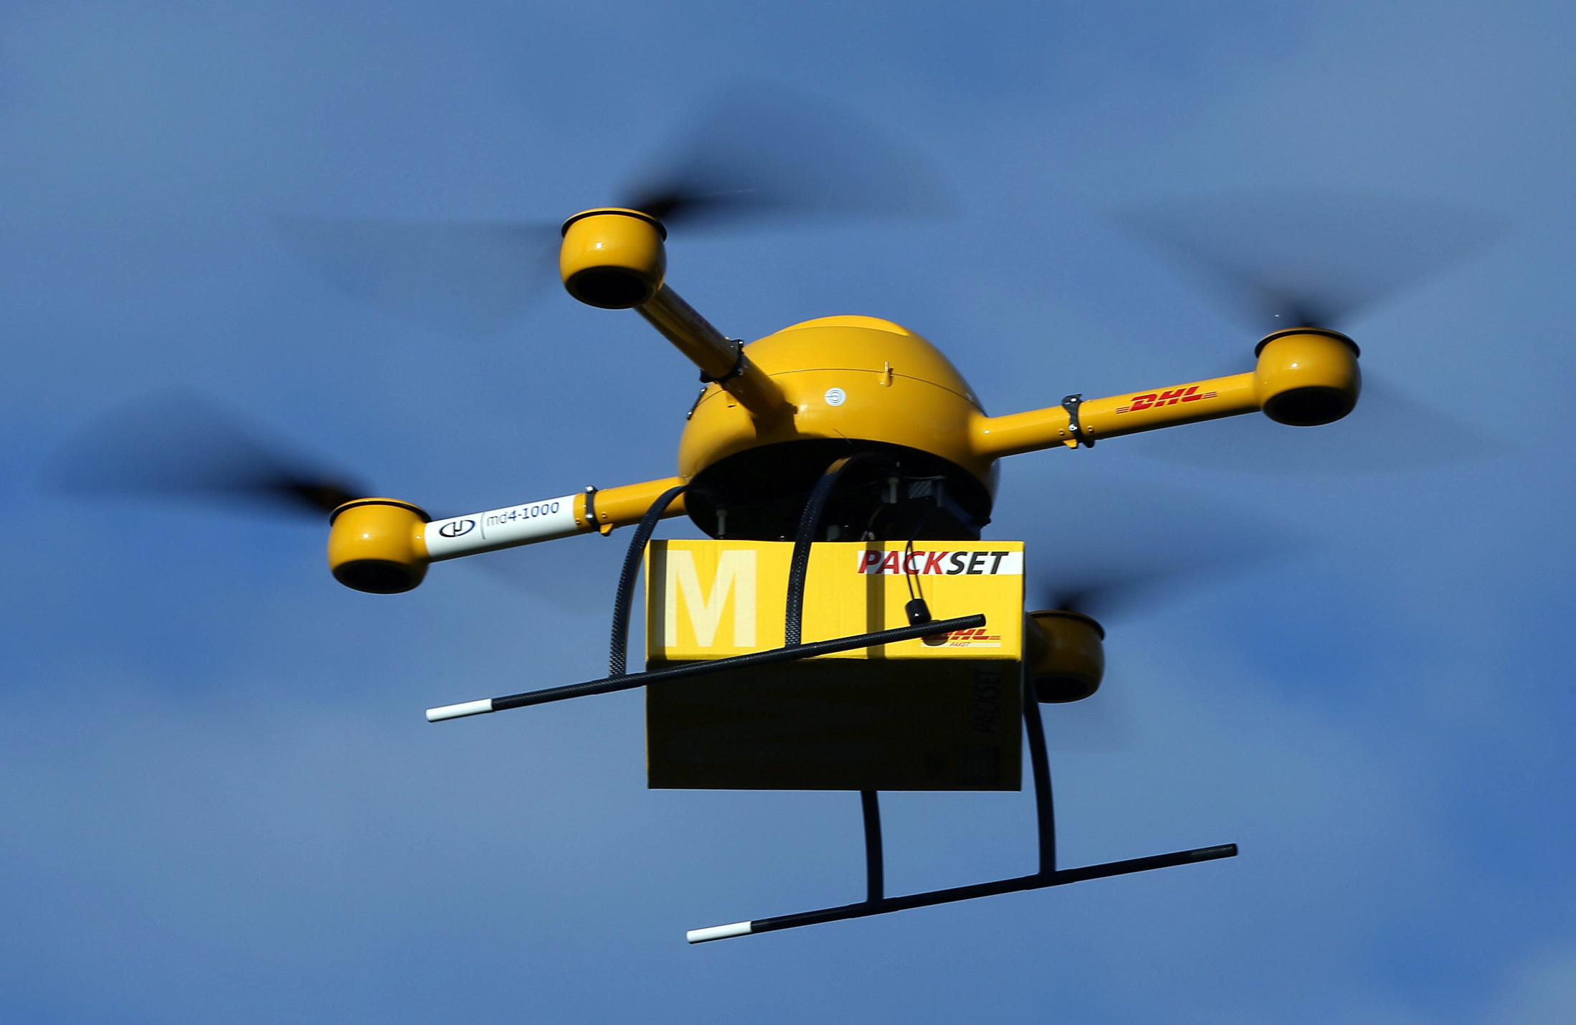
Notes:
The general secure control problem, in which we wish to detect and survive an attack that can arbitrarily manipulate y and u is insoluble: under these conditions, it’s game over. To see why, consider just half the problem – that of secure state estimation ...

Slide 31
Can drones be hacked?
Notes:
The general secure control problem, in which we wish to detect and survive an attack that can arbitrarily manipulate y and u is insoluble: under these conditions, it’s game over. To see why, consider just half the problem – that of secure state estimation ...

Slide 32
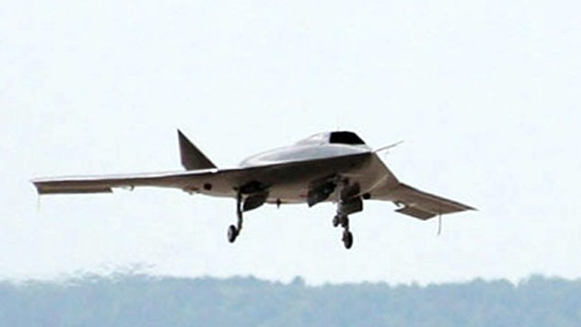
Missing CIA RQ-170 Sentinel
Stealth Drone
December 4, 2011

Slide 33
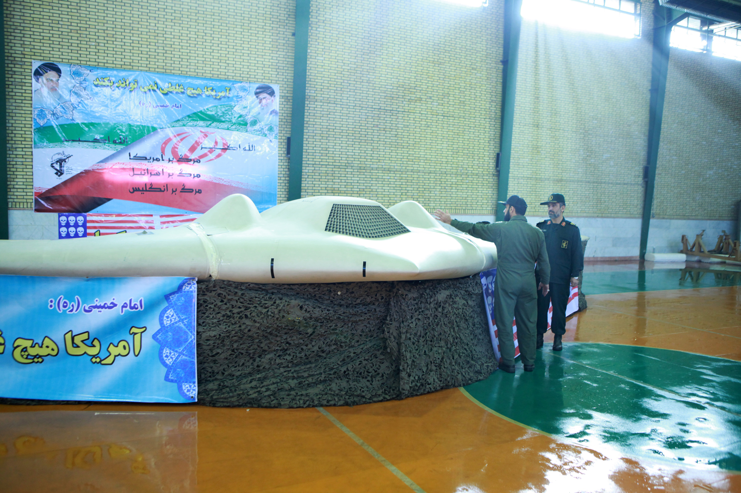
Notes:
The U.S. DOD vigorously denies that Iran was able to bring down the Sentinel, but they haven’t offered a plausible alternative explanation. The most they’ll say is "There was a problem with the aircraft and it landed in an area it wasn't supposed to land“ (U.S. retired Lt. General David Deptula on Nova Rise of Drones).
But the DOD has somewhat low credibility on this topic because
They continue to claim that the drone was monitoring the Afghan-Iranian border on the Afghan side. Think about that. (Crash site was 140 miles inside Iran, stealth)
At first claimed drone crashed into a pile of rubble
They have a lot of explaining to do: how does a drone flying at 50,000 could come down intact except in a mostly-controlled landing?

Slide 34
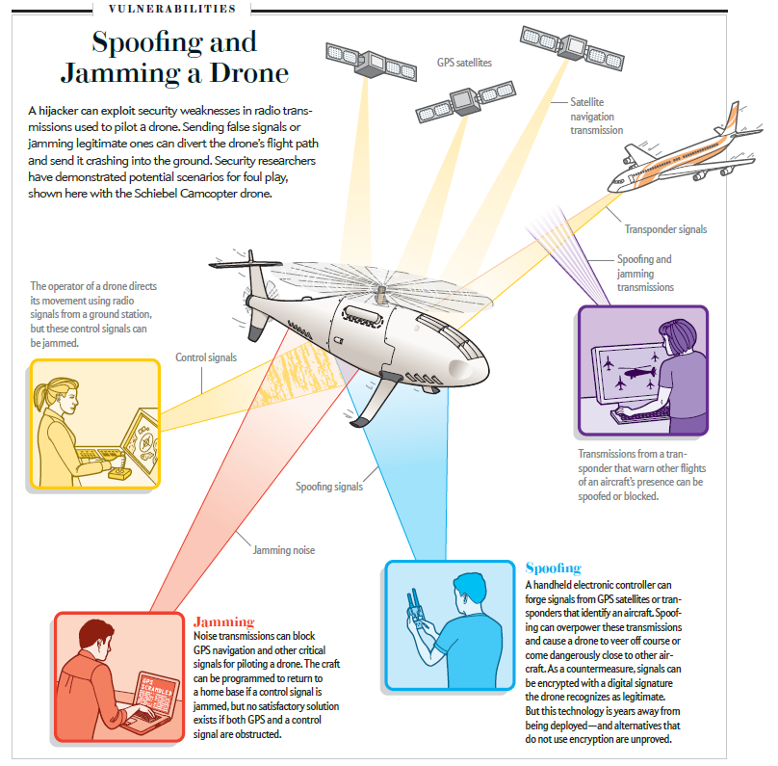
Wesson and Humphreys, Scientific American, Nov. 2013

Slide 35
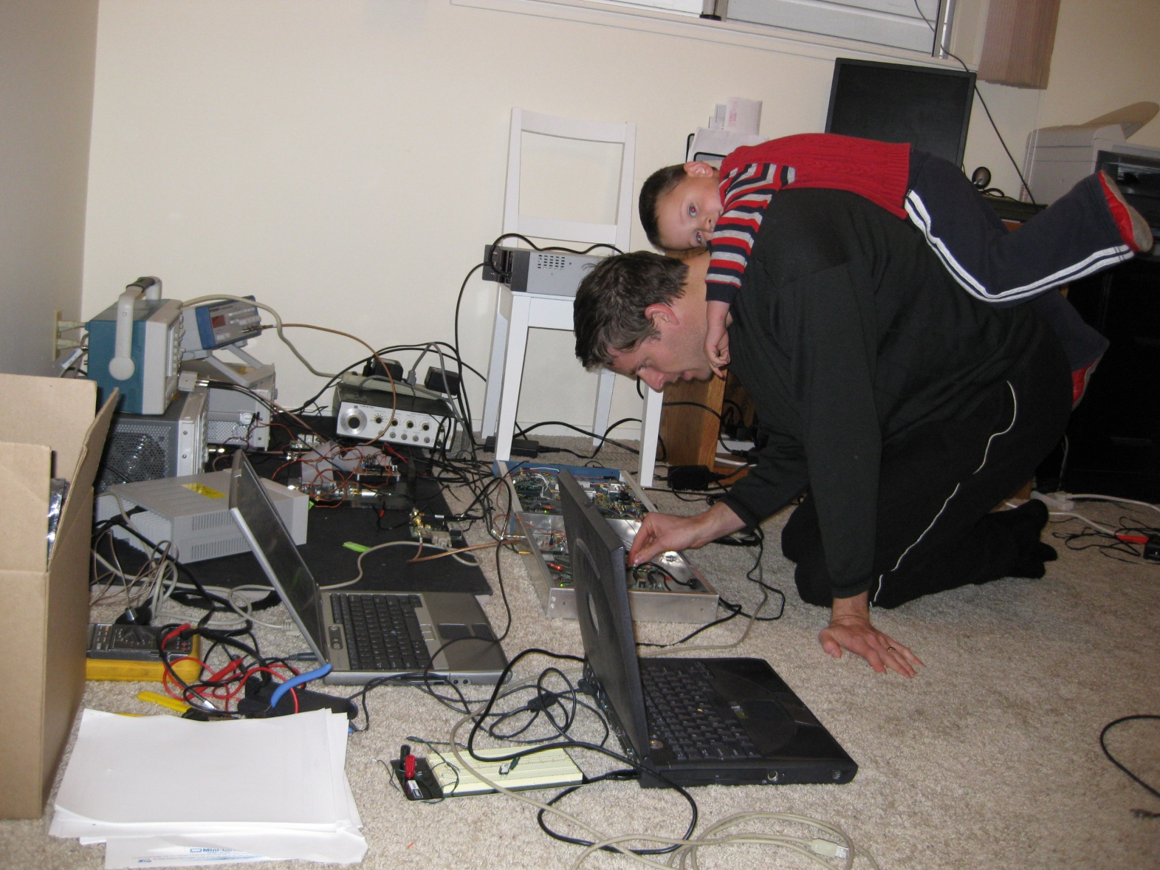

Slide 36
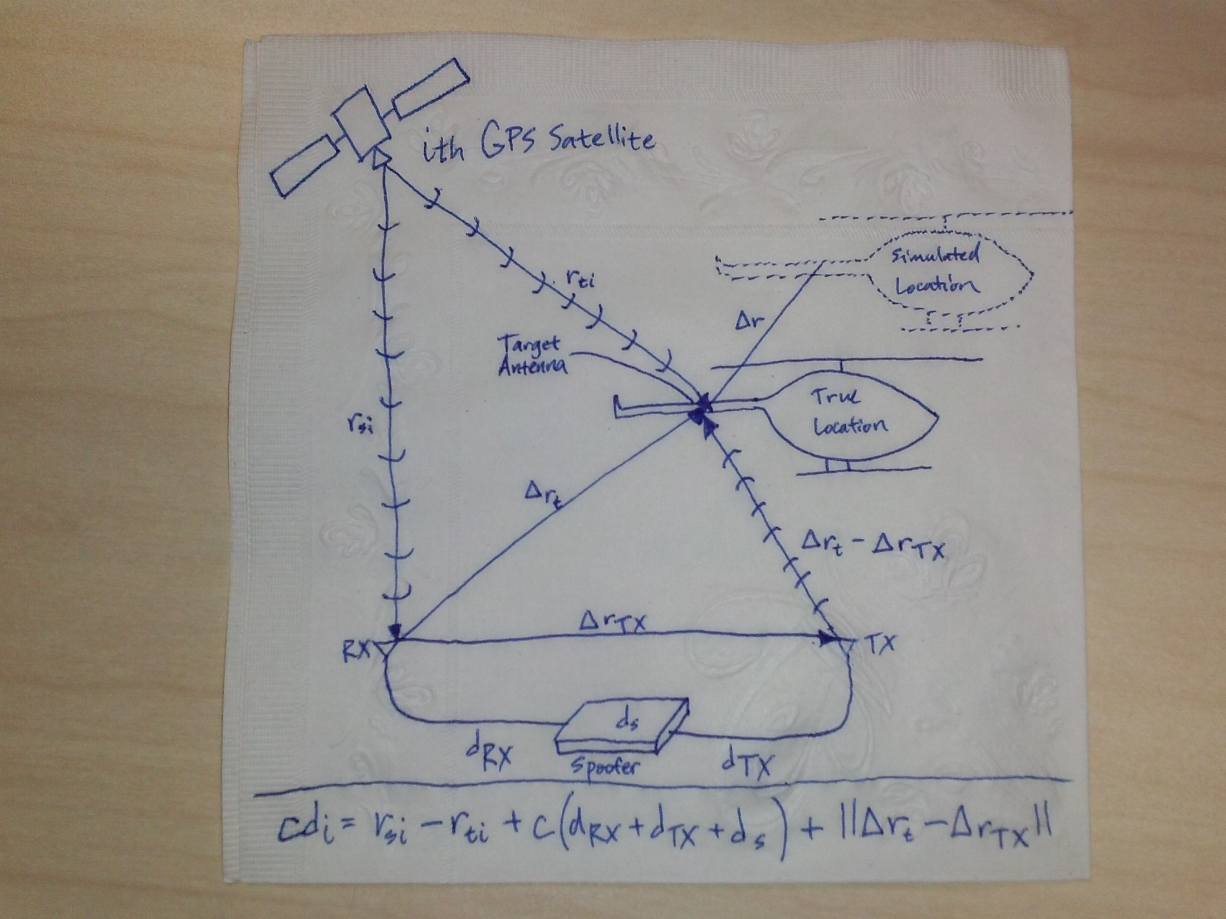
Notes:
By contrast to the so-called proximity spoofing attacks treated in (Humphreys et al., 2008) and (Shepard
et al., 2012b), where the spoofer is effectively co-located with the target receiver, the current presentation considers
spoofing from a distance, as illustrated in Fig. 1. Through its receive antenna, marked RX, the spoofer receives authentic signals from all visible GPS satellites. The vectors rTX and rt represent, respectively,
the 3-dimensional coordinates of the spoofer’s transmit antenna, marked TX, and the target aircraft’s GPS
antenna relative to the spoofer’s receive antenna. The spoofer and target antennas are assumed to be located
at respective distances rsi and rti from the ith GPS satellite.
The spoofer generates a counterfeit signal for each authentic signal received. In the case of an initially-aligned
attack, the spoofer’s counterfeit signal ensemble arrives at the target antenna in such a way that each signal
is approximately spreading-code-phase aligned (within a few meters) with its authentic counterpart. After
capture of the target receiver’s carrier- and code-phase tracking loops, the spoofer adjusts the relative code
phases of its spoofing signals to induce the target receiver to report the simulated (false) location r relative
to its true location; the target receiver’s apparent time offset from true time can also be adjusted by a common
displacement of the counterfeit code phases.
An aligned attack is only possible if the spoofer (1) measures all relevant system delays to within a few
nanoseconds, and (2) compensates for these delays by generating a slightly advanced (predicted) version of
the signals it receives. For civil GPS signals, reliable prediction is trivial because the spreading codes are
unencrypted and openly documented, the satellites follow regular orbits, and the modulating navigation data
follow regular patterns. Military GPS signals, by contrast, enjoy strong encryption of the spreading code;
indeed spreading code unpredictability is the very basis of their security.
For the ith GPS satellite, the total distance-equivalent system delay that must be compensated is given by the equation above.

Slide 37
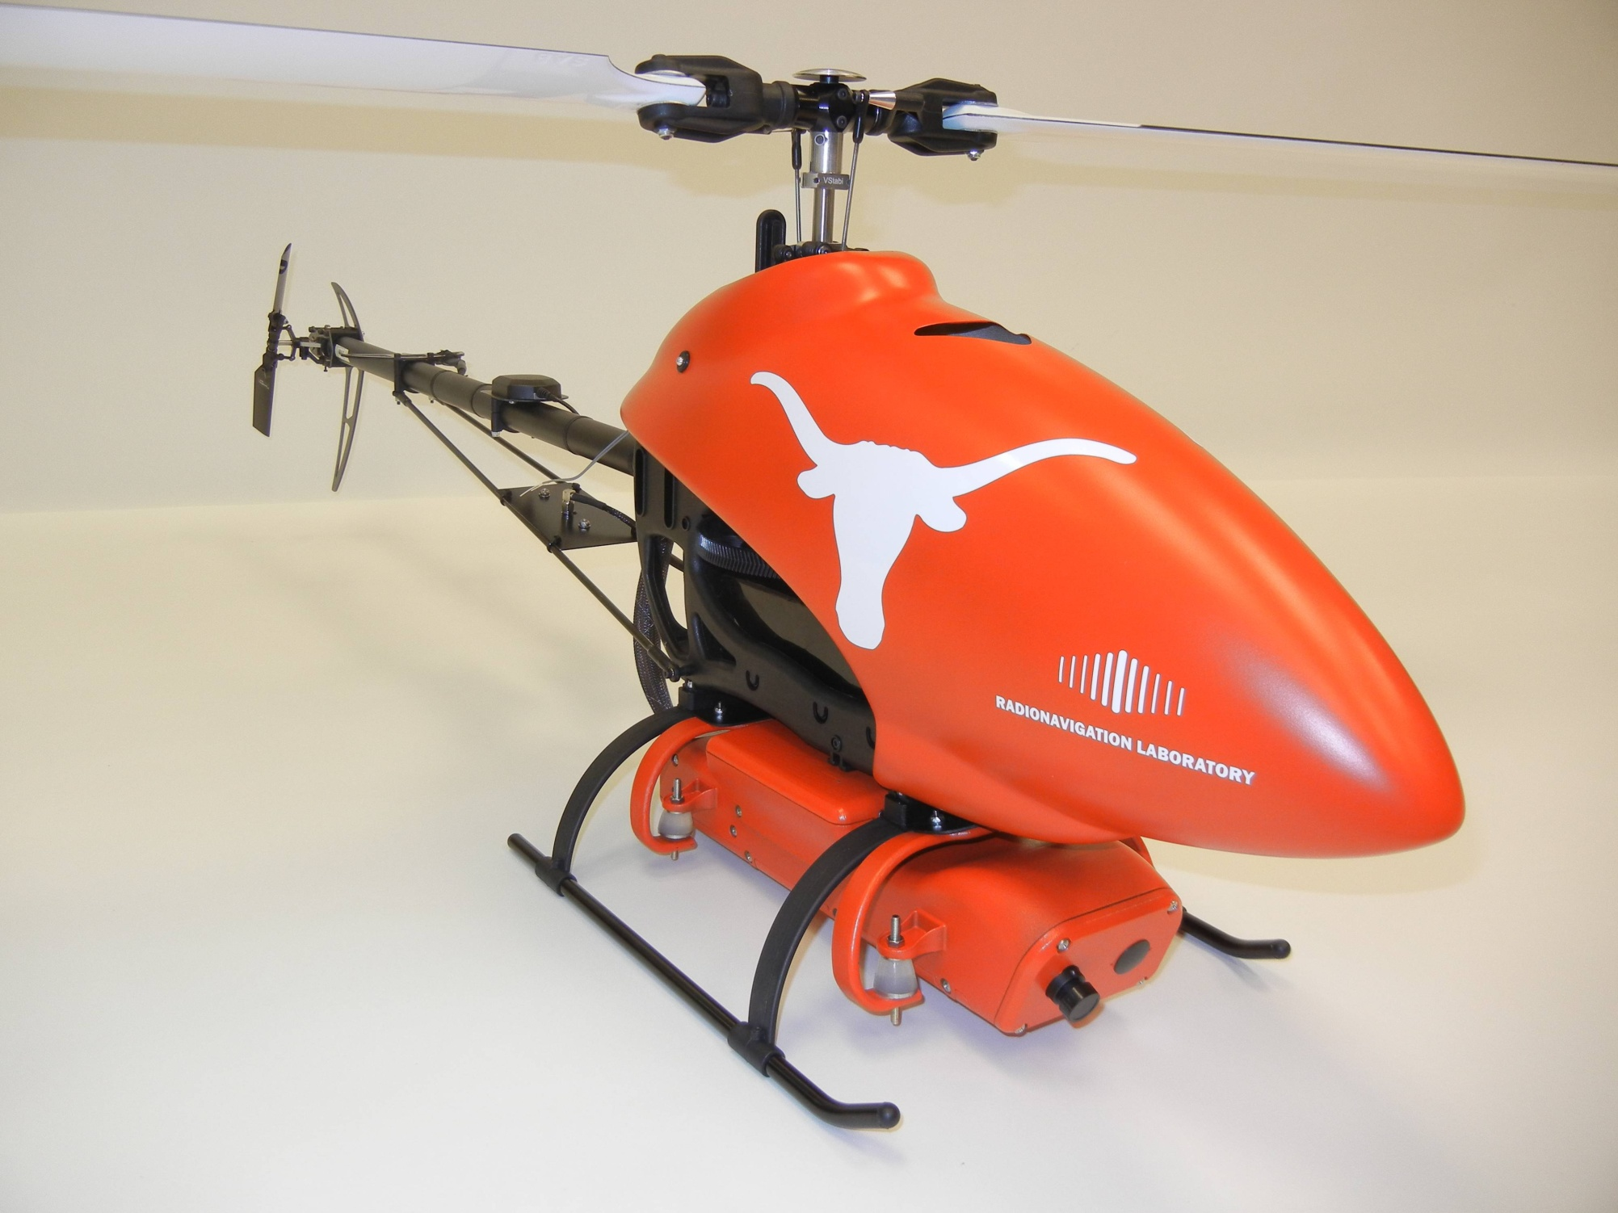

Slide 39
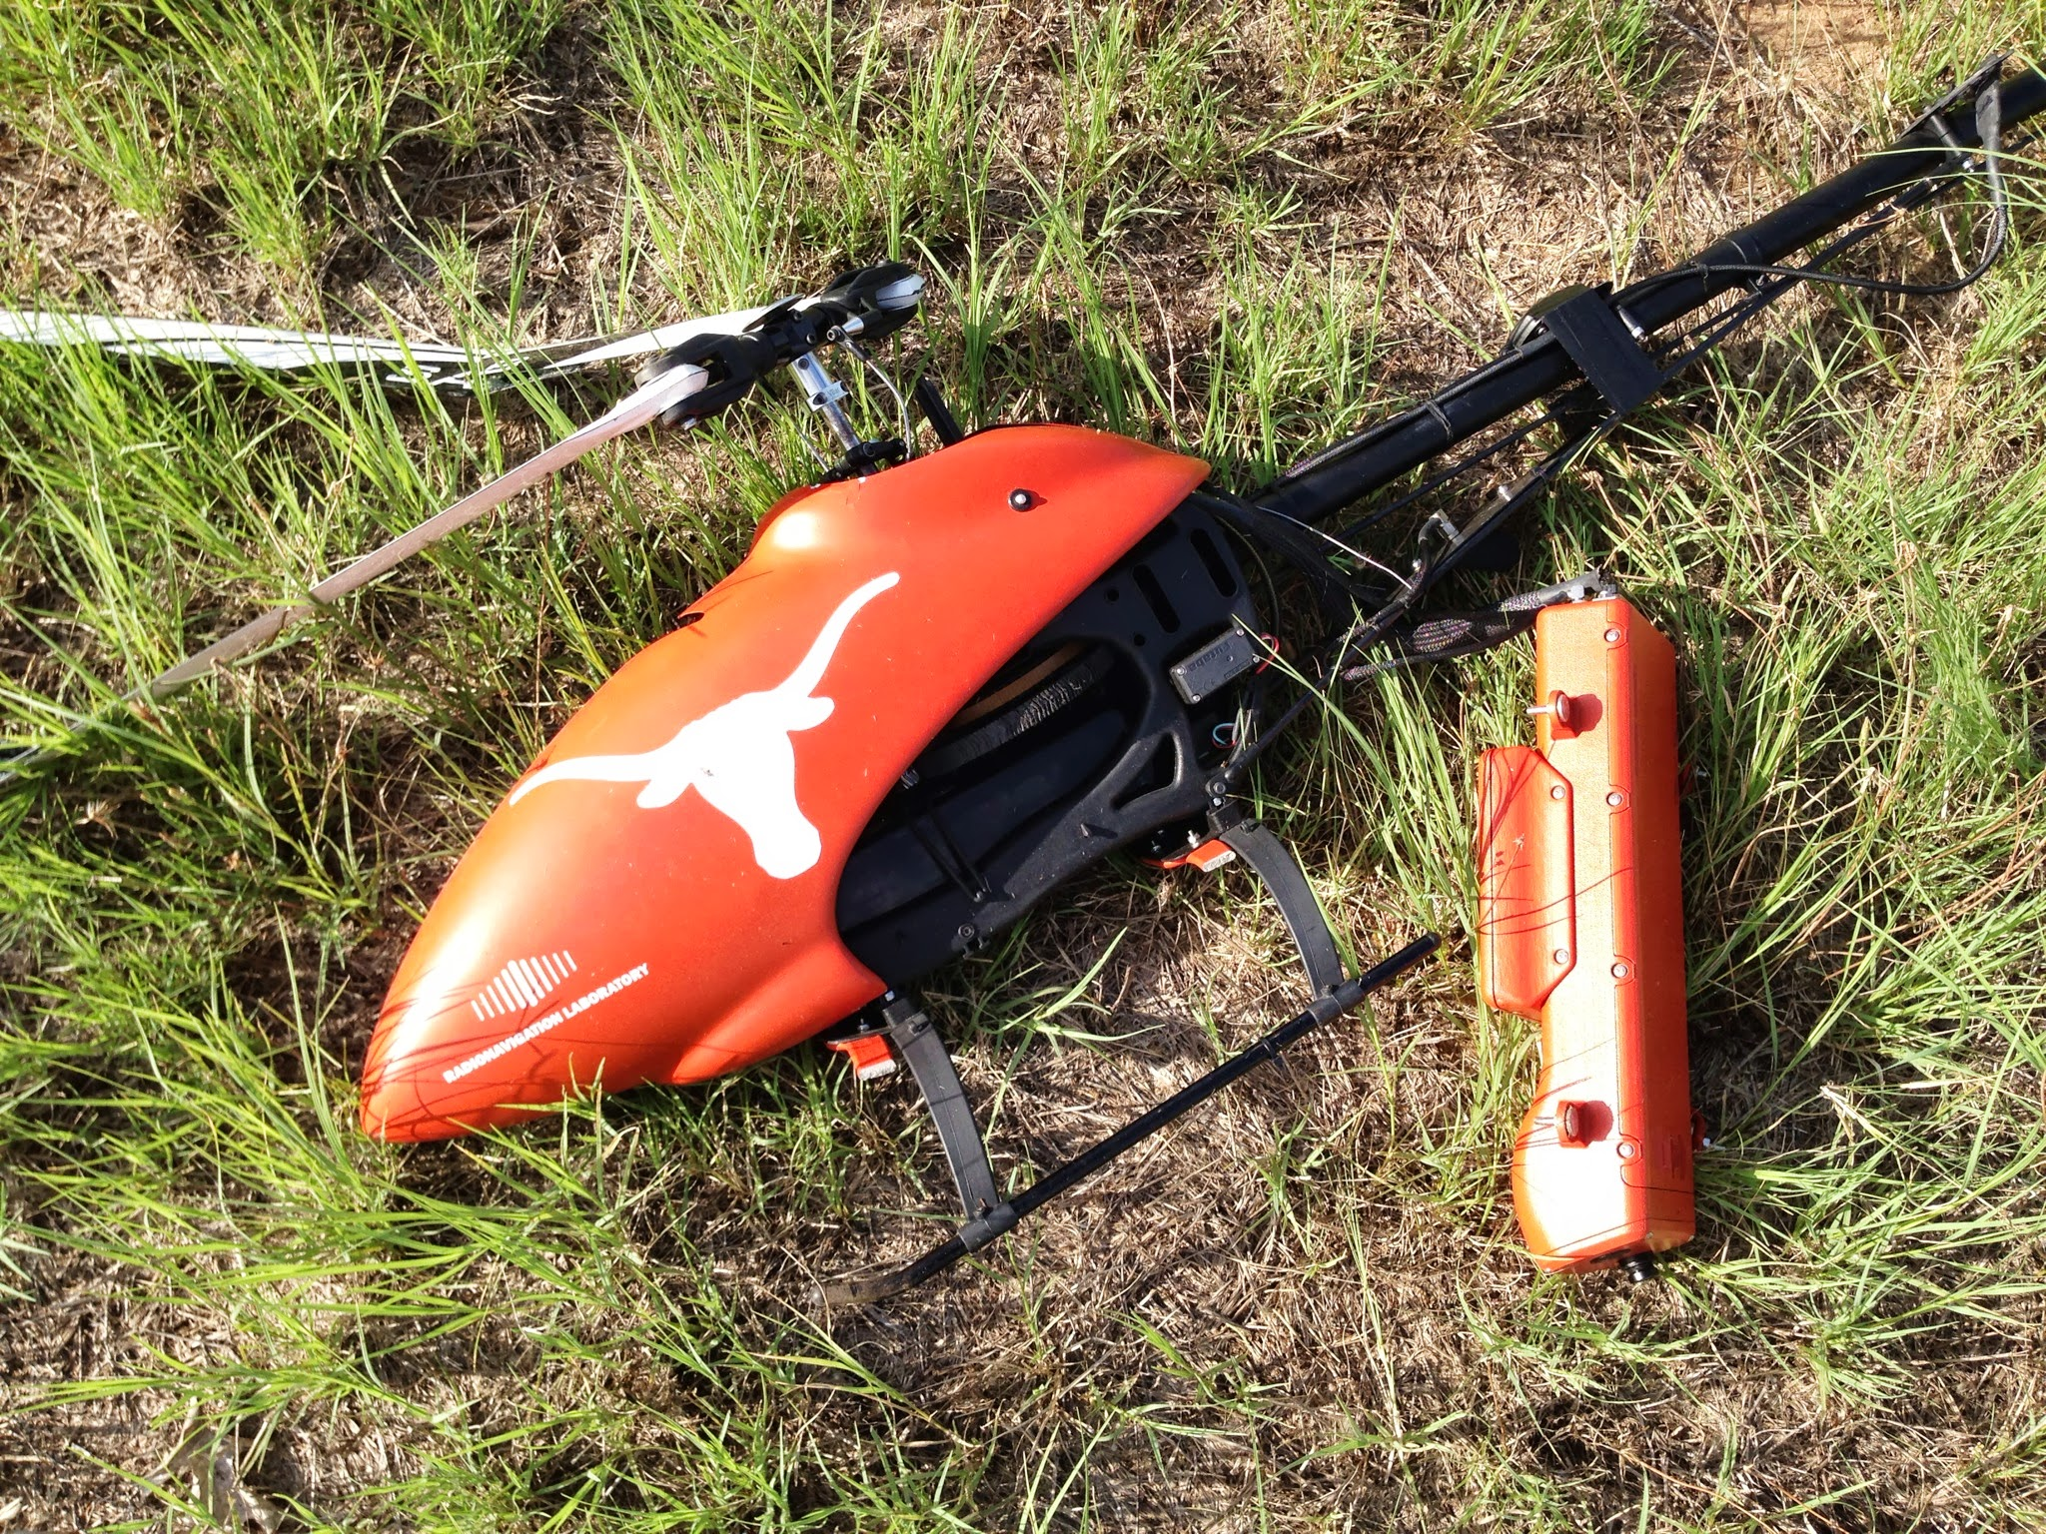
Easier to Crash than to Control

Slide 40
Notes:
The 213-foot, $80M White Rose of Drachs motoryacht.

Slide 42
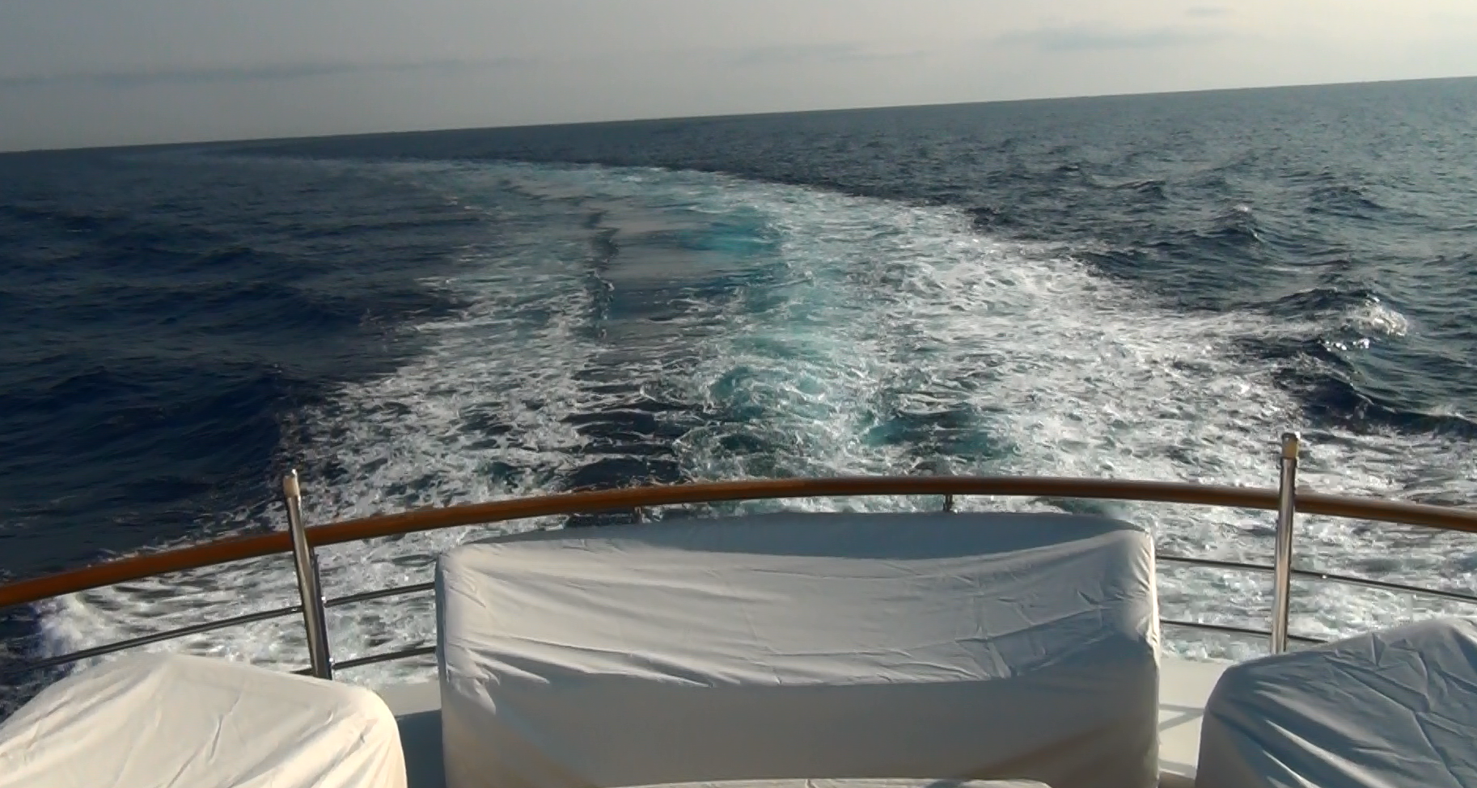

Slide 43
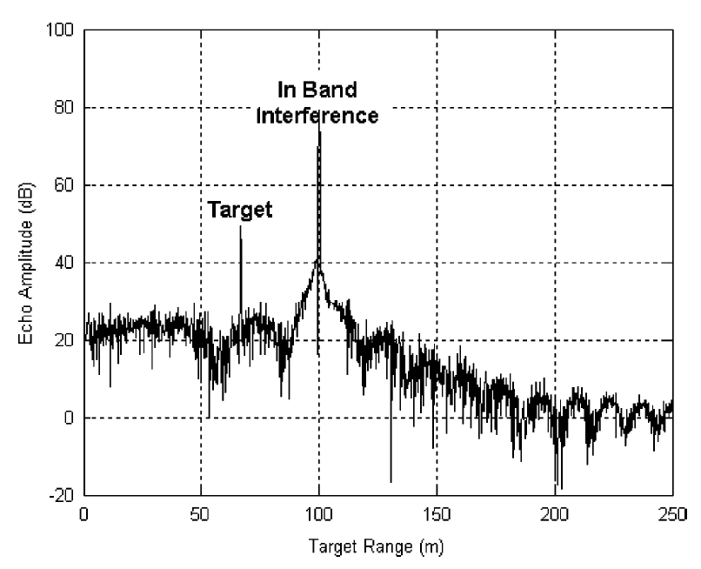
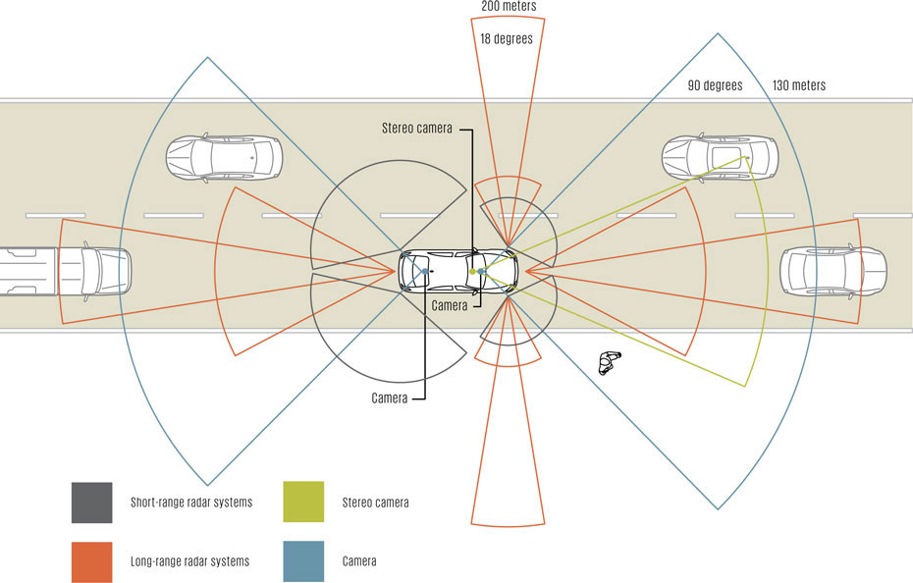
Photo: Daimler
Is automotive radar, a key technology for self-driving cars, also hackable?
Booker, “Mutual interference of mm-wave radar systems.” (2007)
Illustration: John MacNeill

Slide 44
Do drones like to play sports?

Slide 45
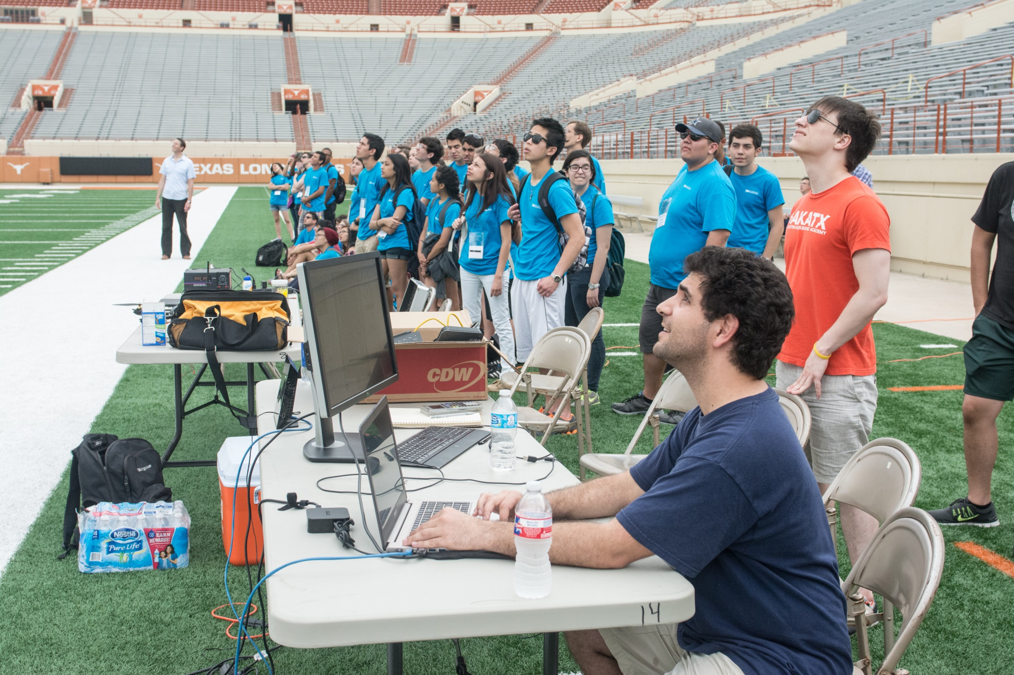

Slide 46
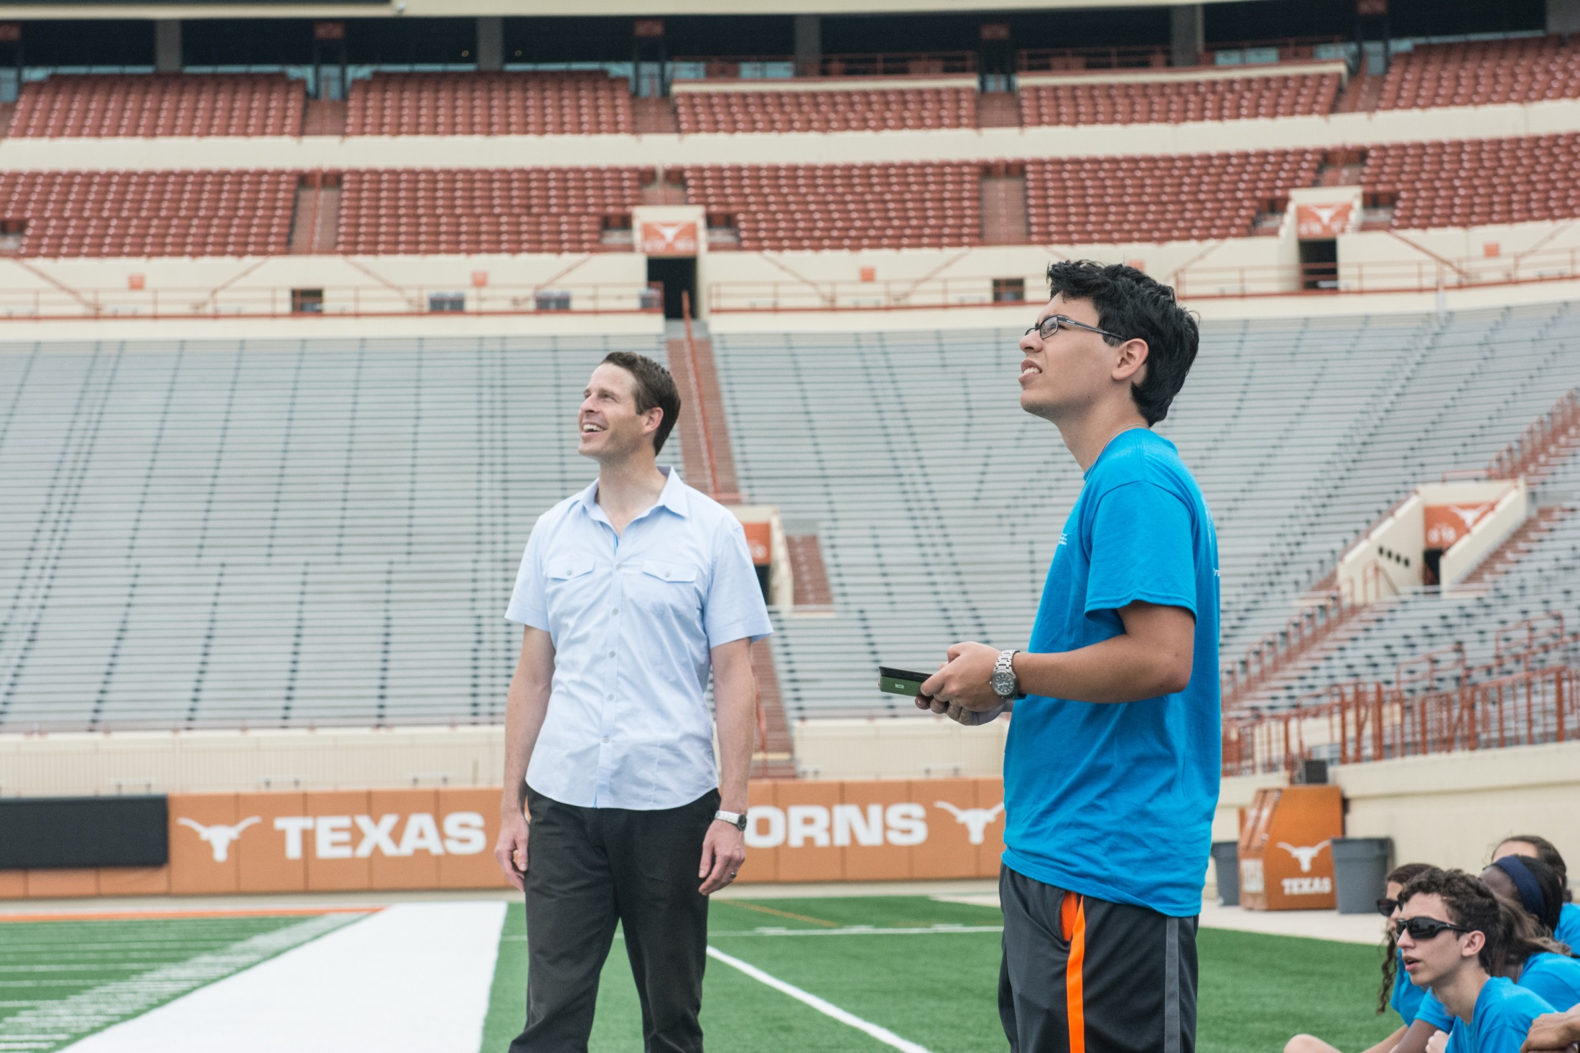

Slide 47
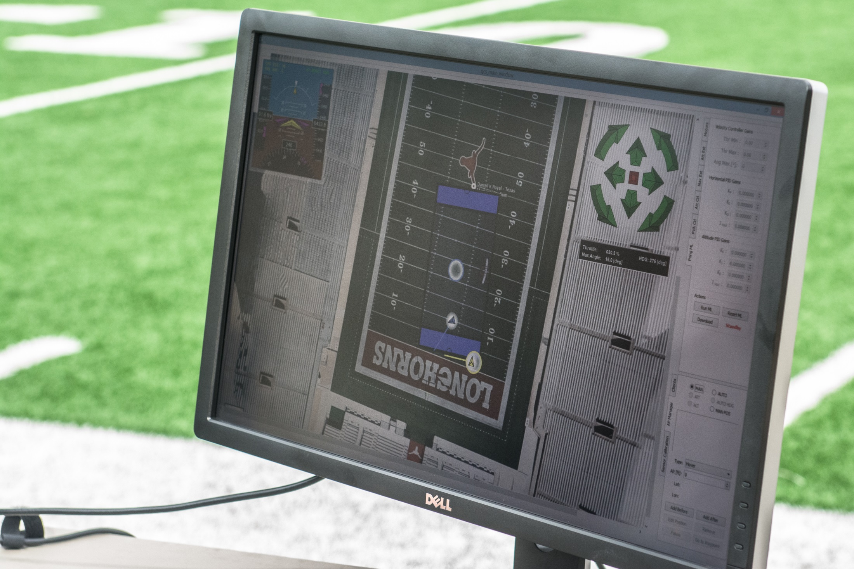

Slide 48
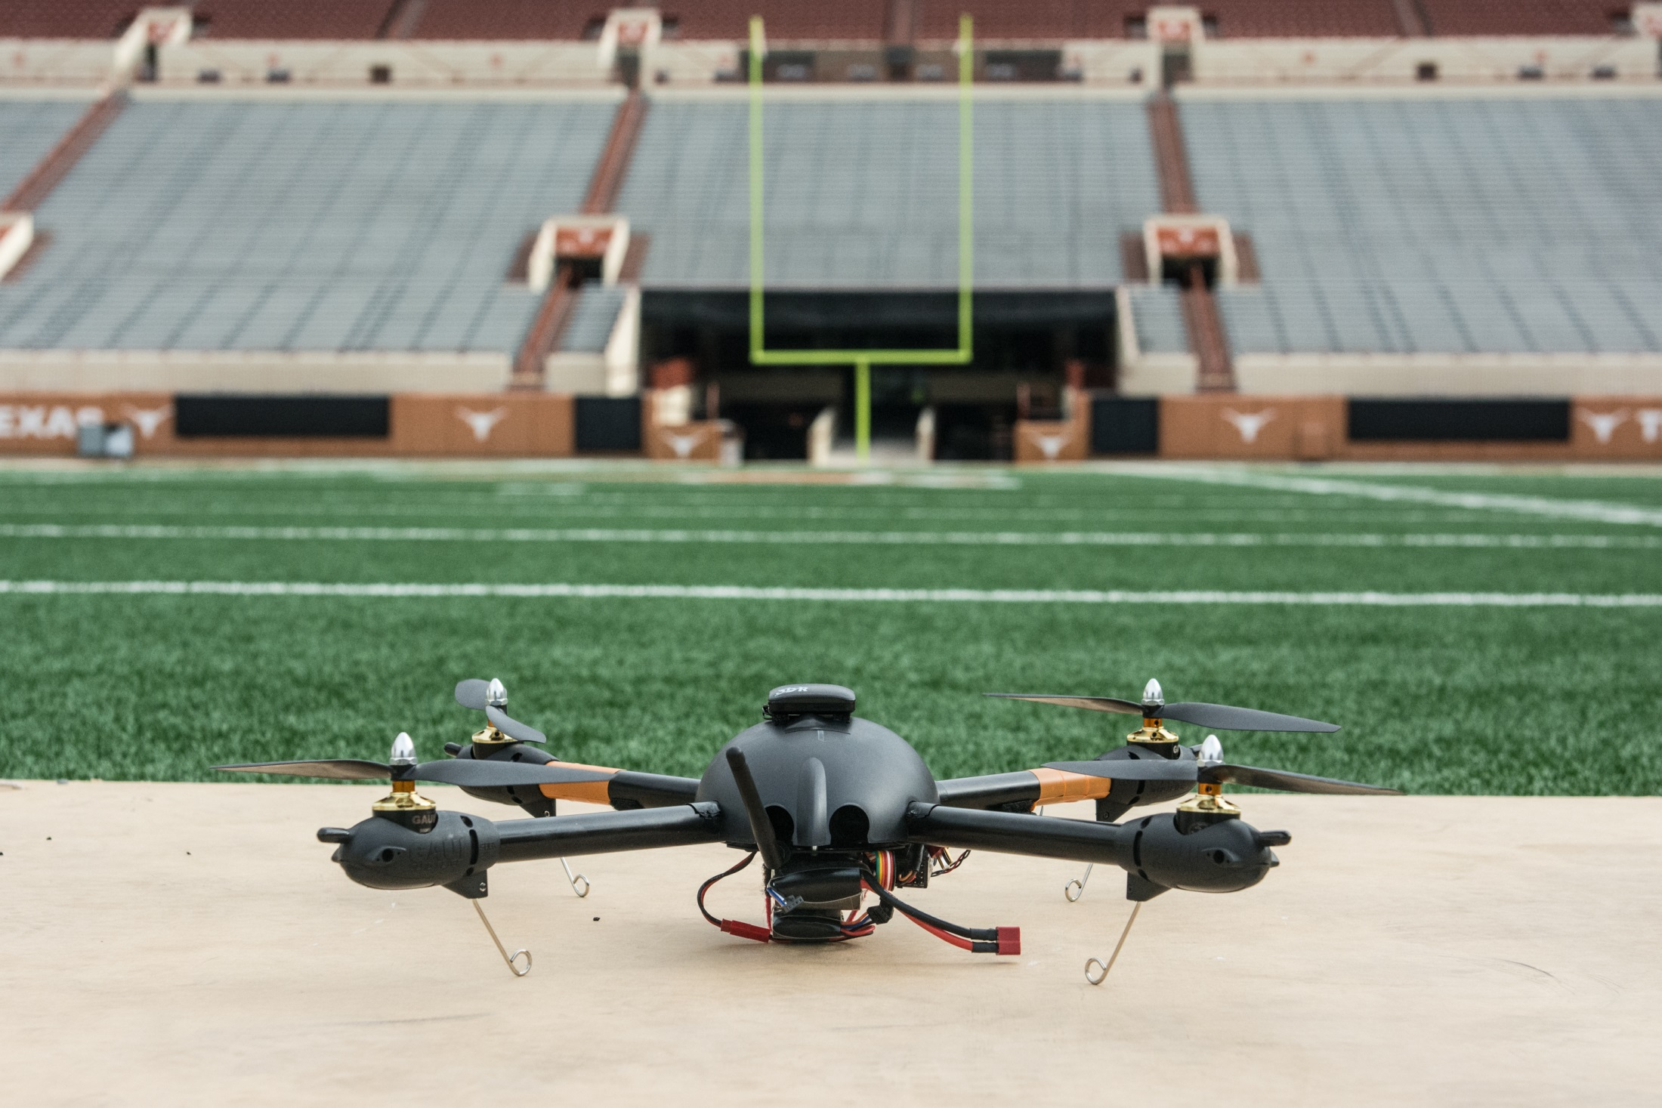

Slide 50
radionavlab.ae.utexas.edu

Slide 51
Dr. Todd Humphreys
Todd Humphreys directs the Radionavigation Laboratory at UT Austin, where advanced radionavigation technology is being developed, and novel ways to exploit and protect radionavigation systems such as GPS are being explored.
Dr. Humphreys has Ph.D. from Cornell University. He received the UT Regents' Outstanding Teaching Award in 2012, the NSF CAREER Award in 2015, and the Institute of Navigation Thurlow Award in 2015. Dr. Humphreys joined the faculty of the Cockrell School of Engineering in Fall 2009.

